Slide 1
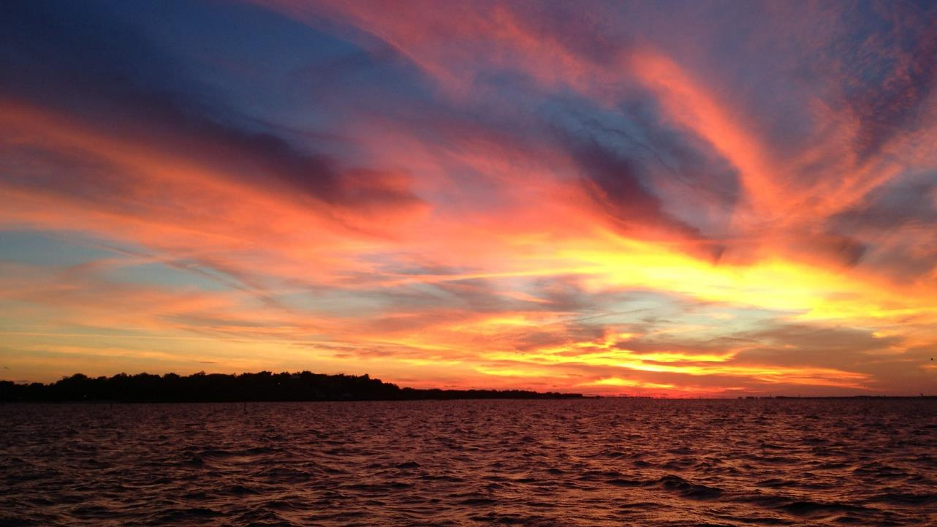

Northern Everglades and Estuaries Protection Program
Coordinating Agency
Public Webinar
December 2, 2020

Slide 2
Projects and Programs
FDEP (4 slides)
  DEAR - Julie
  NPDES - Ed
  Other Programs (FFY, Golf Course BMPs, etc.) - ?
  Funding Programs – Trina/Ed

Slide 3
Lake Okeechobee: S-191 Basin
4 slides:
NPDES facilities/CAFOs
625 Tracker
Historical projects funded in focus areas
BMAP projects

Slide 4
Caloosahatchee : West Caloosahatchee Basin
4 slides:
NPDES facilities/CAFOs
625 Tracker
Historical projects funded in focus areas
BMAP projects

Slide 5
St. Lucie: C-24 Basin, Ten Mile Creek
4 slides:
NPDES facilities/CAFOs
625 Tracker
Historical projects funded in focus areas
BMAP projects

Slide 6

Questions & Comments

