Slide 1

Nitrate Load Management in the Wakulla Springshed
Upper Wakulla River BMAP
February 21, 2012
John Buss, Manager
Water Resources Division

Slide 2
Nitrate Load Management
Summary of Nitrate Problem & Needed Reductions.
What Has the City of Tallahassee Done?
What Remains to be Done?

Slide 3
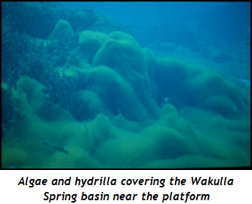

The Problem
Hydrilla and Algae at Wakulla Springs
High Nitrate Concentration
TMDL Regulation
Notes:
What is Nitrate—a form of nitrogen. A nutrient for plants—aquatic plants large (hydrilla) and small (algae)
Not a Health Issue !
– groundwater vs. drinking water (MCL for DW = 10 mg/L vs. 0.35 mg/L affecting the aquatic environment)

Slide 4
Milestones - Advancing Our Understanding of the
Nitrate Problem at Wakulla Spring
2002 | NWFWMD Study (Chelette and Pratt.) | Identified and quantified sources of nitrogen loading to Wakulla Springs.
2005 | Hydrogeology Consortium. | Scientists concurred on the largest nitrate sources. Land use issues led to LAVA Study.
2007 | Leon CO. Aquifer Vulnerability Study (LAVA) | Identified those areas in Leon Co. most susceptible to groundwater pollution from surface land uses. Cody escarpment is apparent as a demarcation. Leads to adoption of a Primary Spring Protection Zone (PSPZ) in Leon County.
2008 | City Commits to AWT Project to Reduce City Nitrate Load. | Results in 75% reduction in nitrate discharge by Dec 2012.
Notes:
Over the last 10 years a number of studies, reports, and regional workshops have been undertaken to further the understanding of the nitrate problem. Some of these activities and significant results are summarized above.

Slide 5
Milestones Continued …
2009 | Tri-Party Memorandum on Regional Partnership. | Executed by City, Leon Co., Wakulla Co. Agreement to work at reducing nutrients from wastewater systems and to address system for better management of septic tanks. Led to initiation of Lombardo Study.
2009 | Second Regional Workshop on Wakulla Spring Restoration | Discussion of progress and future work to reduce pollutants in the groundwater. Septic tanks identified as next target.
2010 | Primary Spring Protection Zone (PSPZ) Established in Comp. Plan | Within Woodville and USA, AWT technology is preferred method for new development. Where AWT not available, High Performance Septic Tanks required.
2011 | COT Master Sewer Plan. | Provides service plan and costs estimate to Leon Co. for target areas outside City without sewer service.
2011 | Lombardo Report Completed. | To achieve the Wakulla TMDL, maximum practicable nitrogen removal is needed when addressing existing septic tanks in the springshed south of the Cody Scarp. In areas north of Cody Scarp, conventional septic tanks with proper inspection and maintenance is needed.

Slide 6
Recent Studies – USGS & Lombardo
Load Quantification Particularly Useful
2010 USGS (Hal Davis, et. al)
  Modeled nitrate movement in groundwater from sprayfield, septic systems and other sources, comparing 2007 to 2018.
2011 Lombardo Associates
  Assimilated the relevant data and conclusions from the previous work to formulate guidance on actions local government can take to better manage the wastewater load from the rural areas of Leon and Wakulla counties.
    ( Much of the data that follows is based on Lombardo, but USGS report is very similar.)
Notes:
A good part of my summary

Slide 7
Annual Nitrogen Load to Wakulla Spring
( Pre- AWT)
229,900 kg/yr

Slide 8
Sources of Annual Nitrogen Load
( Pre- AWT)
229,000 kg/yr
2,400

Slide 9
Allowable Nitrogen Load to Wakulla Spring
( Pre- AWT)
229,900 kg/yr

Slide 10
Nitrate Load Management
Summary of Nitrate Problem & Needed Reductions.
What Has the City of Tallahassee Done?
What Remains to be Done?

Slide 11
What Has the City Done?
Implemented Source Controls through Ordinances and Educational Outreach
  Fertilizer Ordinance; Pet Waste Ordinance; Fertilizer Applicator Certification Program; TAPP Program; PSPZ Ordinance
Structural Projects
  Millions in Stormwater Treatment
  Millions in Wastewater Projects
Operational Changes
  Implemented Water Quality Charge in SW Fee
  Eliminated Disposal of Bio-Solids in Springshed
  Implemented Effluent Reuse.
  Implemented Assessment and Upgrade of Collection System
Notes:
Treatment trains to reduce nitrogen and disinfect

Slide 12
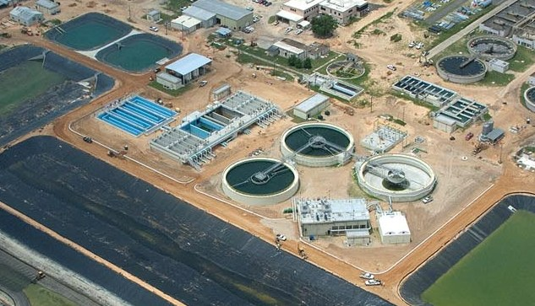
What Has the City Done?
$227 million upgrade to Advanced Waste Water Treatment (AWT)
Reducing Nitrate Concentration by 75% (Total Nitrogen < 3 mg/L)
Compare to Septic System Discharge at approximately 30 mg/L
Lowered Nitrogen “footprint” of 170,000 residents
- far below per capita footprint of others in Springshed
Notes:
Treatment trains to reduce nitrogen and disinfect

Slide 13
What Has the City Done?
- Achieved Nitrogen Reduction Far Ahead of Schedule
Effluent
Nitrogen
< 12 mg/L
Effluent
Nitrogen
< 9 mg/L
Effluent
Nitrogen
< 6.5 mg/L
Effluent
Nitrogen
< 3 mg/L
Achieving <3 mg/L
Permit Required
Permit Req.
Permit Req.
2008 | 2009 | 2010 | Jan 2011 | 2012 | Jan 2013 | Jan 2014
Notes:
We met our goal EARLY -- 75% reduction
13

Slide 14
Impact of City’s AWT Project
73% Load Reduction - - Exceeded 56% Required
229,000 kg/yr
155,5000 kg/yr
Pre - AWT
Post - AWT

Slide 15
What Has the City Done?

Slide 16
What Has the City Done?
Land Use Planning Initiatives
The City, along with the County adopted Wakulla Springs protection Comprehensive Plan policies on January 7, 2009
Both the City and County adopted Primary Springs Protection Zone (PSPZ) ordinances effective April 10, 2009

Slide 17
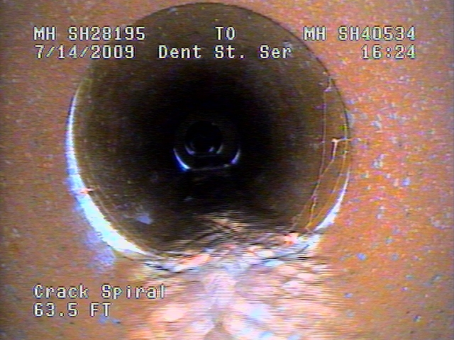
Sewage Collection System
Assessment and Rehabilitation Program
  Assessment & Rehabilitation of Older Sewers
  Initiated in 2011
  To date televised 380 mi of older systems (95% Complete)
  Repair & Replacement Projects Ongoing
  $10 million Program
  Completion 2021
Notes:
FY2011 Budget for $10 million: Repair and Improvement (Smoke Testing, Collection System Rehab&Maint., Pump Station Improvement, FROG, etc.

Slide 18
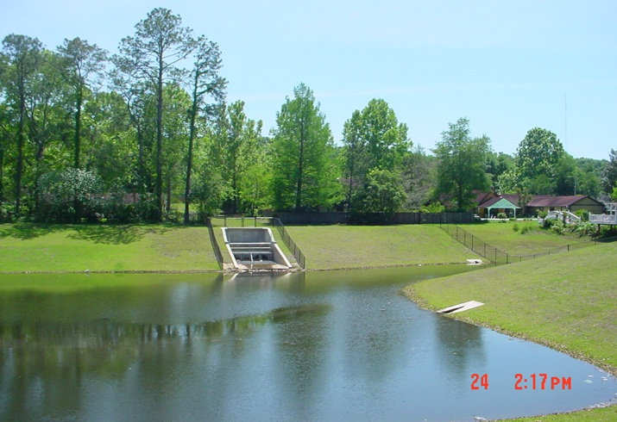
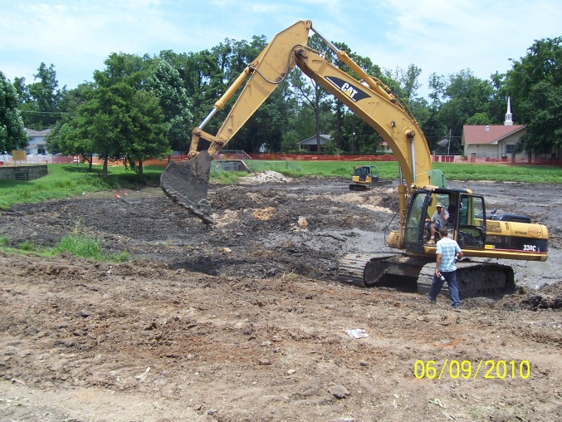
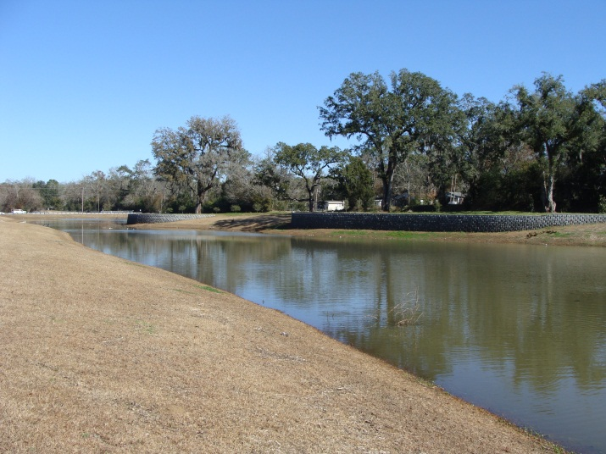
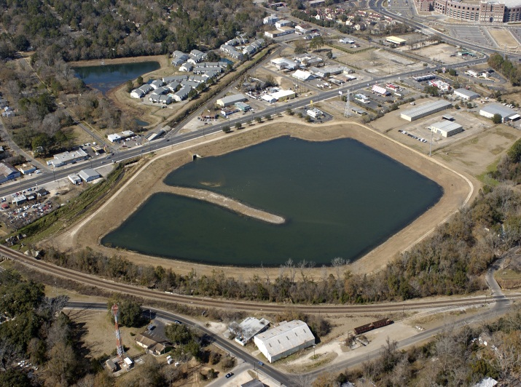
Stormwater Capital Improvement Projects
Abbiegail Pond
Frenchtown Pond
Last 12 years
City-wide
$97.4 Million
149 Projects
Bond Pond
FSU-RSF
Notes:
NOTE: DEP available funding is about $8-9 Million for the entire state for stormwater projects

Slide 19

Reductions Through Source Control
Public Education & Ordinances
TAPP (Think About Personal Pollution)
$1.7 million since 2006
Passed Pet Waste Ordinance (June 2008)
Passed Fertilizer Applicator Ordinance (Jan 2009)
City issued 557 certifications to applicators since 2009

Slide 20

Reductions Through Source Controls
(Pet Waste)
Nitrogen content 2¹/₂ times cow manure
39,350 dogs
= 13.5 ton/da feces
Nitrogen Load
= 34 tons/yr.
30% of dog owners began picking up within the last 6-12 months
Notes:
Details are available and the main point is that this translates to a cost-avoidance of $2.5M/year
Think back to the “value” of nutrients – the cost of removing an ounce of phosphorous from polluted runoff is $847.
Again, it’s far cheaper to prevent pollution than it is to clean it up.

Slide 21
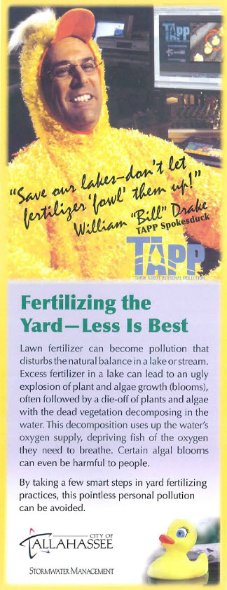
Reductions Through Source Controls
(Fertilizer Use Citywide)
Households that applied fertilizer
(2007 vs. 2012) decreased 49%.
Level of Nitrogen Applied per Household decreased 27%
Source: Florida Department of Agriculture & Consumer Services, Bureau of Compliance Monitoring

Slide 22
Nitrate Load Management
Summary of Nitrate Load & Needed Reductions.
What Has the City of Tallahassee Done?
What Remains to be Done?

Slide 23
Additional Nitrate Reduction Required
(45,600 kg )
229,000 kg/yr
110,000 kg TMDL
45,600 kg
Additional Reduction Required
Pre – City AWT
Post – City AWT

Slide 24
Additional Nitrate Reduction Required
(45,600 kg )
*
* Inflow includes OSTDs north of PSPZ
Post – City AWT

Slide 25
Additional Nitrate Reduction Required
(45,600 kg )
Inflow perhaps can be reduced by management efforts in the More Vulnerable LAVA Mapped Areas
* Inflow includes OSTDs north of PSPZ
Post – City AWT

Slide 26
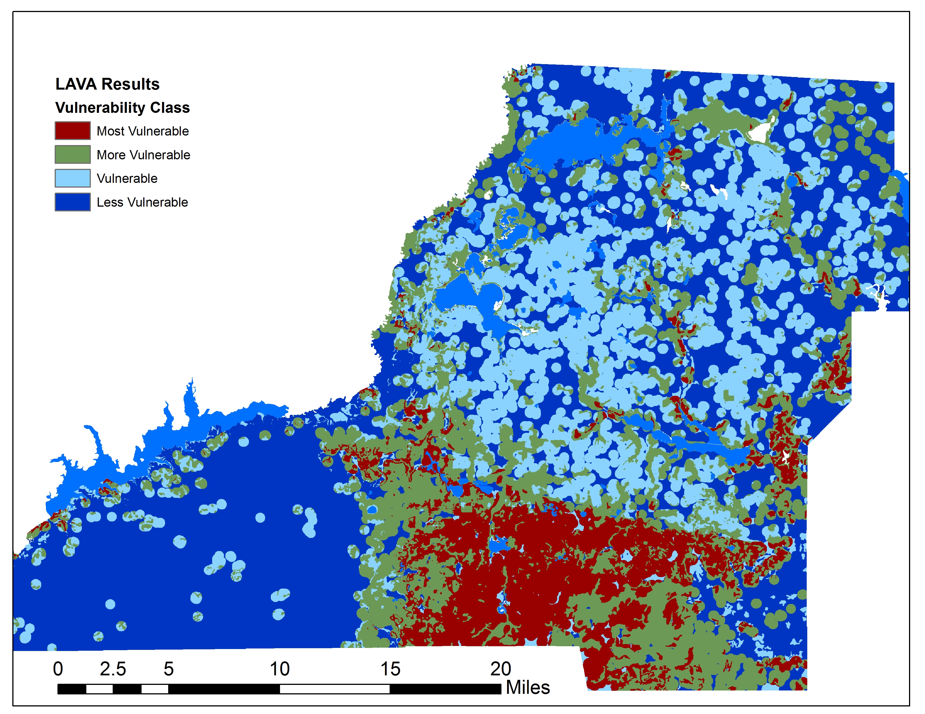
LAVA Model Results
Project Results

Slide 27
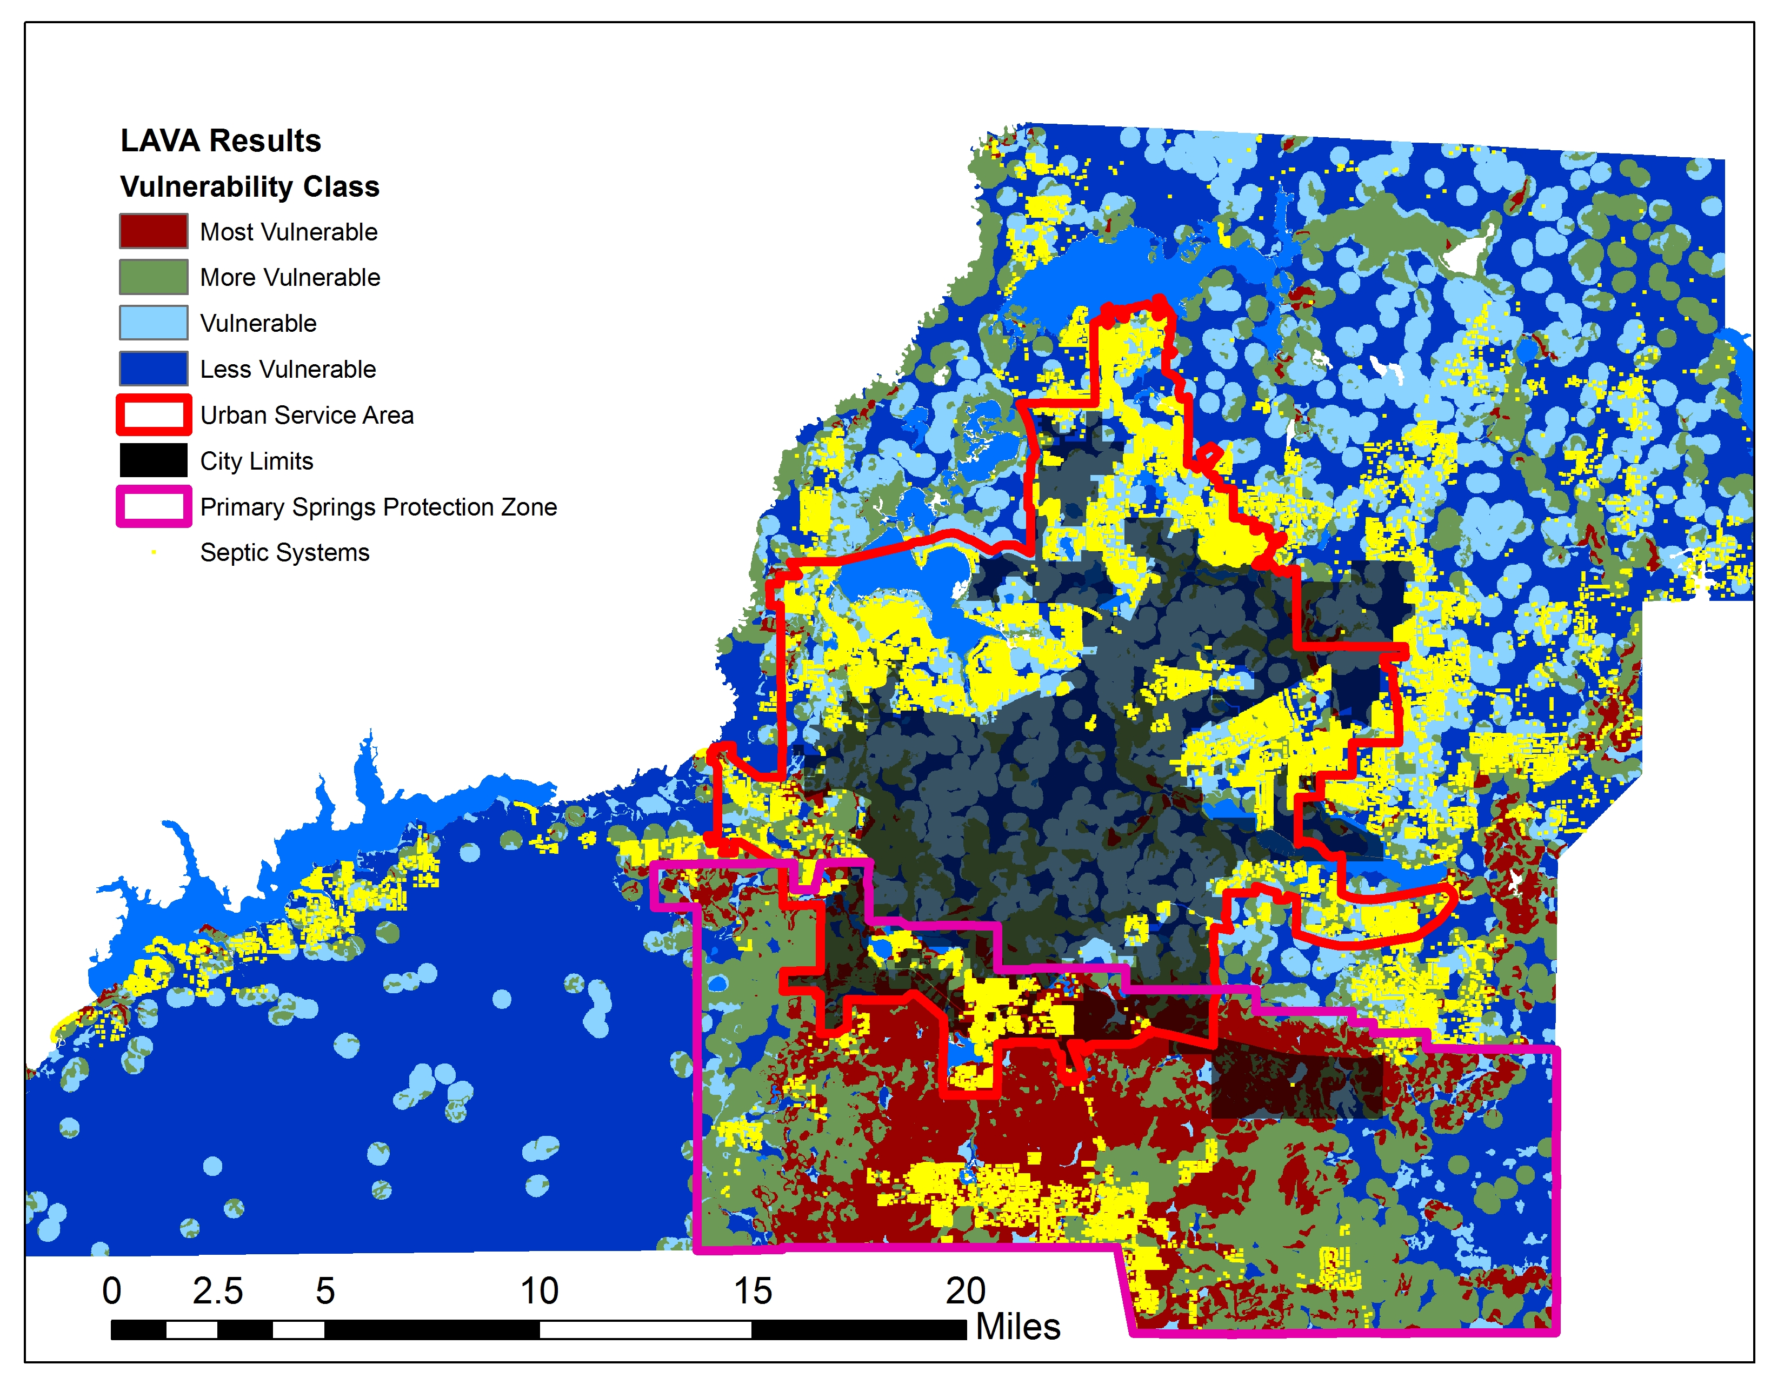
Septic Tanks Located
North and South of The Cody Scarp
Notes:
This map shows the PSPZ with the location of Septic Tanks

Slide 28
Additional Nitrate Reduction Required
(45,600 kg )
* Inflow includes OSTDs north of PSPZ
OSTDs
Possibly the Low Hanging Fruit
Post – City AWT

Slide 29
Lombardo Guidance
Due to significant natural attenuation , there is limited value in seeking additional nitrogen removal north of the Cody Scarp.
To achieve 0.35 mg/L nitrate in Scenario 1, the maximum practicable nitrogen removal is required for all septic systems in the Scenario 1 area.
That means either central sewer or advanced or performance-based septic systems as opposed to conventional septic systems.
Notes:
Attenuation = reducing the nitrate levels. Above the Cody Scarp more of a clay overburden

Slide 30
OSTDs – The Numbers
In Priority Area | Septic Systems
Leon County | 7,500
Wakulla County | 1,100
Tallahassee | 118
Notes:
Leon / SPZ
Wakulla
City

Slide 31

Questions ?

Slide 32
Allowable Nitrogen Load to Wakulla Spring
( Pre- AWT)
229,900 kg/yr

Slide 33
Impact of City’s AWT Project
73% Load Reduction - - Exceeded 56% Required
229,000 kg/yr
155,5000 kg/yr
Pre - AWT
Post - AWT

Slide 34
Additional Nitrate Reduction Required
(45,600 kg )
229,000 kg/yr
110,000 kg TMDL
45,600 kg
Additional Reduction Required
Pre – City AWT
Post – City AWT

Slide 35
What Has the City Done?

Slide 36
Distributive Property of Mathematics
X (a + b + c) = Xa + Xb + Xc
56% ( Total Load ) = 56%(a) + 56%(b) + 56%(c)
So if each of the sources is reduced by 56%
the overall 56% reduction is achieved.

