Slide 1
Bureau of Watershed Restoration
Summary of Water Quality Data and the Existing Monitoring Network : Current & Recent Nitrate Trends in Wakulla Springs & River
Gary Maddox, P.G.
Ground Water Management Section
March 28, 2013

Slide 2
QUESTIONS:
  How do recent (2007-2012) nutrient concentrations in Wakulla Springs & River compare with levels measured during the TMDL Verified Period (February 28, 2000 – June 30, 2007)?

Slide 3
QUESTIONS:
  How do recent (2007-2012) nutrient concentrations in Wakulla Springs & River compare with levels measured during the TMDL Verified Period (February 28, 2000 – June 30, 2007)?
  Which tunnels are contributing elevated nitrates to Wakulla Springs & River?

Slide 4
QUESTIONS:
  How do recent (2007-2012) nutrient concentrations in Wakulla Springs & River compare with levels measured during the TMDL Verified Period (February 28, 2000 – June 30, 2007)?
  Which tunnels are contributing elevated nitrates to Wakulla Springs & River?
  What potential source areas contribute to water quality in major Wakulla tunnels (based on dye-tracing studies)?

Slide 5
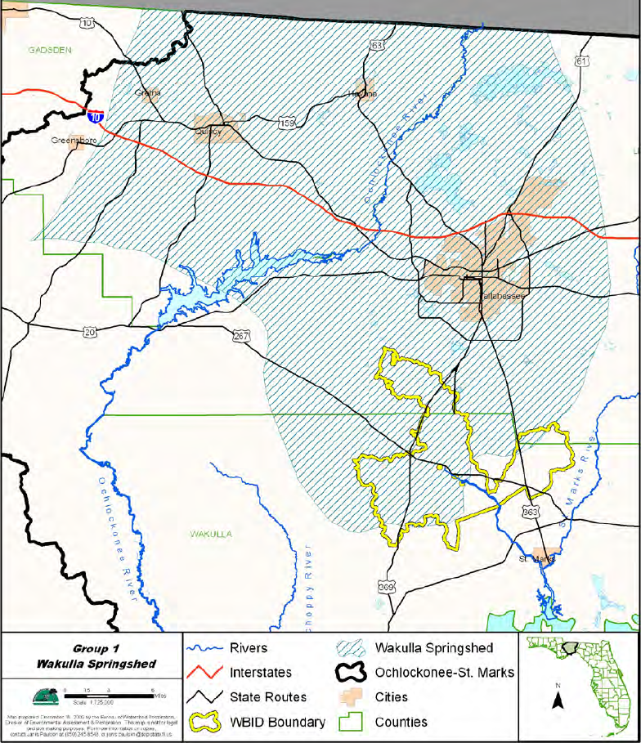
.
WAKULLA SPRINGSHED & WBID 1006 BOUNDARIES
Springshed coverage from NWFWMD (Barrios), 2008

Slide 6
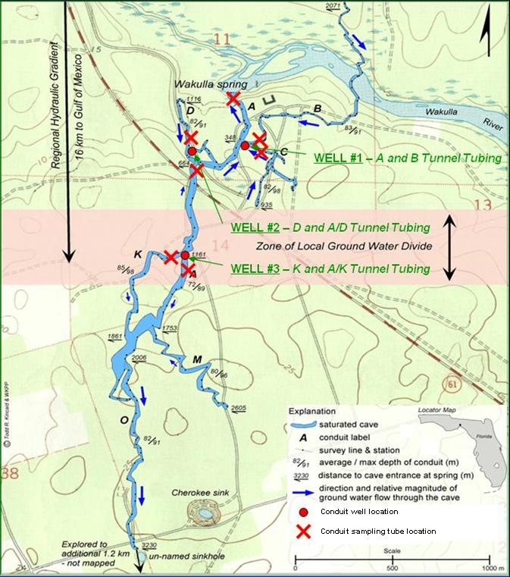
Wakulla Cave Access Well Locations

Slide 7
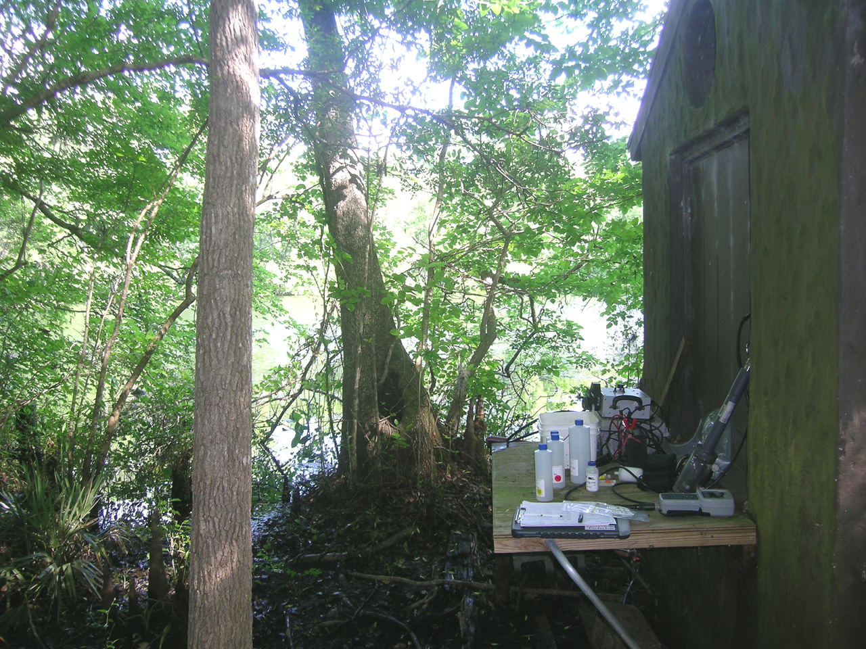
Wakulla Main Spring Sampling Tube

Slide 8
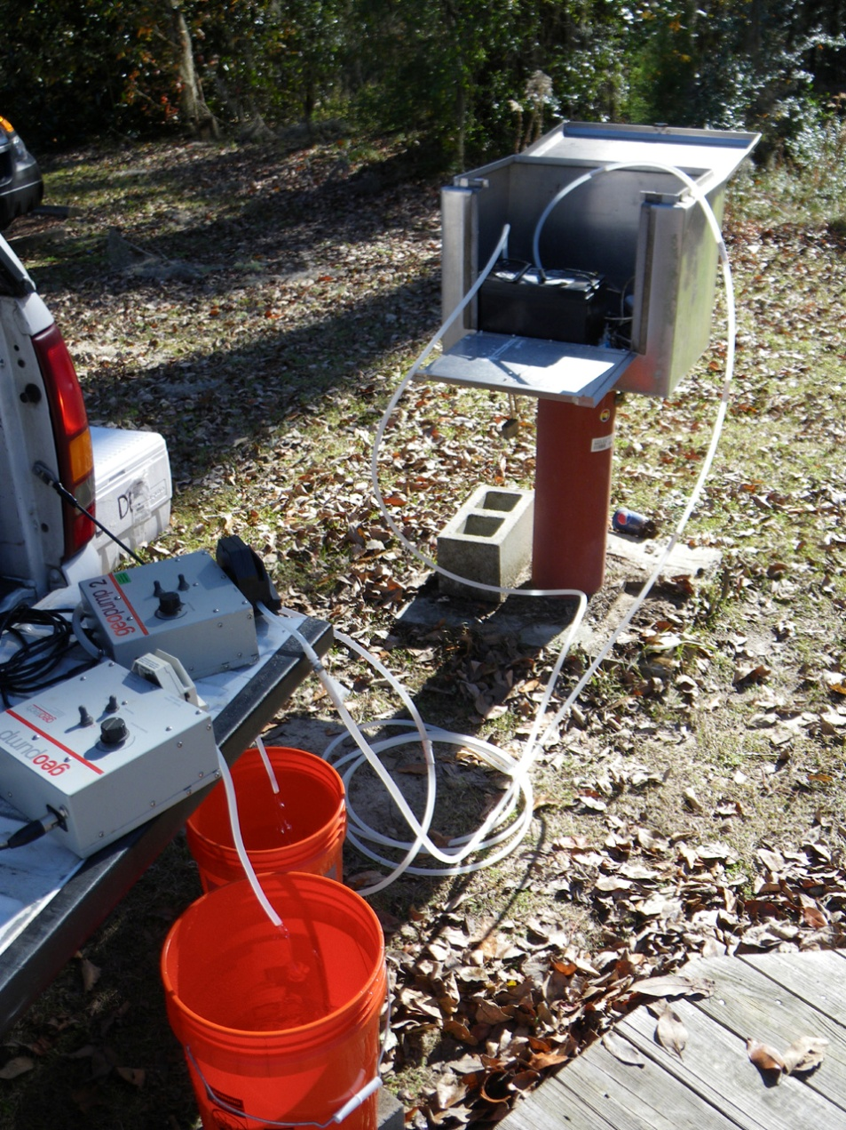
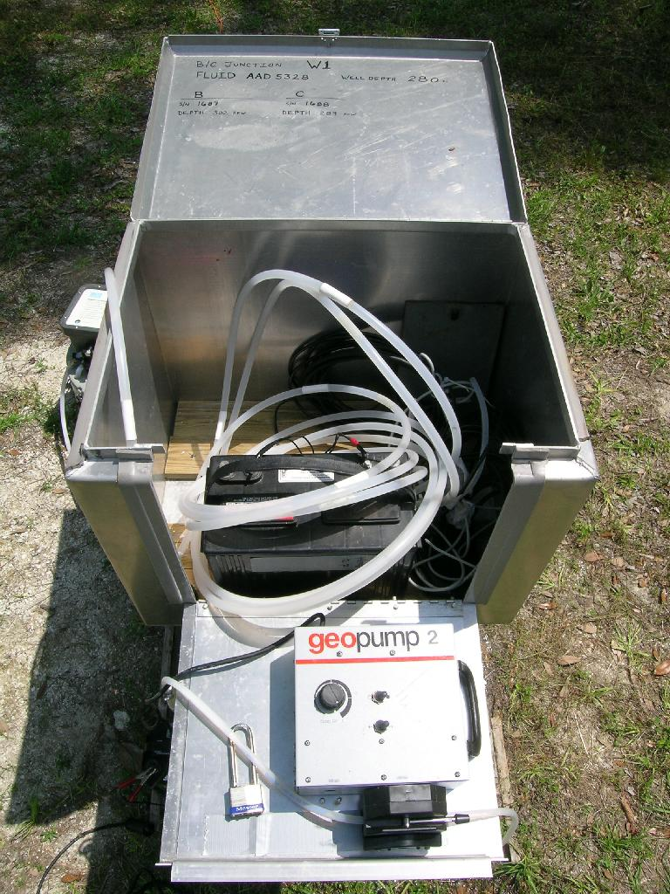
Wakulla B- & C-Tunnel Access Well

Slide 9
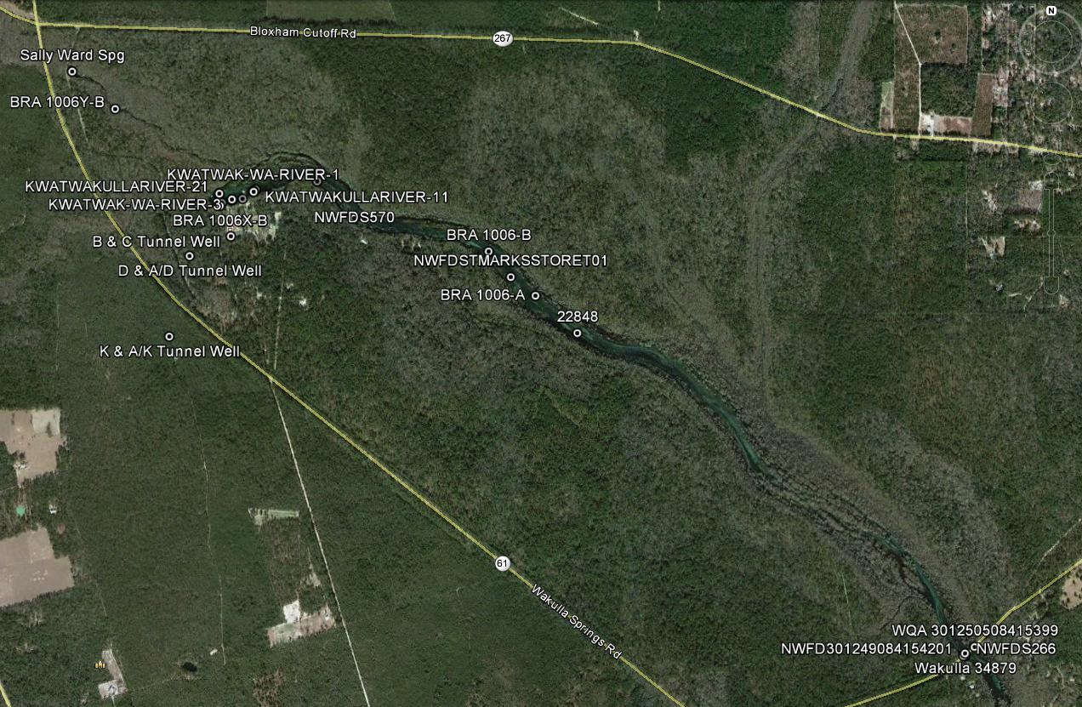
Wakulla Surface Water &
Ground Water Quality Stations

Slide 10
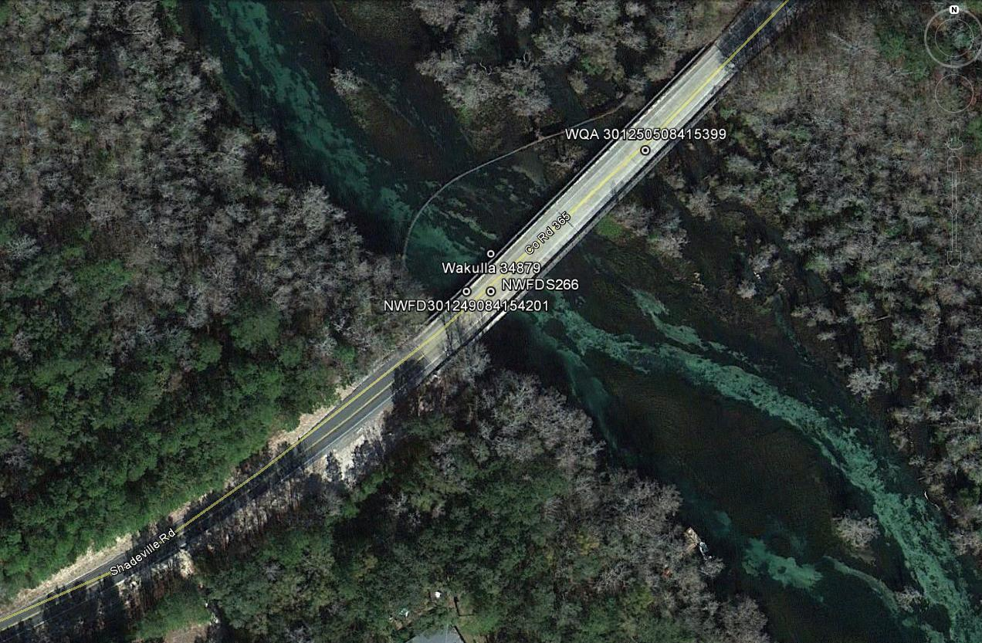
Wakulla River Surface Water Quality
Stations @ County Road 365 Bridge

Slide 11
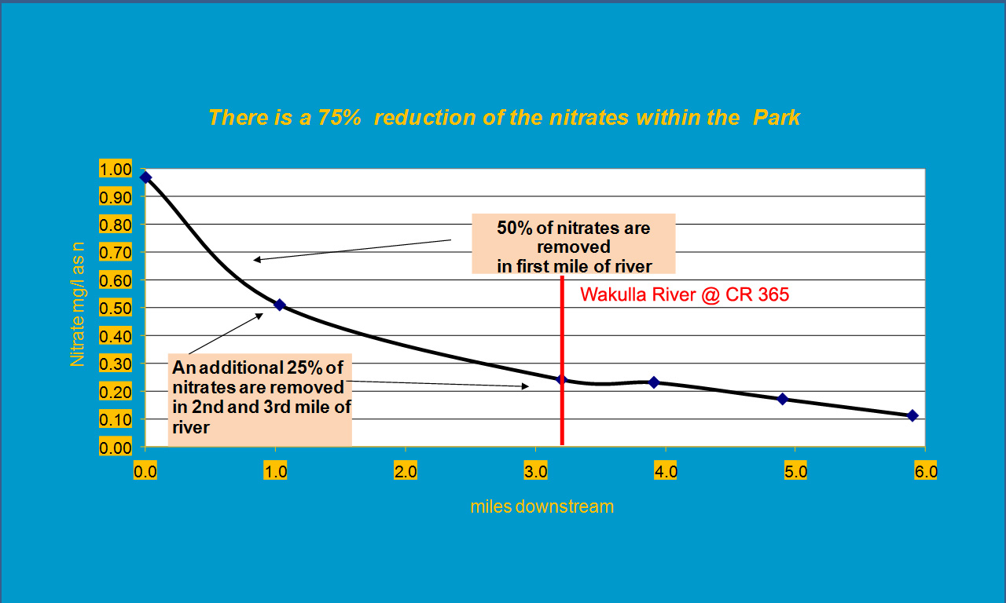
Nitrate Reduction Downstream from Wakulla Main Spring

Slide 12
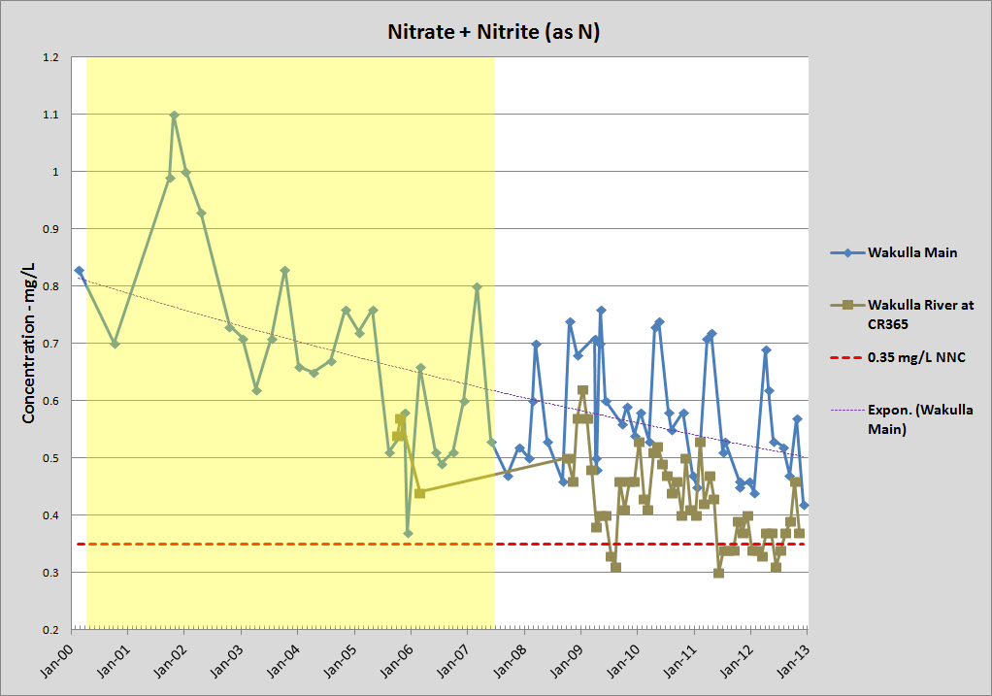
Wakulla Main Spring vs.
Wakulla River @ County Road 365 Bridge

Slide 13
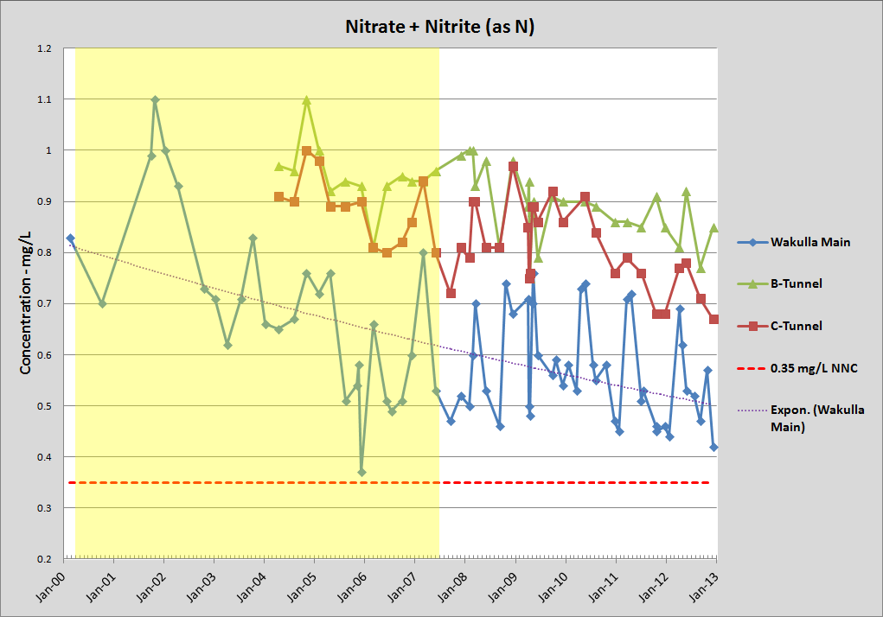
Ground Water Sources – Wakulla Main,
B-Tunnel & C-Tunnel

Slide 14
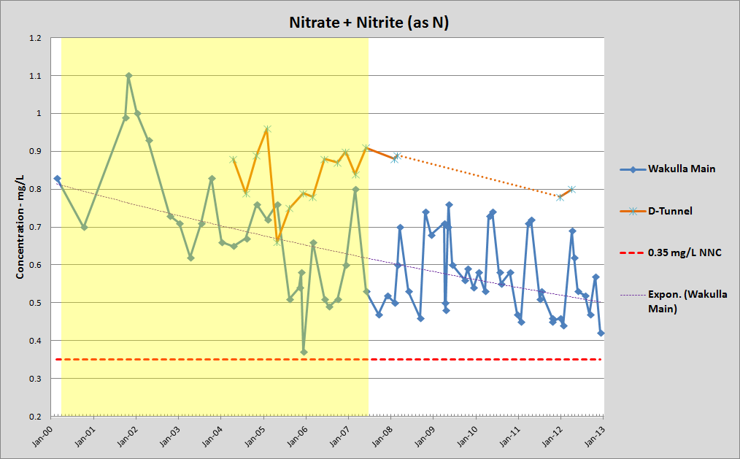
Ground Water Sources –
Wakulla Main & D-Tunnel

Slide 15
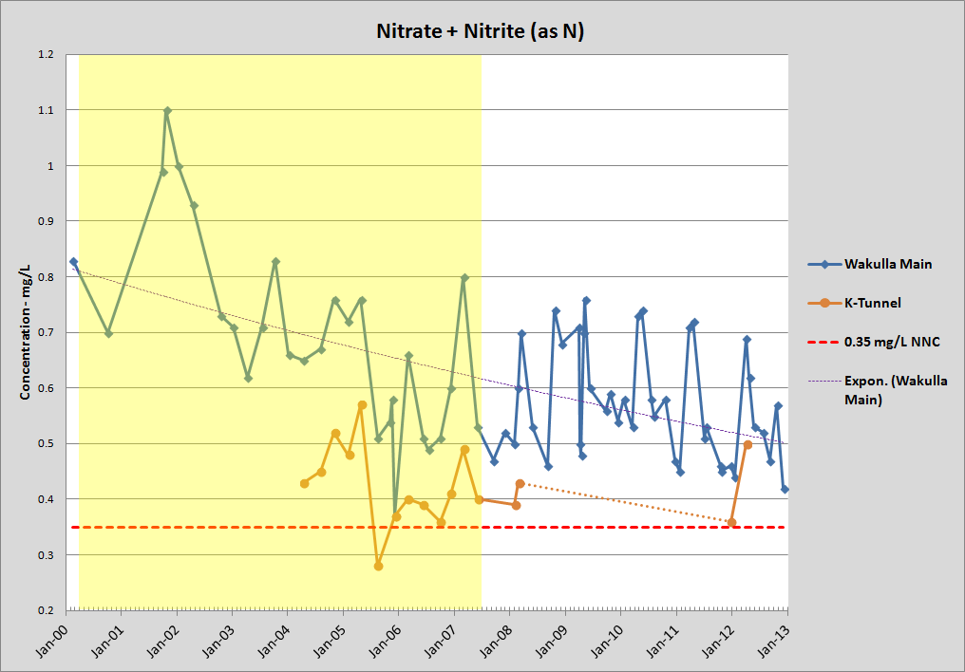
Ground Water Sources –
Wakulla Main & K-Tunnel

Slide 16
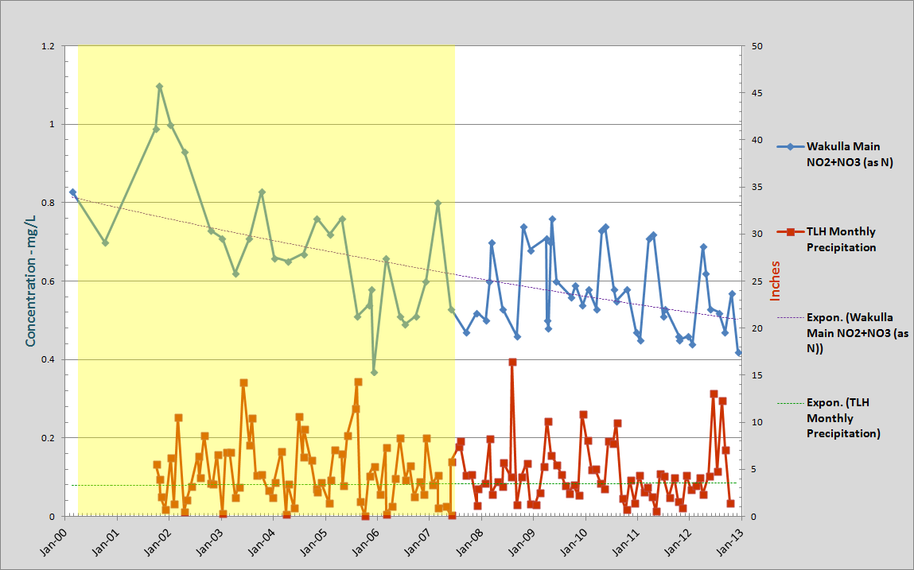
Wakulla Main Spring Nitrate &
Tallahassee Regional Airport Precipitation

Slide 17
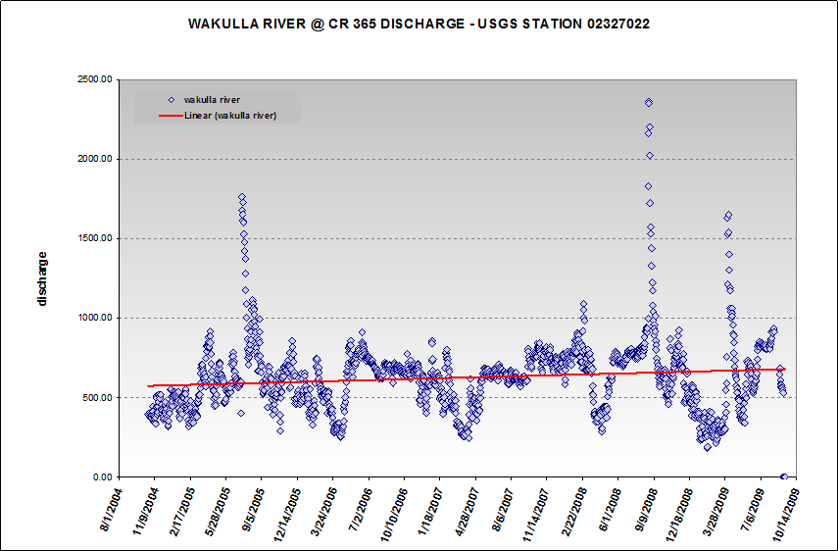
Wakulla River Discharge 2004 - 2009
from Harrington, 2010

Slide 18
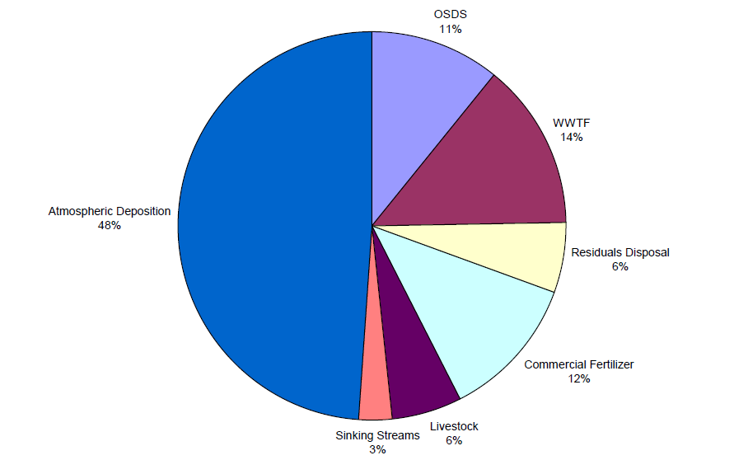
Relative Contribution from Inventoried Land Surface Nitrogen Sources to 1990-1999 Average N-Loading in Southern Leon and Wakulla Counties
Figure from Chelette, Pratt & Katz, 2002

Slide 19
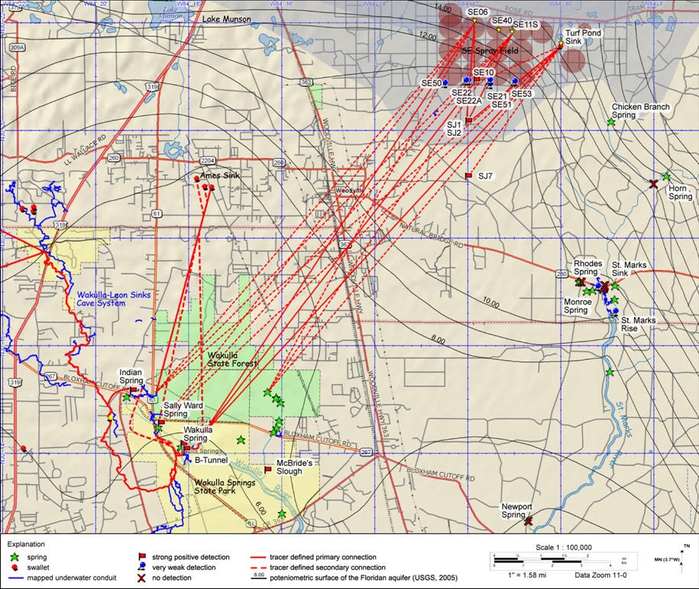
Dye-Tracing Results (2005-2007)
ESTABLISHED CONNECTIONS:
Fisher & Black Creeks → Wakulla-Leon Sinks Cave System → Wakulla R-Tunnel → Wakulla K-Tunnel
Ames Sink → Indian, Sally Ward, Wakulla B-Tunnel
SE Sprayfield → Indian, Sally Ward, McBride Slough, Wakulla B- Tunnel
Map from Kincaid et al, 2007

Slide 20
CONCLUSIONS:
  How do recent (2007-2012) nutrient concentrations in Wakulla Springs & River compare with levels measured during the TMDL Verified Period (February 28, 2000 – June 30, 2007)?

Slide 21
CONCLUSIONS:
  How do recent (2007-2012) nutrient concentrations in Wakulla Springs & River compare with levels measured during the TMDL Verified Period (February 28, 2000 – June 30, 2007)?
    Recent nitrate concentrations in Wakulla Main, B- and C-Tunnels have dropped relative to the TMDL Verified period;

Slide 22
CONCLUSIONS:
  How do recent (2007-2012) nutrient concentrations in Wakulla Springs & River compare with levels measured during the TMDL Verified Period (February 28, 2000 – June 30, 2007)?
    Recent nitrate concentrations in Wakulla Main, B- and C-Tunnels have dropped relative to the TMDL Verified period;
    Nitrate concentrations in D-Tunnel may have dropped relative to the TMDL Verified period, but there is too little post-Verified Period monitoring data to confirm this;

Slide 23
CONCLUSIONS:
  How do recent (2007-2012) nutrient concentrations in Wakulla Springs & River compare with levels measured during the TMDL Verified Period (February 28, 2000 – June 30, 2007)?
    Nitrate concentrations in K-Tunnel appear to be relatively constant, but there is too little post-Verified Period monitoring data to confirm this;

Slide 24
CONCLUSIONS:
  How do recent (2007-2012) nutrient concentrations in Wakulla Springs & River compare with levels measured during the TMDL Verified Period (February 28, 2000 – June 30, 2007)?
    Nitrate concentrations in K-Tunnel appear to be relatively constant, but there is too little post-Verified Period monitoring data to confirm this;
    Nitrate trends in the Wakulla River, measured at the bottom of the WBID, mirror those at Wakulla Main Spring, but with lower nitrate levels.

Slide 25
Wakulla Long-Term Nitrate Trend

Slide 26
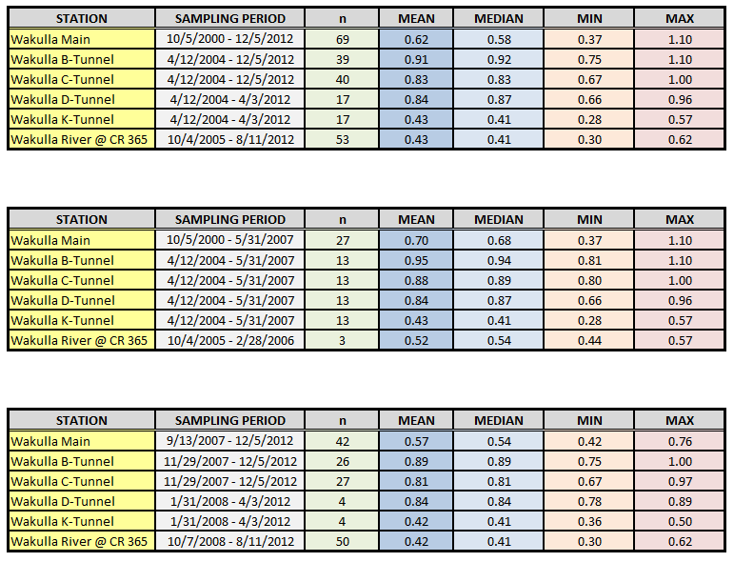
SUMMARY STATISTICS
PERIOD OF STUDY:
February 28, 2000 – December 31, 2012
TMDL VERIFIED PERIOD:
February 28, 2000 – June 30, 2007
POST-TMDL VERIFIED PERIOD:
July 1, 2007 – December 31, 2012

Slide 27
CONCLUSIONS (con’t):
  Which tunnels are contributing elevated nitrates to Wakulla Springs & River?

Slide 28
CONCLUSIONS (con’t):
  Which tunnels are contributing elevated nitrates to Wakulla Springs & River?
    Data from Wakulla B-, C-, D- & K-Tunnels all continue to show mean nitrate concentrations in excess of the 0.35 mg/L Narrative Nutrient Criteria; however, B-, C- & D-Tunnels appear to be the major contributors;

Slide 29
CONCLUSIONS (con’t):
  Which tunnels are contributing elevated nitrates to Wakulla Springs & River?
    Data from Wakulla B-, C-, D- & K-Tunnels all continue to show mean nitrate concentrations in excess of the 0.35 mg/L Narrative Nutrient Criteria; however, B-, C- & D-Tunnels appear to be the major contributors;
    B-Tunnel has the highest measured mean nitrate concentration;

Slide 30
CONCLUSIONS (con’t):
  Which tunnels are contributing elevated nitrates to Wakulla Springs & River?
    Data from Wakulla B-, C-, D- & K-Tunnels all continue to show mean nitrate concentrations in excess of the 0.35 mg/L Narrative Nutrient Criteria; however, B-, C- & D-Tunnels appear to be the major contributors;
    B-Tunnel has the highest measured mean nitrate concentration;
    K-Tunnel has the lowest measured Wakulla Tunnel nitrate concentrations. It receives much of it’s flow from R-Tunnel (Wakulla-Leon Sinks Cave System).

Slide 31
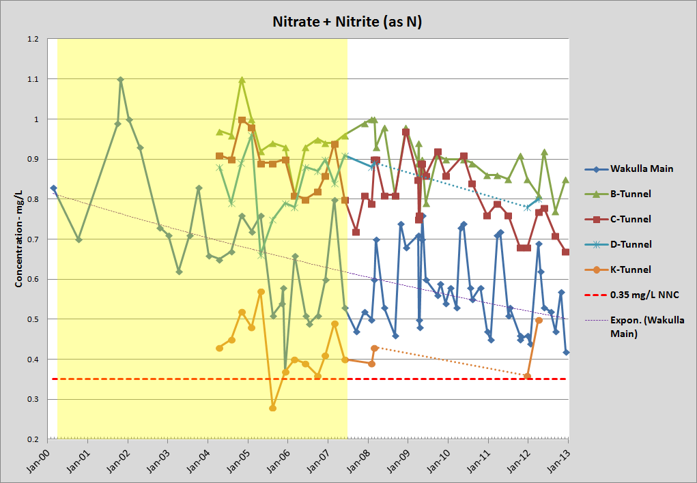
Ground Water Sources –
Principal Wakulla Tunnels

Slide 32
CONCLUSIONS (con’t):
  What potential source areas contribute to water quality in major Wakulla tunnels (based on dye-tracing studies)?

Slide 33
CONCLUSIONS (con’t):
  What potential source areas contribute to water quality in major Wakulla tunnels (based on dye-tracing studies)?
    B-Tunnel: SE Leon, NE Wakulla (including the SE Sprayfield, Ames/Kelley Sinks, and the Woodville area)

Slide 34
CONCLUSIONS (con’t):
  What potential source areas contribute to water quality in major Wakulla tunnels (based on dye-tracing studies)?
    B-Tunnel: SE Leon, NE Wakulla (including the SE Sprayfield, Ames/Kelley Sinks, and the Woodville area)
    C-Tunnel: Same as B-Tunnel

Slide 35
CONCLUSIONS (con’t):
  What potential source areas contribute to water quality in major Wakulla tunnels (based on dye-tracing studies)?
    B-Tunnel: SE Leon, NE Wakulla (including the SE Sprayfield, Ames/Kelley Sinks, and the Woodville area)
    C-Tunnel: Same as B-Tunnel
    D-Tunnel: Similar to B-Tunnel

Slide 36
CONCLUSIONS (con’t):
  What potential source areas contribute to water quality in major Wakulla tunnels (based on dye-tracing studies)?
    B-Tunnel: SE Leon, NE Wakulla (including the SE Sprayfield, Ames/Kelley Sinks, and the Woodville area)
    C-Tunnel: Same as B-Tunnel
    D-Tunnel: Similar to B-Tunnel
    K-Tunnel: Apalachicola National Forest surface water streams - Fisher Creek, Black Creek via R-Tunnel, and Lost Creek via O-Tunnel; also Spring Creek Springs Group

Slide 37
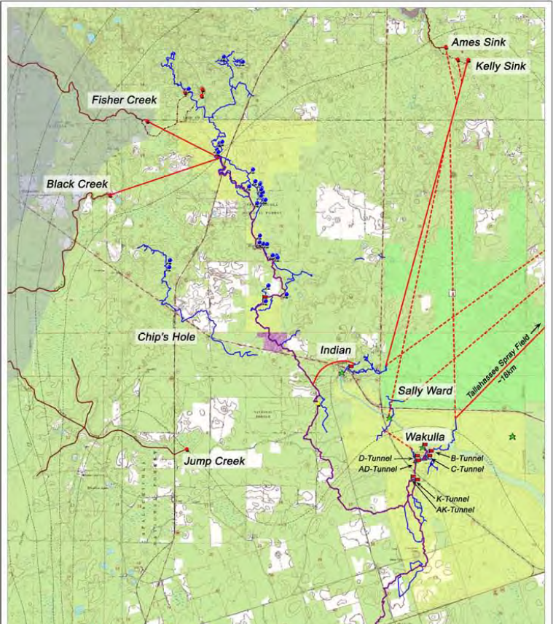
.
WAKULLA TUNNELS & DYE-TRACING RESULTS
Map courtesy of Dr. Todd Kincaid
(H2H Associates)

Slide 38
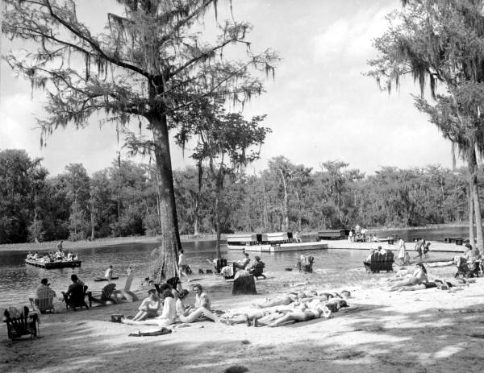
Questions?

