Slide 1

Using Nitrate Isotopes to Identify Sources of Nitrogen in the Wakulla Springs Basin
Brian G. Katz
Florida Department of Environmental Protection
Tallahassee, FL
Brian.Katz@dep.state.fl.us
Wakulla Springs BMAP meeting
April 18, 2013

Slide 2
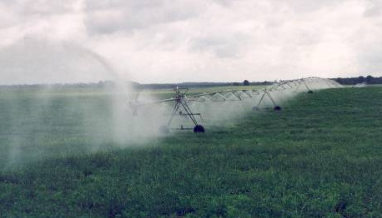




Outline of Presentation
Brief background information on nitrate isotopes* and ranges of nitrate isotope values for various N sources
Nitrate isotope data for water samples collected in the Wakulla Springs basin
*analytical technique has been around for ~ 12 yrs

Slide 3

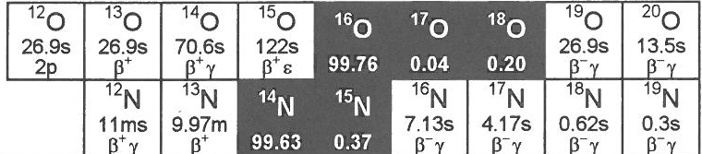
What are Nitrate (NO₃) Isotopes?
All elements have more than one isotope, some of which are stable (do not decay) and some are unstable (radioactive).
The nitrate (NO₃⁻) molecule contains nitrogen and oxygen. Nitrogen has 2 stable isotopes (¹⁵N and ¹⁴N); oxygen has 3:
(¹⁸O, ¹⁷O and ¹⁶O).
Changes in the ratios of the less abundant isotope (¹⁵N relative to ¹⁴N) and (¹⁸O relative to ¹⁶O) reflect biological and physical processes and can be used as tracers of these processes.

Slide 4
How are Nitrate Isotope Data Reported?
Changes in the ratio of nitrogen isotopes (¹⁵N/¹⁴N) are reported relative to atmospheric nitrogen in parts per thousand (‰).
If a sample has a value of 0 ‰ then it has the same composition as atmospheric N
If it has a higher value, it contains more ¹⁵N;
a lower value then more ¹⁴N.
δ¹⁵N (‰) = ([¹⁵N/¹⁴N]_{sample}/[¹⁵N/¹⁴N]_{standard} -1)*1000

Slide 5
How are Nitrate Isotope Data Reported?
By convention, changes in the ratio of oxygen isotopes (¹⁸O/¹⁶O) in nitrate are reported relative to standard mean ocean water (VSMOW) in parts per thousand (‰).
δ¹⁸O (‰) =([¹⁸O/¹⁶O]_{sample}/[¹⁸O/¹⁶O]_{standard} -1)*1000

Slide 6
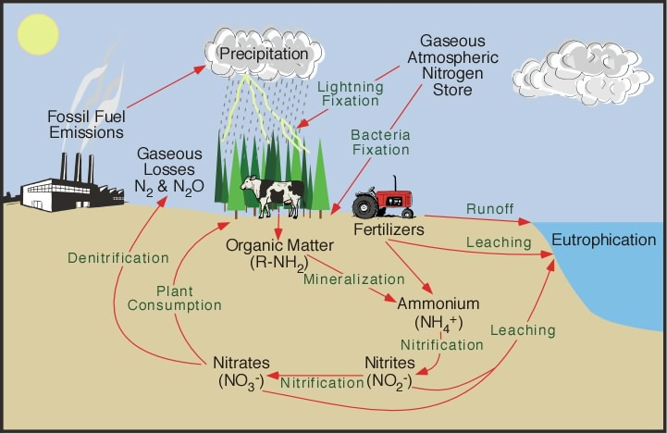
Isotopic Fractionation
During biological processes (e.g. nitrification, denitrification), the lighter isotope (¹⁴N, ¹⁶O) ends up being concentrated in the products while the heavier isotope ends up being concentrated in the reactants.
So, during denitrification (NO₃⁻→ N₂O→N₂), the resulting N₂, N₂O (products) have a lower δ¹⁵N and δ¹⁸O than the residual NO₃ (reactant), which develops a higher δ¹⁵N and δ¹⁸O.

Slide 7


Denitrification– conversion of nitrate to nitrogen gas (N₂)
by bacteria
¹⁴N¹⁶O₃
¹⁴N¹⁶O₃
¹⁴N¹⁶O₃
¹⁴N¹⁶O₃
¹⁴N¹⁶O₃
¹⁴N¹⁶O₃
¹⁵N¹⁸O₃
¹⁵N¹⁸O₃
¹⁴N¹⁶O₃
¹⁵N¹⁸O₃
¹⁵N¹⁸O₃
¹⁴N¹⁶O₃

Slide 8
Ranges of δ¹⁵N and δ¹⁸O of nitrate from different sources– and from transformation processes
Denitrification trend line

Slide 9
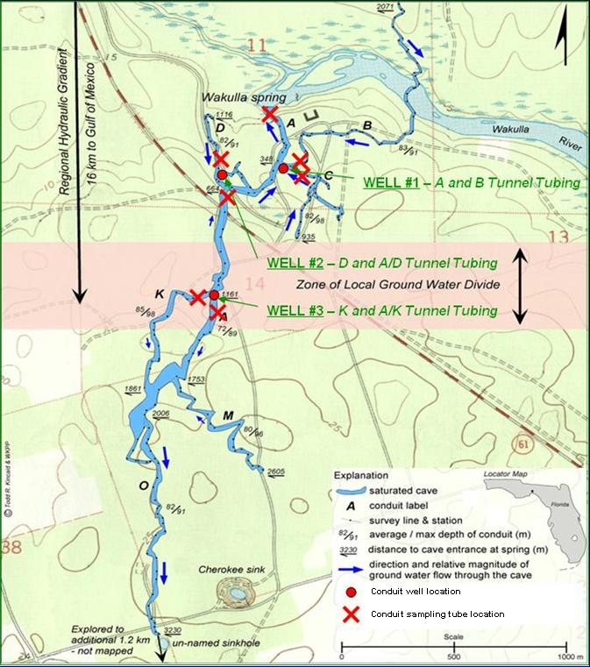
Wakulla Springs Cave System—water samples collected during March-December 2011 for nitrate isotopes and other chemical
indicators.

Slide 10
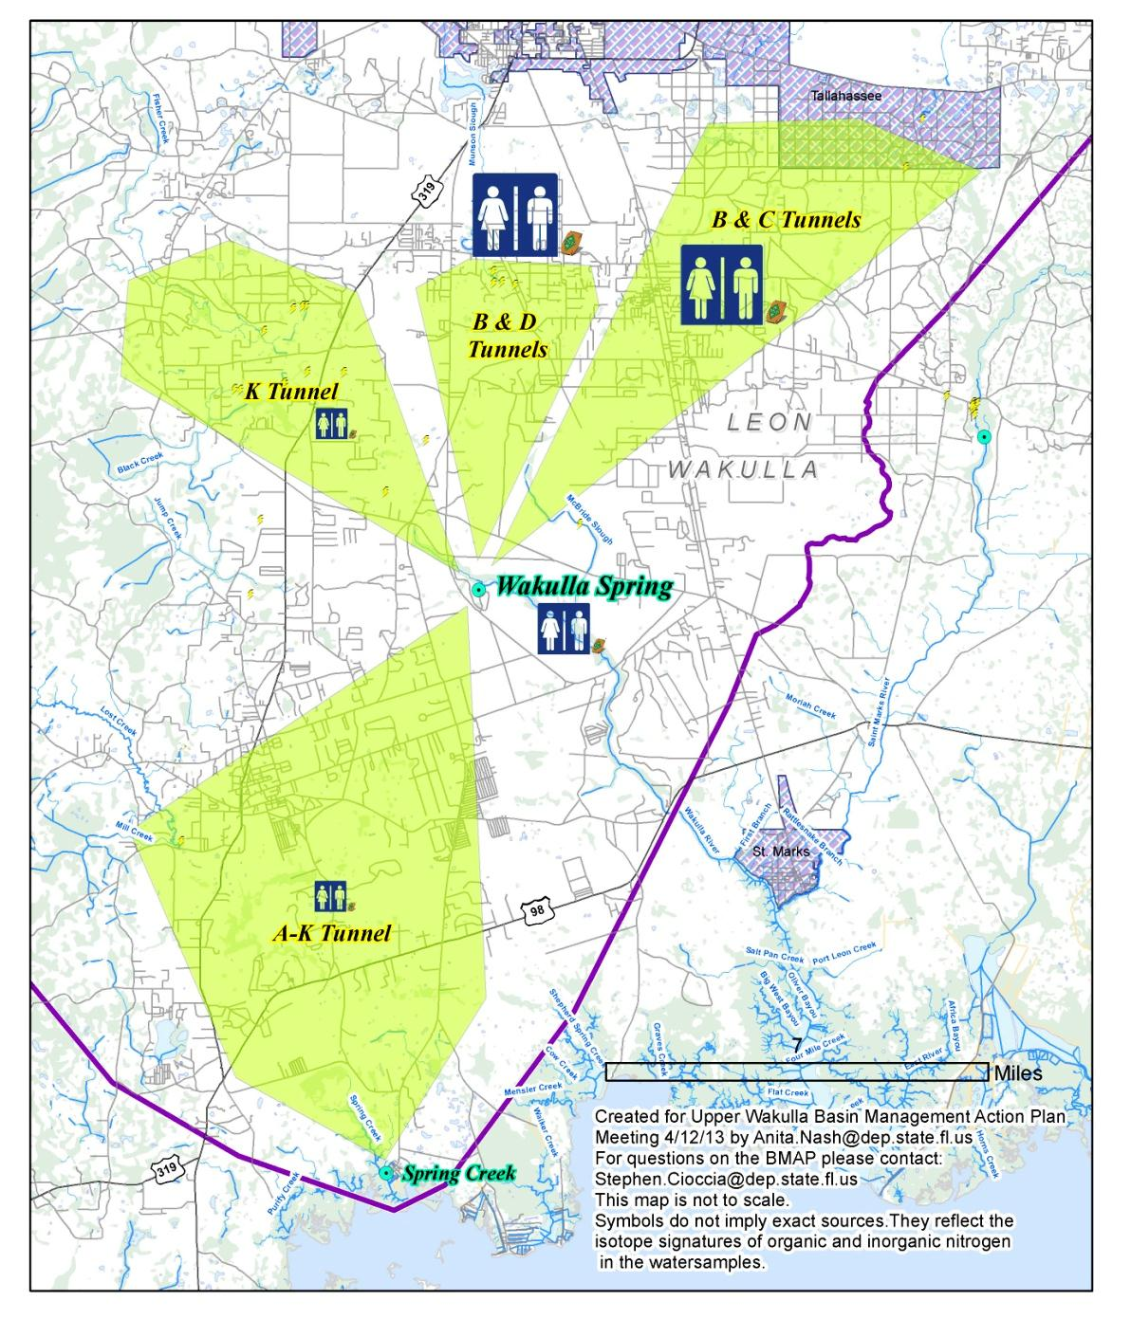
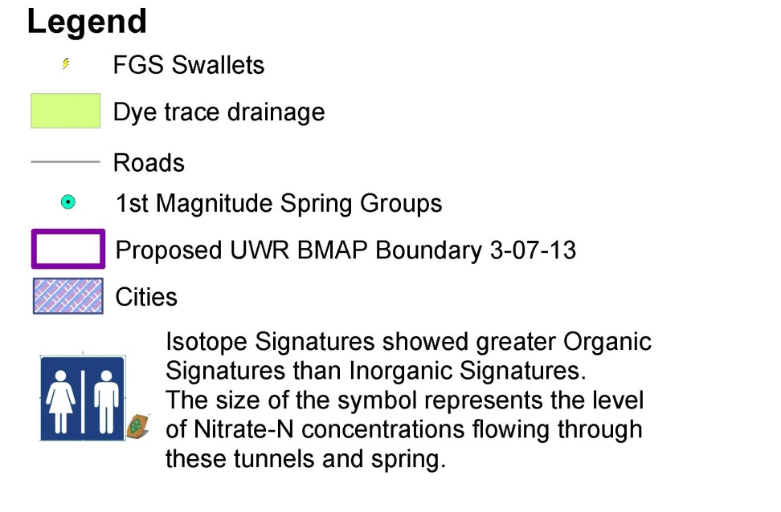
Sources of nitrate and direction of groundwater flow based on dye trace studies for Wakulla Springs and associated tunnels.

Slide 11
Nitrate isotope data– water samples collected by FDEP (March-Dec 2011)
K-tunnel
Wastewater,
manure

Slide 12

Sucralose as a Tracer of Wastewater
Studies around the world have detected sucralose in groundwaters with wastewater influence.
The vast majority of sucralose passes through wastewater and water treatment systems into the final effluent.
It is not affected by chlorination treatment and even survives tertiary-grade wastewater treatment.

Slide 13
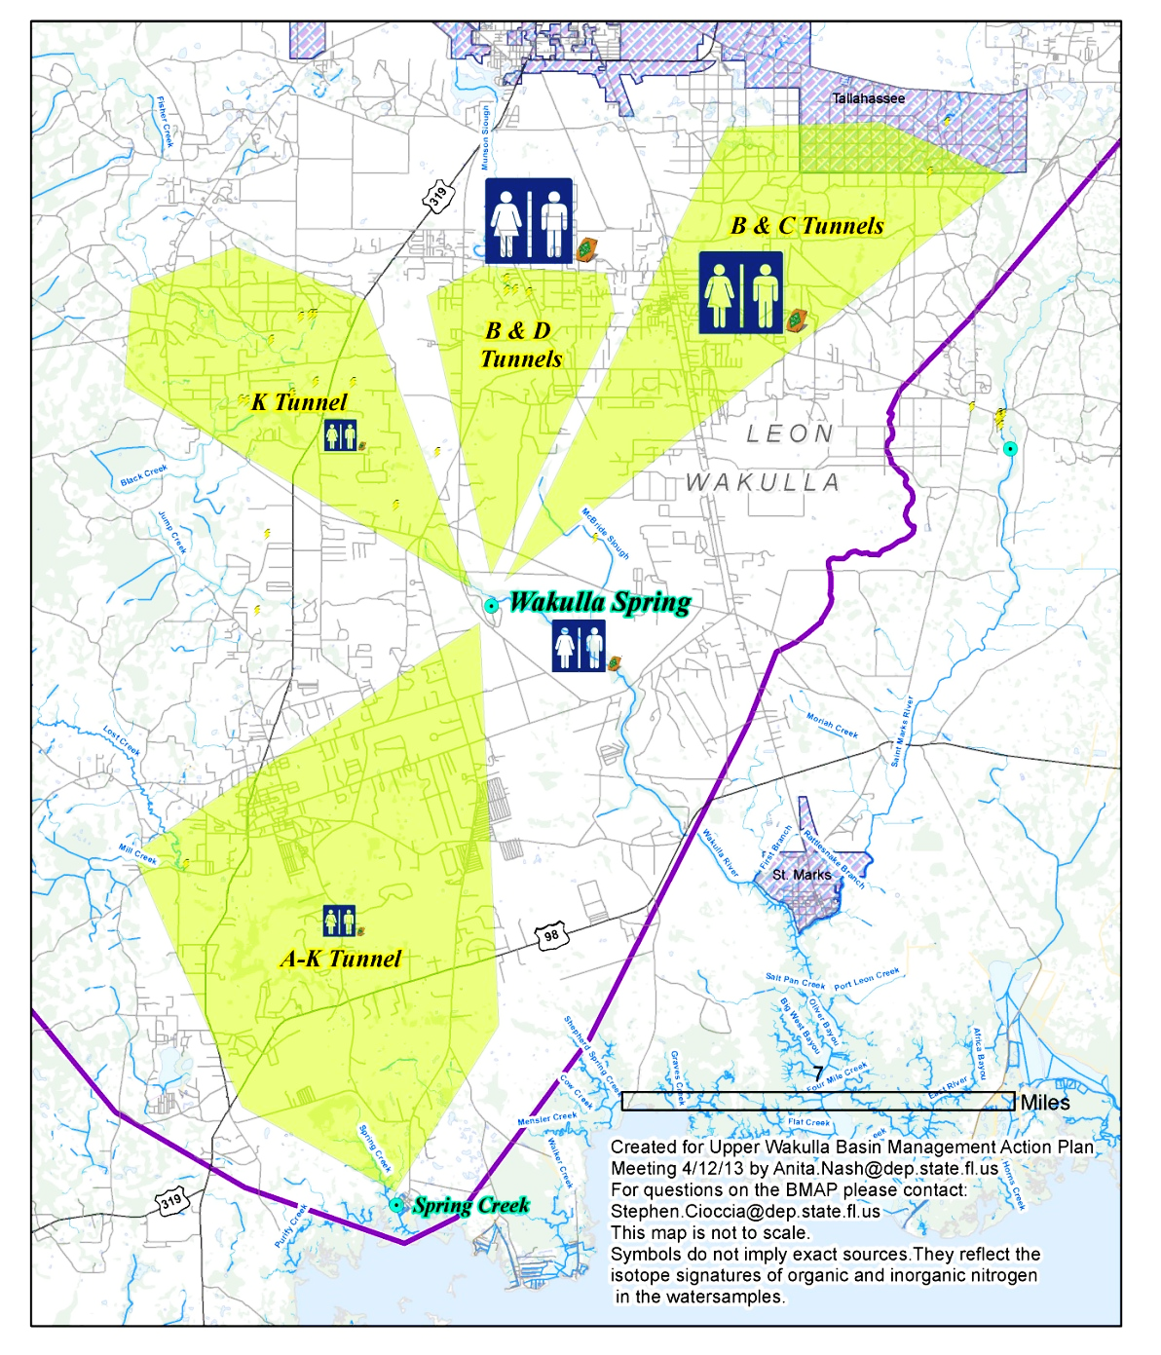
Median Sucralose concentrations (ppb) in Wakulla Springs and associated tunnels
(2011-2012)
0.013
0.035
0.033
0.02
0.011

Slide 14
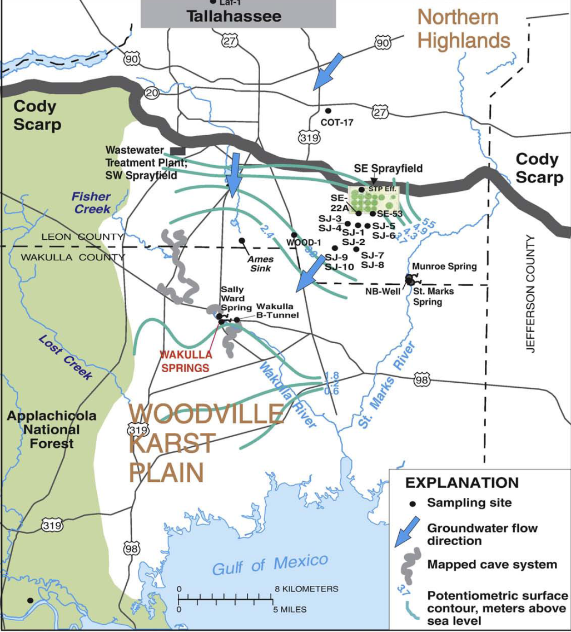
Tallahassee Sprayfield Study
**Distinct N and O isotopic signature for nitrate was found for downgradient waters affected by sprayfield effluent–
11 miles
Nitrate moves with chloride and plots along a dilution line from the sprayfield effluent.

Slide 15
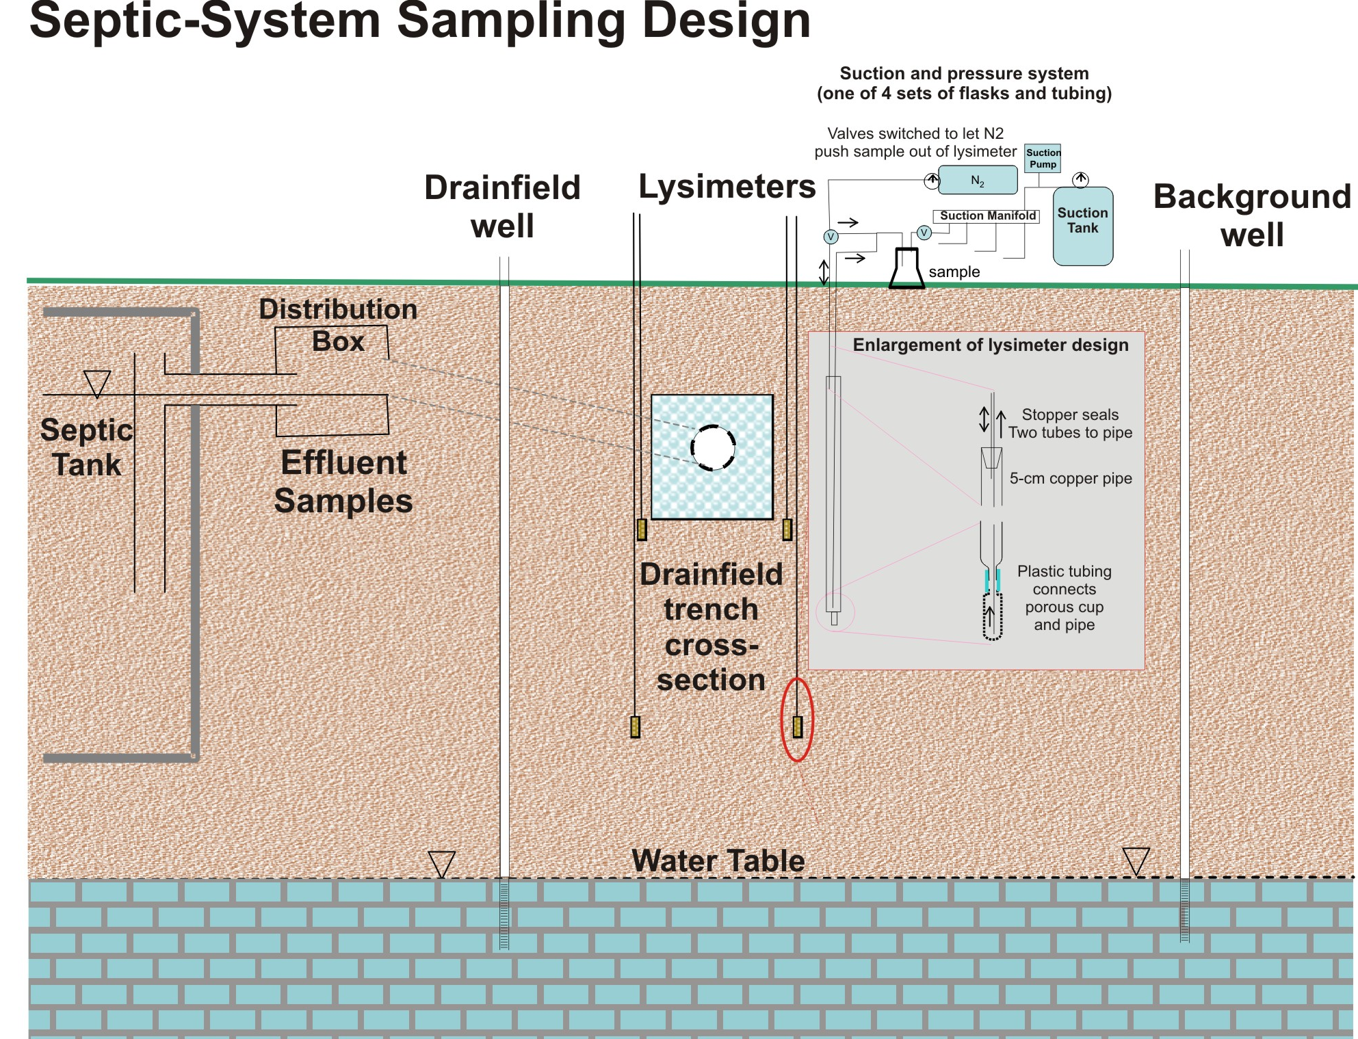
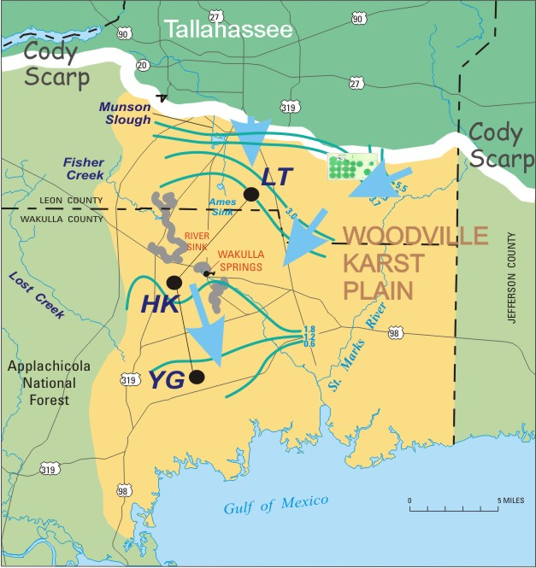

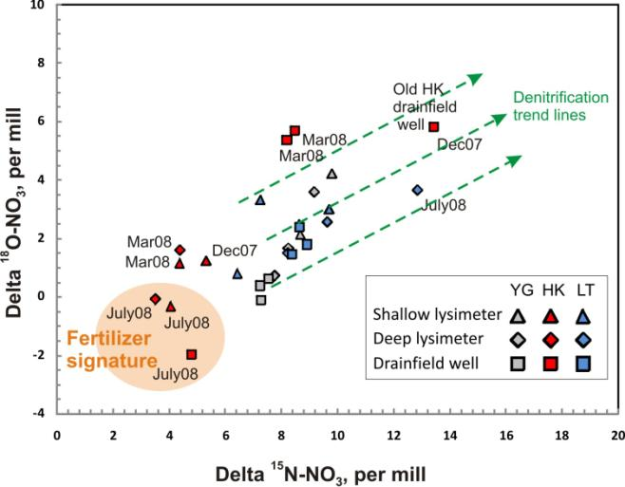
Septic Tank Study—Woodville Karst Plain
1 m
2m
Evidence for some denitrification in shallow lysimeters;
Information about fertilizer application is consistent with the lower ¹⁵N signal.

Slide 16
Summary
Nitrate isotopes (¹⁵N/¹⁴N and ¹⁸O/¹⁶O of NO₃) can provide important information about contaminant sources and nitrogen transformation processes.
Nitrate isotopes are one tool in the toolbox– other information needed on the land use, hydrology and other chemical indicators to understand sources and processes.

Slide 17
Questions ??
Contact:
Brian Katz
Florida Department of Environmental Protection
Bureau of Watershed Management
2600 Blair Stone Rd.
Tallahassee, FL 32399
Brian.Katz@dep.state.fl.us

Slide 18
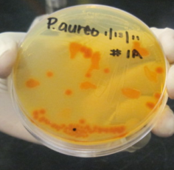
Determining δ¹⁵N and δ¹⁸O of nitrate in water (Revesz and Casciotti, 2007)
A culture of denitrifying bacteria (Pseudomonas chlororaphis and P. aureofaciens) is used to convert nitrate (NO₃) to nitrous oxide (N₂O), which is analyzed by mass spectrometry
The denitrifying bacteria are used in the enzymatic conversion of NO₃ to N₂O
NO₃ -→ NO₂-→NO →1/2 N₂O

