Slide 1
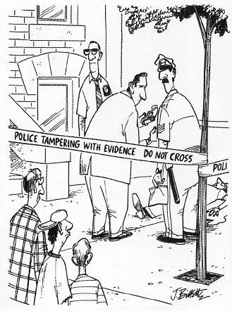
Sample Custody

Slide 2
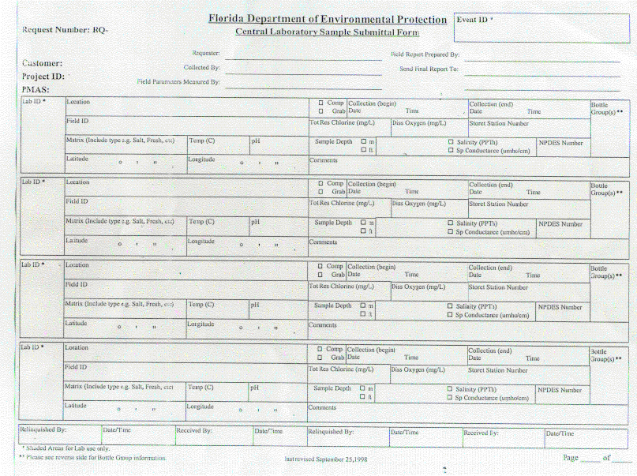
Sample Collection Documentation
Field Sheets

Slide 3
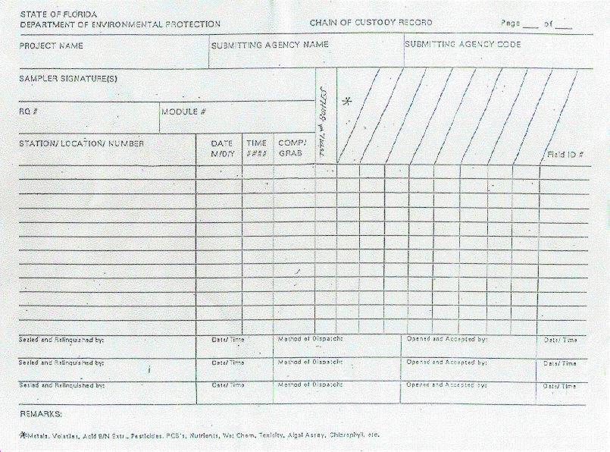
Shipping Documentation
Chain of Custody

Slide 5
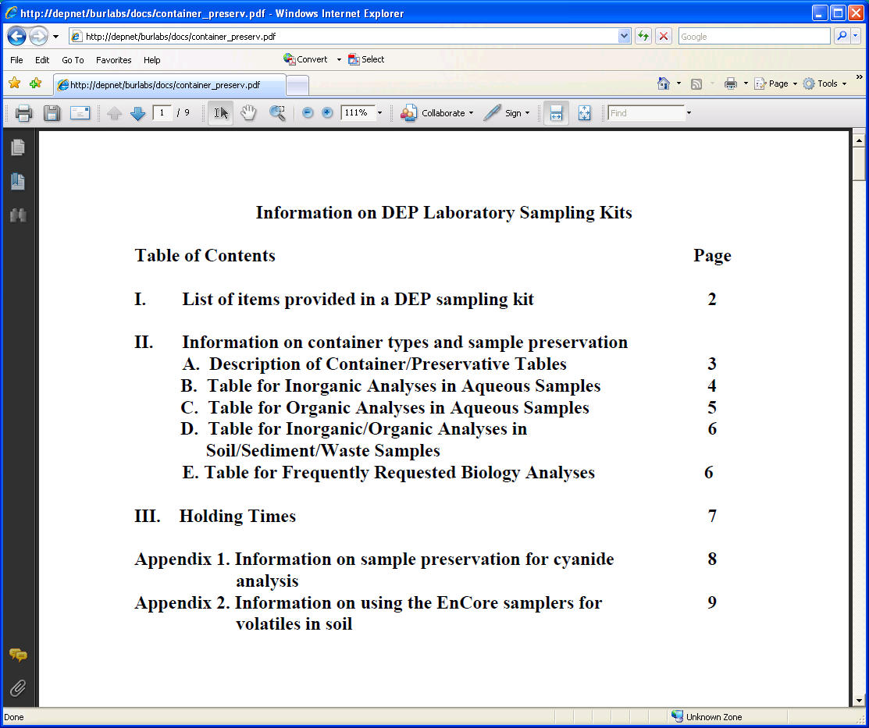
Holding Times, Sample Preservation and Containers

Slide 6
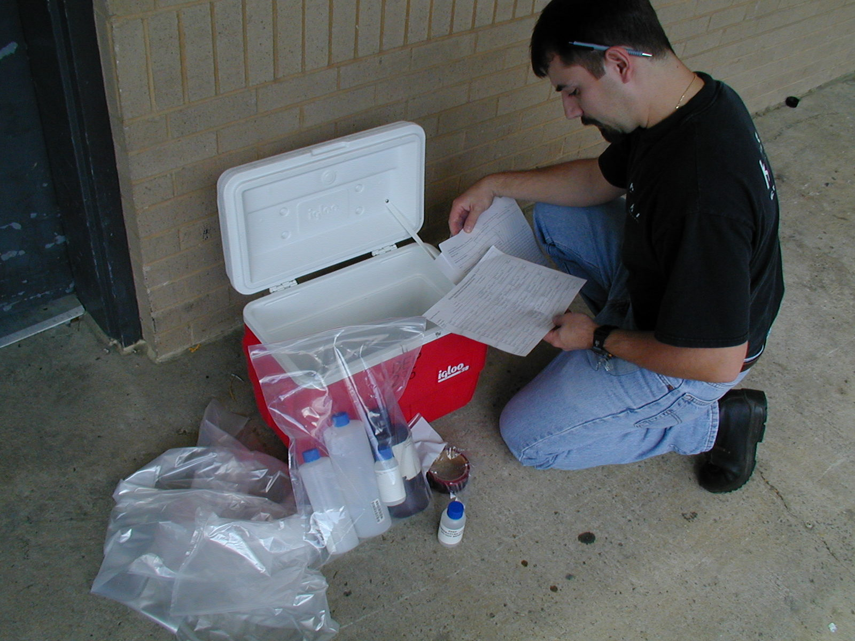
Sample Custody
Check to ensure documentation is correct!

Slide 7
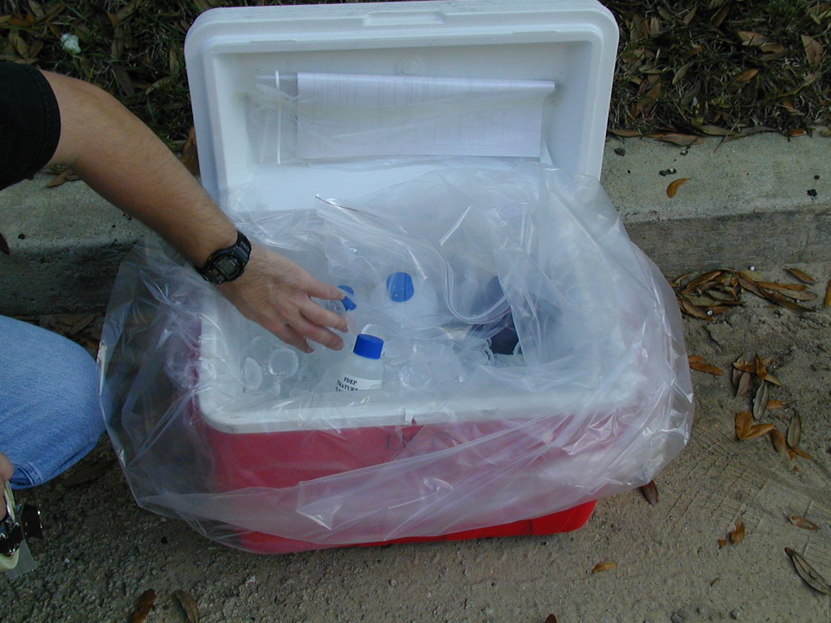
Use plenty of ice for proper preservation.
Ensure cooler won’t leak during shipment.

Slide 8
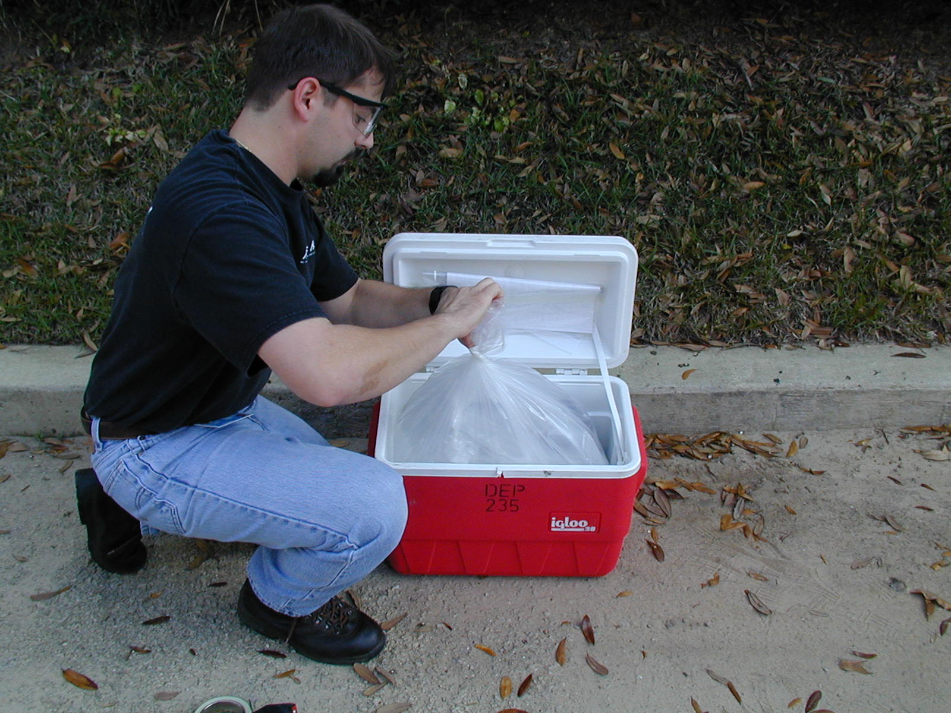
Note the documentation inside the cooler

Slide 9
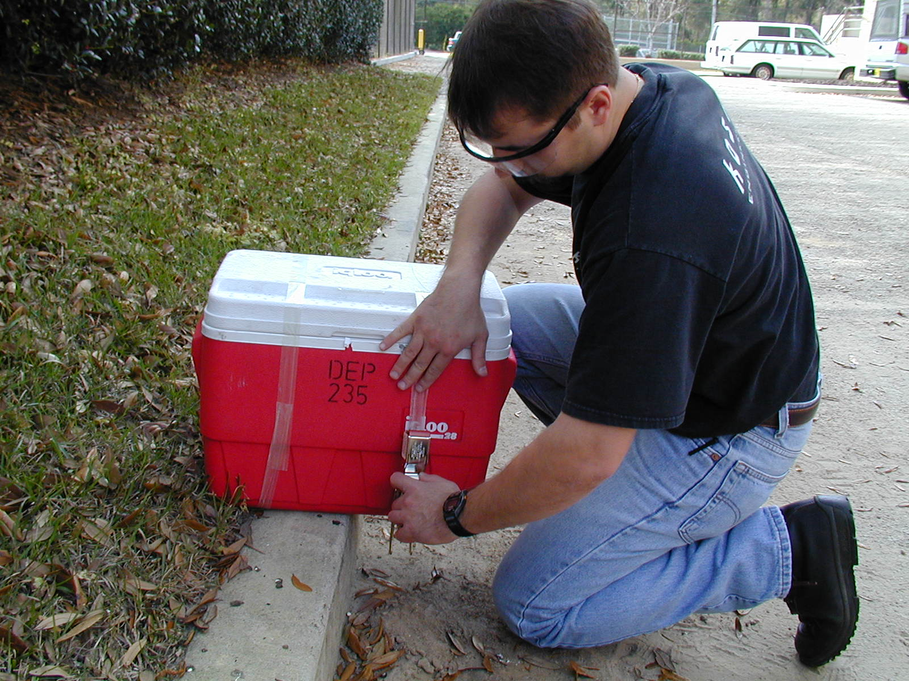
Tape the cooler securely shut

Slide 10
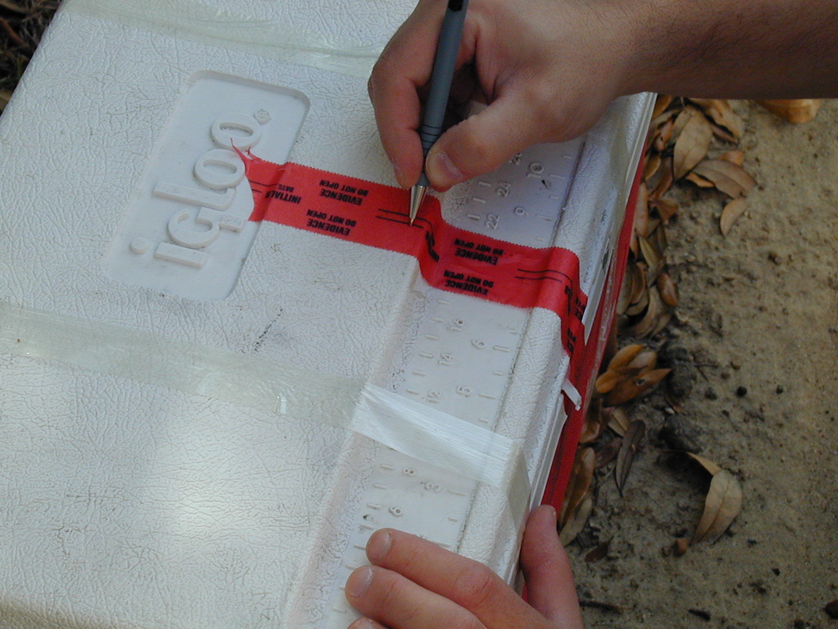
Affix, initial and date evidence tape

Slide 11
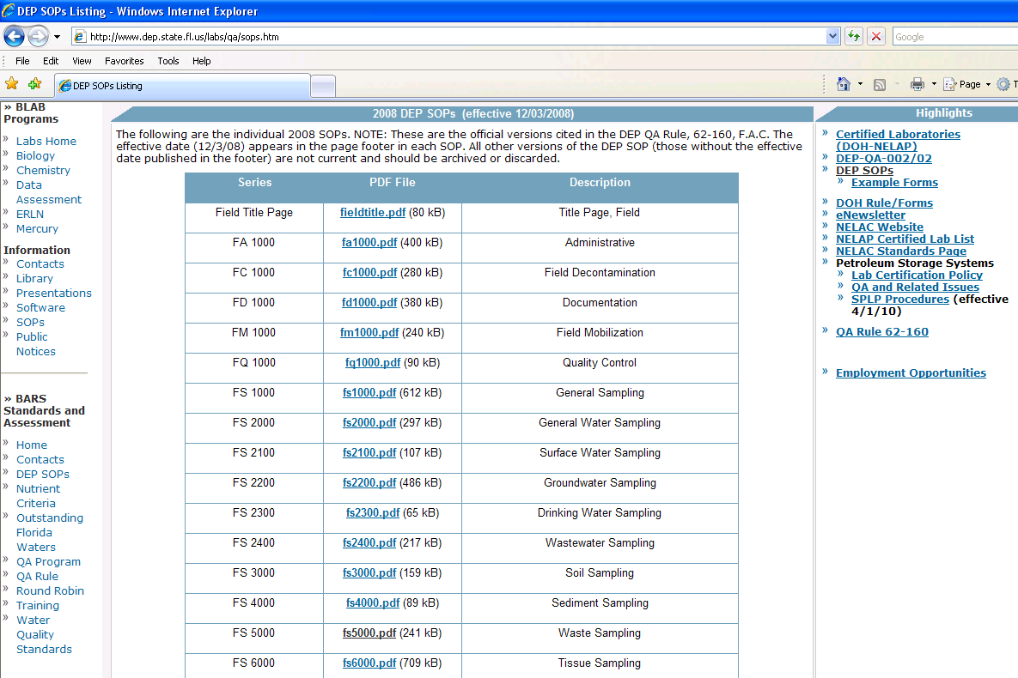
http://www.dep.state.fl.us/labs/qa/sops.htm

Slide 12
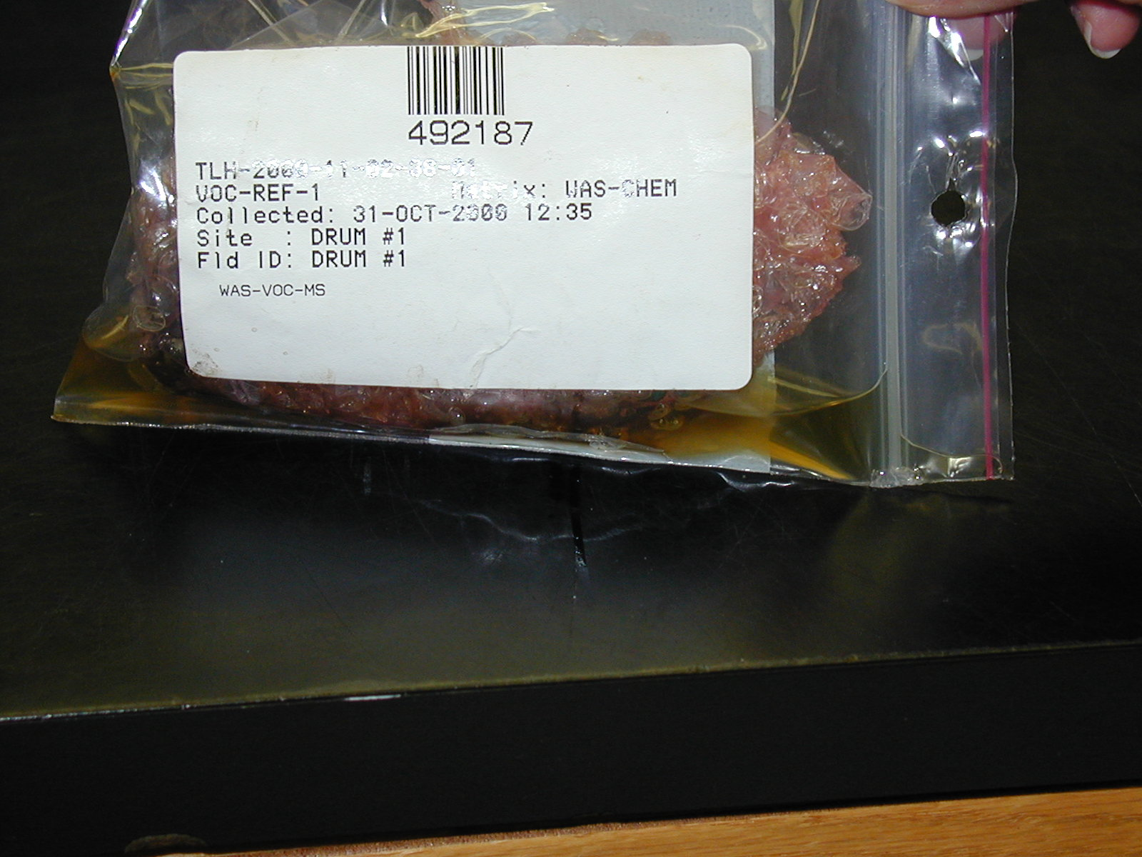
What we hope to avoid
Leaking Sample Containers

Slide 13
Sample Vessels of Ambiguous Quality

Slide 14
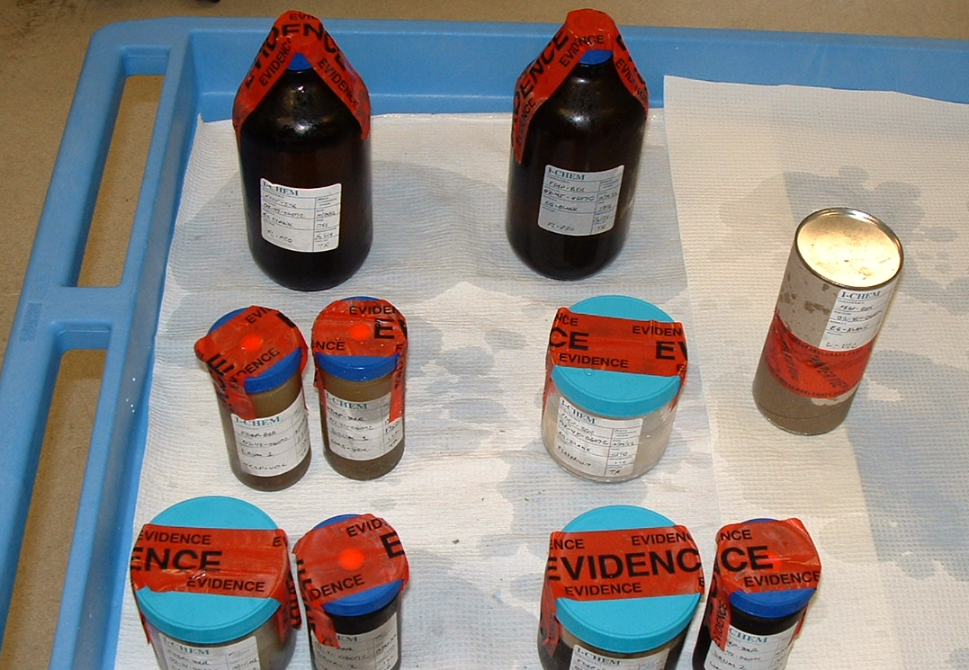
Photographic Documentation of Evidence

Slide 15
Sample storage in a secure custody room under proper preservation conditions

Slide 16
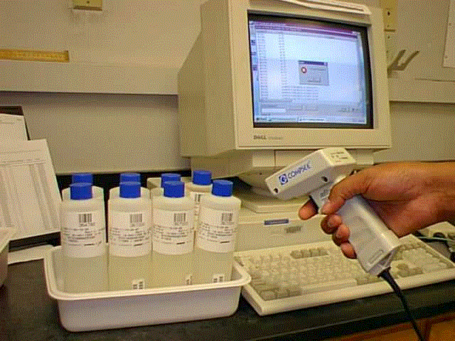
Intra-laboratory custody is maintained on every sample aliquot received by the lab;
Scanning samples out of the laboratory custody room with a bar code scanner

