Slide 1

Woodlea Road WRF
Capacity Evaluation
6/24/2022

Slide 2
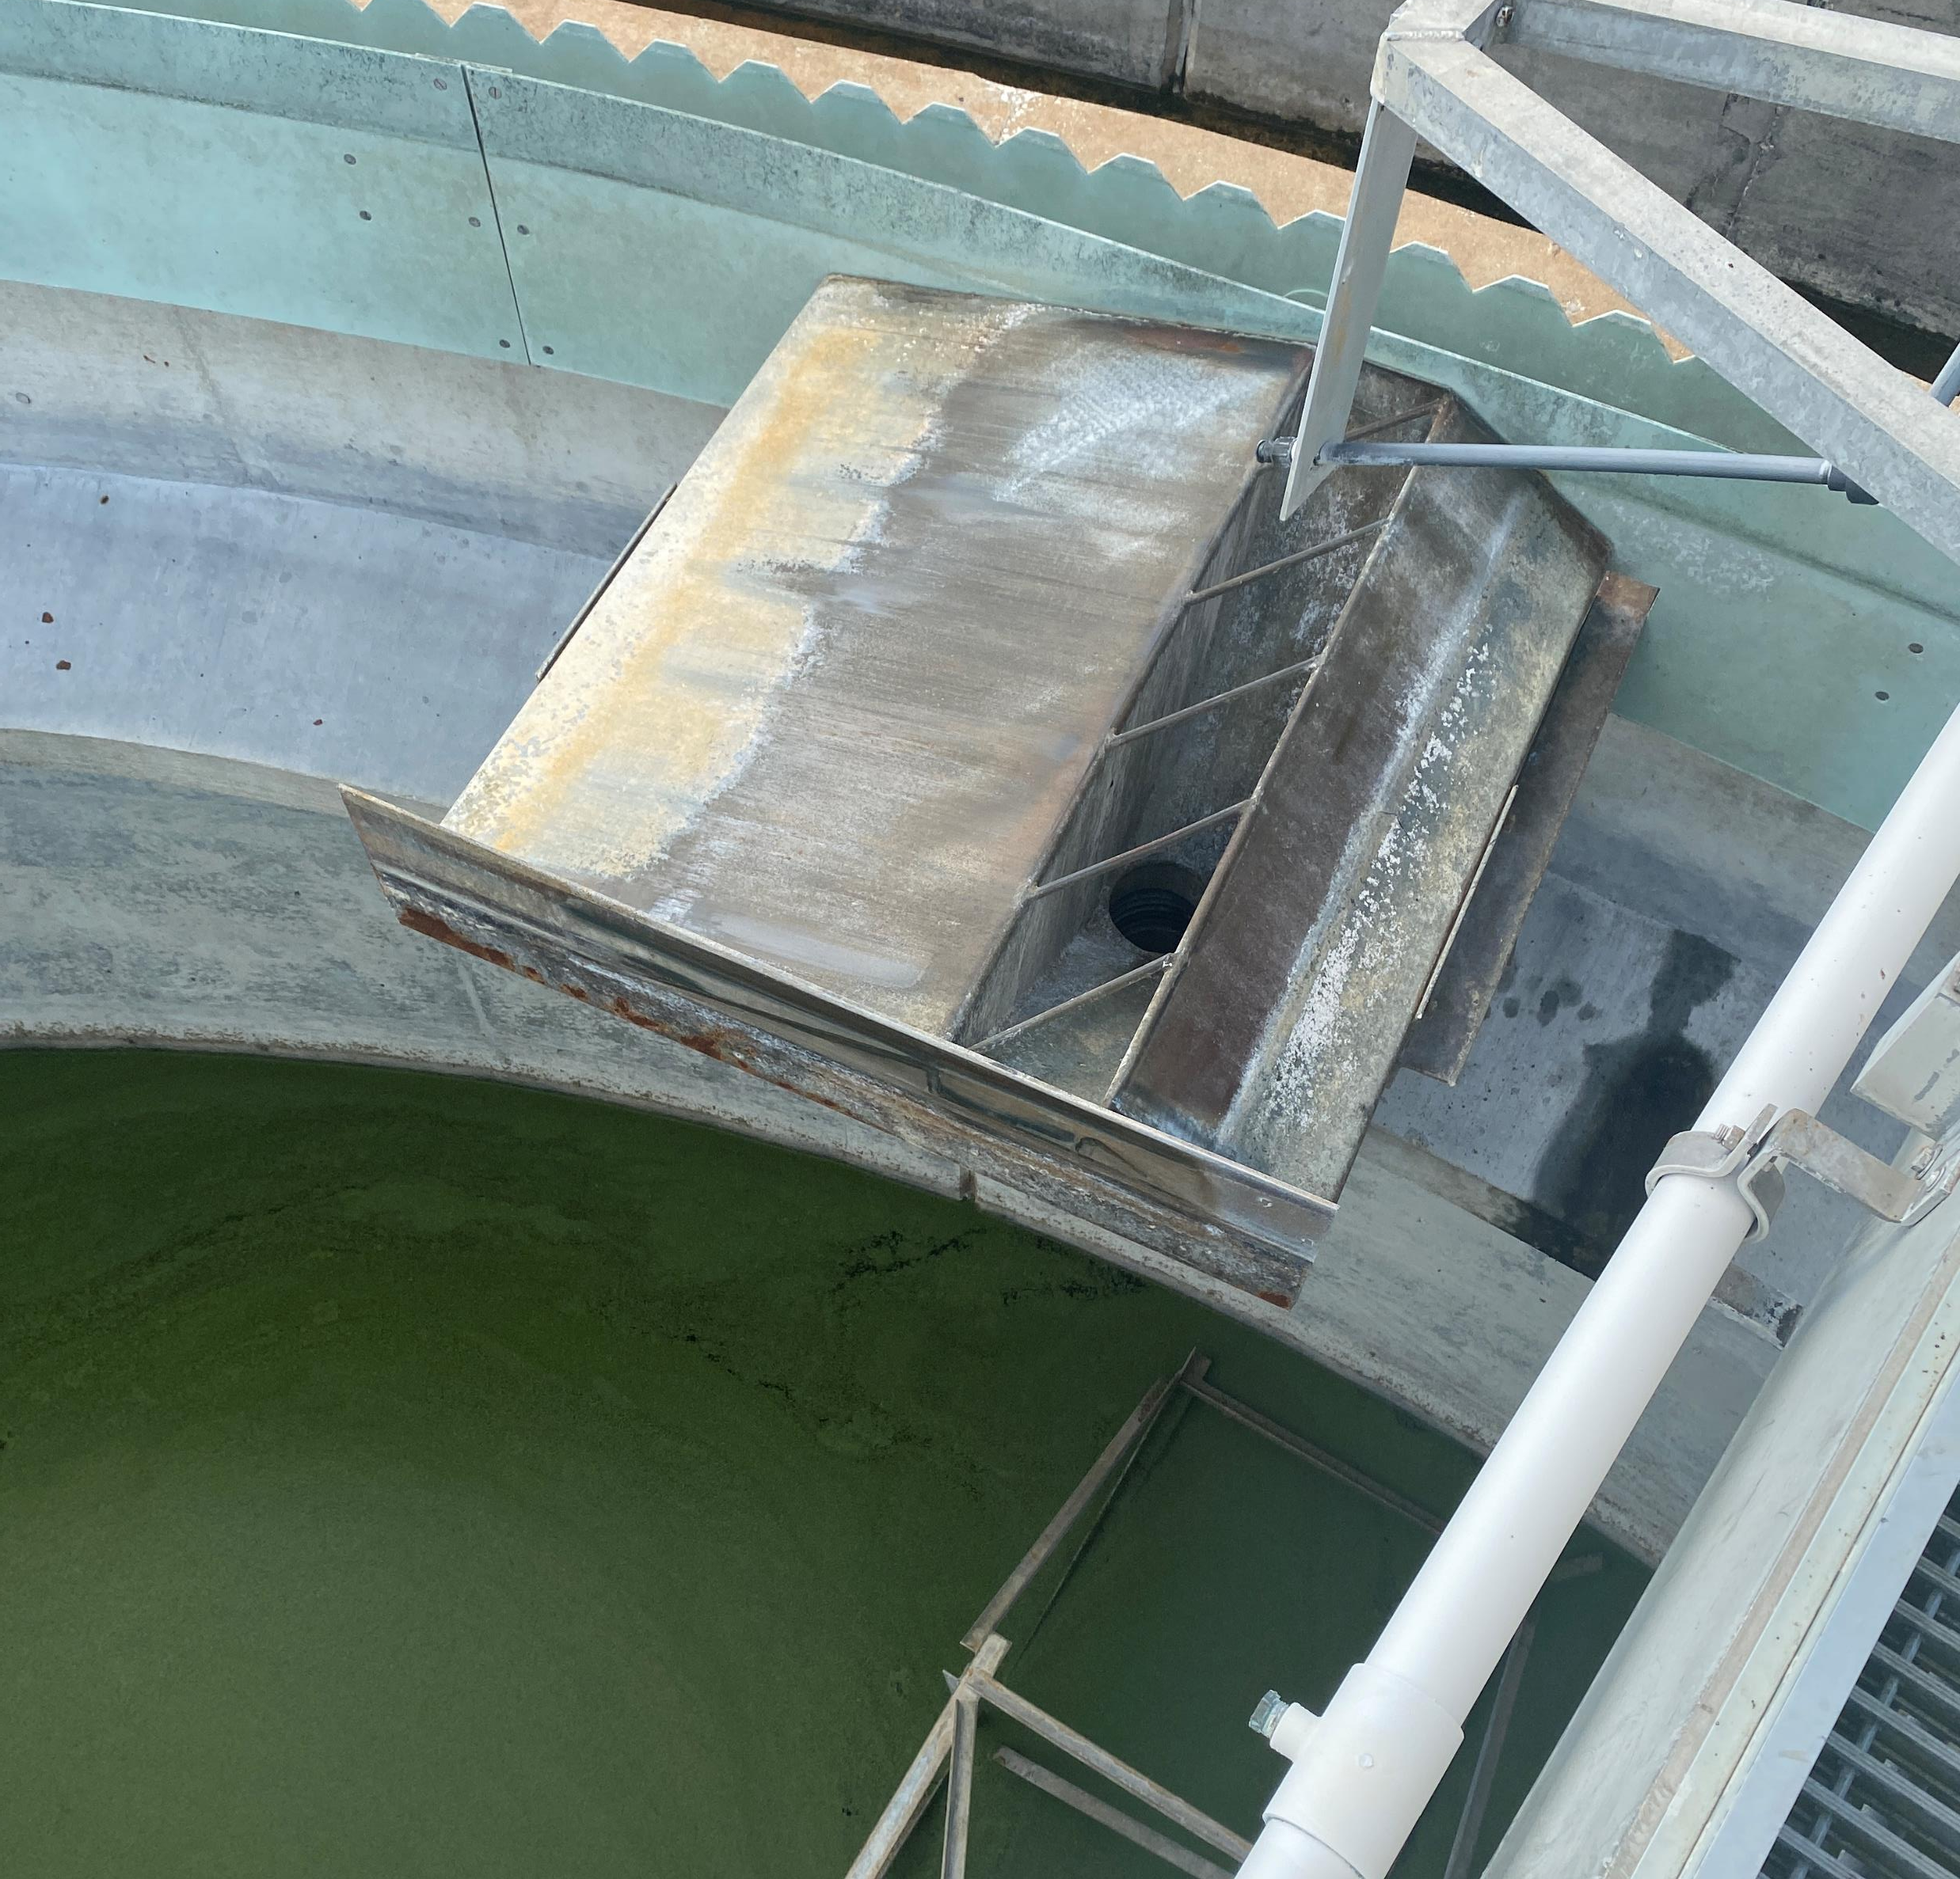
Woodlea Road WRF Capacity Evaluation
Existing Conditions
Hydraulic Capacity (Peak Flow)
Ox Ditch Treatment Capacity (Ave Flow)
Secondary Clarifier Capacity (Peak Flow)
Recommendations

Slide 3
Existing and Future Flow Conditions
Flows from the Sewer Model | Value
Design Average Flow | 3.0 MGD
Existing Average Dry Weather Flow (ADWF) | 1.51 MGD
Existing Peak Dry Weather Flow (PDWF) | 4.50 MGD
Existing Peak Wet Weather Flow (PWWF) | 7.36 MGD
Future ADWF | 2.56 MGD
Future PDWF | 5.52 MGD
Future PWWF | 13.32 MGD

Slide 4
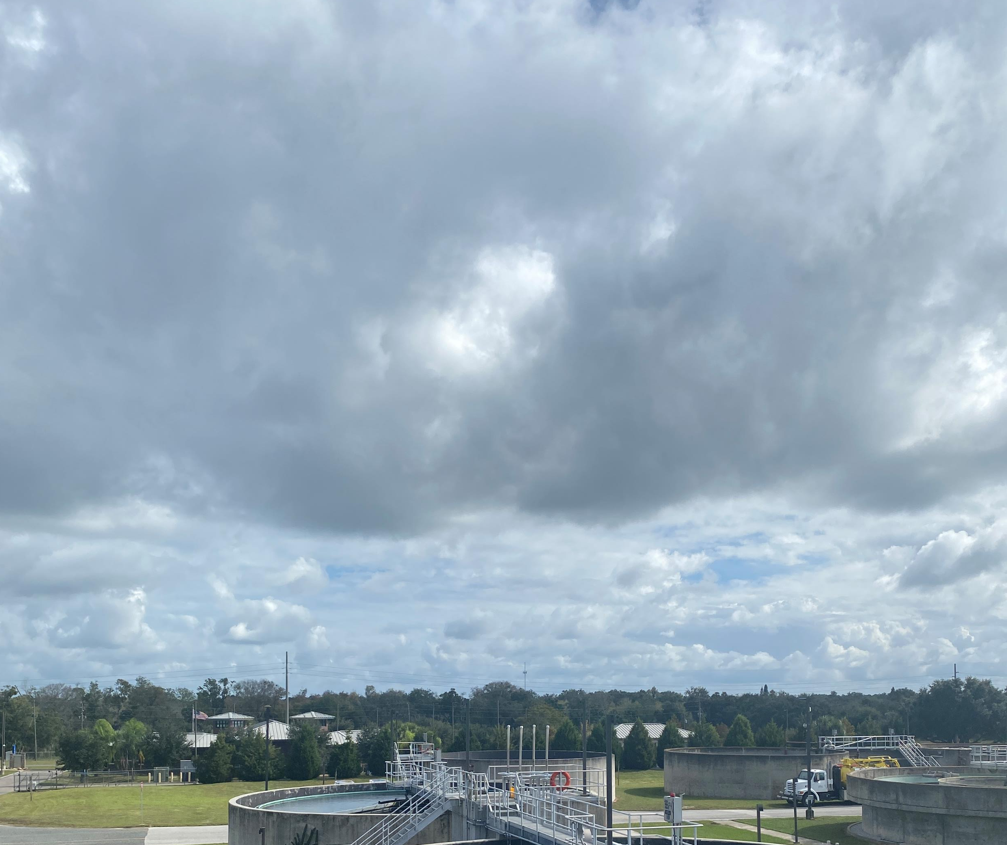
Existing Permit Capacities
3 MGD WRF Capacity
2 MGD to RIBs
1.08 MGD public access reuse
  5 MG storage tank
  FL regs require 3x flow capacity storage
3.5 MG lined reject pond
Increasing permitted discharge capacity required for WRF expansion above 3 MGD

Slide 5
Existing Permit Limits
Summary of FL DEP Permit Limits
Parameter | Units | Discharge to RIBs (R-001) | Discharge to Irrigation (R-002) | Averaging Period
BOD | mg/L | 20/30/45/60 | 20/30/45/60 | Annual/Monthly/ Weekly/Single Sample
TSS | mg/L | 20/30/45/60 | 5*
pH | su | 6.0-8.5 | 6.0-8.5 | Single Sample
Cl Residual (Min) *** | mg/L | 0.5 | 1 | Single Sample
Fecal Coliform | #/100mL | 200/800 | 25** | Annual/Single Sample
NO3 | mg/L | 12 | no limit | Single Sample
Notes: In addition to the limits above, the permit also requires biannual reporting of and Giardia, Cryptosporidium; and weekly reporting of TN and TP for R-002. * single sample ** in addition 75% of monthly samples must be below detection limit *** for disinfection
Future Limits
  Current permit expires in 2023
  BMAP doesn’t appear to impact WRF
  Concern about future TN limit
  Interest in pursing biological phosphorous removal

Slide 6
Existing Process Capacities
Table 1: Flow Conditions
Nominal Process Capacities from the O&M Manual | Design Capacity | Notes
Headworks Screen | 7.2 MGD | Single Mechanical Screen in Operation
Manual Bypass Screen | 6.0 MGD | Listed capacity is based on clean operation, debris will limit capacity.
Grit System | Capacity Not Available | Not Provided in O&M Manual Anticipated to be limited based on hydraulic limitations
Oxidation Ditch | 7.9 MGD | Design Peak Hour – Single Train
Clarifiers | 6 MGD | Combined for all 4 clarifiers Depends on SVI, SOR and other factors
RAS Flow | 6 MGD | 2 of 3 Pumps in operation at each pump station
Filter | 6 MGD | Peak Hour Flow With all 3 units available, does not account for backwash cycle
Chlorine Contact Tanks | 9.9 MGD | Based on total volume of both tanks at 15-minute contact time minimum
Effluent Pumps | 5.8 MGD | 2 of 3 pumps operating in lead-lag-standby O&M assumes double per pump flow, which may overestimate capacity.

Slide 7
Hydraulic Capacity

Slide 8
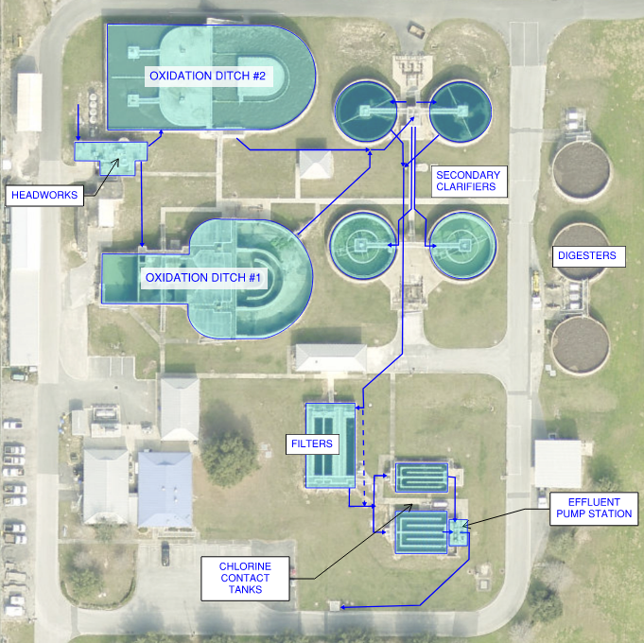
Site Overview

Slide 9
Existing Plant Scenarios
Table 1: Flow Conditions
Process Area | Standard Configuration | High Flow Configuration
Influent Screen | 1 | 1
Grit System | 1 | 2
Oxidation Ditches | 1 | 2
Secondary Clarifiers | 2 | 4
Filters | 2 | 3
Chlorine Contact Tank Trains | 2 | 4

Slide 10
Flow Capacity – Standard Operation
Table 1: Flow Conditions
 | Flow (MGD)
System | 3 | 4 | 5 | 6 | 7 | 8 | 9 | 10
Influent Screen
Grit System
Headworks to Oxidation Ditch Yard Piping
Oxidation Ditch #2
Oxidation Ditch to Secondary Clarifier Yard Piping
Secondary Clarifier Splitter Box
Splitter Box to Secondary Clarifier Yard Piping
Secondary Clarifiers (Two in Operation)
Secondary Clarifier to Filter Yard Piping
Filters (Two in Operation)
Filter to Chlorine Contact Tank Yard Piping
Chlorine Contact Tanks (One in Operation)

Slide 11
Flow Capacity – High Flow Configuration
Table 1: Flow Conditions
 | Flow (MGD)
System | 3 | 4 | 5 | 6 | 7 | 8 | 9 | 10
Influent Screen
Grit System
Headworks to Oxidation Ditch Yard Piping
Oxidation Ditches (Both in Operation)
Oxidation Ditch to Secondary Clarifier Yard Piping
Secondary Clarifier Splitter Box
Splitter Box to Secondary Clarifier Yard Piping
Secondary Clarifiers (Four in Operation)
Secondary Clarifier to Filter Yard Piping
Filters (Three in Operation)
Filter to Chlorine Contact Tank Yard Piping
Chlorine Contact Tanks (Both in Operation)

Slide 12
Removing Bottlenecks
Table 1: Flow Conditions
Process Area | Tier 1 | Tier 2
Second Screen Online |  | X
Second Grit System Online |  | X
Headworks to Oxidation Ditch Yard Piping Upsized to 24” |  | X
Oxidation Ditch to Secondary Clarifier Splitter Yard Piping Upsized to 30” and 36” |  | X
Secondary Splitter to SC Piping Upsized to 24” |  | X
Secondary Clarifier to Filter Yard Piping Upsized to 24” and 30” | X
Additional Filters | X
Filter to CCT Yard Piping Upsized to 24” | X
Increased Effluent Pumping Capacity | X | X

Slide 13
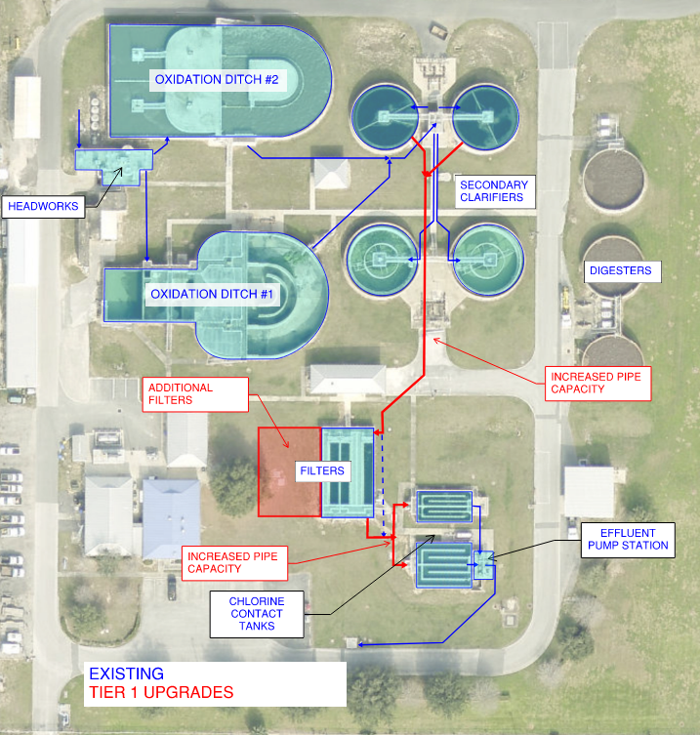
Tier 1 Plant Configuration

Slide 14
Capacity of Flow at Tier 1 Upgraded Condition
Table 1: Flow Conditions
 | Flow (MGD)
System | 3 | 4 | 5 | 6 | 7 | 8 | 9 | 10
Influent Screen
Grit System
Headworks to Oxidation Ditch Yard Piping
Oxidation Ditches
Oxidation Ditch to Secondary Clarifier Yard Piping
Secondary Clarifier Splitter Box
Splitter Box to Secondary Clarifier Yard Piping
Secondary Clarifiers
Secondary Clarifier to Filter Yard Piping
Filters
Filter to Chlorine Contact Tank Yard Piping
Chlorine Contact Tanks

Slide 15
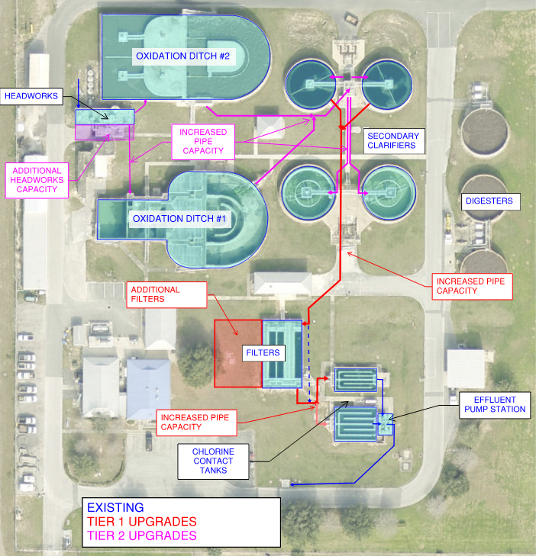
Tier 2 Plant Configuration

Slide 16
Capacity of Flow at Tier 2 Upgraded Condition
Table 1: Flow Conditions
 | Flow (MGD)
System | 3 | 4 | 5 | 6 | 7 | 8 | 9 | 10 | 11 | 12
Influent Screen
Grit System
Headworks to Oxidation Ditch Yard Piping
Oxidation Ditches
Oxidation Ditch to Secondary Clarifier Yard Piping
Secondary Clarifier Splitter Box
Splitter Box to Secondary Clarifier Yard Piping
Secondary Clarifiers
Secondary Clarifier to Filter Yard Piping
Filters
Filter to Chlorine Contact Tank Yard Piping
Chlorine Contact Tanks

Slide 17
Equalization
Best for shaving short duration peaks
  thunderstorms
  daily variation
Not cost effective for longer duration storms (hurricanes)
Increasing plant capacity is likely a better investment

Slide 18
Ox Ditch Treatment Capacity

Slide 19
Ox Ditch #2 Current Performance
Table 1: Flow Conditions
Parameter | 5th Percentile | Median | 95th Percentile
MLSS (mg/L) | 2,200 | 2,800 | 3,600
Solids Residence Time (Days) | 11.2 | 12.5 | 13.3
Sludge Yield | 0.8 | 1.0 | 1.2
ML Temperature (degrees C) | 21 | 25 | 30
Ox. Ditch DO, North (mg/L) | 0.7 | 1.3 | 1.8
Ox. Ditch DO, South (mg/L) | 0.2 | 0.3 | 0.5
SVI, Daily (mL/g) | 140 | 180 | 270
Effluent Total Nitrogen (mg/L) | 1.8 | 4.3 | 17.5
Effluent Nitrate (mg/L) | 0.97 | 2.10 | 4.09
Effluent Nitrite (mg/L) | 0.01 | 0.02 | 1.15
Typically good
Occasional issues with
  Aeration
  Nitrogen removal
  Settleability
Seasonal Fluctuations

Slide 20
Nitrogen Trend 2018-2022

Slide 21
SVI Trend 2018-2022

Slide 22
Oxidation Ditch BOD Removal Capacity
Table 1: Flow Conditions
Parameter | Design MLSS |  | Higher MLSS
 | Ditch #1 | Ditch #1 & #2
MLSS (mg/L) | 4,000 | 4,000 | 4,500
Design SRT (days) | 8 | 8 | 8
Assumed Sludge Yield (lb WAS TSS / lb BOD removed) | 1.1 | 1.1 | 1.1
BOD Loading Capacity (ppd) | 4,000 | 7,300 | 8,300
Equivalent Average Flow Capacity (MGD) | 2.2 | 4.0 | 4.5
Aeration Power Available (hp) | 225 | 375 | 375
Peak Day Power Req’d with Denitrification | 116 | 307 | 345
without Denit. | 213 | 392 | 441
Ditches have theoretical capacity (volume) treat 4.0 to 4.5 MGD average flow.
Redundant aerator at peak day up to 4.0 MGD average flow
Influent TKN data would help refine these estimates

Slide 23
Secondary Clarifier Capacity
Table 1: Flow Conditions
State point analysis provides theoretical peak capacity
Color shows ability to operate at 6 MGD
RAS capacity is sufficient
Improved SVI control needed for reliable performance at 6 MGD.
Operating at 4,500 mg/L will require upgrades
Impact of SVI on clarifier capacity can be plant specific
Achieving these capacities assumes mechanisms work well
SVI (mL/g) | 120 | 150 | 180 | 270
MLSS (mg/L) | Peak Capacity (MGD) Each Clarifier
2,800 | 3.3 | 2.9 | 2.5 | 1.7
3,600 | 2.5 | 2.1 | 1.7 | 1.0
4,000 | 2.1 | 1.8 | 1.5 | 0.8
4,500 | 1.8 | 1.4 | 1.2 | 0.6

Slide 24
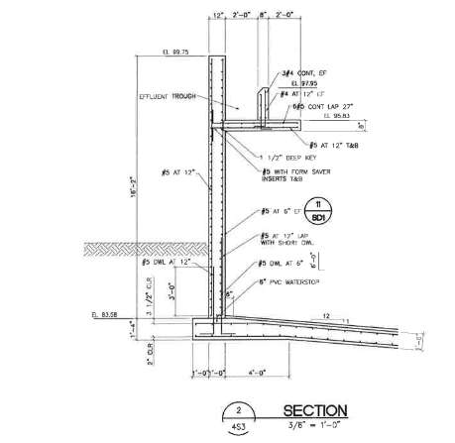
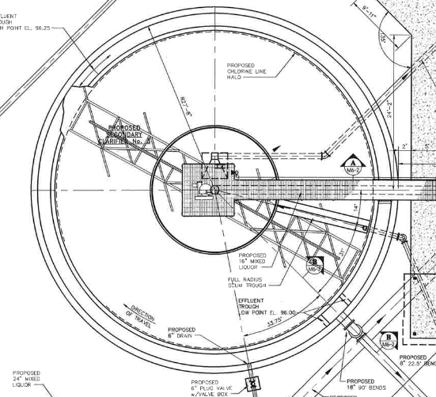
Clarifier Mechanism Improvements to Maximize Peak-Flow Performance
Energy Dissipating Inlet
Sloping (Crosby) baffle
Rapid-sludge removal

Slide 25
Recommendations
Tier 1 Hydraulic Upgrades
  6 to 8 MGD peak hydraulic
  Upsize Piping downstream of clarifiers
  Additional filters
  Increased effluent pumping capacity
Additional effluent disposal capacity
  >3 MGD average
Improved operational controls to realize full capacity of secondary system
  up to 4 MGD average, 6 MGD peak
  Influent TKN sampling to better characterize loads
  Evaluate causes of inconsistent SVI, DO, nit/denit performance
    could include: data analysis, modeling, pilot testing, stress testing
  Restore/improve automatic DO control in both trains
  Necessary upgrades to OD#1 (internal recycle, etc)
  Other improvements as required
    such as: aeration capacity, baffling, additional instrumentation and automation
New secondary clarifier mechanisms to optimize peak flow capacity
  up to 6 MGD peak
  EDI, flocculating centerwell
  rapid sludge collection (such as spiral blade)
  sloping peripheral baffles

Slide 26
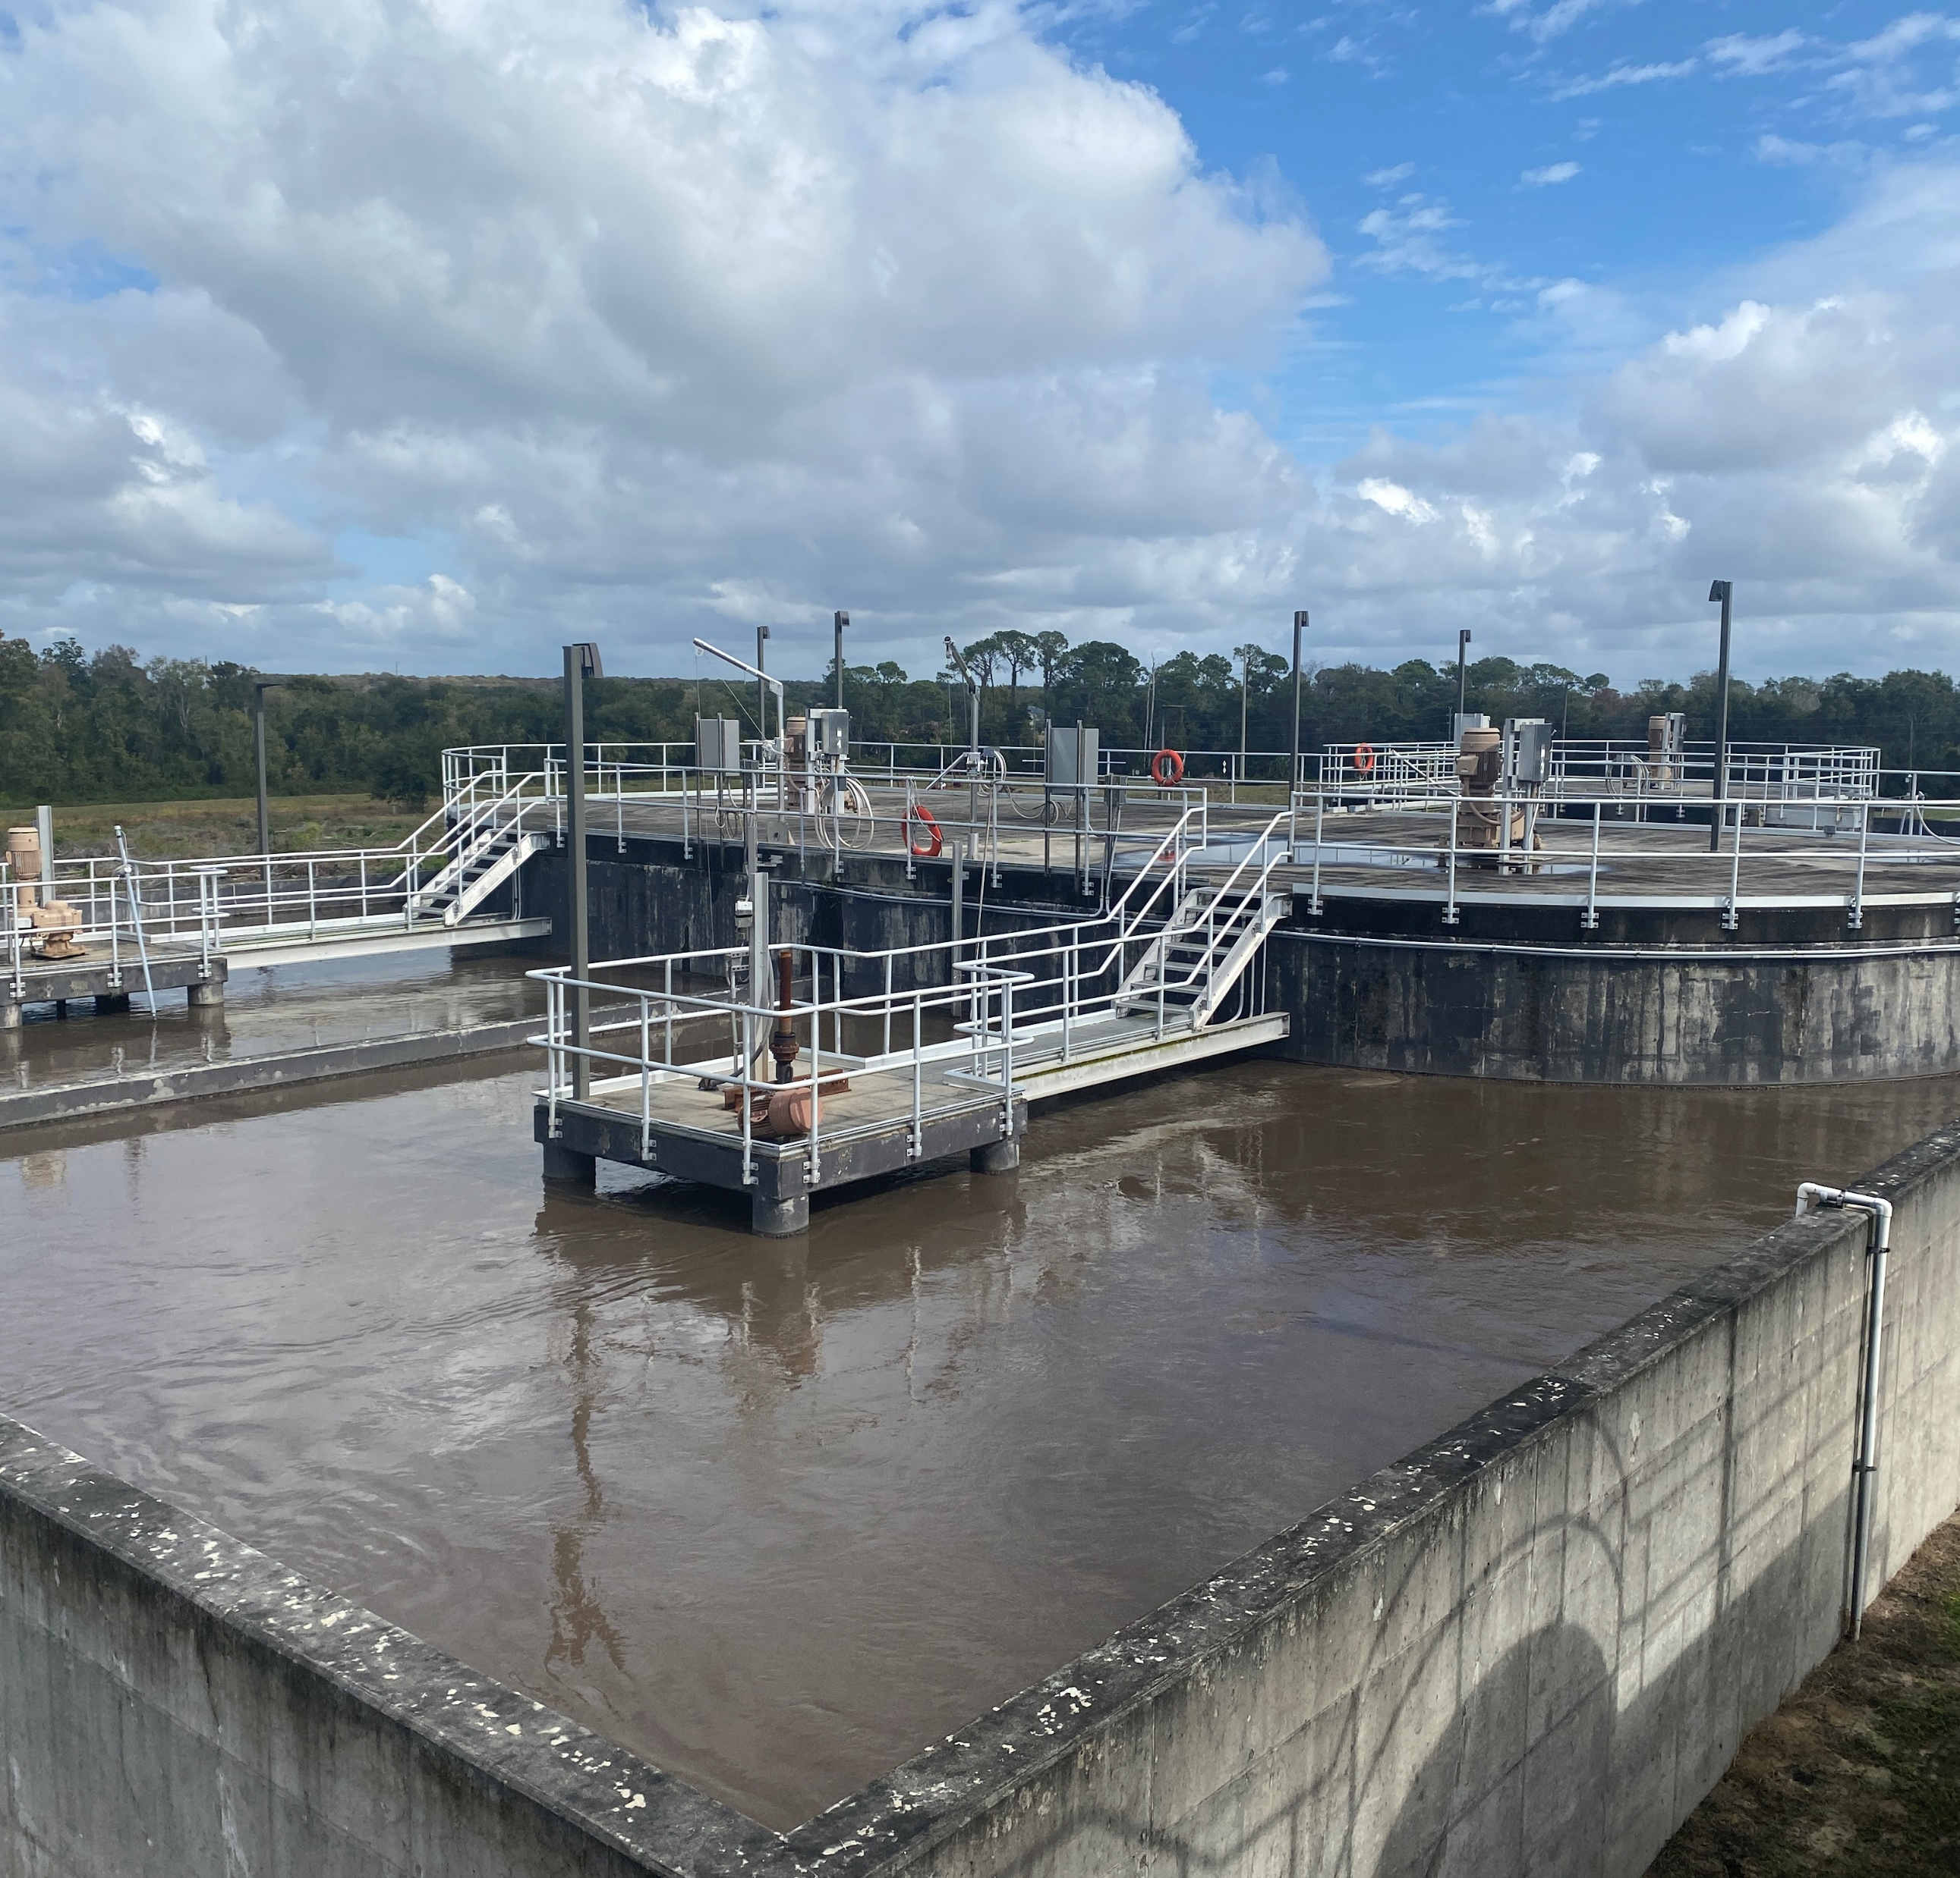
Recommendations
Additional Capacity Upgrades
  4.5 MGD average and 6+MGD peak
  Contact stabilization,
  Enhanced settling, and/or
  Additional clarifiers
Facility plan to provide a roadmap for upgrades
  timing of increased flows
  timing of anticipated permit changes (TN, TP)
  options for increasing effluent disposal capacity
  condition of existing assets
  solids handling
  cost estimates, procurement and funding

