Slide 1
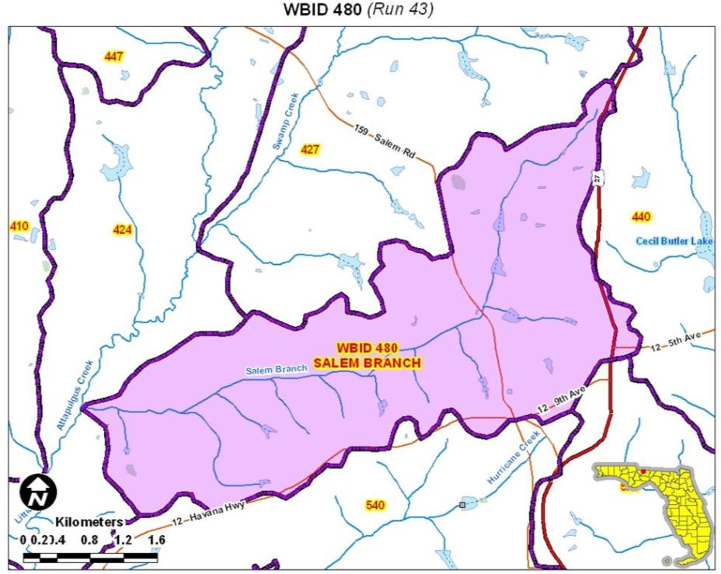
Salem Branch - Stressor Identification
Notes:
Using a suite of site-specific information, including elements from the classification system, identify stressors causing failing SCI scores when there are no known pollutants. This is an example of a site that was listed for DO but nutrients did not exceed regional thresholds. Cells highlighted in red are elements from HBG that indicate whether stream in likely to be non-perennial based on region, drainage area, and soils. In this example, because system is in the northwest region and has Highlands soil characteristics, it’s unlikely the site goes dry, but is at the lower end of the perennial size class.

Slide 2
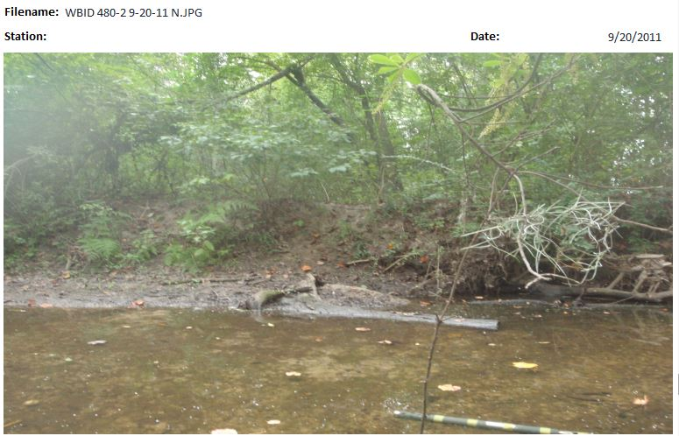
Salem Branch - Stressor Identification
Notes:
Using a suite of site-specific information, including elements from the classification system, identify stressors causing failing SCI scores when there are no known pollutants. This is an example of a site that was listed for DO but nutrients did not exceed regional thresholds. Cells highlighted in red are elements from HBG that indicate whether stream in likely to be non-perennial based on region, drainage area, and soils. In this example, because system is in the northwest region and has Highlands soil characteristics, it’s unlikely the site goes dry, but is at the lower end of the perennial size class.

Slide 3
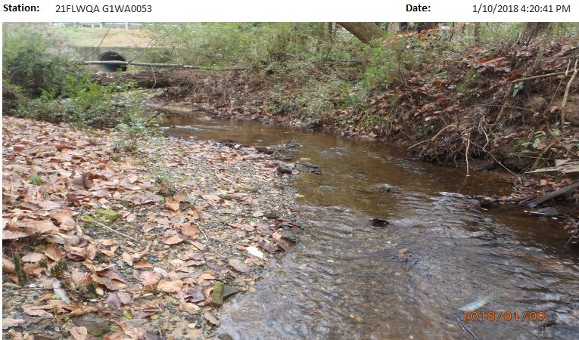
Salem Branch - Stressor Identification
Notes:
Using a suite of site-specific information, including elements from the classification system, identify stressors causing failing SCI scores when there are no known pollutants. This is an example of a site that was listed for DO but nutrients did not exceed regional thresholds. Cells highlighted in red are elements from HBG that indicate whether stream in likely to be non-perennial based on region, drainage area, and soils. In this example, because system is in the northwest region and has Highlands soil characteristics, it’s unlikely the site goes dry, but is at the lower end of the perennial size class.

Slide 4
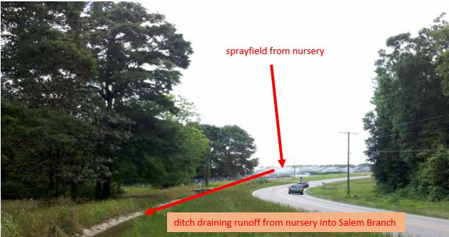
Salem Branch - Stressor Identification
Notes:
Using a suite of site-specific information, including elements from the classification system, identify stressors causing failing SCI scores when there are no known pollutants. This is an example of a site that was listed for DO but nutrients did not exceed regional thresholds. Cells highlighted in red are elements from HBG that indicate whether stream in likely to be non-perennial based on region, drainage area, and soils. In this example, because system is in the northwest region and has Highlands soil characteristics, it’s unlikely the site goes dry, but is at the lower end of the perennial size class.

Slide 5
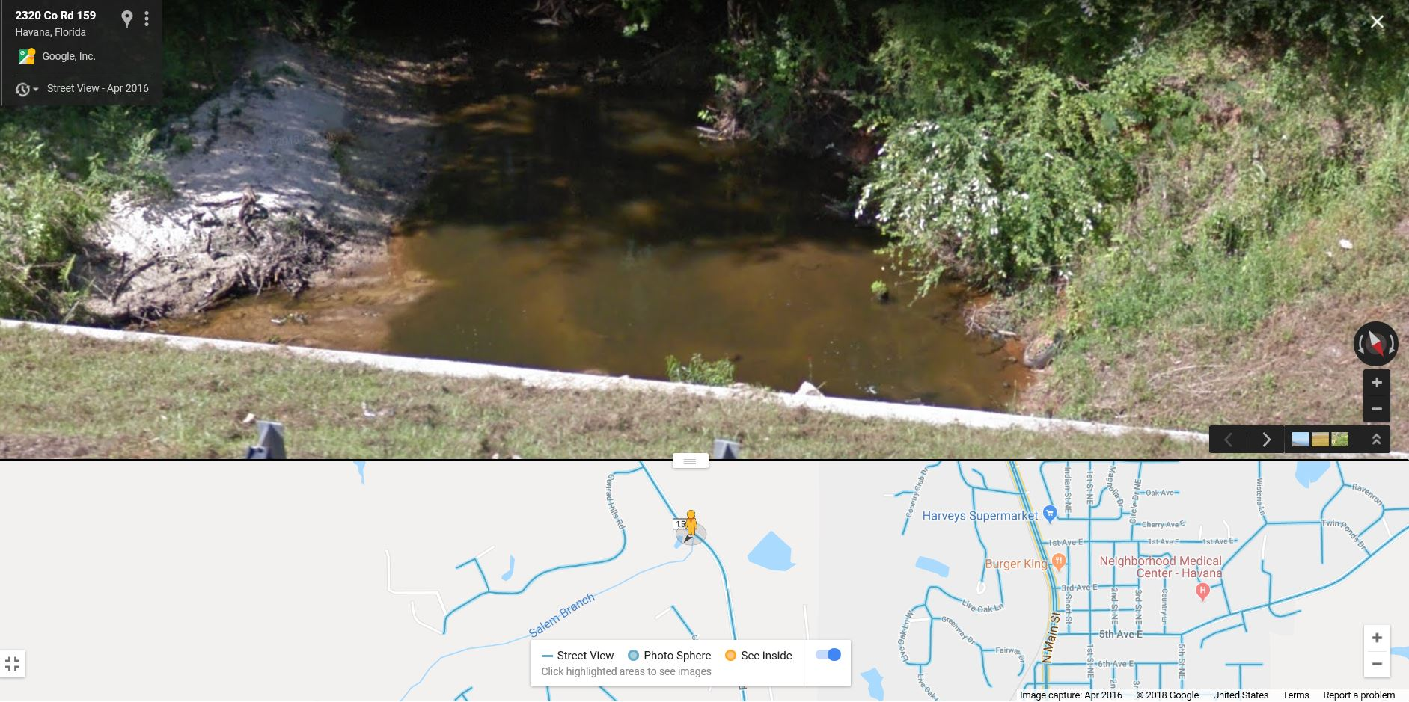
Salem Branch - Stressor Identification
Notes:
Using a suite of site-specific information, including elements from the classification system, identify stressors causing failing SCI scores when there are no known pollutants. This is an example of a site that was listed for DO but nutrients did not exceed regional thresholds. Cells highlighted in red are elements from HBG that indicate whether stream in likely to be non-perennial based on region, drainage area, and soils. In this example, because system is in the northwest region and has Highlands soil characteristics, it’s unlikely the site goes dry, but is at the lower end of the perennial size class.

Slide 6
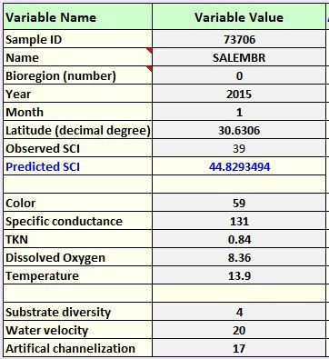
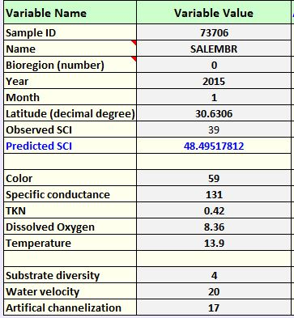
Salem Branch - Stressor Identification
Notes:
If you only lower TKN. You get a higher score.

Slide 7
Salem Branch - Stressor Identification
SITE INFORMATION
WATERBODY |  | Salem Branch
WBID |  | 480
STORET |  | NW2014005
NICKNAME |  | Salembr
LIMS EVENT ID
BIOREGION |  | Panhandle East
LATITUDE |  | 30.6306
LONGITUDE |  | -84.4318
WATERSHED COMPONENTS
SITE LDI (100m buffer) |  | 2.28
WATERSHED LDI |  | 2.9
DRAINAGE AREA (sq mi) |  | 1.7 sq. miles
STREAM ORDER |  | 1
NEAREST GAGE |  | Salem Branch
WATER SOURCE (Kiefer) |  | Highlands
SAMPLE INFORMATION (average of 2 reps)
 | SAMPLE 1 | SAMPLE 2
SAMPLE DATE | 4/1/2014 | 1/6/2015
VISIT ID | 72698 | 73706
SCI SCORE | 35 | 39
% DOMINANT TAXON | 24 | 20
DOMINANT TAXON (NAME) | Rheotanytarsus/Physa | Thienemannimyia
# LONG-LIVED | 1 | 1
# SENSITIVE | 2 | 1
WATER CHEMISTRY
COLOR | 59 | 59
SP COND | 135 | 131
TKN | 0.84 | 0.84
DISSOLVED OXYGEN (MG/L) | 8.32 | 8.36
DISSOLVED OXYGEN (%)
TEMP | 19.6 | 13.9
PH | 7.11 | 6.63
NITRATE | 2.7 | 2.7
CHL-A | 9.1 | 9.1
HABITAT COMPONENTS
SUBSTRATE DIVERSITY | 5 | 4
SUBSTRATE AVAILABILITY | 6 | 7
WATER VELOCITY | 14 | 20
SMOTHERING | 16 | 11
CHANNELIZATION | 20 | 17
BANK STABILITY | 8 | 11
AVG. BUFFER WIDTH | 20 | 17
BUFFER QUALITY | 20 | 15
TOTAL HA SCORE | 109 | 102
STRESSOR MODEL OUTPUT
Actual SCI | 35 | 39
Expected SCI - Sampling Date | 46 | 43
WATERSHED COMPONENTS
SITE LDI (100m buffer) | 2.3
WATERSHED LDI | 2.9
DRAINAGE AREA (sq mi) | 1.7 sq. miles
STREAM ORDER | 1
NEAREST GAGE | Salem Branch
WATER SOURCE (Kiefer) | Highlands
Notes:
Using a suite of site-specific information, including elements from the classification system, identify stressors causing failing SCI scores when there are no known pollutants. This is an example of a site that was listed for DO but nutrients did not exceed regional thresholds. Cells highlighted in red are elements from HBG that indicate whether stream in likely to be non-perennial based on region, drainage area, and soils. In this example, because system is in the northwest region and has Highlands soil characteristics, it’s unlikely the site goes dry, but is at the lower end of the perennial size class.

Slide 8
Salem Branch - Stressor Identification
Link to video
Notes:
Using a suite of site-specific information, including elements from the classification system, identify stressors causing failing SCI scores when there are no known pollutants. This is an example of a site that was listed for DO but nutrients did not exceed regional thresholds. Cells highlighted in red are elements from HBG that indicate whether stream in likely to be non-perennial based on region, drainage area, and soils. In this example, because system is in the northwest region and has Highlands soil characteristics, it’s unlikely the site goes dry, but is at the lower end of the perennial size class.

