Slide 1
BLOOM-ID & ALGAL-ID SAMPLING
Division of Environmental Assessment and Restoration
07/21/2020

Slide 2
Algal Bloom Sampling
FS 7000. GENERAL BIOLOGICAL COMMUNITY SAMPLING
  FS 7110. PHYTOPLANKTON BLOOM SAMPLING
  FS 7240. ALGAL MAT SAMPLING FOR TAXONOMIC IDENTIFICATION OR TOXIN ANALYSIS
  FS 7230 RAPID PERIPHYTON SURVEY
AB-17 Algal Bloom Response
AB-FIELD Cyanobacteria Bloom Response Field Data Sheet
AB-NOTIFY Algal Bloom Notification Form

Slide 3
Types of Bloom Samples
bloom samples
surface (water)
water column at depth
surface grab
surface scum
algal mat
scum core
Note: Representative sampling is discussed in future slides.
7/21/2020
Notes:
Surface grab and surface scum most used for bloom response.

Slide 4
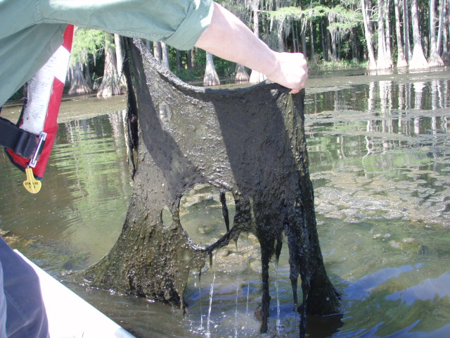
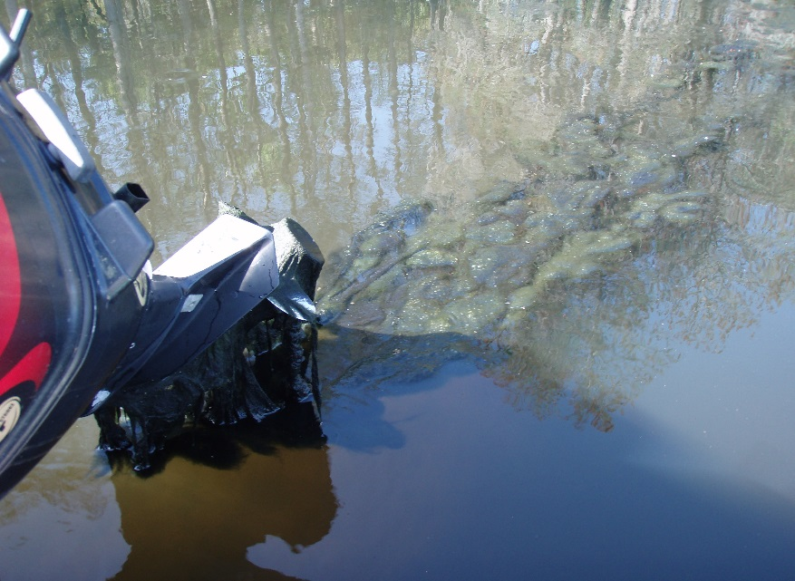
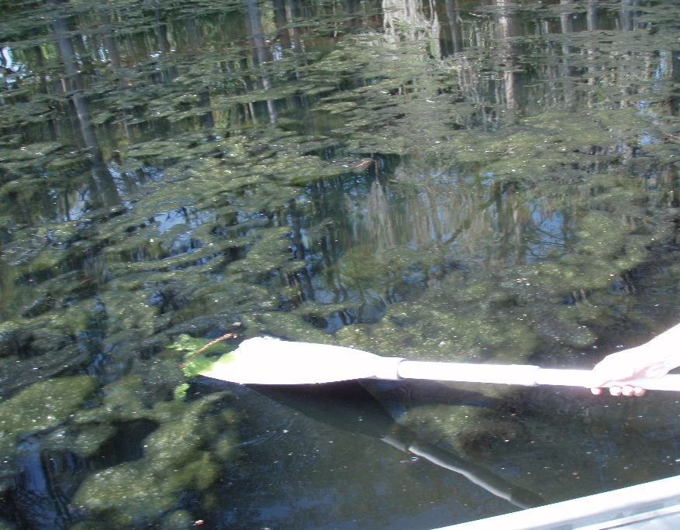
Bloom Sample Types:
Algal Mat
Periphytic algae can detach from the substrate and float to the surface forming algal mats.
When collecting for identification, pull filaments from different substrates if attached or pull from a representative area of a floating mat. Try to collect “fresh” pieces rather than decaying pieces.
Place all aliquots into a container with enough site water to keep the algae submerged.
7/21/2020
Notes:
Collect from as many different substrates as are covered by algal mats and/or excessive algal growth to get a representative sample of the algal mats of interest. Sometimes the bases of the filaments are necessary for identification, so be sure to collect the algae where it is attached to the substrate whenever possible.
Floating mats are a common scenario when responding to an algal complaint/bloom report. Benthic attached mat sampling will be used for >20% coverage of rank 4,5,6 in the RPS.

Slide 5
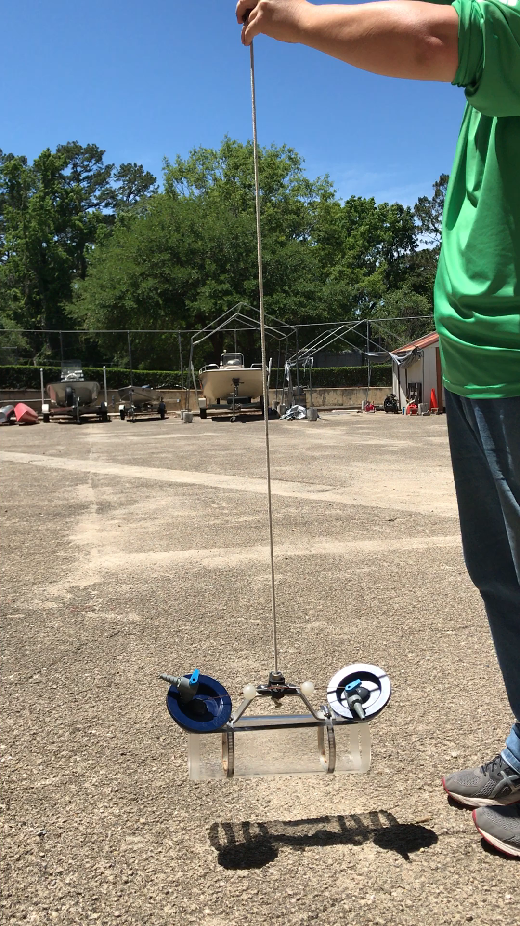
Bloom Sample Types:
Water Column at Depth
Used for determining the algal content of the water column below the surface.
  Is the algal community homogenous?
  Is the algal community suspended below the surface?
Collected at depths greater than 0.3 meters.
Intermediate sampling device such as Niskin/Alpha Bottle/Van Dorn Water samplers or Coliwasa tube would be used.
7/21/2020
Notes:
Video: Niskin Sampler Closing when messenger sent down. The sampler gets lowered to the correct depth, greater than 0.3m, then closed.
Labeling a sample “water column” implies that it was collected as some depth instead of the top 0.3m. Most samples will be surface samples.

Slide 6
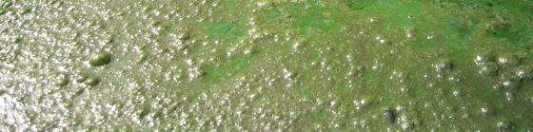
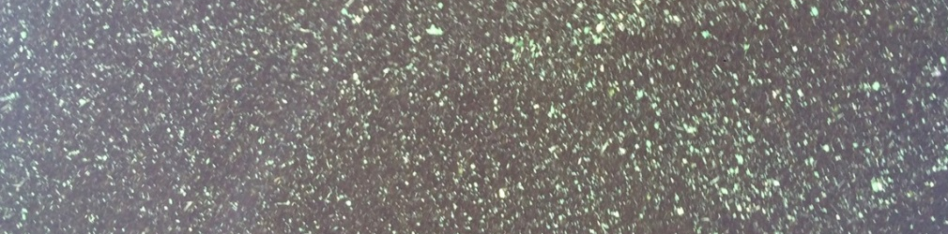
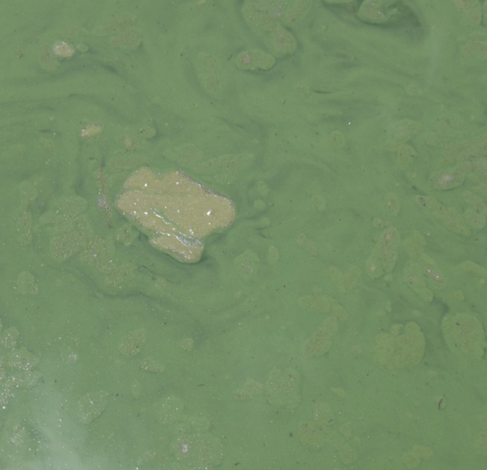
Bloom Sample Types:
Scum Core and Surface Scum
First, what is Scum?
A scum is a consolidated layer of algae floating on the water’s surface.
It is not streaks or specks.
It is not thick, green “soup”.
7/21/2020

Slide 7
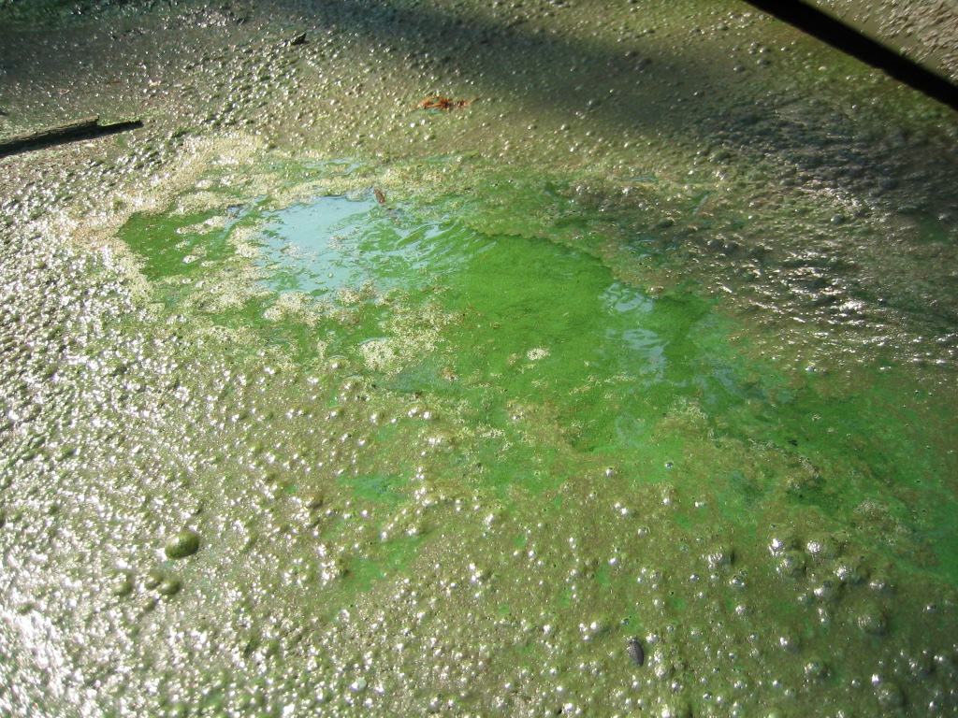
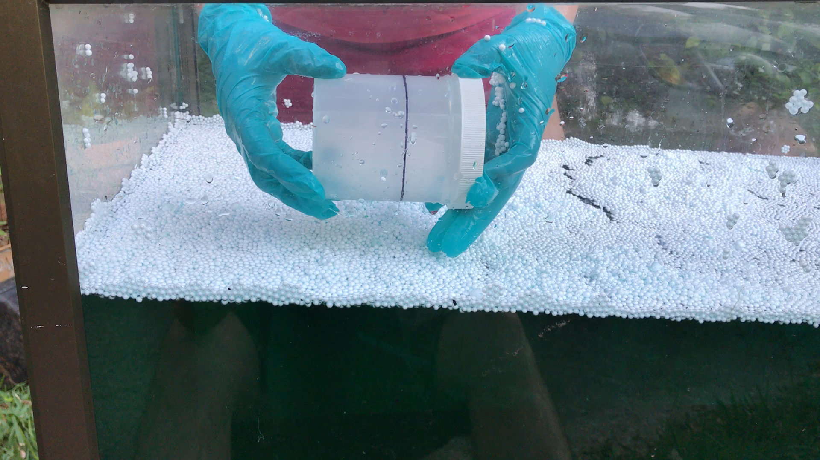
Bloom Sample Types:
Scum Core
To date, there has not been a need for quantitative sampling of a scum.
Recall that DEP does not use any particular values to determine public messaging.
Currently, DEP does not use this method for algal bloom response.
7/21/2020
Notes:
We don’t do this type of sampling. There are not toxin thresholds at which the water is safe so the message is that if the water is green, stay out.
FS7110 Illustration of scum core sampling
Covering this here because some samples had been mislabeled as scum cores when they are regular surface scum samples.

Slide 8
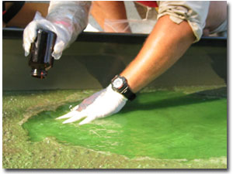
Bloom Sample Types:
Surface Scum
Mix the surface scum of a 0.5 m area with the underlying water to mimic recreational exposure.
  For example, swimming or jet skiing would mix the upper scum layer into the underlying water
Collected in the top 5-10 centimeters of the water column.
Do not collect the sample by skimming the surface.
DEP bloom response does include this method, if appropriate to do so. (Refer to representative sampling).
7/21/2020
Notes:
No deeper than 0.1m.

Slide 9
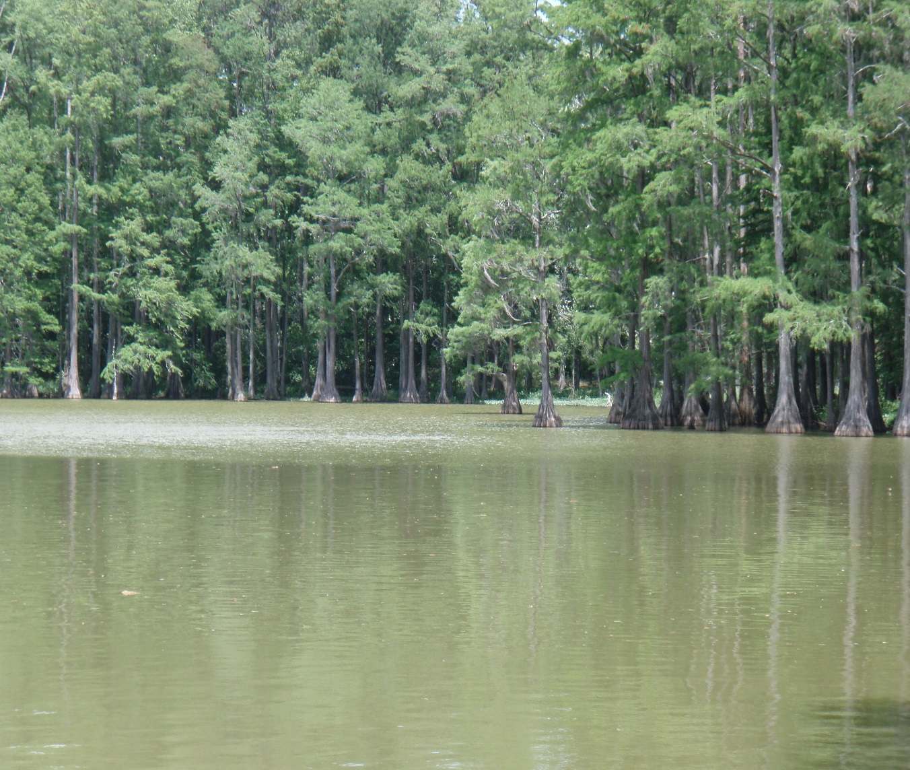
Bloom Sample Types:
Surface Grab
Algae may or may not be visible.
Scum not present.
Collect the sample within the top 0.3m.
This is the most common collection method used in DEP bloom response.
7/21/2020
Notes:
Photo shows green tinted water with no surface scum.
If the waterbody is not visibly blooming, collect this sample type.
It is not correct to label this type of sample as a ‘water column at depth’.
Representative sampling discussed in future slides.

Slide 10
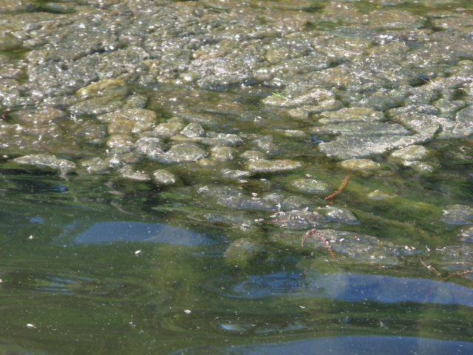
ALGAL-ID Sampling
The DEP Laboratory Information Management System’s (LIMS) ALGAL-ID test code is associated with periphytic algae.
ALGAL-ID samples are collected for algal mats or when the Rapid Periphyton Survey (RPS) rank 4-6 (algae > 6mm thick/long) occurs in greater than 20% of sampled points. This sample type can also be collected when an abundance of periphytic algae is observed.

Slide 11
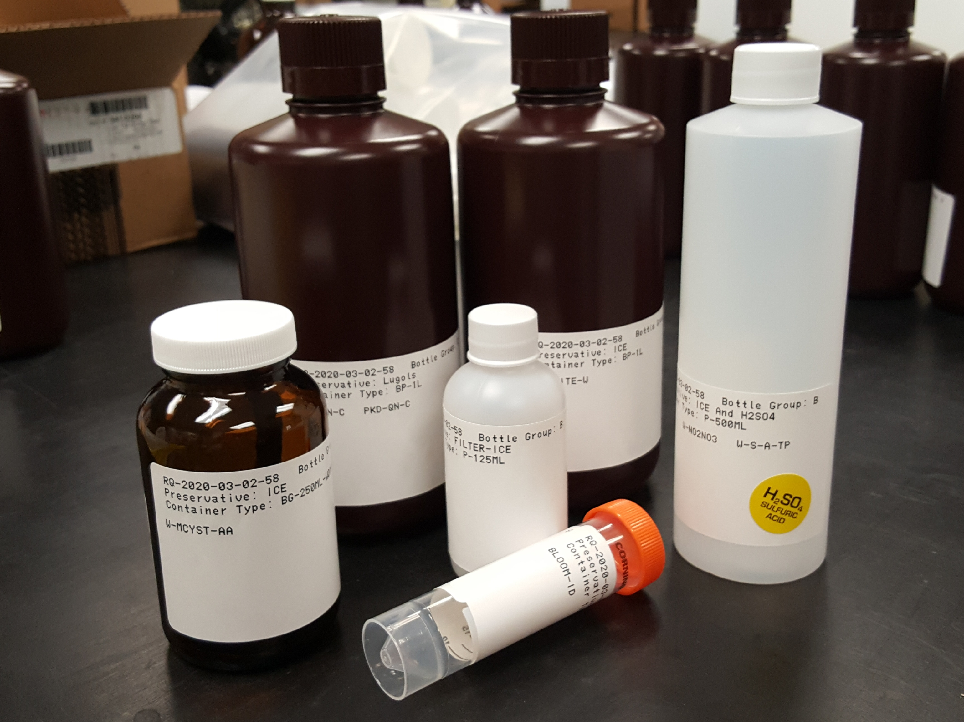
BLOOM-ID Sampling
Full Algal ID
(quantitative)
Chlorophyll
Nutrients
The DEP Laboratory Information Management System’s (LIMS) BLOOM-ID test code is associated with planktonic, free-floating algae.
Sampling may not be planned or scheduled, but occurs as a result of observed field conditions.
Toxins (W-MCYST-AA, W-SAXTN-MS), chlorophyll (CHLSUITE-W), nutrients (W-NH3, W-NO2NO3, W-TKN, W-S-A-TP), ortho-phosphate (W-PO4), and full algal ID (DTY-QN-C/PKD-QN-C) analyses frequently accompany the BLOOM-ID test.
Extra BLOOM-ID tubes and toxin jars can be kept with sampling equipment.
Toxins
Ortho-Phosphate
Dominant ID

Slide 12
Representative Sampling
Determine Representative
  Is the waterbody experiencing a bloom?
  What proportion of the waterbody is affected?
  Is there a scum present? If so, what is the scum’s coverage?
In cases where recreational exposure is possible, DEP collects a sample to capture the condition representative of the majority of the waterbody.

Slide 13
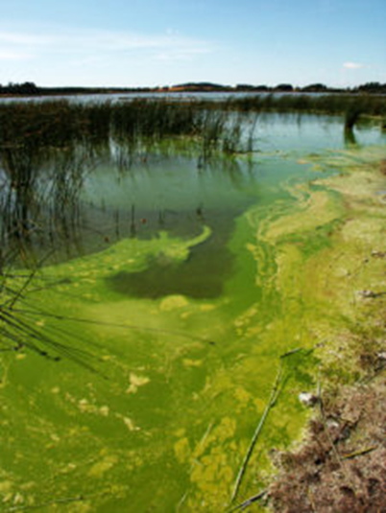
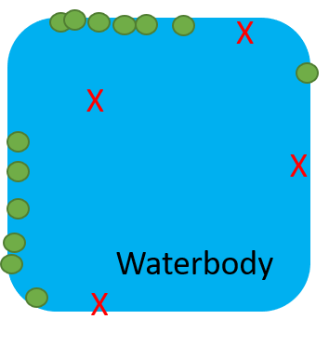
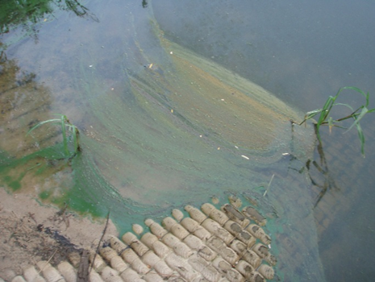
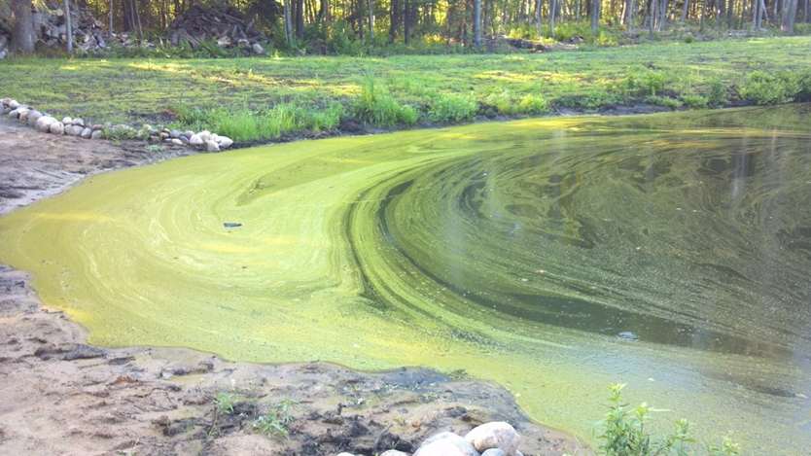
BLOOM-ID Representative Sampling
Scenario 1
Surface scum present on edges of water body.
Depends on extent of bloom and size of waterbody.
Collect a Surface Grab sample in an area where scum is not present.

Slide 14
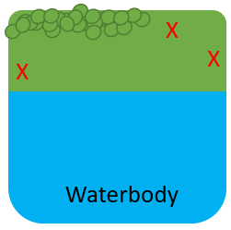
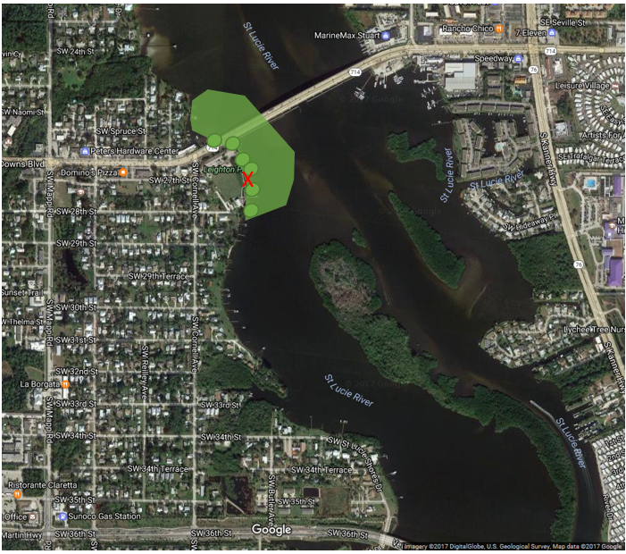
BLOOM-ID Representative Sampling
Scenario 2
1/3 of waterbody is green with a surface scum blown to shoreline.
Where to collect the sample is dependent on the size of the waterbody and practical ability to collect the sample.
Collect Surface Grab sample in area where scum is not present.

Slide 15
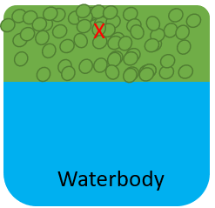
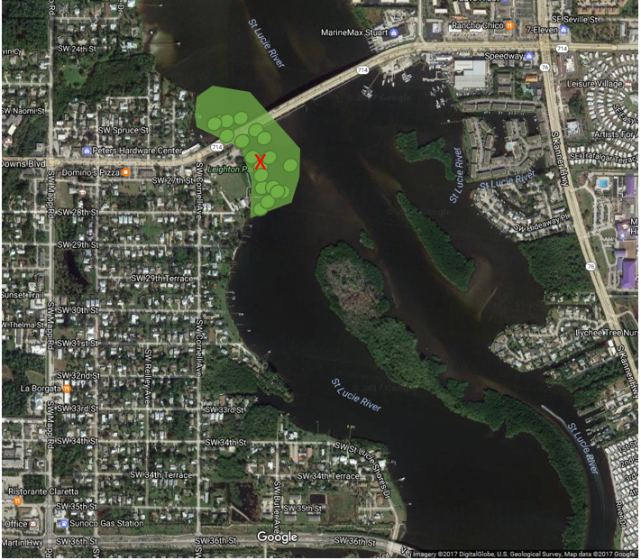
BLOOM-ID Representative Sampling
Scenario 3
1/3 of waterbody is green and covered with a green scum.
Where to collect the sample is dependent on the size of the waterbody and practical ability to collect the sample.
If this represents the majority of the waterbody, collect a Surface Scum sample.
Homogenize 0.5 m area. See FS 7110.

Slide 16
Sample Documentation & Submittal
Label the sample containers with the appropriate information (location, date/time).
For location, use the format [Major waterbody]-[specific location]
If the sample is collected in response to a bloom report, complete form AB-FIELD.
If an un-planned ALGAL-ID or BLOOM-ID sample is collected during a routine sampling event, clearly note in the comment section of the submittal sheet that analysis is not in the original RQ so it can be added at laboratory log-in.
7/21/2020

Slide 17
Sample Documentation & Submittal (continued)
Shipping:
  Freshwater samples—send entire bloom kit to DEP lab in a cooler with ice
  Marine samples—may coordinate with FWC/FWRI to send or split a BLOOM-ID sample
    BLOOM-ID samples to DEP are sent in a cooler with ice and the other bloom kit samples
    BLOOM-ID samples to FWC/FWRI are sent in a cooler with no ice
    Notify DEP and FWRI/FWC that a marine sample has been collected
Enter site visit into Survey123.
7/21/2020

Slide 18


Amelia Rankin
Amelia.Rankin@FloridaDEP.gov
850-245-8182

