Slide 1
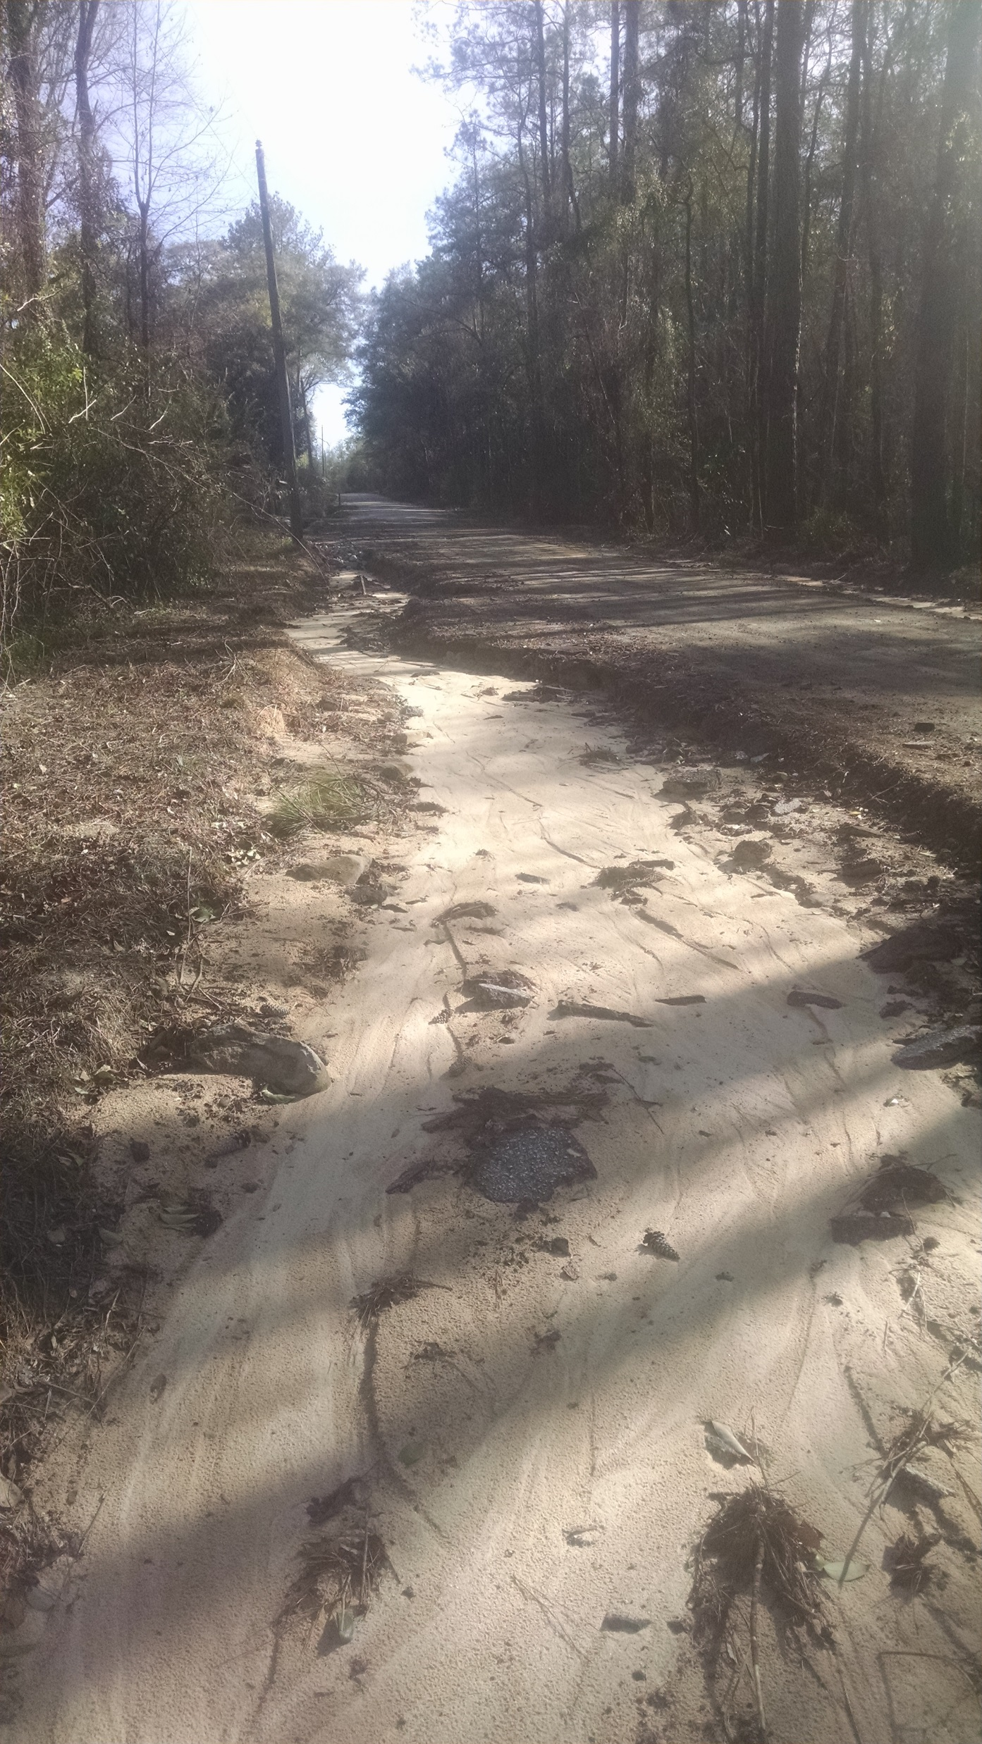
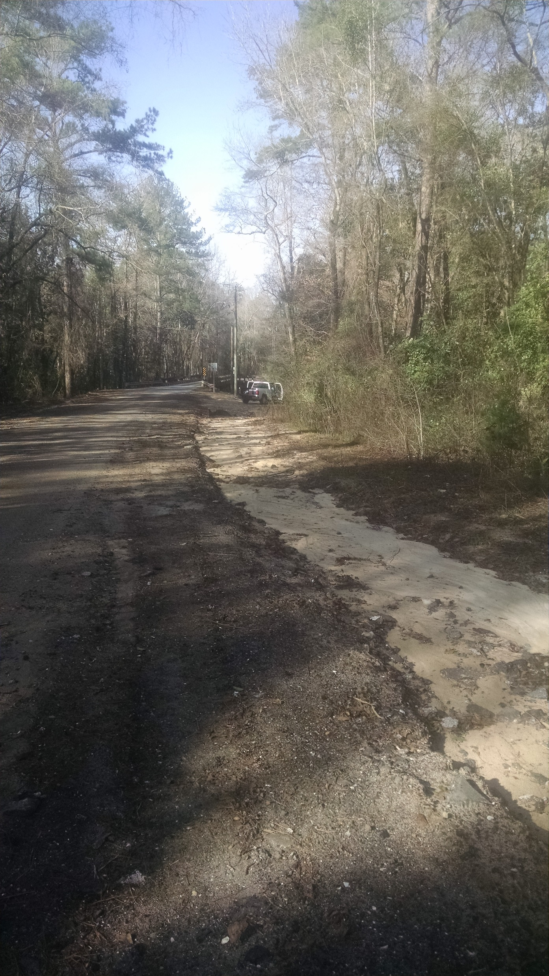
These images show the erosion along Scott Bridge Road.
The image on the left is looking from our vehicle back towards the east.
The image on the right is looking towards our vehicle which is parked on the right shoulder near the bridge and creek.

Slide 2
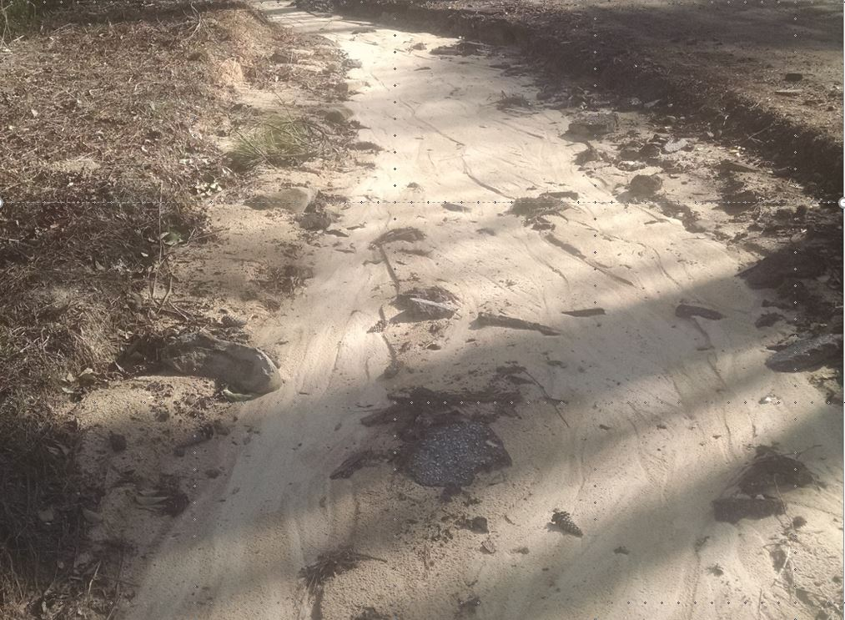
This is the previous image zoomed in to show the road debris that is being washed downstream.
Pieces of asphalt that have been undercut and are making their way downstream towards the creek.

Slide 3
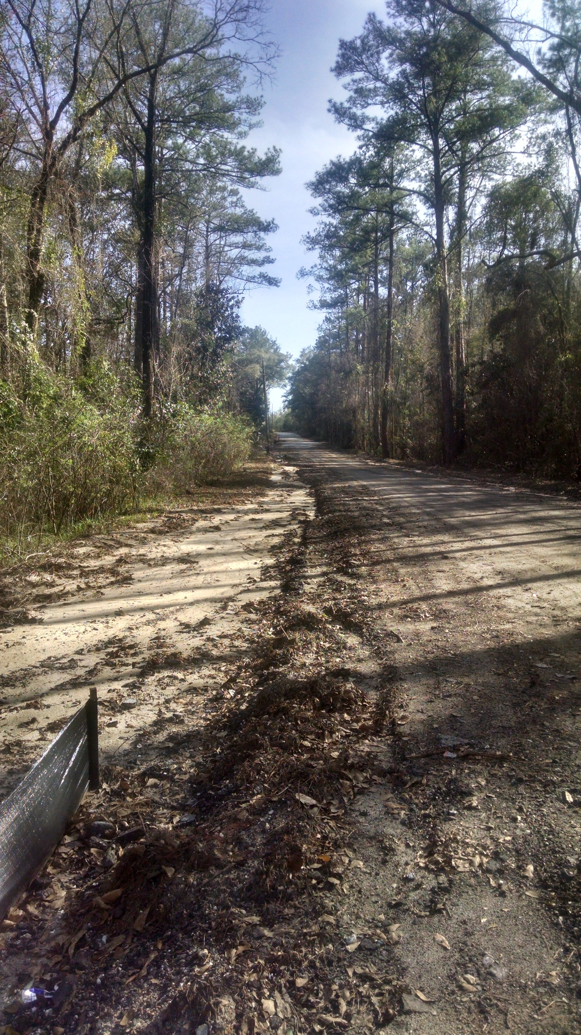
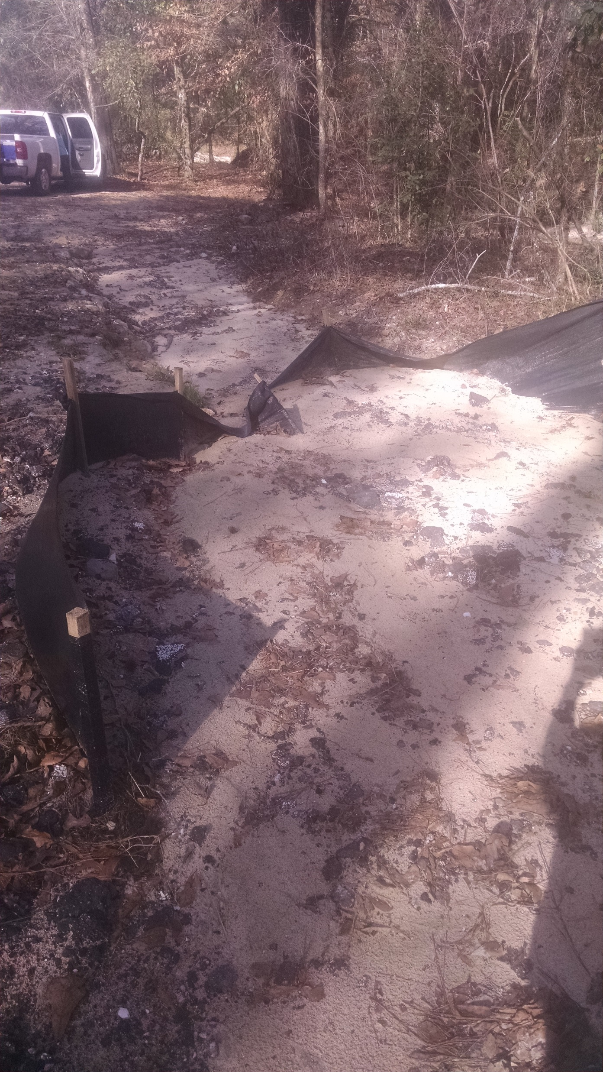
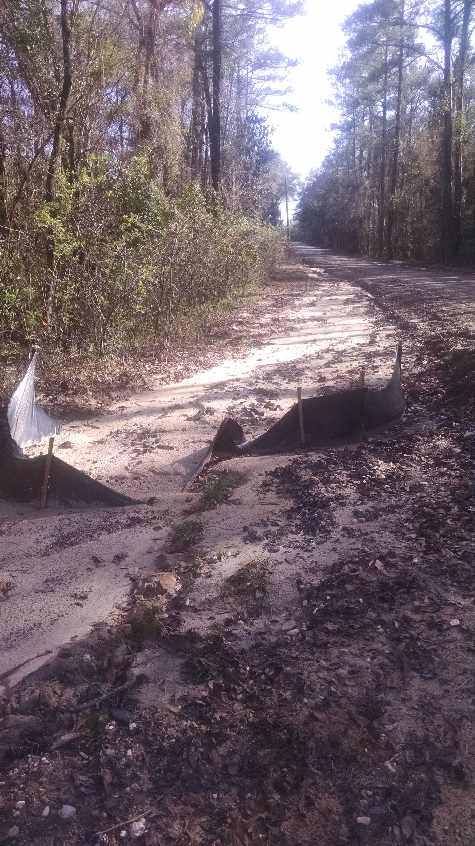
These images show a silt barrier that has been overwhelmed by sediment moving downstream.

Slide 4
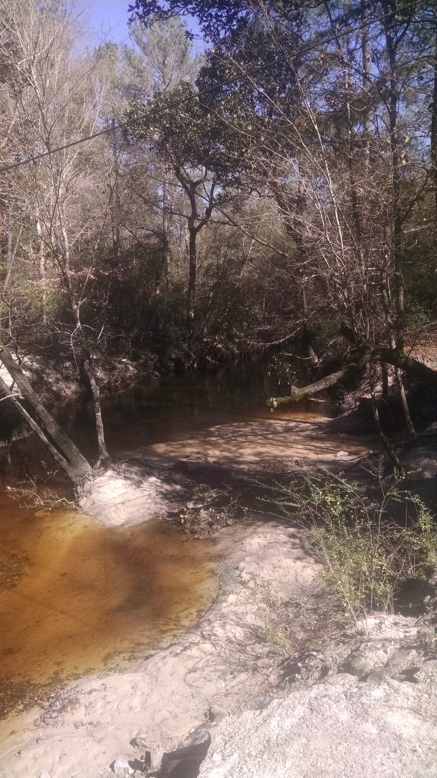
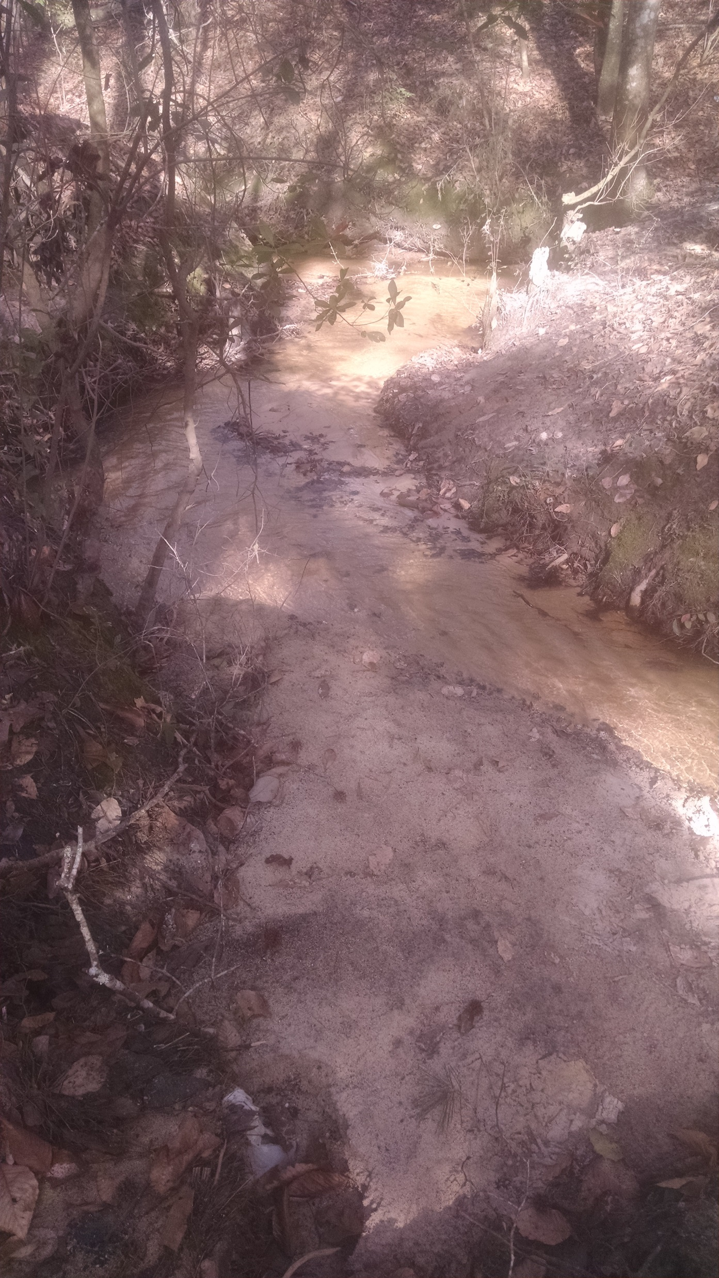
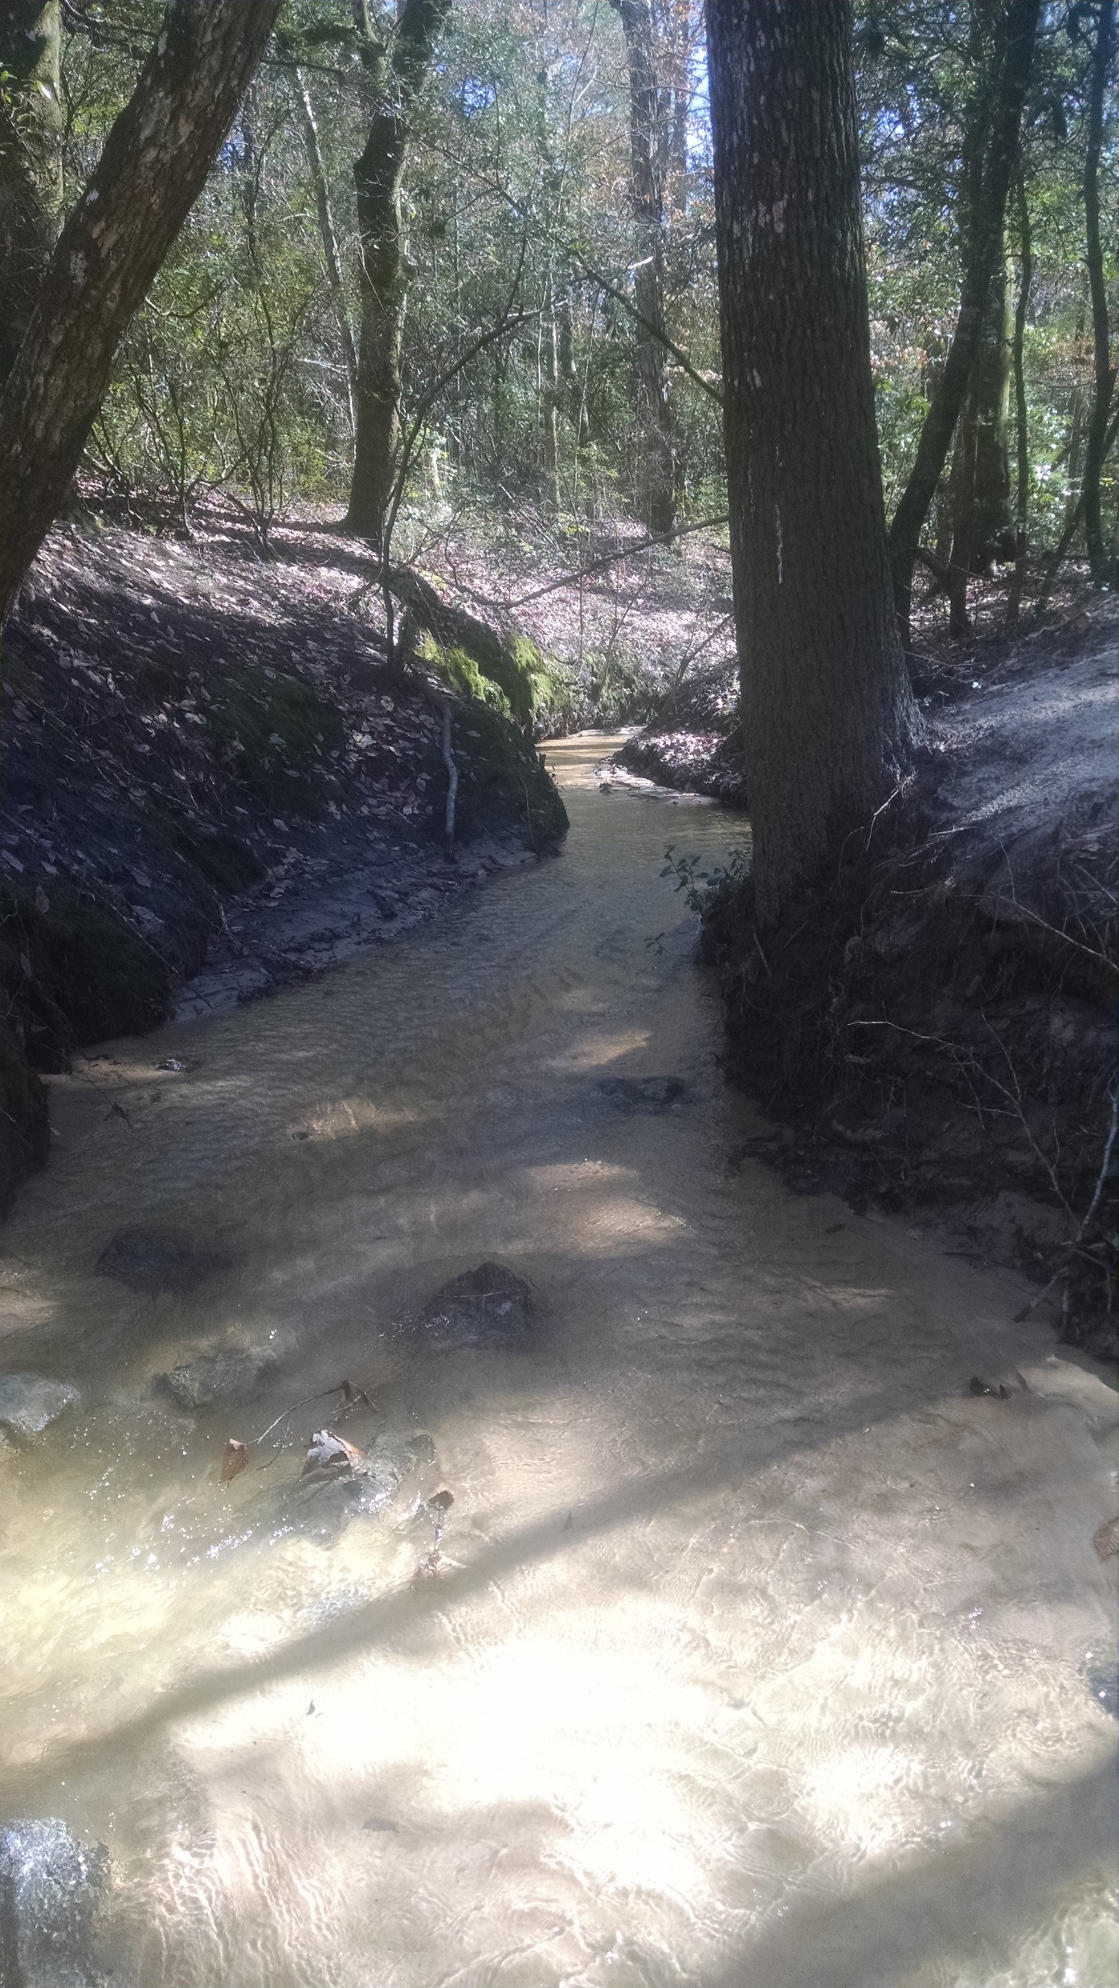
These images show the sand as it is moving down a small side channel and entering the creek.

Slide 5
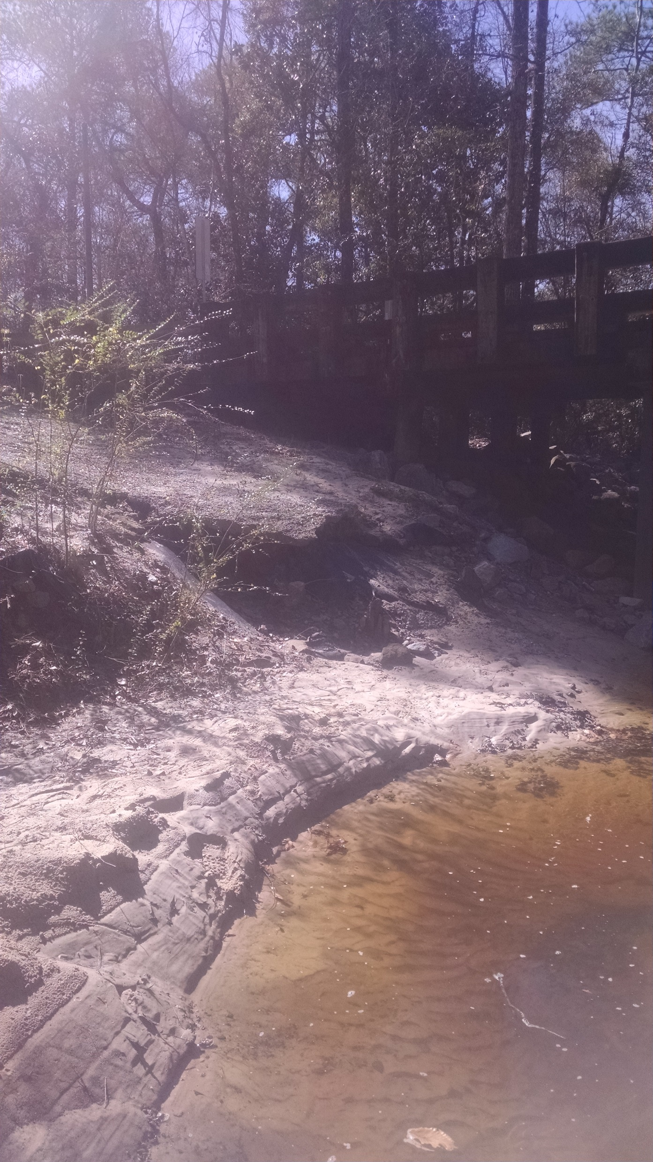
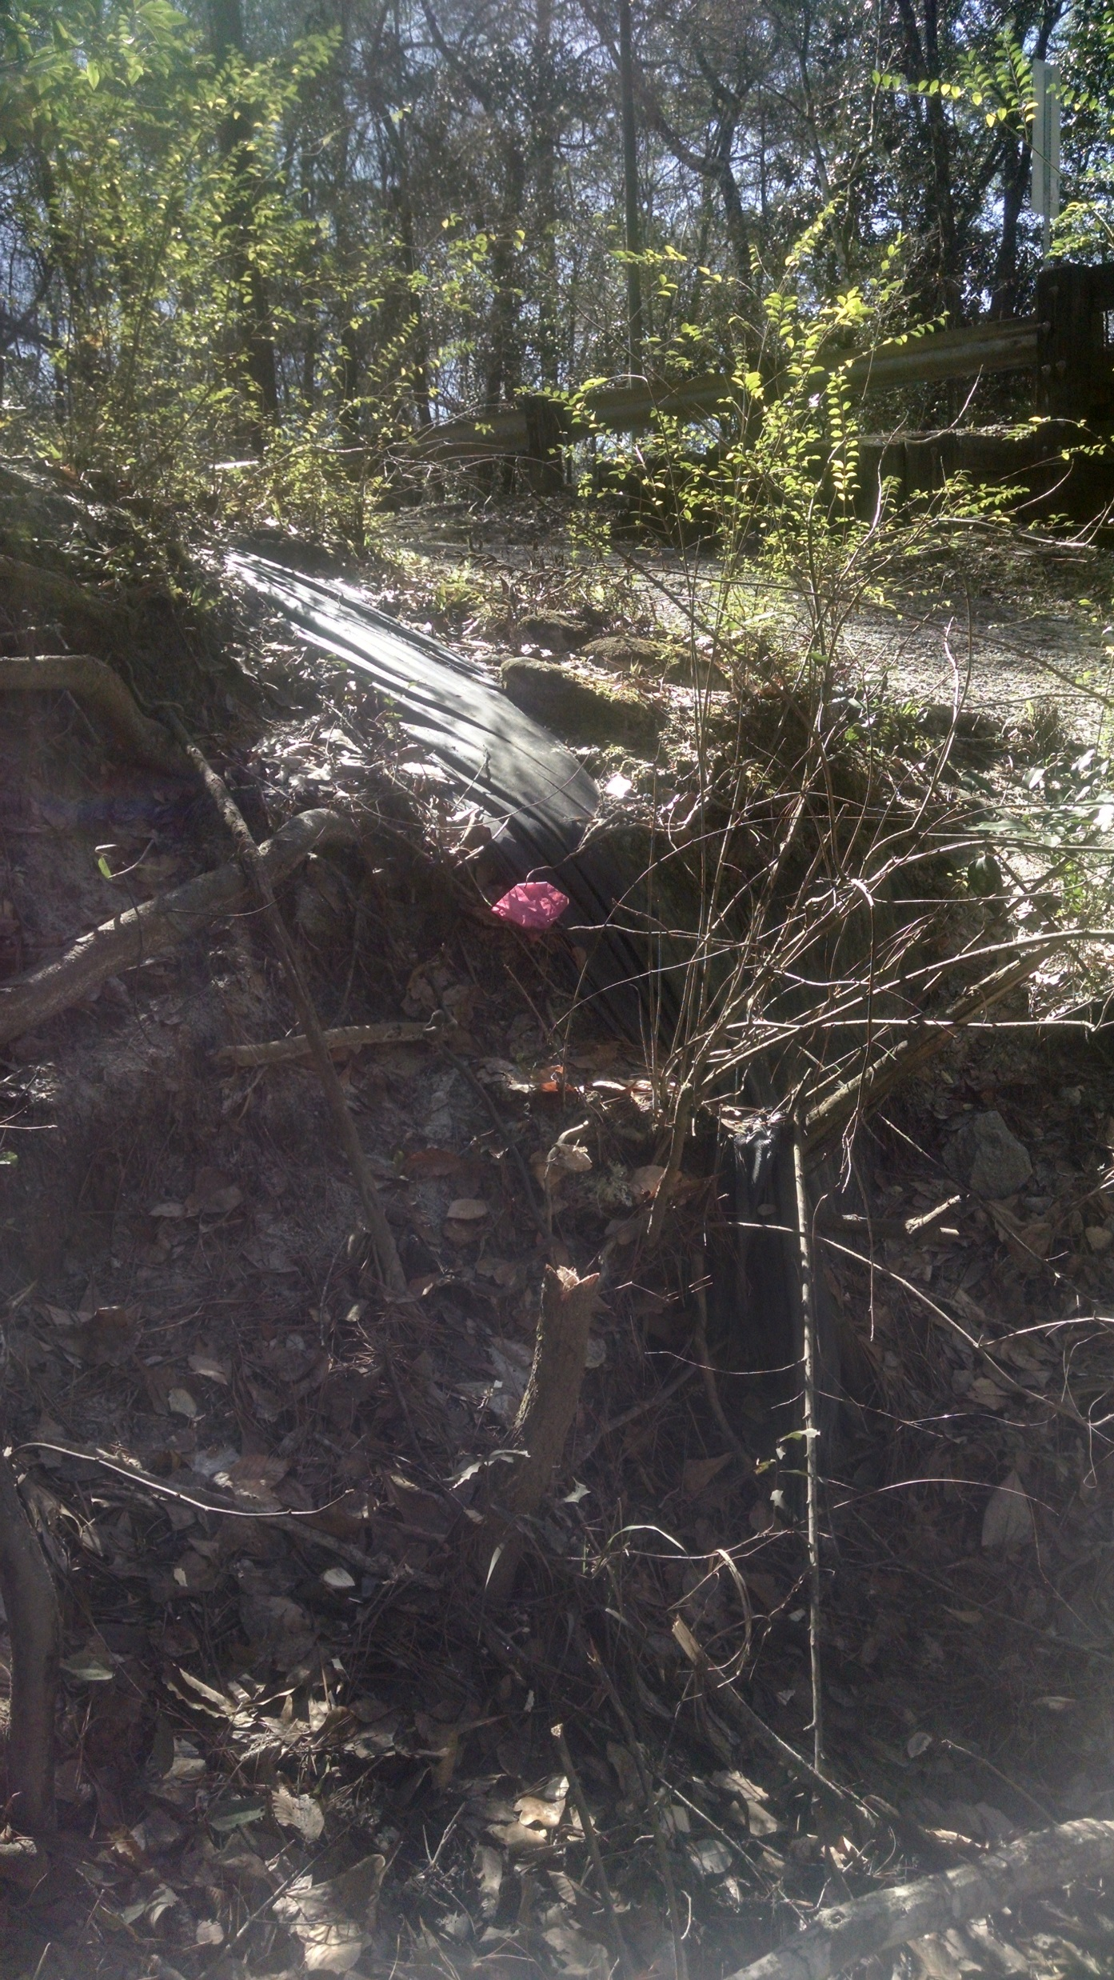
These images show the erosion that is occurring along the banks of the creek at the bridge crossing.
The image on the left shows the undercutting that is occurring.
The image on the right shows a silt barrier that has been completely overwhelmed by the erosion.

Slide 6
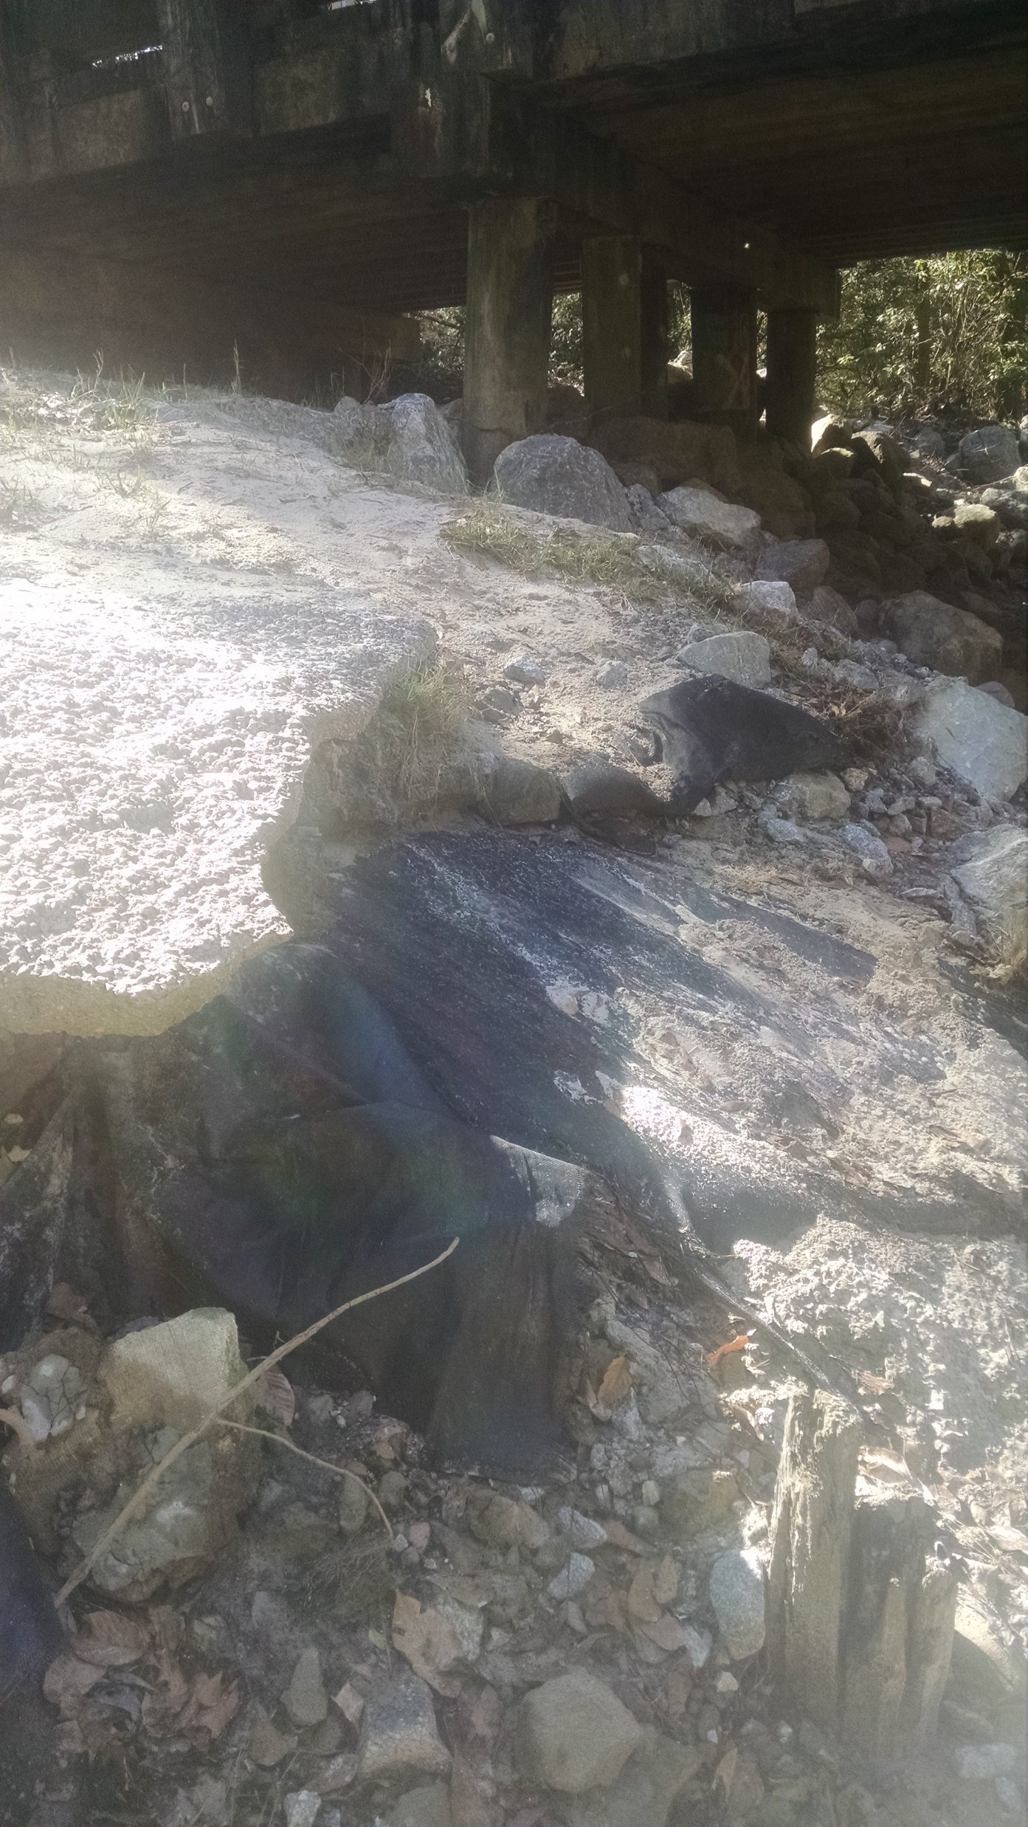
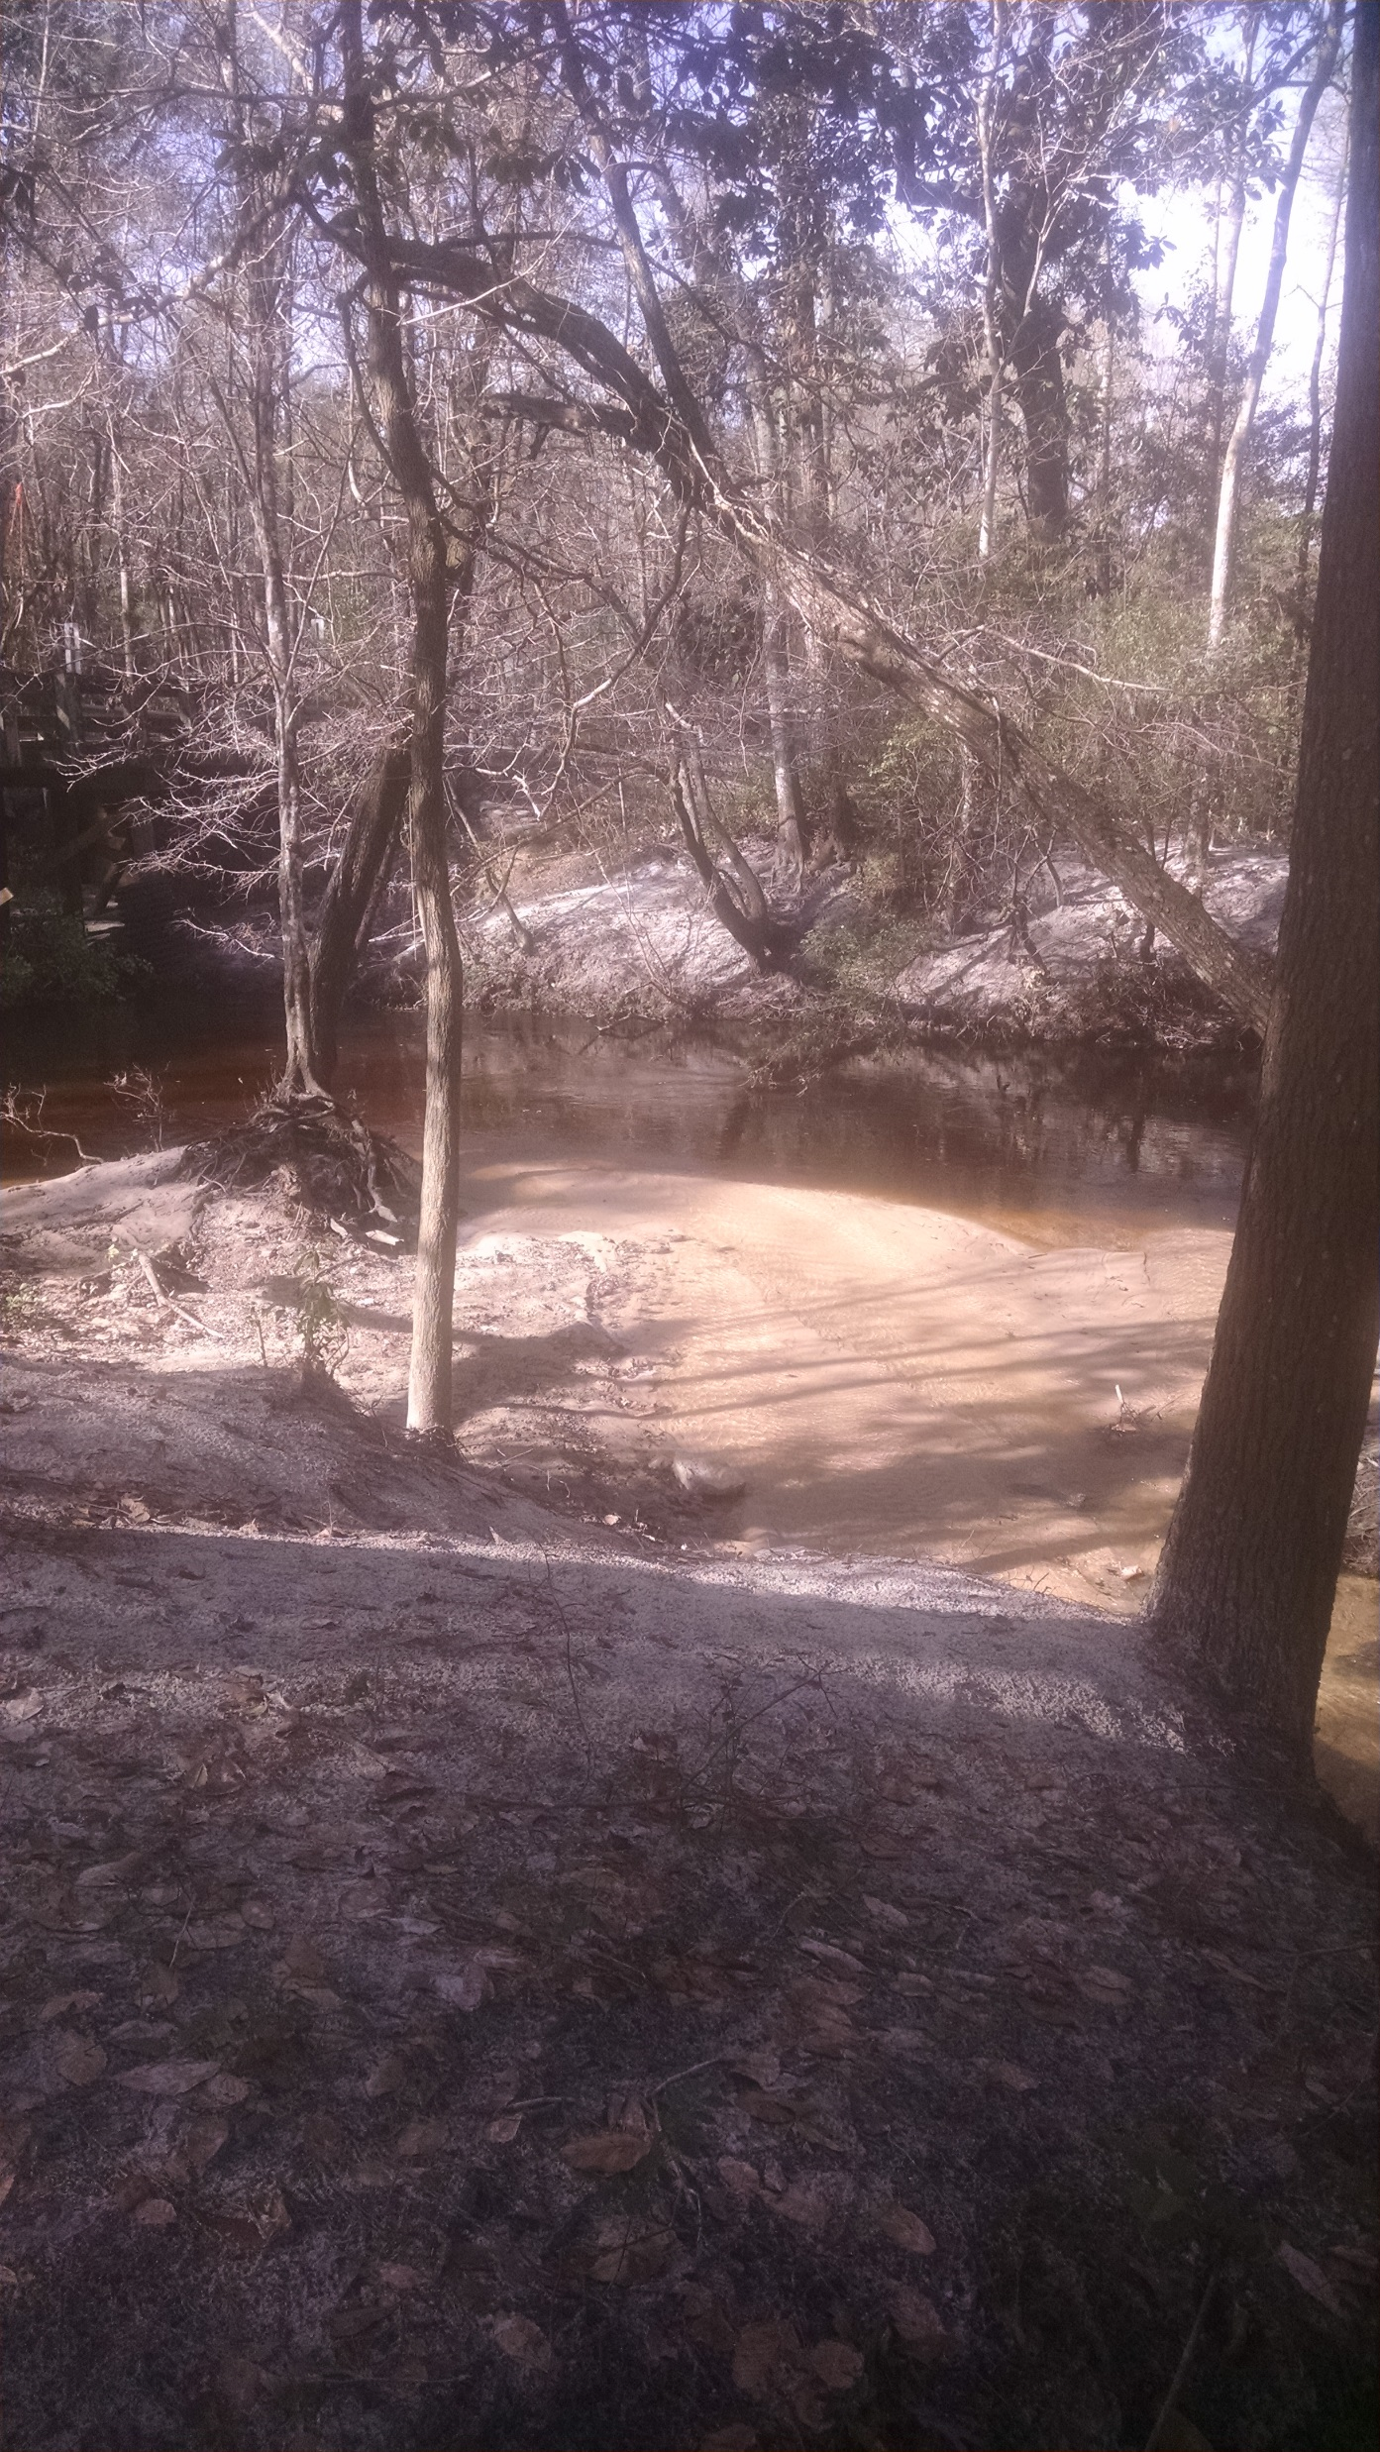
These images show the erosion that is occurring along the east bank of the creek at the bridge crossing.
The image on the left shows the undercutting and destabilization of the sand and rock.
The image on the right shows the sand creating a delta out into the creek burying aquatic habitats.

Slide 7
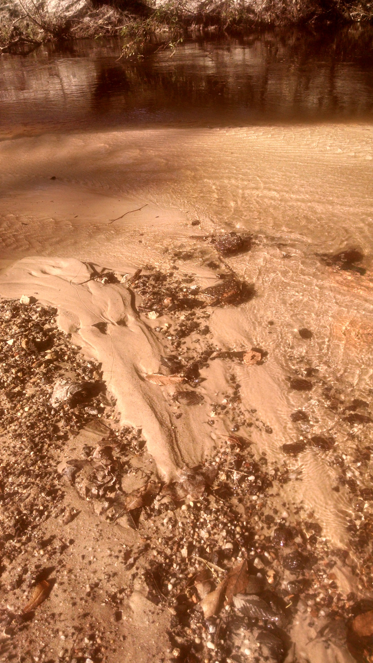
This image is a close up of the sand delta with pieces of asphalt that is being deposited into the creek.
Asphalt is a potential source of PAHs.

