Slide 1
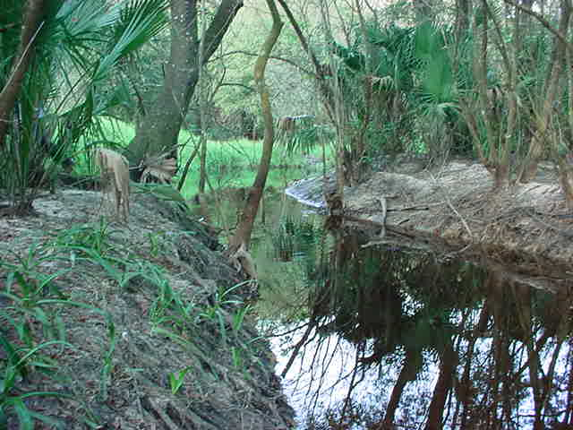
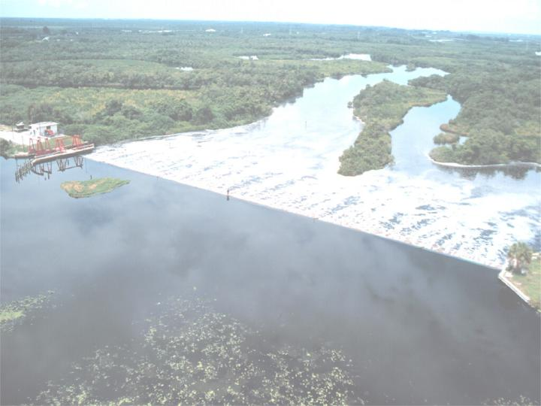
SPJC Reasonable Assurance Plan
Next Steps

Slide 2
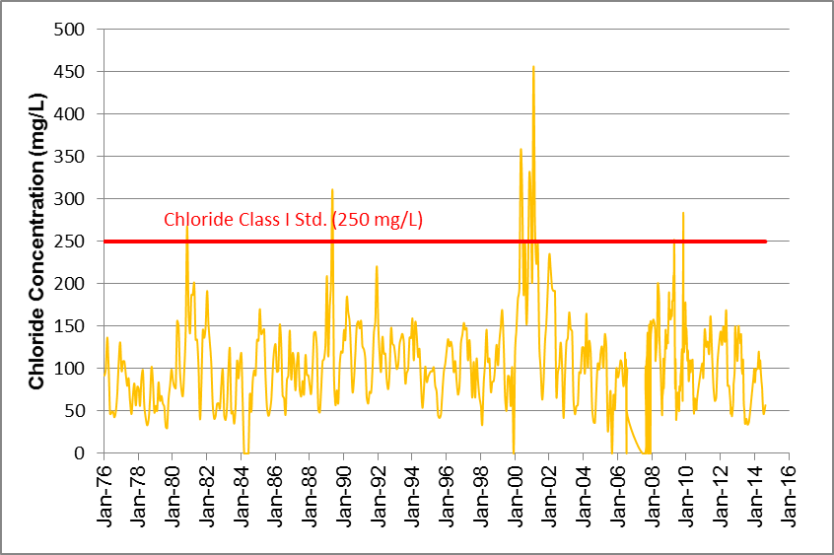
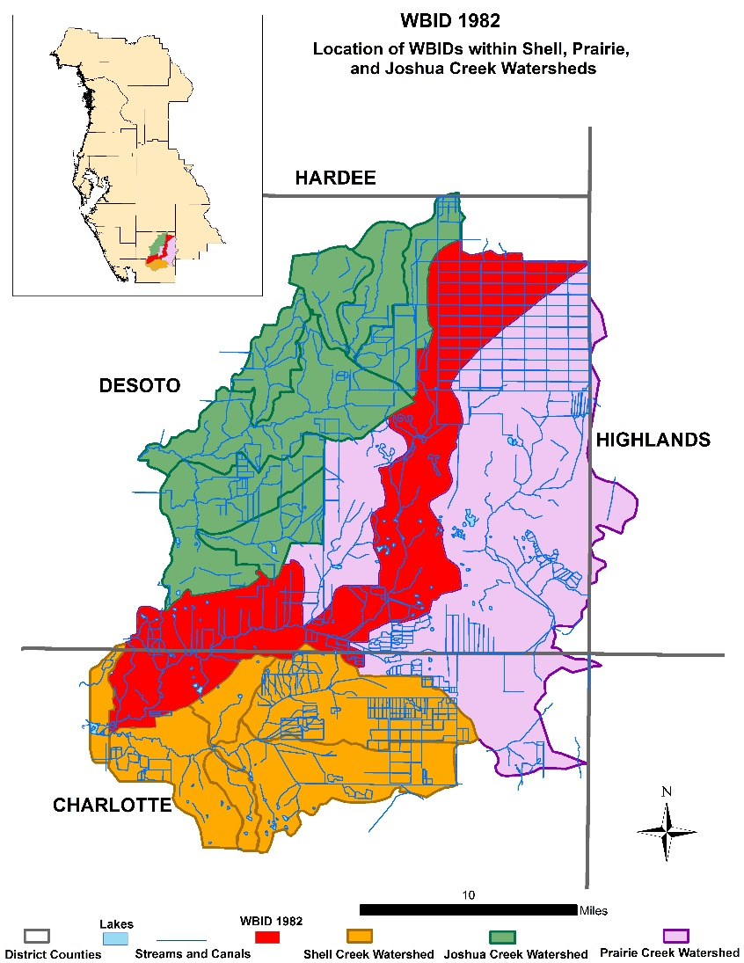
Prairie Creek @ Washington Loop Rd. Water Quality Results for Chloride
Key Monitoring Location WBID 1962
Notes:
As Lizanne pointed out, significant improvements in water quality have been made in the three impaired waterbodies in Shell and Prairie Creek.
Since 2000-2001 period WBID 1962 shows significant reduction in chloride, with influence by climate

Slide 3
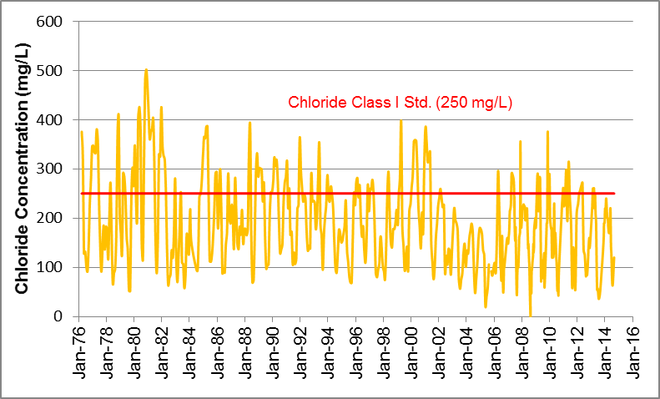
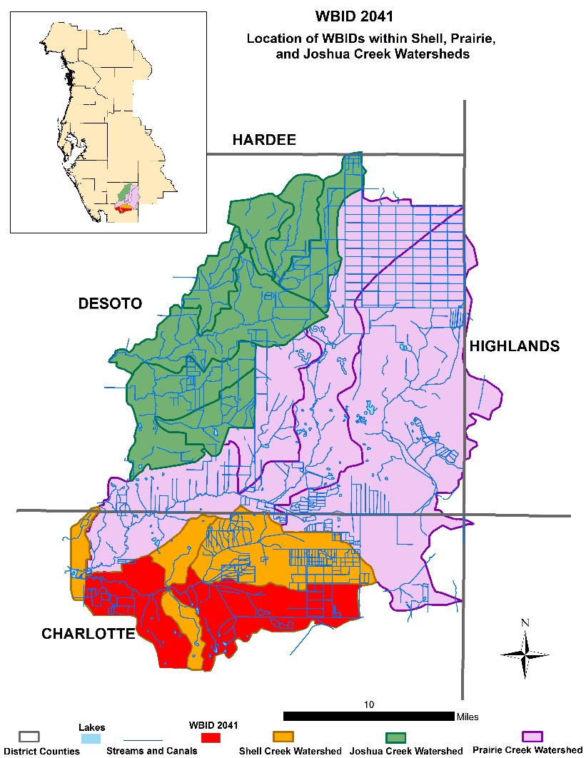
Shell Creek @ Washington Loop Rd. Water Quality Results for Chloride
Key Monitoring Location WBID 2041
Notes:
Shell Creek actually demonstrates even more of a reduction in chlorides through time, however, it is still impaired

Slide 4
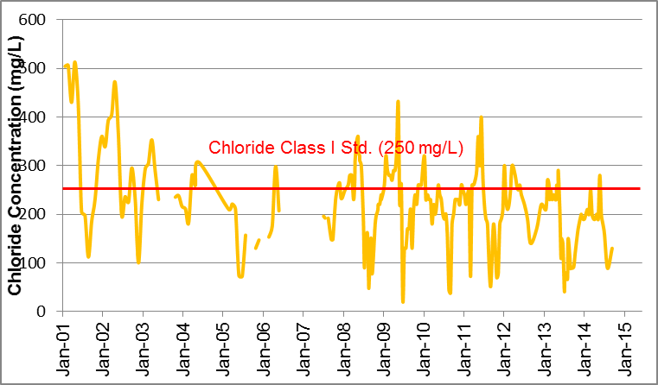
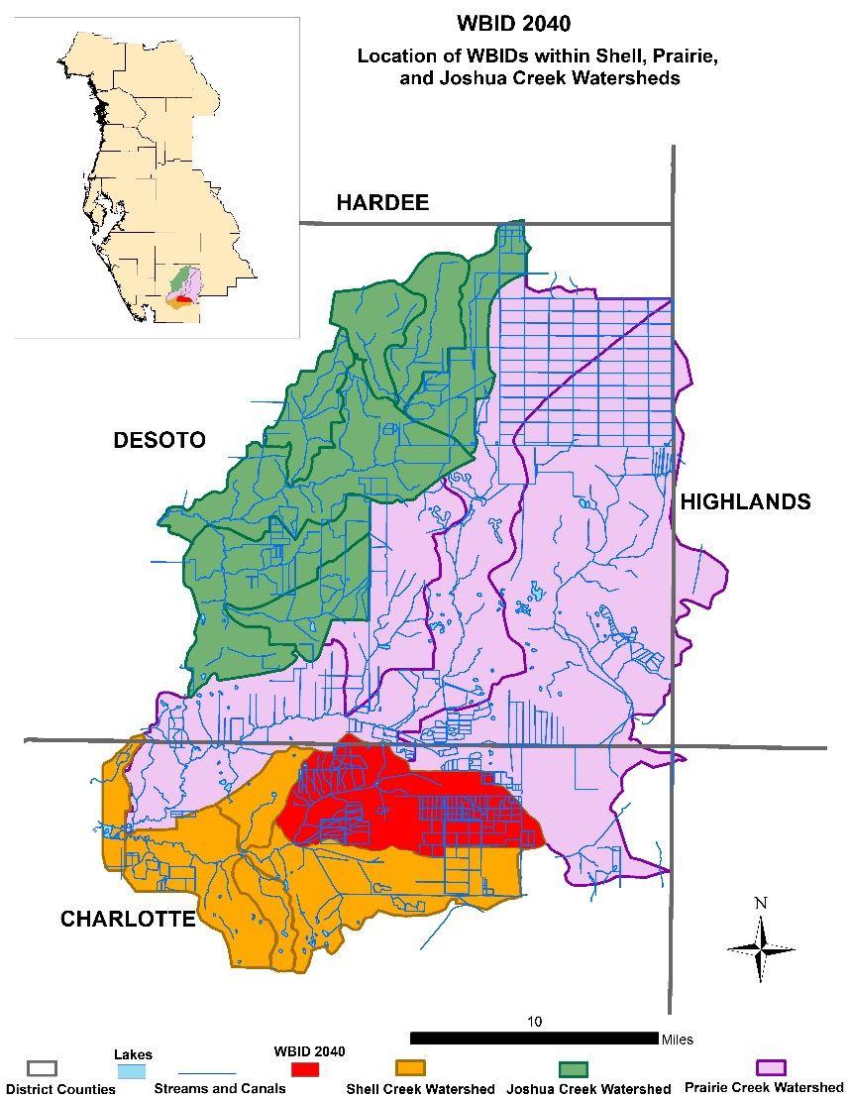
Myrtle Slough @ SR31 Water Quality Results for Chloride
Key Monitoring Location WBID 2040
Notes:
And the case is similar for Myrtle Slough in Shell Creek Watershed – very visible reductions through time but impairment still remains.

Slide 5
Next Steps
SPJC RA Plan time frame to achieve goal was 10 years (2004 - 2014),
Final Performance Monitoring Summary (fifth) is now complete,
Options before us:
  1) Do nothing – FDEP will determine future steps,
  2) Request additional time on RA Plan,
  3) Indicate to FDEP that Stakeholders believe RA Plan objectives have been met, to the extent possible:
  a) WBID 1962 (Prairie Creek) meeting per FDEP (Group 3 TMDL Assessment/IWR Run 49 & 50)
  b) WBID 2041 (Shell Creek) and WBID 2040 (Myrtle Slough – Shell Creek) significant improvement based on Performance Monitoring Summary
  - Additional improvement marginal/not anticipated based on ambient water quality conditions in Shell Creek Watershed.

Slide 6
Next Steps
With stakeholder consent, Option 3 preferred
Provide FDEP with letter indicating:
  Stakeholder group has actively worked on water quality improvements over the ten year period of RA Plan,
  WBID 1962 no longer impaired
    Request FDEP to delist WBID 1962
  WBID 2041 and 2040 still impaired but significantly improved
    Additional improvement expected to be minimal due to natural conditions in Shell Creek
    Will need to discuss how to categorize
  Stakeholder group will continue to implement BMP’s
    BMP’s address additional issues (SWUCA) beyond impairment issue

Slide 8
Assessment Category Assessment Category Definitions
1 - Attains all designated uses
2 - Attains some designated uses and insufficient or no information or data are present to determine if remaining uses are attained
3a - No data and information are present to determine if any designated use is attained
3b - Some data and information are present but not enough to determine if any designated use is attained
3c - Enough data and information are present to determine that one or more designated uses may not be attained according to the Planning List methodology
4a - Impaired for one or more designated uses but does not require TMDL development because a TMDL has already been completed
4b - Impaired for one or more designated uses but does not require TMDL development because the water will attain water quality standards due to existing or proposed measures
4c - Impaired for one or more criteria or designated uses but does not require TMDL development because impairment is not caused by a pollutant
4d - The waterbody does not meet applicable criteria, but no pollutant can be identified; therefore a TMDL will not be developed at this time
4e - Impaired, but recently completed or on-going restoration activities are underway to restore the designated uses of the waterbody
5 - Water quality standards are not attained and a TMDL is required

