Slide 1
IT Workgroup
February 13, 2018

Slide 2
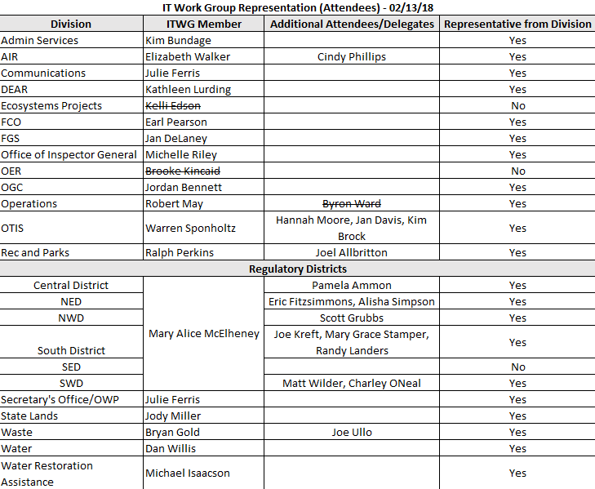
ITWG Meeting Attendees

Slide 3
ITWG Agenda
February 13, 2018 (8:30 – 10:00 a.m.)
Room 423, Bob Martinez Center
IT Governance Membership Changes
Spectre & Meltdown
Internet Explorer 11
Salesforce
Reporting Tool
Cost Allocation
Strategic Planning Sessions
Open Discussion/Quick Topics

Slide 4
IT Governance Membership Changes
ITDB
  Shayna Acree will serve as the ITDB member for the Office of General Counsel.
ITWG
  Jordan Bennett will serve as the ITWG member for the Office of General Counsel.

Slide 5

Spectre & Meltdown
Meltdown
  We have and are installing Meltdown patches from Microsoft. These patches have been tested and appear to have little if any negative side affects on PC performance.
  Older versions of Windows, like Windows 7:
    More vulnerable than fully patched Windows 10 v.1703 or later.
    More prone to performance degradation due to meltdown patching
Spectre
  Intel and other chip manufacturers may put out firmware and BIOS updates for this, but “the long-term solution to this vulnerability involves fundamental changes to the CPU design that could take years to reach the market”.
Notes:
Warren Sponholtz
Two vulnerabilities: Meltdown and Spectre
These have been out for a while, but they recently came out in the news a few months ago.
Meltdown and Spectre are difficult to patch against.
Microsoft has released a patch for Meltdown, but older machines are difficult to patch. Older machines may have some performance issues.
DEP is patching for Meltdown, so you should not be concerned about this.
Spectre will be pushed out by CPU manufacturers. New CPU designs should compensate for this vulnerability.
Cloud providers are looking into these and making sure they are applying the right amount of patching and remediation.
There is not a lot of required action at this point, but we are tracking this. We do not want to over respond.
These patches can come through at any time. The two reboots on Thursday nights ensure that everyone gets the patches.
Dan Willis reported that his bios is out of date on his machine. OTIS pushes out the required updates when received from the manufacturers.
Dennis Cook
Social media is becoming a bigger request for our work lives. DEP had a major incident last week, but we were able to catch it before it became an issue.
Drop Box is a great program for home use, but it is high risk in the IT enterprise. We have other products that we can use.
DEP has an FTP site that can be used by internal and external individuals. This is approved and secure.
Jan Davis will find the email about the Drop Box and send that back out to this group. Training information was included in the original email. Update: Email was sent to the ITWG on 2/13. See below for DEP’s approved alternatives to the Dropbox file sharing service.
DEP file sharing services:
Secure FTP User Guide | How To Articles and Videos for the Secure FTP:
Logging into DEP’s Secure FTP server and adding Folders/Files
Sharing a File and E-mailing within Outlook or the Secure FTP Server
Deleting Files and the Length of Retention
Secure FTP – External Customer
SharePoint | How To Articles and Videos for SharePoint:
How to Share a File Stored in SharePoint
SharePoint Online - Content Sharing
DEP SharePoint Instructions for External Users
Other DEP FTP Services
Evernote vs. One Note
Since we have a tool in place (One Note), it is requested that staff continue using that program. This allows easier assistance and collaboration when everyone works on the same platform.
Ralph Perkins will send some information about Evernote to Dennis Cook.
It is important for staff to have the right tools to complete their jobs, but a couple of the questions worth asking before adding redundant tools is “Does it add enough value to complicate our environment?”.

Slide 6


Internet Explorer 11
IE11
  Based on older framework
  Slower than modern browsers
  Has compatibility issues with modern sites and controls
Chrome, Firefox, Edge
  HTML 5 compliant
  Faster when processing graphics and rich content
  Has compatibility issues with older websites
Notes:
Warren Sponholtz
There is not an official date for IE end of life.
Internet Explorer 11 is certified to run until Windows 10 runs out (2026).
Internet Explorer 11 is slower, and it is not a great HTML5 browser.
Internet Explorer 11 is DEP’s standard, but we are moving away from that.
The problem with the newer browsers is their compatibility with older sites.

Slide 7
Internet Explorer 11
Plan:
  Determining which applications require Internet Explorer
  People First will no longer require Internet Explorer after March 2018
  Looking to make Chrome, Firefox and Edge the defaults
  Will eventually setup Internet Explorer to run as the exception for compatibility with older applications
Notes:
Warren Sponholtz
Eventually Internet Explorer 11 will become the exception and used only for certain legacy software.
There is no news on MFMP changing.
In March 2018, People First will no longer require Internet Explorer, and you will be able to access People First on your mobile device.
SharePoint has some compatibility issues with the modern browsers.
DEP has a long way to go on this; trying to get everyone thinking about this.
When PCs are reimaged, IE, Edge, FireFox and Chrome are installed.

Slide 8
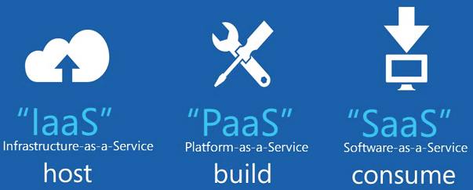
Salesforce Initiatives
Salesforce is a high-productivity aPaaS solution offering:
  Faster solution development
  Moderate customization capabilities
  Integration capabilities with existing systems
  Scalability & easier to manage cloud-based platform
  Easier configuration (reduces maintenance burden)
  Resource/talent availability
  Built-in disaster recovery
  Application markets
Notes:
Warren Sponholtz
This application runs in the cloud. It’s a platform that contains everything DEP needs from deploying to writing applications.
Salesforce is designed to develop applications rapidly.

Slide 9

Salesforce Initiatives
Current:
  Ombudsman’s Office and Correspondence Tracking
    Since 2013
  Grants Management (In Development)
  Forms Automation (In Procurement)
Notes:
Warren Sponholtz
LiveCycle is the current forms automation tool, but we are moving to Salesforce. LiveCycle will be phased out completely by the end of the fiscal year.
The state’s new travel system is also on Salesforce.
DEP is working to get OTIS staff up to speed and setting up training for the program areas.

Slide 10



Reporting Tool
Status:
  We have documented the high level requirements
  We have attended demos for the 3 different solutions
  Next step is a 30-day hands-on evaluation of the solutions
  Still looking good for April 1st decision
Notes:
Warren Sponholtz
All demos look really good. The answer will come out in the hands-on review of the products.

Slide 11
Cost Allocation Data Collection
Divisions review & revise counts for:
  Email Accounts (Facilitated by Jan Davis)
  PC Inventory (Facilitated by Jan Davis)
Note - GIS Installs were managed through the data collection phase in previous years. This year, Kim Jackson will work with GIS Coordinators to finalize software install counts.
Divisions are responsible for reconciling all Cost Allocation factor (cost driver) data based on instructions provided in the IT Cost Allocation – Data Collection SharePoint site.
Notes:
Jennifer Long
Email with instructions and link for Cost Allocation Data Collection will go out to ITWG and delegates today, February 13th. ITWG members or designee(s) are responsible for coordinating for their area(s) of work.
Instructions are located on the cost allocation SharePoint site. Links provided in PowerPoint slide.
May 1st - All counts will be final.
The cost drivers may be used throughout the year to distribute IT shared costs.
Warren Sponholtz
If you have questions, please reach out to Jan Davis or Jennifer Long.
It is important to make sure our counts are right so costs are distributed correctly for enterprise initiatives.

Slide 12
Cost Allocation Data Collection
Deadlines:
  April 13: Division updates to be completed
  April 16-27: OTIS will run a preliminary Cost Allocation report and make necessary final adjustments
  May 1: FY18-19 Finalize counts for cost allocation
Cost drivers will be used throughout the year to distribute shared IT costs.
Notes:
Warren Sponholtz
No major changes to the process. DEP does this every year.

Slide 13
Strategic Planning Sessions
Ecosystems Restoration
  11/16/2017
Regulatory Programs
  1/31/2018
Chief of Staff & Secretary
  2/8/2018
Land and Rec
  2/26/2018
Notes:
Warren Sponholtz
In these sessions, DEP staff talk about the five-year horizon for IT projects. This feeds into the annual work plan planning process.
Everyone should get project solicitation information in March. Those will need to be completed in April. Look for email from Rebecca Northup on this.

Slide 14
Open Discussion
Quick Topics
  Drone Policy Update
  Social Media Applications & Enterprise Security
Questions?
Next Meeting (03/13/18)
Notes:
Warren Sponholtz
Drone Policy
Feedback was received from those who formalize DEP’s directives. This policy is awaiting required signatures.
Kim Jackson and John Carpenter are working on the webpage associated with this policy.

Slide 15
Action Items
Action ID | Responsible Party | Description | Due Date | Resolution
1 | Jan Davis | Resend communication on Drop Box use (slide 5) | 02/27/18 | 2/13/18
2 | Dennis Cook | Work with Ralph Perkins about Evernote topic (slide 5) | 02/27/18
3 | Jennifer Long | Send out cost allocation information via email (slide 11) | 02/13/18
4 | Rebecca Northup | Send out communication via email for project solicitation (slide 13) | March 2018

