Slide 1
1/11/2018 SMP Quarterly

Slide 2
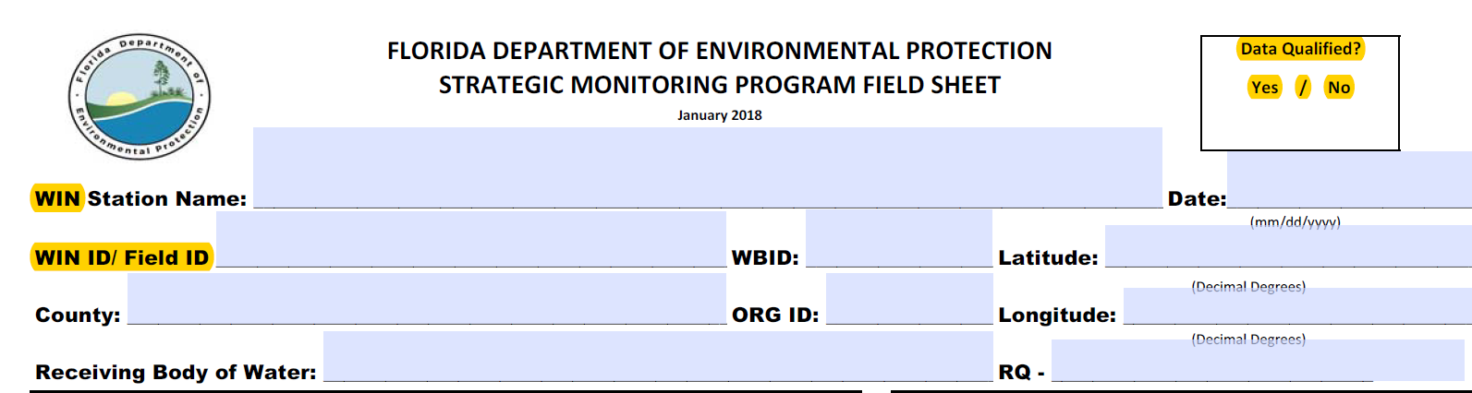
Field Sheet Updates, Notes
Space to note qualified parameters
WIN Added, STORET removed
Station ID (WIN ID) and Field ID merged into one field
    For non-QC samples the Field ID is the WIN ID
The station name needs to be the WIN station name

Slide 3
The station name needs to be the WIN station name
Examples of what not to do
SITE_LOCATION | SITE_LOCATION | SITE_LOCATION
Mullet Creek upstream Hwy 20 | Lake Rowan Center | North New R. @ University Dr.
Mullet Creek @ Hwy 20 | Lake Rowan Ctr. | North New River Canal @ University
G3NW0137 Mullet Ck | Lake Rowan Mid | North New R. @ University Dr North New River Canal @ University Dr
Mullet Creek upstream of Hwy 20 WIN Station Name: Mouth of Mullet Creek @ Hwy 20 | Win Station Name: LAKE ROWAN CTR | North New River @ University Win Station Name: North New River Canal (NNR-3 SF Canal Study/122 Broward)

Slide 4
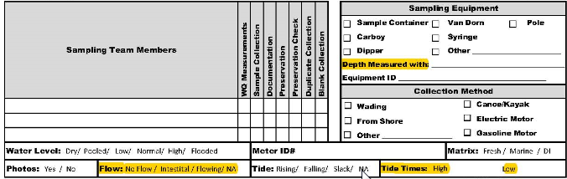
Field Sheet Updates, Notes
Record the tool used to measure the total and sample depths.
  To match the 6 month depth calibration record to field events
Text to document flow is still using STORET values. Currently WIN/WIN-DMT only allow numeric flow values (cfs) not text. When we figure this out you will be informed. The field sheet may need to be updated at that time.
Tide Times High/Low field added. The High and Low times need to bracket the sample time. Ex. High tide: 0600, Sample Time 0955, High Tide 1200.

Slide 5
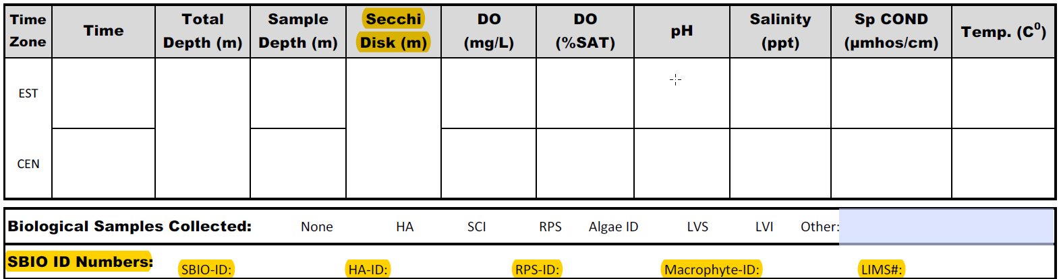
Field Sheet Updates, Notes
The sequence of field measurements/observations has been changed to match the WIN-DMT
Like flow, Secchi Disk in the WIN DMT can only be a numeric value (m), not text. The STORET DMT had an “On Bottom” option. We are working with WIN/DMT people on this issue. Will let you know what we find out.
Fill out all field on the field sheet. Circle the bioassessments collected, if none circle none.
Add fields to record SBIO IDs

Slide 6
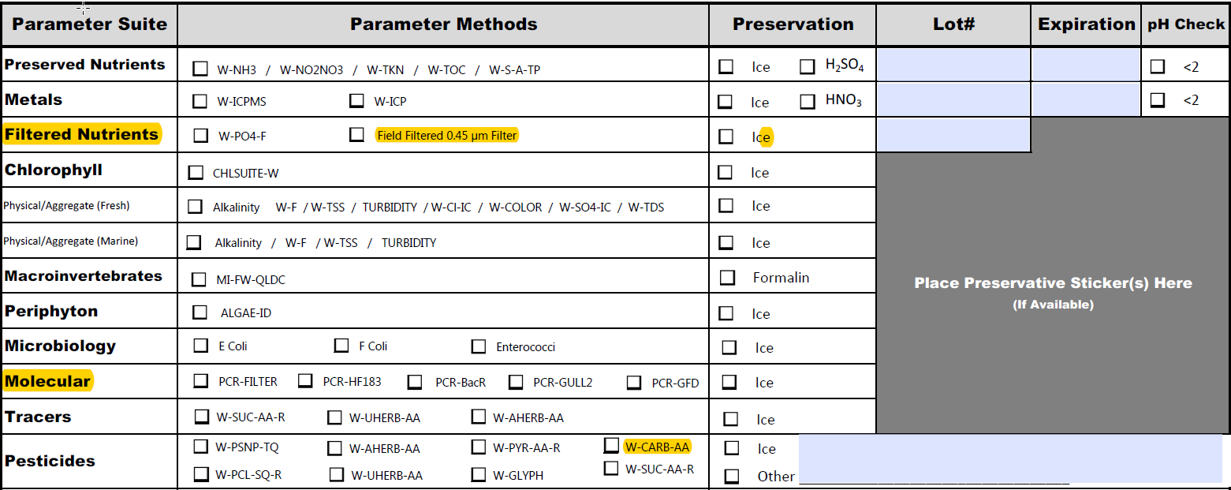
Field Sheet Updates, Notes
Field to record the lot number for the orthophosphate filter added
  Lot numbers and expiation dates field must be filled out. The Acid ampule label is not sufficient
Row added for molecular (PCR) analyses
Updates to the Pesticide analyte list
  W-CARB-AA (default list) All new to SMP
  W-GLYPH, both AMPA, Glyphosate. AMPA new to SMP.
  Update your templates

Slide 7
Carbamates bottle is pre-preserved. Do not dump out the preservative. Do not rinse the bottle
John Watts is sending some preservative to each ROC so we will have some if we build our own kit.
Default list or Complete list nots added to KIT Tab of SMP for pesticides
W-AHERB-AA | Chlorinated (phenoxy acid) herbicides | 2,4,5-T; 2,4-D; 2,4-DB; Acifluorfen; Bentazon; Dicamba; Dichlorprop; Dinoseb; MCPA; MCPP; Silvex; Picloram; Triclopyr | All Analytes, Complete List
W-CARB-AA | Carbamates | Aldcarb; Aldcarb Sulfone; Aldcarb Sulfoxide; Carbaryl; Carbofuran; 3-Hydroxycarbofuran; Methiocarb; Methomyl; Oxamyl; Propoxur | Default List
W-CT-CI-R | Organochlorine pesticides | Chlordane, Toxaphene | Default List
W-GLYPH | Glyphosate and degradants | AMPA, Glyphosate | Default List
W-PCL-SQ-R | Organochlorine pesticides | Aldrin; Alpha-BHC; Alpha-Chlordane; Beta-BHC; Carbophenothion; Chlorothalonil; Cypermethrin; DDD-p,p'; DDE-p,p'; DDT-p,p'; Delta-BHC; Dicofol; Dieldrin; Endosulfan I; Endosulfan II; Endosulfan Sulfate; Endrin; Endrin Aldehyde; Endrin Ketone; Gamma-BHC; Gamma-Chlordane; Heptachlor; Heptachlor Epoxide; Methoxychlor; Mirex; Permethrin; Trifluralin | Default List
W-PSNP-TQ | Organonitrogen and phosphorus pesticides | Acetochlor; Alachlor; Ametryn; Atrazine; Atrazine Desethyl; Azinphos Methyl; Bromacil; Butylate; Chlorpyrifos Ethyl; Chlorpyrifos Methyl; Cyanazine; Demeton; Diazinon; Disulfoton; EPTC; Ethion; Ethoprop; Fenamiphos; Fipronil; Fipronil Sulfide; Fipronil Sulfone; Fonofos; Hexazinone; Malathion; Metalaxyl; Metolachlor; Metribuzin; Mevinphos; Molinate; Norflurazon; Parathion Ethyl; Parathion Methyl; Pendimethalin; Phorate; Prometon; Prometryn; Simazine; Terbufos; Terbuthylazine | Default List
W-SUC-AA-R | Sucralose | Sucralose | Default List
W-PYR-AA-R | Pyraclostrobin | Pyraclostrobin | Default List
W-UHERB-AA | Urea herbicides and other chemicals | Acetaminophen; Carbamazepine; Diuron; Fenuron; Fluridone; Imidacloprid; Linuron; Primidone | Default List

Slide 8
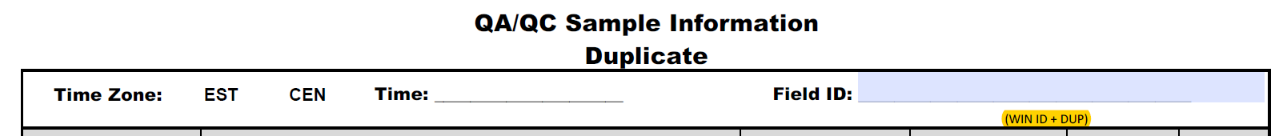
Field Sheet Updates, Notes
Filed ID for Duplicate samples must be WIN ID + DUP
        Ex. G1SW0084DUP

Slide 9
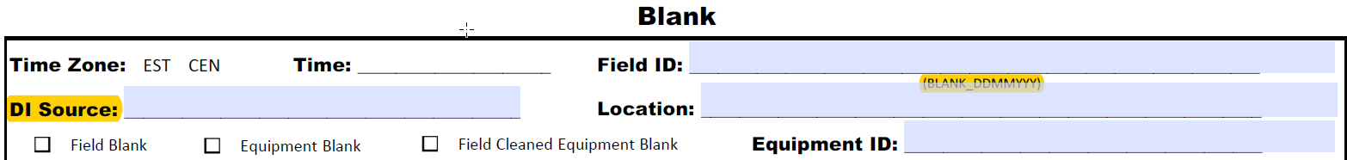
Field Sheet Updates, Notes
DI Source field added for blank samples
Field ID for blanks must be BLANK_Date
    BLANK_01112018

Slide 10
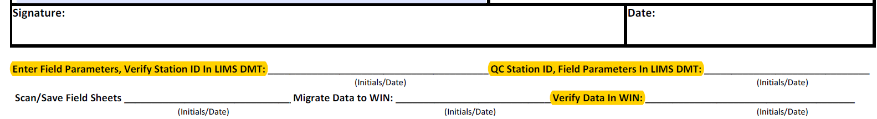
Field Sheet Updates, Notes
Updated text for the LIMS date entry, date QC initial/date fields
    VERIFY WIN ID IS CORRET!!!!!!!!!!!!!!!!!!!!!!!!!!!!!!!!!!!!!!!!
New step added, Verify data are in WIN
    After data are merged into WIN, someone needs to verify the data are in WIN.
      Verify data are in the correct station
      Verify data are in the correct WBID

Slide 11
Field Sheet Notes/Summary
FILL OUT THE ENTIRE FIELD SHEET!!!!!!!!!!!!!!!!!!!!!!!!!!!!!!!!!!
  NOT INDICATING WHICH BOTTLES, OR BIOASSESSMENT COLLECTED IS UNEXCEPATBLE!
  Not filling out the lot, expiration date fields IS UNEXCEPATBLE!
  “If it was documented, it did not happen” DEAR QA Staff
Station name/Station location is the Monitoring Location Name In WIN. Determined before you go into the field, not made up on the fly.
For non-QC samples the Field ID is the WIN ID
The Station name/ Station location, WIN ID and the Field ID on the Field Sheet and on the lab submittal forms (CofC) need to be the same every time.
Record the instrument/tool used to measure total and sample depth
If applicable, record the tide times (High, Low) that bracket the sample time.
Record the bio assessment preformed. If no bioassessments were preformed circle none.
Use the check boxes to indicate which bottles were collated. Do not prefill this section. If a large reptile steals your Chlorophyll bottle and the CHLSUITE-W box was checked before the event, the field sheet is incorrect.
Duplicate Field IDs are the WIN ID + DUP
Blank samples, record the DI source
Blank Field IDs are BLANK_Date
Verify the WIND ID in the DMT is correct
Verify data has been merged into WIN correctly

Slide 12
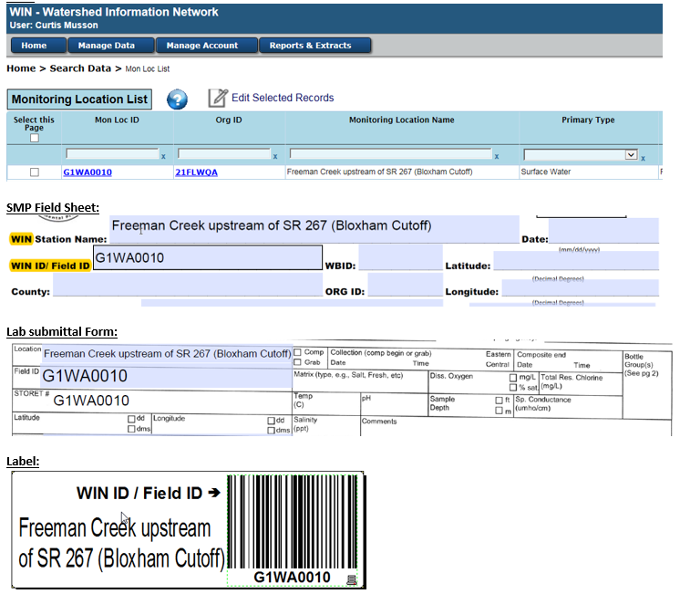
The station description in WIN, on the Field Sheet, on any Chain of Custody and the label must be identical.
The WIN ID in WIN, on the Field Sheet, on any Chain of Custody and the label must be identical.

Slide 13
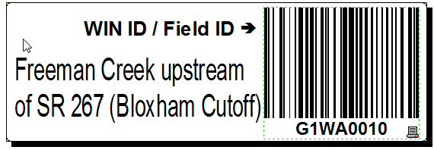
Labels
Required
  WIN ID / Field ID (text)
    WIN ID =Field ID
  1 WIN ID / Field ID Barcode
  Monitoring Location Name
Remove all other info from your labels. Contac Curtis for exceptions
The more info crammed onto the label to more likely receiving will make data entry mistakes.
The location is too often entered into LIMS as “WBID ####”

Slide 14
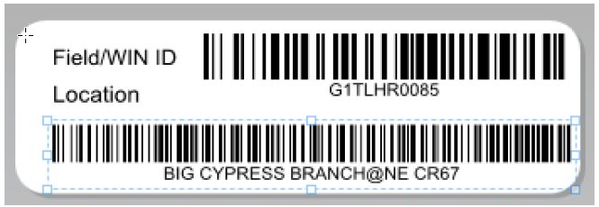
Label Suggestions
Make one template and print labels as you need them. Do not make a new label for each event
Copy and paste WIN ID and Monitoring Location in to label template to eliminate transcription errors.
Put Location in Barcode Format
  >25 characters in a Dymo label barcode. 128A format

Slide 15
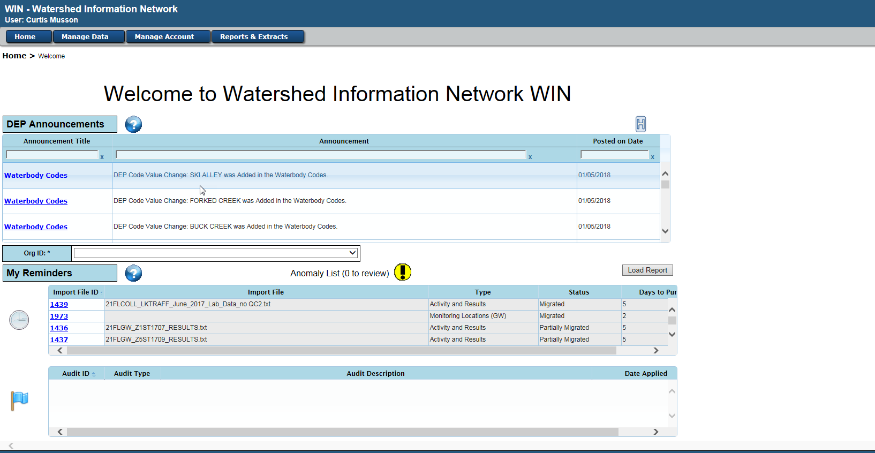
Finding Station Info
Log into WIN > Manage Data > Migrated Data > Search Data

Slide 16
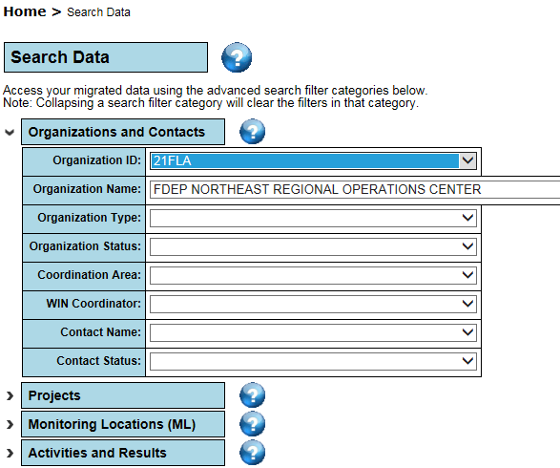
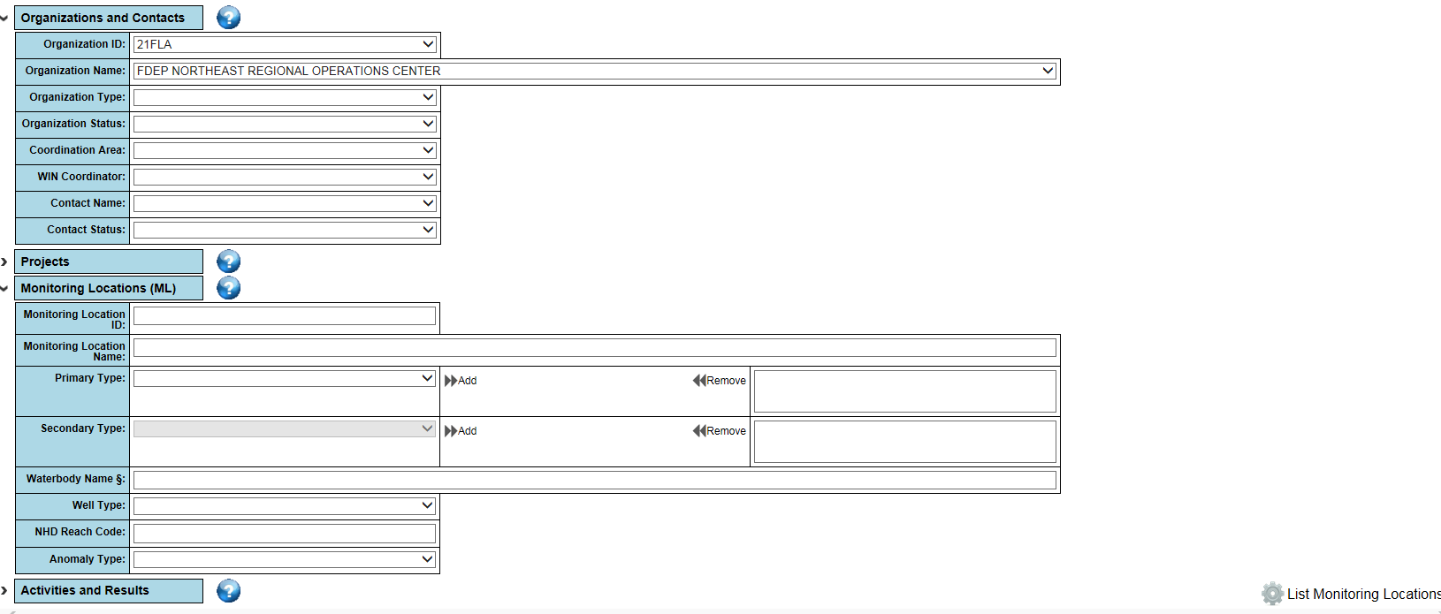
Select your ORG from the Organization Dropdown
Expand the Monitoring Locations Bar
Click List Monitoring Locations

Slide 17
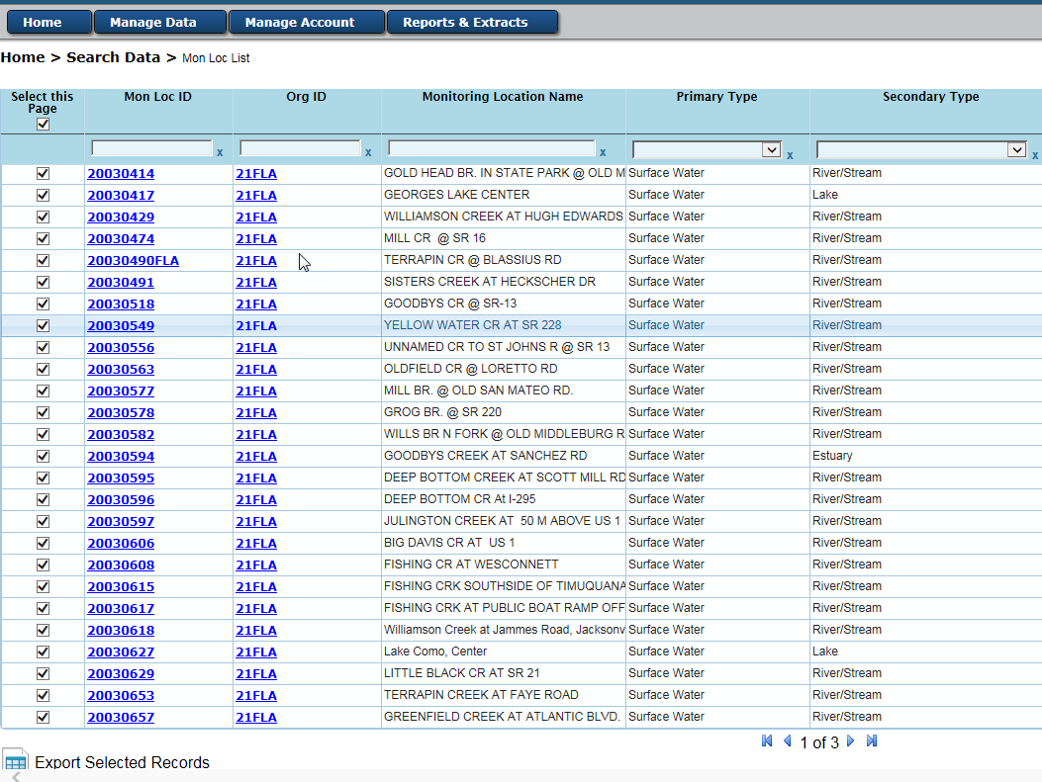
Select the station(s) you are looking for or select all
Click Export Selected Records

Slide 18
Calibration logs, Depth Temperature
Put copies of the Depth and Temp. calibration logs on the FTP in the calibration folder
Hierarchy Guidance document has been updated
  Naming Convention
    Depth: Calibration_ddmmyyy_Depth
    Temp: Calibration_ddmmyyy_Temp

Slide 19
FTP WBID Folder Names
The Folder names need to match the WBID name.
  Use Natalie's awesome excel tool. It is fast and accurate

Slide 20
Tracker
If samples are lost update the tracker by deleting the applicable entries.
Photos have been added to the Tracker
  Streams, 6, North, East, South, West, Upstream, Downstream
  Lakes, Estuaries, 4, North, East, South, West
  One time per year and to document site changes

Slide 21
Scanning Field sheets and other paper work associated with an event – 1 multipage PDF
A field sheet packet must include
  SMP Field sheet
  All bioassessment forms
    HA, PhysChem, RPS, LVS, LVI
  DEP Lab submittal form
  Bacteria Lab submittal form
Optional
  Daily calibration log
  Packing documentation with bottle LOT numbers

Slide 22
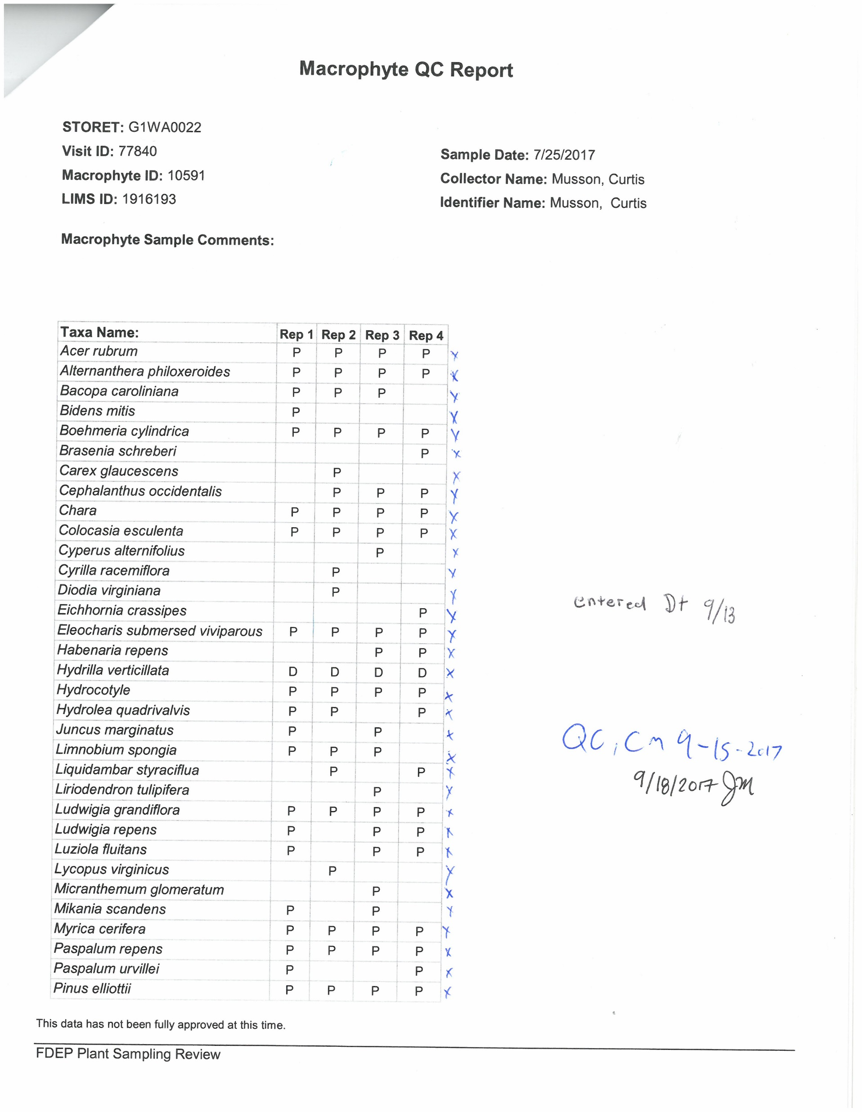
SBIO Data Management
-Documentation
Initial and date each step of the data entry process
  Entry
  QC
  Authorization

Slide 23
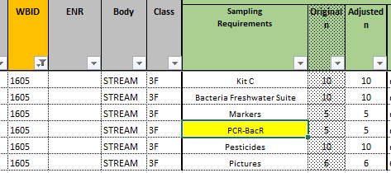
PCR – Requesting Specific Analyses
Most PCR detections are low, T, I, U qualified.
In 2017 we treated all detect the same, and add the detected PCR analyte to the sampling plan.
2018: To reduce the number of PCR analyses we will only request specific PCR tests (in addition to PCR-FILTER) if the site has non-qualified detections.
  The PCR detects table on the FTP is up-to-date.
  The individual PCR tests have been/will be add to the tracker.

Slide 24
Home work
  Pull WIN Stations list and post on the FTP. Excel Format
  Make and SMP process document
    Indicate the staff person(s) responsible for each item
    Include due dates
      Everything after the sample date unto but not including upload to WIN Uplaode, 3 months.

