Slide 1

Division of Water Resource Management
Engineering, Hydrology & Geology Program “Road Show”
May 2014

Slide 2
Engineering, Hydrology & Geology Program (“EHG Heads”)
Richard Musgrove, P.E
P.E. Administrator
Art Sengupta, P.E.
Dam Safety Officer
Mariano Guardo, P.E.
Hydrographic Modeler
Rebecca Prindle
FEMA Grant Manager
Lee Marchman, P.E.
Stormwater Engineer
Vacant
Environmental Specialist
Michael Manausa
Modeler

Slide 3
Art Sengupta, P.E.
Professional Engineer, Professional Geologist, PMP
16 years with South Florida Water Management District in their Dam Safety Division
Other places I have worked include Marathon Oil, Gulf Oil, IT Corporation (now Chicago Bridges), and most recently with AMEC Infrastructure Inc.
Worked in the Gold mines located in Timmons and Sudbury on tailings dam

Slide 4
Quiz
How many dams are there in Florida?
Name the closest dam to your office.
Which dam is the largest in Florida?
Difference between dam and a levee?

Slide 5
Why do dams fail?
Seepage and soil piping
Overtopping
Spillways and other outlets
Slope instability
  Steep Slopes
  Poor Selection of Materials
  Inadequate Placement and Compaction
  Lack of Positive Seepage Control
  Weak Foundation

Slide 6
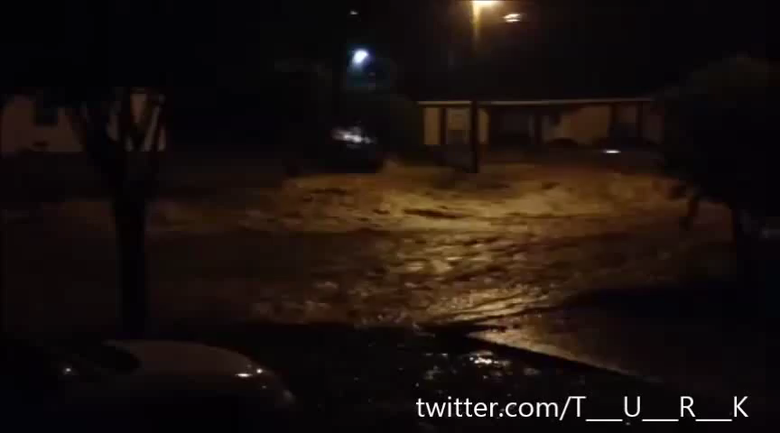
Pensacola Dam Break

Slide 7
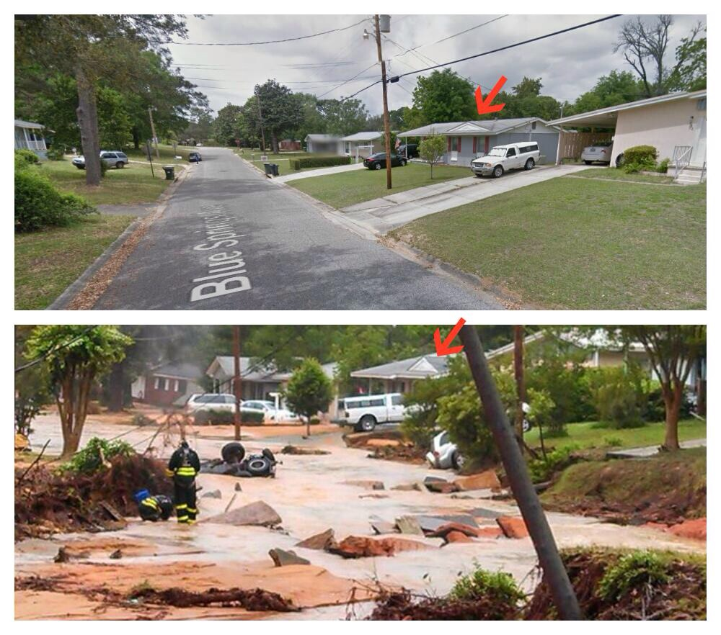
Pensacola-aftermath of the video

Slide 8
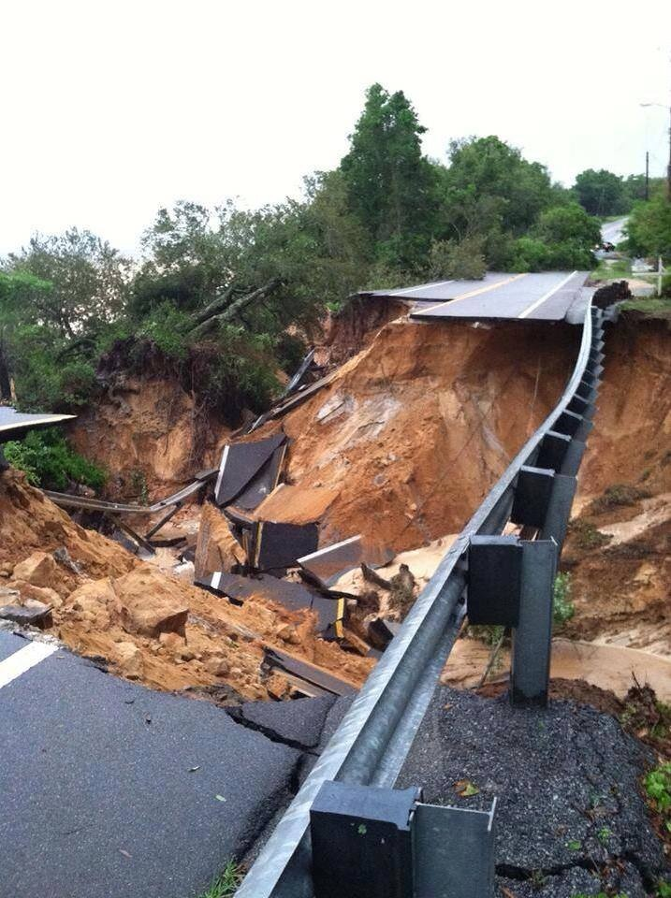
Pensacola- Scenic Drive

Slide 9
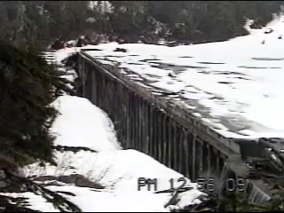
Dam Breach

Slide 10
What Can Art Do To Help?
Provide assistance in dam safety
Interpretation of laws and regulations
Remediation
Review of technical reports
Inspections

Slide 11
How Do I Get Art’s Help
Call early, call often
Use email- include maps and construction drawings when available
Provide information and if necessary site visit
No special forms needed
As much background and insight as you have
If not available, please call Richard Musgrove or Rebecca Priddle

Slide 12
So, What’s on the Horizon?
National Inventory of Dams
  Glitches and fixes
  Review the existing database
  Add new dams
  EAPs for high hazard dams
  FEMA Grant
  Risk communication

Slide 13
So, What’s on the Horizon?
Conditions Assessment
Initiate condition Assessment
Low level assessment of risks
Site visits to verify risk
Mitigation of risk
Complete assessment of at least one WMD

