Slide 1
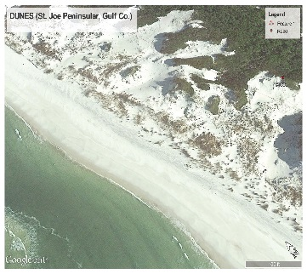
Dune Training
December 8, 2015

Slide 2
Contents
CCCL Establishment
Dune Definitions
Dune Diversity
Dune Protective Value
Governing Laws and Rules
Dune Impacts
Minimization methods

Slide 3
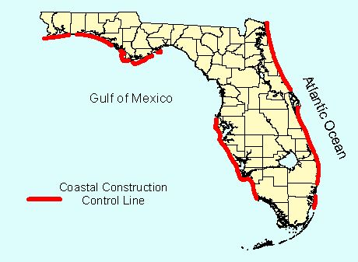
CCCL Location

Slide 4
Dominant Factors in Setting CCCL
100-Year Storm Event Impact Zone defined by erosion or waves
Erosion - Landward extent of erosion. This generally occurs where you have high ground and storm surge is less than 3 feet above ground (e.g. Panhandle and NE Fla. Counties
Flooding - Landward penetration of a 3-foot wave above the storm surge. This condition is dominant in low-lying flood prone areas (e.g. S.W. Fla. Cou

Slide 5
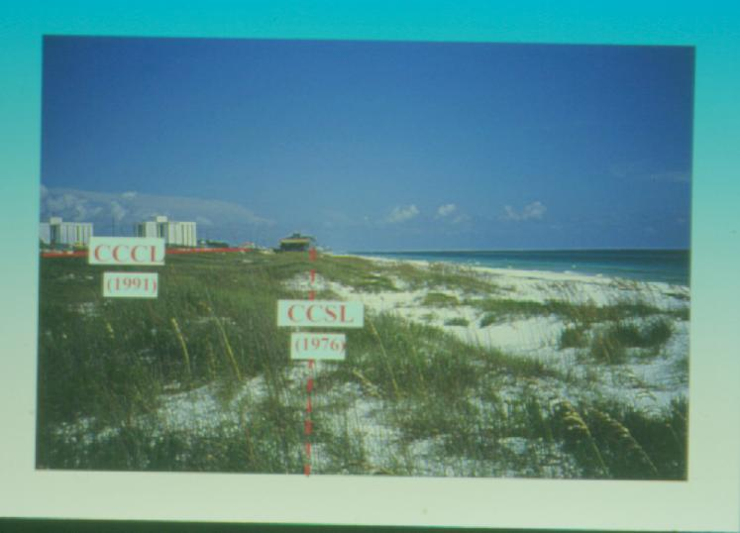
CCCL Location based on Erosion

Slide 6
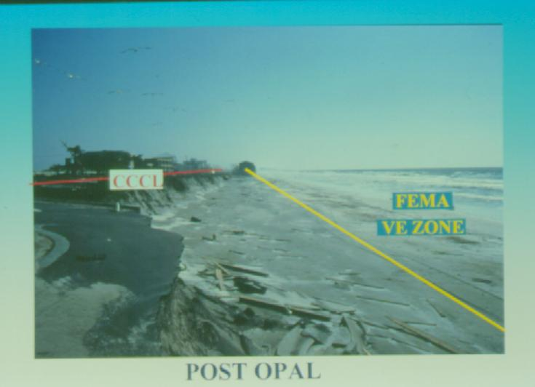
CCCL Location based on Erosion

Slide 7
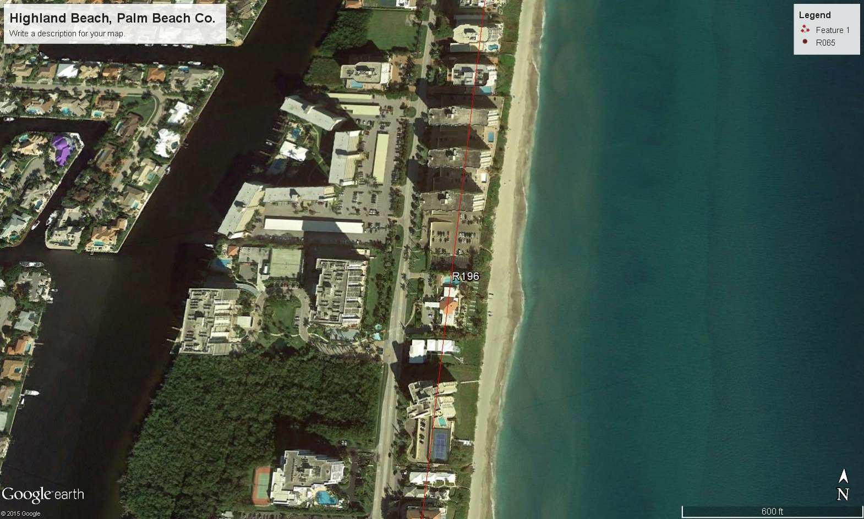
CCCL Established from Erosion

Slide 8
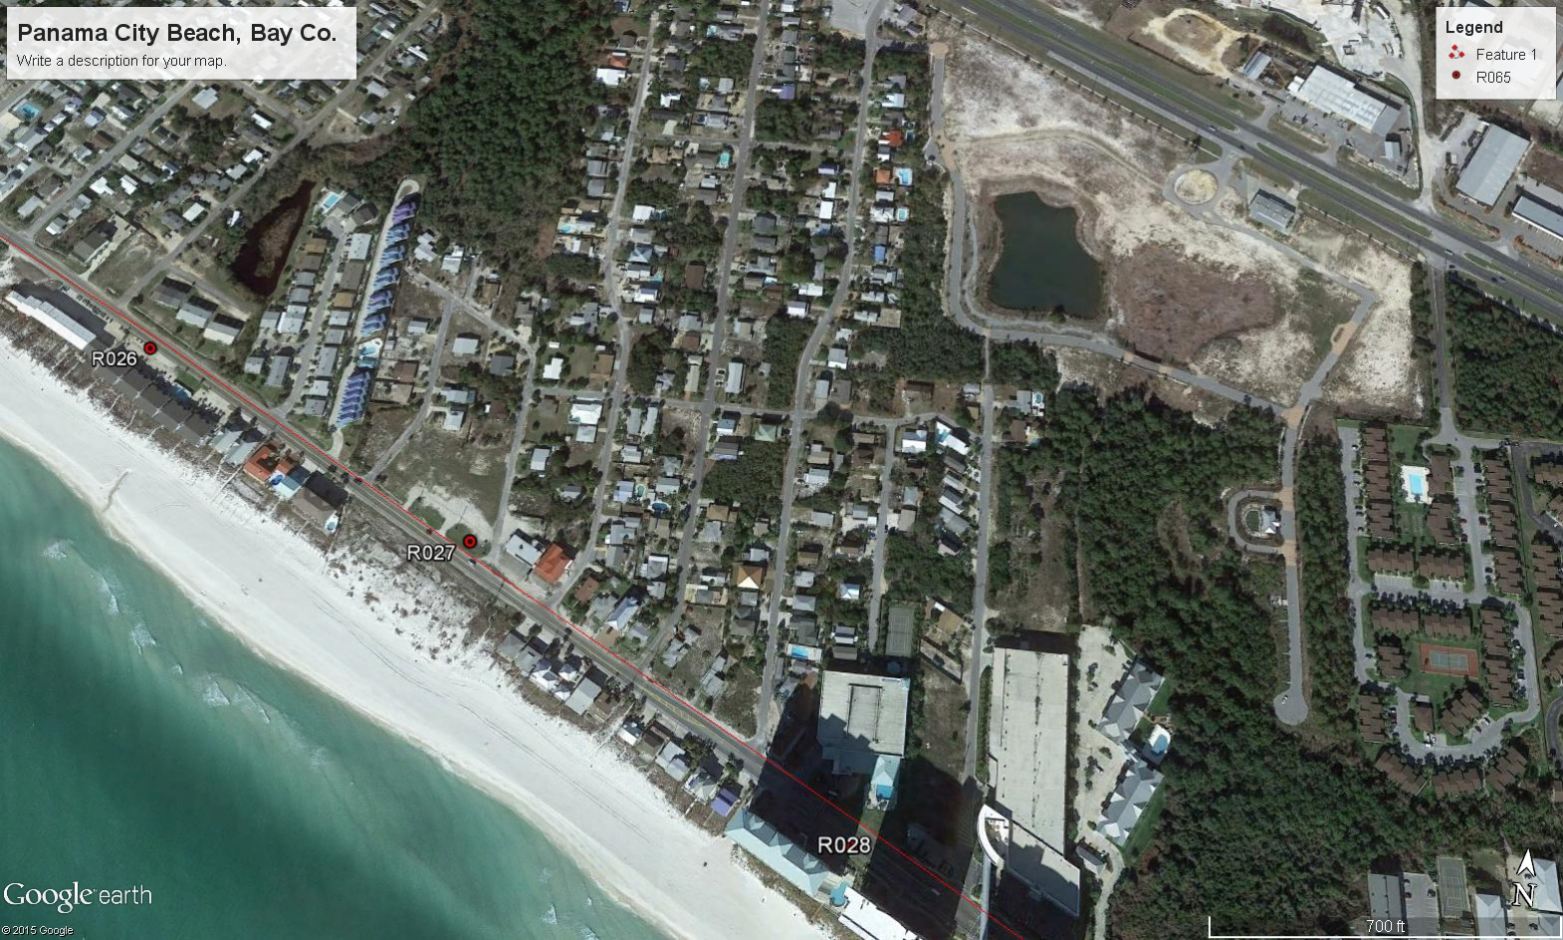
CCCL Established from Erosion

Slide 9
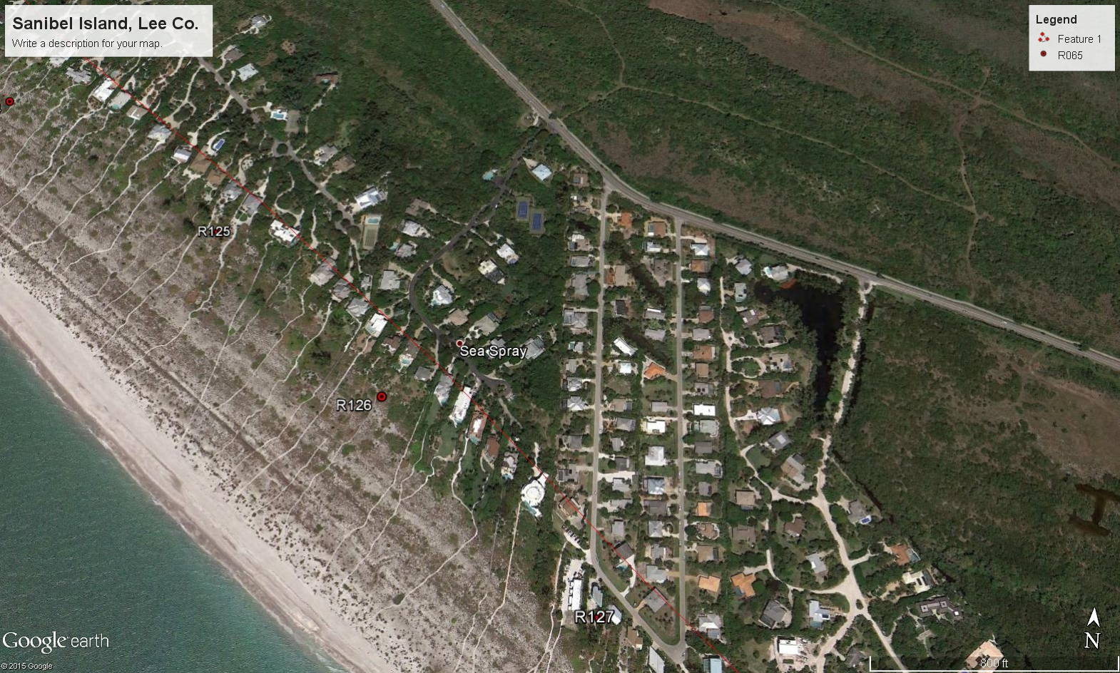
CCCL Established from Flooding

Slide 10
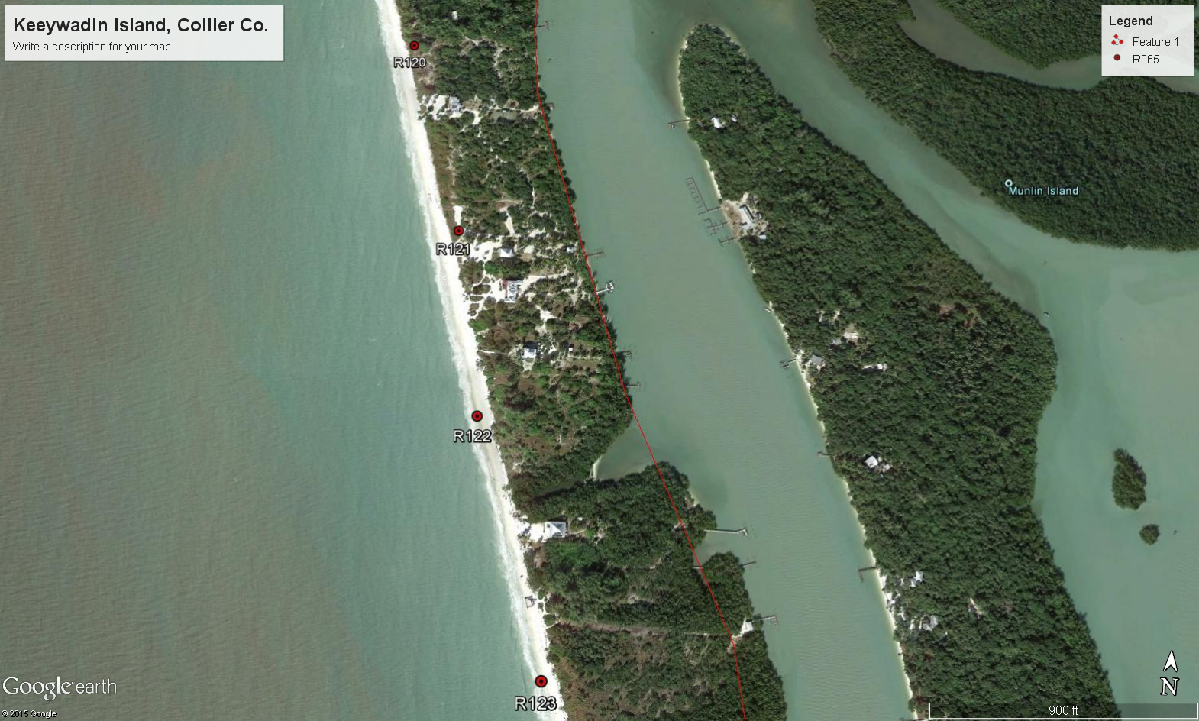
CCCL Established from Flooding

Slide 11
What are dunes
Webster – A ridge or hill of wind blown sand.
Rule 62B-33.002(17), F.A.C. - “Dune” is a mound, bluff or ridge of loose sediment, usually sand-sized sediment, lying upland of the beach and deposited by any natural or artificial mechanism, which may be bare or covered with vegetation and is subject to fluctuations in configuration and location.

Slide 12
Types of Dunes
Significant Dune - “Significant dune” is a dune which has sufficient height and configuration or vegetation to offer protective value. (Rule 62B-33.002(17), F.A.C.)
Frontal Dune - "Frontal dune" means the first natural or manmade mound or bluff of sand which is located landward of the beach and which has sufficient vegetation, height, continuity, and configuration to offer protective value. (ss. 161.053(5)(a)1., F.S.)
Primary Dune - “Primary dune” is a significant dune which has sufficient alongshore continuity to offer protective value to upland property. The primary dune may be separated from the frontal dune by an interdunal trough; however, the primary dune may be considered the frontal dune if located immediately landward of the beach. (Rule 62B-33.002(17), F.A.C.)

Slide 13
Type of Dunes cont.
Manmade Dunes -In order for a manmade frontal dune to be considered as a frontal dune defined under Section 161.053(5)(a)1., F.S., the manmade frontal dune shall be constructed to meet or exceed the protective value afforded by the natural frontal dune system in the immediate area of the subject shoreline. Prior to the issuance of a permit for a single-family dwelling meeting the criteria of Section 161.053(5)(c), F.S., the manmade frontal dune must be maintained for a minimum of 12 months and be demonstrated to be as stable and sustainable as the natural frontal dune system. (Rule 62B-33.005(5), F.A.C.)
Other Dunes – Affords little or no protective value, or are a part of the uplands

Slide 14

SIGNIFICANT DUNES

Slide 15
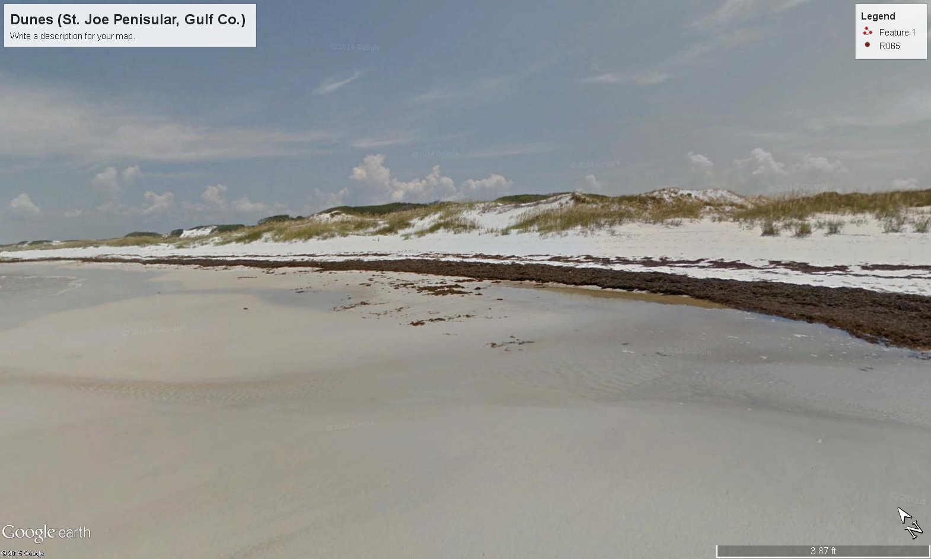
Significant Dune d) Natural

Slide 16
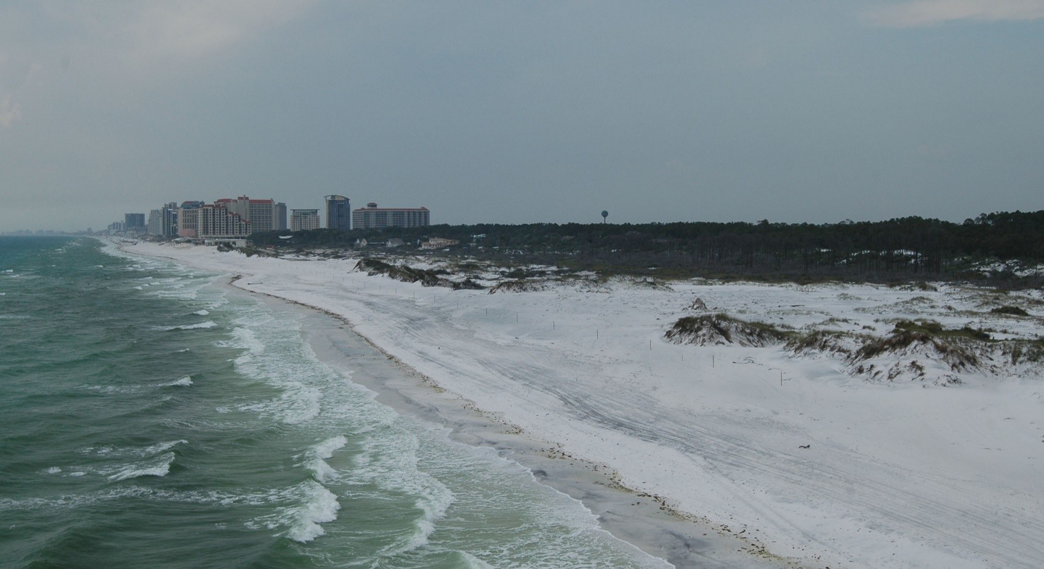
Significant Dunes
breach
dunes
nearshore
beach berm

Slide 17
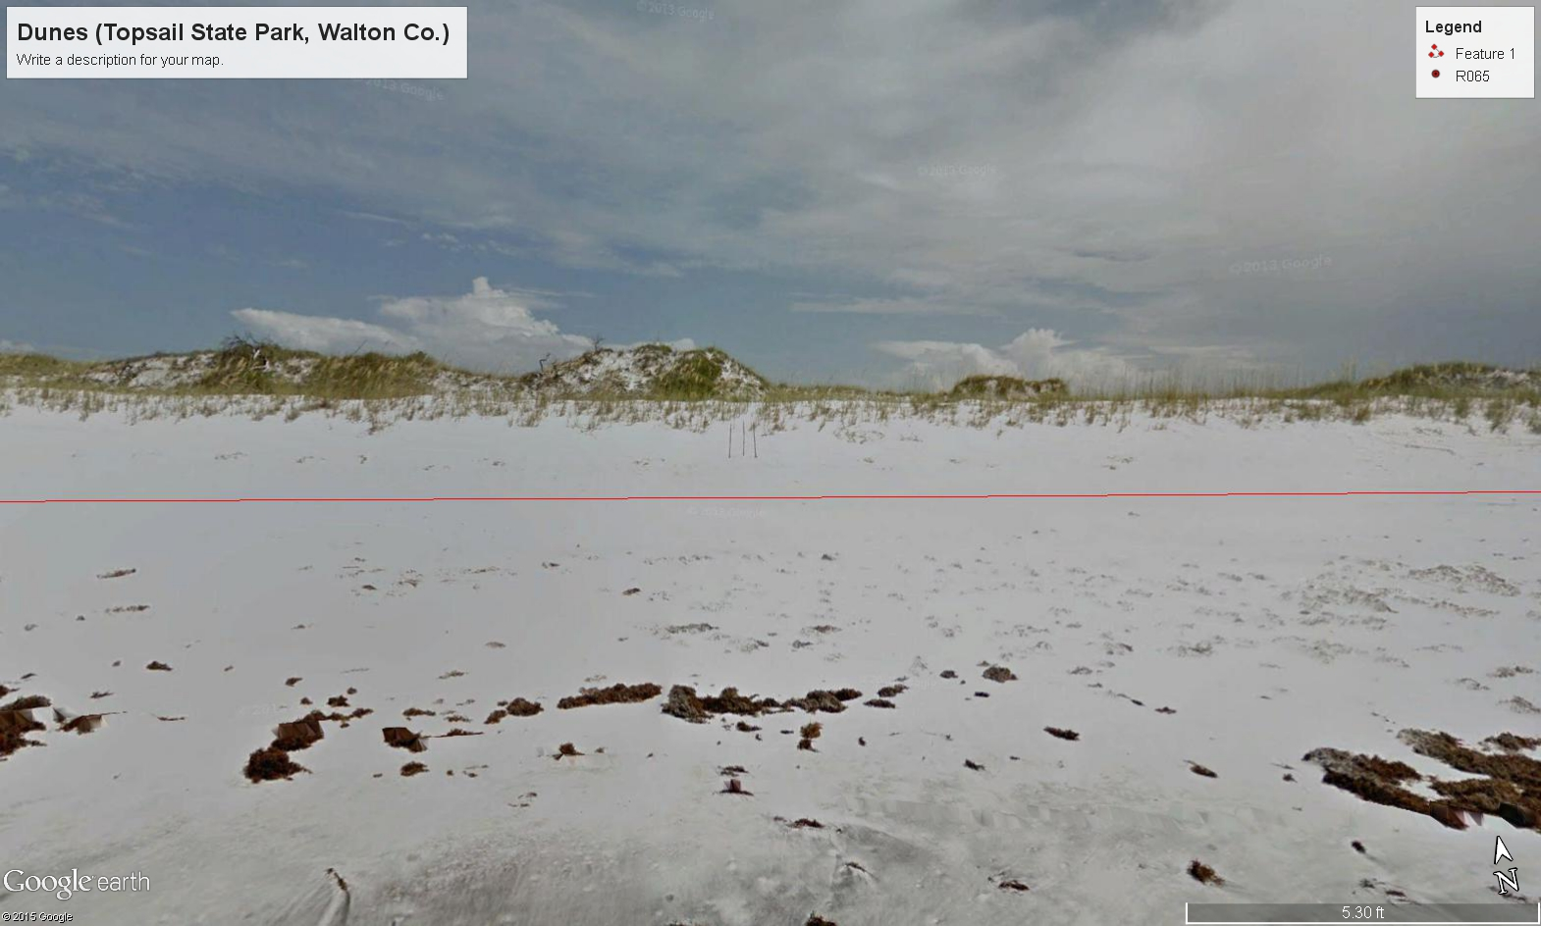
Significant Dune

Slide 18
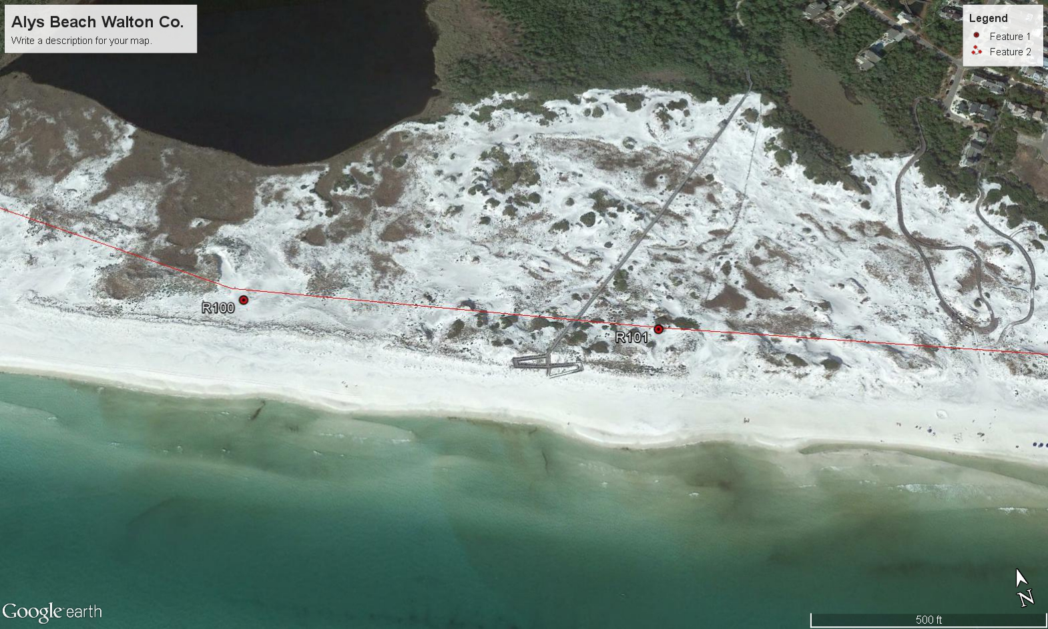
Frontal Dune (Mound) Natural

Slide 19
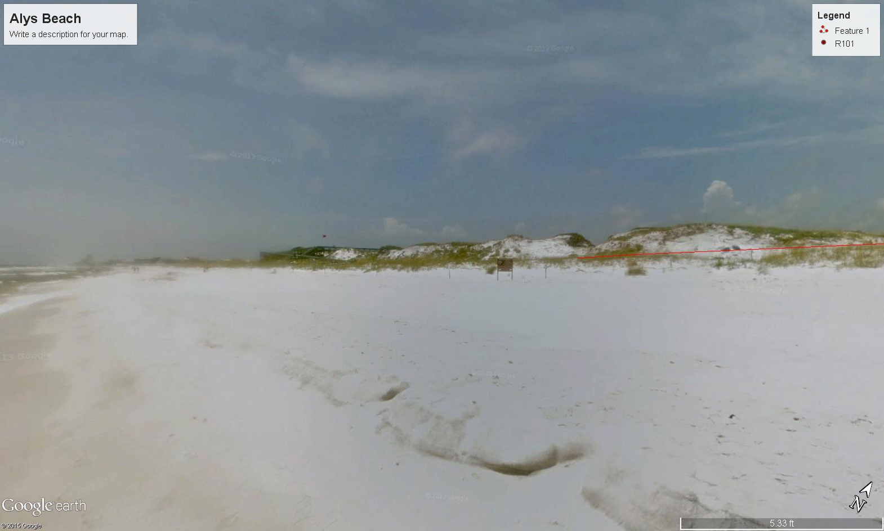
Frontal Dune (Mound) Natural

Slide 20
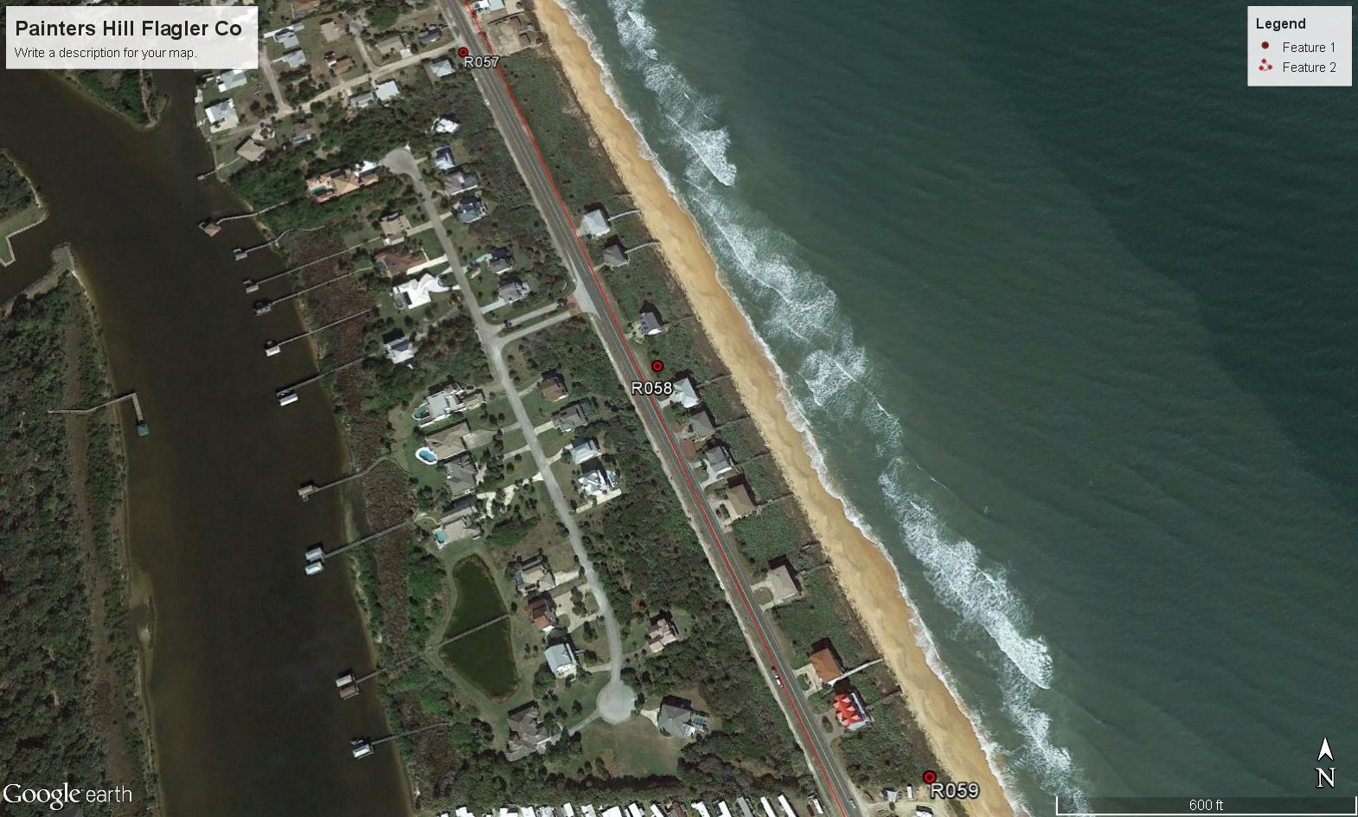
Frontal Dune (Bluff) Natural

Slide 21
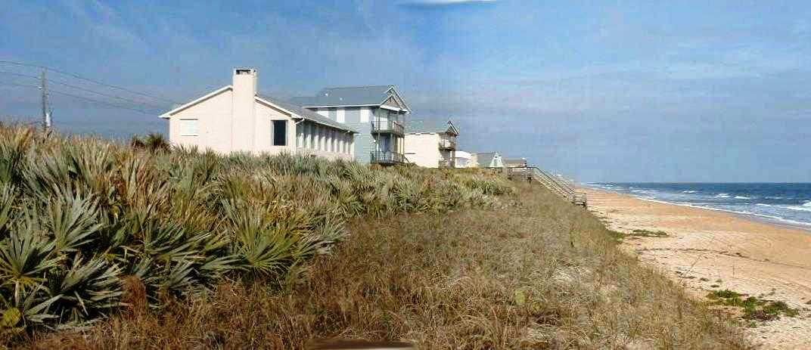
Frontal Dune (Bluff) Natural

Slide 22
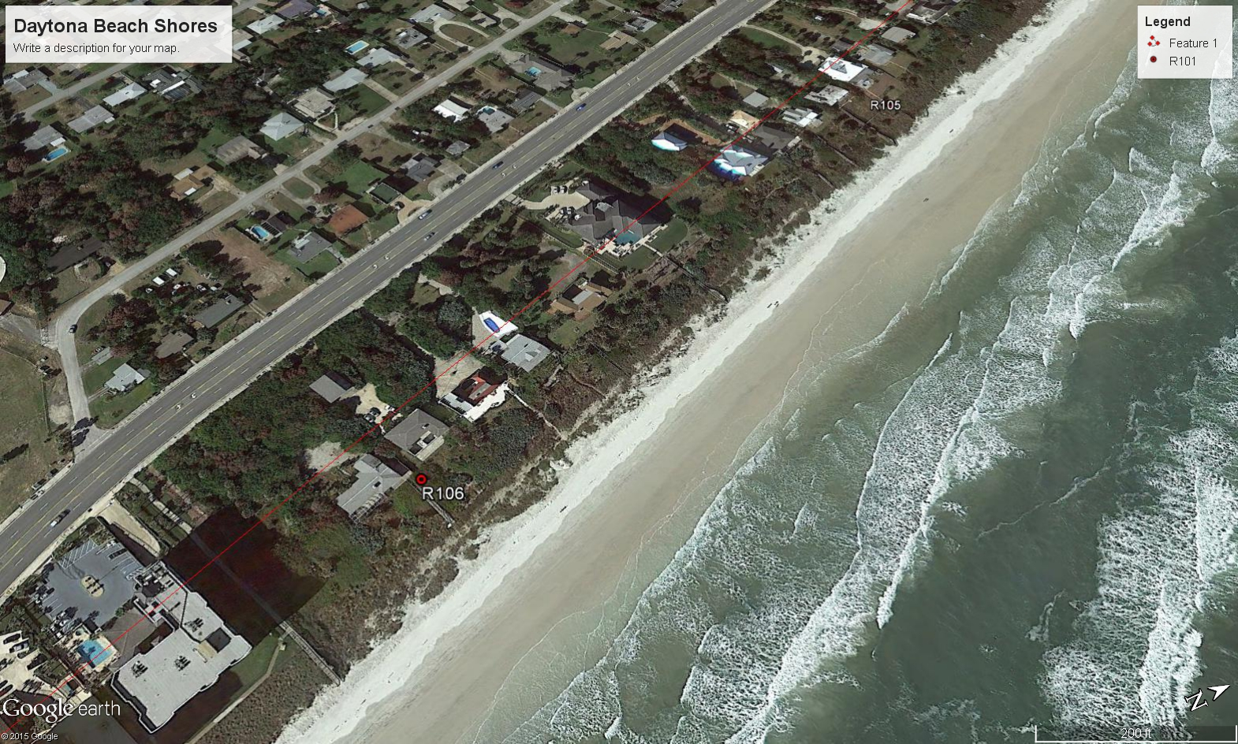
Primary Dune and Frontal Dune

Slide 23
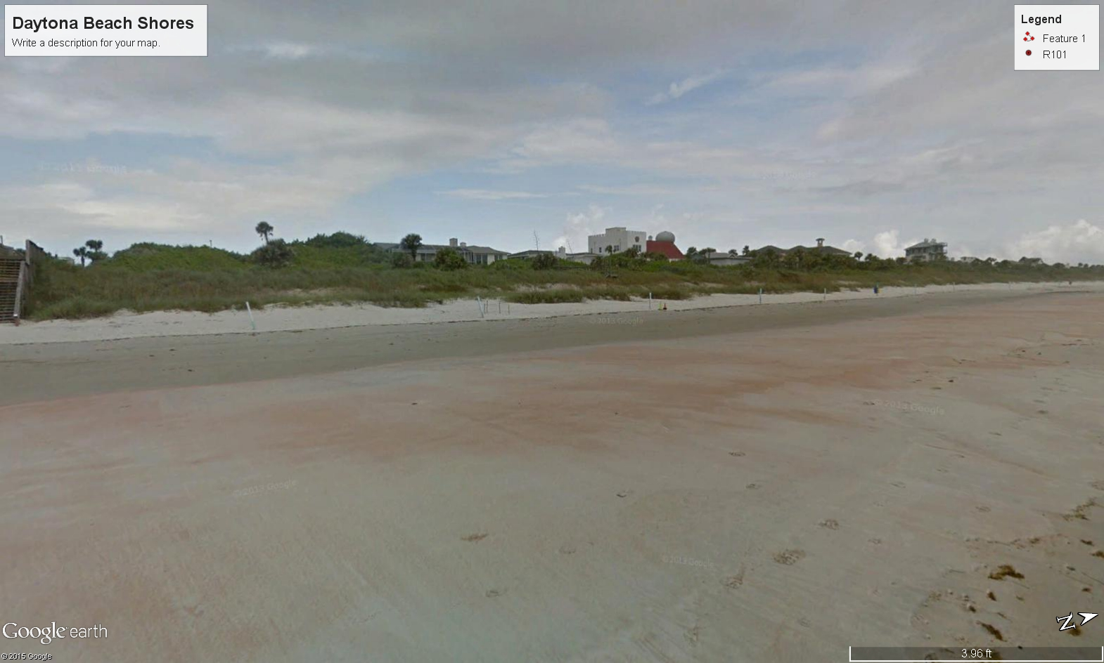
Primary Dune and Frontal Dune

Slide 24
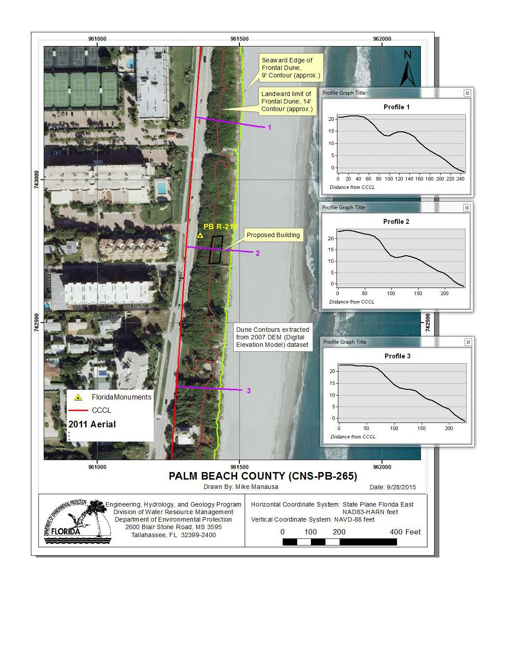
Primary Dune and Frontal Dune

Slide 25
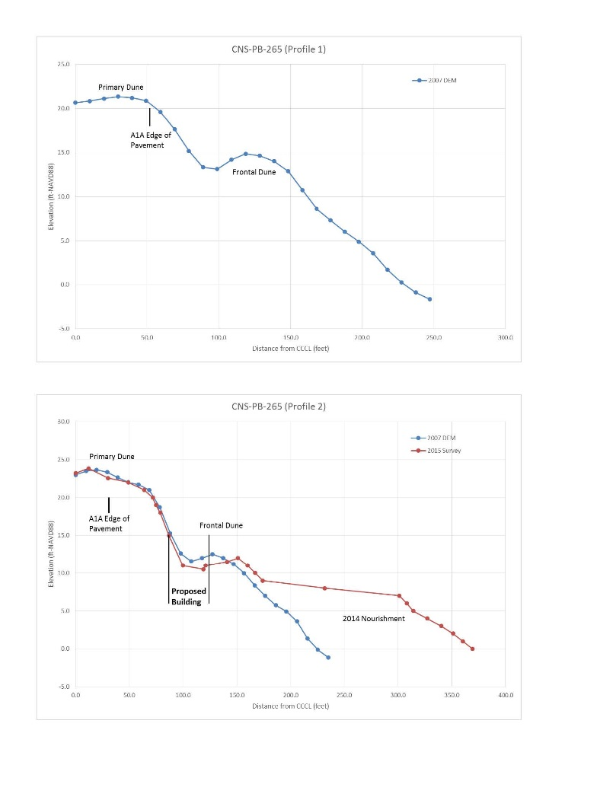
Primary Dune and Frontal Dune

Slide 26
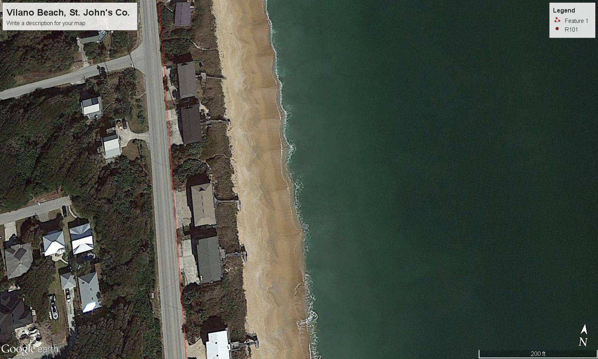
Primary/Frontal Dune

Slide 27
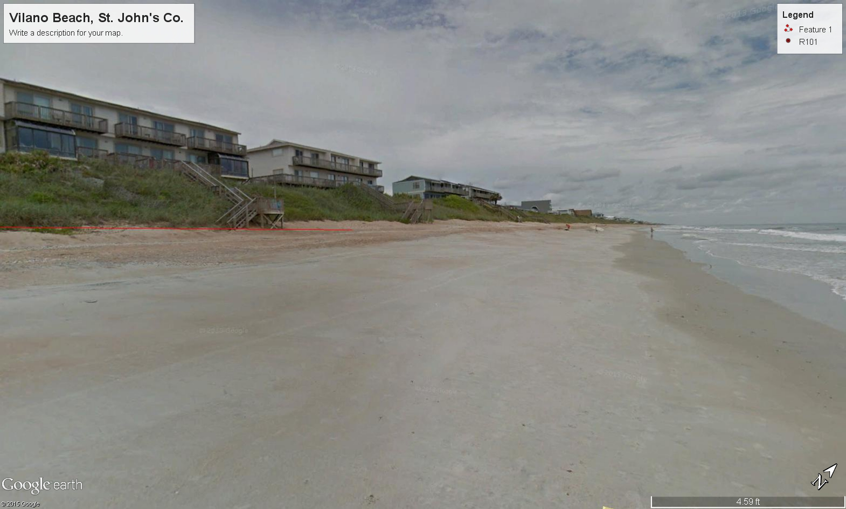
Primary/Frontal Dune

Slide 28
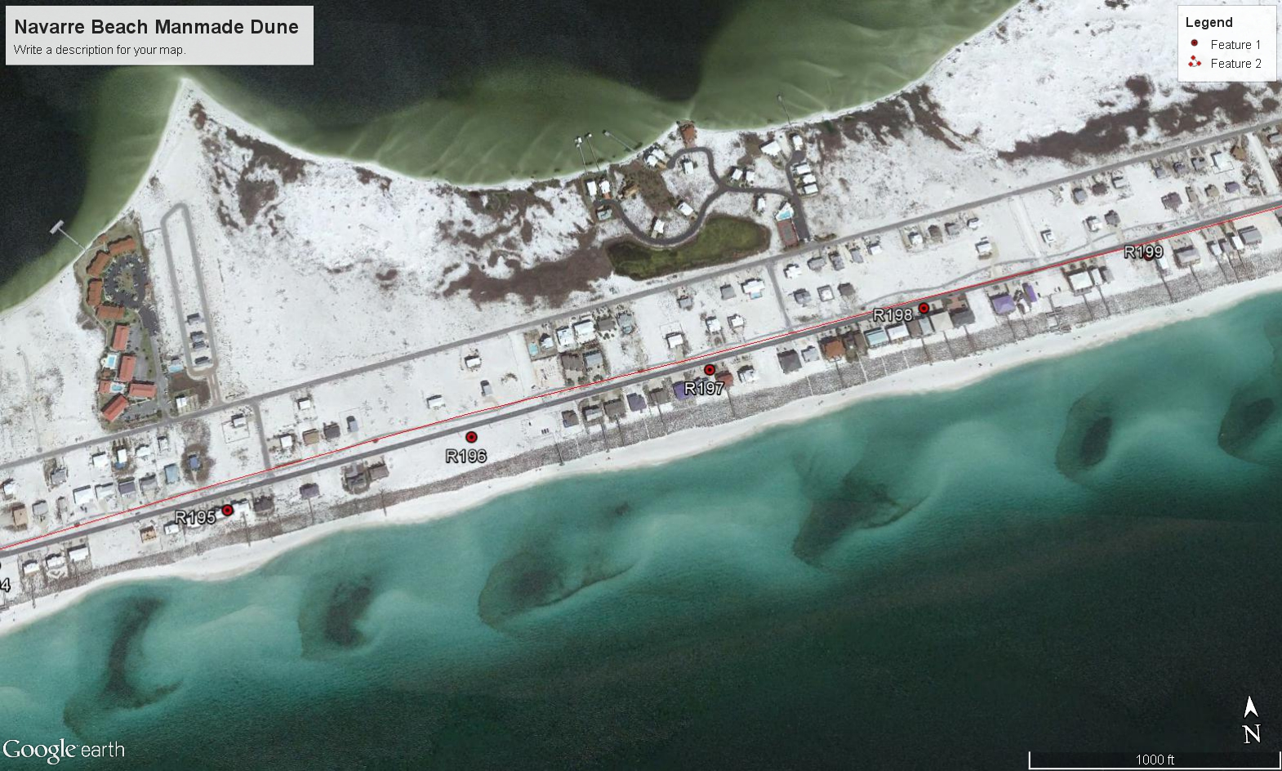
Manmade Frontal Dune (Mound)

Slide 29
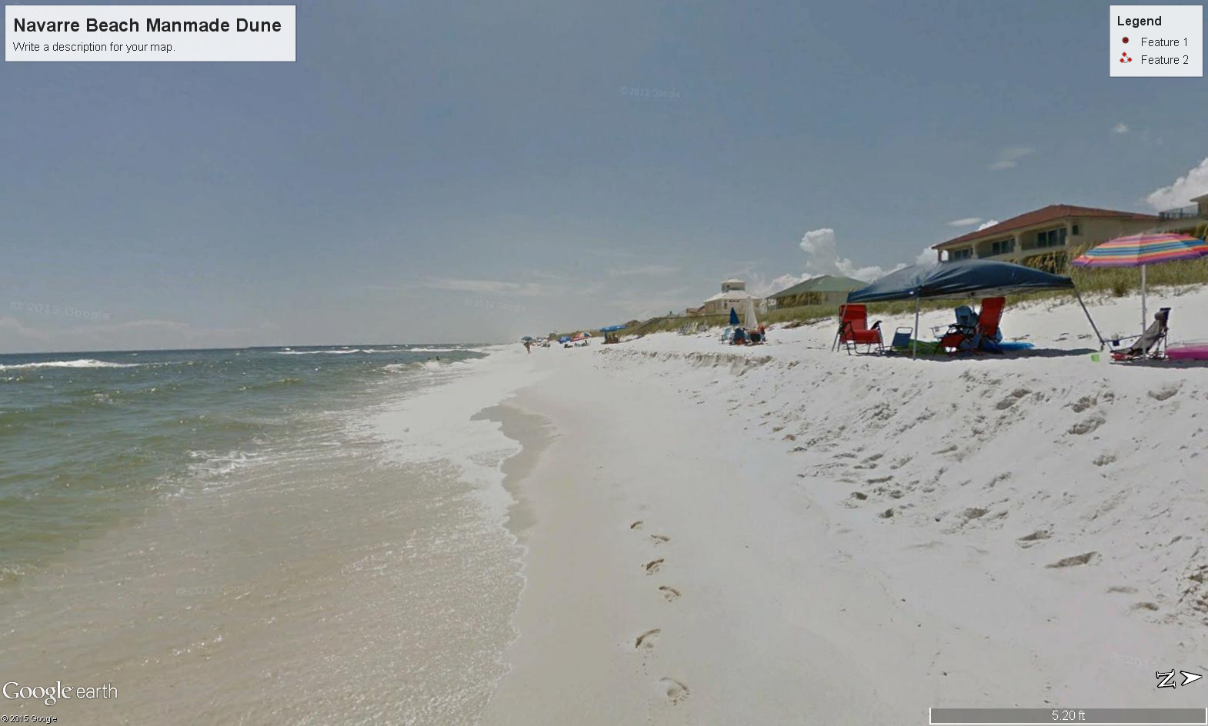
Manmade Frontal Dune (Mound)

Slide 30
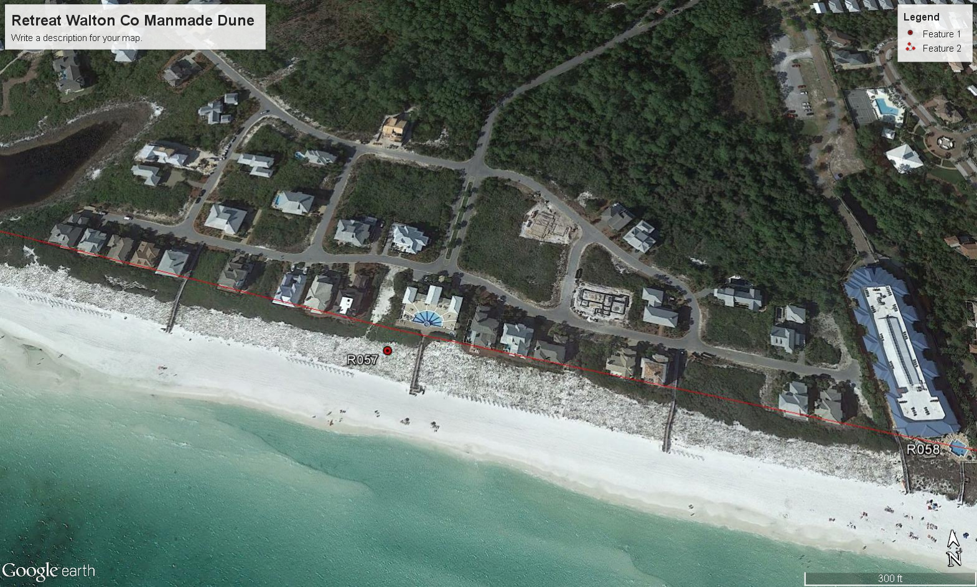
Manmade Frontal Dune (Bluff)

Slide 31
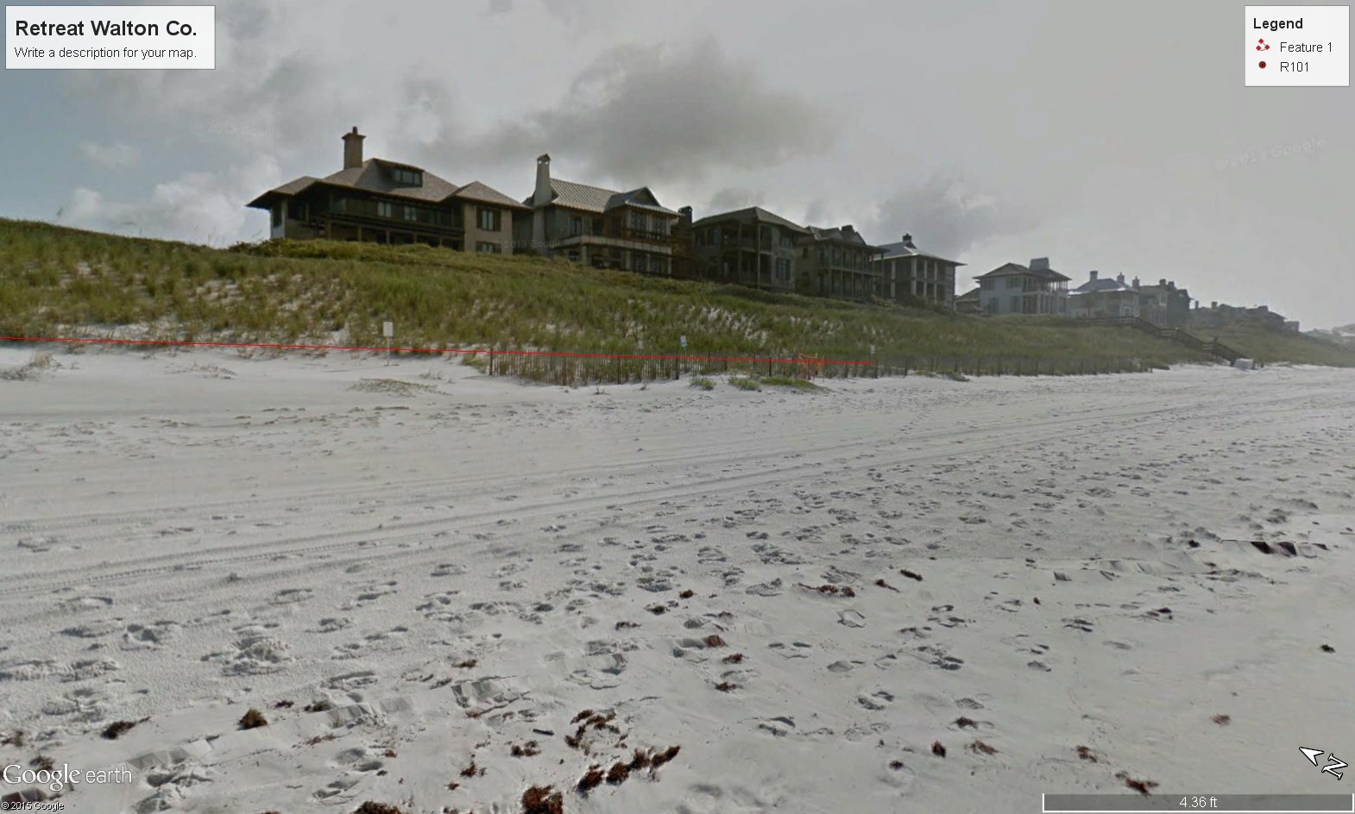
Manmade Frontal Dune (Bluff)

Slide 32
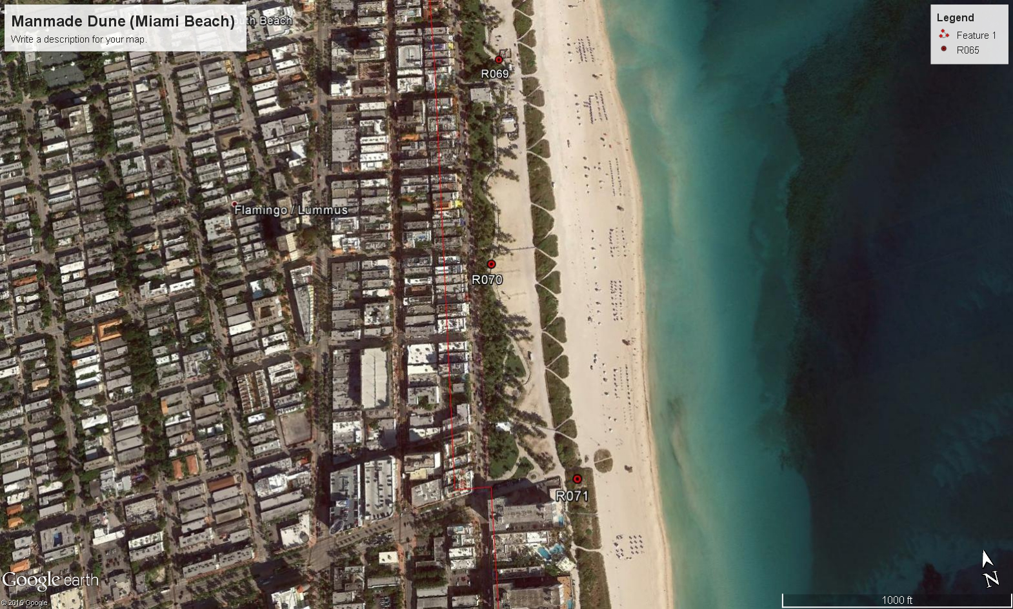
Manmade Dune

Slide 33
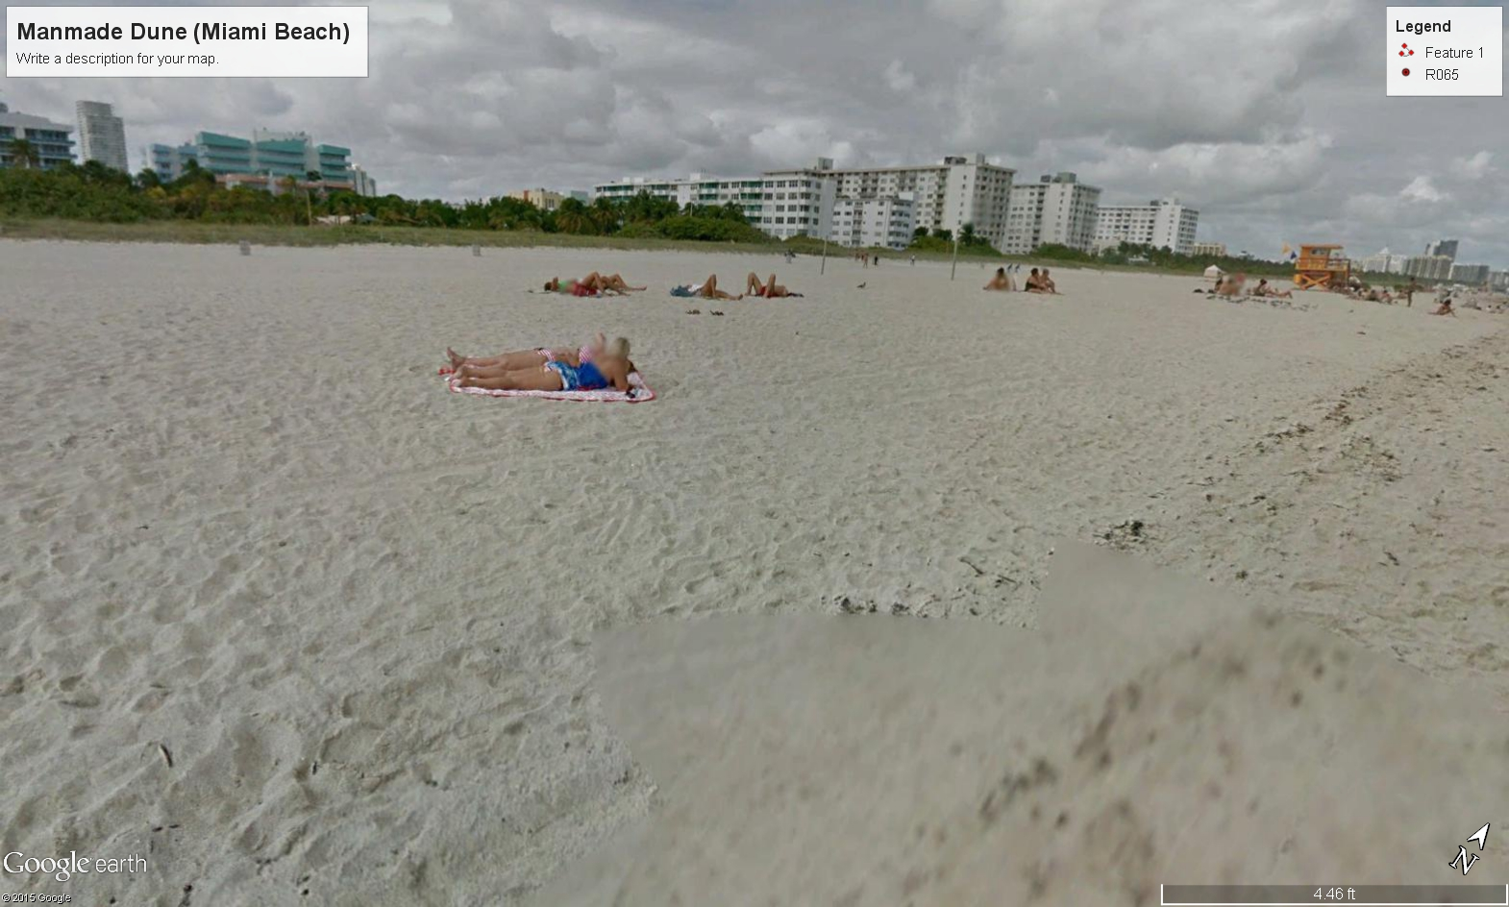
Manmade Dune

Slide 34
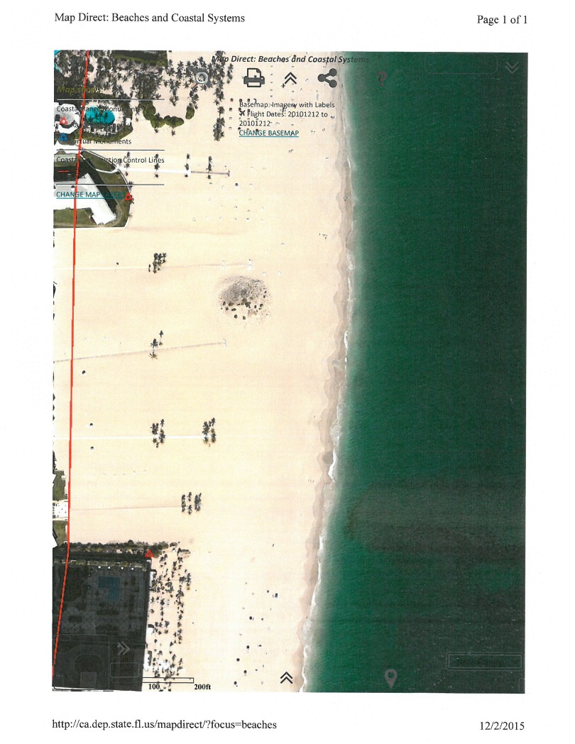
Other Dunes

Slide 35
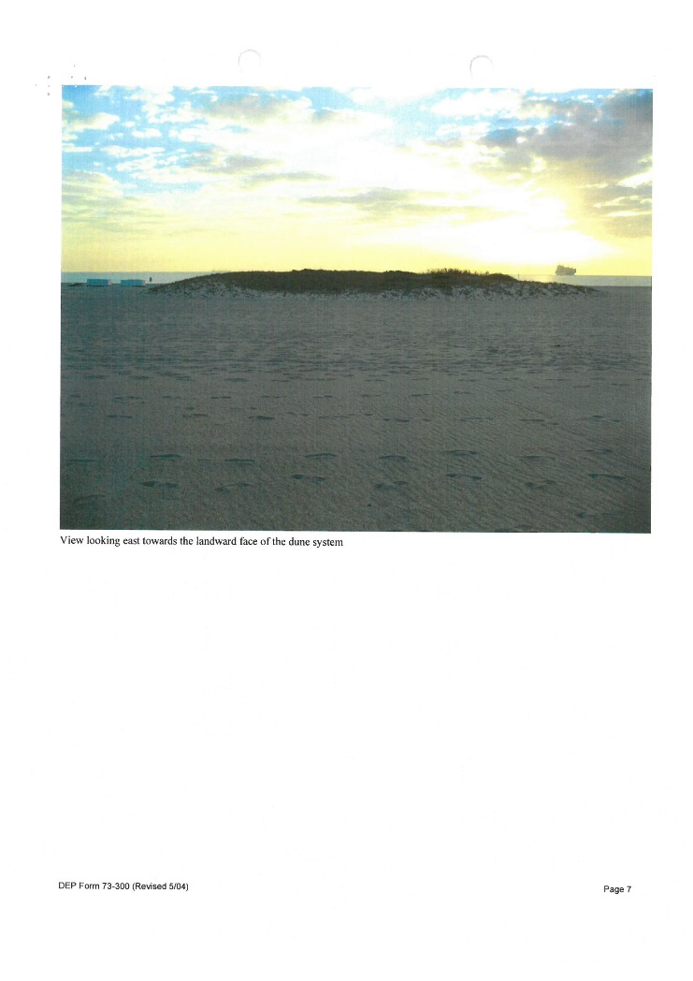
Other Dunes cont.

Slide 36
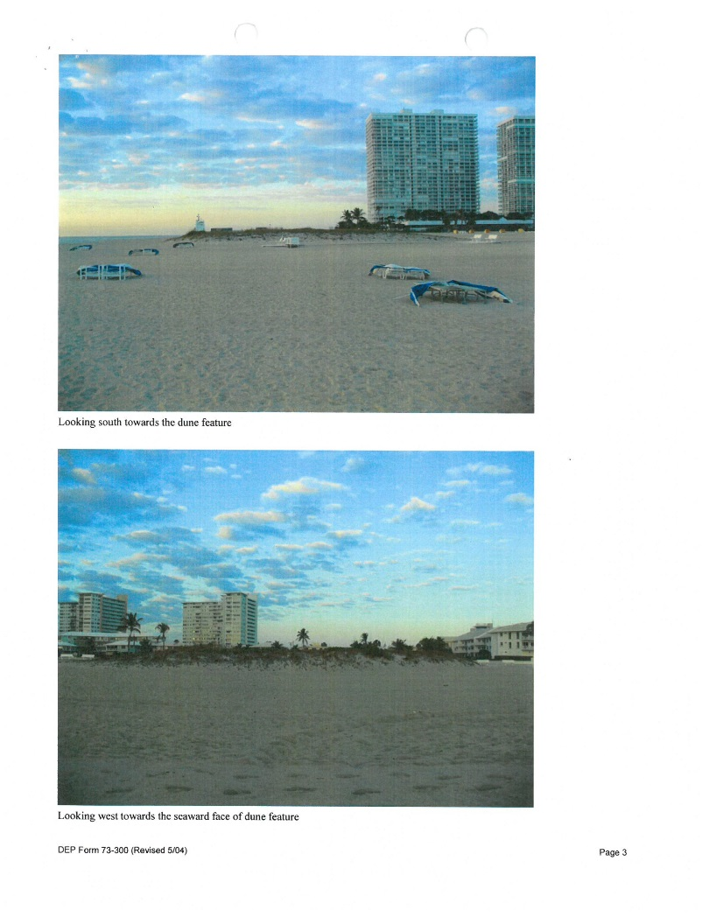
Other Dunes cont.

Slide 37
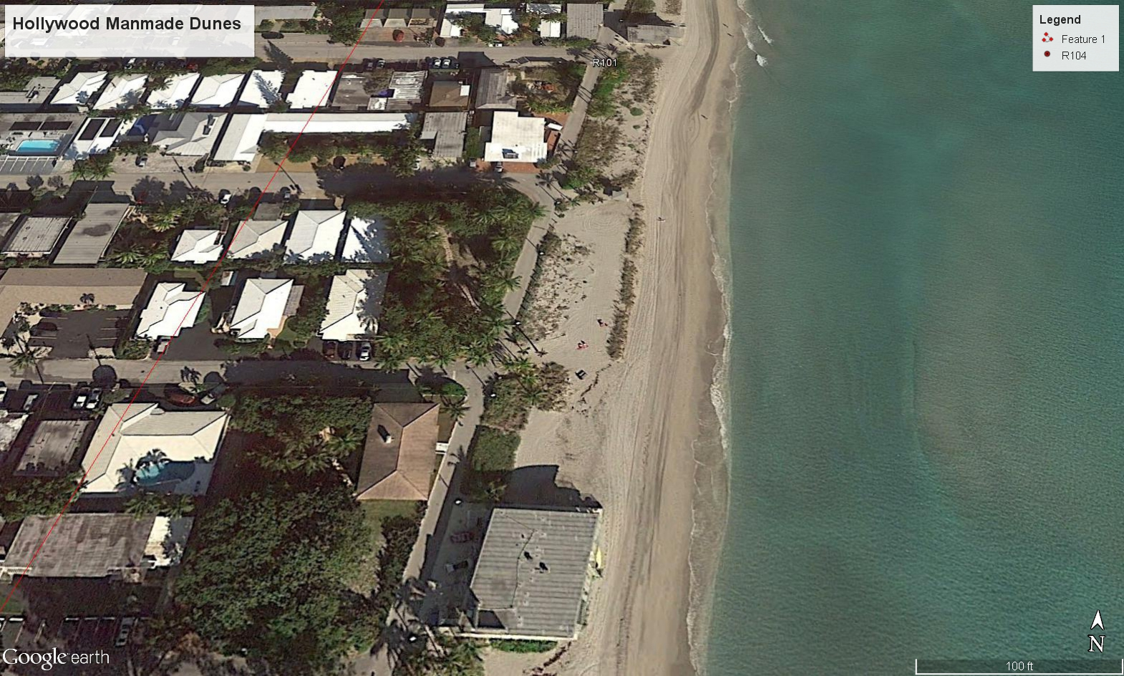
Other Dunes cont.

Slide 38
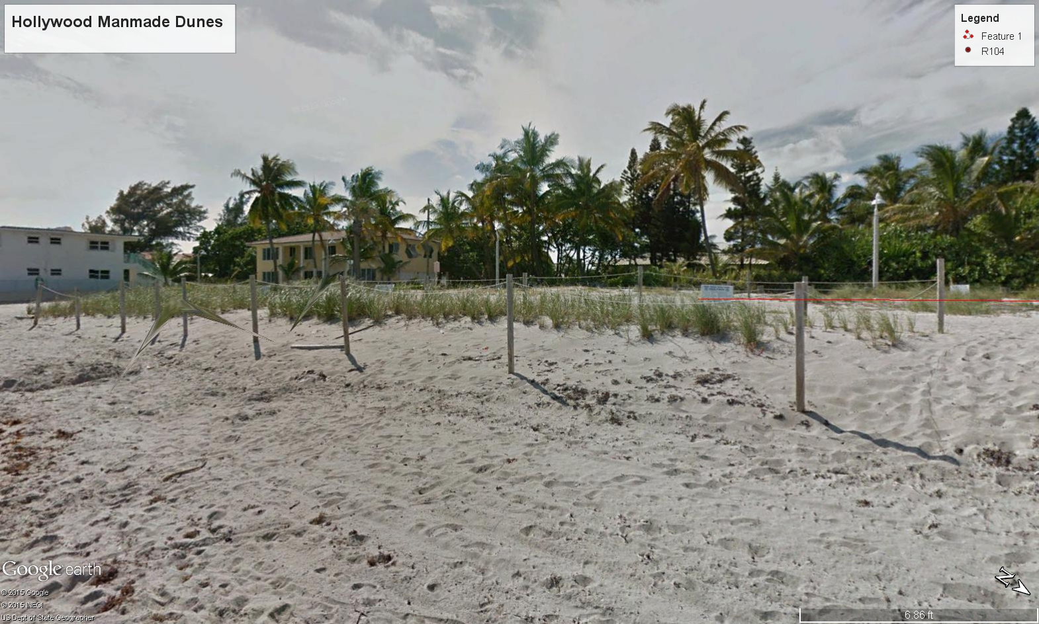
Other Dunes cont.

Slide 39
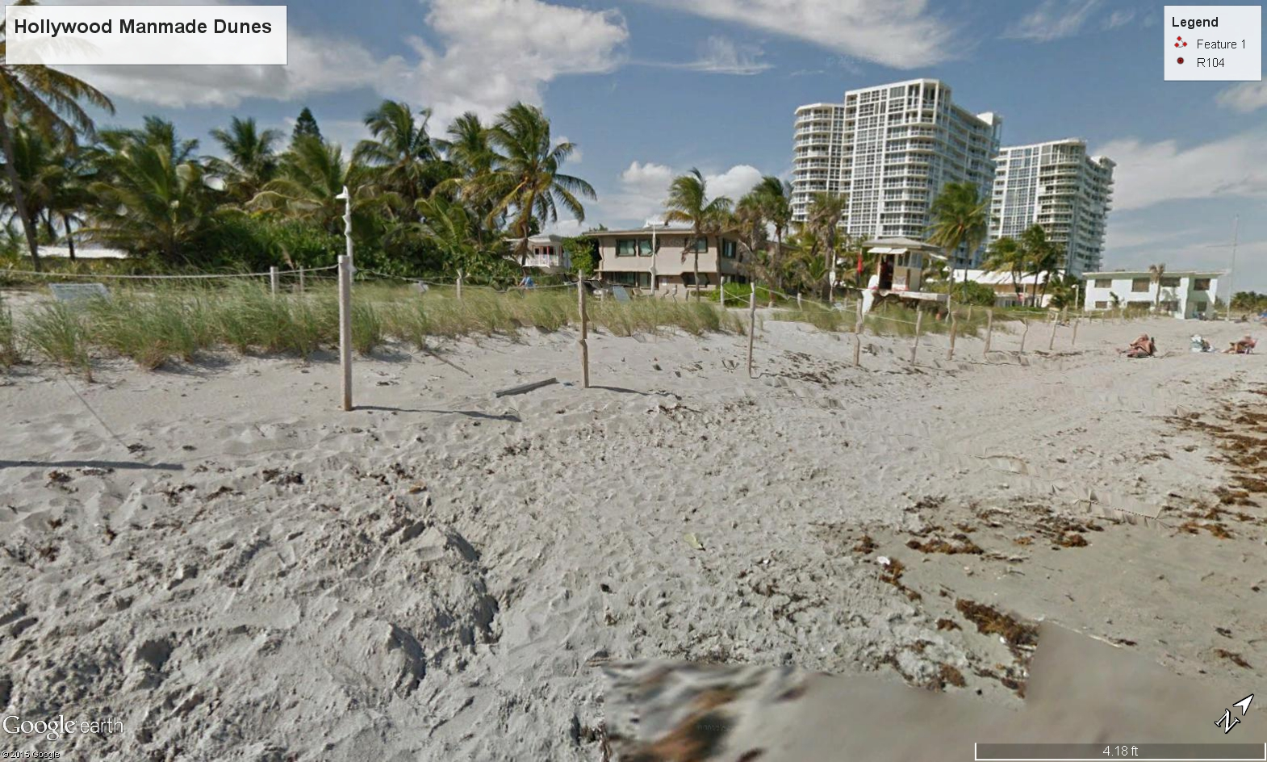
Other Dunes cont.

Slide 40
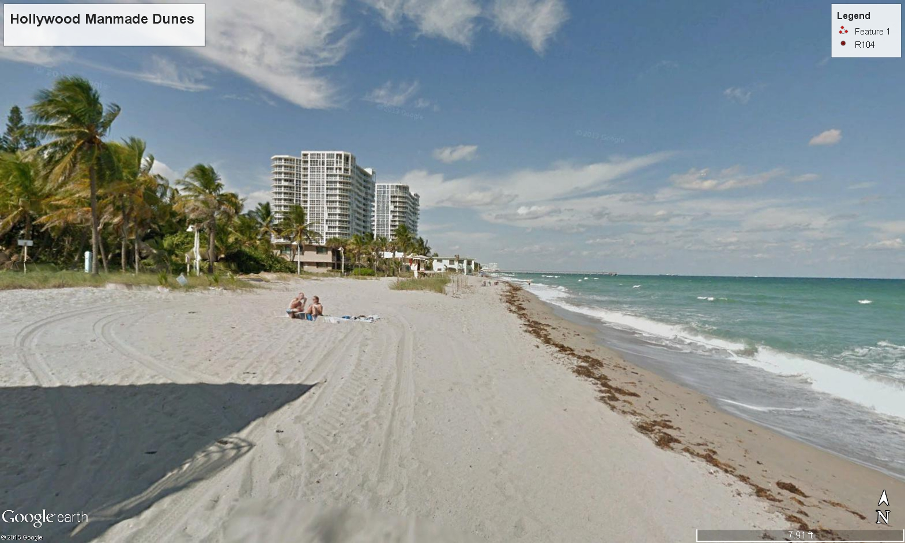
Other Dunes cont.

Slide 41
Dune Diversity and Protection Value
Low Dunes – <10’ Affords protection against frequent storms
(Generally in SW Florida)
Medium Dunes – 10’ – 20’ Affords protection against moderate storms
(Generally in Middle East Coast, Franklin, Okaloosa, Broward and Dade Co.)
High Dunes – Greater than 20’ Affords protection against major storms/hurricanes
(Generally in NE Fla, Palm Beach, Walton, and Parts of Bay and Gulf Co.)

Slide 42
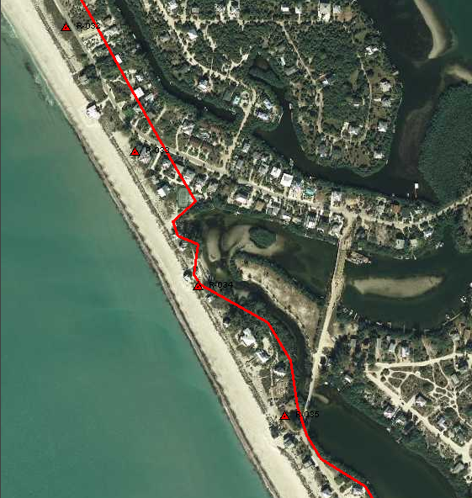
Low Dunes < 10’

Slide 43
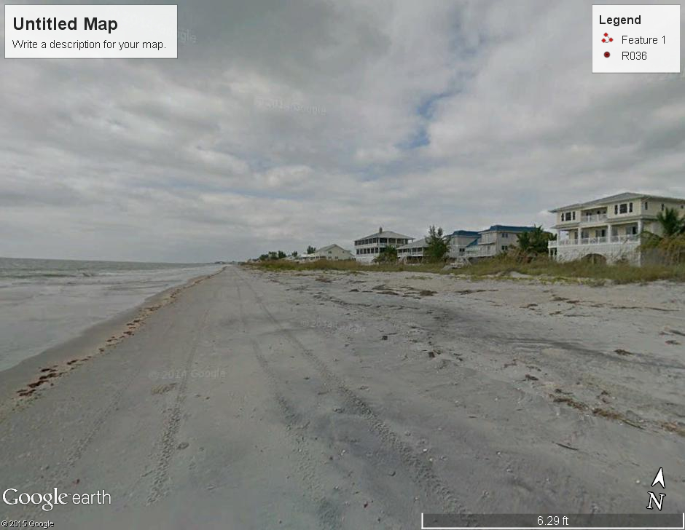
Low Dunes < 10’

Slide 44
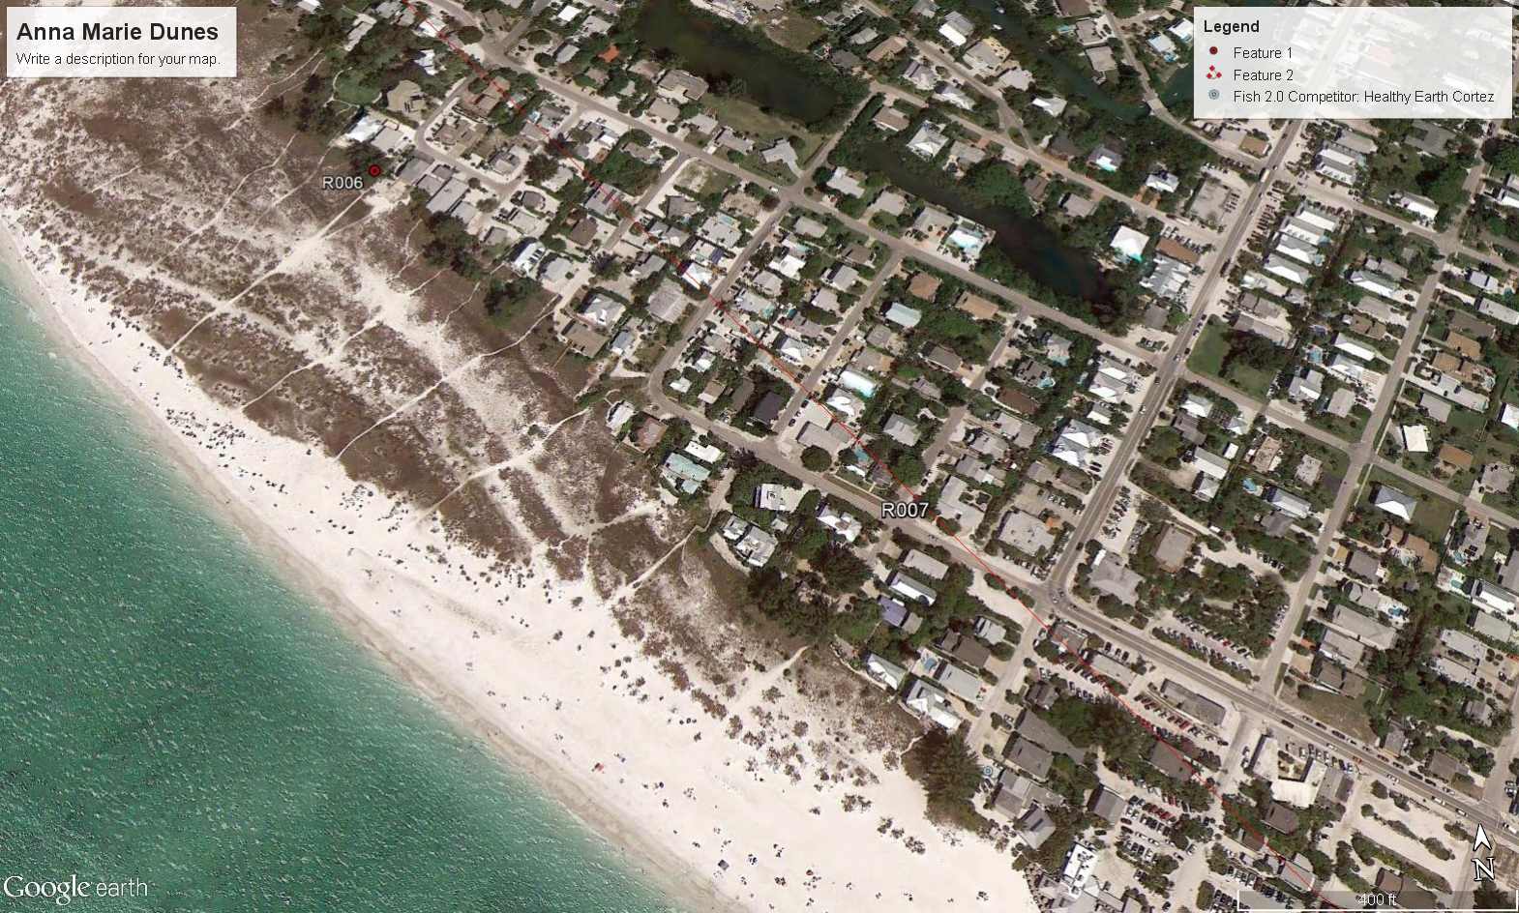
Low Dunes <10’

Slide 45
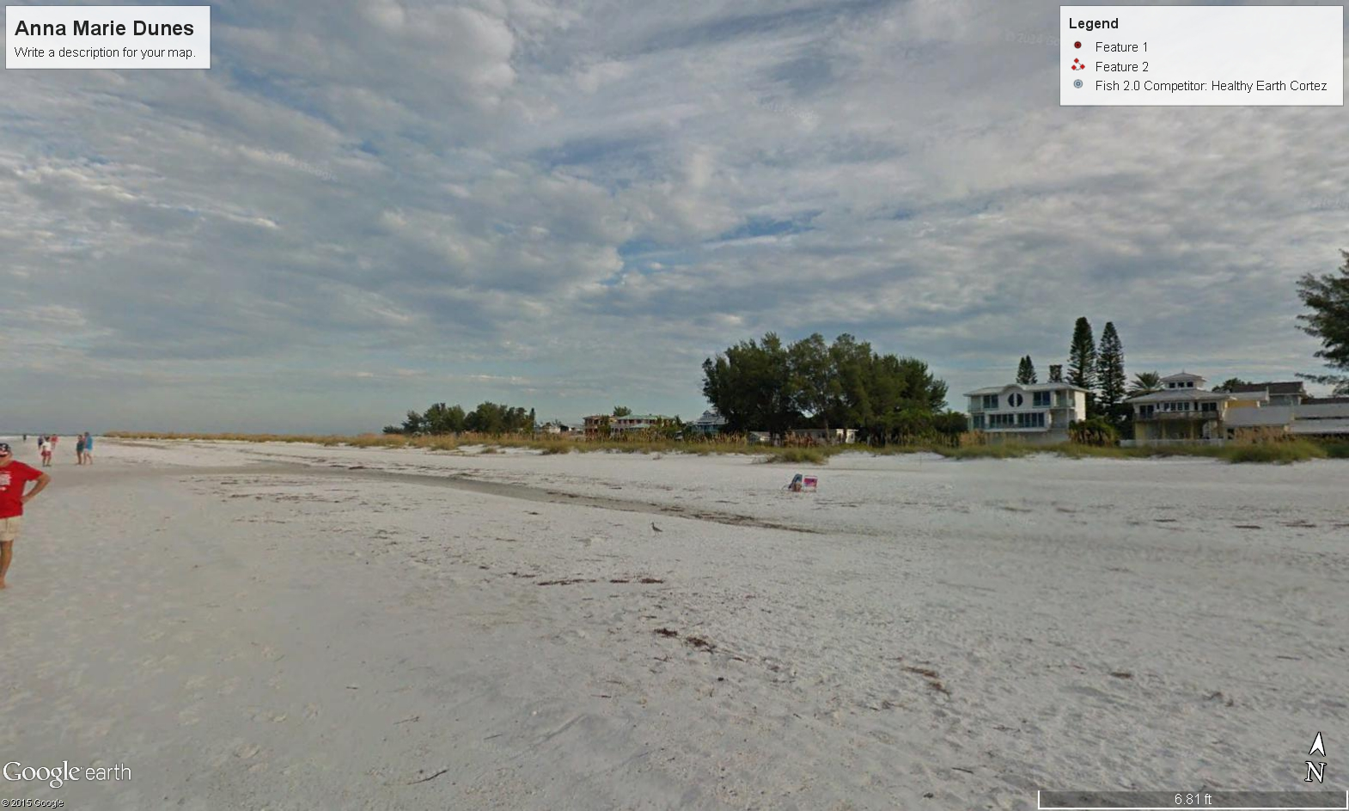
Low Dunes <10’

Slide 46
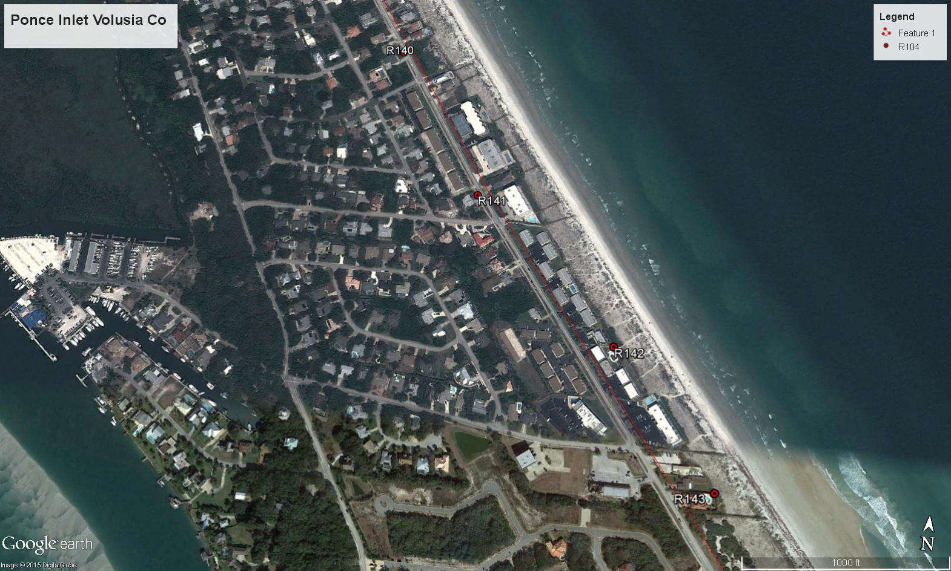
Medium Dunes 10’-20’

Slide 47
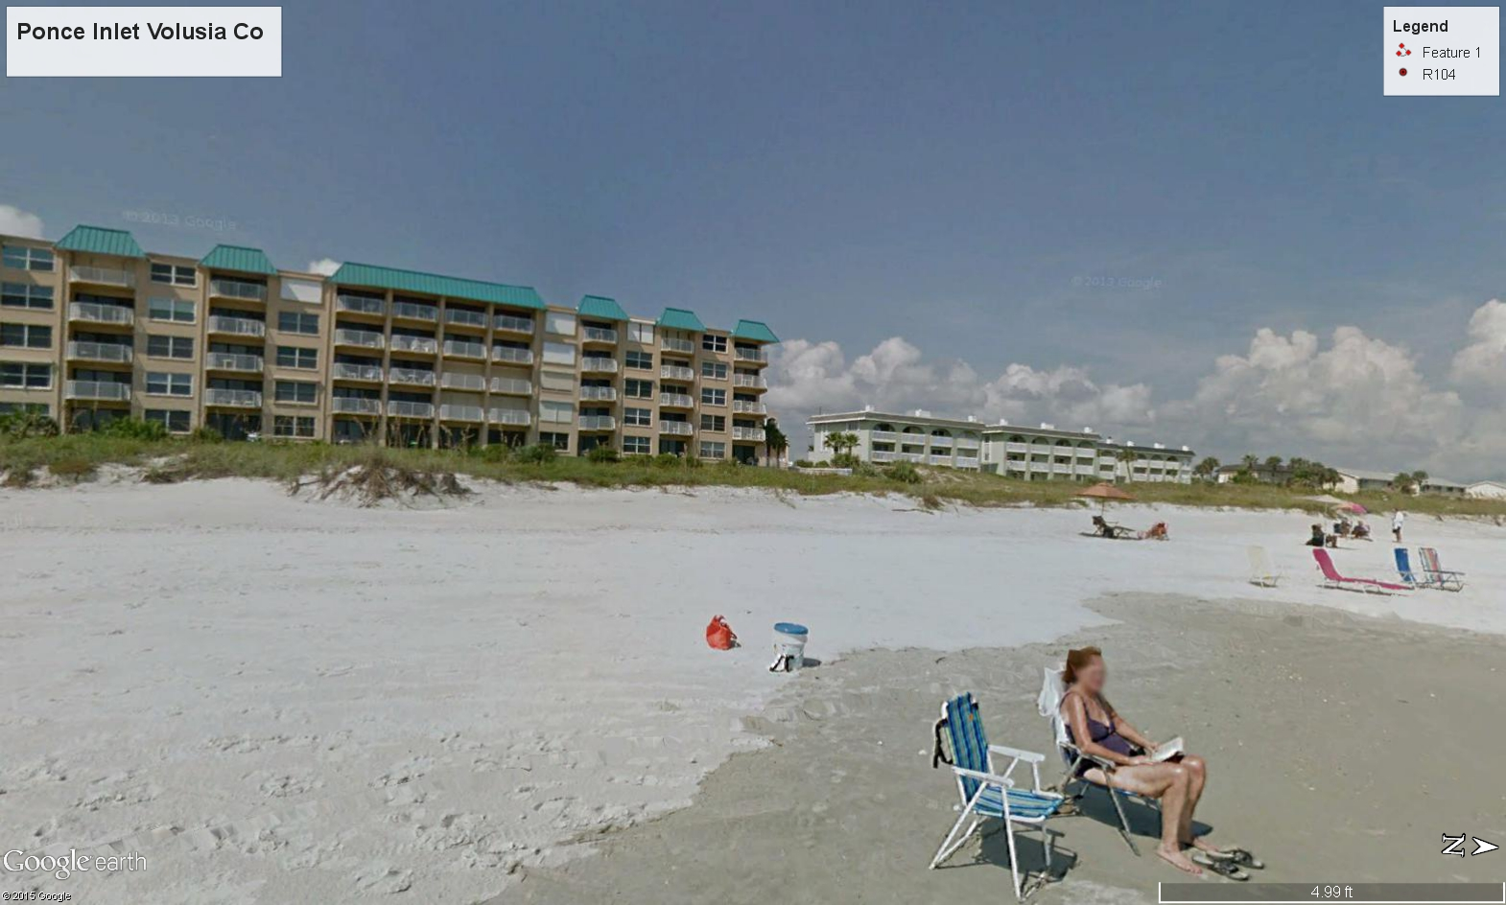
Medium Dunes 10’-20’

Slide 48
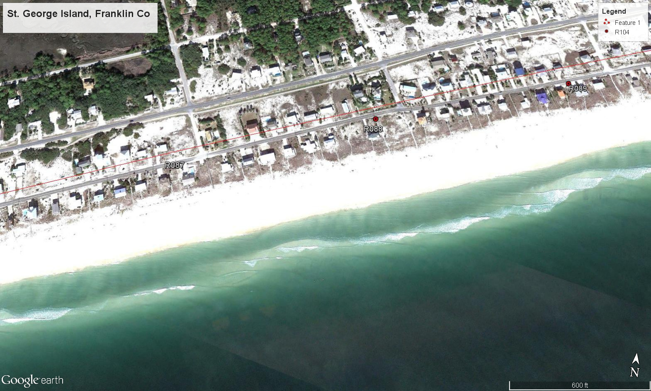
Medium Dunes 10’-20’

Slide 49
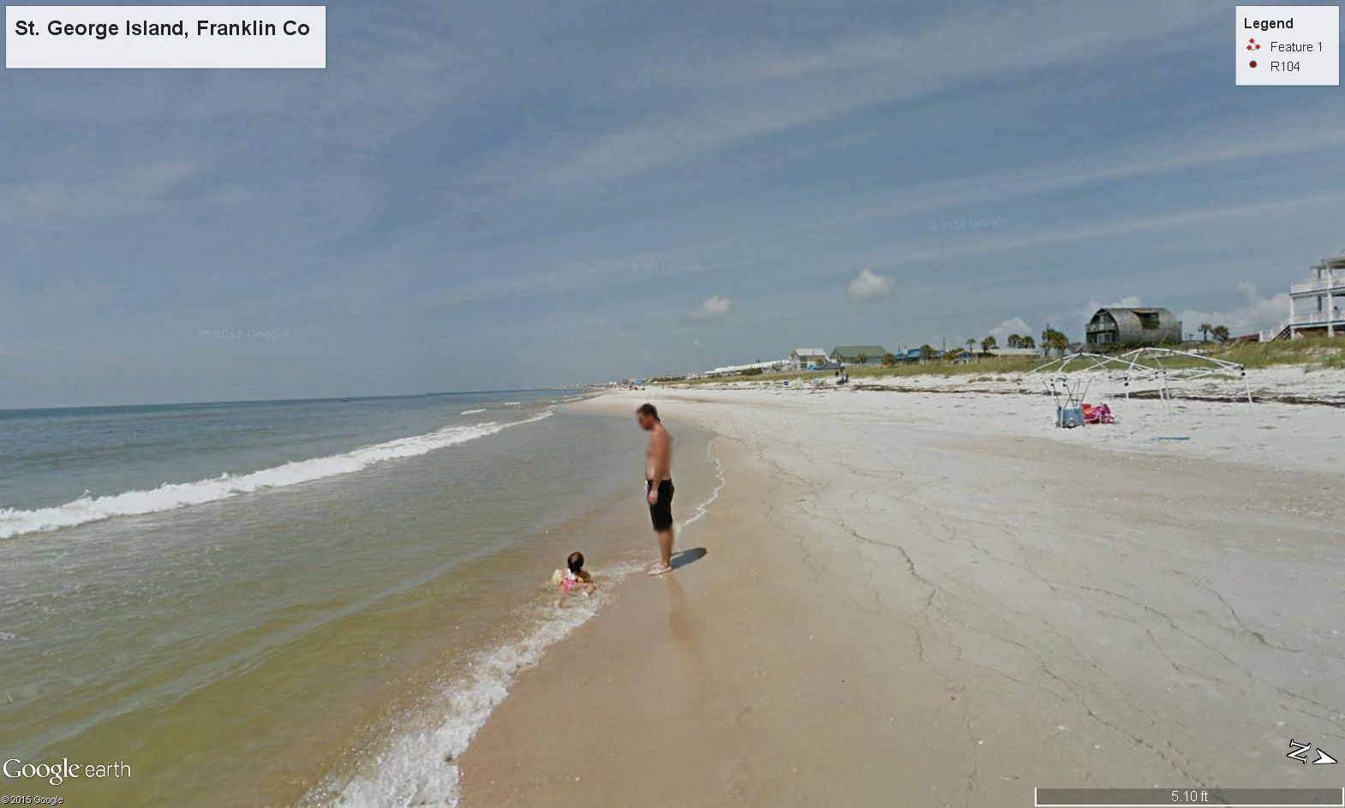
Medium Dunes 10’-20’

Slide 50
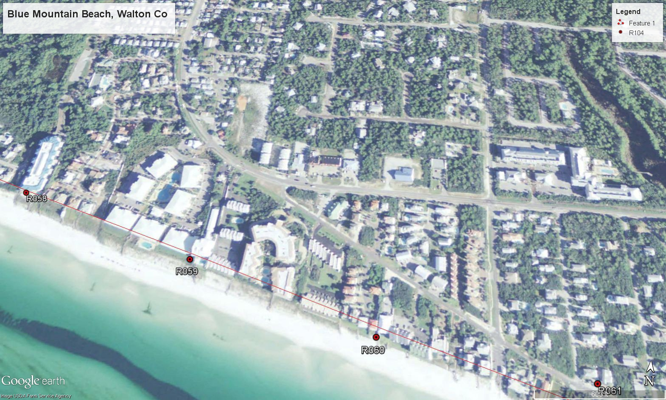
High Dunes >20’

Slide 51
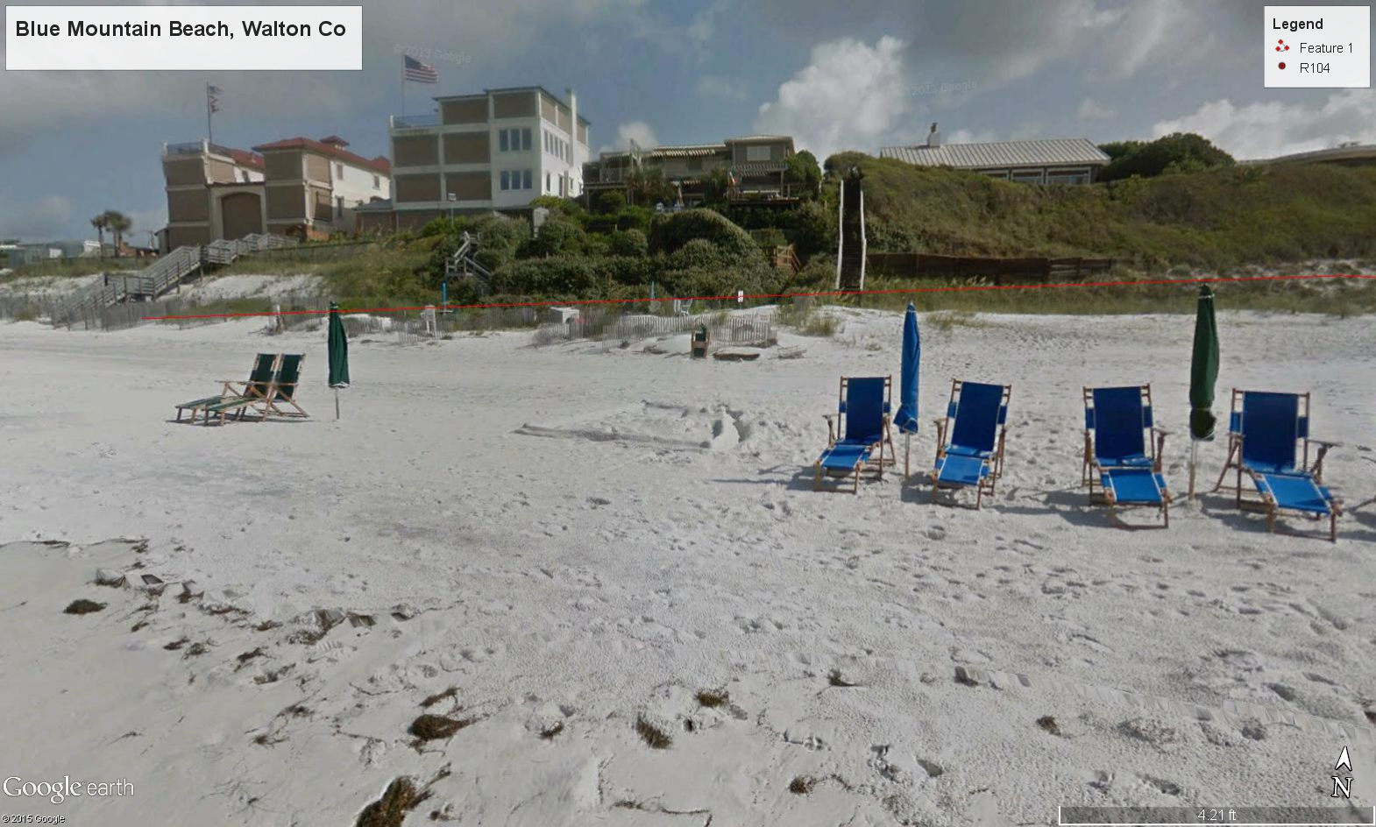
High Dunes >20’

Slide 52
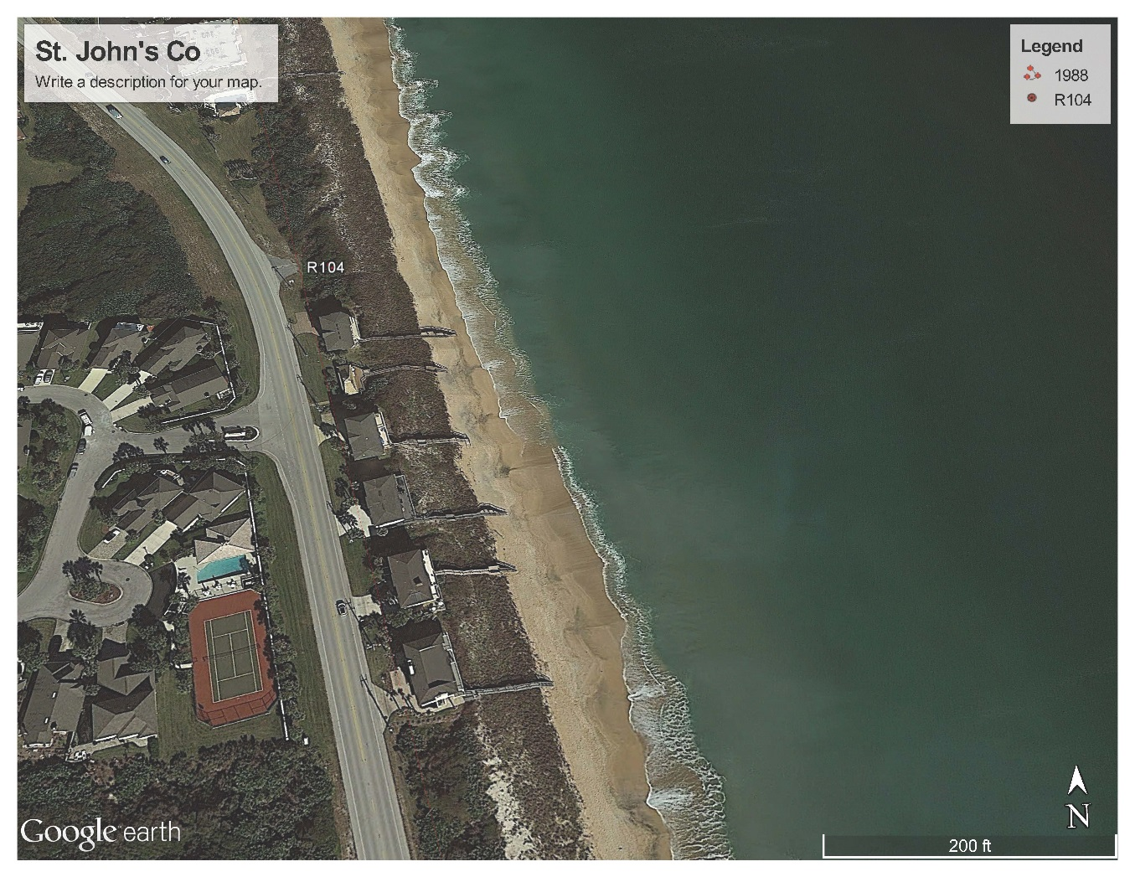
High Dunes >20’

Slide 53
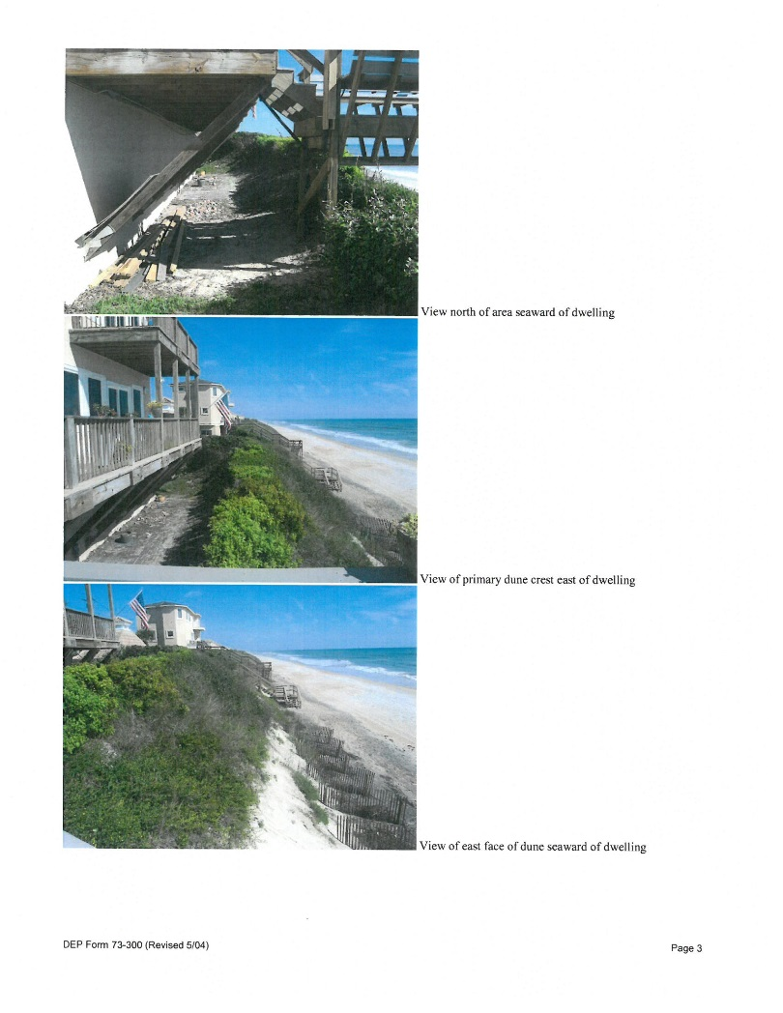
High Dunes >20’

Slide 54
Impact Assessment/Dune Description
II. CHARACTERIZATION OF BEACH/DUNE SYSTEM
A. General Description:
B. Beach Topography:
1. Shoreline alignment:
    2. Berm width: feet.
  3. Berm elevation: feet (NAVD).
C. Frontal Dune/Bluff Topography:
    1. Dune width: feet.
  2. Dune crest elevation: + feet (NAVD).
  3. Crest Location relative to control line: feet seaward.
  4. Landward toe location relative to control line: feet seaward.
    5. Existing vegetation:
6. General conditions:

Slide 55
Impact Assessment/Dune Description cont.
D. Primary Dune/Bluff Topography:
1. Dune width: feet.
2. Dune crest elevation: + feet (NAVD).
3. Crest Location relative to control line: feet seaward.
4. Landward toe location relative to control line: feet seaward.
5. Existing vegetation:
6. General conditions:
E. Secondary Dunes/Upland Coast Topography:
1. General conditions:
2. Average topographic elevation: feet (NAVD).
3. Existing vegetation:

Slide 56
Dune Protective Value
Protective Value - “Protective Value” is the measurable protection level afforded by the dune system to upland property and structures from the predictable erosion and storm surge levels associated with coastal storm events. (Rule 62B-33.002, F.A.C.)
Protects against Erosion – Determined from modeling
Protects against Flooding – Determined from published surge levels and modeling

Slide 57
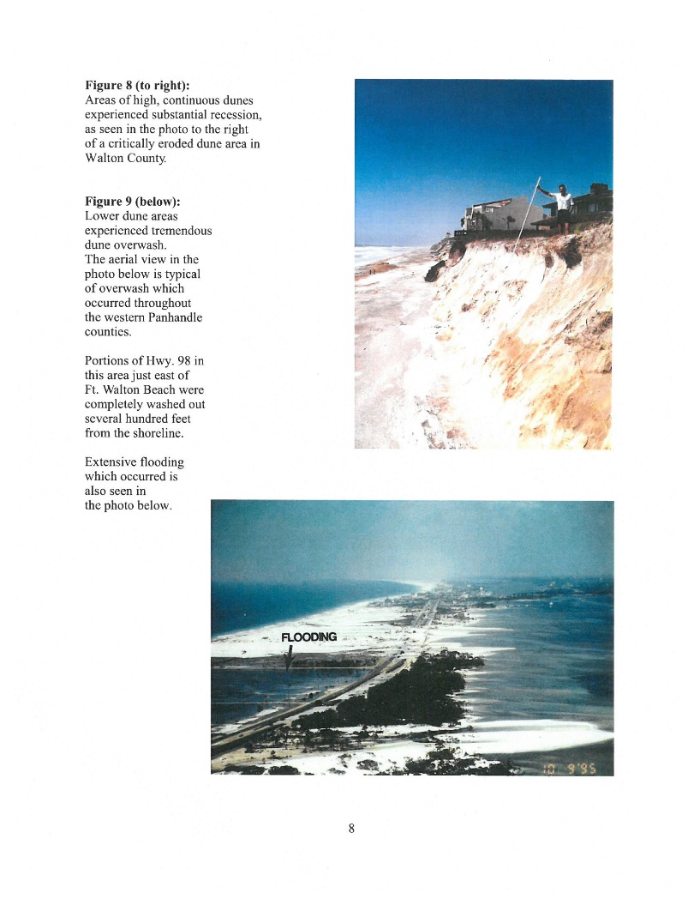
Erosion and Flooding

Slide 58
Erosion Protection
Dunes protect upland property and structures from erosion caused by coastal storms.
Erosion limits determined by numerical modeling for storms up to 100-year storm event.
Eroded dune mass can be deposited either upland from over wash or across the beach and offshore in sand bar.
Protection from erosion ends after dune erodes.

Slide 59
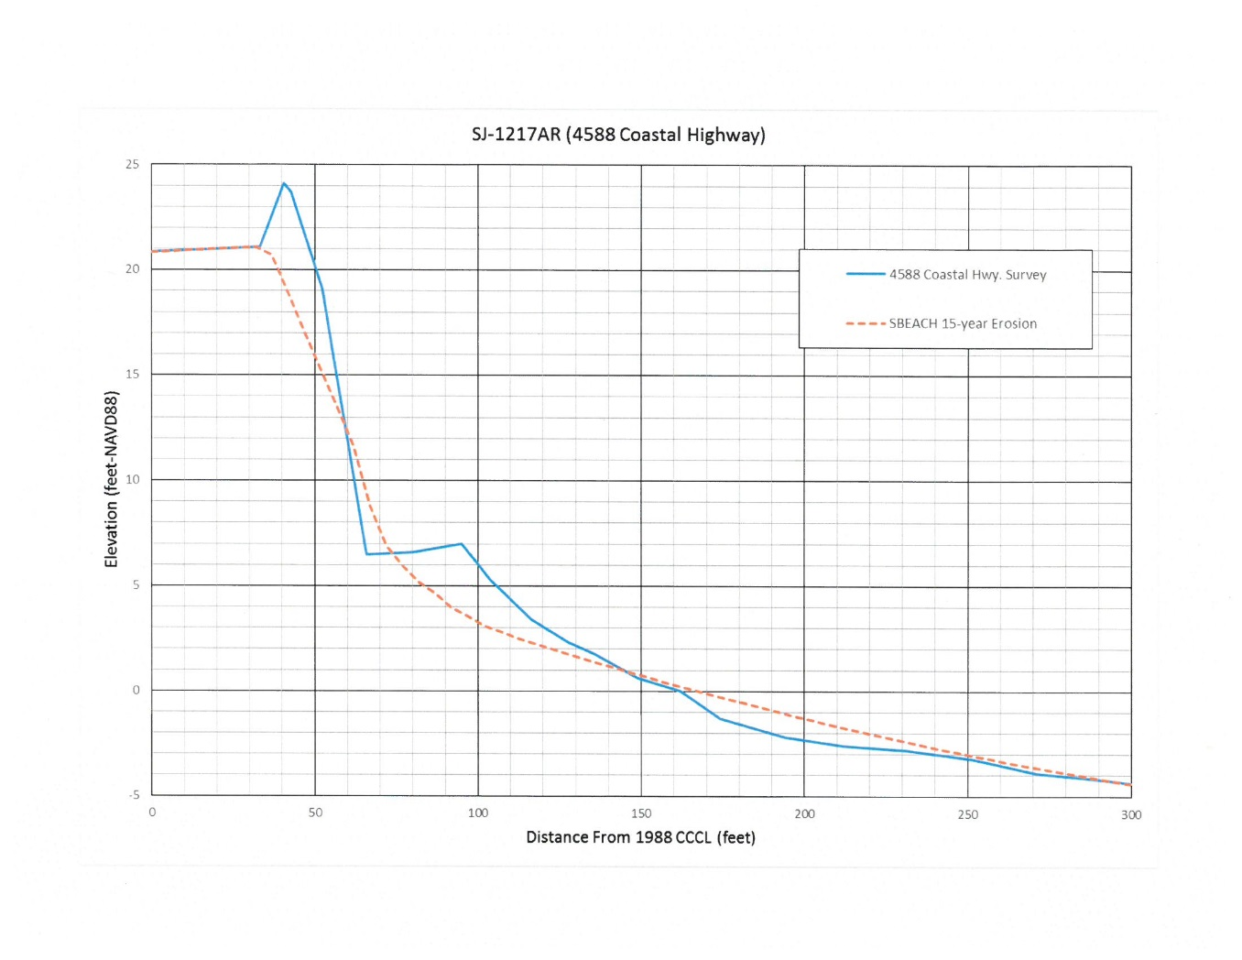
Erosion from Frequent Storm Event

Slide 60
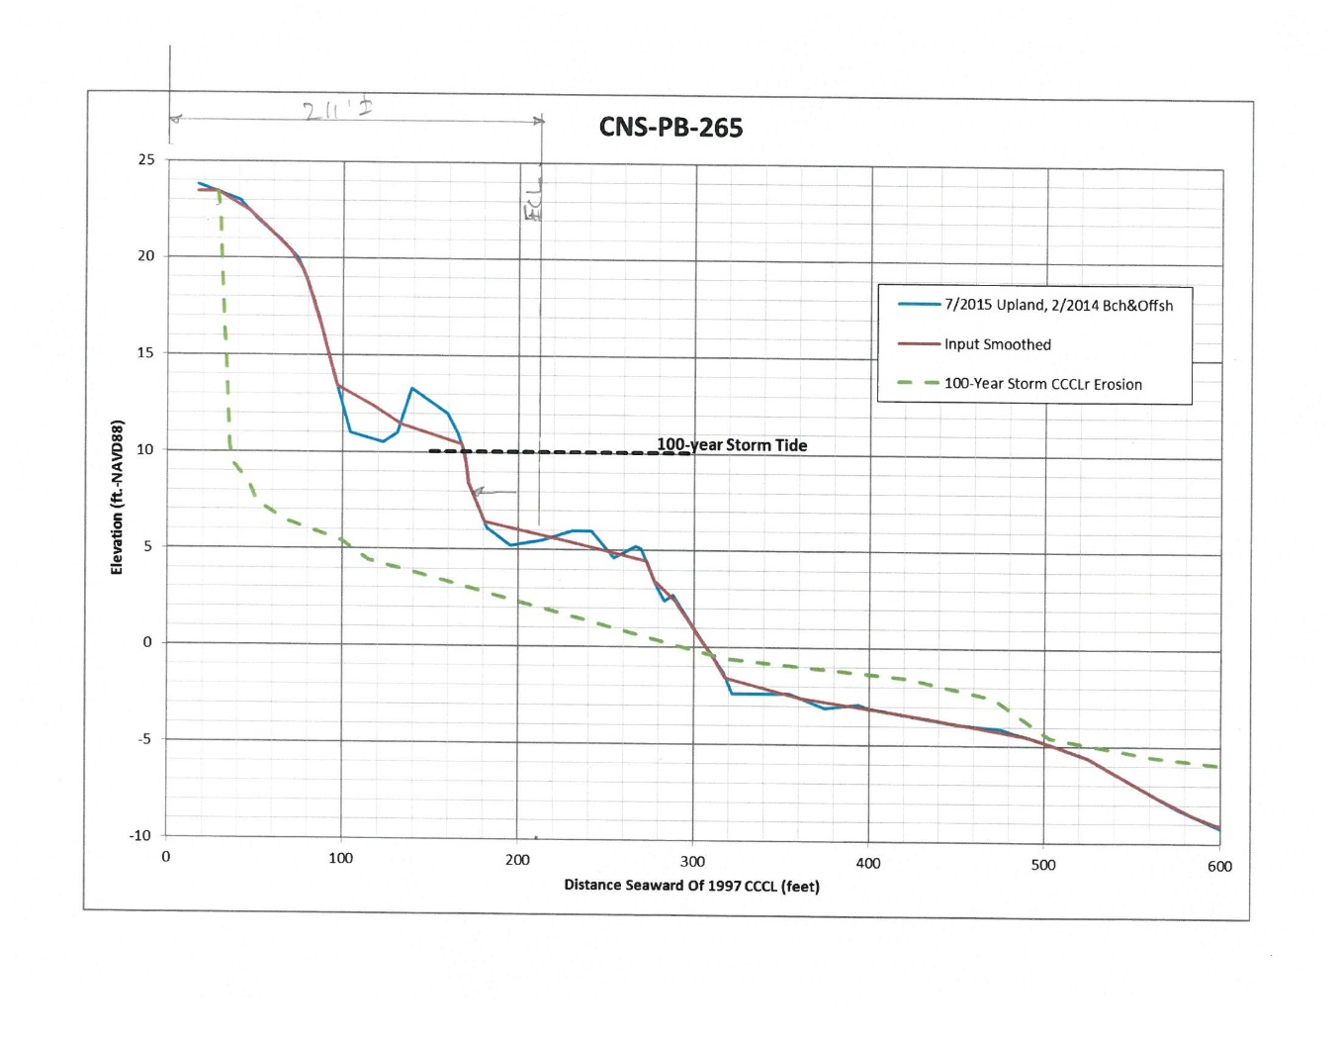
Erosion from Hurricanes

Slide 61
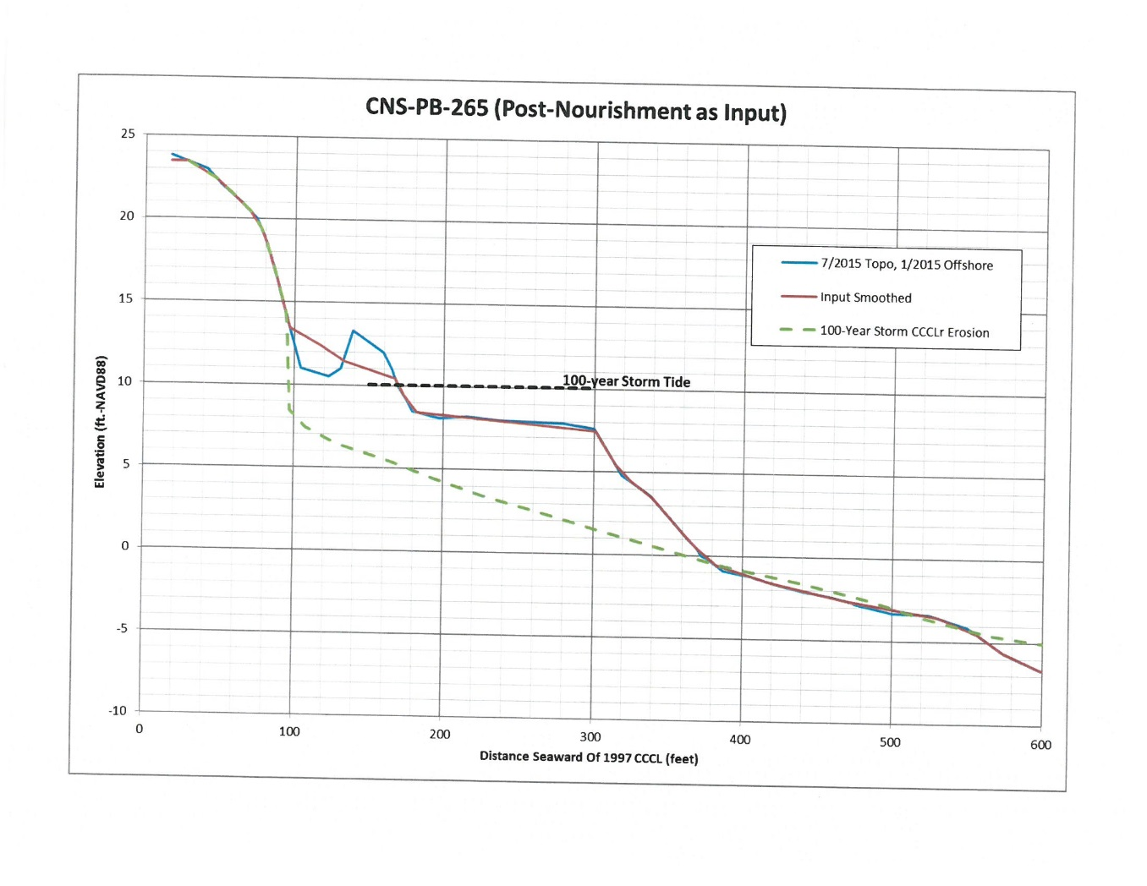
Erosion from Hurricanes cont.

Slide 62

Erosion from Hurricanes cont.

Slide 63

Erosion Damage

Slide 64

Erosion Damage cont.

Slide 65

Erosion Damage cont.

Slide 66

Erosion Conditions

Slide 67
Flood Protection
Dunes protect upland property and structures from flooding caused by coastal storms.
Flood levels determined from storm surges published by DEP.
Flood protection levels determined by height of dune remaining during storm event. Protection ends when water penetrates landward of dune from overtopping, flanking, or breach.
Eroded dune mass deposited across beach or offshore in sand bar attenuates waves for added storm protection.

Slide 68

Storm Surge Table

Slide 69

Storm Surge Graph

Slide 70

Storm Surge Graph

Slide 71

Storm Surge Graph

Slide 72

Flood Damage

Slide 73

Flood Damage cont.

Slide 74

Flood Damage cont.

Slide 75
DUNE RECOVERY
Manmade– Immediate Recovery
Naturally – Long term recovery

Slide 76

Eroded Dune

Slide 77

Dune Recovery

Slide 78

Dune Recovery

Slide 79

Dune Recovery cont.

Slide 80

Manmade dune Restoration with imported sand

Slide 81
Law Criteria (S. 161.053, F.S.)
The Legislature finds and declares that the beaches in this state and the coastal barrier dunes adjacent to such beaches, by their nature, are subject to frequent and severe fluctuations and represent one of the most valuable natural resources of Florida and that it is in the public interest to preserve and protect them from imprudent construction which can jeopardize the stability of the beach-dune system, accelerate erosion, provide inadequate protection to upland structures, endanger adjacent properties, or interfere with public beach access…. Special siting and design considerations shall be necessary seaward of established coastal construction control lines to ensure the protection of the beach-dune system, proposed or existing structures, and adjacent properties and the preservation of public beach access. (ss.161.053(1)(a), F.S.)
After the department has given consideration to the results of such public hearing, it shall, after considering ground elevations in relation to historical storm and hurricane tides, predicted maximum wave uprush, beach and offshore ground contours, the vegetation line, erosion trends, the dune or bluff line, if any exist, and existing upland development, set and establish a coastal construction control line…Upon such filing with the Department of State, no person, firm, corporation, or governmental agency shall construct any structure whatsoever seaward thereof; make any excavation, remove any beach material, or otherwise alter existing ground elevations; drive any vehicle on, over, or across any sand dune; or damage or cause to be damaged such sand dune or the vegetation growing thereon seaward thereof, except as hereinafter provided. (ss.161.053(2)(a), F.S.).

Slide 82
Law Criteria (S. 161.053, F.S.) cont.
Where the application of paragraph (b) would preclude the construction of a structure, the department may issue a permit for a single-family dwelling for the parcel so long as:
1. The parcel for which the single-family dwelling is proposed was platted or subdivided by metes and bounds before the effective date of this section;
2. The owner of the parcel for which the single-family dwelling is proposed does not own another parcel immediately adjacent to and landward of the parcel for which the dwelling is proposed;
3. The proposed single-family dwelling is located landward of the frontal dune structure; and
4. The proposed single-family dwelling will be as far landward on its parcel as is practicable without being located seaward of or on the frontal dune. (ss.161.053(5)(c), F.S.)

Slide 83
Rule Criteria (62B-33.005, F.A.C.)
(4) The Department shall issue a permit for construction which an applicant has shown to be clearly justified by demonstrating that all standards, guidelines, and other requirements set forth in the applicable provisions of Part I, Chapter 161, F.S., and this rule chapter are met, including the following:
(a) The construction will not result in removal or destruction of native vegetation which will either destabilize a frontal, primary, or significant dune or cause a significant adverse impact to the beach and dune system due to increased erosion by wind or water;
(b) The construction will not result in removal or disturbance of in situ sandy soils of the beach and dune system to such a degree that a significant adverse impact to the beach and dune system would result from either reducing the existing ability of the system to resist erosion during a storm or lowering existing levels of storm protection to upland properties and structures;
(c) The construction will not direct discharges of water or other fluids in a seaward direction and in a manner that would result in significant adverse impacts. For the purposes of this rule section, construction shall be designed so as to minimize erosion induced surface water runoff within the beach and dune system and to prevent additional seaward or off-site discharges associated with a coastal storm event.
(d) The construction will not result in the net excavation of the in situ sandy soils seaward of the control line or 50-foot setback;
(e) The construction will not cause an increase in structure-induced scour of such magnitude during a storm that the structure-induced scour would result in a significant adverse impact;

Slide 84
Rule Criteria (62B-33.005, F.A.C.) cont.
(5) In order for a manmade frontal dune to be considered as a frontal dune defined under Section 161.053(5)(a)1., F.S., the manmade frontal dune shall be constructed to meet or exceed the protective value afforded by the natural frontal dune system in the immediate area of the subject shoreline. Prior to the issuance of a permit for a single-family dwelling meeting the criteria of Section 161.053(5)(c), F.S., the manmade frontal dune must be maintained for a minimum of 12 months and be demonstrated to be as stable and sustainable as the natural frontal dune system.
(6) Sandy material excavated seaward of the control line or 50-foot setback shall be maintained on site seaward of the control line or 50-foot setback and be placed in the immediate area of construction unless otherwise specifically authorized by the Department.
(7)…Pools sited within close proximity to a significant dune shall be elevated either partially or totally above the original grade to minimize excavation and shall not cause a net loss of material from the immediate area of the pool.
(8) Major structures shall be located a sufficient distance landward of the beach and frontal dune to permit natural shoreline fluctuations, to preserve and protect beach and dune system stability, and to allow natural recovery to occur following storm-induced erosion…

Slide 85
Dune Impacts
Excavation – Total or partial removal of the dune mass.
Vegetation Removal – The removal of indigenous, dune stabilizing vegetation. Does not include exotics.
Storm water runoff – Storm water runoff discharged or managed within the dune system through open channels or reservoirs
Traversing the dune with pedestrian or vehicular traffic.
Structures during construction or structures which interact with storm surges

Slide 86
Methods of Minimization (Retreat, Skinny it up, and raise it higher)
Landward siting – most effective
Reduce proposed footprint size
Reduce excavation
Manage excavated material on site
Reduce vegetation disturbance
Eliminating unnecessary activities/structures

Slide 87
Impacts and Recommended Solutions Summary
Minor Impacts – Minimize
Adverse Impacts - Minimize and Mitigate
Rebuilding - Seek Net Improvement
Significant Adverse Impacts - Deny Application

Slide 88
By Tony McNeal, P.E.
CCCL Program Administrator
Division of Water Resource Management
Florida Department of Environmental Protection
Email: tony.mcneal@dep.state.fl.us
Telephone: (850) 245-7665

