Slide 1
Florida Beaches Habitat Conservation Plan
Steering Committee February 26, 2013
The ins and outs of the CCCL permitting process
Fritz Wettstein, 850/921-7780
john.wettstein@dep.state.fl.us

Slide 2
Outline
Answers to 7 Questions posed by HCP staff
Case Studies
Q&A – whenever you feel the urge

Slide 3
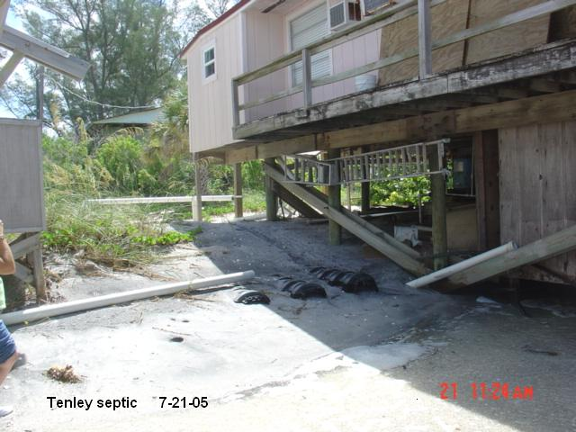
    “Hello, Department of Environmental Protection.
    My name is Lisa, how can I help you?”
    “Yes, this is Mr. Tenley, and I’d like to speak with someone about getting a CCCL permit for some septic tank work.”
Question: Who handles this CCCL permit?
  Lisa transfers Mr. Tenley to the closest warm body in the CCCL program:
  The field inspector,
  A permit manager, or
  A supervisor.
Staff look at their delegation for the simplest way to process the request.
Notes:
What is the general process that a permit application goes through once it is received at DEP?
Who internally “looks at” these applications?
Delegations of authority are in the DEP Directives, currently being updated
Field Permits (refer to the Field Inspector Manual)
processed by field inspectors, sometimes with the guidance of supervisors or permit managers (eg. beach sand placement matrix).
can also be processed by permit managers
Tallahassee Permits (refer to the Permit Manager Manual and RPI process, also to be updated)
refers to standard or administrative permits, general permits, exemption determinations, dune reconstruction, waivers, variances and development agreements
can be looked at by > permit manager > other reviewers > supervisor
Administrative, records center, legal and other staff “handle” CCCL field and applications.

Slide 4
Types of Authorization
Field Permits
Individual Permits
Notice General Permits
Emergency Permits
Development Agreements
Exemptions

Slide 5
Septic Systems are “Minor Structures”
Notes:
62B-33.002 Definitions.
(60) “Structure” is the composite result of putting together or building related components in an ordered scheme. Enumeration of types of structures in this rule subsection shall not be construed as excluding from the application of this rule chapter any other structure which by usage, design, dimensions, or structural configuration meets the general definition herein provided and requires engineering considerations similar to the following:
(b) “Minor Structures” are designed to be expendable, and to minimize resistance to forces associated with high frequency storms and to break away when subjected to such forces, and which are of such size or design as to have a minor impact on the beach and dune system.

Slide 6
DEP Delegations – Field Inspectors
DEP Directive 137 - OBCS-33: Field Inspectors
Issue permits using DEP form 73-122, applying the guidelines set forth in the CCCL Procedures Manual for Field Inspectors, for the following:
Construction of (or repair to) the following structures located a minimum of 30 feet landward of the frontal dune, escarpment, or coastal armoring structure and where the construction will have a minimal impact on the existing beach and dune vegetation:
On-site sewage disposal systems.
Notes:
OBCS-33: Field Inspectors
Issue permits using DEP form 73-122, applying the guidelines set forth in the CCCL Procedures Manual for Field Inspectors, for the following:
Construction of (or repair to) the following structures within vegetated (or unvegetated) dune areas:
Beach access stairs.
Elevated, wooden beach and dune walkover structures meeting DEP standards.
Decks, gazebos, tiki huts, or similar unenclosed, elevated, wooden structures not exceeding 144 square feet in floor area, located a minimum of 30 feet landward of the frontal dune, escarpment, or coastal armoring structure.
Construction of (or repair to) the following structures located a minimum of 30 feet landward of the frontal dune, escarpment, or coastal armoring structure and where the construction will have a minimal impact on the existing beach and dune vegetation:
Unroofed wooden decks (less than 600 square feet) attached to existing buildings.
Building stairways, concrete slabs (less than 144 square feet), and understructure latticework.
Utility or storage sheds (including understructure storage areas) of a breakaway design, not exceeding 144 square feet in floor area.
Fences/privacy walls and sidewalks to existing developments.
Driveways, parking aprons, and understructure parking pads to existing developments.
Enclosures to conceal or protect solid waste containers such as dumpsters, garbage cans, trash bags, etc.
On-site sewage disposal systems.
Water and irrigation wells.
Temporary excavation for subgrade utilities including water, sewer, electrical, and gas lines to existing developments.
Any other minor structures similar in nature to those listed above which would not result in measurable interference with the natural functioning of the beach dune system, after consultation with the permit manager or P.E. Supervisor, Coastal Protection and Engineering.
Repair of the following structures located landward of the frontal dune, escarpment, or coastal armoring structure (no expansion or enlargement of the existing structures is allowed):
Asphalt street and road shoulders, parking, areas and pavements not draining or discharging onto the beach.
Recreational concrete slabs such as tennis courts or shuffleboard courts.
Swimming pools undergoing progressive structural failure.
Existing wooden decks.
Other minor activities:
Beach vehicular ramp maintenance.
Placement of sand fill material, installation of sand fencing, and planting of vegetation for dune restoration, to include the filling of blowouts and other low areas.
Temporary placement of sand fill or sand bags to relieve emergency conditions when no emergency has been declared. The duration of the permit is not to exceed 6 months. This activity will be conducted in accordance with established guidelines for the protection of marine turtles.
Beach cleaning activities.
Placement of sand fill material and sand retention geotextiles immediately landward of existing rigid coastal structures.
Construction of temporary structures or activities for special events in non-vegetated areas of the beach.
Limited grading not to exceed one vertical foot from existing grade elevation landward of the frontal dune.
Landscaping not involving net excavation of existing grade or destruction or removal of native salt resistant vegetation.
Removal of collected windblown sediment provided that it is retained seaward of the CCCL and returned to the active beach or dune system in the general vicinity.
Access to the beach to conduct other authorized activities.
Removal of any rigid coastal structure or loose debris from the upland in areas not requiring the permanent removal of sediment.
Any other activity similar in nature to the activities listed above and which is not expected to cause a measurable interference with the natural functioning of the beach and dune system, after consultation with the permit manager or P.E. Supervisor, Coastal Protection and Engineering.

Slide 7
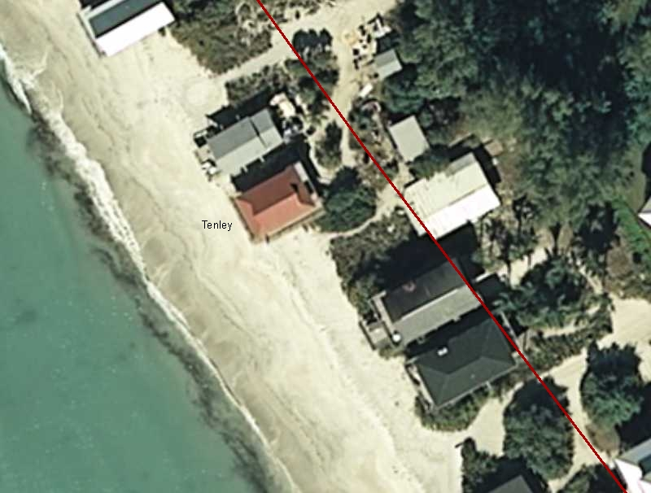
Answer: No Field Permit Issued – house uninhabitable
Notes:
5.3 Field Inspector Manager Manual – Field Permit Procedures
Review with the applicant the proposed project activities, guidelines (located in Section 5.5), and permit conditions (located in Section 5.6). If the project activities are consistent with DEP regulations and are within a Field Inspector’s delegation of authority, then a field permit can be issued (if activities are beyond the inspector’s delegation of authority, direct the applicant to the Tallahassee office).
If required, the applicant shall provide the inspector two (2) copies of the site plan and construction details for any structure. Write the permit number on the approved plans.
Field permits shall be issued only for the time limit necessary to construct the proposed structure or to perform the proposed activity. Normally three to six months (or less) is adequate. In no case shall the permit expire more than one year from the date of issuance or be extended. Permits issued for temporary structures shall have a specific date for removal of the structure. Permits issued for activities on the beach shall expire prior to the marine turtle-nesting season, which occurs from May 1 through October 31 (except in Brevard, Indian River, St. Lucie, Martin, Palm Beach, and Broward counties where the marine turtle nesting season occurs from March 1 through October 31).

Slide 8
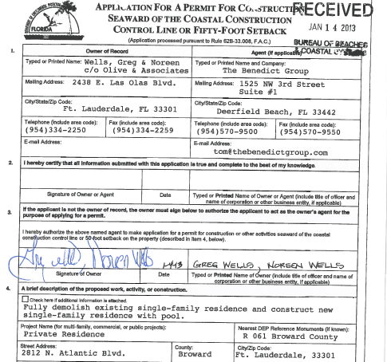
    “Mr. Wells, this is to notify you that your application for a coastal construction control line (CCCL) permit was received by the Department on 1/14/2013 and has been assigned file number BO-670.”
Q: Who handles this application?
  In addition to the Permit Manager, permits may be reviewed by other CCCL staff as well as DEP coastal engineers, FWC staff, State Lands, Office of General Counsel and others.
  Permit processing depends on the type of application, the proposed structures and activities and site conditions.
  Procedures are found in Rule 62B-33.008, the Permit Manager Manual and other program documents.
Notes:
What is the general process that a permit application goes through once it is received at DEP?
Do different types of permit apps go to different people?
Field Permits (walkovers, fill placement, beach cleaning, minor structures)
field inspectors, or
permit managers both can write field permits
Coastal Armoring (administrative) projects are reviewed by
CCCL engineering section (Celora and Tony)
BCS engineering section (high frequency model)
FWC sea turtle section
program administrator (Tony)
Minor Projects (administrative - decks, landward additions, modifications of permitted structures) and General Permits (administrative) are reviewed and approved by the permit manager
Major Projects (administrative - condos, public facilities, single family residential, large fill placements) can involve multiple reviewers:
permit manager
BCS engineering section (30 yr erosion projection, sand quality)
FWC sea turtle section (for non-SFD lighting, beach/dune construction)
JCP or FDEP Division of State Lands (work seaward of an ECL or on state lands)
supervisor or program administrator
Controversial Projects (administrative - threats of legal challenge, public comment objections, denials, “pushing the envelope with line of construction, etc.”
same reviewers as for major projects
FDEP Office of General Counsel
Deputy Division Director and upper management.

Slide 9
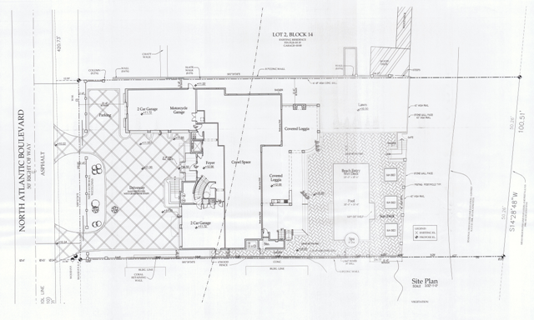
A: Permit Manager reviews “Major Projects”, GP’s, etc.
Notes:
Major Projects (administrative CCCL permits - condos, public facilities, single family residential, large fill placements) can involve multiple reviewers:
permit manager
BCS engineering section (30 yr erosion projection, sand quality)
FWC sea turtle section (for non-SFD lighting, beach/dune construction)
JCP or FDEP Division of State Lands (work seaward of an ECL or on state lands)
supervisor or program administrator

Slide 10
CCCL Processing Steps
Pre-application conference
CCCL application received
Completeness review – 30 day clock
Request for additional information (RAI)
Application deemed complete – 90 day clock
Field inspector performs site inspection
Application submitted to FWC for comments
Staff assessment prepared
Permit issued and notice to proceed released

Slide 11
Permit Application Requirements
Completed permit application form 73-100
Sufficient evidence of property ownership
Written evidence that project does not contravene local setbacks or zoning codes
Special survey of property
Permit drawings - dimensioned site plan, grading plan, exterior lighting plans, landscaping plans, (may also require foundation and construction plans)
Application fees

Slide 12
Time Clocks for Processing Permits
Administrative Permits (s.120.60, F.S.)
30-day completeness review
90-day processing time limit
Noticed General Permits (s.161.053(19),F.S.)
30-day processing time limit
Development Agreements (s.161.0531,F.S.)
No processing time limit

Slide 13
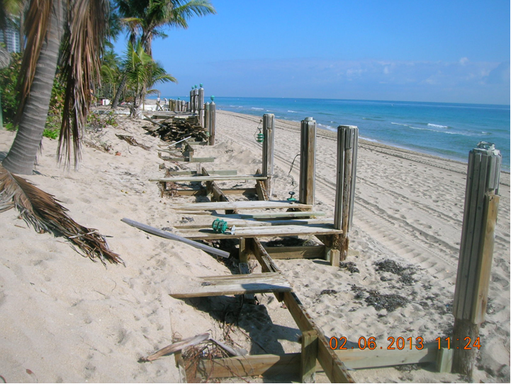
A: expected project effect on sea turtle habitat
Q: What triggers FWC Review?
Notes:
What trips the trigger to have a permit sent over to FWC for comment?
Does the project
include lighting for other than single family residences?
involve work seaward of a frontal dune, seawall or other physical barrier to nesting sea turtles?
modify sea turtle nesting habitat (frontal dune absent or ambiguous, removal of sea grapes or other vegetation modifying the dune silhouette)

Slide 14
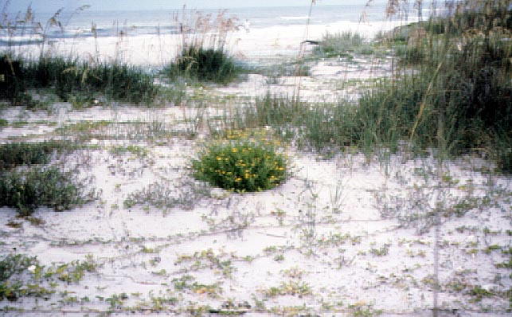
Q: What environmental issues are reviewed?
Appropriate siting of structures upland of the beach and frontal dune
Major structures sited landward of the 30 year erosion projection
Limit excavation and manage excavated fill on-site
Minimize removal or damage to existing dune stabilizing vegetation
Activity should not interfere will public beach access
Avoid “Take” of marine turtle nesting habitat
    Minor Impacts - Minimize
    Adverse Impacts - Minimize and Mitigate
    Rebuilding - Seek Net Improvement
    Significant Adverse Impacts - Deny Application
Notes:
This protection is provided through special siting and design consideration that are described in Rule 62B-33.
Similar to other regulatory programs charged with protecting resources, the CCCL program in reviewing projects attempts to minimize and mitigate adverse impacts and deny project where significant adverse impacts are likely to occur.

Slide 15
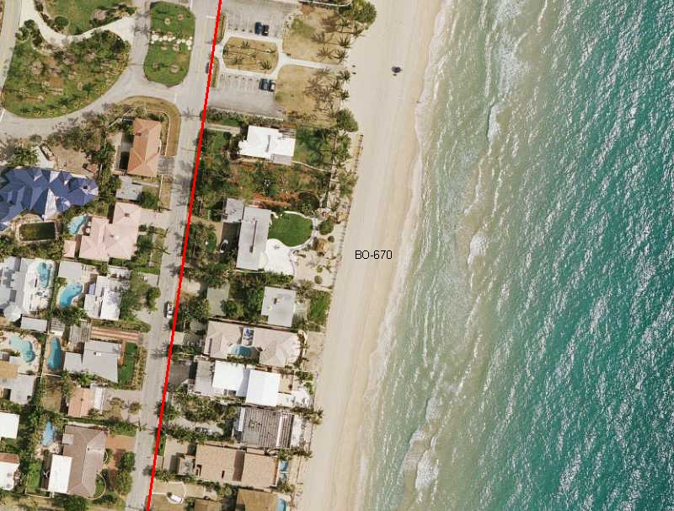
A: BO-670 major issues = siting, sea turtle habitat
Notes:
Staff reviews the applicant’s proposal for consistency with rule and statute.
Siting :Is it
sufficiently landward of beach and frontal dune? (major structures)
landward of 30 year erosion projection? (major structures)
landward of line of construction? (major structures)
located such that adverse impacts have been minimized per rule? (all)
not resulting in take of sea turtles? (all)
Timing: Is it outside of nesting season or approved by FWC? (all)
Design and construction: (all)
Have the expected adverse impacts to dunes, native vegetation, public access or adjacent properties been avoided, minimized or mitigated per rule?
Does it result in take of sea turtles?

Slide 16
Impacts and Recommended Solutions
Minor Impacts - Minimize
Adverse Impacts - Minimize and Mitigate
Rebuilding - Seek Net Improvement
Significant Adverse Impacts - Deny Application

Slide 17
Examples of Minimization
Increase project setback from beach/dune
Reduce project footprint
Minimize excavation and manage onsite
Avoid disturbance to native vegetation
Down-size or remove ancillary structures (decks, viewing platforms, etc.) that impact the frontal dune
Limit exterior lighting fixtures

Slide 18
Examples of Mitigation
Dune restoration activities to include fill placement and the planting of native vegetation
Removal of exotic plant species
Removal of existing structures that adversely impact the beach-dune system
Removal of exterior lighting (visible from the beach) and replacement with turtle friendly lighting

Slide 19
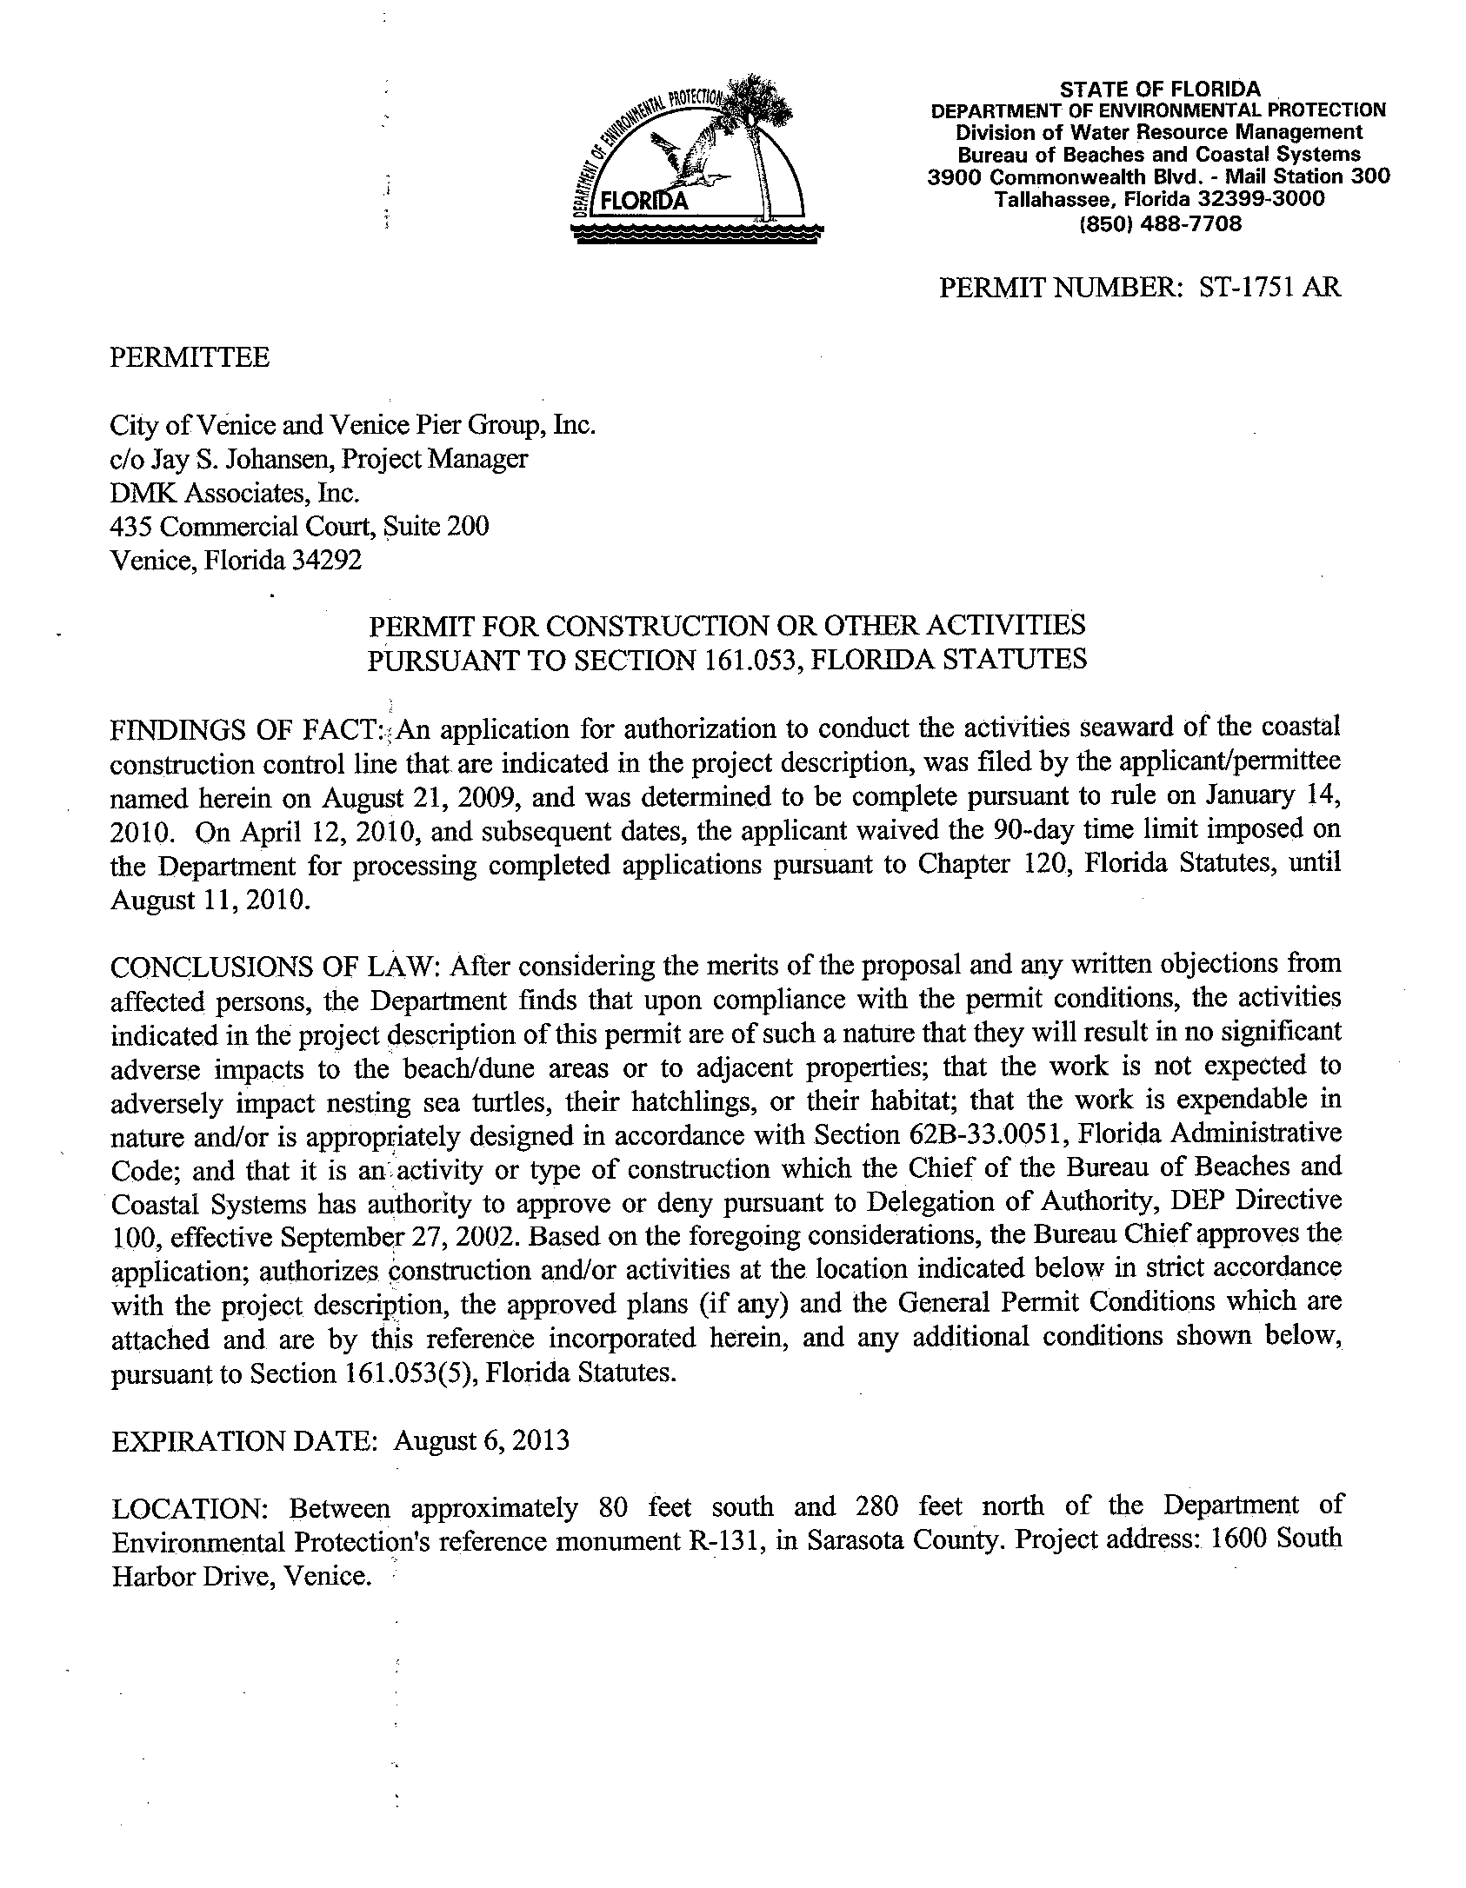
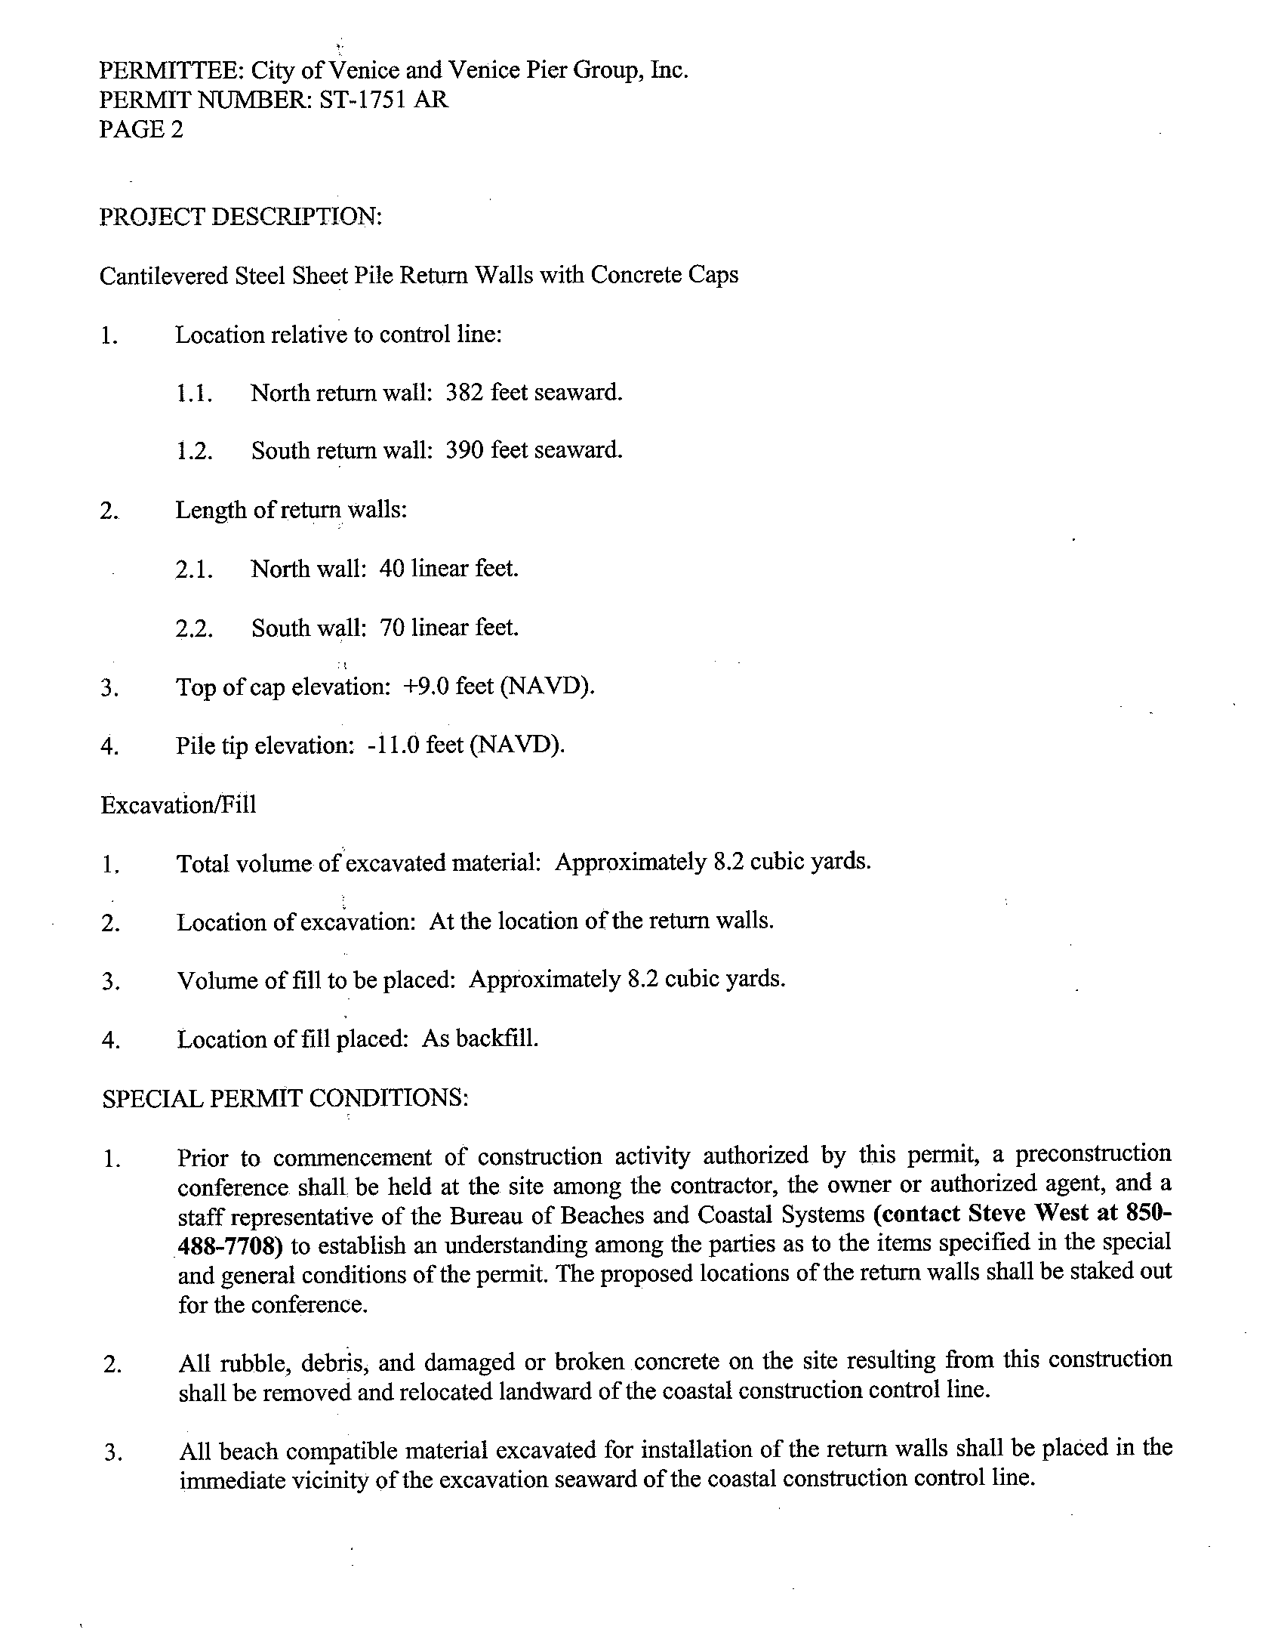
Q: How do staff limit impacts with issued permits?
Notes:
Note: Staff only “proscribes” terms under which a project cannot be conducted as proposed if any part of the project is found to be inconsistent with the rule and statute, in which case the application is denied by the department or more commonly voluntarily redesigned by the applicant. Staff offers recommendations on project consistency as early in the process as possible, whether it is during a site visit by a field inspector, a pre-application consultation, or a recommendation made during the application review process. It is the applicant’s responsibility to locate, time, design and construct the project in accordance with state law.

Slide 20
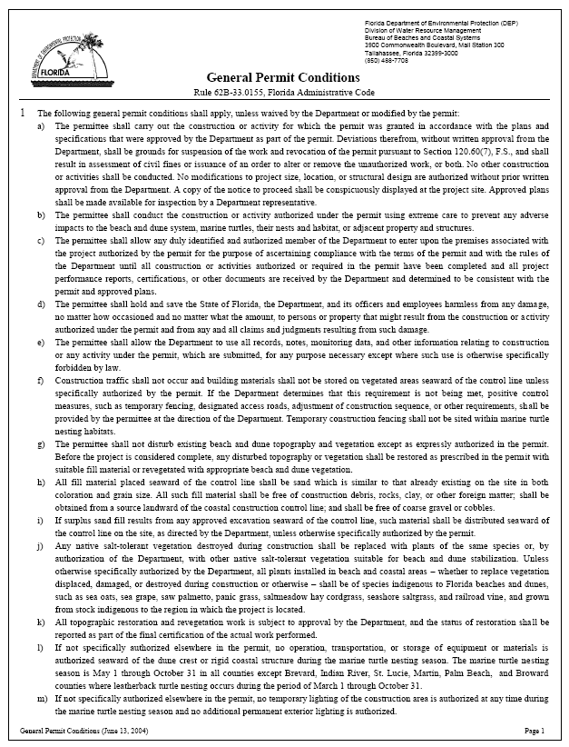
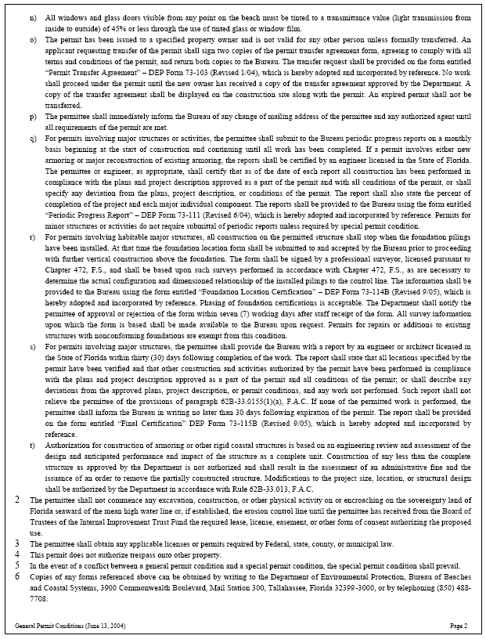
A: Construction is managed through permit conditions
Notes:
The permit provides general conditions for conducting permitted activities, and includes special permit conditions that ensure that the “reasonable expectations” considered in permit review are met. Permit conditions cannot modify the project design, but can assure the project is conducted consistent with the rule such as with requirements for:
A pre-construction conference with the field inspector to go over the permit
Location of construction fences
Inspection of fill quality
Mitigation requirements
Exterior lighting

Slide 21
Q: How is permit compliance monitored?

Slide 22
A: Compliance is monitored thru inspections and reports
Notes:
The permit provides general conditions for conducting permitted activities, and includes special permit conditions that ensure that the “reasonable expectations” considered in permit review are met. Permit conditions cannot modify the project design, but can assure the project is conducted consistent with the rule such as with requirements for:
A pre-construction conference with the field inspector to go over the permit
Location of construction fences
Inspection of fill quality
Mitigation requirements
Exterior lighting

Slide 23
Major Structure Compliance Measures
Preconstruction Meeting
Periodic Progress Reports
Foundation Location Certification
Final Certification

Slide 24
Q: How are historical permits tracked?

Slide 25
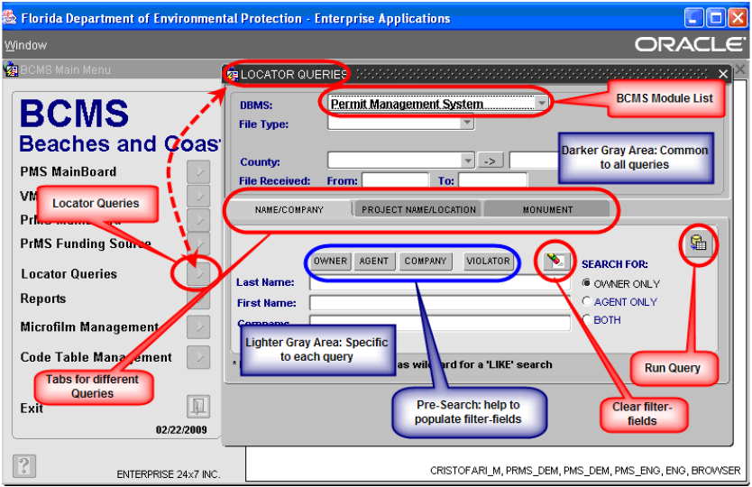
A: Permits are tracked by the BCMS database
Notes:
How are historical permits tracked?
BCMS – Beaches and Coastal Systems Management System Oracle database
Tracks and links consultations, permits, exemptions for a given property
Tracks application evaluation and post issuance compliance
Produces “Locator Reports” by querying all files within the range of specified R-monuments.
Produces “Construction Status Inspection” CSI reports on the compliance activities of all projects that have not been completed and files closed.
PA – FDEP permit application database to which BCMS is linked
Department wide database
Basis of management performance tracking of permit applications time to process (TTP) and time in house (TIH)
CAMapDirect – FDEP on-line GIS to which BCMS is linked
Useful for realtors and general public to locate properties in relation to CCCL or GP line
Includes locations of applications, field permits, admin permits, violations
Links to a summary report of permit file generated from BCMS

Slide 26
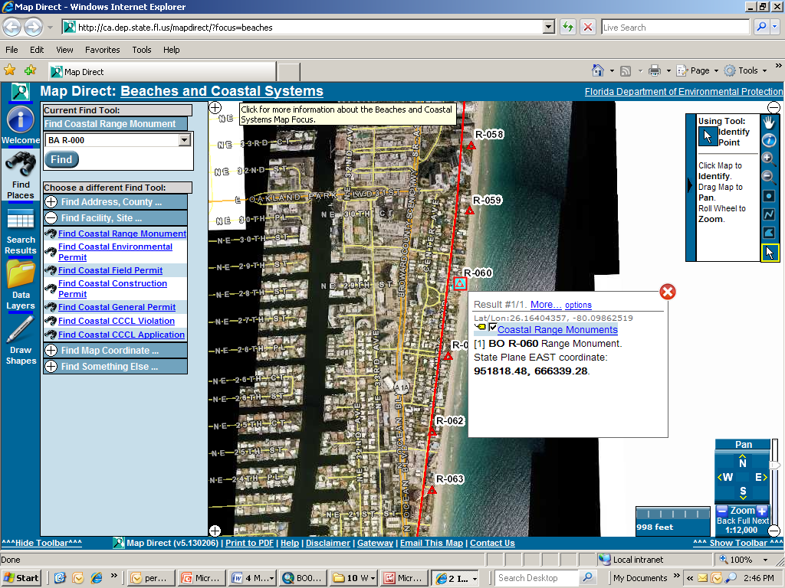
A: Permit Summary Reports are on DEP CA MapDirect
Notes:
How are historical permits tracked?
BCMS – Beaches and Coastal Systems Management System Oracle database
Tracks and links consultations, permits, exemptions for a given property
Tracks application evaluation and post issuance compliance
Produces “Locator Reports” by querying all files within the range of specified R-monuments.
Produces “Construction Status Inspection” CSI reports on the compliance activities of all projects that have not been completed and files closed.
PA – FDEP permit application database to which BCMS is linked
Department wide database
Basis of management performance tracking of permit applications time to process (TTP) and time in house (TIH)
CAMapDirect – FDEP on-line GIS to which BCMS is linked
Useful for realtors and general public to locate properties in relation to CCCL or GP line
Includes locations of applications, field permits, admin permits, violations
Links to a summary report of permit file generated from BCMS

Slide 27
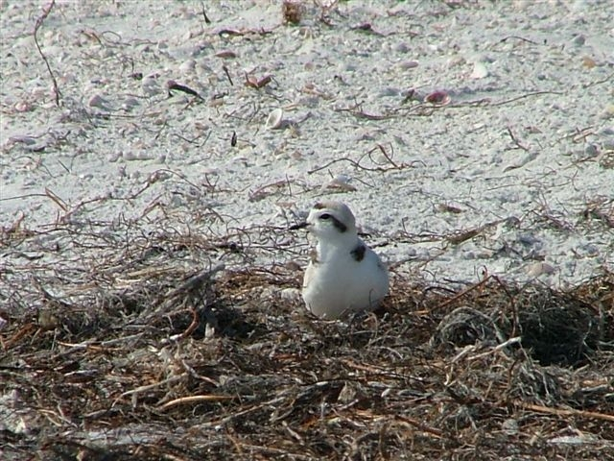
Any Questions ?

Slide 28

Thank You
Fritz Wettstein
Coastal Construction Control Line Program
Division of Water Resource Management
john.wettstein@dep.state.fl.us

