Slide 1
Update on Florida and USNG Implemenation Resources
Richard Butgereit
GIS Administrator
850-413-9907
richard.butgereit@em.myflorida.com
floridadisaster.org/gis

Slide 2
United States National Grid
Lessons learned have taught us that standardized grids are needed for positional reporting.
As far back as Hurricane Andrew, problems were recognized for emergency managers...
Notes:
Lessons learned from recent hurricane seasons have taught us that standardized grid maps for search and rescue and other activities are a necessity. In an effort to standardize maps in Florida for both emergency and other operations, the State Fire Marshal, as the coordinating agency for search and rescue under the State Comprehensive Emergency Management Plan, and the Division of Emergency Management are embarking on a program to adopt the US National Grid (USNG) as the standard in Florida. This project will ensure a uniform grid mapping system across cities and counties in Florida, and will match the system used by the National Guard, the US Coast Guard and the US military when they are deployed into our state.
All GPS units are programmed with the National Grid (or the compatible military grid). Users just have to switch their unit to the proper format to find a grid address.

Slide 3
What’s wrong with current systems?
We already have…
  Latitude/Longitude
  Township/Range/Section
  Street Address and Zip
  UTM

Slide 4
Latitude/Longitude
Multiple formats are confusing
  DD -85.990151, 30.272240
  DM -85 59.409089, 30.16.334386
  DMS 85 59’24.545”W, 30 16’20.063”N
  All the same location!!!

Slide 5
How far is a second anyway?
What is the distance from….
    85 59’24.545”W, 30 16’20.063”N
To here….
    85 59’26.292”W, 30 16’14.546”N

Slide 6
Worse yet…
What is the distance from
    -85.990443, 30.275358
To here….
    85 59.364547, 30 16.504539

Slide 7
Township/Range/Section
Township/Range/Section grid from the Public Lands Survey System is an important and good system…
  basis of land ownership records
  been in use for over 180 years

Slide 8
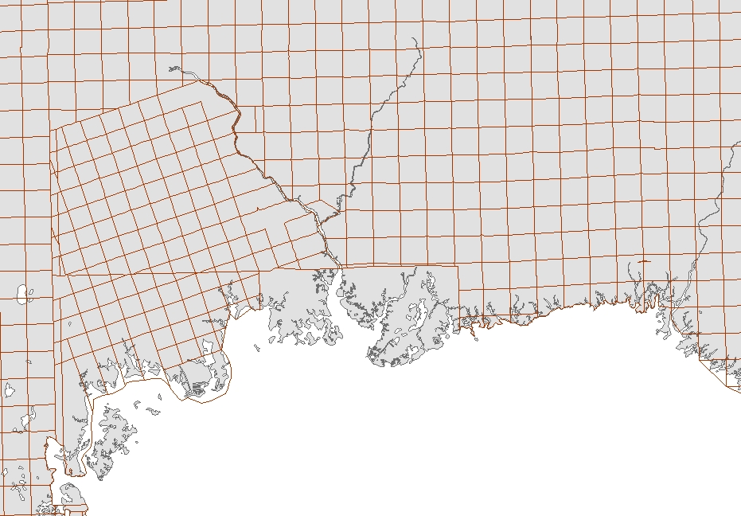
Township/Range/Section
But a perfect section really doesn’t exist
irregular in coastal areas
too large to meet needs of ground crews
Notes:
Florida’s unique geography of miles of coastlines, multiple river corridors, and large watersheds make the use of the common Township/Range/Section grid (PLSS) all but impossible except for a handful of inland counties. As the grid approaches wetlands, river corridors and the coast line, sections become irregular in shape and can be significantly larger than the typical square mile, which is too large to accommodate the needs of ground crews.

Slide 9
Street Address and Zip
Problematic due to…
  rural routes
  post office boxes

Slide 10
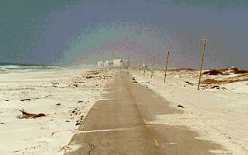
What do you do when the SIGNS are gone?

Slide 11
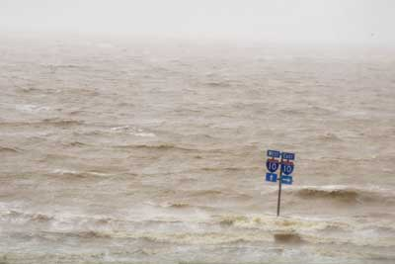
What do you do when the ROADS are gone?

Slide 12
How to read USNG
16R GU 66000 64820
Grid Zone Designation – for a world-wide unique address, identifies the longitude zone number and the latitude band letter
100,000 Meter Grid – identification for regional areas
Grid Coordinates –
Easting and Northing position

Slide 13
Truncate for less precision…
16R GU 66000 64820
Locates within 1 meter
66000 64820
Locates within 10 meters
6600 6482
660 648
Locates within 100 meters
66 64
Locates within 1000 meters

Slide 14
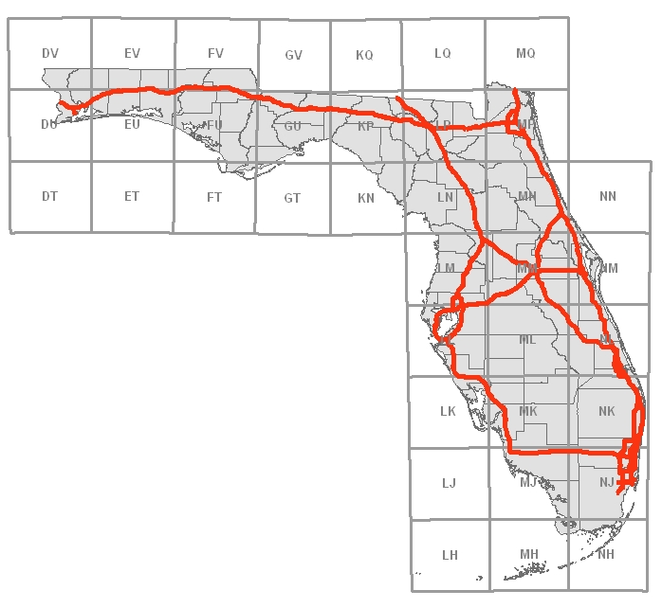
Truncate for locality
16R
17R
16R GU 66000 64820
just like you don’t have to dial an area code to make a local call…
all Florida locations will be 16R or 17R

Slide 15
Truncate for locality
16R
17R
16R GU 66000 64820
100,000 meter zone designation may be dropped when working locally

Slide 16
Support for USNG
http://www.floridadisaster.org/gis/usng
  tools and instructions for GIS staff
FDEM’s Incident Mapper
  simple Google Maps mashup with USNG tools
GeoPDF’s
  new PDF formats have GIS capabilities, including USNG support

