Slide 1
Best Management Practices
Program Update
Florida Department of Agriculture and Consumer Services
Office of Agricultural Water Policy

Slide 2
Florida Department of Agriculture & Consumer Services
18 Divisions and Offices
Administration | Agricultural Environmental Services | Agricultural Law Enforcement
Agricultural Water Policy | Animal Industry | Aquaculture
Communications | Consumer Services | Energy
Florida Forest Service | Food Safety | Food, Nutrition and Wellness
Fruit and Vegetables | General Counsel | Inspector General
Licensing | Marketing and Development | Plant Industry
http://www.freshfromflorida.com/Divisions-Offices/

Slide 3
Office of Agricultural Water Policy
Water Policy Planning: Interaction with DEP on Basin Management Action Plans (BMAPs), agriculture’s role in water supply planning
Program Development: Best Management Plans (BMPs) adoption, implementation verification, research support
Field Staff: Enrollment in BMP program for producers, technical assistance with implementation; coordination of cost-share projects
Finance & Accounting
Currently 51 FTEs and 15 contract technicians in locations around the state

Slide 4
Foundational Statutes
Florida Law
403.067(7)(b)2.g.: A nonpoint source discharger included in a basin management action plan must demonstrate compliance with the pollutant reductions established under subsection (6) by implementing the appropriate best management practices established pursuant to paragraph (c) or conducting water quality monitoring prescribed by the department or a water management district…

Slide 5
Foundational Statutes
Florida Law
403.067(7)(c)2.: The Department of Agriculture and Consumer Services may develop and adopt by rule… best management practices, or other measures necessary to achieve the level of pollution reduction established by the department for agricultural pollutant sources in allocations developed pursuant to subsection (6)… Such rules must also incorporate provisions for a notice of intent to implement the practices and a system to assure the implementation of the practices, including site inspection and recordkeeping requirements.

Slide 6
Foundational Statutes
Florida Law
403.067(7)(c)3: …Implementation, in accordance with rules adopted under this paragraph, of practices that have been initially verified to be effective, or verified to be effective by monitoring at representative sites, by the department, shall provide a presumption of compliance with state water quality standards and release from the provisions of s. 376.307(5) for those pollutants addressed by the practices, and the department is not authorized to institute proceedings against the owner of the source of pollution to recover costs or damages associated with the contamination of surface water or groundwater caused by those pollutants. (Florida Watershed Restoration Act, 1999, as amended)

Slide 7
Agricultural BMPs Overview
Practical measures that use water more efficiently and reduce potential effects of fertilizers, pesticides, and animal waste on water resources; must be developed with economic and technical considerations
BMPs are developed in collaboration with agricultural industry, agencies, non-governmental organizations, and others; verified effective by DEP; adopted by rule; subject to periodic review and update
Applicable practices are selected cooperatively with producers and field staff during on-site enrollment and review; applicability is based on relevance and assessment of existing or potential resource concerns
Supported by cost-share programs from FDACS and others

Slide 8







BMP Manuals
Coming Soon!
Florida Small Farms
Practice Categories: Nutrient Management
Irrigation and Water Table Management
Water Resource Protection
Notes:
Practices also address record-keeping within these categories

Slide 9
Key Expectations in BMPs for Nutrient Management
Quantify all nutrient sources
  Labels for commercial fertilizer
  Book values, other lab analysis, supplier data for other sources
Plan nutrient applications to match plant requirements
  UF/IFAS recommendations are the default; other rates can be used with justification
  Soil and tissue testing
Keep records of sources (w/content), application rates, location, & timing

Slide 10
Key Expectations in BMPs for Nutrient Management
Specific Interpretation Guidance for Biosolids
Proper use of biosolids takes advantage of a nutrient and soil-building source that is otherwise wasted.
The nutrient content of biosolids must be known (including by reference to standard or average values) and accounted for like any other nutrient source (e.g., commercial fertilizer, organic sources, floor sweepings, & nutrient content of irrigation water). Class AA biosolids are labeled as commercial fertilizer, with a guaranteed analysis.
Nutrient applications will be subject the agronomic limits (IFAS rates as a default) calculation, and must consider both N and P. There are site specific soil testing procedures that should govern P application rates.
Evaluation of appropriate application rates will be based on actual production, i.e. if applications are based on hay production rates, hay must actually be produced for sale or use, not just pasture.

Slide 11
Key Expectations in BMPs for Irrigation and Water Table Management
Match irrigation timing and volume to plant requirements
Use Mobile Irrigation Lab services as appropriate
Employ readily available data and technologies
  Soil moisture monitoring
  Irrigation controllers
Maintain records of irrigation systems, events, and equipment

Slide 12
Key Expectations in BMPs for Water Resource Protection
Locate operations to protect sensitive on-site water resources such as perennial streams, wetlands, sinkholes, and springs
Manage operations to protect off-site water resources, including groundwater
Properly store and handle materials such as pesticides, herbicides, and fuels

Slide 13
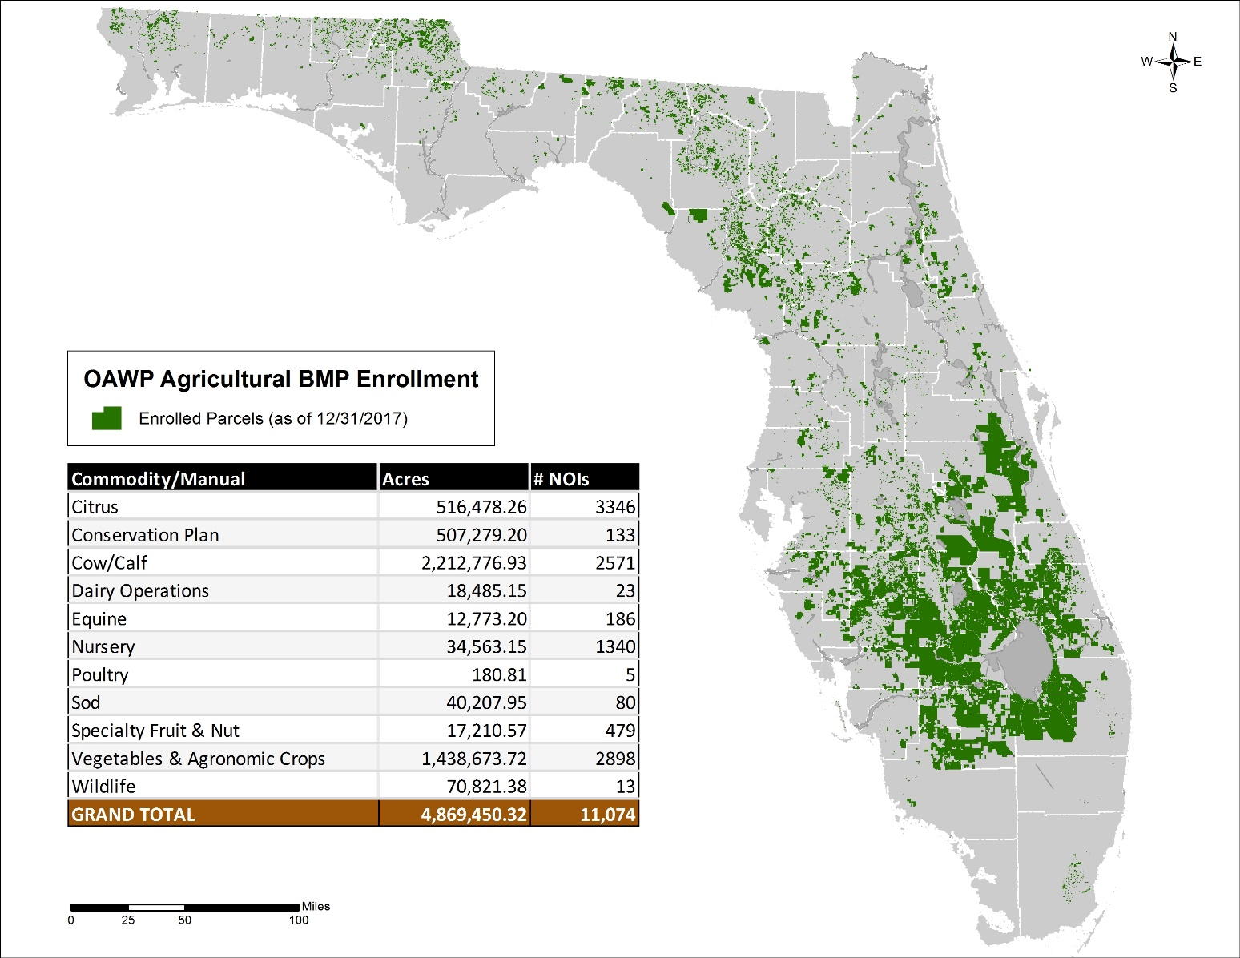
Statewide BMP Enrollment
9 active BMP manuals; 1 in development
11,000+ enrollments covering ~60% of ag land
42,000+ discrete parcels

Slide 14
Implementation Verification Initiatives
Multiple statutory directives to follow adoption of BMPs with systems to verify implementation
Required component of all BMP manual adoption rules
Process to verify the status of implementation of BMPs required by 2016 law to be adopted by rule (DONE)
Data on implementation gathered from site visits, enrollment, follow-ups, and permits
Annual report due each year by July 1
Program objective is to assist all producers to full implementation

Slide 15
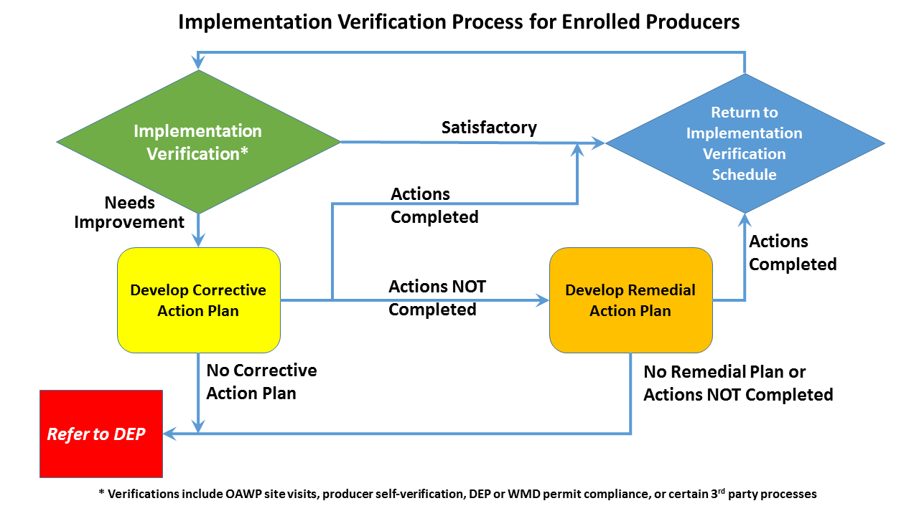
Implementation Verification Program Concept
Program objective is to assist producers to full implementation

Slide 16


Contact us at…
www.freshfromflorida.com/Divisions-Offices/Agricultural-Water-Policy
or
www.floridaagwaterpolicy.com

