Slide 1
Biosolids Use and Regulations in Florida
Division of Water Resource Management
September 2018

Slide 2
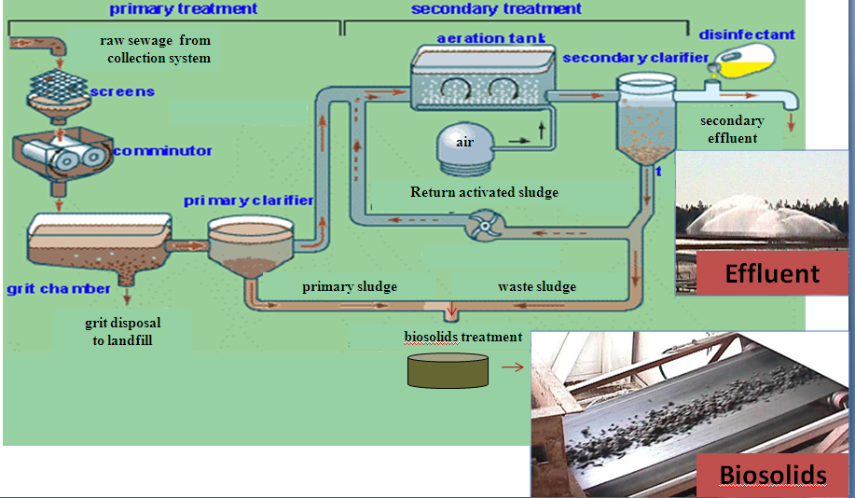
What are Biosolids?
The treatment of domestic wastewater produces two principal end products: effluent and biosolids

Slide 3
What are Biosolids?
Biosolids are the solid, semisolid or liquid material produced during the treatment of domestic wastewater.
Defined as, “solid organic matter recovered from a sewage treatment process and used especially as fertilizer – usually used in plural.”

Slide 4
Biosolids Management Options for a Wastewater Treatment Facility
A wastewater treatment facility can choose from several biosolids use or disposal options:
  Transfer to another facility
  Landfill
  Distribution and marketing (fertilizer)
  Incineration
  Bioenergy (potential)
  Land application
The wastewater treatment facility’s permit will state which use or disposal option the facility is allowed to use.

Slide 5
Biosolids Management in Florida
Total Production → 340,000 dry tons/year.
Estimates indicate approximately two-thirds are beneficially used and one third is landfilled.
Each year, 10,000 - 20,000 dry tons of pellets are imported, distributed and marketed as fertilizer.

Slide 6
Classes of Biosolids for Beneficial Use in Florida
Currently, there are three regulatory classes of biosolids for beneficial use based on treatment/quality:
  Class B – minimum quality for beneficial use
  Class A – intermediate quality for beneficial use
  Class AA – highest quality for beneficial use
Land application - Class B (could also be higher classes).
  Distribution and marketing as a fertilizer - Class AA (equivalent to Class A Exceptional Quality (EQ) under EPA regulations).
Regulations are based on the beneficial use and the class of biosolids to minimize potential risks from pathogens, nutrients and other pollutants.

Slide 7
Treatment
Treatment is required to reduce or eliminate pathogens:
  Class B treatment (significantly reduce pathogens)
  Class A/AA treatment (eliminate pathogens)
A vector attraction reduction option/treatment process must be met (reduces attractiveness to insects, birds, rodents, etc.).
Site restrictions are required for Class B to minimize potential exposure.

Slide 8
Nutrients
Biosolids land application rates are limited to rates that provide for crop nutrient needs; phosphorus restrictions apply in certain geographic areas of Florida.
Land application sites must have a site-specific nutrient management plan (NMP).
Site restrictions minimize potential impacts – site slopes, setbacks, depth to ground water, etc.
While not commonly land applied, Class AA biosolids distributed and marketed as fertilizers (due to their high level of treatment) are exempt from the nutrient restrictions for land applied biosolids.

Slide 9
Other Constituents
Limits for nine metals were developed for biosolids based on an extensive EPA review and risk assessment:
Two categories of pollutant limits were developed:
  Pollutant concentration limits for biosolids
    Ceiling limits
    More restrictive Class AA limits
  Cumulative pollutant loading limits for application site
Site restrictions minimize potential impacts – site slopes, setbacks, depth to ground water, etc.
Arsenic | Mercury | Lead
Cadmium | Molybdenum | Selenium
Copper | Nickel | Zinc

Slide 10
Biosolids Regulations
Federal – Title 40 CFR Part 503 (Florida is not delegated Part 503)
State - Chapter 62-640, Florida Administrative Code (F.A.C.)
  Primarily based on Part 503 but addresses additional items of concern
Local ordinances

Slide 11
EPA - Title 40 CFR Part 503
Promulgated in February 1993 after long rule-making effort
Based on an extensive risk assessment and peer review (14 different exposure pathways)
Technology based standards for pathogens
Self-implementing (i.e., do not issue permits)
Florida is not delegated Part 503, few states are delegated
Does not address phosphorus
EPA biennial review

Slide 12
Florida Biosolids Regulations
First regulations adopted in 1984 (solid waste rule)
Chapter 62-640, F.A.C.
  Effective in 1991, revised in 1998 and 2010
  Adopted primary components of the Federal Part 503 regulations
  Key differences with federal rules:
    Permits issued addressing biosolids
    Nutrient Management Plan (added in 2010)
    Phosphorus provisions
    Additional management requirements and site restrictions

Slide 13
Biosolids Distribution and Marketing – Class AA Biosolids
Distribution and marketing is the sale or giveaway of the biosolids as a fertilizer without restrictions on use
  Stringent pathogen reduction requirements and pollutant limits
  Safe for public use
Approximately 39 Florida facilities produce Class AA
  Larger facilities – treatment processes tend to be expensive
  Primarily sold or given away in bulk quantities
  Some are blended into commercial fertilizer blends
Wide variety of treatment processes
Trend appears to be a slow, steady increase in Class AA
Under the 2010 rule revisions, Class AA must be distributed and marketed as a “fertilizer” or to someone with a fertilizer license (otherwise land application requirements apply, i.e. site permit and NMP)
Many Class AA entities are appearing on the Florida Department of Agriculture’s annual fertilizer tonnage report; note, some traditional fertilizer companies blend Class AA into custom fertilizer blends but this is not apparent in the annual fertilizer tonnage report

Slide 14
Various Types of Florida Class AA Products/Processes
Pellets
Heat-Dried
Compost
Autothermal Thermophilic Aerobic Digestors (ATADs) - liquids
Advanced Anaerobic Digestion
BCR Neutralizer – chlorine dioxide process
Alkaline
  Bioset
  Nviro
  Lime Pasteurization

Slide 15
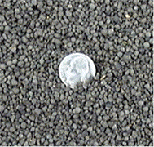
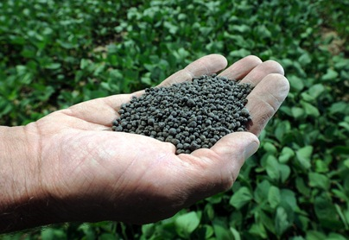

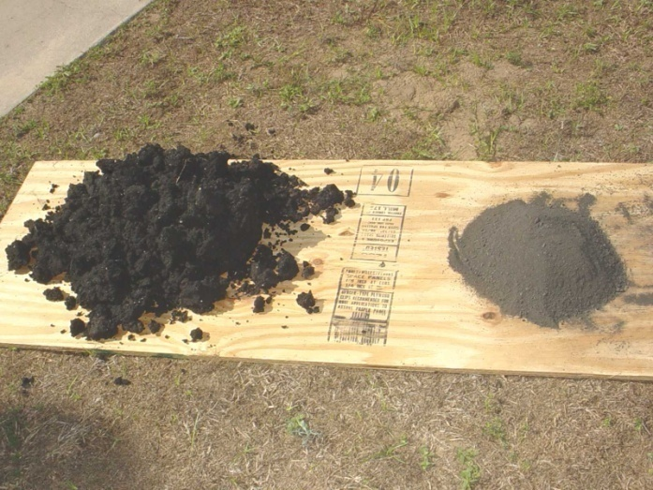
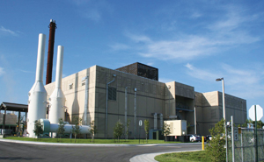
Class AA Pellets

Slide 16
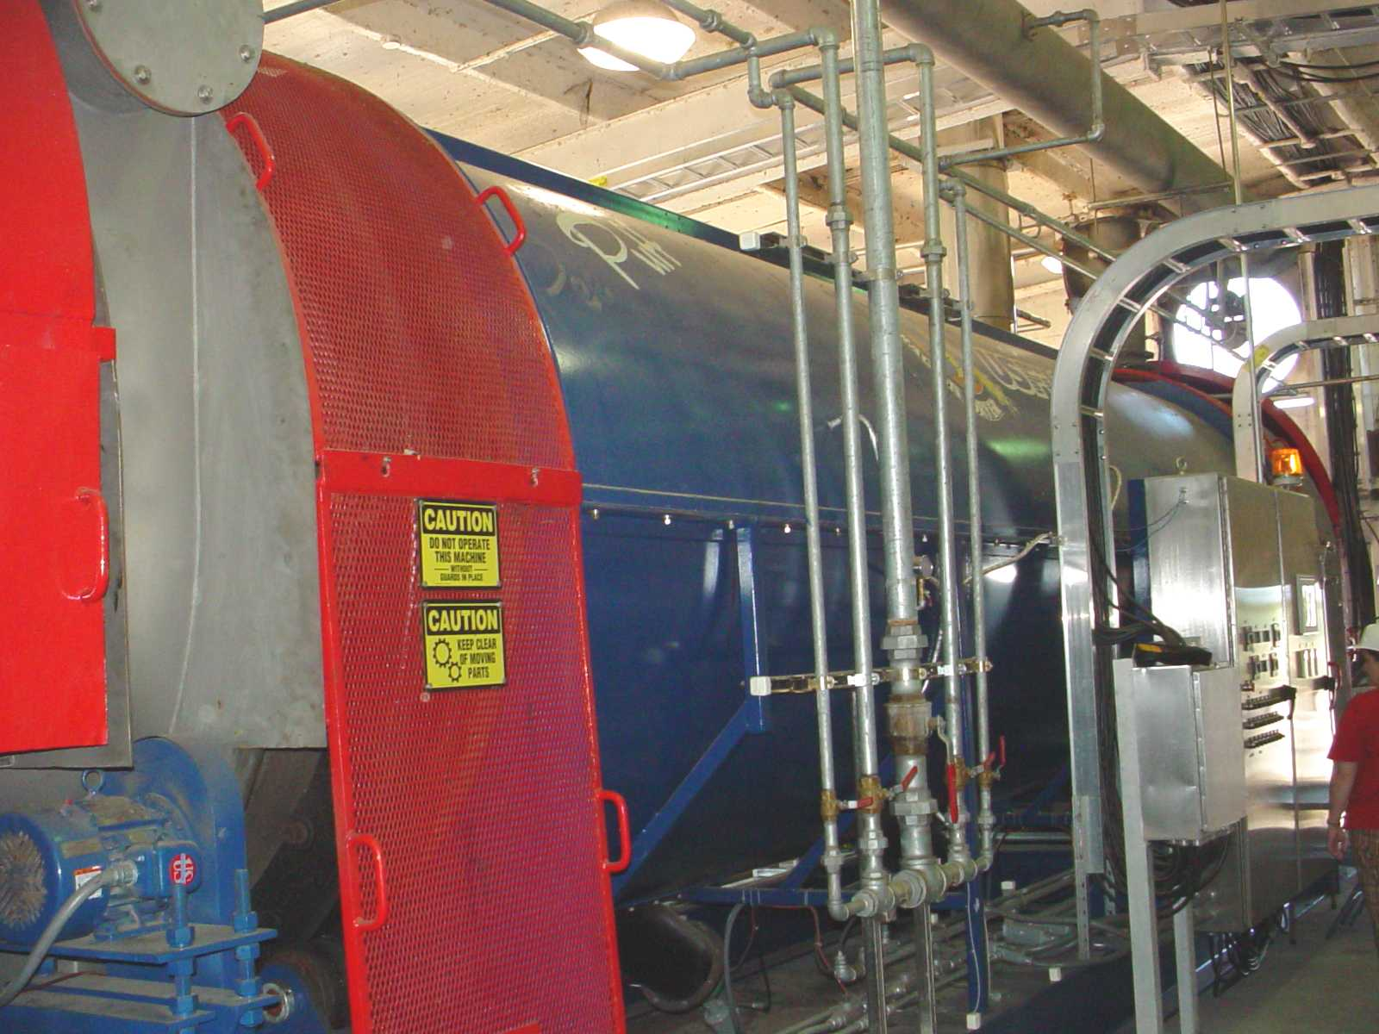
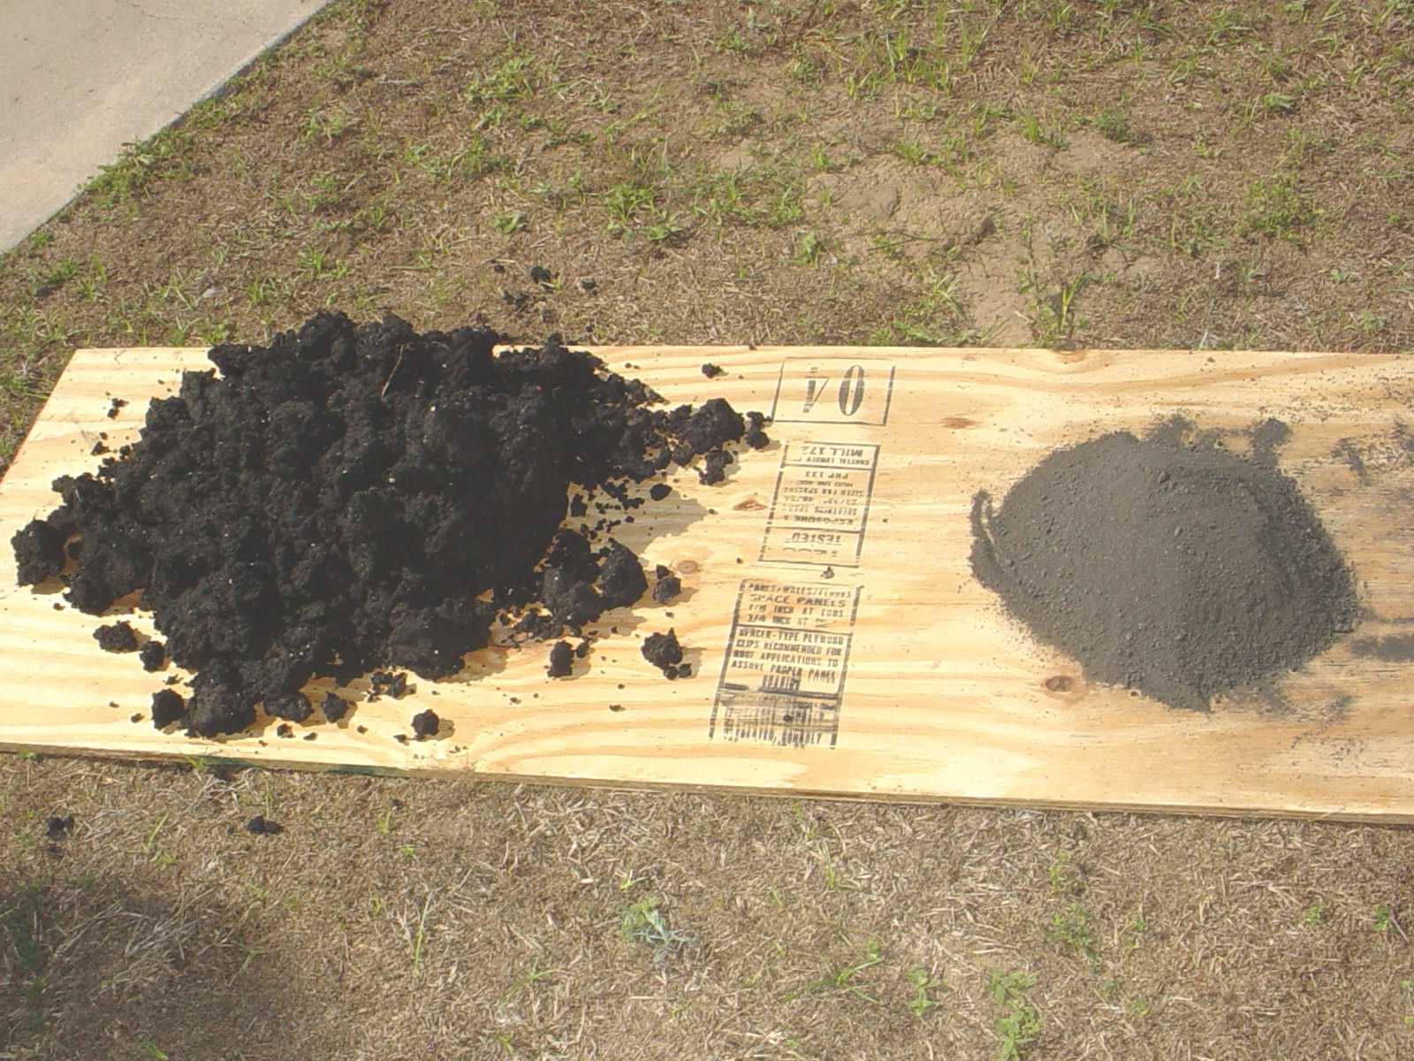
Class AA – Heat Drying

Slide 17
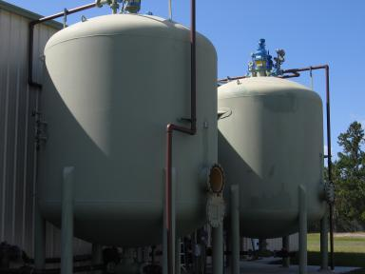
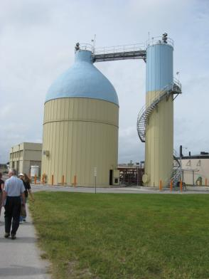
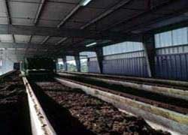
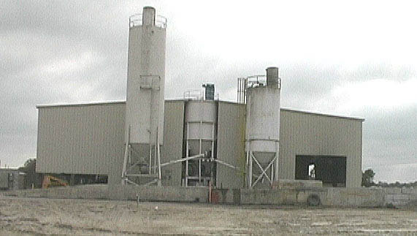
Other Class AA
Chlorine Dioxide
Two Phase Anaerobic Digestion
Composting
High temperature, high pH

Slide 18
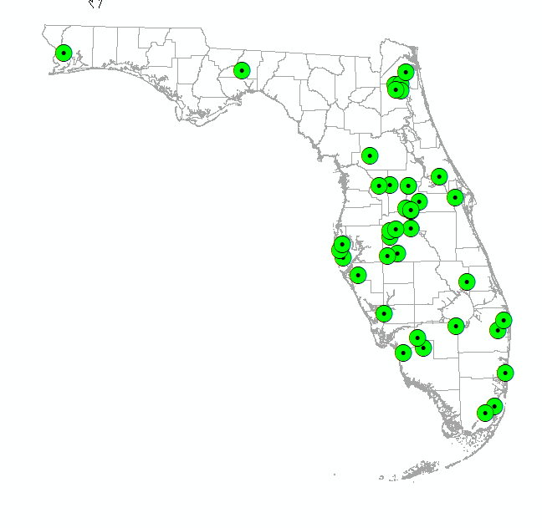
Florida Class AA Facilities

Slide 19
Florida Class AA Biosolids in 2016
39 Florida facilities produced 191,344 dry tons of final Class AA biosolids product
  187,149 dry tons distributed and marketed in Florida
  4,195 dry tons distributed and marketed outside of Florida
5 out-of-state facilities shipped in 9,966 dry tons
A total of 197,115 dry tons of Class AA biosolids product was distributed and marketed in Florida in 2016

Slide 20
Biosolids Land Application
Land application is the beneficial use of biosolids at a permitted site following a nutrient management plan (NMP) and site management requirements
  Biosolids contain macronutrients (N and P) and micronutrients (Cu, Fe, Mn, etc.) that can be used by crops
  Biosolids increase the organic content of the soil
There are approximately 140 permitted land application sites in Florida
  Haulers are the most common site permittees (instead of the land owner or utility)
  Utilities commonly contract with haulers/appliers instead of applying the biosolids themselves

Slide 21
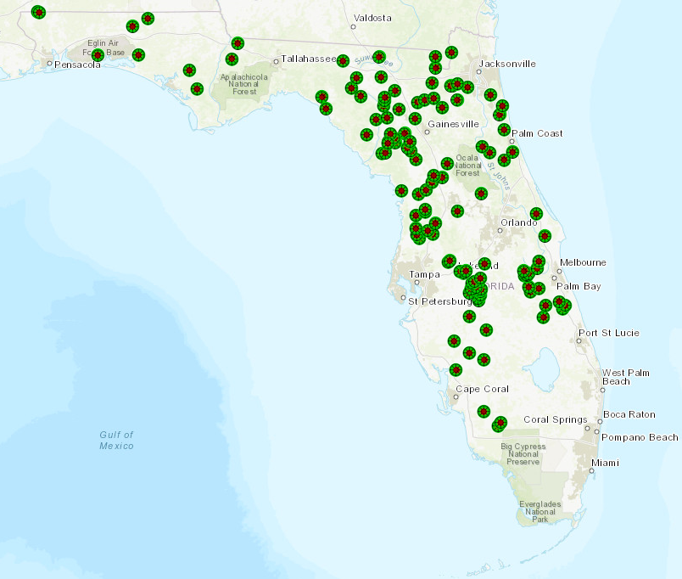
Map of Biosolids Land Application Sites
Biosolids Site Map (2018)

Slide 22
DEP and Biosolids Sites
DEP permits the treatment facilities and the land application sites
  Facility permittee treats and monitors biosolids
    Pathogen reduction, vector attraction reduction, metals limits
    Treatment, monitoring and hauling records
    Reporting - DMRs and land application annual summary report
    Treatment Facility Biosolids Plan identifies the application sites where the treatment facility may send its biosolids
    Class AA distribution and marketing requires a fertilizer license or must be sold or given to someone with a fertilizer license (exception for compost outside Northern Everglades watersheds)
  Site permittee must operate and apply the biosolids in accordance with their permit and state and federal regulations which requires:
    Site and application zone requirements
    Crop and biosolids application rates
    Record keeping - hauling, applications, soil pH, etc.
    Biosolids Application Site Annual Summary reports loadings
    Class AA distribution and marketing does not require a permitted site

Slide 23
Regulatory Program for Land Application – Permitting
Biosolids land application sites must be permitted
  Individual permit is required, except a site may be permitted as part of a facility permit if the facility is the only facility using the site
  Applicant must submit a Biosolids Site Permit Application, DEP Form 62-640.210(2)(d), and a site-specific nutrient management plan (NMP) submitted with the permit application
    Determines application rates based on crop nutrient need
    Phosphorus assessment
    Soil fertility testing
  Must meet site requirements addressing site slope, storage, seasonal high ground water table, setbacks, signage, cumulative application limits, public access, and harvesting restrictions, etc.
  The site permittee does not have to be the land owner – instead, the site permittee could be a biosolids hauler/contractor, or a wastewater treatment facility permittee

Slide 24
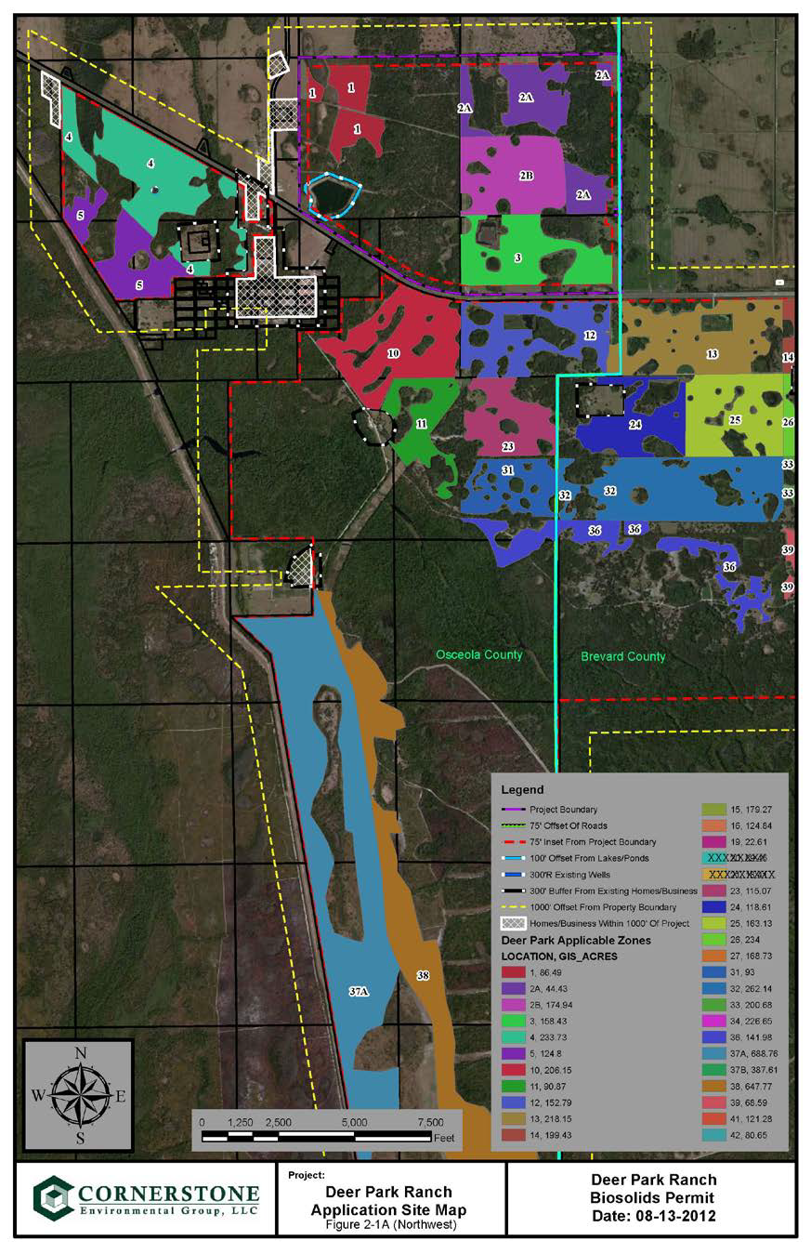
Site Example
Biosolids site in Osceola and Brevard Counties, shows the application zones, setbacks, etc.
This site has 30 application zones covering 5,736 acres
The odd shapes of the application zones, or fields, primarily result from setback buffers (i.e., wetlands, surface waters, residences, etc.)

Slide 25
Regulatory Program for Land Application – NMP
Rule 62-640.500, F.A.C., requires a nutrient management plan (NMP) to be submitted with the permit application for an agricultural site
NMP must be site specific - submitted with site permit application
  Signed by certified nutrient management planner (CNMP) or P.E.
  Identifies application zones, NMP implementation, site operation and maintenance, and record keeping (for NMP), maps, soil survey, soil fertility testing frequency
  Includes any soil, water, plant tissue and biosolids analyses, as applicable
Application rates are the heart of the NMP
  Considerations include phosphorus assessment (Florida P-Index), all nutrient sources, nitrogen mineralization, realistic annual yield goals, biosolids calcium carbonate equivalency, method of land application, calculations
Additional requirements apply in Northern Everglades and Estuary Protection Program areas (Section 373.4595, Florida Statutes)

Slide 26
P-Index
Chapter 62-640, F.A.C., requires the NMP to include an assessment of the potential for phosphorus movement from each application zone
The Florida Phosphorus Index (P-Index) is a field-by-field evaluation tool to assess the potential risk of phosphorus loss from an agricultural field to surface and ground waters based on the phosphorus source, application rate, site characteristics, soil types, and management practices
Published by the Florida Natural Resource Conservation Service (NRCS) and developed in cooperation with other stakeholder agencies
  “The Florida Phosphorus Index: A Phosphorus Risk Assessment Tool,” 190-FLAGRFH, 8/04
  UF IFAS has published guidance on the P-Index for each individual county in Florida that can be used by permittees when using the P-Index http://edis.ifas.ufl.edu/topic_series_florida_phosphorous_index
The P-Index helps evaluate if nutrient management (i.e. application rates) at a biosolids site should be based on nitrogen (N) or phosphorus (P)
The P-Index needs updating – NRCS has been working on an update

Slide 27
Regulatory Program for Land Application – Site Requirements
Record keeping requirements include
  Hauling records of deliveries
  Site logs for applications to each zone (i.e., field)
Application rates are limited by the NMP
Cumulative loading tracking/limits
Annual reporting of loadings to each zone
Tracking of biosolids off-site is prohibited
Objectionable odors are prohibited
Department conducts site visits, inspections, compliance and enforcement

Slide 28
Regulatory Program for Land Application – Site Setbacks
Setback Feature | Distance
*Class I water, Outstanding Florida Water, or Outstanding National Resource Water | 1,000 ft
*Other surface water | 200 ft
*Other surface water – if biosolids incorporated or injected | 100 ft
Subsurface fractures, sinkholes, or other conduits to groundwater | 200 ft
Private potable well | 300 ft
Public potable well | 500 ft
**Occupied buildings - biosolids stored or stockpiled for more than 7 days | 1,320 ft
**Occupied buildings - Class B only | 300 ft
Occupied buildings - Class B only; incorporated or/injected | 100 ft
Property lines - Class B only | 75 ft
* Setbacks from surface waters shall be vegetated.
**May be reduced with building owner consent.
Note - Setbacks do not apply to surface waters owned entirely by one person other than the state which are located completely within the property and will not discharge from the property.

Slide 29
Regulatory Program for Land Application – Application Sites
Depth to groundwater
Runoff provisions (rain events, site slope, frequently flooded sites)
Soil pH
Class B pathogen related restrictions
  Public access restrictions
  Harvesting restrictions
  Grazing restrictions
  Disclosure of restrictions at sale
Notifications – cattle grazing, molybdenum

Slide 30
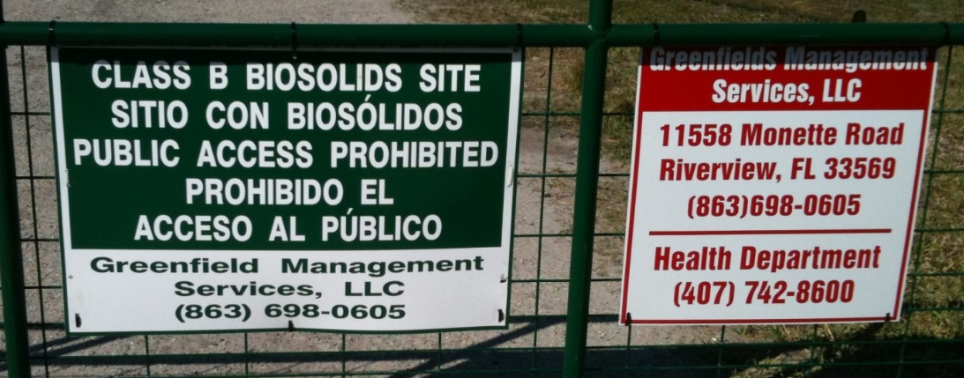
Regulatory Program for Land Application – Site Requirements
Alkaline-treated/lime-stabilized biosolids
  Must be applied within 24 hours of delivery to site
  Must be injected/incorporated or meet a 1,320 ft setback
Storage requirements
  Temporary storage (staging) is limited to 7 days
  Long term storage area must meet 1,320 ft setback
Advisory signs required

Slide 31
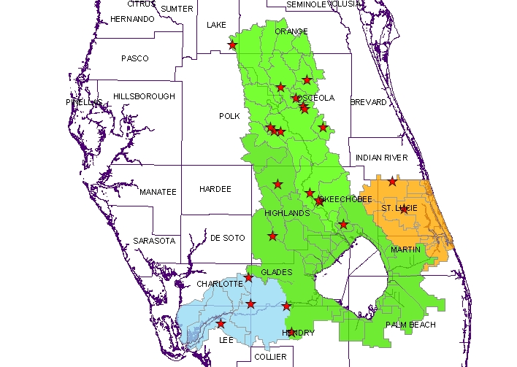
Northern Everglades and Estuaries Protection Program, 373.4595, F.S.
In 2007, legislation passed requiring applicants for land application sites in the Lake Okeechobee (including Kissimmee River), St. Lucie River, Caloosahatchee River watersheds to submit a demonstration of no-net loading for phosphorus/nutrients
  All 43 sites existing at the time of the legislation stopped land application as the facility permits allowing land application expired
  If a site is permitted in one of these areas, the site records will need to include annual documentation that no-net loading of phosphorus/ nutrients was met by accounting for all phosphorus applied to the site with the amount of phosphorus exported in products generated on the site
  Class AA biosolids distributed and marketed as fertilizer are not subject to the provisions

Slide 32
Septage Management Facilities Regulated by DEP
The land application of septage under Florida Department of Health regulations was prohibited after June 30, 2016 (Section 381.0065(6), Florida Statutes)
Approximately 80-90 septage businesses under DOH were affected by the statute
DEP permits for biosolids treatment facilities (BTFs), and septage management facilities (SMFs) are regulated under Chapter 403, Florida Statutes, and may continue to accept, treat, and land apply biosolids and/or septage under Chapter 62-640, F.A.C.
Under DEP rules, septage is regulated as “biosolids”
Since 2016, DEP has issued 42 septage management facility permits

Slide 33
Alternative Technologies
Florida biosolids-related bioenergy technologies and projects
Gasification
  Maxwest (City of Sanford) – no longer operating
Supercritical Water Oxidation
  Orlando pilot project
Anaerobic Digestion Produces energy (methane production)
  Significant volume of biosolids leftover
  Harvest Energy Garden facility in Orlando; planned St. Pete facility (there are also some older facilities)
Waste-to-energy facilities
  A few facilities have option in permit to burn biosolids
  Usually dried or pelletized biosolids
  Air permit required/mercury concerns

Slide 34
For Additional Information
Maurice Barker
Biosolids Coordinator
maurice.barker@dep.state.fl.us
850-245-8614
DEP’s Biosolids Webpage:
https://floridadep.gov/water/domestic-wastewater/content/domestic-wastewater-biosolids

