Slide 1
Biosolids:
Nutrient Management Plans, the Florida Phosphorus Index, and Site Permitting
Division of Water Resource Management
October 2018

Slide 2
Presentation Outline
Part I – Quick Overview of Land Application
Part II – Nutrient Management Plans (NMPs)
Part III – Florida Phosphorus Index (P-Index)
Part IV – Basics for Permitting a Site

Slide 3
Overview

Slide 4
Nutrient Management Plan (NMP)
A biosolids nutrient management plan is a site-specific plan, developed in accordance with Rule 62-640.500, F.A.C., establishing the rate at which all biosolids, soil amendments, and sources of nutrients can be applied to the land for crop production while minimizing the amount of pollutants and nutrients discharged to waters of the state.

Slide 5
Nutrient Management Plans
A site specific Nutrient Management Plan (NMP) is a permit requirement (Rule 62-640.500, F.A.C)
Applies to agricultural biosolids land application sites
Intended to be a stand-alone plan that anyone can read to understand how biosolids are used and managed as part of the agricultural operations at the site for crop production
NMP specifies:
  Site restrictions
  Application rate
  Applications zones
  Application method (surface applied, incorporations, etc.)

Slide 6
NMP Rule Requirements
Rule 62-640.500, F.A.C., requires a site-specific nutrient management plan (NMP) to be submitted with the site permit application for an agricultural site
Florida Natural Resources and Conservation Service (NRCS) Field Office Technical Guide – Nutrient Management, Code 590, September 2007, is specifically listed as providing technical guidance in the preparation of NMPs
NMP must be signed by certified nutrient management planner or a professional engineer (P.E.) registered in Florida
  Certified nutrient management planners are listed on NRCS website under information for Technical Service Providers (TSP)
Identifies the application zones (e.g. fields) to be used at the site, which shall be sized to facilitate accurate accounting of nutrient and pollutant loadings
Additional requirements apply in the Northern Everglades and Estuary Protection Program areas (s. 373.4595, F.S.)

Slide 7
NMP Rule Requirements
NMP Rule Requirements
The components required for the NMP were primarily drawn from FL NRCS Code 590 with appropriate revisions for biosolids
  Aerial maps and soil survey maps
  Guidance for NMP implementation, site operation and maintenance, and record keeping
  Results of any soil, water, plant tissue and biosolids analyses, as applicable
  Frequency of future soil fertility testing (at least once every five years)
  Establish rates of application for at least a five-year period (continued on next slide)

Slide 8
NMP Rule Requirements
Establish rates of application for at least a five-year period; NMP shall include (as applicable):
  Assessment of the potential for phosphorus movement from each application zone (e.g. P-Index)
  Listing and quantification of all nutrient sources for each application zone
  Availability of nitrogen in biosolids being applied and previously applied
  Current and planned plant production and crop rotation for each application zone
  Realistic annual yield goals for each crop for each application zone
  Recommended nitrogen and phosphorus application rates (i.e. nutrient demand)
  Calcium carbonate equivalency of any alkaline-treated biosolids and recommended lime application rates
  Method of land application for each application zone
  Methodology and calculations used to determine the application rates for each application zone

Slide 9
NMP Rule Requirements
Methodology and calculations/Nitrogen availability
  Most of the nitrogen in biosolids is organic and must mineralize to become available to the crop (similar to manure)
  Mineralization occurs slowly over several years
  Biosolids are monitored for total nitrogen (TN)
  Fertilizer rates are generally based on plant available nitrogen (PAN)
  The permittee can calculate an application rate that provides the recommended amount of available nitrogen for the crop
    The application rate may be given as the amount of biosolids TN that should be supplied to provide the amount of available N (PAN) to meet crop demand (most sites in Florida determine application rates in this manner)
    The application rate could also be given in dry tons of biosolids per acre
    Two sites in Florida calculate the amount of PAN in each facility’s biosolids (convert the biosolids TN analysis to PAN) and track loadings in PAN

Slide 10
NMP Rule Requirements
DEP shall accept the following when accounting for nitrogen availability
  Chapter 7 EPA Process Design Manual calculations to account for nitrogen availability over several years (mineralization rates differ depending on the biosolids treatment type)
    First year PAN = NO₃-N + K_{vol}(NH₄-N) + K_{min}(Org-N)
    In the second year, the amount of PAN becoming available from the first year’s application is calculated based off the remaining amount of organic nitrogen (i.e. after the first year’s mineralized nitrogen is subtracted) and using the second year mineralization rate; this is continued for additional years
    The amount of biosolids allowed to be applied in following years basically decreases because of the PAN becoming available from previous years’ applications; settles out around year 4
  Alternatively, permittees can use a conservative 1.5 factor developed by DEP based on more restrictive situations under the EPA calculations
    Provides a single, yearly rate (already accounts for mineralization, etc.)

Slide 11
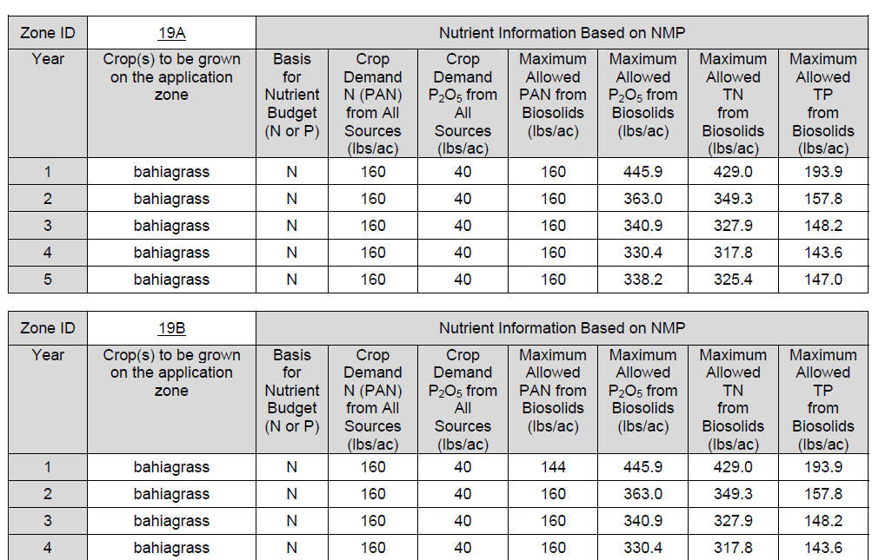
Application Rate Example:
EPA Calculations
11

Slide 12
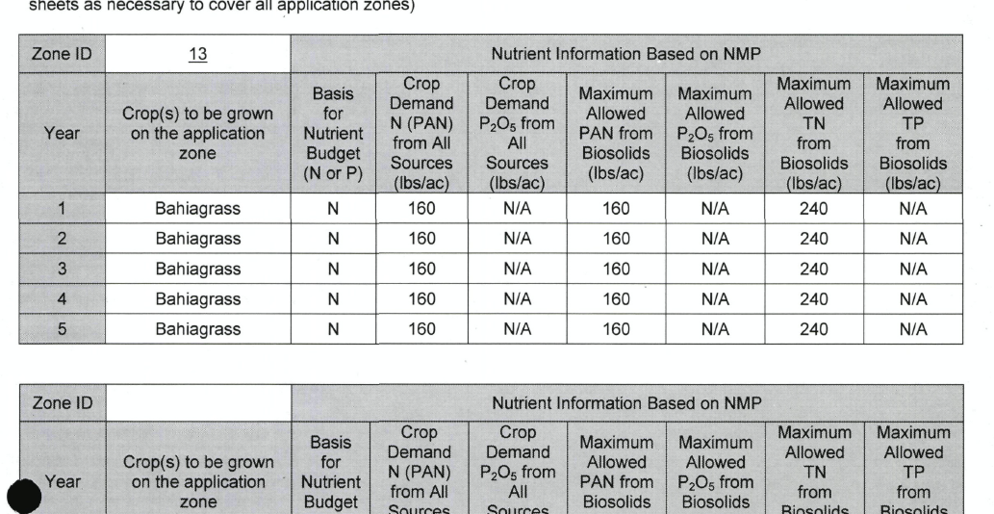
Application Rate Example:
DEP 1.5 Factor
12

Slide 13
NMP Rule Requirements
Other requirements for NMPs under Rule 62-640.500, F.A.C.
  NMPs must be based on phosphorus for specific geographic areas as identified by statute as being subject to restrictions on phosphorus loadings
    Lake Okeechobee watershed, Lake Apoka, Green Swamp, Everglades Agricultural Area
  Additional requirements apply in Northern Everglades and Estuary Protection Program areas (s. 373.4595, F.S.)
    Demonstration of no-net loading of phosphorus required from applicants for land application sites in the Lake Okeechobee, St. Lucie River, and Caloosahatchee River watersheds

Slide 14
NMP and Calcium Carbonate Equivalency (CCE)
The NMP must include the CCE of alkaline-treated biosolids that may be applied and the recommended lime application rates for each application zone
  Informs the land owner or agricultural producer of the liming potential of biosolids compared to the recommended lime recommendations since CCE expresses the relative liming potential of a material compared to pure calcium carbonate
  A CCE value of 30-33% would mean that 3 dry tons of biosolids would also provide the equivalent of about 1 ton of lime
  Alkaline-treated biosolids tend to have lower %TN values resulting in higher loading rates in dry tons
  While many Florida soils are acidic and typically benefit from lime addition, over-liming can be harmful to crops as well, particularly bahiagrass which IFAS recommends a soil pH range of 5.5 – 6.5
  UF IFAS publication SS-AGR-29, “Soil pH and Liming Issues Affecting Bahiagrass Pasture,” noted the loss of substantial portions of bahiagrass to weeds on some pastures in Polk, Pasco, and Hardee counties following repeated applications of excessive amounts of lime-treated biosolids that raised soil pH to about 7
There is no regulatory restriction on the amount of lime equivalent that can be applied by biosolids and no regulatory upper limit on pH of soil at a site (pH must only be higher than 5)

Slide 15
Method of Application
The NMP shall include method of biosolids land application for each zone
Examples – surface application, injection, incorporation, surface application followed by incorporation 1 day later, etc.
The method of application affects the calculations for:
  Application rates when using the EPA calculation method
  P-Index
The method of application can also affect setback distances since some setback distances can be reduced if the biosolids are injected or incorporated (e.g. surface waters, buildings occupied by the public, etc.)

Slide 16
NMP Observations
Almost all NMPs for site permits have been prepared by P.E.s
  P.E.s provide reasonable assurance that NMPs are appropriately prepared
  Majority of P.E.s choose to use the EPA calculations which results in higher loading rates than DEP 1.5 factor
  The applicant, not DEP, selects the crop and recommended fertilizer rates for the agricultural operation at the site
    UF/IFAS recommended fertilizer rates (e.g. SL-129) consider economics of crop yields and costs of fertilizer etc.
    Most sites are pastures; applicants choose the High-N option (160 lbs N)
  The values chosen by the P.E. for the P-Index also affect those calculations
  The NMPs and P-Index calculations are reviewed by DEP
  Regulatory use of NMPs, P-Index, and fertilizer recommendations
NMPs are not always clear, straight-forward, or easy to decipher
  No official “form”; an example was provided based on NRCS training
  Copying of other NMPs, cut and pasting, etc., has been observed

Slide 17
Sample NMP
The specified components for an NMP from Rule 62-640.600, F.A.C., are mixed into the following general format:
NMP Signature Page
Executive Summary
NMP Purpose and Conditions
NMP Body
  Section 1: Site/Operational Information
  Section 2: Maps and Soil Survey
  Section 3: Nutrient Management
  Section 4: Record Keeping
  Section 5: Operation and Maintenance

Slide 18
Nitrogen vs. Phosphorus Rates
When biosolids are applied at an N-based rate, more phosphorus is typically applied than a crop needs
The ratio of N/P in biosolids is different than the ratio of N/P that crops typically need
  Ratio of N to P in biosolids is generally about 2:1 (N to P₂O₅ is about 1:1)
    Florida biosolids average about 5% TN by dry weight
    Florida biosolids average about 2.5% TP by dry weight
  Recommended N to P (or P₂O₅) for crops is higher than concentrations in biosolids (2:1 to 4:1)
  Availability of P in biosolids? 10%? 33%? 40%? 80%?

Slide 19
Florida Phosphorus Index
(P-Index)
Chapter 62-640, F.A.C., requires the NMP to include an assessment of the potential for phosphorus movement from each application zone
The tool available to applicants is the Florida Phosphorus Index (i.e. P-Index) and is referenced in FL NRCS Code 590
The Florida Phosphorus Index (P-Index) is a field-by-field evaluation tool to assess the potential risk of phosphorus loss from an agricultural field to surface and ground waters based on the phosphorus source, application rate, site characteristics, soil types, and management practices, etc.
Published by the Florida Natural Resource Conservation Service (NRCS) and developed in cooperation with other stakeholder agencies
  “The Florida Phosphorus Index: A Phosphorus Risk Assessment Tool, ” 190-FLAGRFH, 8/04
  UF IFAS has published guidance on the P-Index for each individual county in Florida that can be used by permittees when using the P-Index http://edis.ifas.ufl.edu/topic_series_florida_phosphorous_index.
The P-Index helps evaluate whether application rates for biosolids sites should be based on N or P

Slide 20
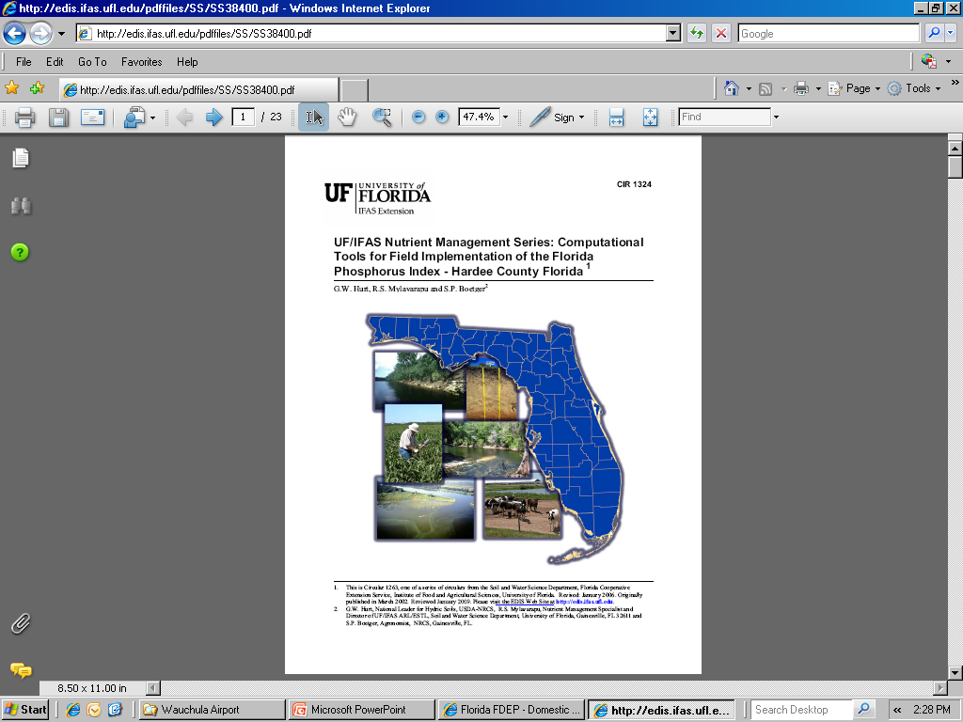
IFAS P-Index County Series

Slide 21
P-Index Table 1
Table 1 (Part A): Transport Potential Due to Site Transport Characteristics
Site Characteristics | Phosphorus Transport Rating | Value (Example)
Soil Erosion (Based on the Revised Universal Soil Loss Equation, this value is s typically “1”. Some NMPs use “0” for no surface outlet which means no overland flow from a 2 year – 24 hour rainfall event (about 5 inches of rain over 24 hours).) | No Surface Outlet = 0 <5 T/Aª = 1 5-10 T/A = 2 >10-15 T/A = 4 >15 T/A = 8 | 1
Runoff Potential (Based on soil type, slope, drainage, etc. This value can be found in the county IFAS P-Index guidance or soil surveys. “0” is used for no surface outlet.) | Very Low = 0 Low = 1 Medium = 2 High = 4 Very High = 8 | 4
Leaching Potential (Based on soil type and characteristics. This value can be found in the county IFAS P-Index guidance or soil surveys.) | Very Low = 0 Low = 1 Medium = 2 High = 4 Very High = 8 | 4
Potential to Reach Water Body (Based on discharge factors. For biosolids, this should be either “0” for no direct discharge or “1” for discharge via a buffer area.) | Very Low = 0 Low = 1 Medium = 2 High = 4 | 1
 | Sum for Table 1 (Part A): Site and Transport^{b} | 10
ª T/A = Tons per Acre per Year
^{b} If the sum for Table 1 is 0 (Zero), then change the sum to 1 (one).

Slide 22
P-Index Table 2
Table 2 (Part B): Phosphorus Loss Potential Due to Source and Management
Phosphorus Source Management | Phosphorus Loss Rating | Value (Example)
Fertility Index Value (Based on the soil test results for available P) | Soil Fertility Index x 0.025 ( ____ ppm P x 2 x 0.025)^{c} | 1.25 (25 ppm P)
P Application Source and Rate^{d} (Based on the type of material. The initial evaluation should be conducted at an N based rate. Note that the phosphorus is in P2O5, so multiply a TP value by 2.3 to get the P2O5 value) | 0.05 x ( ___ lbs P2O5/acre) for fertilizer, manure, or compost 0.015 x ( _____ lbs P2O5/acre) for biosolids 0.10 (x ____ lbs P2O5/acre) for waste water | 5.17 (2.5% TP at 3 dry tons per acre)
Application Method (Based on how the biosolids are applied) | 0 = No Surface Outlet or solids incorporated immediately or injected 2 = Applies via Irrigation or solids incorporated within 1 day of application 4 = Solids incorporated within 5 days of application^{e} 6 = Solids not incorporated within 5 days of application | 6
Waste Water Application (This doesn’t appear to be calibrated for reuse) | 0.020 x ____ acre inches/acre/year | 0
 | Sum for Table 2: Phosphorus Source | 12.42
 | P Index Value: Sum Table 1 x Sum Table 2 | 124.2
^{c} From soil test (Mehlich 1) results
^{d} Initial evaluation should be N-based rates
^{e} Solids include fertilizers, composts, biosolids, and manure and other animal wastes

Slide 23
P-Index Interpretation
The P-Index value determines whether the nutrient management (i.e. application rate) will be based on nitrogen (N) or phosphorus (P)
P Index Value | Generalized Interpretation of P Index for Site
<75 | Low Potential for P movement from site. If farming practices are maintained at the current level there is a low probability of an adverse impact to surface waters from P losses at this site. Nitrogen-based nutrient management planning is satisfactory for this site. Soil P levels and P loss potential may increase in the future due to N-based nutrient management.
75 - 150 | Medium potential for P movement from this site. The chance for an adverse impact to surface water exists. Nitrogen-based nutrient management planning is satisfactory for this site when conservation measures are taken to lessen the probability of P loss. Soil P levels and P loss potential may increase in the future due to N-based nutrient management.
151 - 225 | High potential for P movement from the site and for an adverse impact on surface waters unless remedial action is taken. Soil and water conservation as well as P management practices are necessary (if practical) to reduce the risk of P movement and water quality degradation. If risk cannot be reduced then a P-based management budget based on crop P requirement will be utilized.
> 225 | Very High potential for P movement from the site and for an adverse impact on surface waters. Remedial action is required to reduce the risk of P movement. All necessary soil and water conservation practices, plus a P-based management plan must be put in place to avoid the potential for water quality degradation. The P-based management plan will be based on less than crop P requirement to reduce P over a defined period (not to exceed 20 years).

Slide 24
P-Index Considerations
P-Index last published in 2004
Mehlich I named in the P-Index
Leaching in sandy soils; Soil Phosphorus Storage Capacity (SPSC)
“No surface outlet”
Incorporation considerations
Conservation measures
Regulatory use of P-Index, NMPs, and fertilizer recommendations

Slide 25
Summary – Determining an Application Rate for Biosolids
Determine crop to be grown (e.g. bahiagrass)
Determine crop demand (lbs/acre) for nutrients based on fertilizer rates or crop nutrient removal rates
Subtract N or P from other sources to get adjusted demand for the amount allowed from biosolids (if no other nutrients are applied then biosolids may supply the full demand)
Determine potential application rate for N
  EPA method: PAN per dry ton of biosolids = NO₃-N + K_{vol}(NH₄-N) + K_{min}(Org-N); and the use PAN to determine dry tons; convert to TN
    Project out for at least 5 years to determine each year’s allowed loading rate
    Must account for remaining N to mineralize from previous applications (i.e. how much of the Org-N from previous years’ applications is mineralizing in each future year and subtract this from crop demand)
  DEP method: Required PAN/acre x 1.5 = TN/acre allowed (same rate all 5 years)
Conduct P-Index based on desired application rate
  If P-Index result is low or medium, then can apply at N-based rate
  If P-Index result is high or very high, then apply based on P or try a lower application rate until the P-Index result is low or medium

Slide 26
Permitting a Site
An applicant (site permittee) submits the site permit application form with the site specific NMP to the applicable DEP district office
The DEP district office has 30 days to review the application and NMP for completeness
  If incomplete, a Request for Additional Information (RAI) is sent and the time clock stops
  The district office has 30 days to review the RAI response
  May send multiple RAIs
Once deemed complete by the district office, DEP has 90 days to approve or deny the permit application; new sites are subject to public notice publishing requirements
DEP district offices typically conduct site visits to physically review the site and use online resources, such as GIS, to verify certain information

Slide 27
Site Permitting Basics
Application package includes:
  DEP Form 62-620.910(1) Wastewater Facility or Activity Permit Application—General Information—Form 1
  Biosolids Site Permit Application, DEP Form 62-640.210(2)(d), and related attachments as indicated on the form, such as:
    Maps, documentation, background soil sampling, etc.
    Descriptions of any storage areas, application methods, etc.
    Ground water monitoring plan, if required
    $1000 fee (unless being permitted as an exclusive site under a treatment facility permit)
  Nutrient management plan (NMP) must be submitted with the biosolids site permit application (site-specific)

Slide 28
Biosolids Site Permit Application
Biosolids Site Permit Application, DEP Form 62-640.210(2)(d)
Includes basic information and checklists for requirements
  Part I. General information - site name, permittee name, land owner, etc.
  Part II. Site information checklist - maps, setbacks, ground water level/monitoring, storage, soil testing, recordkeeping, advisory signs, NMP and fee included, etc.
  Part III. Application zone summary – zone ID, acreage, slope, gw table, application method
  Part IV. Application zone initial background soil testing results
  Part V. Application zone current cumulative loadings
  Part VI. Application zones - NMP summary (allowed loadings for each zone)
  Part VII. NMP Checklist
Signatures
  Part VIII. Land owner consent
  Part IX. Site permittee signature/certification
View Biosolids Site Permit Application

Slide 29
Other Items Reviewed
In addition to the NMP and application rates, other key items reviewed during the permit application process include:
Ownership of the land, land owner consent
Nearby water bodies, wetlands, water features, etc.
Any storage provisions for biosolids at the site
Seasonal high ground water table/ground water monitoring
Setbacks (surface waters, wells, sinkholes, property lines, etc.)
Site slopes, “frequently flooded” areas, soil pH
Advisory signs
Any applicable harvesting restrictions
If any alkaline-treated biosolids will be applied to the site
Planned agricultural operations, crops being grown
Application method
Location of site records
For existing sites - past reports, complaints, etc.

Slide 30
Questions?
Maurice Barker
maurice.barker@dep.state.fl.us, 850-245-8614
DEP’s Biosolids Webpage:
https://floridadep.gov/water/domestic-wastewater/content/domestic-wastewater-biosolids

