Slide 1
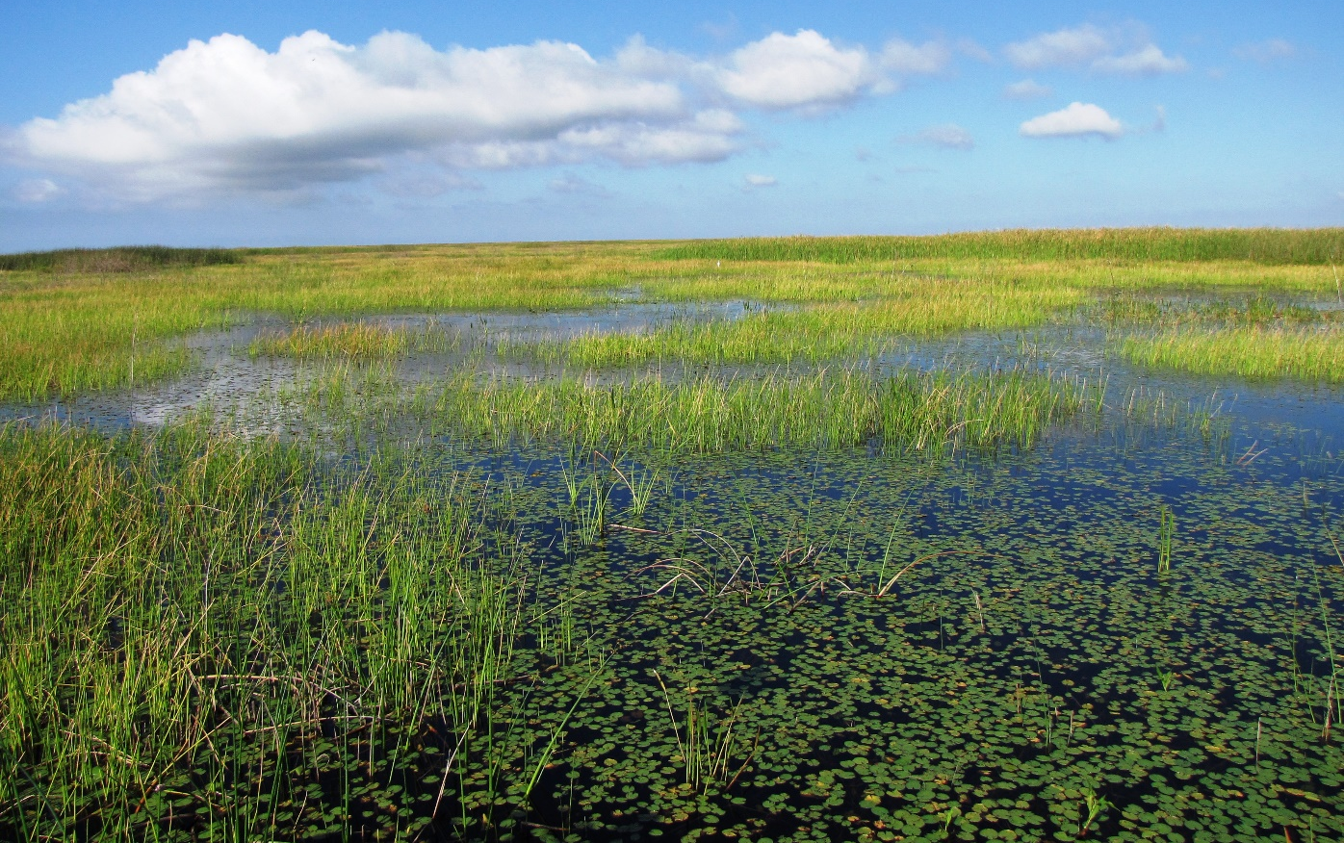

Biosolids
Technical Advisory Committee
Biosolids and water quality criteria
January 23, 2019
Paul N. Gray, Ph.D., Science Coordinator
Everglades Restoration Program

Slide 3
Phosphorus in Okeechobee is way too high
P Goal = 40
Notes:
SFER 2018 Lake O chapter

Slide 4
Lake Okeechobee phosphorus TMDL
Florida Department of Environmental Protection. 2000. Total maximum daily load for total phosphorus Lake Okeechobee, FL. LOTAC Committee, FDEP, Tallahassee
In-lake TP goal is 40 ppb (0.04 mg/l) to avoid harmful algal blooms
Inflow goal is 140 mt/year on a 5-year average
  35 tons from rain and dust
  105 tons from inflows
Each acre of the 2.6 million acre watershed must average about 1/10th of a pound to meet the TMDL

Slide 5
SJRWMD sites
2016: ~46 pounds TP acre
2017: ~55 pounds TP acre
COUNTY | FACILITY ID | SITE NAME | ACRES | DRY TONS APPLIED 2016 | DRY TONS APPLIED 2017
Brevard | FLA395731 | Jakubcin | 200 | 191.70 | 83.1
Brevard | FLA844462 | Port St. John Site | 85.5 | 33.75 | 0
Indian River | FLA896616 | Fellsmere Joint Venture | 2005 | 245.61 | 0
Indian River | FLA626040 | Flying L Ranch | 659 | 1464.50 | 1161.7
Indian River | FLA790940 | Ox Creek Ranch | 432 | 0.00 | 0.00
Indian River | FLA801097 | Pressley Ranch | 3059 | 2932.10 | 5277.4
Okeechobee | FLA499170 | Tir na n'Og Ranch | 161 | 39.65 | 83.96
Osceola | FLA863289 | Bronson Ranch | 1695.4 | 2983.50 | 1954.1
Osceola | FLA697761 | Cecil Whaley Ranch | 3715 | 6876.29 | 3737.8
Osceola | FLA318728 | Clay Whaley Ranch | 1436.3 | 6018.75 | 4809.24
Osceola | FLA829374 | Crescent J Ranch-RMF | 665.2 | 689.00 | 3746.83
Osceola | FLA318655 | Deer Park Ranch | 5735 | 11058.20 | 8966
Osceola | FLA581356 | Deseret Ranches | 42419 | 33280.97 | 49108.82
Osceola | FLA888982 | Folsom Davis Ranch | 339 | 988.00 | 2869.52
Osceola | FLA617903 | Hayman 711 Ranch | 4513 | 0.00 | 1762.7
Osceola | FLA832243 | Kenansville Ranch | 2885.2 | 5138.60 | 1488
Osceola | FLA847241 | Montsdeoca | 1077 | 2078.00 | 4468.89
 |  | Totals | 71081.6 | 74018.62 | 89518.06
Source: Stephanie Gudeman email to Lisa Rinaman 12/15/18

Slide 6
From Maurice Barker’s presentation today (1/23/19)

Slide 7
Significant issue:
The phosphorus index is unrelated to water quality goals

Slide 8
Clean-up cost liability
Depending on many factors, phosphorus removal from waterways generally ranges from $50-150 per pound
If the annual statewide Class B land application is 100,000 tons containing 2,200 tons of TP and about 726 tons of available P, the clean-up liability could be in the range of $73-218 million.

Slide 9
Why target biosolids?
Biosolids can benefit agriculture
But land application primarily is a disposal effort
  Not BMP compliant, not applied seasonally or specifically
  Ranches/farms don’t “need” it
The amounts are increasing and locations to dispose of it are decreasing
  Recipient locations become liable for other people’s nutrients
We have control over it when it is in the truck

Slide 11
Blue Cypress
Blue Cypress
  6500 acres
  Average depth 8 feet
  Calculated volume 52,000 acre-feet
  Watershed area 63,588 acres
Okeechobee
  Volume at 15 feet: 4M acre-feet; 75 times larger volume
  Watershed 2.6 million acres; 40 times larger watershed
  Proportional TMDL 1.4 mt (3.15 mt corrected for 90 ppb goal)

