Slide 1
Total Maximum Daily Loads and Basin Management Action Plans
November 16, 2018

Slide 2
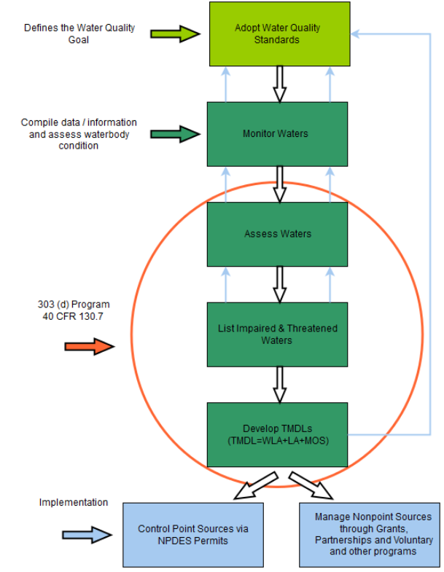
Federal Requirements
Clean Water Act (CWA): 33 U.S.C. §1251 et seq. (1972) water quality-based approach
  Section 303(d) requires states to:
    Identify waters that are impaired or in danger of becoming impaired
    Calculate and allocate pollutant reduction levels necessary to meet approved water quality standards
  Section 319(h) addresses nonpoint sources
    provides funds to state to implement approved nonpoint source management programs
https://www.epa.gov/tmdl/overview-identifying-and-restoring-impaired-waters-under-section-303d-cwa

Slide 3
Total Maximum Daily Load (TMDL)
Maximum amount of a pollutant that a waterbody can assimilate without causing exceedances of water quality standards.
TMDL is a Restoration Target
TMDL =
TMDL ≅ ∑ WLAs_{NPDES wastewater} + ∑ WLAs_{NPDES stormwater} + ∑ LAs + MOS
Sum of wastewater point source loadings within basin
Municipal Separate Storm Sewer Systems (MS4)
Nonpoint Sources

Slide 4
Florida’s Requirements
Section 403.067, Florida Statute (F.S.) established the Florida Watershed Restoration Act in 1999
Set Water Quality Standards
Monitor and Assess Waterbodies
Impaired Waterbodies (303d) List
Total Maximum Daily Load Development
Restoration - Basin Management Action Plan
  Section 373.4595, F.S. - Northern Everglades and Estuaries Protection Program (NEEPP)
  Chapter 373, Part VIII - Outstanding Florida Springs (OFS)
Water Quality Framework

Slide 5
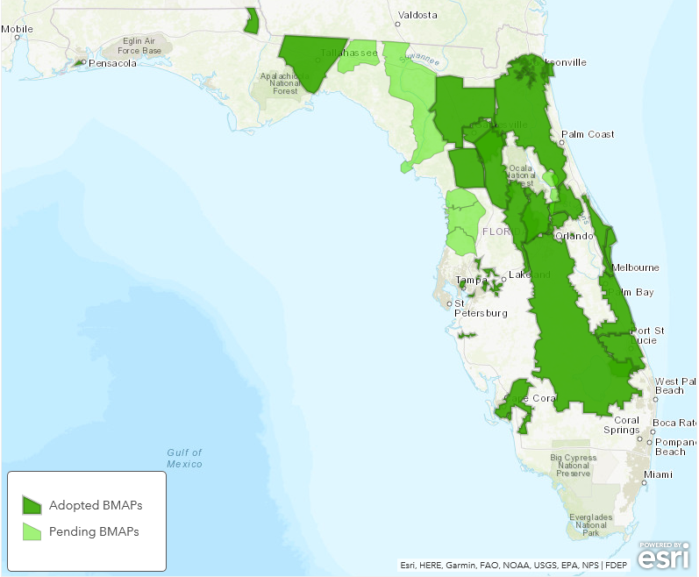
Basin Management Action Plan (BMAP)
One of DEP’s methods for restoring water quality in an impaired water body
BMAPs are:
  Developed with stakeholder input
  Adopted by DEP Secretarial Order
  Enforceable
  Implemented through a phased approach
  Reviewed annually
403.067, F.S. (7) Development of Basin Management Plans and Implementation of Total Maximum Daily Loads.
https://floridadep.gov/dear/water-quality-restoration/content/basin-management-action-plans-bmaps

Slide 6

Agriculture and BMAPs
Agricultural producers within a BMAP must:
  Enroll in Florida Department of Agriculture and Consumer Services (FDACS) Best Management Practices (BMPs);
  or
  Monitor Water Quality For Compliance
Benefits of FDACS enrollment:
  Presumption of Compliance
  Eligibility for cost-share funding
  Technical assistance
  Improved Water Quality
http://www.freshfromflorida.com/Business-Services/Water/Agricultural-Best-Management-Practices

Slide 7
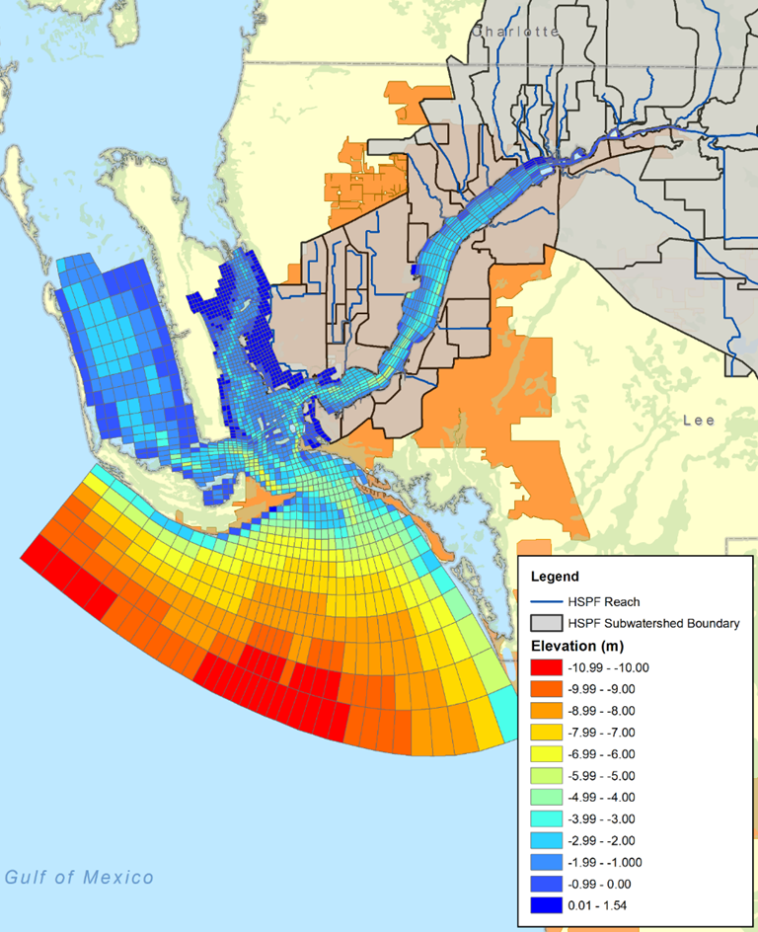
Modeling – TMDLs and BMAPs
TMDLs developed using a range of techniques
  simple mass balance calculations to complex water quality modeling approaches
Fate and transport models based on best available data
  Land Use
  Rainfall data
  Runoff Coefficients (ROCs)*
    coefficient relating the amount of runoff to the amount of precipitation received
  Event Mean Concentrations (EMCs)*
    flow-weighted average concentration for a rainfall-runoff event
    pollution load mass/runoff volume
  *EMCs, ROCs for LU categories, not specific parcels
Distance from impaired waterbody influences pollutant attenuation

Slide 8
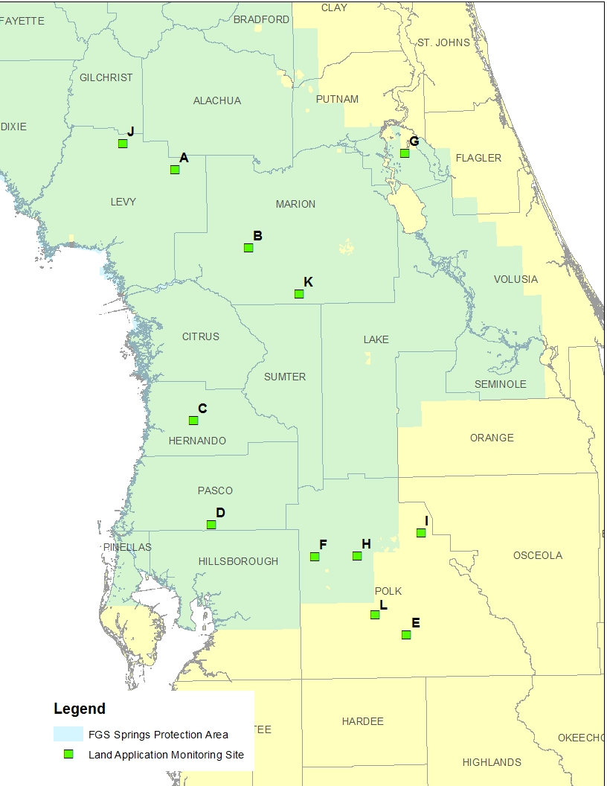
Additional Watershed Studies
For BMAPs, we often need more info and implement additional studies
Study on environmental impacts of septage land application
    12 representative septage land application sites
    Provide information on nitrogen and phosphorus levels in groundwater
    Evaluate the conditions that contribute to higher nutrient levels

Slide 9
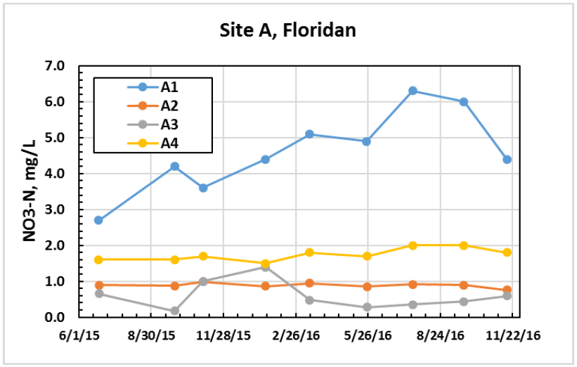
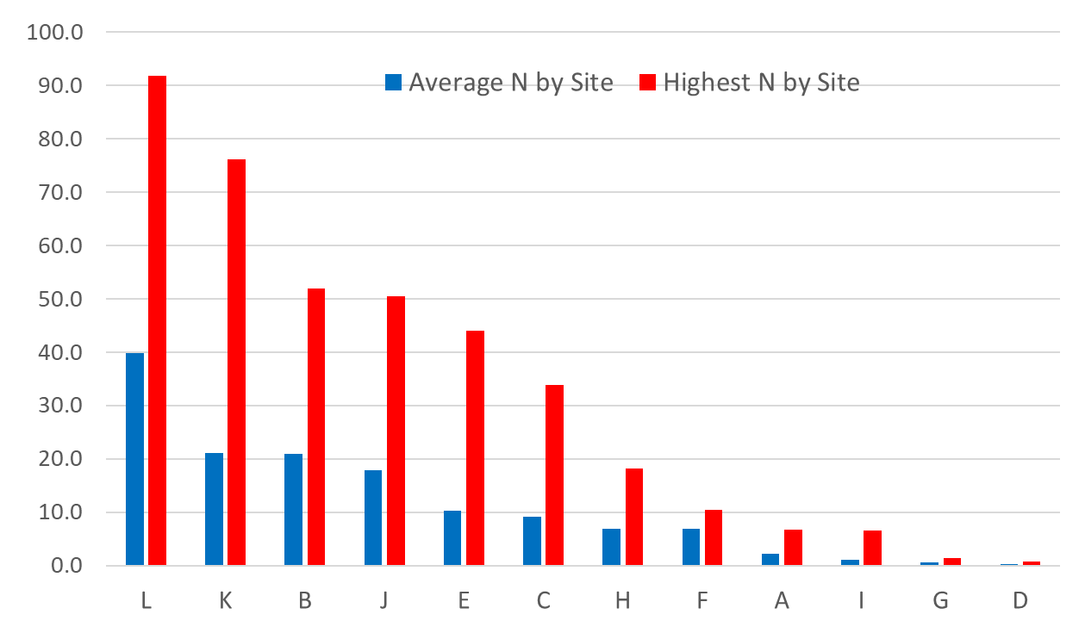
Additional Watershed Studies, cont.
Varied conclusions related to elevation of and temporal trends in nutrient concentrations.
Nitrogen level (mg/L)
Site ID
  Other BMAP studies on nutrient levels in groundwater, nutrient budgets, etc. have been conducted.

Slide 10
Springs BMAPs and Biosolids
Florida Springs and Aquifer Protection Act (Section 373.811, F.S) prohibits specific activities in priority focus areas (PFAs) including
  Land application of Class A or Class B domestic wastewater biosolids not in accordance with a DEP-approved nutrient management plan establishing the rate at which all biosolids, soil amendments, and sources of nutrients at the land application site can be applied to the land for crop production while minimizing the amount of pollutants and nutrients discharged to groundwater or waters of the state.
Additional requirements apply to newly-permitted and existing biosolids and septage application sites upon permit renewal.
  Agricultural operations must be enrolled in the FDACS BMP program.
  Effective nutrient management practices must be ongoing at the application zones in the permit.
  Groundwater monitoring for nitrate is required for all biosolids and septage land application sites in the PFA
    not required under some specific circumstances of reduced application rates

Slide 11
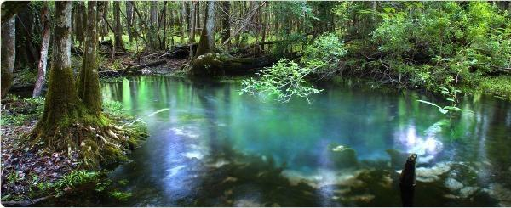
Contact Information
Sara Davis, Environmental Manager
Water Quality Restoration Program
Sara.C.Davis@dep.state.fl.us, 850.245.8825

