Slide 1
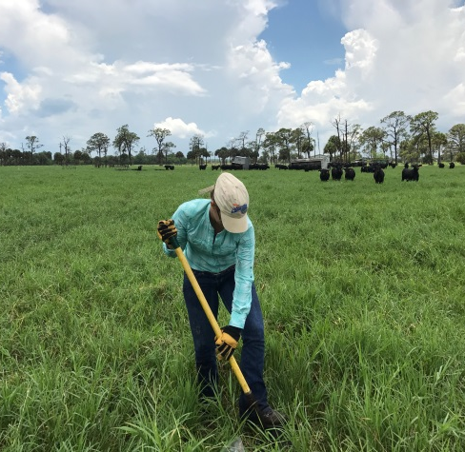
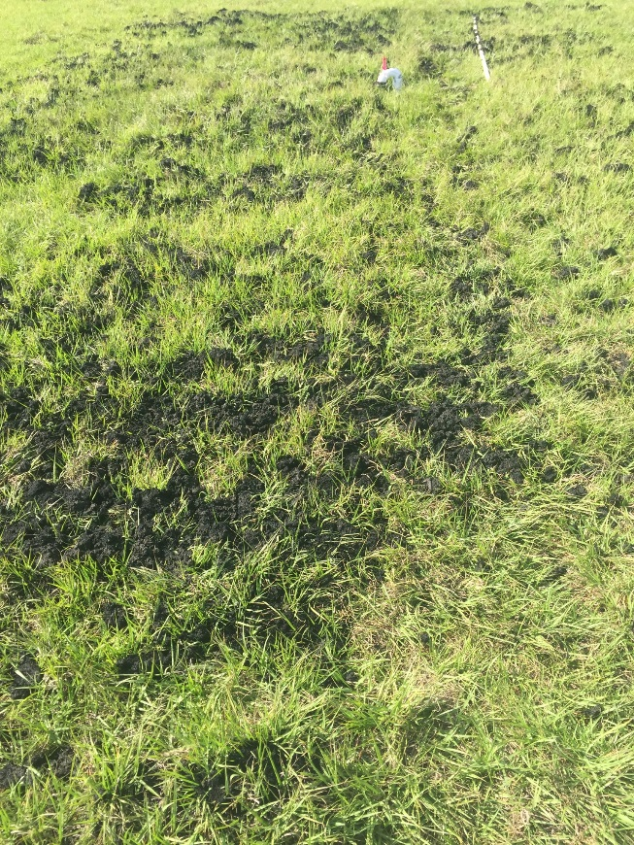
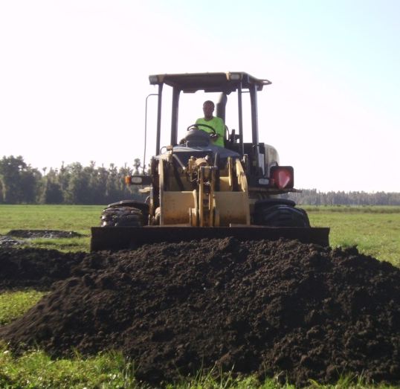
Overview of current biosolids studies and summary results of past projects
DEP Biosolids TAC Meeting, Nov. 28 2018
Maria L. Silveira
Associate Professor, Soil & Water Science, UF/IFAS Range Cattle REC

Slide 2
Outline
Overview of current biosolids studies and summary result of past projects:
Biosolids field study at Ona
Land application of aluminum water treatment residual to bahiagrass
Rainfall simulation
M. Silveira, Soil & Water Science, UF/IFAS Range Cattle REC

Slide 3
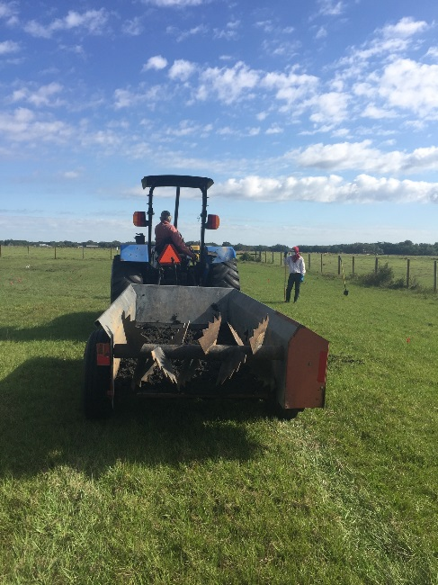
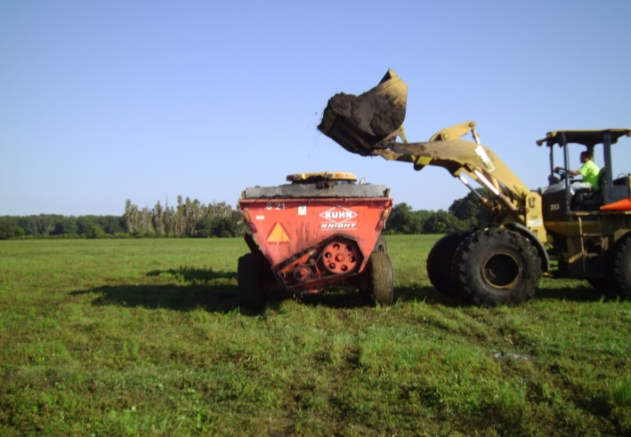
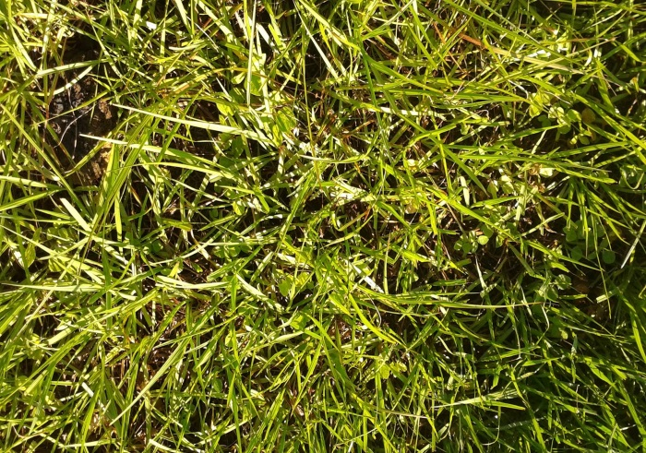
Agronomic and Environmental Impacts of Biosolids Application to Bahiagrass Pastures in Florida
F
Maria L. Silveira, George O’Connor, and Joao Vendramini
Funding source: FCA Beef Enhancement Funds (2016 to current)

Slide 4
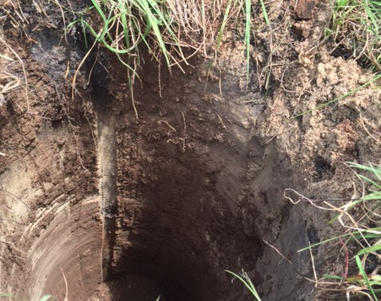
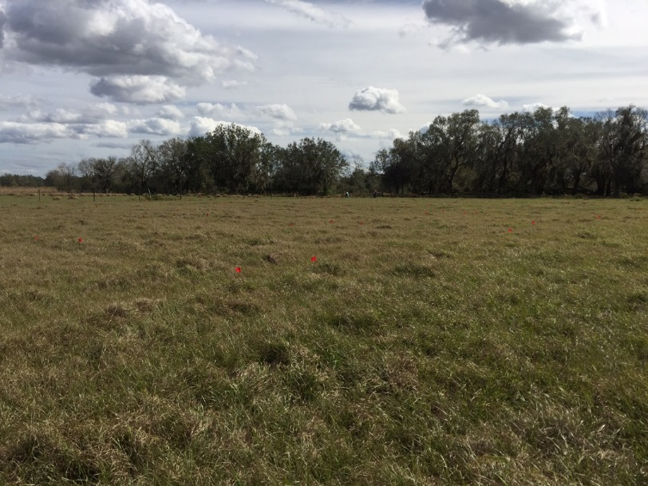
Agronomic and Environmental Impacts of Biosolids Application to Bahiagrass Pastures in Florida
To establish a long-term, instrumented field trial designed to evaluate the agronomic benefits and potential environmental impacts of biosolids application to pastures
To evaluate the effects of co-application of biosolids and biochar (C-rich material that can act as a strong sorbent) on soil chemical (C, N, and P dynamics), physical (water holding capacity, aggregate stability), and biological properties (microbial diversity)
To monitor N and P losses via leaching and gas emissions
Soil type: Smyrna (sandy, siliceous, hyperthermic Aeric Alaquods)
Notes:
Biochars are formed by heating biomass or wastes containing C through a process called pyrolysis. Pyrolysis involves thermal and chemical decomposition of biomass, in limited or zero supply of oxygen. Biochar is typically produced at temperatures between 300ºC–1000ºC (Glaser et al. 2001). The absence of oxygen prevents complete combustion of the material and the amount of biochar and other by-products obtained depends on the temperature. Lower temperatures (300 ºC–600ºC) yield more solid char material and temperatures above 700ºC result in more liquid/gas components.

Slide 5
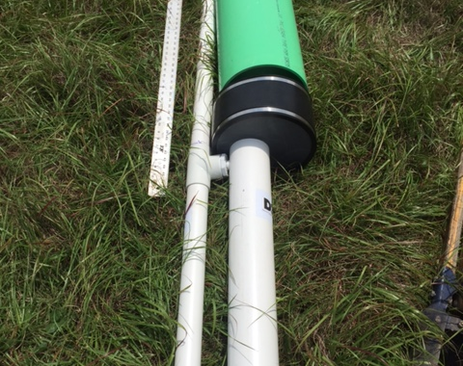
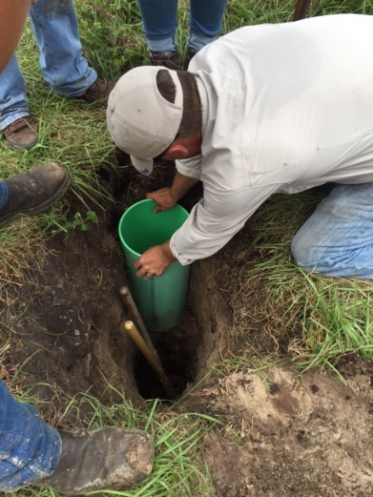
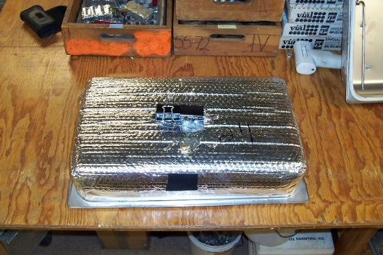
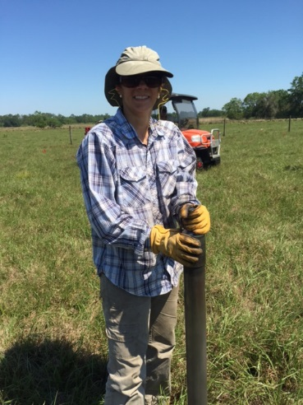
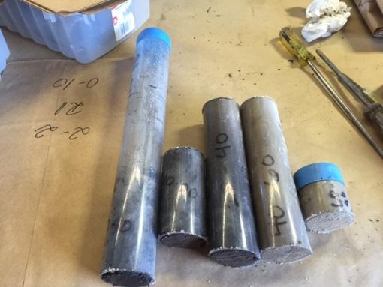
Treatments
3 biosolids (Class AA and Class B) + commercial fertilizer (N and P)
Surface applied at a rate of 160 lb plant available N/A
Treatments alone or in combination with biochar (1% basis)
Why biochar?
Strong sorbent that can control excess N and P in soil and water
Non-hazardous residuals
Low cost
Improve soil chemical, physical, and biological properties
drain gauge lysimeters
Gas chambers
Initial soil characterization

Slide 6

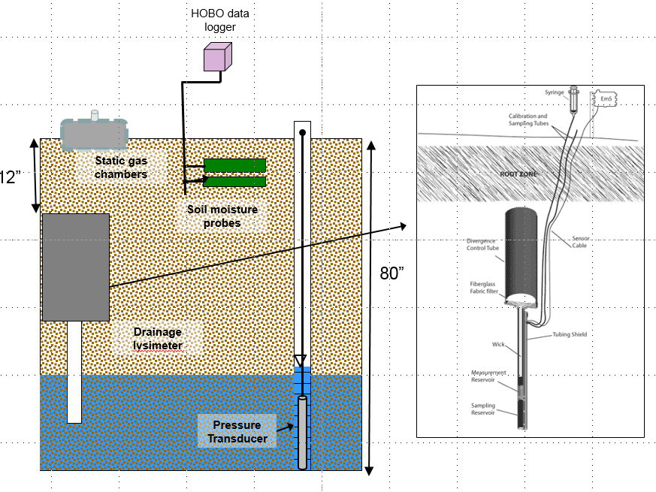
Monitoring Instruments

Slide 7
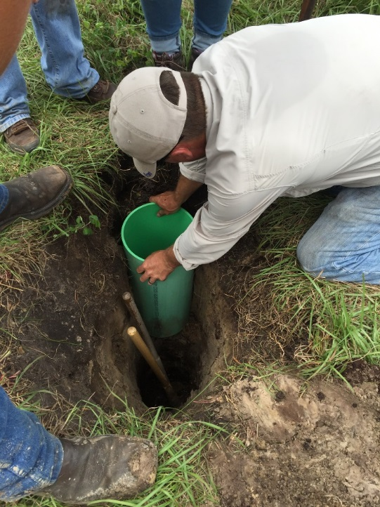
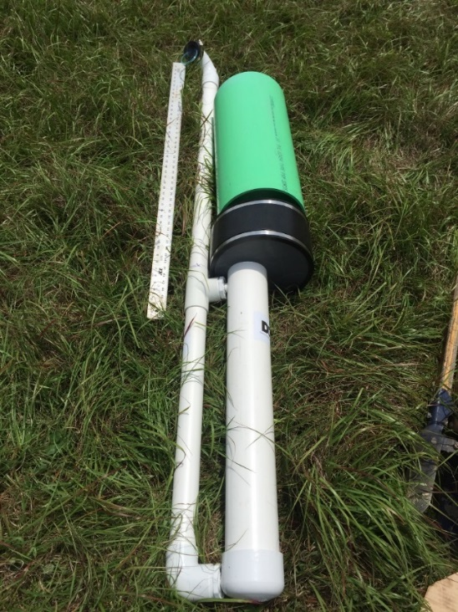
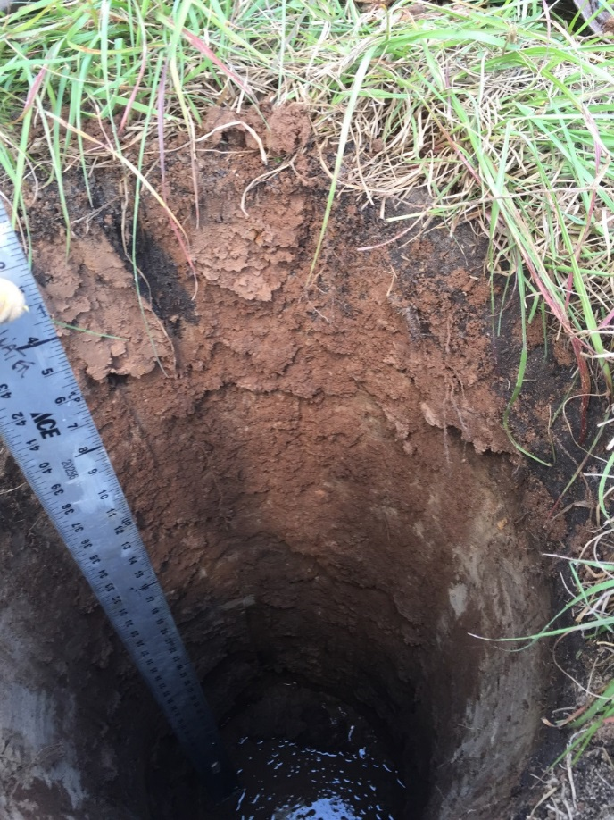
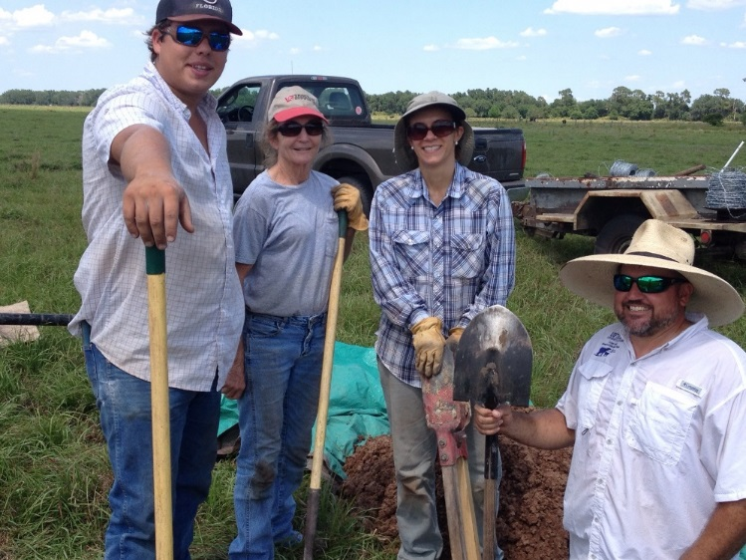
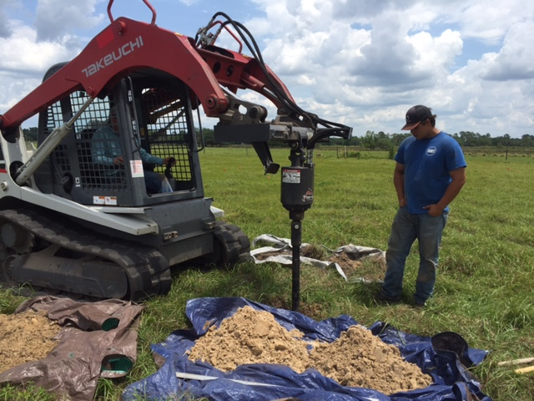
Drain gauge lysimeters

Slide 8
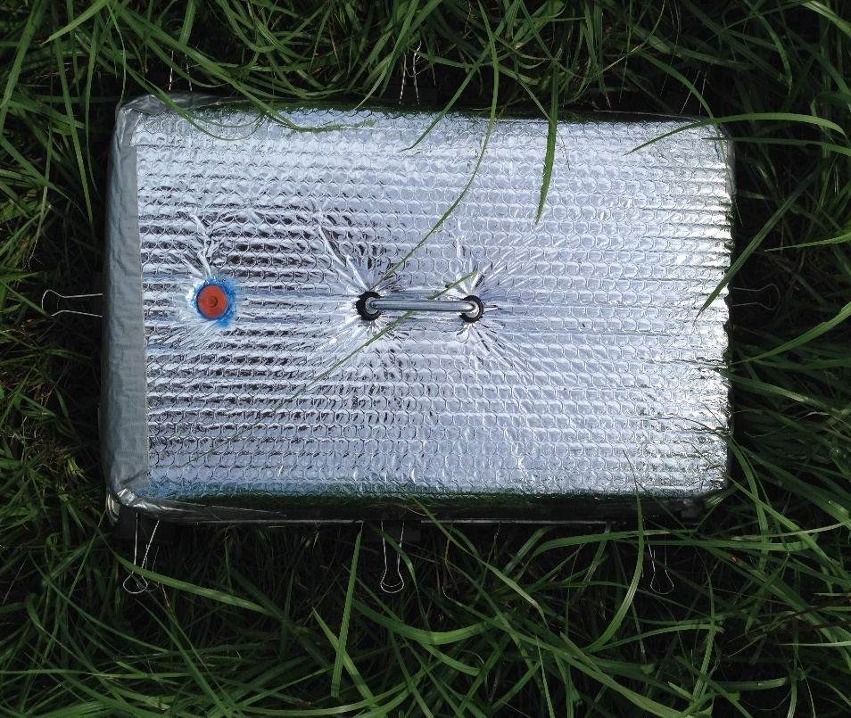
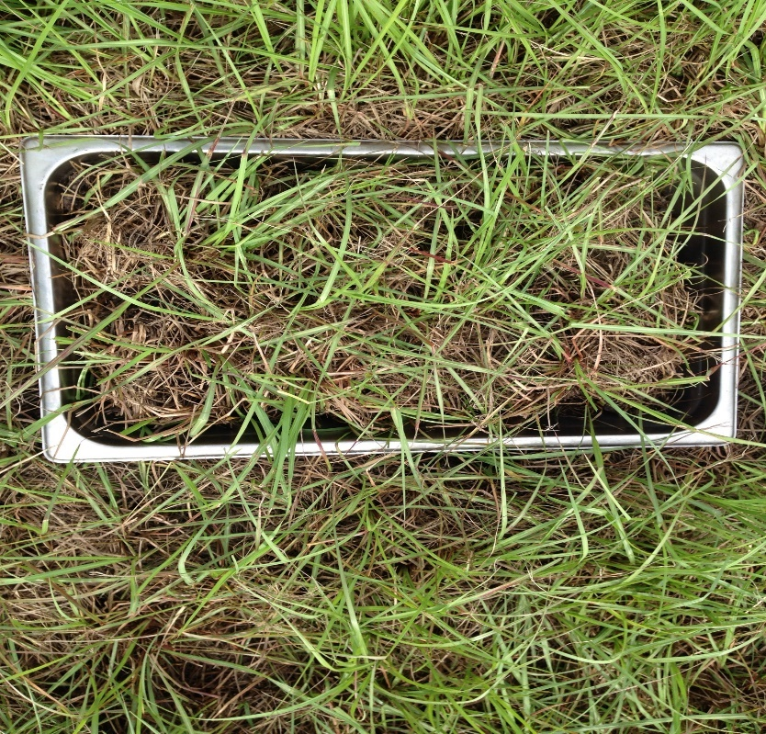
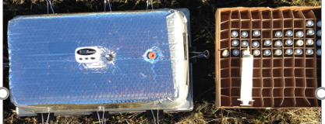
Greenhouse gas collection

Slide 9
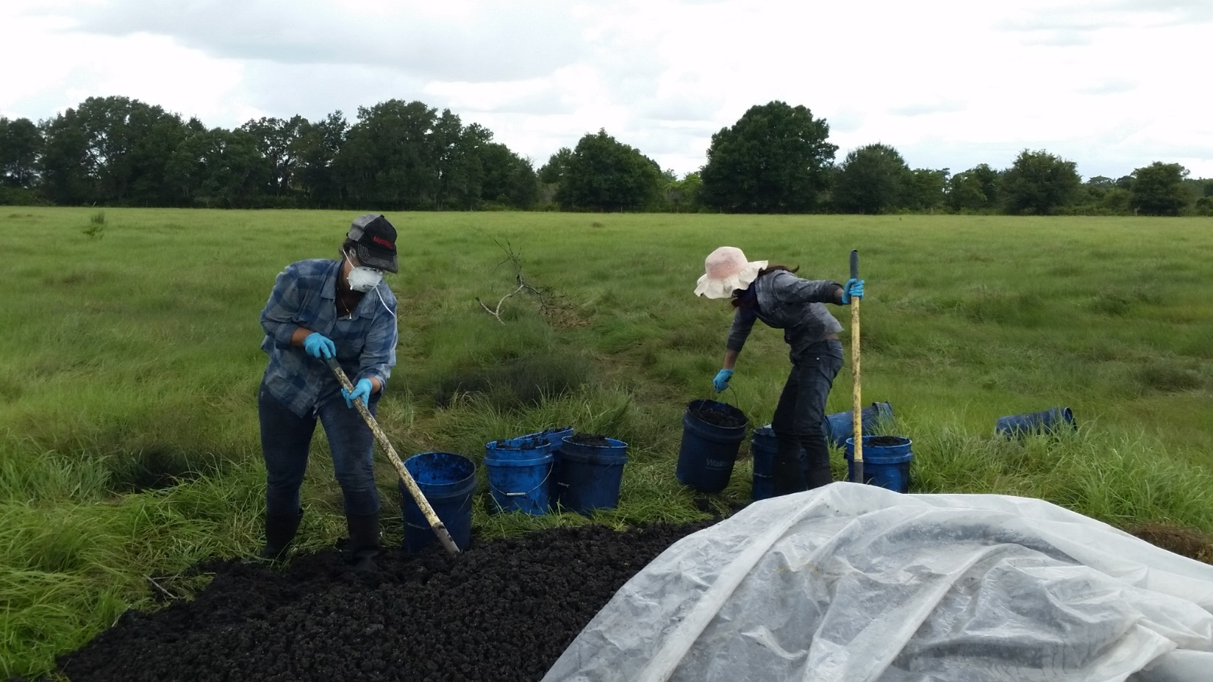
Biosolids and biochar application

Slide 10
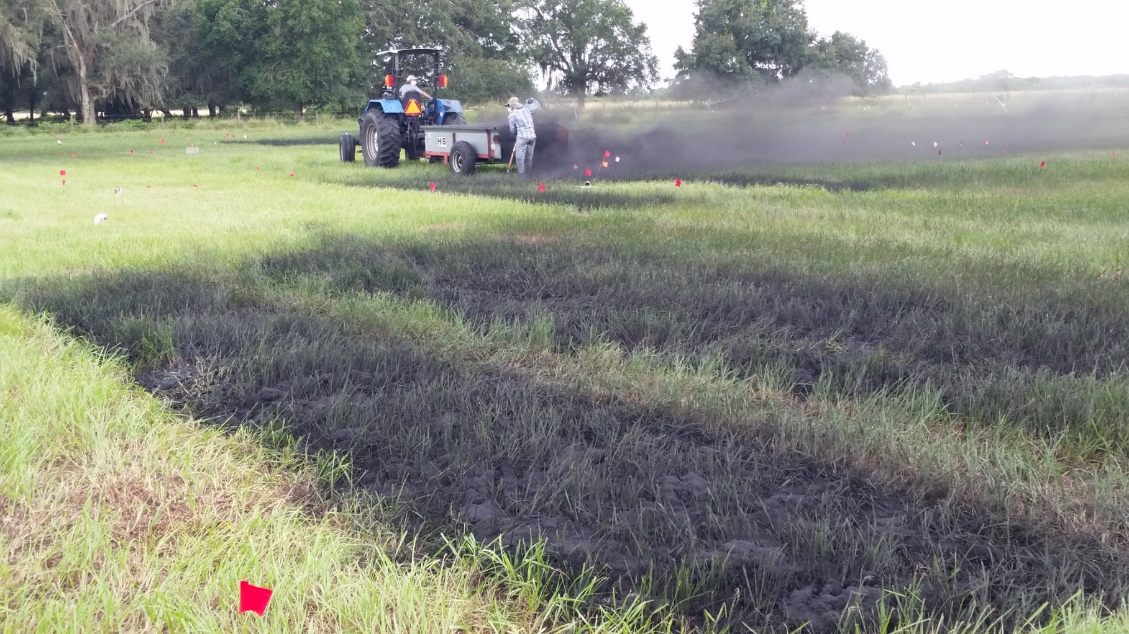
Biosolids and biochar application

Slide 11
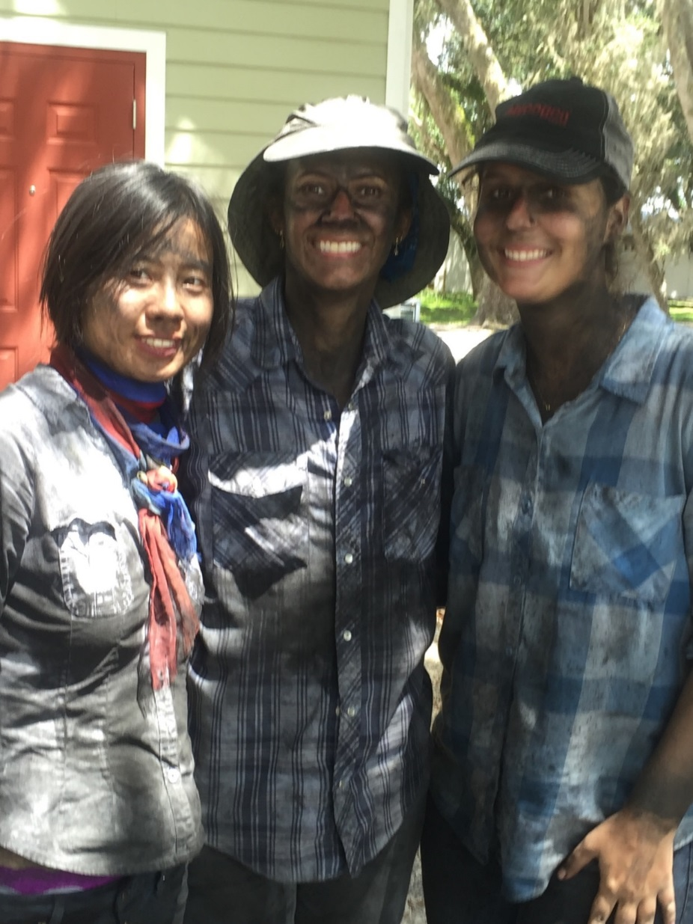

Slide 12
Bahiagrass Herbage Accumulation (2017)
Source: Silveira et al. (unpublished data)
M. Silveira, Soil & Water Science, UF/IFAS Range Cattle REC

Slide 13
Bahiagrass Herbage Accumulation (2017)
Source: Silveira et al. (unpublished data)
M. Silveira, Soil & Water Science, UF/IFAS Range Cattle REC

Slide 14
Leachate N
Source: Silveira et al. (unpublished data)
M. Silveira, Soil & Water Science, UF/IFAS Range Cattle REC

Slide 15
Nitrous Oxide (N₂O) Emissions
Source: Silveira et al. (unpublished data)
M. Silveira, Soil & Water Science, UF/IFAS Range Cattle REC

Slide 16
Summary
Data (2017 and 2018) suggested no significant effect of N source (Class AA, Class B biosolids, and commercial inorganic fertilizer) on bahiagrass herbage accumulation and nutritive value
Biosolids (either alone or in combination with biochar) had no significant impact on leachate N and P concentrations. Large N and P pulses following commercial fertilizer application were observed in 2017 and 2018.
No agronomic/environmental benefits of biochar were observed

Slide 17
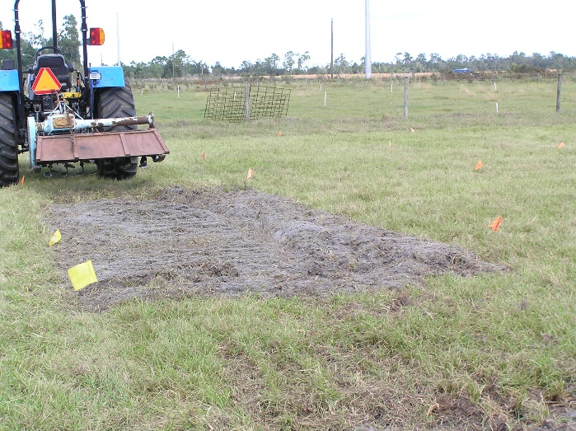
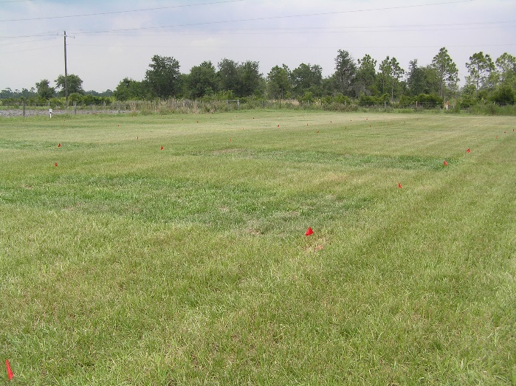
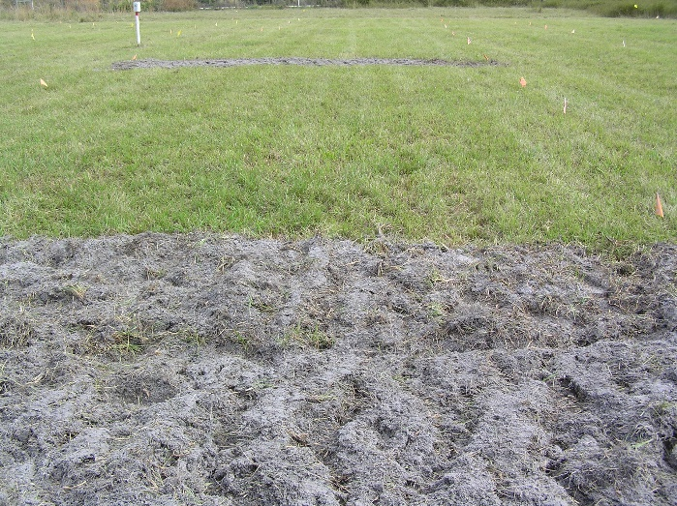
Assessing Potential Phytotoxicity of Water Treatment Residual Use in Bahiagrass Pastures
F
Maria L. Silveira, Don Graetz, Lynn Sollenberger, Joao Vendramini
Funding source: FDCAS (2006-2007); IFAS (2007-2009)

Slide 18
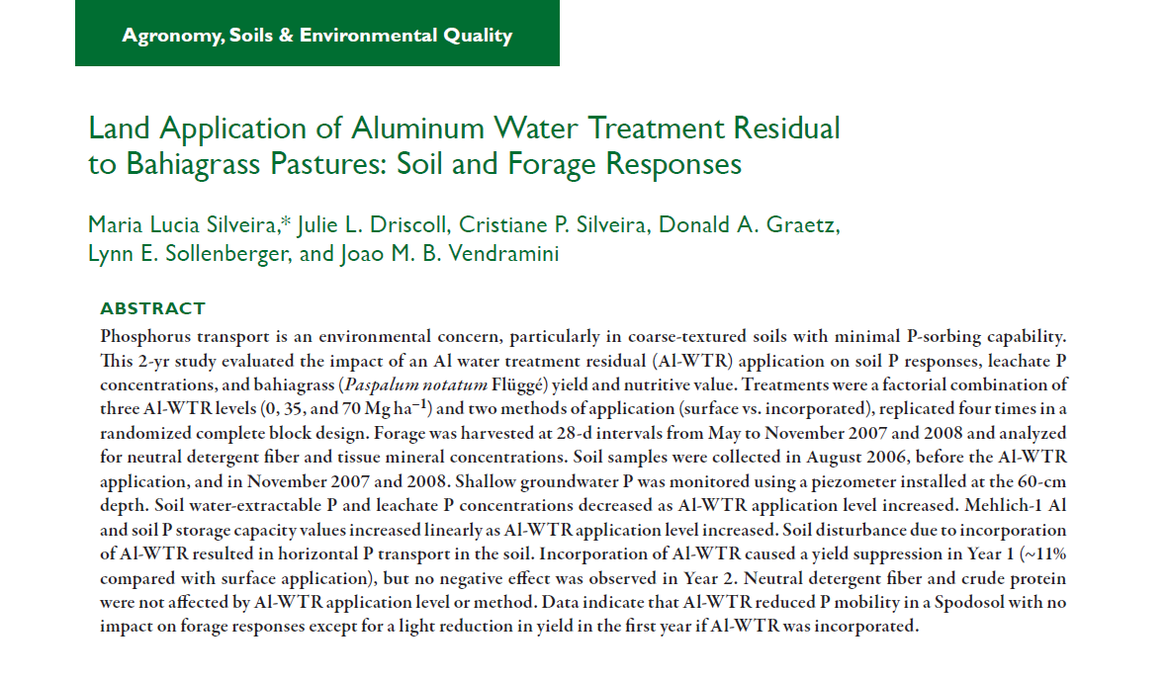
Published in Agron. J. 105:796-802 (2013)

Slide 19
Rationale
Water treatment residuals (WTR), the byproduct of the drinking water purification process, contain amorphous Fe or Al oxides or CaCO3 as well as sediments and humic substances . Extensive research demonstrated WTRs represent a relatively inexpensive alternative to reduce P mobility in P-impacted soils (Makris et al., 2004)
There is concern in the agricultural sector of using an amendment containing Al and the potential effects that may have on crop growth and production (Al toxicity or P deficiency)
Because of its chemical makeup and high concentration of Al, Al-WTR may compete with plants for available P
The objectives of this 2-yr field study were to: (i) examine the impacts of Al-WTR application level (0, 35, and 70 Mg ha⁻¹) and method of application (surface vs. incorporated) on soil P concentration, P sorption capacity, and leachate P concentrations in a Florida Spodosol; and (ii) evaluate bahiagrass yield, nutritive value, and tissue P, Al, Ca, and Mg concentration responses to Al-WTR application

Slide 20
Experimental Setup
Initial soil P concentrations were low (Mehlich-1 P = 2.1 mg kg–1). Additional P was surface applied in April 2007 as triple superphosphate (TSP) with a hand- held fertilizer spreader to all plots at 224 kg P ha–1. Applying TSP at high levels allowed evaluation of the movement of P throughout the soil profile. It also helped to simulate circumstances when P would be applied at high levels to the soil surface, such as in the repeated application of manures or biosolids at N-based agronomic rates. Mehlich-1 soil P level (A horizon) after P fertilizer application was 32 mg kg–1.
Shallow groundwater P was monitored using piezometer installed in the center of each plot at 60-cm depth just above the spodic horizon.
Bahiagrass was harvested at 28-d intervals from May to November in 2007 and 2008 (for a total of five harvests per year).
Notes:
The study site had very low initial P concentrations (Mehlich-1 P = 2.1 mg kg–1 for the A1 horizon) (Table 1) according to the University of Florida soil test interpretation (Mylavarapu et al., 2009). Additional P was surface applied in April 2007 as triple superphosphate (TSP) with a hand- held fertilizer spreader to all plots at 224 kg P ha–1. Applying TSP at high levels allowed evaluation of the movement of P throughout the soil profile. It also helped to simulate circumstances when P would be applied at high levels to the soil surface, such as in the application of manures or biosolids at N-based agronomic rates. Mehlich-1 soil P levels after P fertilizer application were 32 mg kg–1 for the A1 (0–8 cm), 35 mg kg–1 for the A2 (8–15 cm), 10 mg kg–1 for the E (15–30 cm), and 40 mg kg–1 for the Bh (30–60 cm) horizons. Water-extractable P concentrations after P addition were 18 mg kg–1 in the A1, 25 mg kg–1 in the A2, 6 mg kg–1 in the E, and 2 mg kg–1 in the Bh horizons.

Slide 21
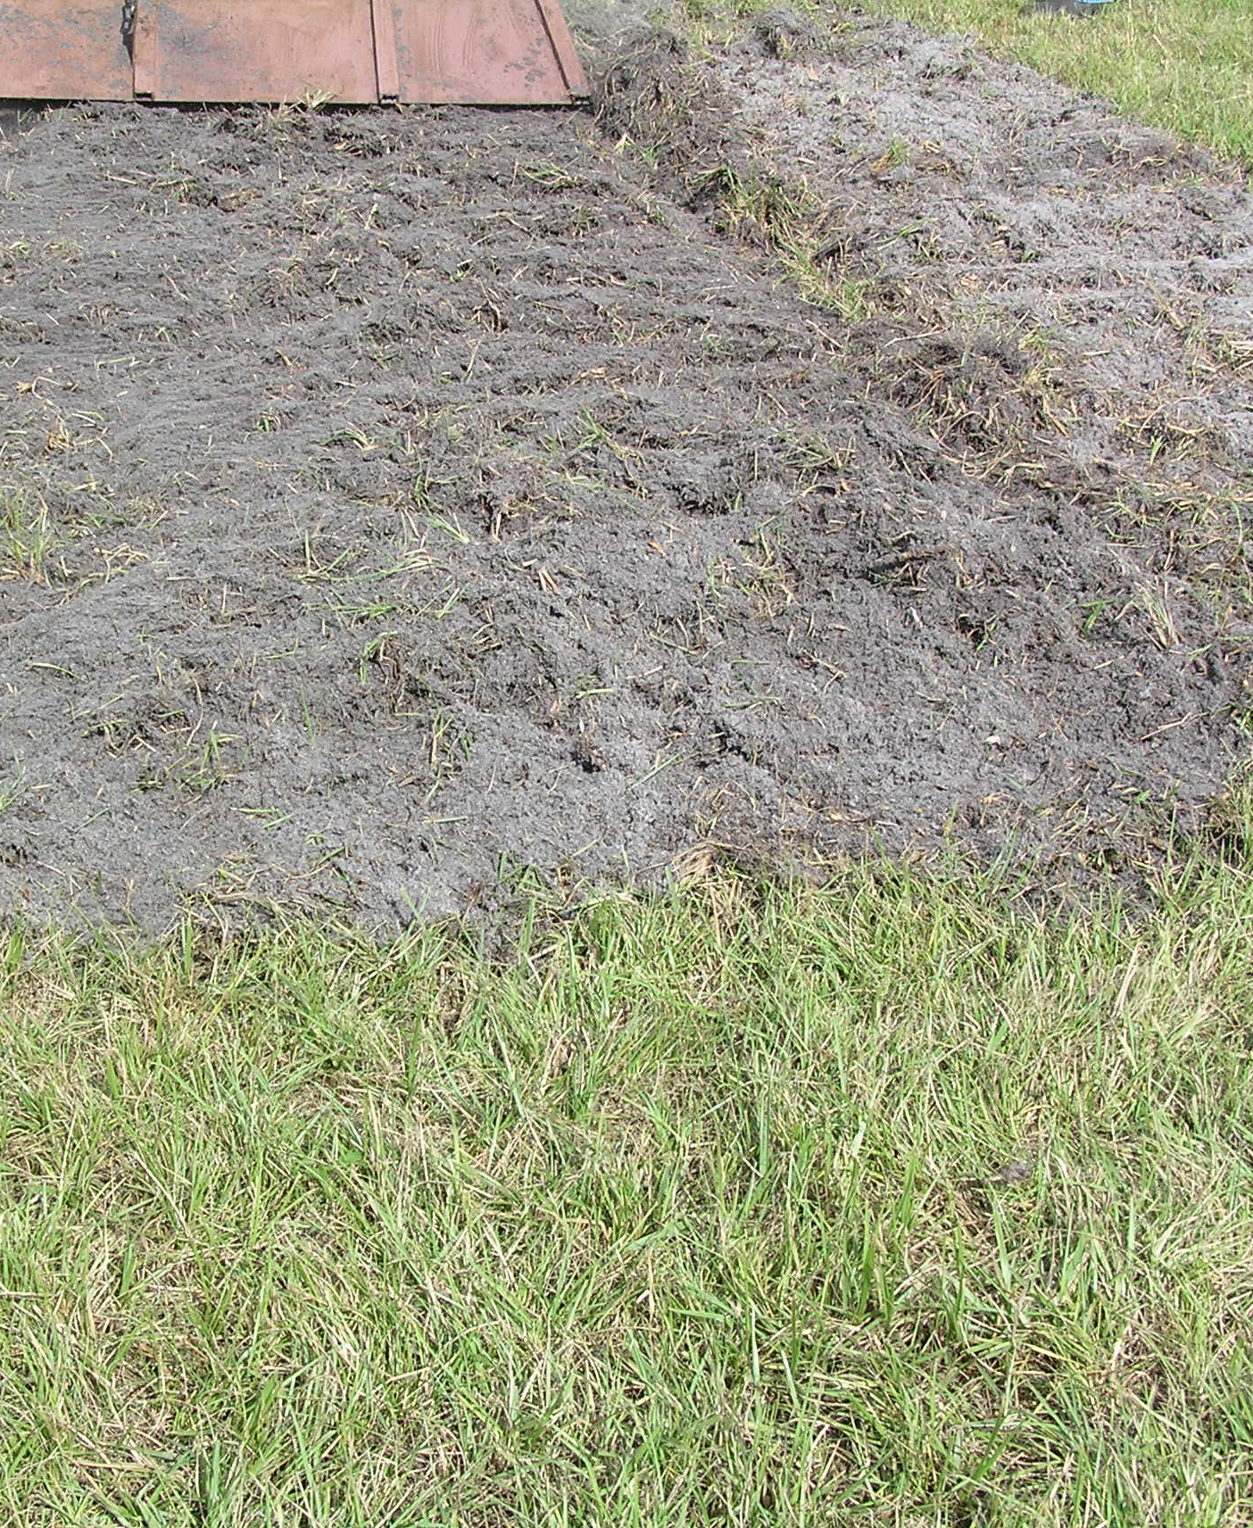

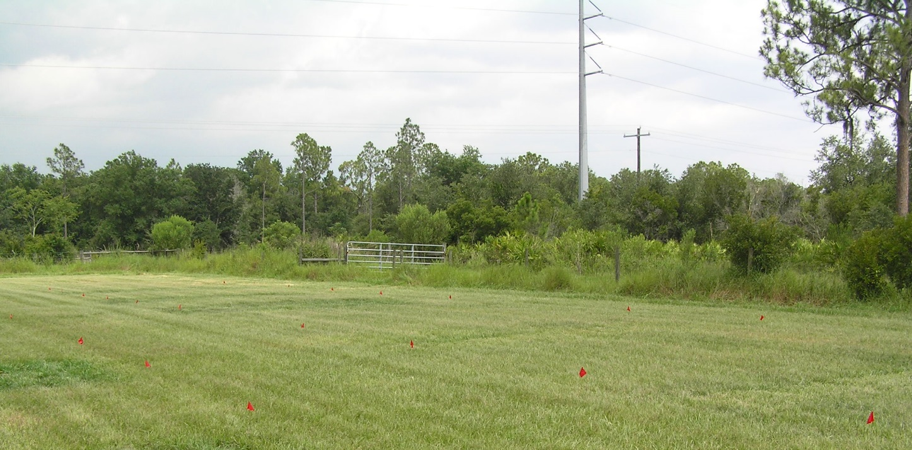

Slide 22
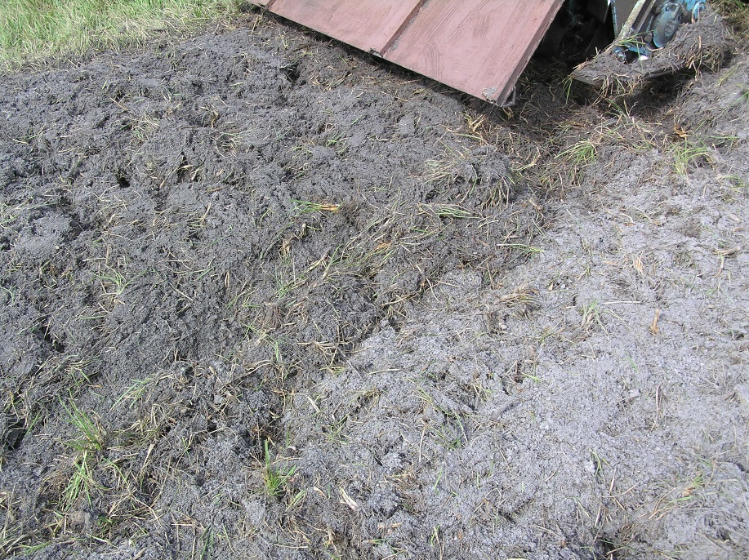
Bahiagrass herbage accumulation as affected by Al-WTR application method and year
Method of WTR application | Bahiagrass Herbage Accumulation (Mg ha⁻¹)
 | 2007 | 2008
Surface applied | 10.6 a | 11.5 a
Incorporated | 9.4 b | 11.6 a
M. Silveira, Soil & Water Science, UF/IFAS Range Cattle REC

Slide 23
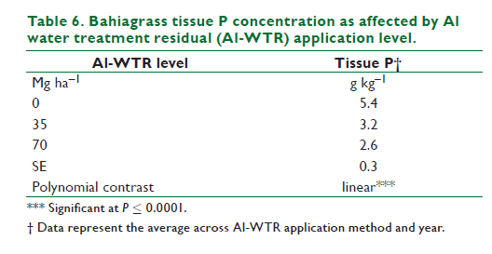
Bahiagrass tissue P concentration as affected by Al-WTR application level
M. Silveira, Soil & Water Science, UF/IFAS Range Cattle REC

Slide 24
Soil water-extractable P (WEP) and P storage capacity (SPSC) in the A₁ (0–8 cm), A₂ ( 8–15 cm), E (15–30 cm), and Bh (30–60 cm) horizons as affected by the Al water treatment residual (Al-WTR) application level at the end of the 2-yr study.
Al-WTR application level | __________ WEP ___________ |  |  |  | __________ SPSC ___________
Mg ha⁻¹ | A₁ | A₂ | E | Bh | A₁ | A₂ | E | Bh
 | _______________________ mg kg-1________________________
0 | 18 | 17 | 4.5 | 1.7 | -32 | -12 | 0.5 | 16
35 | 7.3 | 7.3 | 1.8 | 2.5 | -4 | -0.04 | 9 | 25
70 | 2.8 | 4.6 | 1.4 | 1.0 | 33 | 10 | 22 | 47
SE | 0.9 | 0.7 | 0.4 | 0.6 | 9 | 8 | 11 | 20
Polynomial contrast | L** | L* | L* | ns | L** | L** | ns | ns
M. Silveira, Soil & Water Science, UF/IFAS Range Cattle REC
Notes:
The Al-WTR application level affected the WEP concentrations in the A (0–8- and 8–15-cm depths) and E horizons, but no effect was observed in the Bh horizon (Table 3). At the level of 70 Mg ha–1, Al-WTR application reduced the WEP concentrations by 85, 72, and 69% in the A1 (0–8 cm), A2 (8–15 cm) and E horizons, respectively. The lack of an Al-WTR response in the B horizon was due to the relative higher P-holding capacity (i.e., greater Al and Fe oxides concentrations) and the lower initial WEP concentrations than in the A and E horizons.
The SPSC factor is unique in that it takes into account not only how much P the soil contains from past loadings but also how much P retention capacity remains in the soil. Soil test P (STP) concentrations are often used to determine environmental risk due to P, but a low STP does not necessarily indicate that the soil has the capacity to retain added P (Nair and Harris, 2004). The SPSC values in the A1 and A2 horizons increased linearly as Al-WTR application levels increased.
Surface application of Al-WTR resulted in more positive SPSC values in the A2 horizon than incorporated treatments (5 mg kg–1 for surface vs. –17 mg kg–1 for incorporated Al-WTR treatments). Because Mehlich-1 Fe and Al were not affected by the Al-WTR application method, the decrease in SPSC
observed in the incorporated treatment was due to the increase in Mehlich-1 P concentrations in response to amendment incorporation. This result indicates that soil disturbance may promote downward movement in the soil profile.

Slide 25
Leachate P
Al-WTR application level | Leachate P concentration
 | Surface Incorporated
Mg ha⁻¹ | ____________ mg L⁻¹____________
0 | 1.0b† | 3.4a
35 | 0.4b | 1.4a
70 | 0.2a | 0.5a
SE | 0.4 | 0.4
Polynomial contrast | L* | L**
*Significant at P ≤ 0.05; ns, not significant
** Significant at P≤ 0.01
†Means followed by the same letter within row are not significantly different (P > 0.05)
L = linear
M. Silveira, Soil & Water Science, UF/IFAS Range Cattle REC
Notes:
Leachate P concentrations were affected by ‘application method ´ level interaction. For both surface-applied and incorporated treatments, leachate P concentrations decreased linearly with increasing Al-WTR level (Table 4). At the 35 Mg ha–1 Al-WTR level, treatments subject to amendment
incorporation resulted in greater leachate P concentrations than those with surface application. No differences in leachate P concentrations between surface-applied vs. incorporated treatments were observed when Al-WTR was applied at 70 Mg ha–1. This result indicates that the process of Al-WTR incorporation increased leachate P concentrations, and greater Al-WTR amounts will probably be required to reduce leachate P concentrations if the amendment is incorporated. Control treatments (no Al-WTR added) subjected to soil disturbance (to simulate Al-WTR incorporation) had three times greater leachate P concentrations than the control treatments not subjected to tillage. This response is consistent with the soil data and further demonstrates that incorporation of Al-WTR after application of heavy loads of soluble P fertilizer promotes P leaching in sandy soil.

Slide 26
Summary
Al-WTR reduced soil WEP and Melich-1 P, and the SPSC, particularly in the surface horizon (<15-cm depth). A linear increase in Mehlich-1 Al concentrations in the surface horizons was observed as Al-WTR application increased.
Leachate P concentrations decreased with application of Al-WTR. Soil disturbance due to incorporation of Al-WTR resulted in horizontal P transport in the soil.
Forage yield was affected by Al-WTR only during the first year after application when the amendment was incorporated into the soil. This result was due to disturbance of the bahiagrass stand by disking for the amendment incorporation and not to the effects of the Al-WTR.
Tissue NDF and CP concentrations were not affected by Al-WTR application for the duration of the study. Tissue analysis did not show enhanced accumulation of Al, and accumulation of Ca and Mg was not restricted. This suggests that the application of Al-WTR has no impact on cation accumulation by the plant roots. Tissue P declined with added Al-WTR, but concentrations did not drop below the critical level

Slide 27
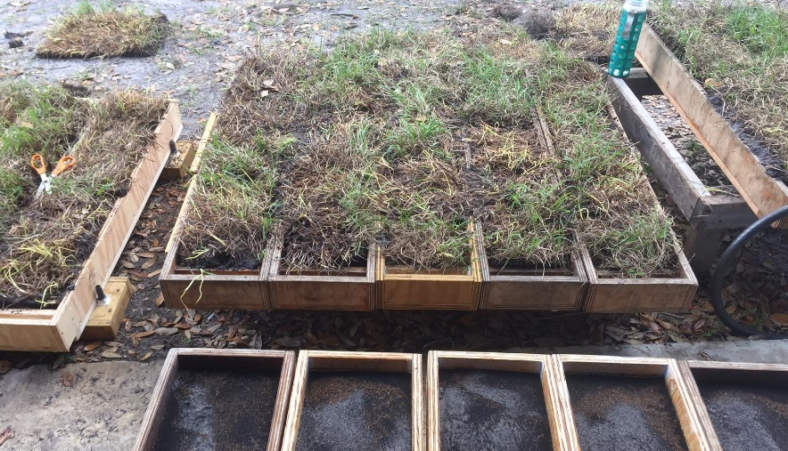

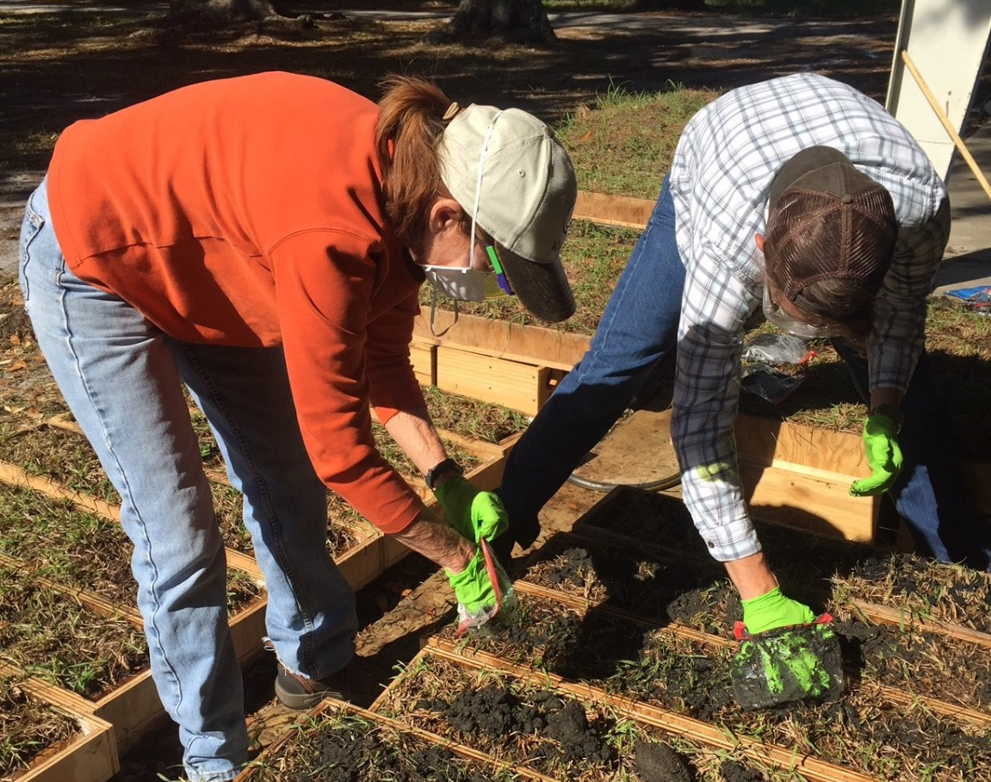
Rainfall Simulation
Runoff and Leachate N and P losses from Bahiagrass Pastures Fertilized with Various Biosolids Sources
Maria L. Silveira¹, George A. O’Connor², Vickie Hoge³, and John Hendrickson³
¹UF/IFAS Range Cattle REC, Ona, FL. ²UF/IFAS Soil & Water Sciences Dept., Gainesville, FL. ³St Johns River Water Management District, Palatka, FL.
Funding source: St. Johns River Water Management District

Slide 28
Rationale
The St. Johns River (SJR) basin in Florida has recently experienced a dramatic increase in biosolids-P application loads (29 tons of biosolids-P in 2000 vs. 1,508 tons in 2015). Concurrently, P levels in runoff have also increased significantly, particularly in the upper basin where the majority of biosolids are applied mainly to bahiagrass pastures and citrus. Although it nearly impossible to determine whether the increases in runoff P are solely due to biosolids application, historical data suggested that soil test P in the basin is gradually increasing
Objectives: 1. Identify and thoroughly characterize the main biosolids materials routinely applied in the SJR basin, 2. determine N and P losses via leaching and surface runoff associated with selected biosolids materials, and 3. evaluate the relationship between biosolids properties (e.g. water extractable P, PSR) and nutrient levels in runoff and leachate to predict potential risks of nutrient transport
M. Silveira, Soil & Water Science, UF/IFAS Range Cattle REC

Slide 29
Biosolids chemical characterization
Biosolids | pH | Solids | Total N | Total P | WEP | NH₄-N | NO₃-N | As | Cd | Cr | Pb |  | Hg | Mo | Ni | Se | Zn
 |  | _______________ g kg⁻¹______________ |  |  |  |  |  | _______________ mg kg⁻¹______________
Broward | 7.6 | 170 | 72 | 23 | 0.6 | 17 | 3 | 6.6 | 1.3 | 28.9 |  | 22.4 | 0.6 | 9.4 | 18.7 | 5.4 | 885
Miami-Dade | 8.1 | 230 | 84 | 28 | 0.9 | 24 | 3 | 6.4 | 6.7 | 62.7 |  | 44.8 | 0.9 | 23.1 | 43.7 | 11.1 | 1266
Tampa | 7.6 | 190 | 61 | 18 | 1.7 | 14 | 3 | 4.8 | 3.9 | 26.6 |  | 43.8 | 0.6 | 16.2 | 26.3 | 42.4 | 1163
Orlando | 5.9 | 170 | 76 | 34 | 15 | 11 | 3 | 6.6 | 0.8 | 15.6 |  | 10.4 | 0.5 | 8.6 | 9.4 | 9.9 | 496
GreenEdge | 6.5 | 920 | 66 | 19 | 1.6 | 6 | 2 | 3.6 | 1.3 | 22.3 |  | 29.1 | 0.5 | 45.1 | 31.7 | 4.9 | 891
Bradenton | 6.8 | 150 | 48 | 33 | 1.9 | 11 | 7 | 4.8 | 1.3 | 22.4 |  | 20.6 | 0.8 | 8.0 | 30.9 | 2.9 | 1805
St. Pete | 7.8 | 160 | 76 | 34 | 4.7 | 3 | 9 | 2.7 | 0.8 | 17.0 |  | 27.7 | 0.7 | 13.9 | 13.4 | 6.6 | 770
N:P ratio of 1.5 to 3.4
% WEP: ~3 to 44% total P
M. Silveira, Soil & Water Science, UF/IFAS Range Cattle REC

Slide 30
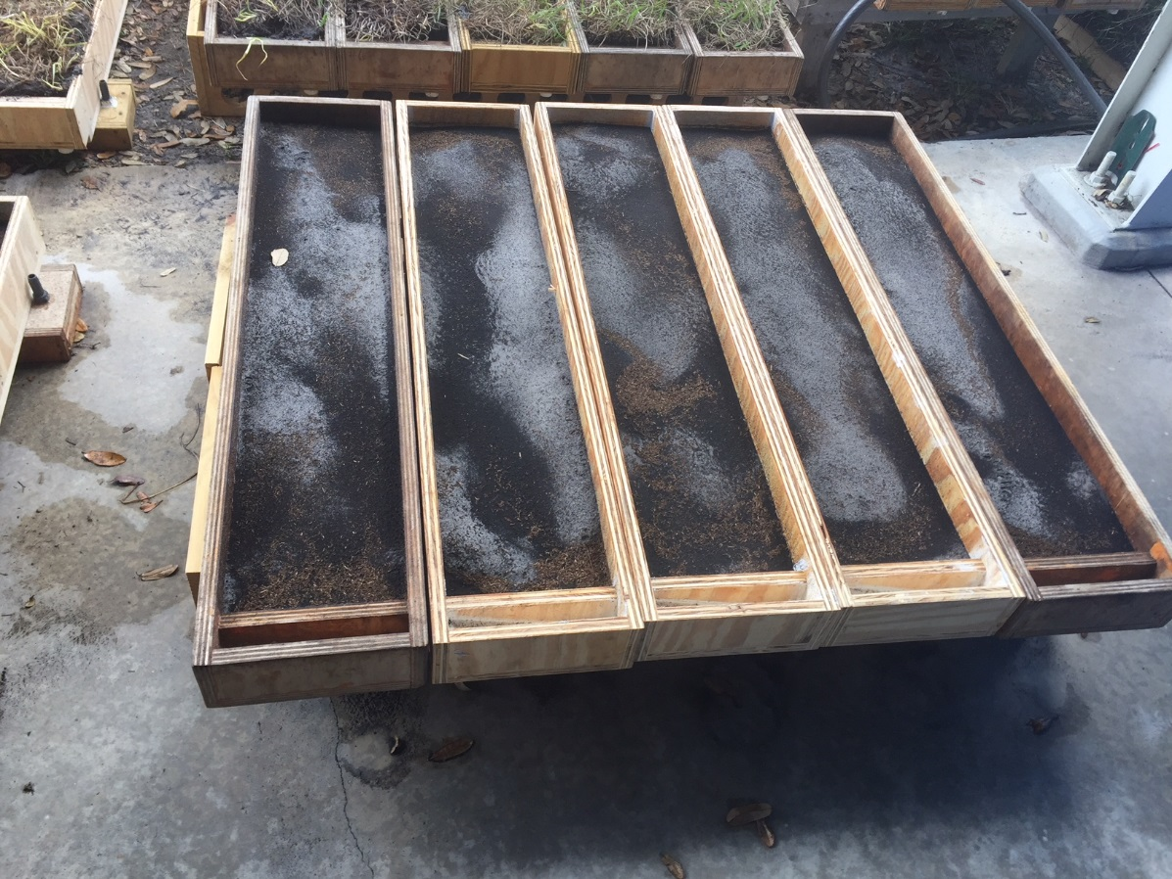
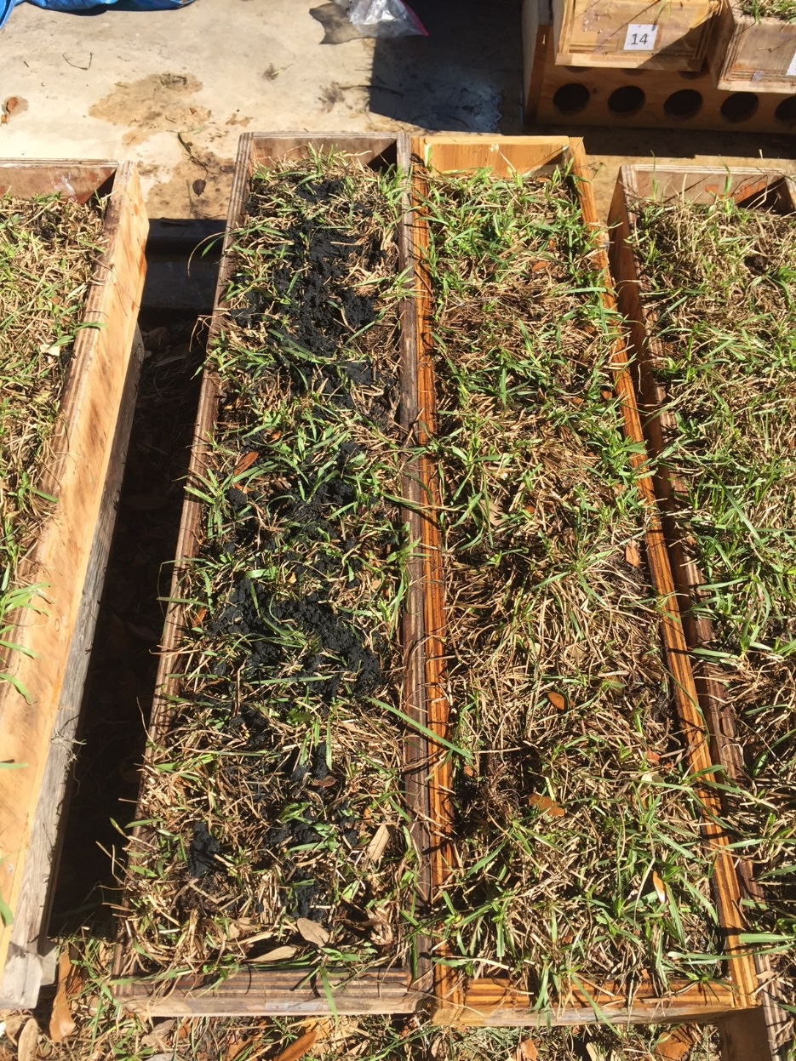
N and P losses in surface runoff and leaching were evaluated using a modified packed box protocol from the U.S. National Phosphorus Research Project (National Phosphorus Research, 2005). The modified design of the runoff boxes allowed simultaneously recovery of leachate and runoff samples

Slide 31
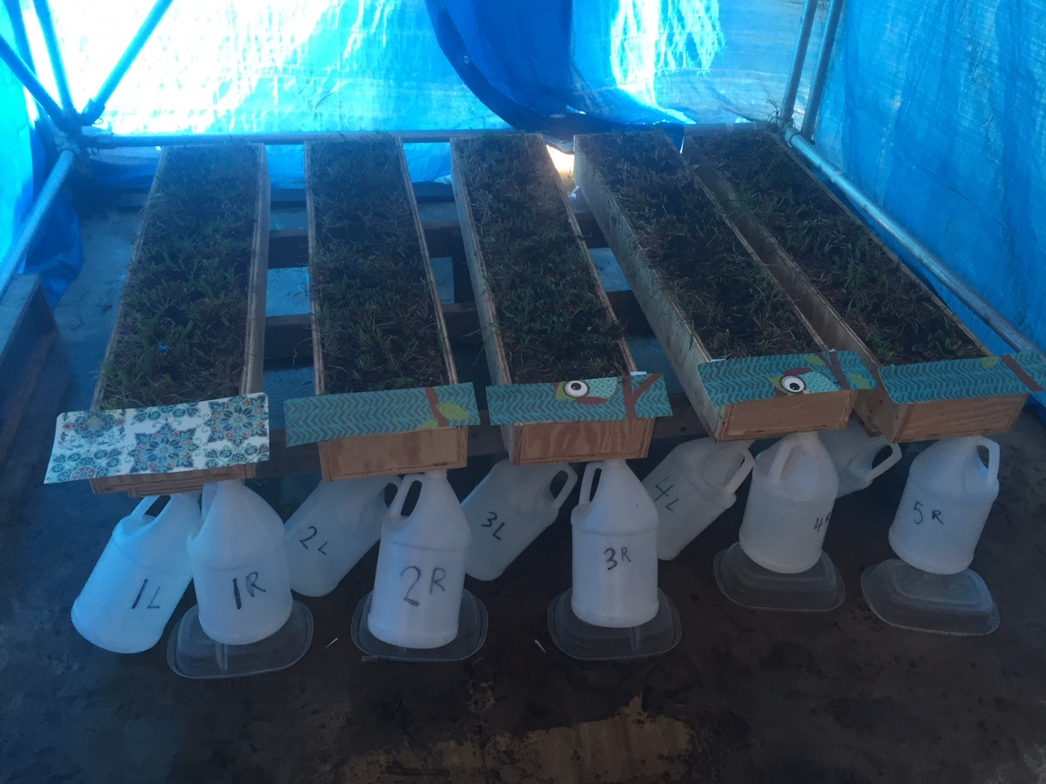

Slide 32
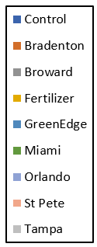
Flow-weighted runoff total P concentration
Source: Silveira et al. (unpublished data)
M. Silveira, Soil & Water Science, UF/IFAS Range Cattle REC

Slide 33
Flow-weighted leachate soluble reactive P concentrations
Source: Silveira et al. (unpublished data)
M. Silveira, Soil & Water Science, UF/IFAS Range Cattle REC

Slide 34
Cumulative P mass loss in runoff and leachate
 | Runoff |  |  | Leachate |  | Total P loss
 | Total P | TDP | SRP | TDP | SRP | P mass in runoff + leachate | Percentage of added P
Treatment | _______________________ mg _______________________ |  |  |  |  |  | %
Control | 13.4 | 10.9 | 9.8 | 7.2 | 6.6 | 20.6 | _
Bradenton | 25.4 | 21.1 | 15.4 | 30.0 | 24.8 | 55.4 | 2.4
Broward | 11.1 | 10.8 | 5.8 | 14.7 | 12.5 | 25.8 | 1.1
Fertilizer | 531.4 | 499.8 | 441.2 | 330.2 | 303.5 | 861.6 | 37.9
GreenEdge | 29.3 | 24.6 | 22.7 | 24.6 | 17.5 | 53.9 | 2.4
Miami | 15.4 | 10.5 | 10.4 | 18.1 | 17.2 | 33.6 | 1.5
Orlando | 156.7 | 145.1 | 139.1 | 52.8 | 50.8 | 209.5 | 9.2
St Pete | 77.7 | 60.9 | 52.9 | 26.4 | 25.6 | 104.1 | 4.6
Tampa | 23.4 | 21.5 | 18.8 | 19.6 | 14.5 | 42.9 | 1.9
SE | 12.4 | 18.7 |  | 18.3 | 17.9
Source: Silveira et al. (unpublished data)

Slide 35
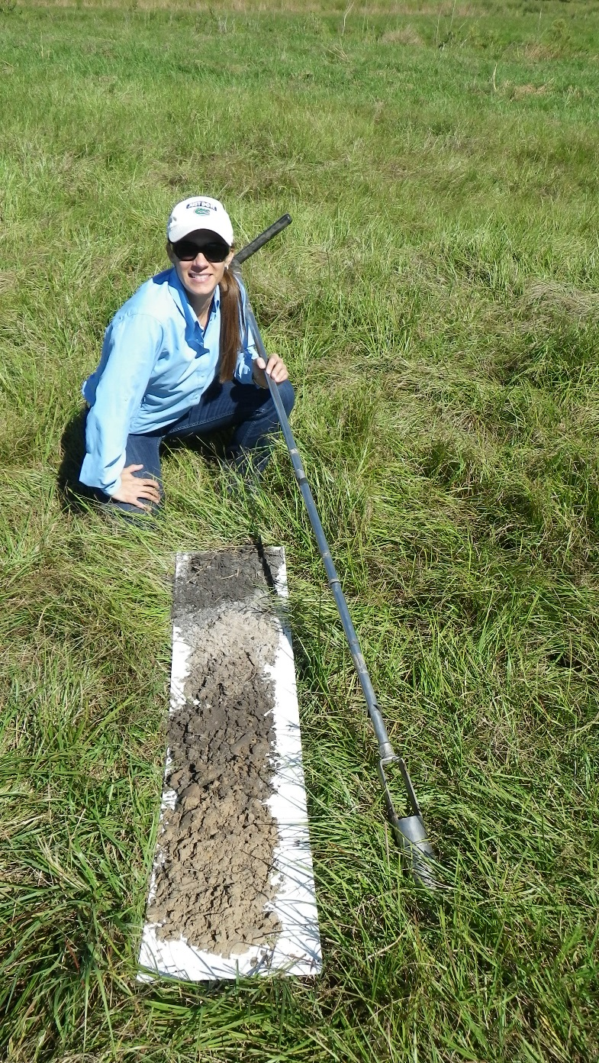
THANK YOU!
Maria Silveira
Email: mlas@ufl.edu
Phone: (863) 735-1314

