Slide 1

Bureau of Licensing and Enforcement
Rashmi Singh, Ph.D.
Division of Agricultural Environmental Services
Tallahassee, Florida
(850) 617-7861
Rashmi.singh@FreshFromFlorida.com

Slide 2
What we will cover:
Definitions
Overview of Licensing
Tonnage Reporting
Fertilizer Sampling and Reporting
Notes:
Law and Rule
Licensing
Tonnage Reporting
What is Fertilizer?
N-P-K, Secondary's and Micronutrients
Fertilizer Labeling
Fertilizer Sampling and Reporting

Slide 3


Law and Rule
Chapter 576, Florida Statues (Agricultural Fertilizers)
Rule 5E-1, Florida Administrative Code
Notes:
The Department of Agriculture and Consumer Services is responsible for enforcing Florida’s Commercial Fertilizer Law, Chapter 576 Florida Statues and Chapter 5E-1 Florida Administrative Code.
The Bureau of Licensing and Enforcement is tasked with enforcing the law but the Bureau of Agricultural Environmental Laboratories, the Bureau of Inspection and Incident response and The Bureau of Scientific Evaluation and Technical assistance play key roles.
This statute gives the department the authority to regulate the sale, distribution and labeling of fertilizer.
This law does not regulate the application of fertilizer or the import and exportation.

Slide 4
Fertilizer: Any substance which contains one or more recognized plant nutrients and promotes plant growth or controls soil acidity or alkalinity or provides soil enrichment or other corrective measures to the soil.
Soil amendment/ conditioner/ additive: means any substance or mixture of substances sold or offered for sale for soil enriching or corrective purposes, intended or claimed to be effective in promoting or stimulating plant growth, increasing soil or plant productivity, improving the quality of crops, or producing any chemical or physical change in the soil, except amendments, conditioners, additives, and related products that are derived solely from inorganic sources and that contain no recognized plant nutrients.

Slide 5
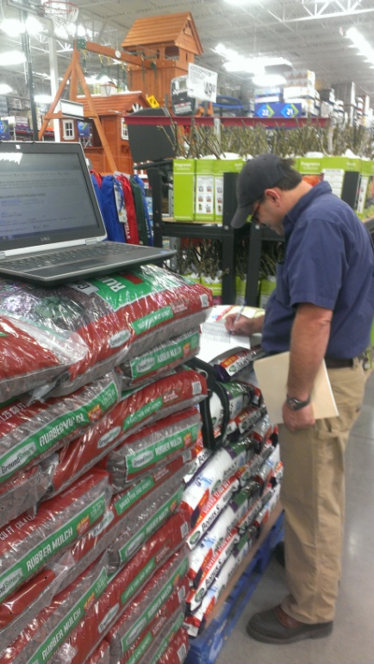
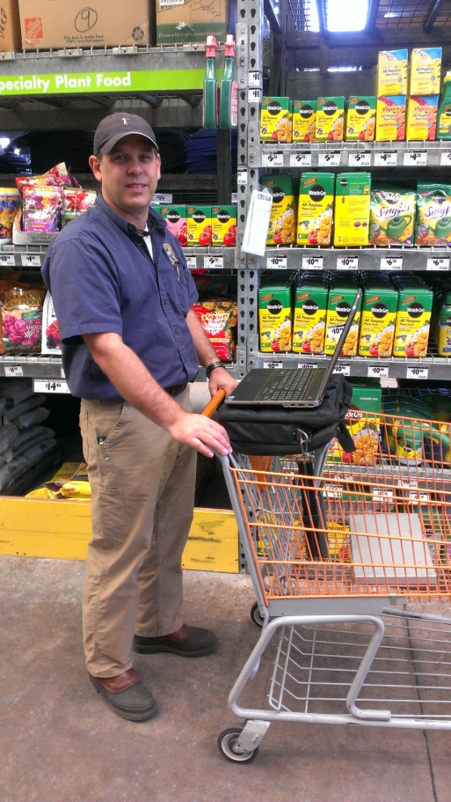
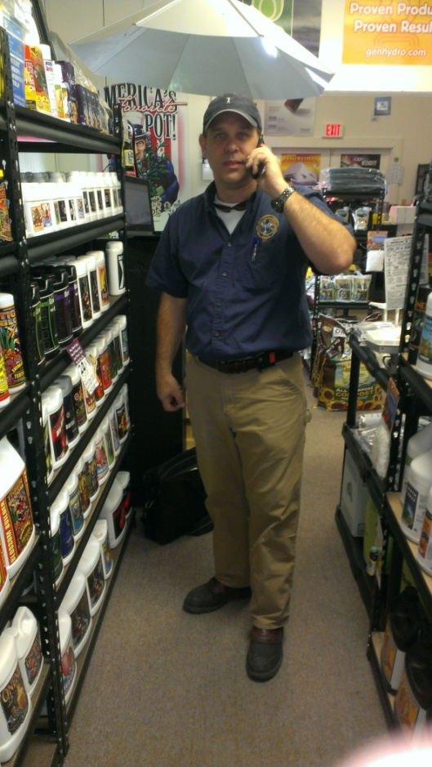
Specialty Fertilizer
Any fertilizer packaged, marketed, and distributed for home and garden use and packaged in containers or bags such that the net weight is 49 pounds or less.
$200 per product, each brand and grade
Notes:
Specialty fertilizer- means any fertilizer packaged, marketed, and distributed for home and garden use and packaged in containers or bags such that the net weight is 49 pounds or less.
These products are the ones that you see on retail shelves in box stores like Walmart, Lowes and Home Depot. Specialty products must be registered with us.

Slide 6
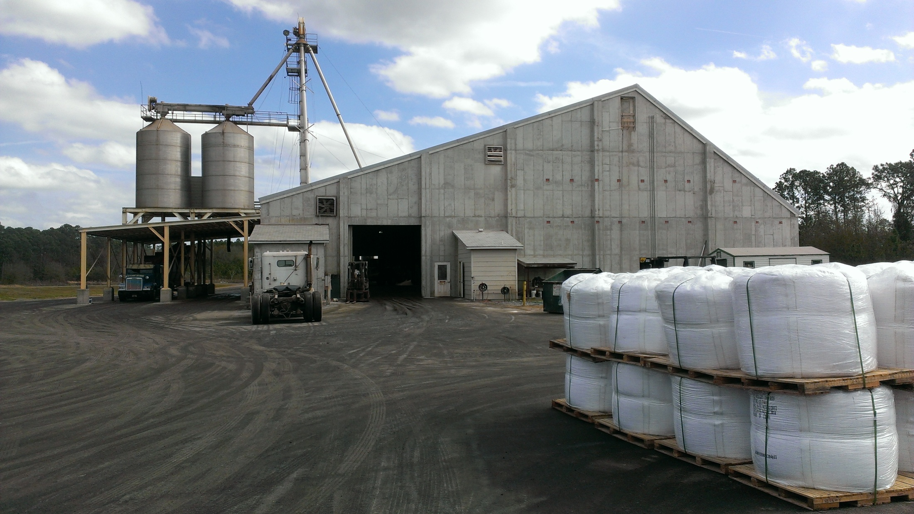

Who Needs a License?
A company that distributes fertilizer with their name on the fertilizer label must have a license
A specialty fertilizer cannot be distributed without being registered
Notes:
Who needs a license?
If you wish to distribute fertilizer in Florida with your name on the label as the guarantor of the product you must obtain a fertilizer license.
If fertilizer is not being sold to an end user or to a consumer we do not regulate it.
Transactions between licensees are not regulated by the Commercial Fertilizer Law. Fertilizer materials that are distributed for further blending or mixing are not regulated by this law.
Products regulated under this law are: Commercial Fertilizer, Specialty Fertilizer, Limestone, Soil Amendments, Soil Conditioners, Soil Additives, Manures, and Fertilizer-Pesticide Mixtures

Slide 7
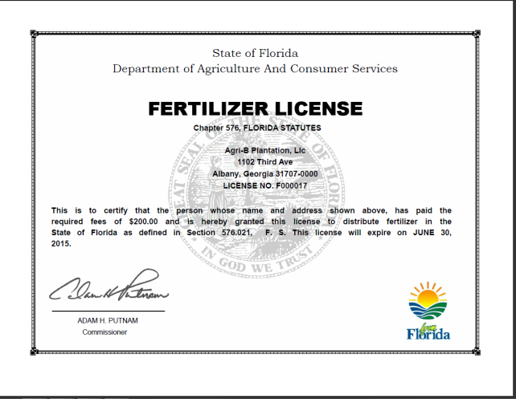

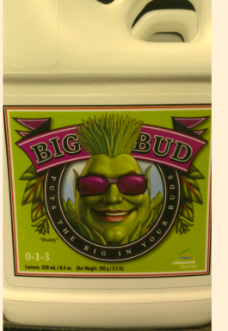

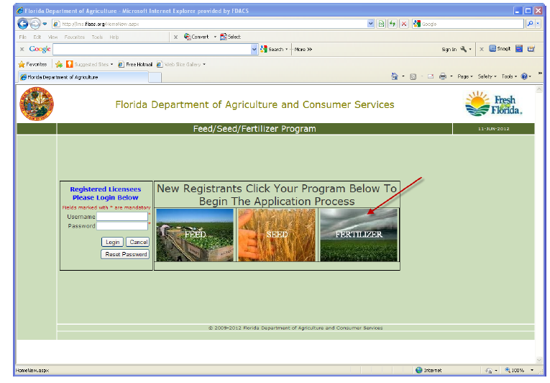
How Much Does it Cost?
$200 for a Fertilizer License
$200 per Specialty product
Everything is done here: http://lims.flaes.org
Notes:
The cost of a fertilizer license is $200. The license renewal fee is $200.
Licensees that distribute Specialty fertilizer products pay a fee of $200 for each product brand and grade. the renewal fee for Specialty product is $200 per product.
Fertilizer Licenses and Specialty products are renewed annually at the same time on July 1.
Fertilizer License Applications and Specialty fertilizer products are submitted online at the URL listed- http://lims.flaes.org. Everything in fertilizer is set up to be paperless.
Applications are approved after the fertilizer labels are reviewed to ensure that they comply with Florida’s labeling guidelines. At this time the labels are reviewed by Bill Cox and myself.
Once the license application is approved, the Authorized Representative receives a system generated email with their payment invoice attached. After the payment is processed by Finance and Accounting, the payment shows up in LIMS as “a payment received” then the payment is approved.
The applicant may pay by check through the mail with the invoice accompanying the check or with a credit card online at the the ROC ecommerce site. Payments usually take 3 to 5 days to be processed by Finance and accounting.
When the payment is approved the applicant is now issued a Florida Fertilizer License Number. This number begins with the letter “F” followed by six digits. The licensee receives a system generated email with their new suitable for framing “Florida Fertilizer License Certificate”. Login credentials for the regulatory website access are sent at the same time. From the regulatory site the licensee will report their fertilizer tonnage sales and update their company information.
The fertilizer licensing process usually takes about 2 to 3 weeks from start to finish depending on their need for label revisions.

Slide 8
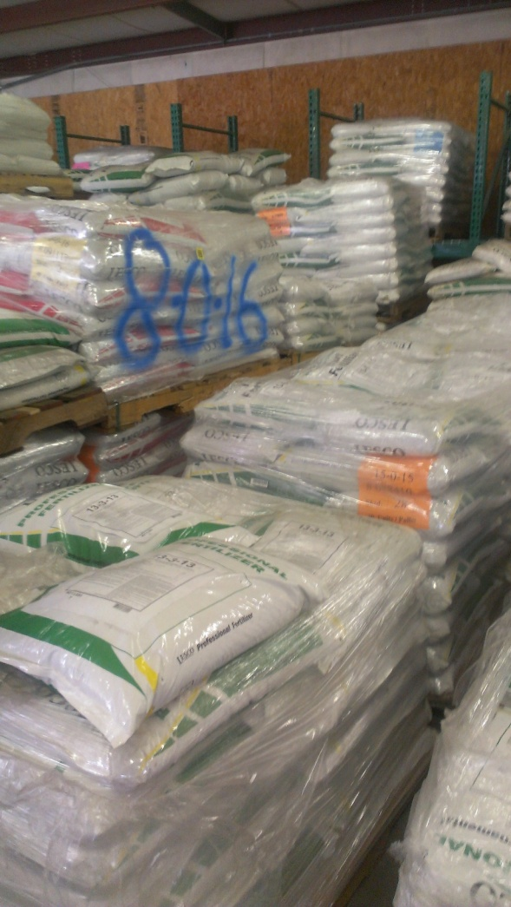
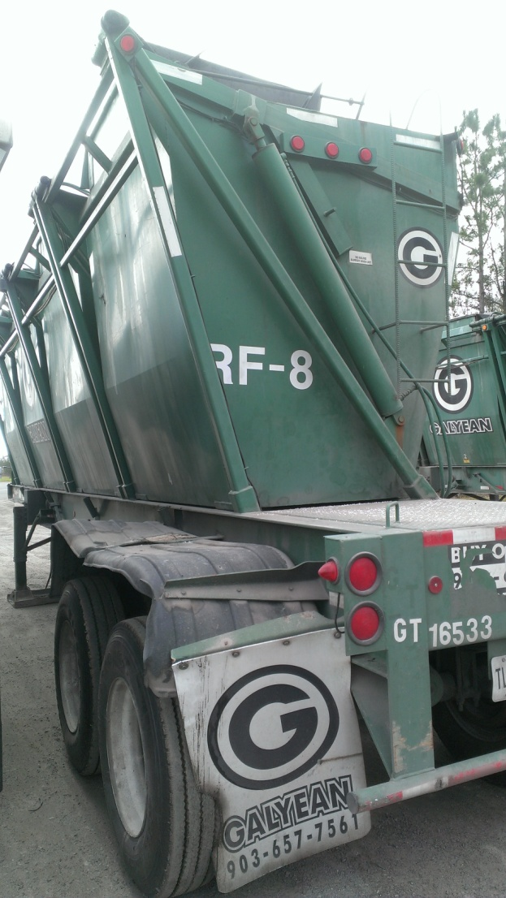
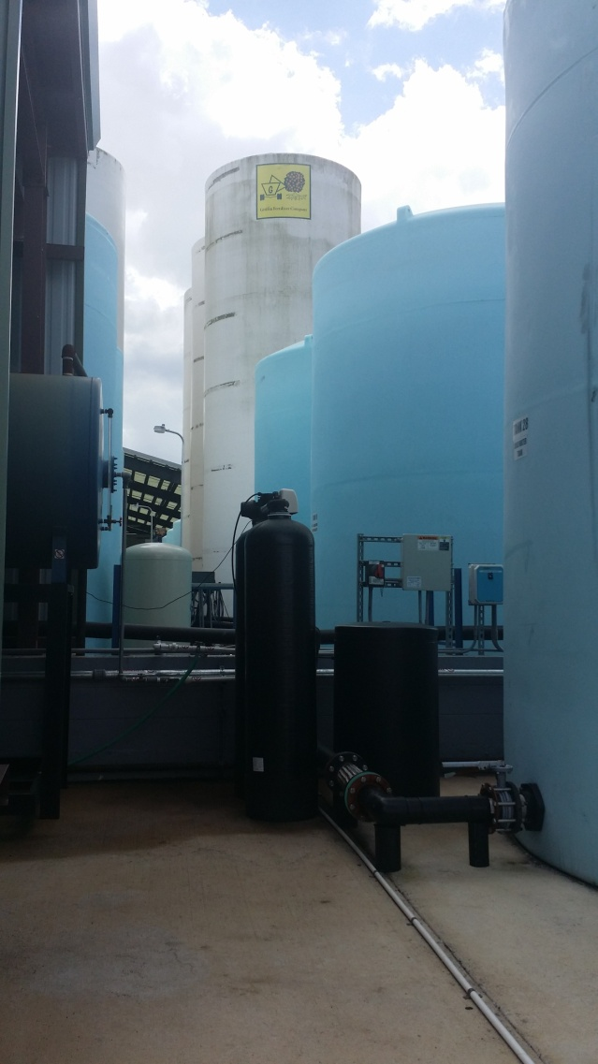
Types of Fertilizers
Bagged
Bulk
Liquid
Notes:
Fertilizers come packaged in three main types of containers: bagged, bulk and liquid.
1. Bagged fertilizer can range from very small bags found on the shelves at retail outlets to 50 pound bags.
2. Bulk fertilizer or sometimes referred to as commercial fertilizer is in a non-packaged form and put into transports like the one seen in the picture.
3. Liquid fertilizer is defined as: A fluid containing plant nutrients, for example, solutions, slurry, decants, or suspensions.

Slide 9
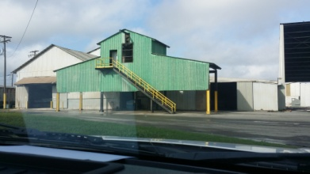
Current Numbers
710 Fertilizer Licensees
45 Fertilizer Bulk Plants in Florida
2148 Specialty Fertilizer Brands
Notes:
How many licensees?
Currently we have 728 Fertilizer Licensees registered. Our licensees are located across the United States, Canada and Australia.
52 of those licensees are Bulk Fertilizer Plants located in the state. Bulk fertilizer plants are regional or local business that distribute fertilizer materials to farmers or growers. These business sometimes sell pesticides, feed and seed too. The larger bulk plants are situated near railroad lines for delivery of bulk fertilizer materials from the manufacturers originating overseas and throughout the U.S.
Straight fertilizer materials may be purchased and or fertilizer can be blended by request from the consumer almost like a recipe depending on the needs of the grower.
We currently have 2076 Specialty fertilizer brands on file. Retail Names you may recognize: Scotts, Miracle Grow, Pennington, Harrell's, Black Cow.

Slide 10
Anderson’s BEST Blooms
The Label
Only The Finest!
Brand Name- means a term, design, or trademark used in connection with one or several grades of fertilizer
Grade- N-P-K expressed in that order. Example: 10-10-10
Guaranteed Analysis- % of plant nutrients
Florida License Number- F00XXXX
Net Weight- Net Weight: 50 lbs
other than primary plant nutrients.
Derivation Statement- Only recognized source materials may appear in the section.
Name and Address of the licensee
Notes:
Now onto labeling.
All fertilizer products must have a label. The label is defined as: A display of written, printed, or graphic matter upon the immediate container of any fertilizer. A label must accompany any fertilizer when moved in bulk also.
As required by law, listed on the label will be the brand name, grade, guaranteed analysis, Florida License Number, Net Weight, all primary, secondary and micronutrients claimed, the derivation statement and name and address of the licensee.
Every new fertilizer label is reviewed and If any of these requirements are missing the label is considered to be misbranded in accordance with our law.

Slide 11
Hayslip’s Best Bloom Fertilizer
0-0-0
GUARANTEED ANALYSIS:
Total Nitrogen (N) …………………………..X%
___% Ammoniacal Nitrogen
___% Nitrate Nitrogen
___% Other/Water Soluble Nitrogen
___% Urea Nitrogen
___% Water Insoluble Nitrogen
Available Phosphate (P2O5) ..........................X%
Soluble Potash (K2O) ....................................X%
Calcium (Ca) ..................................................x%
Magnesium (Mg).............................................x%
Sulfur (S) .........................................................x%
Boron (B).........................................................x%
Chlorine (Cl) ...................................................x%
Cobalt (Co) ......................................................x%
Copper (Cu) .....................................................x%
Iron (Fe) ...........................................................x%
Sodium..............................................................x%
Nickel (Ni) .......................................................x%
Zinc (Zn) ..........................................................x%
Derived From: (list source materials)
F005555
Hayslip’s Hydroponics, LLC
223 Wild Man Lane
Tallahassee, FL 32301
Net Weight – 25 lbs.
Notes:
This is a basic label and how we would review it.
Here we have a label example. The brand name is Hayslip’s Best Bloom Fertilizer, the grade is a triple zero, then you have the nitrogen break down which includes: Ammonaical Nitrogen, Nitrate Nitrogen, Water Soluble Nitrogen, Urea Nitrogen and Water Insoluble Nitrogen which must always be in that particular format.
Then we move onto the secondary’s and micro nutrients which we will go over the formatting in the next few slides.
Onto derivation statement which must contain all of the source materials for guarantees in the analysis. Adjectives and trade names are not permitted in the derivation.
Then we look for the Florida License Number. This number begins with an “F” followed by six numbers. Florida is the only state which requires this number.
After that you have the name and address of the licensee along with the net weight.

Slide 12
Labeling Micronutrients & Secondary Nutrients
SOLUBLE SOURCE MATERIAL: Guaranteed as to “Water Soluble”
Source materials: copper sulfate, magnesium hydroxide, ferrous sulfate, zinc nitrate
Water Soluble Magnesium (Mg)………………………….........................2.00%
Derived from: Magnesium Sulfate
INSOLUBLE SOURCE MATERIAL: Guaranteed as to “Total”
Source materials: iron oxide, iron humate, copper oxide, zinc oxide, manganese oxide
Manganese (Mn)…………………………………………………………..2.00%
Derived from: Manganese Oxide
Notes:
These next few slides are breaking down the format for Labeling Micronutrients and Secondary’s:
What we have are source materials for micronutrients that are either going to insoluble, water soluble or chelated. You may also have materials that could be both water soluble and insoluble like a sucrate material.
For micronutrients and secondary's with a soluble source material, the guarantee must be as to water soluble. We look for the source material in the derivation to be water soluble.
For insoluble source materials the guarantee will be “Total”. Again, we look in the derivation statement to make sure that the source is insoluble.

Slide 13
Labeling Micronutrients & Secondary Nutrients
INSOLUBLE AND SOLUBLE SOURCE : “Total” guarantee will always be
higher than the “Water Soluble” guarantee
Manganese (Mn)…………………………....2.50%
2.00% Water Soluble Manganese (Mn)
Derived from: Manganese Oxide, Manganese Sulfate
CHELATING AGENT SOURCE: Guaranteed as to “Chelated”
Source materials: Zinc EDTA, Zinc Citrate, Iron Glucoheptonate, Copper MEA
Chelated Manganese (Mn) …………………1.00%
Derived from: Manganese EDTA
Notes:
For micronutrients guaranteed with water soluble and insoluble sources the “Total” guarantee will always be higher than the water soluble guarantee. Again checking the derivation source materials.
For chelated agents the guarantee is to chelated.

Slide 14
Labeling Micronutrients & Secondary Nutrients
CHELATING AGENTS, SOLUBLE AND INSOLUBLE SOURCE:
Example Soluble Source and Chelating Agent:
Manganese (Mn)……………………………………1.00%
1.00% Chelated Manganese (Mn)
1.00% Water Soluble Manganese (Mn)
Derived from: Manganese Sulfate, Manganese EDTA
Example Soluble Source, Insoluble Source and Chelating Agent:
Manganese (Mn)…………………………………….2.50%
1.50% Water Soluble Manganese (Mn)
1.00% Chelated Manganese (Mn)
Derived from: Manganese Sulfate, Manganese EDTA, Manganese Oxide
Notes:
For Guarantees with chelating agents, soluble and insoluble sources:
With a Soluble Source and Chelating Agent the chelated portion cannot be higher than the soluble portion of the nutrient guarantee. Both sources are water soluble so they can equal. Always checking the derivation source materials against the guarantee.
With a Soluble Source, Insoluble Source and Chelating Agent: the “Total” guarantee shall be greater than the water soluble and chelated portion. The chelated portion could equal the water soluble portion but it cannot be higher.

Slide 15
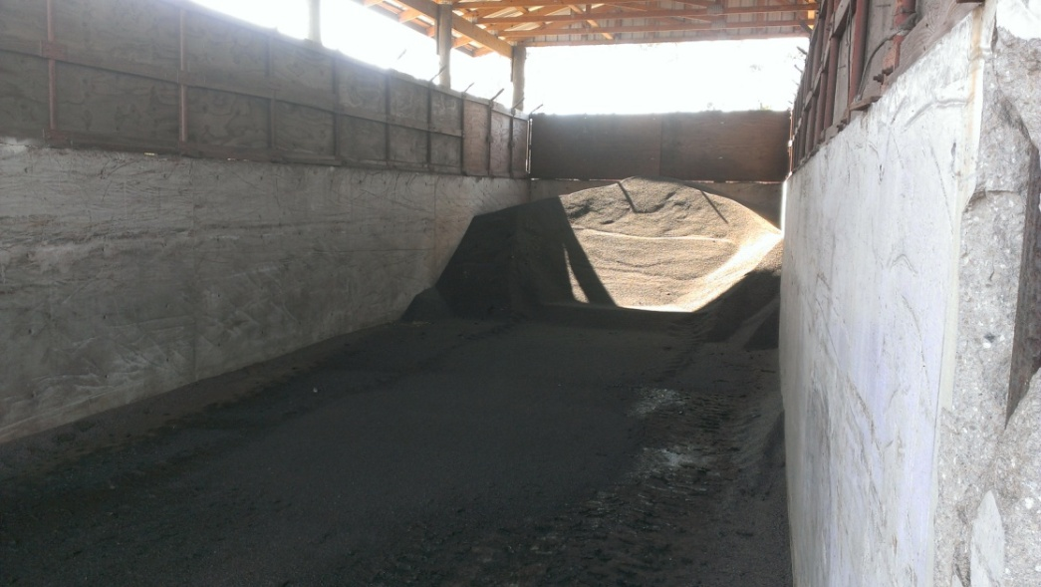
Biosolids
Brand Name
X-X-X
Guaranteed Analysis:
Total Nitrogen (N)............................................0.00%
0.00% Water Soluble Nitrogen
0.00 % Water Insoluble Nitrogen**
Available Phosphate (P₂0₅).............0.00%
Iron (Fe)……………………..……0.00%
Derived From: Class AA Biosoilds
** Slowly Available Nitrogen from Biosolids
F00XXXX
Name and Address
Net Weight
Notes:
This is a label example for Biosoilds.
What are Biosolids? Biosolids is sewerage sludge that is processed by a waste water treatment facilities and used for fertilizer.
This is what we would expect to see listed on a label.
Brand Name
X-X-X
Guaranteed Analysis:
Total Nitrogen (N)............................................0.00%
0.00% Water Soluble Nitrogen
0.00 % Water Insoluble Nitrogen**
Available Phosphate (P₂0₅).............0.00%
Iron (Fe)……………………..……0.00%
Derived From: Biosoilds
** Slowly Available Nitrogen from Biosolids
Note the slow release nitrogen asterisks denoting slow release nitrogen coming from the % of water insoluble nitrogen. If slow release is claimed, 15% of the nutrient must be guaranteed as to slow release. It cannot be guaranteed if it is less than 15% of the total.

Slide 16
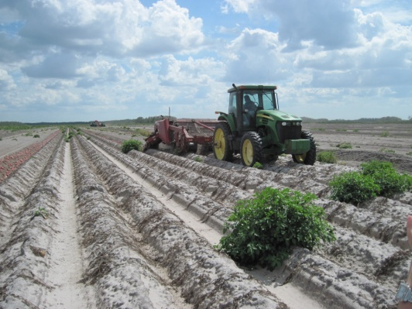
Soil Amendments/Additives/Conditioners
BRAND NAME
Guaranteed Analysis:
Soil Amending Ingredients:
Name of Ingredient................... ___%
Derived From: (Identify and list all soil amending ingredients)
Total Other Ingredients.......... ___%
Purpose of the Product:
Directions for application:
FXXXXXX
Name and Address
Notes:
Soil conditioners, soil amendments and soil additives come within the definition of fertilizer. Potting soils, muck, and peat or compost, when no plant nutrients are claimed, or are exempt from the provisions of this chapter much like unmaipulated manures.
What is a soil amendment? By definition: “Soil amendment,” “soil conditioner,” or “soil additive” means any substance or mixture of substances sold or offered for sale for soil enriching or corrective purposes, intended or claimed to be effective in promoting or stimulating plant growth, increasing soil or plant productivity, improving the quality of crops, or producing any chemical or physical change in the soil, except amendments, conditioners, additives, and related products that are derived solely from inorganic sources and that contain no recognized plant nutrients.
This is a typical soil amendment label example.
BRAND NAME
Guaranteed Analysis:
Soil Amending Ingredients:
Name of Ingredient.................................................... ___%
Derived From: (Identify and list all soil amending ingredients)
Total Other Ingredients............................................. ___%
Purpose of the Product:
Directions for application:
Some common soil amending ingredients are: gypsum, peat,

Slide 17



Urban Turf Rule: 5E-1.003 (3)
Florida’s Urban Turf Rule was adopted in 2007. It regulates the labeling of application rates for home use fertilizer lawn and turf products. It’s purpose is to reduce the amount of (N) and (P) applied by homeowners due to the environmental concerns related to water pollution. This rule mainly applies to “Specialty Fertilizer”
In 2015 the Department adopted changes to the rule after 8 years of research by the University of Florida and funding provided by FDEP
Notes:
Florida's Urban Turf Rule:
Florida’s Urban Turf Rule was adopted in 2007. It regulates the labeling of application rates for home use fertilizer lawn and turf products. It’s purpose is to reduce the amount of (N) and (P) applied by homeowners due to the environmental concerns related to water pollution and water quality. This rule mainly applies to “Specialty Fertilizer”
In 2015 the Department adopted changes to the rule after 8 years of research by the University of Florida and funding provided by FDEP.
The research showed that the timing of the fertilizer applications is a key factor when looking at nutrient loss to the environment. Therefore fertilizer should only be applied to actively growing turf and changes were made the rule. The rule changes were: Increased the (N) application Rate to 2 pounds per 1000 sq ft in the Spring and Summer. Limited the (N) application to 1 pound of total nitrogen per 1000 sq ft in the fall and winter and changes to the Annual Fertilization Guideline Chart were made.

Slide 18


Urban Turf Rule: 5E-1.003 (3), Labeling Requirements for Sports Turf
Have directions for use not to exceed rates recommended in the document entitled University of Florida, Institute of Food and Agricultural Sciences SL191 “Recommendations for N, P, K and Mg for Golf Course and Athletic Field Fertilization Based on Mehlich III Extractant”, revision: October 2013
Have directions for use in accordance with the recommendations in “Best Management Practices for the Enhancement of Environmental Quality on Florida Golf Courses”, published by the Florida Department of Environmental Protection, dated September 2012
Notes:
For sports turf, licensees follow the guideline of two publications put out by FDEP and the University of Florida:
The one from UF is called “Recommendations for N, P, K and Mg for Golf Course and Athletic Field Fertilization”
The publication provided by FDEP is called “Best Management Practices for the Enhancement of Environmental Quality on Florida Golf Courses”
This is the end of labeling

Slide 19
Tonnage Reporting
All reports are made online: http://lims.flaes.org
Reports and payments are made on or before the 15th of the month or the licensee will receive a late penalty
Late penalty is a $25 fee or 10% of the tonnage amount whichever is greater
If a payment is not made for that month, an additional fee of 1.5% will be applied to the next reporting month’s invoice
Notes:
Monthly Tonnage Reporting:
Licensees are required to report their monthly fertilizer sales that are made within the state. They use the same regulatory website site where they submitted their license application.
The report is made on or before the 15th of each month for the previous months sales.
The payment must be processed by Finance and Accounting on or before the 15th or they will receive a late fee.
A late fee is $25 or 10% of the tonnage sales amount whichever is greater.
Last but not least, if a tonnage report is made but the payment is not received for that month, it rolls over to the next month and they receive an additional penalty fee of 1.5% applied to the next month.
1,700,000 Tons of fertilizer reported sold in Florida (FY 2013-2014 est.)

Slide 20
Tonnage Reporting
A Zero report must be filed even when there are no sales made within the state
$1.00 per ton for fertilizer
0.50 cents per ton if contains (N) or (P)
0.30 cents per to for liming materials
Notes:
Fertilizer Tonnage Inspection Fees:
If no sales are made within the state, a zero report must be filed. If you don’t file a report you will receive a penalty fee.
The reporting fees are: $1 per ton for mixed fertilizer or fertilizer materials.
If the fertilizer contains Nitrogen or Phosphorous, the licensee pays an additional $0.50 cents per ton.
phosphate rock, soft phosphate, colloidal phosphate, phosphatic clays, untreated phosphatic materials, gypsum, hydrated lime, limestone, and dolomite are 30 cents per ton.

Slide 21
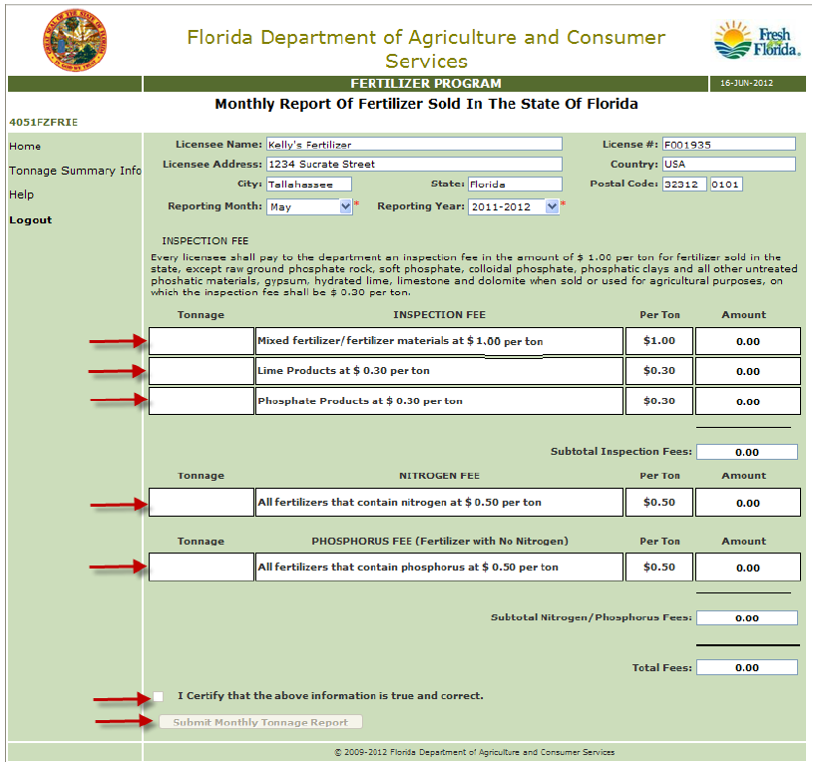
Fertilizer Sales Report
After this report is submitted an invoice is generated for payment
Send the invoice along with a check or pay online using a credit card
Notes:
This is a screen shot of the sales report page.
The licensee selects the reporting month along with the fiscal year then enters the data into the field categories as previously explained.

Slide 22
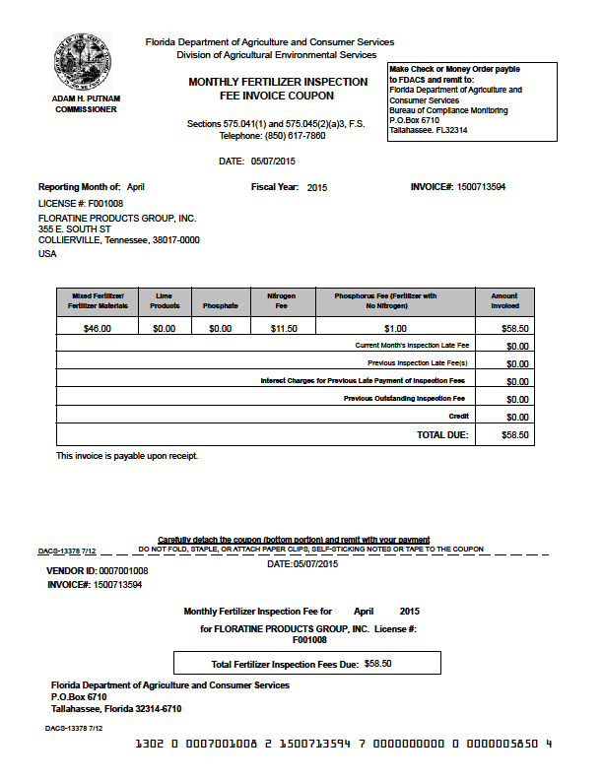
Payment
INVOICE
Send this portion in to F and A or pay online
Notes:
After the tonnage sales report is submitted an invoice is generated . The payment and invoice are sent by the licensee to Finance & Accounting or paid on line using the ROC online Revenue Collection process.
If the payment is not processed by Finance and Accounting the 15th of the month they will get a late fee.

Slide 23
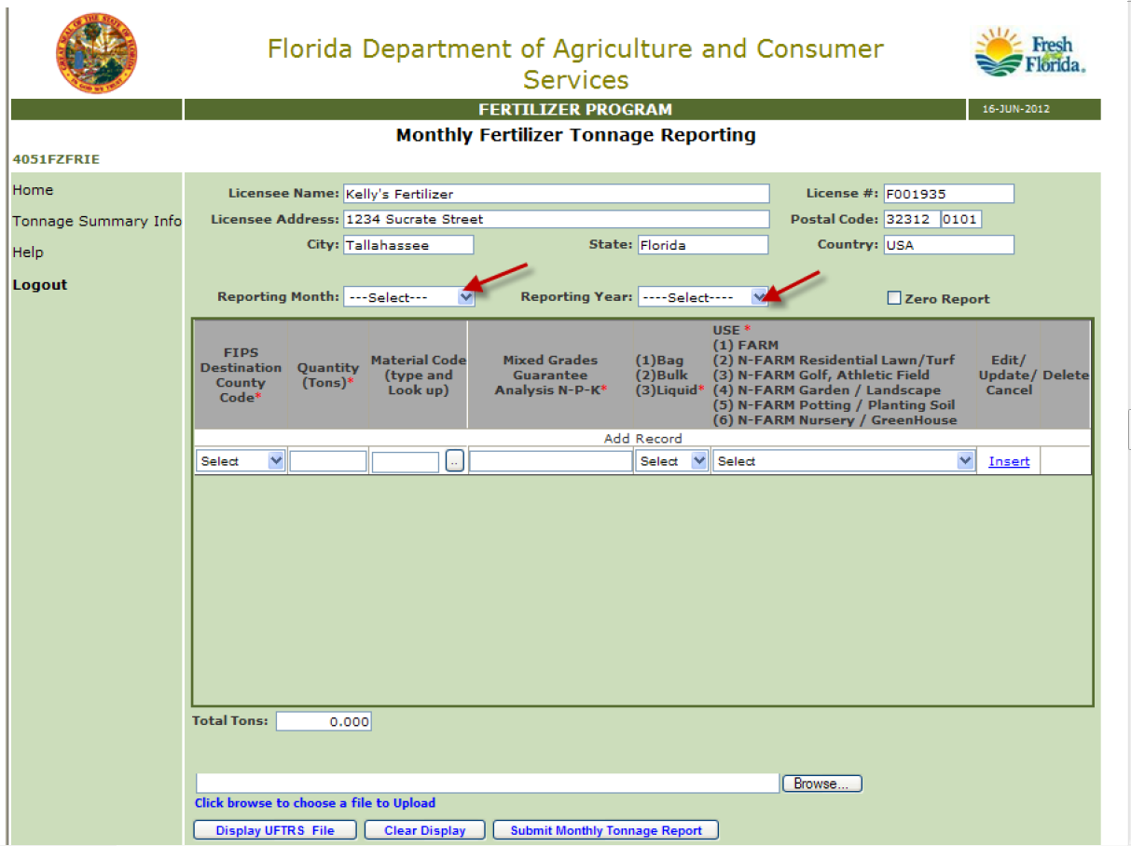
Tonnage Reporting
Notes:
Monthly Tonnage Detail Report:
The licensee selects the reporting month along with the fiscal year then populates the category fields.
The category fields are listed by county, tons, material type, the grade of fertilizer, and the use type.
Use type selections are: Farm, Residential Lawn and Turf, Golf and Athletic Field, Garden and Landscaping, Potting Soil, Nursery and Greenhouse.
For large amounts of data, spreadsheets may be saved as UFTRS format and uploaded. UFTRS stands for Uniform Fertilizer Tonnage Reporting System and has been used for many years throughout the country for tracking and reporting national trends.
The tonnage information is saved and may be accessed on the AES website.
That concludes fertilizer tonnage reporting. Any questions?

Slide 24
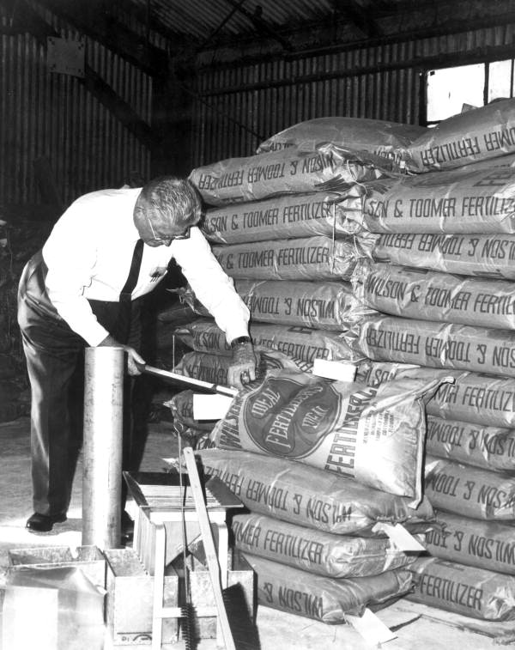

The Bureau of Inspection and Incident Response
Notes:
Now onto the Field Staff side. What is role does the Bureau of Inspection and Incident Response. They play a huge role. Without their efforts we wouldn’t have anything to do so we want to thank them for their services.

Slide 25
Fertilizer Sampling & Reporting
Bureau of Inspection and Incident Response
  Sample collection
  Sample Entry
  Co-ordinate with BLE and BAEL
Bureau of Agricultural Environmental Laboratories
  Sample analysis
  Penalty
  Share label issues with BLE

Slide 26
Thank-You
Email:Rashmi.singh@freshfromflorida.com

