Slide 1
“Dynamics of Biosolids-Borne
Phosphorus in Soils”
George A. O’Connor
Soil and Water Sciences Department
University of Florida
Biosolids Technical Advisory Committee Meeting 2
October 9, 2018
Notes:
Dr. Herschel (Chip) Elliott, Penn State Univ., contributed enormously to the conducting and interpretation of research presented herein, and is a leader in biosolids-P management guidance. Chip frequently addresses NMP and P-Index issues throughout the USA. Some slides used in this presentation came from Chip’s August 2012 Maine presentation (footnoted as “Elliott, 2012”). Chip’s contact information is: email – hae1@psu.edu; telephone – (814) 863-2062.

Slide 2
Purpose
Address biosolids-P loads
Offer some pertinent references
  O’Connor and Elliott. 2006 WERF Report 99-PUM-2T. “The agronomic and environmental availability of biosolids-P”
Describe the dynamics of biosolids-borne P in soils
Describe proposed approaches necessary to characterize the systems and promote sustainable land application
Notes:
O’Connor and Elliott. 2006. The agronomic and environmental availability of biosolids-P (Phase II). WERF Report 99-PUM-2Ta is a major reference for biosolids-P issues nationally and regionally.

Slide 3
Setting the Stage
Representative total P concentrations in biosolids:
  USEPA 1995
    – median = 2.30; mean = 2.50%
  TNSSS 2009/2015
    – mean = 2.07; median 1.76%
  FWEA project 2008 (23 FL materials)
    - range 1.1 to 3.3%; mean = 2.09%
Lability more important
  Phytoavailable and environmental reactivity vary widely for materials with the same total P concentration
Notes:
Total P concentrations in biosolids can vary, but a reasonable value is ~2% by (dry) weight. Lability of total P differs widely.

Slide 4
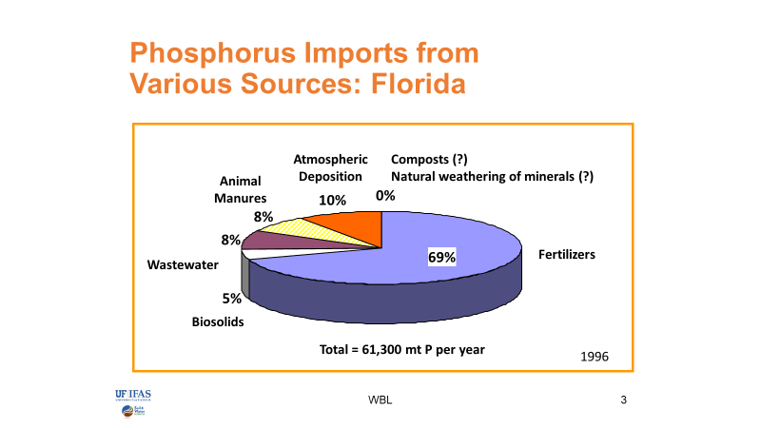
Setting the Stage
Reddy, et al., 1999
Notes:
Reddy, K.R., E. Lowe, and T. Fontaine. 1999. Phosphorus in Florida’s Ecosystems: Analysis of Current Issues, in “Phosphorus Biogeochemistry in Subtropical Ecosystems”, Lewis Publishers.
Of the total of ~61,300 mt P imported to FL in 1996, nearly 70% (~43,000 mt) was as fertilizer; about 5% (~3000 mt) was in the form of biosolids

Slide 5
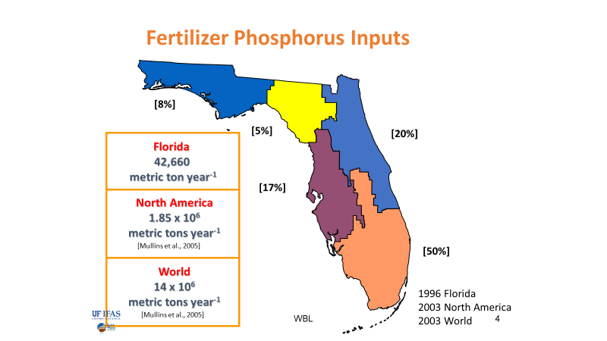
Setting the Stage
Reddy et al., 1999
Notes:
About 50% (~21,500 mt P/y) of the total P fertilizer inputs to FL went to the SFWMD. Using the ratio of biosolids input to fertilizer input percentages shown on the previous figure (5/70), the estimated input of biosolids-P to the entire SFWMD is ~1500 mt P/y. The exact values are expected to vary with time and product amounts and P content, but the gross values are expected to be representative. Biosolids-P is a relatively small contributor to the overall P load in the state and the District.

Slide 6
Setting the Stage
Typical biosolids P loads
  Land application rate ~3 T/A
  Total P concentration ~2%
  Typical P load
    3 T biosolids/A x 0.02 T P/T biosolids = 0.06 T P/A
    1,700 A/property x 0.06 T/A = 102 T P/property
      What’s the risk to water quality?

Slide 7
Biosolids-Borne P Dynamics
Fundamentally the same as for other P-sources, but regarded as “special”
  Value – source of plant-available P (and N)
    Fertilizer – 20% P; N:P = variable
    Animal (dairy) Manure – 5-7% P; N:P = 15-20
    Biosolids – 2-3% P; N:P = ~2-3; “slow-release”
  Hazard – water quality (P) impacts
    Accelerated eutrophication
    Exceedance of MDLs
    “Yuk” factor
Notes:
Value – valuable to farmers/ranchers as cheap fertilizer and OM source
Hazard – sometimes includes the “yuk” factor – draws special attention, especially in some regions of FL

Slide 8
P₂O₅ Loadings When Materials Used to Satisfy Corn* Nitrogen Needs
P₂O₅ removal by corn ~45 lb/ac
*125 bushels per acre corn grain with net PAN need of 84 lb N per acre
Elliott, 2012
Notes:
Note: to convert from P₂O₅ to P, multiply by 0.43. Applying residuals at plant-N required rates (N-based) results in excessive P applications, which are magnified when the N:P of the residual becomes increasingly mismatched with plant needs (~ 10:1). The narrow N:P ratio of most biosolids means much more P is applied than can be taken up by plants. P accumulates in the soil and/or is subject to erosional and leaching losses, both of which can impact surface and ground water quality.

Slide 9
Phosphorus Behavior in Soils
Elliott, 2012
Notes:
Soil test P (STP) levels exceed levels needed to maximize crop yields – no further P addition needed for plant productivity. If/when STP levels dictate residuals application rates, additional biosolids application rates become impractically and uneconomically low, threatening land application programs. But, is there an environmental hazard? STP (high or low values) developed for agronomic purposes are often NOT a good indication of environmental hazard. Especially true for many soil in US that have appreciable P-retention capacity and where erosional control measures instituted. Thus, the focus of biosolids land application – beneficial reuse as P-fertilizer source – vs. environmental protection is critical, but often forgotten. Guidance for land application often based on STP (agronomic considerations) rather than some estimate of environmental hazard, not the intended (or correct/meaningful) use of STPs.

Slide 10
Soil test P: Agronomic vs. environmental interpretations
RDP (mg L⁻¹)
Environmental threshold
(Soil P sorbing sites full)
Agronomic optimum
(26 ppm M3-P)
Change point
Soil Test P (STP)
Agronomic optimum
~3-4 x agronomic optimum
Source: O’Connor, 2013
Notes:
RDP = Runoff Dissolved P

Slide 11
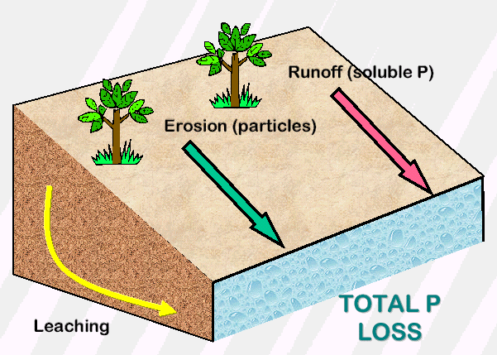
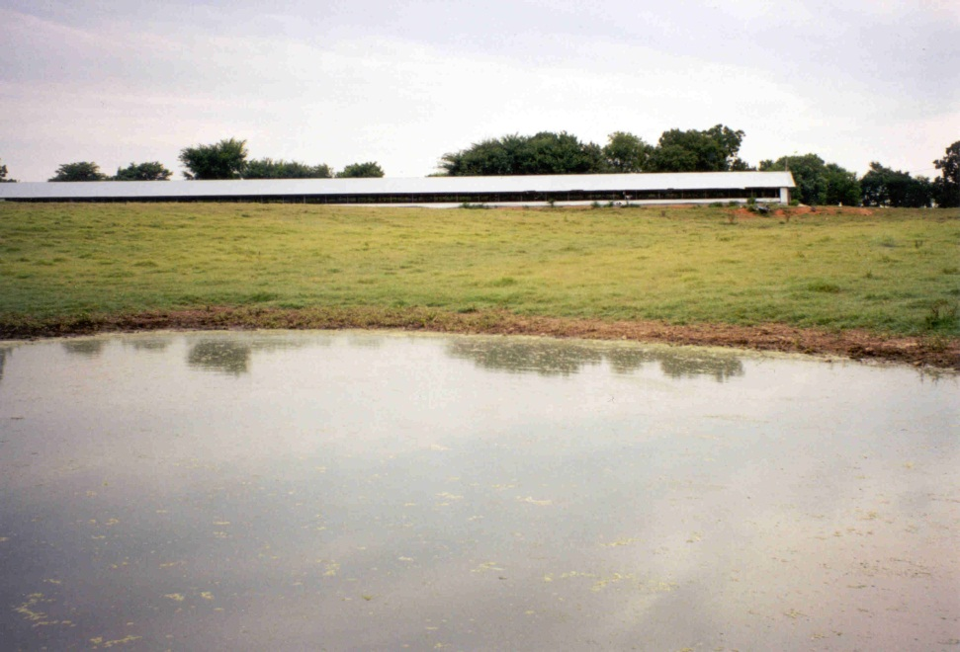
Mechanisms of P Loss
Sandy soils of Florida retain P poorly and often surround P sensitive water bodies
Notes:
Leaching, sub-surface or lateral runoff (through the soil), is often a major mechanism for fugitive P losses to the environment in FL, NOT surface runoff and erosion (off the soil). Thus, soil retention/storage capacity of P is a major factor in determining P leaching. While many FL soils are sandy, some have appreciable P-retention capacity, especially deeper in the soil profile where horizons with greater clay content and solids capable of retaining P accumulate. Not all soils (even FL “sands”) are equal!

Slide 12
Source P Solubility
Brandt et al., 2004
Elliott, 2012
Notes:
P-source solubility varies widely, so environmental hazard can be expected to vary. Various P-sources applied at the same total P rate represent different environmental hazards.

Slide 13
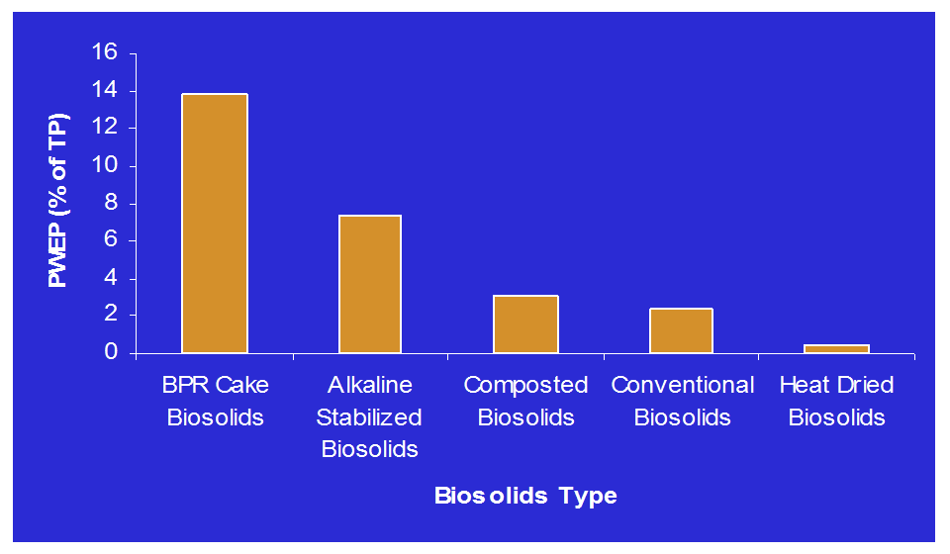
Biosolids P Solubility
Notes:
Biosolids type (treatment and processing) affects P solubility (PWEP = percent of total P that is water extractable). Different biosolids applied at the same rate to the same soil would be expected to represent different environmental hazards.

Slide 14
P Runoff Comparison:
Manure vs Biosolids
Elliott, 2012
Notes:
Study soils were typical, non-sandy, soils from Pennsylvania (low and high STP) amended with different P-sources and subjected to intense, artificially generated rainfall. Dissolved P in runoff represents potential environmental hazard. Leached P was not quantified, but was expected to be low for the P-retentive soil. Note the trend for less P to be lost as runoff as the Fe + Al content of P-source increased; this gave way to the concept of a P source coefficient [PSC = mole P/moles (Fe+Al)], an improvement over simply measuring PWEP of the P-source.

Slide 15
Total BAP loss (mg)
a
b
b
c
d
Treatments with the same letters are not different at p<0.05
Notes:
Here are similar surface runoff and leached P data (expressed as “Biologically Available P” – BAP) for a FL sand with minimal P-retention capacity and amended with different P-sources at the same high rate (224 kg P/ha). P losses from studies with lower P-loadings were less, but the trends were similar. The P loss trends shown here are similar to those found with the Pennsylvania soil, but the majority of P loss in the FL soil was in leachate, rather than in surface runoff, except for low % solids manures and biosolids that “sealed” the soil surfaces and promoted surface runoff. Details of the work are given in Agyin-Birikorang et al., 2008. J. Environ. Qual. 37:1180-1189. The same authors showed that management practices intended to reduce runoff (e.g., incorporation rather than surface application) were effective, but increased leaching losses, so the total P loss to the environment was for each source was essentially the same! Clearly, not all P-sources (or biosolids) are the same.

Slide 16
Summary: Biosolids-P Dynamics
Complicated and affected by many factors
  Focus of biosolids concern
    Agronomic vs. environmental
  Nature and rate of biosolids
    Soluble P content - PWEP or PSC
    Environmentally effective P load = Total P x PWEP
  Soil being amended (P retention/storage capacity)
    Soils with appreciable P-retention capacity
      Surface runoff dominates, PWEP of source important,
    Soils with minimal P-retention and/or shallow
      Leaching dominates (erosion control can exacerbate), PWEP important
Regulations/management necessarily sophisticated

Slide 17
P Index Tool
Field based
Risk based
Annual rating
Critical Area
P Transport
P Source
Notes:
P-Index tool meant to account for several of the complications enumerated previously, although the sophistication of various states’ Indices vary widely. Indeed, some states use only a STP value to guide P management. Maurice Barker described the FL P-Index and its use in nutrient management planning with special attention to biosolids.

Slide 18
Typical P Index Components
Transport Factors
Soil erosion
Leaching potential
Runoff potential
Distance to water body
Source Factors
Soil test P
P₂O₅ application rate
Source characteristics
Application method
Application timing and management

Slide 19
Part A: Transport Potential Due to Site and Transport Characteristics
Site and Transport Characteristics | Phosphorus Transport Rating |  |  |  |  | Value
Soil Erosion | No Surface Outlet 0 | <5T/Aª 1 | 5-10 T/A 2 | 10-15 T/A 4 | >15 T/A 8
Runoff Potential | Very Low 0 | Low 1 | Medium 2 | High 4 | Very High 8
Leaching Potential | Very Low 0 | Low 1 | Medium 2 | High 4 | Very High 8
Potential To Reach Water Body | Very Low 0 | Low 1 | Medium 2 | High 4
Total for Part A: Site and Transport^{b}
ª T/A = tons per acre. ^{b} If the sum for Part A is 0 (zero), then change the sum to 1 (one).
Part B: Transport Potential Due to Phosphorus Source Management
Phosphorus Source Management | Phosphorus Loss Rating |  |  |  | Value
Fertility Index Value | Soil Fertility Index x 0.025 ( _____ ppm P x 2 x 0.025)
P Application Source and Rate | 0.05 x ( _____ lbs P₂O₅) for fertilizer, manure or compost 0.015 x ( _____ lbs P₂O₅) for biosolids 0.10 x ( _____ lbs P₂O₅) for waste water
Application Method | No Surface Outlet Or Solids incorporated immediately or injected | Applied via irrigation Or Solids incorporated within 1 day of application | Solids incorporated within 5 days of application | Solids not incorporated within 5 days of application
 | 0 | 2 | 4 | 6
Waste Water Application | 0.20 x _____ acre inches/year
 | Total for Part B: Phosphorus Source
P Index Value: Multiply Part A x Part B
Notes:
Table shows the P-Index Parts A and B that address transport and source management factors, respectively. This is the official, published FL P-Index, and addresses the factors involved in biosolids-P dynamics we mentioned. Details in Part B distinguish the FL P-Index (primarily by acknowledging differences in the lability of different P sources – highlighted in red), and continues to attract attention.

Slide 20
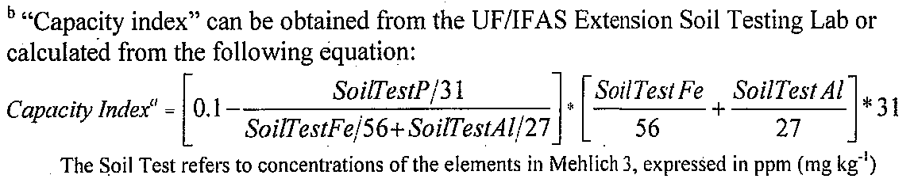
Unpublished Revisions to
P-Index
Approved by the NRCS-sponsored Florida P-Index committee, but not published yet
Uses “Capacity Index” instead of “Fertility Index” to give a relative measure of the soil to hold additional phosphorus (rather than current fertility measure)
There are also some revisions to the “P Application Source and Rate” factor including different coefficients for biosolids (to account for different biosolids-P labilities)
IFAS lab offers a different soil fertility test for the “Capacity Index”
A permittee may choose to use this unpublished version
Notes:
Here is another slide from Maurice’s presentation. The red highlighted words are mine, not Maurice’s, and are added to show how the revisions address points made earlier in my talk. Similarly, the bolding of the last sentence is my editorial emphasis to Maurice's slide. Let’s look at the scientific basis for the published and unpublished revisions to the index.

Slide 21
P Source Coefficients
P sources vary in solubility
Source coefficients in Florida P index (FPSC) accounts for P source solubility
Three (3) coefficients accounts for P sources ?
P Source | FPSC
Waste waters | 0.10
Fertilizer and Manure | 0.05
Biosolids | 0.015
Notes:
First, let’s address the P source coefficients. The FL P-Index PSC values are shown and acknowledge the differences expected in the lability of P in several P-sources. The actual coefficient is not as important as the relative value for a source to say fertilizer-P – assumed to be completely labile. In the published P-Index, animal manure-P is estimated to as labile as fertilizer-P, so both sources have the same coefficient (0.05). P in all biosolids is estimated to be equally labile, but only 30% (0.015/0.05) as fertilizer (and manure)-P. [We’ll leave the assumption that wastewater (recycled water) is twice (0.10/0.05) as labile as fertilizer-P to another day.]. It is important to realize that the initial PSC values were developed before much of the research I’ve shared with you was conducted, and that professional judgment was heavily utilized. We wondered if 3 coefficients were sufficient.

Slide 22
Total BAP loss (mg)
a
b
b
c
d
Treatments with the same letters are not different at p<0.05
Notes:
Recall these surface runoff and leached P data for a FL sand with minimal P-retention capacity and amended with different P-sources that I showed earlier. Clearly, not all P-sources (or biosolids) are the same, nor is fertilizer-P and manure-P the same.

Slide 23
Total BAP loss (mg) vs P applied
(rainfall simulation study)
Independent variable | Intercept | Slope | r² | CV (%) | P-value
P Rate | 36.6 | 0.94 | 0.27 | 95 | 0.0001
Rate*FPSC | 30.9 | 30.3 | 0.54 | 76 | <0.0001
Rate*PSC | 13.5 | 2.11 | 0.77 | 54 | <0.0001
Rate*PWEP | 57.2 | 0.03 | 0.81 | 49 | <0.0001
Notes:
Note that Biologically Available P loss to the environment via surface runoff + leaching for the various sources was poorly correlated to total P (rate) applied. Using the original FL P-Index PSC x the total P rate slightly improved the correlation. Using PSC coefficients from Pennsylvania (where surface runoff is the dominate loss mechanism) improved the correlation, but using the PWEP of each source x P rate – the “environmentally effective P load” as a variable resulted in the best correlation. We have similar data for other soils and P-sources; all show that the simplified 3 coefficients in the published FL P-Index are insufficient to accurately estimate environmental hazard of applied P from biosolids (and animal manures).

Slide 24
P Sources Coefficients
P source | Type of P source | FPSC
Biosolids | Aerobically digested cake | 0.015
 | Anaerobically digested cake | 0.015
 | Biological P removal | 0.015
 | Alkaline stabilized cake | 0.015
 | Composted | 0.015
 | Heat dried | 0.015
 | BPR heat dried | 0.015
 | BPR N-vitro | 0.015
 | Unstabilized | 0.015
Manures | Dairy manure | 0.050
 | Poultry manure (Layer) | 0.050
 | Poultry manure (Broiler) | 0.050
Fertilizer | TSP | 0.050
Solution | Waste water | 0.100
†PWEP (%)
2.75
2.21
13.9
7.39
3.04
0.48
11.3
0.21
10.4
51.8
20.4
20.9
85.2
-
PWEP-based PSC
0.003
0.002
0.013
0.007
0.003
0.0005
0.011
0.0002
0.010
0.052
0.020
0.021
0.085
0.100
(†Elliott et al., 2002)
Notes:
The PWEP for a particular source is easily measured, and the data here show how variable the PSC values can be for various sources. Nevertheless, a compromise was reached between an almost infinite number of PSC values and the required measurement, and resulted in a simplified table of more general coefficients that still reflected important differences – next slide.

Slide 25
Proposed Modifications to
FL P-Index
Part B of Index:
  P Loss Potential Due to Source and Management
    P Application Source and Rate
      0.05 x PSC x (____ lbs P₂O₅/acre)
      Insert the following PSC values %
      P Source PSC Labile
      Municipal wastewater, commercial fertilizer 1.0 100
      All animal manures not treated with alum 0.8 80
      Alum-treated animal manures 0.5 50
      Biosolids – Biological nutrient removal 0.9 90
      Conventionally stabilized 0.5 50
      Heat-dried, with total Fe+Al >5%
      and advanced-alkaline stabilized 0.25 25
Notes:
Note: 1. Impact of alum addition on manures (reduced lability); not discussed here, but widely documented.
2. Biosolids sub-categories recognized: a). Uniquely high lability of BNR materials, unless otherwise treated (e.g., with Fe/Al, heat-dried, etc.); b). Uniquely low lability of heat-dried, Fe/Al-treated, or alkaline-stabilized materials. Actually, the PSC values could/should be ~0.05); c). “conventionally stabilized” materials lumped with a lability of ~50%. Note that this value exceeds the 30% value in the published Index. The values are science-based, but almost all are conservative (over-estimate lability) and are meant to be protective of water quality. Ideally, one would measure the PWEP of the material being applied to better estimate lability, but this refinement is not being recommended now because field validation of the approach for FL conditions is incomplete.

Slide 26
Proposed Modifications to
FL P-Index
Part B of Index
  P Loss Potential Due to Source and Management
    Fertility Index replaced with “Capacity Index”
  Major/contentious change
    Agronomic to environmental focus
    Addresses weaknesses of STP to access hazard
    Is scientifically and conceptually sound, but would profit from additional field validation, especially for biosolids
Notes:
Recall that the ultimate goal of a NMP is environmental protection and agricultural efficiency (account for all nutrient additions and add only that necessary or environmentally benign). STPs are designed to identify fertility issues (primarily, deficiencies). They were not designed, nor do they function well, as environmental guides. A STP measures what is in the soil, not the capacity of a soil profile to accept/store additional nutrient before a “tipping point” ((change point, slide # 9) is reached and unacceptable amounts of nutrient are released to degrade water quality. The “capacity index” was designed to access the remaining capacity. The capacity index increases as the amount of the soil’s inherent capacity to retain P (represented by the extractable Fe and Al content) is satisfied by P already in the soil. The greater the capacity index, the less the ability of the soil to maintain soluble P concentrations in the soil solution/drainage water below critical concentrations that promote eutrophication, so the greater the hazard. Numerous laboratory studies and some field tests have confirmed the Capacity Index, especially on manure-amended soils. There are far fewer biosolids-amended studies. Some contend that the concept is purely academic and unproven under field conditions in FL with biosolids, and that the “unproven” nature of the concept does not justify the major change recommended to the Index. Objections are particularly focused on surface soils with low STP values. “Logically”, such low STP values signal the need for additional P for agronomic purposes and an apparent “safe” (large) capacity of the soil to retain/store P not immediately taken up by plants, either in the surface few inches or certainly in deeper soil horizons. A soil with limited storage capacity for P, however, would be expected to lose added P readily and might actually explain the low STP value: evidence of P loss. It might take many years for the P to reach ground water, but time only delays the inevitable. Repeated loading of a soil profile beyond its P storage capacity (increasing capacity index) promises eventual risk of pollution of groundwaters and “legacy” P that will continue to “leak” from the profile long after additions of P cease. Ironically, soils with high STP values may actually have significant P storage capacity – low capacity index (that’s why the P is there), and would be penalized with a STP-based appraisal when the environmental risk is minimal! Scientists experienced with P chemistry and dynamics in both manure and biosolids-amended soils endorse the capacity index approach. Additional field research is welcomed to confirm our expectations, but funding for such work is extremely scarce. In the meantime, the proposed revision to the FL P-Index is strongly recommended while additional validation comes from field operations utilizing the revisions. Some work currently underway in a field project led by Dr. Maria Silveira through special funding by the Legislature to the Cattlemen’s Association.

Slide 27
Dynamics of Biosolids-Borne
P in Soils
Dynamics of soil-P reactions studied for decades, and reasonably well understood
Biosolids-borne P reactions fundamentally the same, but resist generalizations because
  Not all biosolids, and not all soils, are the same
  Agronomic interests different from environmental interests, which affects biosolids loading rates
Tools like the P-Index are useful to guide sustainable land application when appropriately parameterized
  Revisions to published FL P-Index are needed

Slide 28
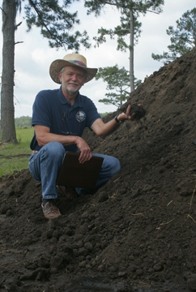
George A. O’Connor
Professor, Soil Environmental Chemistry
Soil and Water Sciences Department
University of Florida
P.O. Box 110290
Gainesville, FL
gao@ufl.edu
352-294-3167

