Slide 1
Biosolids Land Application
Site Inspections
November 28, 2018

Slide 2
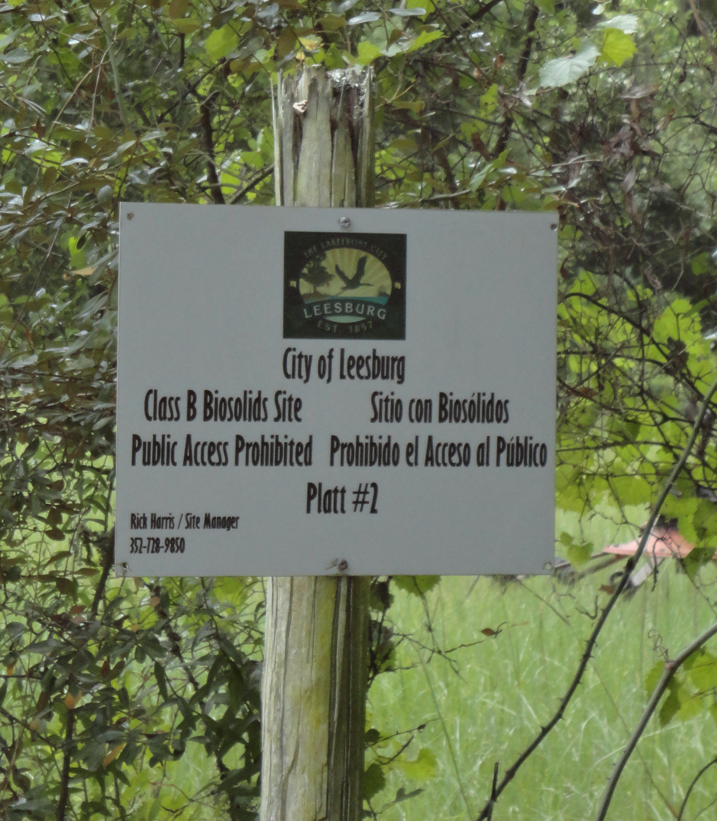
Biosolids Site Inspections
Pre-Inspection
Inspection
Post Inspection

Slide 3
Checklist
Biosolids Land Applications Site Checklist

Slide 4
Pre-inspection
Checklist
Site permit
Nutrient Management Plan (NMP)
Biosolids Annual Summaries (facility BAS and site BAS)
Previous inspections activity
Compliance history

Slide 5
Site Inspection
Site access and signage
People (biosolids, ranchers, farmers, owners or lessees)
Onsite records (manifests, zones (fields), and Biosolids Application Site Log)
Site operations and activities (observe and review site)
Monitoring wells (water table)
Setbacks (wells, conduits, buildings, property lines, and waters of the state)

Slide 6
Site Inspection
Animals
Crops and growth conditions
Application methods and uniformity
Vectors present
Odors
Road conditions (tracking)
Neighbors
Miscellaneous field notes
Onsite compliance assistance offers

Slide 7
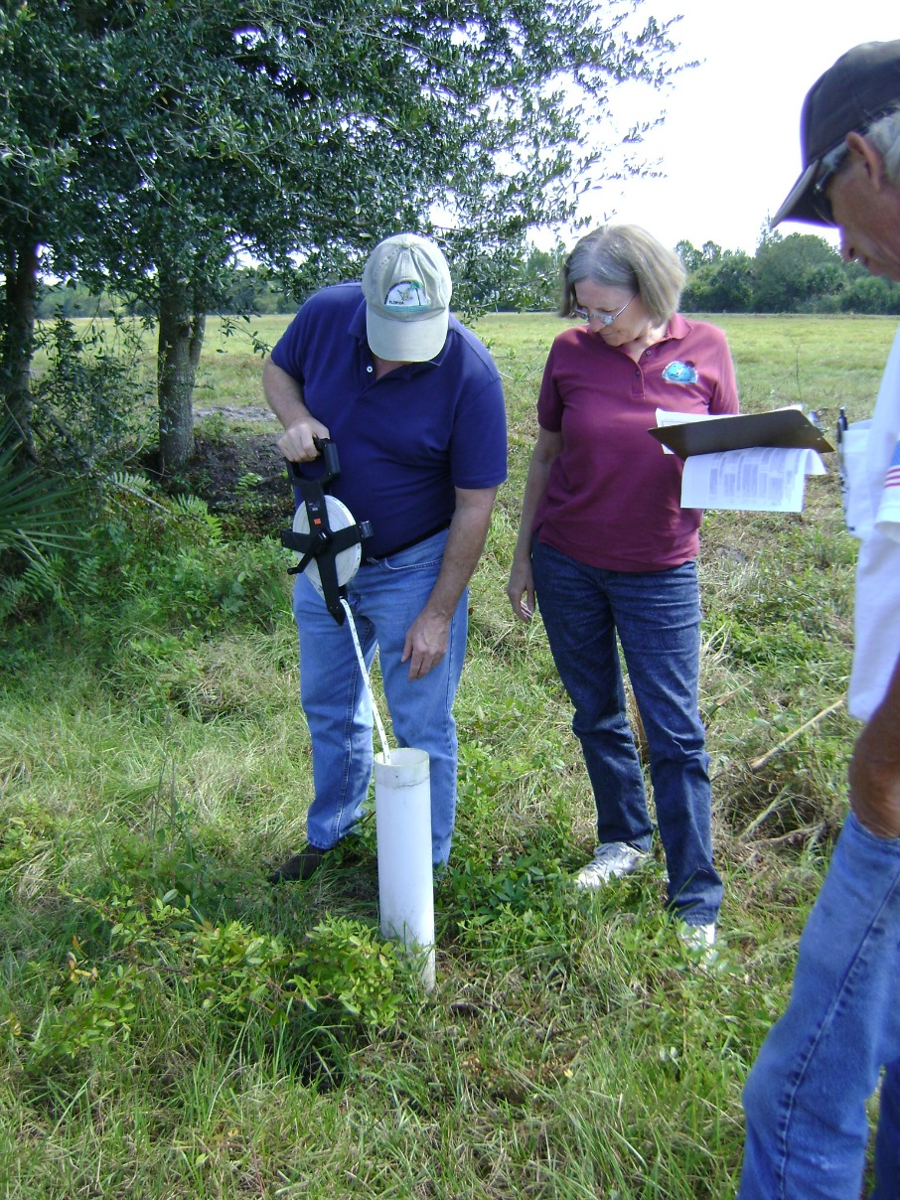
Post Inspection
Report
Compliance issues
Site inspection correspondence

Slide 8
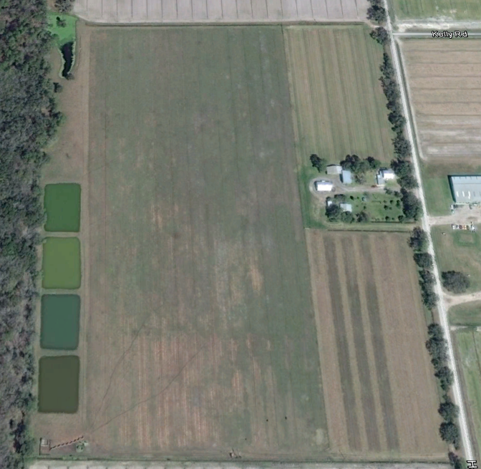
Site Example
75 ft
200 ft
300 ft
¼ mile
Well
Ponds
No setback
300 ft
Property border

Slide 9

Questions
Thank You!

Slide 10
Contact Information
Department of Environmental Protection
Central District
Dr. Phil Kane
407-897-4156
Phil.Kane@dep.state.fl.us

