Slide 1


Standards and Assessment
Implementation of Numeric Nutrient Criteria in NPDES Permitting
Environmental Assessment and Restoration

Slide 2
Summary of Presentation
Current Status of NNC Rulemaking and Litigation
Lessons Learned and Comparisons with EPA’s NNC
Basic Concept and Hierarchical Approach
Florida’s Adopted NNC
Which NNC Apply?
  Exceptions to Streams Definition
Downstream Waters Protection
Reasonable Assurance
Sources of Information
Specific Example Scenarios

Slide 3
NNC Development Timeline
DEP started NNC development in 2001
Litigation began in 2008
  August 2008 – Earthjustice filed suit to compel EPA to establish NNC, alleging that EPA’s 1999 Clean Water Action Plan (CWAP) was a determination that NNC required to implement Clean Water Act
  January 2009 – EPA filed “determination letter,” stating that NNC were required in Florida to implement CWA
  August 2009 – EPA agreed to Consent Decree with Earthjustice

Slide 4
NNC Development Timeline
(continued)
Determination letter and Consent Decree included tight schedule for NNC development
  Called for EPA to propose NNC for all lakes and streams by January 2010 and finalize them by October 2011, and propose NNC for all estuaries and coastal waters by January 2011 and finalize them by October 2012
  EPA met schedule for initial proposal, but Consent Decree schedule was modified several times

Slide 5
NNC Development Timeline
(continued)
On November 14, 2010, EPA finalized NNC for streams, lakes and spring vents
  Based on technical work done by Florida
  Also included criteria for protection of downstream lakes (“downstream protection values” or “DPVs”) and a Site-Specific Alternative Criteria (SSAC) provision
  Included delayed effective date (15 months) to allow time to address implementation issues and to allow parties to apply for SSACs

Slide 6
NNC Development Timeline
(continued)
EPA’s NNC were challenged by many parties, and on Feb. 18, 2012, Federal Judge Hinkle upheld criteria for lakes and spring vents, but overturned NNC for streams and DPVs for unimpaired lakes
  EPA required to re-propose streams criteria and DPVs by June 4, 2012, but later changed to November 30, 2012
  Date for proposal of estuary NNC and S Florida “flowing waters” also changed to Nov. 30, 2012, and date to finalize to Sept. 30, 2013

Slide 7
Status of DEP’s NNC Rulemaking
Florida adopted first set of nutrient standards rules for lakes, streams, spring vents, and Southwest estuaries on Dec. 8, 2011
  Amendment excluded canals/ditches primarily used for water management purposes and with limited habitat from definition of stream
  Estuaries covered ranged from Clearwater to Miami and the Florida Keys
NNC challenged, but all upheld by State Administrative Judge, including streams NNC

Slide 8
Status of DEP’s NNC Rulemaking (continued)
Florida submitted NNC to EPA on June 13, 2012
EPA approved NNC on November 30, 2012
  Approval had several contingencies, including interpretation of “poison pill” language
  First set of estuary NNC are now in effect, but remaining criteria are not yet in effect because of “poison pill” provision

Slide 9
EPA Approval (Rule 62-302.531 (9))
Subsection (9) states that key definitions, NNC for streams/lakes/spring vent, and schedule for estuary criteria development shall be effective only if EPA
  Approves these rules in their entirety,
  Concludes rulemaking that removes federal numeric nutrient criteria in response to the approval, and
  Determines, in accordance with 33 U.S.C. § 1313(c)(3), that these rules sufficiently address EPA’s January 14, 2009 determination

Slide 10
EPA Approval (Rule 62-302.531 (9))
(continued)
The “poison pill” was very important to stakeholders, who wanted to make sure that all elements of nutrient standards were kept together, including the definition of stream and hierarchy
But, created a “Catch 22” of sorts, in that EPA felt they could not fully approve criteria given the provision, and criteria can’t go into effect until EPA fully approves

Slide 11
Path Forward
EPA and DEP reached agreement on March 15, 2013 on a “Path Forward” for NNC development
  If “executed,” EPA said would not finalize their NNC
As part of Path Forward, DEP agreed to
  Adopt NNC for additional estuaries and satellite-based chlorophyll a criteria for coastal waters by 7/1/2013
  Calculate interim numeric values representing current unimpaired conditions of remaining estuaries and submit them to Governor and Legislature by 8/1/2013
    St. Marys, Big Bend, and “gaps” (ICWW)
  Submit New Estuarine NNC, Implementation Document, and interim values to EPA by 8/1/2013

Slide 12
Path Forward
(continued)
Path Forward anticipated state legislation that:
  Establishes that DEP will implement the narrative nutrient criterion and protect downstream waters from nutrients
  Authorizes DEP to implement the adopted NNC consistent with the document “Implementation of Florida’s Numeric Nutrient Standards,” which was incorporated by reference in Chapter 62-302 on April 23, 2013
  Repeals “poison pill” language in Rule 62-302.531(9) if EPA withdraws federal NNC and ceases NNC rulemaking
  Waives ratification for any estuarine NNC adopted in 2013
  Requires NNC for all remaining estuaries by Dec. 1, 2014, and establishes that current conditions of unimpaired waters will be the nutrient standards until NNC adopted

Slide 13
Path Forward
(continued)
EPA agreed to review the NNC and the legislatively established narrative standard, and make final decisions before the deadline in the Consent Decree (CD) for NNC development
  Sept. 30, 2013
EPA revised their “Determination” to exclude SF flowing waters, marine lakes, tidal creeks, and conveyances, and filed Motion to Federal Court to revise CD

Slide 14
Path Forward
(continued)
Federal Judge stayed CD deadlines and held oral arguments on proposed change to CD on September 24, 2013
EPA approved all of our NNC on September 26
On January 7, 2014, Federal Judge ruled in EPA’s favor, approving changes to CD
  Clears way for EPA to rescind their NNC, in which case all State adopted NNC would go into effect
  EPA proposed withdrawal of their criteria on April 2, with a 60-day comment period (thru June 2)
    Don’t know how long EPA will review comments

Slide 15
Lessons Learned – Implementation is Key
To assist EPA’s understanding of Florida’s rules during the EPA review process, DEP wrote a document titled, Implementation of Florida’s Numeric Nutrient Standards
  Describes how the adopted provisions for nutrients in Chapters 62-302, 62-303, and the SCI Primer work in conjunction with each other
  Environmental Community challenged as non-rule policy
Adopted by reference into Chapter 62-302, including floral evidentiary thresholds for stream nutrient standards attainment

Slide 16
Lesson Learned - Everything’s Relative
Federal and State numeric nutrient numbers are almost identical
  Same magnitude, frequency and duration
  Some differences in application of “modified criteria” for lakes
So why have State nutrient rules been so much better received by regulated parties?
  Key differences in implementation provisions

Slide 17
Comparison between Federal and State NNC Rules
(short version)

Slide 18

EPA’s NNC Rule
Slides courtesy of David Childs, Hopping Green & Sams

Slide 19

DEP’s NNC Rule

Slide 20
Comparison between Federal and State Rules
Acknowledgment of previous site-specific interpretations
  Our rule “hierarchy” recognizes nutrient TMDLs (and others), while EPA would require TMDLs to be adopted as Site Specific Alternative Criteria (SSACs)
  EPA rule creates uncertainty about which nutrient standards apply (NNC or TMDL) after stakeholders may have invested billions to attain TMDL

Slide 21
Comparison between Federal and State Rules
(continued)
Use of Biological Information
  Our rule allows bioassessment data to supersede stream nutrient thresholds, while EPA’s did not
    Acknowledges that “reference method’ is not linked to impairment
  Is not “biological confirmation” because biology not required and because biology alone can list
    If stream exceeds the thresholds and biological data are not available, it is placed on 303(d) List
    Standard not attained if biology fails even if stream nutrient thresholds met

Slide 22
Comparison between Federal and State Rules
(continued)
Applicability of Stream Standards
  Florida definition of “streams” excludes non-perrenial (intermittent) streams, tidal creeks, and manmade/altered canals, ditches, and other conveyances used for water management purposes and having poor habitat
    Narrative nutrient criterion would continue to apply in these systems under state rule, while stream standards would apply under federal rule
    All “stream-like” waters presumed to be stream until provide site-specific information

Slide 23
Comparison between Federal and State Rules
(continued)
Spatial Component
  Florida rule clearly states that standards are applied as a spatial average in waterbody, consistent with derivation
  Federal rule is silent on spatial component, and as such, NNC would be applied like other criteria, which are applied as “end of pipe”
  Huge ramifications on required treatment level and cost needed to comply
  Also big ramifications on Water Quality Credit Trading because “end of pipe” concentration-based limits could effectively kill trading
    Trading works much better with load-based TMDLs

Slide 24
Nutrients
Naturally present in aquatic systems
  Necessary for the proper functioning of biological communities
Moderated in how they are expressed by many natural factors
  e.g., light penetration, hydraulic residence time, presence of herbivore grazers and other food web interactions, and habitat considerations
Determining appropriate nutrient regime is site-specific, requiring information about ecologically relevant responses

Slide 25
Basic Concept of NNC Rules
The narrative nutrient criterion is maintained and numerically interpreted using best available information on a site-specific basis using a systematic, hierarchical approach
  Narrative states that “in no case shall nutrient concentrations of a body of water be altered so as to cause an imbalance in natural populations of aquatic flora or fauna.”
  Only applies to waters of the state

Slide 26
Hierarchical Approach
Level II Water Quality-Based Effluent Limitations,
Nutrient Total Maximum Daily Loads,
Site Specific Alternative Criteria,
Reasonable Assurance Plans, and
Estuary-specific Criteria
Cause –Effect (Statistical) Relationships (lakes & springs)
Reference-based thresholds (streams)
combined with biological data (flora and fauna)
Ditches/canals used for water conveyance,
wetlands, non-perennial streams, tidally fluctuating areas, and
South Florida flowing waters
Hierarchy 1
(Site-specific)
Lakes/Springs
Streams
Narrative

Slide 27
Hierarchy 1
DEP adopted TMDLs, Level 2 Water Quality Based Effluent Limits, Estuary Specific Criteria, Site specific Alternative Criteria, and Reasonable Assurance Plan

Slide 28
TMDL as NNC
TMDL calculates the maximum allowable nutrient load that will maintain designated use (healthy, well balanced community)
  TMDL can be expressed as load or concentration
The wasteload allocation provides load-based values (usually pounds/year) that can be applied to point sources

Slide 29
TMDLs as NNC
Only state-adopted nutrient TMDLs eligible as H-1
  Must be based on prevention of imbalances
  DO can be basis if linked to imbalance
TMDL can be written to determine loads that achieve NNC (chl a, TN, and TP) or can establish site-specific biological target
  If site-specific, need to clearly identify and document in H-1 submittals

Slide 30
TMDLs as NNC
(continued)
Currently, no such thing as an H-1 interpretation
  Rule is not in effect (there is no hierarchy)
Any nutrient TMDLs must be publicly noticed as numeric interpretations of the narrative nutrient criterion and as changes to water quality standards
  Once rules go into effect, will add text to subsequent notices that the TMDL is a “hierarchy 1 interpretation of the narrative nutrient criterion”

Slide 31
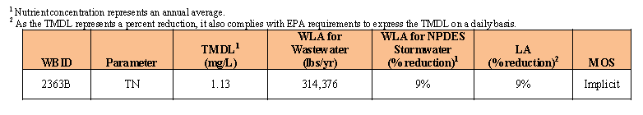
Halifax River TMDL as NNC
Northern Halifax impaired for chlorophyll > 20 ug/L
Reductions in TN required to achieve 1.13 mg/L annual average
  TP and chlorophyll covered in “Report to Governor”
TN wasteload allocation of 314,376 lbs/yr shared by 4 facilities
  Ormond 109,666 lbs/yr
  Holly Hill 21,933 lbs/yr
  Daytona Beach/Bethune Point 182,777 lbs/yr
NPDES stormwater needs 9% reduction in TN
Nonpoint source needs 9 % reduction in TN

Slide 32
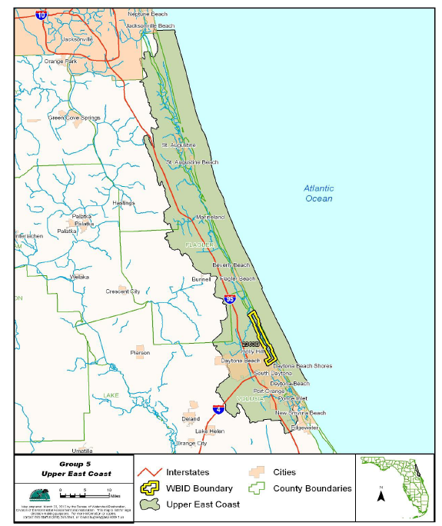
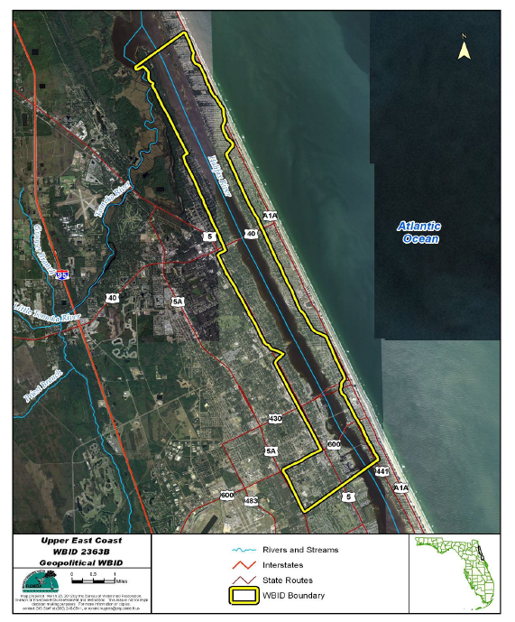
Halifax River

Slide 33
Permits with Direct Hierarchy 1
Permit TN limit based on TMDL wasteload allocation, usually as maximum allowed pounds per year
  Permit limit typically expressed as rolling 12-month total
Permit TP limit based on Report to Governor values
  Because report maintains current unimpaired conditions, can maintain current load limit (hold the line), or
  If no load limit, maintain actual current loading [load during basis for TMDL] or conduct Level II WQBEL
Fact sheet will reference the TN TMDL and TP criteria and note that the limits are based on the numeric interpretations of the narrative nutrient criterion

Slide 34
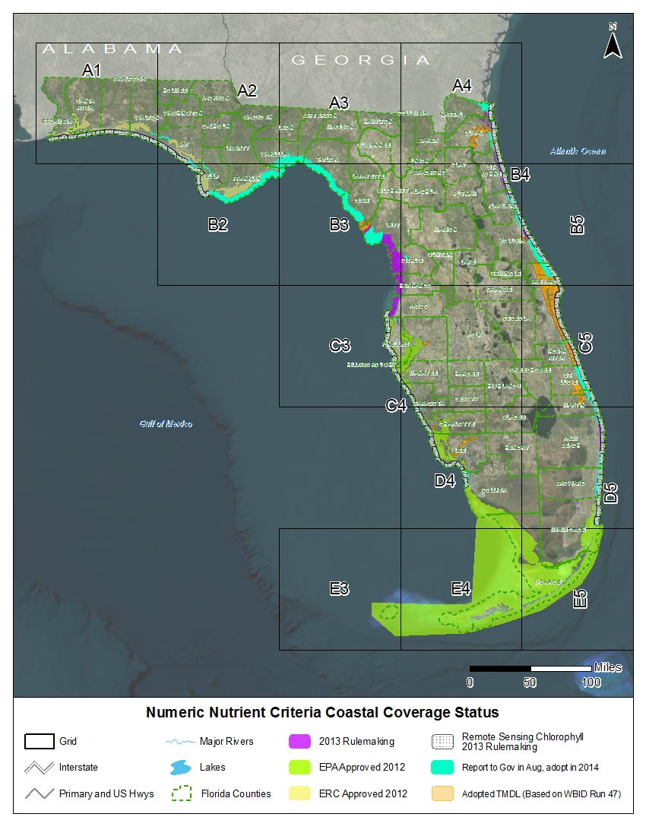
Estuary Numeric Nutrient Criteria: DEP and local scientists developed estuary-specific nutrient standards

Slide 35
Summary of Estuary Criteria
Estuaries, parts 1-3 below, have been adopted by ERC. Report to Governor and Legislature on remaining estuaries (Part 4 below) was approved by EPA in October, 2013. Criteria expressed as segment averages.
Part 1 Estuaries
Clearwater Harbor, Tampa Bay, Sarasota Bay, Charlotte Harbor, Caloosahatchee Estuary, Southwest Coast, Florida Bay, Florida Keys, and Biscayne Bay: THESE ARE IN EFFECT!
Part 2 Estuaries
Perdido Bay, Pensacola Bay, Choctawhatchee Bay, St. Andrews Bay, St. Joseph Bay, and Apalachicola Bay: THESE ARE IN EFFECT!
Part 3 Estuaries
Loxahatchee River, Lake Worth Lagoon, Halifax River, Guana River/Tolomato River/Matanzas River, Nassau River, Suwannee River, Waccasassa River, Withlacoochee River, and Springs Coast
Part 4 Estuaries- Report to Governor
Big Bend from Alligator Harbor to the Suwannee Sound, Cedar Key, St. Mary’s, Southern Indian River Lagoon, several portions of the Intracoastal Waterway (ICWW) connecting estuarine systems, and a variety of small gaps

Slide 36
Estuary | Total Phosphorus | Total Nitrogen | Chlorophyll a
(q) Loxahatchee River Estuary | For estuary segments with criteria expressed as annual geometric means (AGM), the values shall not be exceeded more than once in a three year period. For all other estuary segments, the criteria shall not be exceeded in more than 10 percent of the measurements.
1. Lower Loxahatchee | 0.032 mg/L as AGM | 0.63 mg/L as AGM |  | 1.8 μg/L as AGM
2. Middle Loxahatchee | 0.030 mg/L as AGM | 0.80 mg/L as AGM |  | 4.0 μg/L as AGM
3. Upper Loxahatchee | 0.075 mg/L as AGM | 1.26 mg/L as AGM |  | 5.5 μg/L as AGM
(r) Lake Worth Lagoon | For estuary segments with criteria expressed as annual geometric means (AGM), the values shall not be exceeded more than once in a three year period. For all other estuary segments, the criteria shall not be exceeded in more than 10 percent of the measurements.
1. Northern Lake Worth Lagoon | 0.044 mg/L as AGM | 0.54 mg/L as AGM |  | 2.9 μg/L as AGM
2. Central Lake Worth Lagoon | 0.049 mg/L as AGM | 0.66 mg/L as AGM |  | 10.2 μg/L
3. Southern Lake Worth Lagoon | 0.050 mg/L as AGM | 0.59 mg/L as AGM |  | 5.7 μg/L as AGM
(s) Halifax River Estuary | For estuary segments with criteria expressed as annual geometric means (AGM), the values shall not be exceeded more than once in a three year period.
Lower Halifax River Estuary | 0.142 mg/L as AGM | 0.72 mg/L as AGM |  | 6.2 µg/L as AGM
(t) Guana River/Tolomato River/Matanzas River (GTM) Estuary | Criteria for all estuary segments are expressed as annual geometric mean values not to be exceeded more than once in a three year period.
1. Tolomato | 0.105 mg/L as AGM | 0.65 mg/L as AGM |  | 6.6 μg/L as AGM
2. North Matanzas | 0.110 mg/L as AGM | 0.55 mg/L as AGM |  | 4.0 μg/L as AGM
3. South Matanzas | 0.111 mg/L as AGM | 0.53 mg/L as AGM |  | 5.5 μg/L as AGM

Slide 37
Expression of Estuarine
Interpretations of Narrative
Annual geometric means, not to be exceeded more than once in a three-year period, or
A single sample value not to be exceeded more than 10% of the time
However, permit limits expressed as the load (usually, current load) that ensures attainment of receiving water criteria during ALL years
Criteria apply as average of open water segments
Proposed standards do not apply to tidal creeks
  Tidal creeks are important, but distinct, ecological resource that need separate criteria

Slide 38
Permits with Estuary Specific
Permit TN and TP limit based on current loading that achieves the estuary specific values
  Maintain current load limit (hold the line) or
  If no load limit, maintain actual current loading or conduct Level II WQBEL (may not be H 1)
Fact sheet will reference the TN and TP criteria and note that the limits are based on the numeric interpretations of the narrative nutrient criteria

Slide 39
Remotely Sensed Chlorophyll
Directly applicable to Ocean Outfalls only
  Could be rare cases where need to make statement about downstream protection
Criteria based on healthy reference period (2002-2009), which included existing discharges
  Unless loading has increased from 2002-2009, those discharges should generally be OK
Offshore areas are assessed only from satellite data, not water samples

Slide 40
Water quality based effluent limits
CHAPTER 62-650

Slide 41
WQBEL Definition
Water quality based effluent limitation (WQBEL) “means an effluent limitation, which may be more stringent than a technology based effluent limitation, that has been determined necessary by the Department to ensure that water quality standards in a receiving body of water will not be violated”

Slide 42
DEP WQBEL Obligations
An evaluation of the impact of a proposed or continued discharge on the water quality of the receiving water body shall be conducted by the Department for all permit applications
If TBELs are sufficient, the permit limits will be based on the applicable TBEL, and a brief report will be prepared explaining the Department's rationale for its decision
If TBELs are not sufficient, or if additional information or analysis is determined to be necessary to ensure that the effluent will not violate water quality standards in the receiving waterbody, WQBELs must be determined
Level II WQBEL more complicated (e.g., multiple dischargers) than Level I

Slide 43
Applicant Obligations and DEP Cooperation
The applicant for a permit has the ultimate burden of providing all information necessary for the Department to establish a WQBEL
  Any pertinent information already available to the Department shall be made available to the applicant
However, as provided in Rule 62-650.500, F.A.C., the Department will conduct the required data collection and analysis for initial WQBEL when there are multiple dischargers whose zones of impact overlap
  For subsequent renewals, dischargers with design flow > 1 MGD responsible even if multiple dischargers

Slide 44
WQBEL and Existing Permit
When a Level II water quality study and analysis are required for the renewal of an existing operation permit, the existing permit shall remain in full force and effect if an otherwise sufficient application has been timely filed with the Department unless the discharge at existing permit limits is causing significant detrimental environmental or public health effects
The existing permit limits shall remain in effect until a new permit has been issued or the existing permit has been modified pursuant to Rule 62-4.080, F.A.C.

Slide 45
62-650.500 WQBEL Level II Process
Determine the available assimilative capacity of a waterbody and set WQBEL using computer modeling and other scientific methodology
  Include appropriate margin of safety
Determine new discharge permit limits and evaluate permit renewals when existing water quality data are insufficient to evaluate expected water quality impacts or when the available assimilative capacity of the water body is being completely utilized

Slide 46
62-650.500 WQBEL Level II Process
Level II WQBELs considered valid for a period of five years, and may be entered by the Department in a permit or by separate final order
  WQBELs acting as Hierarchy 1 Interpretations will likely be separate Final Order
  Renewal of Permits?

Slide 47
62-650.500 WQBEL Level II Process
Study Plan (binding, approved in writing) needed to specify information required, accepted methods of data collection and analysis, and quality control/quality assurance requirements
  Must publish Plan of Study in newspaper and FAR
The applicant shall coordinate with the Department during the study and shall present the study results to the Department
  Failure to comply with the plan of study may result in the Department's rejection of some or all of the data

Slide 48
62-650.500 WQBEL Level II Process
Analyses (pre-approved by DEP) may include mathematical water quality computer modeling or other evaluation procedures that are necessary for the Department to develop WQBELs

Slide 49
62-650.500 WQBEL Level II Process
Nothing shall prevent a permit applicant from conducting the required data collection or analysis in accordance with the procedures in this section
Nothing in this paragraph shall preclude the Department from requiring water quality monitoring as a condition of an operation permit for any discharge

Slide 50
62-650.500 WQBEL Level II Process
Upon completion of the Level II data collection and analysis process, a final technical report shall be prepared by the Department

Slide 51
62-650.500 WQBEL Level II Process
After the Department has reviewed the WQBEL technical report, the district office shall issue a notice of proposed agency action pursuant to Rule 62-103.150, F.A.C., and provide notice to the affected dischargers, and any other substantially affected parties
This notice shall set forth those WQBELs that have been established by the Level II process and may include any conditions or monitoring requirements to be imposed on the affected discharge(s)
  The notice shall include a statement indicating the date by which compliance with the requirements of the notice must be achieved

Slide 52
62-650.500 WQBEL Level II Process
For Existing Dischargers, compliance with WQBELs as set forth in the notice required:
  1. Within 90 days when public health impacts or serious adverse environmental impacts are occurring;
  2. Within a period of time defined in a compliance schedule based on a consideration of the current or potential environmental effects; or
  3. At the time of the next operating permit renewal

Slide 53
Level II WQBEL as Hierarchy 1
Level II WQBEL is a Hierarchy 1 interpretation if:
The documentation for the WQBEL includes a site specific numeric interpretation of the narrative criterion at paragraph 62-302.530(47)(b), F.A.C., for the waterbody;
The WQBEL is established pursuant to the Level II Process contained at Rule 62-650.500, F.A.C.; and
The public notice for the WQBEL specifically states that the Level II WQBEL includes a site specific interpretation of the narrative for the receiving waterbody

Slide 54
WQBEL Summary
Permit staff should review existing WQBELS to determine if current data are or are not adequate
Coordinate with applicants in advance to attain needed data
Must have public notice that Level II WQBEL is a site specific interpretation of narrative to be hierarchy 1 interpretation
  Not all Level II WQBELs are Hierarchy 1 Interpretations
For streams, if straight renewal and biology is OK, WQBEL not needed, but WQBEL required for new/expanded discharges or if biology unhealthy
  Biological requirements discussed more below

Slide 55
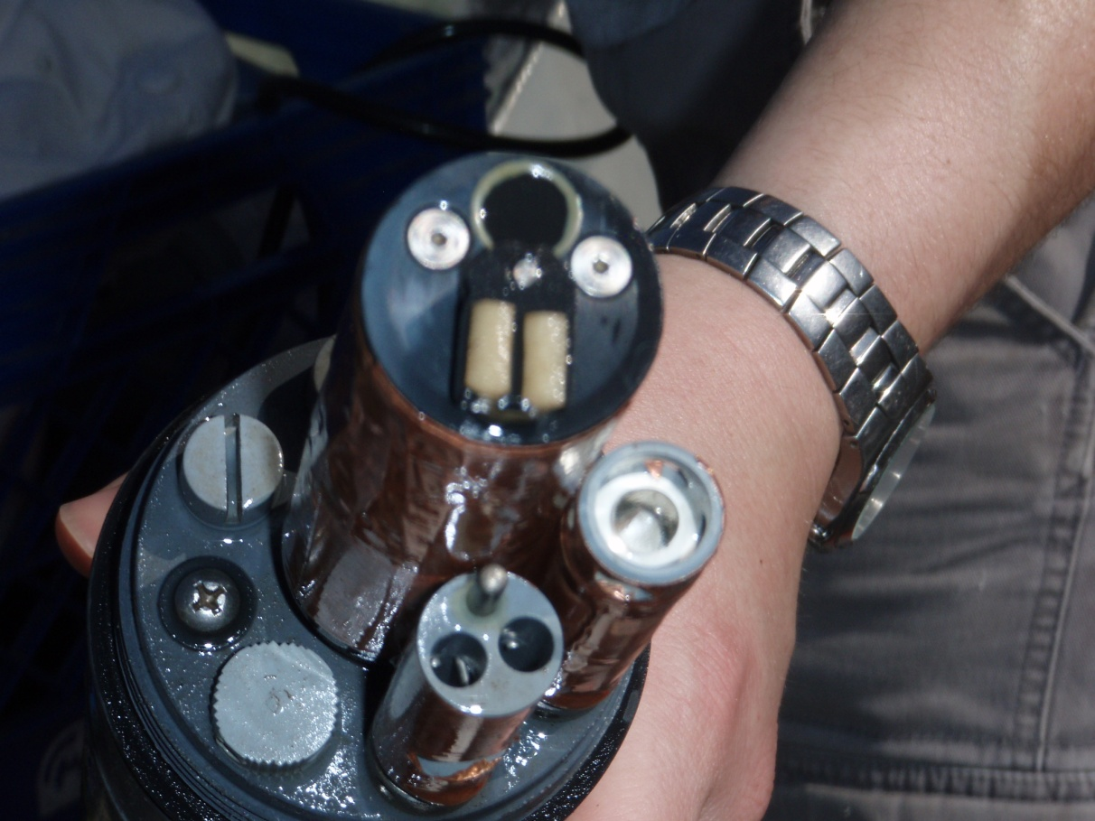
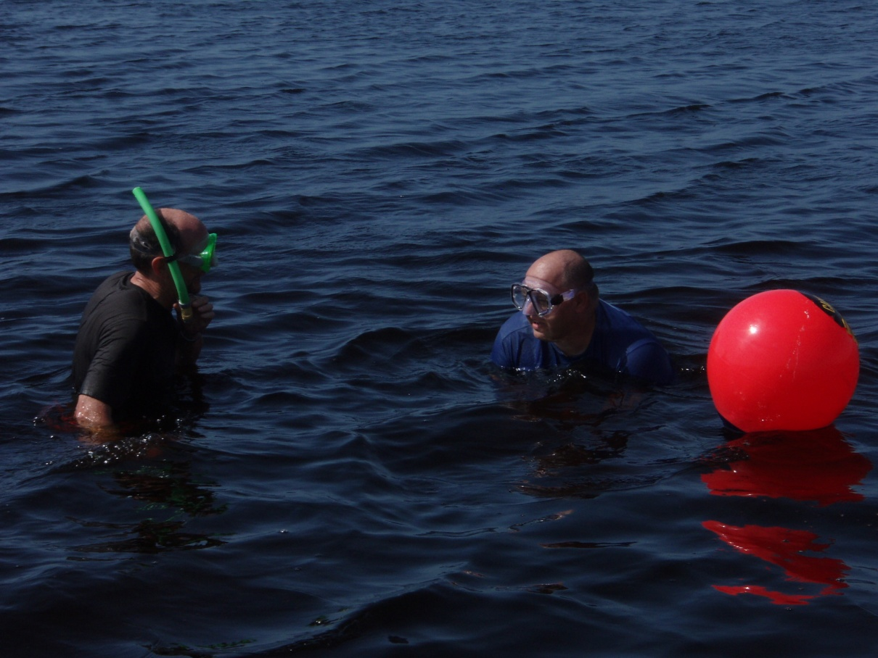
Site specific alternative criteria

Slide 56
Site Specific Alternative Criteria
Rule 62-302.800, F.A.C., allows for establishing a SSAC when an affirmative demonstration is made that an alternative criterion is more appropriate for a specified portion of waters of the state
SSACs usually developed/reviewed in Tallahassee, but District monitoring (now DEAR) staff provide sampling support

Slide 57
Types of Site Specific Alternative Criteria
Type I SSAC based on natural background conditions (reference-based approach)
Type II SSAC must demonstrate that the criterion would fully maintain and protect human health, existing uses, and the level of water quality necessary to protect designated uses
Type III SSAC for nutrients, and requires a demonstration of healthy flora and fauna at given nutrient regime

Slide 58
Type I SSAC-Reference Condition
Reference sites should be:
  Minimally disturbed by anthropogenic activities,
  Functionally comparable to the test site, and
  Have a similar natural disturbance regime to that expected in the assessment watershed
Data used in this approach are collected from rigorously vetted reference sites
EPA approved NNC that were developed using this approach

Slide 59
Type I SSAC Reference Site Criteria
Landscape Development Intensity Index (LDI):
  Score < 2 for land use within the 100 meter corridor 10 km upstream of site;
  Watershed or near-field LDI scores < 3;
No observed significant anthropogenic inputs (watershed visit); and
Biologically healthy (e.g., average SCI scores > 40 or LVI scores > 43)

Slide 60
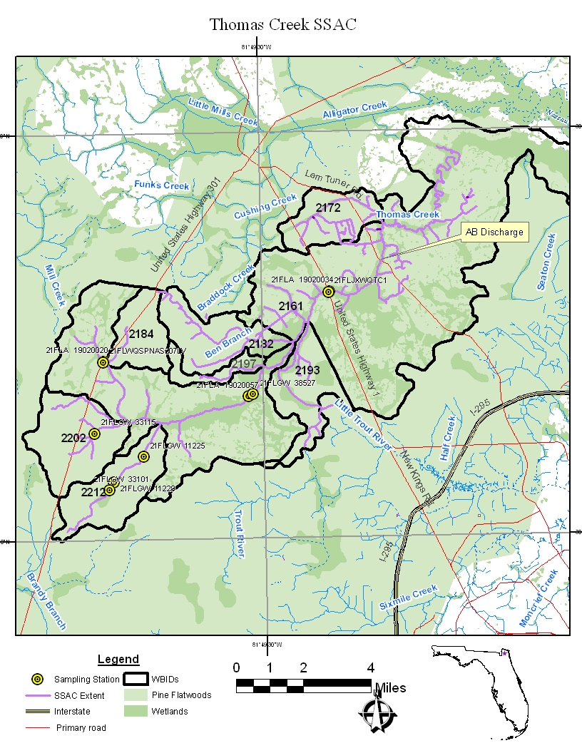
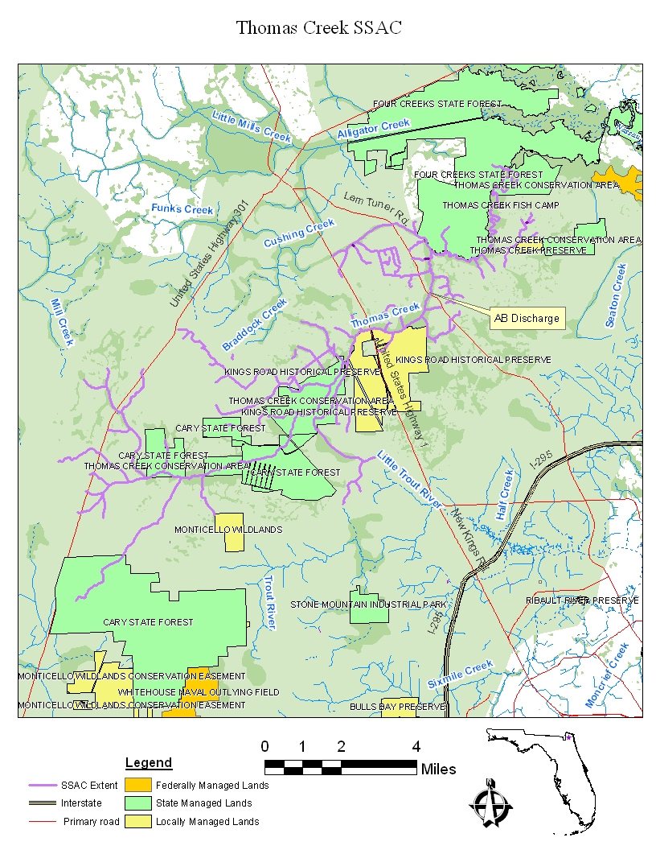
Type I SSAC Example- Thomas Ck.

Slide 61
Thomas Creek Evaluation
Anheuser-Busch Brewery submitted petition for DO SSAC based on natural conditions
  Buffer LDI score is 1.9
  Watershed LDI is 2.1
  Watershed field visit showed benign inputs
  Mean SCI score was 44 at US 1
Concluded low DO is natural condition (swamp inputs)

Slide 62
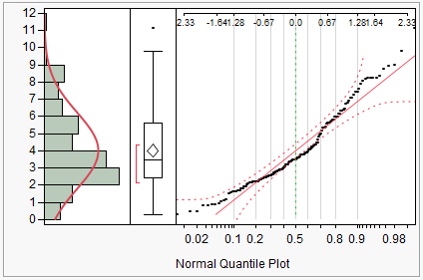
DO SSAC Derivation
Year | N | Mean | Standard Deviation
1998 | 8 | 3.20 | 1.19
1999 | 7 | 4.51 | 2.32
2000 | 7 | 3.23 | 2.18
2001 | 5 | 2.59 | 1.17
2002 | 4 | 3.09 | 1.61
2003 | 3 | 2.62 | 1.01
2004 | 3 | 3.65 | 2.47
2005 | 10 | 3.14 | 1.20
2006 | 6 | 4.52 | 2.65
2007 | 6 | 3.60 | 1.29
2008 | 16 | 5.45 | 2.31
2009 | 12 | 3.42 | 2.06
2010 | 17 | 5.31 | 2.19
2011 | 35 | 3.50 | 2.06
Period of Record | 139 | 3.92 | 2.11
10th Percentile |  | 2.61
The annual average DO concentration shall not be less than 2.6 mg/L,
AND
No more than 10 percent of the individual DO concentration measurements shall be less than 1.6 mg/L.

Slide 63
Type II SSAC
Acknowledges that conditions are not natural background, but establishes criteria that are fully supportive of the designated use (e.g., healthy, well balanced aquatic communities)
Requires demonstration of use support at proposed alternative criteria
  Biological tools
    May require site-specific control
  Modeling (mechanistic or empirical)

Slide 64
Type III SSAC- Nutrients
Rule 62-302.800(3), F.A.C.
Must achieve the narrative nutrient criteria in paragraph 62-302.530(47)(b), F.A.C., and protect downstream waters
  For streams: Healthy flora and average SCI > 40
  For lakes: Healthy flora including LVI > 43
Must follow Development of Type III Site Specific Alternative Criteria (SSAC) for Nutrients, (DEP-SAS-004/11)

Slide 65
Type III SSAC Continued
Study design should include:
  Minimum of two assessments per station or lake (one conducted during the final year of study)
  Link nutrients to biology
  Representative stations and hydrology
  Proper Quality Assurance
Study design concepts similar to NPDES Nutrient studies

Slide 66
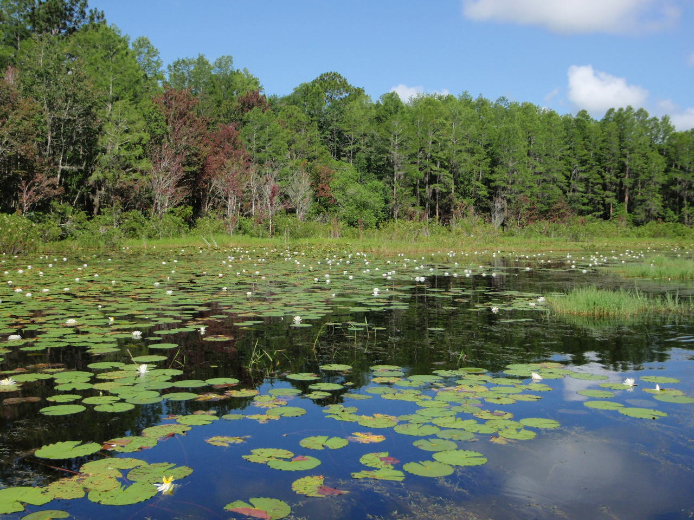
Hierarchy 2- lakes

Slide 67
Derivation of Lakes Criteria based on
Uncertainty Surrounding Regression

Slide 68
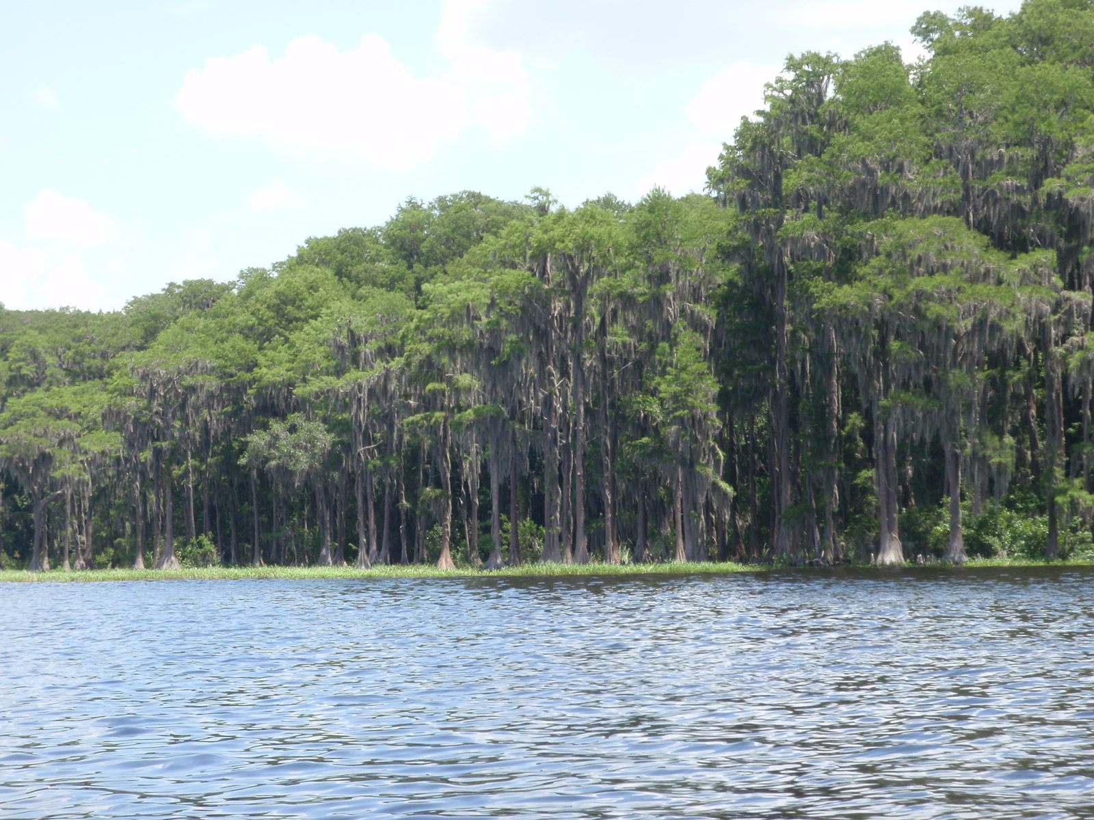
Numeric Interpretations for Lakes
Established chlorophyll a, TN and TP criteria
  Started with target chlorophyll a, and then set TN and TP criteria based on statistical relationship between nutrients and chl a
  Criteria vary depending on color and alkalinity
  Expressed as annual geometric mean calculated on lake-wide averages that cannot be exceeded more than once in a three-year period

Slide 69

NNC for Lakes
Long Term Geometric Mean Lake Color and Alkalinity | Annual Geometric Mean Chlorophyll a | Minimum | Maximum | Minimum | Maximum
 |  | Annual Geometric Mean Total Phosphorus | Annual Geometric Mean Total Phosphorus | Annual Geometric Mean Total Nitrogen | Annual Geometric Mean Total Nitrogen
> 40 Platinum Cobalt Units | 20 µg/L | 0.05 mg/L | 0.16 mg/L¹ | 1.27 mg/L | 2.23 mg/L
≤ 40 Platinum Cobalt Units and > 20 mg/L CaCO₃ | 20 µg/L | 0.03 mg/L | 0.09 mg/L | 1.05 mg/L | 1.91 mg/L
≤ 40 Platinum Cobalt Units and ≤ 20 mg/L CaCO₃ | 6 µg/L | 0.01 mg/L | 0.03 mg/L | 0.51 mg/L | 0.93 mg/L
¹ For lakes with color > 40 PCU in the West Central Region, the maximum TP limit is 0.49 mg/L

Slide 70
Numeric Interpretations for Lakes
Rule allows TN and TP criteria to vary annually depending on chlorophyll a
  If meet chl a value for lake type for a given year, then TN and TP set at annual geometric mean of ambient samples for that year, subject to range shown
  If do not meet chlorophyll a or if insufficient chlorophyll a data, then criteria set at minimum value

Slide 71
Permits for Discharges to Lakes
If lake currently attains criteria, permit TN and TP limit based on current loading
  Maintain current load limit (hold the line) or
  If no load limit, maintain actual current loading or conduct Level II WQBEL
  Fact Sheet will reference the TN and TP criteria
If lake does not attain criteria (including chlorophyll), Level II WQBEL needed to ensure lake attains criteria in ALL years
  Fact Sheet will note that the TN and TP limits are based on numeric interpretations of the narrative nutrient criteria

Slide 72
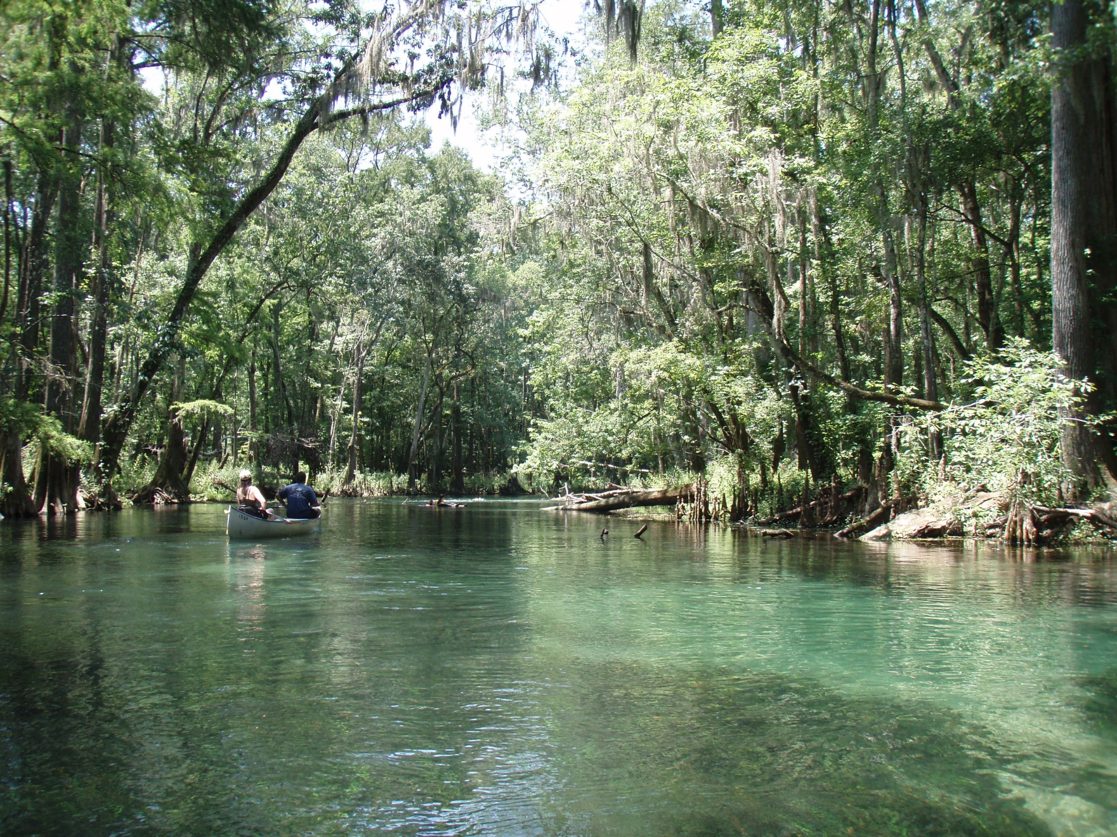
Hierarchy 2- Springs

Slide 73
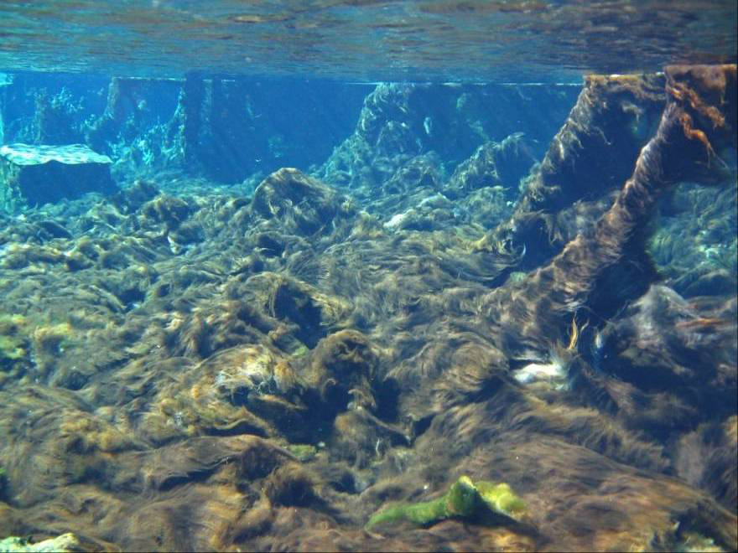
Weeki Wachee, 1950s;
Nitrate < 0.1 mg/L, Eel grass
Weeki Wachee, 2001:
Nitrate ~ 0.7 mg/L, Lyngbya mats
Nuisance Algal Mats in Springs

Slide 74
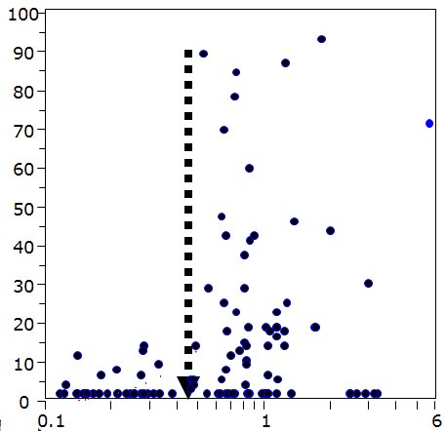
Field Studies: Vaucheria % Cover was Significantly Related to Springs Nitrogen Concentration
Excessive growth and cover of Vaucheria was found at sites with nitrate-nitrite concentrations at or above 0.454 mg/L.
Vaucheria % cover
Total N (mg/L)
Notes:
windows(height=6,width=11.5)
par(mfrow=c(1,2))
par(mar=c(5, 4, 2, 0) + 0.1)
x <- TOTALN
y <- AvgVPCCOVER
plot(x,y, log="x", cex=0.25, typ="n", ylab="Avg Vaucheria % cover", xlab="TN (mg/L)")
points(x, y, xlog=T, cex=1, pch=19, col="black")
lines(lowess(x,y,f=1, iter=3), col="black", lwd=1.5)
par(mar=c(5, 3, 2, 1) + 0.1)
x <- TOTALP
y <- AvgVPCCOVER
plot(x,y, log="x", cex=0.25, typ="n",ylab="", xlab="TP (mg/L)")
points(x, y, xlog=T, cex=1, pch=19, col="black")
lines(lowess(x,y,f=1, iter=3), col="black", lwd=1.5)

Slide 75
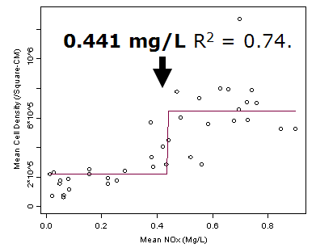
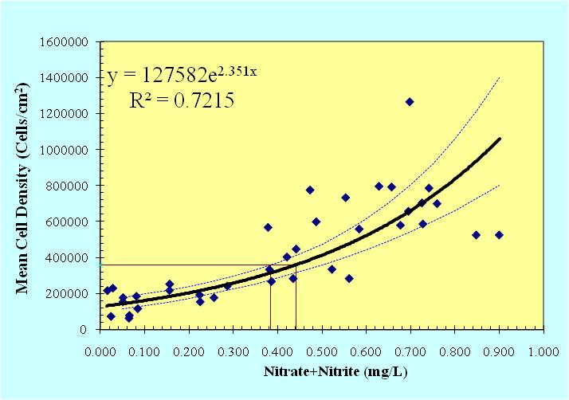
Nitrate-Nitrite
Annual Geomean of 0.35 mg/L

Slide 76
Nitrate in Spring Vents
Based on a regression between nitrate-nitrite and nuisance algal mats
  Criterion established at a concentration that prevents nuisance mats from occurring (compared with natural background levels)
Applicable numeric interpretation of the narrative nutrient criterion is 0.35 mg/L of nitrate-nitrite as an annual geometric mean
Not to be exceeded more than once in any three consecutive calendar year period

Slide 77
Groundwater Discharge and Springs
Rule 62-520.310(2) F.A.C., states that, “Discharge to groundwater shall not impair the designated use of contiguous surface waters”
However, any causal relationship between the discharge and nutrients at downgradient springs is challenging to demonstrate

Slide 78
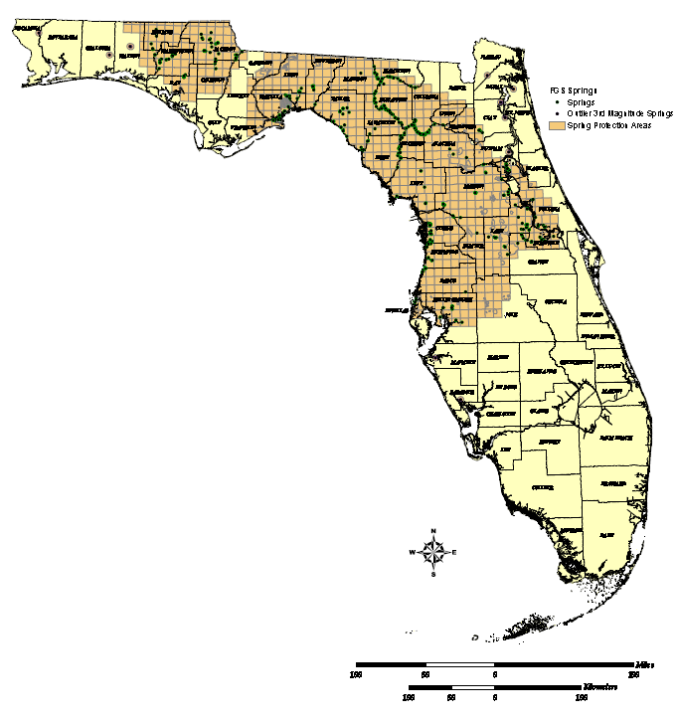
Springs Protection Areas

Slide 79
Groundwater Discharge and Springs (cont.)
Factors to consider:
  TN and TP values in Zone of Discharge (ZOD) based on groundwater monitoring data
  Size of the discharge (small vs. large)
  Distance from springs vent
  Expected nutrient attenuation based on nature of the soil/aquifer matrix and nutrient concentrations in discharge

Slide 80
Groundwater Discharge and Springs (cont.)
Generally, presume that reuse requirements result in discharge that achieves the nitrate levels for the spring (assumes dilution and transformations)
  Would not require “WQBEL” to determine specific requirements
If downgradient springs become impaired, will evaluate dischargers during TMDL/BMAP

Slide 81
Groundwater Discharge and Springs (cont.)
TMDLs and BMAPs for spring vents:
  May address potential nutrient contributions from nearby groundwater discharges
    Permit needs to be consistent with TMDL and BMAP
  DEP is developing tools for quantifying the relationship between effluent discharge and the concentration of nutrients at spring vents

Slide 82
DEP Groundwater Resources
Contact Rick Hicks: 850-245-8229
  Richard.W.Hicks@dep.state.fl.us
Can assist with determining Reasonable Potential for land application facilities and if needed, WQBEL
Springs BMAPs available at:
  http://www.dep.state.fl.us/water/watersheds/bmap.htm

Slide 83
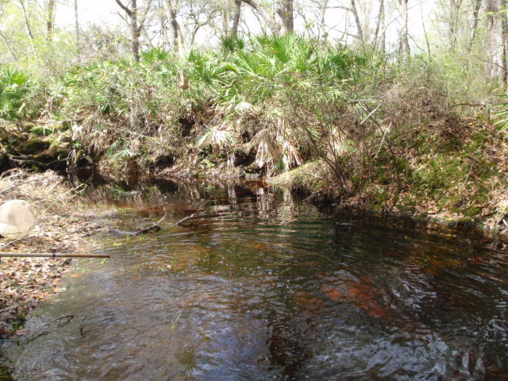
Hierarchy 3- streams
Very complex, stream definition important

Slide 84
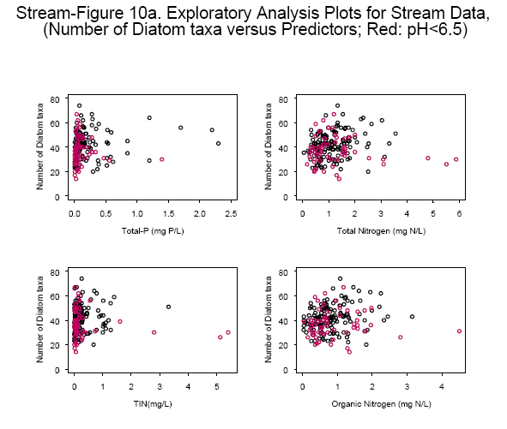
NNC for Streams
Looked extensively for cause-effect relationships between nutrients and biological responses, but they were insufficient to develop criteria
Established numeric thresholds based on “reference approach”, but because there is no link to impairment, Florida established broader evaluation of water chemistry and biological data (flora and fauna) to determine if a stream’s nutrient concentrations are protective
This is why DEP criteria
Include biology (EPA now supports DEP approach)

Slide 85
NNC in Streams Achieved IF:
Information on chlorophyll a levels, algal mats or blooms, nuisance macrophyte growth, and changes in algal species composition do not indicate an imbalance in flora or fauna; AND EITHER
The average score of at least two temporally independent Stream Condition Indices (SCIs) is 40 or higher, with neither of the two most recent SCI scores less than 35, OR
The Nutrient Thresholds (expressed as annual geometric means) are not exceeded more than once in a three year period

Slide 86
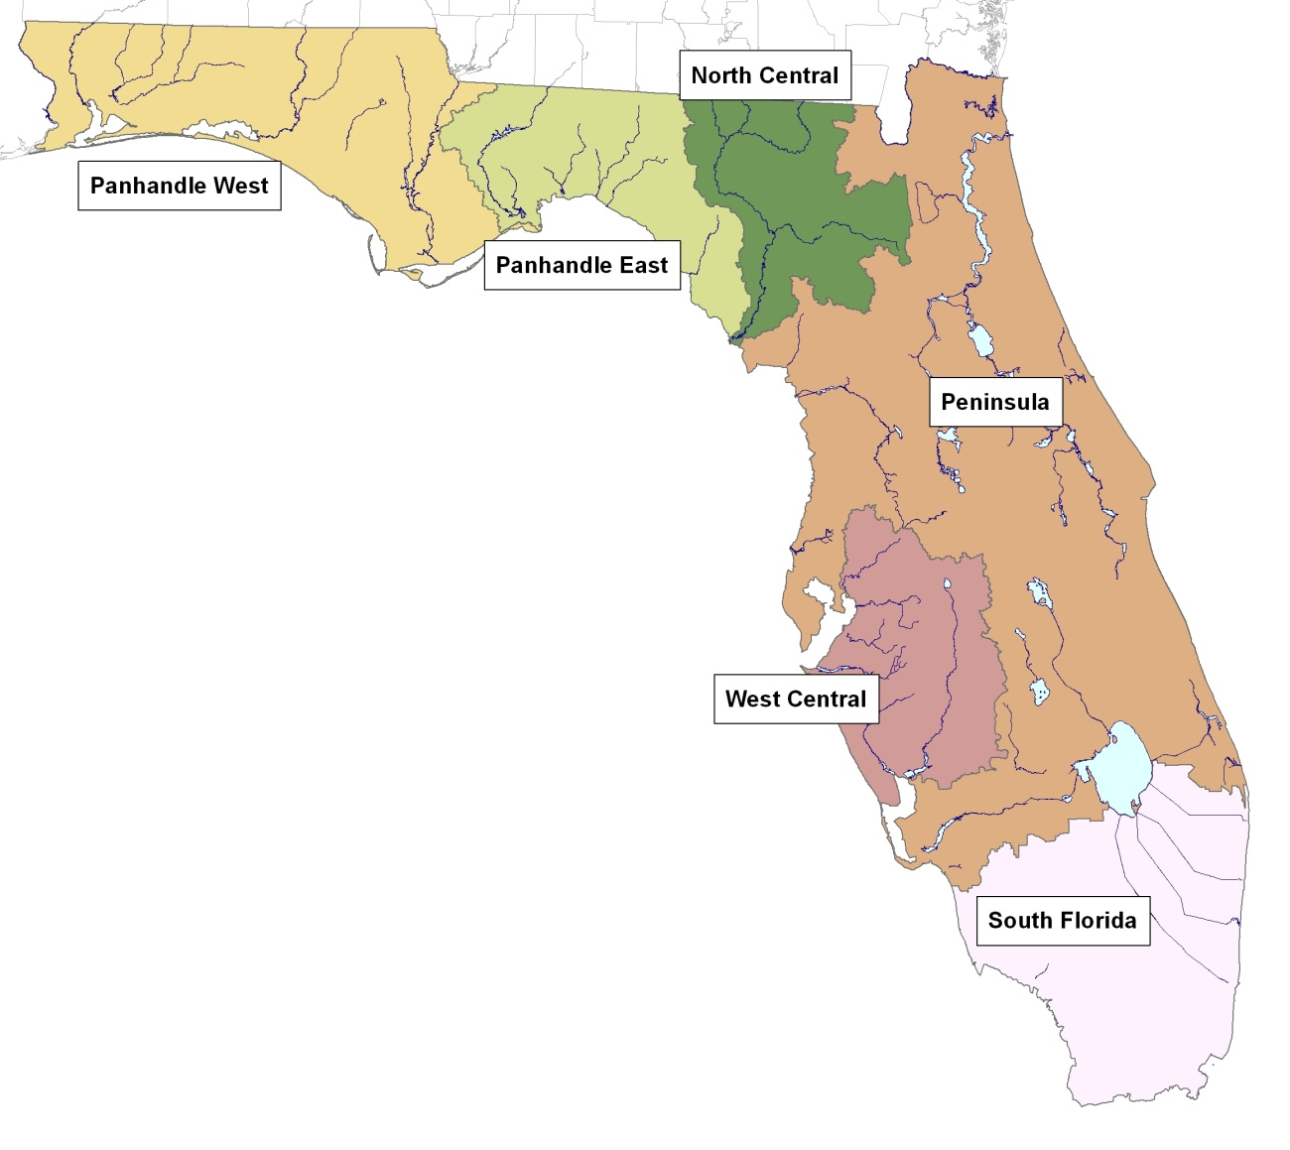
Streams Thresholds and Regions
Nutrient Region | Total Phosphorus Threshold | Total Nitrogen Threshold
Panhandle West | 0.06 mg/L | 0.67 mg/L
Panhandle East | 0.18 mg/L | 1.03 mg/L
North Central | 0.30 mg/L | 1.87 mg/L
Peninsula | 0.12 mg/L | 1.54 mg/L
West Central | 0.49 mg/L | 1.65 mg/L
South Florida | No numeric nutrient threshold. The narrative criterion in paragraph 62-302.530(47)(b), F.A.C., applies.

Slide 87
Discharges to Streams
Permit applicant responsible to provide information about receiving (and downstream) waters
  Whether meet floral measures, and either stream thresholds or SCI
Plan to add floral metrics to 3rd and 5th Year Inspections, but bioassessment data will likely be limited for at least a while
Can either request they collect data up front, or issue permit with AO to collect data
  Contact permittee before renewal application is due
More explanation to follow

Slide 88
Stream NNC Data Quality Objectives
Data collection efforts must meet data quality and quantity objectives
  Study Plan recommended, coordinate between Programs
Ensure representative samples and follow DEP SOPs
  http://www.dep.state.fl.us/water/sas/sop/sops.htm
Select sites to avoid confounding factors (flow considerations, avoid non-representative areas, consider habitat)
Establish clear relationship between the nutrient regime and the system’s biological health
Unless large data set, avoid extreme hydrologic conditions (floods, droughts)
Some facility studies may require sampling for non-NNC parameters (toxic substances, etc.) as well

Slide 89
Stream NNC Data Quantity Objectives
Need at least two temporally independent (> 3 months apart) sets of bioassessment information for the receiving waters
  If 2 consecutive samples “pass”, then reasonable assurance (RA) for biological health demonstrated
  If one “pass” and one “fail” must sample until 2 consecutive “pass” or “fail”
  2 “fail” indicates lack of RA for biological health
For assistance with Study Design, contact Aquatic Ecology and Quality Assurance Section (in Water Quality Standards Program)

Slide 90
Floral Tools in Streams
DEP floral information
  Linear Vegetation Survey
    Coefficient of Conservatism, invasive exotics
  Rapid Periphyton Survey
    Thickness and extent, autecology (interpreting species information)
  Phytoplankton chlorophyll a (current and trends)
  Habitat Assessment
    Substrate type, availability, mapping, etc.

Slide 91
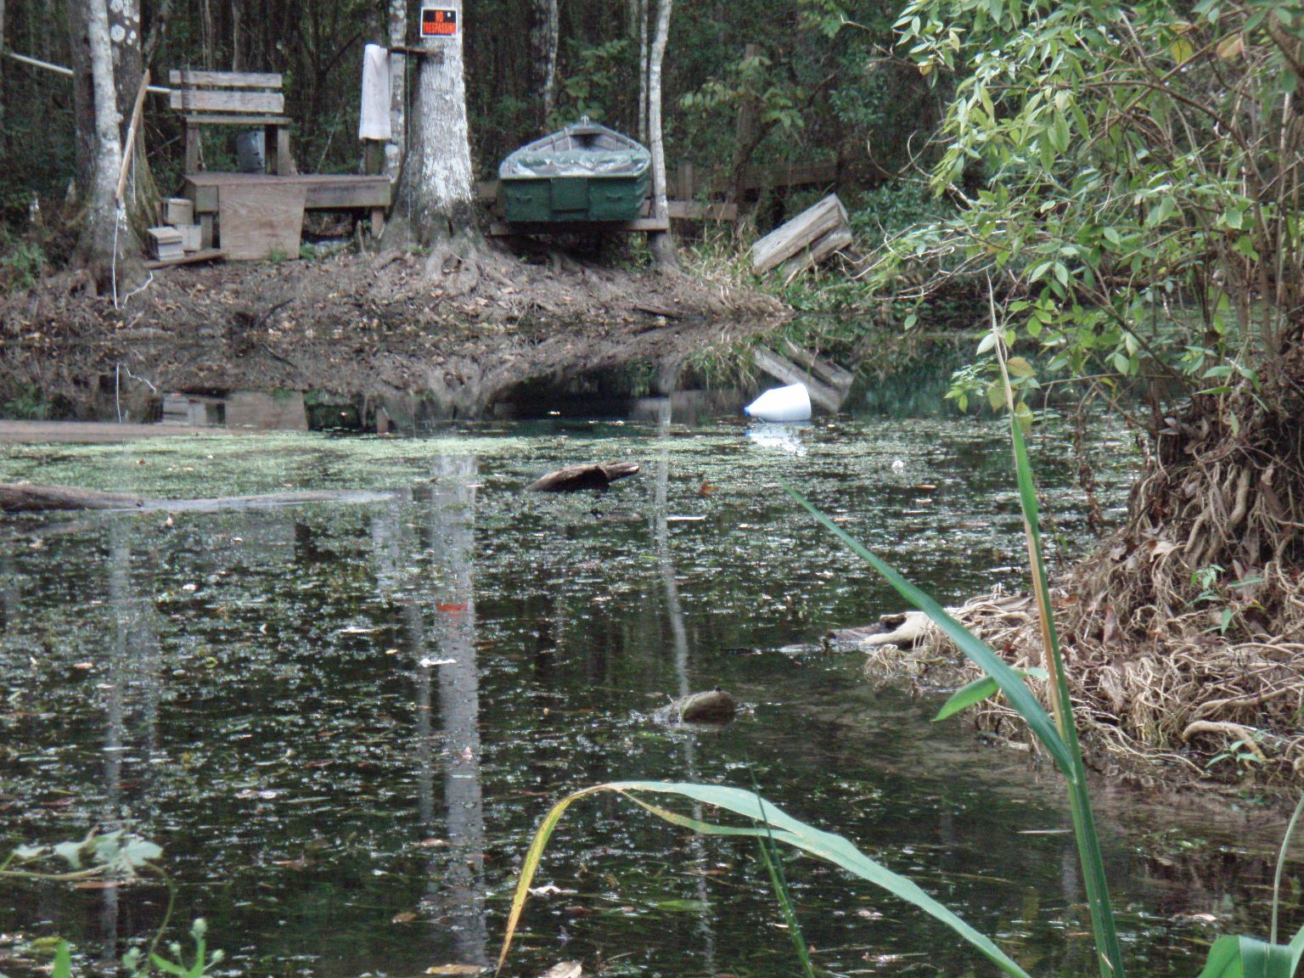
Example of a Site that Would Fail the LVS
Dominated by Hydrilla

Slide 92
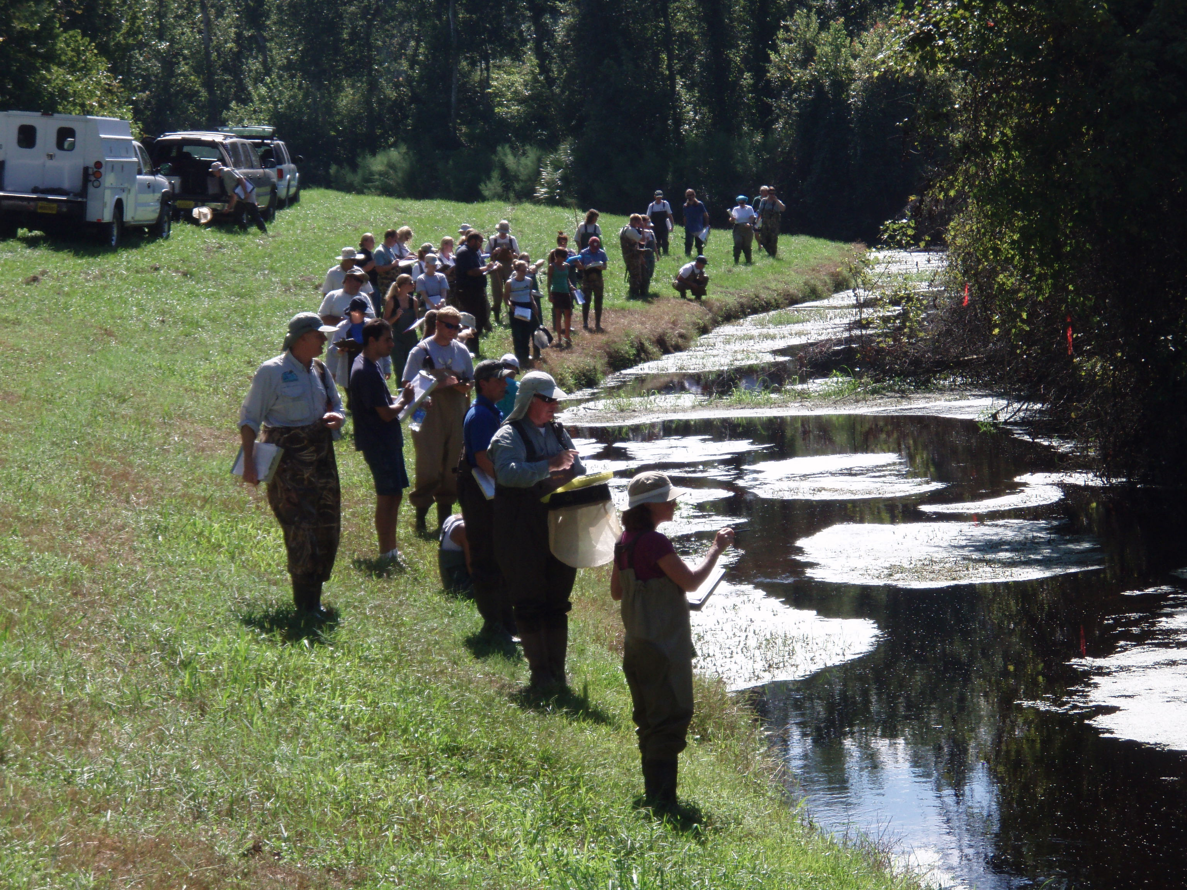

Rapid Periphyton Survey
Example of >50% rank 4-6 RPS
Transect Flags
Close Up

Slide 93
Floral Metric Summary
Floral Metric | Evidentiary Threshold of No Imbalances (All parameters required)
LVS C of C | Site average > 2.5
LVS FLEPPC | Site average < 25%
RPS | < 25% rank 4-6 coverage 20 to 25 % rank 4-6 coverage, evaluate algal autoecological data
Chlorophyll | < 20 ug/L; 3.2 to 20 ug/L = site specific
Algal Community Composition (Autecology) | No adverse shifts in dominant taxa

Slide 94
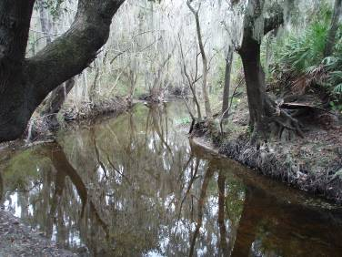
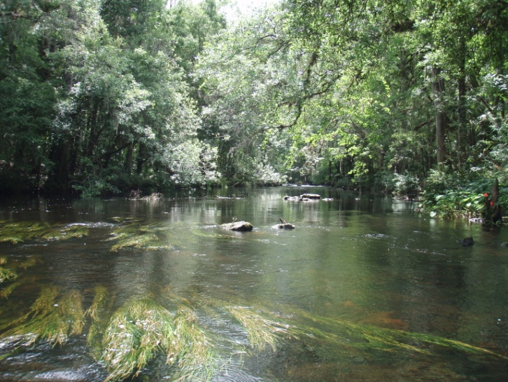
Expected Condition
Nearfield Stream Segment with Healthy Flora and Fauna
Downstream Segment with Healthy Flora and Fauna

Slide 95
Which NNC Applies?
Default Status
Until a demonstration is made that a stream segment meets the provisions (exclusions) in Rule 62-302.200(36)(a) or (b), F.A.C., the generally applicable numeric standards for streams will be used as the Department implements its programs
Permit applicant should provide the needed information (see Implementation Document page 49)

Slide 96
Definitions- Which NNC Applies?
The stream definition excludes several types of waters, which affects applicable NNC or if only narrative applies
  Lake criteria apply to “lake-like” sections of streams
  And (after demonstration is made), only the narrative applies to:
    Wetlands
    Intermittent streams
    Ditches/canals used as water conveyances
    Tidal areas that fluctuate between salt and fresh (4,580 µmhos/cm)
Discussed on p. 49 in Implementation Document

Slide 97
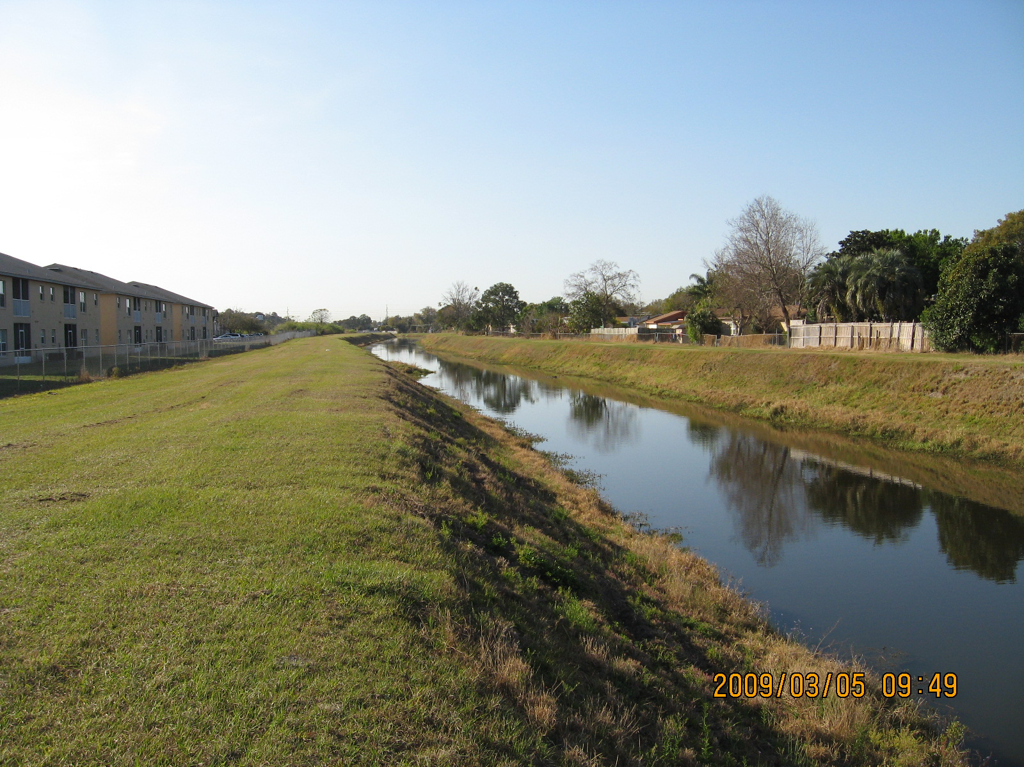
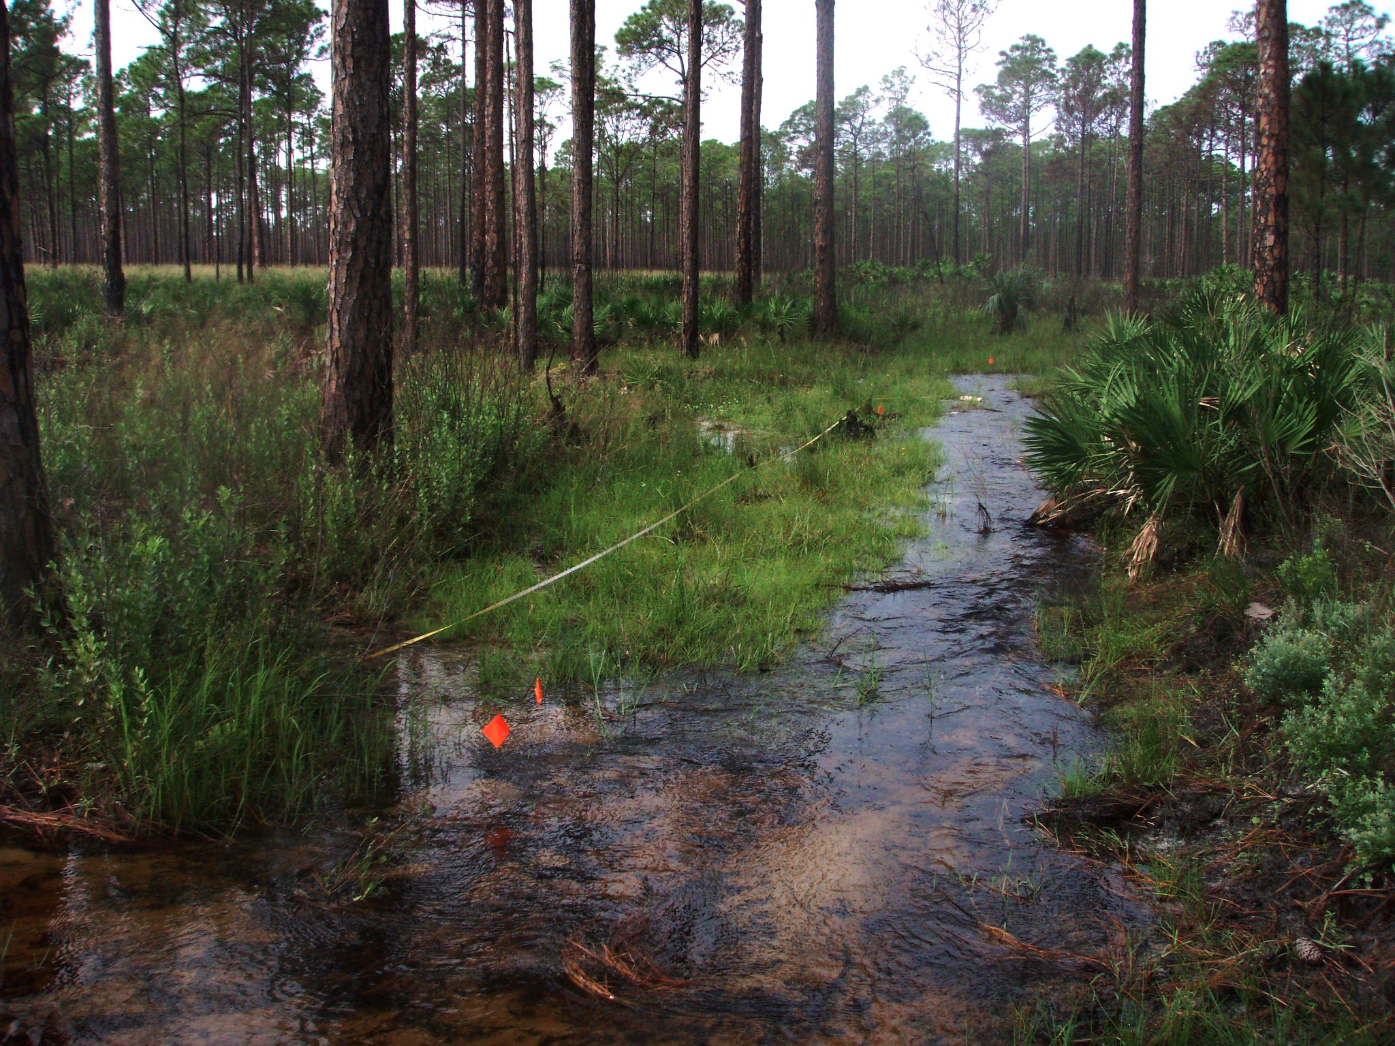
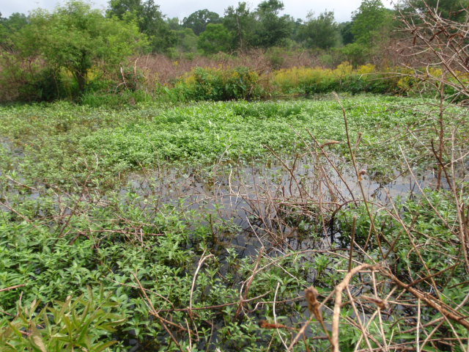
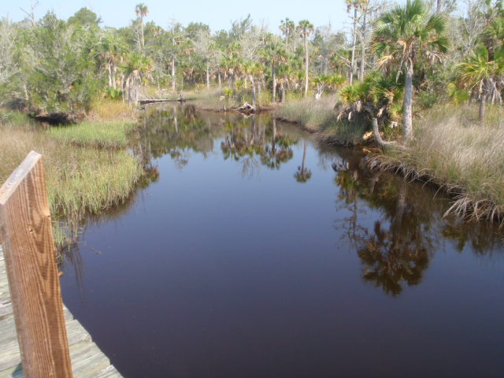
Maintained Conveyance
Non-perennial system: channel has non-obligate plants
Wetland
Fluctuating Salinity

Slide 98
Lake-like Portions of Rivers
Some large rivers have portions that are more lake-like due to long residence time, increased width, or preponderance of biological taxa typically found in lakes
  Portions of St. Johns (see next slide)
  Biological taxa (plants and invertebrates) more lake-like than stream-like
  For permitting purposes, stakeholder would need to provide this information

Slide 99
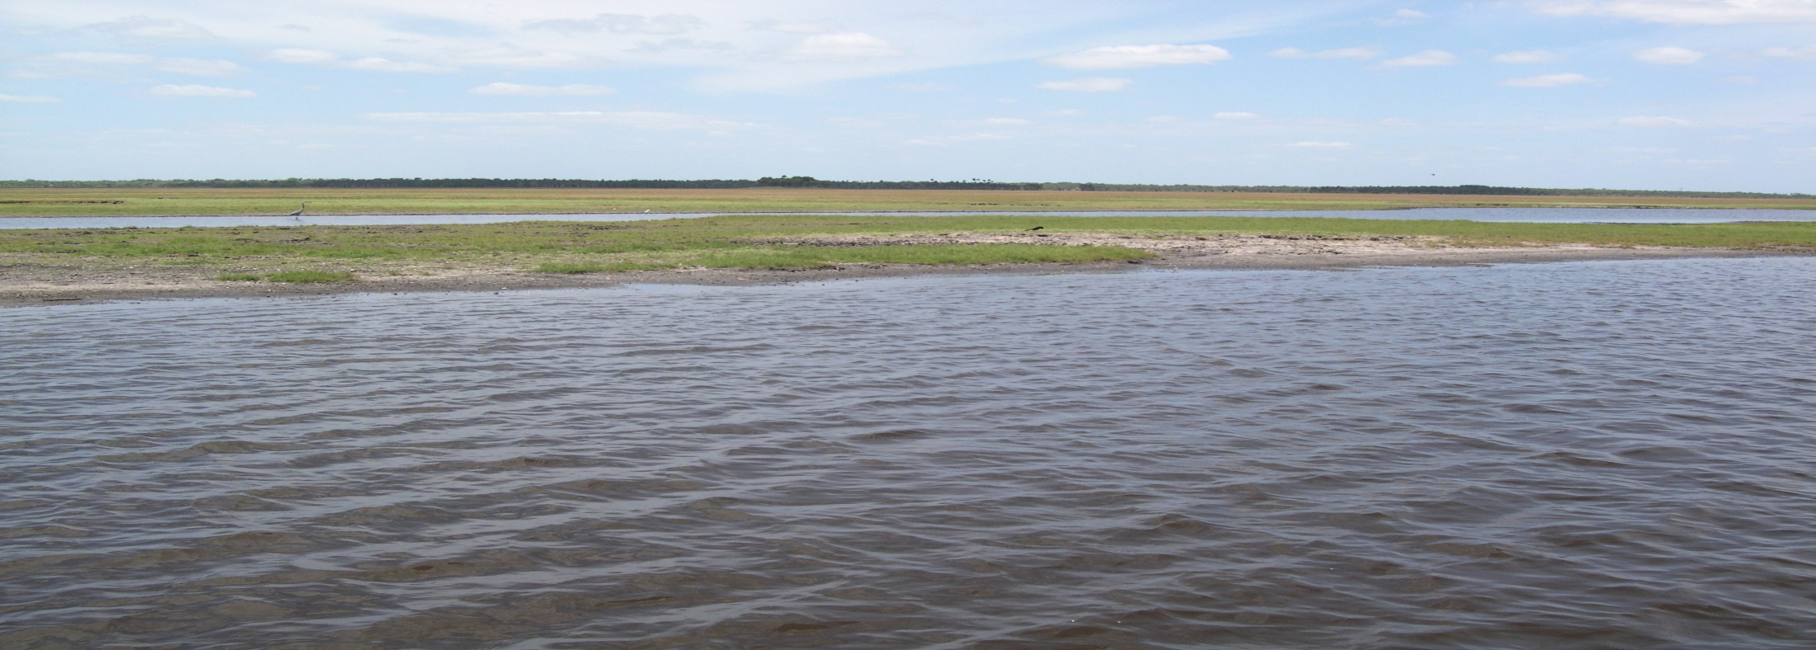
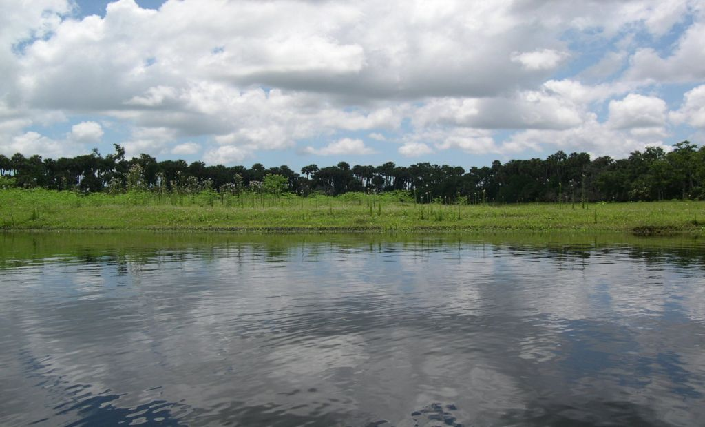
Middle St. Johns River:
Long Retention Time, Lentic taxa prevail, Lake Criteria Apply
Another View of the Middle St. Johns River

Slide 100
Wetlands
Lakes typically have an open water area free from emergent vegetation (submersed or floating vegetation may be present)
  Lakes NNC apply in lakes
Wetlands are characterized as not having this open water area
  Most wetlands go dry routinely, therefore desiccation is dominant stressor
  Wetland taxa prevail

Slide 101
Lake

Slide 102
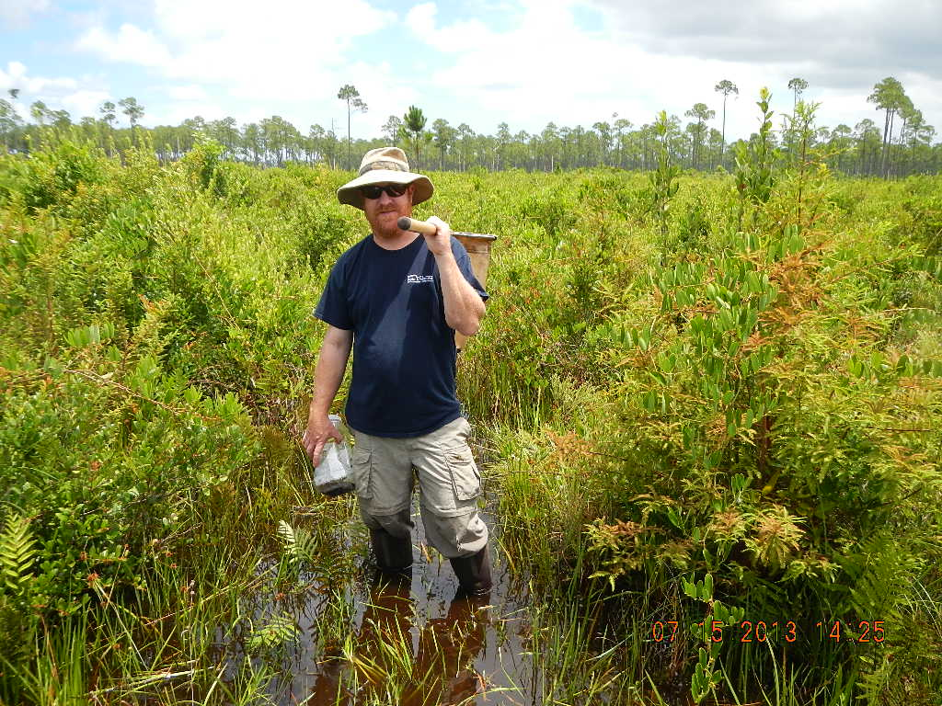
Wetland- narrative applies

Slide 103
Wetland- narrative applies

Slide 104
Non-Perennial Water Segments
To qualify, must use biological indicators, such as vascular plants and benthic macroinverterbates, to show that desiccation results in dominance of taxa more typically found in wetland or terrestrial conditions
  e.g., worms (Dero, Bratislava), midges (Kiefferulus, Monopelopia), mosquitos (Culicidae), grasses (Chasmanthium, etc.)
  See page 50 in Implementation Document

Slide 105
Non-Perennial Water Segments
Vascular plants
  Presence of terrestrial, “facultative”, and “facultative wet” herbaceous vascular plant taxa (defined in Chapter 62-340, F.A.C.) in the channel bed would be an indicator that the system is non-perennial
  “Facultative plants” means those plant species listed in subsection 62-340.450(3), F.A.C. “Facultative Wet plants” means those plant species listed in subsection 62-340.450(2), F.A.C.
  These plants can live in more than one specific set of environmental conditions

Slide 106
Non-Perennial Water Segments
Invertebrates
  Shift from stream to wetland taxa (Tables 8 and 9), and reduction in long-lived taxa
Not sufficient to use NHD coverage alone, must use the biological indicators
  Some “intermittent” systems on map may qualify as a “stream” and NNC would apply

Slide 107
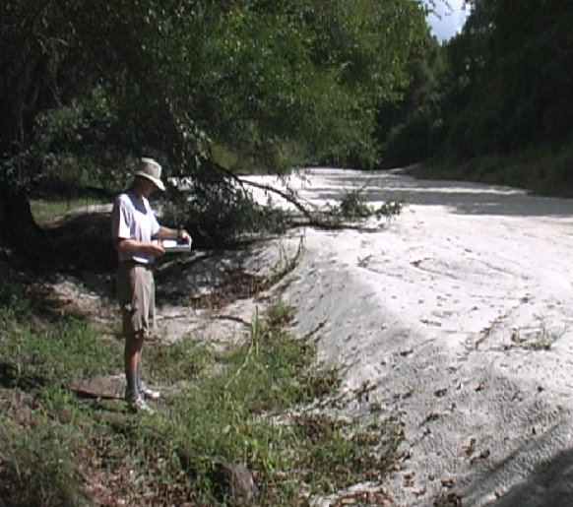
Example of non-perennial system (Alapaha River below sinkhole), only flows during floods (terrestrial taxa prevail)

Slide 108
Non-perennial system: channel has non-obligate plants

Slide 109
Tidally Influenced Segments
Requires permit applicant to collect chloride or specific conductance data during typical hydrologic conditions
  Threshold is 1,500 mg/L chloride or 4,580 µmhos/cm
  Tide and flow data must be temporally coupled with the water quality sampling events and show changing salinity conditions during typical tidal cycle
WQBELs for NPDES permitted discharges into such tidal segments will be based on the applicable NNC in waters both downstream (estuaries) and upstream (streams), while narrative applies in tidal area

Slide 110
Fluctuating Salinity

Slide 111
Ditches/Canals used as Water Conveyance
The narrative applies in channelized or physically altered ditches, canals and other conveyances that:
  Are primarily used for water management purposes, such as flood protection, stormwater management, irrigation, or water supply; AND
  Have marginal or poor stream habitat or habitat components due to channelization and maintenance for water conveyance purposes
  Page 55 on Implementation Document

Slide 112
Ditches, Canals, and other Conveyances
Information must be provided that the conveyance is primarily used for water management purposes such as flood protection, stormwater management, irrigation, or water supply (e.g., maintenance records)
Habitat Assessment (DEP SOP FT 3000, see http://www.dep.state.fl.us/water/sas/sop/sops.htm) used to establish:
  Degree of Artificial Channelization
  Substrate Diversity and Availability
  Overall score

Slide 113
Ditches, Canals, and other Conveyances
If Degree of Artificial Channelization and Substrate Diversity /Availability score in Poor category, and overall score is Poor or Marginal:
  One can conclude that the conveyance is predominantly altered and is being maintained in a manner to serve the primary purpose for water management

Slide 114
Maintained Conveyance

Slide 115
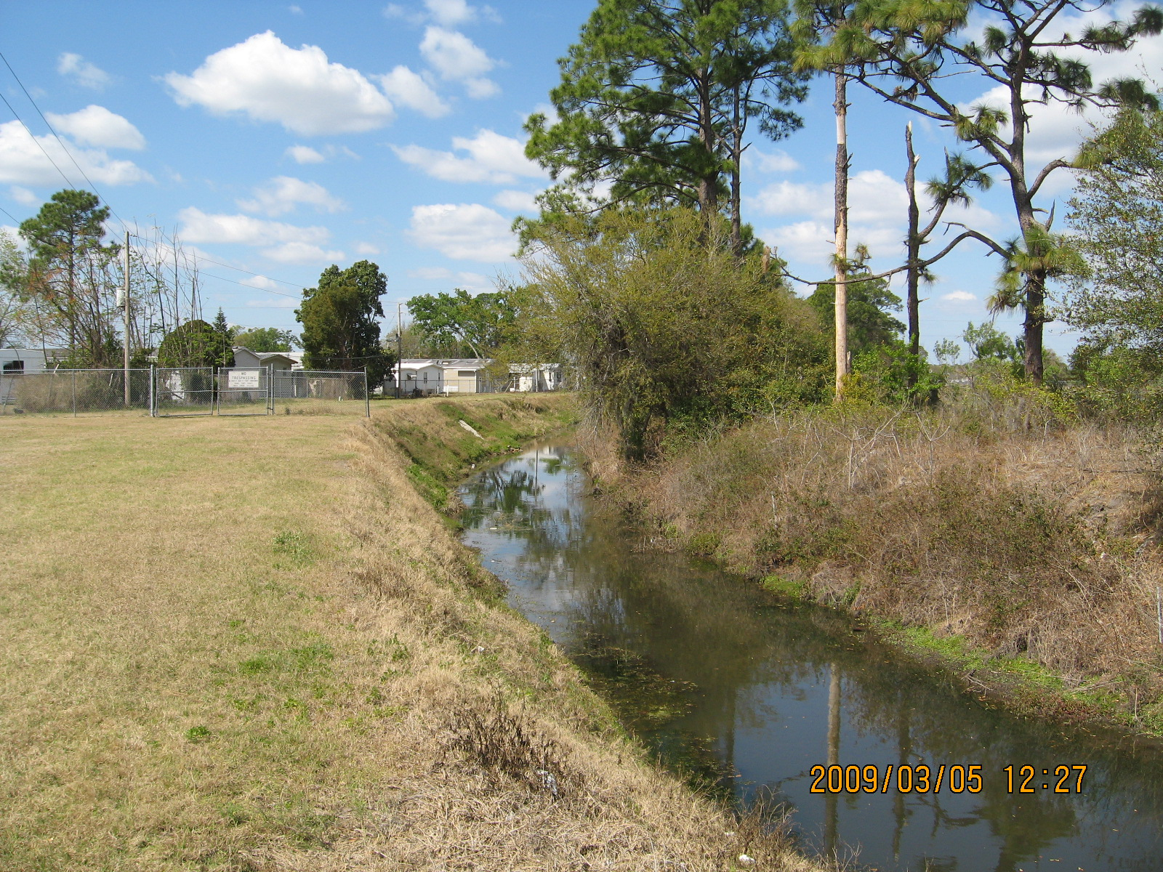
Maintained Conveyance

Slide 116
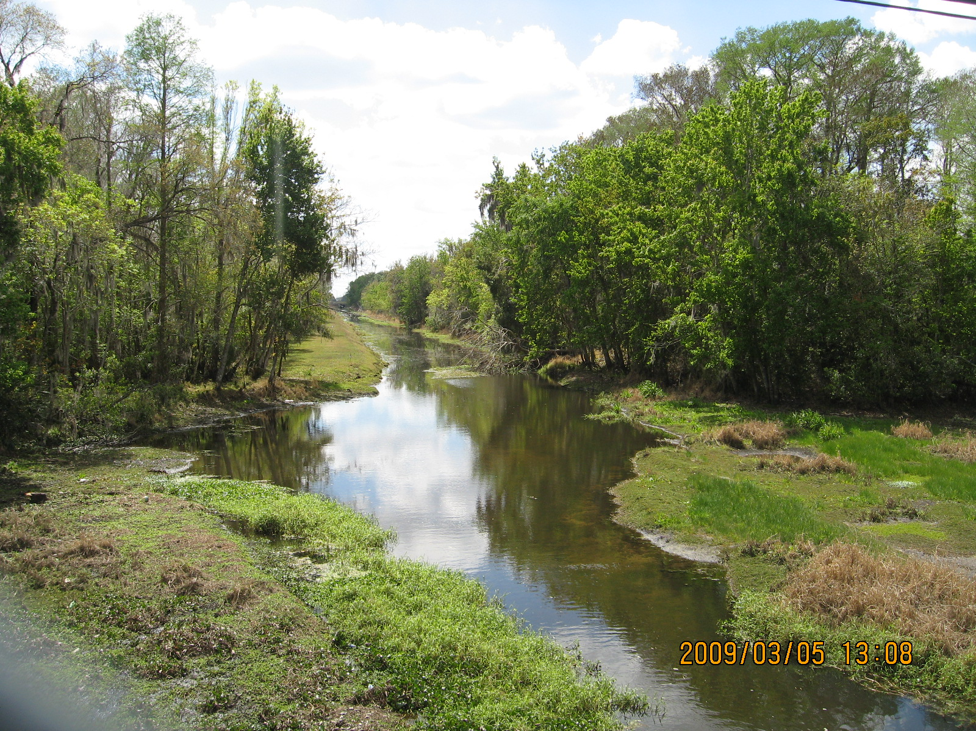
Maintained Conveyance

Slide 117
Downstream Waters Protection
When issuing permit, must ensure that both initial receiving water and downstream waters protected
  Rule 62-302.531(4), F.A.C., states “The loading of nutrients from a waterbody shall be limited as necessary to provide for the attainment and maintenance of water quality standards in downstream waters.”
Implementation Document notes can address by:
  Using models to allocate to upstream watersheds when establishing the TMDL for the downstream waterbody;
  Requiring dischargers to protect downstream waters (if there is reasonable potential that will impact); and
  Identifying trends in nutrient concentrations in all waters, including downstream waters, as part of the the IWR assessment cycle

Slide 118
Downstream Waters Protection (cont.)
If downstream waters currently attain nutrient standards, then current discharge provides for downstream protection
  However, if the facility requests an increase in their permitted load, a Level II WQBEL is needed to evaluate the impacts on downstream waters
  Modeling can be used to determine the acceptable loading of nutrients from the discharger (and other upstream sources) that protects downstream waters

Slide 119
Downstream Waters Protection (cont.)
If downstream waters do not currently attain nutrient standards, then need to see if any downstream TMDLs address the discharge, or alternatively whether the discharge has reasonable potential to cause or contribute to the downstream nutrient impairment
  If TMDL provides allocation, can presume downstream protection
Reasonable potential analysis is site-specific, and should take into account nutrient load, flow, and frequency of the discharge
  For example, no RP if facility nutrient load is 1% of downstream water nutrient load or if facility flow is 1% or less of the receiving water flow

Slide 120
Lessons Learned –
Implementation in Permits is Still Hard
One of EPA’s assumptions is that NNC will help with permits by providing clear targets for permit limits
However, we established NNC as waterbody averages, and expressed as Annual Geometric Means not to be exceeded more than once in a 3 years
This facilitates 303(d) assessments and makes NNC attainable by point sources, but still need to determine permit limit that achieves in-stream NNC
  Some facilities have requested permit limits be written same as NNC, and we currently plan to have 2 sets of permit limits, with one expressed same as NNC and one expressed as never to be exceeded

Slide 121
DEP’s Permitting Process
Require dischargers, at the time of permit issuance, to provide reasonable assurance that their effluent does not cause or contribute to nutrient impairments in:
  the receiving waterbody and
  downstream waterbodies
Process described in NNC Implementation Document, which was adopted by reference in Chapter 62-302, F.A.C.

Slide 122
Reasonable Assurance for Nutrients
Discharge location (both direct and downstream receiving waters) affects the method and complexity of the reasonable assurance demonstration
Direct receiving water has Hierarchy 1 interpretation
Direct receiving water is a lake/spring
Direct receiving water is a stream
Narrative applies to direct receiving water
Downstream waters protection. Could range from Hierarchy 1 waters (including estuaries), to lakes/springs, to streams, or potentially to systems where the narrative would continue to apply
Reasonable Assurance

Slide 123
Reasonable Assurance Provided
NNC currently attained in receiving water and downstream water
  There is RA that the facility does not cause or contribute to nutrient impairment
Site-specific RA demonstration may be:
  Compliance with Hierarchy 1
  Compliance with lakes or springs criteria
  Compliance with streams flora, and nutrient thresholds or fauna
  Compliance with narrative criterion, where applicable
  No reasonable potential for nutrient issues

Slide 124
Permit Issuance when Reasonable Assurance Provided
Final limits based on site-specific demonstration
Additional monitoring considerations for facilities without wasteload allocation
  Need quarterly nutrients and chlorophyll in receiving waters
  Flora, if a stream, and fauna if regional thresholds are exceeded in stream (at least two temporally independent samples during the permit period)
  If another entity (DEP, county, etc.) is sampling nutrients and chlorophyll (minimum of quarterly), and/or flora and fauna in receiving waters, additional monitoring not needed
Standard re-opener

Slide 125
If Additional Time Needed to Demonstrate Compliance with NNC
403.088(2), F.S., provides time to comply with new requirements by issuing permit with Administrative Order (AO)
Permit includes:
  Reference to AO
  Final limits [narrative referencing appropriate NNC Rules 62-302.531, 62-302.532, and 62-302.300(19) FAC]
  Specific re-opener associated with completion of the demonstration
  Standard re-opener

Slide 126
If Additional Time Needed to Demonstrate Compliance with NNC (cont.)
AO includes:
  Interim limits – hold the line
  Description of the steps leading to compliance with NNC
  Schedule to demonstrate compliance with NNC, including
    Necessary monitoring and analyses
    Specific date when compliance with NNC must be attained

Slide 127
Sources of Information
Can get information about adopted nutrient TMDLs from TMDL Tracker
  http://www.dep.state.fl.us/water/watersheds/assessment/tmdl-tracker.htm
List of Nutrient TMDLs on Water Quality Standards Program website
  http://www.dep.state.fl.us/water/tmdl/final_tmdl.htm
Can get adopted NNC from Chapter 62-302.532
  https://www.flrules.org/gateway/ChapterHome.asp?Chapter=62-302
If estuary not addressed in Chapter 62-302, look at August 1 Report to Governor
  http://www.dep.state.fl.us/water/wqssp/index.htm

Slide 128
Additional Information Sources
TMDL webpage
  http://www.dep.state.fl.us/water/tmdl/final_tmdl.htm
FDEP Biological Data Base
  Biologists (access to S-Bio); Tallahassee (WQAP, AEQA, Biology Section
USGS for flow information
  http://waterdata.usgs.gov/fl/nwis/rt
62-304 for looking up TMDLs
  https://www.flrules.org/gateway/ChapterHome.asp?Chapter=62-304
FDEP Map Direct
  http://www.dep.state.fl.us/gis/
IWR Runs
  http://publicfiles.dep.state.fl.us/dear/IWR/

Slide 129
Additional Information Sources
DEP SOPs for collecting Biology and Water Quality data
  http://www.dep.state.fl.us/water/sas/sop/index.htm
Level II WQBELS for multiple and single discharges
  See TMDL Section
Watershed Assessment Complete List of Verified Waters
  http://www.dep.state.fl.us/water/watersheds/assessment/a-lists.htm#vl
Reasonable Assurance Plans
  http://www.dep.state.fl.us/water/watersheds/rap.htm

Slide 130
Example - Discharge to Hierarchy 1
Direct Receiving
Water:
Has Nutrient TMDL, SSAC or Estuary Specific,
or RA
Nutrient TMDL: WQBEL expressed as the load to achieve the nutrient Wasteload Allocation.
SSAC or Estuary Specific: WQBEL ensures that the discharge does not cause or contribute to an exceedance of the SSAC within the spatial area of the SSAC.
Reasonable Assurance Plan: Nutrient-related target in the RA demonstration can serve as the applicable numeric interpretation.
Discharge
Downstream Waters: Hierarchy 1 Interpretations usually also protect downstream, but should check (next slide)

Slide 131
Discharge to Hierarchy 1 to Downstream Hierarchy 1
Direct Receiving
Water:
Has Nutrient TMDL, SSAC or Estuary Specific,
or RA
Discharge
Effluent Limits must achieve Hierarchy 1 interpretation in direct receiving waters*
Downstream Waters: Additional Hierarchy 1 Interpretations * farther downstream
If more stringent, apply these guidelines to the discharger
*Hierarchy 1 Interpretations in streams take precedence over generic stream criteria (flora and fauna)
Notes:
Bottom right box, Should this say “If more stringent, apply these guidelines to the discharger”
Question:
If you have this scenario do you also need to have data on the biology?

Slide 132
Example: Pace WWTP
Discharges to wetland (covered by narrative)
Wetland sheet flows to Escambia River/Upper Escambia Bay
Upper Escambia Bay has Nutrient TMDL (35% reduction in TP, maintain TN)
Remainder of Pensacola Bay has Site Specific Criteria

Slide 133
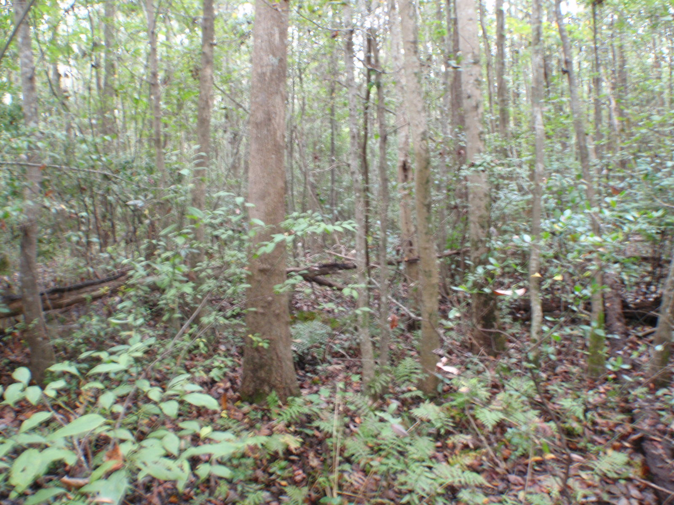
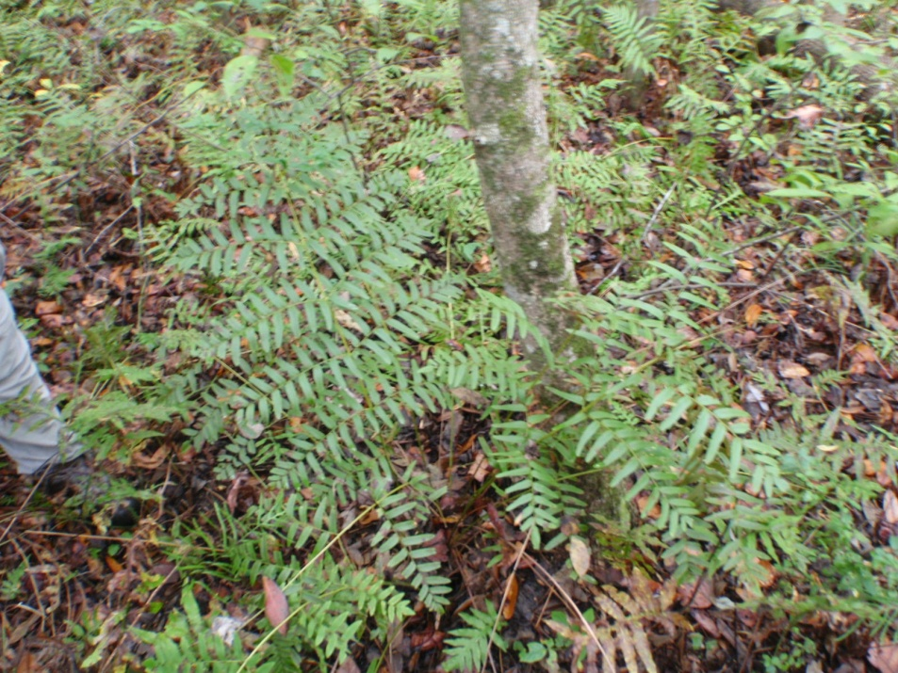
Example: Pace WWTP (cont.)
Receiving wetland has no imbalances
Healthy wetland plants

Slide 134
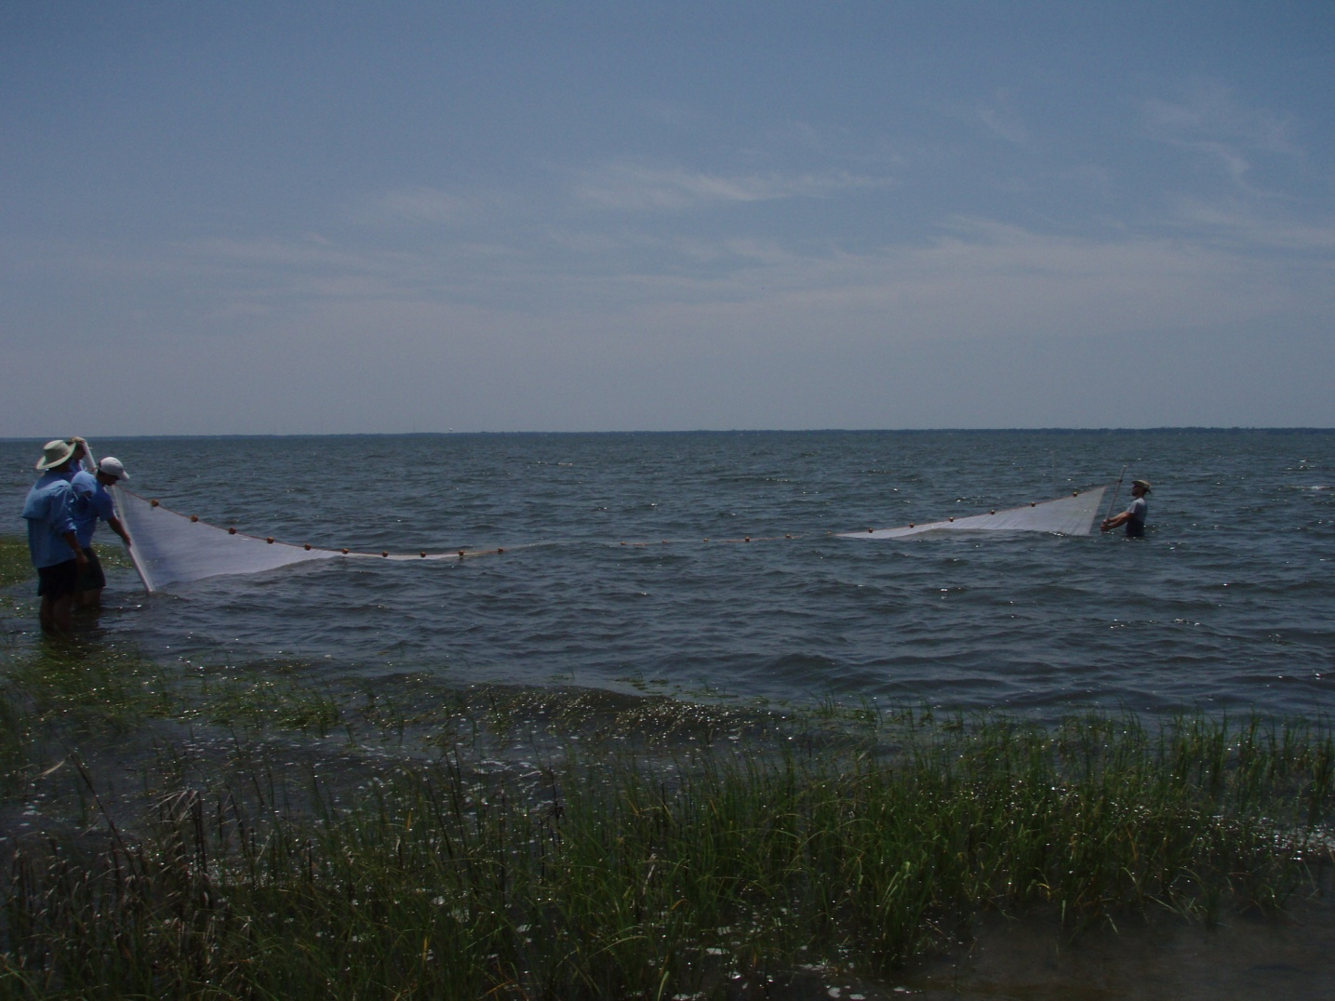
Example: Pace WWTP (cont.)
Upper Escambia Bay has TMDL

Slide 135
Example: Pace WWTP (cont.)
Wasteload Allocation is divided between Gulf Power Company (NPDES permit FL0002275), Pace Water System, Inc. (NPDES permit FL0102202), and Ascend Performance Materials LLC (NPDES permit FL0002488).
  Gulf Power : 2,852 lbs/year for TP and 21,392 lbs/year for TN
  Pace Water System: 3,852 lbs/year for TP and 32,052 lbs/year for TN
  Ascend Performance Materials: 5,147 lbs/year for TP and 73,171 lbs/yr for TN
Pace nearfield wetland has no imbalances so existing levels OK
Permit must ensure allocation is not exceeded

Slide 136
Discussion
How would this be translated to Pace permit limits?
Answer: Express 3,852 lbs/year for TP and 32,052 lbs/year for TN as rolling annual maximum

Slide 137
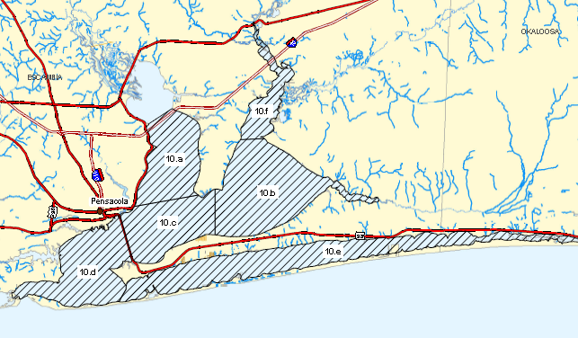
For Facilities not in TMDL Segment
TMDL
 | TP (mg/L) | TN (mg/L) | Chloro (ug/L)
Lower Escambia | 0.076 | 0.56 as AGM | 6.8 as AGM
East Bay | 0.084 | 0.83 | 4.0 as AGM
Upper Pensacola | 0.084 | 0.77 | 6.0 as AGM
Lower Pensacola | 0.024 as AGM | 0.48 as AGM | 3.9 as AGM
Santa Rosa Sound | 0.022 as AGM | 0.41 as AGM | 3.4 as AGM
Blackwater Bay | 0.082 | 0.61 | 11.3
Upper Escambia : WQBEL must meet WLA from TMDL
Other facilities must ensure loading from discharge achieves estuary-specific NNC (the NNC are NOT end of pipe values)

Slide 138
Hierarchy 1 (Estuary-specific):
Pensacola Bay
Permit renewals (outside of TMDL segment) at previous discharge levels (including load) should be permittable because site-specific estuary criteria designed to maintain existing conditions
  Nutrients are not interfering with healthy, well balanced communities
However, may need additional analysis if discharge has been significantly below permitted load, and will need additional analysis if facility wants to increase permitted load
  Start with simple mass balance approach and see if discharge has reasonable potential to increase TN or TP in receiving estuarine segment above NNC

Slide 139
Discharge to Lake to Stream
WQBEL analysis would determine the specific TN and TP levels (subject to the upper nutrient values) that would maintain the appropriate chlorophyll a target for the lake type (6 or 20 µg/L) during all years, including years representing critical conditions. This evaluation would involve water quality modeling set to achieve a “never to exceed” chlorophyll target scenario.
Discharge
Direct Receiving
Water:
Lake
Downstream Waters: Stream, if lake criteria are met, stream thresholds would generally be achieved, but need to check

Slide 140
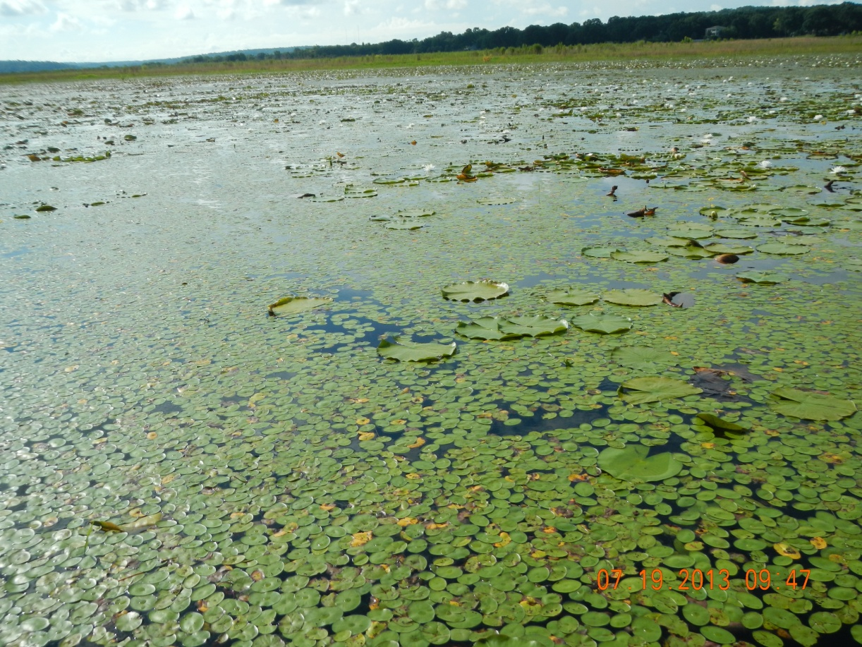
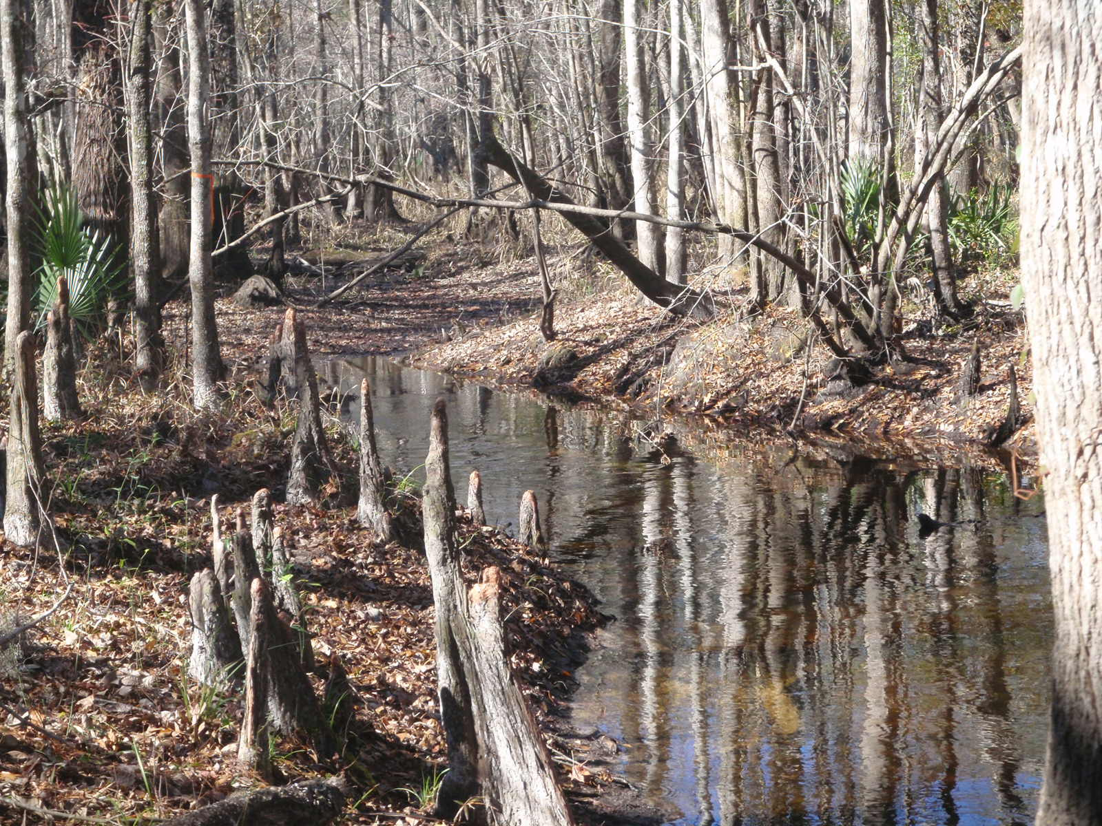
Discharge to Lake with Downstream Stream
Must ensure that Downstream Stream Has Healthy Flora and Achieves Thresholds or Has Healthy Flora AND Fauna
Lake Must Achieve Chlorophyll and TN/TP upper range

Slide 141
Discharge to Lake to Stream (cont.)
Permittee needs to provide data to characterize color and alkalinity of the lake
  Needed to determine applicable NNC
Can use simplified “Bathtub” models to determine nutrient levels that will attain the chlorophyll a criteria, but need to look at all sources

Slide 142
Discharge to Lake to Stream (cont.)
Direct Receiving
Water:
Lake
Discharge
WQBEL achieves lake criteria*
Healthy flora AND fauna?
Downstream Waters: Stream thresholds exceeded in segment downstream from lake
Yes
No
Reasonable Assurance*
Level II WQBEL for downstream protection
*If multiple dischargers, existing loads OK unless nearfield or downstream criteria not achieved, then Level II WQBEL needed

Slide 143
Discharge to Stream to Stream
Healthy flora AND thresholds achieved OR healthy flora AND healthy fauna (SCI >40)?
Direct Receiving
Water:
Stream
Discharge
Yes
No
Reasonable Assurance
Level II WQBEL
Downstream Waters: Stream until where discharge is <1 % of flow or load
Healthy flora AND thresholds achieved OR healthy flora AND healthy fauna (SCI >40)?
Yes
No
Reasonable Assurance
Level II WQBEL

Slide 144
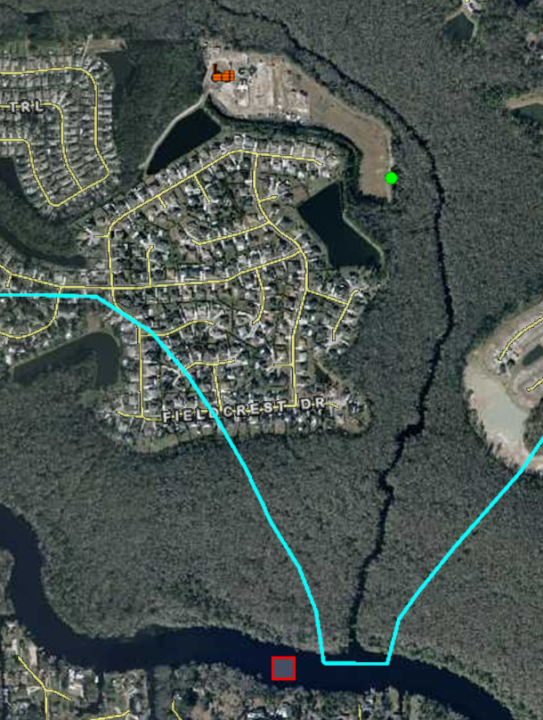
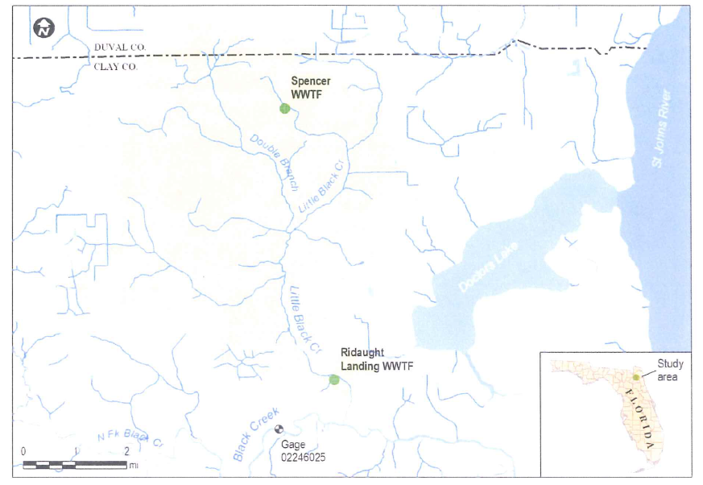
Example Clay County

Slide 145
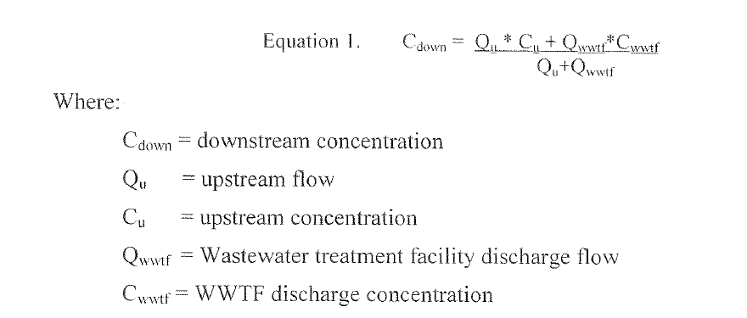
Nutrient Mass Balance Equation

Slide 146
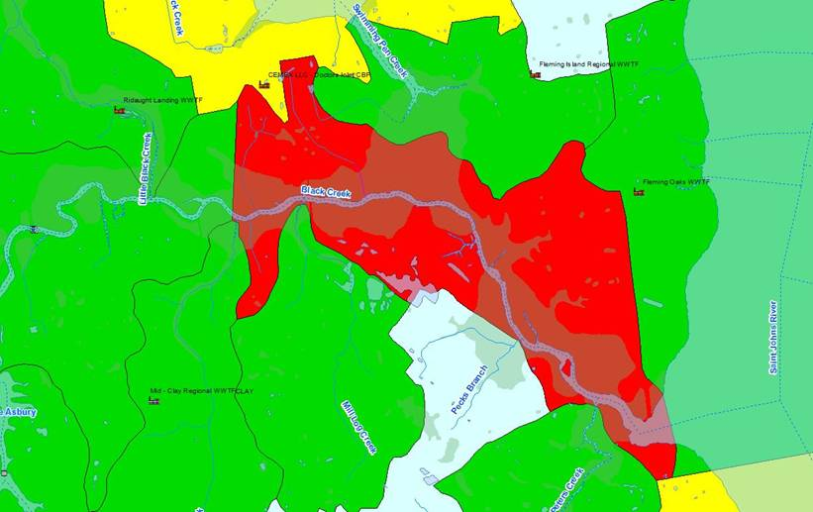
Downstream Waters (Black Ck.) Listed for DO (TP as Causative)
Ridaught Landing WWTP
Flow

Slide 147
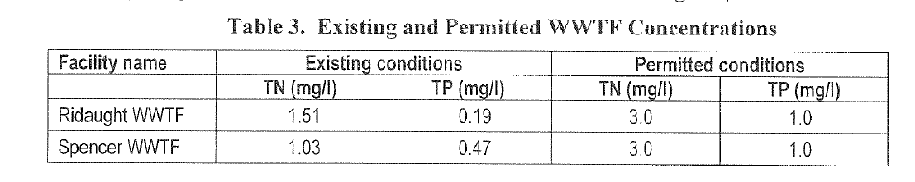
Existing and Permitted Nutrients

Slide 148
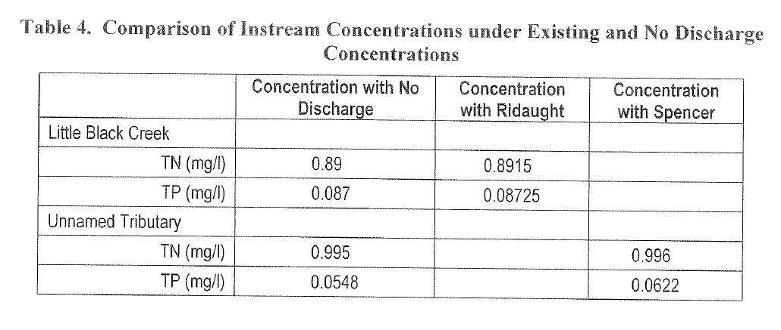
Instream Concentrations: Existing
Peninsula Thresholds | 0.12 mg/L TP | 1.54 mg/L TN

Slide 149
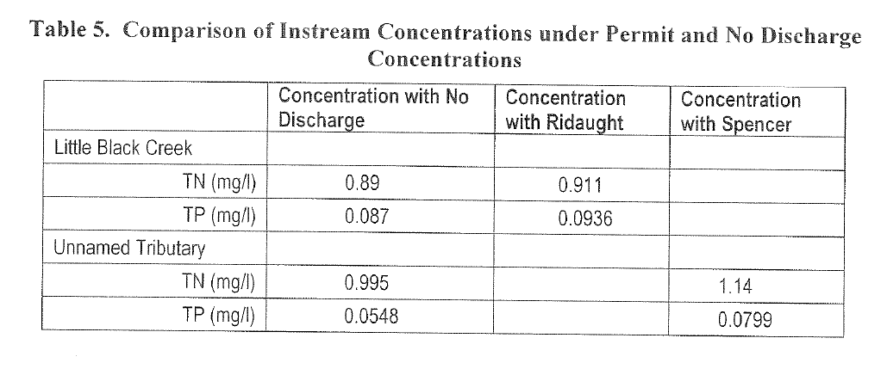
Instream Concentrations: Permitted
Peninsula Thresholds | 0.12 mg/L TP | 1.54 mg/L TN

Slide 150
Conclusion
Facility has demonstrated that nutrient thresholds will be achieved (existing and at full permitted discharge)
Still need to demonstrate healthy flora
Load is <1% to Little Black Creek (de minimus) and would not cause or contribute to DO impairment in Black Creek
  Complies with St. Johns TMDL

Slide 151
Discussion
How this would be translated to permit limits?
Answer:
  Existing permitted load acceptable
  Require floral monitoring and, if thresholds exceeded, require faunal monitoring as discharge approaches permitted load
  Minimum of 2 temporally independent samplings, but may need more if failure occurs

Slide 152
Example: Potash Corp. Saskatchewan
PCS, in conjunction with DEP, is conducting a study to potentially develop Site Specific Alternative Criteria for nutrients in 4 creeks and the Suwannee River
  Study can serve as a template for other SSAC investigations
SSAC can serve as Hierarchy 1 Interpretation for permit

Slide 153
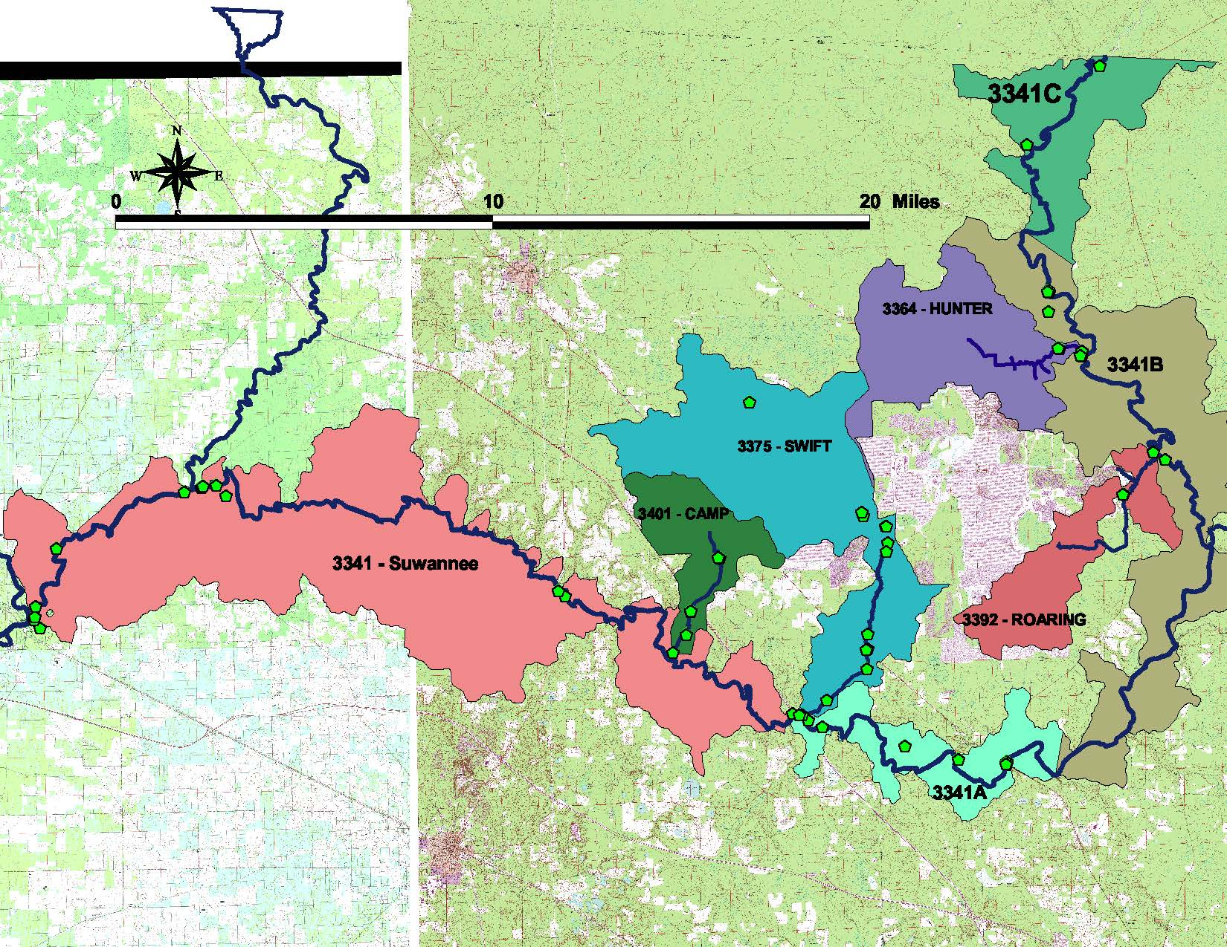
PCS Watersheds

Slide 154
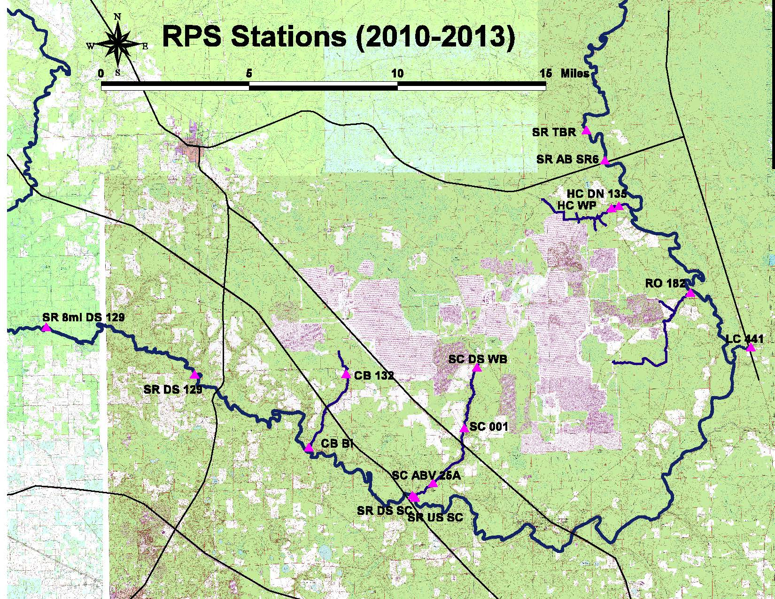

Slide 155
Creek Stations
CREEK/STATION NAME | DISTANCE TO MOUTH (miles)
Hunter
HC CW (WQ) | 1.6
HC WP (WQ) | 0.9
HC DN 135 (SCI) | 0.6
Roaring
RO 003A (WQ) | 1.7
RO 182 (WQ) | 0.2
RO 182 (SCI) | 0.1
Swift
SC WB (WQ) | 5.9
SC 001 (WQ and SCI) | 3.2
SC CR 25A (WQ) | 0.9
Camps Branch
CB 132 (WQ) | 3.3
CB 004 (WQ) | 1.4
CB BI (WQ and SCI) | 0.1

Slide 156
SCI Scores: All above 40
STUDY STATION | STATION DESCRIPTION | 2012 SCI BIOREGION | OCT/NOV 2012 |  | FEB 2013
 |  |  | SCI SCORE | WATER LEVEL | SCI SCORE | WATER LEVEL
SR AB SR6 | Suwannee at Turner Boat Ramp, 2.5 miles upstream of SR 6 | Big Bend | 85 | 75.69 ft | 81 | 74.82 ft
SUW 010 | SUW010 Suwannee River at SR 6 (FDEP SCI Station) | Big Bend | 76 | 75.69 ft | N/A | N/A
SR US SC | Suwannee River upstream of Swift Creek | Big Bend | 88 | 52.16 ft | 80 | 50.59 ft
SR DS SC | Suwannee River downstream of Swift Creek | Big Bend | 85 | 52.16 ft | 71 | 50.59 ft
SR DS 129 | Suwannee River downstream of US 129 | Big Bend | 76 | 39.73 ft | N/A | N/A
SC 001 | Swift Creek at Methodist Church road | Big Bend | 55 | 86.67 ft | 57 | 86.50 ft
HC WP | Hunter Creek at CR 135 (Woodpecker road) | Big Bend | 52 | 91.08 ft | 53 | 90.73 ft
CB BI | Camp Branch upstream of sink | Big Bend | 65 | N/A | 83 | N/A
RO 182 | Roaring Creek at CR 182 | Big Bend | 82 | 93.56 ft | 70 | 93.56 ft

Slide 157
Flora
Preliminary data indicate acceptable RPS and LVS
Chlorophyll in Swift Creek is between 3.2 and 20 ug/L, meaning site specific evaluation needed
  Assess functionally similar reference sites for similarity

Slide 159
Notes:
TP ALL STREAMS STUDY PLOT

Slide 160
PCS Example
If final results show healthy flora and fauna in near-field and downstream waters, existing TN and TP levels would be acceptable
  Permit would ensure that the levels associated with the healthy conditions are maintained
  Develop permit limit expressed as never to be exceeded that will attain criteria expresses as not to be exceeded more than once in three years
If results show imbalance, Level II WQBEL needed
Although Lower Suwannee impaired for nitrate, no RP for PCS discharge that far downstream

Slide 161
Discharge to Stream to Lake
Healthy flora AND thresholds achieved OR healthy flora AND healthy fauna (SCI >40)?
Direct Receiving
Water:
Stream
Discharge
Yes
No
Reasonable Assurance
Level II WQBEL
Downstream Waters: Lake
WQBEL analysis to determine TN and TP levels that would maintain the appropriate chlorophyll a target for the lake type (6 or 20 µg/L) during all years

Slide 162
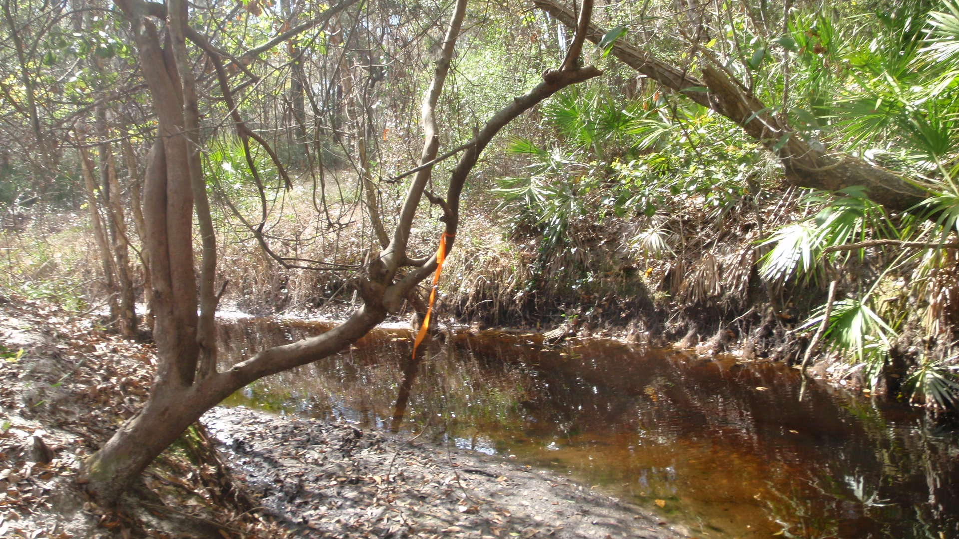

Downstream Lake Achieves Chlorophyll and TN/TP upper range in all years
Stream Segment with Healthy Flora and Fauna (exceeds TN threshold)

Slide 163
Discharge to Stream to Hierarchy 1
Healthy flora AND thresholds achieved OR healthy flora AND healthy fauna (SCI >40)?
Direct Receiving
Water:
Stream
Discharge
Yes
No
Reasonable Assurance
Level II WQBEL for nearfield protection
Downstream Waters: Hierarchy 1 interpretation
Analysis to ensure achievement of Hierarchy 1, may need Level II WQBEL if discharge has reasonable potential (not de minimus)

Slide 164

Mosaic Discharges to Alafia River
Various NPDES outfalls to ditches/intermittent wetlands (narrative would apply)
Eventually flow to Alafia River
Tidal Alafia has TMDL
  Mosaic’s existing load was deemed de minimus and WLA was set at their 2001-2007 loads
Hillsborough Bay has RA Plan, and Mosaic has WLA for their facilities

Slide 165

Mosacia Outlf
Mosaic Outfalls discharge to wetlands or ditches (narrative applies) and then to North and South Prongs of the Alafia (NNC applies)

Slide 166
SCI Results: All Exceed 40

Slide 167
Flora: RPS and LVS Indicate Healthy
LVS: 26 native taxa comprising expected in-stream plant community. Low FLEPPCC occurrences.
 | Algal Thickness Rank (RPS)
 | 0 | 1 | 2 | 3 | 4 | 5 | 6
 | 0 mm rough | <0.5 mm or slimy | 0.5 - 1 mm | >1 to <6 mm | 6 - 20 mm | 2-10 cm | >10 cm
Site
Alafia 601 South Prong | 42 | 0 | 0 | 1 | 4 | 7 | 0
Alafia 495 North Prong | 39 | 5 | 0 | 0 | 0 | 5 | 0
Alafia 602 North Prong* | 57 | 0 | 0 | 0 | 0 | 1 | 0
Alafia 603 Main stem | 31 | 27 | 2 | 0 | 1 | 14 | 0
Alafia 600 Main stem | 22 | 1 | 0 | 0 | 0 | 12 | 0
< 25% Rank 4-6

Slide 168


Combined outfalls must achieve Downstream Segment TN TMDL (5,140 pounds per year)
Healthy Flora and Fauna confirm existing levels of TP and TN are OK (even if they exceed regional thresholds)

Slide 169
Discussion
How this would be translated to permit limits?
Answer
  Existing TN and TP levels are approvable because flora and fauna are healthy and downstream waters attain TMDL and RA allocations

Slide 170
Discharge to Excluded Water to Estuary (or Site Specific Criteria)
Direct Receiving
Water:
Ditch/canal, wetland, tidally fluctuating, intermittent stream
Narrative applies to excluded waterbody
Discharge
Analysis to ensure achievement of the specific TN and TP levels/loads and chlorophyll a target for the estuarine segment during all years, including years representing critical conditions. This evaluation would involve water quality modeling set to achieve a “never to exceed” scenario.
Downstream Waters: Estuary/SSAC

Slide 171


Downstream Estuary must comply with TN, TP, and Chlorophyll Criteria
Narrative Applies in Ditch

Slide 172
Discharge to Excluded Water to Stream
Direct Receiving
Water:
Ditch/canal, wetland, intermittent stream
Narrative applies to excluded waterbody
Discharge
Healthy flora AND thresholds achieved OR healthy flora AND healthy fauna (SCI >40) both nearfield and downstream?
Downstream Waters: Nearfield stream and segment until where discharge is <1% of load
Yes
No
Reasonable Assurance
Level II WQBEL

Slide 173


Must ensure that Downstream Stream Has healthy Flora and Achieves Thresholds or Has Healthy Flora AND Fauna
Narrative Applies in Ditch

Slide 174
Discharge to Excluded Water to Stream to Estuary
Direct Receiving
Water:
Ditch/canal, wetland, intermittent stream
Narrative applies to excluded waterbody
Discharge
Healthy flora AND thresholds achieved OR healthy flora AND healthy fauna (SCI >40)?
Downstream Waters: Nearfield stream and then estuary
Yes
No
Reasonable Assurance
Level II WQBEL
Analysis to ensure specific TN and TP levels/loads and chlorophyll a target for the estuarine segment during all years

Slide 175



Downstream Estuary must comply with TN, TP, and Chlorophyll Criteria
Narrative Applies in Ditch
Stream Segment must have Healthy Flora and Achieve Thresholds Or Healthy Flora and Fauna

Slide 176

Inlet Beach WWTP
Discharges to golf course ponds and ultimately, to the ICW near Pablo Creek and mouth of St. Johns River

Slide 177
Inlet Beach WWTP
NNC would not apply to golf course ponds (not waters of the State)
NNC for ICW from Report to Governor:
Segment | Parameter | Number of Observations | Mean | 90 Percent Prediction Interval (Numeric Interpretations) | AGM Years | AGM (Numeric Interpretation)
ICWW from north Tolomato to St. Johns River | TP (mg/L) | 58 | - | - | 7 | 0.191
 | TN (mg/L) | 41 | 0.66 | 1.28 | 13 | -
 | Chlorophyll a (µg/L) | 39 | 4.0 | 10.3 | 5 | -

Slide 178
Discussion
How this would be translated to permit limits?
Answer
  Golf Course ponds are not waters of the State, so NNC do not apply
  Because the discharge from the ponds to the (marine) ICW occurred during the healthy time period for NNC establishment, existing loads are permittable

Slide 179
Rule/Water Body | ERC Adoption | Legislative Ratification | EPA Approval | Federal Court Action | In Effect Y / N | Notes
EPA’s standards for flowing waters | NA | NA | NA | Vacated | N | Standards were determined to be arbitrary and capricious
EPA’s standards for lakes | NA | NA | NA | Found to be valid | Y | The effective date was delayed multiple times by the court, but criteria went into effect on January 6, 2013.
EPA’s standards for springs | NA | NA | NA | Found to be valid | Y | The effective date was delayed multiple times by the court, but criteria went into effect on January 6, 2013.
FDEP standards for flowing waters | 12-8-2011 | Waived by 2012 legislation | 11-30-2012 | Required | N | In effect if EPA withdraws federal NNC and ceases NNC rulemaking, assuming court approval of changes to Consent Decree
FDEP’s Standards for lakes | 12-8-2011 | Waived by 2012 legislation | 11-30-2012 | Required | N | In effect if EPA withdraws federal NNC and ceases NNC rulemaking, assuming court approval of changes to Consent Decree
FDEP’s standards for springs | 12-8-2011 | Waived by 2012 legislation | 11-30-2012 | Required | N | In effect if EPA withdraws federal NNC and ceases NNC rulemaking, assuming court approval of changes to Consent Decree
FDEP’s standards for estuaries, Part 1 | 12-8-2011 | Not required | 11-30-2012 | Not Required | Y | Criteria are in effect and listed in 62-303.532
FDEP’s standards for estuaries, Part 2 | 11-13-2012 | Not required | 9-26-2013 | Not Required | Y | Criteria are in effect and listed in 62-303.532
FDEP’s standards for estuaries, Part 3 | 6-20-2013 | Not required | 9-26-2013 | Required | N | In effect if EPA approves the criteria, withdraws its federal NNC and ceases NNC rulemaking, assuming court approval of changes to Consent Decree [See Chapter 2013-71, Laws of Florida]

Slide 180
Rule/Water Body | ERC Adoption | Legislative Ratification | EPA Approval | Federal Court Action | In Effect Y / N | Notes
FDEP’s standards for estuaries, Part 4 | NA | Not required | 9-26-2013 | Required | N | Narrative standards set forth in Chapter 2013-71, Laws of Florida, approved by EPA. Values in August 1 Report will serve as NNC until final standards adopted by December 2014.
South Florida Canals | 12-8-2011 |  | 11-30-2012 | Required | N | Covered by narrative criteria
Coastal Areas | 6-20-2013 | Not required | 9/26/2013 | Required | N | Waiting on EPA Approval
Non perennial streams | 12-8-2011 | Not required | 11-30-2012 | Required | N | Covered by narrative criteria once demonstration made that biology representative of wetland or terrestrial conditions
Wetlands | 12-8-2011 | Not required | 11-30-2012 | Required | N | Covered by narrative criteria
Man-made or physically altered ditches primarily used as water conveyance | 12-8-2011 | Not required | 11-30-2012 | Required | N | In effect if EPA withdraws federal NNC and ceases NNC rulemaking, assuming court approval of changes to Consent Decree. Covered by narrative criteria once demonstration made that used and managed primarily for water management purposes and habitat is poor.
Everglades | 2003, 2005 | Not required | 2005 – 2006 | Not Required | Y | Previously approved by ERC and EPA.

