Slide 1

Implementation of Numeric Nutrient Criteria in NPDES Permitting
Short Refresher
October 2014

Slide 2
Summary of Presentation
Introduction: Previous Training, Contacts, Current Status, and Basic Concepts
Summary of Rules and Key Concepts
  Hierarchical Approach
Downstream Waters Protection
  Implementation in Permits
    Straight Renewal
    New or Expanded Discharge
    Administrative Orders
Other Permitting Considerations
  Applications in-house when rules become effective
  Continuous and non-continuous discharges
Where to Find Information on Nutrients and Nutrient Criteria

Slide 3
Previous Nutrient Criteria Training
Statewide training for permitting staff and sampling teams
  December 2013 in Jacksonville, Okeechobee, Tampa, and Pensacola
  April 2014 in Tallahassee
Additional materials provided to Staff, WFAs and Managers
  Administrative Order Template
  Comprehensive training presentation
  DRAFT Permit Writers Manual section on nutrient criteria
Available at http://publicfiles.dep.state.fl.us/DWRM/Industrial_Wastewater/Outgoing/Presentation/

Slide 4
Contacts
Division of Environmental Assessment and Restoration (DEAR) contacts for water quality standards development and surface water assessment information/data
Water Resource Management Division (WRMD) wastewater programs contact for permitting information
  Allen Hubbard, allen.hubbard@dep.state.fl.us, x57606
Water Quality Standards Program - Daryll Joyner, daryll.joyner@dep.state.fl.us, x58431 - Ken Weaver, Kenneth.Weaver@dep.state.fl.us, x58414 - Nia Wellendorf, Nijole.Wellendorf@dep.state.fl.us, x58190 | Water Quality Assessment Program - Julie Espy, Julie.Espy@dep.state.fl.us, x58416 - Kevin ODonnell, kevin.odonnell@dep.state.fl.us, x58469

Slide 5
Current Status of DEP NNC Rules
NNC previously in effect
  Estuaries from Clearwater through the Keys to Biscayne Bay (2012)
  Panhandle Estuaries (2013)
NNC in effect as of Monday (October 27, 2014)
  Streams, lakes, spring vents and miscellaneous estuaries on the east coast and Big Bend
NNC to be adopted by ERC on Nov. 19 (in effect in early Jan 2015)
  Estuaries addressed in the August 2013 Report to the Governor, including portions of the Big Bend from Alligator Harbor to the Suwannee Sound, Cedar Key, St. Mary’s River estuary, Southern Indian River Lagoon, Mosquito Lagoon, several portions of the Intracoastal Waterway (ICWW)
Some waters still covered by the narrative only
  South Florida canals, tidally affected streams in coastal areas, non-perennial streams, wetlands, man-made or altered water conveyance ditches

Slide 6
Where to Find Nutrient Rules for Surface Waters
Nutrients are defined in Subsection 62-302.200(22), F.A.C.,
  “total nitrogen (TN), total phosphorus (TP), or their organic or inorganic forms”
Nutrient Criteria Rules
  Narrative nutrient criteria in Rule 62-302.530(47), F.A.C.
  NNC for site-specific interpretations, lakes, spring vents and streams in Rule 62-302.531, F.A.C.; and
  NNC for specific estuaries in Rule 62-302.532, F.A.C.
Implementation Document
  Subsection 62-302.300(19), F.A.C., establishes that NNC “under Rules 62-302.531 and 62-302.532, F.A.C., shall be implemented consistent with the document titled Implementation of Florida’s Numeric Nutrient Standards, April 2013” (Implementation Document)
  Incorporated by reference into the rule (makes it the same as part of the rule!)
  Available at http://www.flrules.org/Gateway/reference.asp?No=Ref-02905

Slide 7
Basic Concepts for Nutrients in Surface Water
Nutrients are naturally present in aquatic systems
  Necessary for the proper functioning of biological communities
Nutrient levels in surface water are a function of many natural factors
  e.g., light penetration, hydraulic residence time, presence of herbivore grazers and other food web interactions, and habitat considerations
Determining appropriate nutrient regime in a surface water is site-specific, requiring information about ecologically relevant responses

Slide 8
Basic Concepts of NNC
The narrative nutrient criterion is maintained and numerically interpreted using best available information on a site-specific basis using a systematic, hierarchical approach
  Narrative is the foundation for the numeric nutrient criteria
  Narrative continues to apply even where NNC apply
Narrative states that “in no case shall nutrient concentrations of a body of water be altered so as to cause an imbalance in natural populations of aquatic flora or fauna.”
Only applies to surface waters of the state

Slide 9
Basic Concepts of NNC
Acknowledgment of previous site-specific interpretations
  “Hierarchy” recognizes existing nutrient TMDLs, SSACs, and WQBELs
Spatial Component
  Rule clearly states that standards are applied in ambient surface waters as a spatial average, consistent with their derivation
  NNC are not applied in permits as end-of-pipe effluent limits
Use of bioassessment information for streams
  Rule allows bioassessment data to supersede stream nutrient thresholds
    Standard not attained if biology fails even if stream nutrient thresholds met

Slide 10
Basic Concepts of NNC
Applicability of Stream Standards
  Definition of “streams” excludes non-perennial (intermittent) streams, wetlands, tidal creeks, and manmade canals, ditches, other conveyances, and altered streams used for water management purposes and having poor habitat
  Narrative nutrient criterion continues to apply
  However, all “stream-like” waters presumed to be stream until provide site-specific information
    Permittee is responsible for providing information demonstrating that the stream NNC does not apply

Slide 11
Hierarchical Approach
Level II Water Quality-Based Effluent Limitations,
Nutrient Total Maximum Daily Loads,
Site Specific Alternative Criteria,
Reasonable Assurance Plans, and
Estuary-specific Criteria
Stressor-Response Relationships (lakes & springs)
Reference-based thresholds (streams)
combined with biological data (flora and fauna)
Ditches/canals used for water conveyance,
wetlands, non-perennial streams, tidally fluctuating areas, and
South Florida flowing waters
Hierarchy 1:
(Site-specific)
Hierarchy 2:
Lakes/Springs
Hierarchy 3: Streams
Hierarchy 4: Narrative

Slide 12
Hierarchy 1
Site-Specific Numeric Interpretations of the Narrative Criteria

Slide 13
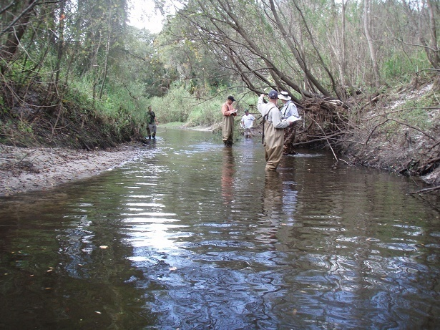
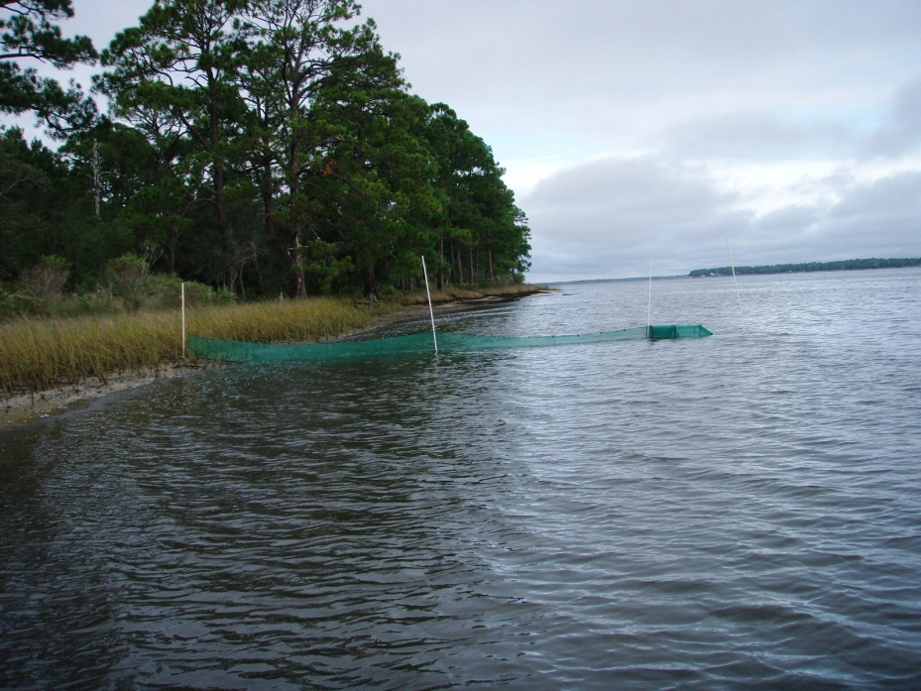
Hierarchy 1: Existing Site Specific Numerical Interpretation
Rule 62-302.531(2)(a):
  Where a site specific numeric interpretation of the criterion in paragraph 62-302.530(47)(b), F.A.C., has been established by the Department, this numeric interpretation shall be the primary interpretation.
Hierarchy I site specific interpretations:
  DEP TMDLs adopted in Chapter 62-304
  Level II Water Quality Based Effluent Limits (WQBELs) (Rule 62-650.500)
  Estuary Specific Criteria (Rule 62-302.532)
  Site Specific Alternative Criteria (SSAC) (Rule 62-302.800)
  Reasonable Assurance (RA) Plans (Rule 62-303.600)

Slide 14
Hierarchy 1: Existing Site Specific Numeric Interpretations - TMDLs
Only state nutrient TMDLs adopted in Chapter 62-304, F.A.C.
  Based on prevention of imbalance (not just DO), publicly noticed, and approved by ERC and EPA
  TMDLs available via TMDL Tracker and other Department websites
  Does not include TMDLs developed by EPA

Slide 15
Hierarchy 1: Existing Site Specific Numeric Interpretations - WQBELs
Level II WQBEL is a Hierarchy 1 interpretation if:
  The documentation for the WQBEL includes a site specific numeric interpretation of the narrative criterion at paragraph 62-302.530(47)(b), F.A.C., for the waterbody;
  The WQBEL is established pursuant to the Level II Process contained at Rule 62-650.500, F.A.C.; and
  The public notice for the WQBEL specifically states that the Level II WQBEL includes a site specific interpretation of the narrative for the receiving waterbody
Permit is renewed with an AO that requires Permittee to conduct Level II WQBEL study
  When study is complete, WQBEL is issued as Final Order by District, but must be approved by EPA before permit is revised to implement WQBEL

Slide 16
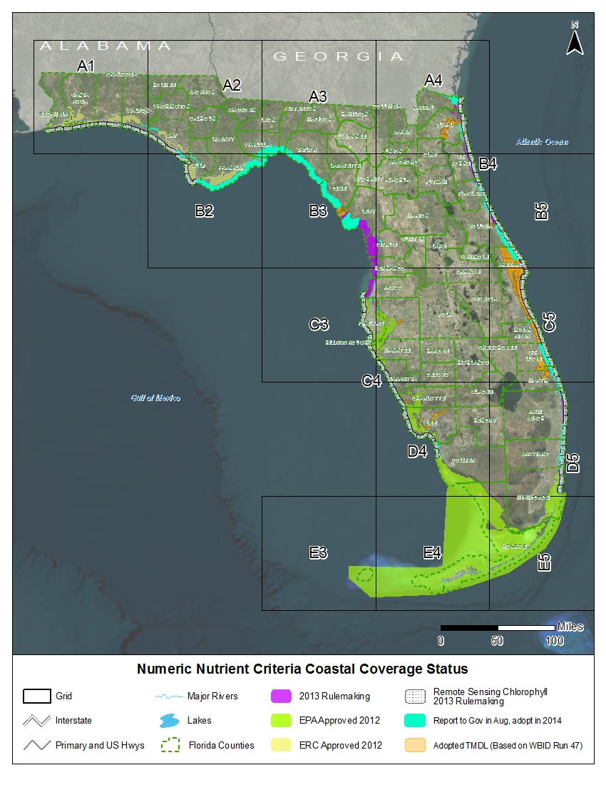
Estuary Numeric Nutrient Criteria: applied as average over estuary segment (not end-of-pipe)

Slide 17
Estuary | Total Phosphorus | Total Nitrogen | Chlorophyll a
(q) Loxahatchee River Estuary | For estuary segments with criteria expressed as annual geometric means (AGM), the values shall not be exceeded more than once in a three year period. For all other estuary segments, the criteria shall not be exceeded in more than 10 percent of the measurements.
1. Lower Loxahatchee | 0.032 mg/L as AGM | 0.63 mg/L as AGM |  | 1.8 μg/L as AGM
2. Middle Loxahatchee | 0.030 mg/L as AGM | 0.80 mg/L as AGM |  | 4.0 μg/L as AGM
3. Upper Loxahatchee | 0.075 mg/L as AGM | 1.26 mg/L as AGM |  | 5.5 μg/L as AGM
(r) Lake Worth Lagoon | For estuary segments with criteria expressed as annual geometric means (AGM), the values shall not be exceeded more than once in a three year period. For all other estuary segments, the criteria shall not be exceeded in more than 10 percent of the measurements.
1. Northern Lake Worth Lagoon | 0.044 mg/L as AGM | 0.54 mg/L as AGM |  | 2.9 μg/L as AGM
2. Central Lake Worth Lagoon |  | 0.66 mg/L as AGM |  | 10.2 μg/L
3. Southern Lake Worth Lagoon | 0.050 mg/L as AGM | 0.59 mg/L as AGM |  | 5.7 μg/L as AGM
(s) Halifax River Estuary | For estuary segments with criteria expressed as annual geometric means (AGM), the values shall not be exceeded more than once in a three year period.
Lower Halifax River Estuary | 0.142 mg/L as AGM | 0.72 mg/L as AGM |  | 6.2 µg/L as AGM
(t) Guana River/Tolomato River/Matanzas River (GTM) Estuary | Criteria for all estuary segments are expressed as annual geometric mean values not to be exceeded more than once in a three year period.
1. Tolomato | 0.105 mg/L as AGM | 0.65 mg/L as AGM |  | 6.6 μg/L as AGM
2. North Matanzas | 0.110 mg/L as AGM | 0.55 mg/L as AGM |  | 4.0 μg/L as AGM
3. South Matanzas | 0.111 mg/L as AGM | 0.53 mg/L as AGM |  | 5.5 μg/L as AGM

Slide 18
Site Specific Alternative Criteria
Under Rule 62-302.800, F.A.C., an alternative water quality criterion may be established for a specific waterbody based on a demonstration that the SSAC is more appropriate
SSACs usually developed and reviewed by DEAR in Tallahassee with sampling support from staff based in District offices
Types of SSACs
  Type I SSAC based on natural background conditions (reference-based approach)
  Type II SSAC must demonstrate that the criterion would fully maintain and protect human health, existing uses, and the level of water quality necessary to protect designated uses
  Type III SSAC for nutrients, and requires a demonstration of healthy flora and fauna at given nutrient regime

Slide 19
Example - Discharge to Hierarchy 1
Direct Receiving
Water: Has Nutrient TMDL, SSAC or Estuary Specific, or RA
Are both TN and TP in this discharge covered by a H1 NNC?
Yes No
Discharge
Downstream Waters: Hierarchy 1 Interpretations usually also protect downstream; verify in hierarchy 1 development documentation
Nutrient TMDL: WQBEL expressed as the load to achieve the nutrient WLA.
SSAC or Estuary Specific: WQBEL ensures discharge does not cause or contribute to an exceedence of SSAC.
Reasonable Assurance Plan: Nutrient-related target in the RA Plan is the NNC
Implement applicable numeric interpretation for the waterbody type or conduct Level II WQBEL
Evaluate downstream protection

Slide 20
Hierarchy 2
Numeric Interpretations of the Narrative Criteria FOR LAKES AND SPRING VENTS

Slide 21
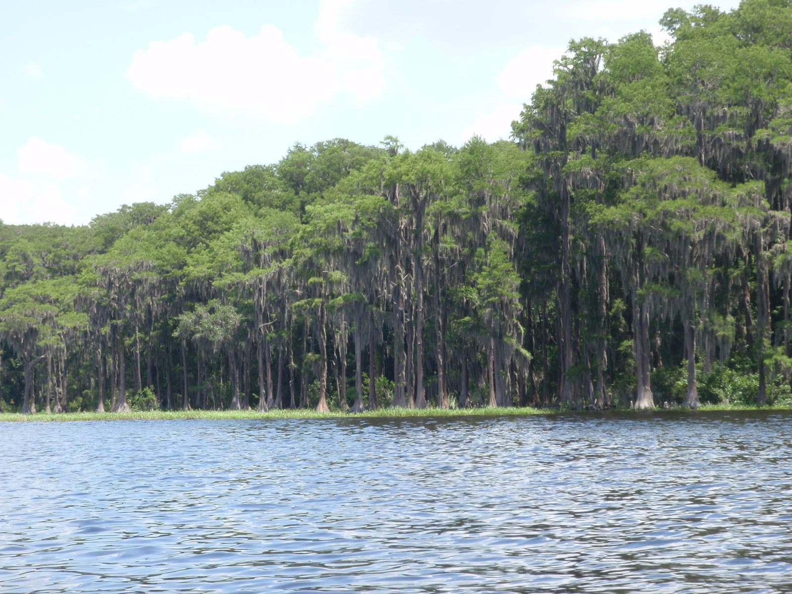
Hierarchy 2: Lakes
Established chlorophyll a, TN and TP criteria
  Started with target chlorophyll a, and then set TN and TP criteria based on statistical relationship between nutrients and chl a
  Criteria vary annually depending on color and alkalinity
  Expressed as annual geometric mean (AGM) calculated as lake-wide averages that cannot be exceeded more than once in a three-year period
  Effluent limitations should be expressed as annual averages not to be exceeded
    WQBEL would establish load that attains NNC (at critical conditions)

Slide 22

NNC for Lakes
Long Term Geometric Mean Lake Color and Alkalinity | Annual Geometric Mean Chlorophyll a | Minimum | Maximum | Minimum | Maximum
 |  | Annual Geometric Mean Total Phosphorus | Annual Geometric Mean Total Phosphorus | Annual Geometric Mean Total Nitrogen | Annual Geometric Mean Total Nitrogen
> 40 Platinum Cobalt Units | 20 µg/L | 0.05 mg/L | 0.16 mg/L¹ | 1.27 mg/L | 2.23 mg/L
≤ 40 Platinum Cobalt Units and > 20 mg/L CaCO₃ | 20 µg/L | 0.03 mg/L | 0.09 mg/L | 1.05 mg/L | 1.91 mg/L
≤ 40 Platinum Cobalt Units and ≤ 20 mg/L CaCO₃ | 6 µg/L | 0.01 mg/L | 0.03 mg/L | 0.51 mg/L | 0.93 mg/L
¹ For lakes with color > 40 PCU in the West Central Region, the maximum TP limit is 0.49 mg/L

Slide 23
Numeric Interpretations for Lakes
Rule allows TN and TP criteria to vary annually depending on chlorophyll a
  If meet chl a value for lake type for a given year, then TN and TP set at annual geometric mean of ambient samples for that year, subject to range shown
  If do not meet chlorophyll a or if insufficient chlorophyll a data, then criteria set at minimum value
NOTE: Lake criteria may apply to areas in large rivers that are more lake-like than stream-like due to
  Due to long residence time and increased width; and
  preponderance of biological taxa (plants and invertebrates) typically found in lakes rather than streams
  Determination of the appropriate NNC would require a biological and hydrographic assessment of the river area in question

Slide 24
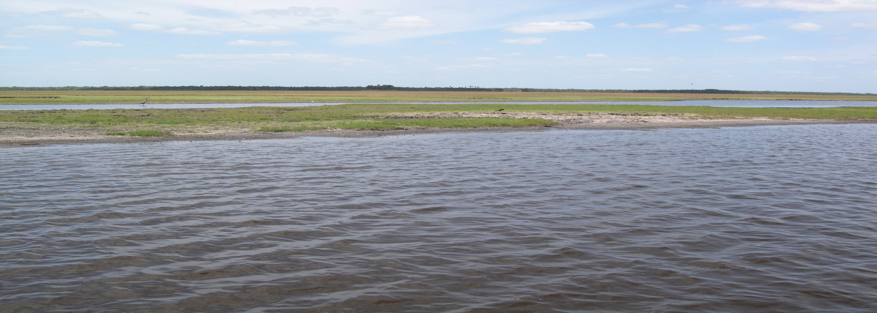
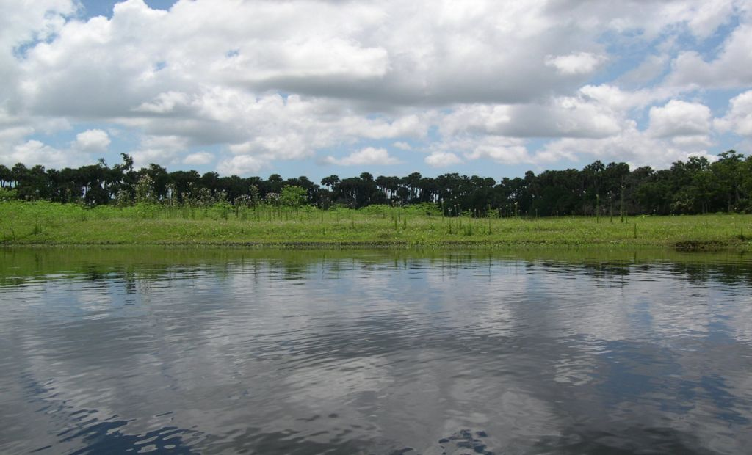

Middle St. Johns River:
Long Retention Time, Lentic taxa prevail, Lake Criteria Apply
Another View of the Middle St. Johns River

Slide 25
Discharge to Lake
Direct Receiving
Water:
Lake
Discharge
WQBEL achieves lake criteria*
Yes
No
*If there are multiple dischargers to the lake, existing loads are OK unless the direct receiving water (lake) or downstream water criteria are not achieved. If either criteria are not attained, then a Level II WQBEL is needed to establish effluent limits that do not cause or contribute to non-attainment
Reasonable Assurance*
Level II WQBEL for lake or downstream water protection

Slide 26
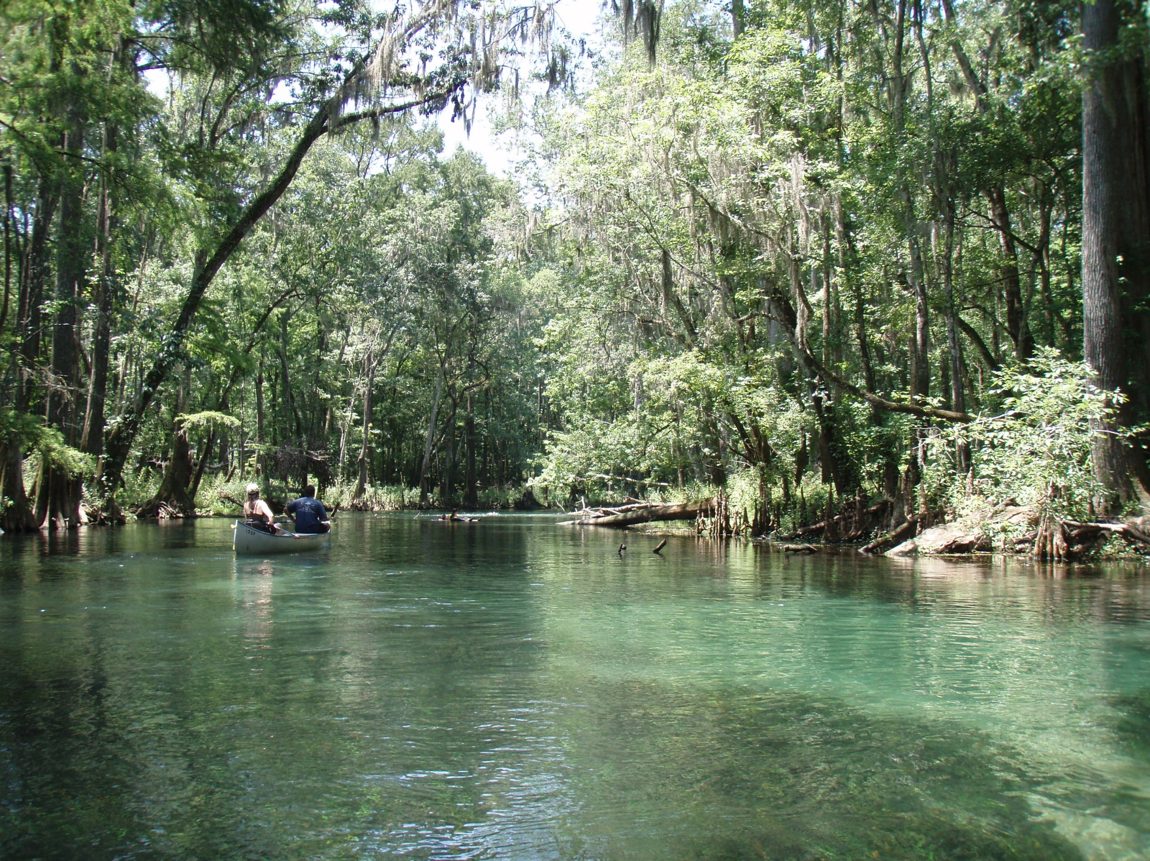
Hierarchy 2- Springs

Slide 27
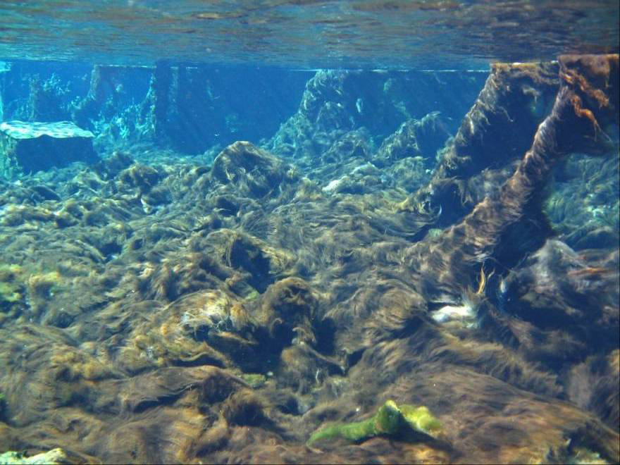
Nuisance Algal Mats in Springs
Weeki Wachee, 1950s;
Nitrate < 0.1 mg/L, Eel grass
Weeki Wachee, 2001:
Nitrate ~ 0.7 mg/L, Lyngbya mats
Applicable numeric interpretation of the narrative nutrient criterion is 0.35 mg/L of nitrate-nitrite as an annual geometric mean

Slide 28
Groundwater Discharge and Springs
As a permitting issue, the NNC for spring vents address land application more than NPDES permitting
Rule 62-520.310(2) F.A.C., states that, “Discharge to groundwater shall not impair the designated use of contiguous surface waters”
However, any causal relationship between the discharge and nutrients at downgradient springs is challenging to demonstrate

Slide 29
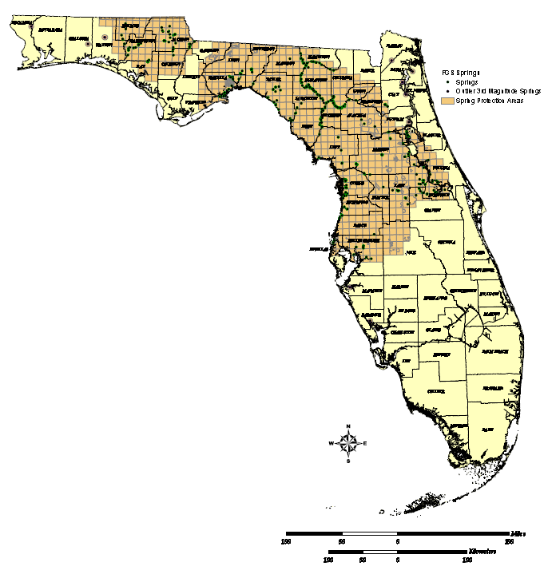
Springs Protection Areas
Factors to consider:
TN and TP values in Zone of Discharge (ZOD) based on groundwater monitoring data
Size of the discharge (small vs. large)
Distance from springs vent
Expected nutrient attenuation based on nature of the soil/aquifer matrix and nutrient concentrations in discharge
  Nitrate – very soluble, very little attenuation
  Phosphorus - attenuation in certain soils

Slide 30
Hierarchy 3
Numeric Interpretations of the Narrative Criteria FOR STREAMS

Slide 31
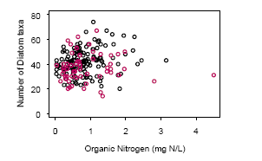
NNC for Streams
This is why DEP criteria
Include biology (EPA now supports DEP approach)
Looked extensively for cause-effect relationships between nutrients and biological responses, but they were insufficient to develop criteria
Established numeric thresholds based on “reference approach”, but because there is no link to impairment, Florida established broader evaluation of water chemistry and biological data (flora and fauna) to determine if a stream’s nutrient concentrations are protective

Slide 32
Hierarchy 3: Discharges to Streams
A stream is considered to be in compliance with its NNC if:
There are no imbalances in aquatic flora or fauna (based on chlorophyll a levels, algal mats or blooms, nuisance macrophyte growth, and changes in algal species composition (i.e. stream passes the aquatic flora bioassessment)
and either:
The average score of at least two temporally independent (>3 months apart) Stream Condition Index (SCI) monitoring events performed at representative locations and times is 40 or higher, with neither of the two most recent SCI scores less than 35 (i.e. stream passes the aquatic fauna bioassessment)
or:
TN and/or TP in the stream are less than or equal to the regional thresholds in subparagraph 62-302.531(2)(c)2., F.A.C. (i.e. stream TN and TP concentrations are sufficiently low)

Slide 33
Floral Metric Summary
Floral Metric | Evidentiary Threshold of No Imbalances (All Metrics Needed to Demonstrate Attainment)
Linear Vegetation Survey (LVS) Coefficient of Conservatism (C of C) | Site average > 2.5
LVS Florida Exotic Plant Protection Council (FLEPPC) | Site average < 25%
Rapid Periphyton Survey (RPS) | < 25% rank 4-6 coverage 20 to 25 % rank 4-6 coverage, evaluate algal autoecological data
Chlorophyll | < 20 ug/L; 3.2 to 20 ug/L = site specific
Algal Community Composition (Autecology) | No adverse shifts in dominant taxa

Slide 34
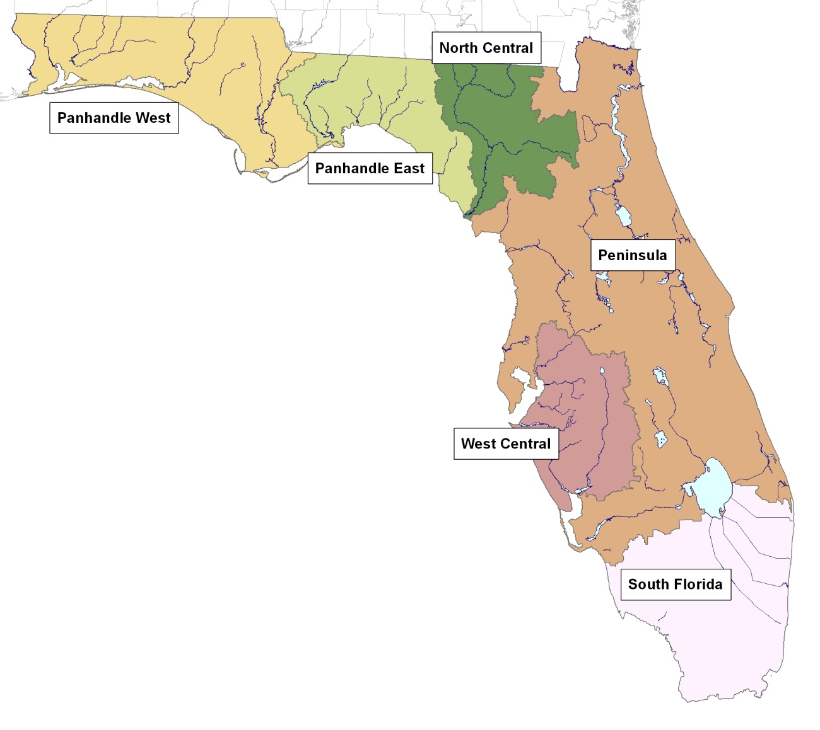
Streams Thresholds and Regions
Nutrient Region | Total Phosphorus Threshold | Total Nitrogen Threshold
Panhandle West | 0.06 mg/L | 0.67 mg/L
Panhandle East | 0.18 mg/L | 1.03 mg/L
North Central | 0.30 mg/L | 1.87 mg/L
Peninsula | 0.12 mg/L | 1.54 mg/L
West Central | 0.49 mg/L | 1.65 mg/L
South Florida | No numeric nutrient threshold. The narrative criterion in paragraph 62-302.530(47)(b), F.A.C., applies.

Slide 35
Discharge to Stream
Direct Receiving
Water:
Stream
Healthy flora AND thresholds achieved OR healthy flora AND healthy fauna (SCI >40)?
Discharge
Yes
No
Reasonable Assurance
Level II WQBEL

Slide 36
Hierarchy 4
Waters in which Only the Narrative Criteria Apply

Slide 37
Hierarchy 4: Narrative Criteria
Subsection 62-302.530(47) Narrative Nutrient Criteria
(47)(a) The discharge of nutrients shall continue to be limited as needed to prevent violations of other standards contained in this chapter. Man-induced nutrient enrichment (total nitrogen or total phosphorus) shall be considered degradation in relation to the provisions of Rules 62-302.300, 62-302.700, and 62-4.242, F.A.C.
(47)(b) In no case shall nutrient concentrations of a body of water be altered so as to cause an imbalance in natural populations of aquatic flora or fauna.

Slide 38
Hierarchy 4: Narrative Criteria
Definitions of “lake” and “stream” exclude the following:
  Wetlands (see definitions in Subsections 62-302.200(16) and (36), F.A.C., for “lake” and “stream,” respectively);
  Non-perennial water segments (see Subsection 62-302.200(36), F.A.C.);
  Ditches, canals and other conveyances or segments of conveyances that are primarily used for water management purposes and have marginal or poor stream habitat components (see Subsection 62-302.200(36), F.A.C.).
However, Permittee or DEP must document that a water is excluded from categories covered by numeric criteria
  see p 49-57 Implementation Document

Slide 39
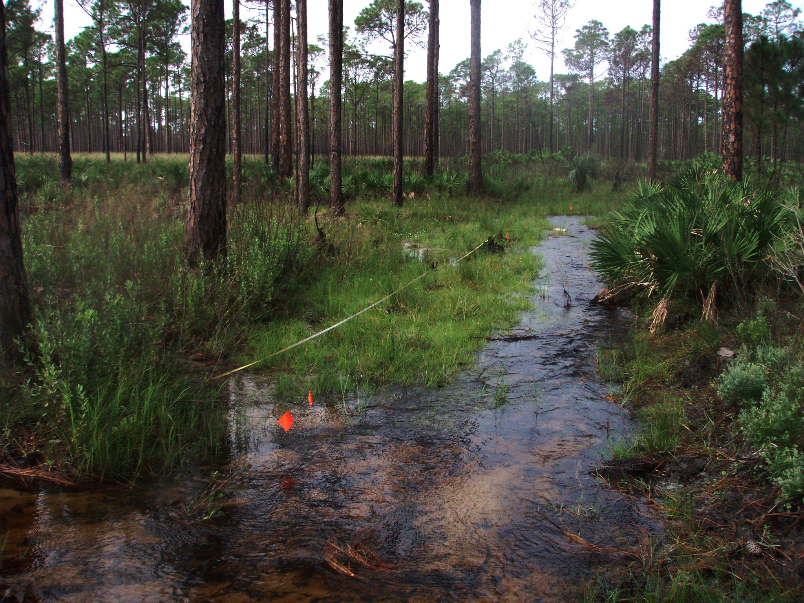
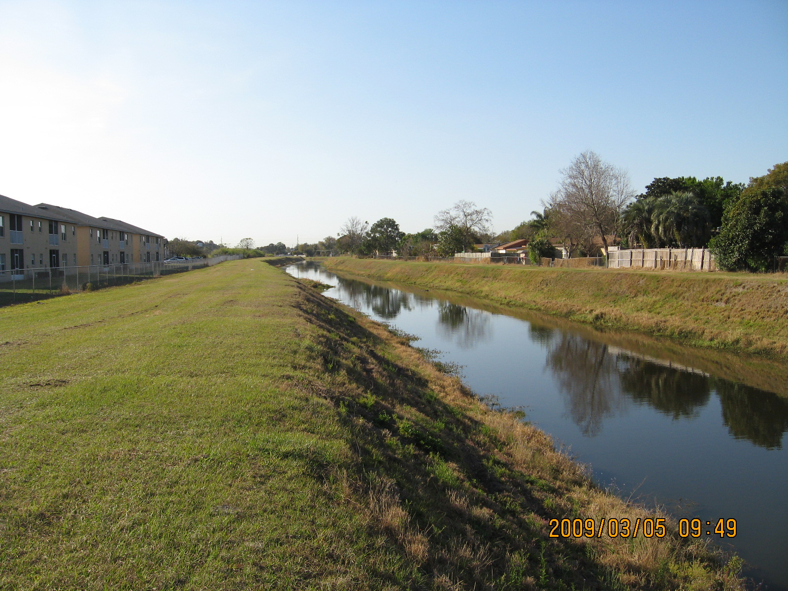
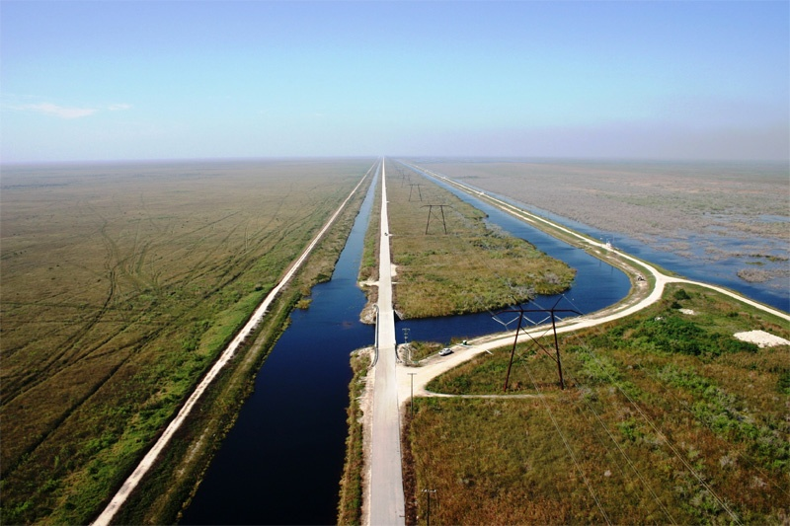
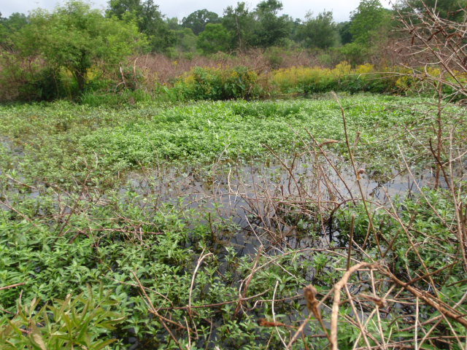
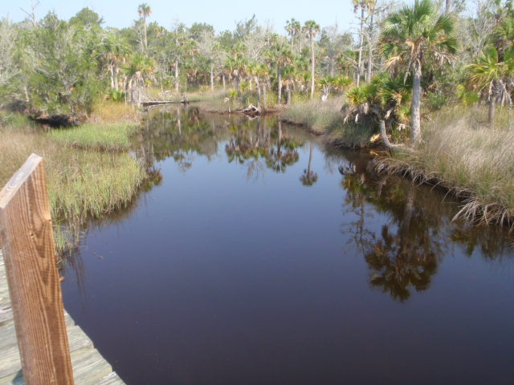
Hierarchy 4: Narrative Criterion Applies to these waters
Non-perennial system
Maintained Conveyance
South Florida Canals
Wetland
Fluctuating Salinity

Slide 40
How to Identify Waters Subject Only to the Narrative Criterion (see pages 49-56)
First, determine the boundaries of the waterbody segment
  Upstream and downstream extent of the segment
  Physical, chemical biological information
Non-perennial streams – based on biological evidence
  vascular plants and benthic macroinvertebrates show dominance of taxa more typically found in wetland or terrestrial conditions
Tidally influenced streams – fluctuate between marine and fresh
  chloride or specific conductance data collected during typical hydrologic conditions, taking into account tidal cycles and seasonal and climatic variability
Wetlands – typically minimal open water area
  wetlands routinely go dry, therefore desiccation is dominant stressor
  Wetland taxa prevail

Slide 41
How to Identify Waters Subject Only to the Narrative Criterion
Water management conveyances – artificial, or altered streams
  the current purpose of the man-made or physically altered conveyance is primarily water management such as flood protection, stormwater management, irrigation, or water supply. Use photos, local agreements, permits, memoranda of understanding, contracts, etc.
  Designed/maintained for primary water management purpose
  marginal or poor stream habitat limiting biological function (evaluated using the DEP Habitat Assessment SOP); i.e. trapezoidal, armored banks, or maintained for water conveyance.
If used for navigation or boat access to an adjacent waterbody, or other frequent recreational activities such as swimming or boating, then the primary purpose is not water management and nutrient stream standards apply
  Canals developed to provide boat access to waterbodies are an example of a navigation or access as a primary purpose

Slide 42
DOWNSTREAM PROTECTION

Slide 43
Reasonable Assurance for Nutrients
Permittee must demonstrate reasonable assurance that nutrient standards are attained in direct receiving waters and downstream waters
Direct receiving water has Hierarchy 1 interpretation
Direct receiving water is a lake/spring
Direct receiving water is a stream
Narrative applies to direct receiving water
Downstream waters protection. Could range from Hierarchy 1 waters (including estuaries), to lakes/springs, to streams, or potentially to systems where the narrative would continue to apply
Reasonable Assurance

Slide 44
Downstream Waters Protection (cont.)
If downstream waters currently attain nutrient standards, then current discharge provides for downstream protection
However, if the facility requests an increase in their permitted load, a Level II WQBEL may be needed to evaluate the impacts on downstream waters
  Modeling can be used to determine the acceptable loading of nutrients from the discharger (and other upstream sources) that protects downstream waters
  Level II WQBEL not needed if simple mass-balance approach demonstrates there is no reasonable potential at higher load

Slide 45
Downstream Waters Protection (cont.)
If any downstream water does not currently attain nutrient standards, then need to determine if
  Any downstream TMDLs address the discharge
    If a TMDL provides a waste load allocation (WLA), can presume downstream protection if the effluent limitation is set at the WLA
  Alternatively whether the discharge has reasonable potential to cause or contribute to the downstream nutrient impairment
Reasonable potential analysis is site-specific, and should take into account nutrient load, flow, and frequency of the discharge
  For example, there is no reasonable potential if the effluent nutrient load is not a significant contributor to the downstream water

Slide 46
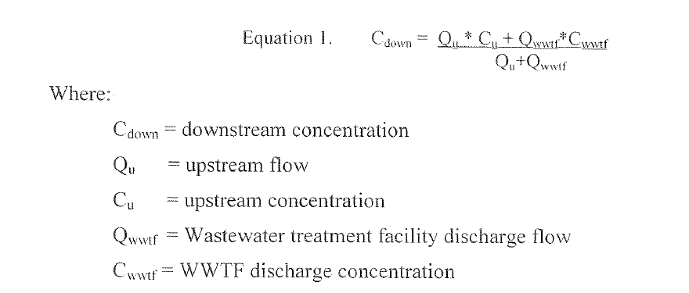
Nutrient Mass Balance Equation
Reasonable Potential Analysis could be as simple as mass balance calculation

Slide 47
Discharge to Excluded Water to Stream
Direct Receiving
Water:
Ditch/canal, wetland, intermittent stream
Narrative applies to excluded waterbody
Discharge
Healthy flora AND thresholds achieved OR healthy flora AND healthy fauna (SCI >40) both direct receiving water and downstream?
Downstream Waters: Nearfield stream and segment until where discharge is not a significant component of load
Yes
No
Reasonable Assurance
Level II WQBEL

Slide 48
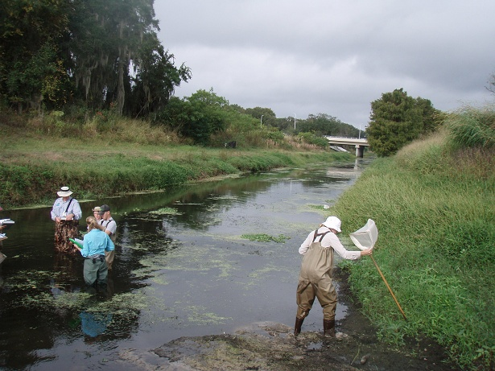
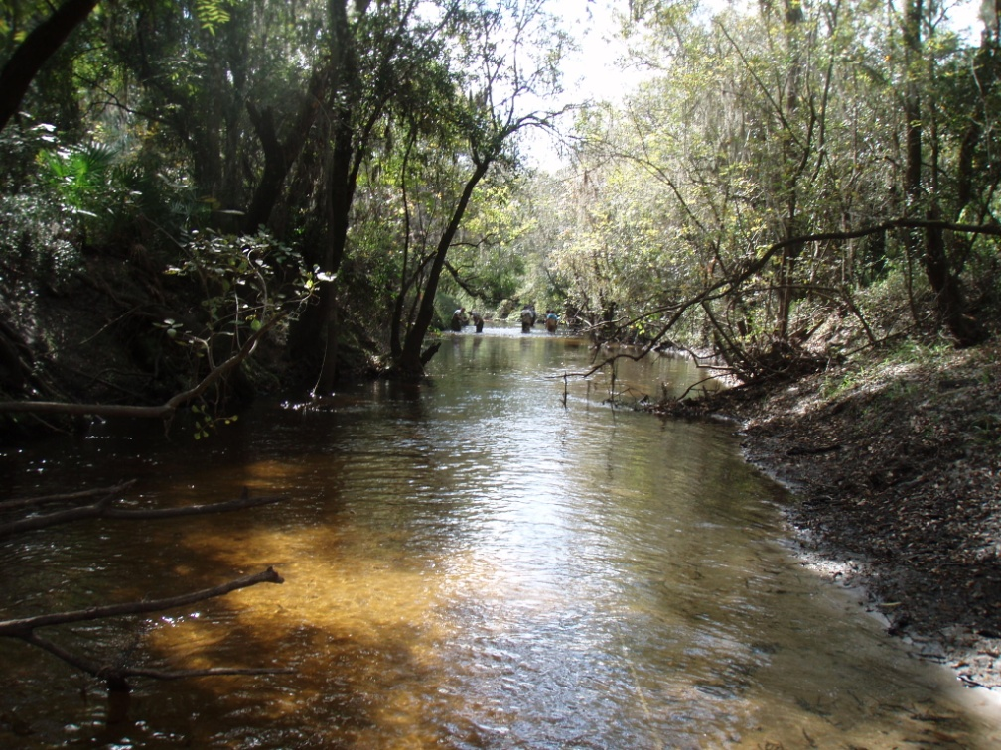
Must ensure that Downstream Stream Has healthy Flora and Achieves Thresholds or Has Healthy Flora AND Fauna
Narrative Applies in Ditch

Slide 49
Discharge to Hierarchy 1 to Downstream Hierarchy 1
Direct Receiving
Water:
Has Nutrient TMDL, SSAC or Estuary Specific,
or RA
Discharge
Effluent Limits must achieve Hierarchy 1 interpretation in direct receiving waters*
Downstream Waters: Additional Hierarchy 1 Interpretations * farther downstream
If more stringent, apply these guidelines to the discharger
*Hierarchy 1 Interpretations in streams take precedence over generic stream criteria (flora and fauna)
Notes:
Bottom right box, Should this say “If more stringent, apply these guidelines to the discharger”
Question:
If you have this scenario do you also need to have data on the biology?

Slide 50
Discharge to Excluded Water to Estuary (or Site Specific Criteria)
Direct Receiving
Water:
Ditch/canal, wetland, tidally fluctuating, intermittent stream
Narrative applies to excluded waterbody
Discharge
Analysis to ensure achievement of the specific TN and TP levels/loads and chlorophyll a target for the estuarine segment during all years, including years representing critical conditions. This evaluation would involve water quality modeling set to achieve a “never to exceed” scenario.
Downstream Waters: Estuary/SSAC

Slide 51
Implementation in Permits

Slide 52
Straight Renewal
No New or Expanded Discharge
Hierarchy 1 – Site-Specific Numeric Interpretation
The easiest (and most familiar) scenario is that the H1 includes a WLA for the facility
  Permit must implement WLA for TMDLs and Level II WQBELs, and can be expressed as load (typically rolling 12-month total) and/or concentration
For discharge to a water with a H1 and water attains the NNC:
  Maintain current load limit (need to evaluate further if permitted load much greater than current load); or
  If there is no established limit (report only), determine the current load (site-specific statistical analysis that takes into account effluent variability) and use as the limit

Slide 53
Straight Renewal – No New or Expanded Discharge (continued)
If receiving water does not attain the Hierarchy 1 interpretation (and a WLA is not available for the facility), TMDL or Level II WQBEL is needed
  Can renew permit with AO that provides time to determine appropriate effluent limit (discussed in more detail later)

Slide 54
Straight Renewal – No New or Expanded Discharge (continued)
Hierarchy 2 -- Lakes
If lake currently attains criteria, the permit TN and TP effluent limit will be based on current loading
  Maintain current load limit (hold the line) or
  If no load limit, maintain actual current loading or conduct Level II WQBEL
If lake does not attain criteria (including chlorophyll), a Level II WQBEL (Bathtub model) will be needed to develop effluent limits that do not cause or contribute to the non-attainment
  Issue permit with Administrative Order providing time to conduct the Level II WQBEL
  WQBEL will identify other nutrient inputs to lake
  Include final limits in the permit referencing 62-302.531(2)(b)1.

Slide 55
Straight Renewal – No New or Expanded Discharge (continued)
Hierarchy 3 (Streams) – No New or Expanded Discharge
If stream currently attains criteria, the permit TN and TP effluent limit will be based on current loading
  Maintain current load limit (hold the line) or
  If no load limit, maintain actual current loading or conduct Level II WQBEL
Permit applicants responsible for providing data needed to demonstrate attains criteria as part of general responsibility to provide reasonable assurance that discharge will comply with applicable WQS
  Data showing stream meets floral measures, and either SCI or stream thresholds
  DEAR staff are including bioassessment (floral metrics and SCI) in 5th Year Inspections and will work with Permittees to identify data needs for renewal and existing data from other sources
  If data are unavailable, inconclusive or negative, use AO to provide time to collect data

Slide 56
Straight Renewal – No New or Expanded Discharge (continued)
Hierarchy 4 – Waters in which only the narrative criterion applies
Narrative should have been addressed in previous permit review, and standard review practice for renewals should continue to apply
TN and TP effluent limits will be based on current loading
  Maintain current load limit (hold the line) or
  If no load limit, maintain actual current loading or conduct Level II WQBEL
However, in many cases, a downstream waterbody will have an applicable NNC, and need to address protection of downstream waters

Slide 57
Straight Renewal – No New or Expanded Discharge (continued)
In the Fact Sheet
Under “Changes from the previous permit”
  Note the changes to new nutrient criteria and cite the applicable nutrient standard for the permit from 62-302.530, .531, or .532
  If applicable, also cite rule references from 62-304 (TMDL), 63-302.800 (SSAC), etc.
  If the existing discharge is already meeting a WLA or other Hierarchy 1 requirement, or if the current discharge is acceptable under Hierarchies 2-4, explain the situation and briefly explain why current discharge meets rule requirements
Under “Administrative Orders and Consent Orders””
  If an AO is issued with the permit, briefly describe the reasons and work to be completed under the AO
  Fact Sheet language is already covered in Permit Builder and in Standard Permit Conditions

Slide 58
New or Expanded Discharge
If a new or expanded discharge, a Level II WQBEL may be needed to evaluate the impacts on direct receiving water and downstream waters
  Modeling can be used to determine the acceptable loading of nutrients from the discharger (and other upstream sources) that protects downstream waters
  Level II WQBEL not needed if simple mass-balance approach demonstrates there is no reasonable potential
Rule 62-302.300(7), F.A.C., requires all new or expanded surface water discharges to meet antidegradation requirements

Slide 59
NNC Administrative Order (AO)
Statutory basis for AO -- 403.088(2)(e)-(f), F.S.
Reasonable assurance may not be achieved based on information provided with the renewal application
The statute enables DEP to issue AO providing the Permittee a reasonable amount of time to comply with new permit requirements, provided that
  The AO is issued with a permit renewal or revision; and
  The facility is in compliance with current permit requirements and applicable statutes and rules

Slide 60
Needed in the Permit and AO
Permit includes:
  Reference to AO
  Final limits for hierarchy 1 use WLA, or applicable site-specific limitation, for hierarchies 2 or 3 reference applicable NNC Rules in 62-302.531, 62-302.532, and 62-302.300(19), F.A.C.
  Standard reopener
AO includes:
  Interim limits – hold the line
  Description of the steps leading to compliance with NNC
  Schedule to demonstrate compliance with NNC, including
    Necessary monitoring and analyses
    Specific date when compliance with NNC must be attained

Slide 61
NNC Administrative Order (AO)
Example actions required under an AO (under “It Is Ordered”)
  Engineering modifications to the facility and treatment systems to reduce nutrients in the discharge
    Engineering feasibility evaluation of alternatives such as modifications to the treatment system, process or facilities to achieve compliance with the NNC
    Schedule for implementing one or more feasible options including, for example, start and completion dates and appropriate milestones for testing, design, construction, operation, etc.
  Level II WQBEL if receiving waterbody and/or downstream water do not attain NNC, or for expanded discharge
    Plan of Study (Plan) for a Level II WQBEL pursuant to Rule 62-650.500, F.A.C.
    Public notice of study plan
    Schedule for completion of all study activities, report and status reports
  Water quality evaluation other than a Level II WQBEL
    Plan of Study for bioassessment, nutrient monitoring, in-stream water quality, calculation or modeling to evaluate reasonable potential to cause or contribute, etc. and final report with recommendations regarding compliance with NNC
    Schedule for completion of all study activities, final report and status reports

Slide 62
Other permitting considerations

Slide 63
Renewal Applications Currently Processing
Approximately 40 applications for renewal and substantial revisions for NPDES individual wastewater in-house October 24, 2014
  Stage of processing ranges from awaiting fee verification to NOI issued
Subsection 62-620.620(1),F.A.C., states:
  Permit conditions shall be based on relevant statutory or regulatory provisions in effect prior to the final administrative disposition of a permit.
Department and EPA Region 4 are discussing NNC implementation for these permit applications

Slide 64
Continuous and Non-Continuous Discharges
Paragraph 62-620.620(2)(e),F.A.C., states:
(e) Non-continuous discharges. Non-continuous discharges shall be particularly described and limited, considering the following factors, as appropriate:
1. Frequency;
2. Total mass;
3. Maximum rate of discharge of pollutants during the discharge; and
4. Prohibition or limitation of specified pollutants by mass, concentration, or other appropriate measure.
Should take these factors into account when evaluating non-continuous discharges
  Whether there is reasonable potential to exceed the NNC, especially those expressed as an annual geometric mean, and
  Appropriate effluent limitations, which can be expressed as a load to provide operational flexibility, but may need a concentration limit too

Slide 65
Where to find nutrient criteria information

Slide 66
Sources of Information
Can get information about adopted nutrient TMDLs from TMDL Tracker
  http://www.dep.state.fl.us/water/watersheds/assessment/tmdl-tracker.htm
List of Nutrient TMDLs on Water Quality Standards Program website
  http://www.dep.state.fl.us/water/tmdl/final_tmdl.htm
Can get adopted NNC from Chapter 62-302.532
  https://www.flrules.org/gateway/ChapterHome.asp?Chapter=62-302
If estuary not addressed in Chapter 62-302, look at August 1 Report to Governor
  http://www.dep.state.fl.us/water/wqssp/index.htm

Slide 67
Additional Information Sources
TMDL webpage
  http://www.dep.state.fl.us/water/tmdl/final_tmdl.htm
FDEP Biological Data Base
  Biologists (access to S-Bio); Tallahassee (WQAP, AEQA, Biology Section
USGS for flow information
  http://waterdata.usgs.gov/fl/nwis/rt
62-304 for looking up TMDLs
  https://www.flrules.org/gateway/ChapterHome.asp?Chapter=62-304
FDEP Map Direct
  http://www.dep.state.fl.us/gis/
IWR Runs
  http://publicfiles.dep.state.fl.us/dear/IWR/

Slide 68
Additional Information Sources
DEP SOPs for collecting Biology and Water Quality data
  http://www.dep.state.fl.us/water/sas/sop/index.htm
Level II WQBELS for multiple and single discharges
  See TMDL Section
Watershed Assessment Complete List of Verified Waters
  http://www.dep.state.fl.us/water/watersheds/assessment/a-lists.htm#vl
Reasonable Assurance Plans
  http://www.dep.state.fl.us/water/watersheds/rap.htm

Slide 69
Ditches, Canals, and other Conveyances
Habitat Assessment (DEP SOP FT 3000, see http://www.dep.state.fl.us/water/sas/sop/sops.htm) used to establish:
  Degree of Artificial Channelization
  Substrate Diversity and Availability
  Overall score

Slide 70
Additional Information Sources
DEP Groundwater Resources
Contact Rick Hicks: 850-245-8229
  Richard.W.Hicks@dep.state.fl.us
Can assist permitting staff with evaluations such as determining reasonable potential for land application discharges to affect spring vents
Springs BMAPs available at:
  http://www.dep.state.fl.us/water/watersheds/bmap.htm

