Slide 1
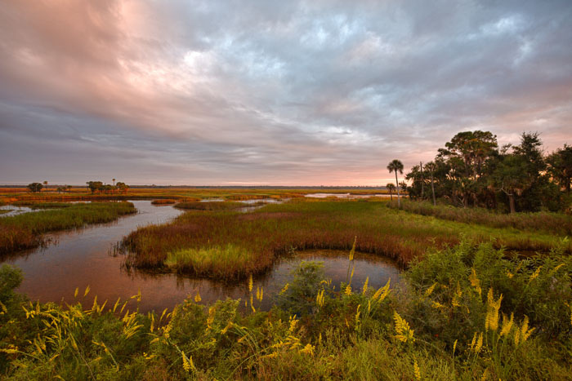
Environmental Resource Permit Reviews for Fish & Wildlife
Florida Fish and Wildlife Conservation Commission
Division of Habitat and Species Conservation
Office of Conservation Planning Services
Notes:
Photo cover: Hickory Mound at Big Bend Wildlife Management Area (FWC)
Illustrations by AnnMarie Tavares (FWC)

Slide 2

Questions for ERP Processors
Why request comments on ERP applications from FWC?
What ERP projects does FWC not review?
How are comments from FWC requested?
When will comments be received back from FWC?
What does FWC do with a request for comments on ERP applications?
Who in FWC reviews ERPs?
What is FWC staff looking for in an ERP request for comment?
How can applicants expedite FWC ERP review?
Why do FWC agency comment letters read that way?
What’s new with FWC fish and wildlife conservation?
How do I find out more about protecting Florida’s fish and wildlife?

Slide 3
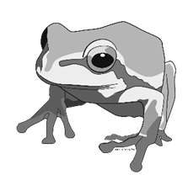
Why request comments from FWC?
For fish and wildlife species and habitat expertise per Chapter 373, Florida Statutes
For federal consistency review under the Florida Coastal Management Program and the federal Coastal Zone Management Act.
For federal and state listed fish and wildlife species coordination to avoid unauthorized “take.”

Slide 4
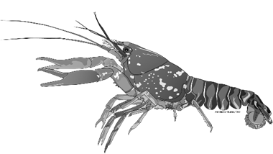
What ERP projects does FWC not review?
Wetland delineations – determinations of the landward extent of wetlands and other surface waters (formal, renewal, revocation, informal)
Permit transfers, partial releases of financial responsibility, final releases, transfers, removal and abandonment
Conversion to operation and maintenance
Exemptions (agriculture/forestry, single-family residential, arthropod control, swales, docks/piers…)

Slide 5
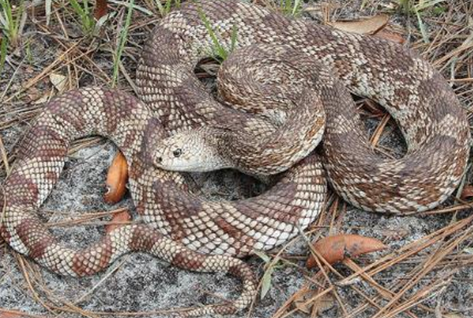
How are comments from FWC requested?
Email FWCconservationplanningservices@myfwc.com
Mail to
  Office of Conservation Planning Services
  Florida Fish and Wildlife Conservation Commission
  620 S. Meridian St., Mail Station 5B5
  Tallahassee, FL 32399-1600
Call or email CPS wildlife biologist (see map that needs updating)

Slide 6
Office of Conservation Planning Services (CPS)
CPS Office Director – Jennifer Goff
Land Use Planning Administrator– Fritz Wettstein
Biological Administrator II – Jason Hight
Fish & Wildlife Biological Scientists
- land use planning biologists
- transportation biologists
FWCConservationPlanningServices@MyFWC.com
Notes:
Projects are received through a “general correspondence” inbox (FWCConservationPlanningServices@MyFWC.com)
Projects are screened for appropriateness and logged into the FWC log
GIS analysis run for each project logged
Lead reviewer assigned for each project

Slide 7

When will comments be received back from FWC?
FWC “no comment” projects reported to DEP bi-weekly
30-day target timeline to complete review, issue letter
30-day timeline deferred for some RAI
Note: only one agency comment letter is typically sent, not both a formal RAI response plus a final letter

Slide 8
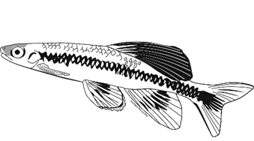
What does FWC do with a request for comments on ERP applications?
Project screened, logged into Project Tracking System (Log), materials uploaded to SharePoint, assigned to FWC Section; Section assigns “Lead” project reviewer.
Lead reviews application and runs GIS “ERA” to screen for potentially affected resources
  If minimal resources affected, recommends “no comment”
  If potential impacts identified, requests review by subject matter experts

Slide 9
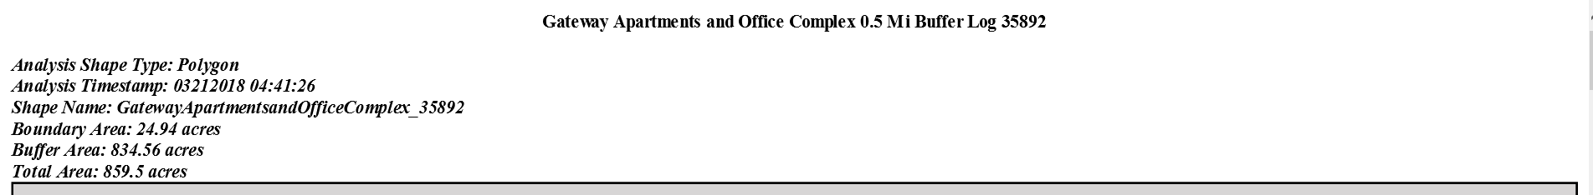
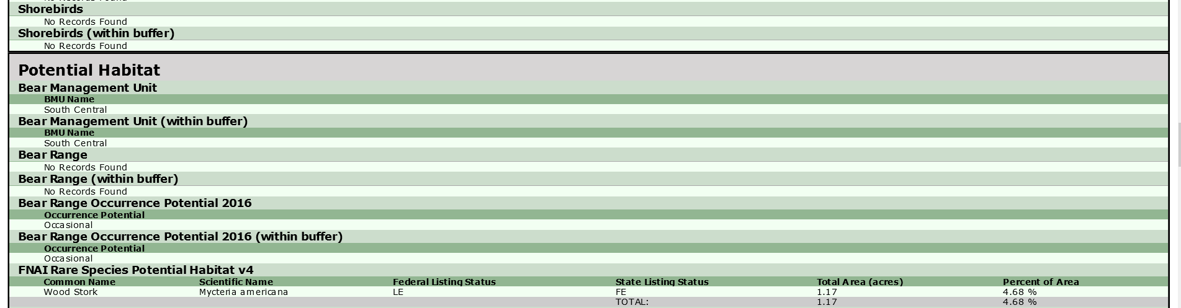
What does FWC do with a request for comments on ERP applications? (ERA)

Slide 10
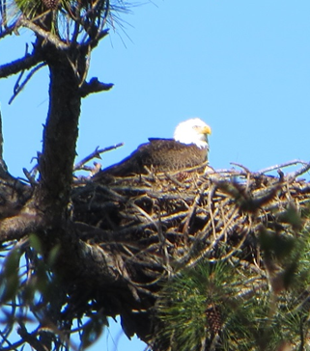
What does FWC do with a request for comments on ERP applications? (continued)
Subject matter experts (SMEs) coordinated within Sections by taxa coordinators or regional biologists
Lead continues application reviews
  Calls/emails ERP staff, consultants for additional info.
  Uploads additional information to SharePoint workspace
  Prepares landscape buffer, Google Earth KMZs
  Compiles SME input; drafts project description, assesses potentially affected resources, prepares comments/recs

Slide 11
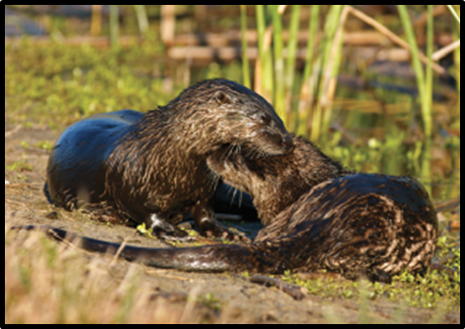
What does FWC do with a request for comments on ERP applications? (continued)
Section finalizes, approves and distributes letter
Note: if ERP issued, letter addressed to applicant
Lead closes project
  Receives, uploads issued ERP permit
  Completes in-house Conservation Survey locating and quantifying onsite preservation areas
  Continues technical assistance to ERP staff, permittee

Slide 12
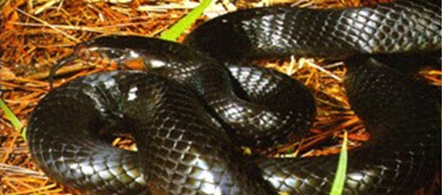
Who in FWC processes ERPs?
Judy Taylor-Fischer and Alex Lovern, Chelsea Kendall (ESIIs) monitor CPS in-box and log projects in
Mary Duncan in the Imperiled Species Management Section receives and assigns most in-water dredging & construction projects for manatee or sea turtle review by “murtle” ISM biologists. (see map)
Jason Hight in CPS receives and assigns the bulk of the remainder of ERPs (stormwater, interior wetlands, mitigation banks, mining, etc.)

Slide 13
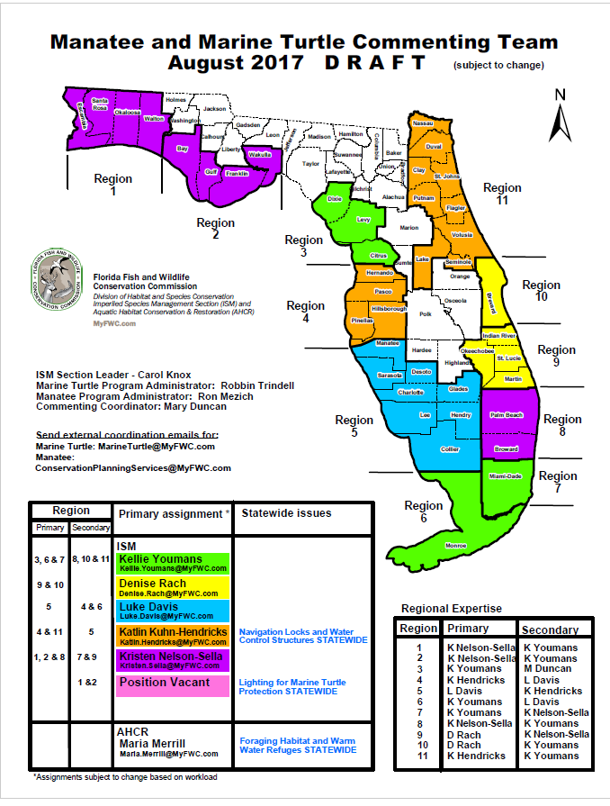
Imperiled Species Management Section
ISM Section Leader – Carol Knox
Marine Turtle Program Coordinator – Robbin Trindell
Manatee Program Coordinator - Ron Mezich
Commenting Coordinator – Mary Duncan
Marine Turtles
marineturtle@myfwc.com
Manatees
Conservationplanningservices@myfwc.com
Note: the old manatee FCMPmail@myfwc.com mailbox has been phased out. Sea turtle permits still handled separately.
Notes:
FCMPmail@myfwc.com mailbox is being phased out.
ISM staff serve as leads for many in-water projects where sea turtles and manatees are primary affected resources: dredging, powerplants
Work with the marine and estuarine subsection of AHCR
Marine Fisheries staff also frequently serve as lead handling fisheries related issues.

Slide 14
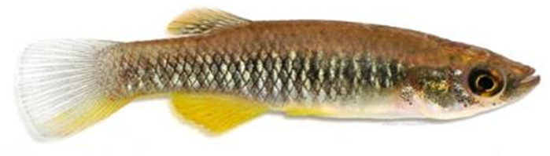
Who in FWC reviews ERPs? (continued)
Maria Merrill in Aquatic Habitat, Conservation and Restoration Section manages a lot of the wetland restoration, Living Shorelines type work
Lisa Gregg in Marine Fisheries Management handles coral relocation and saltwater fisheries special permits
Freshwater Fisheries Management staff handles dead-head logging permits
KOEBCC team work on S. Fla. Ecosystem projects

Slide 15
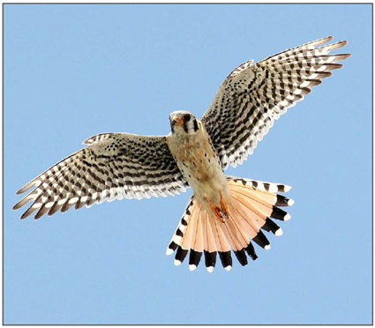
Who in FWC reviews ERPs? (continued)
CPS transportation biologists review FDOT ERPs
SMEs can be from any part of the agency, including the Florida Fish and Wildlife Research Institute
Species Conservation Planning SMEs look at the most projects for listed species coordination
Section Leaders and Directors approve and sign letters
Traci Wallace in CPS formats and distributes letters and produces bi-weekly ERP No Comment report

Slide 16
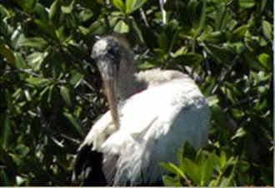
What is FWC staff looking for in an ERP request for comment?
“Potentially affected fish and wildlife resources” of listed and managed species, wildlife management areas and important habitats within project area
Types and timing of activities and impacts of land development or water conversion
History of development, agency reviews or wildlife permits within project area
Wildlife surveys and assessments, including methods
Proposed conservation measures
Notes:
FWC also looks for wildlife conflict, public safety and recreational resource issues.

Slide 17
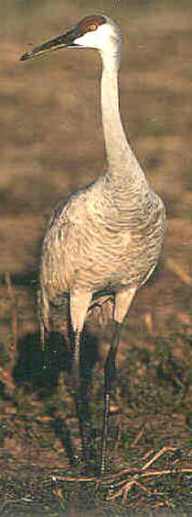
How can applicants expedite FWC ERP review?
Avoidance – don’t mess with high quality habitat!
Pre-application conferences – CPS and other FWC staff available to meet onsite, in meetings or on the phone
Documentation of previous FWC reviews, wildlife permits such as gopher tortoise relocation permits
Wildlife surveys per USFWS/FWC survey guidelines
Wildlife assessments including land cover classification for entire project area
Final preservation options, conservation areas

Slide 18

Why do FWC agency comment letters read that way?
Letter provides technical assistance, not authorization; federal consistency applies only to coastal counties
Information is minimal required to identify and locate project and proposed activities, identify potentially affected resources and provide comments and recommendations based on habitat suitability
Agency review covers all listed species within project boundaries to notify landowner of potential presence

Slide 19
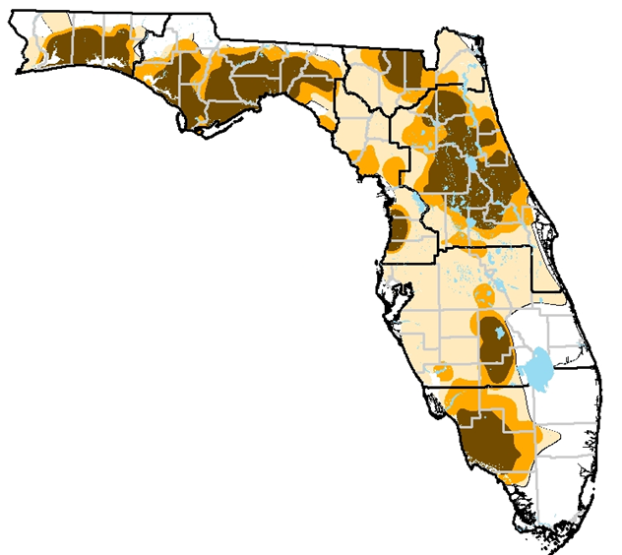
FWC Bear Comments
Important for safety of the public and bears
Bear ERA based on number of “bear calls” and road kills within buffer.
Bear commenting and project review language, recommendations, and data are updated annually

Slide 20
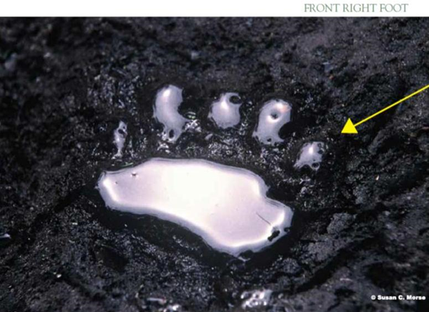
What’s new with FWC fish and wildlife conservation?
ERP review streamlining
  FWC no comment projects (ERP screening, NC reports)
  Standard RAI language and permit conditions under development
  CPS staff resources and training
  Bear only comments
Species Guidelines - 8 original, 8 new, 4 wading birds under development
Listed wildlife species that are aquatic or wetland dependent and that use upland habitats for nesting and denning

Slide 21
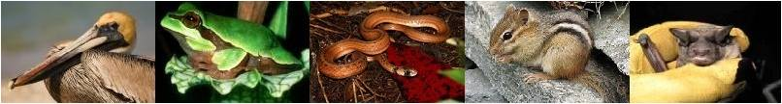
Imperiled Species Management Plan
The Commission developed a new Imperiled Species Management System in 2010 for 64 species
Federal and State Listed Species identified in Chapter 68A-27, F.A.C.
2016 Commission approved the Imperiled Species Management Plan
8 Species guidelines were approved at that time
Notes:
As part of the Imperiled Species Management Plan (ISMP) approval in 2016, staff was directed to create Species Conservation Measures and Permitting Guidelines (Guidelines) for all 57 species included in the ISMP. Eight Guidelines were approved in November 2016 and staff is now bringing an additional 8 Guidelines for Commission review. Guidelines contain information on species biology and habitat needs, identify what constitutes take through habitat modification, and provide guidance on survey methodology and voluntary conservation practices. The Guidelines outline activities not expected to cause take, methods for avoiding take and in some cases authorize take for certain activities such as emergency actions for human safety or certain forestry management activities. The Guidelines also provide options for achieving conservation benefit as required in Rule 68A-27.007 through a combination of minimization and mitigation when take cannot be avoided.
The Barbour’s Map Turtle, Florida Bog Frog, and Georgia Blind Salamander are proposed to change from SSC to Threatened.
The Alligator Snapping Turtle will remain SSC until we can make a determination on the status of the two new species in this range.
The Pine barrens treefrog is proposed to be removed from the list but is still protected from possession by our proposed rules.

Slide 22
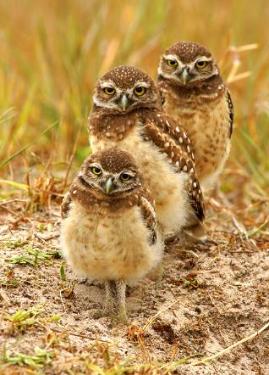
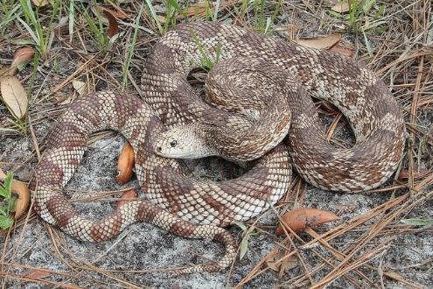
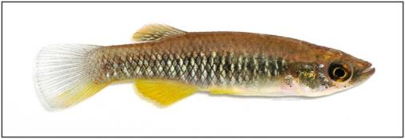
New Species Guidelines
Florida burrowing owl
Florida pine snake
Big Cypress fox squirrel
Barbour’s map turtle
Blackmouth shiner
Saltmarsh topminnow
Santa Fe Cave crayfish
Black Creek crayfish.
Notes:
All 8 species are state designated Threatened species, and in addition to their state listing status, most have some existing protections in place through cave protection statutes, Forestry and Wildlife Agricultural Best Management Practices, Florida Department of Environmental Protection requirements for Outstanding Florida Waters, and overlap with FDEP Environmental Resource Permitting.

Slide 23
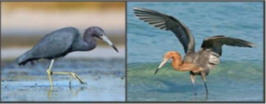
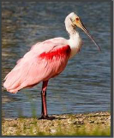
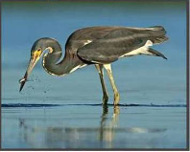
Proposed Species Guidelines -
Wading Birds
Little Blue Heron
Reddish Egret
Roseate Spoonbill
Tricolored Heron
Notes:
All 4 species are state designated Threatened species, and in addition to their state listing status, most have some existing protections in place through Forestry and Wildlife Agricultural Best Management Practices, Florida Department of Environmental Protection requirements for Outstanding Florida Waters, and overlap with FDEP Environmental Resource Permitting.

Slide 24
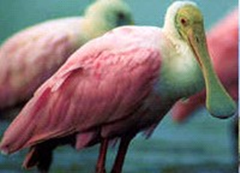
Helpful Information
Biological info:
  Essential behaviors/habitats/range
  Threats
  Specific “take” information
Conservation Measures and Avoidance
Survey methods and Mitigation options

Slide 25
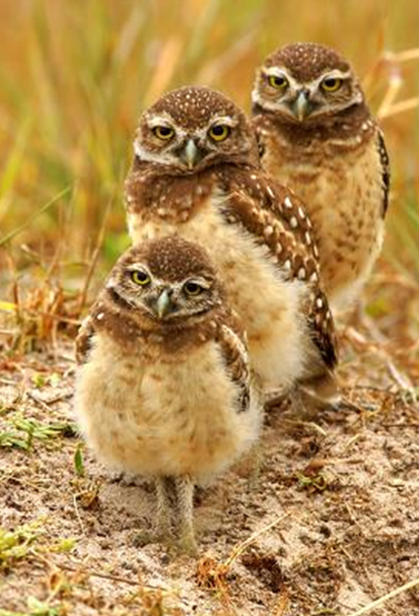
How do I find out more about protecting Florida’s fish and wildlife?
Florida Fish and Wildlife Conservation Commission Rules https://www.flrules.org/Gateway/Department.asp?DeptID=68
Imperiled Species Management Plan http://myfwc.com/wildlifehabitats/imperiled/plan/
Species Action Plans http://myfwc.com/wildlifehabitats/imperiled/species-action-plans/

Slide 26
How do I find out more about protecting Florida’s fish and wildlife? (continued)
Species Conservation Measures and Permitting Guidelines http://myfwc.com/wildlifehabitats/imperiled/species-guidelines/
Gopher Tortoise Permitting http://www.myfwc.com/license/wildlife/gopher-tortoise-permits/
Florida Wildlife Conservation Guide (http://myfwc.com/conservation/value/fwcg/
Florida Black Bear Management Plan http://myfwc.com/wildlifehabitats/imperiled/management-plans/

Slide 27
How do I find out more about protecting Florida’s fish and wildlife? (continued)
Manatees http://myfwc.com/wildlifehabitats/managed/manatee/permit-review/
Sea Turtle Lighting http://myfwc.com/conservation/you-conserve/lighting/
Breeding Bird Protocol for Florida’s Seabirds and Shorebirds https://public.myfwc.com/crossdoi/shorebirds/PDF-files/BreedingBirdProtocolForFloridasSeabirdsAndShorebirds.pdf.

Slide 28
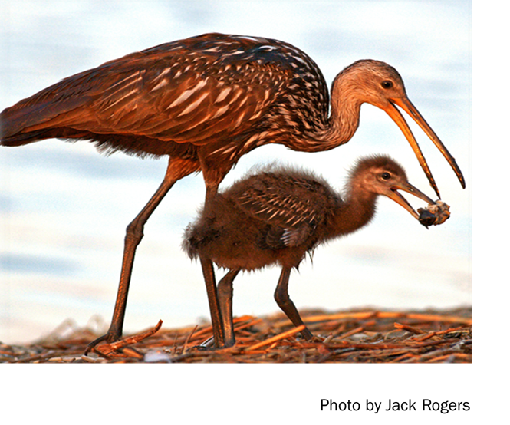
Questions?

Slide 29


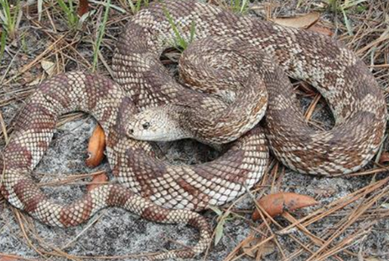

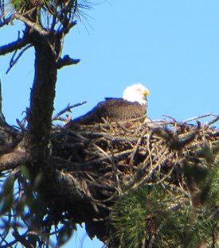


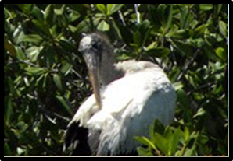
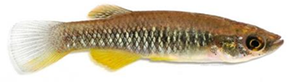
Listed wildlife species that are aquatic or wetland dependent and that use upland habitats for nesting and denning?

Slide 30

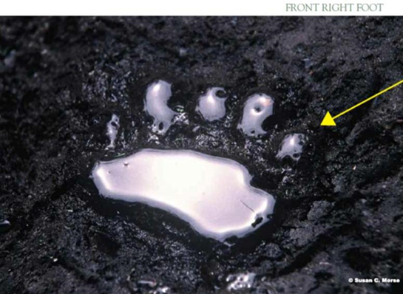
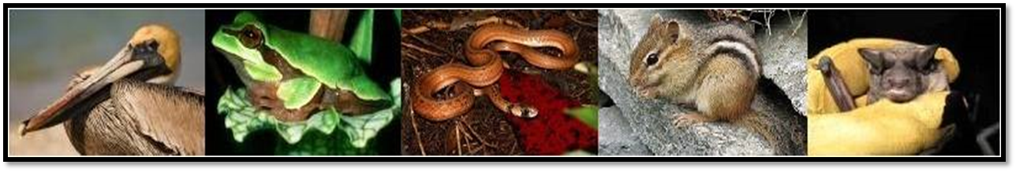
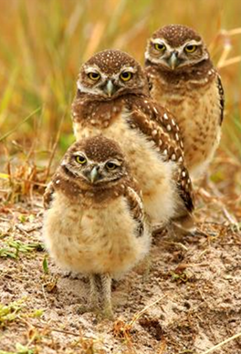
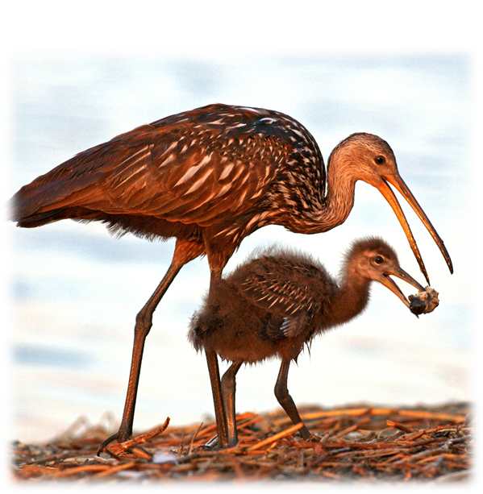



Listed wildlife species that are aquatic or wetland dependent and that use upland habitats for nesting and denning?

Slide 31
Contact Information:
Fritz.Wettstein@MyFWC.com
850/617-9408
http://myfwc.com/conservation/value/land-use-planning/

