Slide 1

How ERP Works with DHR
Jason Aldridge
Compliance Review Supervisor
March 21, 2018

Slide 2
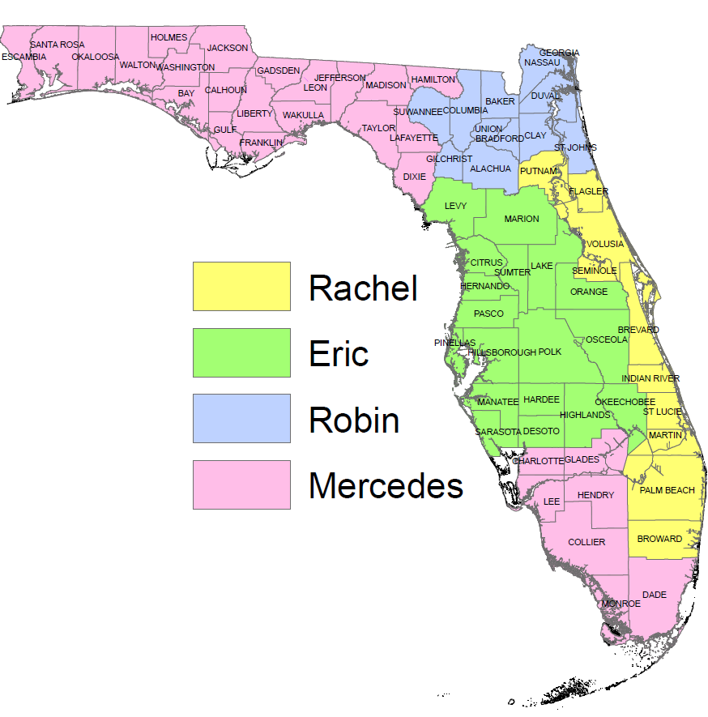
Division of Historical Resources:
Compliance Review Section
Compliance Supervisor
  Jason Aldridge
Review Staff for DEP and WMD
  Robin Jackson
  Mercedes Harrold
  Rachel Thompson
  Eric Griffis

Slide 3
Chapter 267, Florida Statutes
Created the Division of Historical Resources
  “Cooperate with federal and state agencies, local governments, and organizations and individuals to ensure that historic resources are taken into consideration at all levels of planning and development.”
  “Advise and assist, as appropriate, federal and state agencies and local governments in carrying out their historic preservation responsibilities and programs.”

Slide 4
Chapter 267, Florida Statutes
“Each state agency of the executive branch shall initiate measures in consultation with the division to assure that where, as a result of state action or assistance carried out by such agency, a historic property is to be demolished or substantially altered in a way which adversely affects the character, form, integrity, or other qualities which contribute to historical, architectural, or archaeological value of the property, timely steps are taken to determine that no feasible and prudent alternative to the proposed demolition or alteration exists, and, where no such alternative is determined to exist, to assure that timely steps are taken either to avoid or mitigate the adverse effects, or to undertake an appropriate archaeological salvage excavation or other recovery action to document the property as it existed prior to demolition or alteration.” – 267.061(2)(b), Florida Statutes

Slide 5
What are Historical Properties?

Slide 6
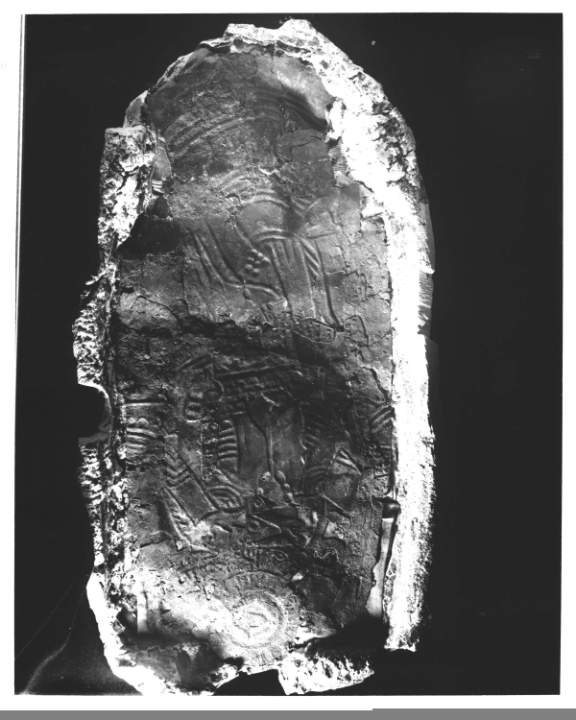
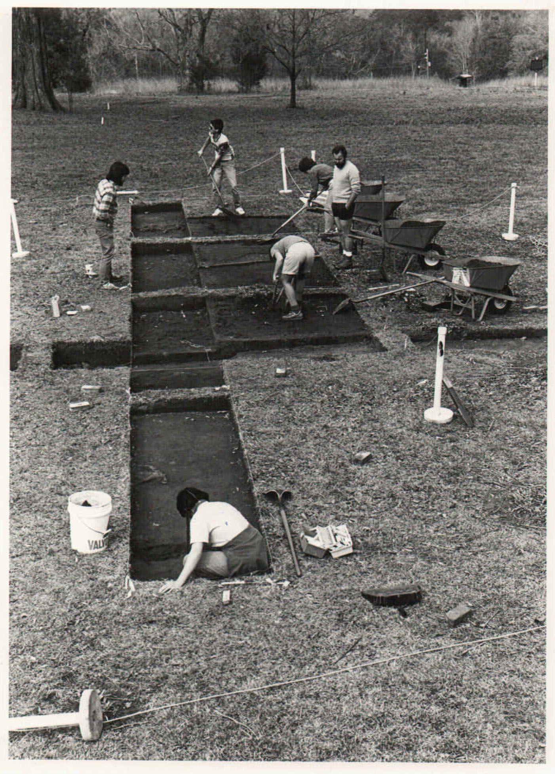
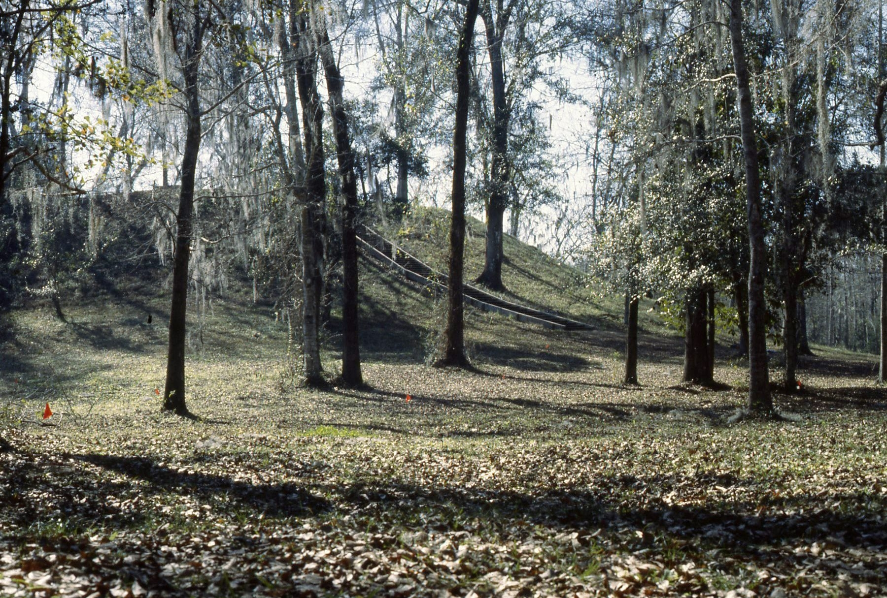
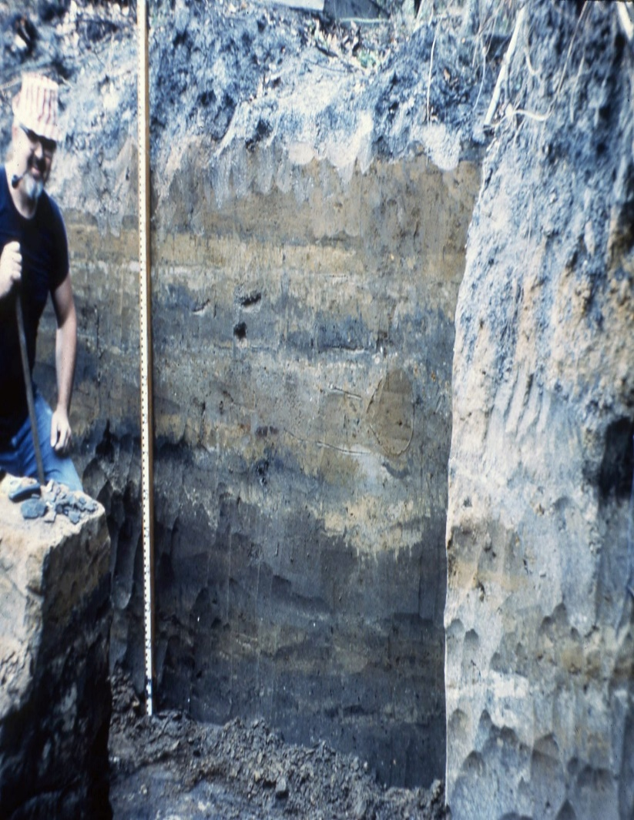
Archaeological Sites
Notes:
History of the Site File. Started at UF in 50s as Goggin’s inventory of AR sites. Moved around and came to State in late 60s early 70s

Slide 7
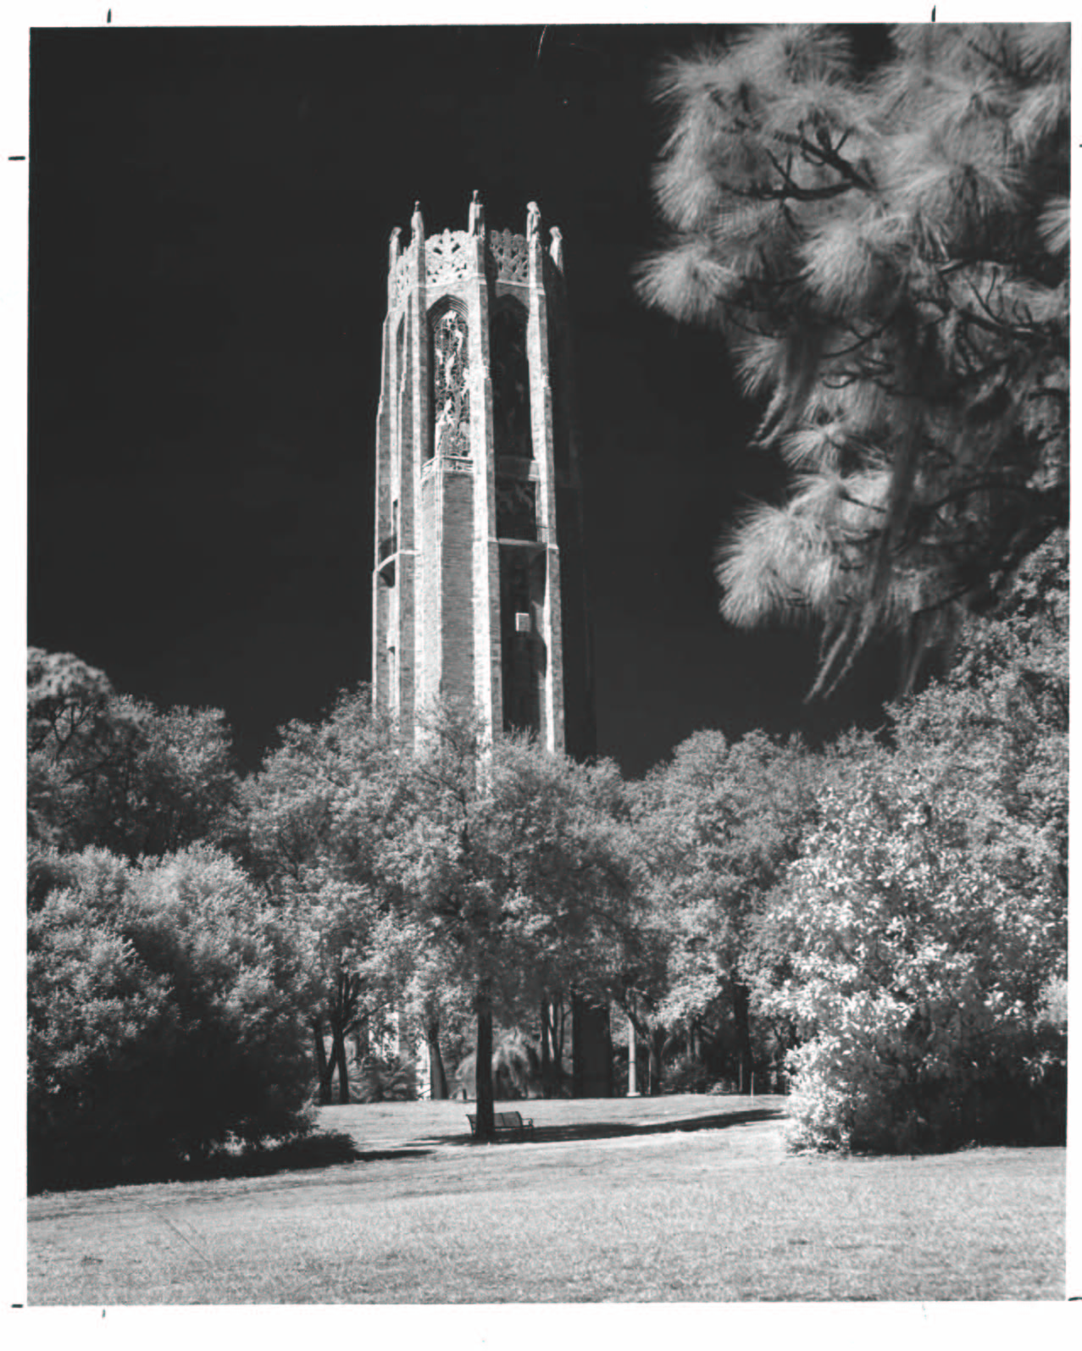
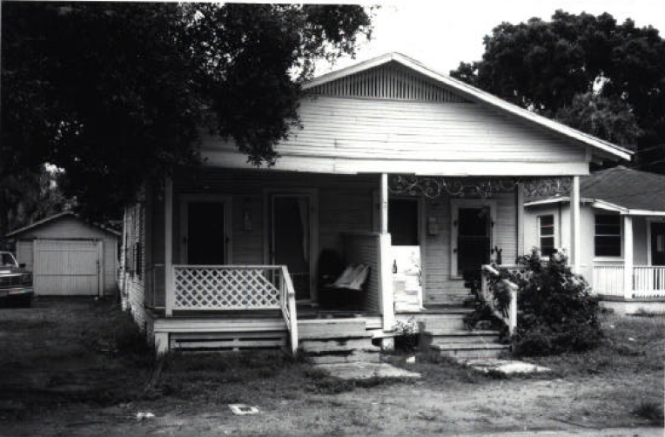
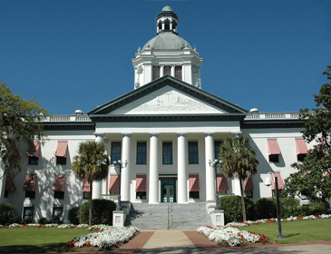
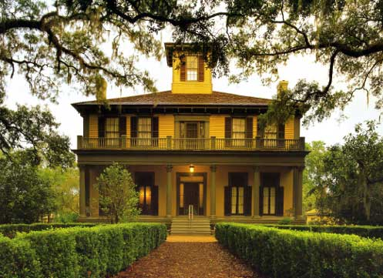
Historic Structures
Notes:
Historic Structures (Old Cap., Brokaw McDougall, Bok Tower). But also more mundane, vernacular structures (makes up the majority of resources recorded)

Slide 8
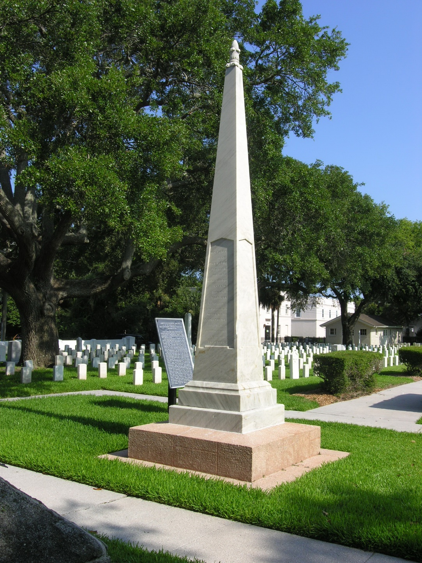
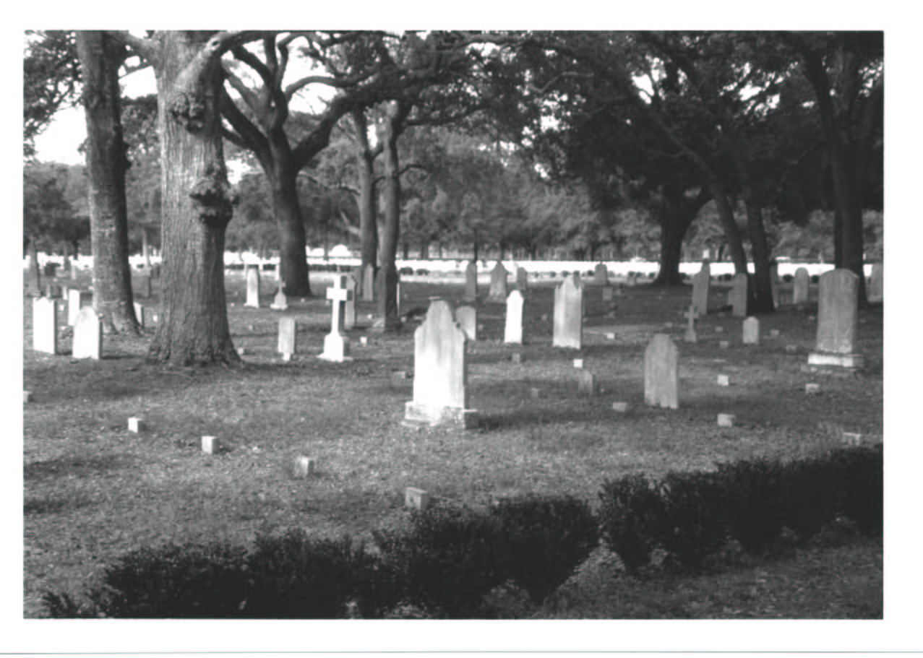
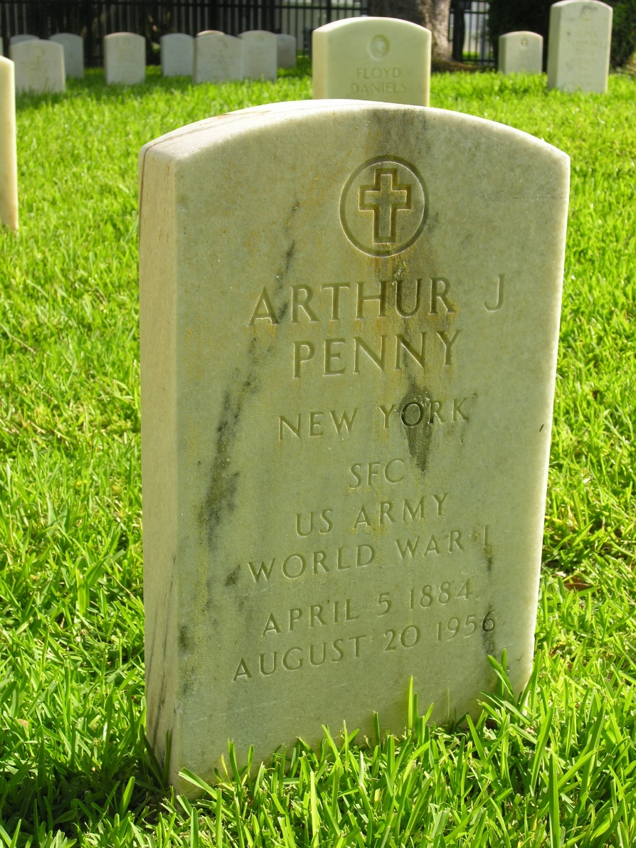
Historic Cemeteries

Slide 9
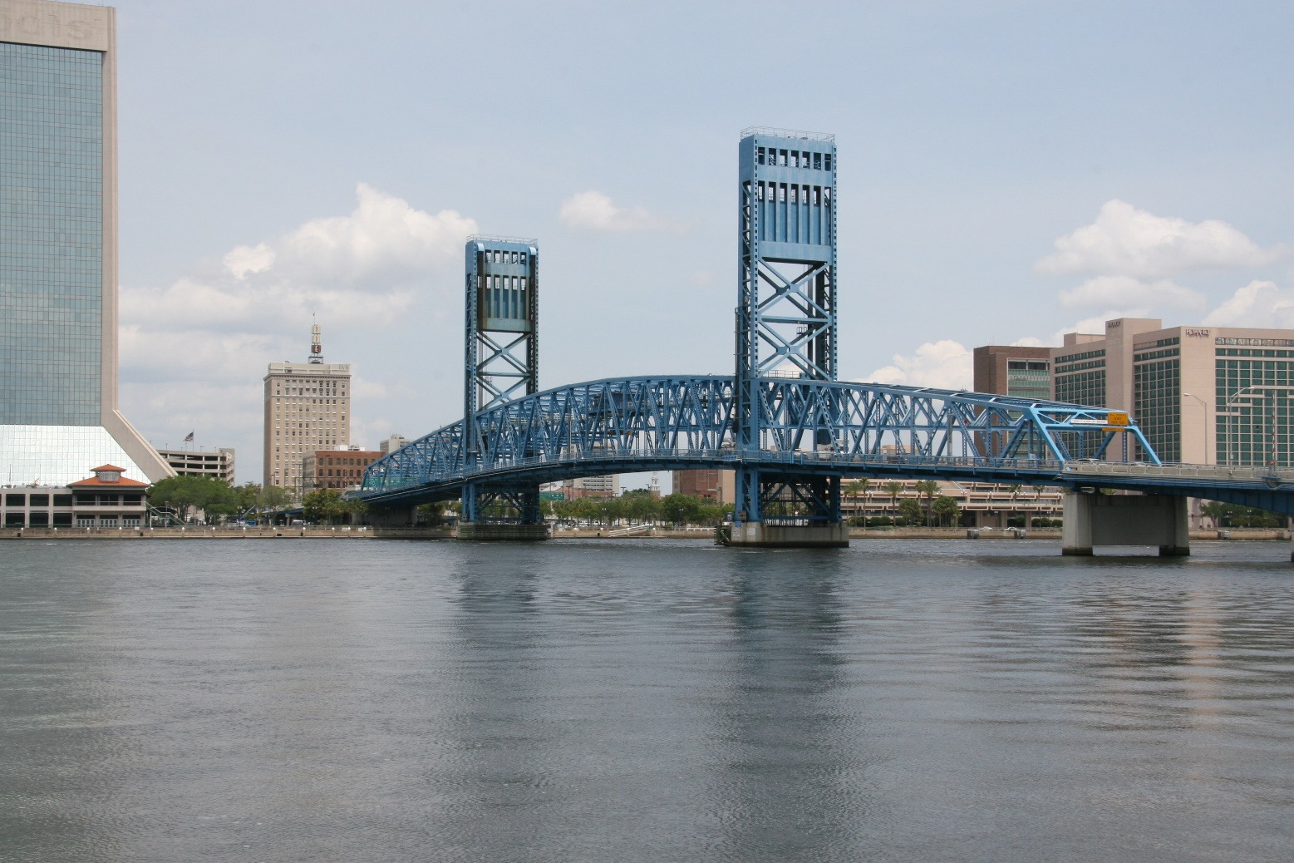
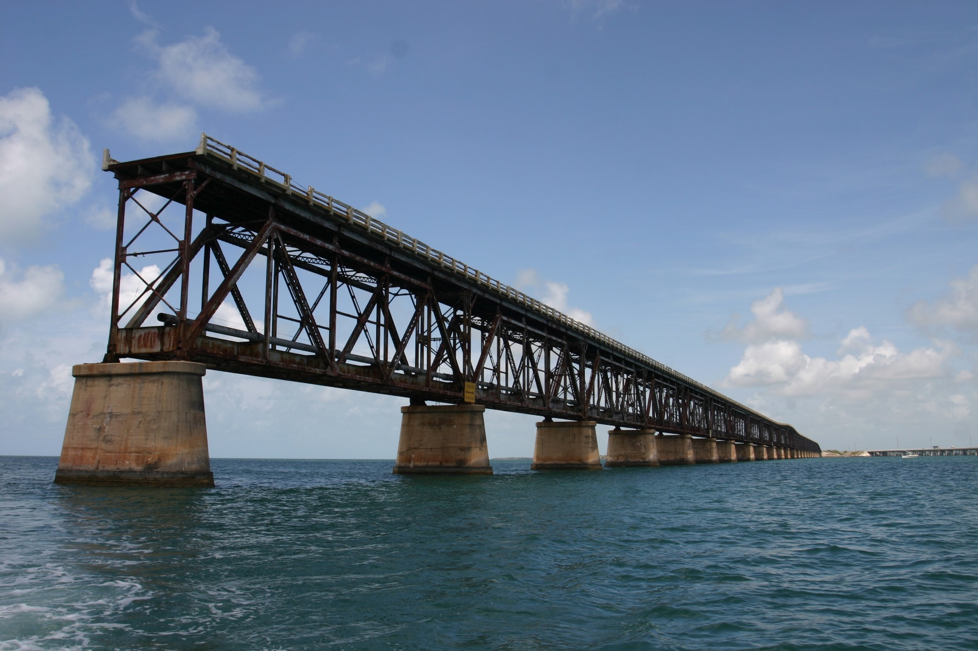
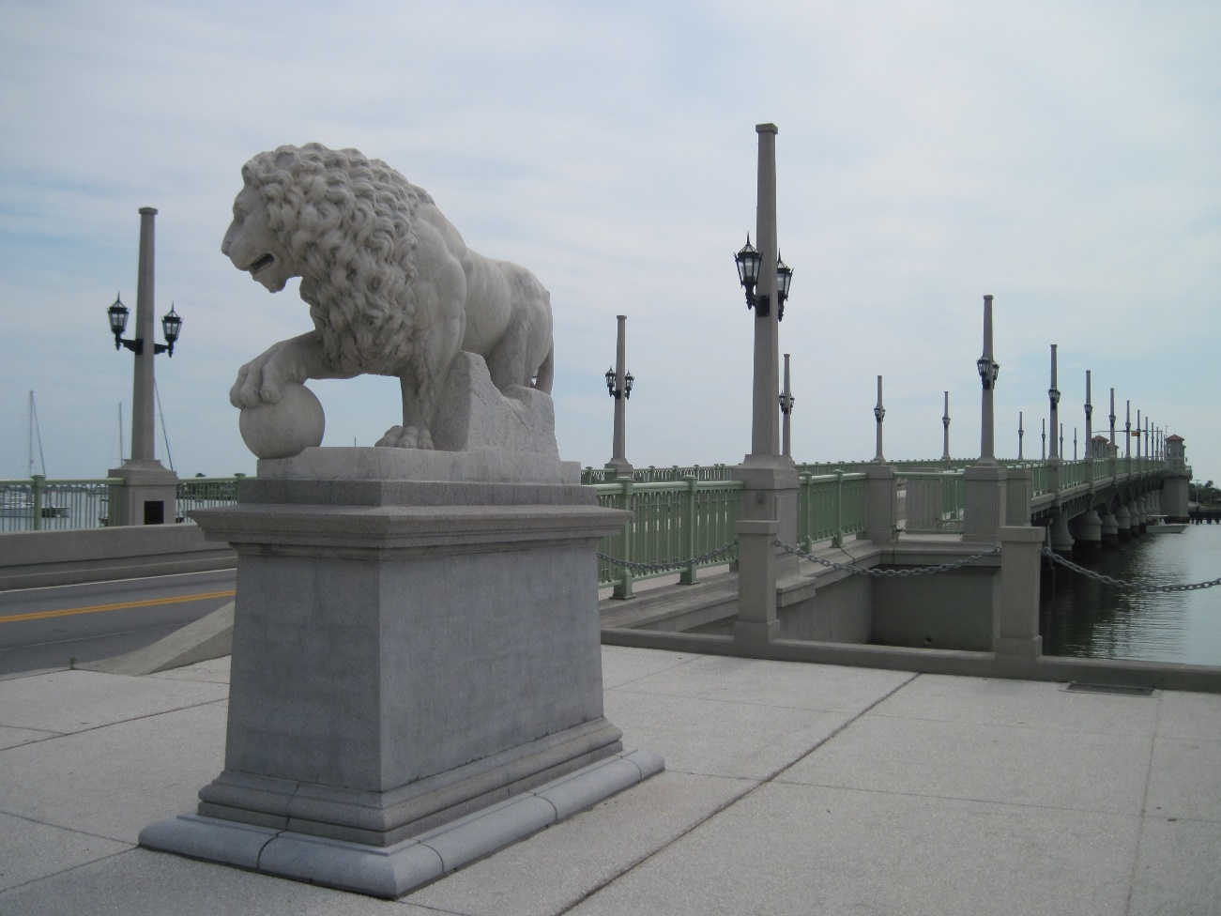
Historic Bridges

Slide 10
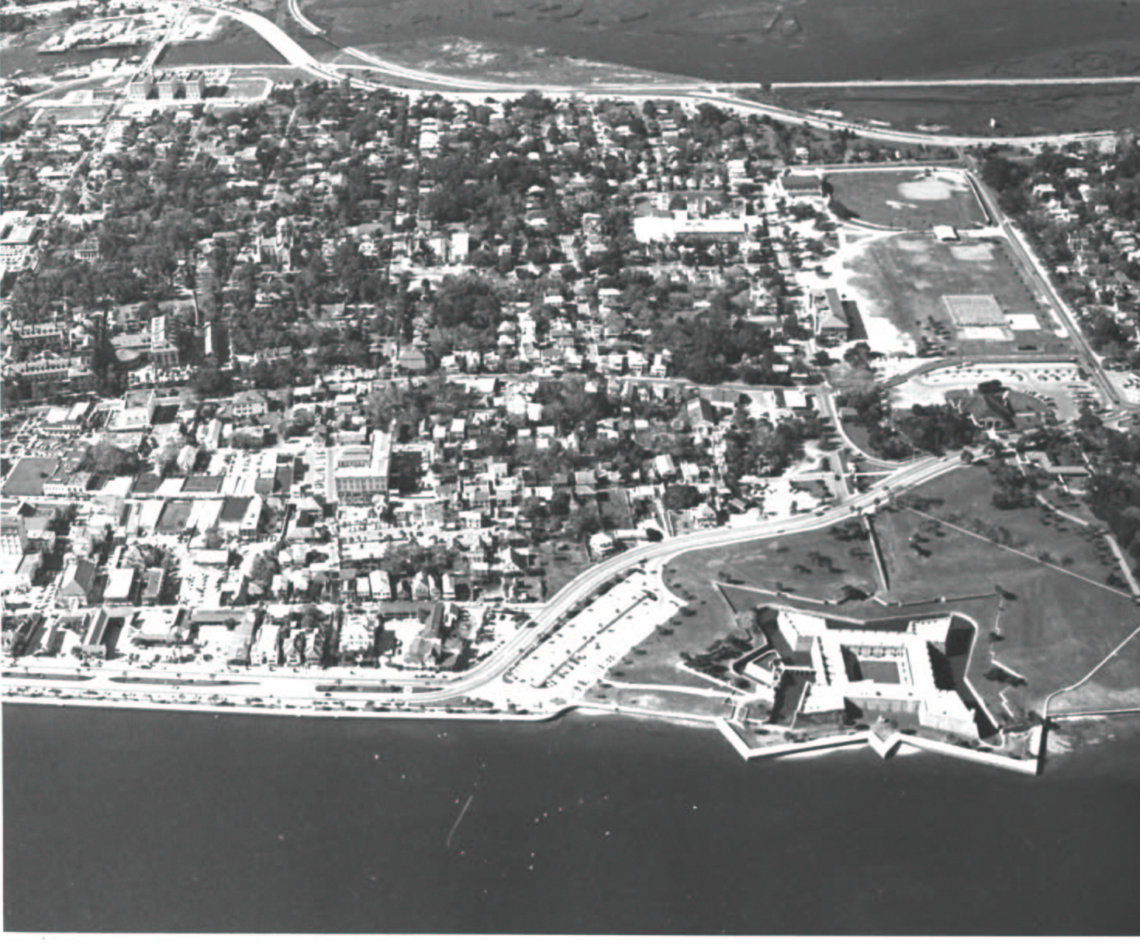
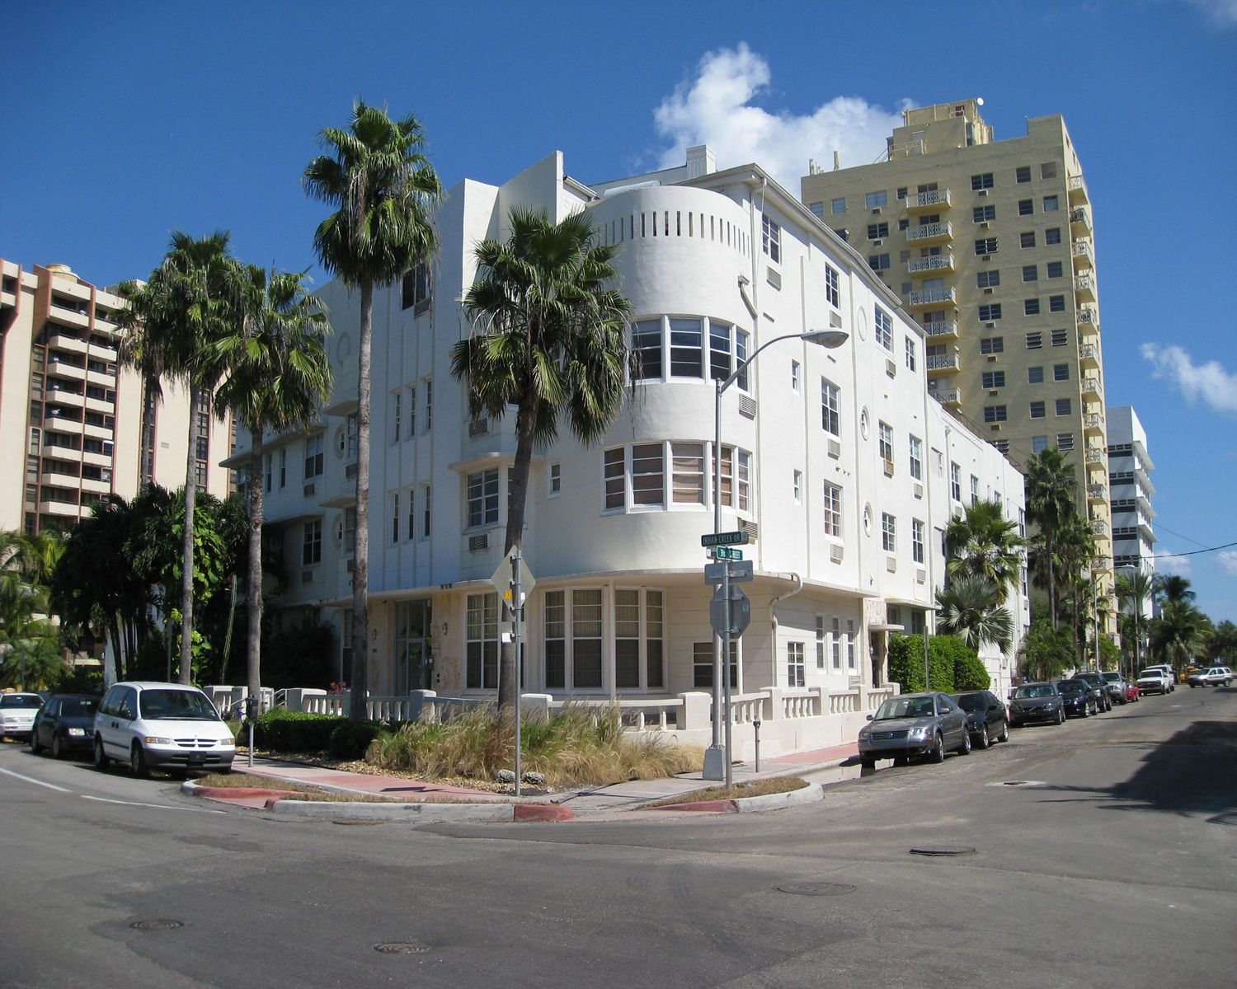
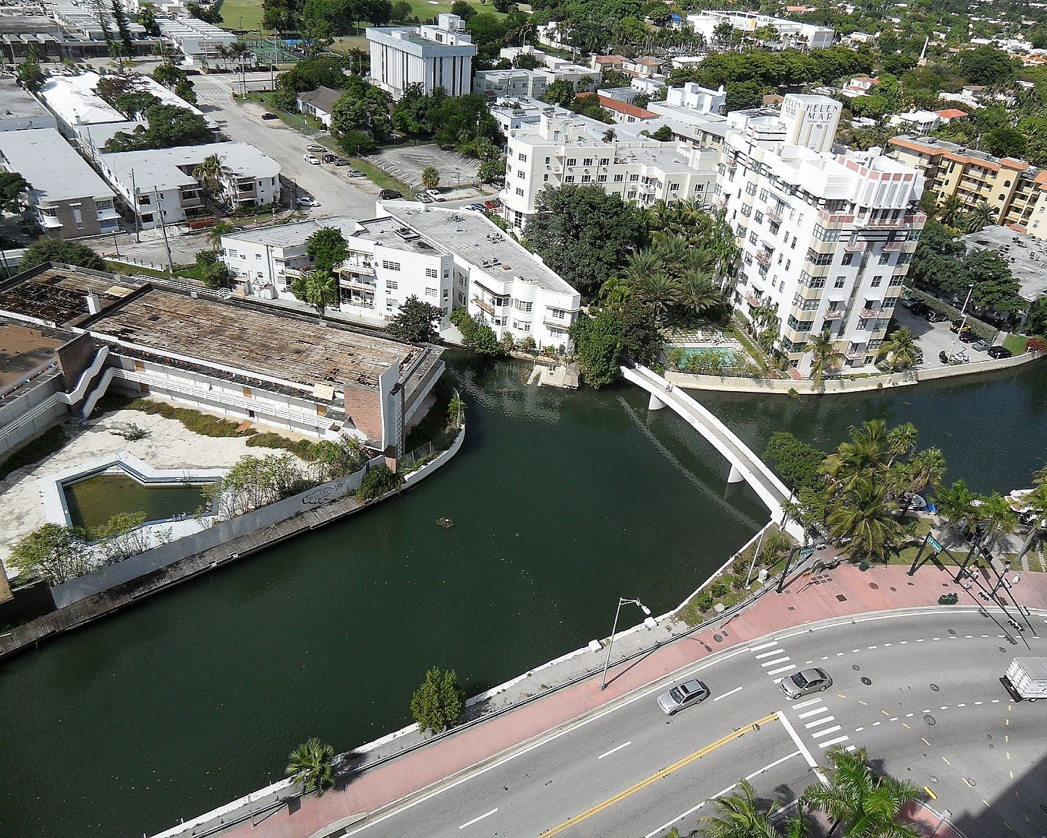
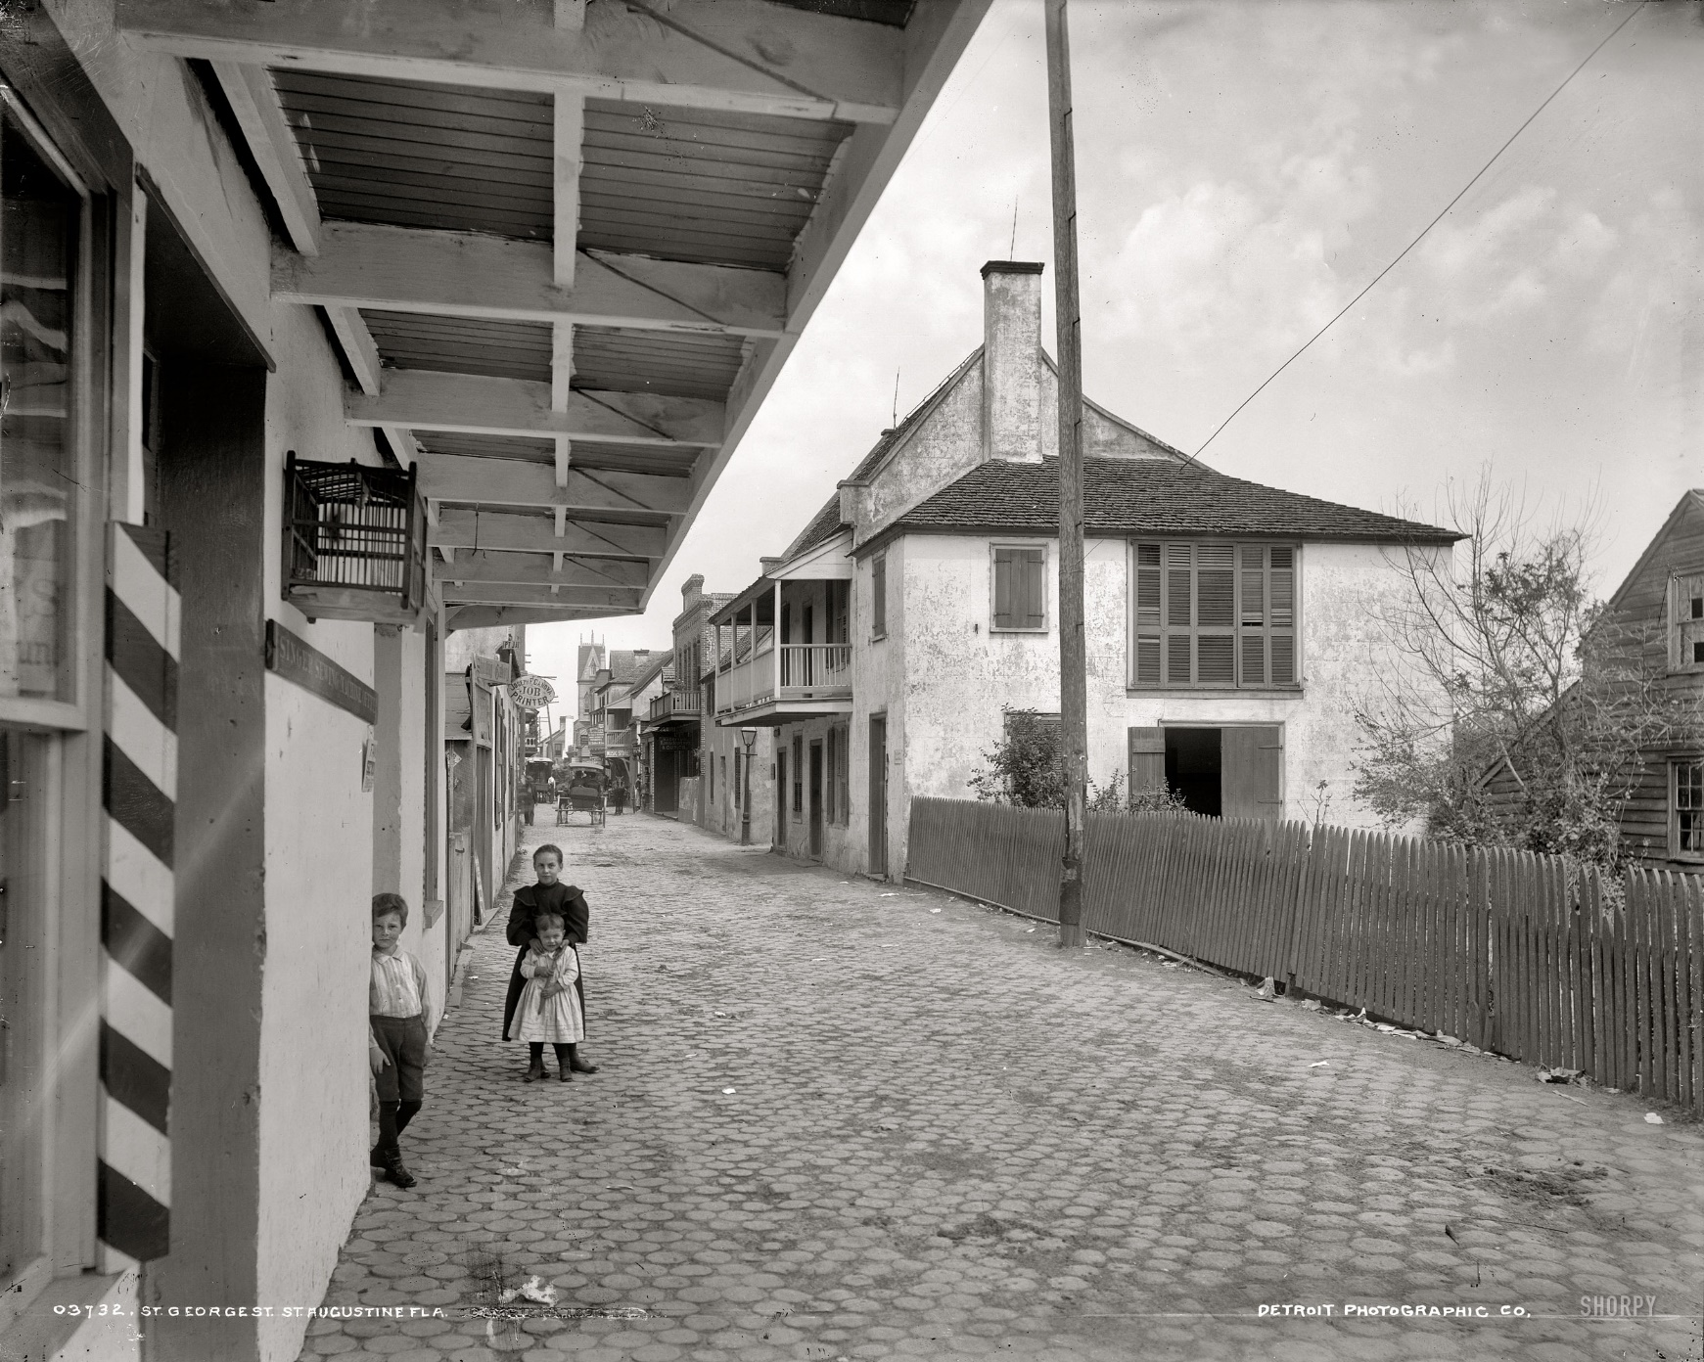
Historic Districts

Slide 11
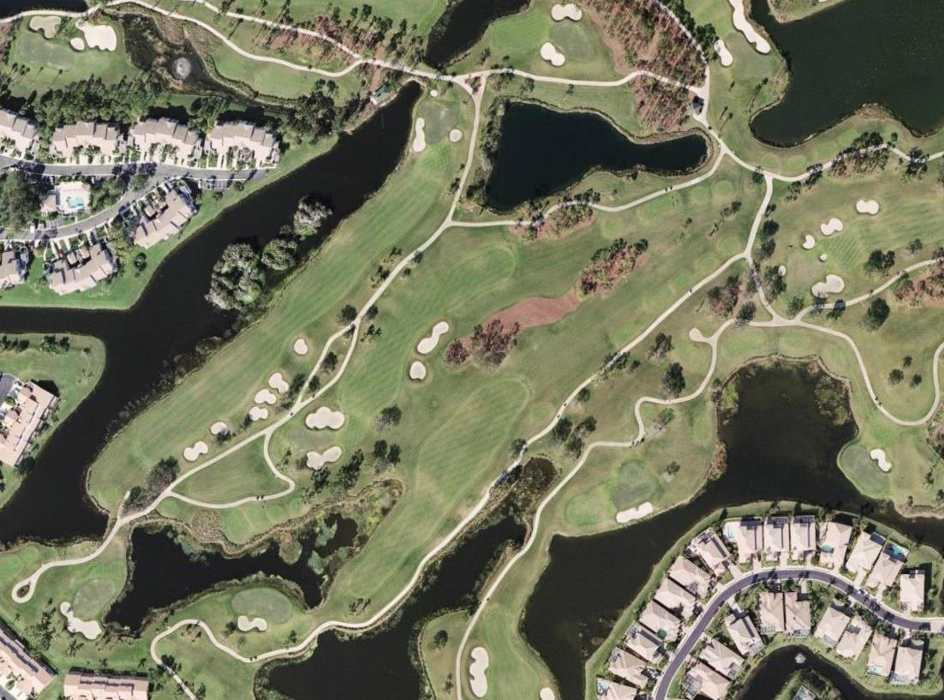
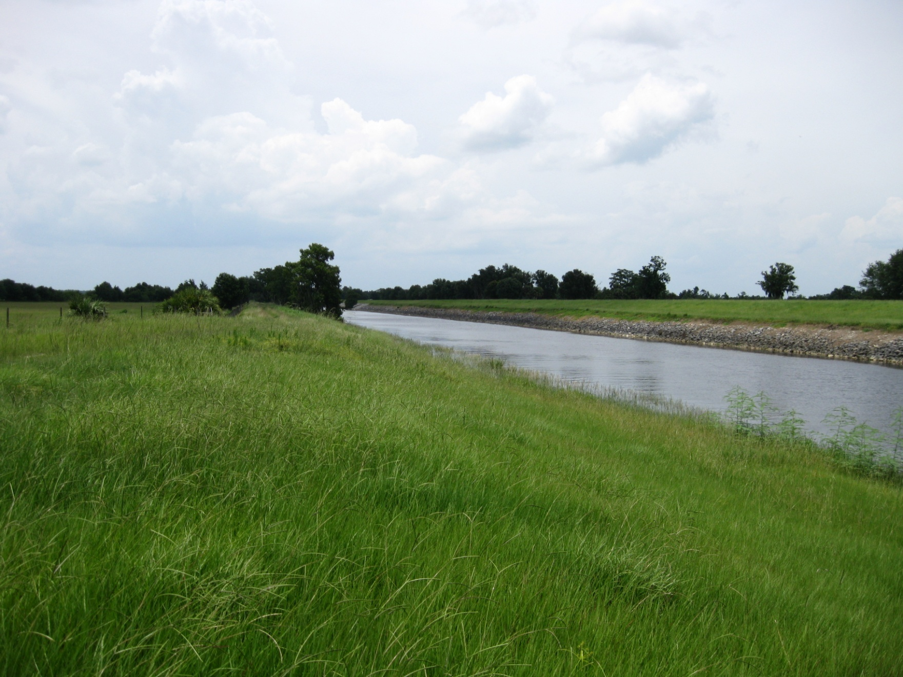
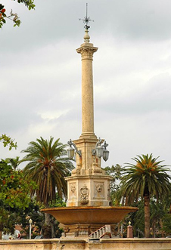
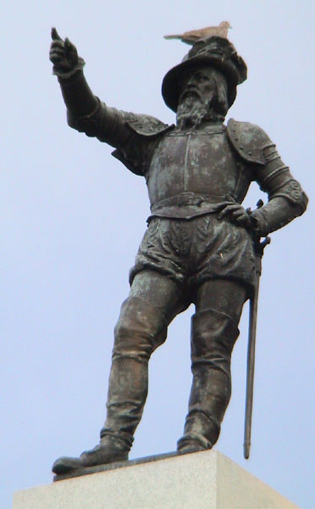
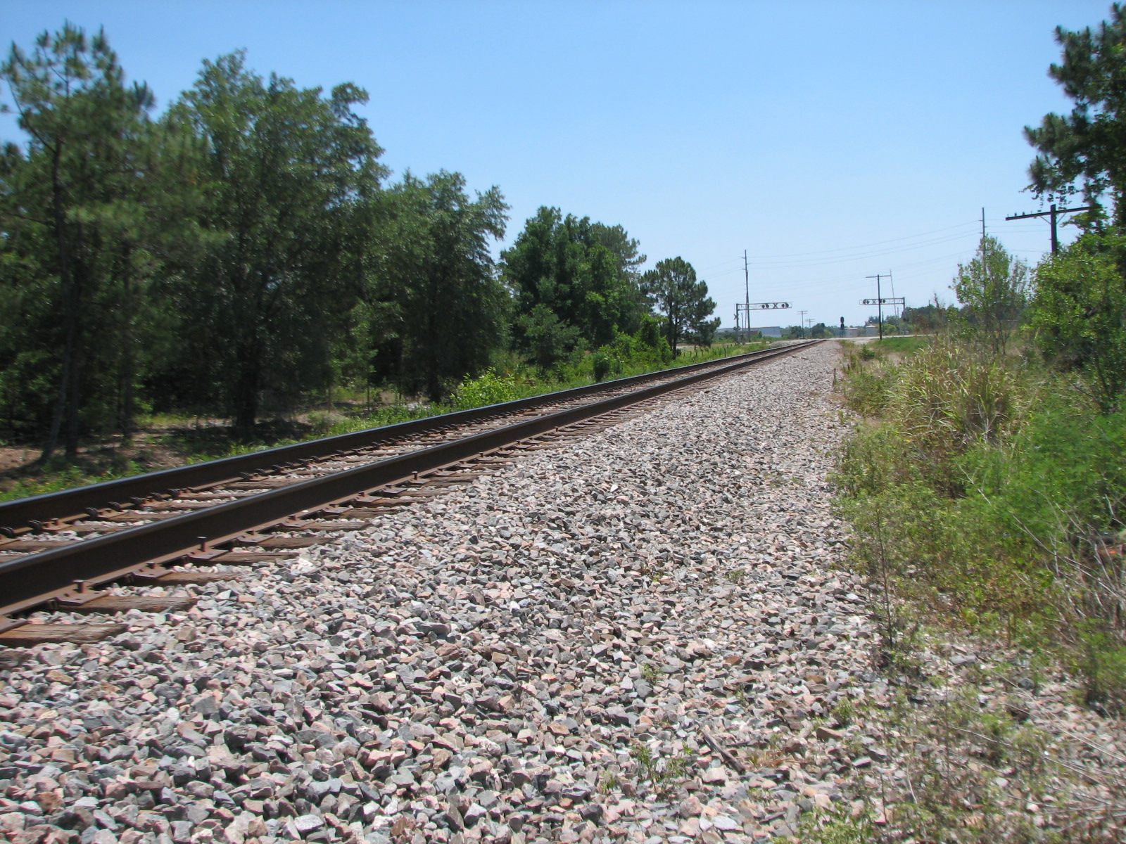
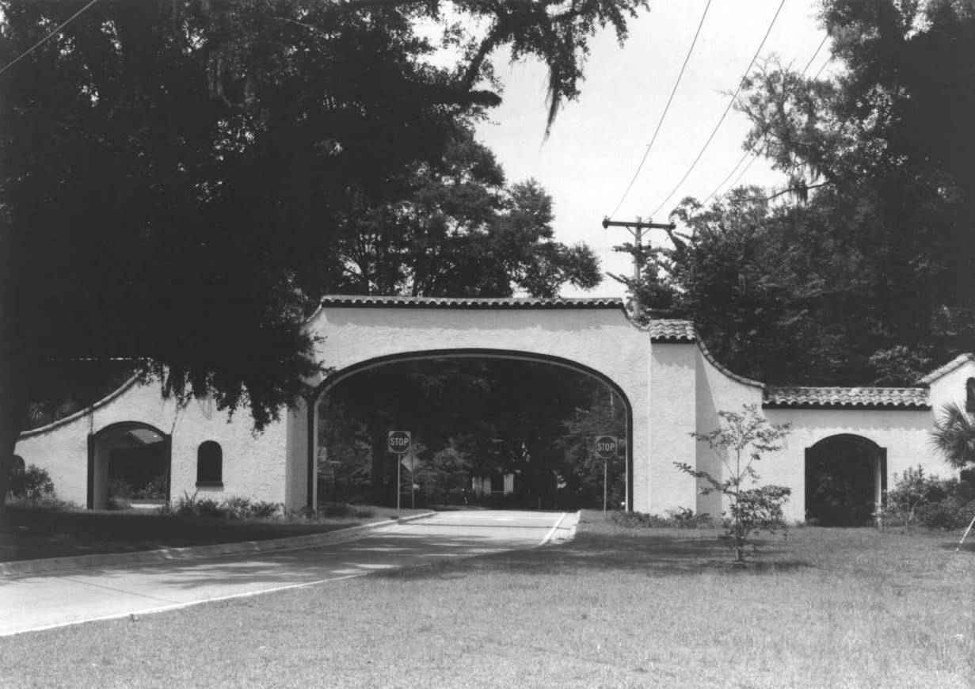
Other Resources

Slide 12
Resource Numbers
Cultural Resources – 205,748*
  165,398 Historic Structures
  35,280 Archaeological Sites
  1,287 Historic Cemeteries
  1,289 Historic Bridges
  2,494 Resource Groups
Manuscripts – 23,692
  Field Survey Reports from Archaeologists or Historians
  Excavation Reports
  Other Unpublished Preservation Documents
1996 – 100,895 cultural resources recorded
*Compiled May 7, 2017
Notes:
-Numbers are increasing (development pressure and addition of structures).
-In many other states structures and archaeological resources are in separate offices (sometimes in separate cities!)
-We offer one-stop shopping

Slide 13
DHR Review Process
Initiate
Identify
Assess
Resolve

Slide 14
Initiate the Review
Receive permit application or other notification from agency
Reviewing the project activities and the project area to determine:
  Does the undertaking have the potential to affect historic properties?
  Is the undertaking located in an area with documented historic properties or that is likely to contain undocumented historic properties?

Slide 15
Identify Historic Properties
Review Available Information
  Florida Master Site File Data
  Historic maps and aerial photographs
  Environmental characteristics
  Historic research
Request a Cultural Resources Assessment Survey
  Available information suggests that historic properties are present or are likely to be present in the project area.

Slide 16
Assess Effects to Historic Properties
Does the property possess historical significance and integrity?
  National Register of Historic Places
    Criteria A
    Criteria B
    Criteria C
    Criteria D
  Seven Aspects of Integrity
Does the activity diminish the “character, form, integrity, or other qualities which contribute to historical, architectural, or archaeological value of the property…”?

Slide 17
Resolve Adverse Effects
Avoid
Minimize
Mitigate

Slide 18
What to expect from our review
Request for additional information
No historic properties affected
No adverse effect
Conditional no adverse effect to historic properties
Adverse effect

Slide 19
Unexpected Discoveries Clause
If prehistoric or historic artifacts, such as pottery or ceramics, projectile points, dugout canoes, metal implements, historic building materials, or any other physical remains that could be associated with Native American, early European, or American settlement are encountered at any time within the project site area, the permitted project shall cease all activities involving subsurface disturbance in the vicinity of the discovery. The applicant shall contact the Florida Department of State, Division of Historical Resources, Compliance Review Section at (850)-245-6333. Project activities shall not resume without verbal and/or written authorization. In the event that unmarked human remains are encountered during permitted activities, all work shall stop immediately and the proper authorities notified in accordance with Section 872.05, Florida Statutes.

Slide 20
What to submit
In body of email or attached PDF
  Application #, Permit #
  Project Name
  Applicant Name
  Project Description
  Location Information
    Township/ Section/ Range
    Project Address
    City/ County
  Location Map
    Show the project area
A complete and current permit application
  Attached as PDF or link in body of email
Agency point of contact
  Who can we contact with questions
  Who needs to receive our letter

Slide 21
How to submit
Electronic
  CompliancePermits@dos.myflorida.com
  If too large for email, send FTP link or use Dropbox or a similar online program
Mail
    State Historic Preservation Officer
  Compliance & Review Section
  500 South Bronough Street – 4th Floor
  R. A. Gray Building – MS #8
  Tallahassee, Florida 32399-0250

Slide 22
Questions?

