Slide 1
SPGP-V
Heather Simpkins - SLERC

Slide 2
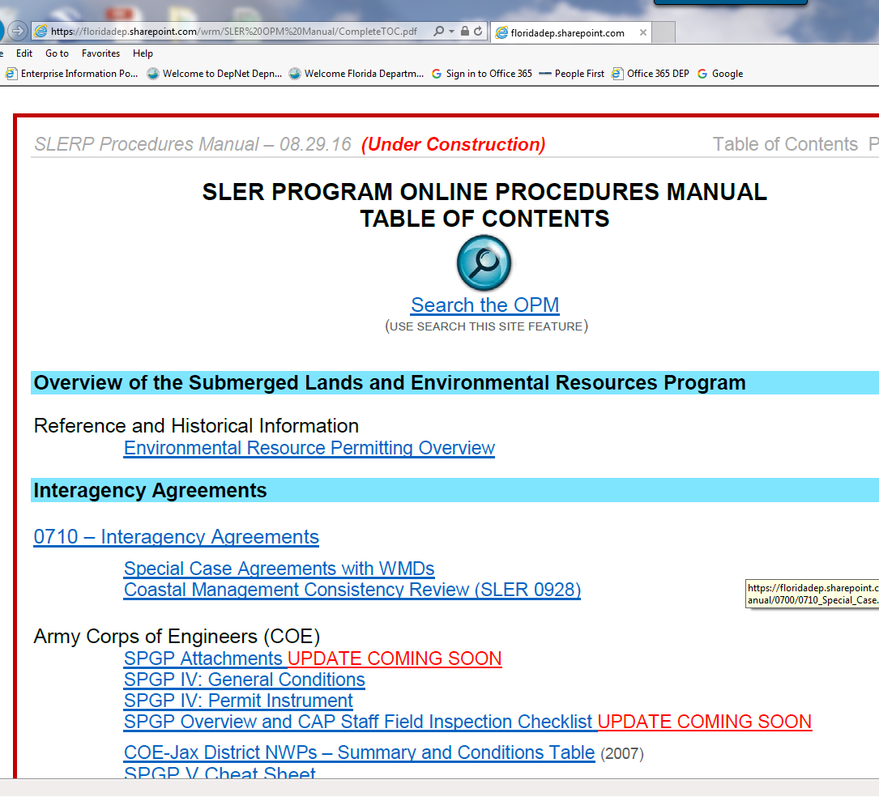
Resources: OPM
SPGP Overview and CAP Staff Field Inspection Checklist
SPGP V Cheat Sheet
Updated links and SPGP-V documents will be posted here soon.
Use this link to go to OPM https://floridadep.sharepoint.com/wrm/SLER%20OPM%20Manual/CompleteTOC.pdf

Slide 3
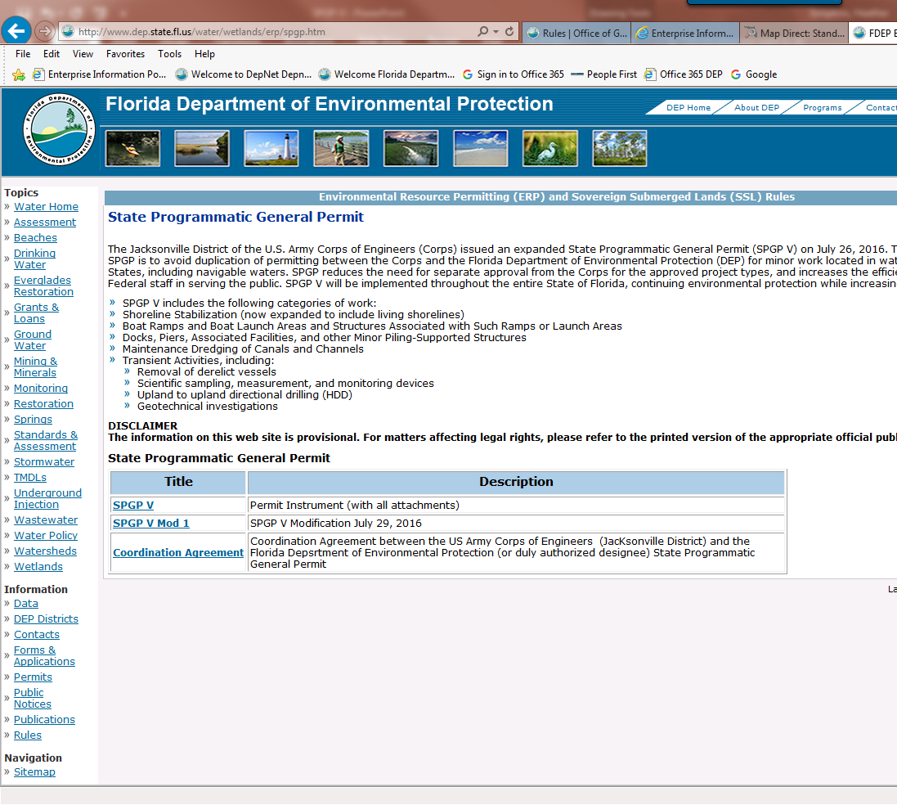
Resources: FDEP Web-Site
SPGP V Permit Instrument
SPGP V Modification 1
SPGP Coordination Agreement
Use this link to go to FDEP SPGP page http://www.dep.state.fl.us/water/wetlands/erp/spgp.htm

Slide 4
What is SPGP?
The US Army Corps of Engineers (USACE) is authorized to issue general permits*, under Section 10 of the Rivers and Harbors Act of 1899 and Section 404 of the Clean Water Act. Florida’s current State Programmatic General Permit V (SPGP) is a special type of programmatic general permit (PGP) that was issued to DEP (or its designee) by the Regulatory Office of the US Army Corps of Engineers, Jacksonville District. It authorizes DEP to verify qualification for federal authorization to perform specific, routine activities within wetlands and surface waters under federal jurisdiction. Florida’s current SPGP expires July 26, 2021.
*Some other states also have their own SPGPs, too. Also, certain local governments or other jurisdictions (such as the City of Cape Coral, or Miami-Dade County) within Florida have their own PGPs. Regional general permits (RGPs) are not issued to other entities, but rather cover certain activities within a defined geographic area.

Slide 5
DEP typically verifies SPGP qualification either:
In conjunction with a formal agency action taken on an application (such as issuance of an ERP permit or verification of exemption). In such cases, ERP permitting staff review the application and supporting documents, and determine whether the project (as proposed) meets the terms and conditions of the SPGP. –OR–
Via automated verification through DEP’s online, self-certification (self-cert) system. For self-certs, “applicants” certify that they will abide by those terms and conditions. Based on the location of the project (as identified by the applicant) the self-cert system checks against certain GIS data, and will verify SPGP only when the project appears to be located outside of certain sensitive resource areas*, such as designated critical habitats for listed species (e.g. smalltooth sawfish or Johnson’s seagrass), as specified within the SPGP. *Note that the GIS data used by the self-cert system includes precautionary buffers around resource areas, which means that in some cases, a project may actually qualify for SPGP, but not be able to receive that verification via self-cert. In such cases, they would simply have to apply as described above.

Slide 6
Florida’s SPGP covers the following basic types of activities:
Shoreline stabilization (e.g. seawalls and riprap)
Single family docks, piers and other piling-supported structures
Boat ramps and associated structures
Maintenance dredging
Transient Activities

Slide 7

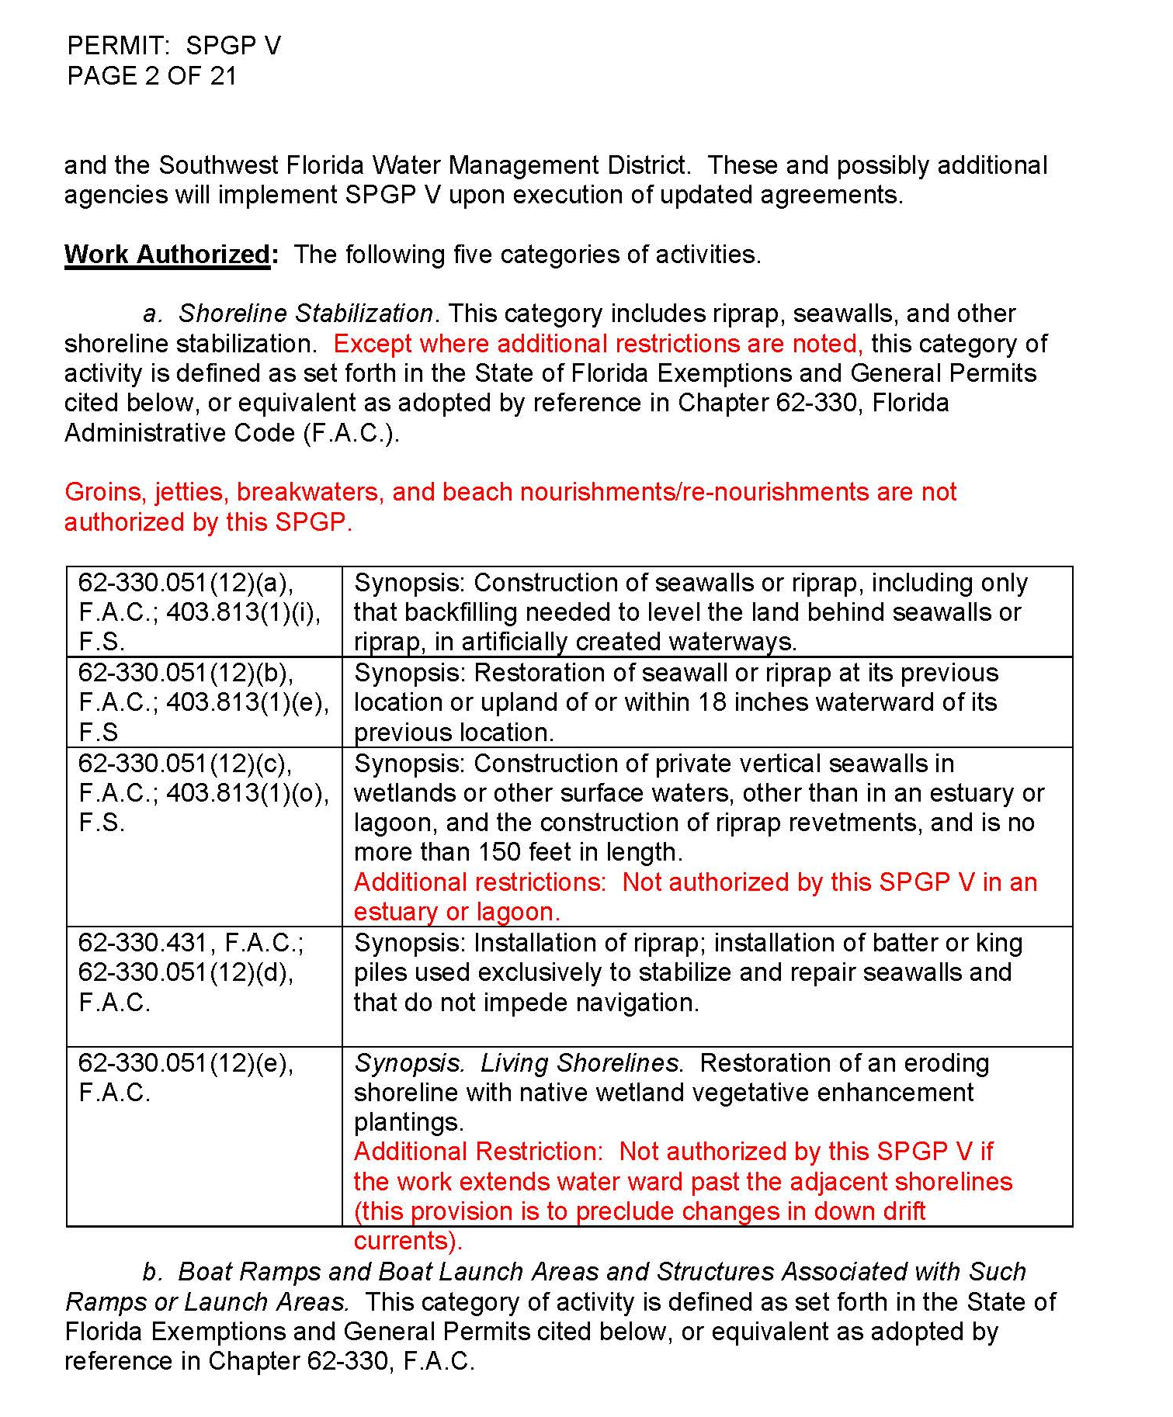
Permit Instrument: Work Authorized-pg.2
Some Restrictions will be listed under the activity categories.
Additional Restrictions are also located within the Synopsis of some of the activity types.
Notes:
Activity categories- ex: “Groins, jettie,…..”
Synopsis: red font in tables

Slide 8
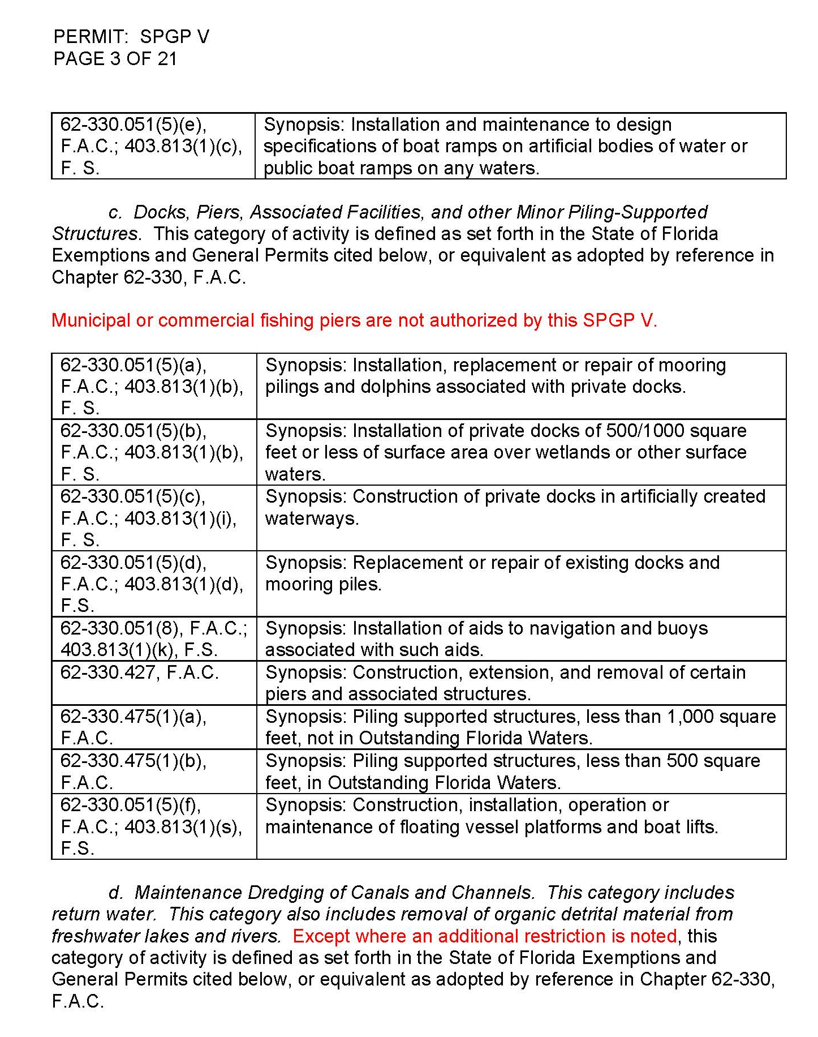
Permit Instrument: Work Authorized-pg.3
Some Restrictions will be listed under the activity categories.
Additional Restrictions are also located within the Synopsis of some of the activity types.

Slide 9
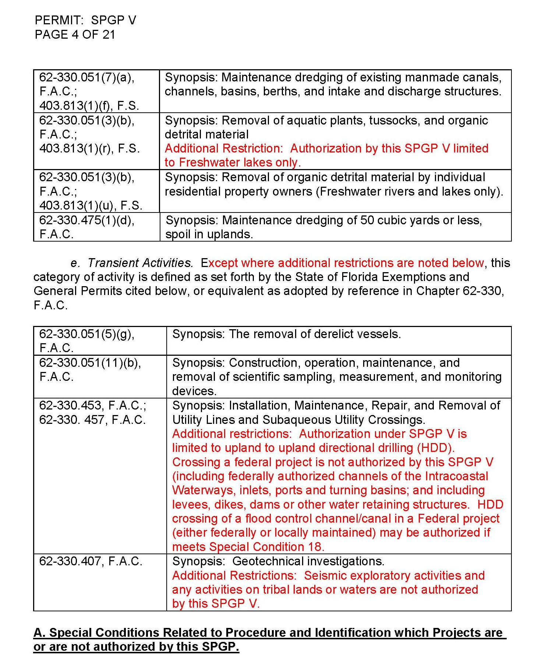
Permit Instrument: Work Authorized-pg.4
Additional Restrictions located within the Synopsis of some of the activity types.

Slide 10
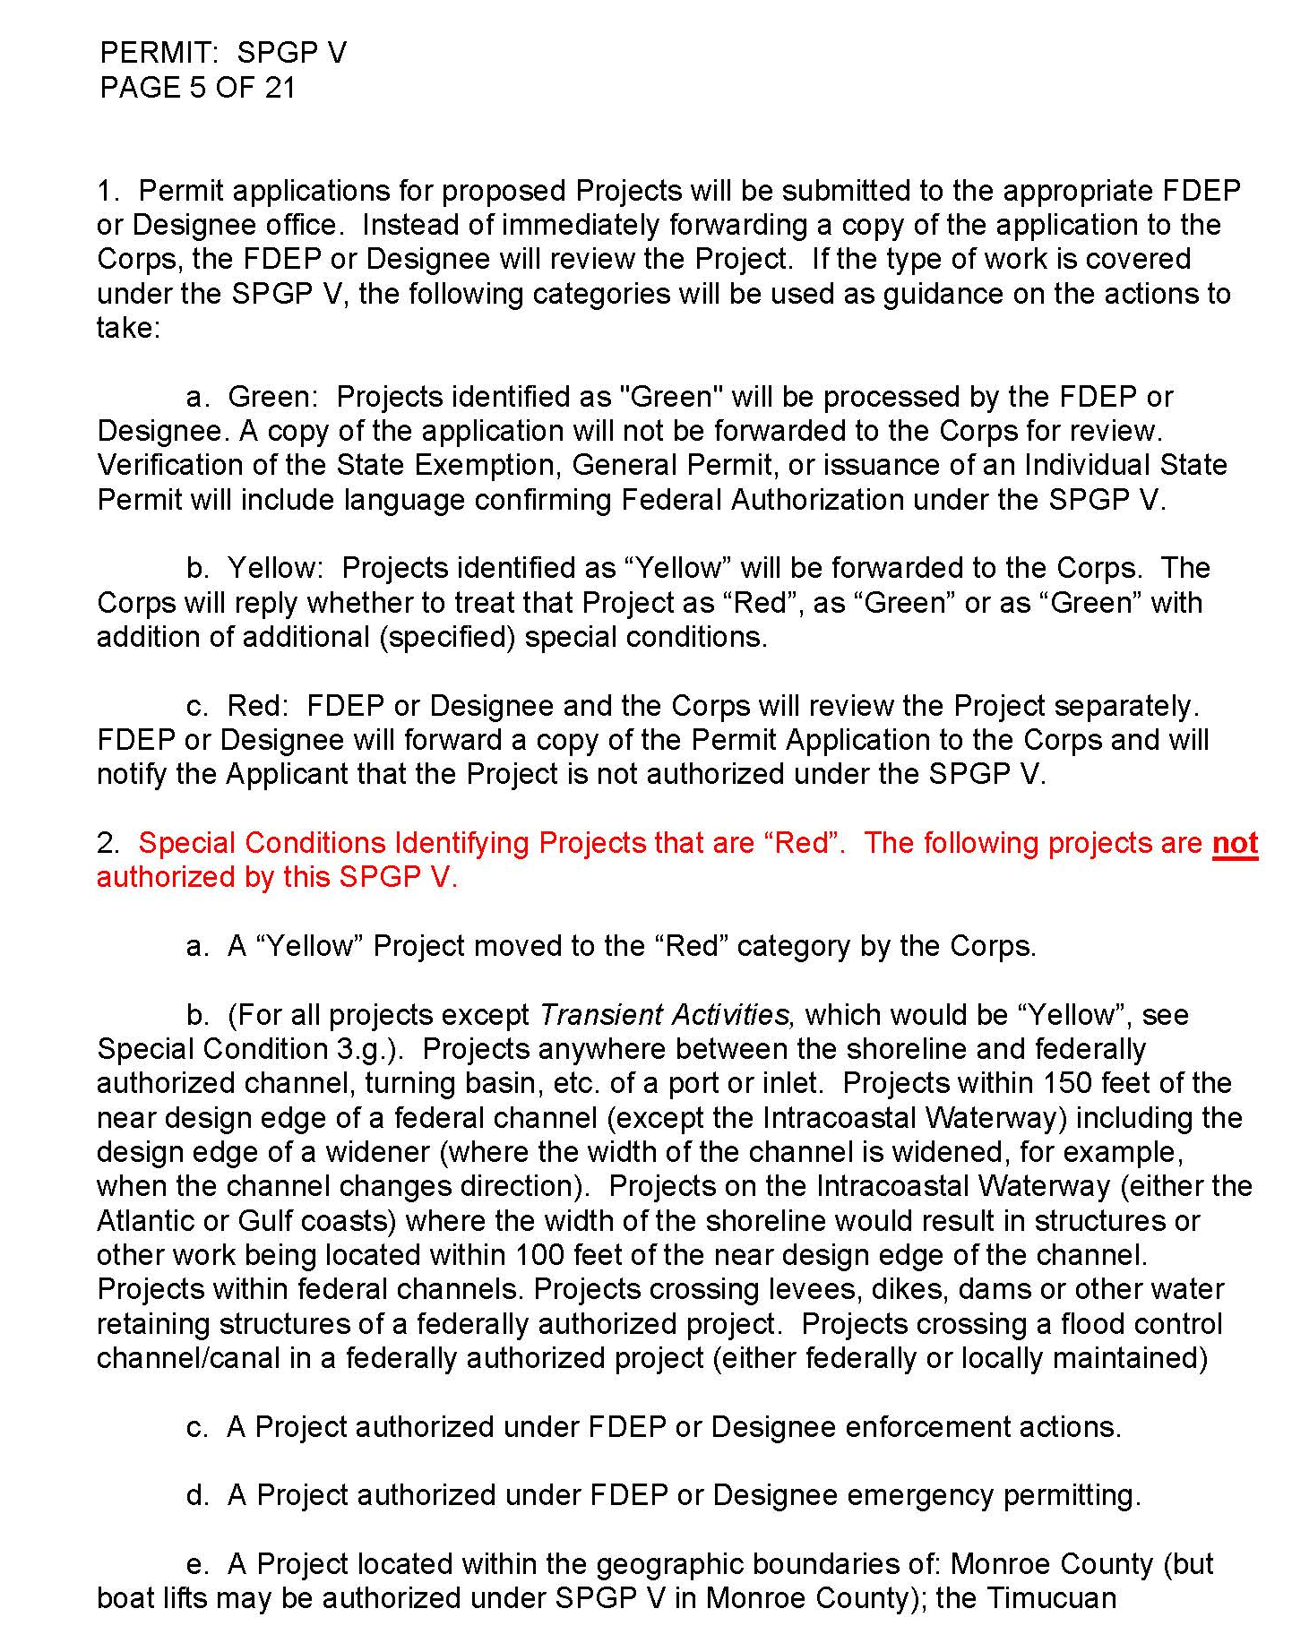
SPGP-V Permit Instrument- Part A.
Pages 4-12 of the Permit Instrument contain A. Special Conditions Related to Procedure and Identification of which Projects are or are not authorized by this SPGP.
These special conditions are grouped into categories based upon the appropriate designation as either red (A. 2.), yellow (A. 3.), or green (A. 4.).
The Cheat Sheet takes these special conditions and separates them by activity type.

Slide 11
SPGP Color Designations
Green: Projects which are considered "green" will be processed by the DEP or Designee. Verification of the state exemption, noticed general permit, or issuance of an individual state permit will include language confirming Federal authorization under the SPGP V.
Yellow: Projects under this category require review by the Federal commenting agencies. The Corps and the appropriate Federal resource agencies will meet to discuss the project. A combined Federal position will be forwarded to the DEP or Designee. This position may include: all concerns have been addressed during the meeting and the project is now considered in the "Green" category; concerns can be addressed by the addition of special conditions which should be incorporated into the Federal authorization under the SPGP V, in which case the project will be placed in the “green” category; the Corps elects to evaluate the project separately, and the project is now considered in the "Red" category.
Red: DEP or Designee and the Corps review the project separately.

Slide 12
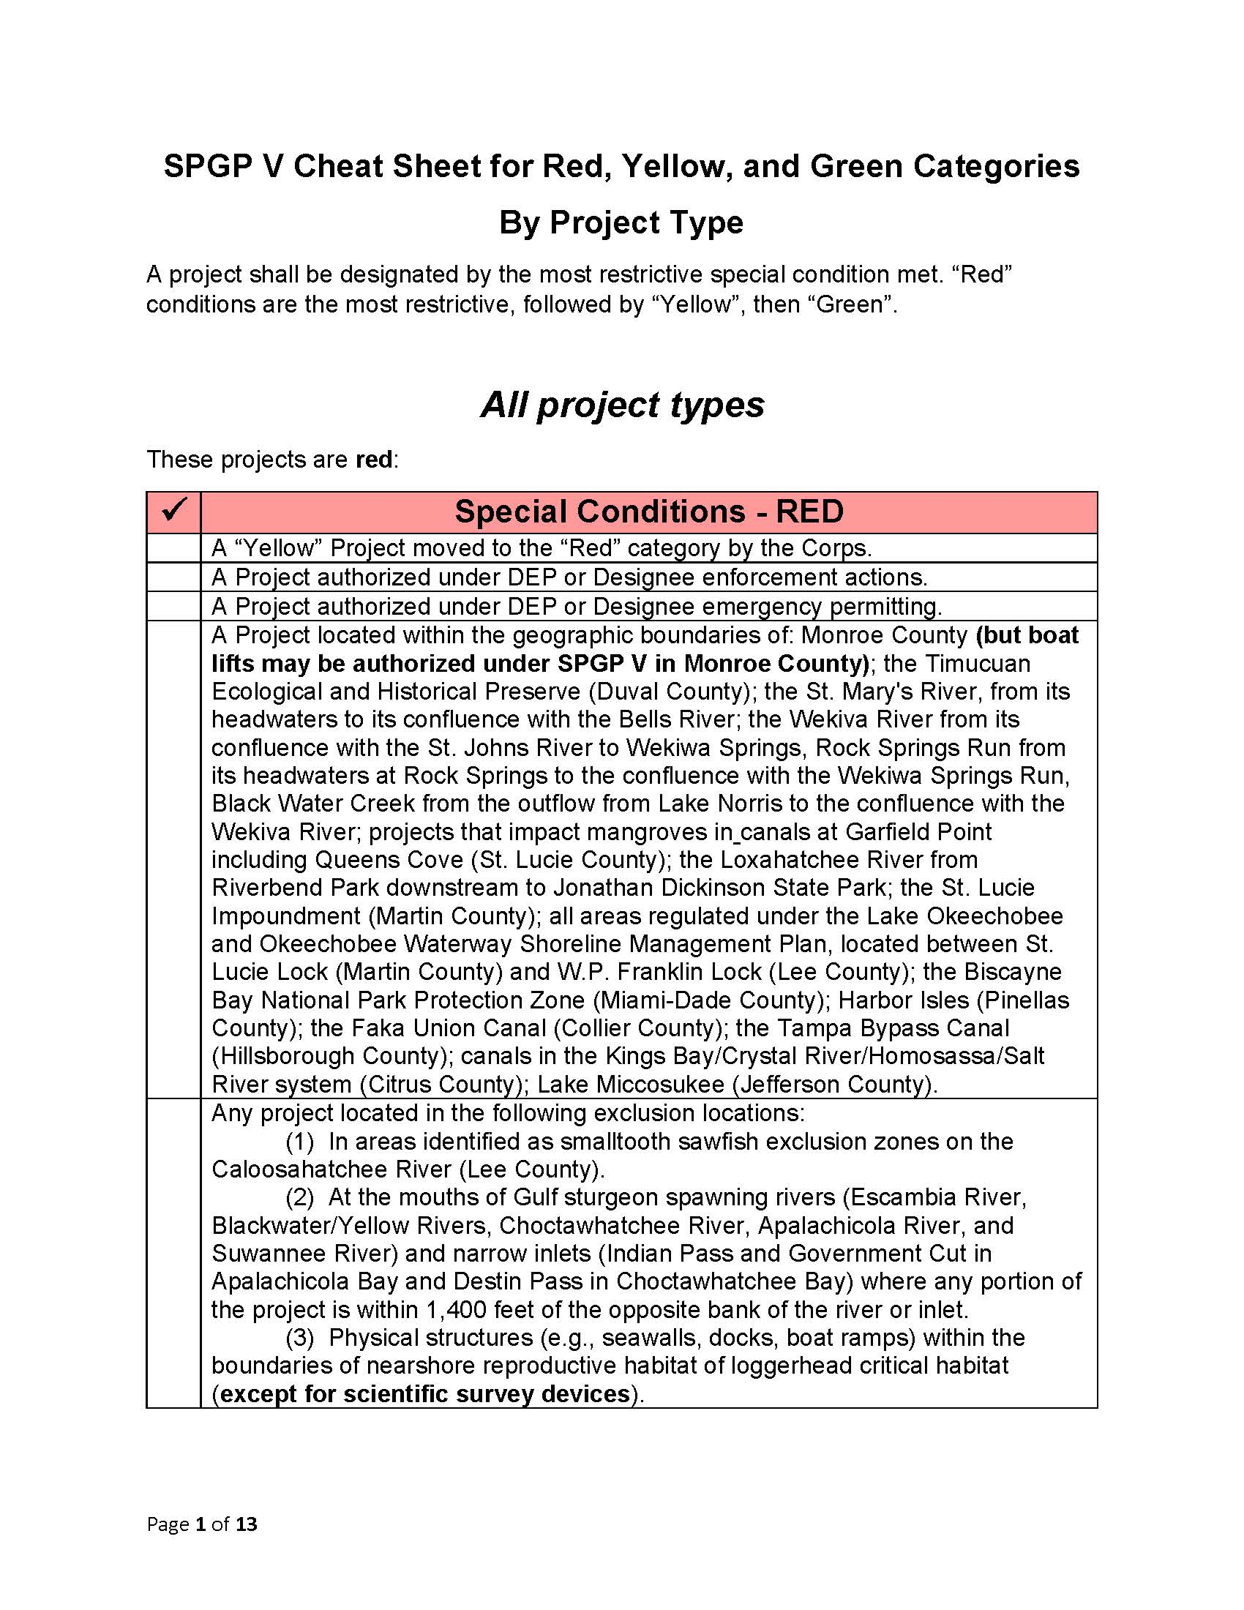
SPGP-V Cheat Sheet
Organizes Part A special conditions by activity type.
Takes some of the guess-work out of interpretation of the Permit Instrument language.
Has been reviewed and given the OK by the USACOE.
*Does not include special conditions located in Part B of Permit Instrument.
Notes:
* 17 is only real issue for this, everything else is construction like conditions and not activity limitations.

Slide 13
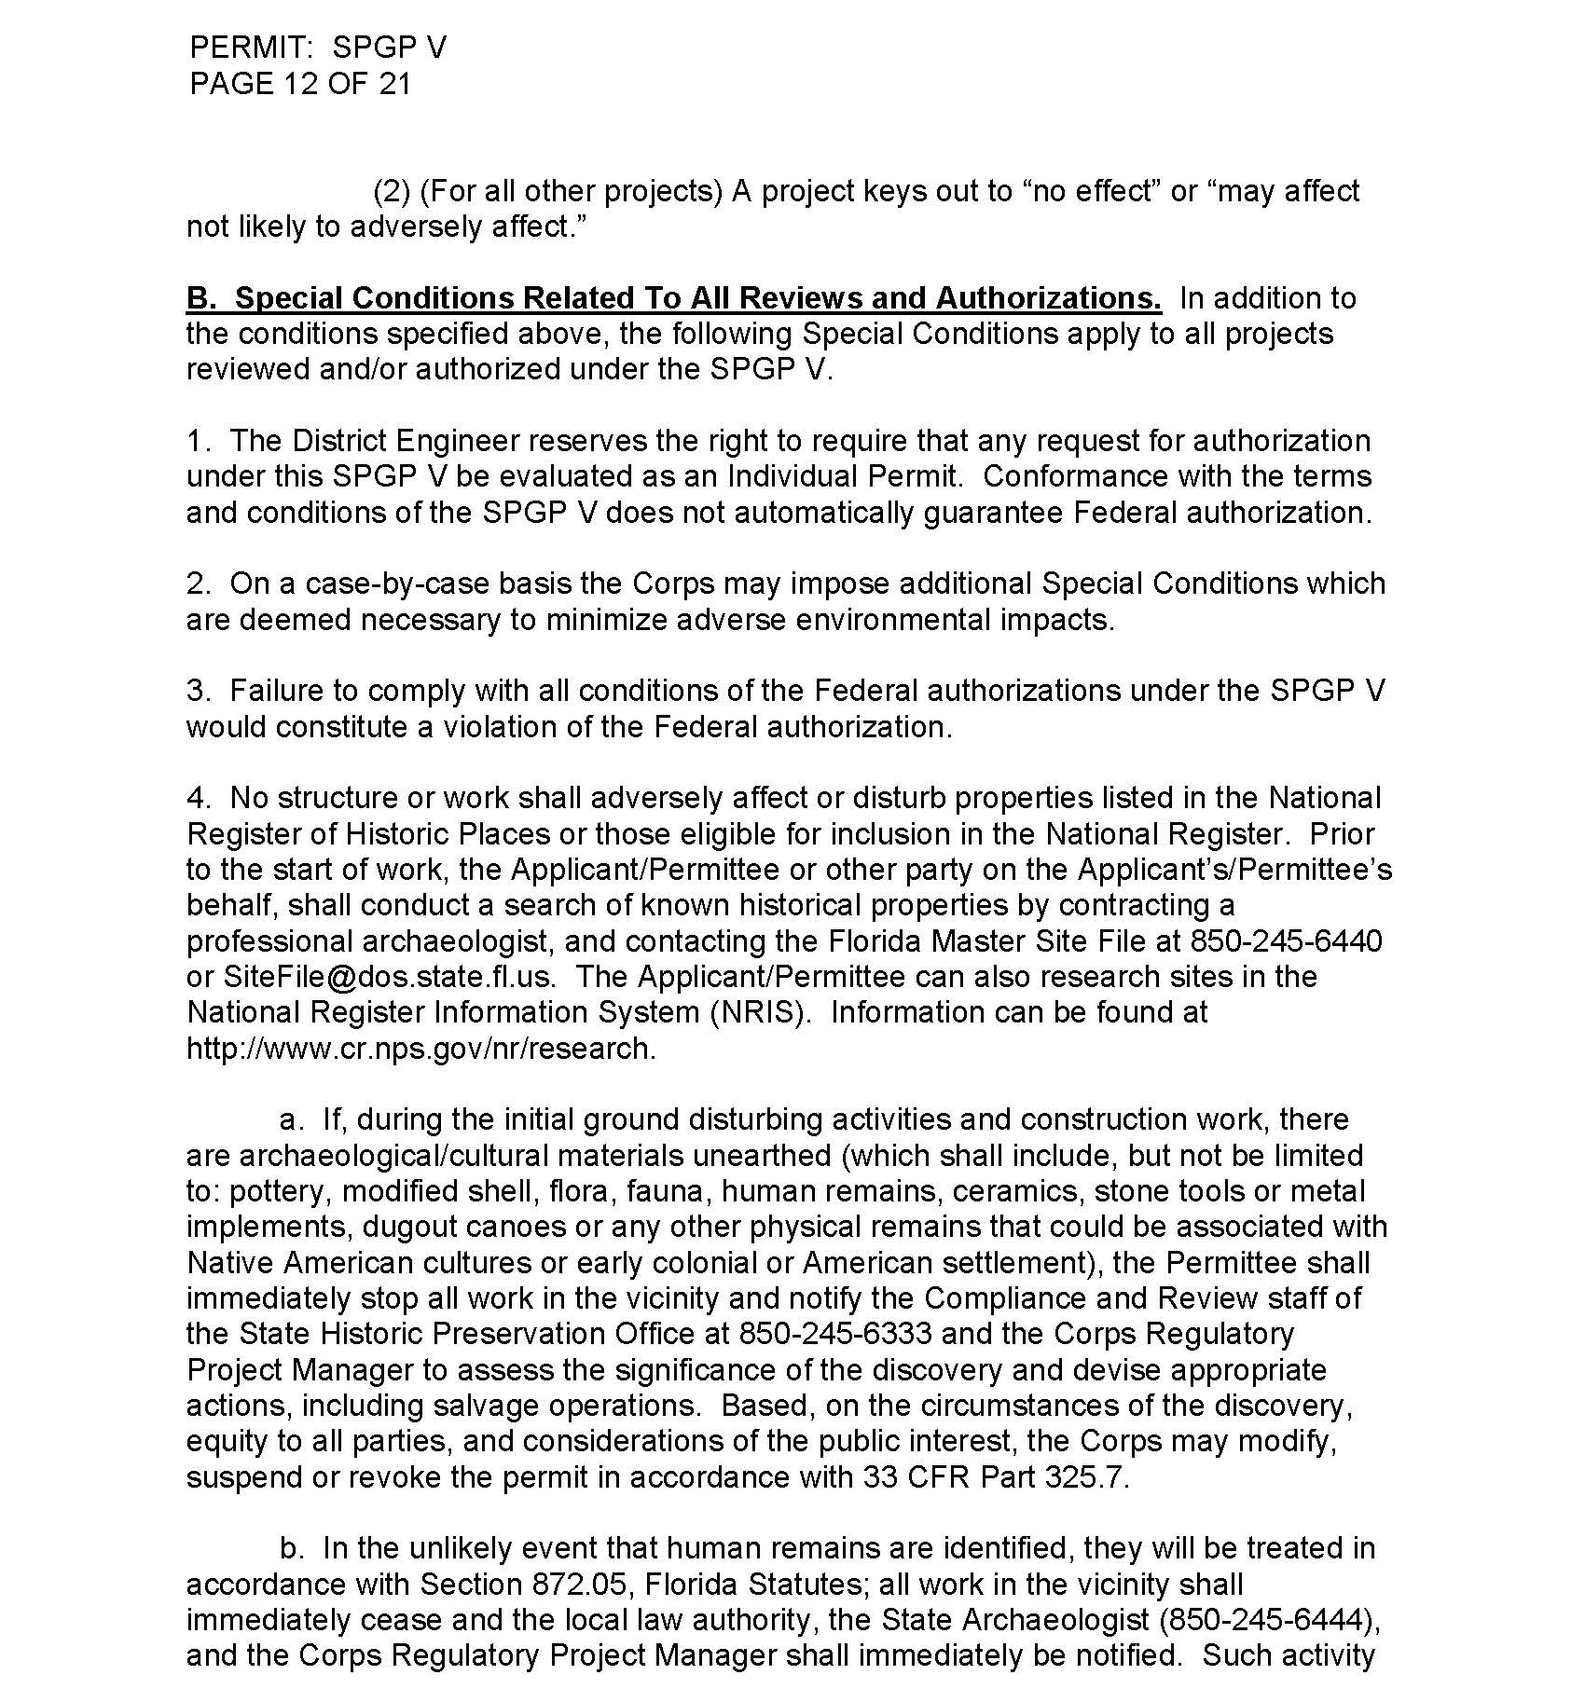
SPGP-V Permit Instrument- Part B.
Pages 12-19 of the Permit Instrument contain B. Special Conditions Related to All Reviews and Authorizations.
These special conditions are written into every SPGP authorization.
Some of the special conditions listed here should be considered when reviewing certain project types in order to identify projects which are not to be authorized by the SPGP. Specifically 17. on page 16 lists SPGP limitations for Living Shoreline designs.

Slide 14
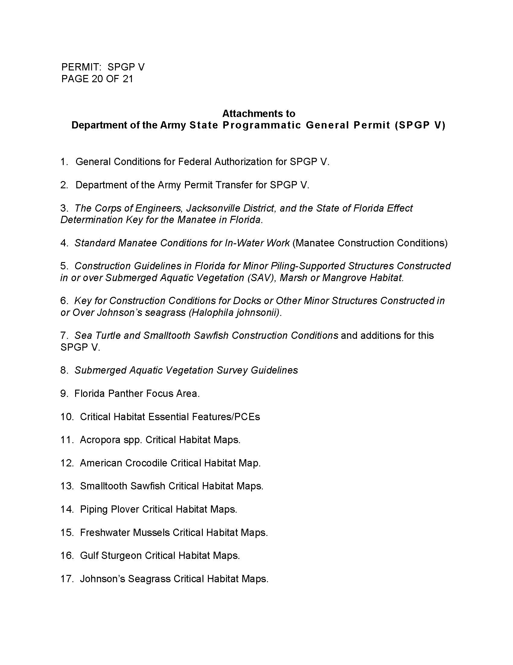
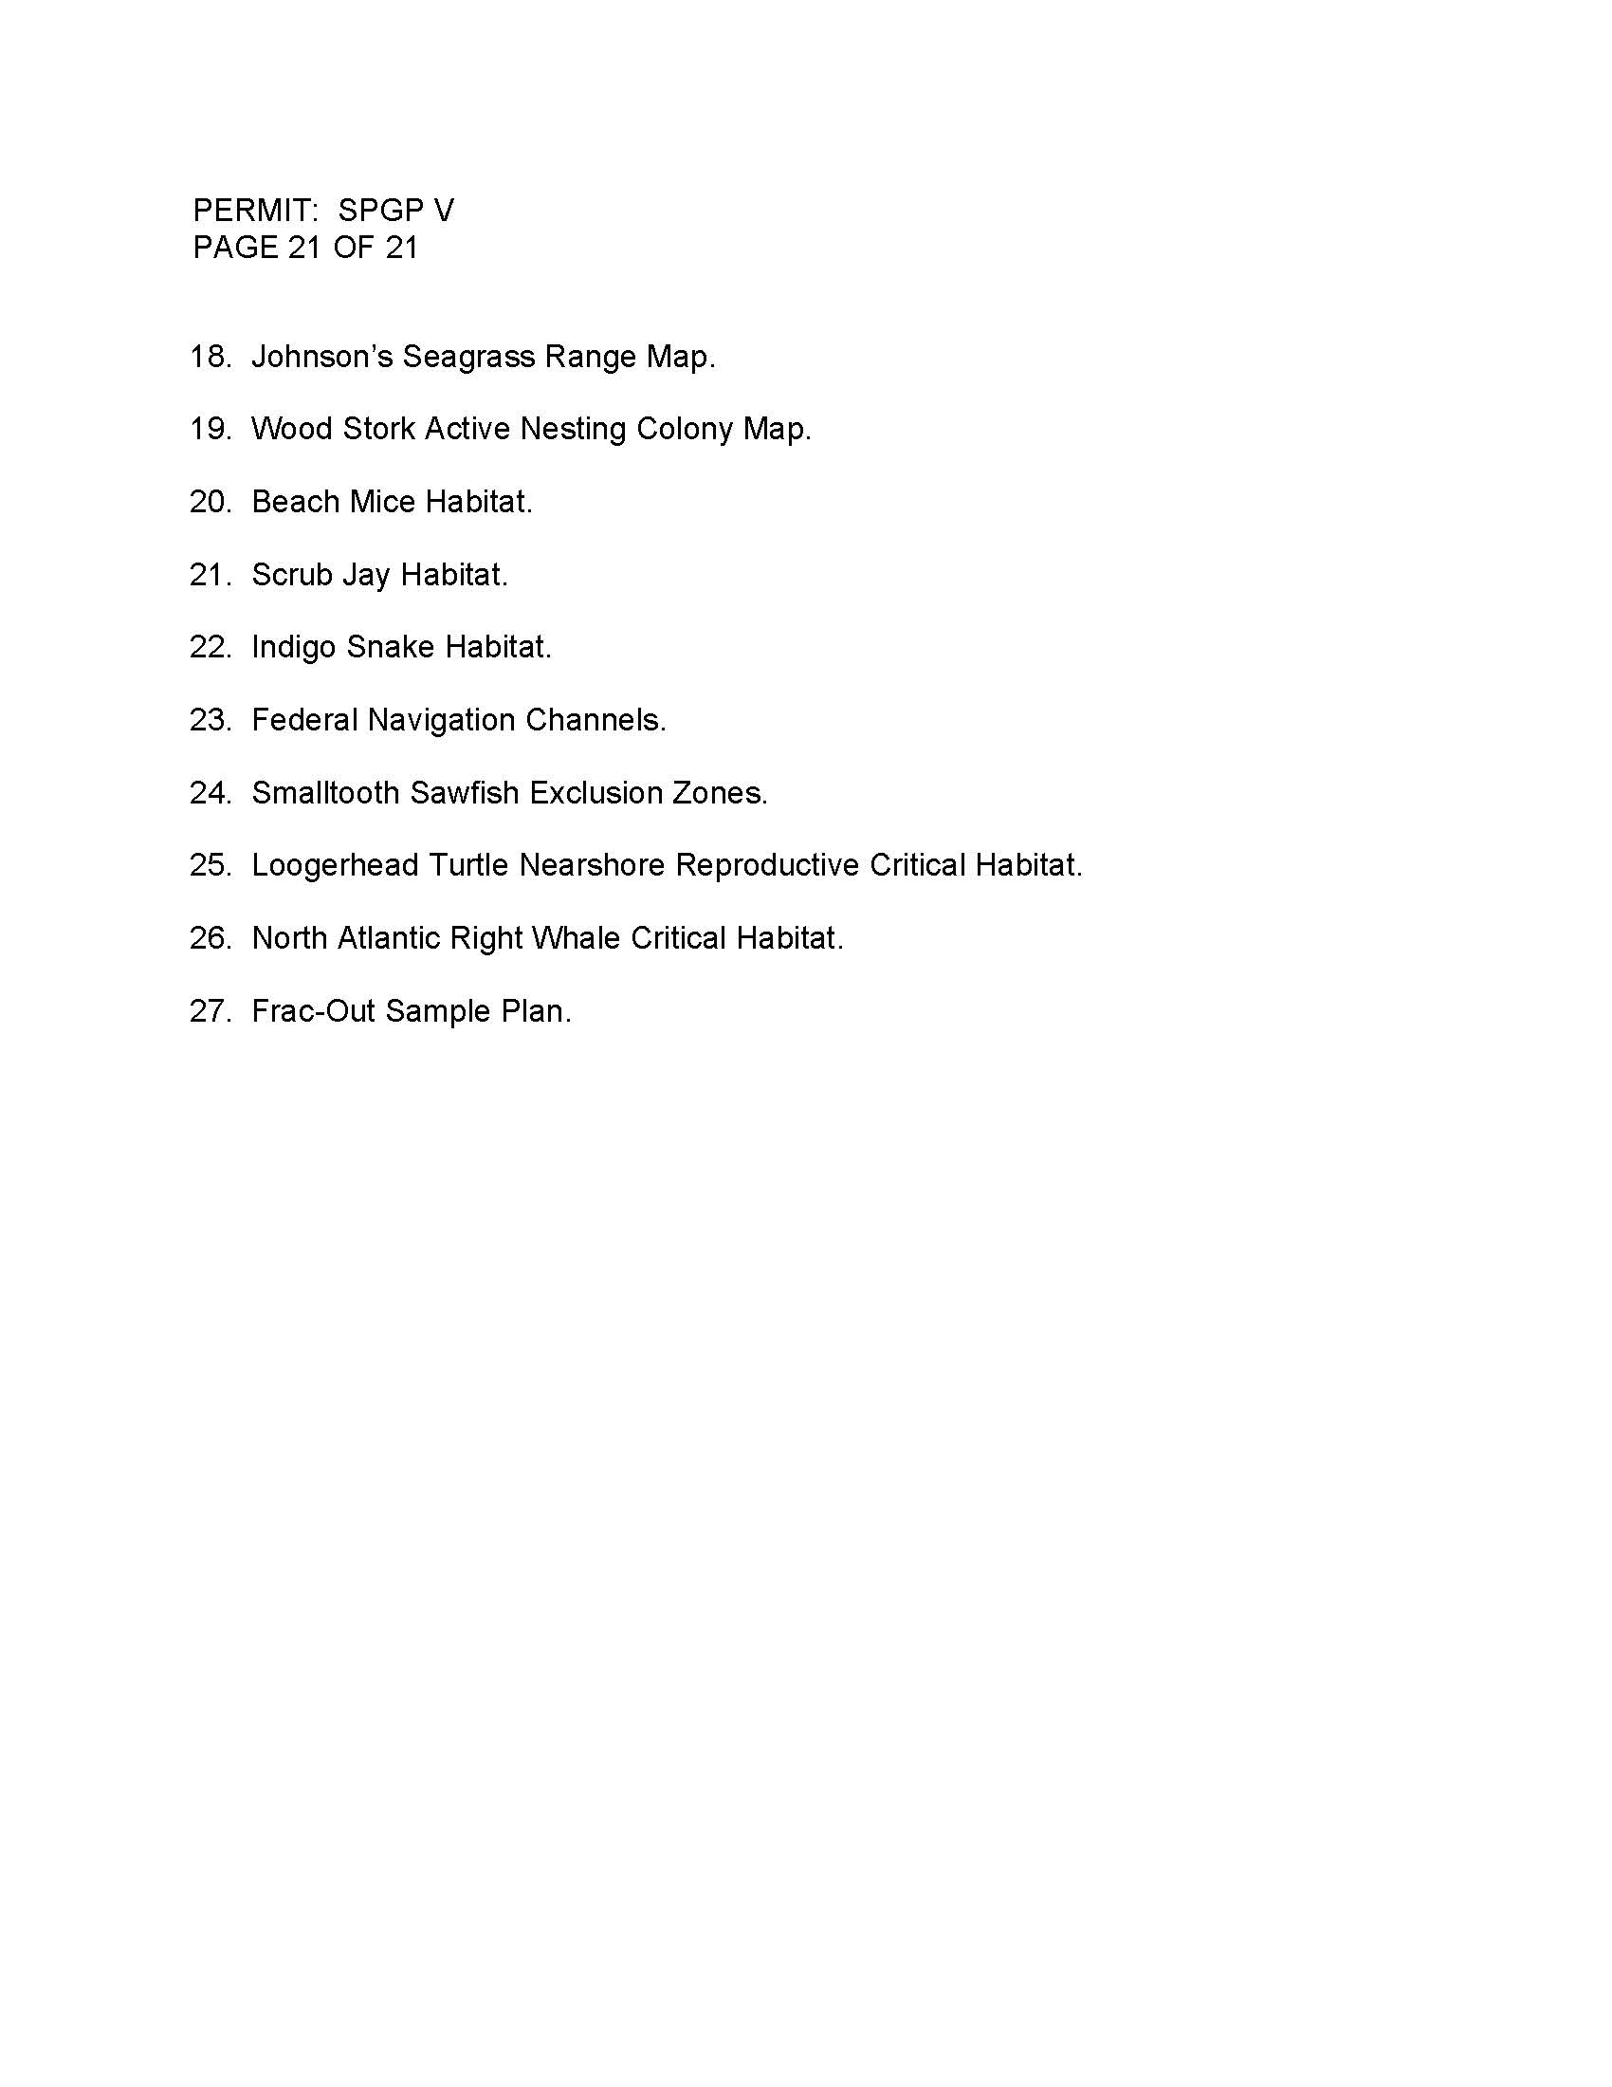

Slide 15
Dock Application
Example 1

Slide 16
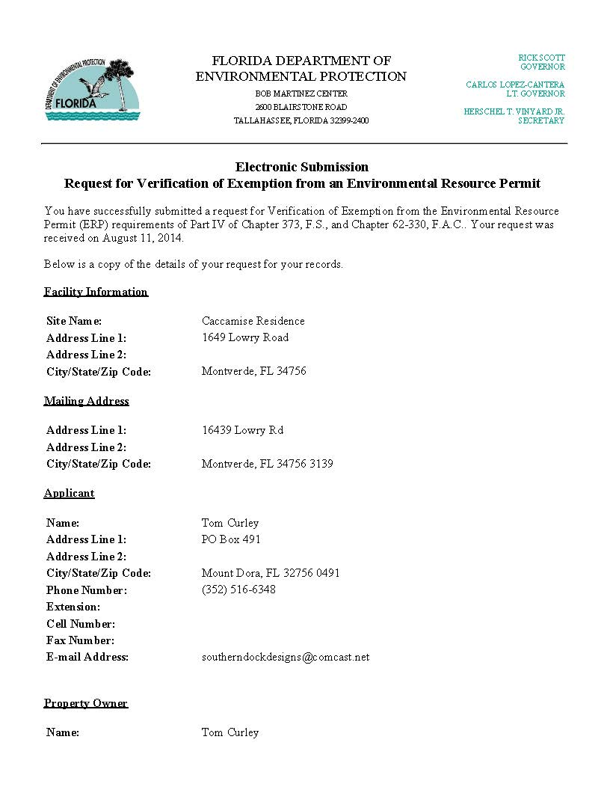
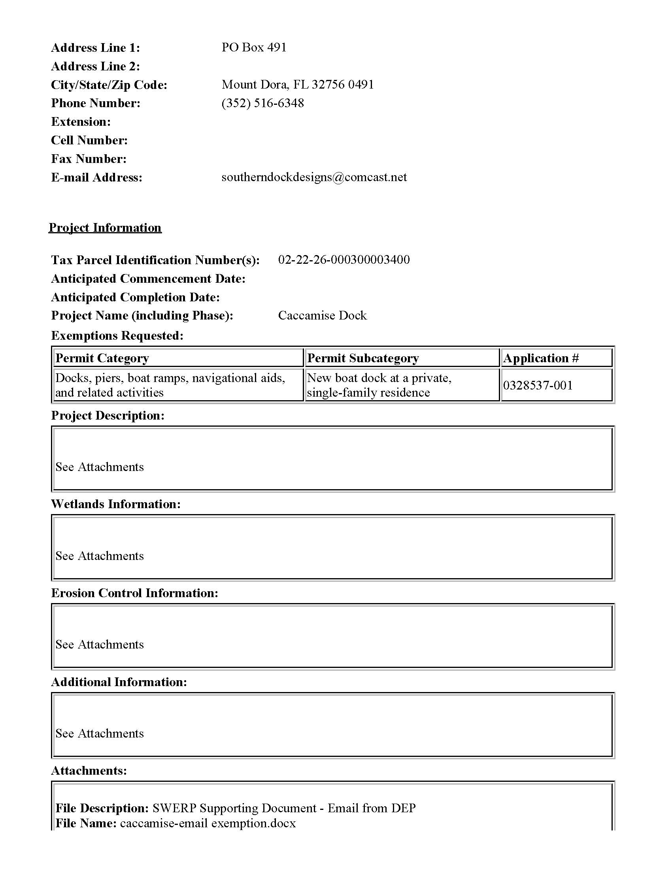
Notes:
Lake County

Slide 17
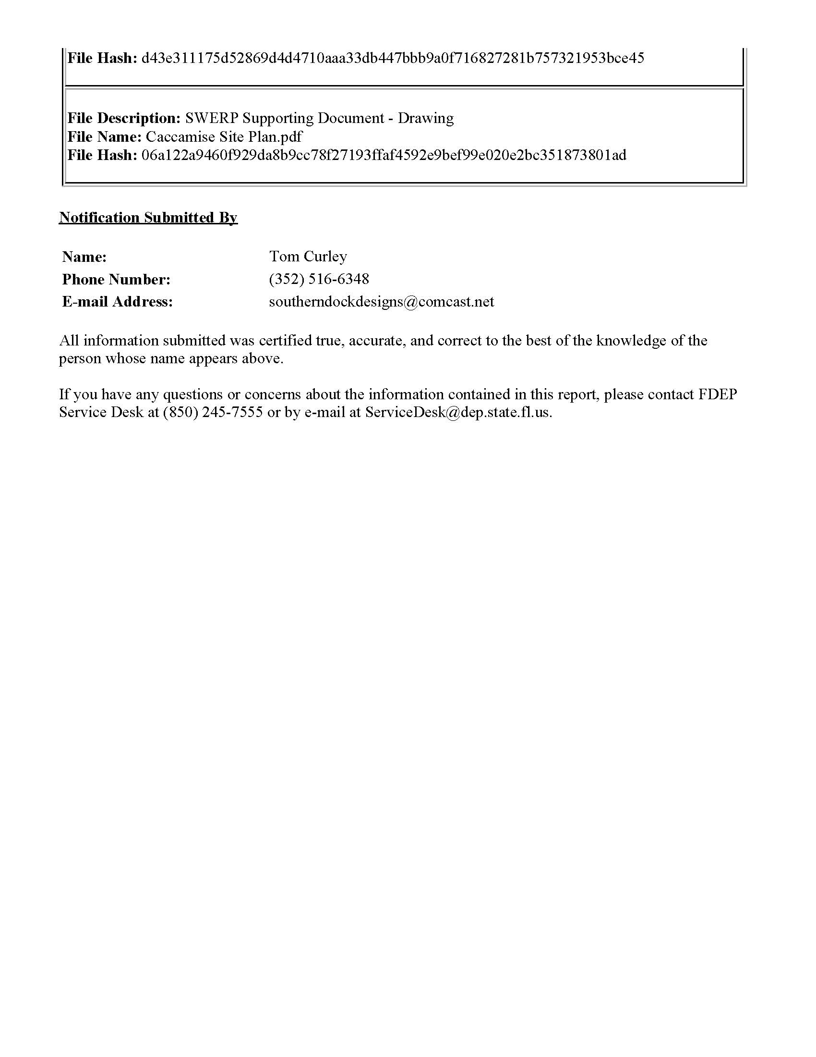
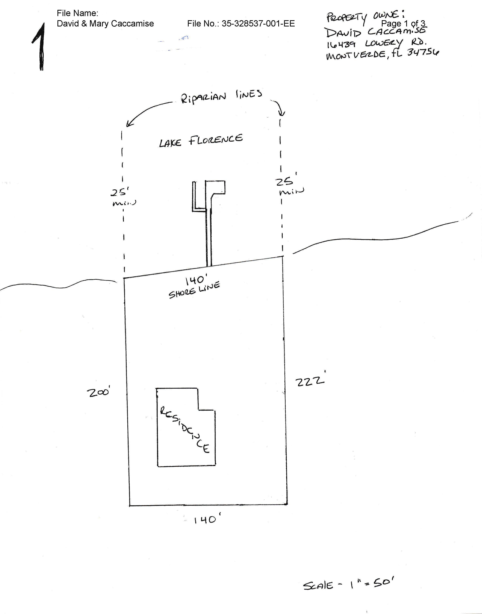

Slide 18
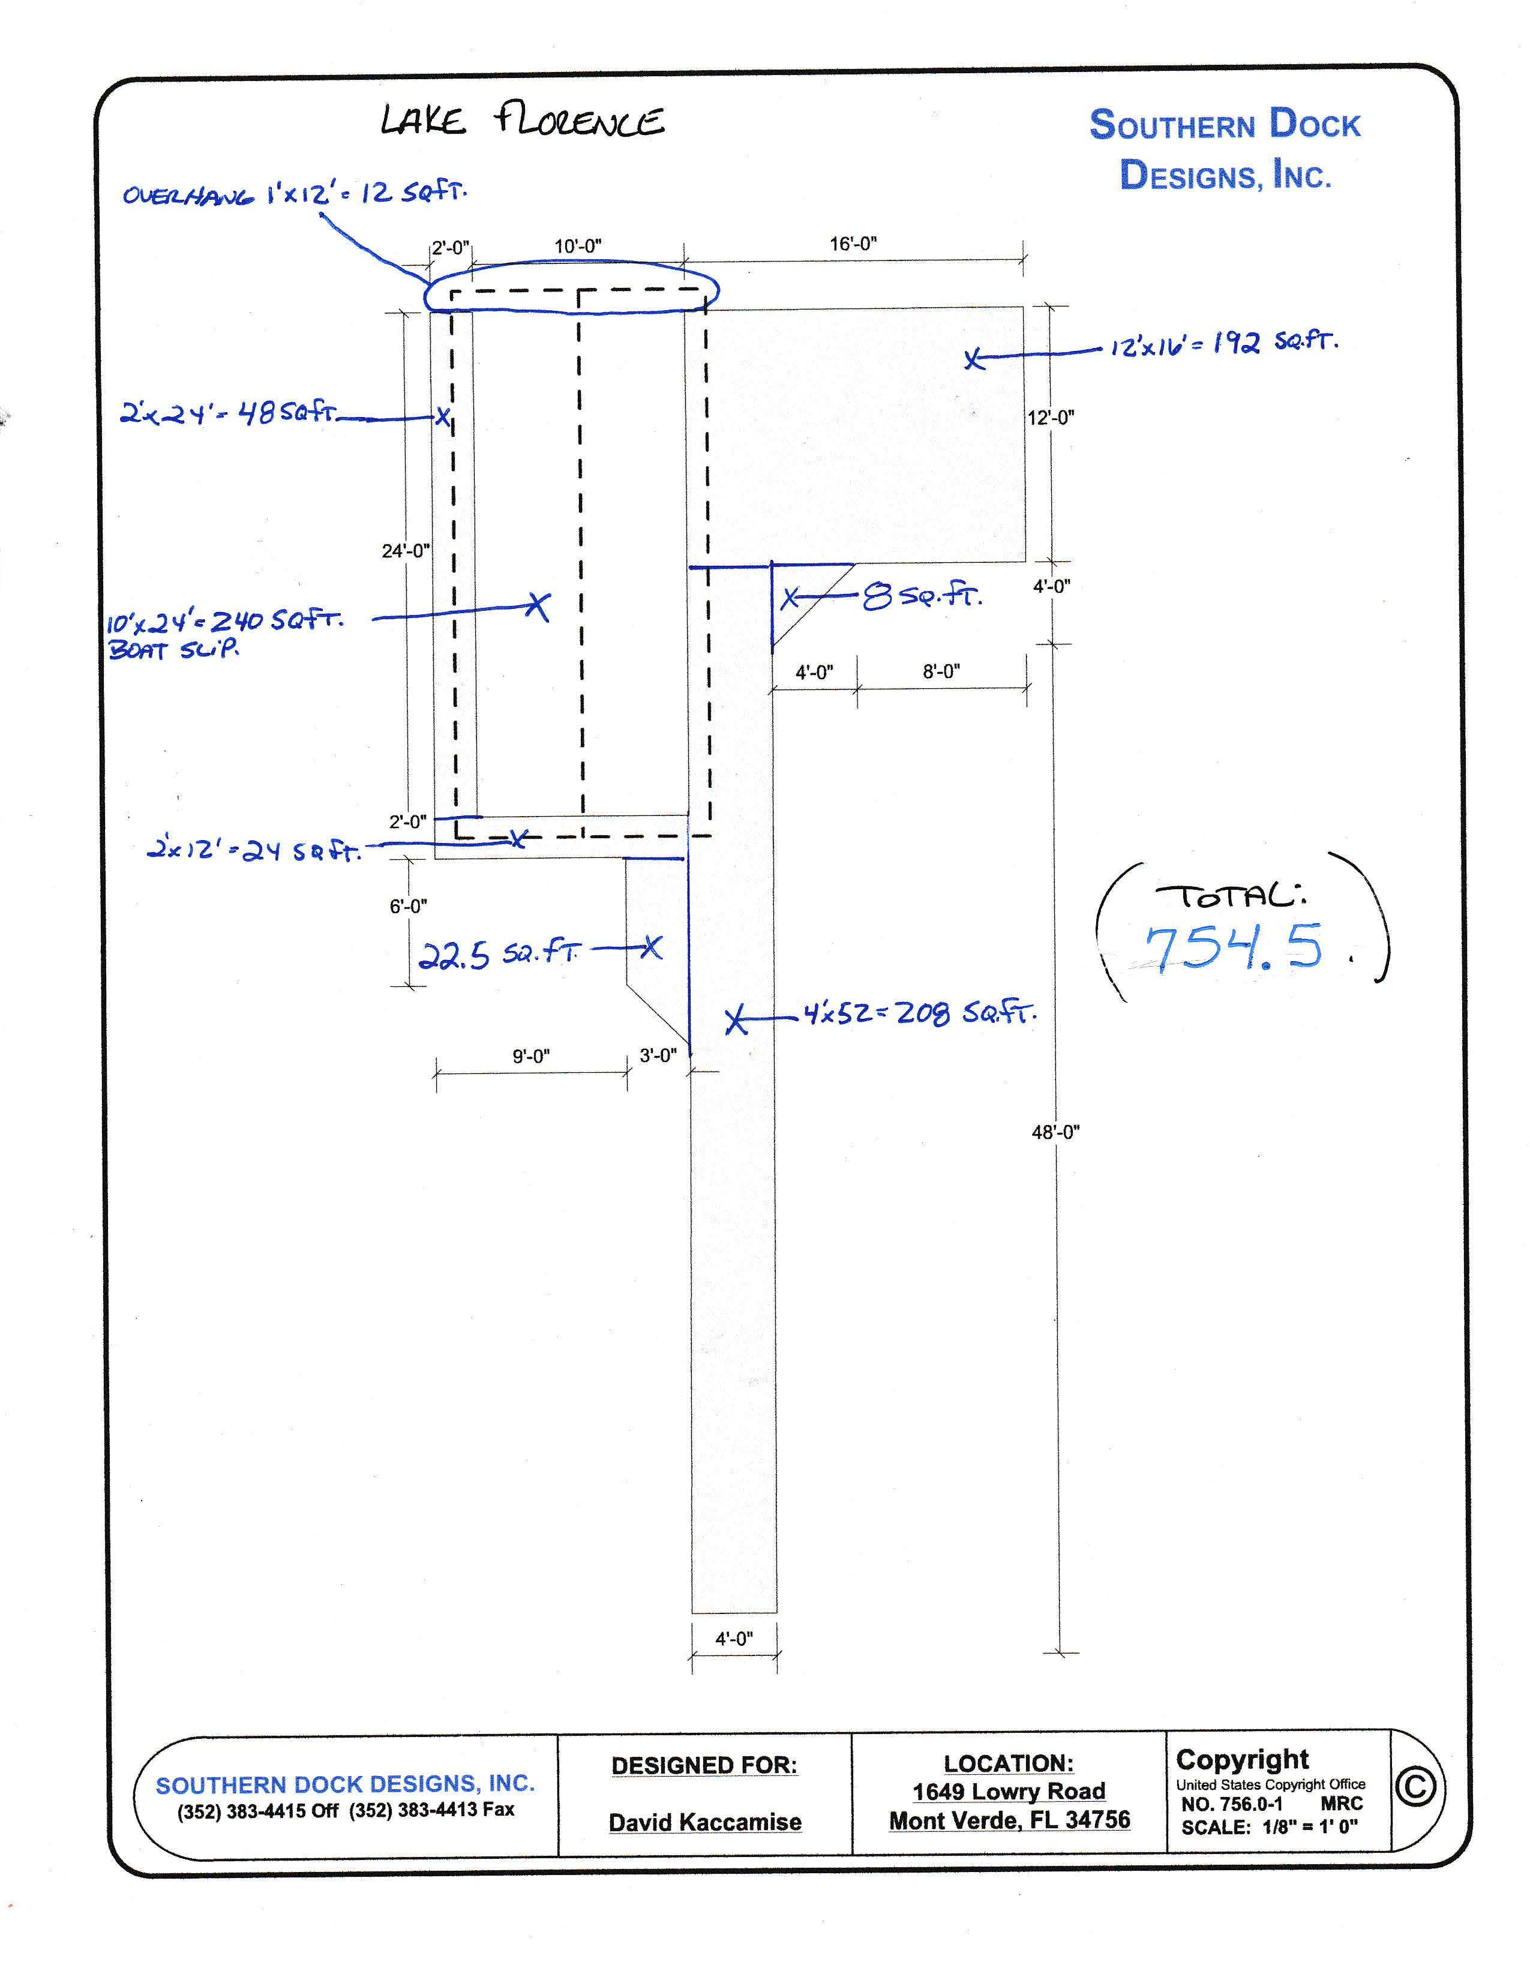
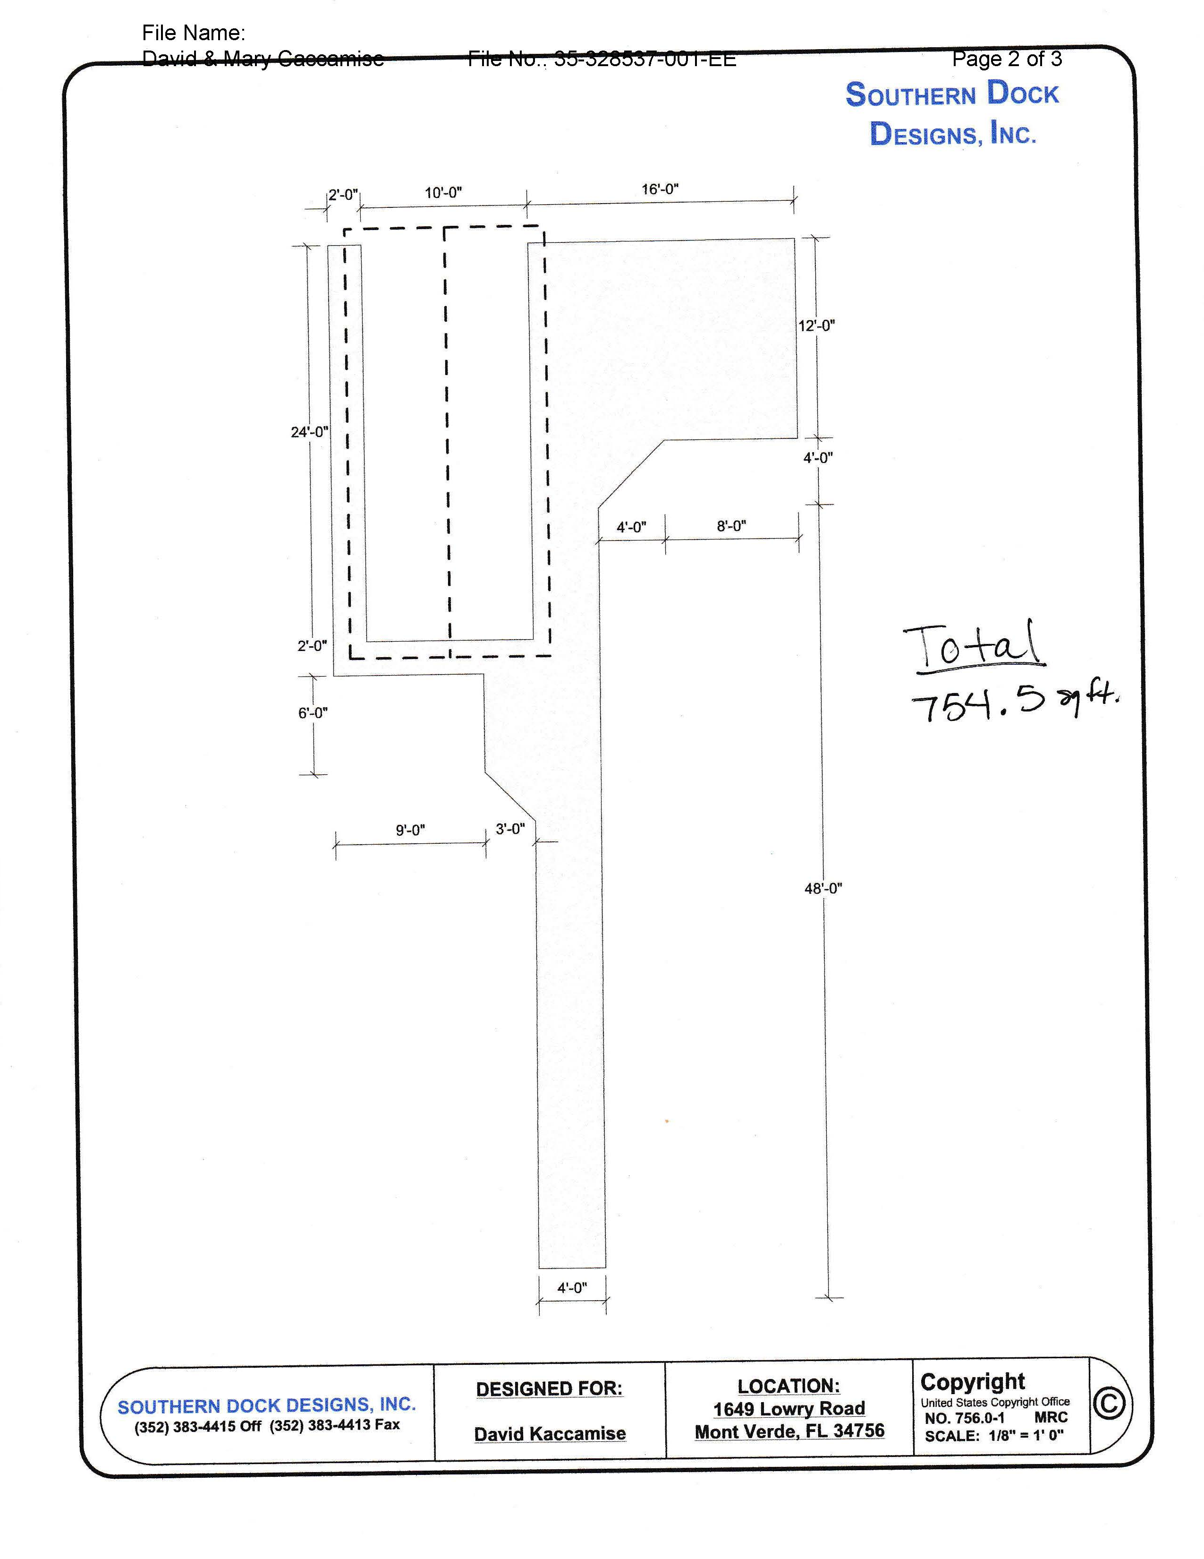

Slide 19
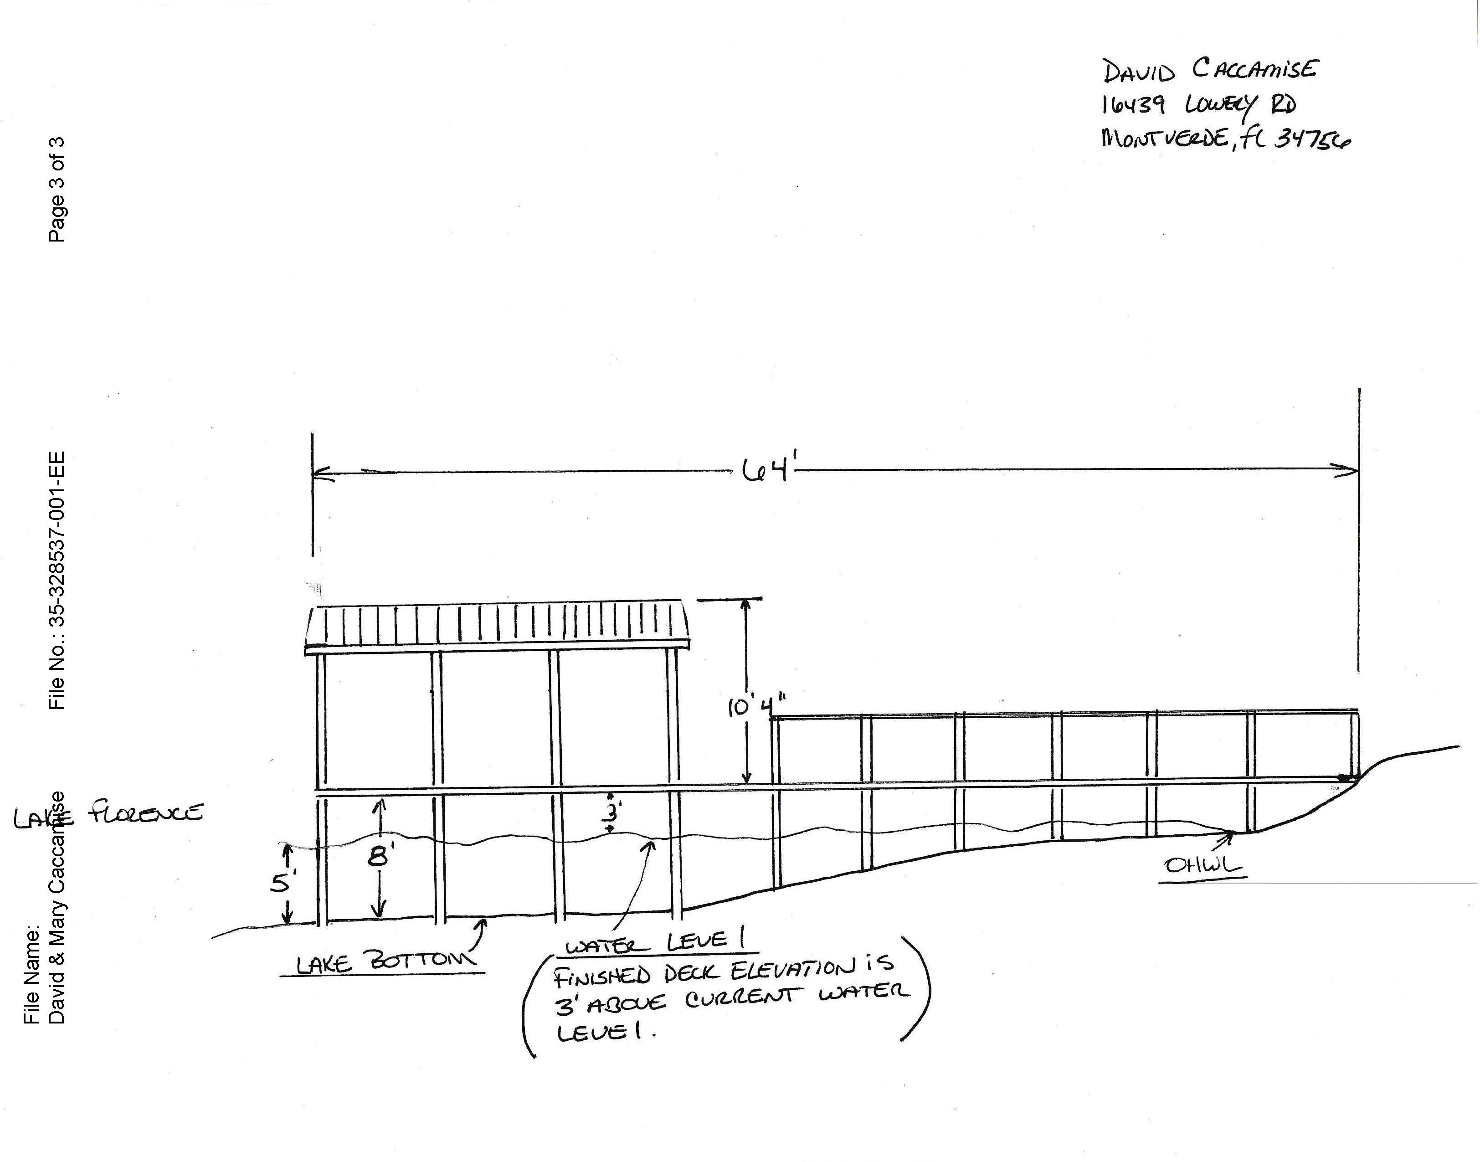
Notes:
Cross section

Slide 20
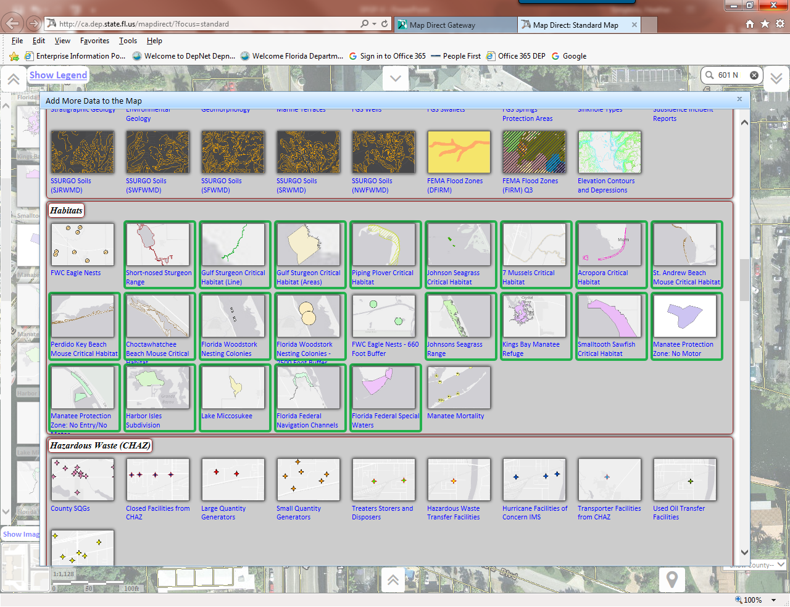

Slide 21
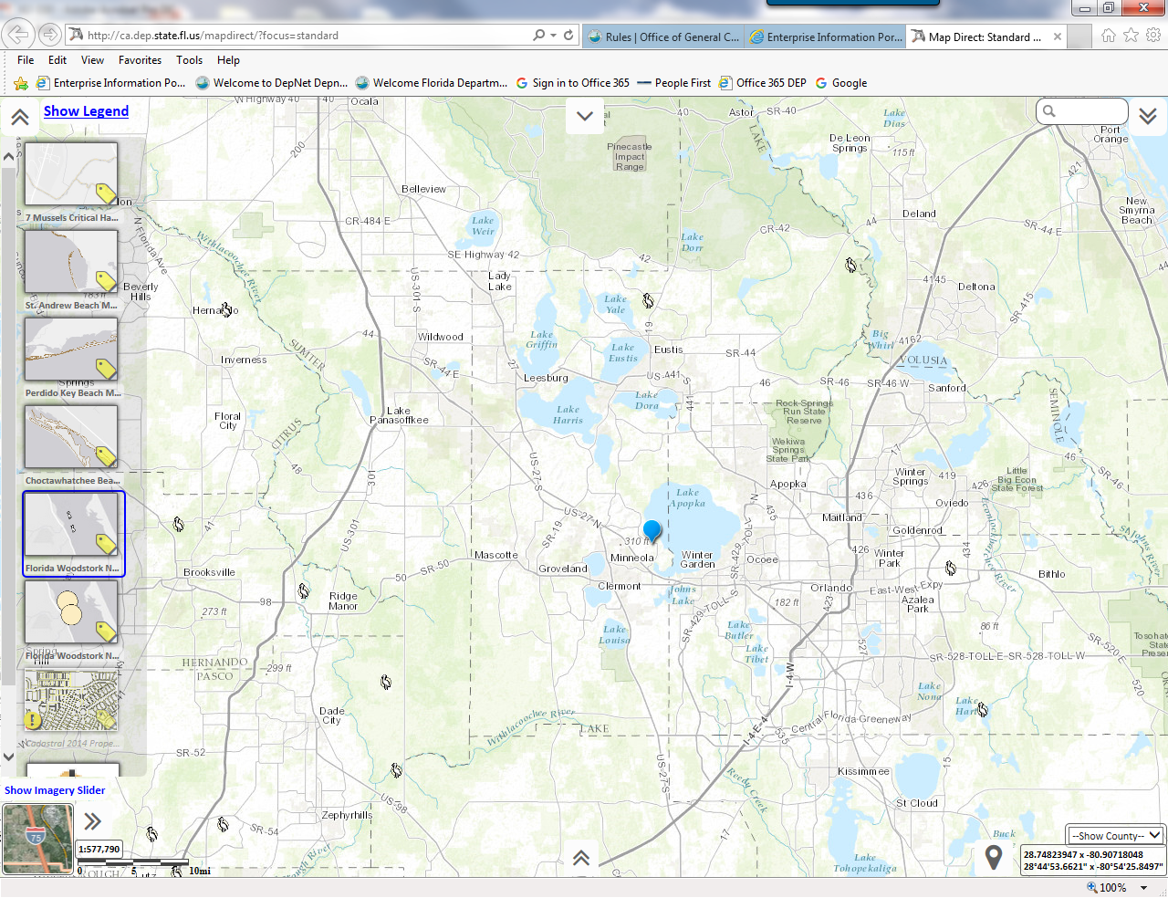

Slide 22
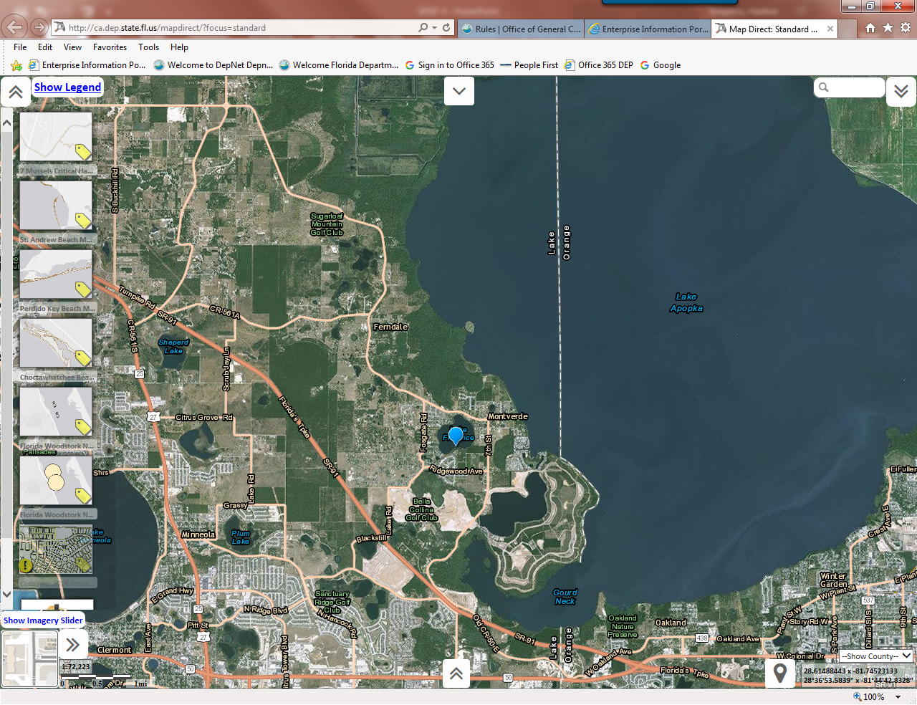

Slide 23
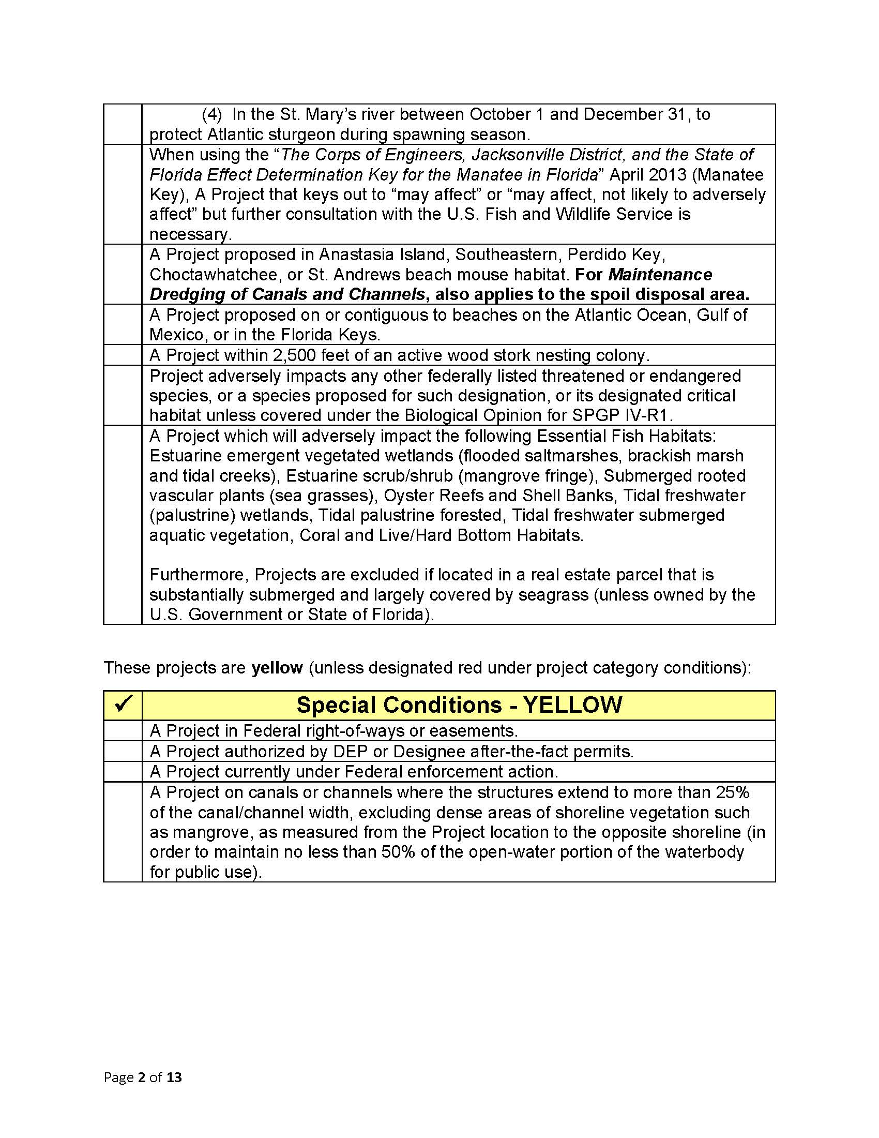
Notes:
Highlight geographic boundaries within your district…
(4) Most of St. Marys excluded anyways
Manatee Key “further consultation required” ex. : multi slip facility in certain counties and repair or rehabilitation of a multi slip in an important manatee area. Pag. 5 of 12 / Att. 3

Slide 24
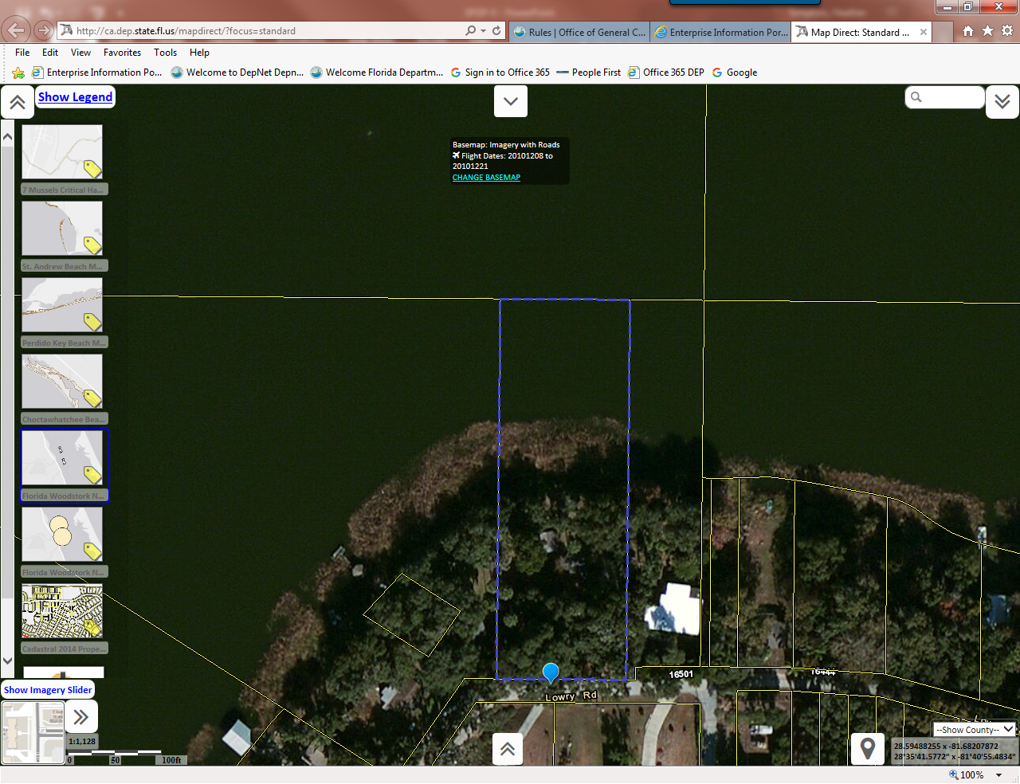

Slide 25
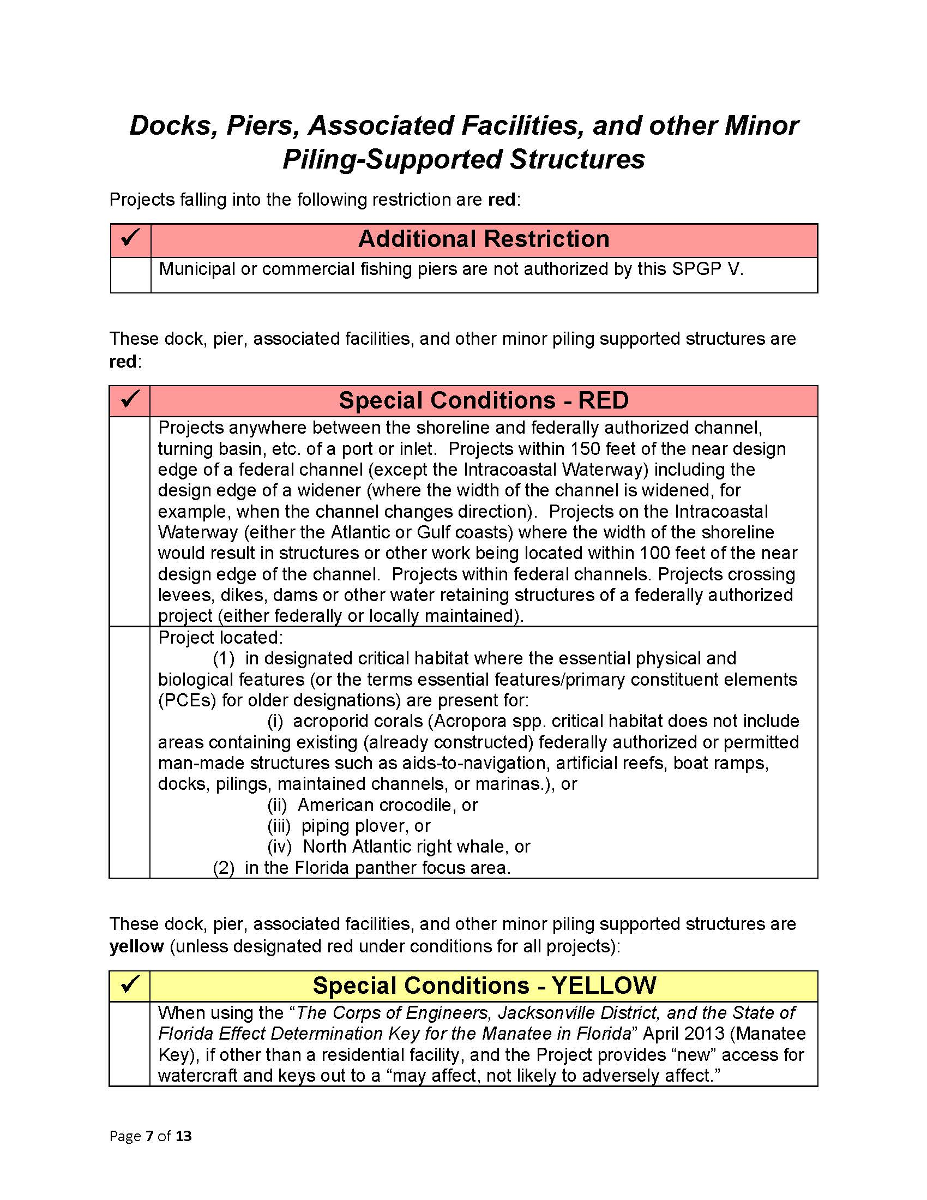
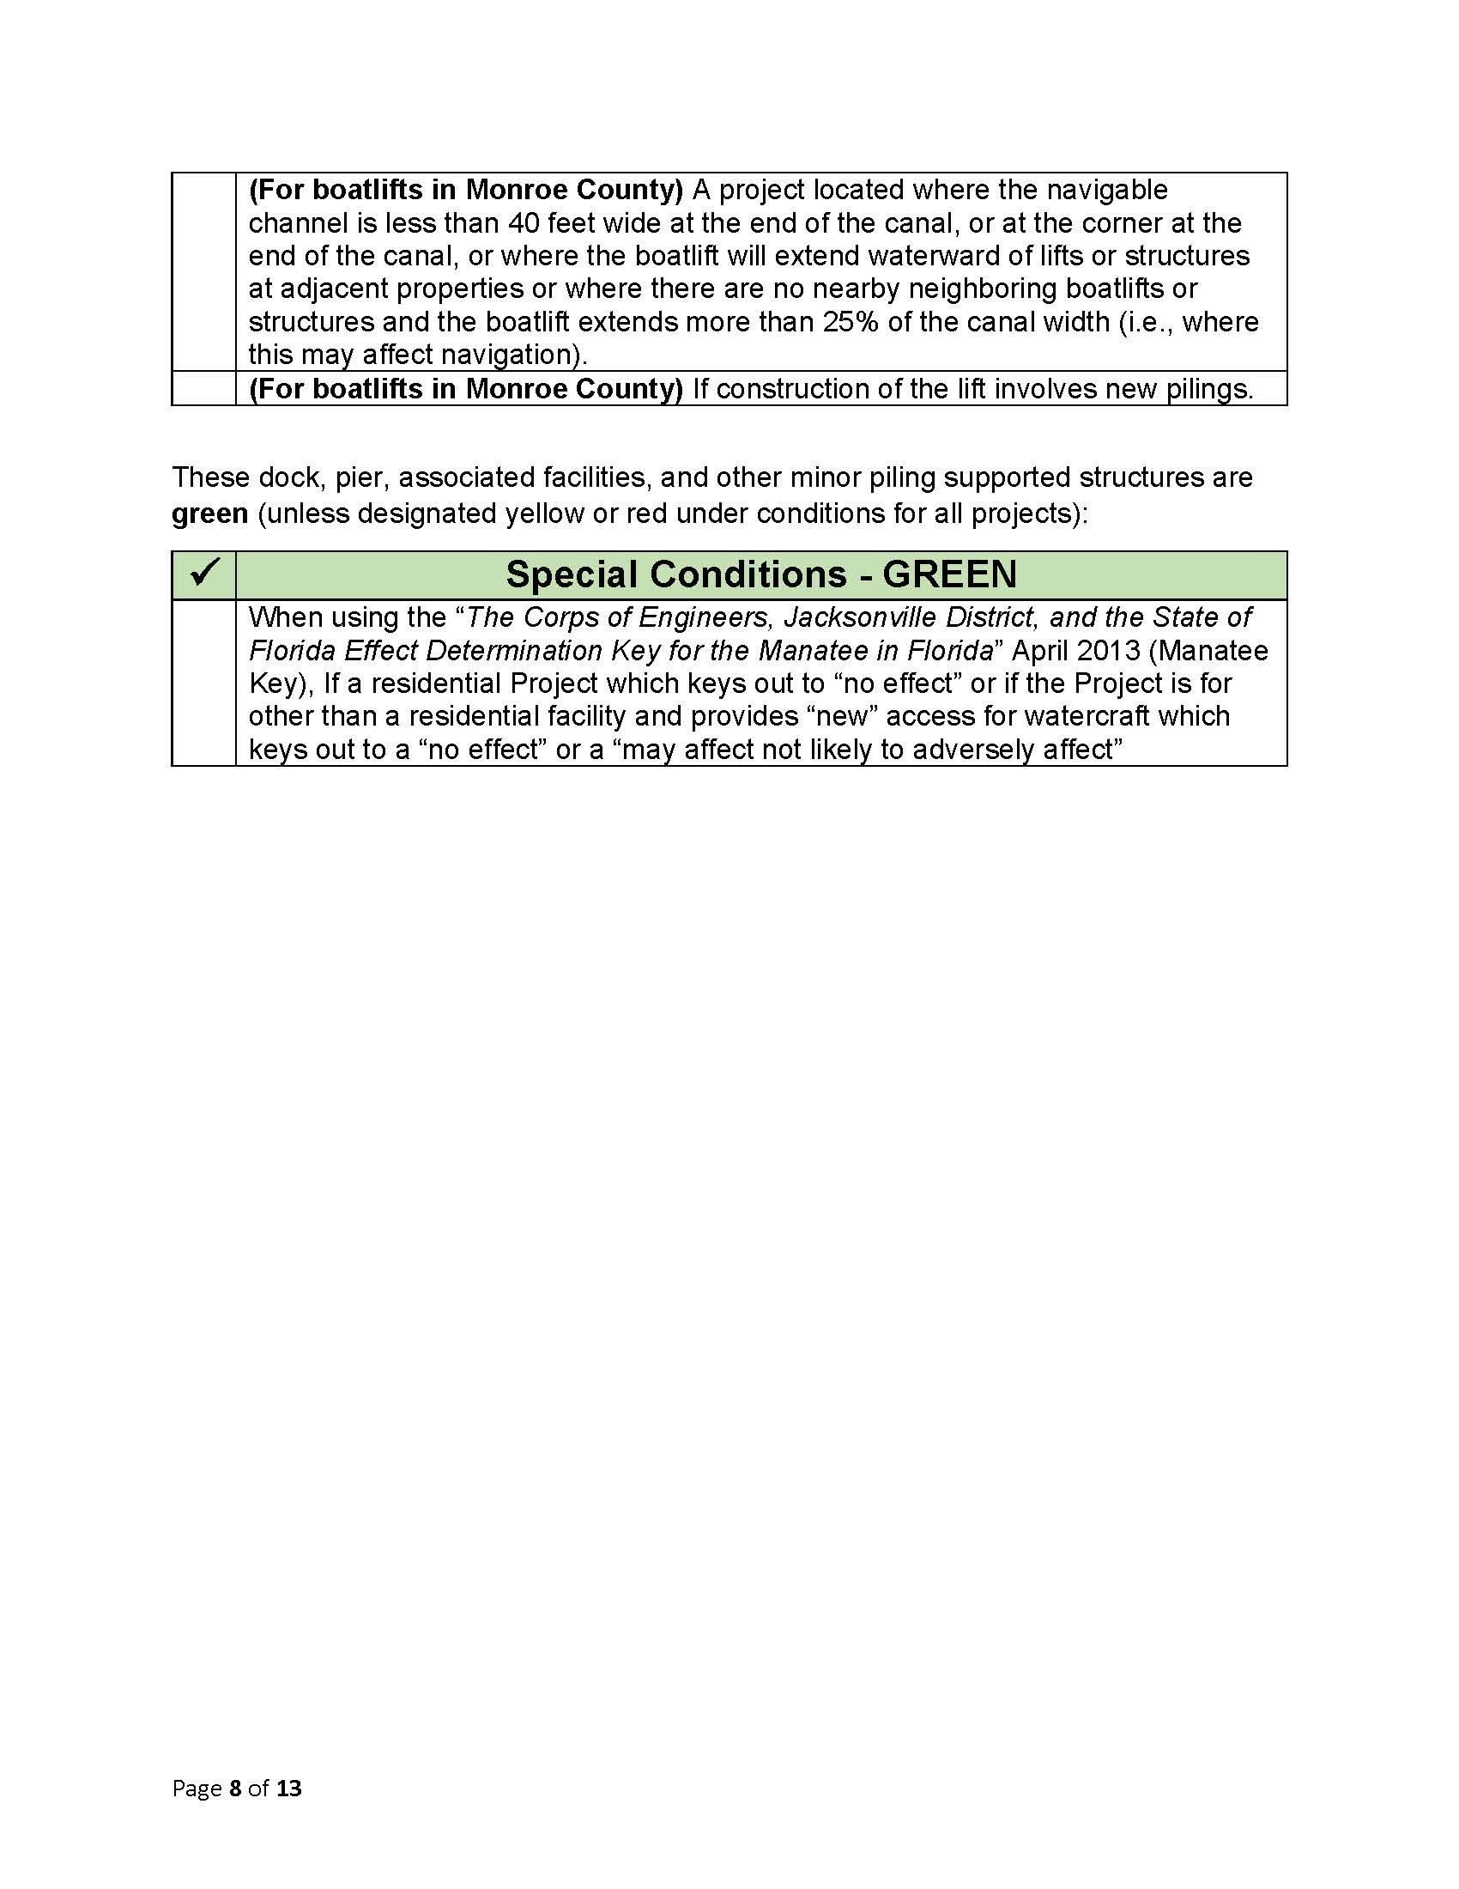
Notes:
Additional Restrictions were included in Cheat Sheets
not manatee acessable

Slide 26
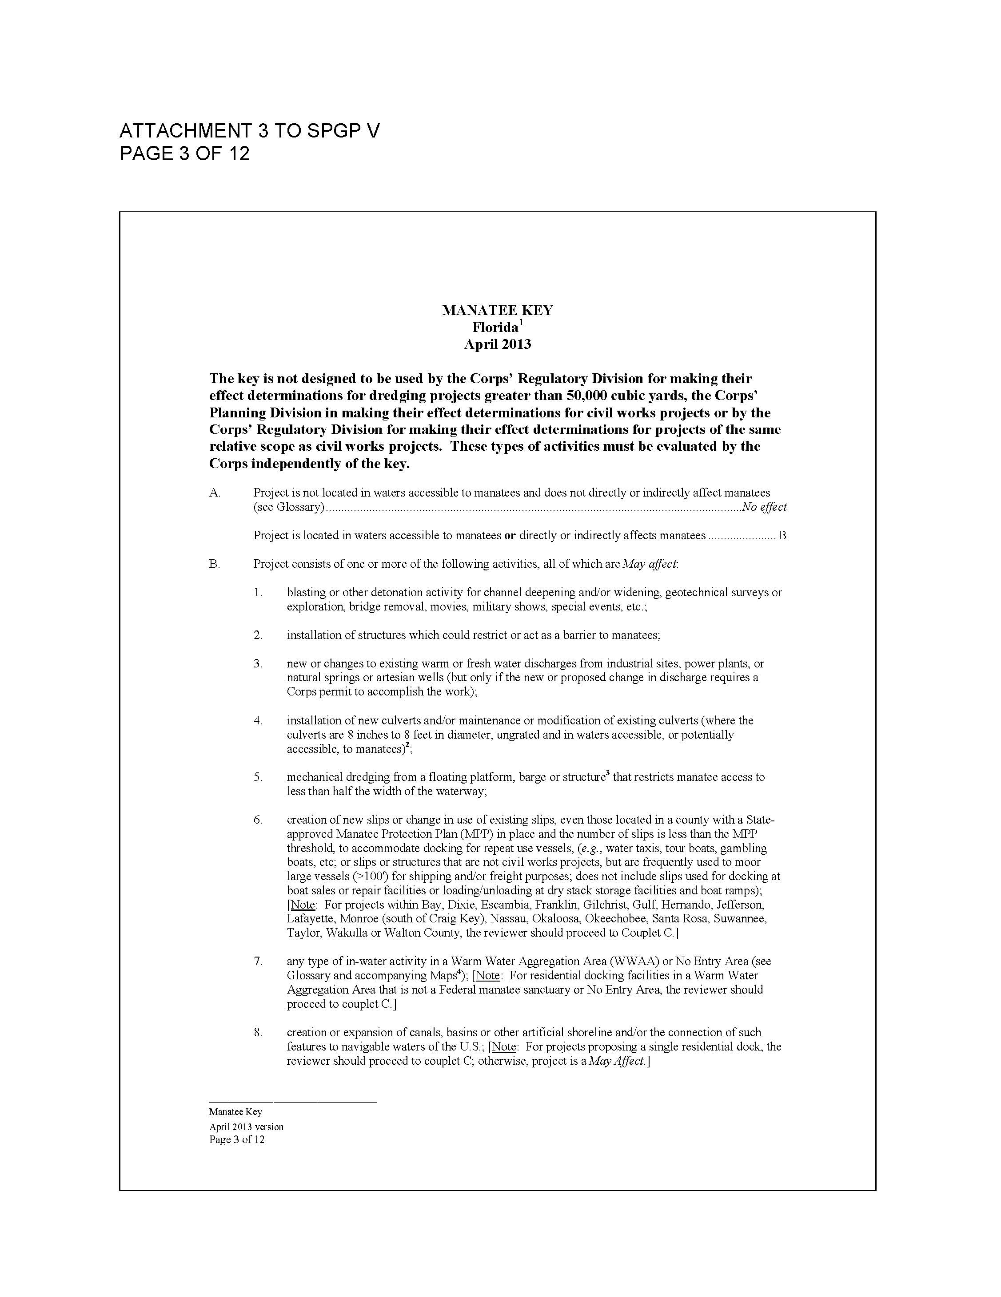

Slide 27
Seawall Application
Example 2

Slide 28
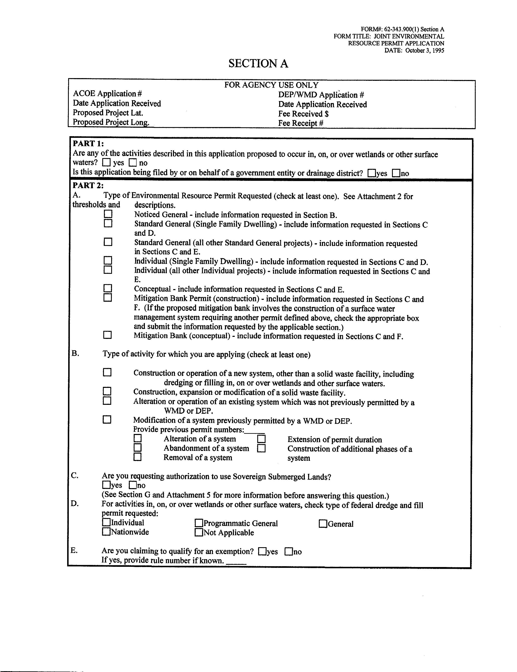
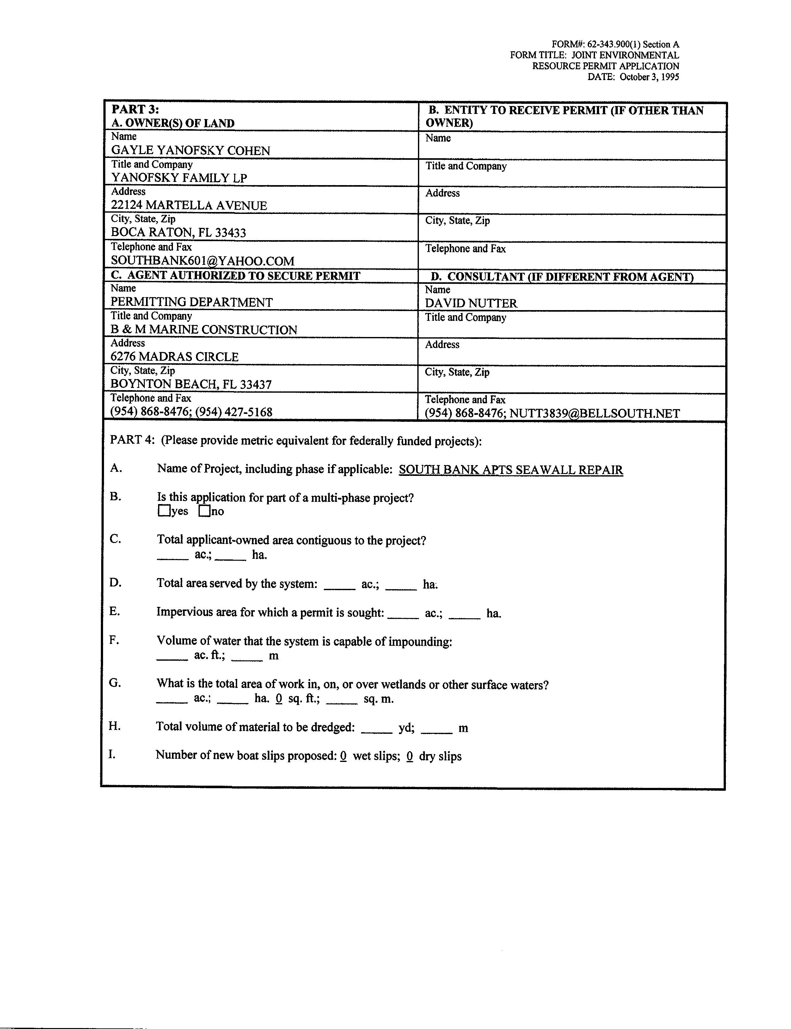

Slide 29
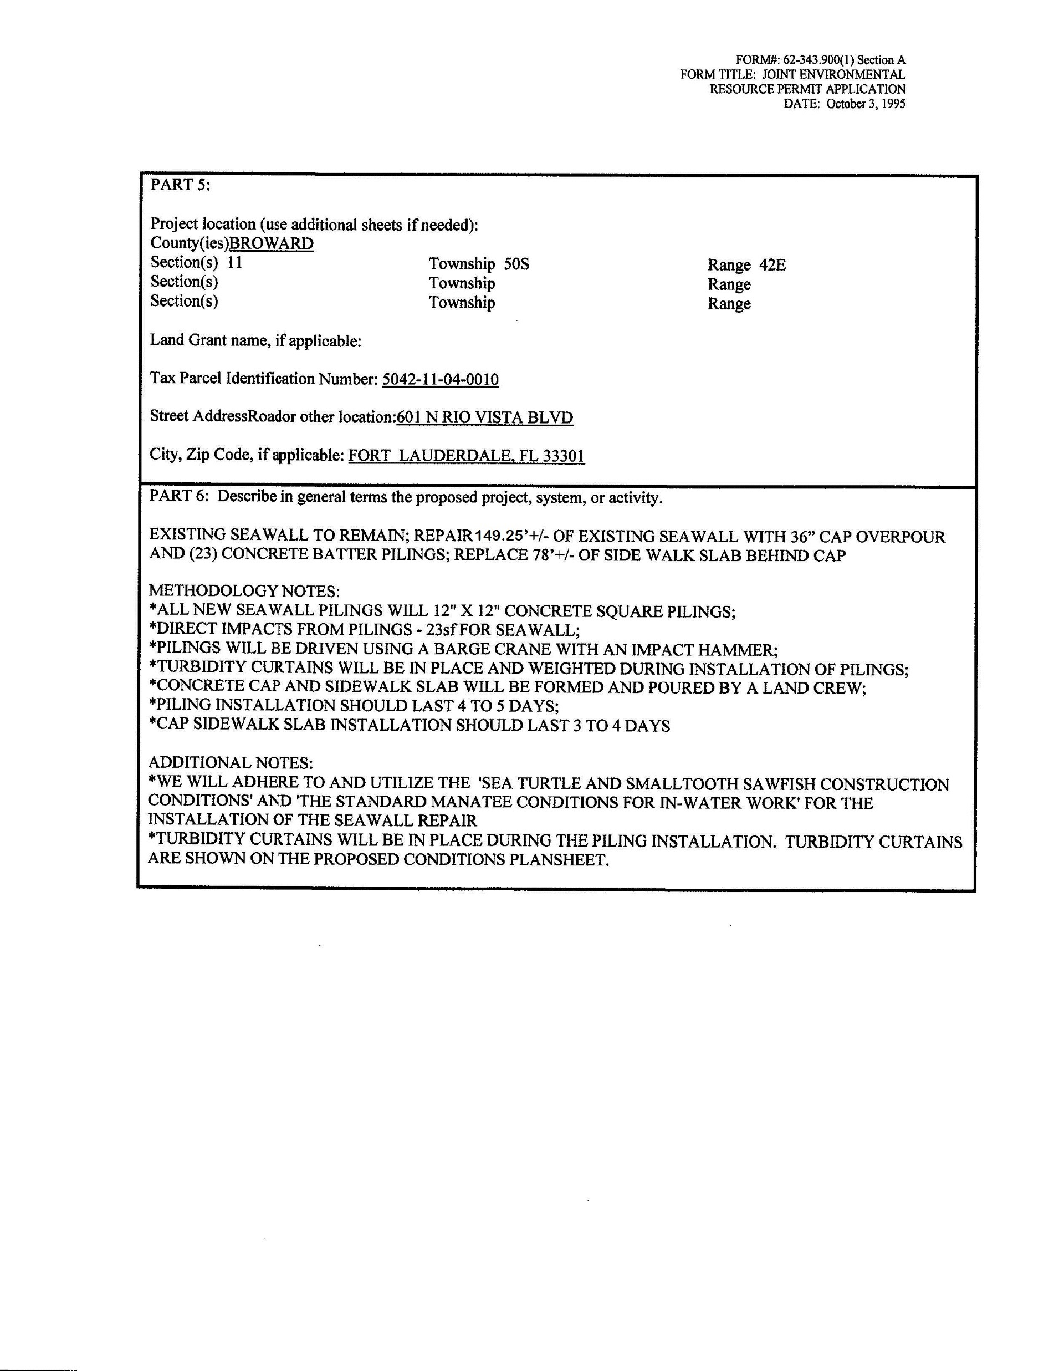
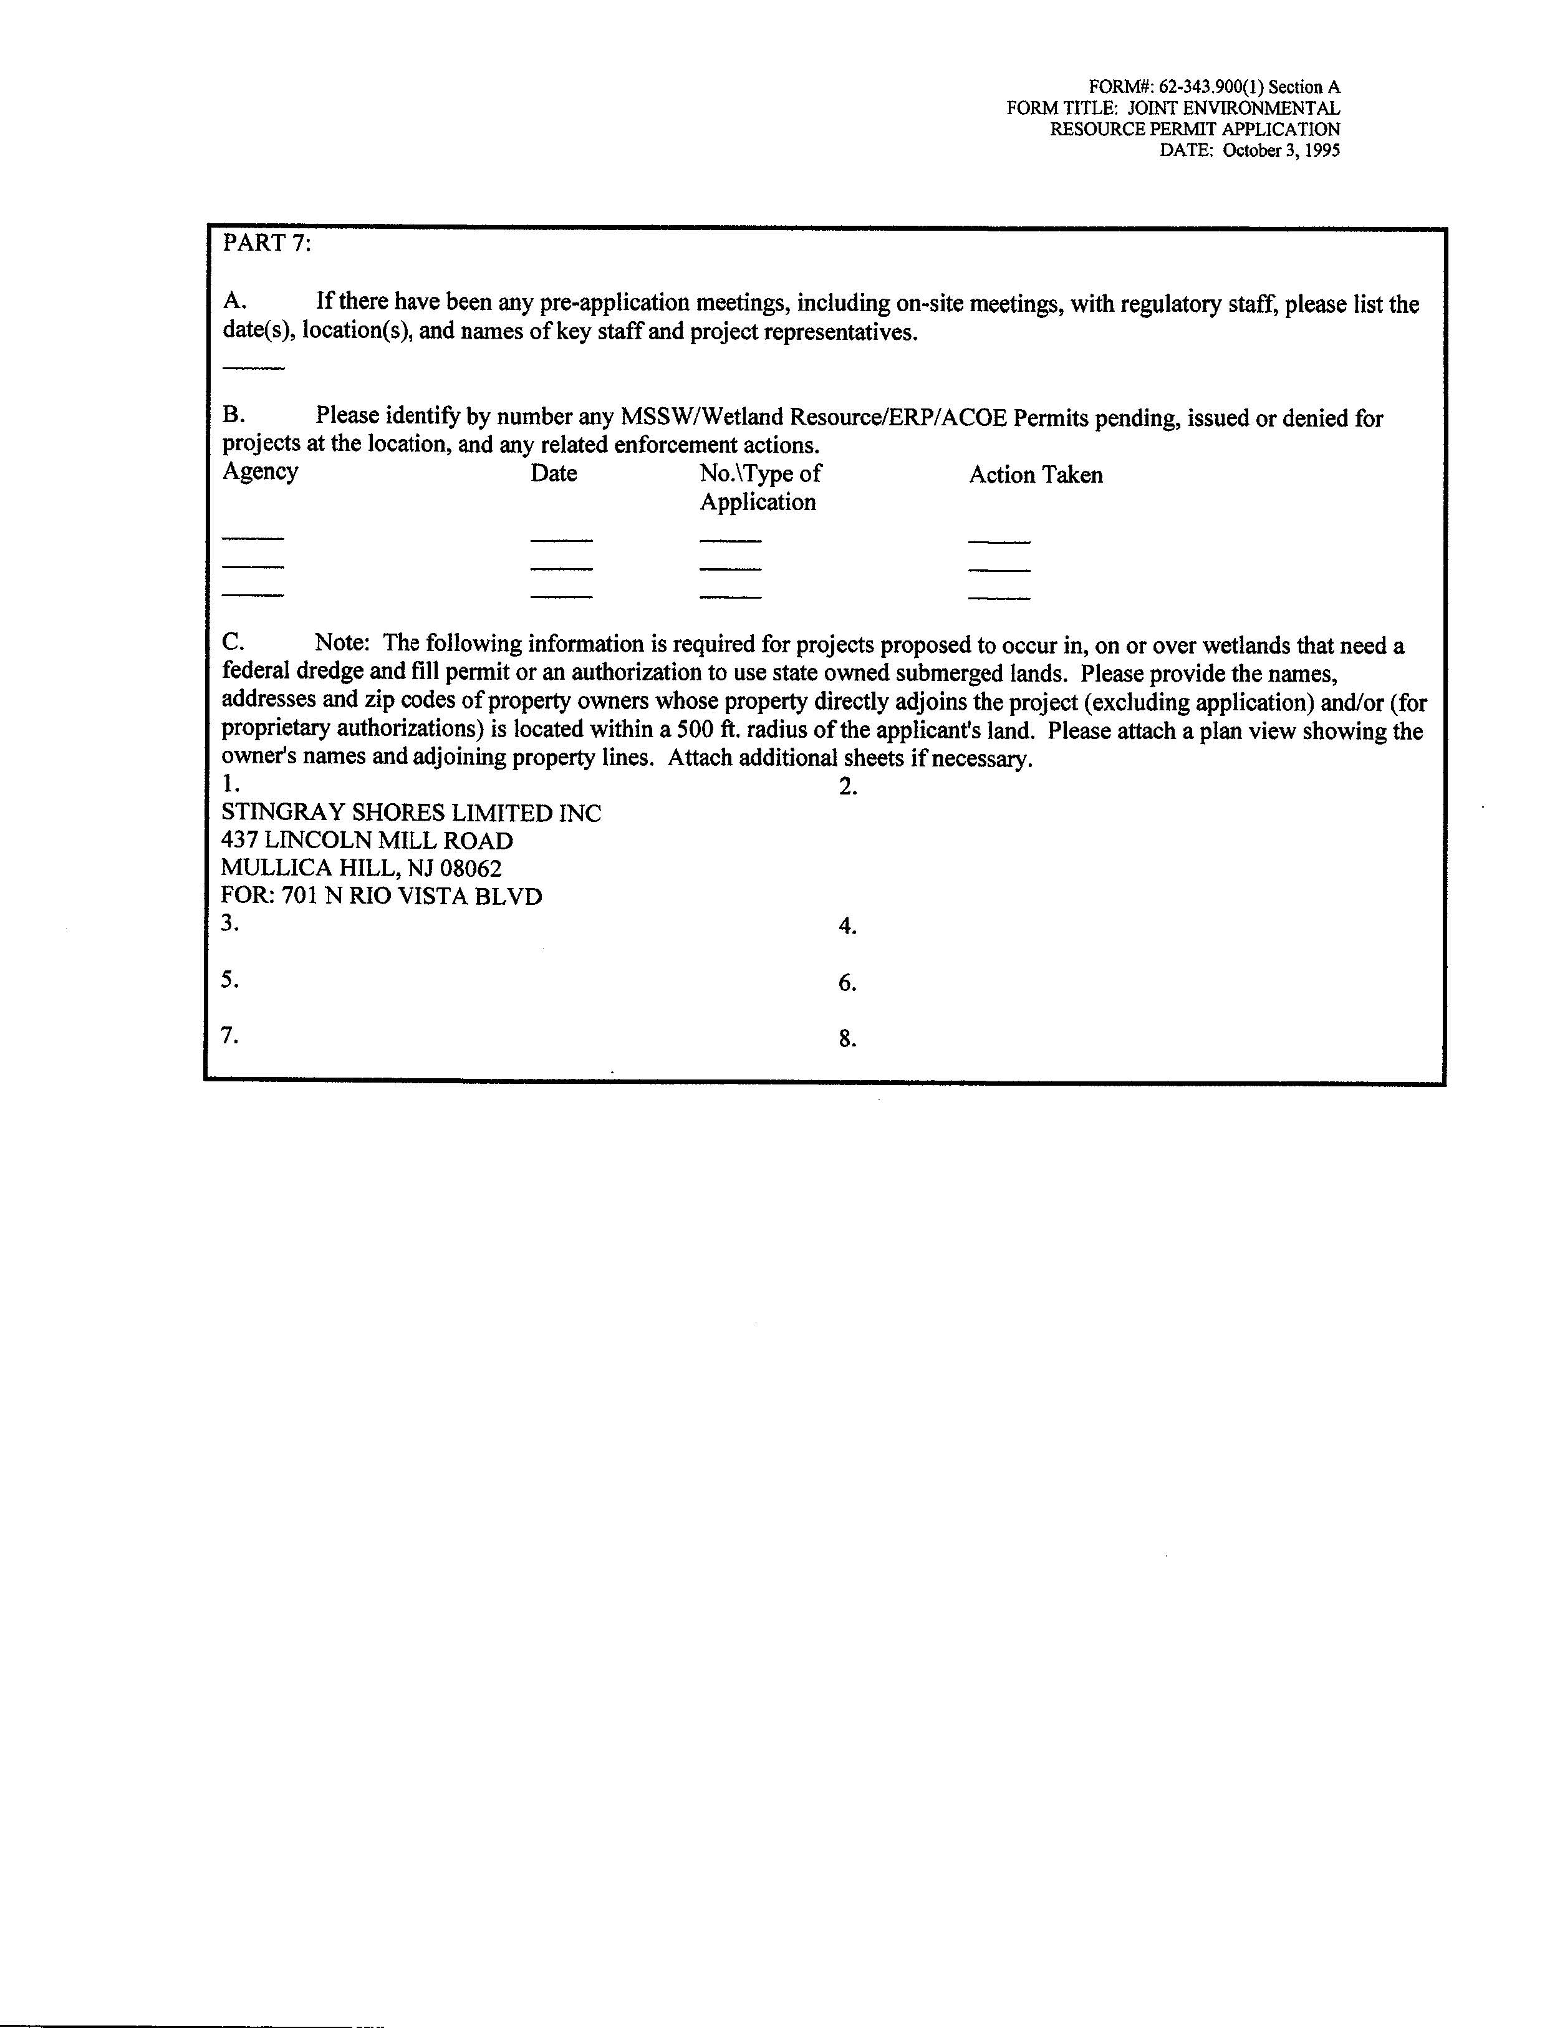

Slide 30
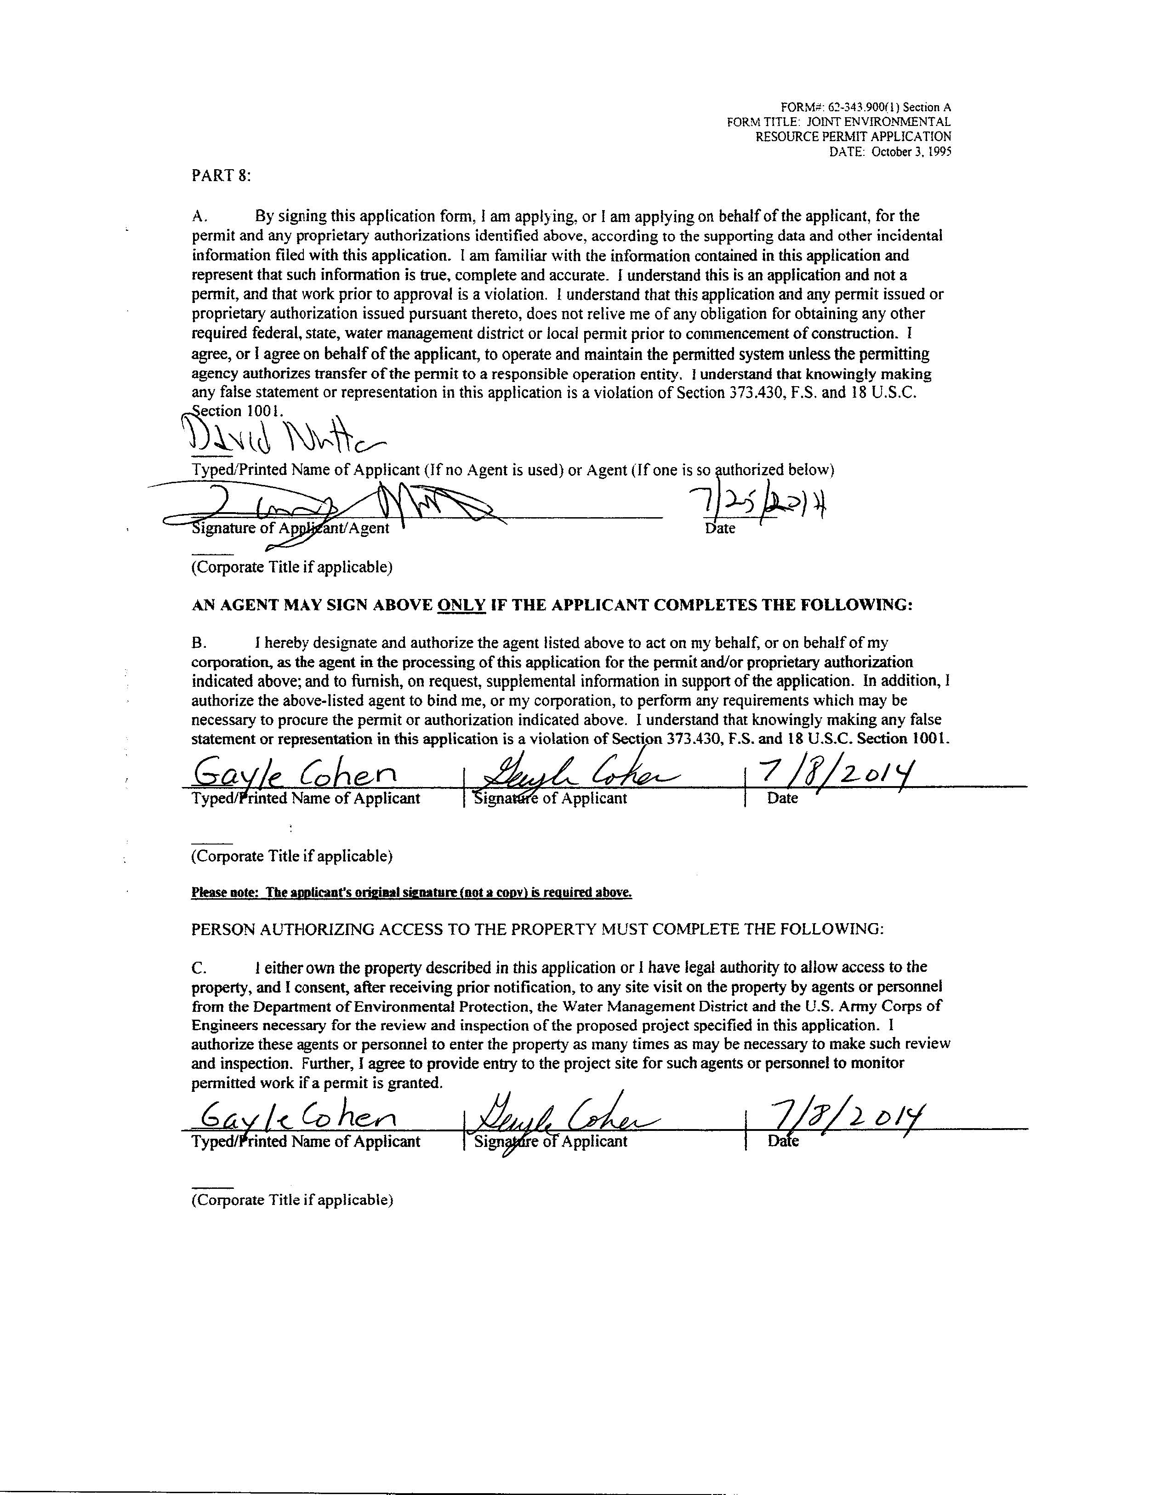
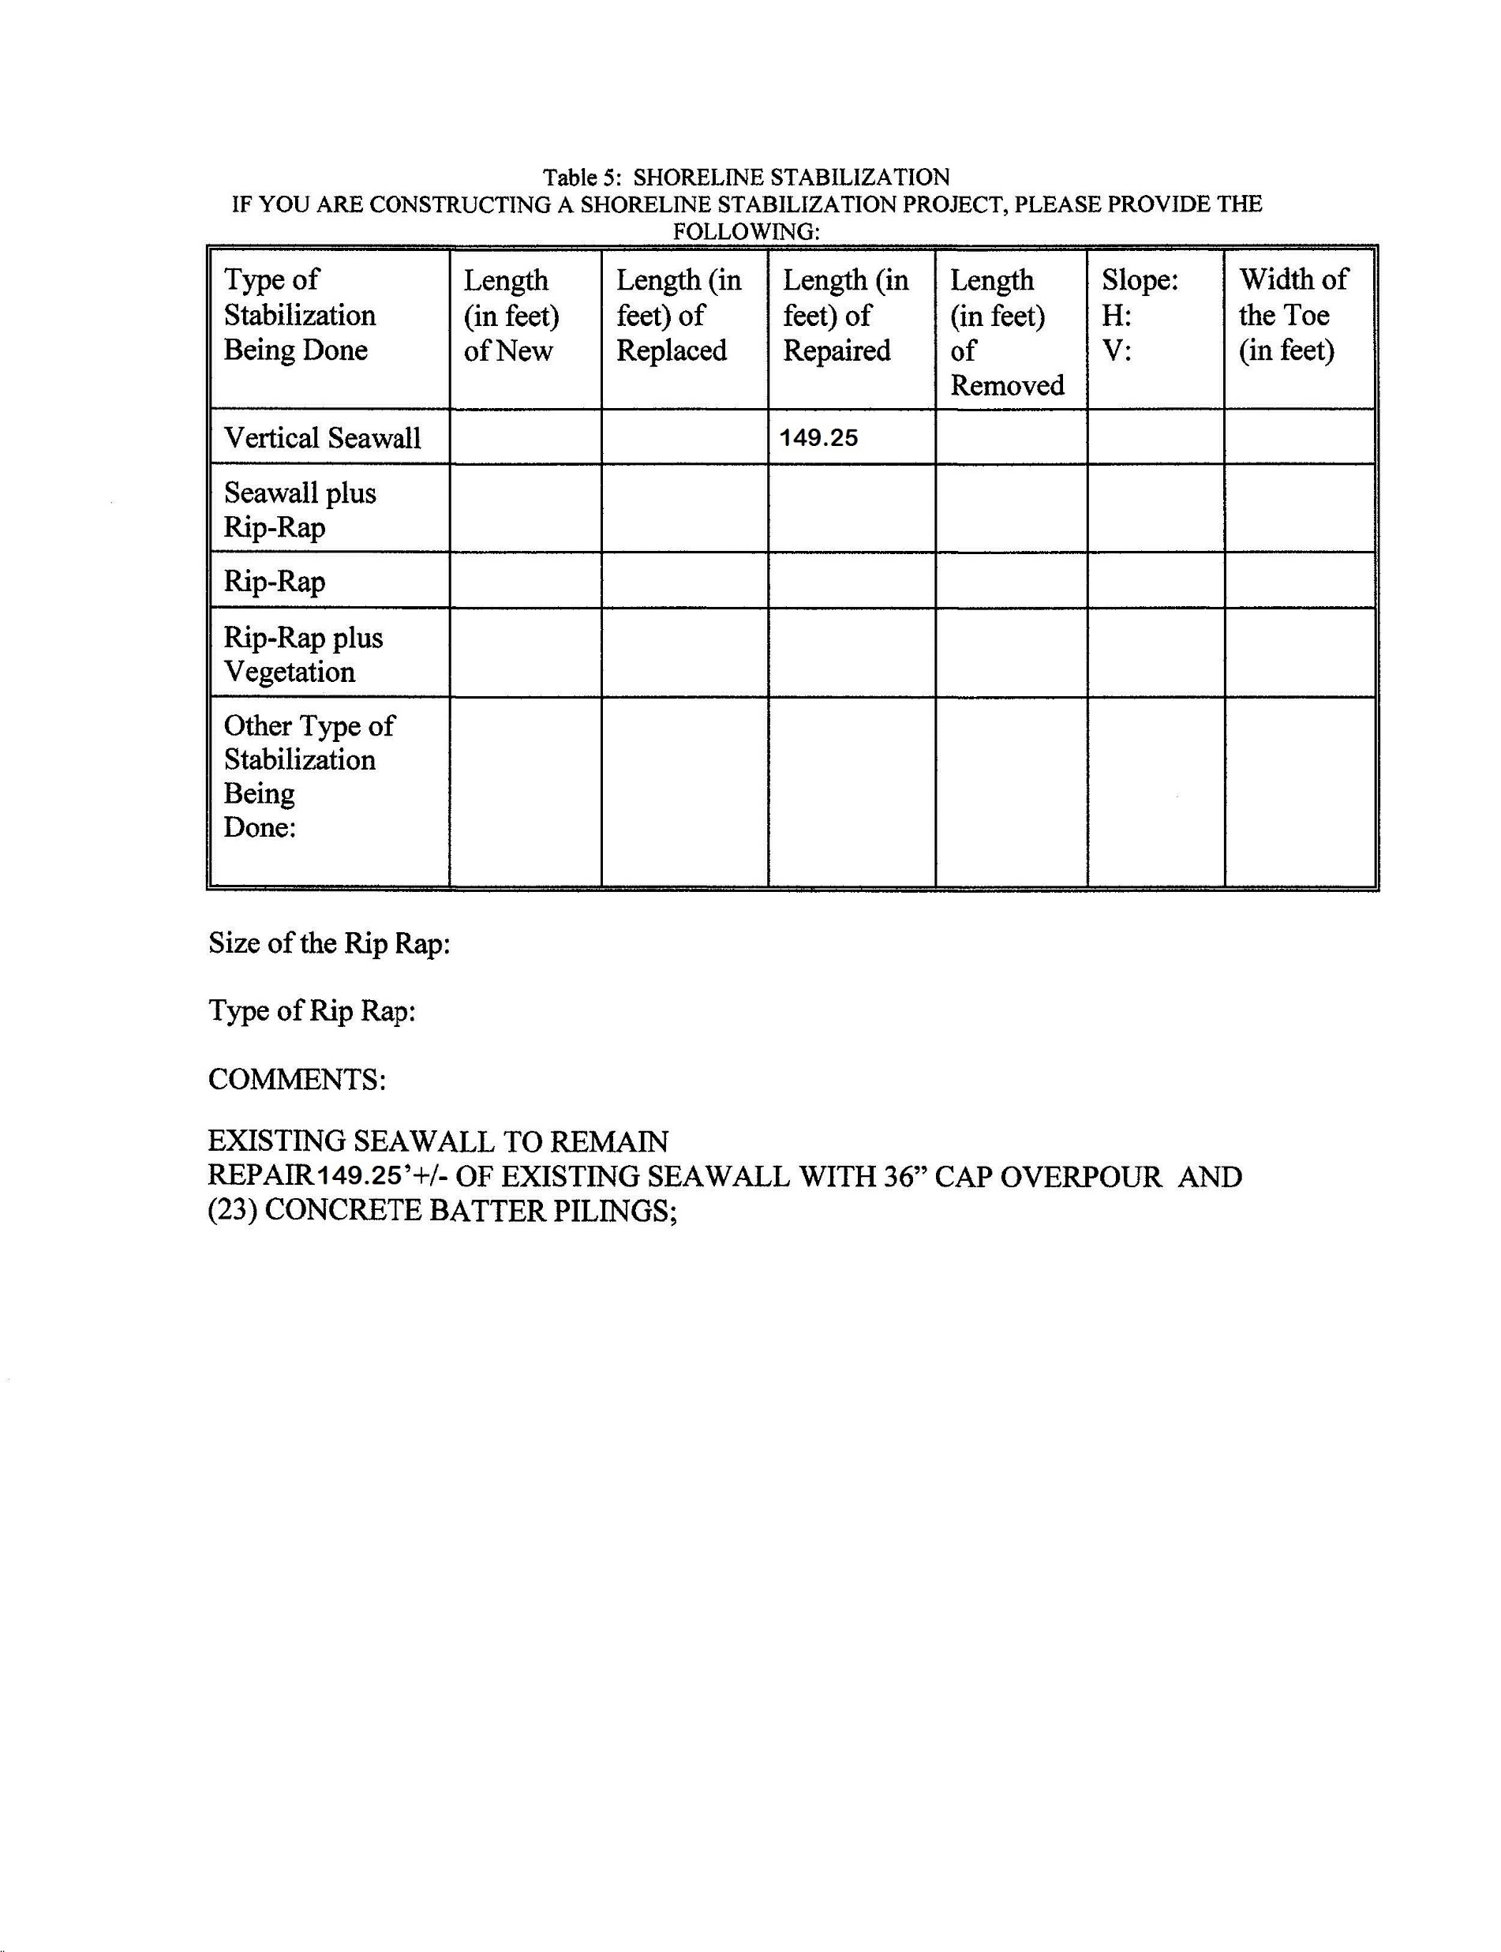

Slide 31
Permit Instrument: Work Authorized-pg.2
Some Restrictions will be listed under the activity categories.
Additional Restrictions are also located within the Synopsis of some of the activity types.
Notes:
Activity categories- ex: “Groins, jettie,…..”
Synopsis: red font in tables

Slide 32
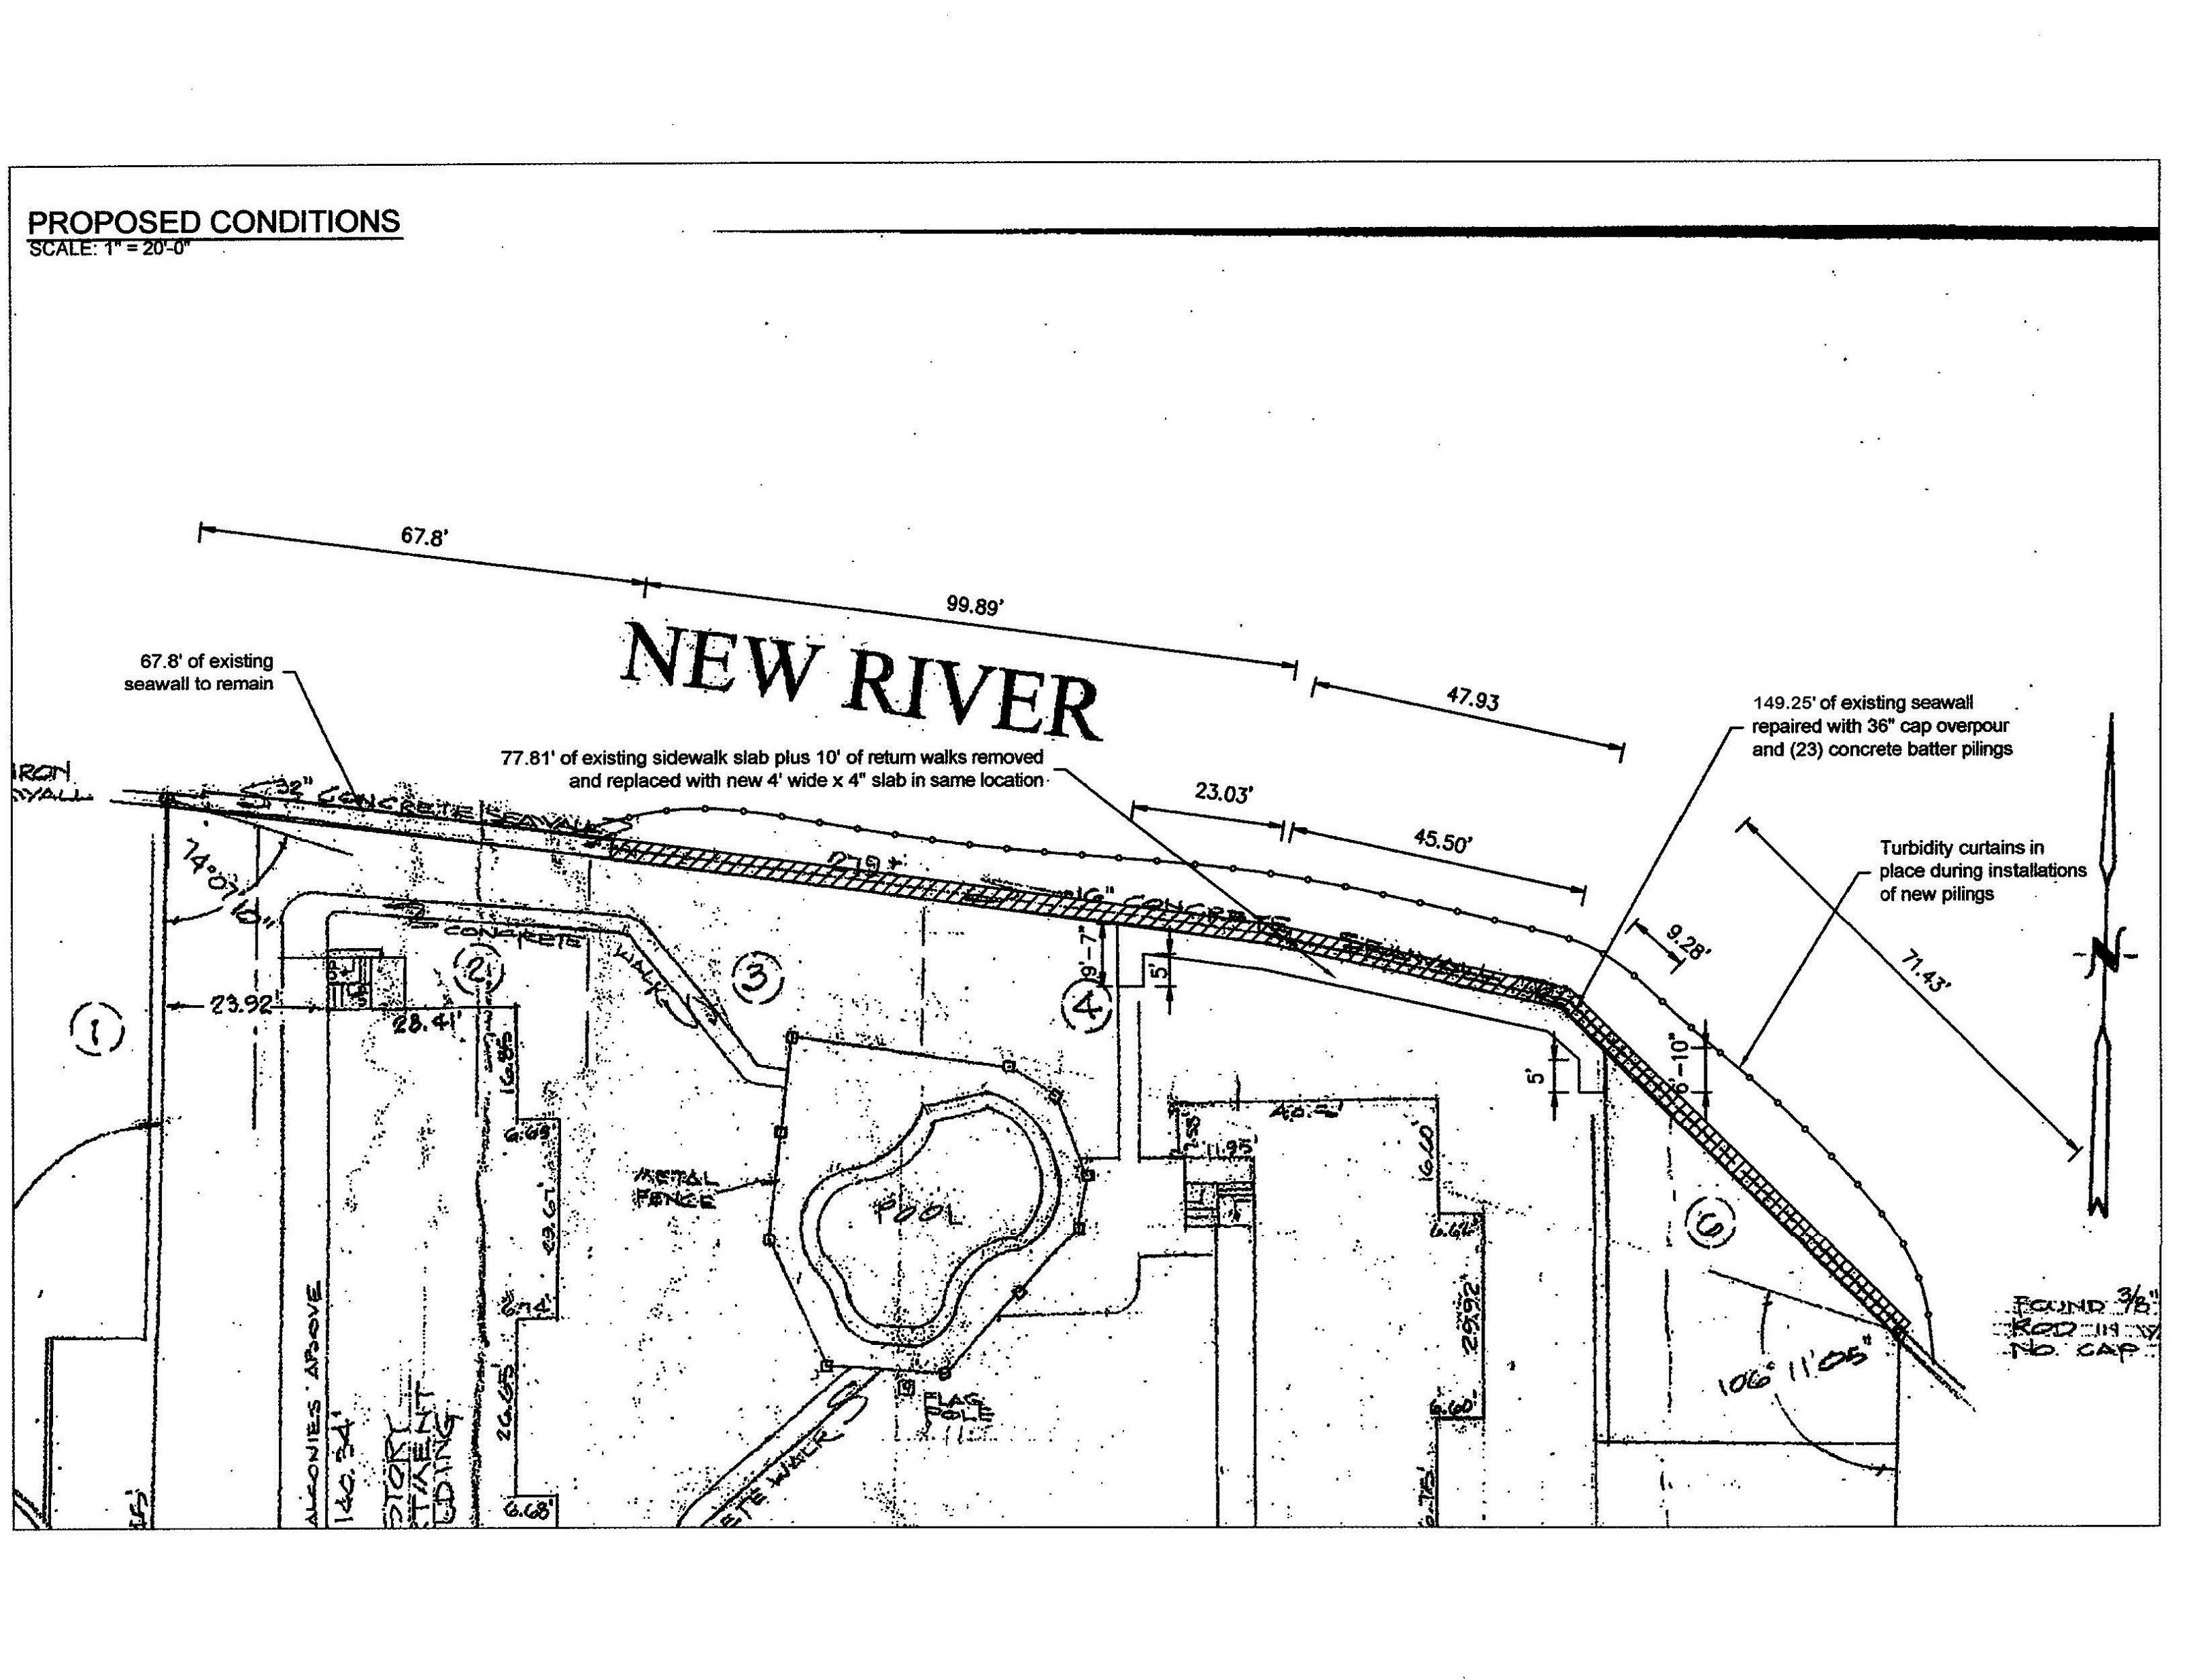

Slide 33
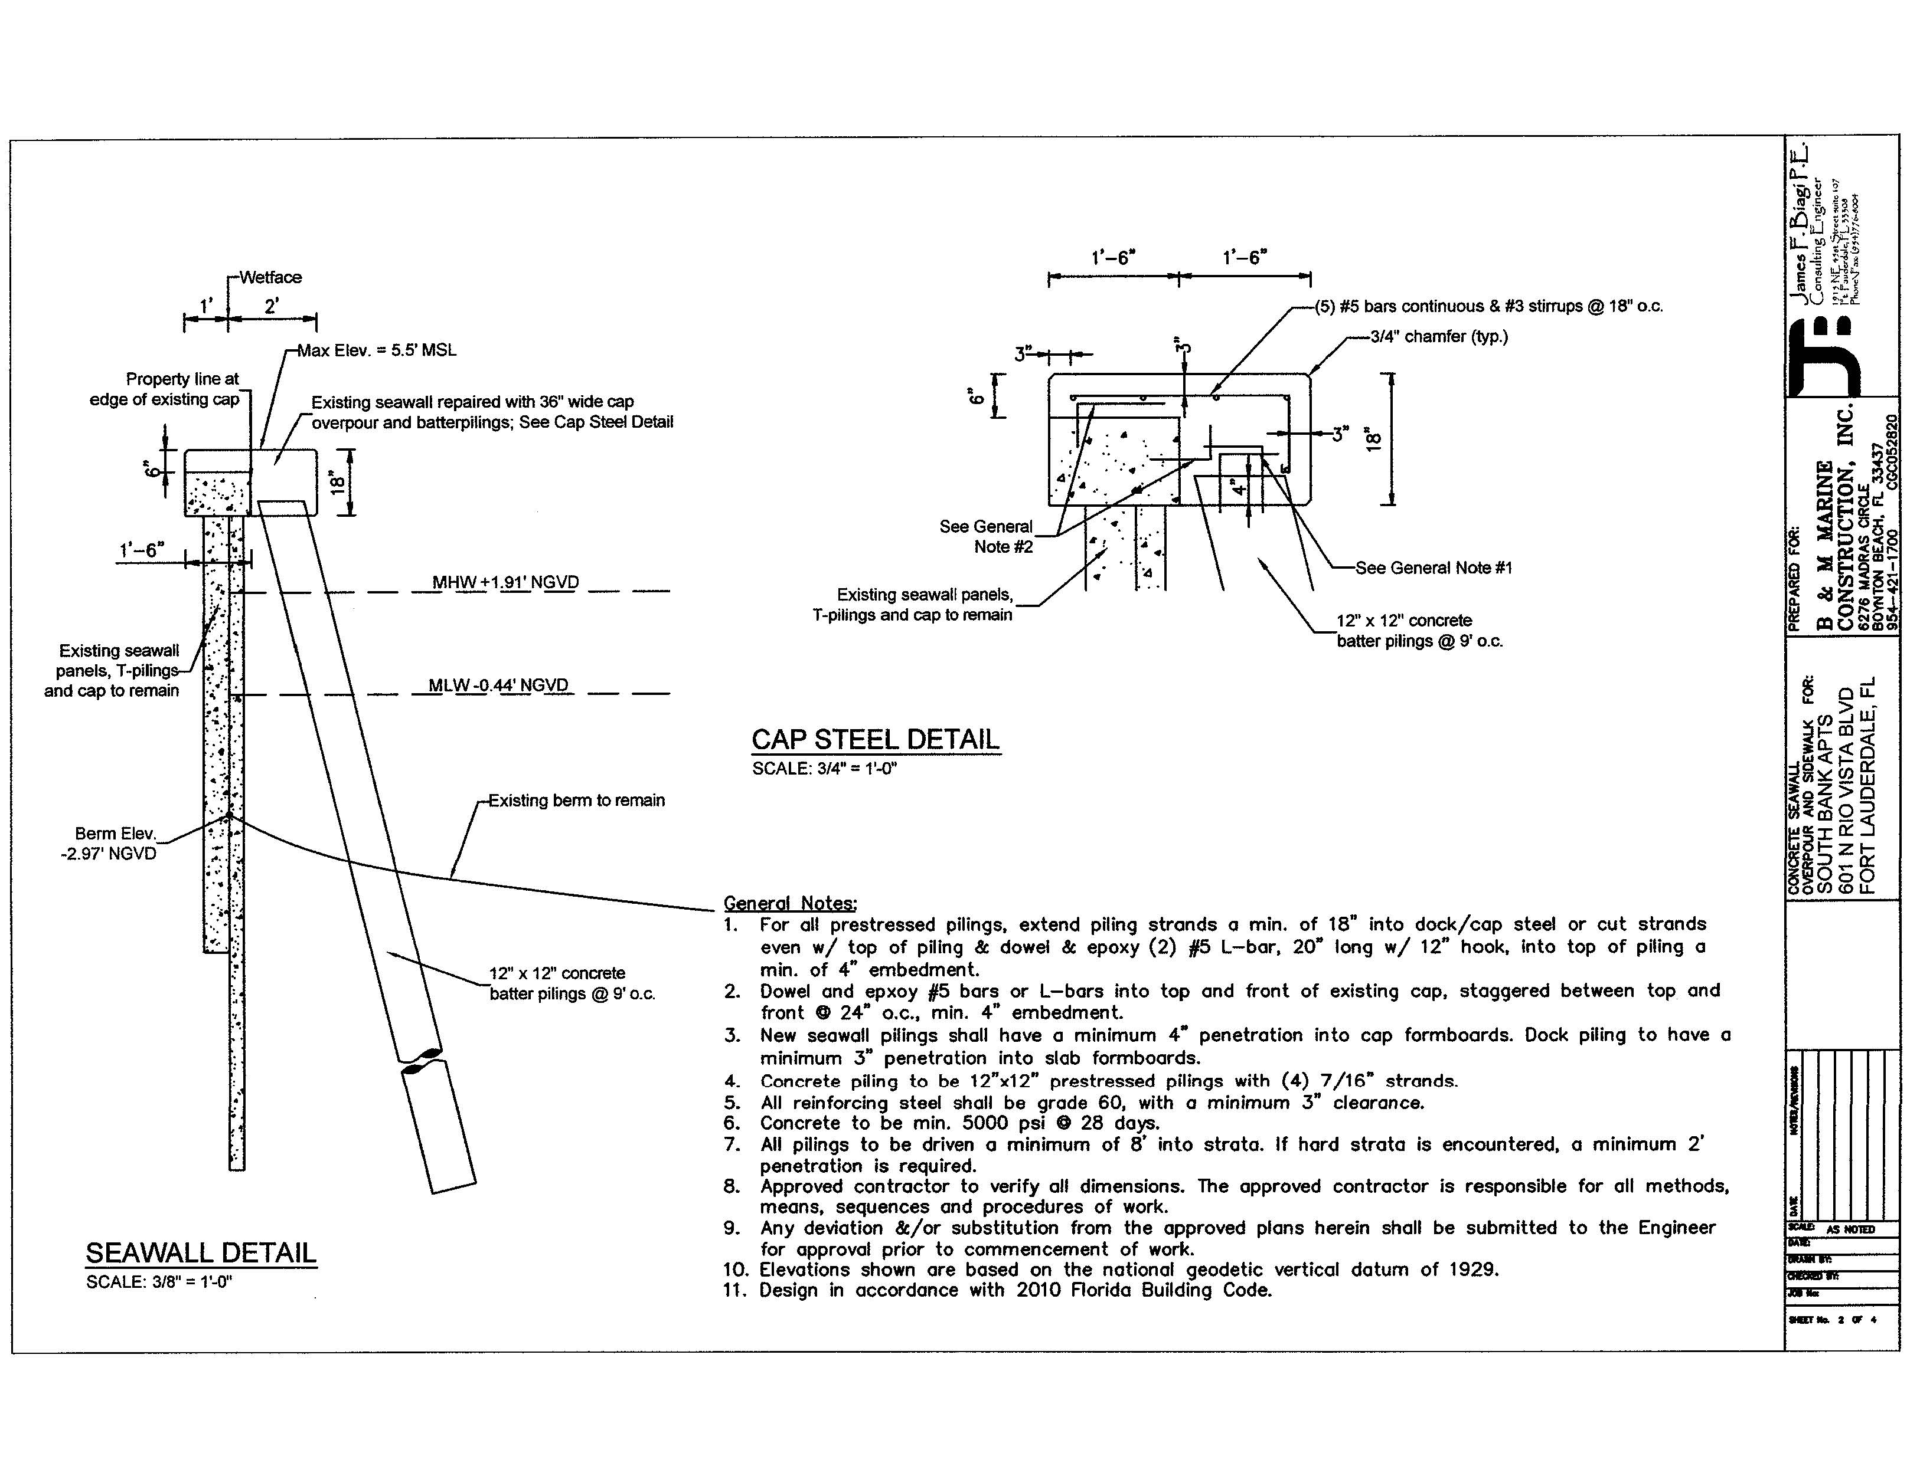

Slide 34
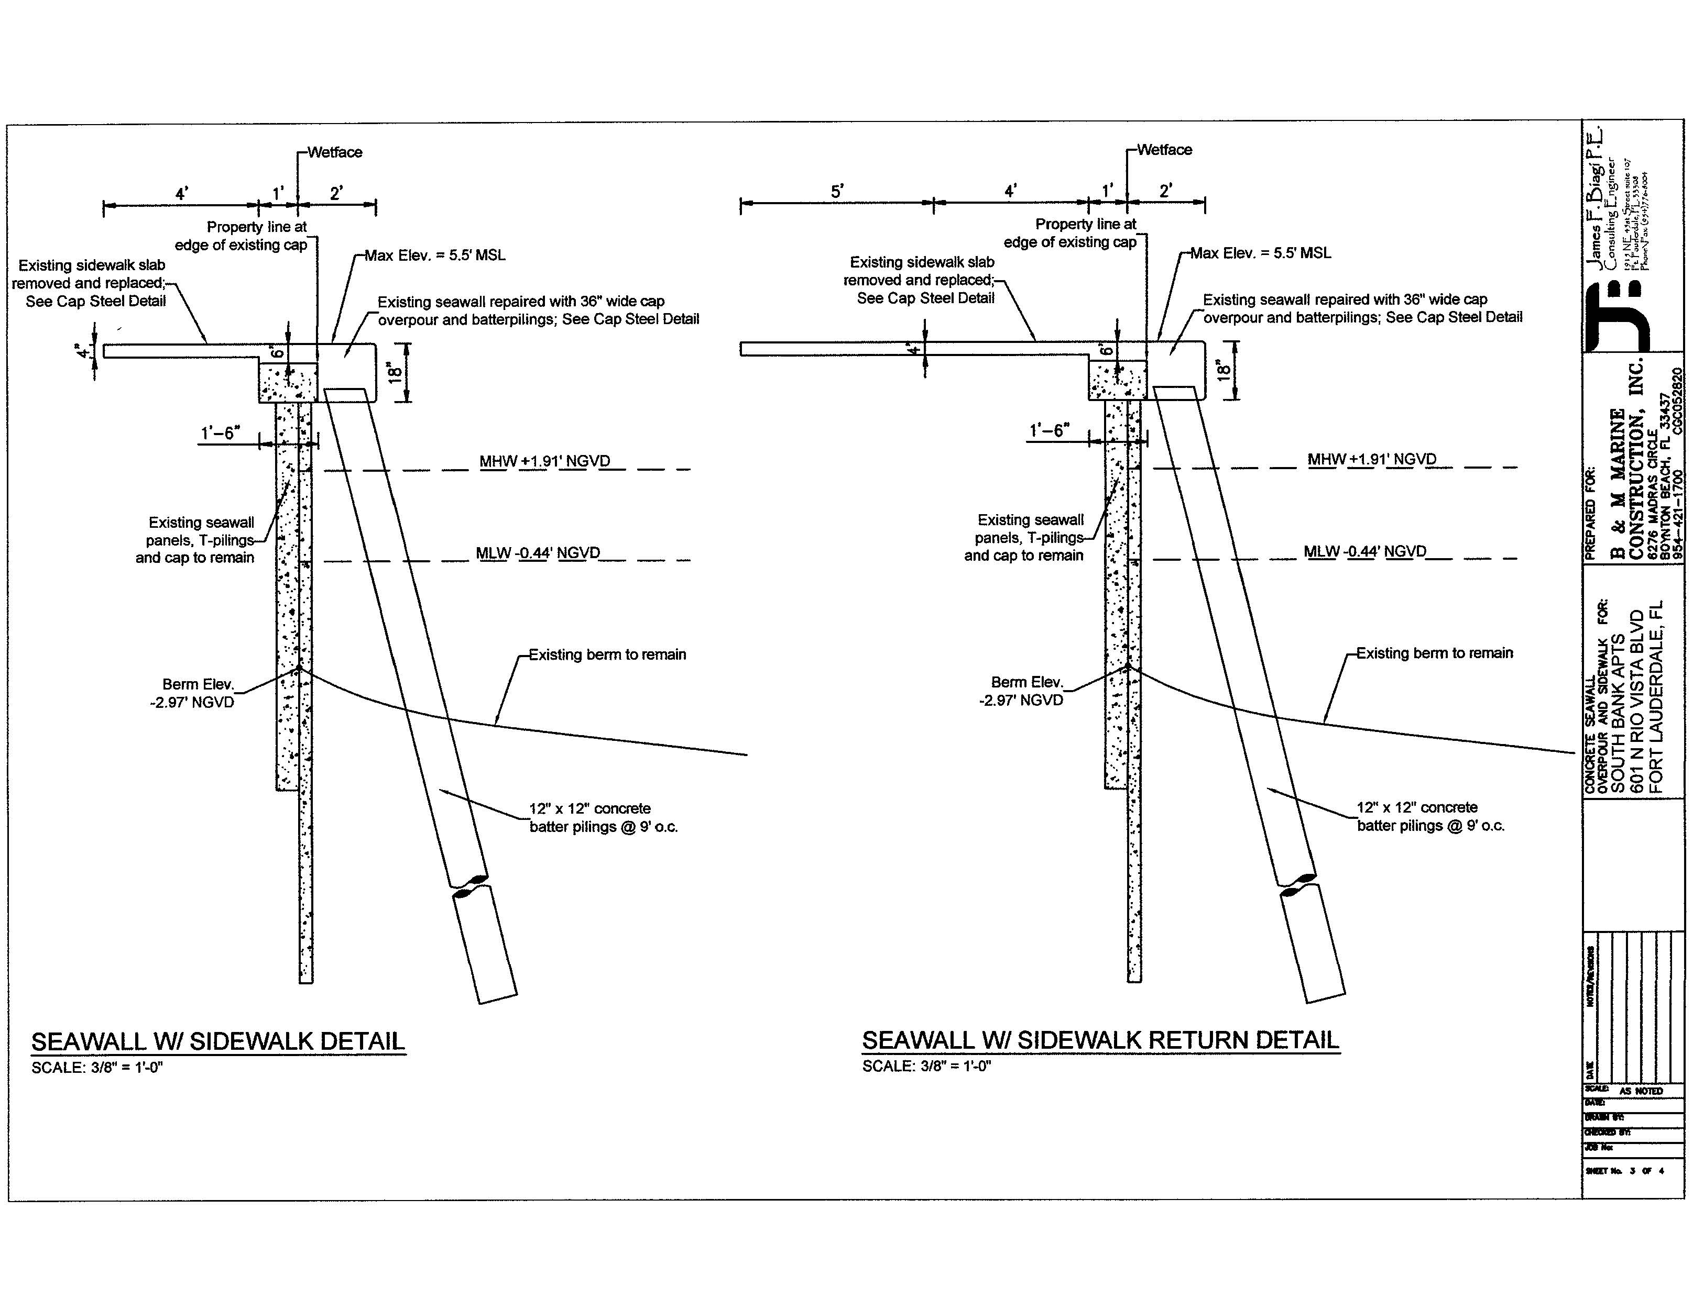

Slide 35
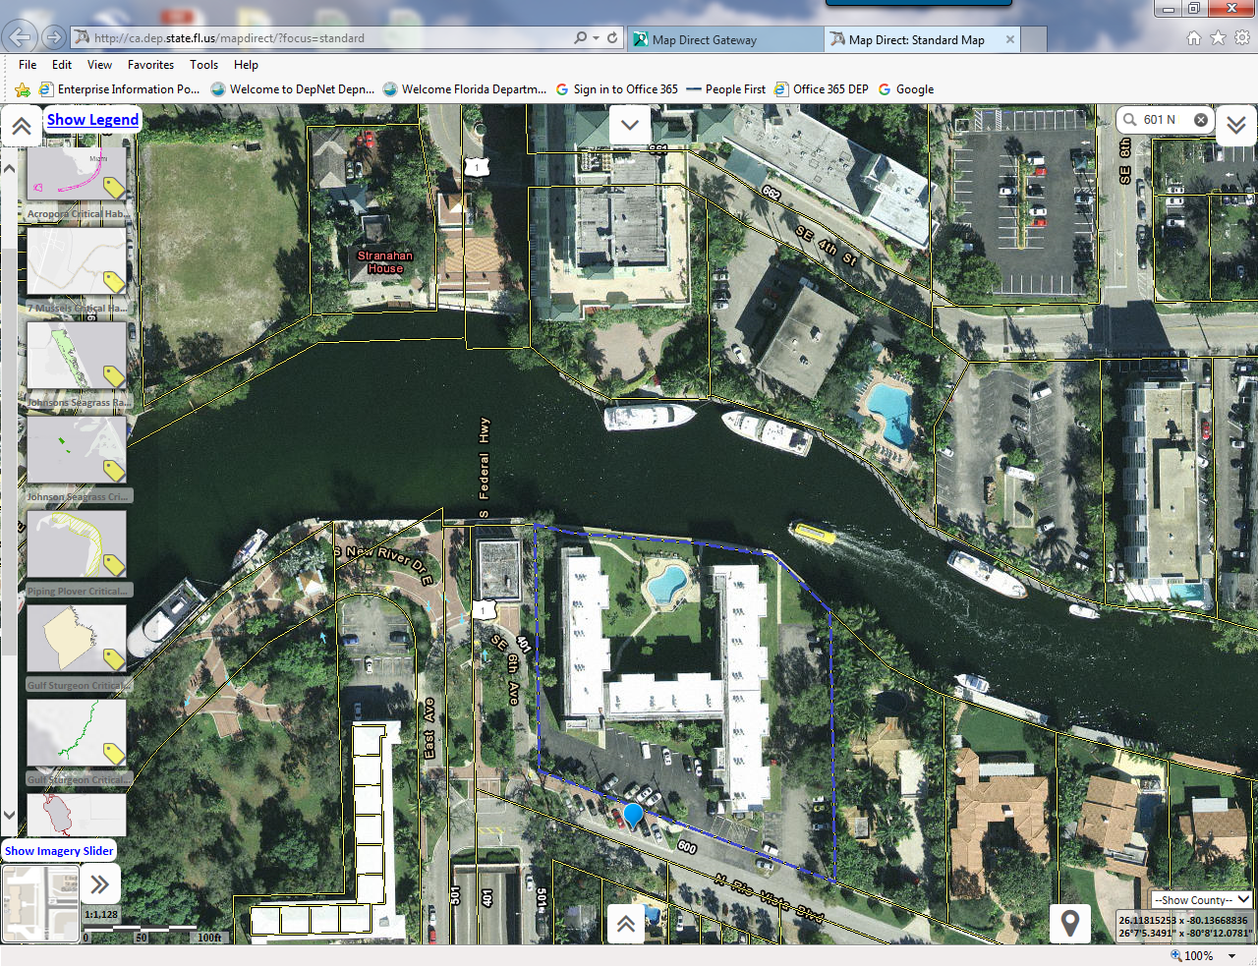

Slide 36
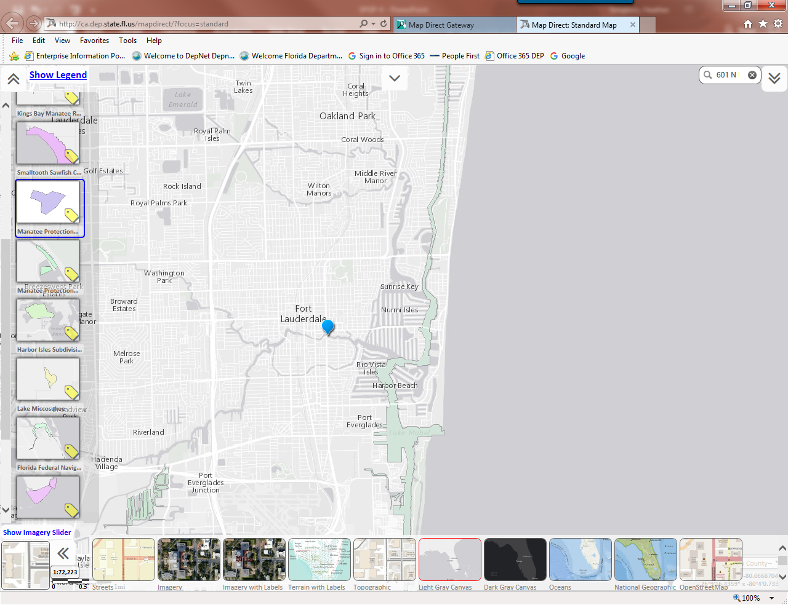

Slide 37
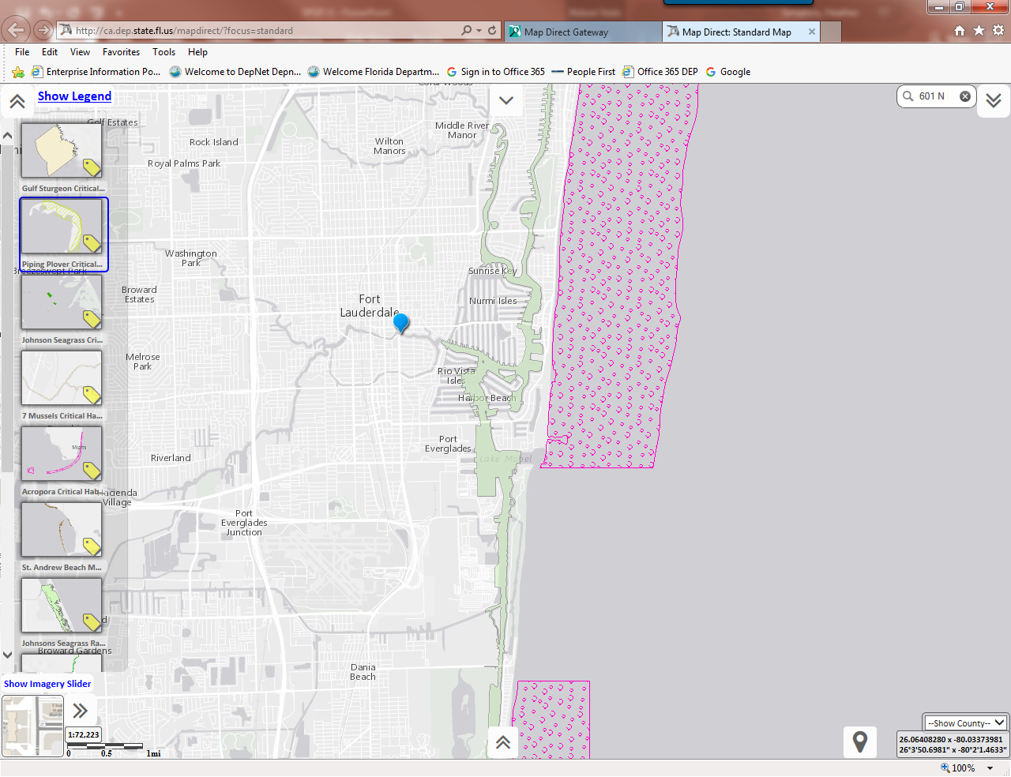

Slide 38
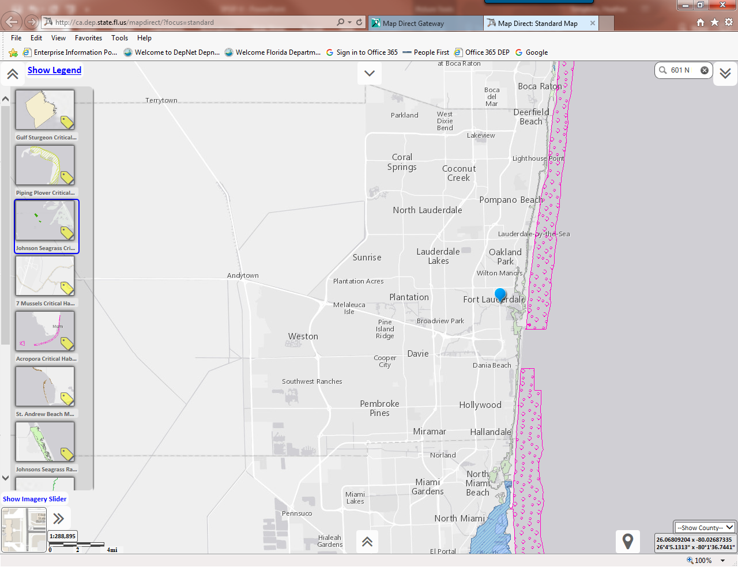

Slide 40
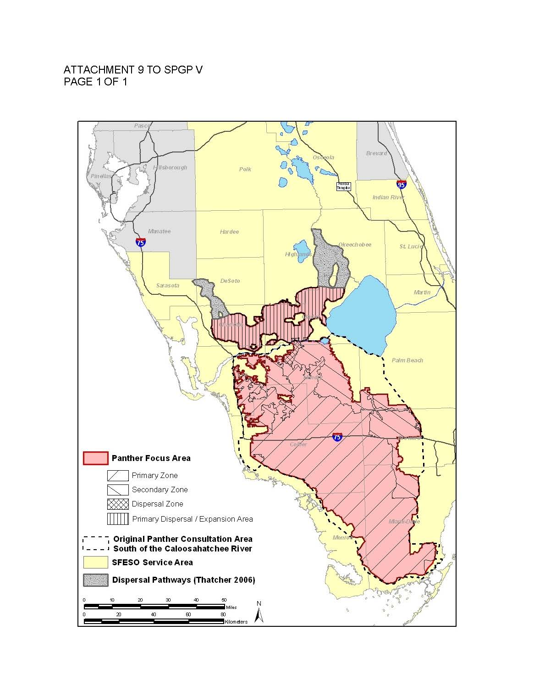
Notes:
Highlight geographic boundaries within your district…
(4) Most of St. Marys excluded anyways
Manatee Key “further consultation required” ex. : multi slip facility in certain counties and repair or rehabilitation of a multi slip in an important manatee area. Pag. 5 of 12 / Att. 3

Slide 41
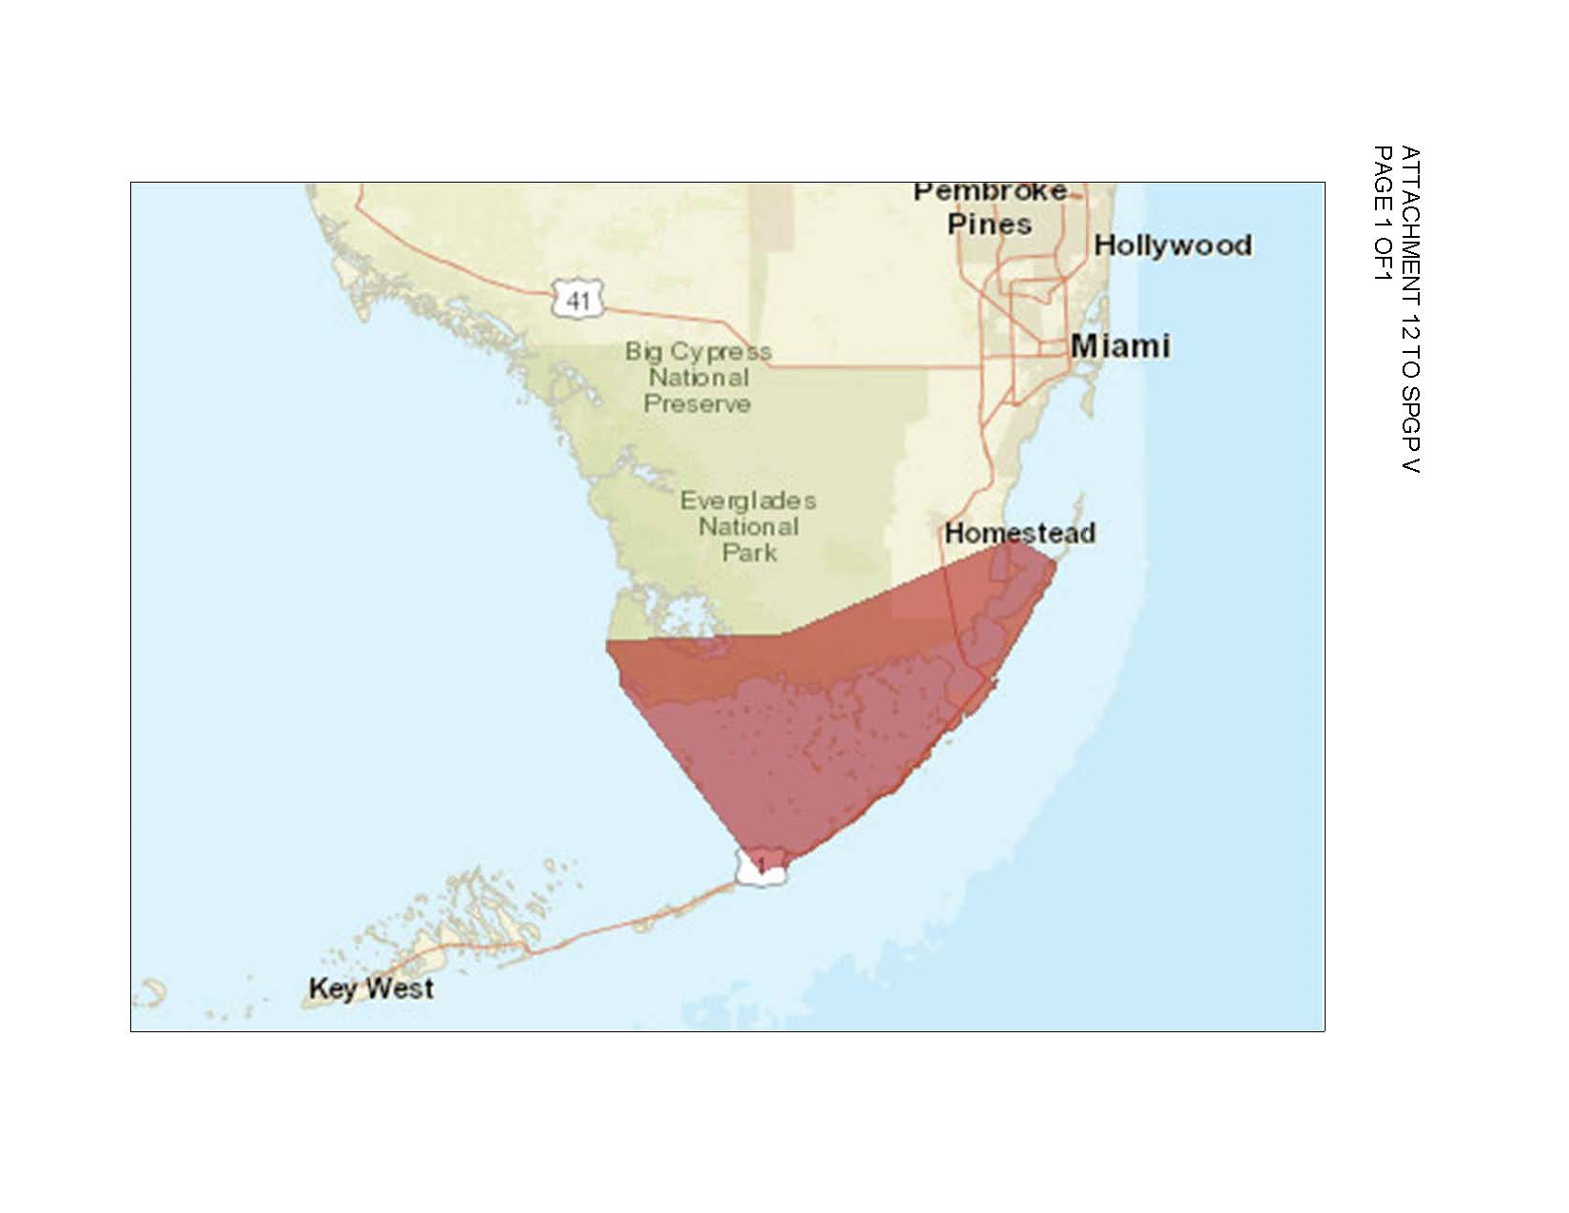
Notes:
Highlight geographic boundaries within your district…
(4) Most of St. Marys excluded anyways
Manatee Key “further consultation required” ex. : multi slip facility in certain counties and repair or rehabilitation of a multi slip in an important manatee area. Pag. 5 of 12 / Att. 3

Slide 42
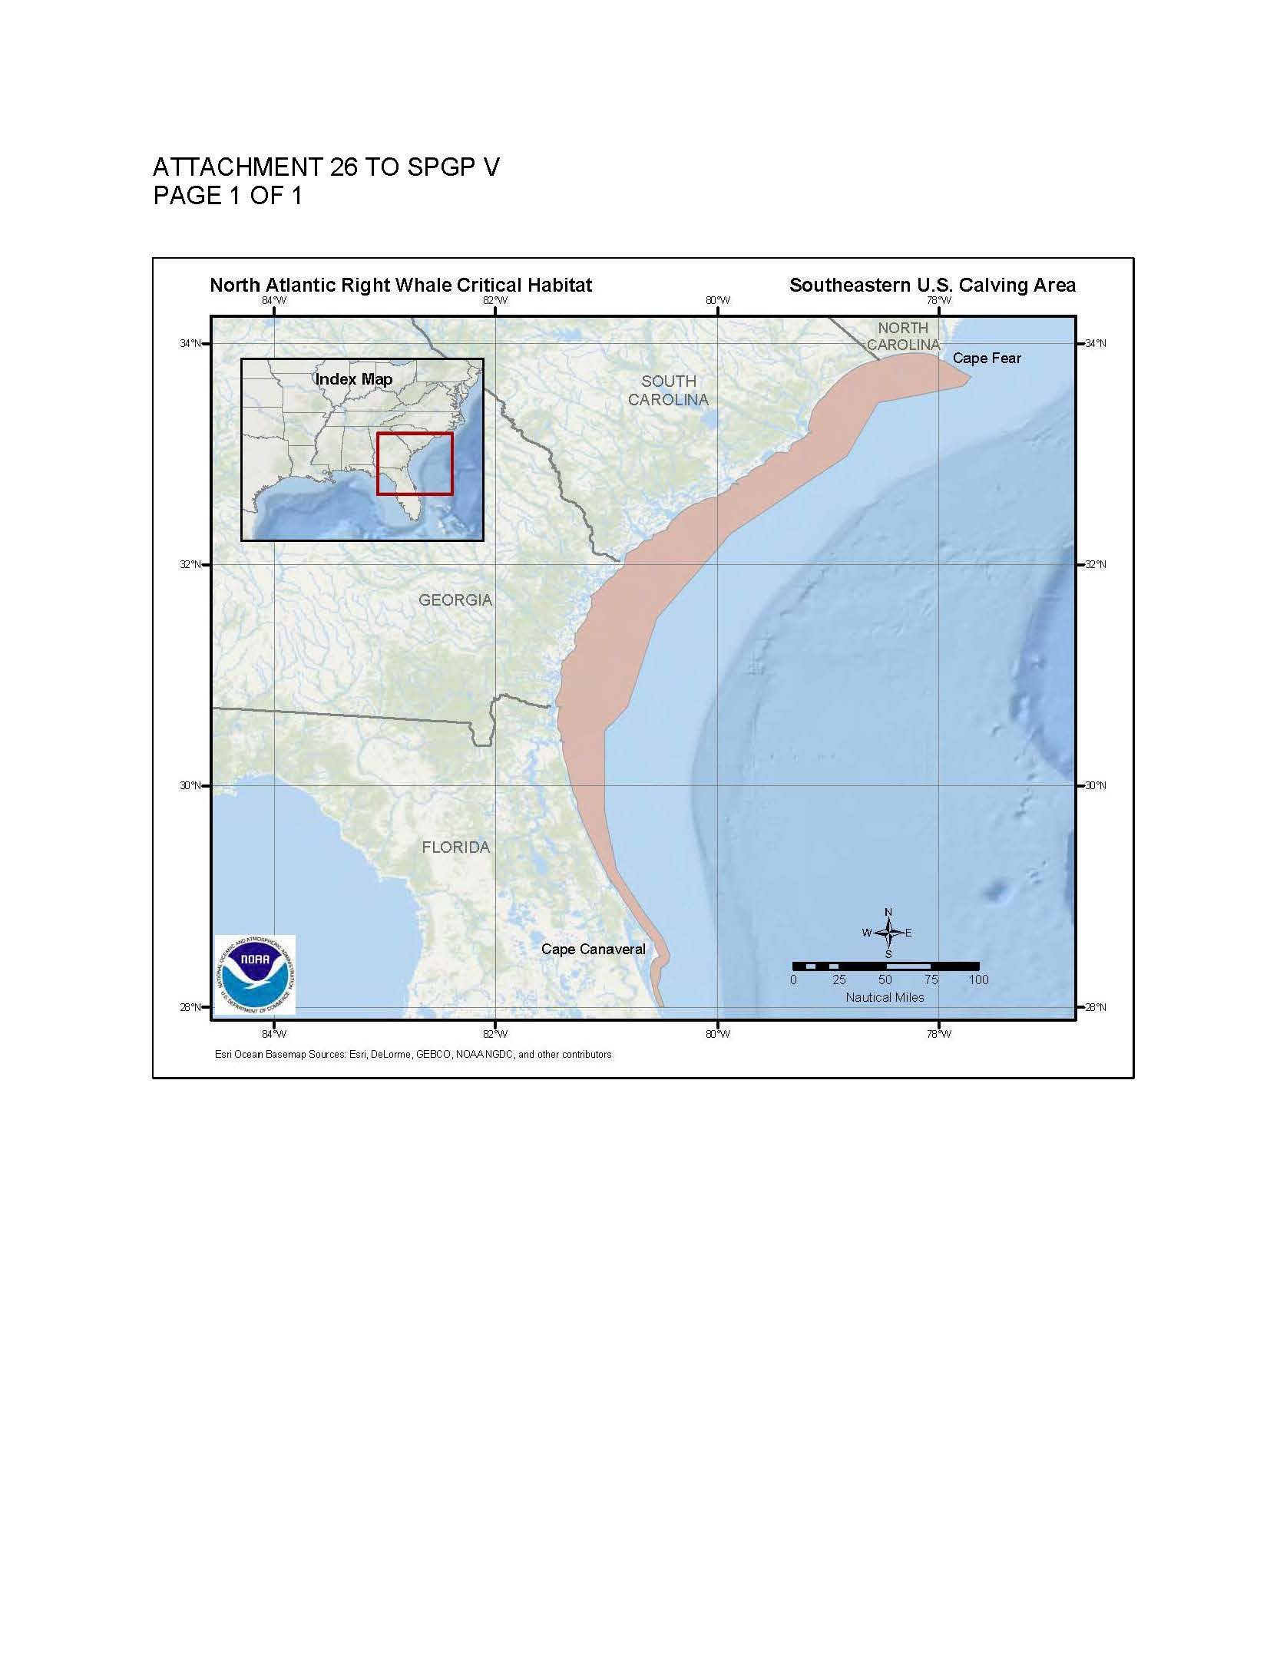
Notes:
Highlight geographic boundaries within your district…
(4) Most of St. Marys excluded anyways
Manatee Key “further consultation required” ex. : multi slip facility in certain counties and repair or rehabilitation of a multi slip in an important manatee area. Pag. 5 of 12 / Att. 3

Slide 43
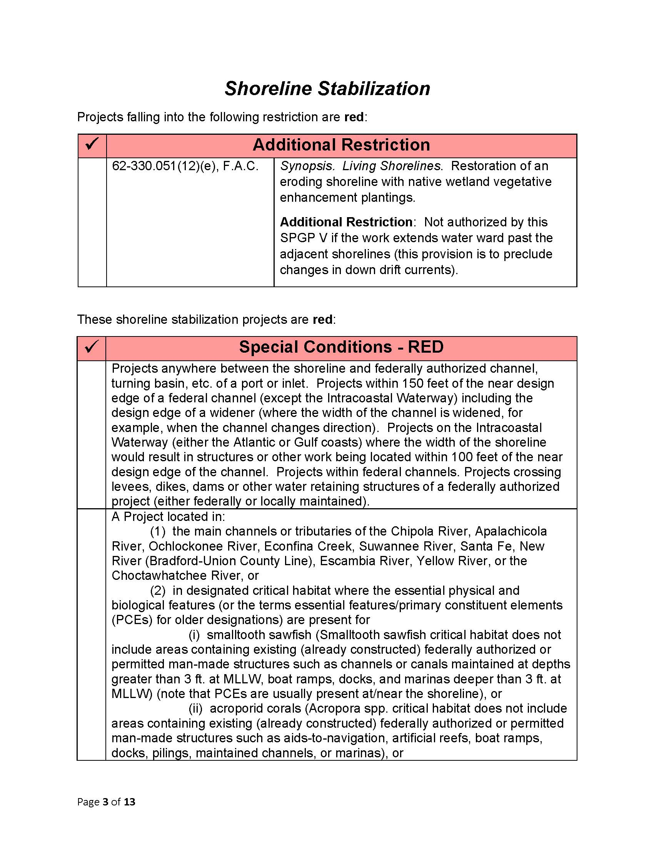
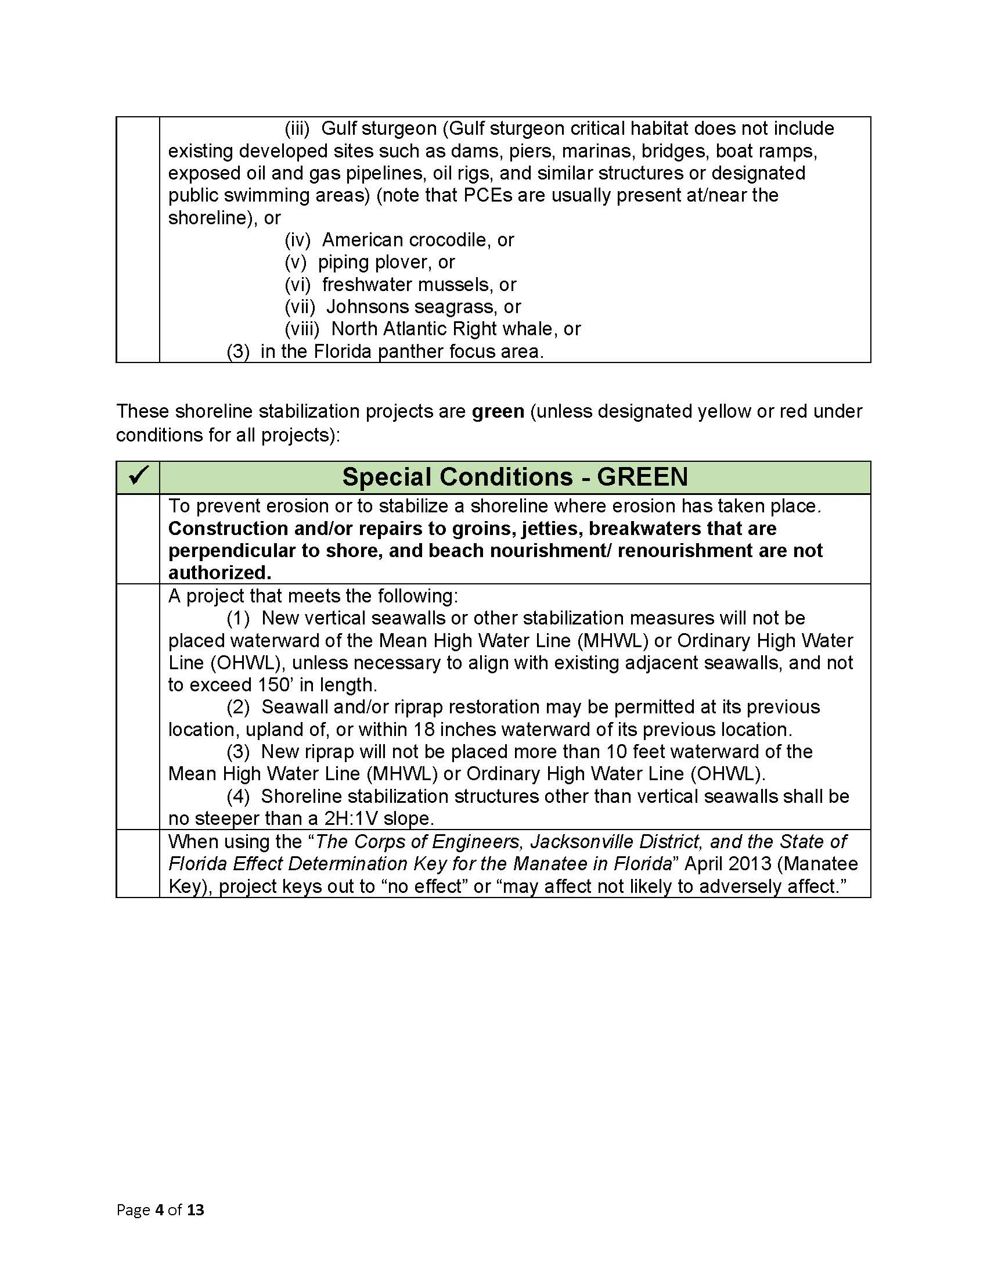

Slide 44
Manatee Key
Should be used like a plant ID key.
Projects that key to a “may affect” determination equate to “likely to adversely affect” situations, and those projects should not be processed under the SPGP or any other programmatic general permit. See Part A. 2. j. & Page 2 of Cheat Sheet.

Slide 45
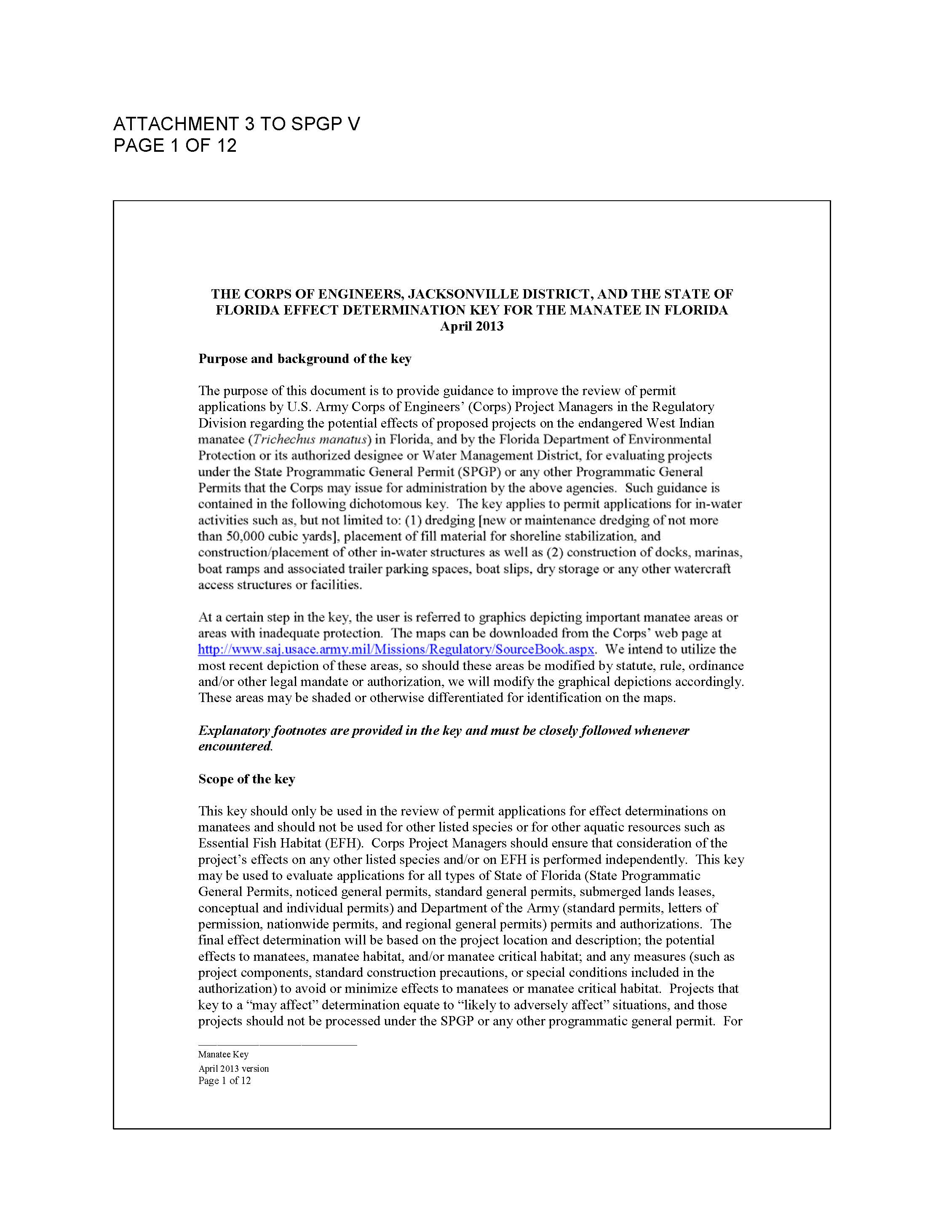
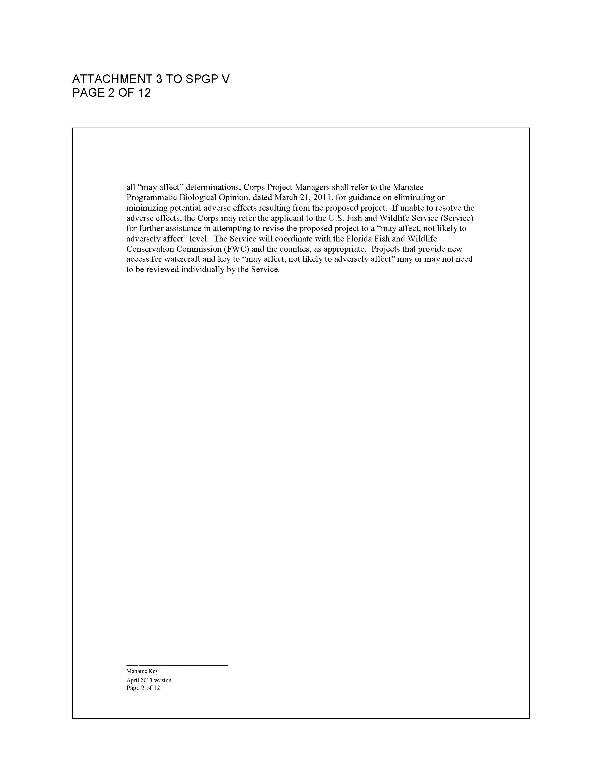

Slide 46
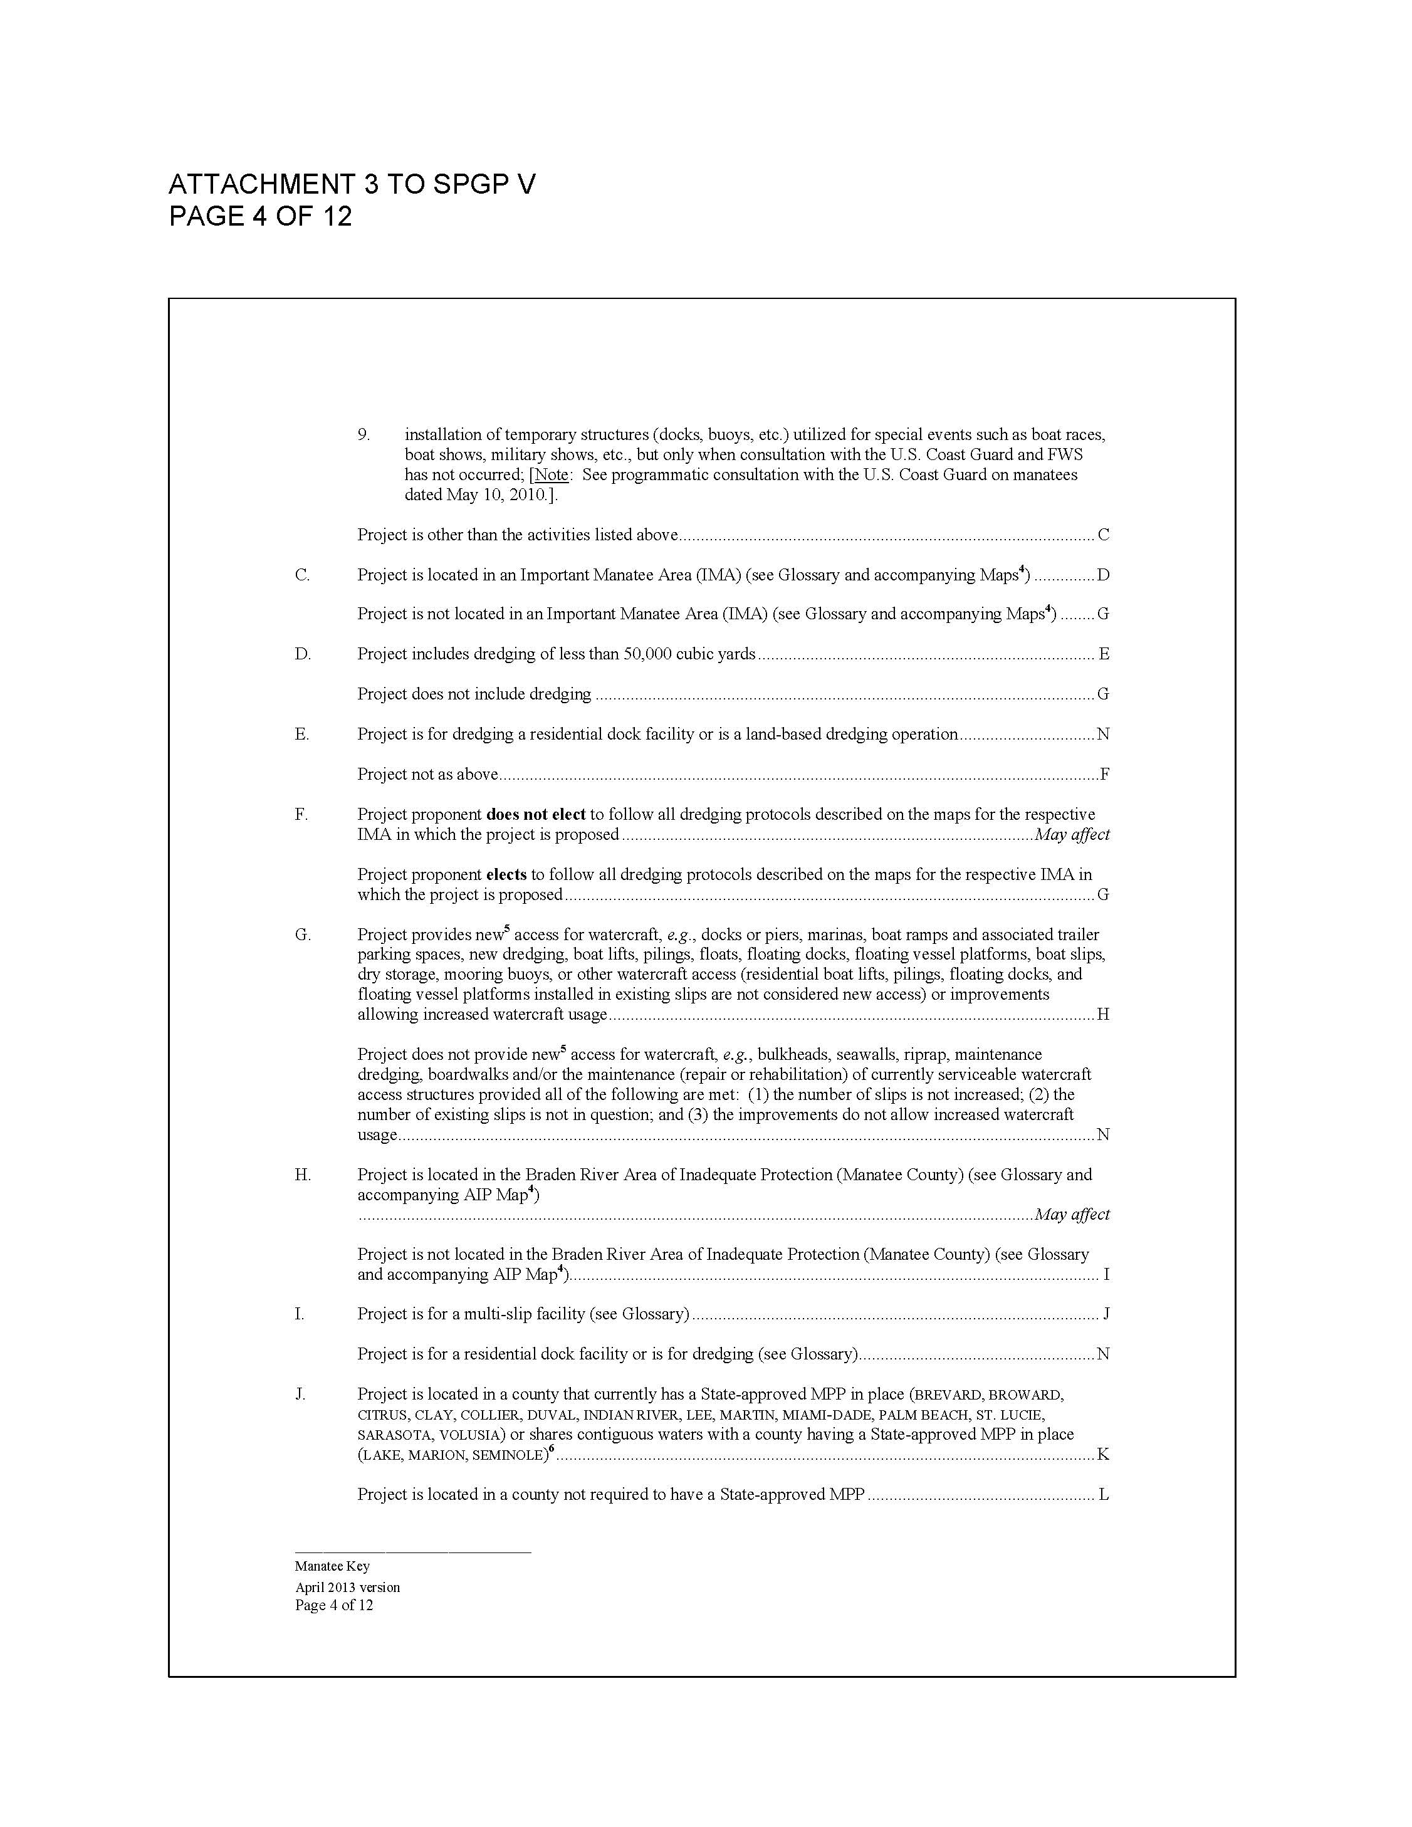

Slide 47
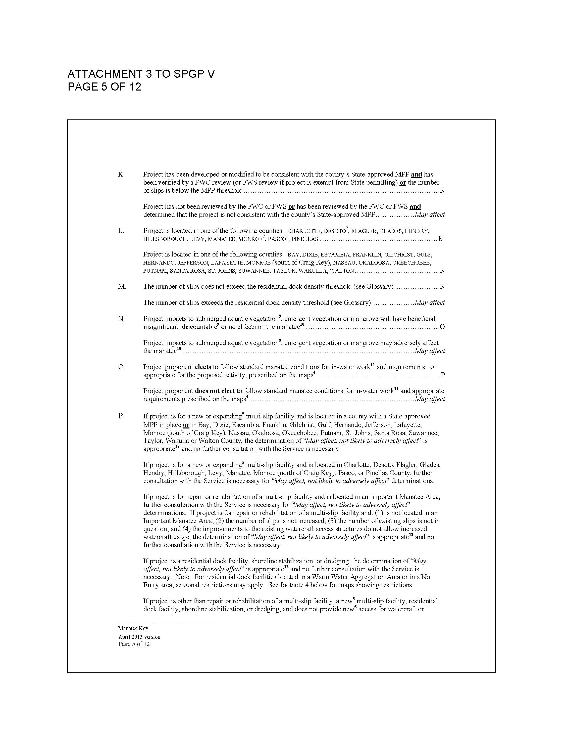

Slide 48
Dredge Application
Example 3

Slide 49
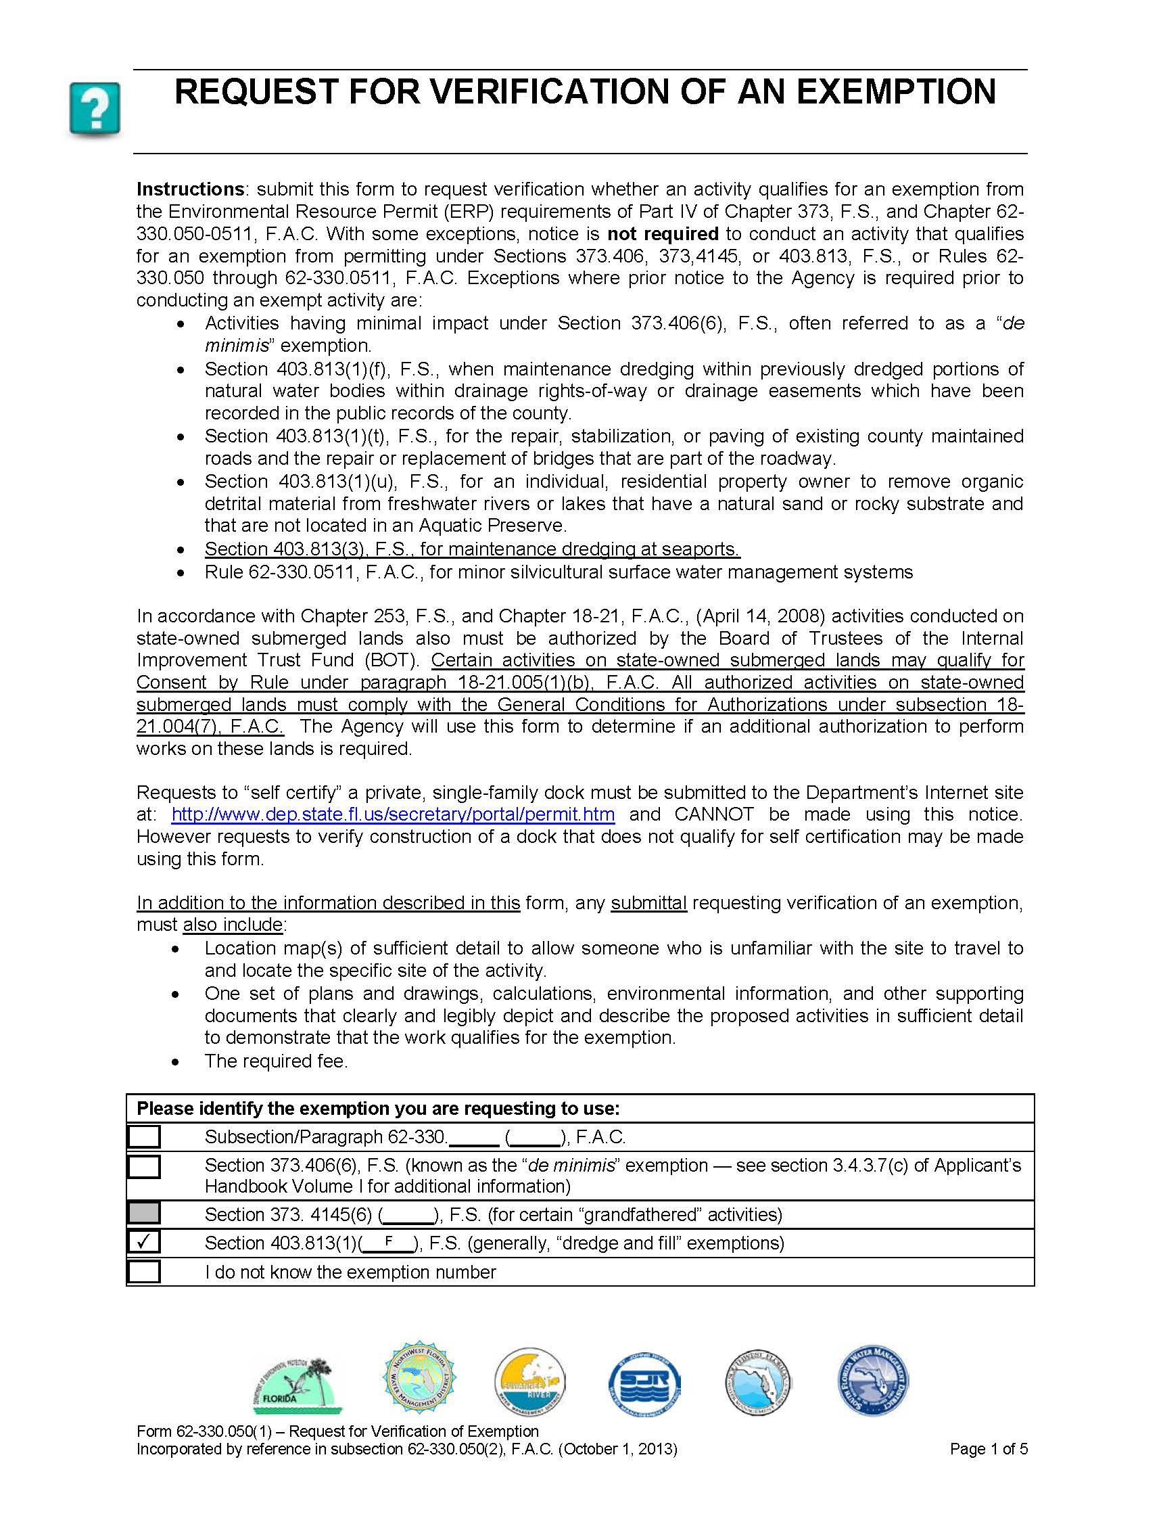
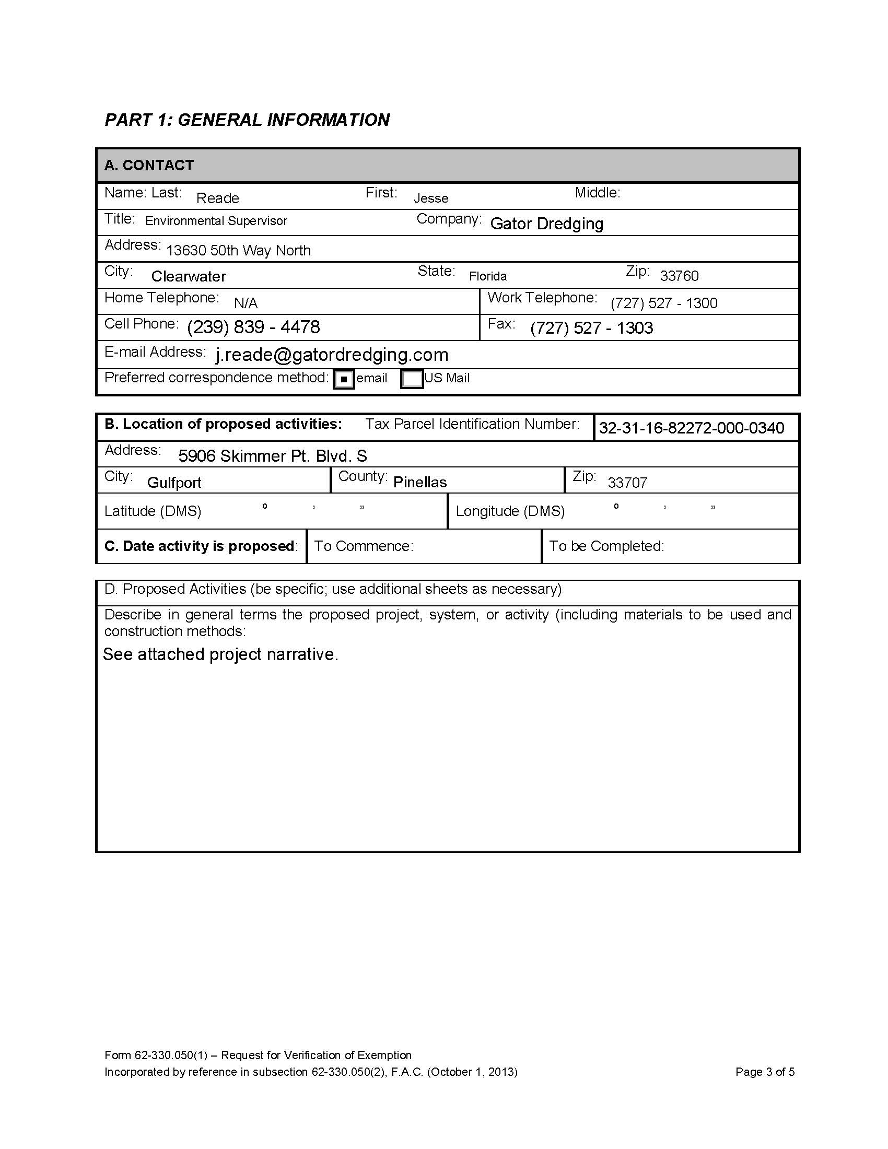

Slide 50
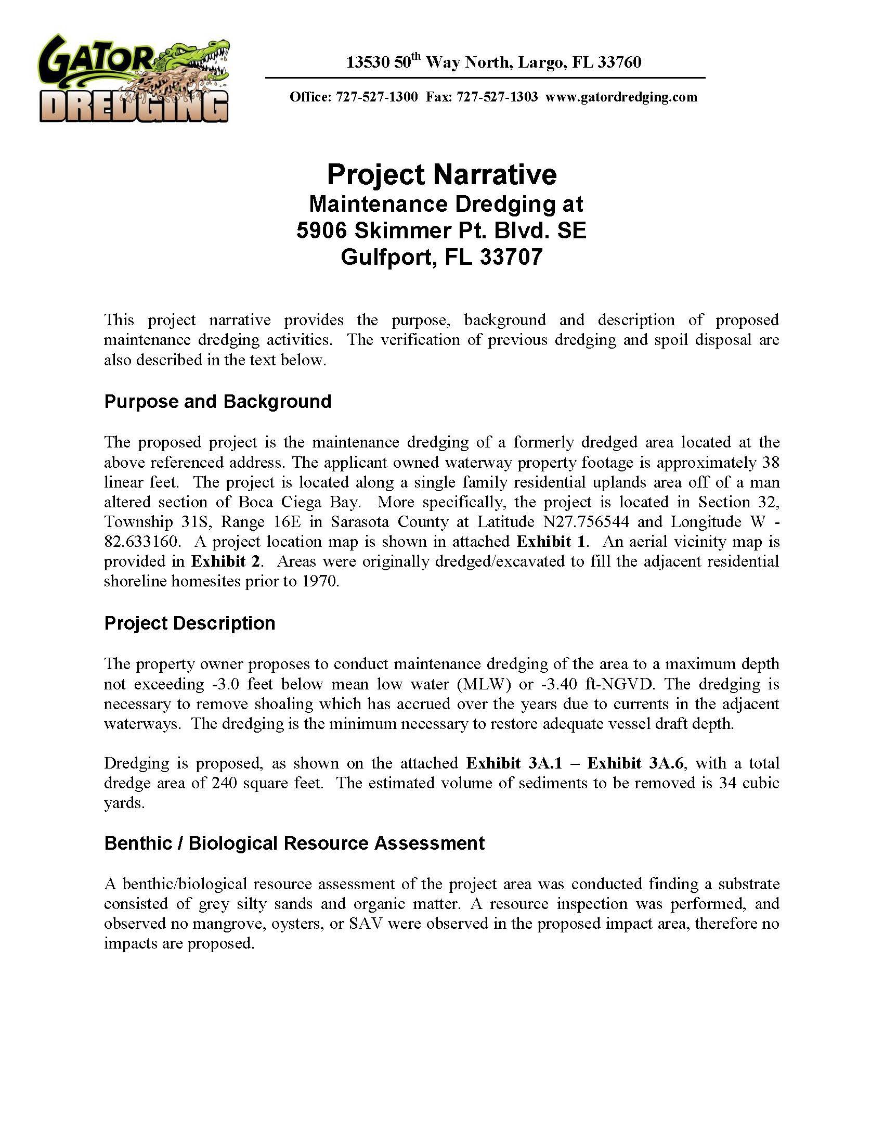


Slide 51


Slide 52


Slide 53


Slide 54


Slide 55


Slide 56


Slide 57


Slide 58


Slide 59


Slide 60


Slide 61


Slide 63



Slide 64
ITM – Inland Testing Manual
This has been interpreted to mean that if the sediments or effluent require testing, then it should be yellow. If it is a project where we (FDEP) are not requiring the applicant to test the sediments because contamination is unlikely (like when the material is less than 10% fines, or it is in an area where contamination is not likely), then it can be green, but if we are requiring sediment testing, and then possibly effluent testing because we think there is a chance the sediments could be contaminated, it should be yellow.

Slide 65


Slide 66
Manatee Key
Should be used like a plant ID key.
Projects that key to a “may affect” determination equate to “likely to adversely affect” situations, and those projects should not be processed under the SPGP or any other programmatic general permit. See Part A. 2. j. & Page 2 of Cheat Sheet.

Slide 70

What is “equivalent”?

Slide 71
“equivalent” cont.
Suggest to “yellow” the following examples of obvious equivalency:
  Boat ramps width is limited 30’ for FDEP and limited to 40’ for the Corps (see part A. 4. c. (2) of the permitting instrument and Cheat Sheet page 6.)
  Living Shoreline plantings and breakwaters restricted to placement not beyond 10’ from the mean high water line for FDEP exemption and GP and only restricted to no more than 35’ past high tide line for the Corps.
    The trend here is a project meets the Corps conditions for SPGP but needs an individual permit from FDEP due to more stringent FDEP conditions.
  Commercial Docks
Anything not so obviously “equivalent” and if there are any questions should be sent “yellow” to obtain Corps concurrence.

Slide 72
To be continued………….

