Slide 1
Transitioning to SPGP V
DEP, SJRWMD, SWFWMD, Hillsborough EPC

Slide 2


SPGP V – arriving on schedule!

Slide 3
What if someone has SPGP IV-R1, but asks to be re-authorized under SPGP V?

Slide 4
Step 1
Find out if the requestor meets provisions of SPGP IV-R1 Special Condition 14:
  “If the SPGP IV-R1 expires or is revoked prior to completion of the authorized work, authorization of activities which have commenced or are under contract to commence in reliance upon the SPGP IV-R1 will remain in effect provided the activity is completed within 12 months of the date the SPGP IV-R1 expired or was revoked.”
    Contract = signed or verified agreement to do the work. Quotes are not contracts.
Yes?
  No action required
No?
  Proceed to Step 2

Slide 5
Step 2
Review the previously authorized project under the new SPGP V special conditions.
  No fee
  Use template letter (will be put on OPM and sent out after SPGP V is signed)
  Red?
    Copy letter stating project does not qualify to Corps local office
  Yellow?
    Send link to previous authorization and file to the Corps
    Wait 5 days for Corps response (No response in 5 days = auto “Red”)
  Green?
    Re-send NMFS checklist (previously filled out checklist ok if you have on file)
    Wait 10 days
    Issue letter
    Record letter in agency databases

Slide 6
Yay! Boat lifts in Monroe County!

Slide 7
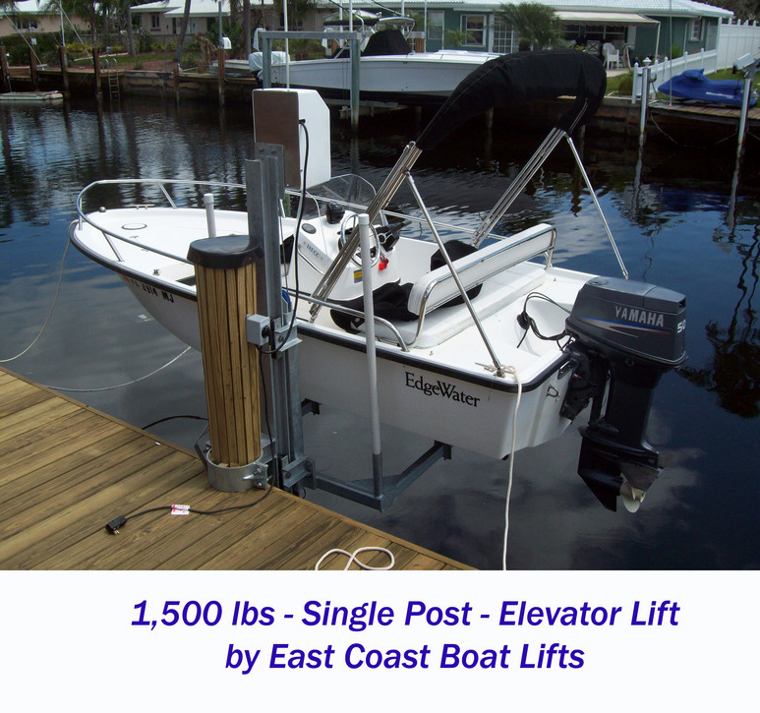
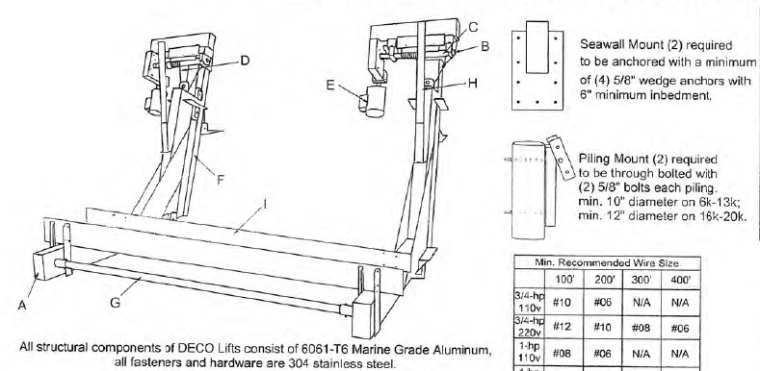
Boat Lifts in Monroe County
“Yellow” if new pilings are proposed.
  Options?
    Construct lift on existing pilings
    Cantilever lift
    ______________?
Canal condition

Slide 8

What Else is New?

Slide 9
New Project Types
Shoreline stabilization
  Living shorelines
  Seawall repair/replace to 18 inches!
Transient activities
  Derelict vessel removal
  Scientific sampling, measurement, and monitoring devices
  Upland to upland directional drilling
  Geotechnical investigations

Slide 10
New Conditions
Familiarize yourself with all conditions of the SPGP V. Some are new.
New format
  Cheat sheet that breaks conditions down by project type will be provided
Additions to Sea Turtle and Smalltooth Sawfish Construction Conditions
  Accident/injury reporting
  Take reporting
  Report smalltooth sawfish encounters
  All work during daylight hours
Right whale critical habitat
And more…

Slide 11

New Coordination Agreements
DEP, SJRWMD, SWFWMD, Hillsborough EPC
  Nearly identical
  Contain new, simplified language – check it out!
“Yellow” projects
  Send to Corps within 5 calendar days of receipt
  Corps will reply within 5 calendar days of their receipt
  If no Corps reply in 5 calendar days – auto “Red”
    Previously auto “Green”
New 10-day wait for NMFS
10% compliance monitoring included in agreement

Slide 12

Questions?
Heather Mason
FDEP
SLERC
(850) 245-8480
Heather.Mason@dep.state.fl.us

