Slide 1
Federal Consistency
February 2017

Slide 2

Coastal Zone Management Act
The Coastal Zone Management Act of 1972 (16 U.S.C. § 1451, et seq.) made coastal states eligible to develop management programs
Addressed national issues by incentivizing state coastal management by providing funding and federal consistency review, a limited waiver of federal authority
Federal consistency regulations promulgated by NOAA: 15 CFR 930

Slide 3
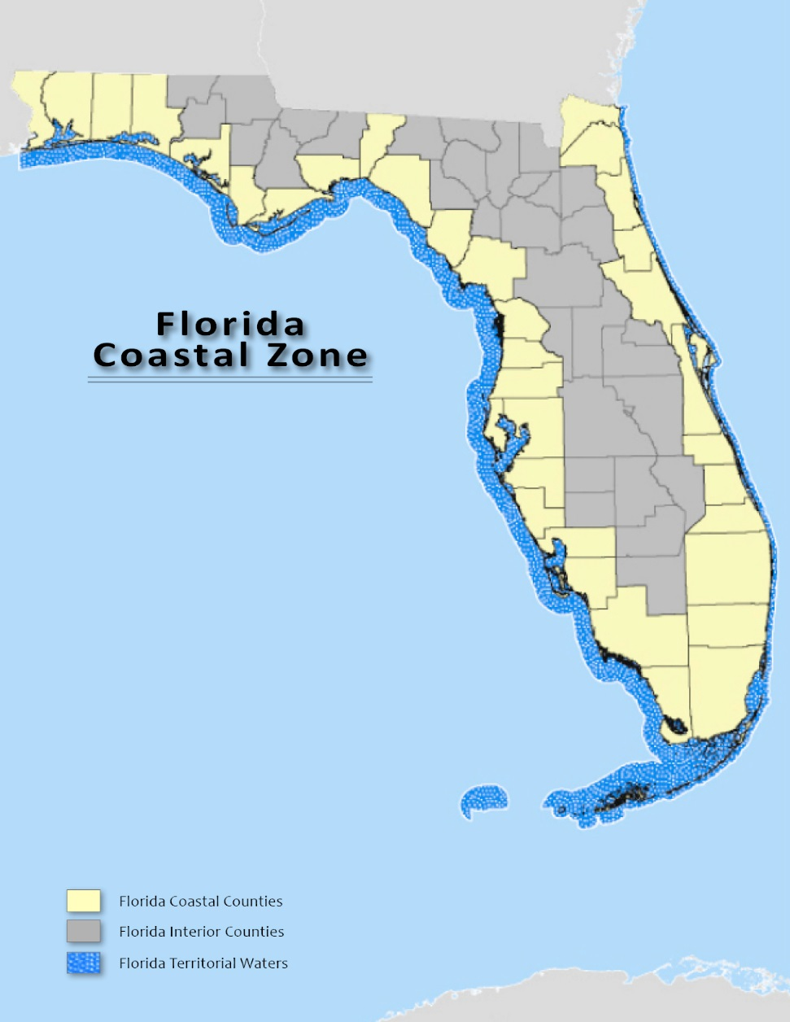
Florida’s Coastal Zone

Slide 4
Florida Coastal Management Program – Network of Agencies
Department of Environmental Protection -Lead Agency
Department of Agriculture and Consumer Services
Department of Economic Opportunity
Division of Emergency Management
Fish and Wildlife Conservation Commission
Department of Health
Department of State, Division of Historical Resources
Department of Transportation
Florida Building Commission, (Department of Business and Professional Regulation)
Northwest Florida Water Management District
St. Johns River Water Management District
South Florida Water Management District
Southwest Florida Water Management District
Suwannee River Water Management District

Slide 5
Coastal Management Program
Network of 24 Florida Statutes*
Chapter 161 Beach and Shore Preservation
Chapter 163, Part II Growth Policy; County and Municipal Planning; Land Development Regulation
Chapter 186 State and Regional Planning
Chapter 252 Emergency Management
Chapter 253 State Lands
Chapter 258 State Parks and Preserves
Chapter 259 Land Acquisitions for Conservation or Recreation
Chapter 260 Florida Greenways and Trails Act
Chapter 267 Historical Resources
Chapter 288 Commercial Development and Capital Improvements
Chapter 334 Transportation Administration
Chapter 339 Transportation Finance and Planning
Chapter 373 Water Resources
Chapter 375 Outdoor Recreation and Conservation Lands
Chapter 376 Pollutant Discharge Prevention and Removal
Chapter 377 Energy Resources
Chapter 379 Fish and Wildlife Conservation
Chapter 380 Land and Water Management
Chapter 381 Public Health: General Provisions
Chapter 388 Mosquito Control
Chapter 403 Environmental Control
Chapter 553 Building and Construction Standards
Chapter 582 Soil and Water Conservation
Chapter 597 Aquaculture
*Only portions of these chapters constitute enforceable policies for the purposes of federal consistency review. Check http://www.dep.state.fl.us/cmp/federal/24_statutes.htm for most current information.

Slide 6
Federal Consistency
What is Federal Consistency?
Authority to review certain federal activities for consistency with Florida laws.
When a state coastal management program is approved by the federal government, state laws become requirements that apply to federal agencies. This limited waiver of federal supremacy effectively equates state and federal law.
[Section 307 of CZMA, 16 USC 1456]
What is the effect of the Federal Consistency process?
Allows state law to influence federal actions.

Slide 7

Actions Subject to
Federal Consistency Review
Actions subject to review: all direct and indirect federal activities affecting land, water, or natural resources of the coastal zone
  Direct activities
  License or permit activities --JCP and ERP permit process includes federal consistency review
  Assistance activities

Slide 8
Actions Subject to
Federal Consistency Review
Federal activities that affect Florida’s land, water, natural resources, historic resources or transportation system:
  Activities conducted by the federal government - USACE public works projects, Air Force base construction
  Federal licenses or permits - USACE Dredge and Fill permits, FERC power plant licenses
  Federally funded activities - HUD CDBG projects and apartment complexes, FDOT roads and railroads, EPA water mains or USDA rural development projects
  Outer Continental Shelf activities - federal permits for exploration and extraction of oil, gas and minerals offshore in federal waters

Slide 9
Actions Subject to
Federal Consistency Review
Federal licenses or permits - USACE Dredge and Fill permits, FERC power plant licenses
  Conducting consistency reviews of wetland permits is one way the state reviews federal actions for consistency with state laws.
Consistency reviews of wetland permits and proprietary authorizations have been conducted since the 1980s
These reviews continue today by DEP, WMDs, and delegated local governments.

Slide 10
2012 Operating Agreement
Permit-consistency reviews were addressed simplistically in the 2012 DEP-WMD-COE Operating Agreement, which is still in effect and can be viewed on the OGC Web site: http://www.dep.state.fl.us/legal/Operating_Agreement/operating_agreements.htm
In short, the agreement states:
Issuance = Consistent (including exemptions)
Denial = Inconsistent
Consistency review time frame starts when an application is complete
Refers to the 180-day timeclock requirements in federal regulations

Slide 11
Conditional Concurrences
Agencies and/or applicants should cooperate with State to develop conditions during the review period to include in Federal agency final decision (Subpart C) or approval (other Subparts) that allow the State to concur
If instead the State issues a conditional concurrence, it must state the conditions which must be satisfied to ensure activity is consistent, an explanation of why those conditions are necessary, and identification of relevant specific enforceable policies
Correspondence shall state that in the event the conditions are not met, the conditional concurrence shall be treated as an objection
Federal agency must notify State if conditions are not acceptable

Slide 12
SLER 928
Your friend, the ERP Operations and Procedures Manual contains SLER 0928
Developed in 1999 and updated in periodically, it is the best guidance to follow.
SLER 928 identifies the relevant statutes and the permits for projects (located in coastal counties) to be reviewed for consistency, and provides general guidelines for soliciting comments from appropriate agencies or DEP programs.
Processors are responsible for providing applications to any affected state agencies or DEP programs so they have an opportunity to make a consistency decision.
Reviewing agencies may also request data and information necessary for their review.
Processors should forward information requests to the applicant to handle, but keep apprised of the outcome.
http://depnet/wrm/sler/erp/docs/slerp_online/0900/0928_Coastal_Mgmt_Consistency_Review_Procedures.pdf

Slide 13
Agency Comments
Most are advisory and offer general recommendations
If a processor receives a letter of objection based on a finding of inconsistency:
Call FCMP for assistance : FCMP will help determine if the objection is legitimate and timely
Forward to the applicant using the cover letter template in SLER 928
The applicant and the objecting agency will be responsible for resolving the inconsistency issue.
The permit processor must be informed about the progress of the matter, especially if it results in a changed project design or plan of procedure.
If the consistency objection is not resolved, DEP is obligated to deny, provided the objection is timely, legally proper, and supported by the agency head.

Slide 14
Technical Support
SLER 928 includes example letters and language for Notice of Denial.
Use of the ‘RAI Final Letter’ (SLER 901) and 90-day Waiver form will synchronize ERP and consistency procedures.
FCMP can help evaluate objections for legal authority, timeliness, track timeclocks and deadlines, assist with interagency consultation, and assist with writing denial notices.
The objecting agency is responsible for defending the objection in any subsequent administrative hearings or other legal proceedings

Slide 15
Contacts
Becky Prado, Program Administrator
Rebecca.Prado@dep.state.fl.us
850-245-2103
Ann Lazar, Environmental Administrator Ann.Lazar@dep.state.fl.us
850-245-2168

