Slide 1


QA Rule 101
What DEAR needs to know about Chapter 62-160, F.A.C.
January 10, 2022
Sarah Noble
Aquatic Ecology and Quality Assurance
Notes:
Define quality assurance and its importance;
Identify DEP’s authority and the guiding principals of QA;
Review how QA applies to you and your position;
Overview of Chapter 62-160, Florida Administrative Code (the QA Rule); and,
Discuss where to find resources and help for QA issues

Slide 2

Quality Assurance is FUN!

Slide 3

Quality Assurance is IMPORTANT!

Slide 4
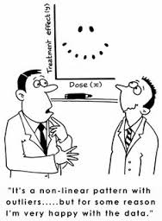
What is Quality Assurance?
And why should you care?
QA is the act of maintaining and improving the quality of work (data) produced by giving attention to every stage of the process.
For DEP and DEAR, this means implementing and managing a Quality System that sets data quality requirements for environmental data and specifies the criteria and procedures by which to verify that those requirements have been met.
Notes:
Each organization shall establish and maintain a quality system that will:
Identify, implement and promote quality assurance policies and procedures that will produce data of a know and verifiable quality;
Create and/or identify and follow standard operations procedures for all activities, both technical and administrative;
Monitor adherence to the established policies, procedures and written SOPs;
Establish and use procedures for continual improvement through both corrective and preventive action policies; and,
Monitor the quality of the organization’s product.

Slide 5
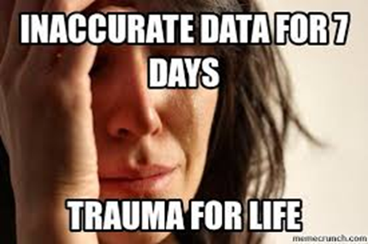
Why is Quality Assurance Important?
Possible consequences of poor data quality:
Create or use erroneous data
Reach unsupported decisions
  If “real” result is higher than reported, the environment is not protected.
  If “real” result is lower than reported, costly and unnecessary treatment activities may occur.
In either case there can be legal challenges and adverse publicity, ultimately leading to more staff time and money spent.

Slide 6
Authority and Obligations
Chapter 403.0623, Florida Statutes
  Directs DEP to “establish, by rule, appropriate quality assurance requirements for environmental data submitted to the department and the criteria by which environmental data may be rejected by the department”
Chapter 62.160, Florida Administrative Code
  DEP’s “QA Rule” contains requirements for field and lab data submitted to DEP
DEP Policy 972
  QA Policy establishes internal agency policy and distributed responsibility for QA throughout DEP
Quality Management Plan (QMP)
  Explains DEP’s QA processes to EPA and is a requirement for funding and delegation of federal programs to DEP
Notes:
Legislative Statues, Florida Administrative Code, and Department Policy
Policy 972 establishes a tiered application of responsibilities for quality assurance because no single person or work unit can manage all QA functions of DEP. Consistent implementation of DEP’s Quality Assurance Policy across programs and work units results in a department-wide culture of competence and responsibility for the management of scientific data.

Slide 7
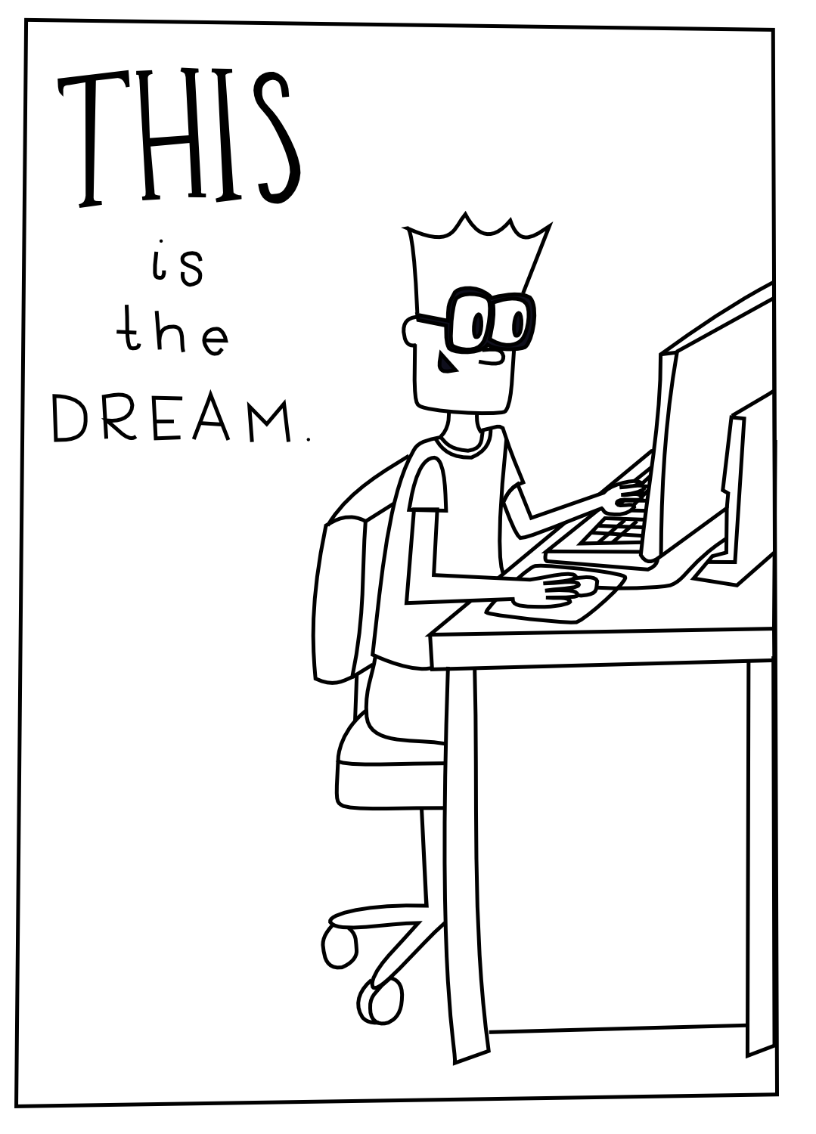
What is your QA Role?
One or more of the following tasks are part of your job duties, and you should become familiar with specific Quality Assurance activities associated with those tasks as they pertain to the environmental data
You have the authority to request documentation and ask questions about reported data, sampling and analysis procedures. Be persistent! There are resources throughout the department to assist you with any issues that may arise
Data generator - Samplers/Lab Analysts
Data entry
Data use
Data management
Grant/Contract management
Notes:
Data generator
Environmental Samplers
Receive appropriate SOP training
Carefully follow appropriate SOPs for environmental sampling and measurements
Participate in performance audits
Maintain appropriate documentation and Quality Control procedures
Lab Analysts
Receive appropriate lab SOP training
Follow lab SOPs and Quality Manual
Perform and document quality control appropriate for each method
Have results reviewed by a second analyst
Demonstrate capability and track QA in the Laboratory Information Management System (LIMS)
Participate in DOH audits
Data entry
Employees will have a general understanding of the database and its capabilities
Ask questions while entering the data such as:
Were appropriate QC checks performed?
Are data qualifiers needed?
Is the documentation complete and legible?
Are the data provided in the appropriate format for the database?
Are data entries verified by another person?
Is there a mechanism for feedback about suspect data?
Data users
Request training on program specific requirements
Question the quality of the data
Make sure data are collected and analyzed with sufficient quality for your use
Check to see if sampling sites were appropriate
Review QC data to ensure appropriate use of qualifiers
Ensure detection limits are sufficient for your use
Provide feedback to data generators about suspect data
If you are using environmental data, conduct these easy checks to ensure data are of sufficient quality for your use.
Is the report complete? Does it include:
All sample data and relevant QC data
Sampling and analysis dates and times
Relevant field measurements and observations
Is the lab certified?
Were the appropriate analytical methods used?
Are detection limits reported and appropriate for your data use?
Are the correct data qualifiers attached to the data?
Do these qualifiers prevent your use of the data?
Data management
Employees will have an in-depth understanding of the database(s) and its capabilities
Within DEAR, data managers utilize the statewide water quality database (SBIO), Watershed Information Network (WIN), and GIS and NHD layers
Provides Quality Assurance checking and editing of geospatial data, data analysis and support
Perform QAQC procedures for data repositories
Provide feedback to data generators about suspect data
Grant/Contract management
As an agreement manger, it is your responsibility to:
Discuss field and lab work with the contractor during project initiation
Decide whether the project requires a Standard or Research QA Exhibit, and include it in the agreement
Provide a Quality Assurance Plan template to contractor/grantee
Review and approve the QA Plan deliverable and other deliverable(s) for adherence with QA requirements

Slide 8
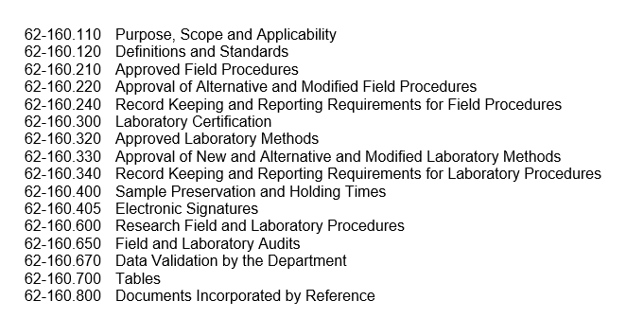
QA Rule, 62-160, F.A.C.
Samplers/Lab Analysts
Data entry
Data use
Data management
Grant/Contract management
Contents
https://www.flrules.org/gateway/ChapterHome.asp?Chapter=62-160
Notes:
As you can see, the QA Rule contains a lot of information regarding environmental data, such as field procedures, laboratory certification, sample preservation and holding times, audits, and data validation.
Keep in mind, as we explore the different sections of the QA Rule, that depending on your Program or your specific QA role, certain parts of the rule may be more relevant or part of your direct responsibilities.

Slide 9
62-160.110
Samplers/Lab Analysts
Data entry
Data use
Data management
Grant/Contract management
Purpose, Scope, Applicability
Ensure reliable environmental data
Covers all environmental data required by or reported to DEP
Applies to sample collection, field testing, lab activities, certain vendor services, data review and data validation
Supersedes QA requirements in other DEP rules, except
  DEP permits, contracts, orders and other rules can have more stringent QA requirements
What is Environmental Data?
Environmental data includes measurement of environmental matrices and media for biological, chemical or physical characterization.
  Water, sediment, animal tissue, plant tissue, bioassessment, field testing, etc.
  DEP has specified Data Quality Objectives (DQOs) for the data
    Requirements and procedures for sample collection or measurement
    Other program-specific criteria for data quality
Notes:
Physical: Support chemical and biological characterization; provide data for other required testing
Examples:
pH, conductivity, dissolved oxygen, temperature
Dye tracing, measurements to calculate discharge or stream flow
Color, turbidity
Measurements to determine groundwater levels
Stream habitat assessments
Canopy cover for RPS
Biological:
Stream Condition Index, Lake Vegetation Index, chlorophyll
Chemical:
Total Phosphorus, nitrate-nitrite, TKN
Microbiological:
E. coli, enterococci, algal taxonomy
Toxicological:
Whole effluent toxicity, Emerging Substances of Concern (ESOCs) bioassays (biotoxicity studies)

Slide 10
62-160.120
Samplers/Lab Analysts
Data entry
Data use
Data management
Grant/Contract management
Definitions and Standards
Defines terms, for example:
  Data quality objectives
  MDL, PQL
  Matrices
    Drinking Water
    Non-Potable Water (surface water, groundwater, effluents)
    Solid/Chemical Materials
    Biological Tissue
  Types of new or alternative method approvals
    Limited use method
    Statewide use method
  Quality Assurance Project Plan
Notes:
Data quality objectives are a set of qualitative and quantitative statements derived from a systematic planning process that clarify the purpose of the study, define the most appropriate type of information to collect, determine the most appropriate conditions from which to collect that information, and specify tolerable levels of potential decision errors.
MDL: Method Detection Limit is an estimate of the minimum amount of a substance that an analytical process can reliably detect.
PQL: Practical Quantitation Limit is the lowest level of measurement that can be reliably achieved during routine laboratory operating conditions within specified limits of precision and accuracy.
Alternative method is a field procedure or analytical laboratory method that is intended to be used in place of an existing Department-approved laboratory method or field procedure.

Slide 11
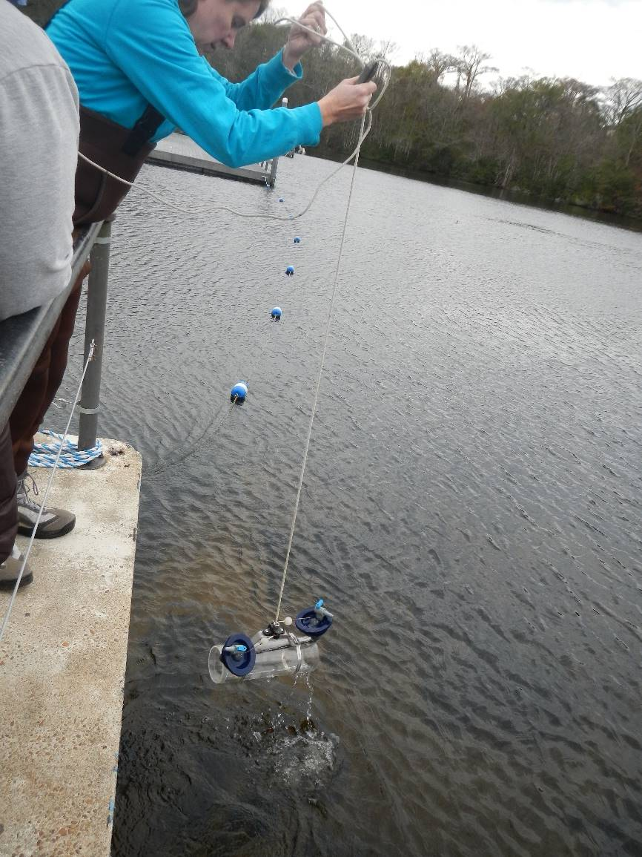
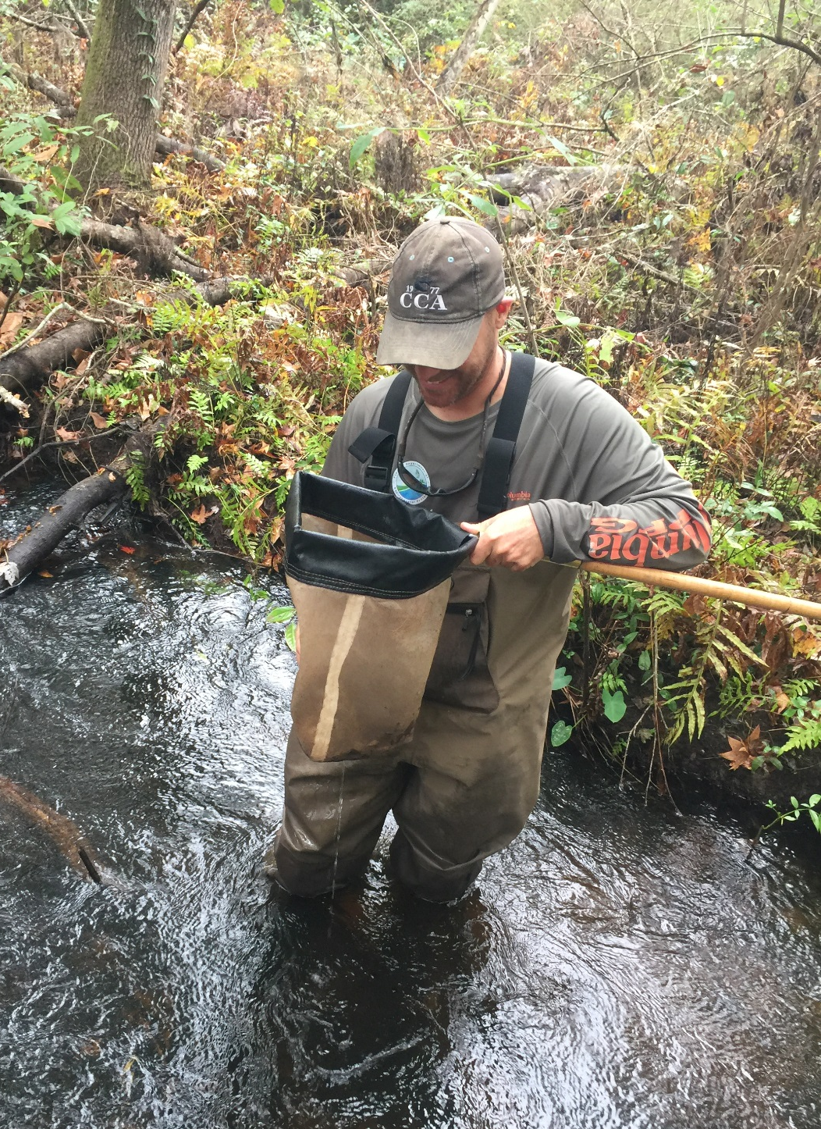
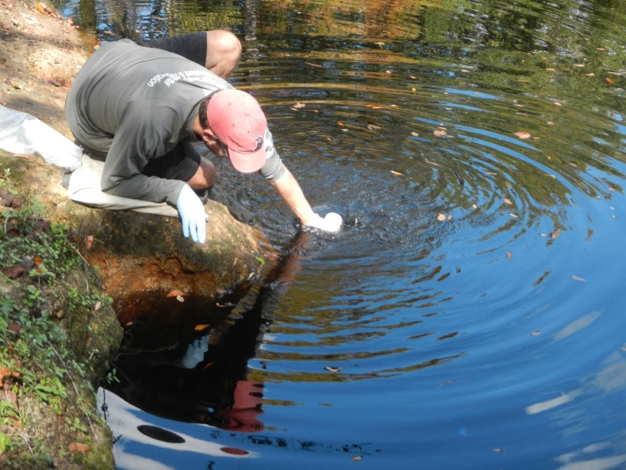
62-160.210
Samplers/Lab Analysts
Data entry
Data use
Data management
Grant/Contract management
Approved Field Procedures
Requires use of DEP SOPs for sample collection and field-testing activities, if applicable
  Including bioassessment methods
Notes:
All data generators that conduct or support field activities and field measurements shall follow the applicable procedures and requirements described in the DEP SOPs for field activities and bioassessment activities.
Additionally, if you’re performing bioassessment activities such as the SCI, BioRecon or LVI, the applicable Primers must be followed.

Slide 12
62-160.220
Samplers/Lab Analysts
Data entry
Data use
Data management
Grant/Contract management
Approval of Alternative Field Procedures
Specifies process and criteria for obtaining approval of alternative or modified procedures not in the DEP SOPs
  Any alternative field procedure must be approved by the Department prior to use
Lists procedures for which alternative field procedures cannot be approved
  FT 3000, BRN 1000, LVI 1000, SCI 1000
Limited use approval vs. statewide use approval
Typically requires side-by-side equivalency study of the two procedures with a comparison of paired samples
DEP SOP FA 2000
Notes:
Limited-use methods: Can only be used by the person/organization submitting the request based on the info and data provided to the department. Not incorporated into the FDEP SOPs.
Statewide-use methods: Can be used by all persons and organizations. The department requires the design of a collaborative study conducted by two or more independent persons/organizations to investigate the efficacy. Does not guarantee applicability for all potential uses.
Examples:
Statewide approval for reagent-less in-line chlorine meters (first and only statewide approval, 2020) –
DEP SOP FT 2000, the only technology approved for continuous monitoring in domestic wastewater is titrimetric method using an amperometric detector from Standard Methods – SM requires the use of reagents. Newer instruments can read chlorine directly. Approved several limited-use approvals. This approval is limited to use of meters for meeting the continuous monitoring requirements of domestic wastewater facilities for reuse of reclaimed waters. This use will be incorporated into the next revision of the DEP SOPs.
Alternative sample preservation (NOTOX) for macroinvertebrate samples.
Alternative methods for holding time (increased) and sample preservation (freezing) of analytes specified in approval package.
DEP SOP FA 2000 describes the application to use alternative or modified procedures as well as outlines the approval process including requirements for a completed procedure validation package.

Slide 13
62-160.240
Samplers/Lab Analysts
Data entry
Data use
Data management
Grant/Contract management
Record Keeping and Reporting Requirements for Field Procedures
Cites the DEP SOPs for record keeping requirements
  DEP SOP FD 1000 is the primary source for minimum field documentation
Specifies minimum retention time for records (5 years after data generation)
Explains when electronic records can be equivalent to paper records
Lists field records that must be provided to DEP, if requested
Prohibits alteration of data or removal of data qualifier codes by a submitter who is not the originator of the field data
Notes:
In FD 1000 you can find the universal documentation requirements as well as documentation requirements for specific procedures or conditions, such as cleaned equipment, reagents and supplies, calibration of field-testing instruments, sample collection, preservation and transport.
Electronic records shall be acceptable as documentation and shall be considered equivalent in status and function to paper records or documents, unless otherwise specified in a Department contract, order, permit or Title 62 rules. All documentation requirements apply equally to paper and electronic records.

Slide 14

62-160.300
Samplers/Lab Analysts
Data entry
Data use
Data management
Grant/Contract management
Laboratory Certification
Requires certification by DOH ELCP for most data reported to DEP
  Certification based on defined matrices
  Labs may report “equivalent methods” based on certifications in non-potable water matrix
Describes exceptions to certification requirements
  Using drinking water methods for non-potable water tests
  Reporting data before receiving certification
  Drinking water tests conducted by a licensed operator
  Field tests covered by DEP SOPs
  Lab tests conducted for research projects
  Statutorily created volunteer monitoring organizations that have undergone review by DEP
  Matrix/method/analyte combinations not included in DOH ELCP scope of accreditation
  Other specific exceptions
This Photo by Unknown Author is licensed under CC BY-NC
Notes:
Florida Department of Health, Environmental Laboratory Certification Program
Matrices: Drinking Water, Non-potable Water, Solid and Chemical Materials, and Biological Tissue (found in 62-160.120 Definitions and Standards)
For non-potable water matrix, labs may report results by any method that is equivalent in technology to the method for which they hold certification, provided they are certified for the analyte that is reported.

Slide 15
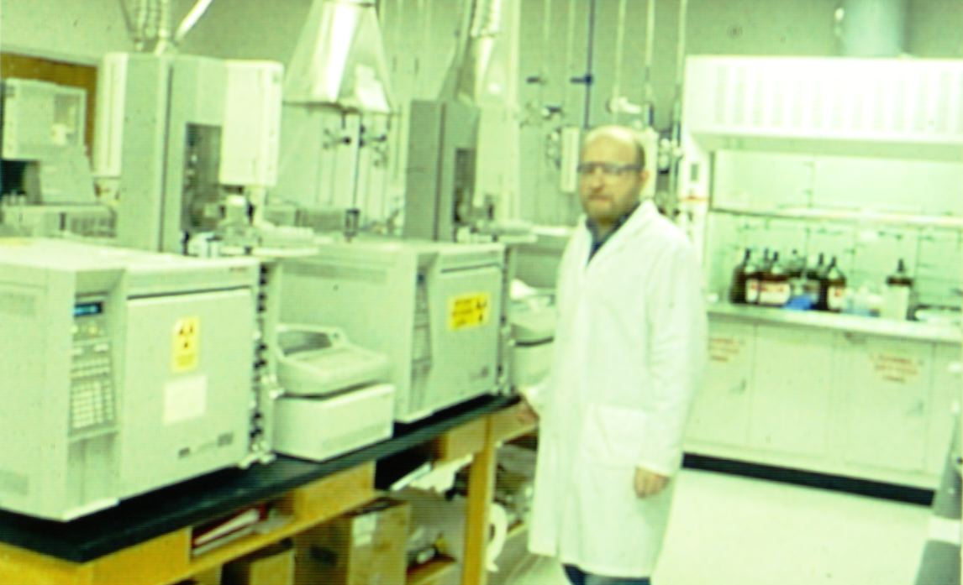
62-160.320
Samplers/Lab Analysts
Data entry
Data use
Data management
Grant/Contract management
Approved Laboratory Methods
Methods approved by DEP
  Cited in DEP rules, permits, contracts and orders
  If not cited above, approved per DEP lists of “recognized” methods and sources
  DEP SOP methods required for lab portions of DEP bioassessment methods
Notes:
When methods are specified by a Department rule, contract, order or permit, only those methods shall be used.
Note: There is no set list of methods approved for ambient water quality monitoring or assessment. Published methods are acceptable and must be performed by a certified lab for assessment and regulatory purposes.

Slide 16
62-160.330
Samplers/Lab Analysts
Data entry
Data use
Data management
Grant/Contract management
Approval of Alternative Laboratory Methods
Defines “alternative” methods
  Disallows alternative or modified methods for:
    “Method-defined analytes”
    DEP SOP bioassessment lab methods
Defines “method modification” with respect to “published methods”
Describes criteria and procedures for DEP evaluation and approval of alternative and modified methods
  Includes “limited-use” vs. “statewide-use” criteria
  Also describes how approvals may be rescinded
DEP-QA-001/01, Alternative and Modified Analytical Laboratory Methods
Notes:
Alternative laboratory approvals are typically associated with regulatory programs, where specific lab methods are required.
“Method-defined analytes” is defined by the EPA as an analyte whose result is totally depended on how the measurement is made. For example, CBOD (carbonaceous biological oxygen demand), and Oil and Grease.
DEP defines a laboratory method modification as any change to a published analytical method that alters the scope and applicability, specifications, procedures, steps, performance criteria, or any other requirements described in the published method.
Examples:
Combined sample preparation procedures for EPA method 8270D in Single Ion Mode (polycyclic aromatic hydrocarbon analysis) and FL-PRO 2018 – preparation steps for both methods are combined, and the resulting extract is analyzed separately for each method.
Method modification for the analysis of samples using the DEP FL-PRO method (determination of petroleum-range organics).
Alternative and Modified Analytical Laboratory Methods document discusses requirements for method validation documentation, which may include a demonstration of capability, determination of MDLs and PQLs, demonstration of method equivalency and inter-laboratory, collaborative method validation studies.

Slide 17
62-160.340
Samplers/Lab Analysts
Data entry
Data use
Data management
Grant/Contract management
Record Keeping and Reporting Requirements for Laboratory Procedures
Cites DOH certification rule for documentation and reporting requirements (NELAC Standards)
Specifies minimum retention time for lab records (5 years)
Lists lab records to be provided to DEP, if requested
Requires use of the Data Qualifier Codes in Table 1 of the QA Rule
Lists additional items for lab analytical reports
Requires amendment of final lab reports per TNI standard for any changes after final report is first issued
Requires reporting using DEP-specified paper or electronic formats, where requested
Notes:
NELAC: National Environmental Laboratory Accreditation Council
TNI: The NELAP Institute

Slide 18
62-160.400
Samplers/Lab Analysts
Data entry
Data use
Data management
Grant/Contract management
Sample Preservation and Holding Times
Cites DEP SOP FS 1000, part FS 1006 (and FS 1000 Appendix Tables) for preservation, containers, and holding times
  40 CFR, Part 136.3, Table II (non-potable water)
  Miscellaneous analytes not in 40 CFR 136.3
  Drinking water analytes
  Solid & waste matrices
  VOCs in soils & wastes (EPA Method 5035)
  Biosolids and protozoans
  Fish tissue
  SPLP and TCLP analytes
Defers to analytical method or best available info for analytes not in above tables
Notes:
Holding time is the storage time allowed between sample collection and sample preparation and/or analysis.
40 CFR (Code of Federal Regulations, EPA), Part 136.3 – applicable to non-potable water (NPDES permit)
VOC: volatile organic compounds
SPLP (synthetic precipitation leaching procedure) and TCLP (toxicity characteristic leaching procedure) – solid waste and contaminated soil characterization.

Slide 19
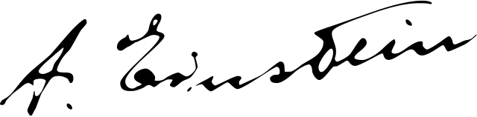
62-160.405
Samplers/Lab Analysts
Data entry
Data use
Data management
Grant/Contract management
Electronic Signatures
Electronic signatures for lab and field records acceptable when:
  Integrity of electronic signatures assured
  Signatures are unique to individuals
  Written policies and procedures are established for use of electronic signatures
    Includes ensuring security, confidentiality, integrity and auditability of electronic signatures

Slide 20

62-160.600
Samplers/Lab Analysts
Data entry
Data use
Data management
Grant/Contract management
Research Field and Lab Procedures
Typically, only required for direct contracts with DEP or for special regulatory projects
  Development and/or evaluation of innovative technologies, sampling procedures or analytical methods
    If developed for regulatory use, alternative method requirements apply
  Other designated non-regulatory research projects
Procedures must be described in contracts, study plans, work plans or research proposals
  Rule lists minimum applicable topics required
    DEP will decide if lab certification required for any methods
    DEP will decide whether any TNI standards apply
This Photo by Unknown Author is licensed under CC BY-NC
Notes:
Innovative grants focused on methods to prevent, combat or clean-up harmful algal blooms.

Slide 21
62-160.650
Samplers/Lab Analysts
Data entry
Data use
Data management
Grant/Contract management
Field and Laboratory Audits
DEP will conduct audits of field & lab procedures and records
  On-site assessments of procedures
  Validation of DEP project- or program-specific data
  Submission of performance test samples to audited organization
  Audit of associated information per DEP contracts, orders, permits or rules
Audited party must provide all requested field and lab records to DEP
Rule describes process and timeline for preliminary and final audit reports, including responses by the audited party
  Alternative schedules and procedures can be specified in other DEP rules, contracts, orders or permits
Parts of this rule do not apply to bioassessment field proficiency audits
Notes:
Performance test samples: blind, split, and/or performance check samples.

Slide 22
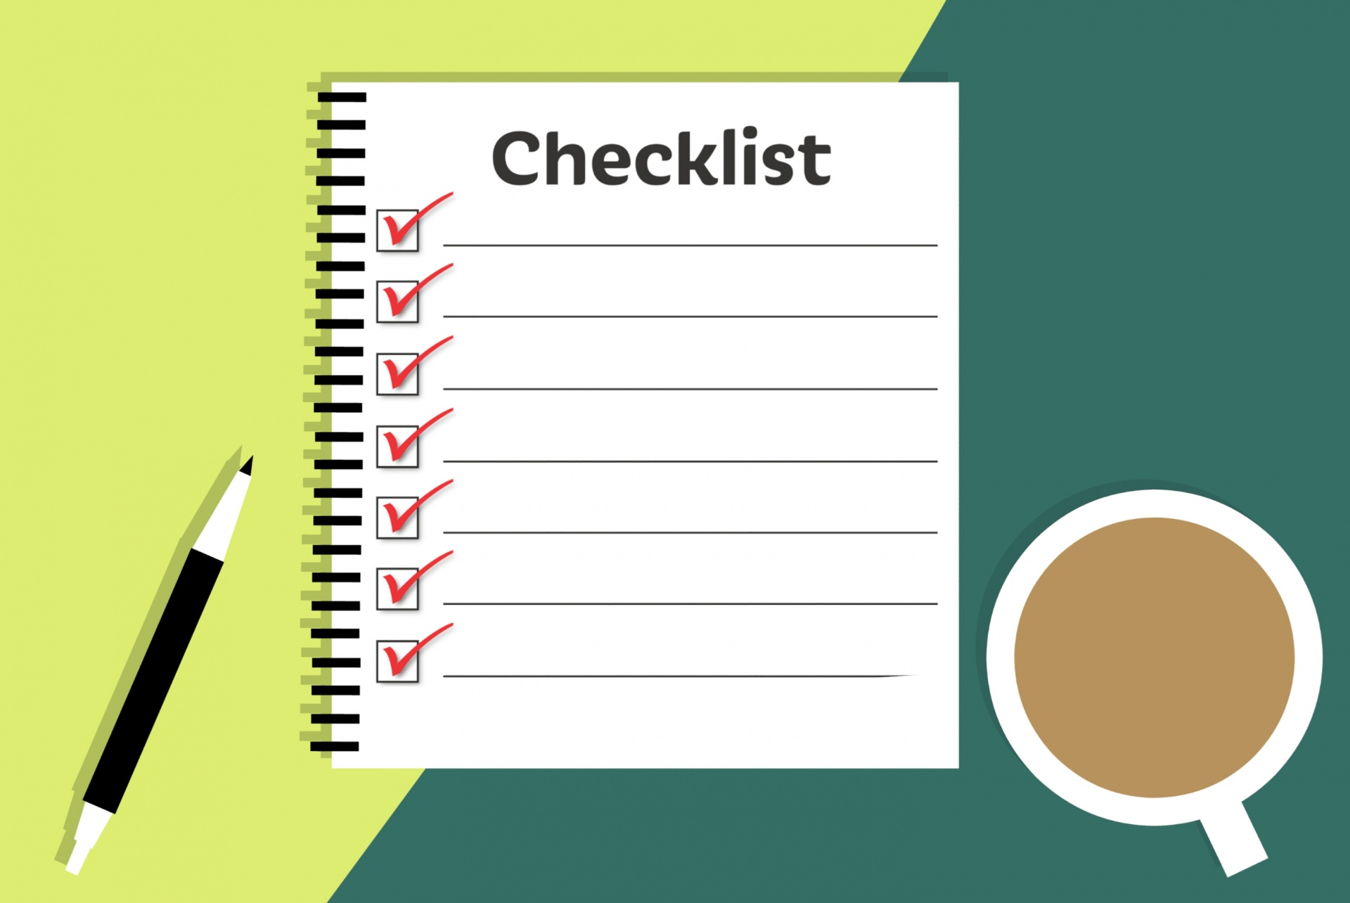
62-160.670
Samplers/Lab Analysts
Data entry
Data use
Data management
Grant/Contract management
Data Validation by DEP
Any data submitted to or used by DEP may be subject to verification and validation
  Usability determinations only apply to intended use, which may be different than original use or purpose of data generation
Evaluation criteria for data usability include:
  Sample collection, preservation and handling procedures
  Lab analytical methods
  Adequate QC measures for analytical results
  Acceptable instrument calibrations
  Ability to reconstruct and track sample history via field and lab documentation and linkage
    Sufficient and complete documentation per QA Rule requirements
  Laboratory certification status for audited results
  Evaluation per DEP-EA-001/07 (data usability document)
Notes:
Data Usability Document outlines the process to be used by the department when evaluating data quality indicators and determining the usability of analytical data.
Data quality objectives: specifications (descriptive and/or prescriptive) established for an intended use of a set of data. A target or goal describing a level of expected data quality.
Data quality indicators: A specified, numerical or qualitative criterion used to evaluate data for conformance with a DQO.
Example:
DQO: Use DEP SOPs for sampling
DQI: Collected groundwater samples per DEP SOP FS 2200
DQO: Achieve detection levels lower than water quality standards
DQI: Lab reported MDL of 0.05 ug/L for silver. (WQ standard is 0.07 ug/L).

Slide 23
62-160.700
Samplers/Lab Analysts
Data entry
Data use
Data management
Grant/Contract management
Table 1 – Data Qualifier Codes
Codes in Table 1 must be used by lab and field organizations (or other data reviewers) according to code definitions
Common Lab Qualifiers
I | The reported value is greater than or equal to the lab MDL but less than the PQL.
V | Indicates the analyte was detected at or above the MDL in both the sample and the associated method blank and the blank value was greater than 10% of the associated sample value.
Q | Samples analyzed beyond the required holding time (hours or days, for prep or analysis)
U | Indicates the compound was analyzed for but not detected.
Y | Improperly preserved sample (thermal or chemical preservation, either preserved too late or insufficiently)
J | Estimated value. Narrative explanation must be provided in comment (Ex. No QC measures performed, QC failure, matrix interference, improper lab or field procedures, lab or field calibration failure)
Common Field Qualifiers
G | Indicates that the analyte was detected at or above the MDL in both the sample and the associated field blank, equipment blank, or trip blank, and the blank value was greater than 10% of the associated sample value.
S | Secchi disk was visible to bottom of waterbody.
R | Significant rain in the past 48 hours. (Significant rain typically involves rain in excess of ½ inch within past 48 hours.)
J | Estimated value. Narrative explanation must be provided in comment (Ex. No QC measures performed, QC failure, matrix interference, improper lab or field procedures, lab or field calibration failure)
Notes:
Codes shall be added by organization collecting (field qualifiers) or analyzing (lab qualifiers) the samples.

Slide 24
62-160.800
Samplers/Lab Analysts
Data entry
Data use
Data management
Grant/Contract management
Documents Incorporated by Reference
Lists reference documents cited in the QA Rule necessary for complying with the Chapter
Include reference documents cited in the DEP SOPs
Reference document examples:
  DEP SOPs, DEP SOP Forms, Primers
  DEP New/Alternative Methods and Data Usability documents
  EPA Methods, CFR rules and QAPP document
  Selected methods from APHA, ASTM, USGS, AOAC
  Selected NELAC and TNI Standards
  Journal articles
  Invertebrate taxonomy reference
Documents incorporated by reference are enforceable as rule

Slide 25
QA Rule, 62-160, F.A.C.
The Quality Assurance rule applies to all entities involved with sampling, field testing, lab analysis, data review & presentation, and vending services for sampling supplies (kits) or instrument calibration
More stringent requirements can be imposed by contracts, orders, permits, or other DEP rules
Most sampling and field testing is routine and must follow the DEP Standard Operations Procedures (SOPs)
There are minimum documentation and reporting requirements for both field & lab records. DEP can:
  Ask for any required records at any time
  Specify the format of data reports submitted to the department
Most lab analyses must be performed by certified labs
Most lab methods are routine, are “recognized” as approved by DEP, and may be specified in DEP rules, contracts, orders or permits, where required

Slide 26
QA Rule, 62-160, F.A.C.
Alternative or modified field & lab procedures and methods must be pre-approved by DEP
Most sample preservation & holding time procedures are standard and are required as listed in the DEP SOPs (FS 1000 tables)
Research field and lab procedures must be pre-approved via work plans, sampling and analysis plans, or contracts and grants that provide required minimum information
  Includes purchase orders for sampling, field testing, lab analysis
DEP can audit samplers, field records and lab records at any time
There are minimum criteria for validating data generated for DEP
Specific Data Qualifier Codes must be used for reported data associated with quality control failures (Table 1 in the QA Rule)

Slide 27
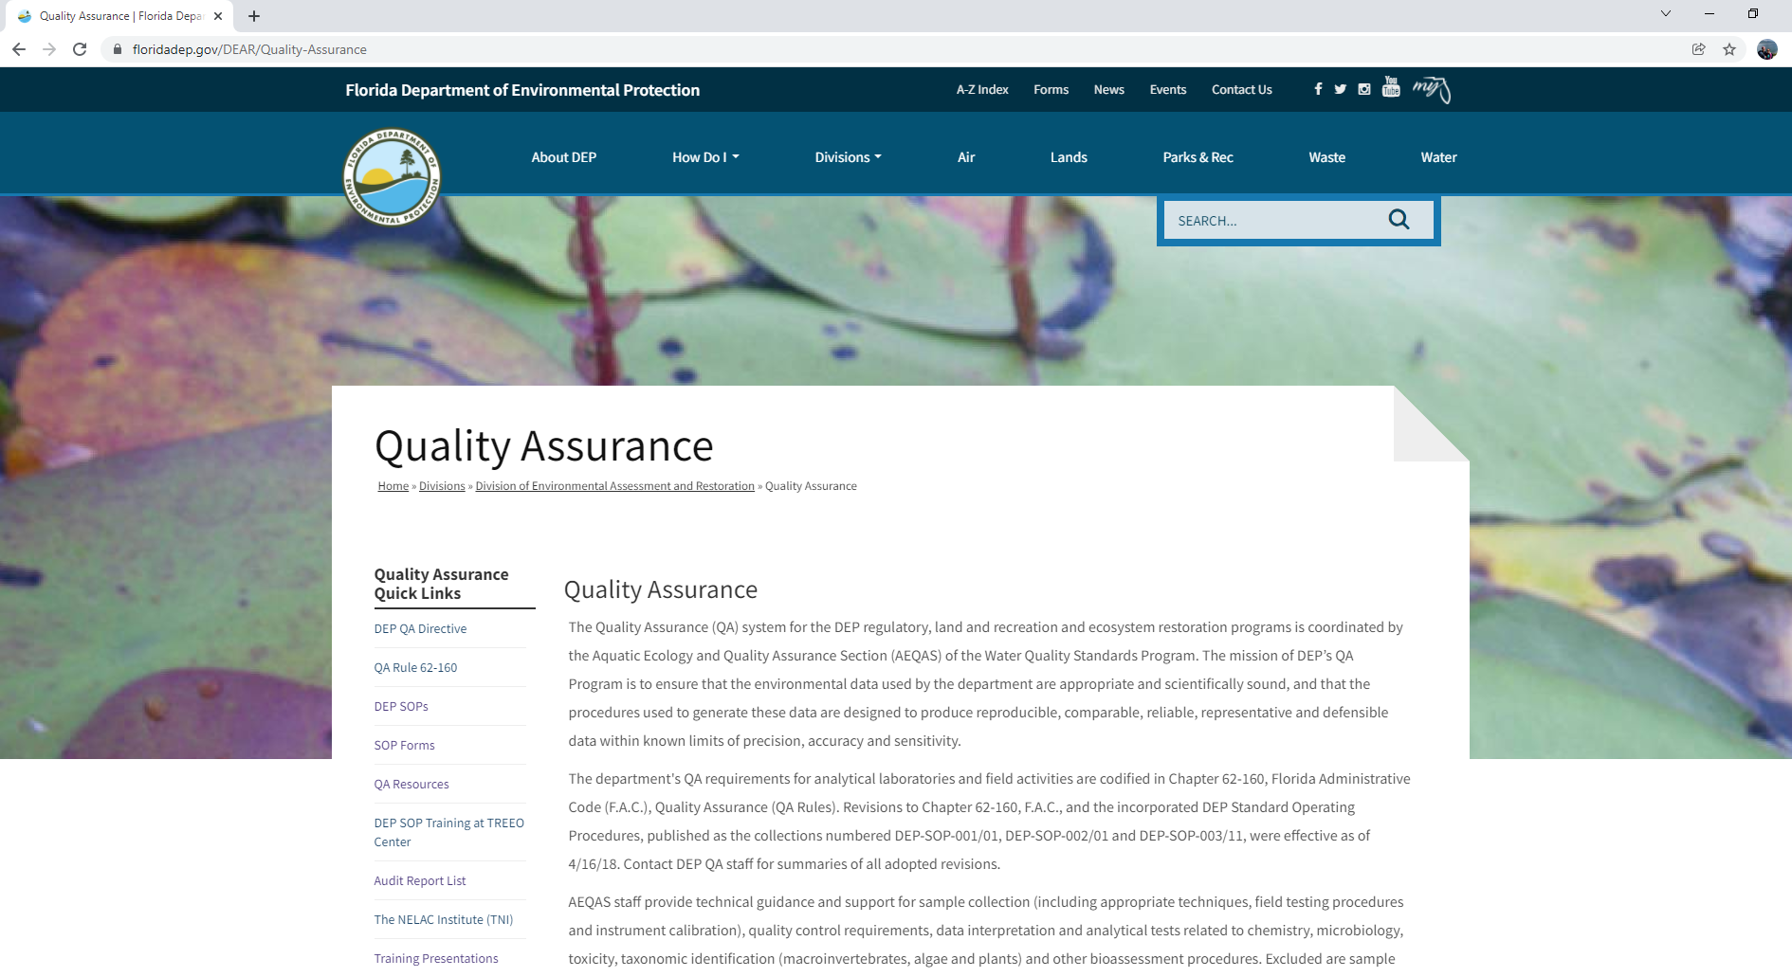
QA Resources
QA website https://floridadep.gov/DEAR/Quality-Assurance
  62-160, F.A.C.
  DEP SOPs & Forms
  Quality Plans
  Training Presentations
  List of FDOH Certified Labs
  Alternative Method Approvals
Quality of Science Review
Intro to QA
Notes:
AEQAS supports DEP’s Quality System by:
Participating in division specific teleconferences to disseminate information to QA Officers and managers throughout the agency
Assisting in the review and development of Quality Plans
Reviewing the Quality System of the agency through development of the QA Annual Report, and
Acting as a liaison with the EPA and DOH
Learn about your QA responsibilities by:
Meeting your work unit’s QA Officers,
Reading your work unit’s Quality Plan, and
Asking what QA training and resources you need to do your job
Quality of Science Review: Evaluate the effectiveness and implementation of a program’s quality system while assisting with quality assurance improvements though examination of the documentation of the quality system and activities conducted.

Slide 28


Quality_Assurance@FloridaDEP.gov

