Slide 1
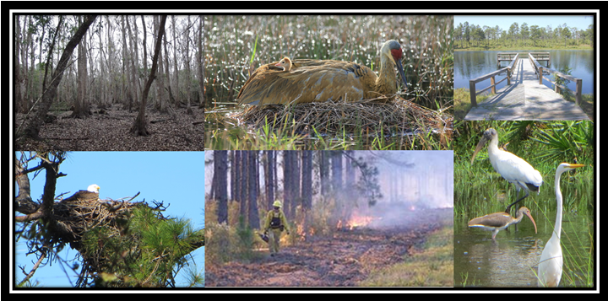
Jennifer Goff, Land Use Planning Program
Innovative Approaches in FWC’s Review of Environmental Resource Permits
Office of Conservation Planning Services
Florida Fish and Wildlife Conservation Commission
Notes:
Intro—who I am and what the Land Use Planning Program does. Overview on next slide.
Overview of presentation—start with overview of FWC and our responsibilities, then talk a little about CPS and what we do, then specifically how CPS interacts with DEP and ERPs. Describe how we normally review and provide input on ERPs, explain our take rule that prompted changes in our approach, explain the comprehensive management plan approach and how that differs from the normal approach, provide examples of Mosaic and Suncoast, and discuss how this approach can be applied in the future.

Slide 2
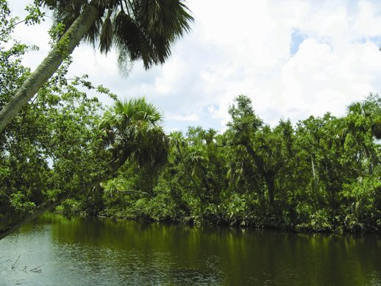
Overview
FWC and our responsibilities
Conservation Planning Services (CPS)
How CPS interacts with DEP and ERPs
Typical ERP review
Rule change for defining “take”
Comprehensive management plan approach
and examples (Mosaic and Suncoast II)
How this approach can be applied in the future
Notes:
Not sure how familiar folks are with what FWC does as a whole, so we’ll start with a general overview
start with overview of FWC and our responsibilities, then talk a little about CPS and what we do, then specifically how CPS interacts with DEP and ERPs. Describe how we normally review and provide input on ERPs, explain our take rule that prompted changes in our approach, explain the comprehensive management plan approach and how that differs from the normal approach, provide examples of Mosaic and Suncoast, and discuss how this approach can be applied in the future.

Slide 3
FWC’s Responsibilities
The FWC is responsible for managing Florida's fish and wildlife resources for their long-term well-being and the benefit of people.
Areas of Public Responsibilities:
Management - FWC manages the state's fish and wildlife resources based on the latest scientific data
Law Enforcement - We enforce rules to protect fish and wildlife, keep waterways safe and cooperate with other law enforcement agencies providing homeland security.
Research - Our scientists work to provide information for the FWC and others to make management decisions based on the best science available involving fish and wildlife populations, habitat issues and the human-dimensions aspects of conservation.
Outreach - We communicate with a variety of audiences to encourage participation, responsible citizenship and stewardship of the state's natural resources.
Notes:
Management includes things such as land management, game management, and also imperiled species management
Research is not just on fish and wildlife and habitat, but has a human dimensions component
We have staff that concentrate outreach to encourage participation in conservation and stewardship of Florida’s resources

Slide 4
FWC’s Responsibilities
Florida has...
53,927 square miles of land and 12,133 square miles of water
More than 34 million acres of public and private land
      Including 5.8 million acres of wildlife management areas (one of the largest public-hunting systems in the country)
2,276 miles of tidal shoreline (8,426 "detailed" miles)*
Approximately 12,000 miles of fishable rivers, streams and canals
About 7,700 lakes (of 10+ acres), covering 3 million total acres
The FWC protects and manages...
More than 575 species of wildlife
More than 200 native species of freshwater fish
More than 500 native species of saltwater fish
...balancing these species' needs with the needs of nearly 19 million residents and the millions of visitors who share the land and water with Florida's wildlife.
Notes:
Lakes—looking at health of lake for fish and wildlife, and recreational use of the area—some folks may be familiar with fish attractor permits DEP issues to FWC as part of our fish management
19 million residents—millions of visitors—balancing wildlife and people is a core part of our responsibilities
“Detailed” is just how fine a scale you look at—if you follow the shoreline of bays to the head of the tidewater or to where the bay/sound narrows to 100ft.
*From The Florida Handbook 2009-2010 compiled by Allen and Joan Morris. "General" coastline is the measurement of the general outline of the seacoast. "Tidal" shoreline includes measurement of bays, sounds and other waterbodies where these narrow to a width of three statute miles. "Tidal shoreline, detailed" takes bays, sounds and other bodies either to the head of tidewater or to a point where such waters narrow to 100 feet.

Slide 5
Conservation Planning Services
What do we do?
Landowner Assistance Program
Private Landowners
Technical Assistance
Habitat Management
Private Land Use Planning
Financial Assistance
Land Use Planning Program
Private Sector
Public and Government
Potentially Affect Resources
Avoidance and Minimization
Site Design
Notes:
Within FWC, CPS is the office that facilitates our responsibilities as a state review agency—explain CPS and interactions with things like dispersed water storage; working with landowners and NRCS to restore wetlands on ag lands; sector plans and comprehensive plan amendments, etc.
Conservation Planning Services consists of Landowner Assistance Program staff and Land Use Planning staff. Staff in CPS work together on some of the same projects providing different types of technical assistance during different parts of the project. We work in both non-regulatory and regulatory situations. LAP staff….. LUP staff work with landowners pursuing some sort of development. In order to help form one set of agency comments on the potential fish and wildlife resource impacts, we gather information from any staff/programs in the agency that may have a concern with the project. We are trying to gather information from agency staff that have expertise with a species or habitat type so we can provide a comprehensive agency review of a project. The projects may be long-term planning efforts or projects in a regulatory review. In both instances, CPS staff have the opportunity to proactively work with landowners, other agencies, the public, non-profits, and partners. It is important to build strong stakeholder relationships because we are able to help them make informed wildlife and habitat decisions without the use of regulatory tools, even though they may be available. We’ll talk a little more later when we get into examples of working with our stakeholders instead of trying to regulate them. I work on the LUP side, so most of my stakeholder interactions have been through the land use planning processes, which is what most of my examples focus on today.

Slide 6
Conservation Planning Services
Land Use Planning
Conservation Planning Services facilitates “agency commenting” for FWC
Land Use Planning Program staff lead a large number of project reviews
Many projects are also lead by staff across the agency depending on the main issue
Subject Matter Expert review is essential
Notes:
Agency commenting is essentially when FWC is asked to weigh in on fish and wildlife resource issues. This usually comes in the form of a request from outside the agency to review a project. We’ll talk more about these requests in the coming slides.
LUP staff receive a large number of projects and serve as “leads” on behalf of FWC. Several other staff across the agency may also serve as lead, and many more staff contribute as subject matter experts. Because we receive thousands of requests each year, it’s not possible to review every project that may affect fish and wildlife. Using a decentralized approach, where many staff across the agency lead a project, helps us achieve better conservation because each D/O is review projects that are priorities for their programs. Each lead, whether in CPS or in another part of the agency, should contact SMEs.
Many staff have expertise in a particular area that is useful to provide as part of a project review (i.e. Justin does PC crayfish along with many other things, but he would be an SME for PC crayfish). Collaborating across the agency helps us speak with one voice and avoid contradicting ourselves.

Slide 7
Conservation Planning Services
Land Use Planning
Projects are received through a “general correspondence” inbox (FWCConservationPlanningServices@MyFWC.com)
Projects are screened for appropriateness and logged into the FWC log
GIS analysis run for each project logged
Lead reviewer assigned for each project

Slide 8
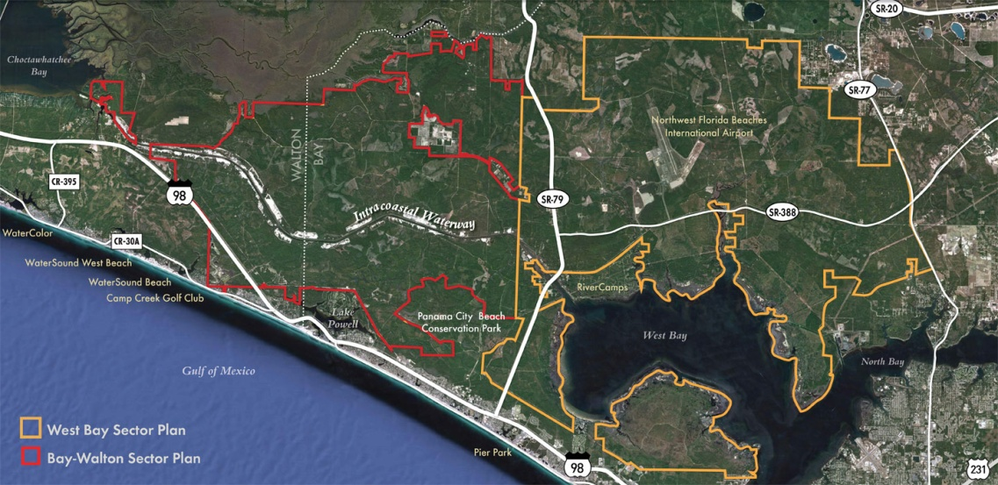
Conservation Planning Services
Land Use Planning
What project types does FWC review?
  Local land use changes
  Commercial/residential/industrial development
  Sector Plans/DRIs
  Oil and Gas
  Exploration
  Roadway projects
  (DOT and local)
  Natural Gas Transmission Pipelines
  Mining and mineral permits and reclamation
Notes:
What are all of these people asking us to review?

Slide 9
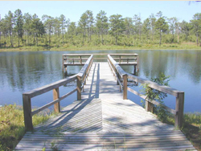
Conservation Planning Services
Land Use Planning
Additional review types:
  Coastal/Marine/Estuarine impacts (seawalls/docks/coastal developments)
  Dredge and Fill permits/ (404s/JCPs/CCCLs)
  Military and Federal Lands (INRMPS/NPS/USACE)
  Siting Act projects (Power Plants)
  Environmental Resource Permits
Eglin WMA
Notes:
ERPs—everything from deadheads to ports

Slide 10
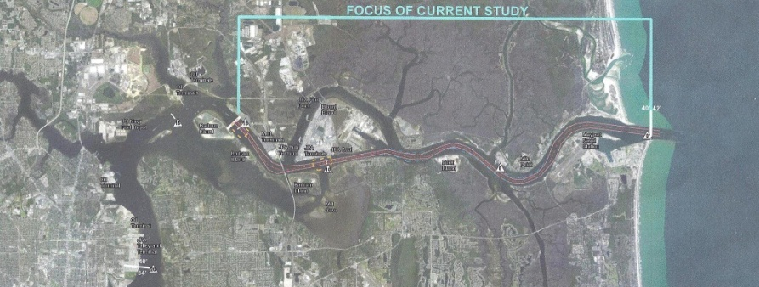
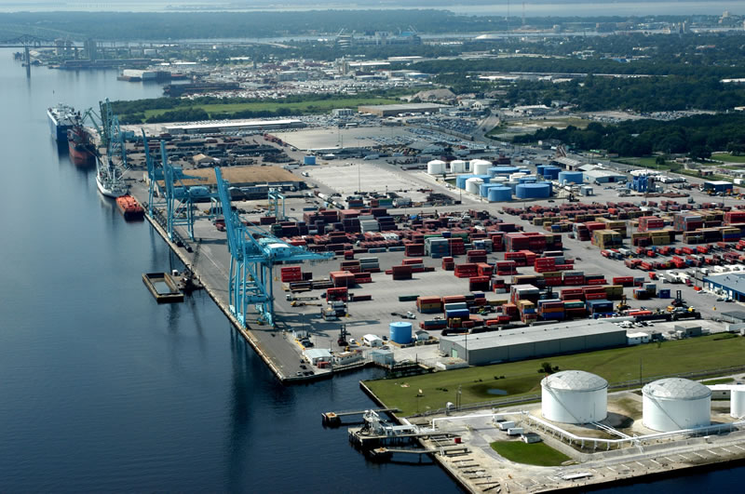
Conservation Planning Services
Land Use Planning
Agency-wide collaborative approach
FWC’s interests are coordinated internally
    Single point of contact for FWC
Coordinate project review with:
    Landowners
    Local governments
    State review agencies
    Federal agencies
Notes:
Regardless of the project type, we follow a similar process. When a lead is reviewing a project, whether they are in Land Use Planning or another part of FWC, they coordinate across the agency the make sure that all of FWCs interests are coordinated. Staff use an agency-wide collaborative approach to gather subject matter input and make sure all of FWC’s interests are covered during the review. Staff work closely with the landowners, local governments, and state review agencies to identify and address impacts. Landowners and agencies can have a single point of contact within FWC and that person will provide a coordinated review in an expedited manner. We provide better information to the applicant/agency when we coordinate internally and provide one response that covers all of FWC’s concerns.

Slide 11
FWC and the Environmental Resource Permitting Program
FWC is a state agency that participates in the review of applications to the Environmental Resource Permitting Program implemented by FDEP and the 5 WMDs under Part IV of Chapter 373, F.S.
FWC staff assess the potential project impacts to fish and wildlife resources, state imperiled species and imperiled species habitat, and identify impacts in accordance with Chapter 379, Florida Statutes (F.S.) and Chapter 68A-27, Florida Administrative Code (F.A.C).
FWC is responsible for administering Chapter 68A-27 F.A.C., which includes “take” and “harm” defined as: “Take” is to harass, harm, pursue, hunt, shoot, wound, kill, trap, capture, or collect, or to attempt to engage in such conduct.
“Harm” is an act which actually kills or injures fish or wildlife, which may include significant habitat modification or degradation, that impairs essential behavior patterns, including breeding, feeding or sheltering
Notes:
FWC reviews ERPs b/c of the potential to impact state listed species and habitat; we review ERPS under our own rules (379 and 68A-27). Our imperiled species rule defins “take” of species; in 2010 our imperiled species rule changed to include a definition of “harm”. The new definition is in line with the federal definition, and provided a way of assessing take of species due to significant loss of habitat. The loss of habitat must be significant and must impair essential behaviors of listed species to be considered “take” under rule
FWC is a state agency that participates in the review of other state agency regulatory programs. One such example is the ERP program implemented by FDEP and the 5 WMDs under Part IV of Chapter 373, F.S. FWC staff review the applications submitted to FDEP and the 5 WMDs the ERP program and assess the potential project impacts to fish and wildlife resources, including state imperiled species and imperiled species habitat as authorized under Chapter 379, Florida Statutes (F.S.) and Chapter 68A-27, Florida Administrative Code (F.A.C).

Slide 12
FWC and the Environmental Resource Permitting Program
Applications for impacts to wetlands are reviewed for potential impacts to state imperiled species that are dependent upon those wetlands for essential behaviors such as breeding, feeding, or sheltering.
FWC staff provide FDEP and the applicant with recommendations for state imperiled species including:
measures for avoiding impacts
measures for minimizing potential impacts
permitting alternatives for unavoidable impacts
mitigation alternatives for impacts to listed species (including essential habitat)
The ERP authorizes impacts to wetlands that may be used by state imperiled species, and impacts to these wetlands may include significant habitat modification or degradation that impairs essential behavior patters (breeding, feeding, or sheltering).
Notes:
When FWC staff review applications to FDEP for impacts to wetlands, FWC staff are considering the potential impacts to state imperiled species that are dependent upon those wetlands for essential behaviors such as breeding, feeding, or sheltering.
FWC staff then provide FDEP and the applicant with recommendations for avoiding, minimizing, permitting, or mitigating impacts to state imperiled species.
The ERP authorizes impacts to wetlands that may be used by state imperiled species, and impacts to these wetlands may include significant habitat modification or degradation that impairs essential behavior patters (breeding, feeding, or sheltering).

Slide 13
FWC and the Environmental Resource Permitting Program
The applicant is legally responsible for avoiding “take” of state imperiled species relying on wetlands for essential behaviors when those wetlands are permitted for impacts through the ERP.
Ch. 68A-27.007, Permits and Authorizations for the “take” of Florida Endangered and Threatened Species:
  Incidental Take: taking otherwise prohibited, if such taking is incidental to, and not the purpose of the carrying out of an otherwise lawful activity. [Ch. 68A-27.007(2)(b) ]
    Could the take be avoided or minimized
    Activity won’t have a negative impact on survival of the species
    Requires mitigation to offset the impact, provide net scientific or conservation benefit to species
Notes:
As such, the applicant that receives an authorization to impact these wetlands would also be legally responsible for avoiding “take” of state imperiled species relying on these wetlands for essential behaviors.

Slide 14
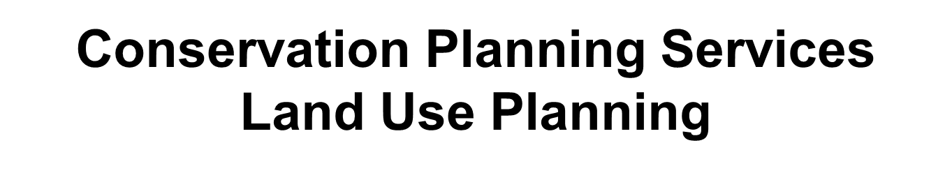
Florida Sandhill Crane
The area adjacent to Reedy Creek Swamp and the wetlands on the property contains foraging habitat for Florida sandhill crane and the freshwater emergent marsh adjacent to the upland buffers may provide potential nesting habitat for this species. FWC staff recommends that surveys for nesting sandhill cranes be conducted prior to construction that occurs from January through August, during their breeding season. If there is evidence of nesting during this period, we recommend that the nest site be buffered by 400 feet to avoid disturbance by human activities until nesting is complete (Stys 1997; draft Sandhill Crane Species Action Plan (http://www.myfwc.com/media/2738849/Florida-Sandhill-Crane-Species-Action-Plan-Final-Draft.pdf). If nesting is discovered after construction has begun or if maintaining the recommended buffer is not possible, we recommend that the applicant contact FWC staff identified below to discuss potential permitting needs. We also advise the applicant that Florida sandhill cranes do not nest in the same location every year so if construction occurs over several years, it may be necessary to determine if nesting is occurring each year.
Notes:
Typical language found in ERP letters from FWC. The red highlight indicates the habitat to be impacted and recommendations for identifying, avoiding, or permitting impacts.

Slide 15
FWC’s Incidental Take Permitting and the ERP Program
If an ERP authorizes impacts to wetland habitat that results in the modification or degradation of habitat supporting essential behavior patterns for state imperiled species, then the permittee may be liable for “take” as defined in Ch 68A-27 and would need to obtain an Incidental Take Permit (ITP).
There is a “net conservation benefit” for the species required to obtain the ITP and may include replacement of the functional loss of habitat impacted by the lawfully permitted activity.
This “net conservation benefit” may already be occurring through the existing ERP program.
Notes:
If an ERP authorizes impacts to wetland habitat that results in the modification or degradation of habitat supporting essential behavior patterns for state imperiled species, then the permittee may be liable for “take” as defined in Ch 68A-27 and would need to obtain an ITP.
The “net conservation benefit” required to obtain the ITP may include replacement of the functional loss of habitat impacted by the lawfully permitted activity.
This “net conservation benefit” may already be occurring through the existing ERP program—this is the concept we have been exploring over the past year. We’ll talk a little more in the next slides about how and why we think that’s the case, and how that influences our review of larger projects.

Slide 16
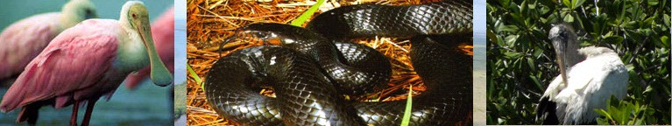
Wetland Mitigation as part of the ERP Program
Mitigation is required only to offset the adverse impacts to the caused by regulated activities.
Mitigation might consist of restoration, enhancement, creation, or preservation of wetlands, other surface waters, or uplands.
Mitigation can be conducted on-site, off-site, or through the purchase of credits from a mitigation bank, or through a combination of approaches.
The mitigation must offset the adverse impacts to wetlands and other surface waters.
Notes:
DEP staff are familiar with this as part of the ERP, but this serves the same purpose as the ITP. We have been looking at how the ERP process works, seeing the similarities with the requirement so an ITP, and recognizing that there is duplication in the request on applicants to do “extra” for species.

Slide 17
FWC’s Incidental Take Permitting and the ERP Program
Chapter 62-345, F.A.C., identifies the Uniform Mitigation Assessment Method to be used to assess functions provided by wetlands and other surface waters, the amount those functions are reduced by the proposed impact, and the amount of mitigation needed to offset that impact.
FWC is participating in the current UMAM Rule Revision regarding assessment of fish and wildlife resources
FWC regularly participates in review of mitigation bank applications regarding value to fish and wildlife resources, including habitat necessary for essential behaviors of imperiled species

Slide 18
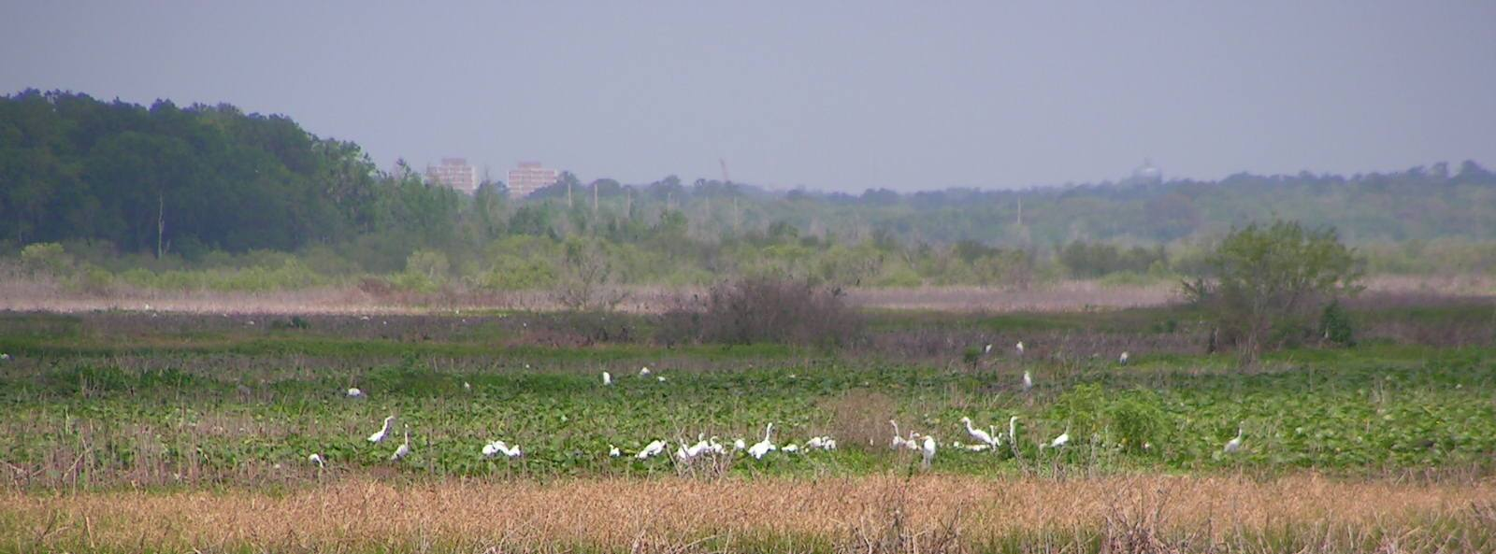
FWC’s Incidental Take Permitting and the ERP Program
Mitigation as determined through UMAM and the use of mitigation banks both offset the functional loss of wetlands and other surface waters
Therefore, existing requirements for mitigation may offset the loss of habitat used for essential behavior patterns for state listed species.
Use of wetland mitigation through the ERP program may effectively serve as the “net conservation benefit” necessary to receive an ITP.
This does not preclude the need for avoidance and minimization measures to avoid “take” of state imperiled species

Slide 19
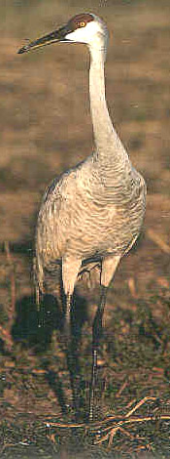
FWC’s Incidental Take Permitting and the ERP Program
If conditions included as part of the ERP contain measures to avoid and minimize impacts to state imperiled species and
If wetland mitigation offsets the functional loss of the wetland habitat through a mechanism that provides:
Long-term conservation of habitats
Perpetual management of habitats
Perpetual funding source
Then the conditions of the ITP could possibly be met
through the ERP program.

Slide 20
Concurrent Issuance of ITP
FWC staff are exploring the possibility of issue and Incidental Take Permit concurrent with the ERP
Chapter 68A-27 allows FWC to issue an ITP without the permittee submitting an application to FWC
Showing a “net conservation benefit” is required to receive an ITP
Mitigation occurring through the existing ERP program may constitute the “net conservation benefit” necessary to receive an ITP
An Incidental Take Permit (ITP) for unavoidable impacts to state imperiled species can be issued by FWC based on avoidance, minimization, and mitigation measures specified in the ERP as long as those measures achieve a “net conservation benefit” and “do not jeopardize the survival potential of the species”.
Notes:
Important to remember that the ITP for projects that get an ERP would only be for wetland dependent species. There are several upland species that would not be captured, which led us to explore different options for upland species. Tha t's a separate topic (modified UMAM)—can give an overview after the example if requested.

Slide 21
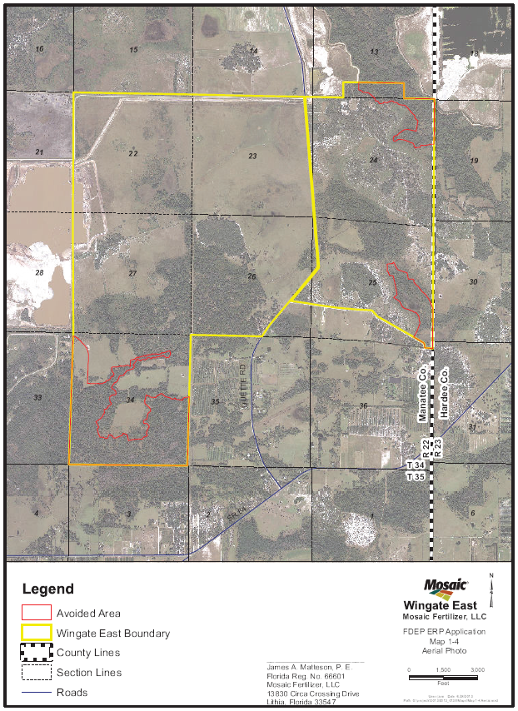
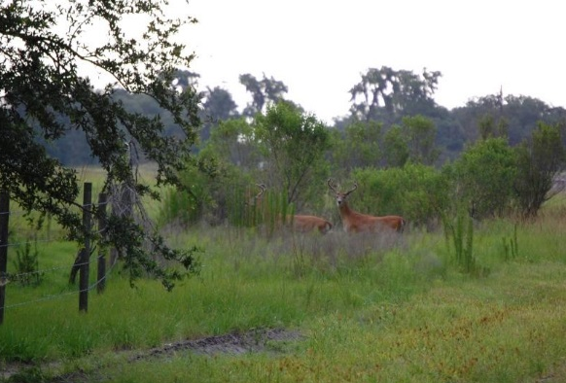
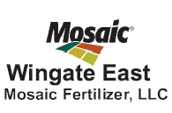
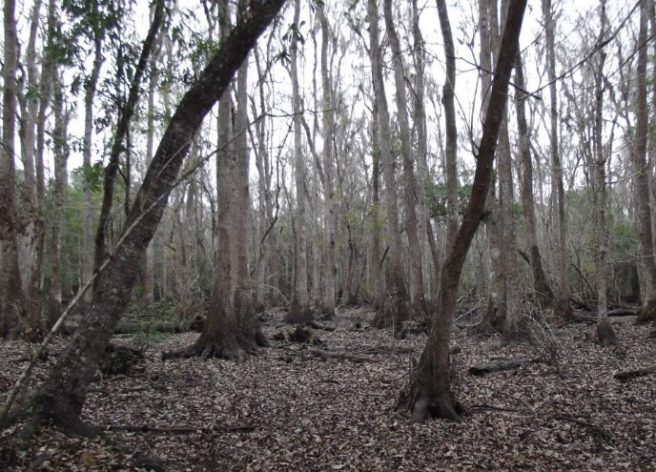
FWC Conservation Planning Services
Project Example
Wingate East Mine Expansion
Multi-species Permitting
Notes:
Some projects are large scale and have multiple wetland and upland habitat types. Wingate is an example where the applicant provide an ERP application and associated Conceptual Reclamation Plan that covered upland and wetland habitat types and upland dependent listed species. FWC staff received the application for review and began coordinating internally and with Mosaic staff prior to providing comments to DEP. Our involvement with mines historically has been directly with the applicant to work with them on their WHMPs associated with mines. We are moving more towards an integrated approach where we hope to work proactively with DEP and the applicant during pre-app meetings. We were not involved early on for Wingate, so this was a hybrid of the planned approach. In the future, we’d like to work with DEP on better/early coordination.

Slide 22
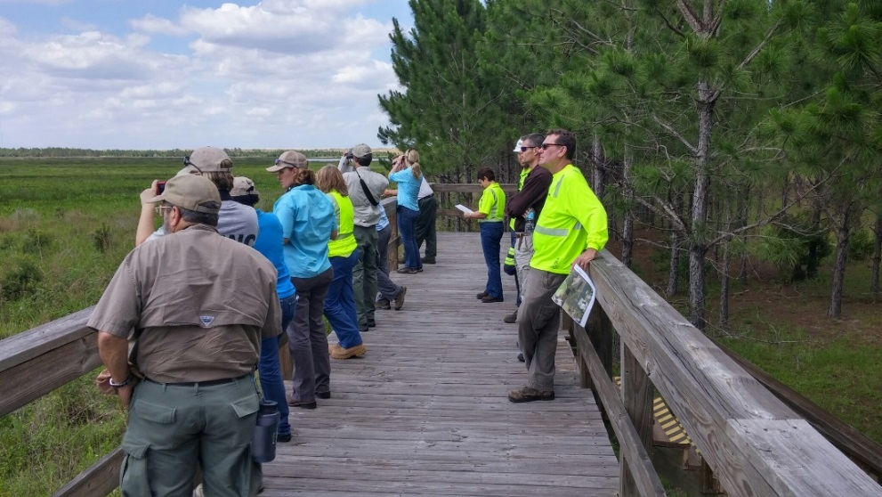
FWC Conservation Planning Services
Project Example
  Mosaic proposes phosphate mining on a 4,345-acre site in east central Manatee County—DEP permit required
  FWC’s “take” rule includes a definition
  of “harm” that would let FWC regulate
  habitat that is necessary for “essential behaviors”—
  FWC permit MAYBE required
  A Wildlife and Habitat Management
  Plan was developed for the 50-year mine
  Conservation benefit for listed
  species associated with “take” is
  outline in rule—does the WHMP address this?
Notes:
Mosaic proposed a mine and sent and ERP app to DEP. FWC received the app to review and we also recognize that there are habitats to be impacted that fall under FWC rules. Mosaic submitted a WHMP that addressed the proposed impacts and mitigation, and included information on state listed species. Conservation benefit outlined in rule; FWC started discussing with Mosaic if and how the WHMP might meet the intent of the rule as far as addressing take.
Mosaic Fertilizer, LLC is currently seeking a permit from the Florida Department of Environmental Protection for the proposed Wingate East phosphate mine site on a 4,345-acre tract located between State Road 62 and State Road 64 in the east central portion of Manatee County. As part of the FDEP permit application, Mosaic developed a Wildlife and Habitat Management Plan for the 50-year mine life that consists of an overarching habitat management plan along with generally accepted avoidance, minimization, and mitigation measures for each species occurring or potentially occurring on the proposed mine site. The habitat management plan includes specific habitat management activities and conservation measures that will take place for both disturbed and undisturbed areas, prior to and during mining activity, and post mining reclamation. FWC staff from LUP and ISM coordinated closely with Mosaic staff on the development of additional conservation measures to be incorporated into the project to further minimize potential impacts to state-listed fish and wildlife resources that occur or may potentially occur on the proposed mine site. This coordination consisted of an onsite field review of the site and ongoing mining operations on other Mosaic lands; and multiple meetings with Mosaic staff and FWC staff from the Southwest Regional Office and Tallahassee. This coordination has resulted in the development of additional species-specific measures to be incorporated into the project for the Florida sandhill crane and Southeastern American kestrel that will further benefit the conservation of these species. This effort contributes to FWC’s Private Lands Strategic Initiative, Strategy 5.2.

Slide 23
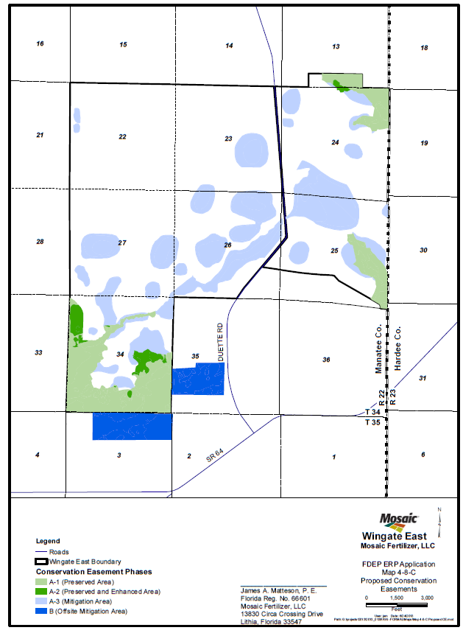
Notes:
Area of significant size, mosaic of uplands and wetlands. Wetlands addressed during ERP/CRP, uplands addressed to some extent in CRP. Some areas were proposed for avoidance and/or conservation, other areas for restoration, other areas for reclamation. Many areas onsite contain potential listed species habitat.

Slide 24

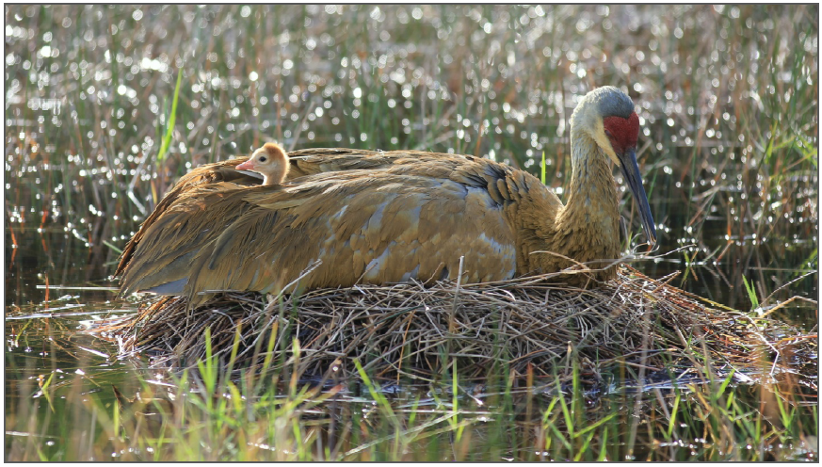
FWC Conservation Planning Services
Project Example
  FWC’s “take” rule change prompted ISMP and new language in ISMP affects mining
WHMP provided mitigation, but was it enough and was it appropriate to achieve a “conservation benefit”?
Developed additional conservation measures for state-listed fish and wildlife resources to be included
  Conservation benefits for the Florida Sandhill crane and Southeastern American kestrel
Notes:
We started having a series of meetings with Mosaic staff during DEPs the review process and discussing FWC’s imperiled species management plan as it relates to mining. The ISMP includes language that talks about mining as it relates to take of habitat under the revised rule, and discussion with Mosaic includes conversations about the ERP/CRP process as it relates to wildlife.
Benefits for the kestrel, which is not on the wetland dependent species list in the applicants handbook so would not necessarily be addressed as part of an ERP.

Slide 25
FWC Conservation Planning Services
Project Example
FWC is taking a comprehensive approach to management planning for large scale projects like mining
WHMPs may provide benefits for state listed species
Challenges include accounting for impacts and benefits to individual species in a project with a mosaic of habitat types
Early and frequent coordination is essential for this approach to be successful
Notes:
We are continuing conversations with Mosaic on the best approach for large scale mining operations. The comprehensive approach incorporates wetland AND upland impacts, measures to avoid/minimize/mitigate, and measures to meet the intent of FWCs take rule for large scale projects. The WHMP may be able to show the conservation benefit for listed species and that the project does not impact the survival potential of the species. This can reduce the time spent but the applicant in the permitting process and reduce the time it takes FWC to review the project for species impacts.

Slide 26
FWC Conservation Planning Services
Future Projects and Coordination
FWC staff will continue to review ERPs and provide DEP staff and the applicant with fish and wildlife information
We will continue internal discussions with FWC and DEP legal on implementing a simultaneous permit process—this will not affect DEPs process
Important to include conditions for wetland dependent wildlife in the ERP
Exploring an approach to use UMAM for assessing impacts and mitigation on uplands
Notes:
Modified UMAM to supplement comprehensive approach

Slide 27
FWC Conservation Planning Services
Future Projects and Coordination
FWC issued an ITP for Suncoast II that used a modified UMAM approach to assess impacts to uplands—more of this in the future
Engaging with the applicant as early as possible is essential
FWC staff should be in pre-application meetings
We can work out wildlife issues during pre-apps to shorten review time
Upon approval of the ISMP, FWC staff may begin issuing ITPs for wetland dependent species simultaneously with ERPs at the applicant’s request
Notes:
The approach taken in Suncoast II combined with the comprehensive management plan approach will allow us to address impacts to both upland and wetland listed species at the same time, using the same process.

Slide 28
Summary Points
Chapter 68A-27 defines “take” to include “harm” which may include significant habitat modification or degradation, that impairs essential behavior patterns, including breeding, feeding or sheltering.
An Incidental Take Permit (ITP) may be required for unavoidable impacts to state imperiled species
Showing a “net conservation benefit” is required to receive an ITP
Mitigation occurring through the existing ERP program may constitute the “net conservation benefit” necessary to receive an ITP
FWC staff may issue an ITP concurrent with the ERP without receiving a separate application for incidental take

Slide 29
Summary Points
FWC staff are work with other state agency staff to build upon the UMAM criteria include an assessment of impacts to uplands
This procedure could be used as part of the Incidental Take Permit application process.
.
This includes consideration of an ecological community’s current condition, hydrologic connection, uniqueness, location, fish and wildlife utilization, time lag, and mitigation risk for UPLANDS.
Includes evaluating impacts to listed wildlife species and determining the mitigation necessary to supply the “net conservation benefit” as part of the ITP
This does not preclude the need for avoidance and minimization measures to avoid “take” of state imperiled species

Slide 30
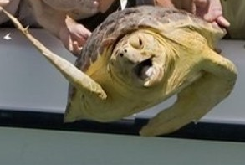
Questions?

