Slide 1
Notice of Permits
Process and Procedures

Slide 2
Presentation Overview
Background
What needs to be noticed
Notice of Permit process
  Reviewer’s role
  Permit Technician’s role
  Regulatory Support’s role
Questions / discussion

Slide 3
Recording Notice of Permits
Purpose
To notify the public:
  Existence of an Agency permit over certain property
  Agency permits do NOT run with the land

Slide 4
Permit Condition
Permit conditions state that “within 30 days of any conveyance or division of ownership or control of the property or the system…the new owner shall request transfer of the permit.”
62-330.350(1)(l)(2), F.A.C.
  Permitted property is often conveyed to another entity but a permit transfer is not requested.
  Noncompliance is likely due to lack of knowledge rather than intent to violate District rules.

Slide 5
Rule – Notice of Permit
Section 62-330.090(7), Florida Administrative Code
Section 12.6(b), Applicant’s Handbook Vol. 1
“The Agency shall cause a “Recorded Notice of Environmental Resource Permit” Form No. 62-330.090(1)…to be recorded in the public records of the county where the property is located…This notice shall not be considered an encumbrance upon the property.”

Slide 6
Notice of Permit
Benefits
Buyers are notified of Agency permits through a title search prior to purchase.
Operation transfer process is facilitated by satisfying public notice requirement.
More permit ownership transfer requests are submitted after property conveyance.
General compliance with permit conditions is increased.

Slide 7
What requires notice?
Permit types include:
  Conceptual Approval Permits
  Individual Permits
  Major Modifications
Application types include:
  Mitigation banks
  Formal wetland determinations
  Privately owned institutions

Slide 8
Permit Extensions
Verify if permit being extended was previously noticed.
  Yes – no notice required
  No – notice required
  Reference the application(s) being extended
Extensions can indicate construction plans are taking longer to complete, therefore:
  Greater potential for ownership change
  Higher probability of compliance issues

Slide 9
What does NOT require notice?
10-2 Permits
General Permits
Minor Modifications
Variances
Informal Wetland Determinations

Slide 10
What does NOT require notice?
Property owned by a governmental entity
  Public roads/highways
  State/county/city parks, buildings, etc.
  Public airports
A previously noticed application
  Within the same permit number
  Includes the previous permitted boundaries
Exclusions are included in 62-330.090(7)(a) through (f)

Slide 11
Notice of Permit Process:
Reviewer’s Role

Slide 12
Reviewer’s Role
Locate a legal description for the property under review
What qualifies as a legal description?
  Legal description from a plat
  Legal description from a survey (must be legible and include sketch, if stated)
  Legal description from the deed

Slide 13
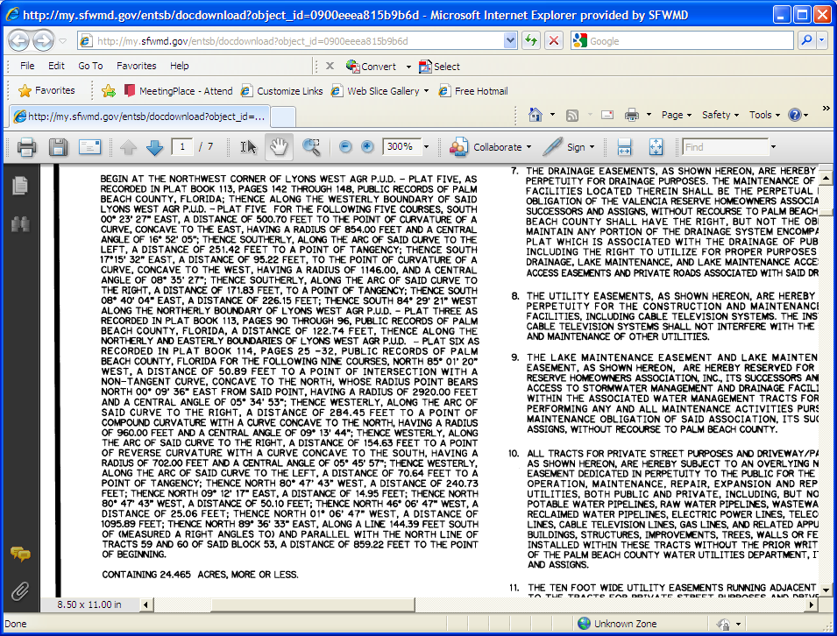

Example:
Sufficient Legal Description
Example from Plat

Slide 14
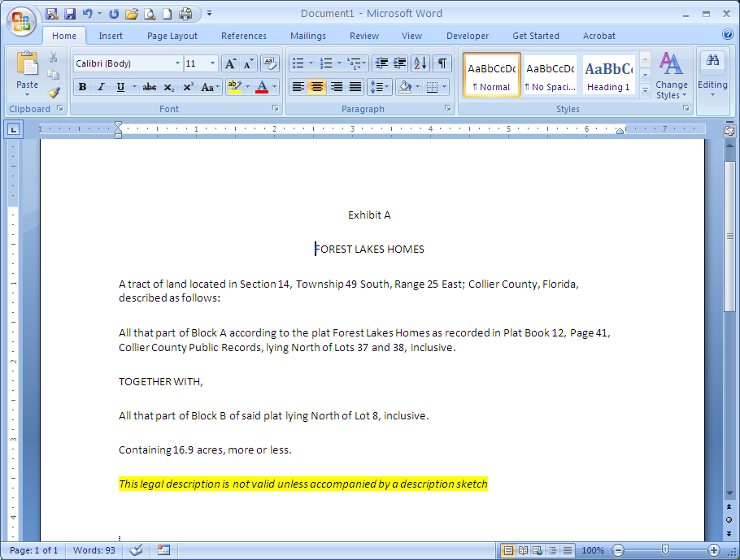
Example:
Sufficient Legal Description
  Example from a survey (legible and with sketch) Part 1

Slide 15
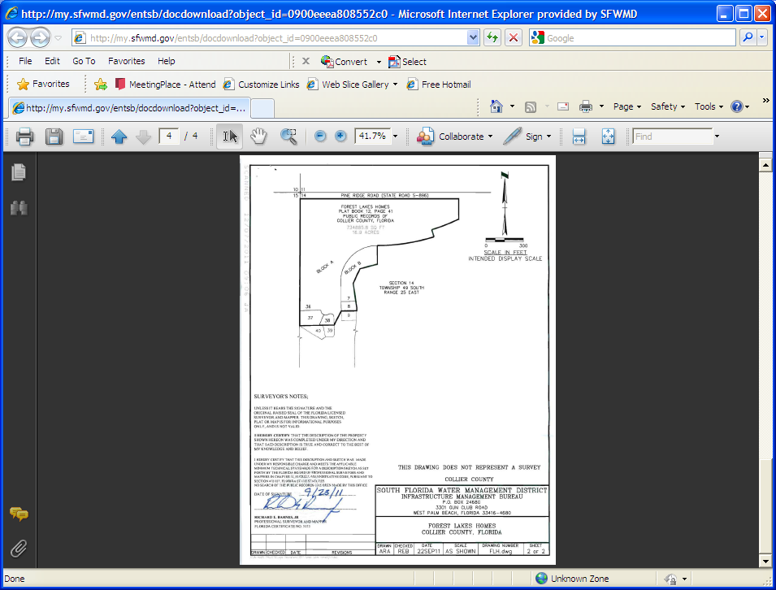
Example:
Sufficient Legal Description
  Example from a survey (legible and with sketch) Part 2

Slide 16

Example:
Sufficient Legal Description
Example from Deed #1

Slide 17
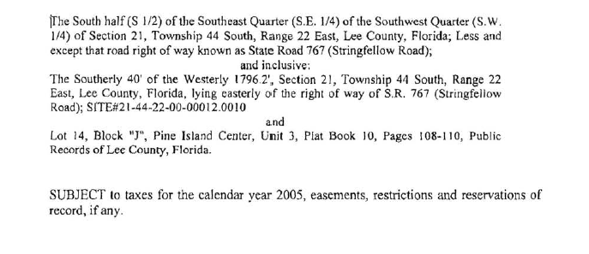
Example:
Sufficient Legal Description
Example from Deed #2

Slide 18
Reviewer’s Role
What does NOT qualify as a legal description?
  Property appraiser summary page
  Legal descriptions from property appraiser website
  Map, survey, or sketch
  Legal descriptions of easements

Slide 19
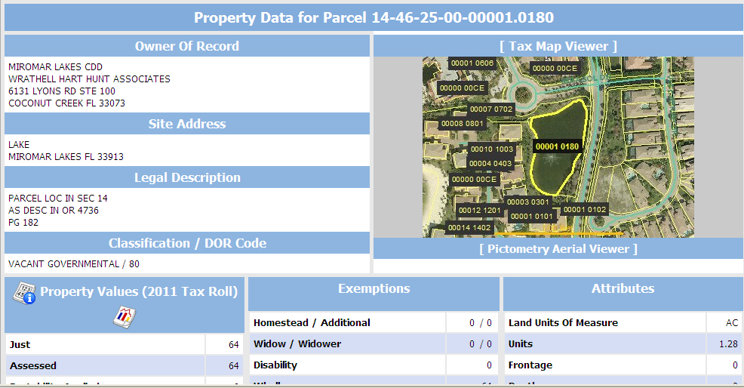

Example:
Insufficient Legal Description
Example of Property Appraiser Summary

Slide 20
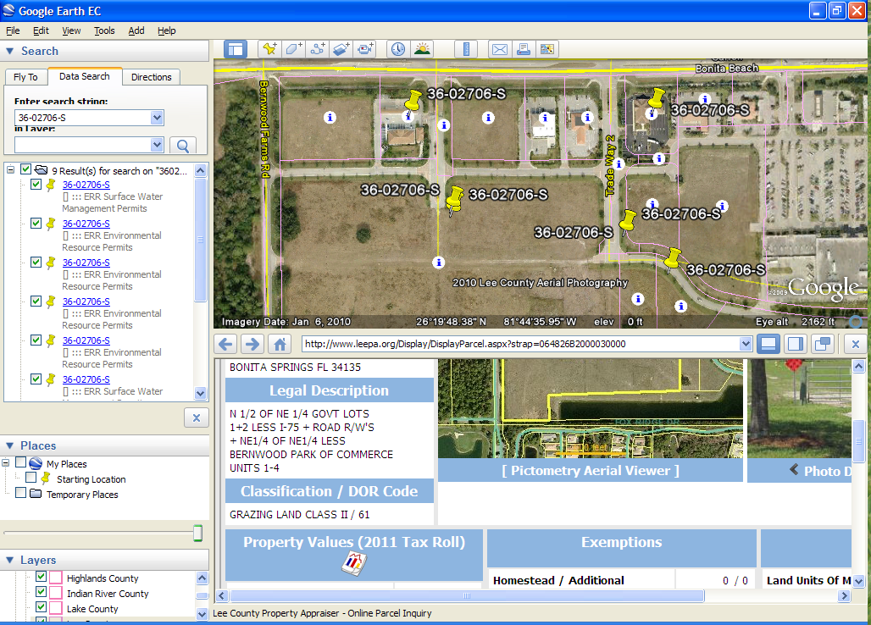
Example:
Insufficient Legal Description
  Example of legal description from property appraiser website

Slide 21
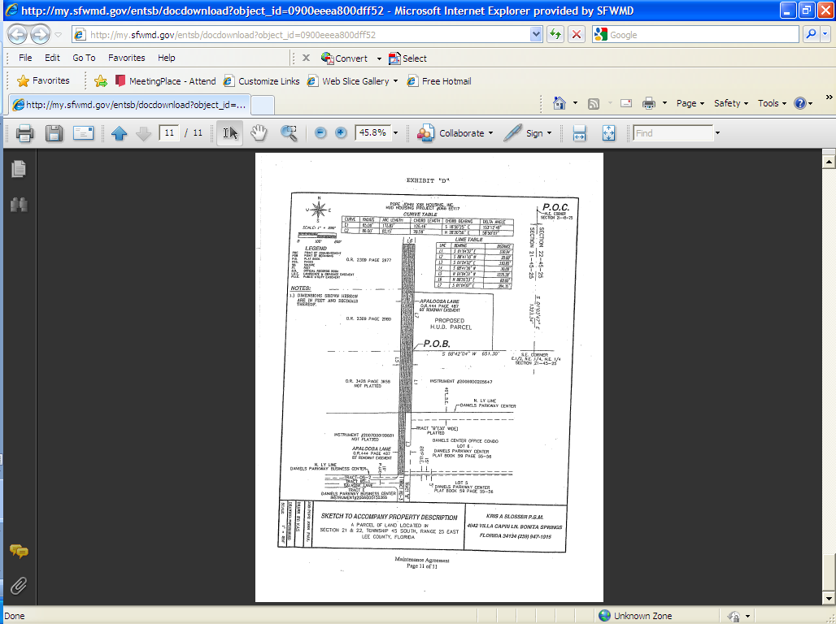
Example:
Insufficient Legal Description
Example of Sketch with no legal description

Slide 22
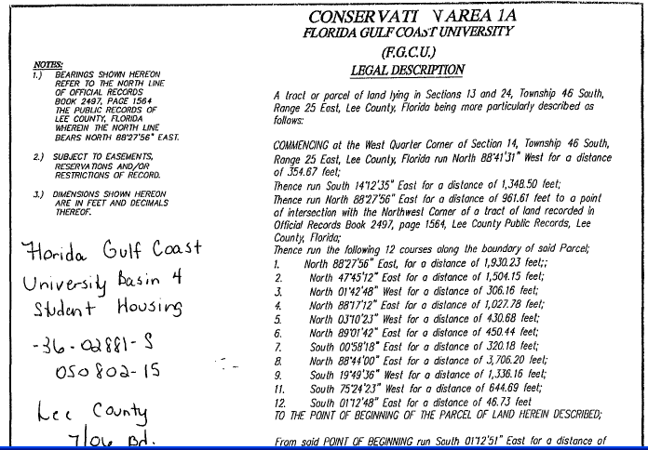
Example:
Insufficient Legal Description
Example of easement (only) legal description

Slide 23
Reviewer’s Role
Notice required:
  If notice was NOT previously recorded
  If notice was previously recorded but coverage is outside previously noticed boundaries
Notice NOT required:
  If notice was previously recorded and coverage is within previously noticed boundaries

Slide 24
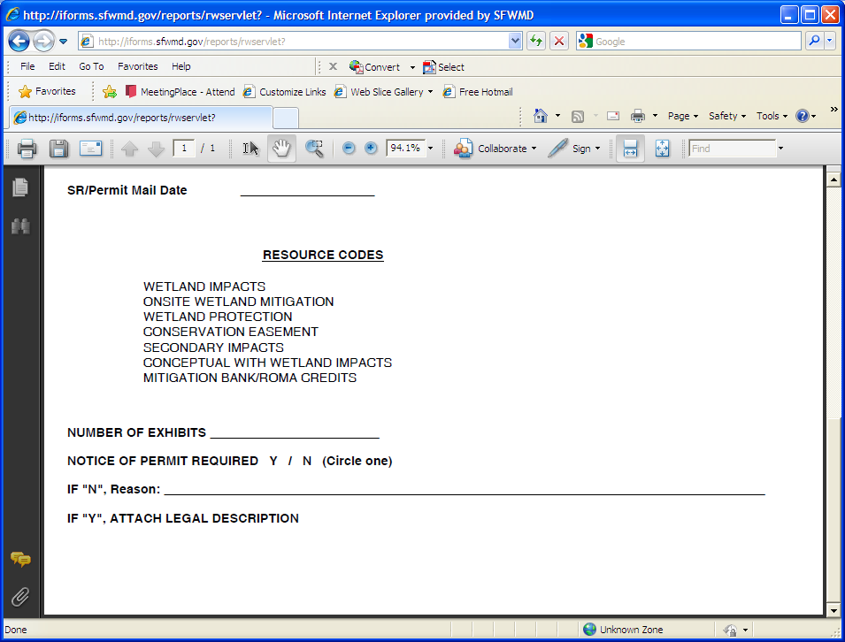
Reviewer’s Role
Complete Staff Report Route Sheet
If NOP is required, attach appropriate legal description
If NOP is not required, provide explanation:
  List previous application(s) noticed
  If NOT previously noticed, provide additional comments

Slide 25
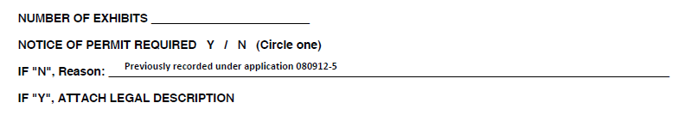
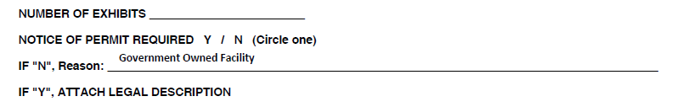

Examples:
Completed Route Sheets

Slide 26
Notice of Permit Process
Permit Technician’s Role

Slide 27
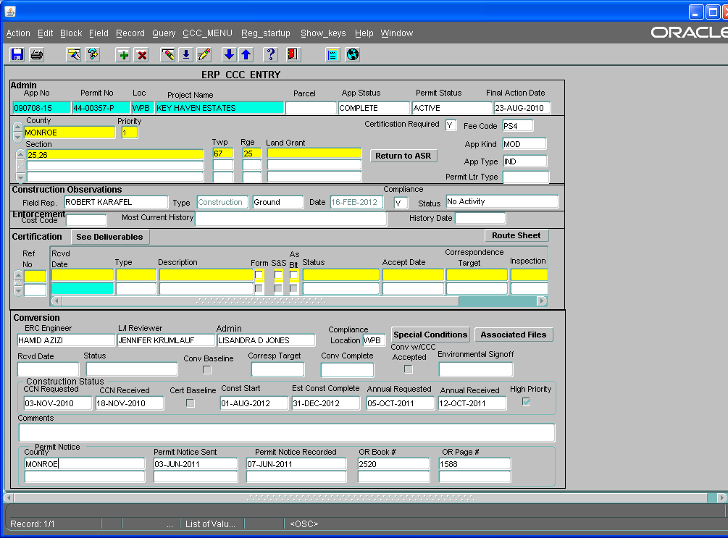
Permit Technician’s Role
Review Staff Report Route Sheet
If NOP is not required, update database
    If NOP not required because the application was previously noticed, enter information of the application noticed:

Slide 28
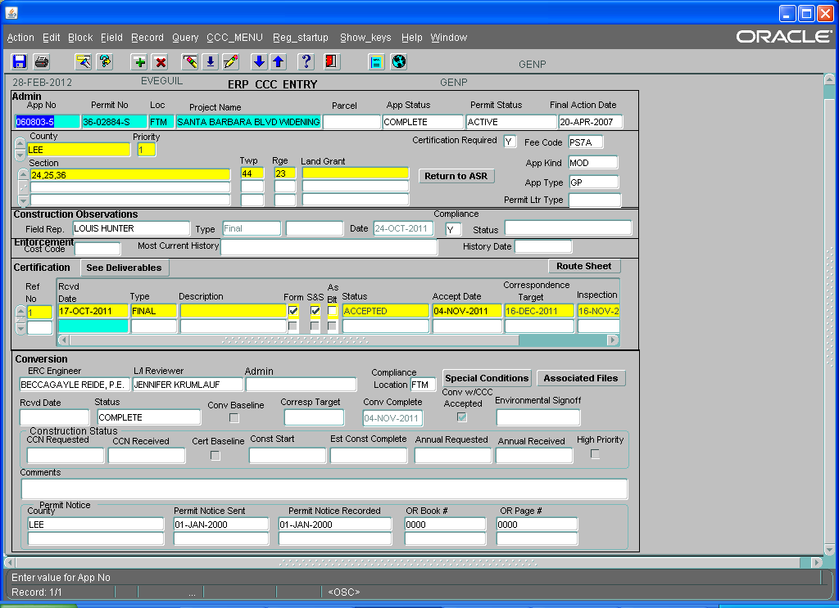
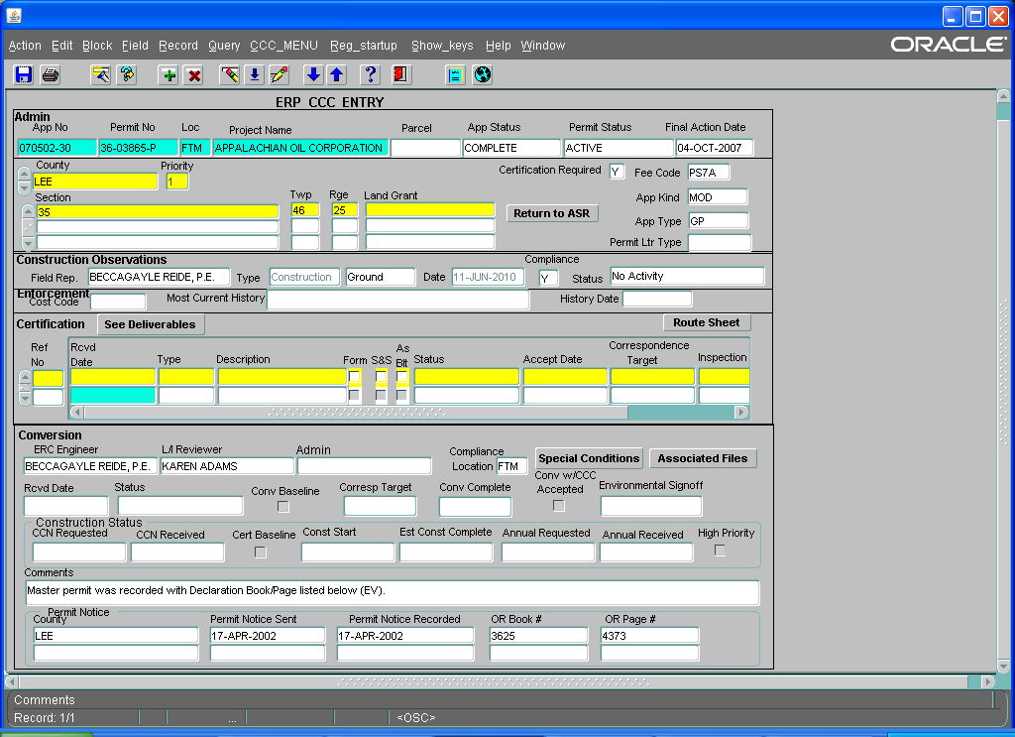
NOP Process
Permit Technician’s Role
If NOP not required because the permittee is a government entity, enter default recording information:
If NOP not required because the permit was included in declaration of covenants:
  Update database with the OR Book and Page of recording
  Include additional comment for explanation

Slide 29
Permit Technician’s Role
If notice is required:
  Prepare Form 62-330.090(1)
    Permit Number
    Grantee (Project Name)
    County
    Parcel ID
  Attach legal description provided by reviewer

Slide 30
Notice of Permit Process
Regulatory Support’s Role

Slide 31
Regulatory Support’s Role
Verify information provided
Prepare Page 2 of Form 62-330.090(1), clerk and notarize
Prepare recording payment
Update database
Send to appropriate county for recording
  Seven (7) counties currently recorded electronically
Update database upon return of recorded document
Scan and post recorded document in ePermitting

Slide 32
Questions?

