Slide 1
Agenda Process
Preparing the Agenda Item for the Board of Trustees

Slide 2
When is an Agenda Item required
Pursuant to Subsection 18-21.051(2) F.A.C. Approval of the following will require approval from the BOT:
Docking facilities with more than 50 slips, and additions to existing docking facilities where the number of proposed new slips exceeds 10% of the existing slips and the total number of existing and proposed additional slips exceeds 50;
Docking facilities having a preempted area, as defined in Rule 18-21.003, F.A.C., of more than 50,000 square feet, and additions to existing docking facilities where the size of the proposed additional preempted area exceeds 10% of the existing preempted area and the total of existing and proposed additional preempted area exceeds 50,000 square feet;
Private easements of more than 5 acres, except for the installation of telecommunication lines and associated conduits in special consideration areas designated in paragraph 18-21.004(2)(l), F.A.C., in which case, prior to taking final agency action for such installations, staff will provide the Board with notice and an opportunity to request that the application be placed on the Trustees agenda;
The establishment of a mitigation bank; or
Applications involving approval of an exception to the maximum cumulative preemption for a private residential multi-family dock or pier in accordance with subparagraph 18-21.004(4)(b)2., F.A.C.
Notes:
All other activite on SOL’s have been delegated to the district offices unless the activity is of “heightened public concern”

Slide 3
Heightened Public Concern
the activity due to its size, potential effect on the environment or the public, controversial nature, or location, are reasonably expected to result in a request for administrative hearing.
The HPC memo (with project description) should be utilized when staff recommends approval and any of the following apply (for “Linked” WMD projects only):
one or more objection letters have been recieved,
There are potential legal challenges,
negative comments from state or local agencies have been received , or
The project is of a controversial nature or has a controversial location.
Additionally, any application to change from having a facility that is 90% open to the public under a lease is of “heightened public concern” as well as any “mixed use” or “hybrid” facilities (i.e. facilities serve both residential and commercial needs).
Notes:
Questions on HPC- ask your general counsel for further guidance.

Slide 4
Agenda Item preparation
Consult the agenda schedule and plan ahead, it is important to start the preparation of the agenda item well in advance
Your project will still need to meet the 60 day permit review timeframes
Keep in mind that the agenda item is due to the office of Cabinet affairs (OCA) 12 days prior to the first meeting (preliminary agenda Staff meeting- PASM)
Even though your item has made it to PASM scheduling is tentative until the decision is made By Executive staff at the Agenda Staff meeting to present to the BOT

Slide 5
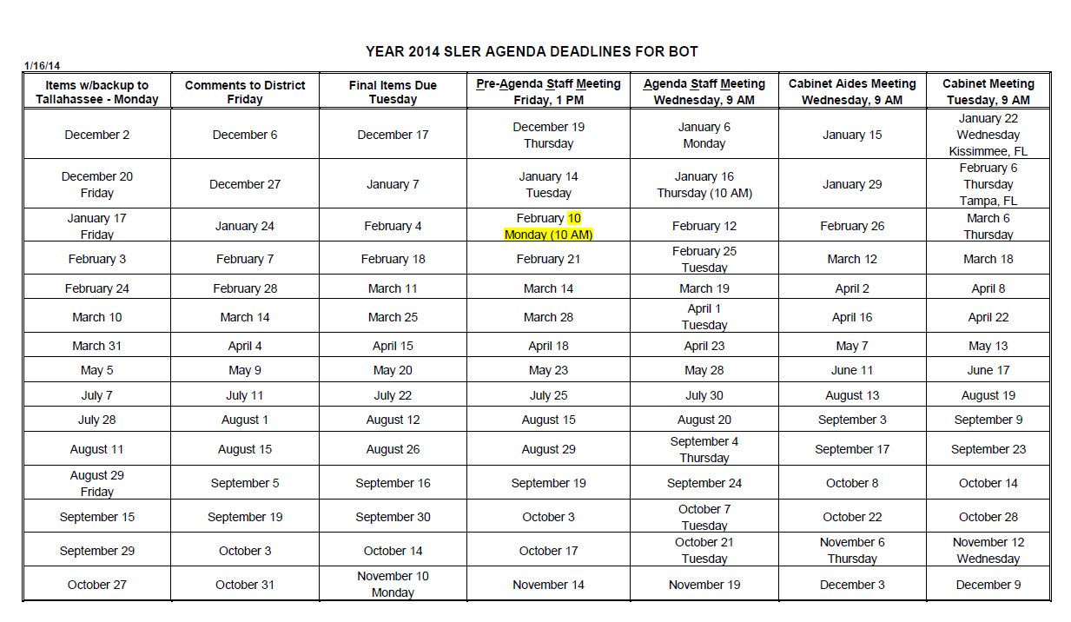

Slide 6
The “Face” of the agenda Item
Detailed description of the proposed project, including: request, applicant name, consideration of the use of Sol’s, staff remarks and staff recommendation.
Use SLER 0820 Guidance Document, SLER 0820-A (lease or LOC), SLER 0820-B (Public of Private Easement), and/or SLER 0820-C (conveyance or exchange) as applicable
the recommended “consolidated notice of Intent to Issue” is also included as part of the Face
information from commenting agencies will be discussed in this portion but it is rarely attached to the item
Make sure that all documents are clearly labeled as “draft”, “Draft Item” and/or “draft agenda item is subject to change”

Slide 7
Back up Documentation
Location map
Survey/sketch and detailed project drawings that represent the project (legal description not included as backup information)
Any materials which aid in explaining any unusual circumstances (profile or plan view drawings, tables, charts, or letter explaining project)
Include deed (If request is for Deed clarification)
Copy of any previous board actions (certificate of Board Action)
Representative letter(s) opposing or supporting project if controversial (include a tally of letters received or list of names and dates of letters)
Copies of photographs clearly labeled with appropriate titles, descriptions, dates and file number
Staff notes on drawing explaining particulars of a project to aid other staff in better understanding or interpreting

Slide 8
Office of Cabinet Affairs (OCA)
Coordination with the OCA ensures:
the information provided in the agenda item is consistent with all applicable rules , statutes, and previous board items
that each agenda item is complete and free of grammatical errors
that all deadlines are met( 60 day permit timeframes as well as BOT agenda timeframes)
That staff and applicants informed on the status of the review
Staff needs to work with OCA to answer any questions in a timely manner. Staff will need to provide all relevant information regarding the project including, who will attend the BOT meetings, is any opposition expected, is the item controversial, etc.

Slide 9
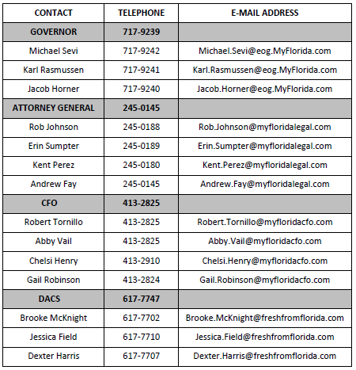
Cabinet Affairs
Contacts
Connie Byrd will contact FDEP and WMD offices with any updates or revisions to the agenda schedule.
She will contact FDEP and WMD offices to see what, if any, items will need to be presented to the BOT and when the anticipated completion and presentation date will be.

