Slide 1

Sler Operations and procedures manual (OPM)
Allyson Minick- Allyson.Minick@dep.state.fl.us

Slide 2

Access to the opm
The OPM can be accessed by external users at the following address:
http://waterwebprod.dep.state.fl.us/slerp/CompleteTOC.pdf
If you have difficulty accessing this site, please contact your IT staff, if the problem persists, please contact FDEP Service Desk (850)245-7555. Please tell the Service Desk that you are having difficulties accessing DEPNET externally.

Slide 3

External Access
The External OPM is used to share guidance documents with multiple agencies.
This includes:
All the WMD’s (SRWMD, SJRWMD, SWFWMD, SFWMD, NWFWMD)
Delegated local governments (Dade County DERM, Broward County, Hillsborough County EPC, etc.)

Slide 4

OPM ORGANIZATION
Broken up into sections (SLER 0700- SLER 1900)
Each section groups like subjects (or like processes).
SLER 0700 contains valuable historical proprietary guidance and all delegation and interagency coordination documents.
Most of the applicable proprietary guidance and forms are found in the SLER 0800,General Application Processing, and the SLER 0900, Completeness Summaries sections.

Slide 5
Section Overview
SLER 1000 contains additional guidance for multi-family docking facilities
SLER 1100 “Other Activities and Coordination Review”- This includes guidance on AP’s, Dredge info. including channel mitigation, Sales and exchanges of state lands, FDOT bridge and roadways authorization for SSL’s

Slide 6
Section Overview
SLER 1200 “Rule Interpretation, Direction, Guidance, Legal Issues” – includes BOT Direction to Staff, 62-25, ADA compliance guidance, as well as info on federal navigation servitude, Indian Lands projects, etc.
SLER 1300 “General Permit/Authorization Processing Forms” Templates for all ERP permit documents and guidance on when to use them.

Slide 7
Section Overview
SLER 1400 “Environmental Resource Permits (ERP’s)” Evaluation of ERP’s, Modifications and Transfers, Duration and Extensions, Variances, Suspension and Revocations, Mit. Banks, and PE Certification/Signing and sealing by DEP PE’s
SLER 1500 “Application Evaluation” Contains Water Quality and Sediment Data, Information on Reporting, Polymers and Flocculants, Mitigation Procedures and Conservation Easements, etc.

Slide 8
Section Overview
SLER 1600 “ Wetlands Evaluation and Delineation” Formal Determination Information (updates in progress)
SLER 1700 “Compliance and Enforcement”
SLER 1800 “Forms and Attachments” links to DEP forms (includes application info.)
SLER 1900 “Process Improvement” resources for staff, some training information, contact information, checklists, etc.

Slide 9
How will the OPM become more user friendly for the WMD’s?
A WMD cheat sheet is being created to identify which documents are most applicable to the WMD’s
The cheat sheet will be a link on the OPM
This cheat sheet will follow the order of the OPM
Each document will be identified by section number
Each section will have a brief summary of contents
The section number will be an active link to the live OPM document

Slide 10
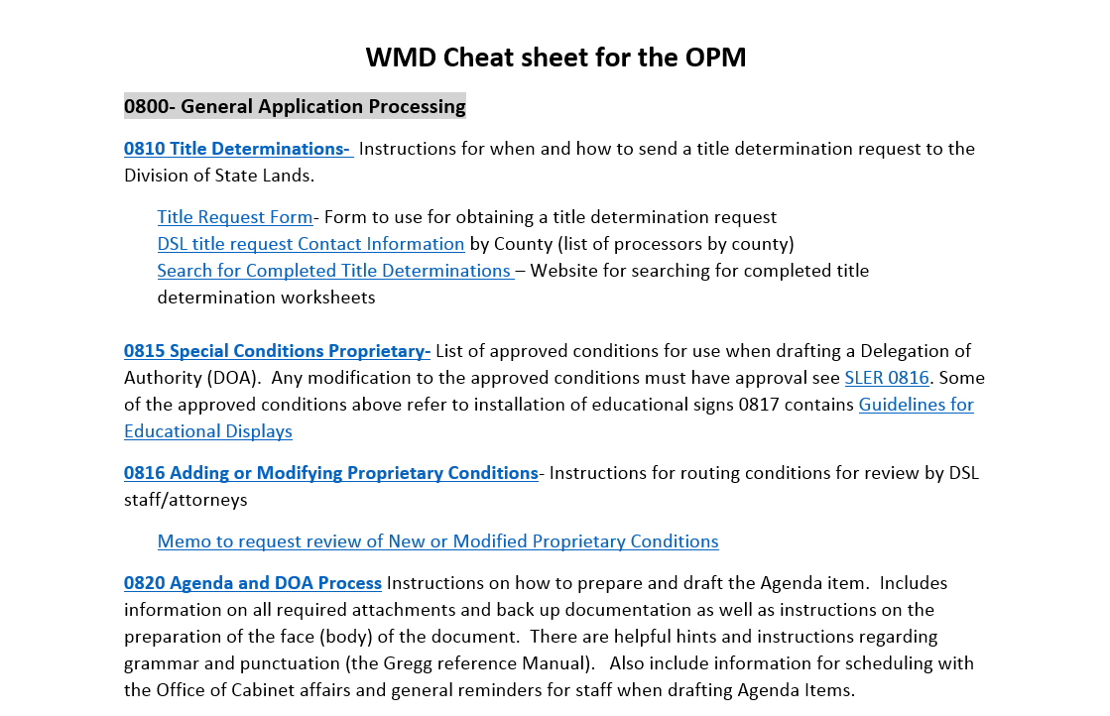

Slide 11
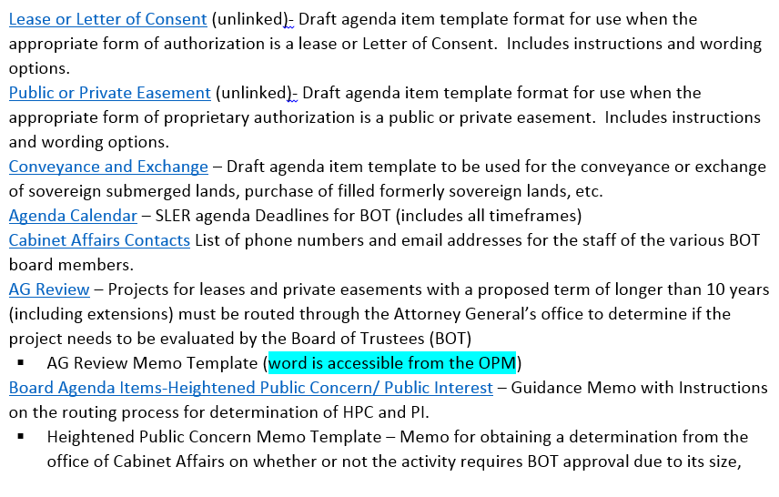

Slide 12
SLERC section Contacts
Alice Heathcock- (850) 245-8483 (Alice.Heathcock@dep.state.fl.us) Sovereign Submerged Lands, all Rule Making and Conservation Easements
Allyson Minick-850) 245-8489 (Allyson.minick@dep.state.fl.us) ERP, OPM, and Mangroves
Andy May- --(850) 245-8495 (Andrew.May@dep.state.fl.us), General Training, ERP, and Rule Making
Donna Kendall- (850)245-8488 (Donna.Kendall@dep.state.fl.us) Compliance and Enforcement, Deadhead logging and Mangroves
Doug Fry-(850)245-8480 (Doug.Fry@dep.state.fl.us) ERP, Permit and Rule making questions
Jennifer Butler- (850) 245-8485 (Jennifer.Butler@dep.state.fl.us) General ERP, Training, and Deadhead logging
John Humphreys-(850)245-8487 (john.humphreys@dep.state.fl.us) UMAM
Tim Rach-(850)245-8015 (Timothy.Rach@dep.state.fl.us) ERP questions the above can not address.

Slide 13

SLERC (WETLAND STAFF) Contacts
Camille Beasley(850) 245-8493, Camille.Beasley@dep.state.fl.us
62-340, F.A.C., Plant ID, Training, and Certification questions
Lisl Hinrichs (850) 245-8385 Stephanie.Hinrichs@dep.state.fl.us
62-340, F.A.C., Soils, Training, and Certification questions
Eric Hickman (850)245-8496, Eric.Hickman@dep.state.fl.us Legal questions and questions that can not be answered by the above
Division of State Lands Contacts
Sue Jones (850) 245-2754, Sue.Jones@dep.state.fl.us Lease packages, New Leases, DOA’s for Leases
Tiana Brown (850)245-2730, Tiana.D.Brown@dep.state.fl.us Easements and Lease/Easement Assignment changes
Jimmy Wright (850) 245-2731James.E.Wright@dep.state.fl.us General Information

Slide 14

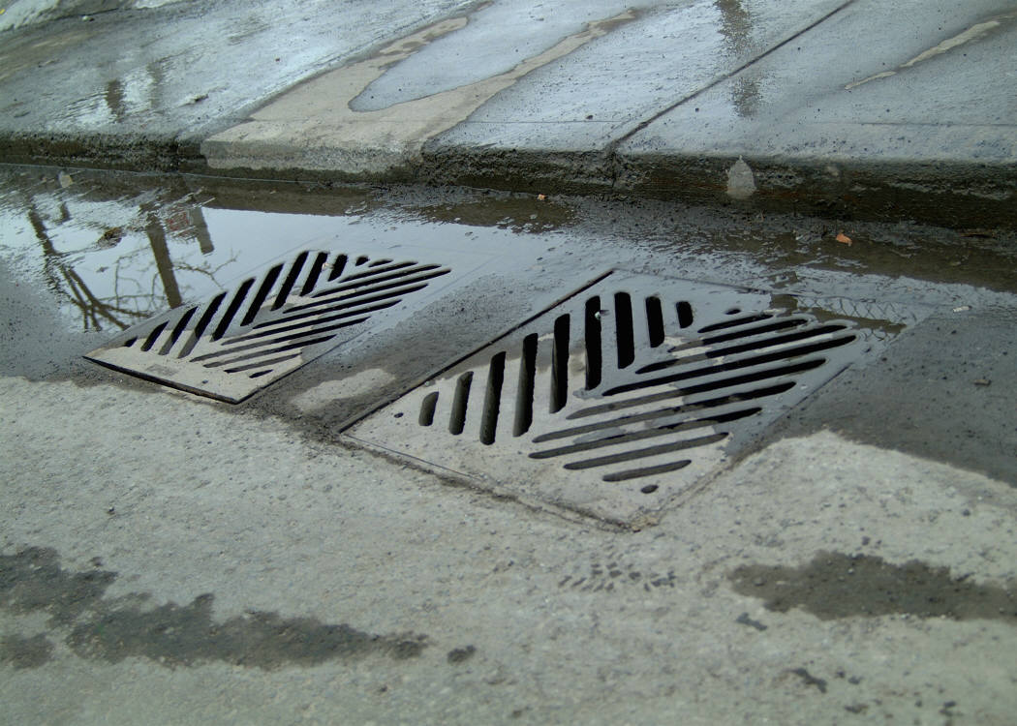

Engineering, Hydrographic, and Geology (EHG)Contacts
Lee Marchman (850)245-8520, Lee.Marchman@dep.state.fl.us, Engineering and Storm water questions
Mariano Guardo (850) 245-7512 Mariano.Guardo@dep.state.fl.us, Hydrographic Engineering review questions
Richard Musgrove (850)413-7807, Richard.Musgrove@dep.state.fl.us General Engineering questions

