Slide 1
Division of Water Resource Management
ERPce Basics
Training Presented by: Division DIS and ERP
11-14-2017

Slide 2
Training Topics Covered
ERPce Navigation Buttons, Forms, and Query Tips
ERPce Sites
  Searching for and Creating New Sites
  Using WebShapeLite to verify location
  Site Tabs
ERPce Projects
  Searching and Creating New Projects
  Project Tabs
Activities and Violations
  Searching and Creating Activities
Complaints
  Searching and Creating Complaints
  Complaint Tabs
ERPce Reports

Slide 3
Helpful Links and Tools
Oracle Production: Used for live data in Oracle applications
  http://depapps.dep.state.fl.us/
Oracle Beta: Used to test and practice in Oracle applications
  http://depbeta.dep.state.fl.us/
PA Reports: Web page used to query data within PA
  https://fldep.dep.state.fl.us/parep/default.asp
ERPce Reports: Web page used to query data within ERPce
  https://fldep.dep.state.fl.us/erpce_rep/
ERPce Online Manual:
  https://floridadep.sharepoint.com/wrm/sler/ERPceManual/ERPce_manual.pdf
ERPce Step by Step Guide:
  https://floridadep.sharepoint.com/rdt/_layouts/15/DocIdRedir.aspx?ID=NPVFY6KNS3ZM-876-440
For both Oracle Production and Oracle Beta, access can be granted via the Service Desk.
Application access levels for PA or ERPce can be granted via Ian.Binns@dep.state.fl.us

Slide 4
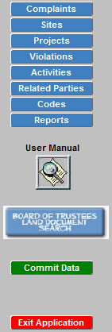
Navigating ERPce
Navigation Buttons
Theses buttons are found along the top and left sides of the ERPce main window at all times.
Common Buttons
Save/Commit Data
Enter Query
Execute Query
List of Values (LOV)
Create Record
Delete Record
Hovering over buttons with your mouse will show the operation of that button.

Slide 5
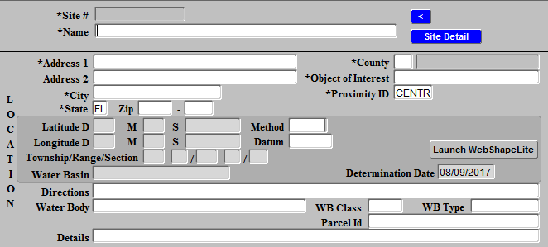
Forms in ERPce
Found throughout ERPce and used for both data entry and query of data.
Use the “Enter Query” action button while in a form before entering query criteria.
LOV – List of Values is important to remember during data entry as some fields are limited to a selection of values. For these fields use the LOV action button to see entry options for each field.
Other fields may also be limited by type of data accepted, for instance number or date fields.

Slide 6
Helpful Query Tip
“%” - Wildcards help when complete information is unknown for your query
Example: Street Addresses can be data entered in multiple ways.
- 4000 2nd Street or 4000 Second Street
Query Instead: 4000%
  This will ensure your query returns any address starting with 4000 regardless of how the name of the street is spelled.

Slide 7
Sites in ERPce
One ERPce Site per geographic location.
  There can be multiple projects per site.
Always, Always, Always query in both ERPce and PA prior to manually creating a new ERPce site
  There should never be duplicate Sites.
Many sites are autogenerated in ERPce from the issuance of a permit in PA.
Other sites can be retrieved from PA as needed.
The last resort can be manual entry of an ERPce site.

Slide 8
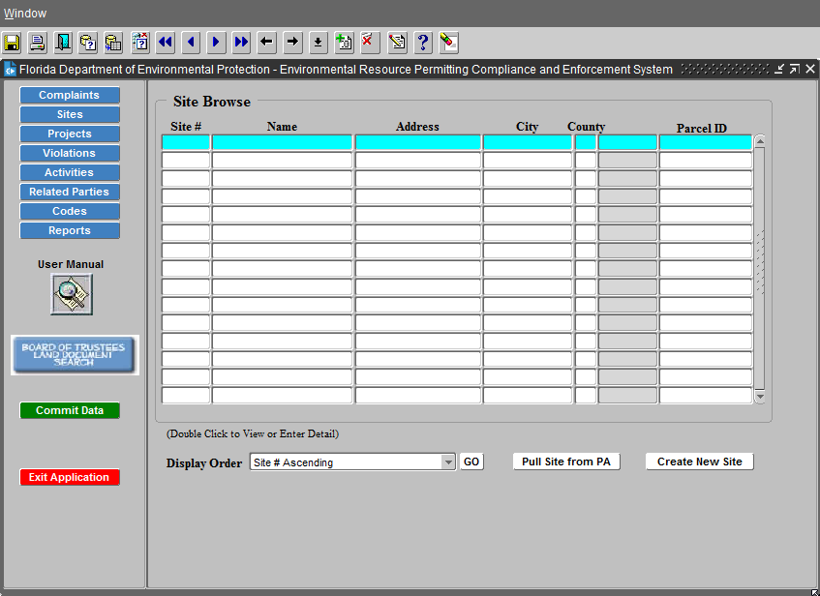
Site Browse Form
Query ERPce for Preexisting Sites
Pull Sites From PA
Create New Site
  Always the
  Last Option
Accessed via
the Sites Action
button on the left.

Slide 9
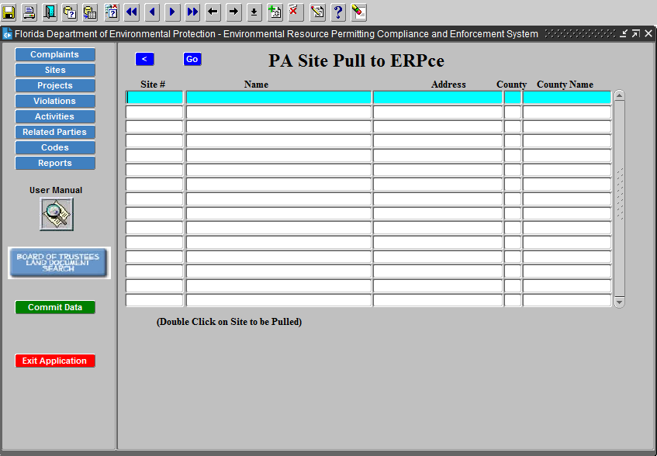
Pull Sites from PA
Accessed via the
Pull Site From PA
button on the
previous form
Used to query
PA for preexisting
ERP sites.

Slide 10
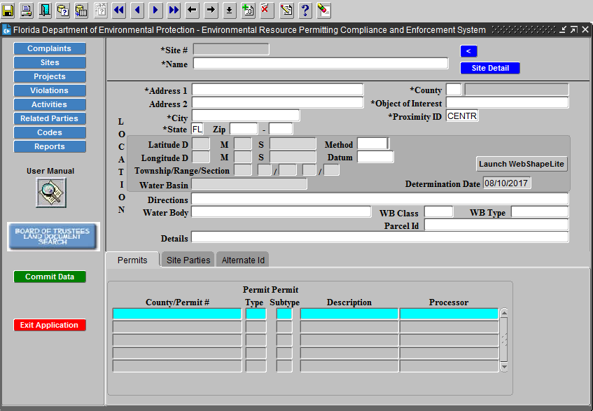
Create New Site
Always the
last Option!!!
Data entry of
new ERPce sites
WebShapeLite
GIS Component
  Used to verify a
  site’s geographic
  location

Slide 11
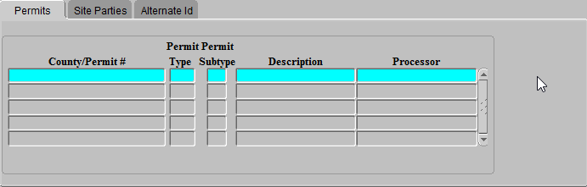
Site Tabs
Site’s Related Permits, Parties, and Alternate Ids
Found at the bottom of the Site Form
Permits Tab is updated from associated permits in PA
Related parties can be queried and data entered
Alternate Ids are updated from the Comet database
  Can also be data entered by users

Slide 12
ERPce Projects
Projects Must have a Site they are linked to
Many are Auto-Created Via Permits Issued in PA
Used to Describe Conditions of Compliance and Enforcement Projects of a Permit or Site
Can Be Created Manually if:
  PA Permit did not create ERPce Project
  ERPce Complaint Results in a Project
  Tracking a State Lands Lease
  Always query for a project before creating a new one.

Slide 13
ERPce Projects Types
Compliance Projects
  Open – Under Construction or Actively Monitored
  Operational – Ongoing Monitoring Post Construction Completion
    Examples: State Land Lease, Stormwater Management Systems
  Closed – Complete and no longer monitored
Enforcement Projects
  Open – Unresolved and in need of Agency Action
  Monitoring – Post Settlement with outstanding conditions
  Closed – All conditions have been meet.

Slide 14
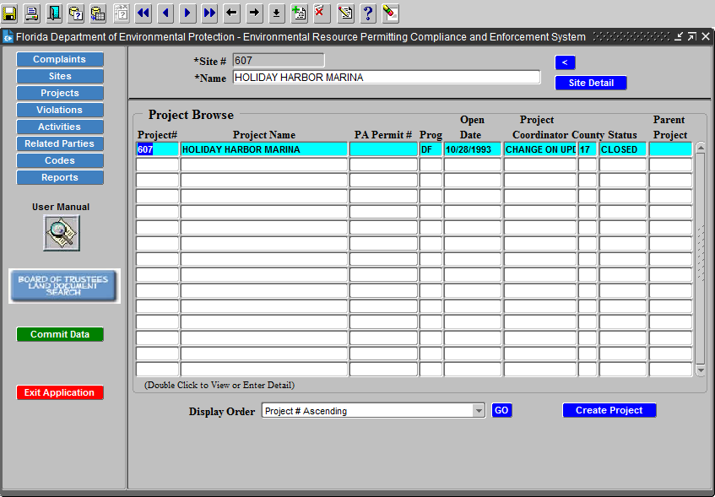
Projects Browse
Selecting the Projects action button will provide a list of projects for the site you are currently viewing.

Slide 15
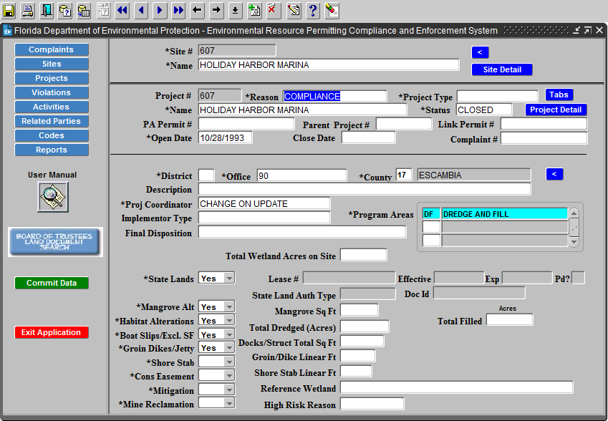
Projects Form
View Project Details and Project Tabs
Use the Action Buttons to Switch Between Them
Included at the bottom
are the various
conditions and related
information for each
project.

Slide 16
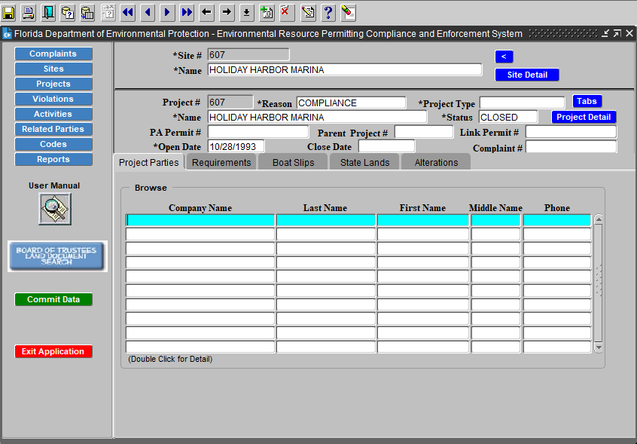
Projects Tabs
Project Tabs populate based on those conditions that are marked yes on the project details form.
Complete data entry
in this section for each
condition.
Note: If a tab is open,
it must have data prior
to closing the project.

Slide 17
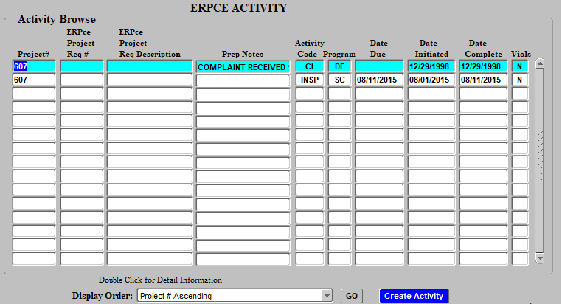
Project Activities
Activities must be associated with a project, which in turn must be associated with a site.
  As such, searching an activity requires opening the correct site and project.
Activities are accessed by selecting the action button on the left side of the screen.
This list also provides
the Create Activity action
button.

Slide 18
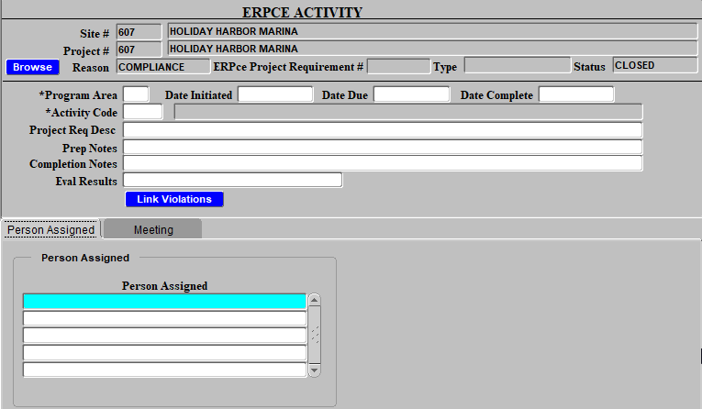
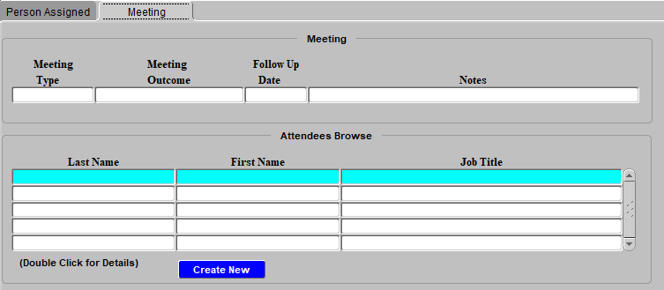
Creating Activities
Activates are created for projects using this form.
Program area and Activity Code are Required fields.
Each activity can also have assigned personnel and meeting details.

Slide 19
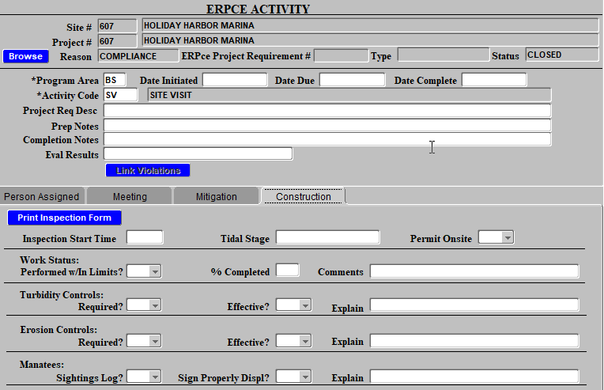
Activity Types
Various types of activities, for example:
  Site Visits
  Conversations
  Inspections
  Hearings
  Agreements
  Reports
  Orders
Note that some activity types will open additional activity tabs for data entry related to that activity.

Slide 20
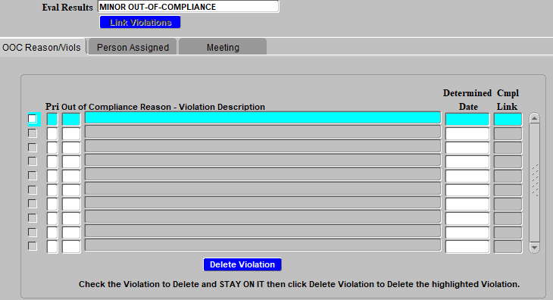
Violations - Creating
Certain activities require evaluation results data to be entered.
If the evaluation is found to be out of compliance an out of compliance reason/violations tab will open and require data entry.
The data entered into this tab is linked to the current project as an open violation.

Slide 21
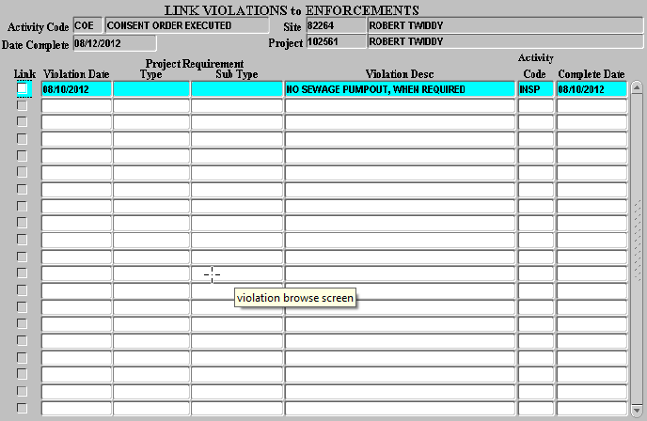
Violations - Resolving
Certain activities, such as consent orders or enforcement orders are used to resolve violations for a project.
When data is entered for one of these activities you can link a violation for that project to indicate it is the violation being resolved.

Slide 22
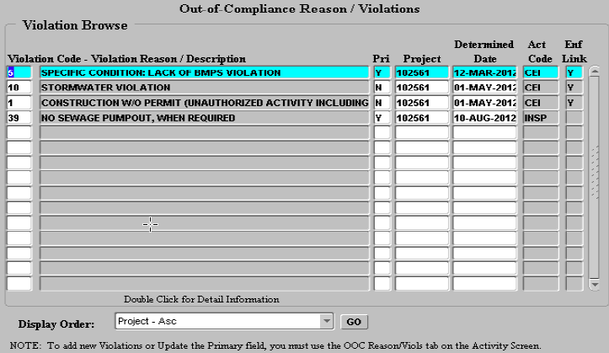
Open Violations
When an ERPce project has open violations it is considered out of compliance.
To view a list of all violations for a project both resolved an unresolved click the Violations action button on the left side of the screen.
Note, those with no
enforcement link are
open violations.

Slide 23
Complaints
Used in ERPce to track activities reported by the public that may or may not need enforcement.
A site is not created for a complaint unless it is found to need enforcement.
  This means location description should be specific when data entered.
Information for complaintants can be data entered if they wish to know the resolution results.

Slide 24
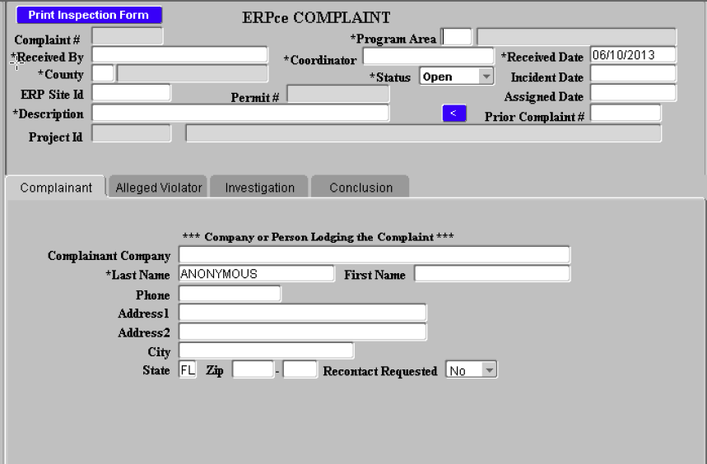
New Complaints
Browse and create new Complaints using the Complaints action button.
Data Entry Tabs
  Complaint
  Alleged Violator
  Investigation
  Conclusion

Slide 25
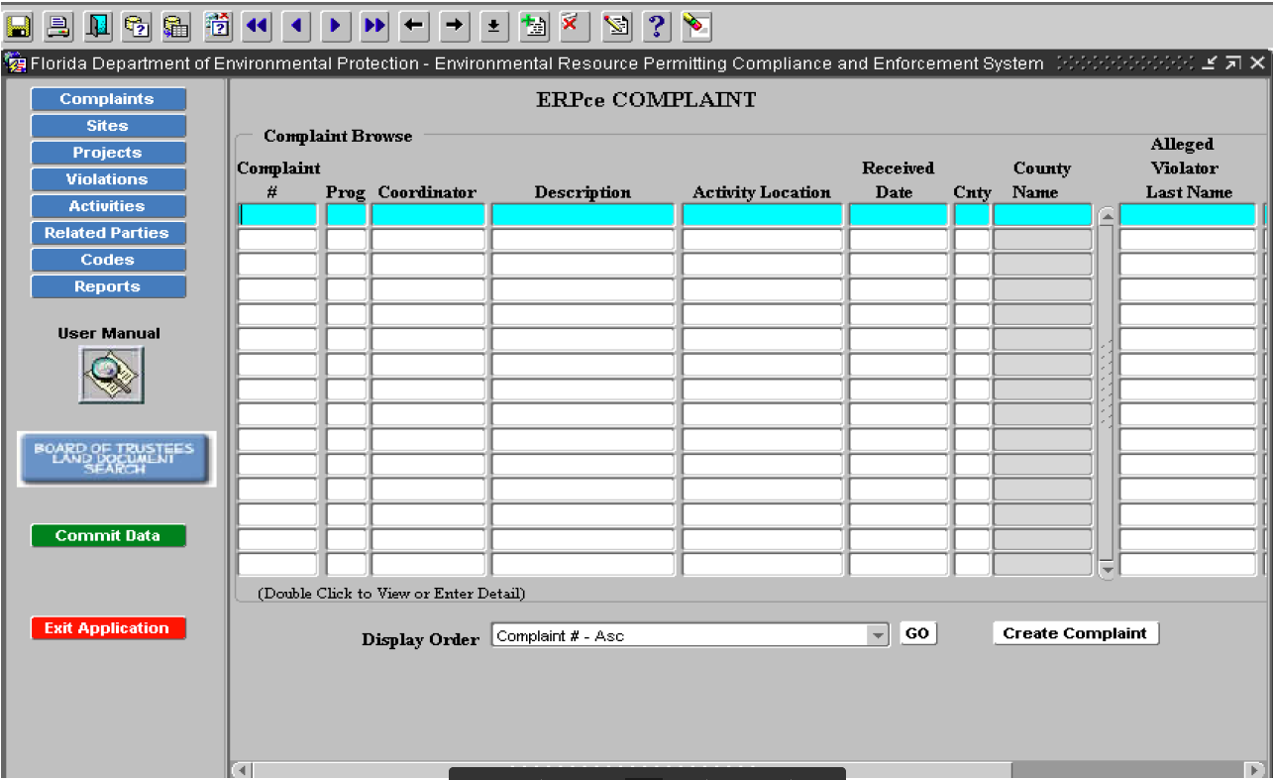
Complaints Browse
Remember to use the Enter Query and Execute Query action buttons

Slide 26
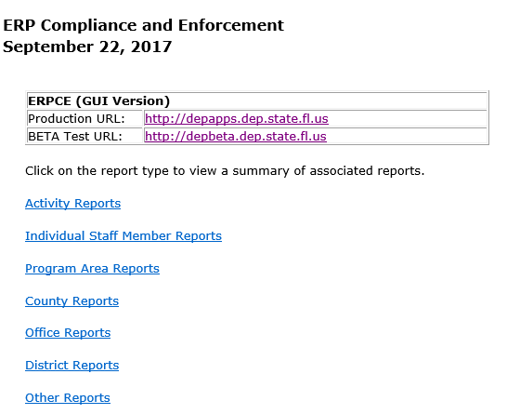
ERPce Reports
Web Link: https://fldep.dep.state.fl.us/erpce_rep/
Many Report Types Available
  Employee Specific Reports
  Manager Workload Reports
  District Effectiveness Reports
  Program Position Reports
  Public Request Reports
Reports can be viewed as HTML or Excel Exports
Other specific quires are available upon request

Slide 27
Questions
Future Questions: Email Ian.Binns@dep.state.fl.us

