Slide 1
SLERC
Environmental Criteria for ERP Permitting
March 21, 2016

Slide 2
Overview
Conditions for Issuance
Additional Conditions for Issuance
Environmental Conditions for Issuance (AH I, section 10.1)
Environmental Criteria (AH I, sections 10.2-10.3.8)
Technical Staff Report
Good Record Keeping

Slide 3
Conditions for Issuance
62-330.301, F.A.C.
  Water quantity
  Flooding
  Water storage and conveyance
  Value of functions provided to fish and wildlife and listed species
  Water quality
  Secondary impacts
  Surface or ground water levels or surface water flows
  Works of the District
  Capability of performing and functioning as proposed
  Financial, legal and administrative capability
  Special basin or geographic area criteria
  Net improvement

Slide 4
Additional Conditions for Issuance
62-330.302, F.A.C.
  Public interest test (7 criteria)
  Cumulative impacts
  Class II waters
  Vertical seawalls
  Past violations and resolutions

Slide 5
Environmental Conditions for Issuance
Applicant’s Handbook 10.1.1
  A regulated activity will not adversely impact the value of functions provided to fish and wildlife and listed species by wetlands and other surface waters [paragraph 62-330.301(1)(d), F.A.C.];
  A regulated activity located in, on, or over wetlands or other surface waters will not be contrary to the public interest, or if such an activity significantly degrades or is located within an Outstanding Florida Water, that the regulated activity will be clearly in the public interest [subsection 62-330.302(1), F.A.C.];
  A regulated activity will not adversely affect the quality of receiving waters such that the water quality standards set forth in Chapters 62-4, 62-302, 62-520, and 62-550, F.A.C., including any antidegradation provisions of paragraphs 62-4.242(1)(a) and (b), subsections 62-4.242(2) and (3), and Rule 62-302.300, F.A.C., and any special standards for Outstanding Florida Waters and Outstanding National Resource Waters set forth in subsections 62-4.242(2) and (3), F.A.C., will be violated [paragraph 62-330.301(1)(e), F.A.C.];
  A regulated activity located in, adjacent to or in close proximity to Class II waters or located in waters classified by the Department of Agriculture and Consumer Services as approved, restricted, conditionally approved, or conditionally restricted for shellfish harvesting willcomply with the additional criteria in section 10.2.5, of this Volume [paragraph 62-330.302(1)(c), F.A.C.];
  The construction of vertical seawalls in estuaries and lagoons will comply with the additional criteria in section 10.2.6, of this Volume [paragraph 62-330.302(1)(d), F.A.C.];
  A regulated activity will not cause adverse secondary impacts to the water resources [paragraph 62-330.301(1)(f), F.A.C.]; and
  A regulated activity will not cause unacceptable cumulative impacts upon wetlands and other surface waters [paragraph 62-330.302(1)(b), F.A.C.].

Slide 6
Application Review
How do you review a project to make sure it meets the environmental conditions for issuance?
  Applicant’s Handbook Volume I, Section 10.2-10.3.8

Slide 7
Elimination or Reduction of Impacts
10.2.1

Slide 8

Elimination or Reduction of Impacts
Environmental principle:
  Protection of wetlands is better than destruction and mitigation
Practicable Design Modifications:
  Not significantly different in type or function
  Are technically possible to implement
  Won’t adversely affect public health & safety
  Are economically viable
    Does not have to remove all economic value of the property to be considered not practicable
  Does the environmental benefit justify the cost?
Notes:
Protection better than destruction because of the temporal loss of ecological value (time lag) and uncertainty associated with recreation of functions through mitigation.

Slide 9
Elimination or Reduction
Not required when:
  Ecological value of functions is low, and mitigation will provide greater long term ecological value
  Applicant proposes mitigation that provides regional ecological value and greater long term ecological value than the wetland or other surface water to be adversely affected.
    “The deal you can’t turn down”
What is Regional Ecological Value?
  Mitigation that adds functional value to regionally significant ecological resources or habitats, such as national or state parks, outstanding Florida waters, or conservation lands, or that will provide corridors between these resources.

Slide 10
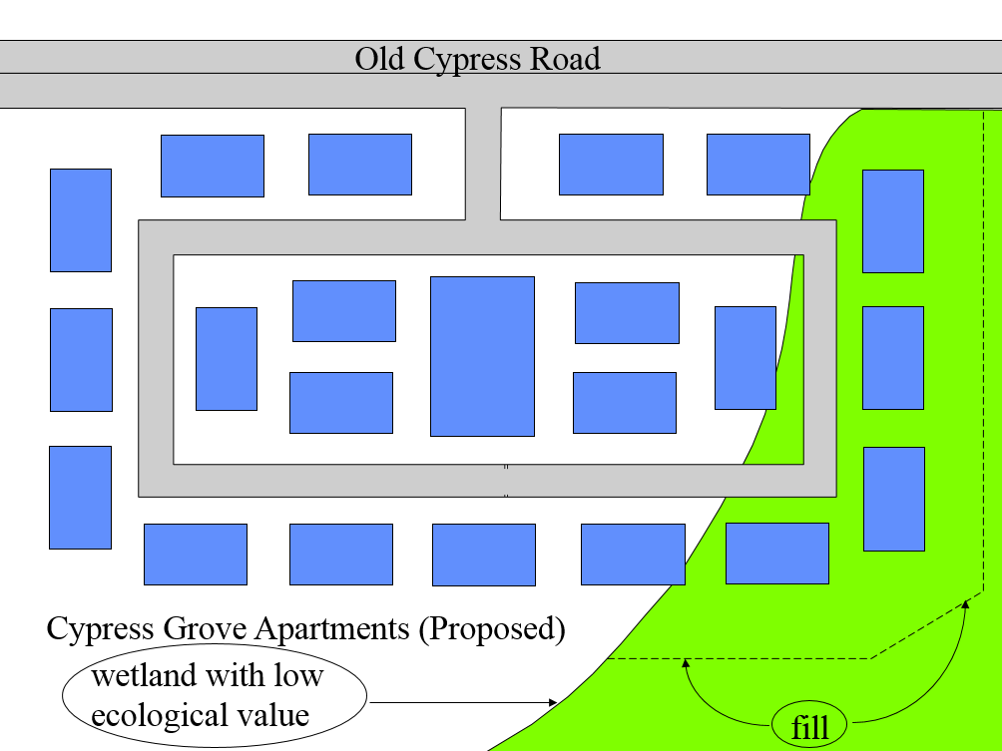
Example 1 – wetland with low ecological value

Slide 11
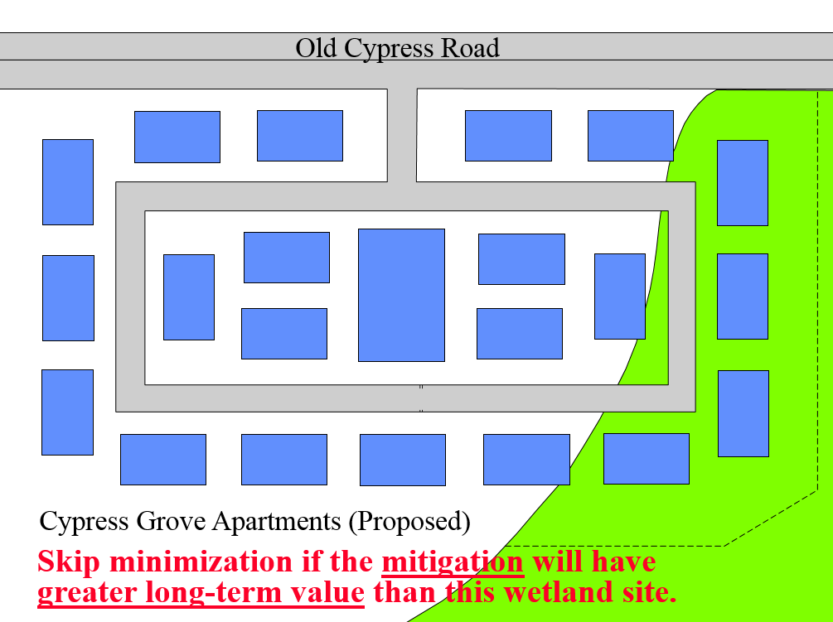
Example 1 – wetland with low ecological value

Slide 12

Example 2 – regionally significant mitigation with greater long-term benefit than impact area

Slide 13
Example 2 – regionally significant mitigation with greater long-term benefit than impact area
Applicant proposes high quality mitigation that will help link some important wildlife corridors that benefit listed species. The mitigation will also protect hydrology in adjacent conservation lands.
  Regional ecological value?
  Greater long-term ecological value than proposed impact area?

Slide 14
Example 2 – regionally significant mitigation with greater long-term benefit than impact area
Applicant proposes high quality mitigation that will help link some important wildlife corridors that benefit listed species. The mitigation will also protect hydrology in adjacent conservation lands.
  Regional ecological value?
  Greater long-term ecological value than proposed impact area?
Reduction of impacts not required

Slide 15
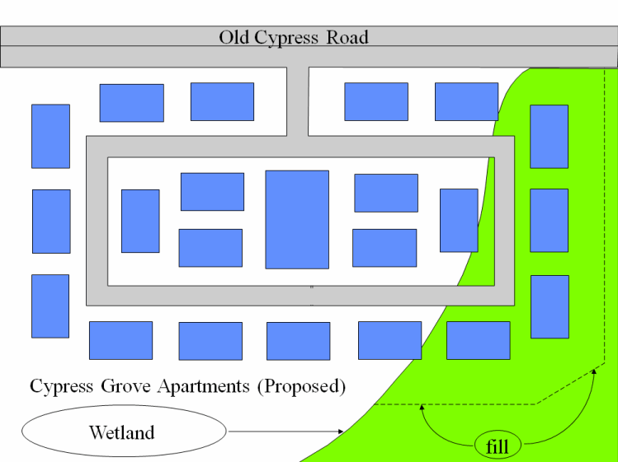
Example 3 – Typical Project (Eliminate or Reduce)
Original plan: 21 building complex with wetland fill.

Slide 16
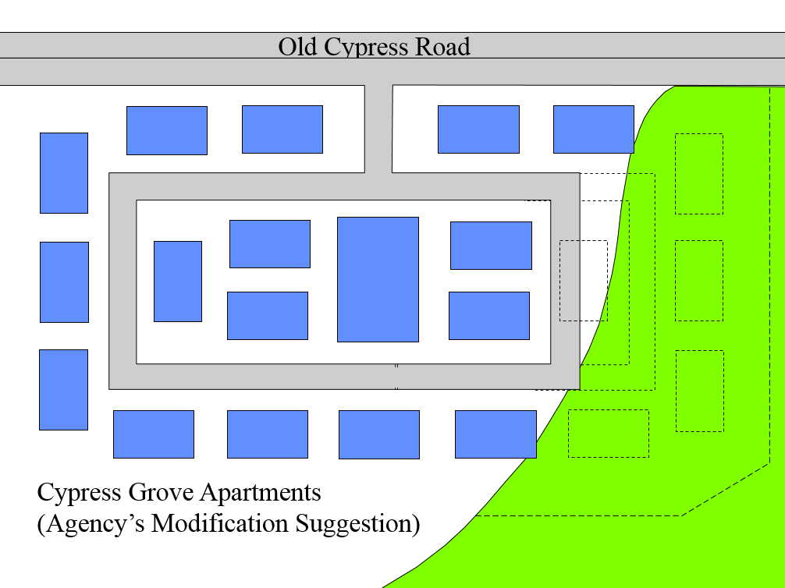
Example 3 – Typical Project (Eliminate or Reduce)
Agency’s suggested modification:
16 building complex, very little wetland fill.

Slide 17
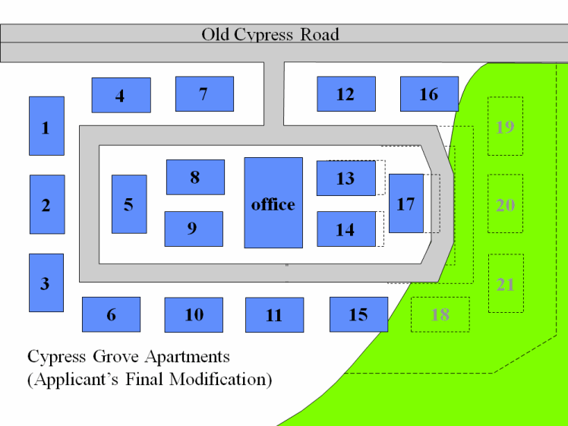
Example 3 – Typical Project (Eliminate or Reduce)
Applicant runs numbers. Needs at least
17 buildings for viable project. Proposes project with significantly reduced impact.

Slide 18
Example 3 – Typical Project (Eliminate or Reduce)
Applicant reduced and eliminated wetland impact as much as practicable
Project may be permitted with appropriate mitigation

Slide 19
Ways to Eliminate or Reduce
All structures, etc. in uplands if possible.
Piling supported structures.
Stem-wall foundation instead of fill slopes.
Smaller structures.
Multi-story structures.
Sewer instead of septic.
Alternate alignments for linear projects
Discourage unnecessary construction in wetlands
____________________________?

Slide 20
Fish, Wildlife, Listed Species and their Habitats
10.2.2

Slide 21
Fish, Wildlife, Listed Species, and their Habitats
Abundance and diversity of fish, wildlife, listed species, and the bald eagle
Habitat of fish, wildlife, and listed species
De minimis effects not considered
Florida Fish and Wildlife Conservation Commission (FWC) is our commenting agency
  May send:
    Request for Additional Information (RAI)
    Request for wildlife survey
    Modification suggestions/requests
    Coastal Zone Management (CZM) objection
Notes:
If agency issues CZM objection signed by their division director, then deny permit. Objecting agency is responsible for defending objection.

Slide 22
Fish, Wildlife, Listed Species, and their Habitats
Review:
  Comments and recommendations from:
    FWC
    United States Fish and Wildlife Service (USFWS)
    Applicant
    Public
  Scientific literature
  Technical assistance documents
  Management plans
  Recovery plans
  Habitat and conservation guidelines
  Florida Wildlife Conservation Guide

Slide 23


Fish, Wildlife, Listed Species, and their Habitats
Assess 5 factors:
  Condition
  Hydrologic connection
  Uniqueness
  Location
  Fish and wildlife utilization

Slide 24
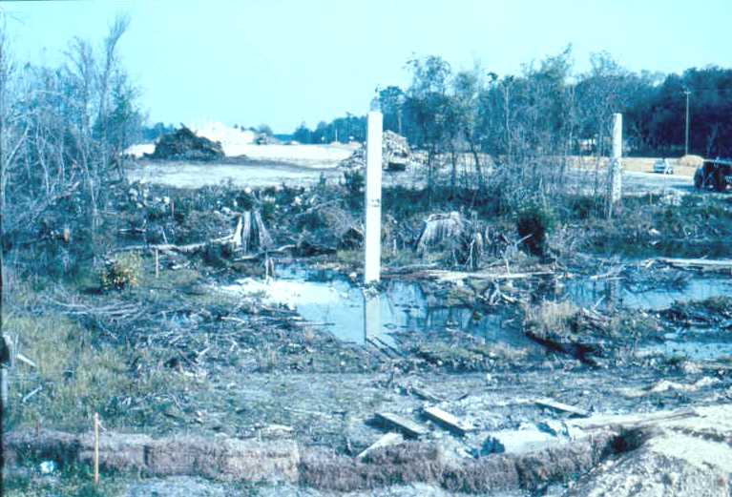
Fish, Wildlife, Listed Species, and their Habitats
Condition
  Natural or disturbed state?
    hydrology, water quality, or vegetation?
  Assess illegally altered sites as if the alteration had not occurred

Slide 25
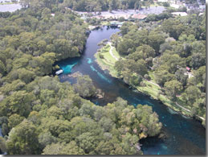
Fish, Wildlife, Listed Species, and their Habitats
Hydrologic connection
  Nature and degree of off-site connection?
    Detrital export, base flow maintenance, water quality enhancement, nursery habitat?

Slide 26
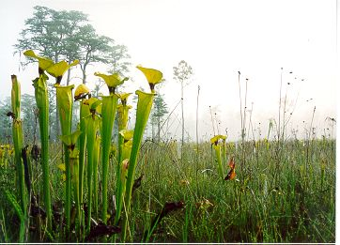
Fish, Wildlife, Listed Species, and their Habitats
Uniqueness
  Is the wetland type or floral/faunal components rare or common?
    www.fnai.org

Slide 27
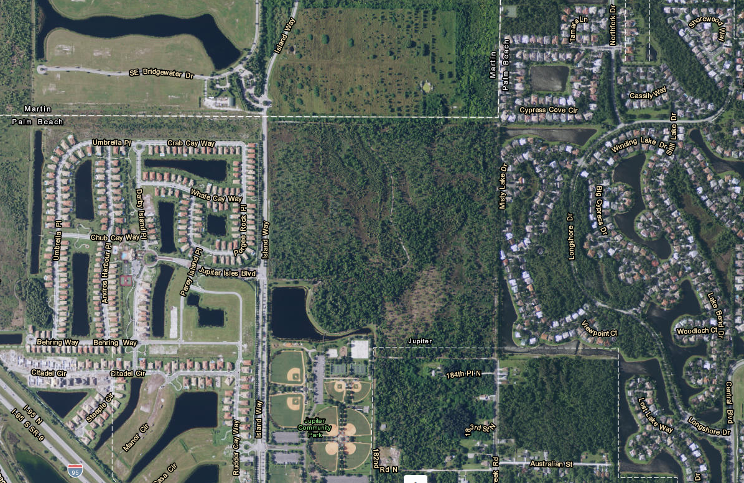
Fish, Wildlife, Listed Species, and their Habitats
Location
  Is the site surrounded by development or natural areas?
  Use Florida Natural Areas Inventory (FNAI), comprehensive plans, and government maps

Slide 28
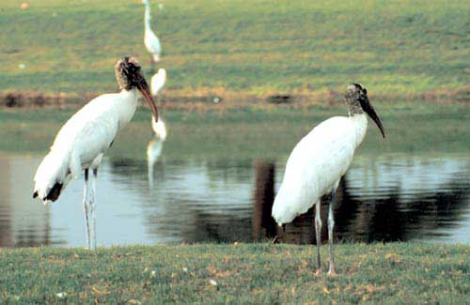
Fish, Wildlife, Listed Species, and their Habitats
Fish and wildlife utilization
  Use of wetland for resting, feeding, breeding, nesting, or denning by all fish & wildlife, but especially listed species

Slide 29
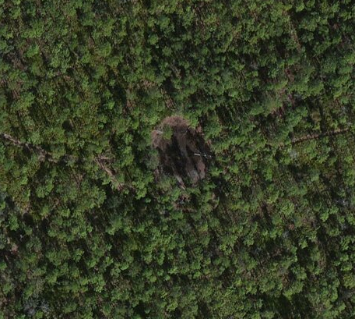
Fish, Wildlife, Listed Species, and their Habitats
Isolated wetlands less than ½ acre
  Is the wetland used by endangered/threatened species?
  Is the wetland located in an area of critical state concern?
  Is the wetland connected at seasonal high water level to one or more wetlands, combined greater than ½ acre?
  Is the wetland (or group of isolated wetlands) of more than minimal value to fish and wildlife?
  If yes to any, then fully evaluate
  If no to all, then evaluate only for the
  following:
    Elimination or reduction of impacts
    Water quality impacts

Slide 30
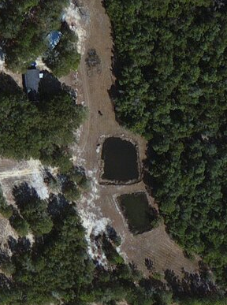
Fish, Wildlife, Listed Species, and their Habitats
Alterations in:
  Wholly-owned ponds
    Constructed entirely in uplands
    Less than 1 acre
  Drainage ditches
    Constructed entirely in uplands
If:
  No significant habitat for endangered/threatened species; and
  Constructed before a permit was required, or pursuant to a permit under Part IV, Chapter 373, F.S.; and
  Was not constructed to divert natural stream flow
Then, evaluate only for the following:
  Water quantity impacts
  Water quality impacts

Slide 31
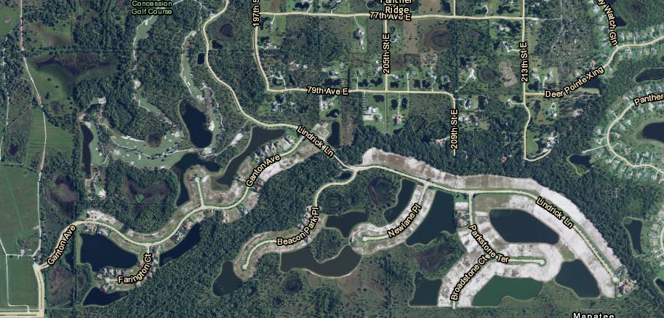
Water Quantity Impacts
(Relating to Fish, Wildlife, Listed Species, and their Habitats)
Drawdowns/diversions
  Basins, ponds, canals, ditches
  May dry out adjacent wetlands
  Applicant must perform an analysis of drawdown

Slide 32
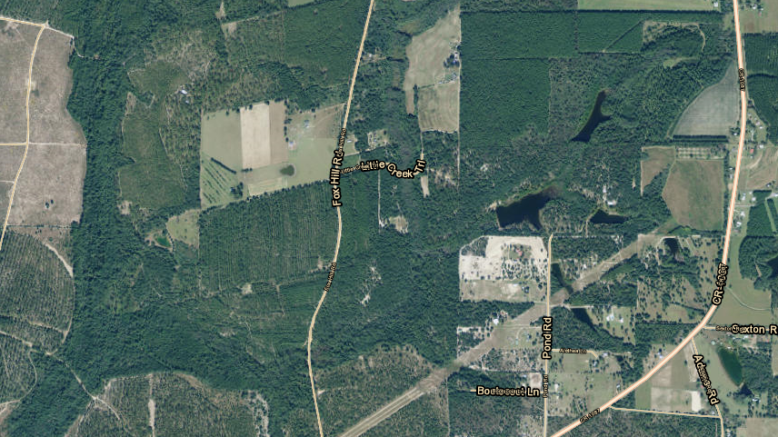
Water Quantity Impacts
(Relating to Fish, Wildlife, Listed Species, and their Habitats)
Impounding
  Increasing depth, duration, or frequency of inundation
  May cause change in wetland type/function
  Analyze for existing type-specific functions

Slide 33
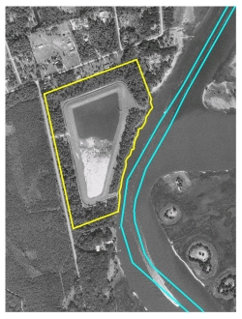
Water Quantity Impacts
(Relating to Fish, Wildlife, Listed Species, and their Habitats)
Monitor and/or modify
  Modify project to prevent adverse impacts
  Monitor project to demonstrate no adverse impacts
Aicw.org

Slide 34

Public Interest Test
10.2.3

Slide 35
Public Interest Test
The Seven ____________
  Whether the regulated activity will adversely affect the public health, safety, or welfare or the property of others;
  Whether the regulated activity will adversely affect the conservation of fish and wildlife, including endangered or threatened species, or their habitats;
  Whether the regulated activity will adversely affect navigation or the flow of water or cause harmful erosion or shoaling;
  Whether the regulated activity will adversely affect the fishing or recreational values or marine productivity in the vicinity of the activity;
  Whether the regulated activity will be of a temporary or permanent nature;
  Whether the regulated activity will adversely affect or will enhance significant historical and archaeological resources under the provisions of Section 267.061, F.S.; and
  The current condition and relative value of functions being performed by areas affected by the proposed regulated activity

Slide 36


Public Interest Test
Within an OFW
Not in an OFW
Clearly in the public interest
Not contrary to the public interest

Slide 37
Public Interest Test
Public Health, Safety, or Welfare or the Property of Others
Will the project cause an environmental hazard or improvement to public health, safety, or property of others?
  Mosquito control
  Waste disposal (solid, hazardous, domestic, industrial)
  Aids to navigation
  Hurricane preparedness/cleanup
  Environmental remediation
  Enhancement or restoration
  Closure or restriction of shellfish harvesting areas
  Flooding or alleviate flooding
  Environmental impacts to property of others (not including property values)
  ______________________________?

Slide 38
Public Interest Test
Fish and Wildlife and their Habitats
Use same criteria as previously discussed
  AH I, section 10.2.2

Slide 39
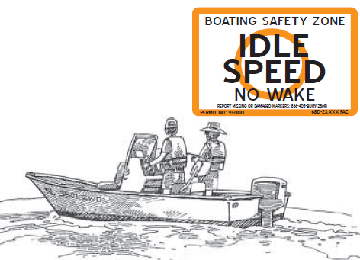
Public Interest Test
Navigation, Water Flow, Erosion and Shoaling
Florida Fish and Wildlife Conservation Commission (FWC) is our commenting agency for navigation.
Will the project:
  Impede or enhance navigability? (current uses only)
    Bridge clearance & vessel type
    Docks & navigation channels
    Marking temporary hazards
    Navigational aids
  Cause or alleviate erosion or shoaling?
    Hydrographic review
      Jetties, breakwaters, groins, bulkheads, beach nourishment
      Channel relocation
    Artificial reefs
      Location & depth
    Use of erosion control best management practices (BMPs)
  Impact or enhance water flow
    Sheet flow
    Channelization

Slide 40
Public Interest Test
Fisheries, Recreation, Marine Productivity
Florida Fish and Wildlife Conservation Commission (FWC) is our commenting agency.
Will the activity cause:
  Adverse affects to fisheries/marine productivity?
    Fish nursery habitat
    Water temperature changes
    Salinity changes
    Detrital export
    Nutrient levels
    Population effects
  Adverse effects or improvements to recreation?
    Boating
    Fishing
    Swimming
    Waterskiing
    Hunting
    Birdwatching

Slide 41
Public Interest Test
Temporary or Permanent Nature
Frequency and duration of impacts
  Temporary impacts less harmful than permanent impacts of the same nature and extent
Temporary | Permanent
Construction mooring | Marina
Construction access | Road
Construction drawdown | Irrigation system
? | ?

Slide 42
Public Interest Test
Historical and Archaeological Resources
Department of State, Division of Historical Resources (DHR) is our commenting agency
  May send:
    Request for additional information
    Request for archaeological survey
    Suggestions for modification
    Specific conditions for the permit
    CZM objection

Slide 43

Public Interest Test
Current Condition and Relative Value of Functions
Previously disturbed?
Hydrology impacted?
Exotic species present?
Still providing beneficial functions?
  Will project reduce or eliminate remaining functions?
Will the project affect the ability of the resource to maintain its functions?
If temporary clearing, will vegetation regenerate successfully?

Slide 44
Water Quality
10.2.4

Slide 45
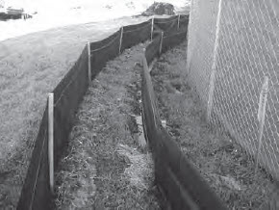
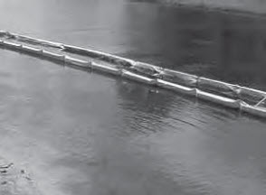
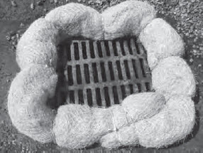
Short Term Water Quality Considerations
Turbidity, sedimentation, and erosion best management practices (BMPs)
  State of Florida Erosion and Sediment Control Designer and Reviewer Manual
  Florida Stormwater Erosion and Sedimentation Control Inspector’s Manual
Proper construction access (no prop dredging/rutting)
Proper maintenance of construction equipment
  Prevent release of oils, greases, gasoline, etc. into wetlands/other surface waters
Proper spoil disposal site use
  Control discharge, maintain perimeter berms
Prevent violations of state water quality standards

Slide 46
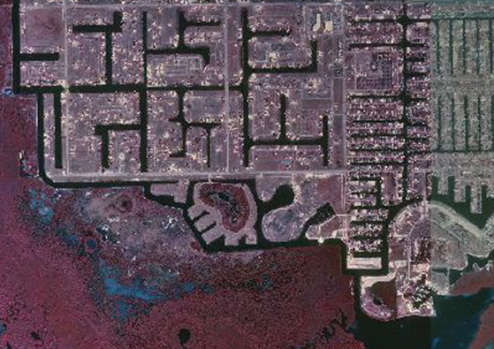
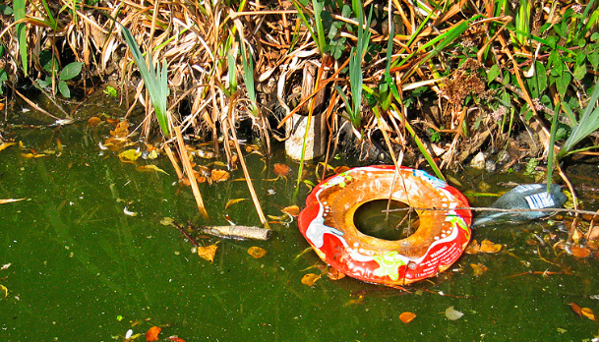
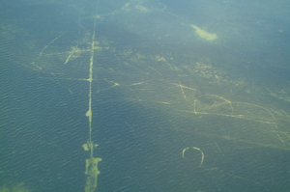
Long Term Water Quality Considerations
Good design
  Prevent
    Low dissolved oxygen
    Resuspension of sediments
    Debris traps
    Stagnant areas
  Erosion, siltation, or prop dredging
    Turbidity violations
  Prevent violation of state water quality standards

Slide 47
Additional Water Quality Considerations for Docking Facilities
Hydrographic study may be required
  Adequate flushing
  Adequate pollutant dispersal
Marina management plan
  Fueling facility operation and safety
  Pump-out station operation and safety
Liveaboard vessels
Waste management
Water quality testing
  Must not cause a violation of state water quality standards

Slide 48
Mixing Zones
Temporary mixing zones pursuant to 62-4.242 and 62-4.244(5), F.A.C.
  62-4.242, F.A.C. – Anti-degradation requirements
    Time limits
      30 days
  62-4.244(5), F.A.C. – Mixing zone size limits
    ERP – 150 meters (downstream or radius)
    JCP – 1000 meters
    Shall not encompass hardbottom communities, corals, or submerged aquatic vegetation beds unless those areas are evaluated as impact sites.
    Larger mixing zone needed? - Variance

Slide 49
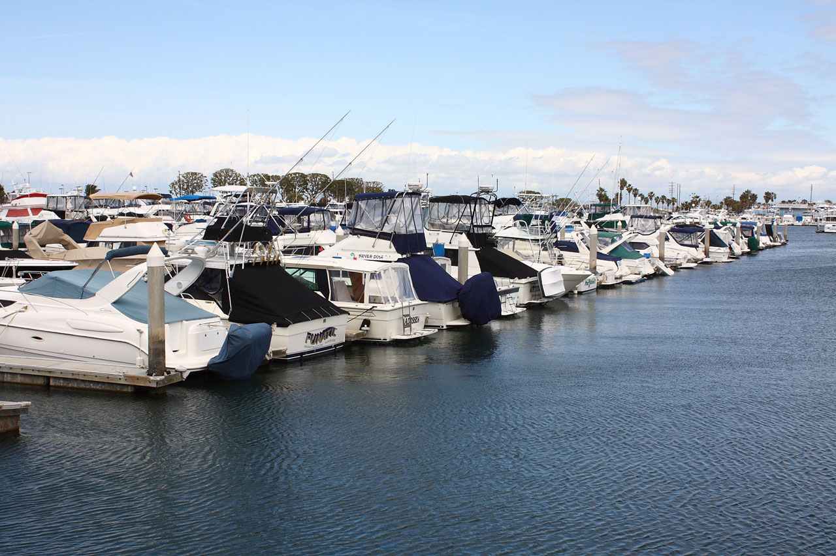
Where Ambient Water Quality Does Not Meet Standards
Project must not cause new or contribute to existing violations
May provide mitigation or net improvement

Slide 50
Class II Waters; Waters Approved for Shellfish Harvesting
10.2.5

Slide 51
Class II / Shellfish Harvesting Waters
How can I find out what the harvesting status is?
  Department of Aquaculture and Consumer Services (DACS) Shellfish Harvesting Area Maps.
  MapDirect
  Classification categories:
    Approved
    Conditionally approved
    Restricted
    Conditionally restricted
    Unclassified/unapproved
  Some areas have different seasonal classifications
    Use most protected classification [section 10.2.5(a)]
Notes:
Approved – normally open (unless extraordinary circumstance, like red tide. Conditionally Approved – Periodically closed due to pollution events, like rainfall or increased river flow. Restricted – allowed only by special permit and supervision. Conditionally Restricted – restricted activity is periodically suspended due to pollution events. Prohibited – harvesting not permitted due to actual or potential pollution. Unclassified = unapproved – not permitted pending bacteriological and sanitary surveys.

Slide 52
Class II / Shellfish Harvesting Waters
Agencies shall deny permits for regulated activities located in:
  Class II or III waters, “approved”, “restricted”, “conditionally approved”, or “conditionally restricted” for shellfish harvesting. Except:
    Maintenance dredging of navigational channels
    Construction of shoreline protection structures
    Installation of transmission and distribution lines for potable water, electricity, or communication cables within rights-of-way previously used for such things
    Clam & oyster culture
    Certain docking facilities
  Other Class II or III (if adjacent or close proximity to Class II) waters, unless applicant submits plan/procedure to protect Class II waters.

Slide 53
Class II / Shellfish Harvesting Waters
Requirements for docking facilities:
  Single family limited to 2 slips & 2 vessels
  Multi-family, governmental, or commercial dock limited to 10 slips & 10 vessels
  No discharges of trash, waste, or fuel
    Reasonable assurance for vessels with heads
  Enclosed, non-water dependent structures on uplands
  Boat shelters not enclosed
  1-foot clearance above top of resources at MLW
  Structures over grassbeds must provide light penetration
  No overnight occupancy on the dock or on vessels
“Vessel” = all sailboats and motorized boats except personal watercraft (jet skis)

Slide 54
Vertical Seawalls
10.2.6

Slide 55
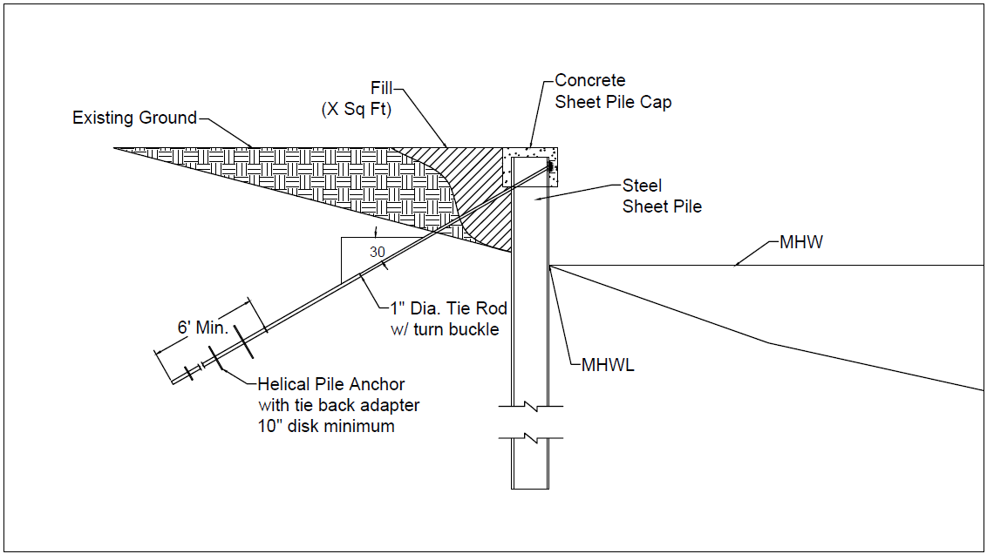
What is a Vertical Seawall?
Seawalls with a waterward face steeper than 75 degrees to the horizontal without riprap covering the waterward face to the mean high water line.
  May cause:
    Increased erosion on adjacent properties
    Undercutting of the wall/wall failure

Slide 56
Vertical Seawalls
Vertical seawalls cannot be permitted in estuaries and lagoons, except when:
  Located within a port
  Necessary for creation of a marina, to provide access to watercraft, or if necessary for public facilities
  Proposed within an existing man-made canal, and the walls of the canal are already occupied (whole or part) by vertical seawalls
  Construction is to be conducted by public utility, when providing service to the public
  Within coastal areas of Collier, Lee, Miami-Dade, and Monroe counties, in Charlotte Harbor/Peace River in Charlotte County designated as critical habitat for smalltooth sawfish.

Slide 57
Secondary Impacts
10.2.7

Slide 58
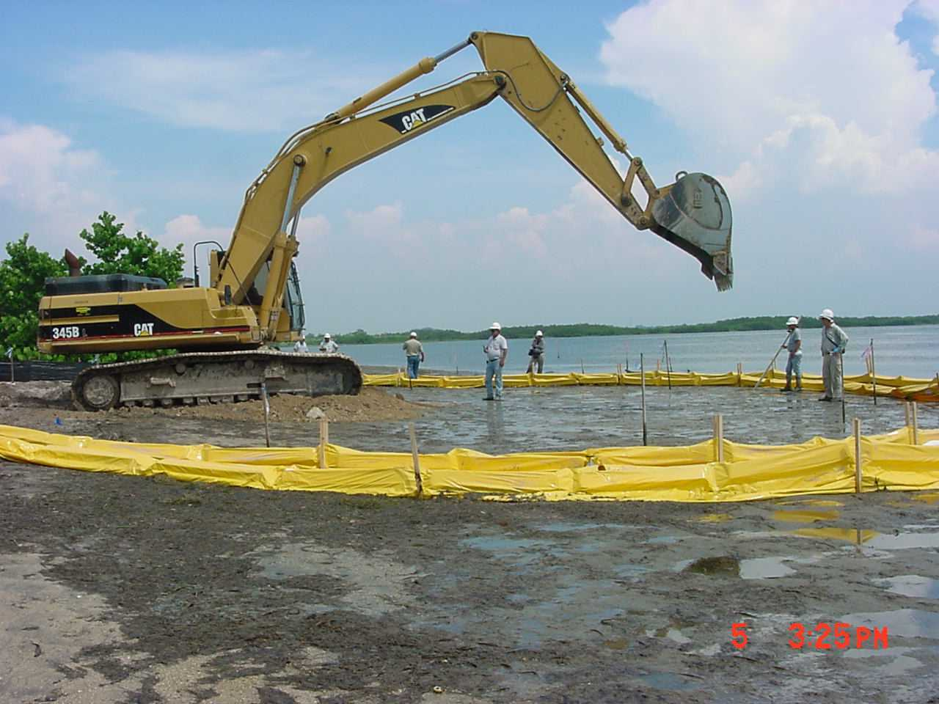
Primary (Direct) Impacts
Impacts associated with the activity itself
  Dredging or filling
  Construction
  Turbidity
  Effluent

Slide 59
What are Secondary Impacts?
Impacts that would not occur, but for the permitted activity
  Closely linked and causally related
  Examples:
    Leachate from boat paint and treated wood
    Pollutants from boat motors
    Discharge from boat heads (sewage)
    Discharge of fish cleaning debris & trash
    Prop dredging
    Boat wakes increase erosion & turbidity
    Increased hazards to manatees
    Shading of grassbeds
    Impacts from changes in flushing
    _______________________?

Slide 60
Secondary Impact Review – 4 Parts
Secondary impacts from construction, alterations, and intended or reasonably expected use of the activity will not:
  Cause or contribute to a violation of state water quality standards or adversely impact the functions of wetlands or other surface waters
  Adversely impact the ecological value of uplands for bald eagles, and aquatic or wetland dependent listed species for existing nesting or denning
    Does not include foraging areas or wildlife corridors
  Adversely impact significant historical or archaeological resources
  Be caused by future phases or closely linked and causally-related on and offsite activities

Slide 61
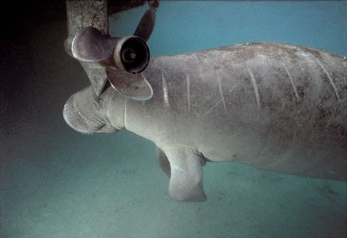
Secondary Impacts – Example 1
A permitted marina causes increased boat traffic, which increases the threat of collision with manatees, and the threat of damage to nearby seagrass beds by propeller damage
Savethemanatee.org

Slide 62
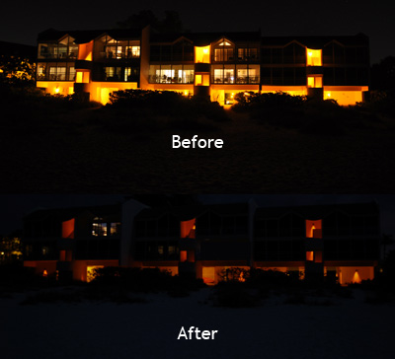
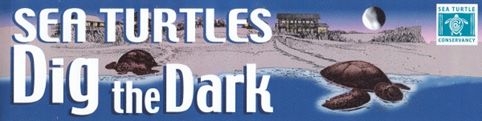
Secondary Impacts – Example 2
Lights from a permitted development adjacent to a sea turtle nesting beach increase the chances of hatchlings crawling toward the development instead of the water
www.conserveturtles.org

Slide 63
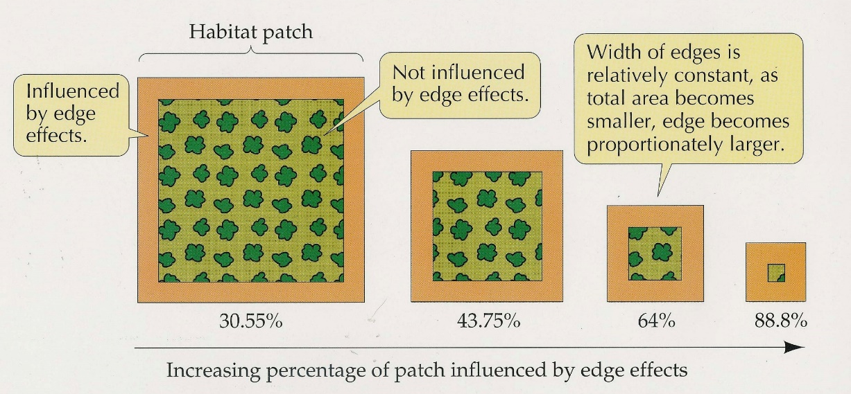
Secondary Impacts – Example 3
Development adjacent to a wetland:
  Increases “edge effects”
    Vegetative community structure
    Hydrology
  Increases nutrient load
    Fertilizers
    Pet waste
    Septic tanks and drainfields

Slide 64
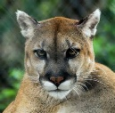
Secondary Impacts – Example 4
A road permitted through a wetland effects wetland dependent species
  Roadkills
  Barrier (genetic isolation, limiting movement)
  Habitat fragmentation

Slide 65
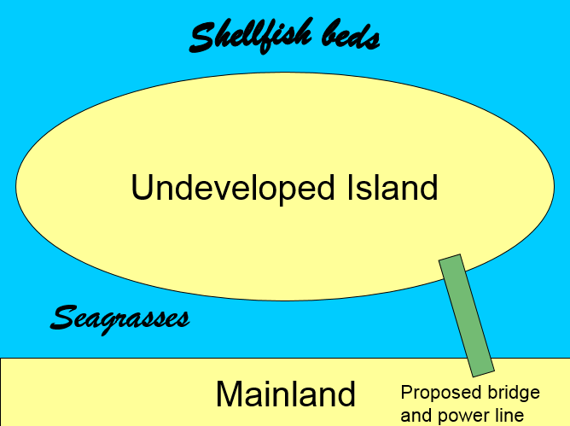
Secondary Impacts - Example 5

Slide 66
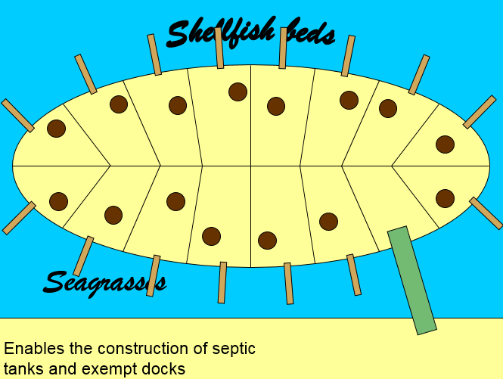
Secondary Impacts - Example 5

Slide 67
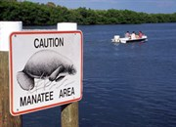
Preventing Secondary Impacts
Upland buffers (avg. 25 ft, min. 15 ft)
Special lighting
Bridges or wildlife crossings
Manatee education & speed limits
Sewer instead of septic
Seagrass awareness signs & marked channels
_________________________?
Myfwc.com

Slide 68
Cumulative Impacts
10.2.7

Slide 69
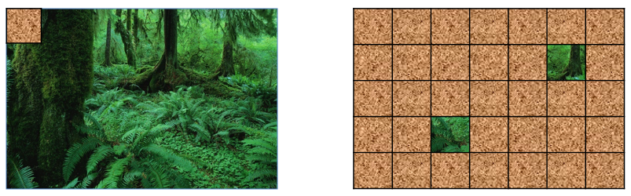
What are Cumulative Impacts?
Small impacts add up (cumulate) to larger impacts over time
  1 dock in a waterbody vs. 100 docks along a waterbody
  ½ acre fill in large wetland system vs. ½ acre fill for every lot in a large subdivision
Drainage basin scale

Slide 70
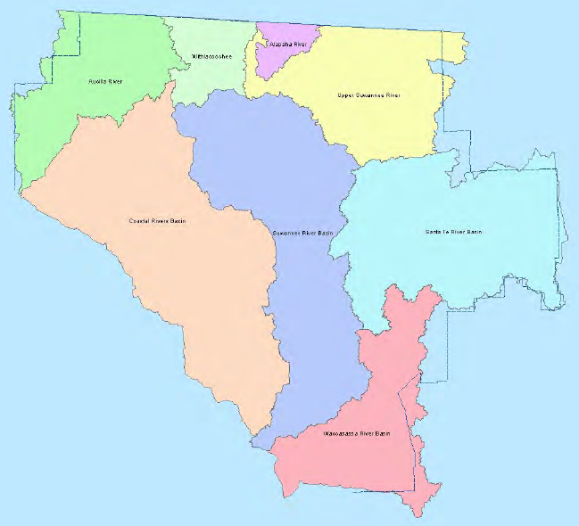
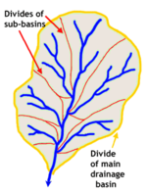
What are Drainage Basins?
Notes:
Drainage basin means a subdivision of a watershed. Watershed means the means the land area which contributes to the flow of water into a receiving body of water. (373.403, F.S.)

Slide 71
Scenario 1 - Within-Basin Mitigation
If mitigation is in the same drainage basin as the impacts, and fully offsets those impacts, then no unacceptable cumulative impacts.
Impact
Mitigation

Slide 72

Scenario 2 – “Spill-over” Mitigation
If mitigation is not in the same drainage basin as the impacts, but the functions provided by the mitigation “spill over” into the impacted drainage basin and fully offset the impacts within the impacted basin, then no unacceptable cumulative impacts.
Impact
Mitigation
Wetland-dependent species

Slide 73
Scenario 3 – Out-of-Basin Mitigation
If mitigation is proposed outside of the impacted drainage basin, and the functions provided by the mitigation do not offset impacts within the impacted drainage basin, then applicant must provide a “cumulative impact analysis”
  Cumulative impact analysis can be:
    Expensive
    Time-consuming
    Uncertain

Slide 74
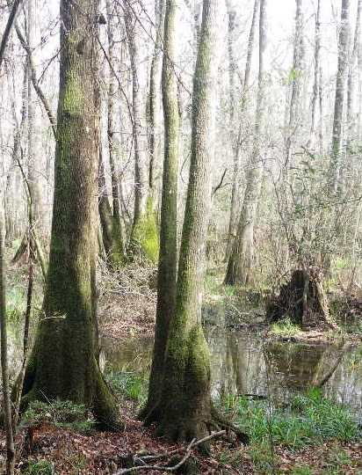
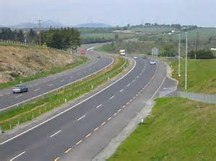
Cumulative Impact Analysis
Cumulative Impact Analysis must address:
  Similar impacts from projects that are existing, under construction, or for which permits or determinations have been sought
  Similar impacts from projects reasonably expected to be conducted in the future
    Project under review, approved, or vested under Section 380.06, F.S.
    Comprehensive plans adopted pursuant to Chapter 163, F.S.
    Applicable land use restrictions and regulations
  “Similar Impacts” – impacts to same type of water resources and functions, not same type of activity.

Slide 75
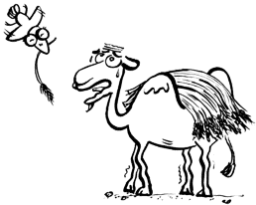
Cumulative Impact Analysis…
  Consider as if all reasonably expected future projects will propose the same amount of out-of-basin mitigation.
  The analysis must show that the project, along with existing, current, and reasonably expected future projects will not be the “straw that breaks the camels’ back”.
    In other words, will not cause violations of state water quality standards or unacceptable impacts to fish, wildlife, listed species and their habitats.

Slide 76
Mitigation
10.3

Slide 77
Mitigation
Any adverse impacts remaining after elimination and reduction of impacts may be mitigated
  Assess functions using the environmental criteria of Applicant’s Handbook Volume I, section 10.2
  Mitigation must replace lost functions
  Next webinar: Mitigation

Slide 78
Technical Staff Report
Provide clear information to the public and colleagues
  ALWAYS fill out a Technical Staff Report (TSR), or equivalent, for:
    Individual permits
    Conceptual approval permits

Slide 79
Good Record Keeping
All information considered in review should be put into Oculus
  Documents & emails
  Site visit documentation
    Labeled photos
  Comments
    Agencies
    Public
  Technical Staff Report may contain
    References
    Links
    Explanation of use of reasonable scientific judgement
Notes:
Mention reviews?

Slide 80

Questions?

