Slide 1
Using a Dichotomous Key to Identify Plant Species
Dicot Edition
Camille Beasley
Camille.Beasley@dep.state.fl.us
FDEP SLERC
February 17, 2015

Slide 2
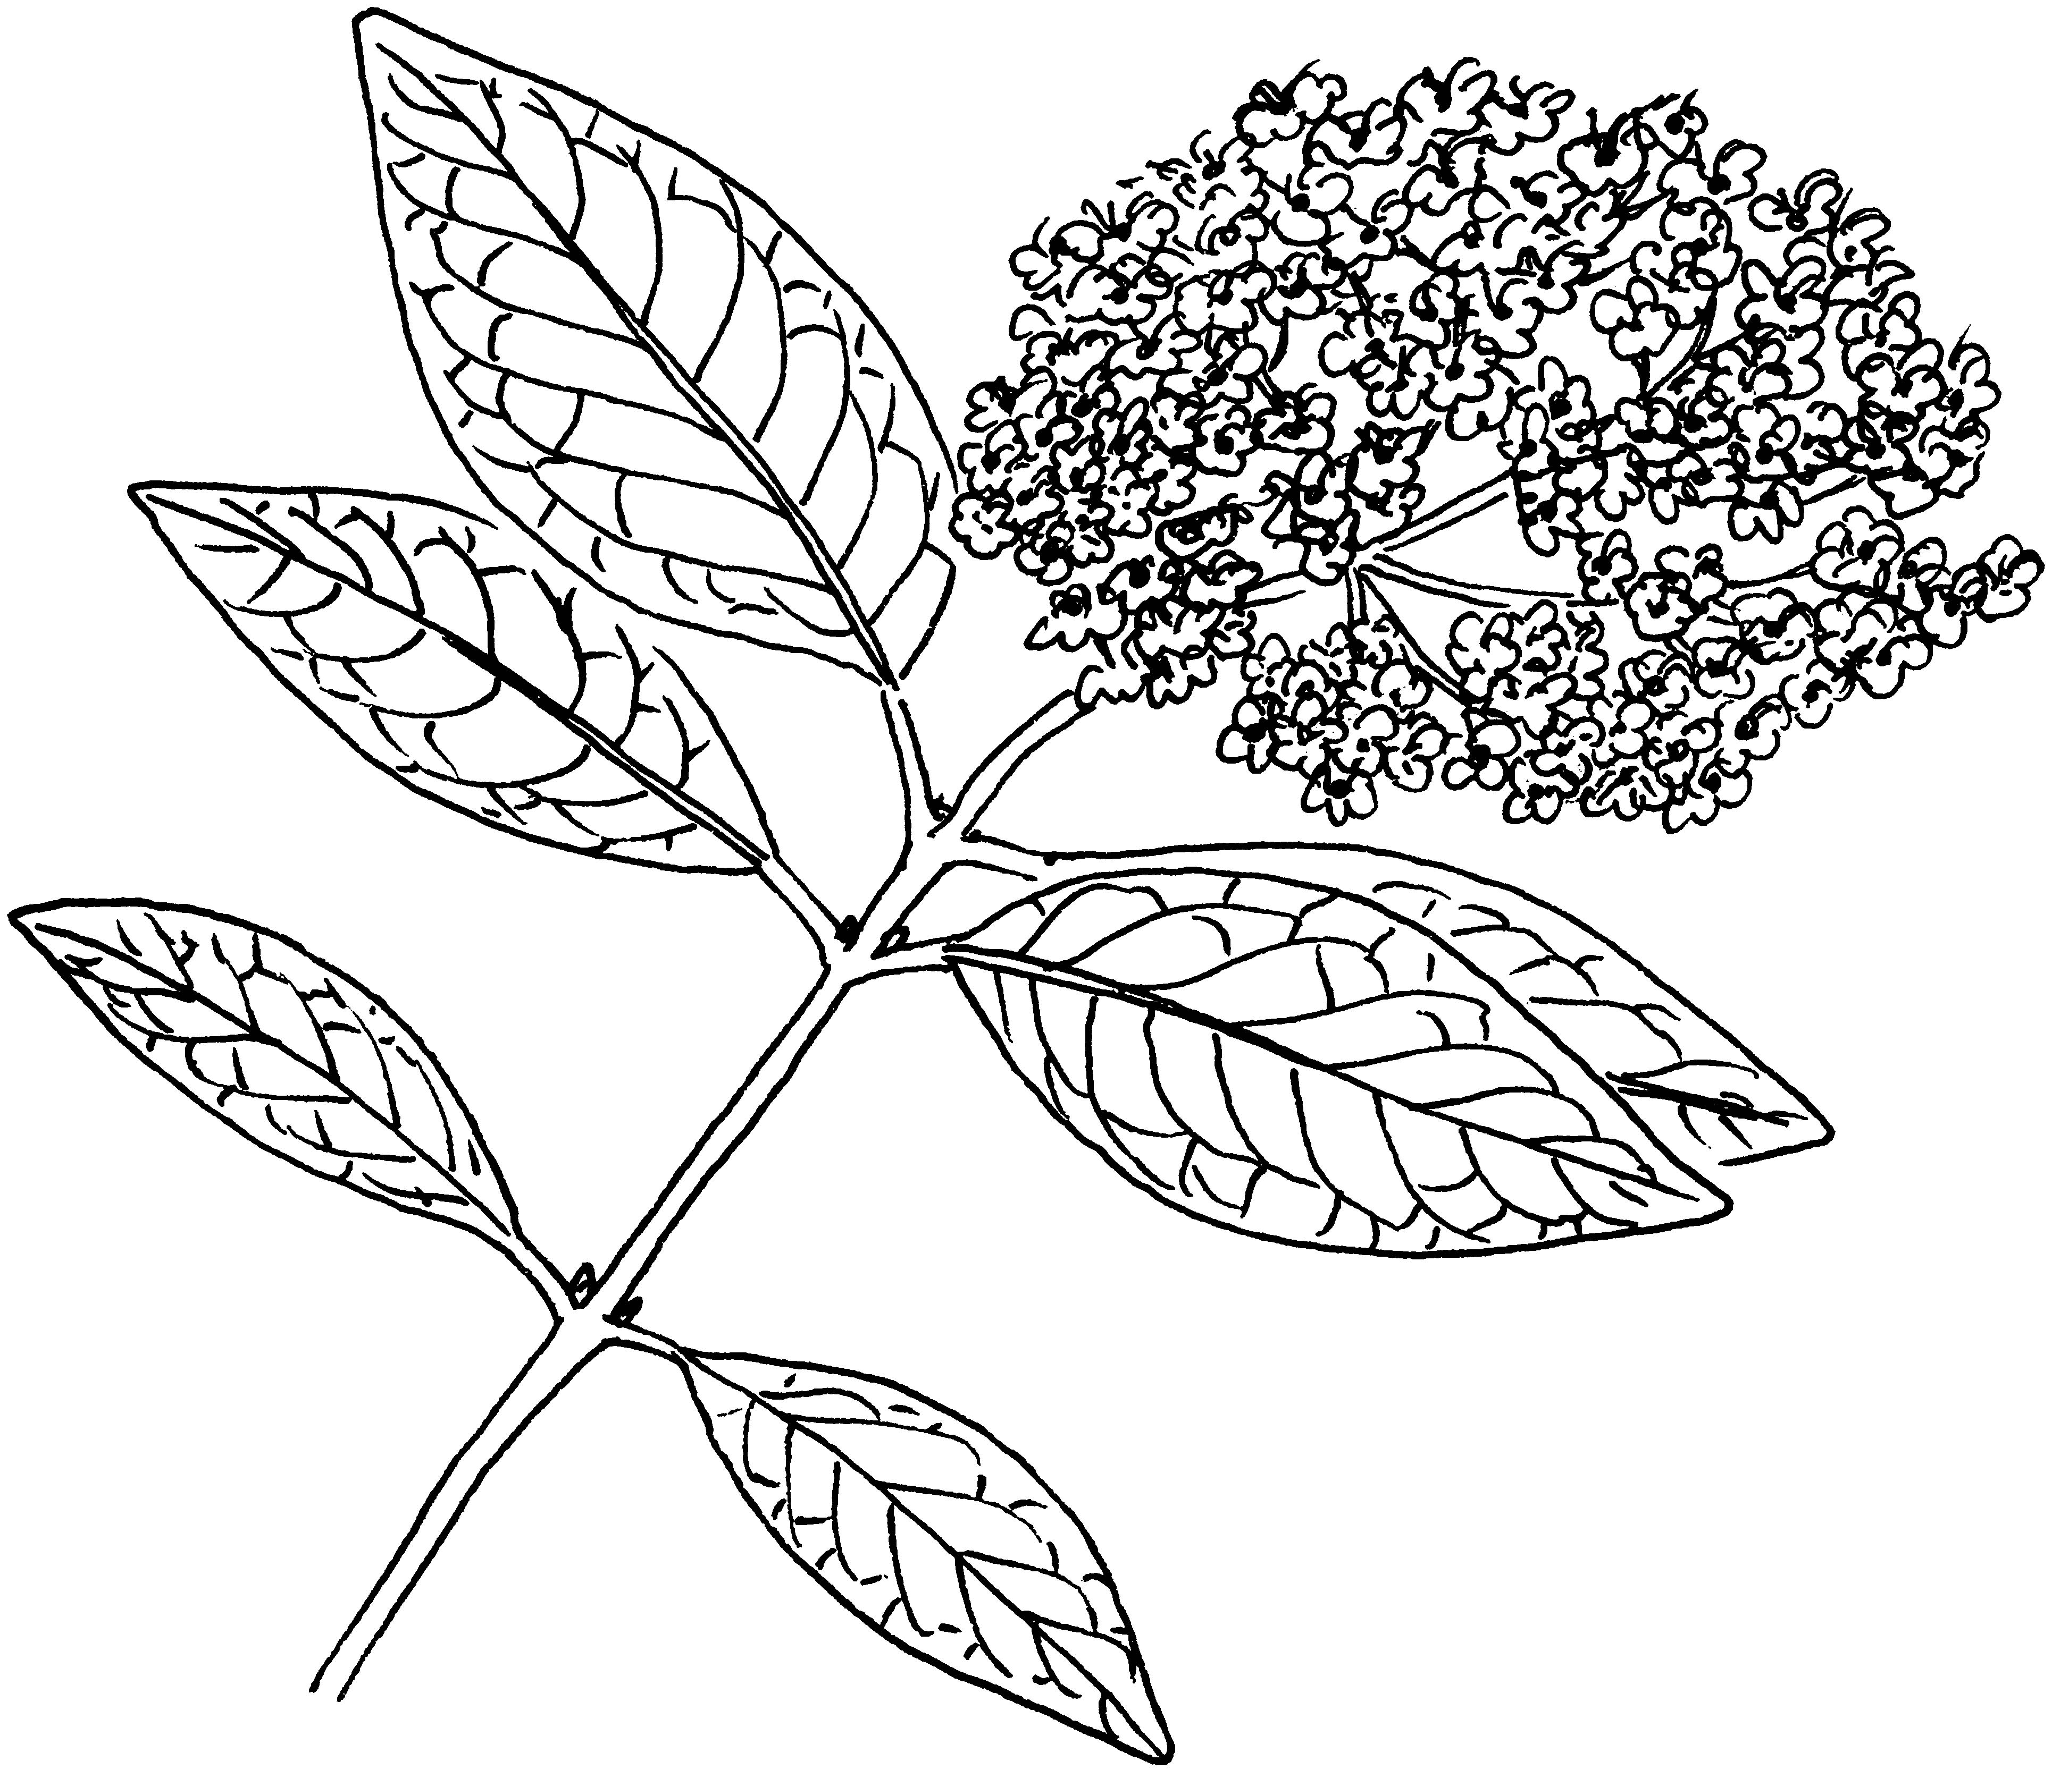
Leaf Parts
Margin
Midrib
Lateral Vein
Bud
Node
Petiole
Base
Apex
Blade
Notes:
The whole wide part of the leaf is called blade, the tip is called the apex, and where it attaches is called the base. Often there is a petiole, like a short stalk, that attaches the leaf to the stem, but sometimes leaves sit directly on the stem and are called sessile. The outer edge of the leaf is called the margin, the primary vein running up the middle is the midrib, and the veins out to the side are called lateral veins. Where a leaf attached to the stem, there will typically be a bud, although it’s not conspicuous on all species. And anywhere a leaf attaches is called a node, with the spaces in between called internodes.

Slide 3
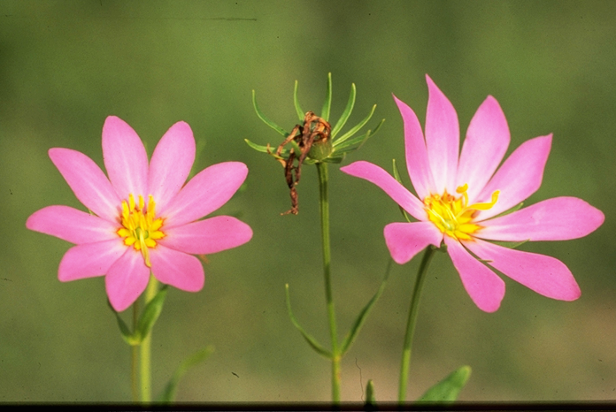
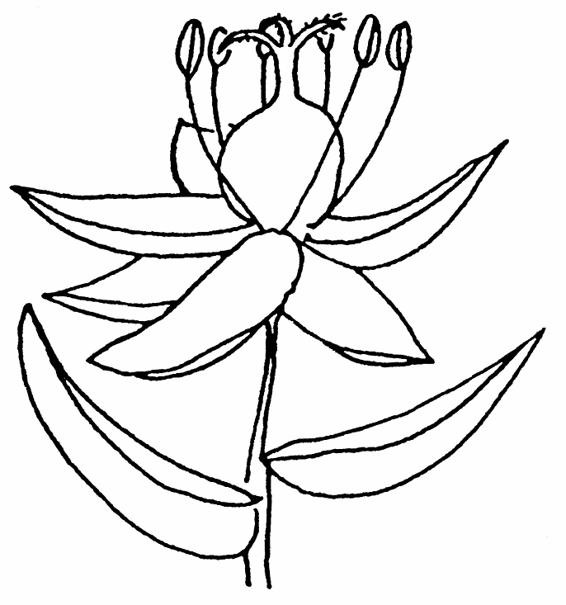
Flower Parts
Corolla + Calyx = Perianth
Calyx =
Sepals
Stigma
Stamen
Pistil
Style
Anther
Ovary
Filament
Corolla = Petals
Notes:
Petals are typically the more colorful, soft appendages, and all together they are called the corolla. The sepals typically are more leaflike and lie under the petals, and together that are known as a calyx. Not every species has both a calyx and corolla, and some have none, but these two entities together are called the perianth. As for the reproductive parts on the flower, the female parts in red are altogether known as the pistil. This consists of an ovary, where seeds form, a style, which is like a tube leading to the ovary, and the stigma on top, which catches pollen grains for fertilization. The male parts are collectively called the stamen, and the consist of an anther, where the pollen sits, and a filament, which is the thin stalk that attaches it to the flower. Not all flowers contain both male and female parts, and if they only have one, they’re called unisexual.

Slide 4
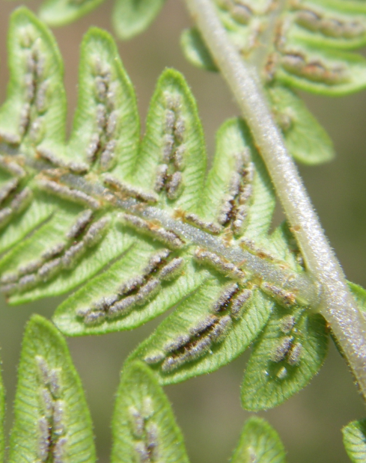

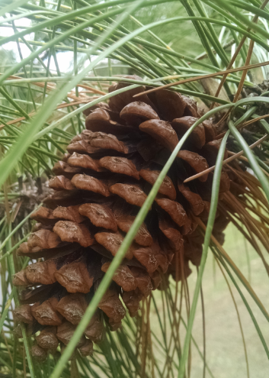
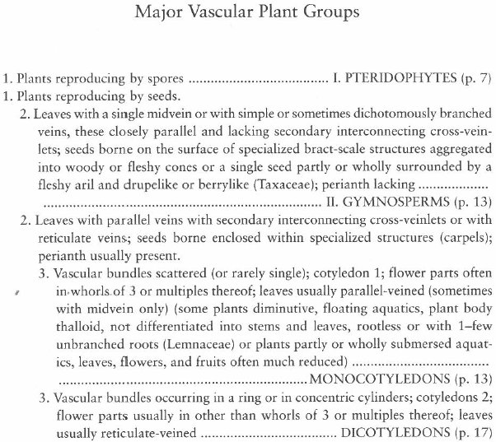
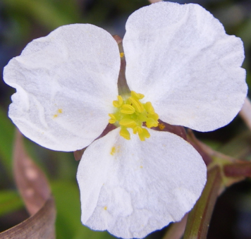
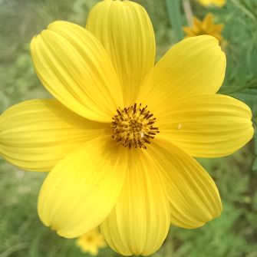
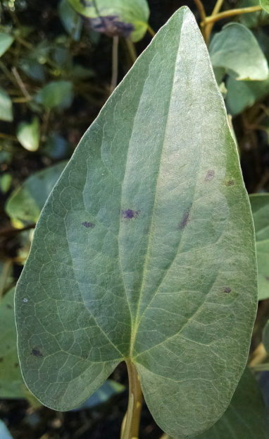
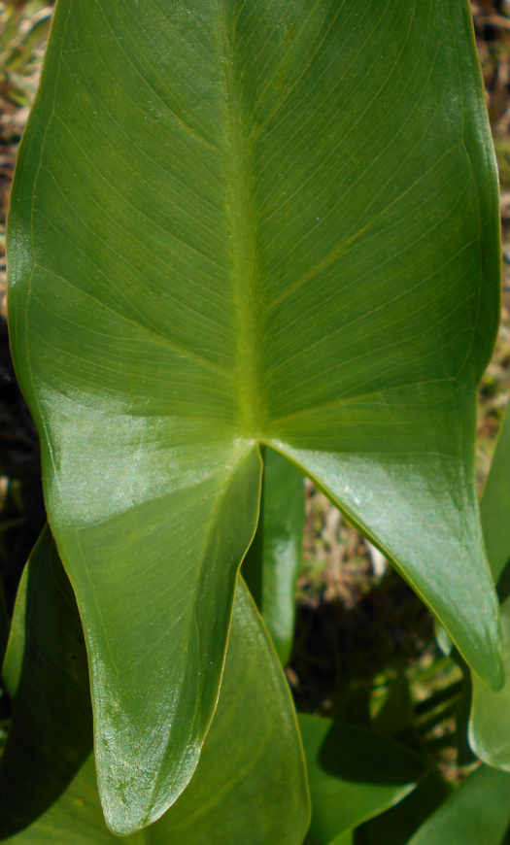
Key from Guide to the Vascular Plants of Florida by Wunderlin
Notes:
Now we can determine what major vascular plant group we’re in. So the first question is whether the plant reproduces by spores or seeds. Spores are often produced directly on the leaves and don’t involve things like pollen, flowers, fruits, cones, and so on. Plants that produce spores are the pteridophytes, which include things like ferns, club mosses, and horsetails. Next, of the plants that reproduce by seeds, we’re going to differentiate them by looking at their veins, the structures that their seeds are borne on, and whether they have a perianth. Plants without interconnecting cross-veinlets, whose seeds are on scales aggregated into cones or inside what’s called an aril, and which never have petals or sepals are called gymnosperms. These are your pines, cypresses, cedars, firs, spruces, etc. Everything else is called an angiosperm, and these are broken into 2 groups, named for how many “cotyledons” or “seed-leaves” they have – 1 or 2. The monocots have 1 seed-leaf, the vascular bundles in their stems are scattered, their flowers have parts in multiples of 3, they typically have parallel veins, and they have a few special cases, as mentioned in those parentheses. Dicots have 2 seed-leaves, vascular bundles that are arranged in a ring or concentric rings, flower parts that are typically not in multiples of 3, and reticulate, or net-like venation. So monocots are things like grasses and sedges, as well as plants with showier flowers like this iris that have parts in multiples of 3. Dicots include most trees and shrubs, except for gymnosperms and palms, as well as a lot of herbaceous species that you’ll see have flower parts that aren’t in threes, and leaves with reticulate veins, or sometimes rather specialized leaves.

Slide 5
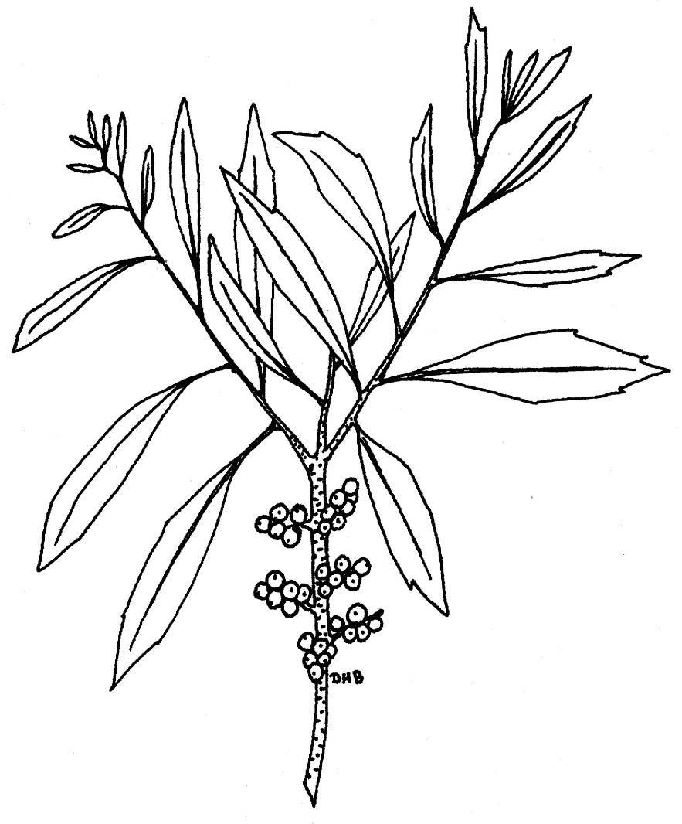
Leaf Arrangements
The location and orientation of leaves on a plant:
1. Alternate: leaves attached in an alternating fashion along the stem.
Myrica cerifera FAC
Notes:
For dicots in particular, leaf arrangement refers to the location of the leaves in relation to one another along the stem. First, we have alternate leaves, which are attached in different places along the stem, essentially “alternating” as they move up the stem.

Slide 6
2. Opposite: Two or more leaves that occur across from one another on the stem.
Viburnum nudum FACW
Notes:
Opposite leaves are attached directly across from one another on the stem, at the same lateral position.

Slide 7
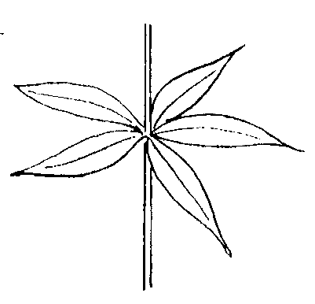
3. Whorled:
A leaf arrangement with 3 or more
leaves arising a single point on the stem.
Galium tinctorium FACW
Notes:
When 3 or more leaves are attached at the same lateral position, it’s called “whorled”

Slide 8
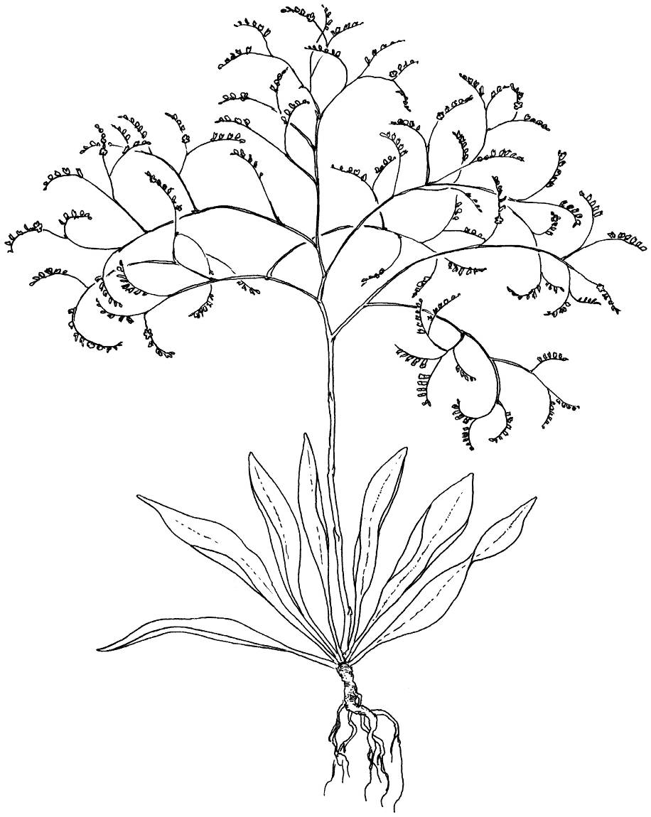
4. Basal leaves:
Leaves that arise or occur at the base of the plant.
Limonium carolinianum OBL
Notes:
Leaves can also all be concentrated where the stem enters the ground, and these are called basal leaves, or often a basal rosette

Slide 9
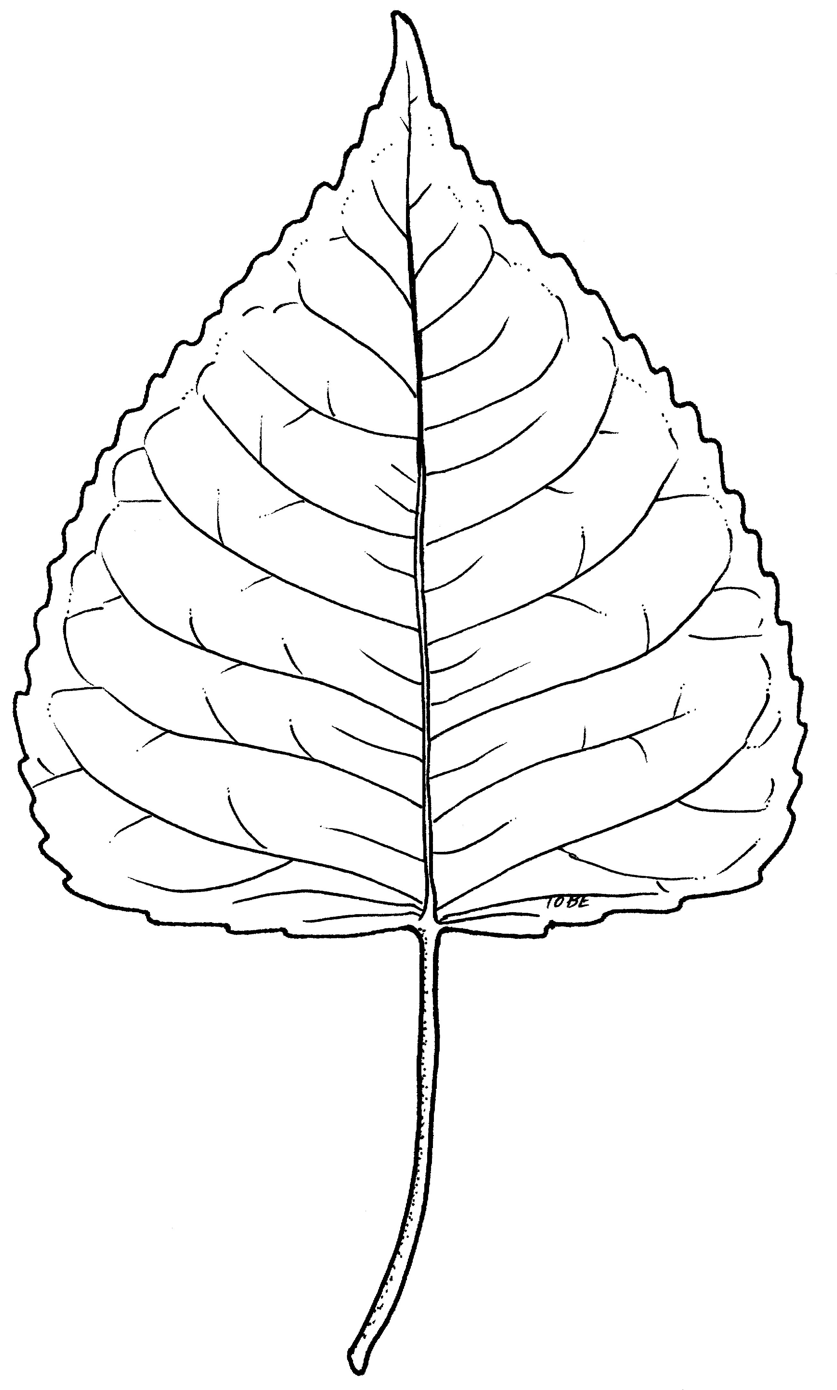
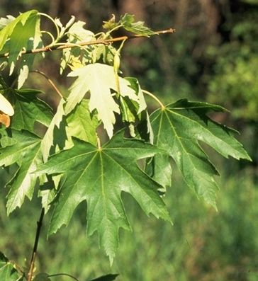
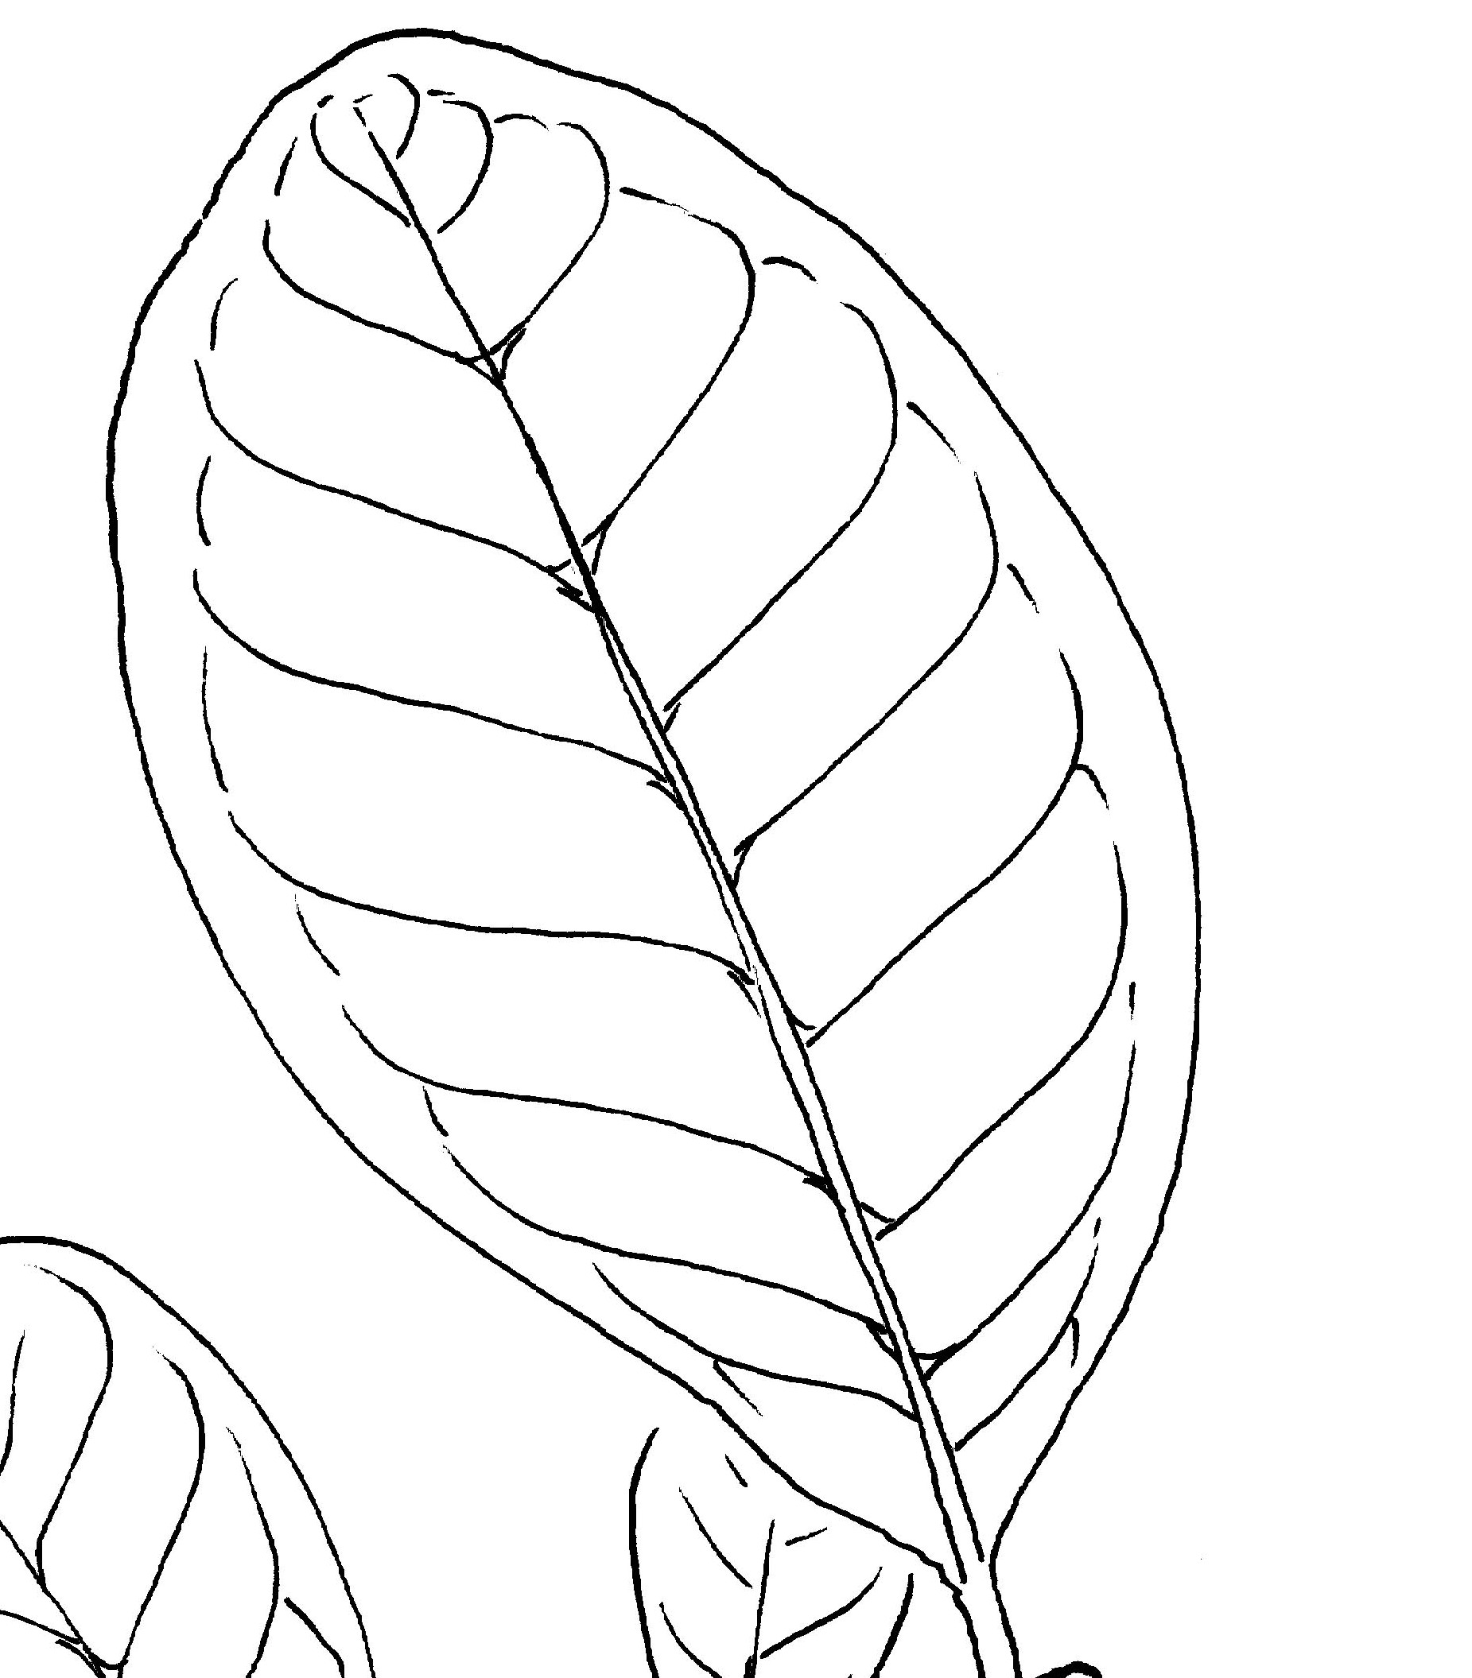
Leaf types
1. Simple: A leaf blade that is undivided; it may have teeth
and/or lobes, or be entire (smooth).
Notes:
Leaves themselves can be simple or compound. Simple leaves are just a single, undivided blade. They may have smooth (or entire) margins, toothed margins, or deep lobes, but they’re a single blade.

Slide 10
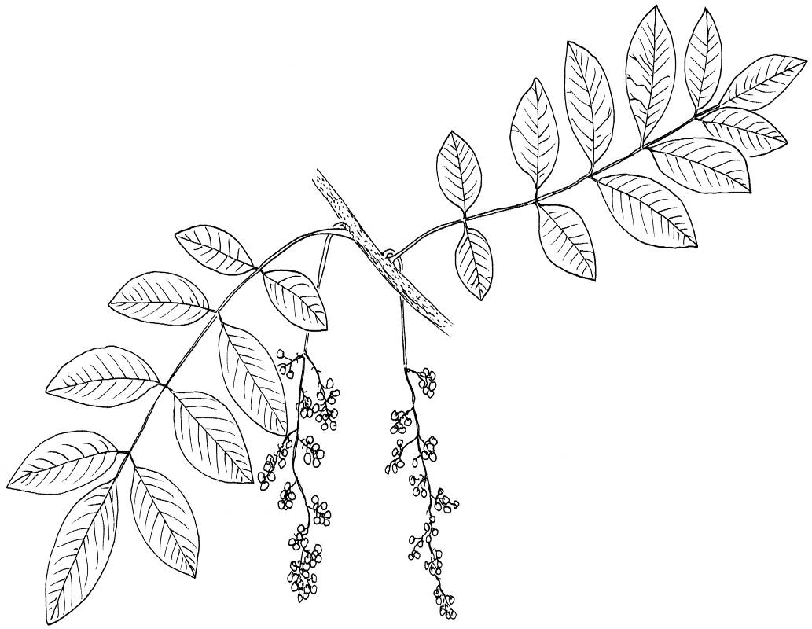
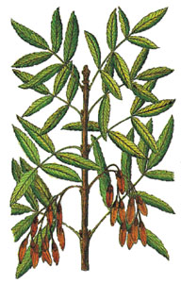
2. Compound leaf: a leaf divided into 2 or more leaflets.
Like simple leaves, compound leaves can be
Alternate or Opposite
Toxicodendron vernix FACW
Fraxinus pennsylvanica FACW
Notes:
Compound leaves consist of multiple leaflets attached along a central stalk, or rachis. These can be attached alternately or oppositely to the main stem.

Slide 11
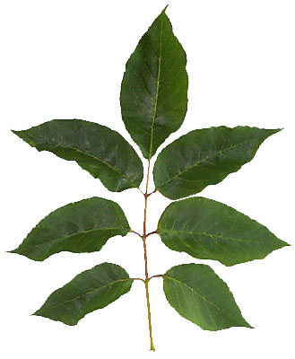
A leaflet will not have a bud near the axis at its base and is really just part of a deeply lobed/divided, leaf.
No bud!
Leaf
Leaflets
Location of bud
Notes:
What’s important is where the bud is. If you see a bud right where the leaf attaches, it’s a simple leaf. If you don’t, it’s a leaflet, and the bud will be at the base of the rachis.

Slide 12
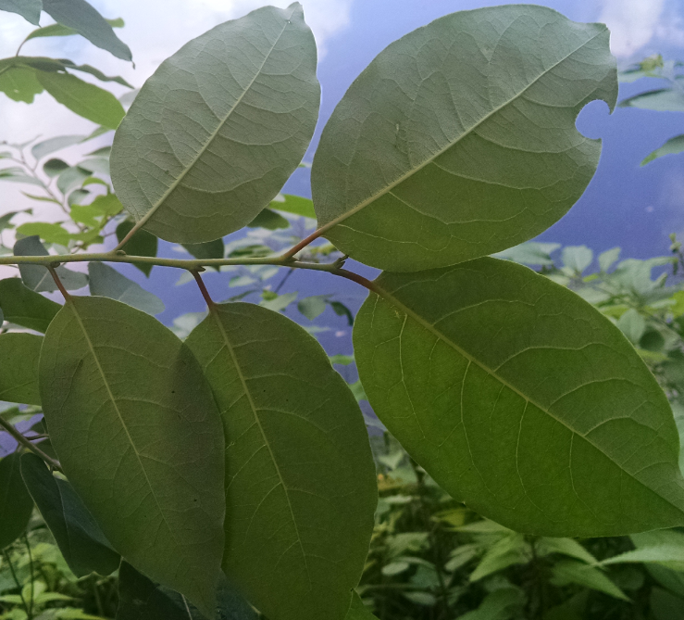
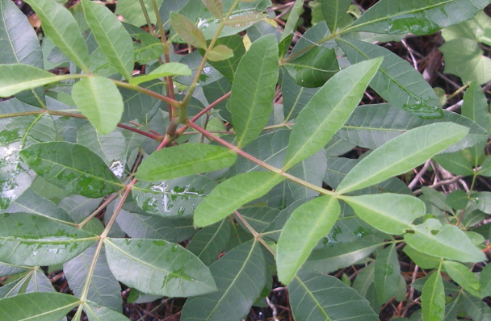
Compound leaves have buds at the base of the rachis, but not at the bases of leaflets
Bud is here, not here
Simple leaves have buds at the base of each one

Slide 13
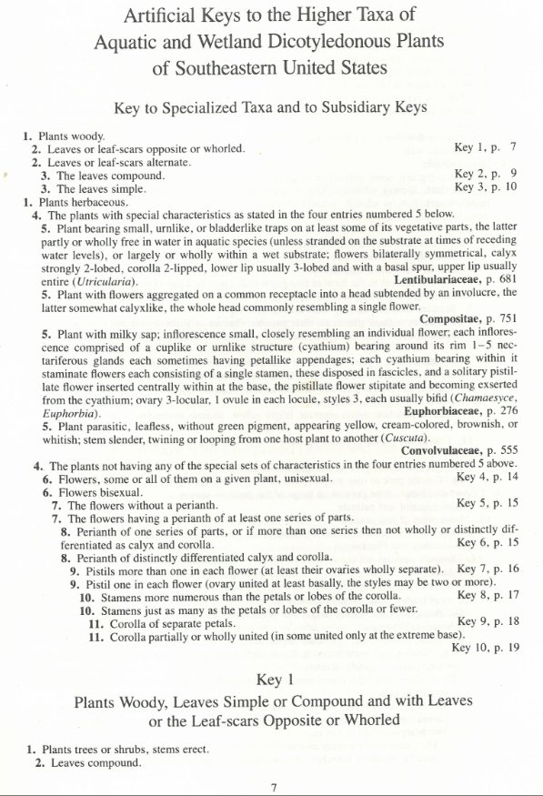
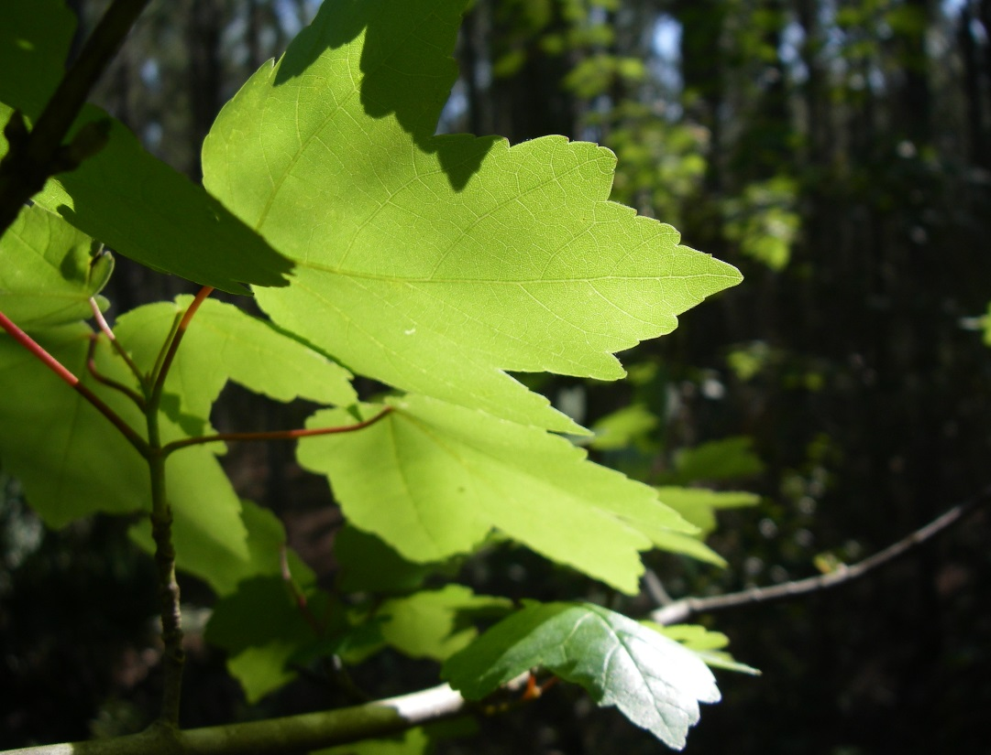
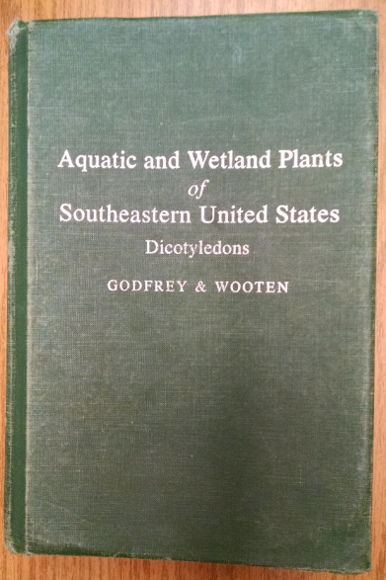
Key from Aquatic and Wetland Plants of the Southeastern United States: Dicotyledons
by Godfrey and Wooten
Notes:
I’m using Aquatic and Wetland Plants of the Southeastern United States: Dicotyledons as my key. It’s very thorough and I definitely recommend having it around, although keep in mind that it’s a bit old and some plant names will have changed. Also keep in mind that it’s for wetland plants, so if you’re looking at an upland plant, you probably won’t find it in here, and you’ll need to have a more general key with you. This key actually starts with a mini key that will take you to a more specific key for your plant. The first question, denoted by the 2 #ones, is whether the plant is woody or herbaceous. So that’s how the questions are asked: you read all the options with that particular number in front of them. So in this photo I have in the corner, we can kind of see a woody branch running along the bottom, and most of you probably recognize that this is a tree, so the correct answer is the first choice – it’s woody. So we move onto question 2: are the leaves opposite or whorled, or are they alternate? It give the option to look at leaf scars too, because in the winter, when all the leaves have dropped, they all leave a scar and that may be all you have to look at. We can see that these leaves are opposite – both of them attaching to the twig at the same lateral position. So when we pick an answer choice and there’s something written out to the side of it, that either tells us what the plant is, or it tells us where to go next. In this case, we go to Key 1, which starts at the bottom of the page. Unfortunately, the other half of question one is on another page because there’s a lot of stuff in between but I’ll just tell you that the other option is whether the plant is a woody vine. We already know this plant is a tree, so we’ll go with the first option. The number 2 options are also split, so remember that the one on this page is for compound leaves.

Slide 14
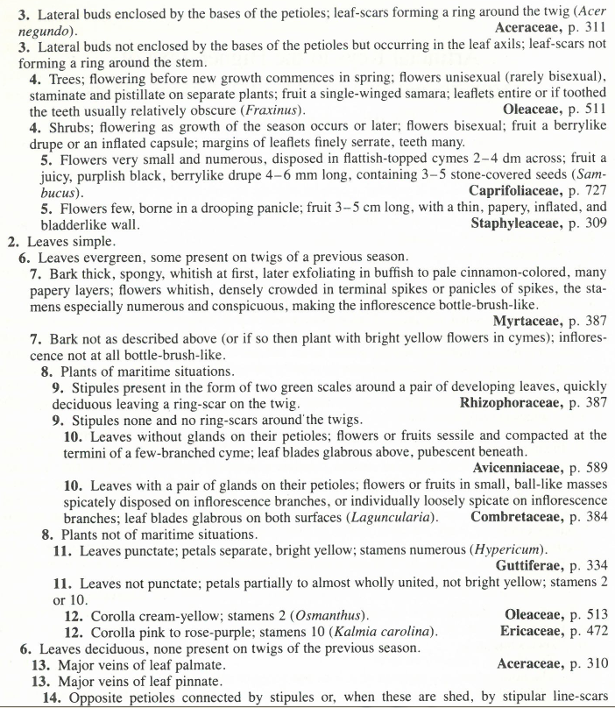
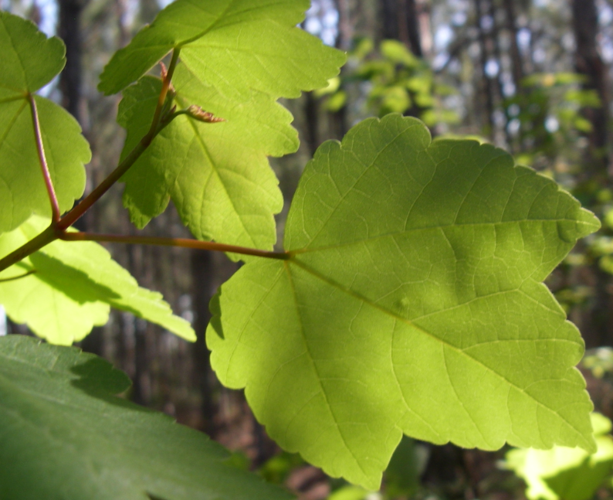
OR
Notes:
Now we can see that the second #2 option is that the leaves are simple. It can be hard to see lateral buds on this species, but if we look at the end of the twig, we can see a terminal bud at the base of those leaves. You won’t see a bud anywhere except the very base of a compound leaf, so we can tell these are simple leaves. Now you’ll notice our next pair of options has a number 6 instead of a number 3. That’s because 3, 4, and 5, pertained to the answer choices following the first #2 option, and each pair of choices needs its own number. So just drop down to the first option following the answer you just selected, look at the number in front of it, and find its match further down the key. For #6 we want to know whether the leaves are evergreen or deciduous. If it’s not the middle of winter, you can usually tell this by looking at qualities of the leaf. If it’s relatively thin, papery, and light in color, there’s a good chance it’s deciduous. If it’s thick, leathery, and dark in color, there’s a good chance it’s evergreen. Also look for leaves on the ground, and how disintegrated they appear (but keep in mind, some may decay by the next season). These leaves fit the deciduous description well, and most of you know these turn pretty colors and fall off in the fall. Now we move to #13 and look at whether the major leaf veins or palmate or pinnate. Palmate veins radiate out from a central point, like your fingers from the palm of your hand. Pinnate veins are more like a feather, with a single central vein and all other veins radiating outward from it. Here we can see the leaf has 3 major veins radiating from the base of the leaf, so we call these palmate. This takes us to the Aceraceae family, and we turn to page 310.

Slide 15
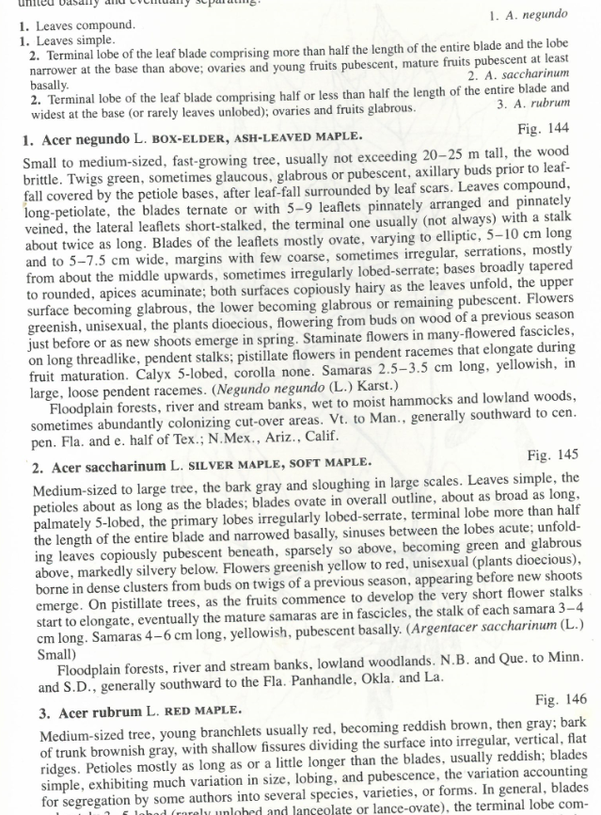
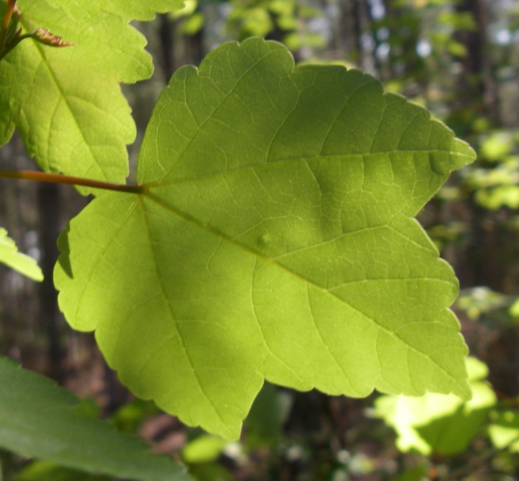
Notes:
Now we’re at a mini key that pertains only to the Aceraceae family. We’ve already determined that the leaves are simple, so we move to #2. Is the terminal lobe of the leaf blade… more than half… and in this case we can’t see fruits, so ignore that. Or is the terminal lobe… less than half. Well here’s the terminal lobe, and here’s the rest of the leaf, so I’d say it’s less than half, as well as wider at the base. So we have Acer rubrum, or red maple, which many of you probably recognized already. In this key, we can double check our answer by reading the description below the plant name down here.

Slide 16
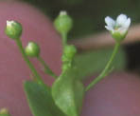
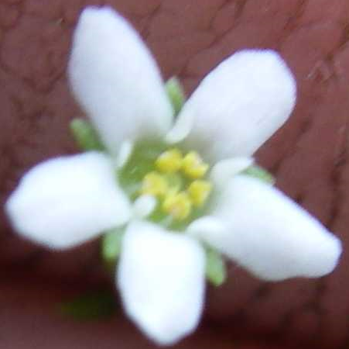
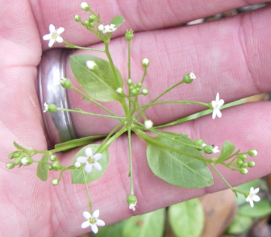
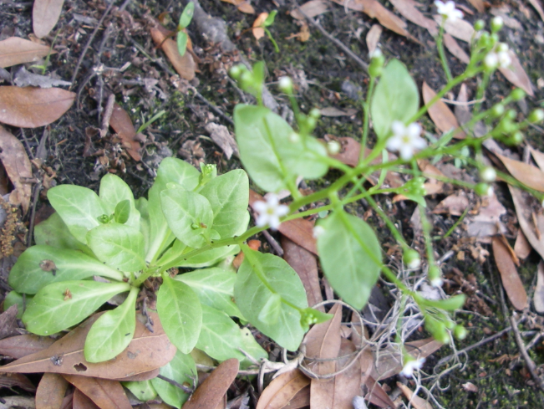
Petals (corolla)
Perianth
1
2
5
3
4
Stamen
Pistil
Sepals (calyx)
Key from Aquatic and Wetland Plants of the Southeastern United States: Dicotyledons
by Godfrey and Wooten
Notes:
This next plant will take a little longer to get to and will have some more complex questions to answer, but you’ll see the principle is the same, and you just have to stick with it. We’ll start with the same question from the mini key: woody or herbaceous? In this case, our plant is herbaceous – it’ll always be green and flexible, not becoming hardened. Next question is a little strange: it asks whether the plant fits into one of 4 special categories or not. It describes these categories using 4 #5 choices, instead of 2, so you just read through those choices to determine whether your plant belongs to one of those families or whether you should continue along in the key. Just for time’s sake I’m going to tell you it doesn’t fit into any of those special descriptions, so we pick the second #4 choice and move onto question #6. This one has some terms you may not be familiar with in terms of plants, but you can look them up in the glossary of this key. Unisexual flowers are those that either only have male parts or only have female parts. Bisexual flowers have both parts. Unfortunately my photo isn’t super clear, but if you look close you can definitely see stamens, with their yellow pollen, and in the middle is a pistil, which is a bit more hidden. So these flowers are bisexual. Next, do they lack a perianth or do they have one? This flower clearly has both petals and sepals, so the second choice is correct – they have a perianth. Now, does the perianth only have one part, or does it clearly have a calyx and corolla? Again, this one has both, so onto # 9. This is another one that’s difficult to tell from a photo, but if you had the flower in hand and could get a closer look at all of its parts, you’d see that it has just one pistil with a single ovary. Now we have to count the stamens and compare to the number of petals. We’ve got 5 stamens, and 5 petals, so they’re just as many or fewer. Finally at the last choice, we’re looking at whether the petals are fully separated or the corolla is united, at least partially. If you pulled back the sepals on this flower, you’d see that the petals are somewhat united at the base, so we go to key 10.

Slide 17
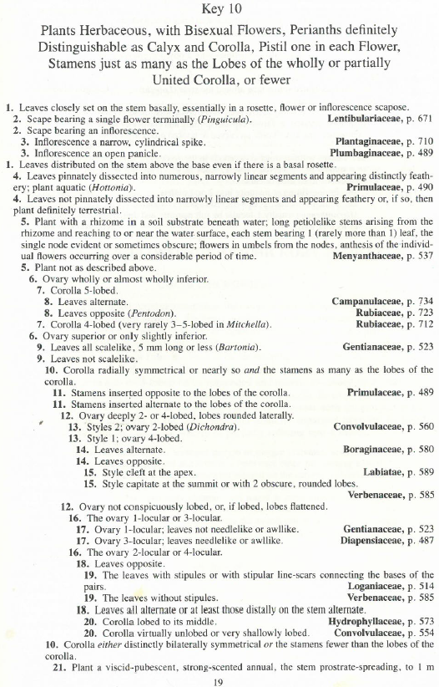
Notes:
The first question is whether the leaves are all basal, or whether there are some on the stem. Well even though this plant has a basal rosette, it still has stem leaves, so we go with the second choice. Are the leaves pinnately dissected and feathery? No, they are entire, so second choice. Does our plant have a rhizome in soil substrate beneath water with stems reaching up to the surface, and all these other characteristics? No it’s clearly rooted directly in the ground and not submersed, so not as described above. Question #6 can be a bit hard to determine. The ovary is the bulbous round part at the base of the flower. If the ovary is inferior, all of the perianth will be attached above it. If it’s superior, the perianth parts will all attach at it’s base, sort of cupping it. In this case, the perianth doesn’t quite reach all the way to the base, but it’s almost there, so we call it slightly inferior. Now we ask if the leaves are scale-like, and they are not. So now we look at the symmetry of the corolla. Is it radially or bilaterally symmetrical? Well we can draw multiple lines across which the flower parts are reflected, and the stamens equal the number of petals, so we have radial symmetry. Next, are the stamens inserted opposite or alternate to the corolla lobes? Since they line up roughly with the middle of each petal, we call the opposite. If they were alternate, they’d be aligned with the spaces in between the petals. Since we picked the first choice, that finally brings us to a family! So we’ll turn to page 489

Slide 18
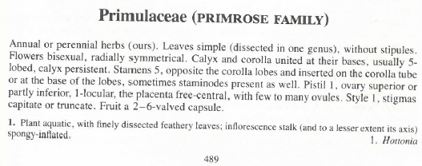

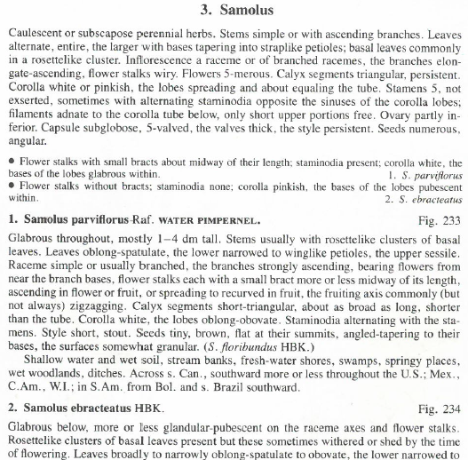
Bract
At least 25mm
Notes:
Within this family, we need to figure out what genus we have. So first we ask if the plant is aquatic with some special characteristics or terrestrial with simple leaves. This plant is clearly terrestrial in this photo, the ground may get pretty wet, but it’s not submerged for most of its life. Now for the next question, determining whether a plant is annual or perennial is difficult, but luckily this question has a second part. The leaves on this plant are often quite small, but the largest basal leaves will be over 20mm long and you’d be able to tell this better if you had the plant in hand, rather than a weird perspective photo. Here’s where we look at the ovary again, and like I said before, it’s just slightly inferior. Additionally, the corolla is white, so it fits the first option, which means we’re in the Samolus genus. We can now turn to the page with Samolus, and luckily we only have 2 choices. On this species, the flower stalks have small bracts, and the corolla is white and glabrous (or smooth) inside. Staminodia is a term you can find in the glossary, and it refers to these little fleshy white things here, which are like stamens that don’t have any pollen. Thus we’ve determined we are looking at Samolus parviflorus, or water pimpernel.

Slide 19



Slide 20
