Slide 1
Office of Communications
Common Wetland Plants
Wetland and Other Surface Water Referral Training
Level 3
March 2015

Slide 2
Why plants?
Plants are one of the three puzzle pieces of wetland delineation.
Hydrophytic vegetation is
Wetlands are dominated by hydrophytes because they outcompete the upland species which cannot tolerate inundation or anaerobic soil conditions.
The following plants are some of the most common and easy to recognize wetland plants.
Finding one or more of these species is be a good indication that the area of interest may be a wetland

Slide 3
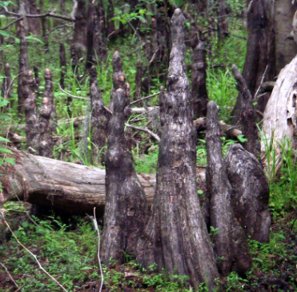
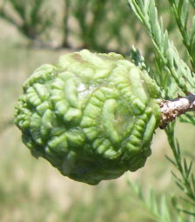
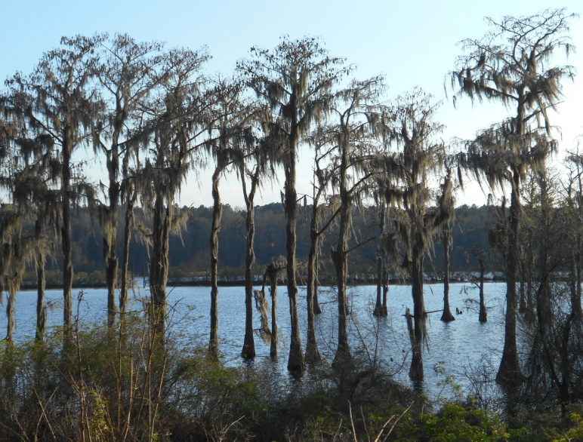
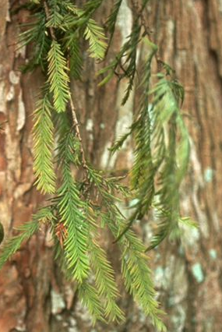
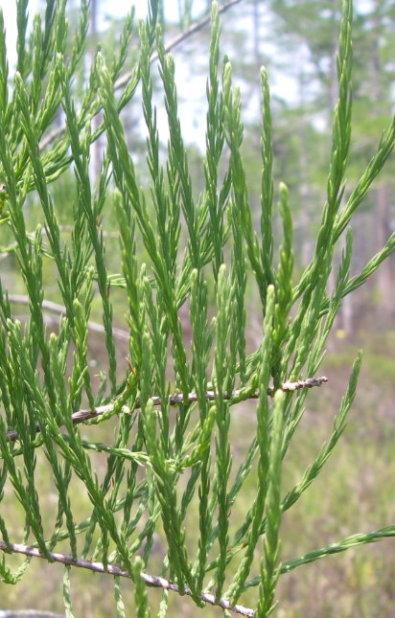
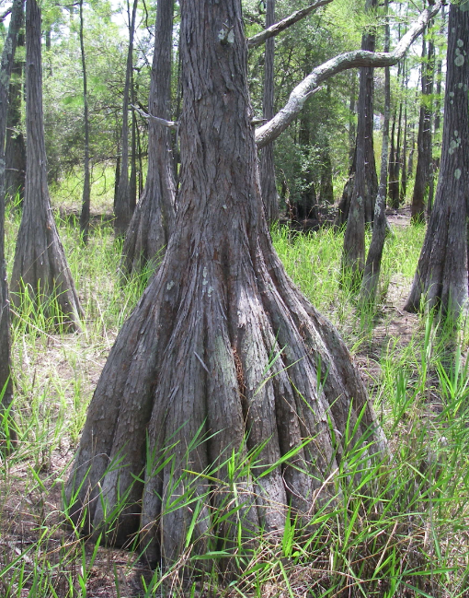
Taxodium spp. cypress OBL
Cypress knees
Round, fleshy cones, turning woody
Taxodium distichum (bald cypress) has feather-like, spreading needles
Taxodium ascendens (pond cypress) has needles that hug the twig
Fluted, buttressed trunks and bark in peeling strips

Slide 4
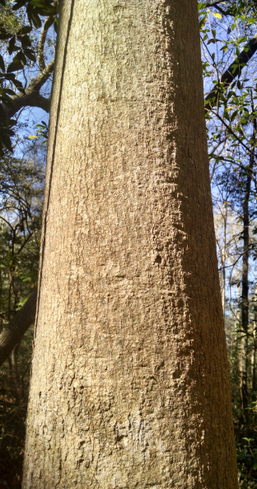
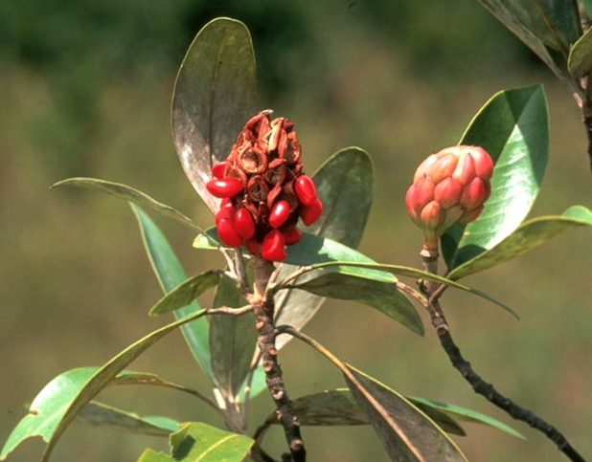
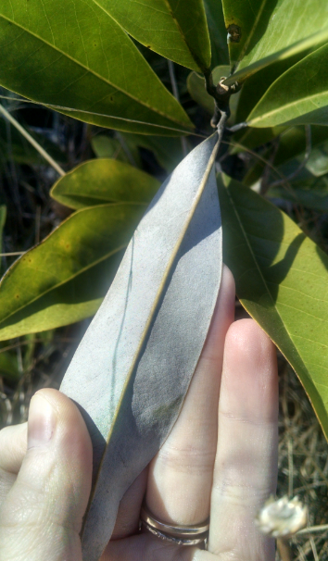
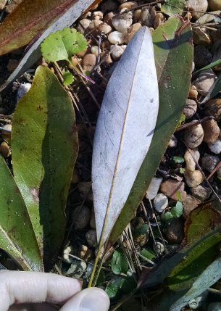
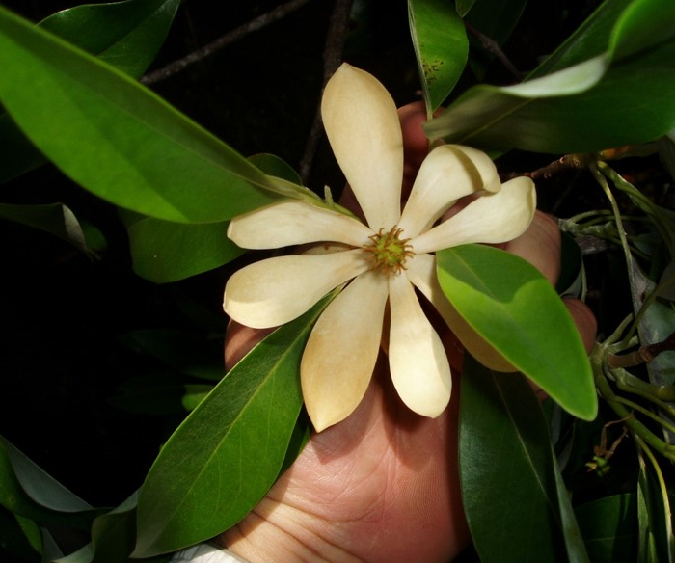
Magnolia virginiana sweetbay magnolia OBL
Bark smooth and gray-brown
Fruit a cluster of follicles that produce red seeds
Leaves dark green on top, silvery gray on bottom
Long, elliptical evergreen leaves
Aromatic when crushed
Flower creamy white and fragrant

Slide 5
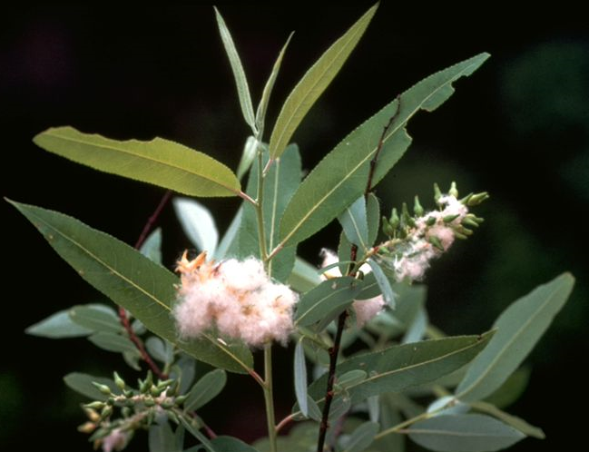
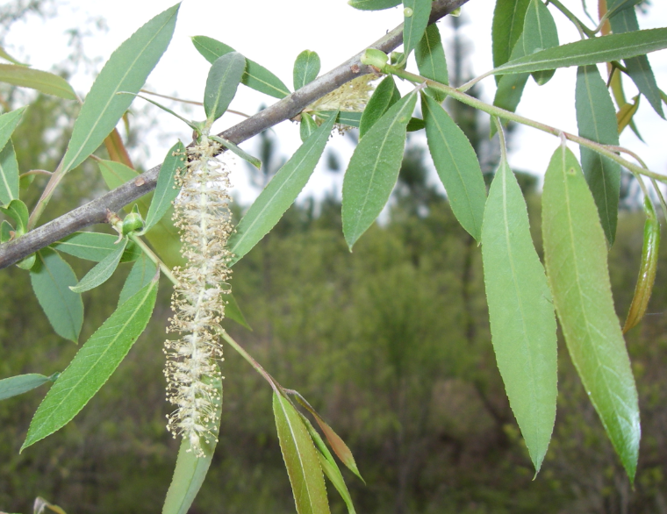
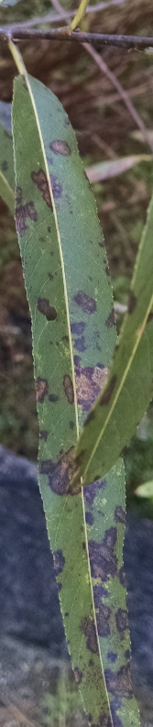
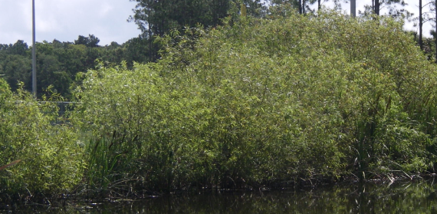
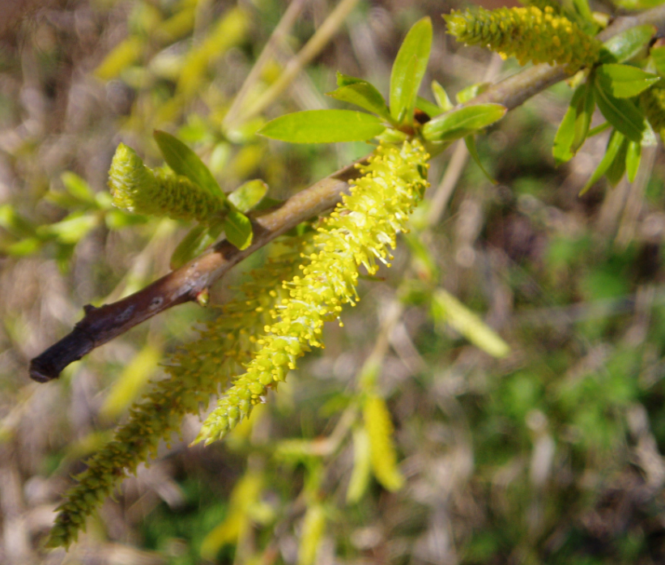
Salix spp. willow OBL
Seeds have tufts of hair to catch the wind, appearing cottony
Yellow-green catkins becoming white
Often small tree growing in dense clusters
Long, narrow leaves with serrated edges

Slide 6
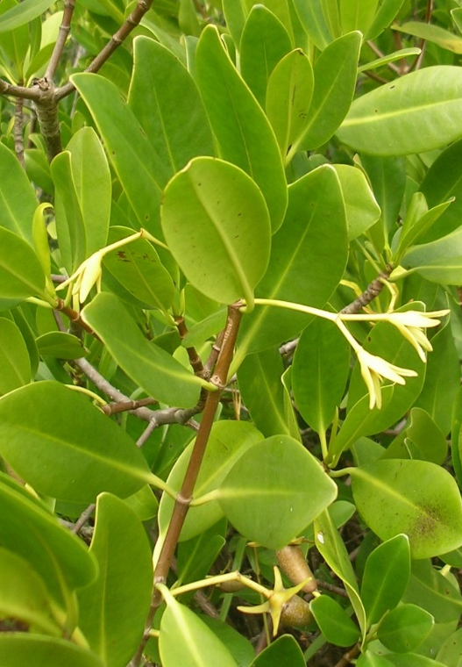
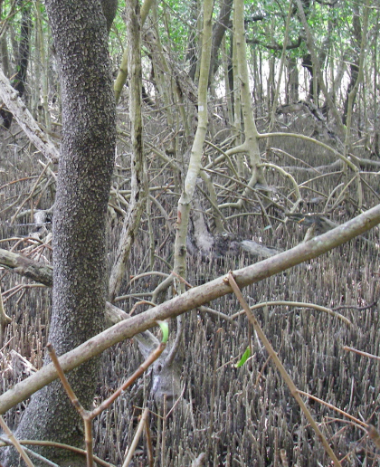
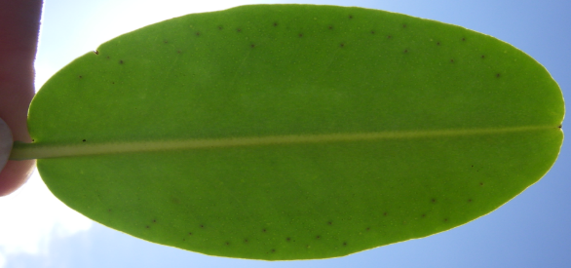
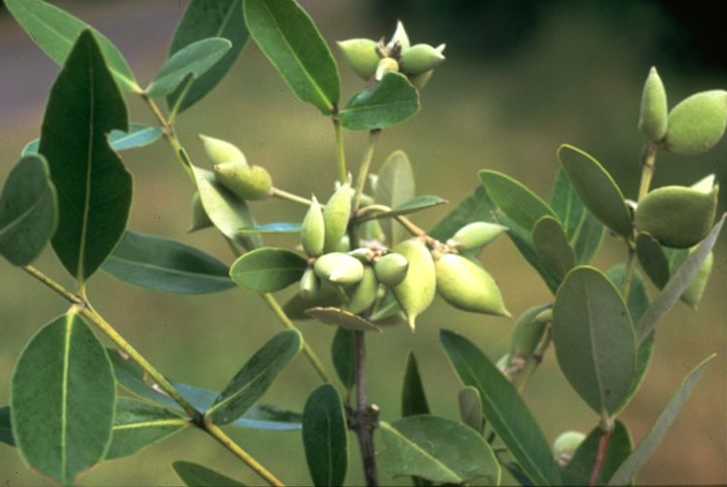
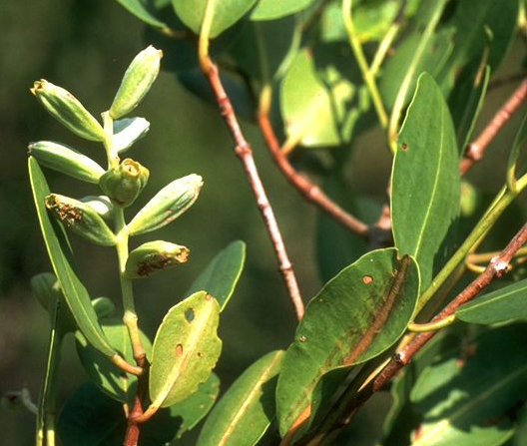
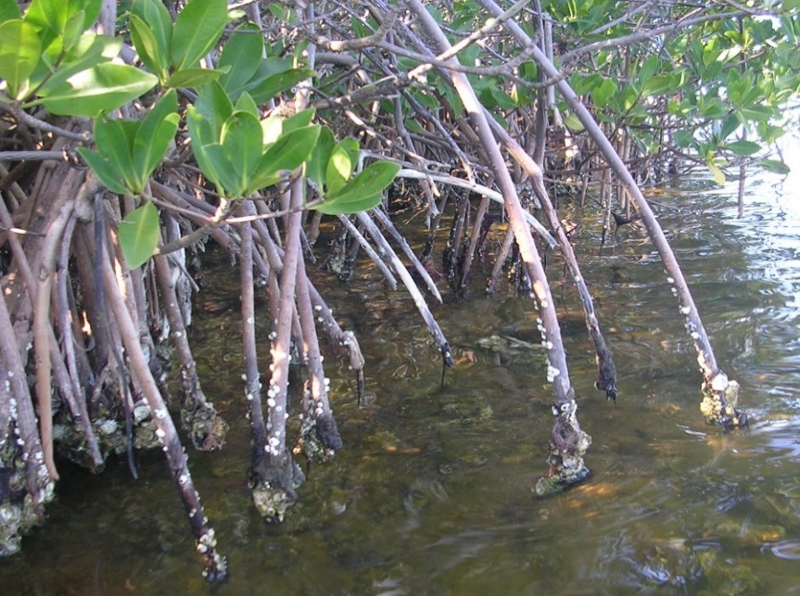
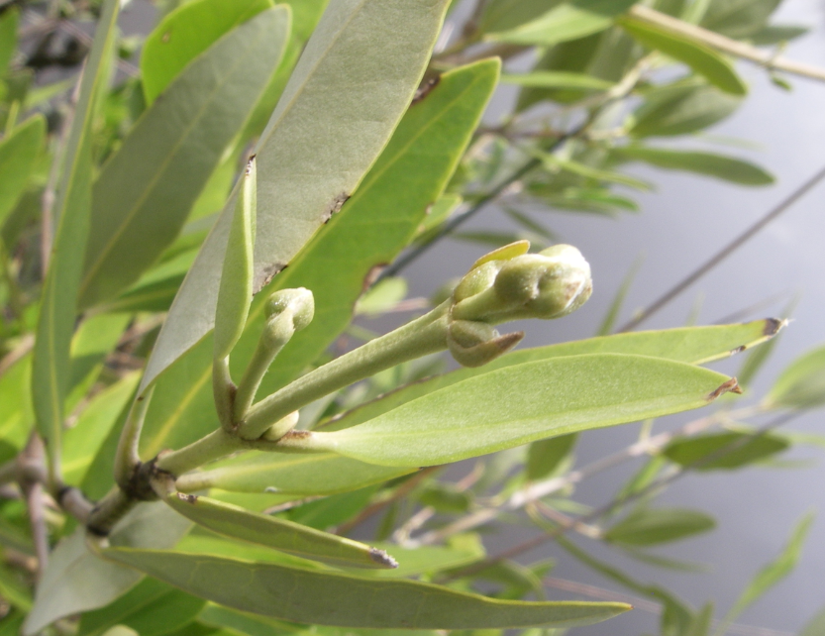
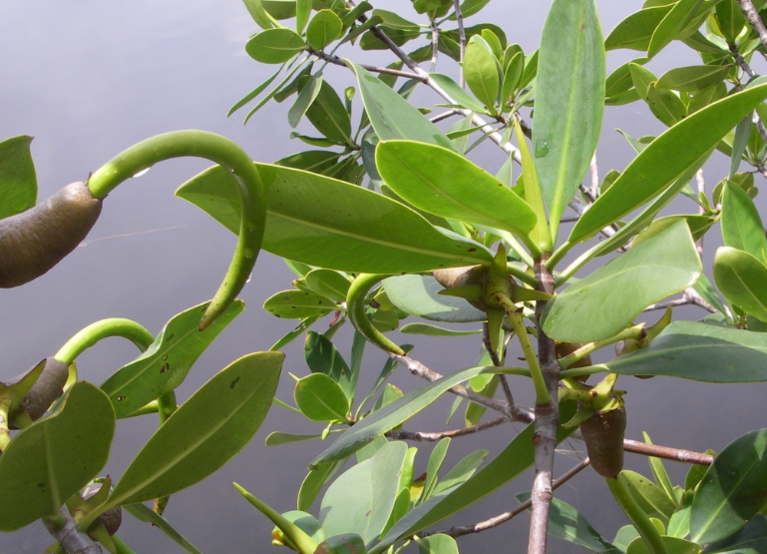
Mangroves
OBL
Avicennia germinans Black
Laguncularia racemosa White
Rhizophora mangle Red
Red
Black mangroves have pneumatophores sticking up from the ground
Black
White
White
Evergreen leaves grow opposite one another on branches and have smooth edges
New plants, or “propagules” grow on parent plants before falling off
Red mangroves have arching prop roots
Black
Red

Slide 7
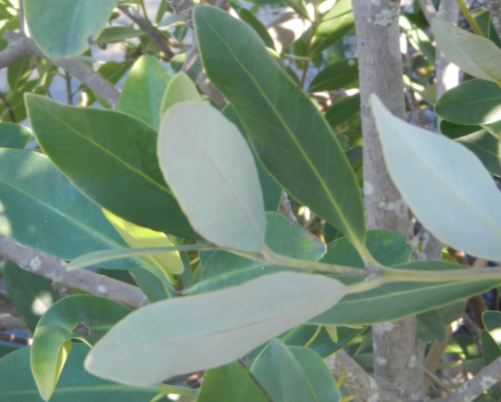
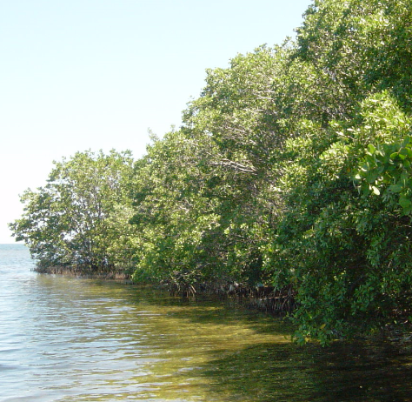
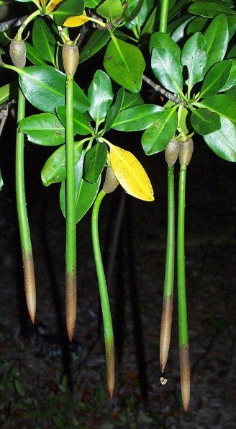
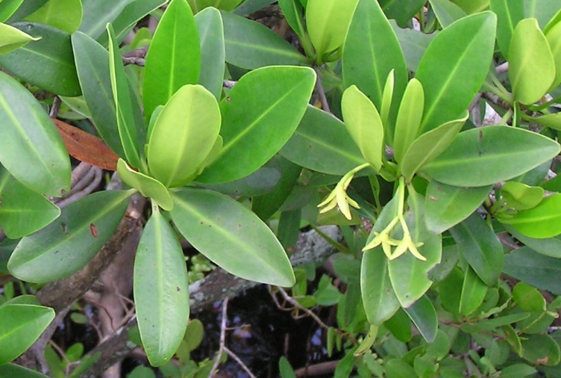
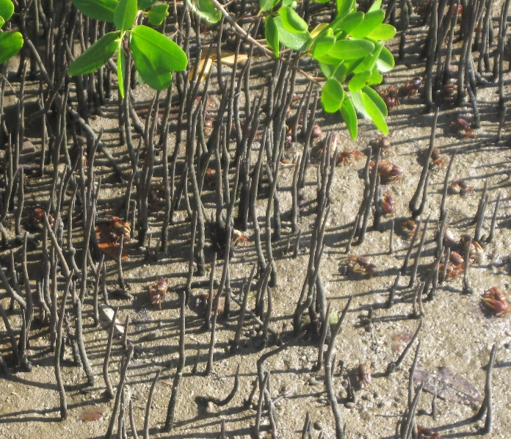
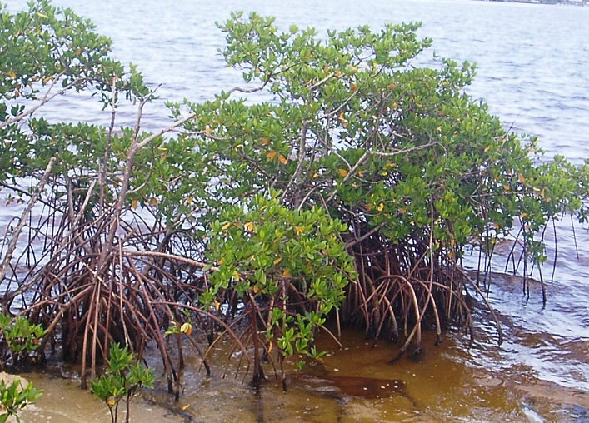
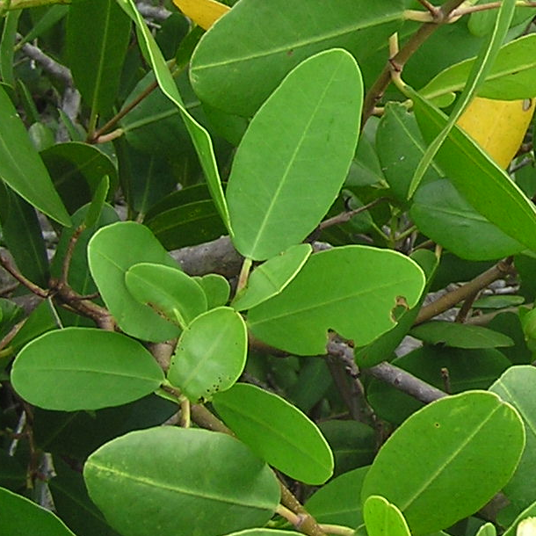

Mangroves
OBL
Avicennia germinans Black
Laguncularia racemosa White
Rhizophora mangle Red
Black
Evergreen leaves grow opposite one another and have smooth edges
Often growing along salt water bodies
Red
White
New plants, or “propagules” grow on parent plants before falling off
Black mangroves have pneumatophores sticking up from the ground
Black
Red
White
Red mangroves have arching prop roots

Slide 8
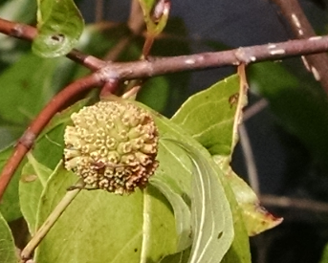
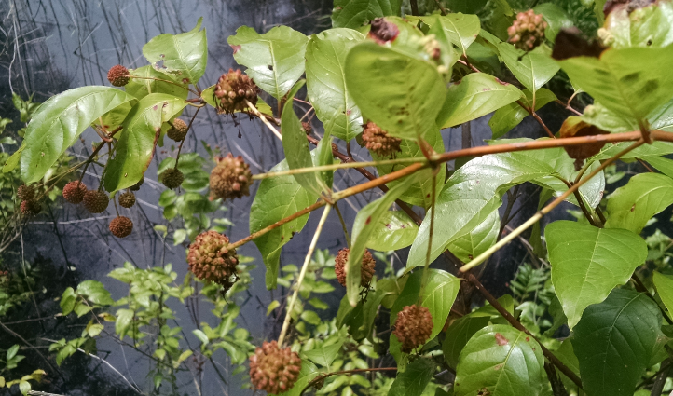
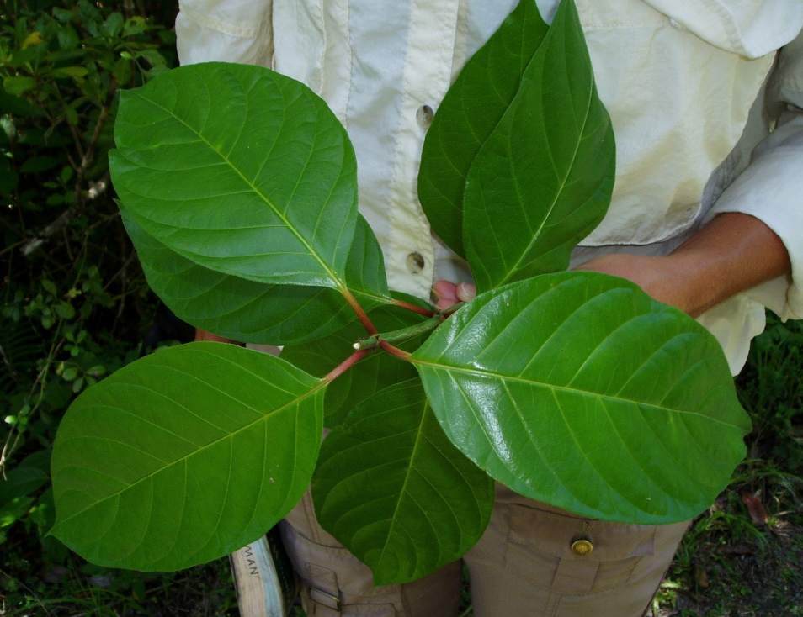
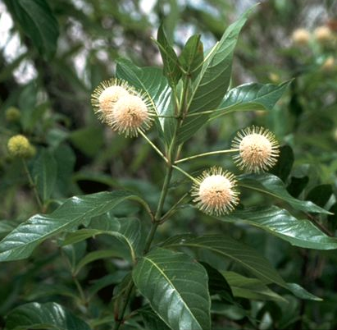
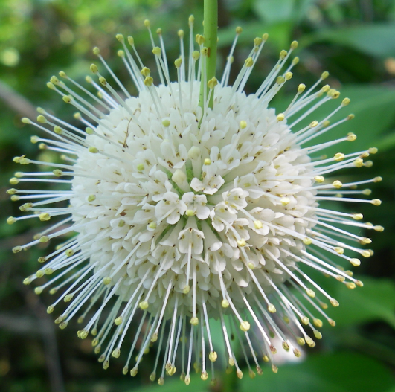
Cephalanthus occidentalis buttonbush OBL
Fruit is a ball of nutlets persisting into winter
Leaves can be “whorled” with 3 attached at same point on stem
Spherical head of many small white flowers

Slide 9
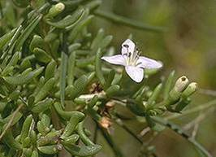
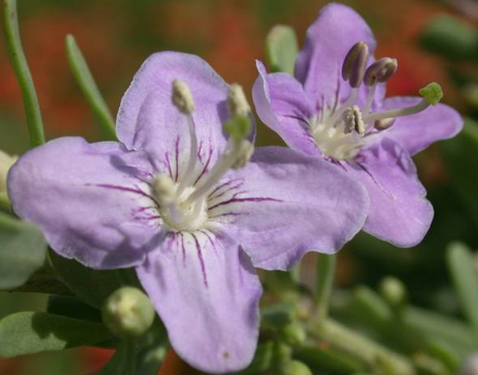
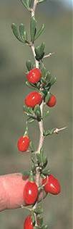
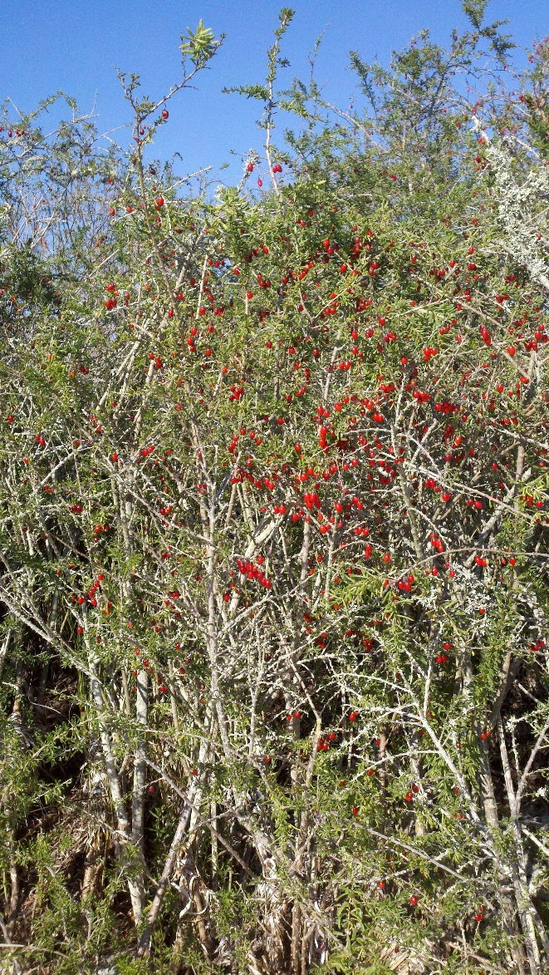
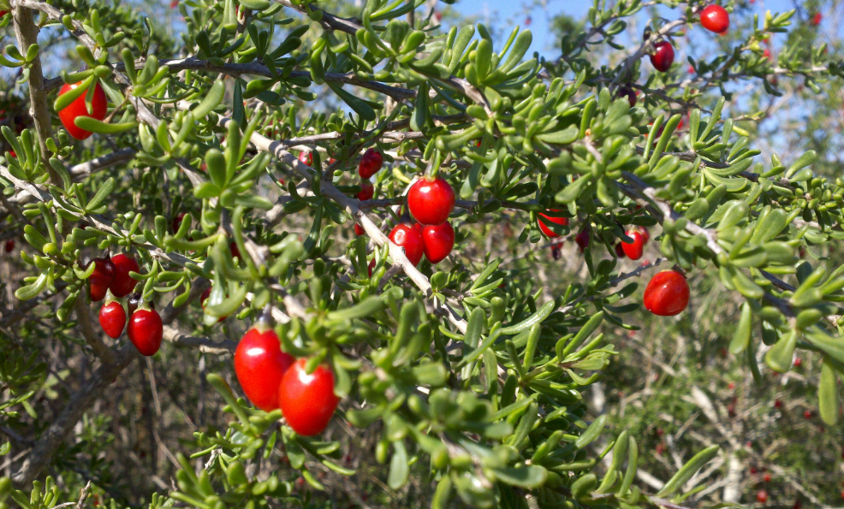
Sharp woody thorns on twigs
Can grow alone or in dense thickets
Small lavender flowers with 4 petals
Small, linear succulent leaves
Bright, oval, shiny red berries

Slide 10
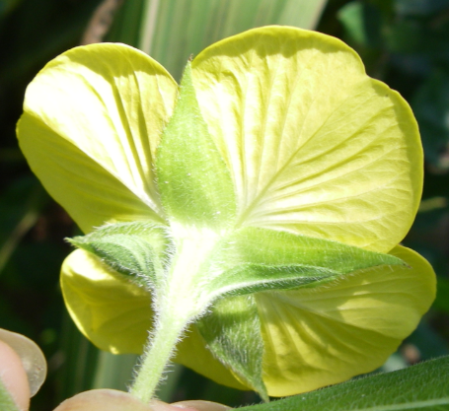
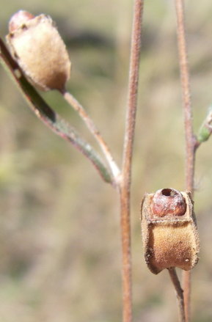
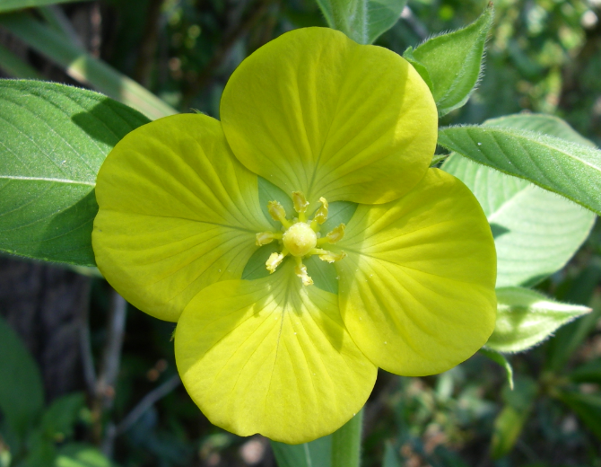
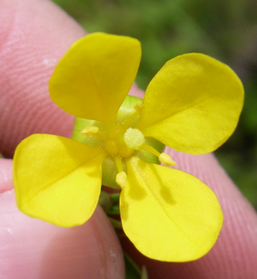
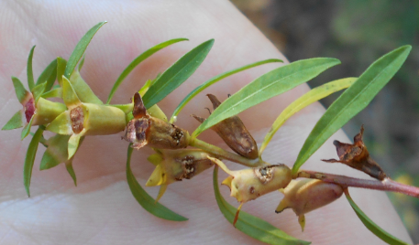
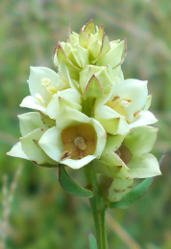
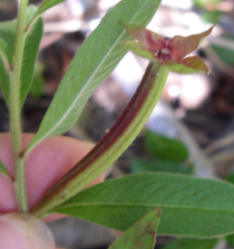
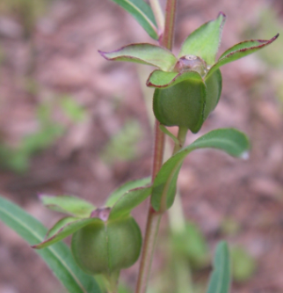
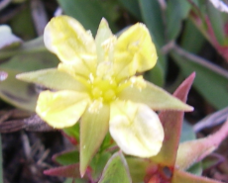
Ludwigia spp. seedbox or water-primrose FACW or OBL
Seeds in a 4-sided capsule that remains on the plant after it dries
Flowers always with 4 yellow petals
4 leaflike sepals beneath petals
Different species have flowers of different sizes
Capsules come in many sizes

Slide 11







Drosera spp.
Sundew FACW or OBL
Some species with rounded leaves, others linear
Some species with single flowers, others with a drooping stalk of many
Hairs tipped with sticky substance to trap insects

Slide 12







Rhexia spp. meadow-beauty FACW or OBL
Most species pink to purple, one yellow
Leaves have 3 prominent veins
Urn-shaped seed capsules that remain on the plant after drying
Showy flowers with 4 petals that fall off easily and stamens that hang at right angles

Slide 13





Typha spp. cattail OBL
Seeds with tufts of hair, making flower spike fluffy when they ripen
Long, strap-like leaves all like on one plane
Flowers densely clustered, appearing as a brown cylinder
Can form large colonies, especially in disturbed wetlands

Slide 14







Colocasia esculenta wild taro OBL
Pontederia cordata pickerelweed OBL
Thalia geniculata fire flag OBL
Sagittaria spp. arrowhead OBL
These plants tend to have large leaves with long stalks and grow in areas that inundate
Colocasia
Sagittaria
Thalia
Pontederia

Slide 15









Eriocaulon spp. Pipeworts OBL
Lachnocaulon spp. Bogbuttons OBL or FACW
Syngonanthus spp. Bantam-buttons FACW
Flower heads on long stalks extending from basal leaves
Eriocaulon has air pockets in the leaves
Leaves in basal rosettes
Compact, round heads of white to grey flowers

Slide 16





Cladium jamaicense sawgrass OBL
Can form dense, very extensive marshes
Straw-colored inflorescence stands up above blades
Tiny saw-teeth along edges and midrib, can cut

Slide 17







Juncus spp. rush FAC, FACW, or OBL
Cylindrical leaves which sheathe one another, often with sharp, pointy tips
Can grow in clumps or dense, expansive marshes
Flowers/seeds grow from middle of leaf in some species

Slide 18








Hydrocotyle spp. pennywort FACW
Leaf shape varies, but generally round with stalk attaching at center of leaf underside
Often growing in colonies, especially in disturbed areas
Clusters of tiny white flowers at end of stalk

Slide 19







Xyris spp.
Yellow-eyed grass FACW or OBL
Mucus-like substance between leaves which all attach at base of plant
Dried flower head looks like a tiny pinecone and persists through winter
3-petaled flowers blooming one at a time on round, scaly head
Flowers mostly yellow, sometimes white
Often prolific

Slide 20





Saururus cernuus
Lizard’s tail OBL
Distinctive heart-shaped leaves
Long spikes of white flowers that stick upward and then droop over
Often in dense, tangled colonies along the ground

Slide 21





Gordonia lasianthus loblolly bay OBL
Leaf edges are serrated or scalloped
Bark is deeply furrowed with wide, flat ridges
Fragrant white flowers with 5 petals
Leaves appear clustered at ends of branches
Fruit is a woody capsule that splits along 5 lines

Slide 22











Acer rubrum red maple OBL
Liquidambar styraciflua sweetgum FACW
Acer rubrum
Liquidambar styraciflua
Woody, spiked ball of capsules
Young twigs winged
Paired seeds with wings
Red flowers early in spring
Both species have star-shaped leaves
Leaves with 3-5 lobes attach opposite each other
Rough, ridged bark
Leaves with 5 lobes
Smooth gray bark

Slide 23









Andropogon spp. bluestem FACW or FAC
Erianthus spp. plumegrass OBL or FACW
Erianthus
More or less fluffy-looking seed heads
Andropogon
Bunch grasses, grow in clumps but can cover large areas
Seeds have tufts of white hair
Seed heads extending above leaf blades
3/23/2015
23

Slide 24




Fern understories
Pteridium aquilinum is an upland fern
Leaf blades may be divided up to 3 times
fern
Communities with fern-dominated groundcover are often wetlands, except when the species is Pteridium aquilinum

