Slide 1
RULEMAKING AND NOTICING IN FLORIDA
AND HOW DEP COMPLIES
Presented 2010 by:
Cynthia Christen
Office of General Counsel
(Now retired;
Some 2015 updates made)

Slide 2
Outline of Training
Chapter 120, F.S.
  Chapter 1B-30, F.A.C. (Dept. of State rules)
  Rule and Unadopted Rule
  FAC
  FAR
Let the Process Begin
  Why in Rulemaking?
  Initiation of Rulemaking
Notices
Rulemaking Clock Begins (with publication of NPR)

Slide 3
Outline cont’d.
Rulemaking
  Notice of Proposed Rule
  Incorporation of Reference Material
Writing and Formatting
JAPC
SBRAC
OTTED – new name ____
SERC
Hearing
Post Hearing

Slide 4
CHAPTER 12O, F.S.
Titled “Administrative Procedures Act”
  Rule
  Unadopted Rule
  FAC
  FAR
  JAPC
Section 120.54 is main section on rulemaking
Section 120.541- some reqts for SERC

Slide 5
Chapter 1B-30, F.A.C.
Dept. of State rules on rulemaking and noticing in FAR
Formatting
Law Implemented
Rulemaking Authority
Coding
File for Adoption
  Includes forms for certification packages

Slide 6
What is the FAR?
Florida Administrative Register
  Published by Secretary of State
  Now published Monday – Friday (unless is state holiday)
  Cost is $___ cents per FAR-published word
  Both on-line and paper versions are available
    http://far.dos.state.fl.us/index.html

Slide 7
LET THE PROCESS BEGIN
Why are we in rulemaking?
Initiation of Rulemaking
  TAC or TAG process
  Permission from Deputy Secretary
    OGC File # and assignment of attorney & economist
  Notice of Development of Rulemaking
  Notice of Rule Development Workshop(s)
  https://www.flrules.org/Agency/login.asp

Slide 8
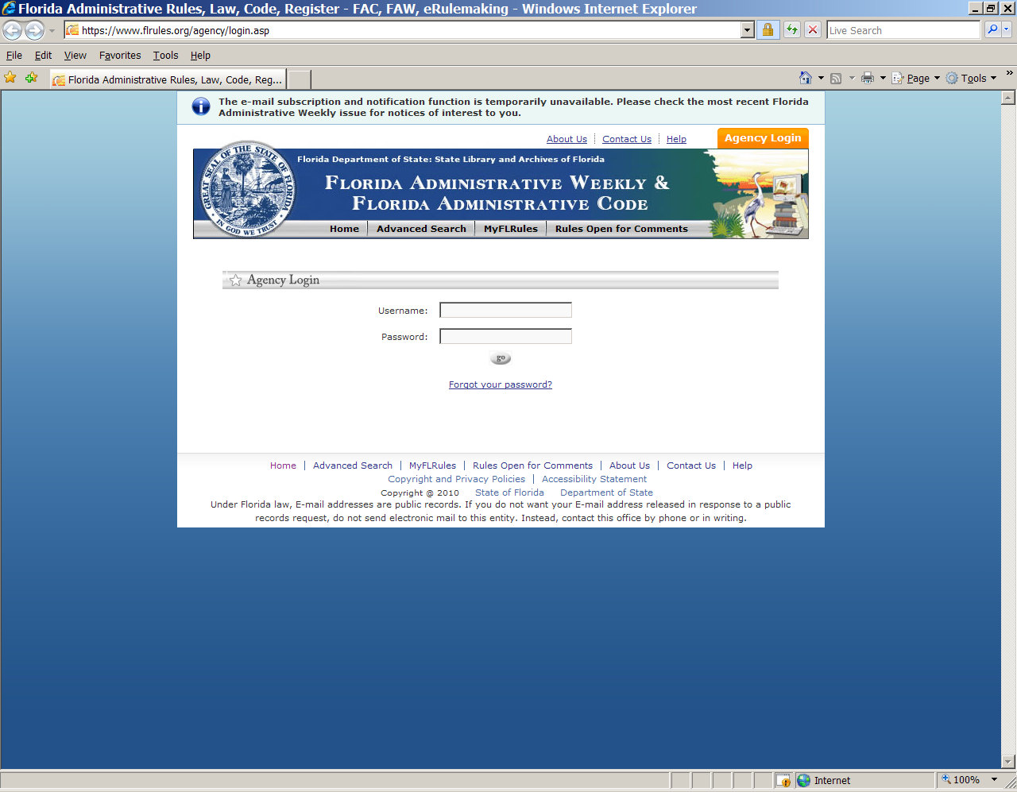

Slide 9
FAR Publication
DEP Internal Process
  Permission from Division Director/DDM
  Billing process
  FAR Cover sheet
  OGC program attorney’s role
  Program staff’s role
    Use of E-Rulemaking Site
  More on the FAR later

Slide 10
Permission from Division Director/DDM
Because of cost, this person usually wants to “sign off” any notice that will be published
Provide FAR Cover sheet and copy of actual notice
  This can be all electronic if DD is OK
  Change to eDocLog process !

Slide 11
Billing Process
A Billing Unit Profile is updated by the “billing unit” with a new purchase order each July 1
Be sure the new DO number is sent to Syndie Kinsey, in OGC, to update the E-rulemaking site

Slide 12
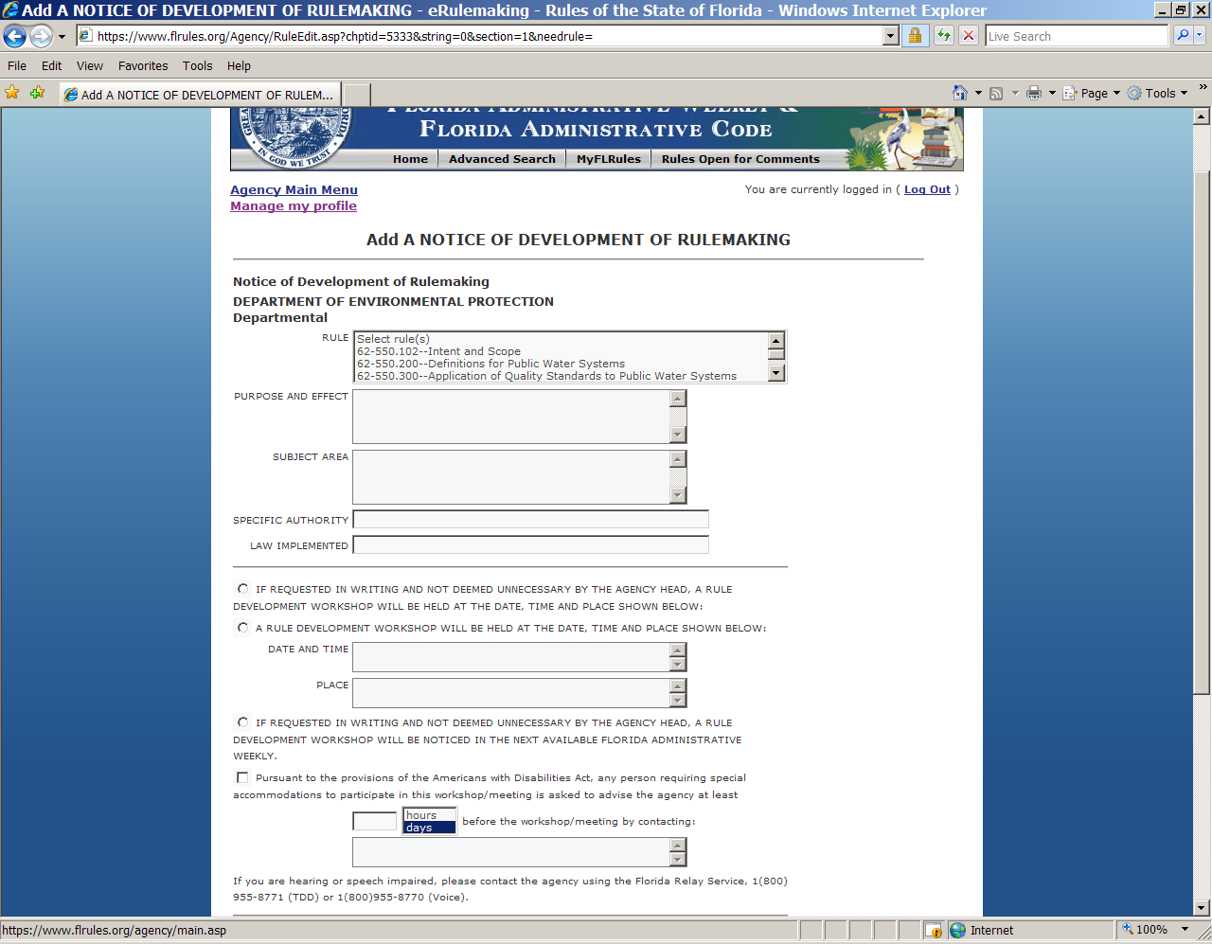

Slide 13
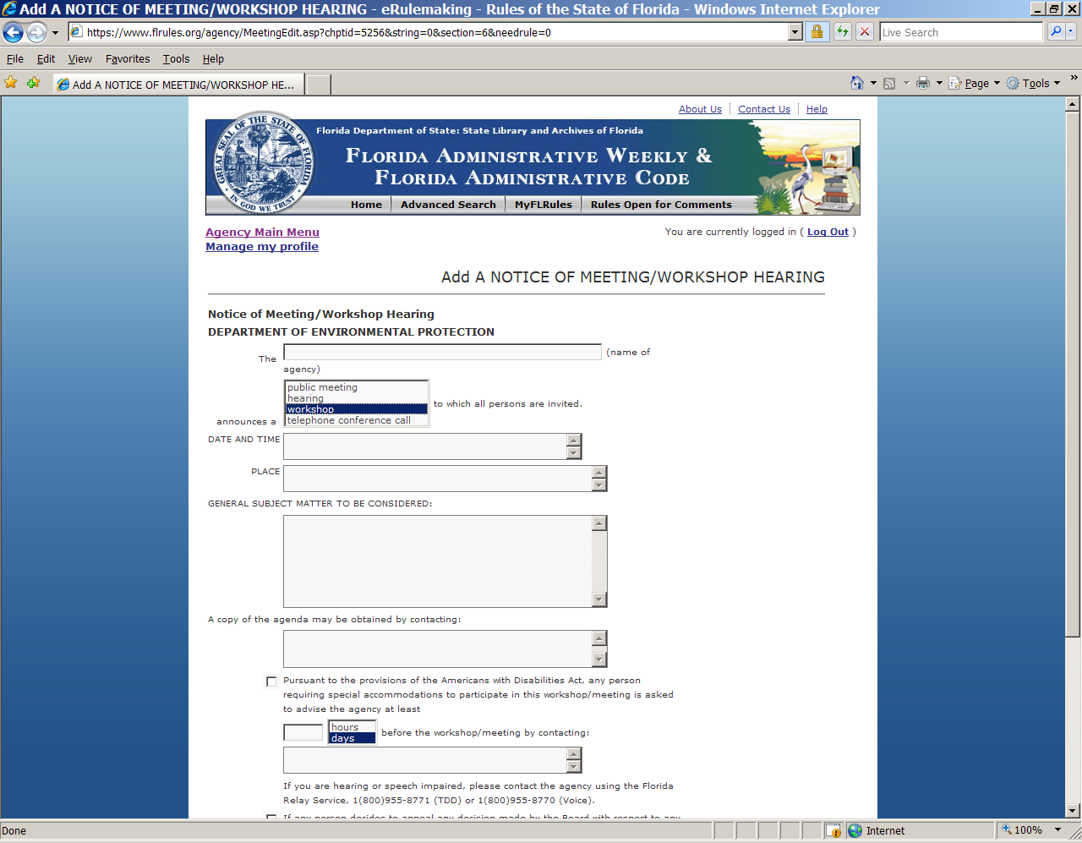

Slide 14
Program Staff Duties
First, obtain Deputy Secretary approval for rule development (check internal Div. procedure)
Obtain approval by DD/DDM
Check that attorney availability for review and time needed
Prepares notices on e-rulemaking site under notices in preparation
Tells program attorney it is there to review

Slide 15
Program Staff Duties, cont’d.
Be sure Attorney has OK’d notice so can be sent timely
All FAR notices of meetings, workshops, and hearings must also be on DEP Website at least 7 days before
  Must be compliant with DEP web reqts
On publication date, check FAR
If rulemaking, know due dates of notices/JAPC package/Certification package
If rulemaking, coordinate with Nick Stratis, economist MANY times during process

Slide 16
OGC Program Attorney’s Role
May review e-mail version first, must OK notice in preparation on e-rulemaking site
Review notice for timing, content, and format
Coordinate with staff on timing
Open dialogue with Economist, write rule summary for SERC with program staff
Assist in meeting, workshop and hearing

Slide 17
OGC Program Attorney’s Role, cont’d
Proof rule drafts with FAC, the bound version is the official one!
Get comments to program staff early in process
Near end of rulemaking, OGC attorney prepares and gets Secretary permission to file cert. package (new combo request NPR and file Cert Pkg)
Send cert. Pkg. to Syndie with OGC File # on it, and e-mail final rule as filed

Slide 18
Syndie Kinsey’s Role
Syndie puts all of the billing numbers on the e-rulemaking site, but each billing unit must send that to her yearly on or after 7/1
Syndie is Administrator of DEP’s role in site and can add staff for preparation and sending to e-rulemaking site
She also assigns an OGC File # for rulemaking when she receives a Request for Assignment of Attorney and Economist

Slide 19
FAR Process
Timing
  Publication is Friday (unless a state holiday, then next earlier non-holiday)
  Submission of notice (filing) deadline is noon Wednesday, which is 9 days before publication date-- unless not Friday publication, then less than 9 days before publication
  FAR staff no longer reviews notices because of short publication timeframe, and may reject for format

Slide 20
FAR Process Cont’d
FAR publication schedule is in Rulemaking Handbook –now daily and schedule is online
Meeting notice must be published at least 7 days before meeting
Billing process
  Must have pre-filed billing profile
    Discussed earlier

Slide 21
FAR Rule Format
Each line is single spaced from previous and next line
Page setup - 1 inch border on all sides, tabs set at 0.25 inches apart
Times New Roman, 10 pitch (except in rule, the entire history note is 9 point)

Slide 22
Rule Formatting
No bold
No track changes, ever!!!
No redlining, ever!!!
Page numbers on bottom, center 2
  BUT no page numbers on version submitted to the FAR

Slide 23
Rule Formatting, cont’d.
Indent 0.25 inch for every numbered or lettered line
Use of capitals at beginning of each new indented line (indent should ALWAYS start with a number or letter)
Underline new text before strike-through of existing text (add before delete, A before D)
No right justify, just natural spacing

Slide 24
Rule Formatting cont’d.
You cannot have a (1) without a (2); (a) w/o (b); 1. w/o 2.; a. w/o b., etc.
Use tabs set for .25 inch apart for indent, further tab for title after number
  62-520.410 Minimum Criteria.

Slide 25
Rule Formatting, cont’d.
Type one space after end of sentence within body of rule (not at end of a paragraph)
Italics may be used for text that, as final, would be underlined (Latin terms, book titles, etc.)
If entire rulemaking or just one rule (section) is new, underline either entire or the one, including the rulemaking authority, etc.

Slide 26
Formatting cont’d.
To change capital letter to lower case, or vice versa, you must type the entire word and underline it, then type the entire word and strike it:
Permits permits (not “Ppermits”)
  Example to change permit to permitting. You cannot just underline the “ting”, it must be: permitting permit
  Same for citations:
  62-520.300(1) 62-520.300(3), F.A.C.

Slide 27
Rule Formatting, cont’d.
The “FS” does not have periods, and there is no comma preceding it:
Rulemaking Authority 403.031 FS.
Law Implemented 403.087, 403.088, 403.131 FS.
History– New 4-10-96, Amended 8-22-00, 2-4-01,-------.
These 3 items are not started on separate lines and are not indented

Slide 28
Rule Numbering
Chapter 62-520, F.A.C.
Rule 62-520.300, F.A.C.
subsection 62-520.300(3), F.A.C.
paragraph 62-520.300(3)(a), F.A.C.
subparagraph 62-520.300(3)(a)1., F.A.C.
sub-subparagraph 62-520.300(3)(a)1.a.
sub-sub-subparagraph 62-520.300(3)(a)1.a.(I), F.A.C.
    This is a Roman numeral, and use them for further smaller units

Slide 29
Rule Numbering cont’d
sub-sub-sub-subparagraph 62-520.300(3)(a)1.a.(I)(A), F.A.C.
sub-sub-sub-sub-subparagraph 62-520.300(3)(a)1.a.(I)(A)I., F.A.C.
Florida Statutes: (always capital S for Section; no paragraphs, etc.)
  Section 403.087, F.S.
  Section 403.087(3), F.S.

Slide 30
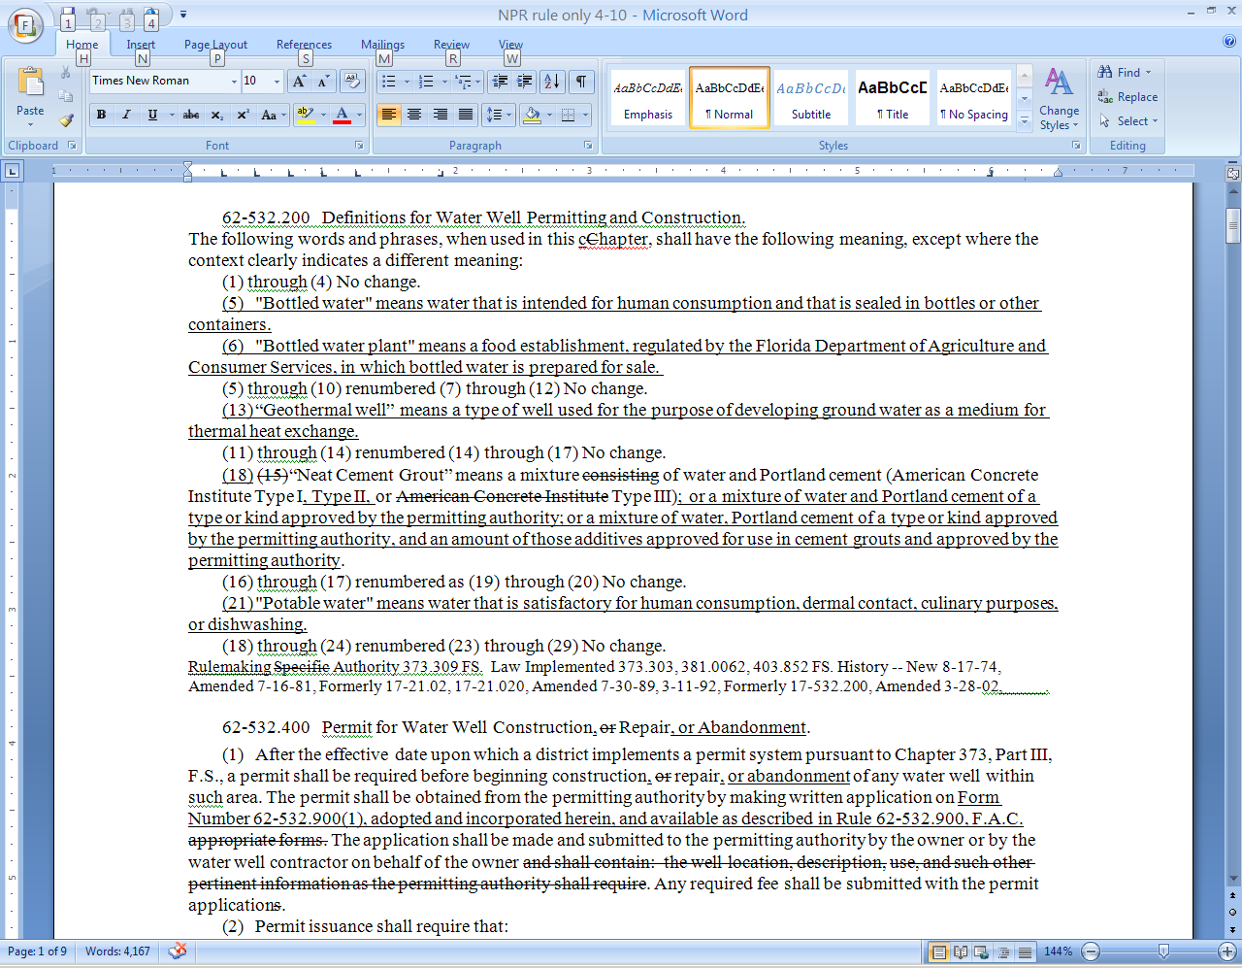

Slide 31
More on FAR Format
For specific examples see Rulemaking Handbook (more detail later) on DEP Intranet http://depnet.dep.state.fl.us/legal then look under rulemaking
Also, look at a recent previous issue of FAR on-line

Slide 32
RULEMAKING
Timing
  Publication in FAR
  If submit notice by 3:00 pm, it will be published the following day.
  However, it is best to submit a couple days before desired publication date so there’s time for any changes or to set up a mailout (which needs to include the link to the notice)

Slide 33
Rulemaking Timelines
  Section 120.54, F.S. (Administrative Procedure Act) has required rulemaking steps and timing
  Program attorneys REALLY need to know these

Slide 34
Rulemaking Steps
  APA Required Steps and DEP Steps
    Permission from Deputy Secretary to initiate rulemaking (DEP-required)
    Notice of Development of Rulemaking (may be with notice of workshop)
    Notice of Workshop (publish 14 days before)
    Permission from Deputy Secretary to Publish Notice of Dev and hold Workshop

Slide 35
Notice of Proposed Rule
    NPR (starts 90-day clock)
      Includes list of rules being added, amended, or repealed; Purpose and Effect; Summary of SERC; Hearing information
      Also Summary- which is a brief summary of what the rulemaking is doing AND:
        A list of other rules in other chapters that reference each of the rules you are amending with an explanation of the affect this rulemaking will have on those other rules
          This went into effect 7/1/09
          See 120.54(1)(i)2, F.S.

Slide 36
More on the NPR and After
    The JAPC package for the NPR must be hand-delivered, and e-mail SBRAC & OTTED
      More on these later
Hearing if ERC, may be none if not ERC
Notice of Change or Letter of No Change
    To JAPC and publish Notice of Change

Slide 37
Rulemaking Steps cont’d
APA required and DEP steps after changes since NPR
  Must wait 7 days after JAPC receives Letter of No Change or 21 days after Notice of Change is published to
    Get written permission from Secretary and File Certification Package with Secretary of State (APA deadlines must be met: 90 days after NPR; or 45 days after Notice of Change or Hearing; 21 days after receipt of all material authorized to be submitted at hearing, or filing of hearing transcript; or JAPC tolling of 90 days)
    Rule usually in effect 20 days after filing cert.

Slide 38
Rulemaking Steps cont’d.
    Syndie gets copy of Cert. Pkg. and e-mail of final rule. Posted on Rules Drawer \\tlh_ptt1\rules in Word format & tells OGC Web person to get rule from FAC on-line, PDF format, and place on DEP/OGC Website
    Staff person should check FAC on-line for accuracy and report mistakes to program attorney

Slide 39
Incorporation of Reference Material
After 12/31/10 all NPRs must have reference material accessible on E-rulemaking website unless under federal copyright
Also submit electronically for Cert. Package
DOS will have rules on this and training this Fall

Slide 40
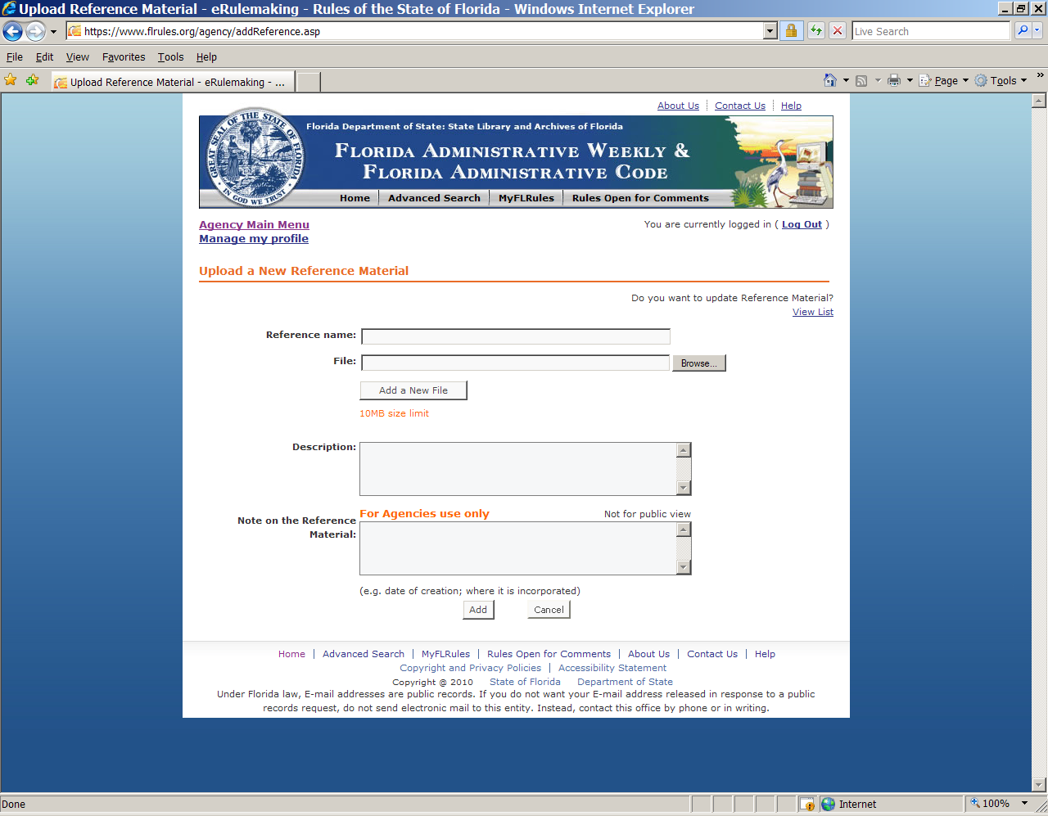

Slide 41
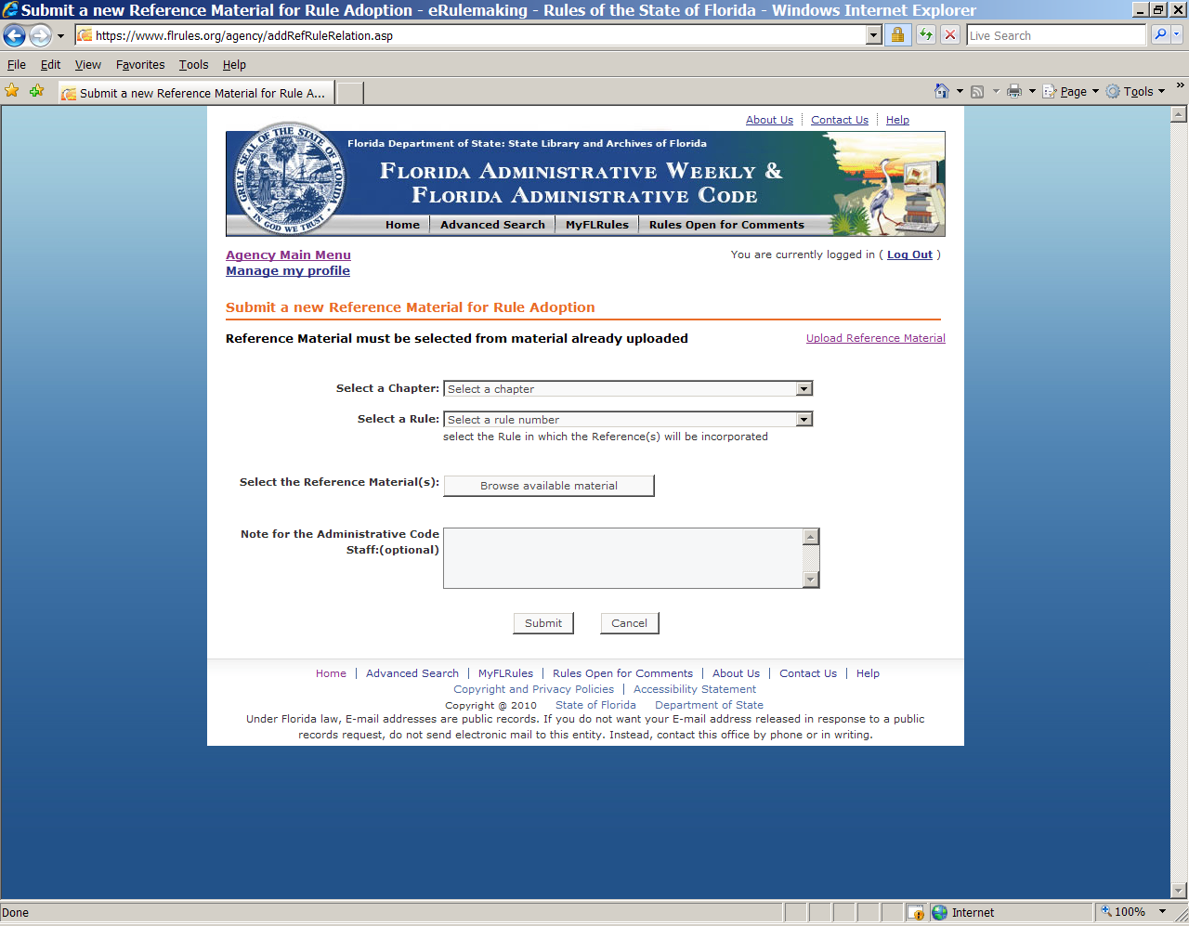

Slide 42
Other Rulemaking Notices
Emergency rule (only lasts 90 days)
Fast track
  403.8055, F.S., for adoption of EPA regs
    No SERC, no notice of rule development, no SBRAC
    Do send an abbreviated JAPC package with copy of fed regs. JAPC VERY strict on what can be fast tracked.
Withdrawal
Repeal
Notice of Correction

Slide 43
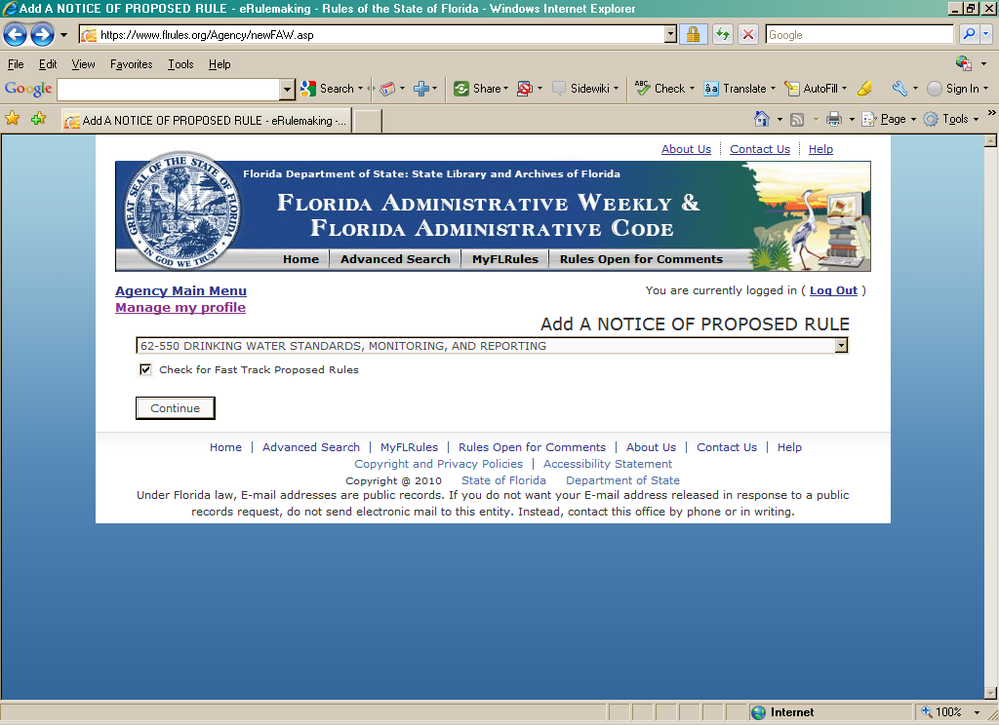

Slide 44
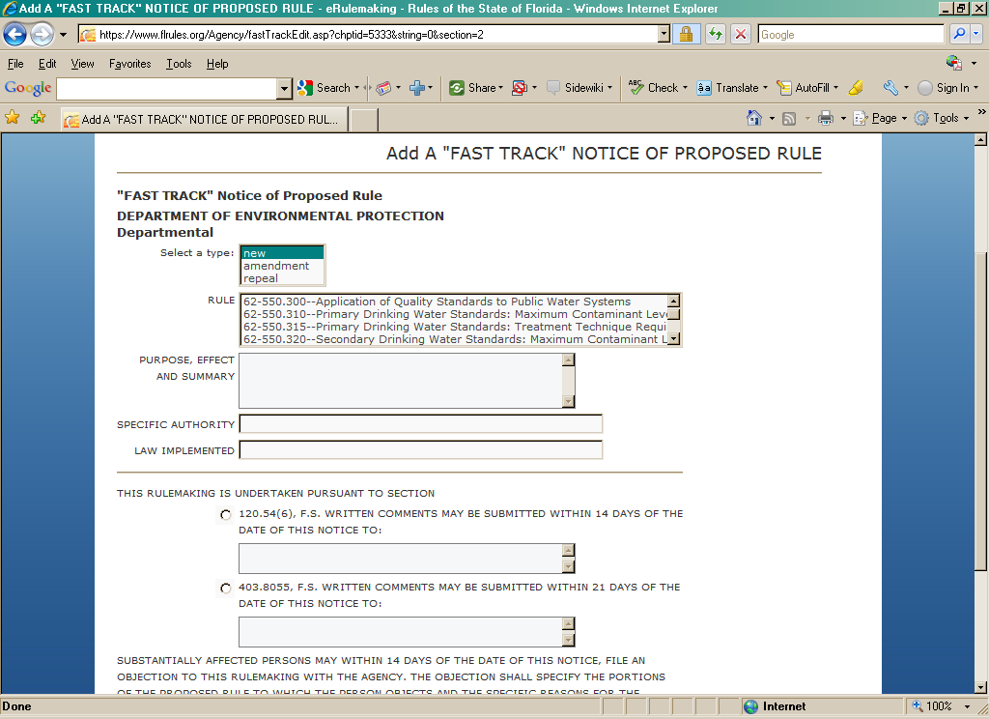

Slide 45
Rule Repeal
FAR notice shows rule number and title, NO TEXT, and the full history note with repealed.
  62-520.446 Monitoring of Aquifer.
Rulemaking Authority 403.061 FS. Law Implemented 403.088 FS. History– New 1-1-83, Amended 8-3-96, Repealed .
Cert pkg-- copy rule from FAC and draw diagonal line across text only.

Slide 46
Notice of Correction
This is used not to CHANGE rule text but to correct an FAR notice that was posted incorrectly from what DEP submitted, or for a date or location in a notice of meeting, workshop, or hearing.

Slide 47
Joint Administrative Procedures Committee JAPC
Staff attorney assigned to DEP
Reviews all proposed rules, FAR notices, existing rules, agency Websites, public comments
Must receive JAPC package timely– on or very close to date of FAR publication of NPR (hand deliver w/copy for DEP)
Comments on proposed rules
  OGC attorney MUST respond in writing to all letters

Slide 48
The JAPC Package
Rules and notice (full NPR)
Detailed Written Statement
Federal Comparison Statement
SERC, if prepared
Reference materials
Cover Letter listing above

Slide 49
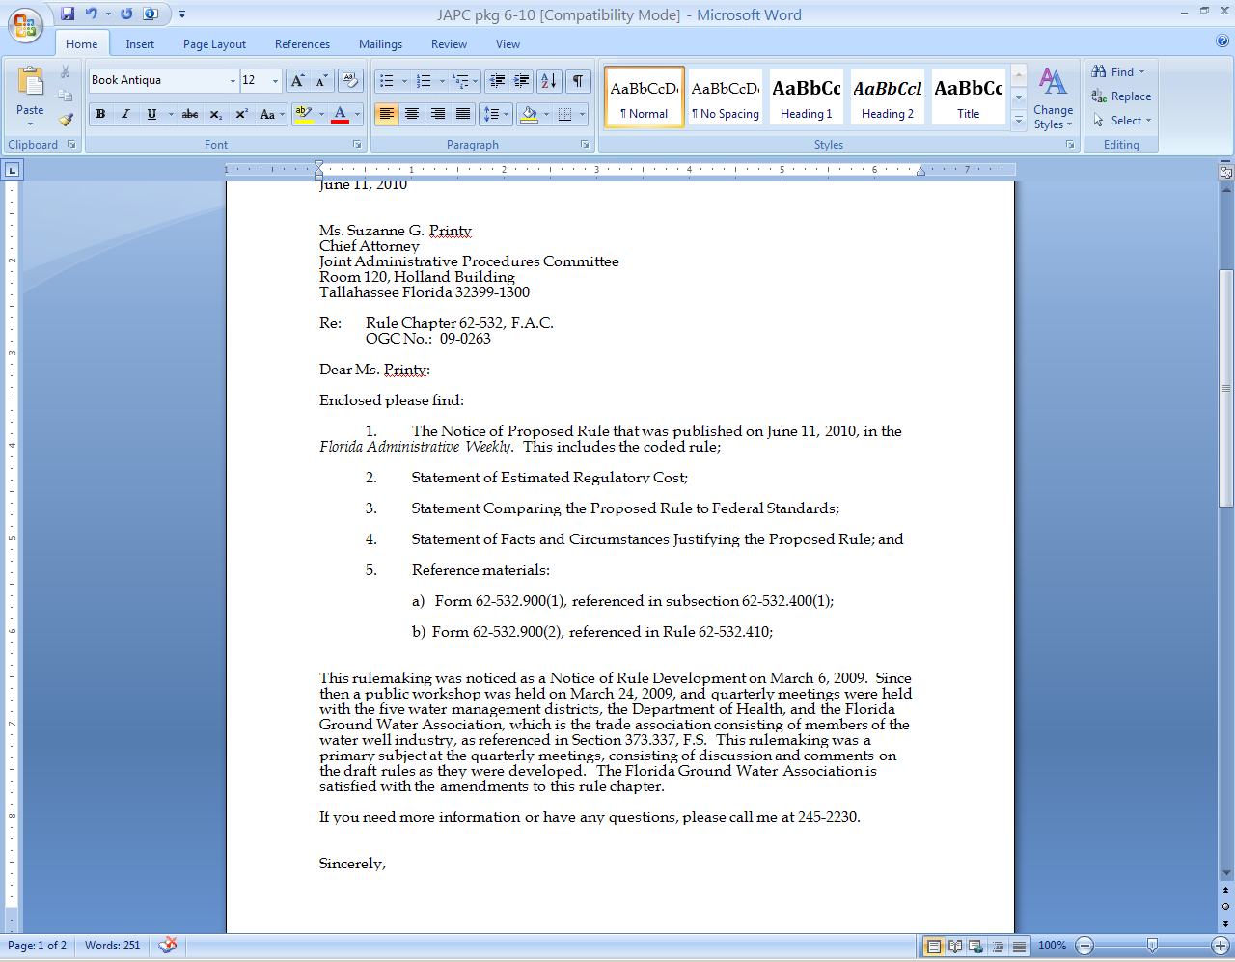

Slide 50
Small Business Regulatory Advisory Council - SBRAC
Established in 2008, Section 288.7001, F.S.
Reviews proposed rules for impacts to small business. DEP must e-mail NPR (and other docs) to them and SERC, if prepared.
Holds monthly or more frequent meetings by telephone. Agenda e-mailed about 5-7 days before meeting.
OGC attorney will usually be on phone when program rule is on agenda. Often program person, too.

Slide 51
Small Business Definition
Means an independently owned and operated business concern that employs 200 or fewer permanent full-time employees and that, together with its affiliates, has a net worth of not more than $5 million or any firm based in this state which has a Small Business Administration B(a) certification. As applicable sole proprietorships, the $5 million net worth requirement shall include both personal and business investments.
    Section 288.703(1), F.S.

Slide 52
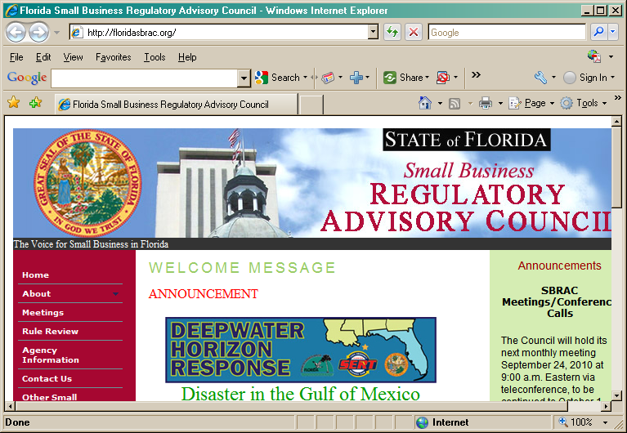

Slide 53
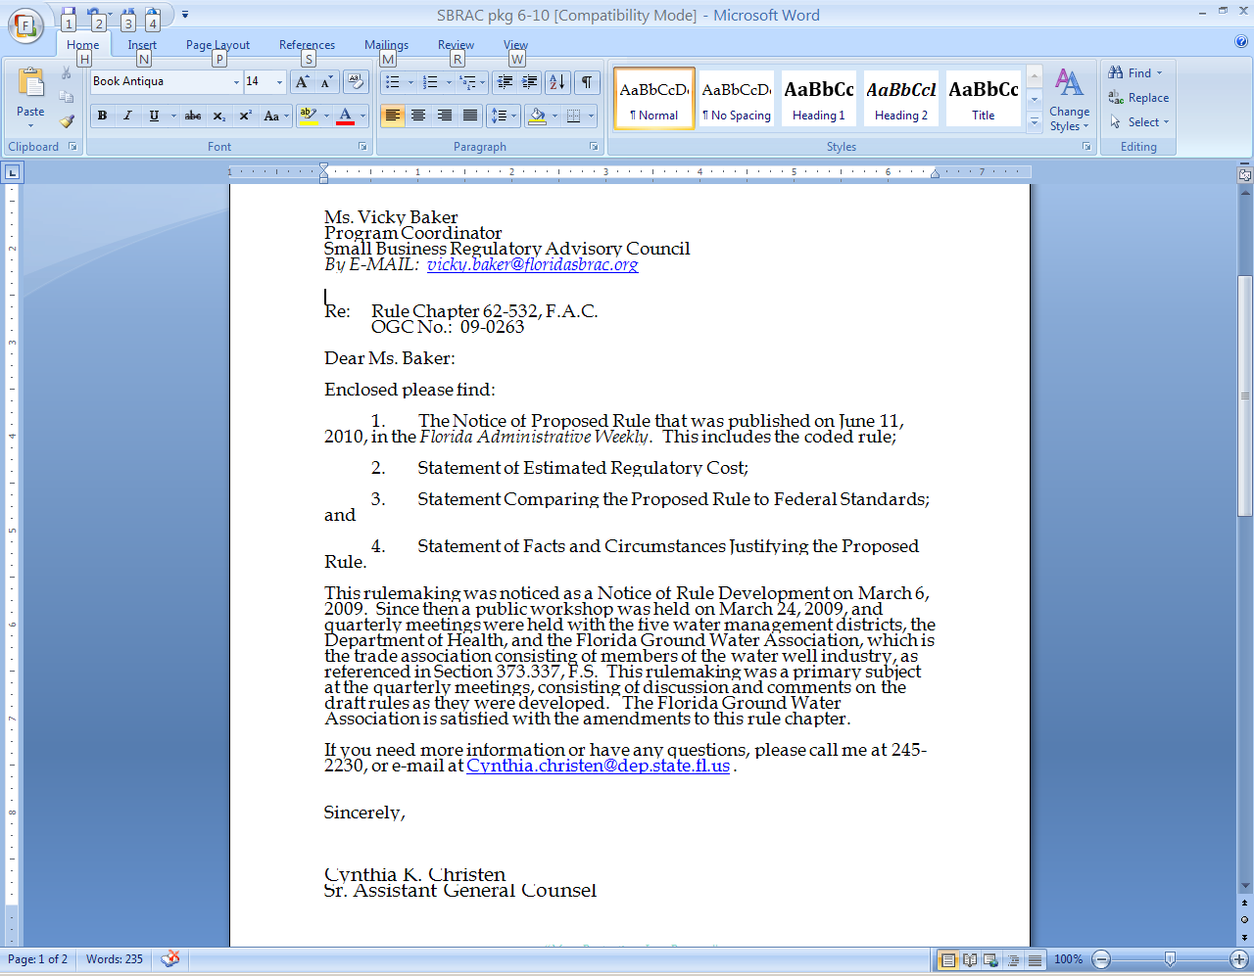

Slide 54
OTTED
Office of Tourism, Trade, and Economic Development in the Office of the Governor
Must send them proposed rule package. (e-mail is preferred)
It has ability to comment on rules and suggest less burdensome rules, but DEP has never had a comment.

Slide 55
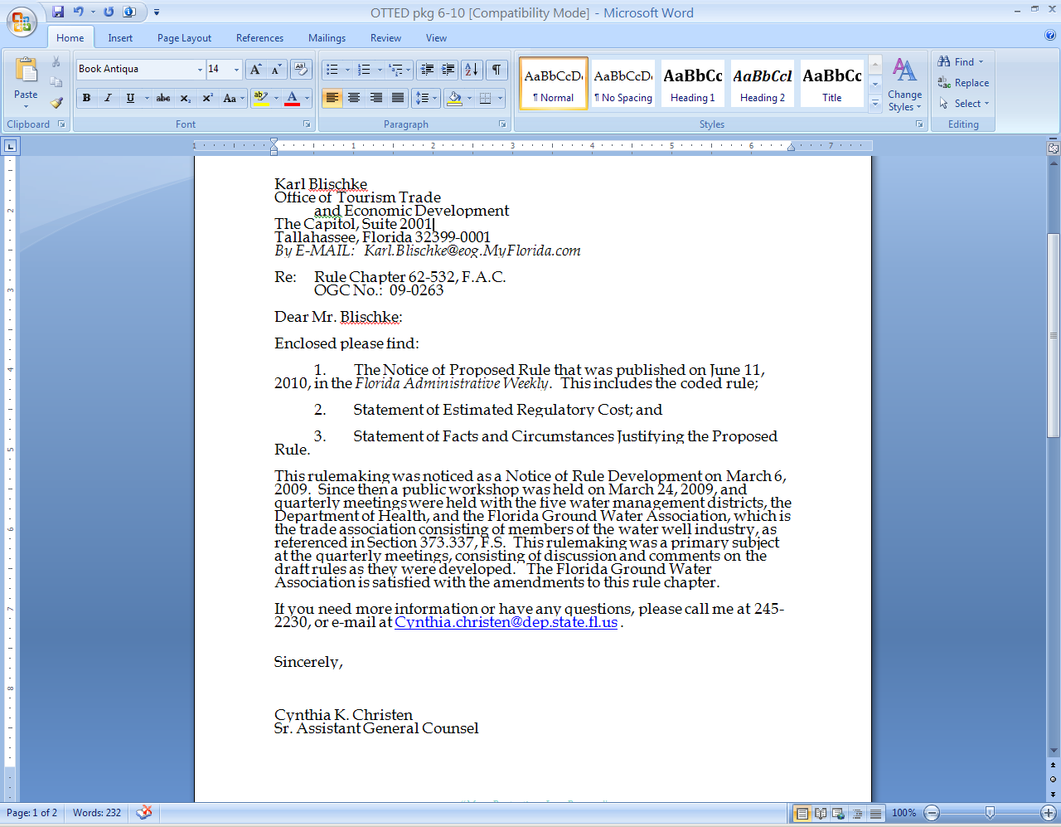

Slide 56
The Hearing
Will be held before ERC if standard-setting
    See 403.804, and 20.255(7), F.S.
Or if Governor and Cabinet action
May be held otherwise
  Presiding Officer may be bureau chief, staff NOT heavily involved in rulemaking, not the program attorney.

Slide 57
Notice of Change
Whenever substantive changes made to rule (from comments w/in 21 days of NPR, at hearing, JAPC, or SBRAC comments)
  MUST be published in FAR and sent to JAPC, and SBRAC requests
  Must wait at least 21 days to file cert package because 20 days for rule challenge
Technical change– only letter to JAPC
NO Change – only letter of no change to JAPC

Slide 58
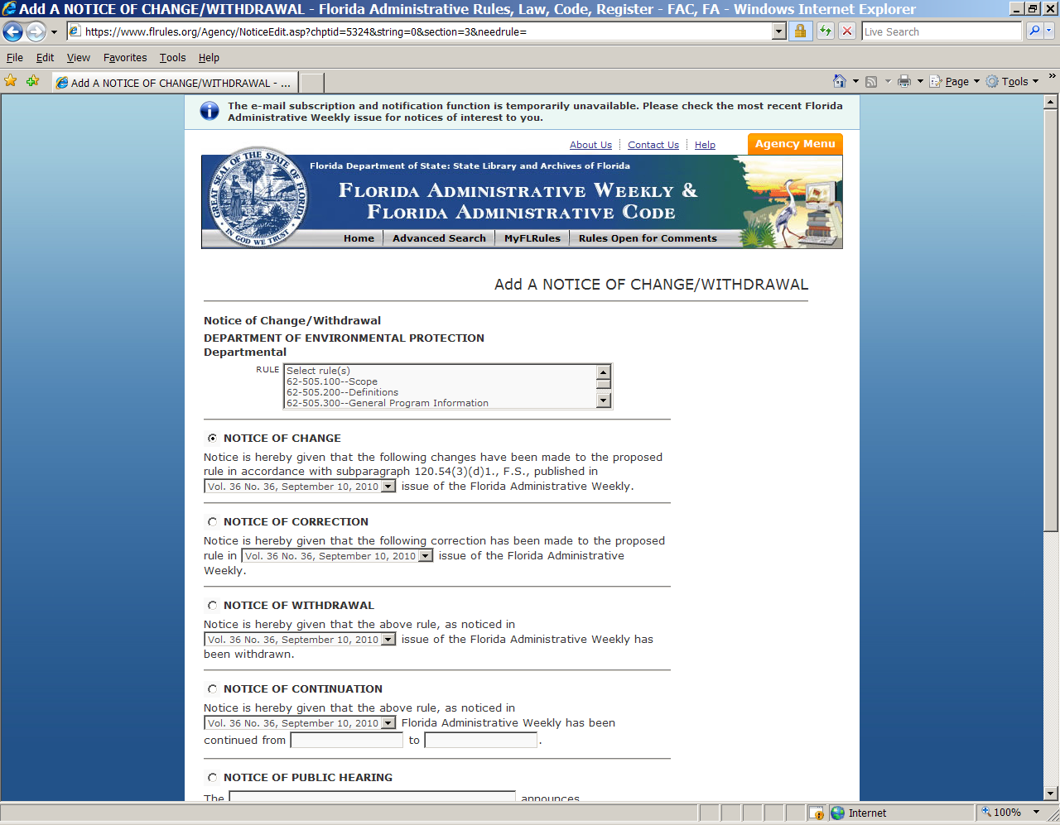

Slide 59
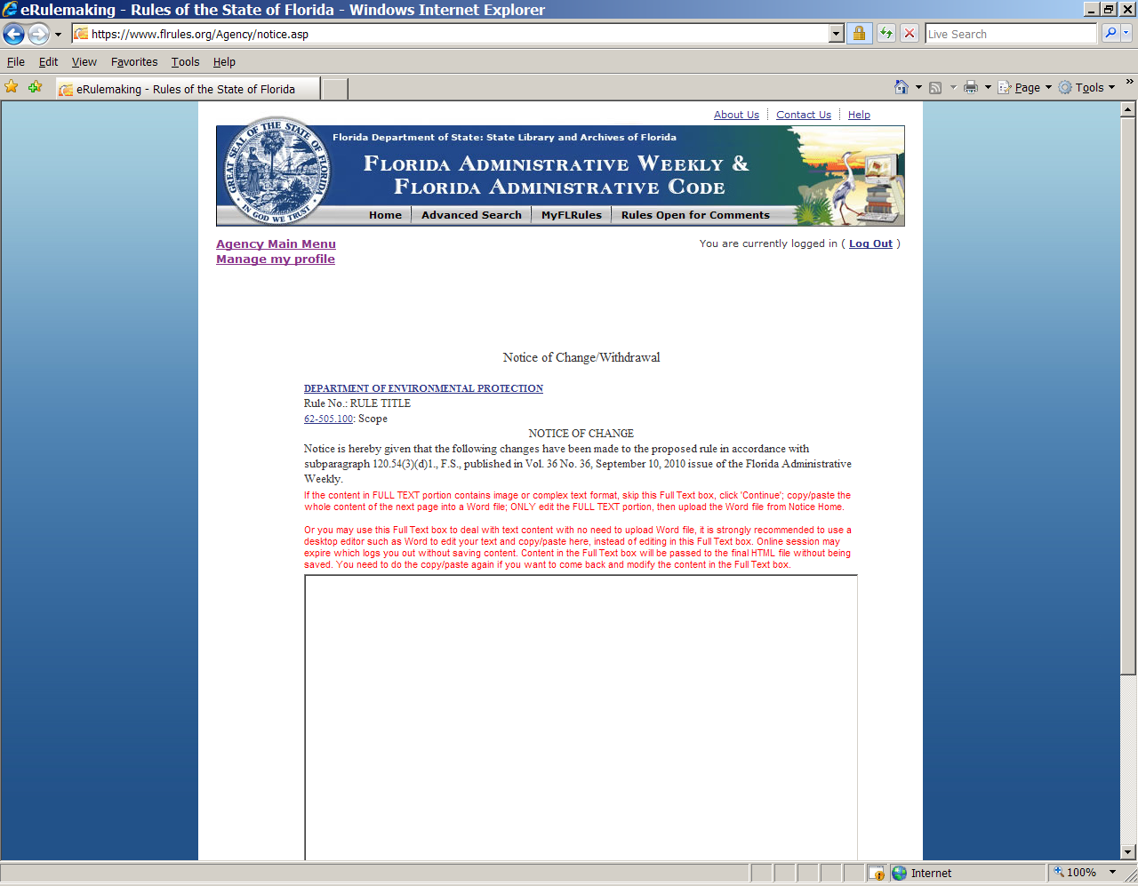

Slide 60
Post Hearing
After notice of change or no change, certification package is prepared
  Form
  Rule in DOUBLE space format, same font and pitch as NPR, page numbers
  Detailed Statement of Facts and Circumstances
  Summary of Rules
  Summary of Hearing
  Cover Letter
  Disk or CD with rules

Slide 61
After Cert. Package ATTORNEY tasks
Copy to Syndie Kinsey with OGC number on top
E-mail Syndie the rule in underline, strike-through
Be sure the rulemaking file gets scanned into OCULUS

Slide 62
SERC
This will be covered by Nick Stratis, Economist, DEP.
  There is also extensive information in the Rulemaking Handbook.

Slide 63
Questions????
This is an update to Cynthia’s ppt (3/30/15) alice continue page 35!

