Slide 1
Submerged Lands & Environmental Resources
Rulemaking
Overview
November 22, 2016

Slide 2
Overview
Rulemaking
Rules are needed to implement the Statutes
Needed so that the Public knows what is required to obtain authorization to construct a project
When we require the public to do something or submit something, it must be included in rule

Slide 3
Overview
Noticing
Notice of Rule Development
Notice of Workshop
Notice of Proposed Rule (and Hearing date)
Notice of Correction (to a notice or information)
Notice of Change
Notice of Withdrawal
Notice of Proposed Rule (to Repeal)

Slide 4
Rulemaking Guides
Chapter 120, F.S., Administrative Procedures Act
required rulemaking steps, notices, workshops, hearings, retention (see 120.54)
OGC Rulemaking Handbook
process, forms
Timeline/Checklist
developed by OGC; expanded by SLERC to include DWRM and SSL requirements, explanations of review steps and challenge periods, mailouts, web posting, etc.
Current FAR online (notice templates)

Slide 5
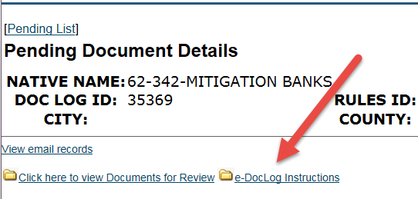
eDocLog
Internal “electronic” routing and review
http://webapps.dep.state.fl.us/DepDocLog/pending-list
Load documents for review
Includes link to “Instructions” (how to load new rule, shows who has to review different requests)

Slide 6
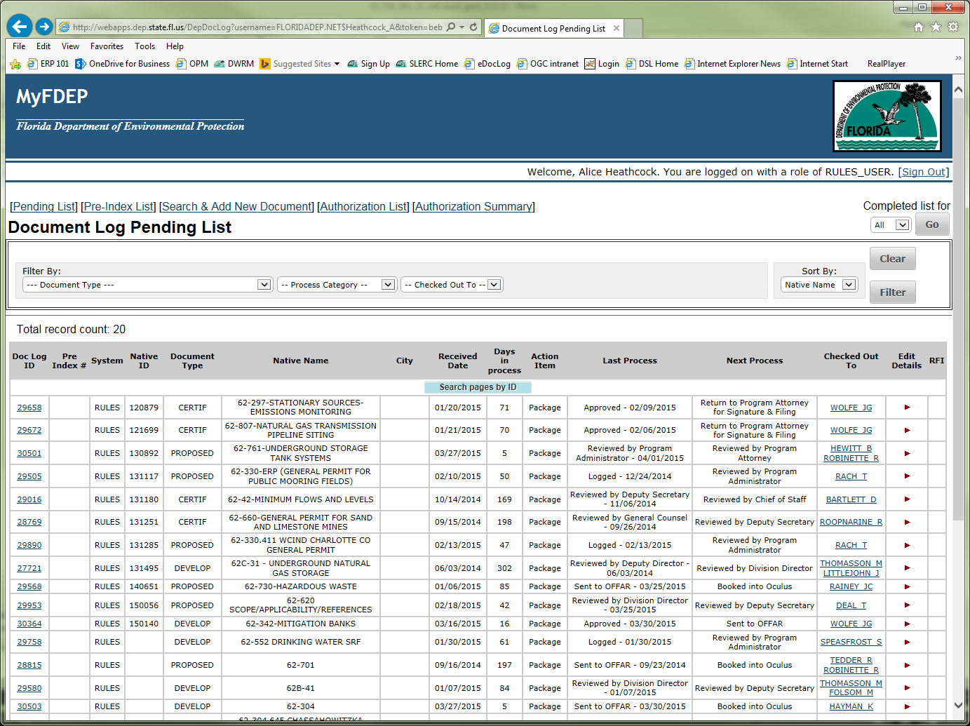
eDocLog - Pending List

Slide 7
FAR
Florida Administrative Register
    https://www.flrules.org/
    Formerly a weekly publication; now Monday through Friday (except holidays) (submit by 3pm, published next day)
    Published online, but paper version is “official”
    Fill-in the blank template online (copy/paste from Word)
    Cannot alter the template (but can add more information)
    Does not fit all circumstances

Slide 8
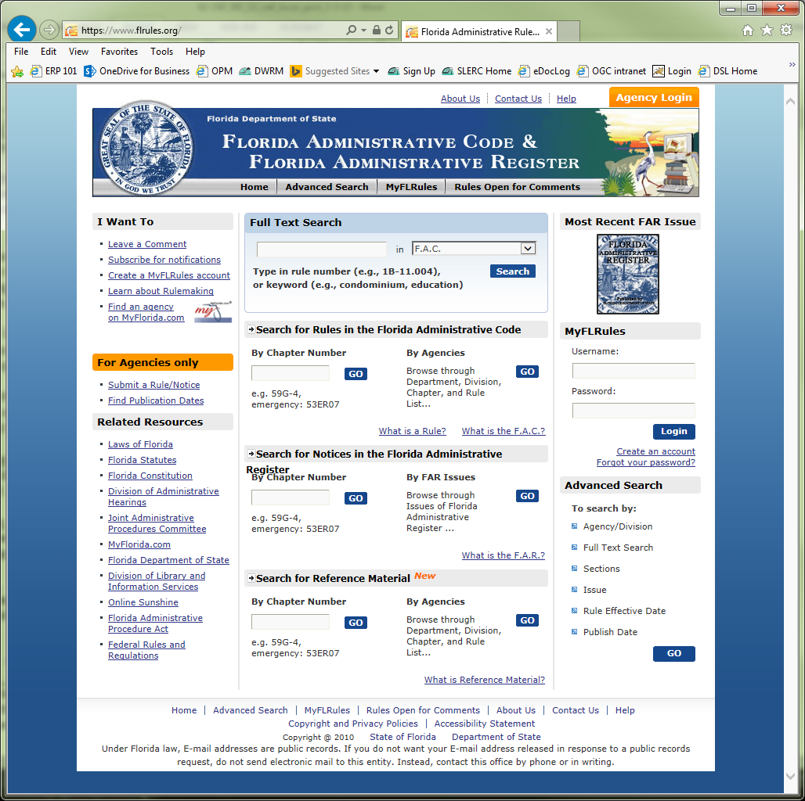
FAC and FAR

Slide 9
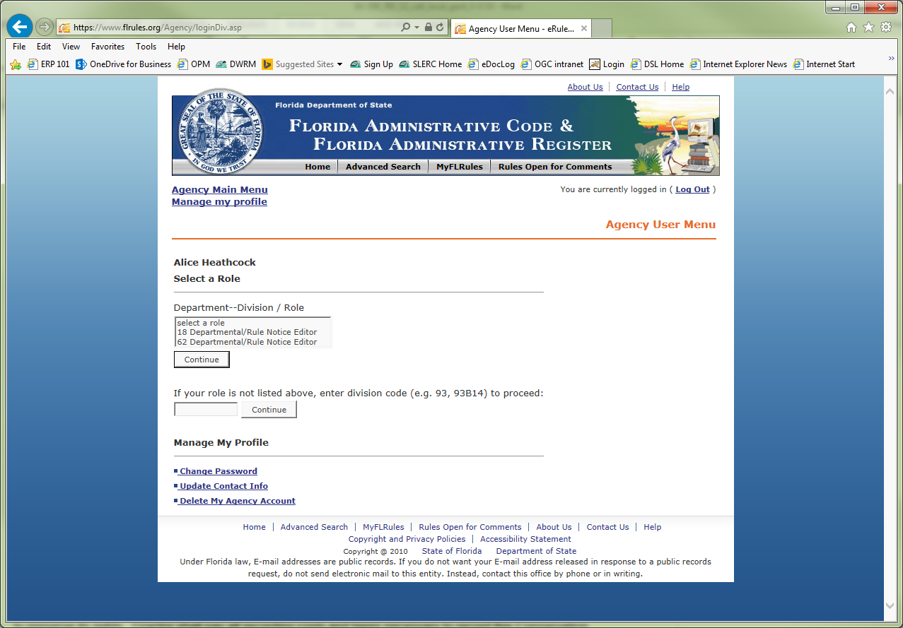
Agency Login

Slide 10
FAR online
Add notices (NRD, Meeting/Workshop/Hearing, NPR, NOC, Miscellaneous)
Add new Rule numbers (before loading a Notice of Proposed Rule so that the new rules can be selected in the notice template)
Submit Technical Change
Reference Material – submit, modify
(User Guide for Electronic Reference Material)
Submit about 3 days before Filing Cert. Pkg.

Slide 11
FAR online hints
If upload a Word version of a notice, it replaces whatever you entered in the standard template.
If a rule amendment is very long or has tables and maps, you might send a Word version as a copy to Admin Staff – explaining you just submitted a notice, but here’s a Word doc in case it’s needed.

Slide 12
Coded Rule
Must show changes to entire word:
permitting permit (not permitting)
62-520.300(1) 62-520.300(3), F.A.C.
Except “Ppermits” is allowed
(1)(2) no space for numbering changes for lists, but do add space for number changes within text
(3) renumbered (4) No change.
Notes:
Although I thought we also had to repeat words to change capitalization. But this is correct per OGC Handbook and Chapter 120 or Rule 1S-1 ?

Slide 13
Coded Rule
1 space between words and sentences; no space at the end of a paragraph
Indent numbered or lettered text 1 tab (.25)
For numbered items, can use 1 space or a tab (.25) after the number [suggest using 1 space because sometimes tabs look like there’s no space at all, and the FAC uses 1 space]

Slide 14
Rule Numbering
Chapter 62-330, F.A.C.
Rule 62-330.300, F.A.C.
subsection 62-330.300(3), F.A.C.
paragraph 62-330.300(3)(a), F.A.C.
subparagraph 62-330.300(3)(a)1., F.A.C.
sub-subparagraph 62-330.300(3)(a)1.a., F.A.C.
sub-sub-subparagraph 62-330.300(3)(a)1.a.(I), F.A.C.
sub-sub-sub-subparagraph 62-330.300(3)(a)1.a.(I)(A), F.A.C.
sub-sub-sub-sub-subparagraph 62-330.300(3)(a)1.a.(I)(A)I.,
Chapter 403, Florida Statutes:
Section 403.087, F.S.
Section 403.087(3), F.S. (always capital Section; no paragraphs)

Slide 15
Text Tips
Preparing the NPR
Compare word-for-word against current rule text
Each comma, space, period and capitalization matter
Use “show/hide” function to see spaces, remove the little circles marking spaces
Also use “show/hide” to see colors, then convert any colors in the text to all black
After a notice is published, compare word-for-word the printed version against what we submitted. Usually, some changes are made by FAC staff or the publisher. We need to make those changes to our copy so that we include the correct published final rule in the Certification Package.
Rule Attorney will compare printed FAR (“Red” book), which is the ‘official’ version (the published online version is not the official version)

Slide 16
F.A.R. page

Slide 17
Underlining

Slide 18
DOS revises submitted text
62-341.439 General Permit for the Construction or Maintenance of Culverted Driveways or Roadway Crossings, and Bridges of Artificial Waterways.
(1) A general permit is hereby granted to any person for the purpose of constructing or maintaining a culverted driveway or roadway crossing, or bridge of an artificial waterway, provided:
(a) this general permit shall apply only to wholly artificial, non‑navigable drainage conveyances;
(b) a culvert or culverts shall be placed under the roadway or driveway;
(c) the size and number of the culvert(s) shall be . . .
(d) the elevation of the culvert invert shall be at the existing bottom grade of the artificial waterway;
**Admin staff or the Publisher capitalized the items in the above list (we found it by comparing the published NPR against what we submitted)

Slide 19
Coding differences
We submitted this:
the boundaries of delineated wetlands wetland or other and surface waters water boundaries during that period.
This was published:
the boundaries of delineated wetlands or other wetland and surface waters water boundaries during that period.

Slide 20
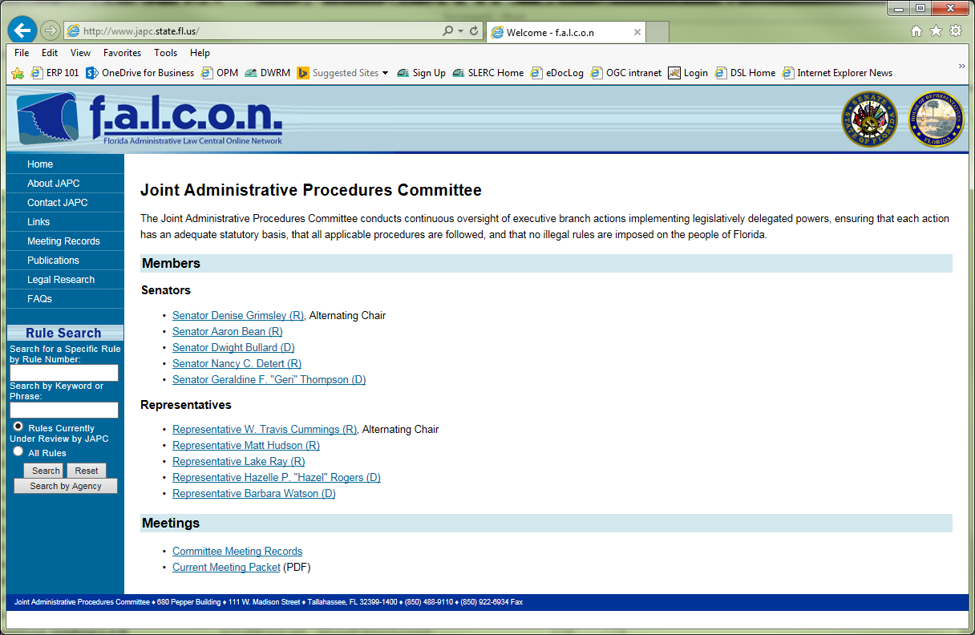
JAPC
falcon http://www.japc.state.fl.us/
(Florida Administrative Law Central Online Network)

Slide 21
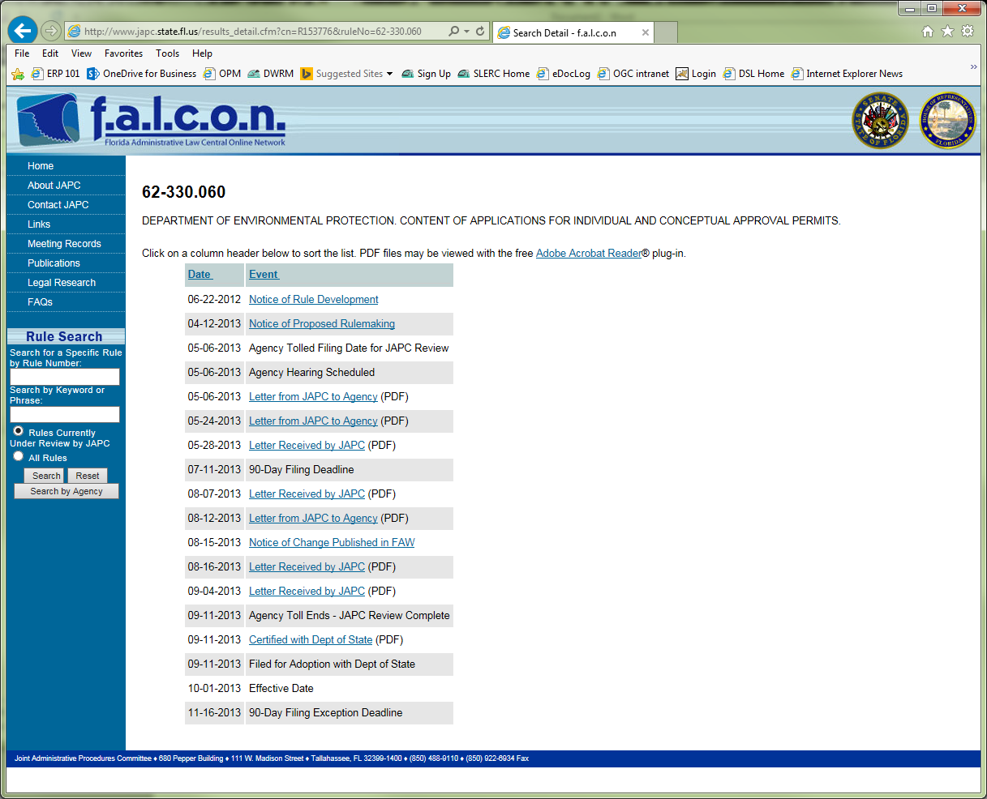
f.a.l.c.o.n. – tracks rule steps

Slide 22
Correction or Rulemaking?
JAPC determines whether a change qualifies as a “Technical Correction” or if it requires rulemaking
OGC and JAPC may discuss; may agree; may disagree
DOS Administrative Staff do not make this determination; they rely on the Agency and JAPC already deciding before a “Technical Correction Letter” is filed with DOS

Slide 23
Publishing Notices
  Publication in FAR
  Load it to DOS site, then request program attorney to review (again)
  If submit notice by 3:00 pm, it will be published the following day
  However, it is best to submit a couple days before publication date so there’s time for any changes; set up the mailout (which includes a link to the FAR notice); and post on Public Notices Calendar (includes FAR notice link)

Slide 24

Noticing the Public
Once you have submitted a notice to the FAR site and have a publication date, we have to notify the public 2 ways:
1--GovDelivery email
notification (sent to
those who sign up on
the web)

Slide 25
Noticing the Public (contin)
and
2--Public Notices Calendar
(submit the meeting / workshop / hearing information so that it can be posted 7 days prior to the event)
Agencies are required to publish in the FAR and on the agency’s website (per 120.525, F.S.)

Slide 26
Rulemaking Steps
  APA Required Steps and DEP Steps
    Permission from Deputy Secretary to initiate rulemaking (DEP-required)
    Notice of Development of Rulemaking (may include notice of workshop)
    Notice of Workshop (publish 14 days before)
    Permission from Deputy Secretary to publish Notice of Rule Development and hold Workshop (and is submitted to OFARR)

Slide 27
Rulemaking Steps (contin)
Notice of Proposed Rule (may include notice of hearing)
Permission from Secretary (and is submitted to OFARR)
Notice of Change (if significant or changes meaning of rule, must route to Secretary again)

Slide 28
SERC
This previously was covered by Nick Stratis, Economist (DEP no longer has an economist).
  You/we now make the decision of whether a SERC is required or not by filling out the “Is a SERC Required Checklist”
  There is also extensive information in the Rulemaking Handbook

Slide 29
Notice of Proposed Rule
    NPR (starts 90-day clock)
      Includes list of rules being added, amended, or repealed; Purpose and Effect; Summary of SERC; Hearing information
      Also Summary—which is a brief summary of what the rulemaking is doing AND:
        A list of other rules in other chapters that reference each of the rules you are amending with an explanation of the effect this rulemaking will have on those other rules
          This went into effect 7/1/09
          See 120.54(1)(i)2, F.S.
With each publication NRD, NPR, NOC – send package or letter to JAPC (JAPC Package)

Slide 30
Notice of Proposed Rule
NAME OF AGENCY
Departmental
RULE NO.: RULE TITLE:
PURPOSE AND EFFECT:
SUMMARY:
OTHER RULES INCORPORATING THIS RULE:
EFFECT ON THOSE OTHER RULES: (both are required, though not in the FAR template) (paste all this text into the summary block)
SUMMARY OF STATEMENT OF ESTIMATED REGULATORY COST AND LEGISLATIVE RATIFICATION: The . . .

Slide 31
“Other Rules” and “Effect”
OTHER RULES INCORPORATING THIS RULE: list of rules that refer to the rules being amended
EFFECT ON THOSE OTHER RULES: whether those rules will need to be revised or not
This helps us remember to update citations to the rules we’ve just amended. Otherwise, if a reference is to a citation that no longer exists and it doesn’t make sense -- the public, staff and OGC have to spend time figuring out what is meant. We have to track back through rule changes to find the previous text and how the numbering changed.
This is also why it is recommended to add some identifying text as to what is in the citation that you are using. Such as “to the general conditions in Rule xx-xxx.xxx” that way, if the citation numbering changes we can more easily see the general conditions are now in (b), so it must be that (c) changed to (b). Then we can track rule and verify this.

Slide 32
Notice of Workshop
Not in FAR template online,
But must choose “This notice has nothing to do with any rule or rulemaking process”
And remember to include the chapter number in the description of the meeting

Slide 33
Rulemaking Steps (contin.)
APA required steps and DEP steps when changes are made after the NPR
  Must wait 7 days after JAPC receives Letter of No Change or 21 days after Notice of Change is published to
    Get written permission from Secretary and File Certification Package with Secretary of State (APA deadlines must be met: 90 days after NPR; or 45 days after Notice of Change or Hearing; 21 days after receipt of all material authorized to be submitted at hearing, or filing of hearing transcript; or JAPC tolling of 90 days)
    Rule usually in effect 20 days after filing certification

Slide 34
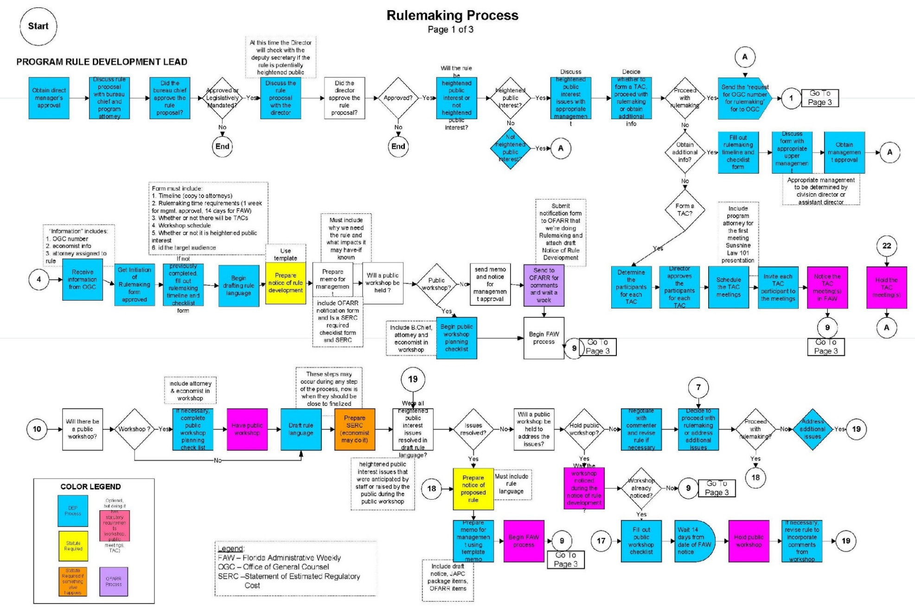
Details are in OGC Handbook

Slide 35
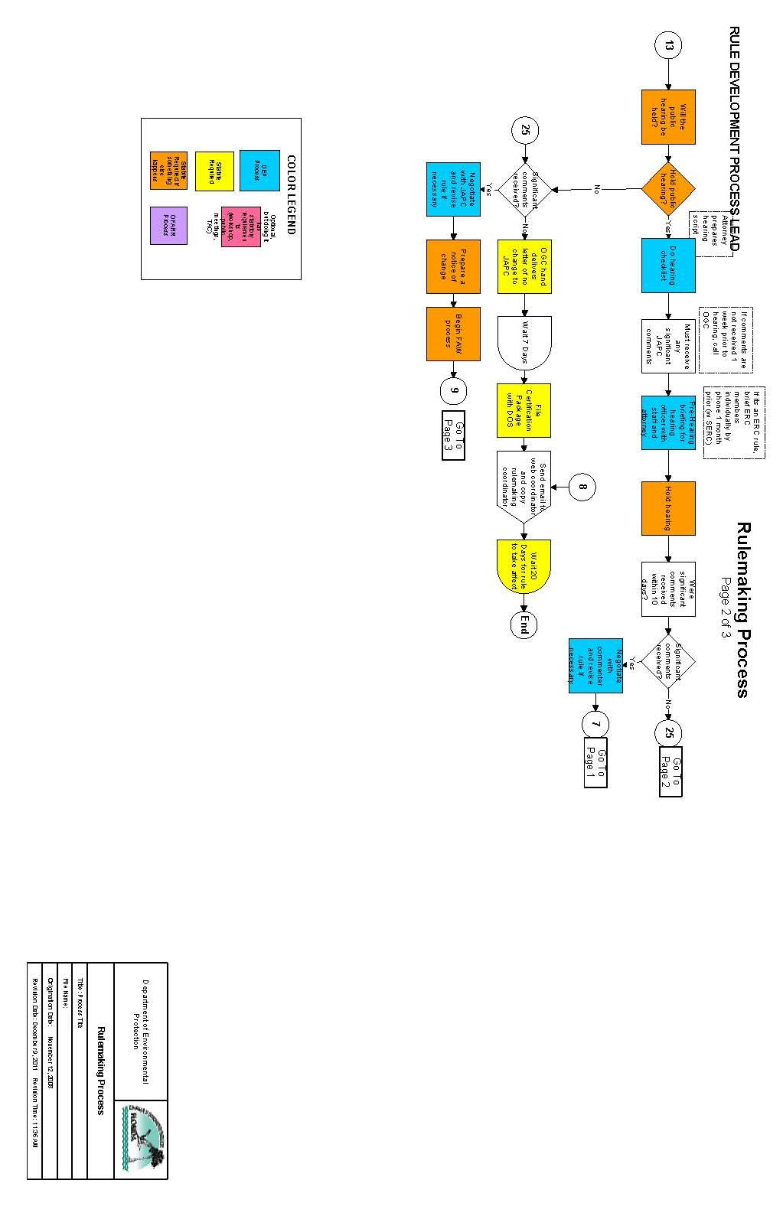
. . .all in the OGC Handbook
Lots of steps !! They are color-coded to show which are required by statute or OFARR, and which are required by the agency or are optional.
. . . Just take one step at a time!

Slide 36
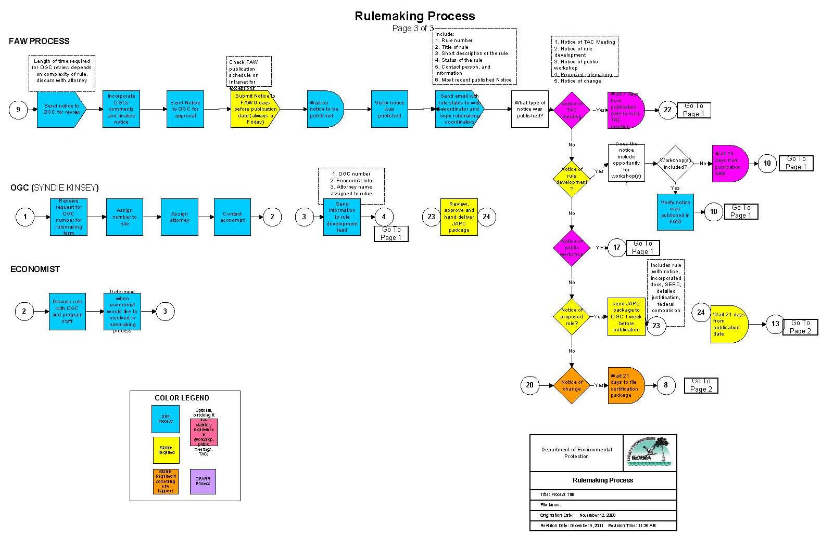
OGC Handbook . . .

Slide 37
Reference Material
After 12/31/10 all NPRs must have reference material accessible on E-rulemaking website unless under federal copyright
Prior to publishing NPR--Load to DEP website (to satisfy this requirement of making them available to the public)
Prior to Filing Certification--upload to DOS site; copy the URLs into the rule text and Cert. Pkg.
Then “submit” materials electronically on DOS site to obtain acceptance emails to file with the Certification Package

Slide 38
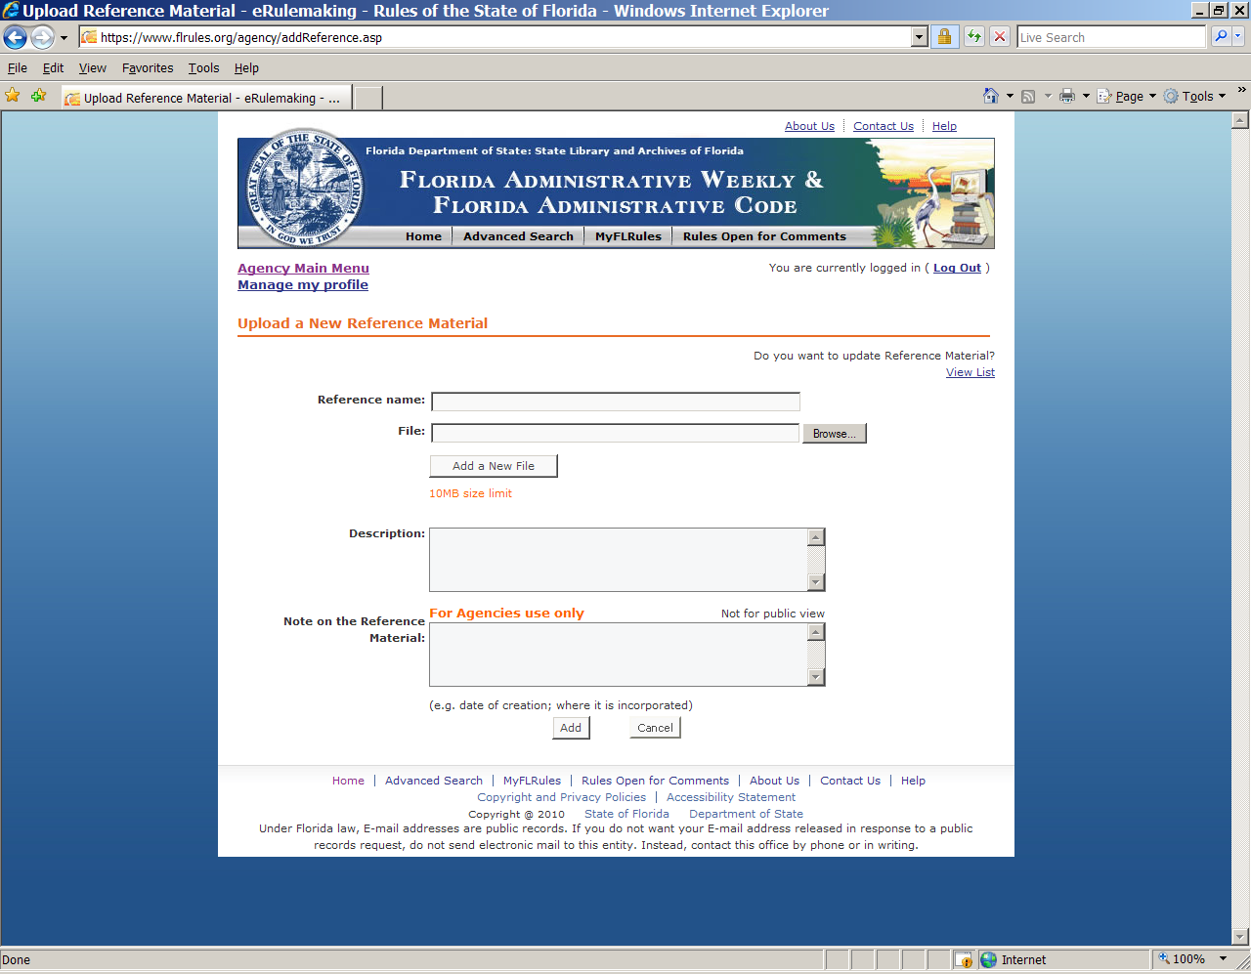
Upload Reference Material

Slide 39
Joint Administrative Procedures Committee (JAPC)
Staff attorney assigned to DEP
Reviews all proposed rules, FAR notices, existing rules, agency Websites, public comments
Must receive JAPC package timely—on or very close to date of FAR publication of NPR (email and hand deliver w/copy for DEP)
Comments on proposed rules
  OGC attorney MUST respond in writing to all letters
JAPC Package (cover letter, listing the Notice of Proposed Rule, Detailed Written Statement of Facts and Circumstances, Federal Comparison Statement, SERC, Reference Materials)

Slide 40
OFARR
Office of Fiscal Accountability and Regulatory Reform (formerly reviewed by SBRAC established in 2008)
Reviews “Notification of Rulemaking” form
They have 1 week to review the package to publish a Notice of Rule Development and 1 week for a Notice of Proposed Rule
They do not review Notice of Change, or Notice of Correction

Slide 41
Hearing
Rare for SLERC rules to require hearing before the ERC
If Governor and Cabinet action, they may require hearing before final adoption
May be held
  Presiding Officer may be bureau chief, or staff NOT heavily involved in rulemaking; should not be the program attorney
Notes:
This said “Or if Governor and Cabinet action – I don’t know what that meant so I changed it to as shown 6/25/15.

Slide 42
Certification Package
After notice of change or no change, draft a certification package
  Cover Letter (from DEP Attorney)
  Certification (of rules filed, time periods were met, signed by OGC)
  Follow template and order
  Rule in DOUBLE space format, same font and pitch as NPR, with page numbers (certify # rule pages)
  Detailed Statement of Facts and Circumstances
  Summary of Rules
  Summary of Hearing
Notes:
The entire package has to be double spaced

Slide 43
Certification Package
Timing for Filing:
OGC sends a letter to JAPC announcing plan to file on XX date (which is 7 days away)
This allows time for JAPC to certify to the DOS that there are no outstanding concerns
This sets the effective date (month and year), which you add to any materials and forms
The forms and materials incorporated or modified get uploaded to the DOS site
The resulting DOS Gateway URL is inserted in the rule text in the Certification Package

Slide 44
File Retention & Oculus
OGC inserts notices, anything signed by attorney
Check to see what OGC placed in Oculus, then add additional documents from SLERC’s rule files.
Comments have to be retained per 120.54(8), and are part of OFARR form (include in Oculus)
Don’t need to retain records of rules that didn’t become effective (but keep copy of latest draft in case it is reactivated or for reference)

Slide 45
A FEW POINTS
Comments – public comments give us other viewpoints and make a rule clearer and more complete
Timing – Session, vacations, holidays
“Now” – do your part as soon as you can because others have full schedules and there are lots of steps and reviewers
Details – there are requirements for everything; lots of details; read rules and notices word-for-word to make it as correct as possible

Slide 46
MORE POINTS. . .
“now” is also good because before a rule is filed, these actions can slow or stop rulemaking:
Challenge can be filed against the rule (this stops the clock and all activities until the challenge is resolved or dropped) (however, once a rule is filed, it becomes effective and the challenge is resolved separately)
E.O. can be issued to hold rulemaking
Elections anticipated or just occurred may result in rulemaking being on hold until the new XX is familiar with rule changes
Rulemaking can be placed on hold until all rules are reviewed (2011, 2015); annual Agency Regulatory Plans

Slide 47
MORE. . .
This might be harder to decipher: 3.24.3.7(c)
Clearer to me would be: 3.2.4.3.7(c)
It should be this and is easier: 3.2.7(c) 3.4.3.7(c)
Takes time to figure this out: Corpors
Easier to understand this change: Corps Corpers
(for the AH’s and forms that are not published in the FAR, some different styles are allowed, but we should follow the same required rulemaking style)

Slide 48
Learned. . .
Map of locations and contacts found in the Attachments 1-3 of the Joint Application, Section A, form 62-330.060:
we were required to “incorporate” it because it had the appearance of being incorporated based on the way it is referenced in the application

Slide 49
How to draft a rule
After all this – how do you write the text for a rule?
Usually we are revising existing text – based on it being misunderstood, update to statute changes, and other reasons
For new proposed text – look at similar existing text; match to style in the chapter or section (rule)
Write what is clear to you and then break it down
Look at WMD or other rule text for examples
If a word is defined, use the exact full word

Slide 50
Actual Writing (contin.)
Look back at older rules vs today’s
Also remember the Governor’s Plain Language initiative
Eliminate unnecessary words. Examples:
Instead of: with regard to by means of in the event that until such time during such time in respect of in view of the fact on the part of subsequent to under the provisions of with a view to it would appear that it is probable that notwithstanding the fact that adequate number of excessive number of | Use: about by if until while for because by after under to apparently probably although enough too many
Instead of: accomplish ascertain disseminate endeavor expedite facilitate formulate in lieu of locality optimum strategize utilize | Use: do find out send out, distribute try hasten, speed up make easier, help work out, devise, form instead of place best, greatest, most plan use

Slide 51
References / Guidance
GROUPS/Rules/rules/Rulemaking_Procedures-Tracking contains:
General information
OFARR package
OGC procedures and rule forms
(includes trainings, checklists,
“FAR-IntroducingFAR”)
SLER procedures and rule forms
TRACKING (next slide for contents)

Slide 52
References / Guidance
TRACKING
Adopted ch 18 and ch 62 rules
(search by chapter or OGC Tracking #)
Closed ch18 and ch 62 rulemaking
Rule Status (table for web)
(this infor gets transferred to the adopted or closed tables)

Slide 53
References / Guidance
OGC Rulemaking Handbook (maintained by Justin Wolfe) https://www.fldepnet.org/content/ogc/ogc-rulemaking-handbook
DOS “User Guide for Filing Reference Material in Electronic Form” (in the Agency Login page)
FAR presentation “Introducing the Florida Administrative Register” (9/17/12)
Plain Language Handbook
eDocLog Instruction manual (online)

Slide 54
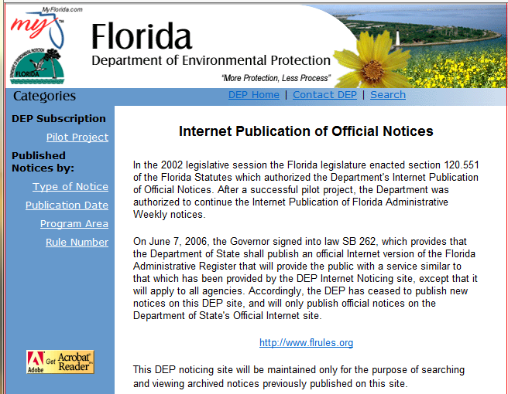
Dec. 2001 - June 2006
https://tlhora6.dep.state.fl.us/onw/pilot.asp
DEP published notices on web
DOS published 1st electronic FAR, Oct. 1, 2012
(FAR/FAC web begins with 1999 issues)

Slide 55
Close
Lots of steps to rulemaking
Slight variations in reviews and steps among divisions
DSL rules require approval from the Board of Trustees to initiate, publish, and file
OGC Rulemaking Handbook, it’s all written down but things change, so get memos and templates from there (Justin Wolfe maintains it)
Go one step at a time, talk to your Rule Attorney – and all will work out fine!

