Slide 1
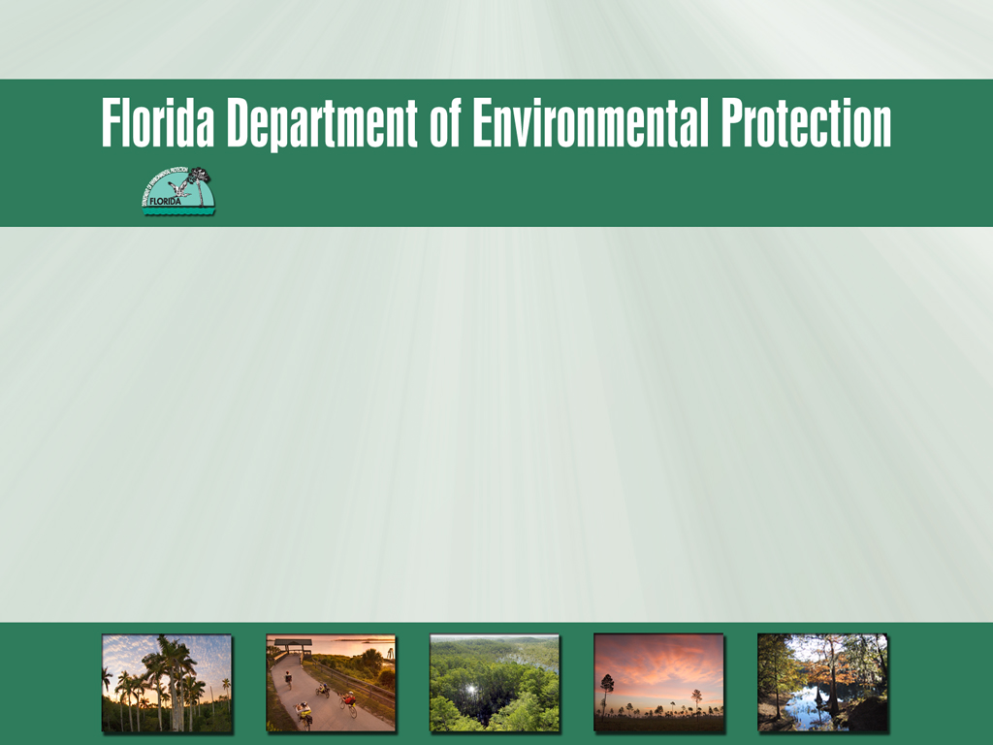
Submerged Lands and Environmental Resources Coordination Program
Overview of ERP and SSL program for DEP CAP staff
Donna Kendall & Andy May, SLERC Program, Div. of Water Resource Management
Tuesday, June 10, 2014

Slide 2

Long, long ago, there was no ERP program in Florida. Instead, there was a program for the regulation of dredge and fill activities, administered by the former Department of Environmental Regulation, and another for the management and storage of surface waters, administered by the Water Management Districts….
In 1993, a major reorganization occurred, and in 1995, the new ERP program rules were first established. Over time, these were expanded and modified by DEP and the WMDs, under many different chapters of the Florida Administrative Code, including: 40B-4, 40B-400, 40C-4, 40C-40, 40C-42, 40C-400, 40D-4, 40D 40, 40D-400, 40E-4, 40E-40, 40E-400, 62-341, 62-346, 62-343, etc….
That left a patchwork of environmental resource regulation in effect across the state, with five separate sets of environmental permitting criteria governing the same regulated activities. The result was an inconsistent and complicated regulatory environment, especially for those entities that must obtain permits in different parts of the state….
For these reasons, DEP sought legislative authorization to create a more uniform set of ERP criteria. In 2012, the State Legislature passed House Bill 7003, which gave DEP the authority to develop statewide ERP rules, in coordination with the WMDs. Now, the first phase of that work is complete, and a new era has begun…

Slide 3
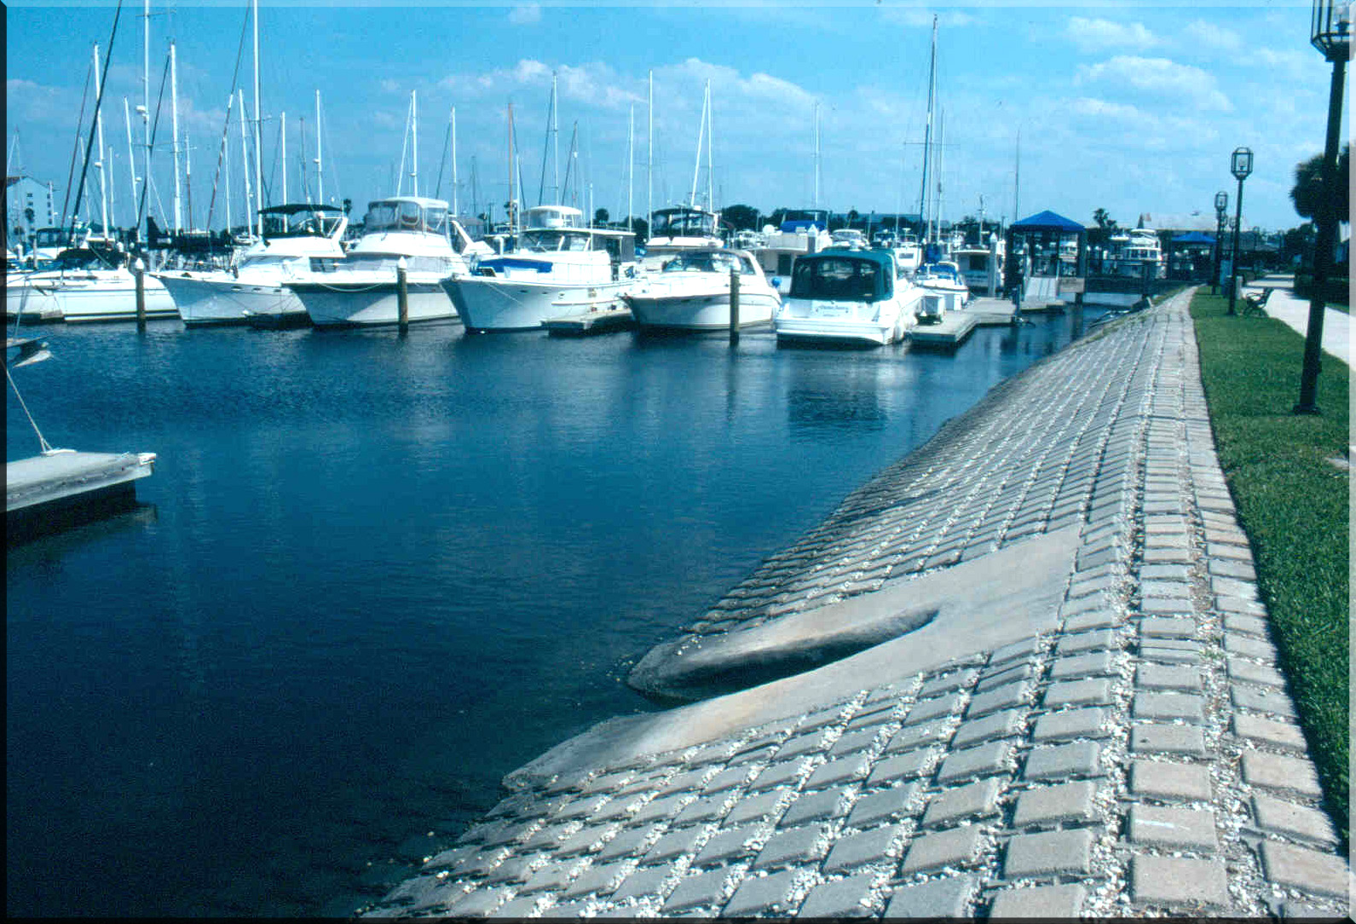
So what does ERP regulate…?
Environmental Resource Permits are required for:
  “Unless expressly exempt ...the construction, alteration, operation, maintenance, abandonment, or removal of any stormwater management system, dam, impoundment, reservoir, appurtenant work or works, including dredging or filling in, on, or over wetlands and other surface waters” (62-343.050, F.A.C.)
  This means almost every type of non-exempt land development activity!!!

Slide 4
Conditions for Issuance (MSSW)
ERP Merged Earlier Programs
+
Additional Conditions (D&F)
FUNCTIONS WETLANDS AND SURFACE WATERS PROVIDE TO FISH & WILDLIFE
WATER QUALITY STANDARDS
MAINTENANCE OF FLOWS AND LEVELS
ADVERSE SECONDARY IMPACTS
ELIMINATION & REDUCTION OF IMPACTS
WATER QUANTITY
STORAGE & CONVEYANCE
PUBLIC INTEREST TEST: 7 FACTORS FROM D&F
CUMULATIVE IMPACTS
SHELLFISH WATERS
VERTICAL SEAWALLS IN ESTUARIES & LAGOONS
PAST VIOLATIONS OF D&F OR MSSW RULES
Notes:
15
13

Slide 5
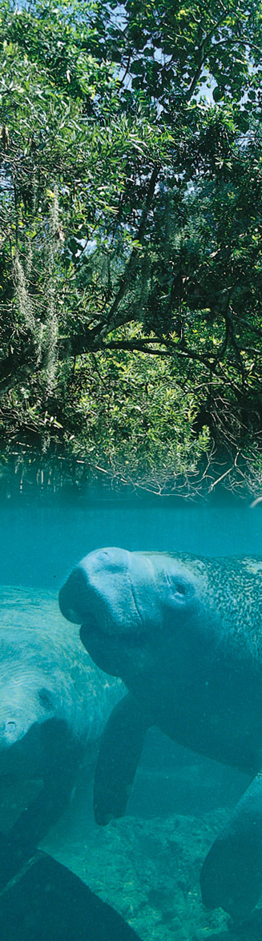
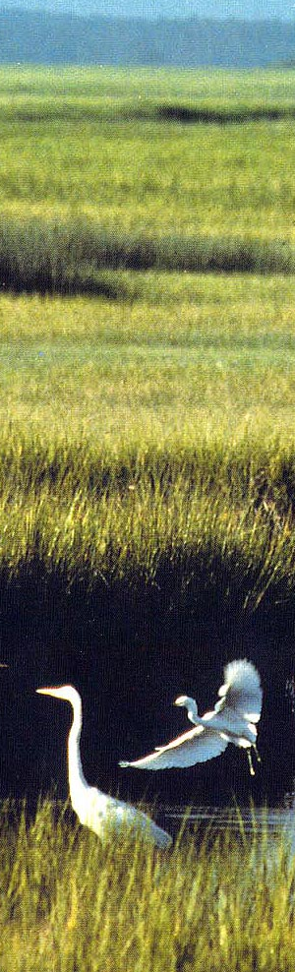
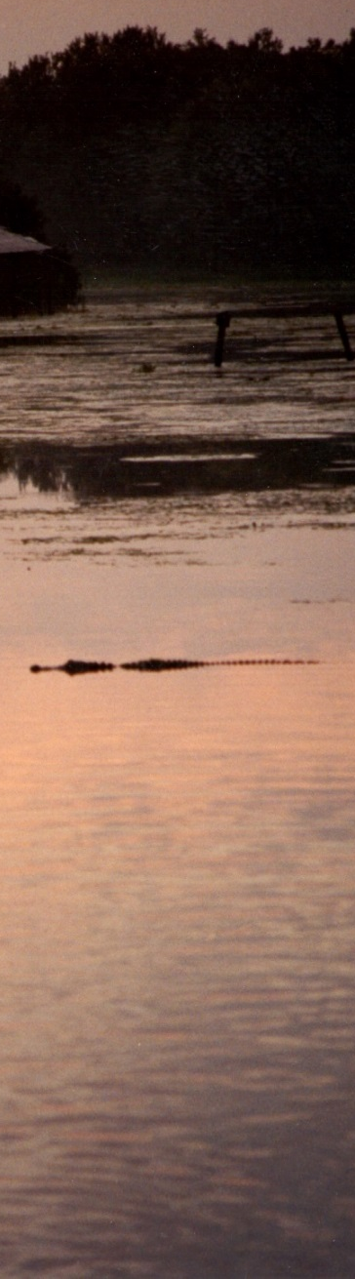
Functions Wetlands And Surface Waters Provide To Fish & Wildlife
Include:
Feeding
Nesting
Breeding
Refuge
Development

Slide 6
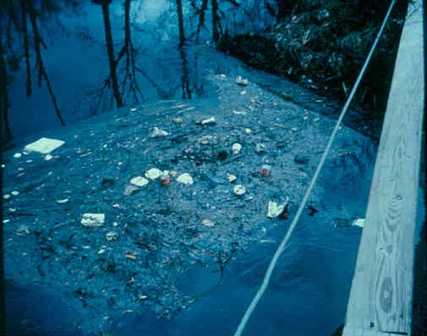
Water Quality Standards
Purpose?
To conserve the waters of the State to protect, maintain, and improve the quality thereof for public water supplies, for the propagation of wildlife, fish and other aquatic life, and for domestic, agricultural, industrial, recreational, and other beneficial uses.
Section 403.021, F.S., & 62-302.300(11), F.A.C.

Slide 7
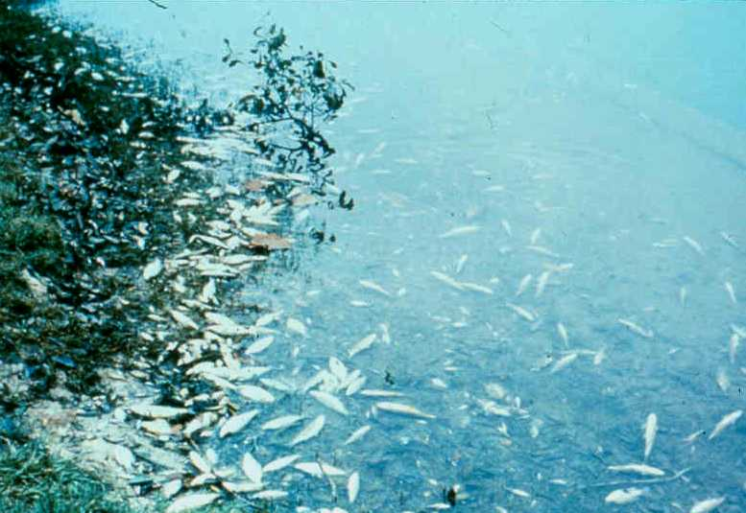
State Water Quality Standards
373.414(1) & 403
  “the department shall require the applicant to provide reasonable assurance that state water quality standards applicable to waters as defined in s. 403.031(13) will not be violated…”
62-4
  Anti-degradation requirements, includes OFWs (62-4.242)
  Mixing Zones (62-4.244)
62-302
  Numeric and narrative standards
    “Free - Froms”
    Class I, II, II, IV, & V Waters
    “New” numeric standards (DO, NNC)
  List of OFWs
62-520, 62-522, & 62-550
  Groundwater Standards

Slide 8
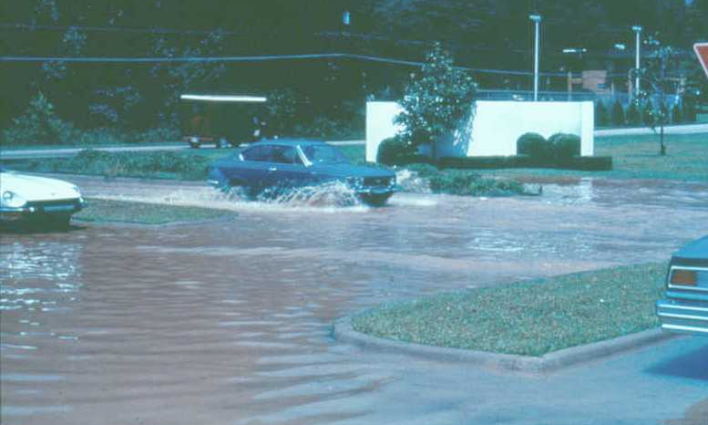
STORMWATER
Sources:
  Impervious surfaces (roads & buildings)
  Clearing (reduced percolation)
Potential for Harm:
  Total suspended solids/turbidity
  Harm to water resources
  Biological integrity
  Nutrients, Metals, and other pollutants
  Flooding damage and risk to human safetey

Slide 9
ERP Stormwater
Design & performance criteria for new stormwater management systems; based on a “rebuttable presumption”:
  Designed to achieve at least 80% reduction of average annual load of pollutants (TSS surrogate)
  At least 95% reduction for OFWs
  May substitute basin-specific criteria
  Erosion & sediment control plans
  Watershed-specific stormwater pollutant load reduction goals for older stormwater management systems (through SWIM plans)

Slide 10
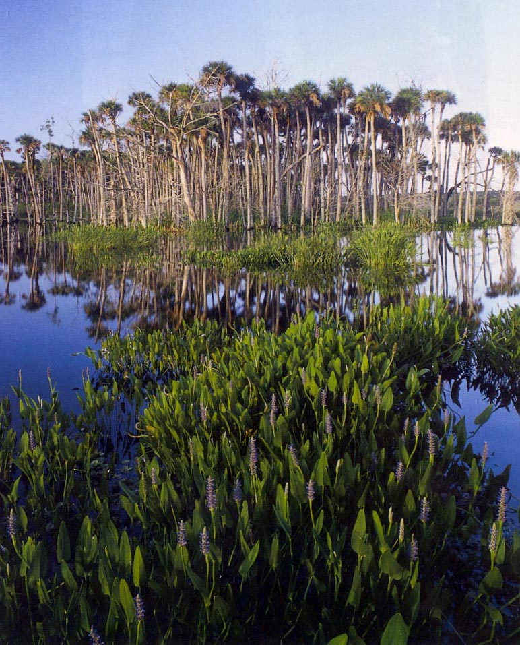
Maintaining Habitat Functions Provided to
Fish & Wildlife, Including Listed Species
The ERP Program:
Requires elimination and reduction of impacts
Evaluates both direct and indirect (secondary) impacts
Prohibits adverse individual or cumulative impacts
Allows for mitigation to offset unavoidable impacts
Provides extra protections for listed species

Slide 11
Public Interest Test - 373.414(1)(a)
(a) In determining whether an activity…is not contrary to…or is clearly in the public interest…the department shall consider and balance the following criteria:
1. Whether the activity will adversely affect the public health, safety, or welfare or the property of others;
2. Whether the activity will adversely affect the conservation of fish and wildlife, including endangered or threatened species, or their habitats;
3. Whether the activity will adversely affect navigation or the flow of water or cause harmful erosion or shoaling;
4. Whether the activity will adversely affect the fishing or recreational values or marine productivity in the vicinity of the activity;
5. Whether the activity will be of a temporary or permanent nature;
6. Whether the activity will adversely affect or will enhance significant historical and archaeological resources under the provisions of s. 267.061; and
7. The current condition and relative value of functions being performed by areas affected by the proposed activity.

Slide 12
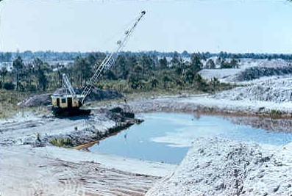
Short-Term Concerns
Improper site controls can result in offsite discharges of turbidity, sediment or other pollutants
Construction can directly impact important habitats and resources (e.g. mature forested wetland or hardbottom habitats)
May also lead to secondary impacts to those resources, (e.g. disturbance of nesting eagles or woodstorks, dewatering impacts on adjacent wetlands)
Projects that impound or alter the flow of surface waters may cause adverse flooding impacts to offsite properties

Slide 13
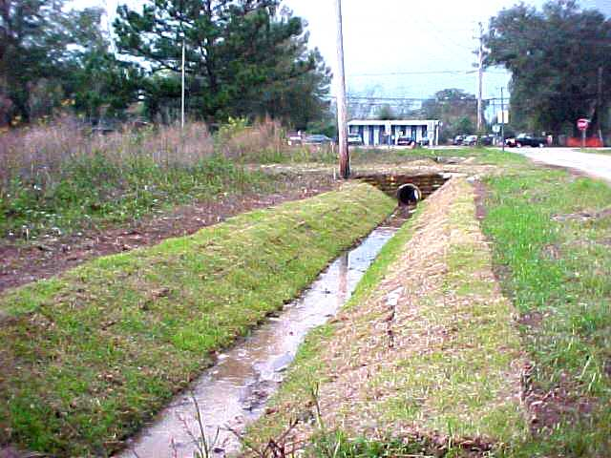
Long-Term Concerns
Proper design, construction, operation & maintenance of surface water management systems to prevent releases of pollutants that cause water qualify violations
Ability of constructed or altered waterbodies to continually meet water quality standards, including ability to properly mix
Long term control of erosion, sedimentation and turbidity
Loss of marine productivity
Adverse impacts to fish & wildlife
Disruption of natural water flow

Slide 14
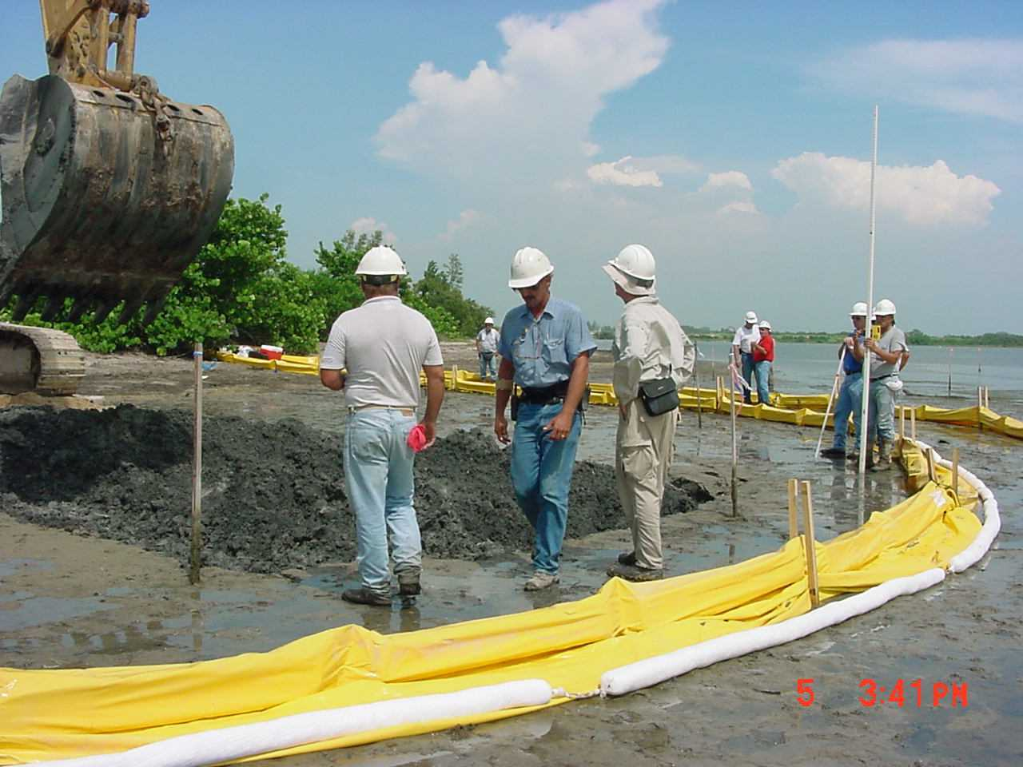
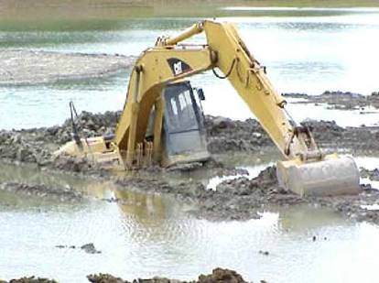
Best Management Practices (BMPs)
Generally required in ERPs to provide reasonable assurance that WQ standards will be met during construction work
Based on industry-accepted methods and practices
Often implemented by the contractor/builder
Can be very effective, but only if appropriately installed and consistently maintained!
Worst Management Practices…?

Slide 15
O&M REQUIREMENTS IN ERP PERMITS
Depending on the nature and complexity of the project, operation & maintenance requirements may be addressed in specific conditions of the permit, and/or a concise O&M plan…often via a combination of both, particularly with more complex systems. Simple, “cookie-cutter” stormwater systems often use an O&M plan, which may be included as a permit attachment. Specific conditions, however, are often easier for compliance staff to enforce and are often favored for:
Mitigation monitoring & success criteria
Critical requirements that must be performed and verified;
Requirements with a particularly sensitive timing component

Slide 16

ERP Regulatory Program is
“Linked” to Proprietary SSL Program
“Sovereignty” Submerged Lands
Florida Constitution Article II, section 7:
“It shall be the policy of the state to conserve and protect its natural resources and scenic beauty.”
Florida Constitution Article X, section 11:
“The title to lands under navigable waters, within the boundaries of the state, which have not been alienated including beaches below the mean high water lines, is held by the state, by virtue of its sovereignty, in trust for all the people.”

Slide 17
Public Trust Doctrine
Generally speaking, navigable waters, the lands beneath these waters, and the living resources inhabiting them are subject to the Public Trust Doctrine.
A legal doctrine rooted in history:
Roman Emperor Justinian: The seashore belongs to everyone and to no one. (6th Century A.D.)
Old English Law: Two coexisting rights in the seashore -- (1) private rights (jus privatum) and (2) rights of the Public (jus publicum)

Slide 18
The Public Trust Doctrine in Florida
Florida admitted to Union on March 3, 1845
Board of Trustees of the Internal Improvement Trust Fund est. 1854
All lands beneath navigable water and tidelands, to MHWL/OHWL
Out to 3 nautical miles in Atlantic Ocean, 3 leagues (~9 naut. miles) out in Gulf of Mexico
“Navigability-in-fact” = used in inland waterbodies
Only protects “traditional uses” which vary from state to state (e.g. right to skate in MN)
Fish are a trust resource; they don’t belong to the one who owns the bottom or the upland
Notes:
CLICK -The Public Trust Doctrine dates back to the sixth century A.D., specifically between 629 and 634 A.D.
CLICK A Roman emperor Justinian codified the Public Trust Doctrine into its laws which were called Institutes.
the intent was to assure that the NEEDS of ALL the citizens of Rome CLICK could approach the seashore provided that they respected the habitations, monuments and the buildings.
It also gave them the right to build a cottage, dry or repair nets, fish or use the bank of rivers to tie boats to trees and to place any part of their cargo there, even though the banks of the river were private property
The Roman Laws eventually influenced the jurisprudence of Western European Nations and was adopted by English law
The English law recognized the special nature of the tidelands and waters, giving them protection in the king’s name for all English subjects calling them CLICK sovereign submerged lands
So from England to America colonies, through the American Revolution to the 13 original state the public trust Doctrine survives in the U.S. as one of the most important and far reaching doctrines of American property law. Each of thirteen original states following the American Revolution acquired title to the sovereign lands within its jurisdiction under the public trust doctrine. Maritin v. Waddell 41 U.S.(16Pet.) 367,410-11 (1842). States joining the union received equal footing which included the “right and duty of the states to own and hold the lands under navigable waters for the benefit of the people.” ID at 408

Slide 19

As the public trusteeS, we are stewards of that which Emperor Justinian claimed, by the law of nature, to be common to all mankind.

Slide 20
Preemption
Florida’s State-owned Submerged Lands program manages those lands in the public trust, but allows for reasonable exclusionary use by individuals
  Minimal “preemption” of those submerged lands, including the some elements of the traditional uses and other public rights associated with those lands may be allowed, in accordance with the SSL rules (Chapters 18-21, 18-20, and 18-18) and statutes (Ch. 253 & 258, F.S.)
  Some form of authorization is often required to preempt those state-owned submerged lands, including the minimum necessary rights or interest.
Notes:
Example of limiting an activity: lowering the height of a bridge may change which types of vessels can navigate under it. The result would not prevent the activity of navigating under the bridge, but would reduce the number of vessels that could navigate under the new or revised bridge.

Slide 21
Resources
Statutes: http://www.flsenate.gov/Statutes/index.cfm?Tab=statutes&submenu=1
Rules:
  http://fac.dos.state.fl.us/
  http://www.dep.state.fl.us/legal/legaldocuments/rules/rulelistnum.htm
  http://www.dep.state.fl.us/water/rules.htm
ERP Home Page (Overview,Forms, Rules, WMD links, SPGP, NWPs, water quality certification)
  http://www.dep.state.fl.us/water/wetlands/erp/
Operating Agreements w/ WMDs (link is through:)
  http://www.dep.state.fl.us/water/wetlands/erp/rules/guide.htm
Application & Other Forms:
  http://www.dep.state.fl.us/water/wetlands/erp/forms.htm
OPM:
  http://depnet/wrm/sler/erp/docs/slerp_online/LeadPage.pdf

