Slide 1
Office of Ecosystem Projects
Picayune Strand Restoration Project:
Permitting Challenges and Solutions
June 11, 2014

Slide 2
Comprehensive Everglades Restoration Plan
CERP provides a framework and guide to restore, protect, and preserve the water resources of central and southern Florida, including the Everglades.
CERP covers 16 counties over an 18,000-square-mile area
68 components
Objectives to improve water
  Quality
  Quantity
  Timing
  Distribution

Slide 3
Comprehensive Everglades Restoration Plan
WRDA 2000
50/50 cost share
  To date, state has spent $2 billion on CERP
  An additional $2 billion on WQ improvements necessary for CERP
Permittees:
  Federal Sponsor: U.S. Army Corps of Engineers
  Local Sponsor: South Florida Water Management District
Notes:
WRDA 2000
FL Legislature 2000 identified SFWMD as local sponsor

Slide 4
Permitting Authority
Comprehensive Everglades Restoration Plan Regulation Act (CERPRA), Section 373.1502, F.S.
  “Permits issued under this subsection are in lieu of all other permits required under this chapter or chapter 403, except for permits issued under any delegated or approved federal program.”
  The permit application must provide reasonable assurances that:
  The project component will achieve the design objectives set forth in the detailed design documents submitted as part of the application.
  State water quality standards, including water quality criteria and moderating provisions, will be met. Under no circumstances shall the project component cause or contribute to violation of state water quality standards.
  Discharges from the project component will not pose a serious danger to public health, safety, or welfare.
  Any impacts to wetlands or threatened or endangered species resulting from implementation of the project component will be avoided, minimized, and mitigated, as appropriate.

Slide 5
The “Missing Piece” of the Puzzle
Urban Development
Florida
Panther
National
Wildlife
Refuge
The “Missing Piece” of the puzzle
Restores ecological connectivity between publicly owned lands
Makes up the largest restoration opportunity in southwest Florida
Offers one of the few locations in southern Florida where large areas of cypress forests can be restored
Big
Cypress
National
Preserve
Picayune
Strand State
Forrest
Fakahatchee
Strand State Preserve
Rookery
Bay
National
Estuarine
Research
Preserve
Collier
Seminole
State
Park
10,000
Islands
National
Wildlife
Refuge
Everglades
National
Park
Picayune
Strand
Notes:
Currently, SGGE creates drainage and fire impacts to the adjacent lands and acts as a barrier to movement and growth of populations of plants and animals between the adjacent lands.
The Federal and State preserves and parks surrounding SGGE would be linked and enhanced by the restored conditions within SGGE.
The combined natural area would be able to function as one regional ecosystem.

Slide 6
Land Acquisition
1985 - plan to purchase South Golden Gate Estates using Conservation and Recreation Lands (CARL) funds under the "Save Our Everglades" program
Involved acquiring land from 17,000 landowners
These parcels, some of which were owned by individuals in foreign countries or were inherited by others from the original purchasers, took more than a decade to assemble
The Department has expended approximately $180 million dollars, including $38 million in grants from the U.S. Department of Agriculture
SFWMD working on acquiring the remaining parcels

Slide 7
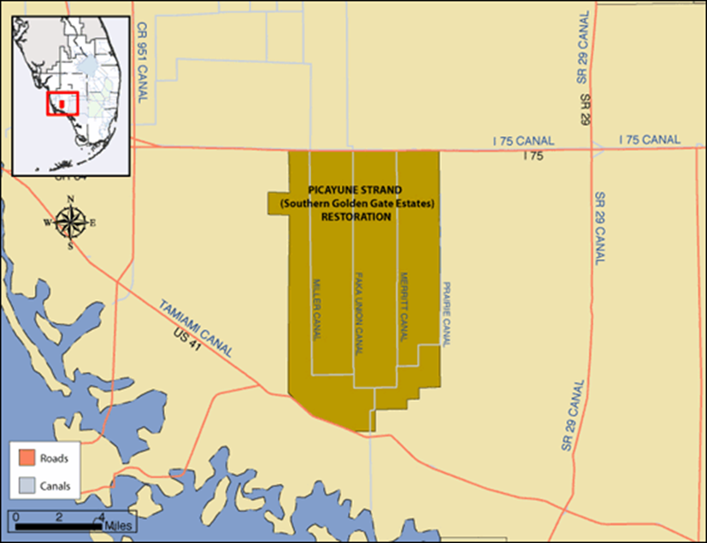
Picayune Strand Restoration Project
55,000 acres located in southern Collier County
Logged for cypress trees in the 1940's
Developed in the 1960's to be the largest subdivision in America, “Golden Gate Estates”
The development eventually went bankrupt
Notes:
Within the timber harvesting time period, a large tract approximately 1,450 acres was used as agricultural land. This land was known as Dan House Prairie and used primarily for tomato farming.
Originally dug to provide flood protection for a sprawling residential area that was never built
due to seasonal flooding – failed

Slide 8
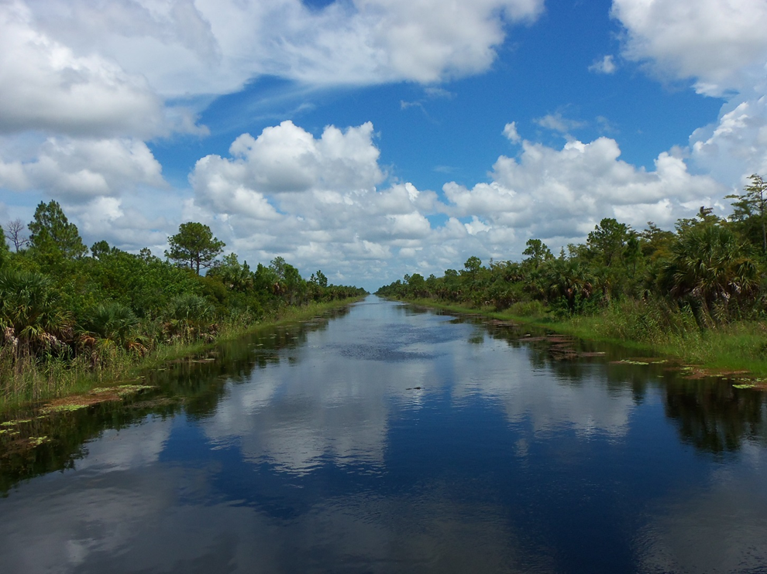
Ecological Impacts
Roads and four large canals have over-drained the area resulting in:
the reduction of aquifer recharge
greatly increased freshwater point source discharges to estuaries
increased frequency and intensity of forest fires
shifts in vegetative communities to more upland species
loss of ecological connectivity and associated habitat
complete loss of cypress trees from large areas of the forest
significant loss of organic soils
Notes:
sabal palm becoming invasive because of the alterations (drainage and intense fires)
soils - (over 1’ in some areas) due to drainage and subsequent oxidation of organic soils

Slide 9
Project Objectives
Restore flowways and hydroperiods to near historic levels
Improve conditions in downstream estuaries by reducing point source discharges
Restore and enhance habitats within and adjacent to the project area
Constraint: Maintain existing levels of flood protection for adjacent developed areas
Notes:
Lands adjacent to SGGE – Fakahatchee Strand State Preserve, Florida Panther National Wildlife Refuge, Belle Meade CARL, and Collier-Seminole State Park.
Discharge of fresh water from the canal system into Faka Union Bay would be reduced from 35,300 acre feet per month to 8,300 acre feet per month during September, the peak of the wet season. This 76% reduction will greatly improve oyster reefs and open water fish habitat.
Over 55,000 acres in Picayune Strand would be ecologically restored
Over 36,200 acres increase of wetland vegetation communities (cypress, marsh, wet prairie, and wet pine) in SGGE
42 of the 48 miles of canals in SGGE would be plugged.
260 of the 279 miles of roads would be degraded, and 227 of the 260 would be allowed to revegetate naturally.

Slide 10
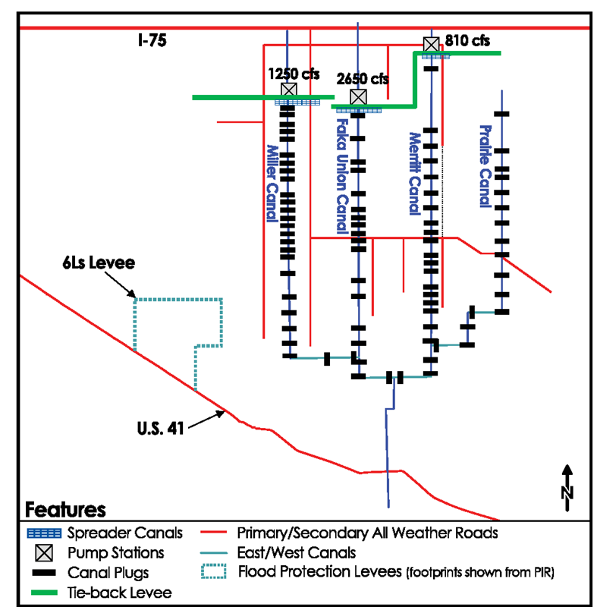
Project Components
3 pump stations: Merritt, Faka Union and Miller Canal
3 spreader berms/basins
Plugging 48 miles of canals
Removing and degrading 260 miles of roads
Features to maintain current levels of flood protection (levees, canals and culverts)
Features to mitigate effects of manatee refugium at the Port of the Islands Marina
Notes:
Size, cfs
Emphasize miles of road and canals

Slide 11
Stakeholders and Land Managers
Picayune Strand State Forest – Florida Forest Service
Fakahatchee Strand Preserve State Park – Florida Division of Recreation and Parks
Collier-Seminole State Park – Florida Division of Recreation and Parks
Ten Thousand Islands National Wildlife Refuge – U.S. Fish and Wildlife Service
Rookery Bay National Estuarine Research Reserve – FDEP/NOAA
6Ls Farm/ Private Property

Slide 12
Wetland Assessment
While it is recognized that the project objective is ecosystem restoration, it is necessary to clearly demonstrate that those benefits outweigh the impact to wetlands from the construction of the project features
Provide the current and historic ecological and hydrologic conditions as well as the reasonable assurances that exist to demonstrate that impacts to wetlands from the project have been avoided, minimized, and mitigated
Notes:
Methodology:
Determine the spatial extent of impacts to jurisdictional wetlands within the footprint of the Project infrastructure components
Determine the functional value of those wetlands proposed to be impacted
Demonstrate that the benefits to wetlands from the Project will off-set the impacts to existing wetlands from the construction of Project infrastructure components

Slide 13
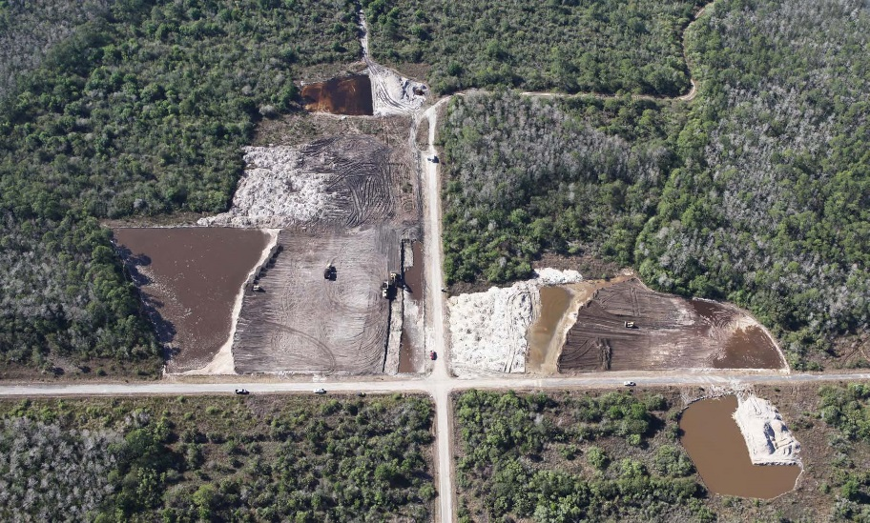
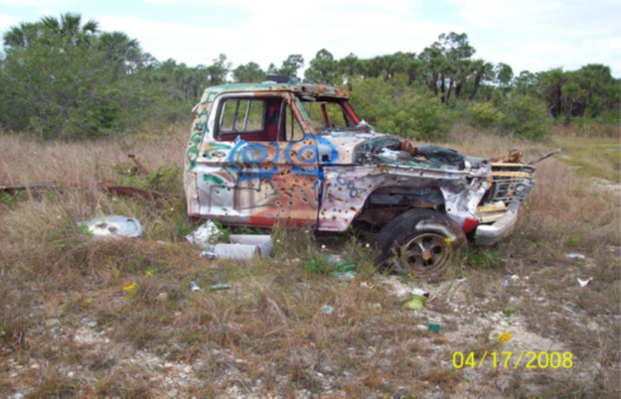
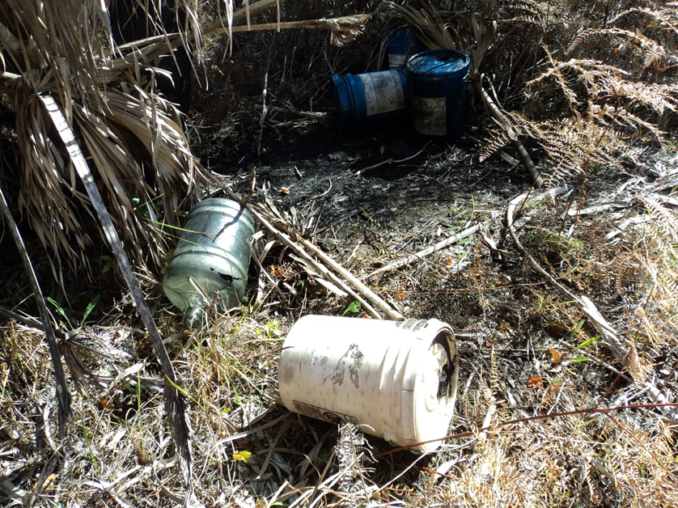
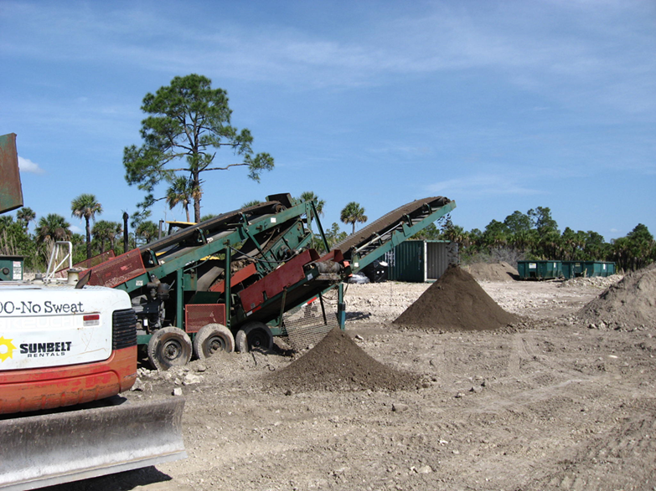
Challenges: Soil Remediation
Chlordane
Lead
Solid Waste
Notes:
Within the timber harvesting time period, a large tract approximately 1,450 acres was used as agricultural land. This land was known as Dan House Prairie and used primarily for tomato farming.
Results of several environmental risk evaluations of the 55,000-acre SGGE project area found that 68.5 acres exhibited chlordane concentrations greater than 100 ug/kg.
Since offsite disposal and soil capping are cost prohibitive, the viability of soil inversion was selected to be further investigated. A pilot test was chosen to evaluate the effectiveness of soil inversion utilizing a pan scraper based on the fact that chlordane impacts cover a relatively large area.
Inversion of the chlordane impacted soils entails inverting the top 6-inch bioturbation zone with a lower soil horizon. Impacted soils are essentially capped in situ at sufficient depth so that the risk potential to aquatic and sediment dwelling organisms is reduced to acceptable levels.
Soil inversion utilizing a pan scraper consists of pulling a scraping device across the remediation area and removing the soil in localized four to six inch horizons. Surface soil that has been removed by the laser-guided scraper blade is held in the pan scraper hopper until it is stockpiled at its desired chlordane impacted location. The pan scraper would then place, in four to six inch localized lifts, the former upper horizon in the lower horizon and the former lower horizon in the upper horizon.

Slide 14
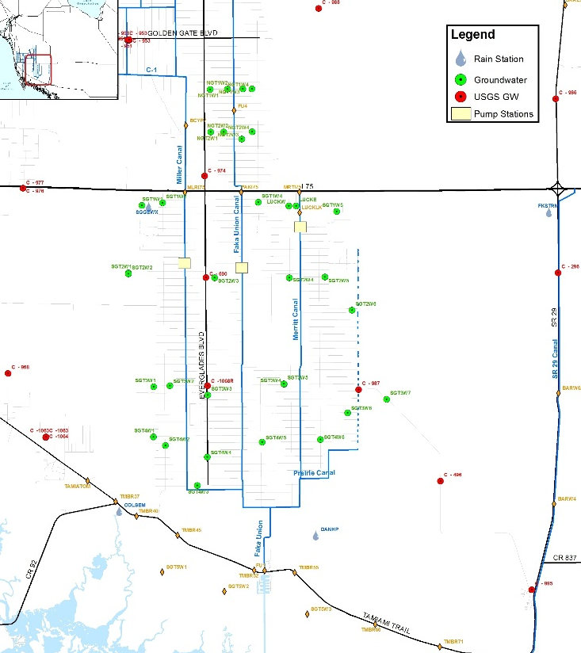
Monitoring
Water Quality
Groundwater and Surface Water Levels
  Project Area Restoration
  Upstream Wetlands
Notes:
Groundwater and surface water monitoring – both in project area to show restoration and upstream to show PS have no effect on upstream wetlands
WQ

Slide 15
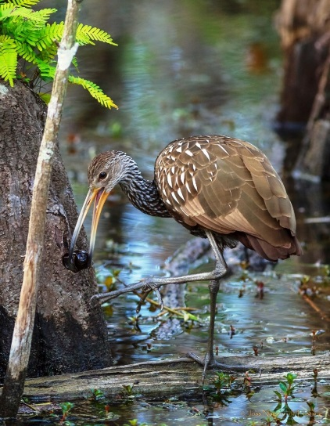
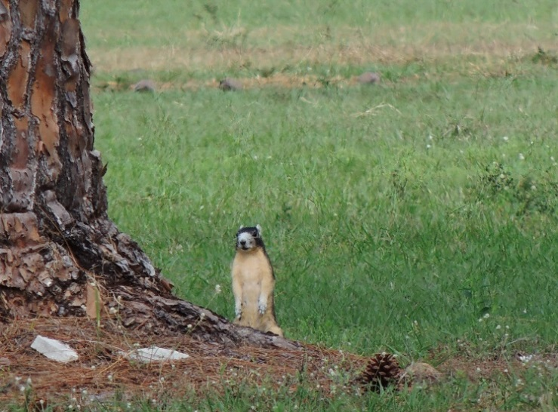
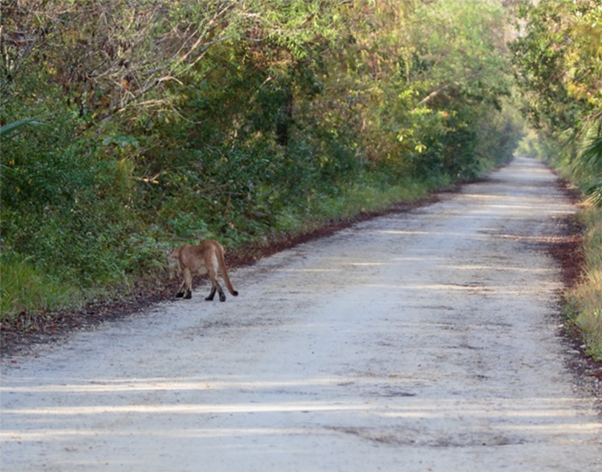
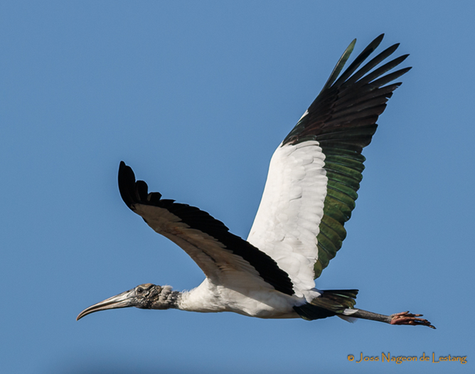
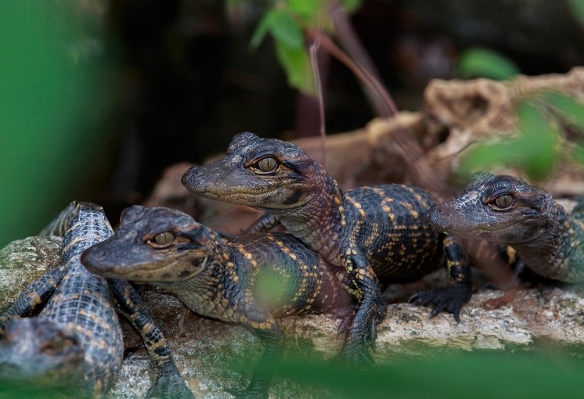

T&E Species
Florida Panther
Puma concolor coryi
Big Cypress fox squirrel
Sciurus niger avicennia
Limpkin
Aramus guarauna
© Paul Julian
© Joss Nageon de Lestang
Wood Stork
Mycteria americana
American alligator Alligator mississippiensis
Notes:
Big Cypress fox squirrel – State-designated Threatened
Alligator - Federally-designated Threatened species due to similarity of appearance
Limpkin - State Species of Special Concern
Woodstork – endangered, proposed for threatened
Panther - endanagered

Slide 16
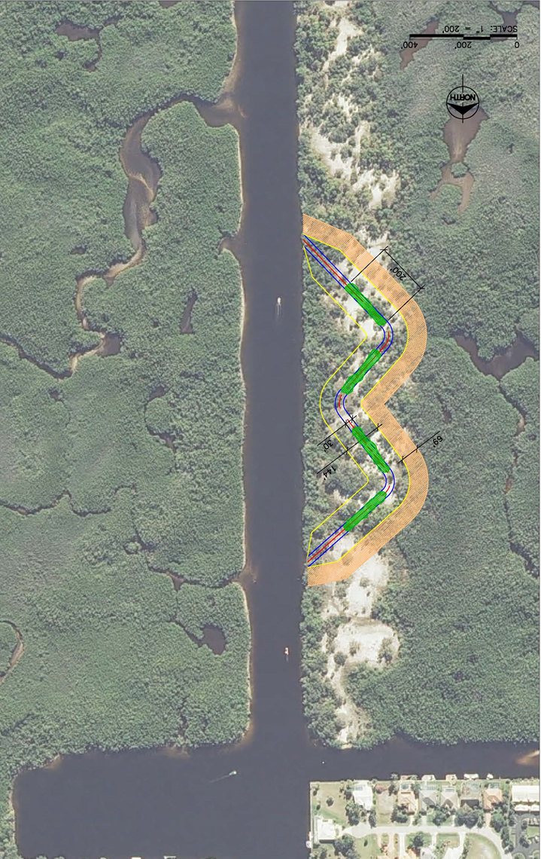
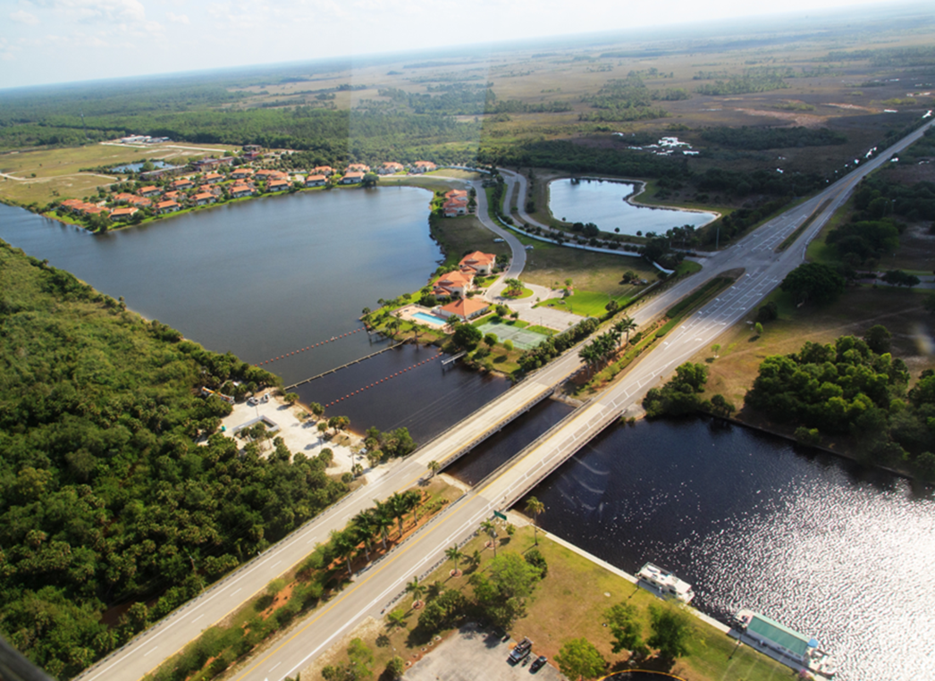

Manatee Refugium Mitigation
During cold, wet times, a large fresh-water flow over Faka Union Weir #1 creates a “blanket” that encapsulates warmer salt water
Project will reduce flows in Faka Union Canal and will spread water over the landscape and affect refugium

Slide 17
Progress: Prairie Canal
2007 – SFWMD completed plugging the Prairie Canal, removed about 65 miles of roadways adjacent to the canal, and cleared exotic plant species from the canal banks
Restoration benefits seen to date:
  Reemergence of foraging wading birds and native vegetation
  Successfully reduced drainage of the adjacent Fakahatchee Strand State Preserve

Slide 18
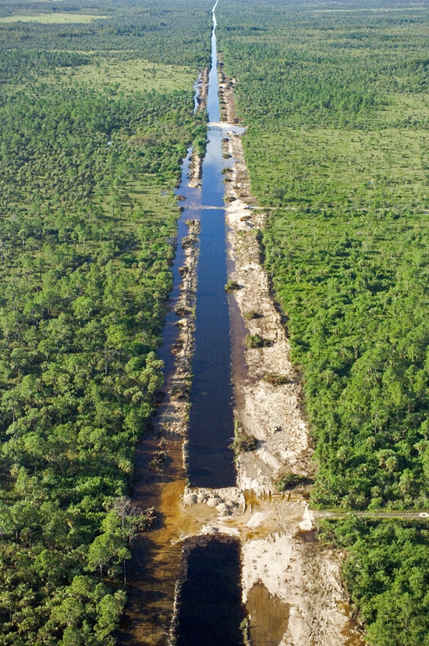
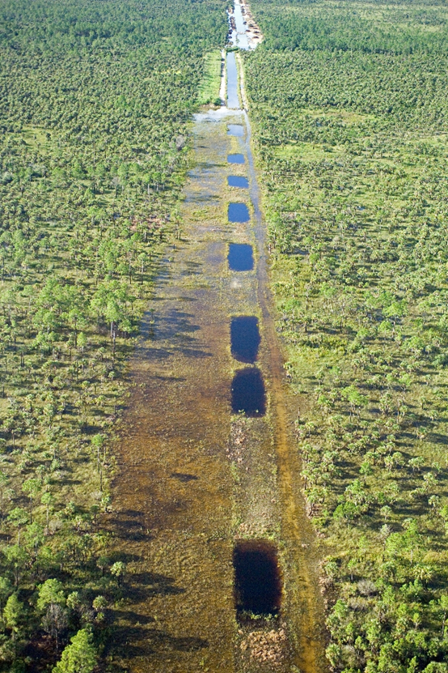
Progress: Prairie Canal Plugging

Slide 19
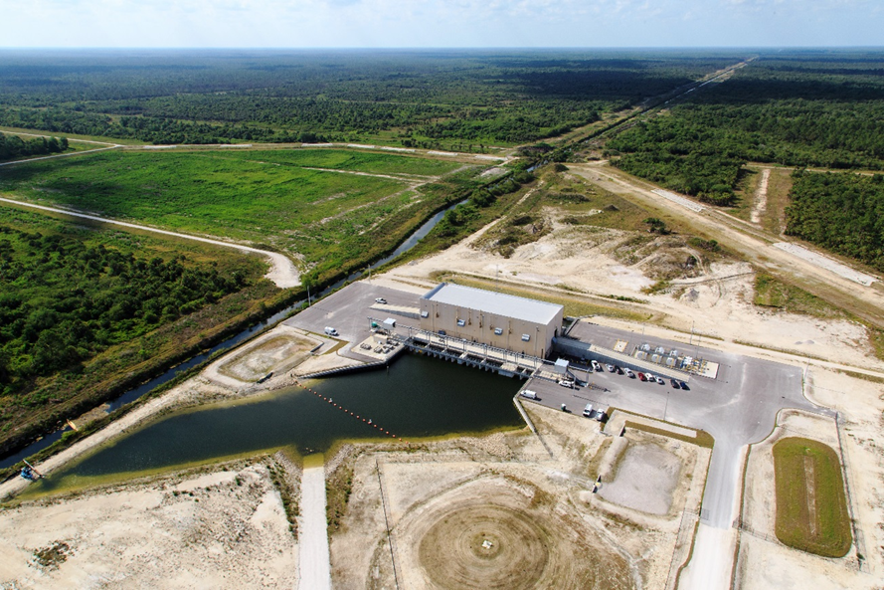
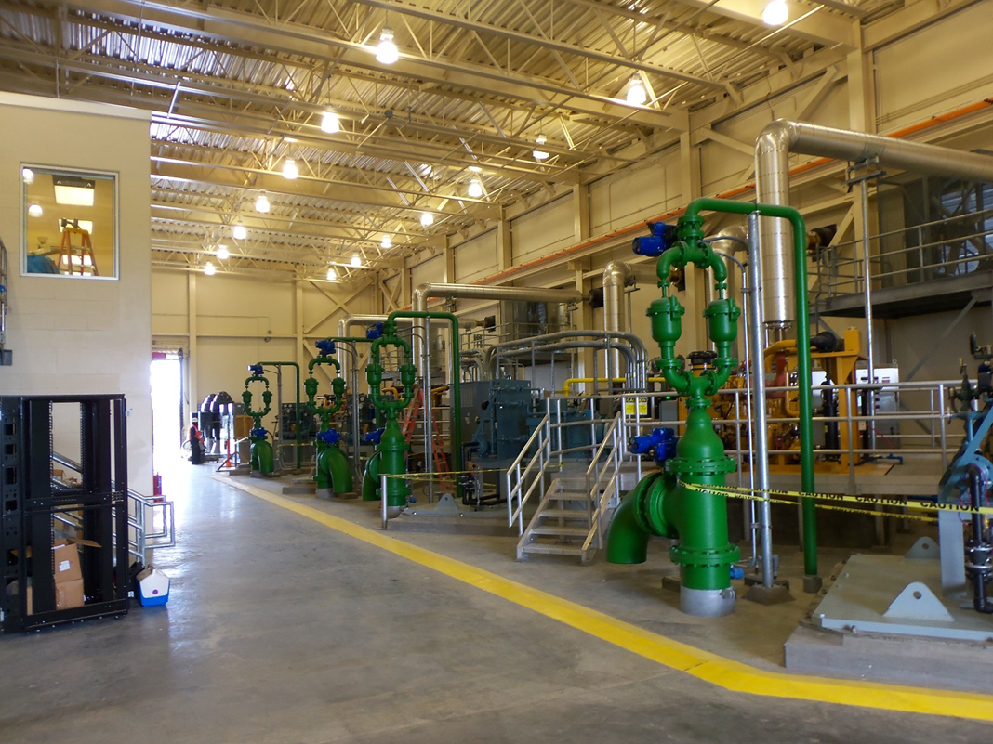
Progress: Merritt Pump Station
N

Slide 20
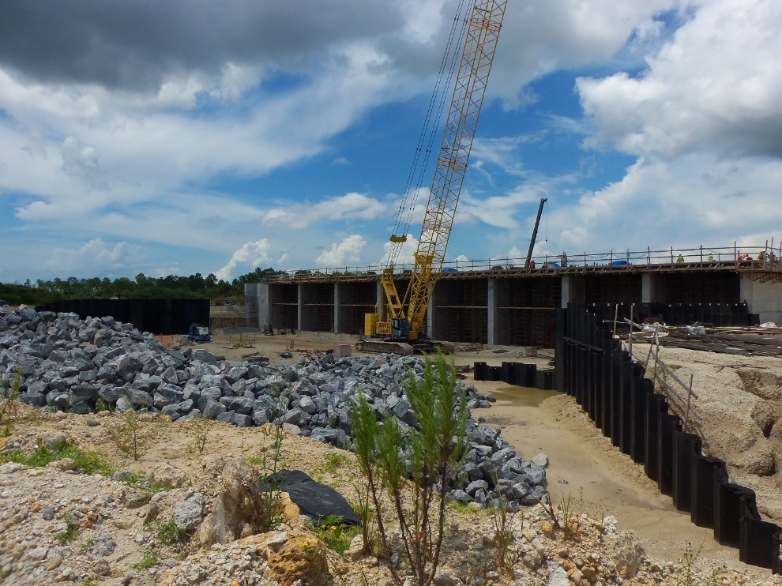
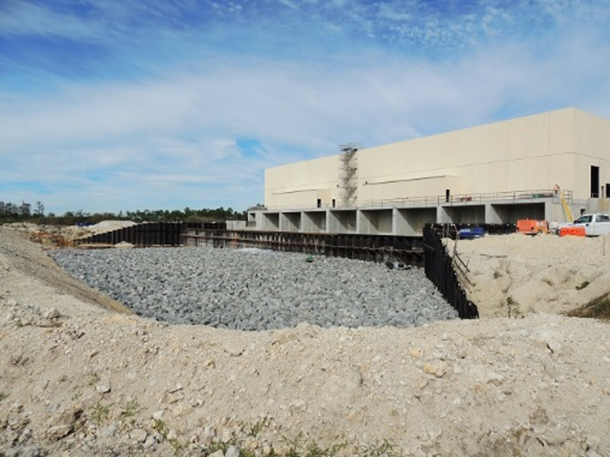
Progress: Faka Union Pump Station

Slide 21
Contact Information
Jordan Pugh
Senior Permit Lead
Office of Ecosystem Projects
Florida Department of Environmental Protection
3900 Commonwealth Boulevard, MS 24
Tallahassee, FL 32399
850.245.3160
Jordan.Pugh@dep.state.fl.us

Slide 22
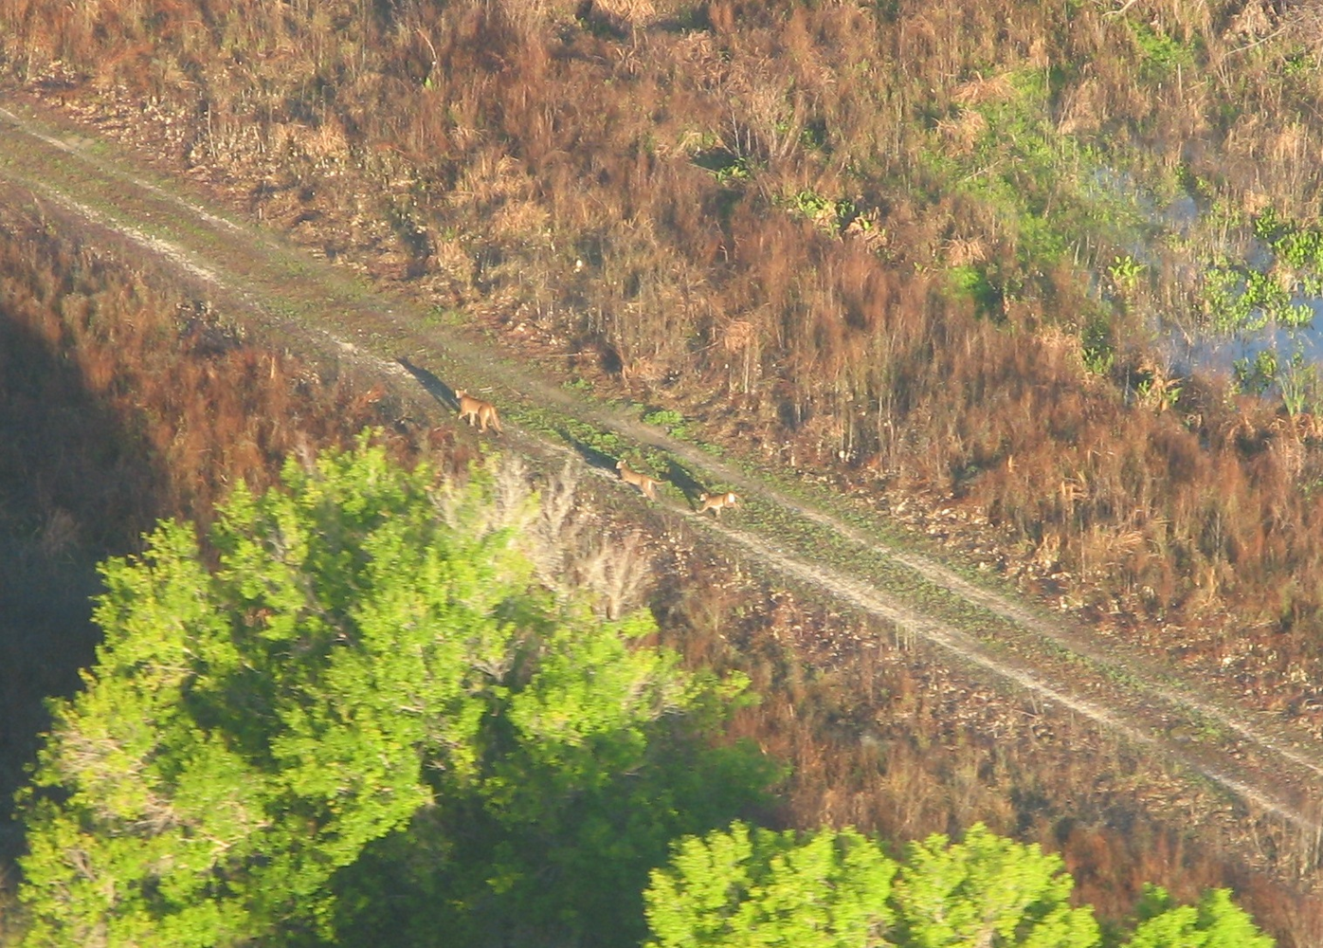
Questions?

