Slide 1

Introduction to Sovereignty Submerged Lands Lease and Easement Inspections
SLERCON June 10th, 2014
Notes:
Section 253.03(1), F.S., gives the Board of Trustees the broad authority to administer, manage, control, and supervise all lands owned by the Board of Trustees.

Slide 2
Sovereign Submerged Lands
DEP “regulates” activities that occur on state-owned, or sovereign / sovereignty, submerged lands
  Florida Constitution, Article X, Section 11: “The title to lands under navigable waters, within the boundaries of the state, which have not been alienated including beaches below the mean high water lines, is held by the state, by virtue of its sovereignty, in trust for all the people.”
Lands are held in trust for the citizens of Florida by the Board of Trustees of the Internal Improvement Trust Fund (Governor, Attorney General, Chief Financial Officer, and Commissioner of Agriculture)
  Board of Trustees has delegated authority to the Department and the Water Management Districts to review activities that require authorization
Notes:
“Sovereignty submerged lands” means those lands including but not limited to, tidal lands, islands, sand bars, shallow banks, and lands waterward of the ordinary or mean high water line, beneath navigable fresh water or beneath tidally-influenced waters, to which the State of Florida acquired title on March 3, 1845, by virtue of statehood, and which have not been heretofore conveyed or alienated. For the purposes of this chapter sovereignty submerged lands shall include all submerged lands title to which is held by the Board
When Florida became a state title to all land beneath navigable waters within the state boundaries became vested in the state. The state boundaries extend 3 miles offshore on the Atlantic coast and a little over 9 miles out on the Gulf Coast.
Article X Section 11 of the Florida Constitution states that those lands are to be held in trust for all the people.
The Board of Trustees of the Internal Improvement Trust Fund of the State of Florida holds title to sovereign submerged lands.

Slide 3
Statute and Rule Authority
Proprietary Program Statutes
-- Chapters 253 and 258, F.S.
Rules (F.A.C.):
  18-14: Administrative Fines
  18-18: Biscayne Bay Aquatic
  Preserve (only in Biscayne Bay –
  Dade and Monroe Counties)
  18-20: Aquatic Preserves
  18-21: Sovereignty Submerged Lands Management (your main rule source for lease/easement compliance issues)
Notes:
Chapter 253 is the State Lands Statute
Chapter 258 is the State Parks and Preserves Statute
Part II of 258 Covers Aquatic Preserves.
An Aquatic Preserve is an exceptional area of Submerged Lands and its associated waters set aside for being maintained essentially in its natural or existing condition.

Slide 4
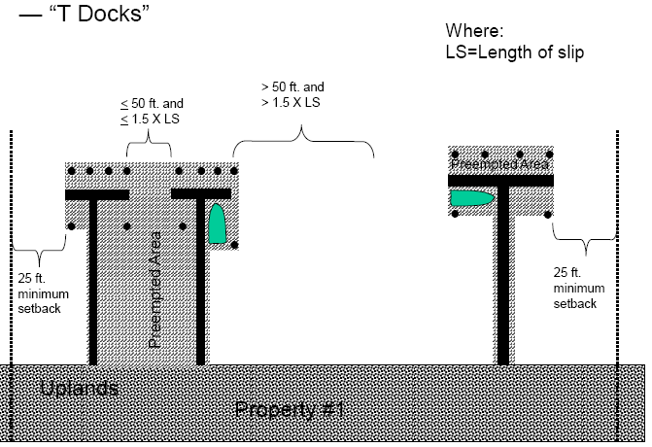
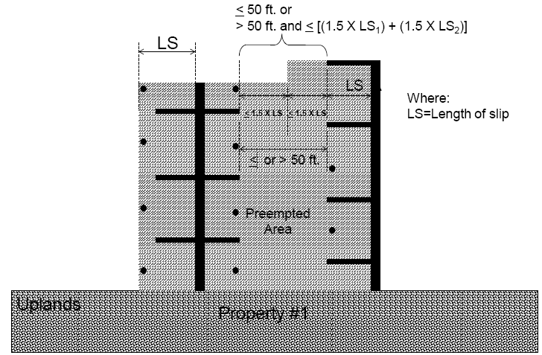
State Lands Vocabulary
  Preempted Area: “the area of sovereignty submerged lands from which any traditional public uses have been or will be excluded by an activity, such as the area occupied by docks, piers, and other structures . . . Including areas where mooring routinely occurs that are no longer reasonably accessible to the general public. . .”
  Basically, the lease “box”.
  Examples:
Notes:
The SLER 1004 in the OPM has some pretty good guidance with examples illustrating explaining how to determine preempted area. The presentation after this is a tutorial on the OPM so if you are not familiar with the OPM I encourage you to stick around for the next presentation.

Slide 5

State Lands Vocabulary
  Revenue generating: “any structure or activity on sovereignty submerged lands that generates revenue or income by any means or serves as an accessory activity or facility to any revenue-generating or income producing operation, such as docking for marinas, restaurants, hotels, motels, commercial fishing, shipping, and boat or ship construction, repair and sales. However, the following shall not be construed to be revenue-generating or income producing: the sole act of mooring a commercial vessel at the vessel owner’s private residential single-family dock; incidental aquaculture activities on a private residential dock or pier; rental of a private single-family residence with a dock or pier; or construction by a developer of a private residential single-family or multi-family dock or pier.”
Notes:
It is important to understand the term “revenue generating” because rule requires that all revenue generating activities on sovereign submerged lands be authorized through a submerged lands lease.
If you rent a house with a dock on state lands behind it the homeowner does not need a lease.
If you rent an apartment unit and the apartment complex has a dock the dock would need a lease.

Slide 6
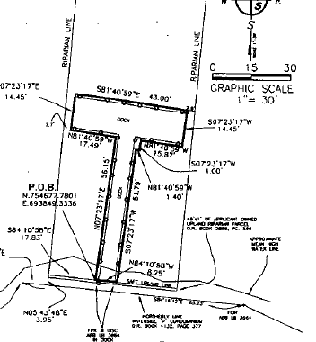
State Lands Vocabulary
  Riparian Rights: “those rights incident to lands bordering upon navigable waters as recognized by the courts and common law”.
  Surveys show the lease “box” and the surveyor’s opinion of riparian lines. DEP’s Bureau of Survey and Mapping may review riparian lines for consistency with commonly agreed to standards, but does not establish or “approve” riparian lines.
Typical riparian lines: basically drawn from the navigation channel landward to the intersection of mean high water and upland owner’s property lines. More guidance available in SLERC Operations and Procedures Manual (OPM) on DEP intranet site. http://depnet/wrm/sler/erp/docs/slerp_online/LeadPage.pdf
Notes:
Riparian rights include such things as the right to access for swimming, boating and fishing; the right to erect structures such as docks, piers, and boat lifts.
The state lands rules require applicants to have riparian rights in order to be granted authorization to use sovereign submerged lands except for activities that occur offshore.
Additionally, if proposed activities extend within 25 feet of riparian rights lines, setback waivers must be obtained from the neighboring property to which the activity comes within 25 feet.
This image shows that dock is a couple of feet from the riparian lines. So, a setback waiver from both neighbors would be required.

Slide 7
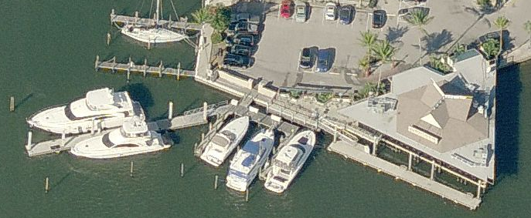
State Lands Vocabulary
  Water Dependent Activity: “an activity which can only be conducted on, in, over, or adjacent to water areas because the activity requires direct access to the waterbody or sovereign submerged lands for transportation, recreation, energy production or transmission, or source of water, and where the use of the water or sovereign submerged lands is an integral part of the activity.”
Non-water dependent restaurant
Water dependent docks
Notes:
So, roads, bridges, docks, fishing piers, utility lines are considered water dependent per rule definition.
18-21.004(1)(g) Activities on sovereignty lands shall be limited to water dependent activities only unless the board determines that it is in the public interest to allow an exception as determined by a case by case evaluation.
Public projects which are primarily intended to provide access to and use of the waterfront may be permitted to contain minor uses which are not water dependent if:
1. Located in areas along seawalls or other nonnatural shorelines;
2. Located outside of aquatic preserves or class II waters; and
3. The nonwater dependent uses are incidental to the basic purpose of the project, and constitute only minor nearshore encroachments on sovereign lands.
(h) Stilt house, boathouses with living quarters, or other such residential structures shall be prohibited on sovereignty lands.

Slide 8
State Lands Vocabulary
  Easement: “a non-possessory interest in sovereignty lands created by a grant or agreement which confers upon the applicant the limited right, liberty, and privilege to use said lands for a specific purpose and for a specific time.”
  Lease: “an interest in sovereignty lands designated by a contract creating a landlord-tenant relationship between the board as landlord and the applicant as tenant whereby the board grants and transfers to the applicant the exclusive use, possession, and control of certain specified sovereignty lands for a determinate number of years, with conditions attached, at a definite fixed rental.”
  Both are real estate contracts.
Notes:
Easements and leases are two forms of state lands authorization. The easement grants a limited right, liberty, and privilege use state lands for a specific purpose and for a specific time.
The lease is grants exclusive use, possession and control of sovereign submerged lands for a determined amount of time at a fixed rental.

Slide 9
Who Has a Lease?
Multi-slip docking facilities serving upland residential condominiums and subdivisions.
Various revenue generating activities such as commercial marinas, yacht clubs, restaurants. hotels, commercial fishing, mooring fields, etc.
Larger single-family docking facilities.
Notes:
Brush up on SF dock criteria in AP, roofs, etc. Review new guidance on minimum-dock size criteria.
“Minimum-size dock or pier” means a dock or pier that is the smallest size necessary to provide reasonable access to the water for navigating, fishing, or swimming based on consideration of the immediate area’s physical and natural characteristics, customary recreational and navigational practices, and docks and piers previously authorized under this chapter. The term minimum-size dock or pier shall also include a dock or pier constructed in conformance with the exemption criteria in Section 403.813(1)(b), F.S., or in conformance with the private residential single-family dock criteria in subsection 18-20.004(5), F.A.C.
Those make up the majority of the submerged lands leases. In addition, there are some grandfathered stilt house lease and hunting camp leases. Also some swim areas. There are also special events leases which are used to authorize boat shows.

Slide 10
Who Has an Easement?
Linear structures such as bridges and utility lines.
Shoreline protection structures such as groins/breakwaters.
Some navigation channels.
Some intake and discharge structures.
However, utility lines installed/maintained by counties qualify for an exception in 153.04, F.S.
Notes:
Public easement vs. private easement?
Many easement’s are non-exclusive, meaning that there is not necessarily any preempted area. An example would be a pipeline which is installed below the surface of the submerged bottom, or transmission lines or bridges where the public still has the ability to recreate underneath them.

Slide 11
Lease Compliance Inspections
(Why and When)
Annual renewal/midterm requests from Division of State Lands (DSL).
Reassignment requests from DSL.
Complaints
ERP permitting requests
ERP permit inspections (transfer to operation requests)
Notes:
18-21.008(1)(b)3. Leases are renewable, modifiable, and assignable, subject to: approval by the Board under this rule; compliance with the statutes and rules of the Board in effect at the time of lease renewal, modification or assignment that apply to or affect sovereignty submerged lands, including those that require modification of existing legally authorized structures… Non-compliance with any material term or condition of the lease to be renewed, modified or assigned or of any other current or prior lease between the applicant and the Board; evidence of the applicant’s previous trespass, damage, or depredation to sovereign submerged land or the products thereof caused by the facility or use; or failure to pay any fees or fines assessed under Rule 18-21.011 or Chapter 18-1, F.A.C., for such leases; shall result in termination of the lease, corrective action, or enforcement under Section 253.04, F.S., or Chapter 18-14, F.A.C. No application to renew, modify or assign the lease shall be approved unless all such non-compliance is corrected.

Slide 12
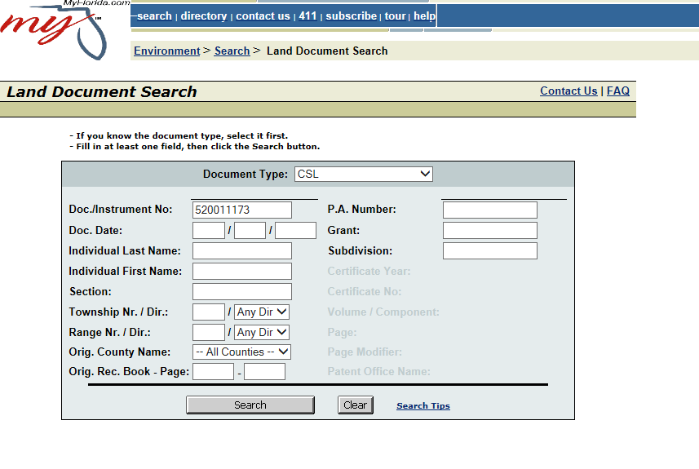
Board of Trustees Land Document System (BTLDS)
http://199.73.242.56/default.asp
BTLDS (“boatloads”) can be accessed via the Division of State Lands Intranet site. http://depnet/stland/
FAQs for abbreviations of document types
Enter Lease #
Notes:
You can find the land document system on the Division of State Lands intranet site. Explain how to search for a submerged lands lease/easement.
For easements the Document Type Code Is TFI

Slide 13
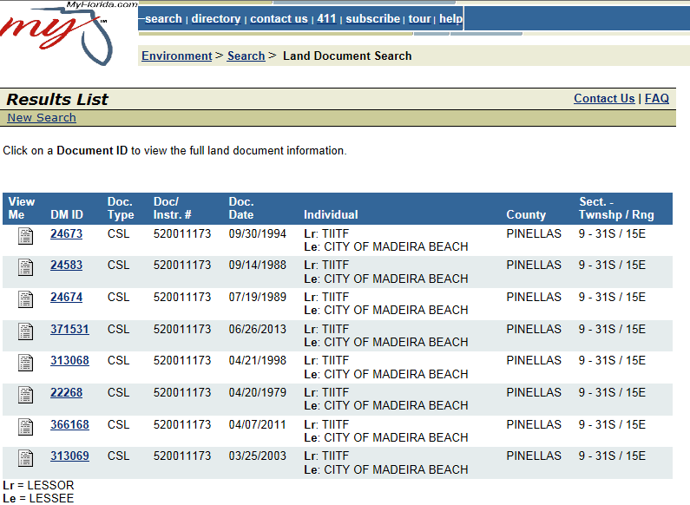
BTLDS Document Search
Initial lease and subsequent renewals and modifications
Notes:
You are going to have your initial lease and subsequent renewals and modifications.
You will want to take the most recently executed lease with you for your inspection, since the others are no longer valid.
In the past only leases and easements that were recorded in the County records for where they are located were placed into BTLDS.

Slide 14
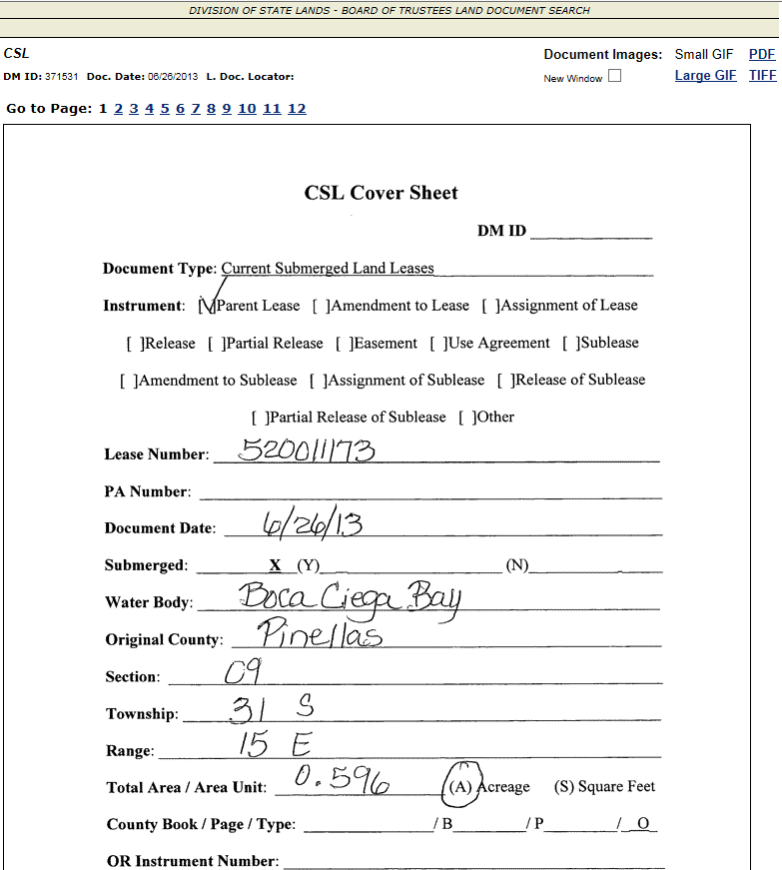
BTLDS Document Search (continued)
Notes:
Mention lease cover sheet is the first page of the document in btlds

Slide 15
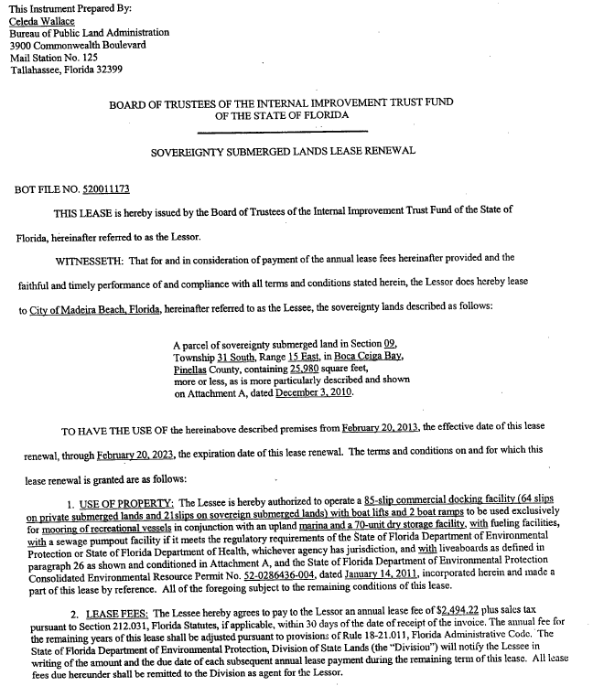
Lease Instrument

Slide 16
Pre-Inspection Steps
Review latest lease/easement for:
- what’s authorized (see page 1 of instrument)
- special conditions
- survey/sketch attachment
Review current and recent (last few years) aerial photos to confirm mooring is generally within lease boundary (may not be able to determine exactly, but obvious non-compliance may be determined).
Review revenue reporting and payment status on ILMS and SUPRS.
Review Environmental Resource Permit or Consent Order referenced on page 1 of the lease/easement.
Possible pre-notification to lessee/grantee: email copy of lease/easement and inspection report template.
Notes:
Jimmy Wright will be providing and ILMS/SUPRS training tomorrow. Prior to inspecting a facility an inspector needs to see if the lessee has any past due lease fees invoices or if revenue reporting forms are due. If they do you will want to attempt to hand deliver the invoice or reporting forms.

Slide 17
Pre-Inspection-Other Programs?
  NPDES Stormwater
  Hazardous Waste
  Solid Waste
  Air
  Tanks
  Industrial Waste Water
  Clean Marina
Notes:
Good opportunity for cross training with other staff. CAP is multimedia we as inspectors should always be thinking about what other program areas may need to be addressed during out inspections.

Slide 18
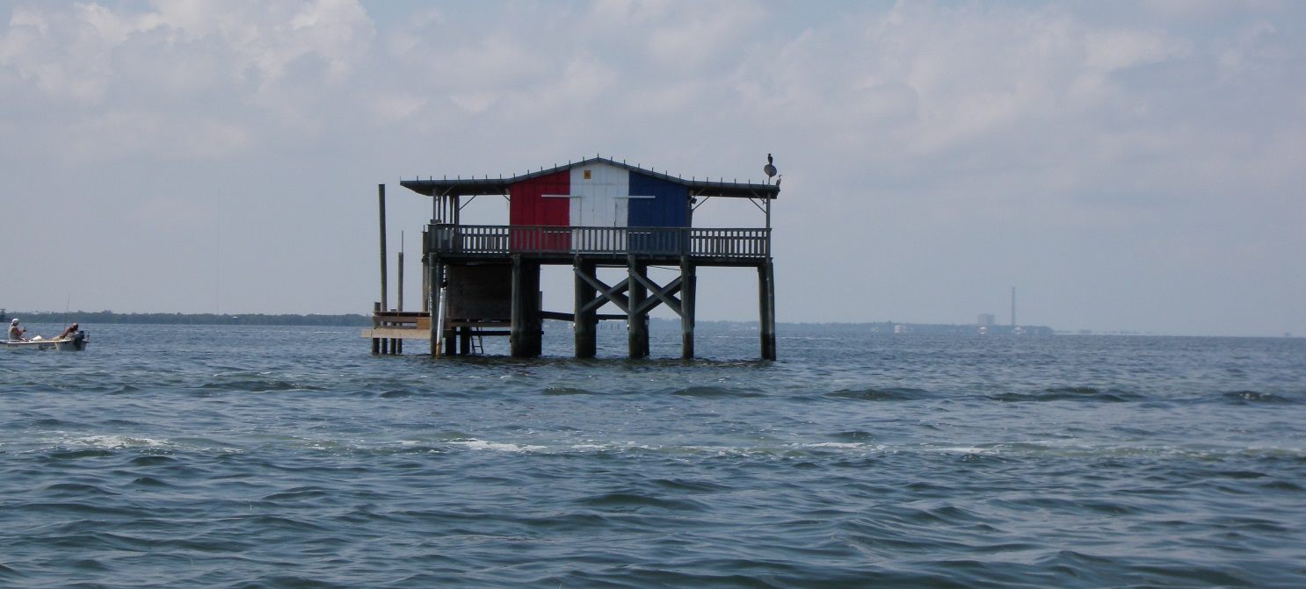
Pre-Inspection Steps-Safety
  If traveling by boat, complete Float Plan and leave copy with supervisor.
  What will the weather conditions be? Rain, wind, lightning, and temperature can affect safety considerations.

Slide 19
Inspection Tools - Safety
Depends on type of inspection (in water, on dock, etc.) and means of travel (vehicle only, boat, etc.)
  Bug Spray
  Sunscreen
  Water
  Sunglasses
  Hat
  Cellphone
  If getting in the water, snorkeling equipment (are you DEP certified?) including dive flag, weather, current, boat traffic.

Slide 20
During Your Inspection-Safety
Observe your surroundings for potential safety concerns.
  At marinas: watch for equipment (errant fork lifts can ruin your day), slippery areas from water, oils and greases.
  In the water: Weather, current, water temperature (avoid hypothermia), boat traffic, wildlife.

Slide 21
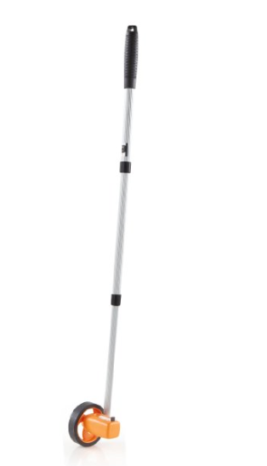
Inspection Tools (continued)
Copy of Lease
Copy of lease inspection report
Copy of ERP permit / consent order
Camera
Tape measure
Measuring pole
Measuring Wheel

Slide 22
Lease Inspection Focus
Are all structures (docks, pilings) and activities (mooring, etc.) within the lease area and match the structures shown on the survey/sketch. Are the uses observed consistent with what’s authorized in the lease?
Are all special lease conditions in compliance?
Are all signs installed and visible? Usually manatee signs, “no mooring” signs, etc.
Resource issues: evidence of prop dredging, turbidity or other resource impacts?
Notes:
Maybe change this to inspection report

Slide 23
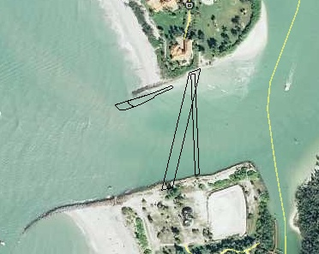
Easement Inspection Focus
Gordon Pass, Collier County
Two subaqueous utility lines
Groin/
Breakwater (GIS layer a bit off)
Question: How do you inspect a subaqueous utility line buried several feet below the bottom of a river/bay/pass?
Answer: Good question. Next question.
Notes:
When it comes to easement inspections, you are just trying to see if what was authorized is still in use, and who is using it. If there are any changes to what was authorized. A two lane bridge is now a four lane bridge. Gulf Coast Heritage- A footbridge had a step down dock to access boats.

Slide 24
Common Non-compliance
Structures added within the lease area.
Structures and/or mooring activities located outside of the lease area.
Non-compliance with special lease conditions.
Advertising the sale of alcohol on/over sovereign submerged lands.
Unauthorized liveaboards.
Non-compliance with use of property paragraph.

Slide 25
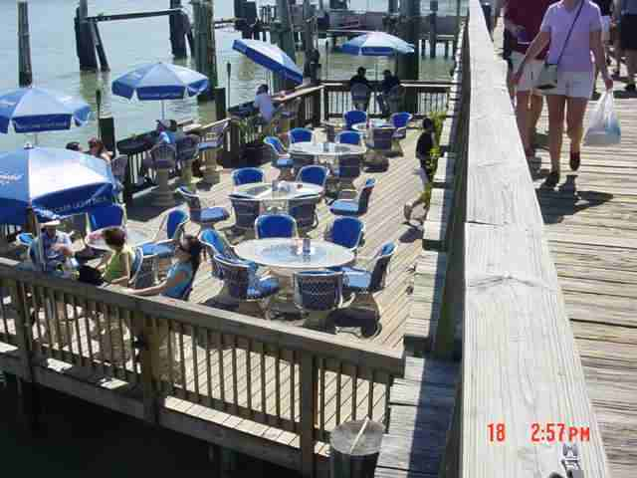
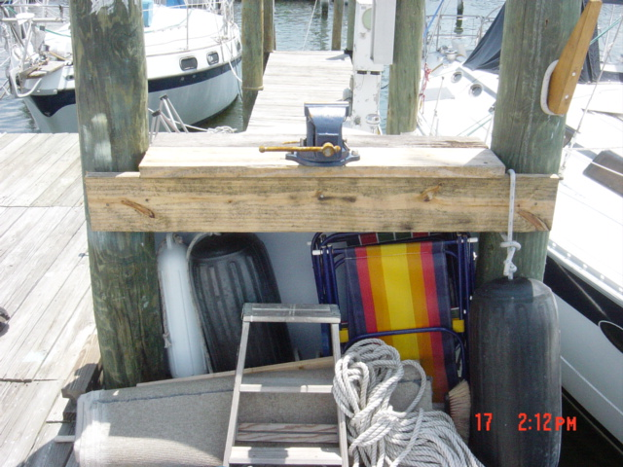
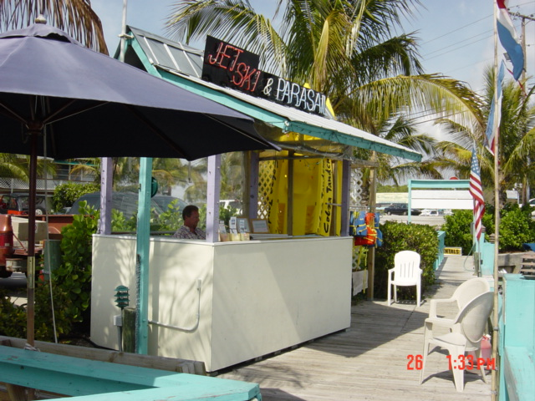
Non-Water Dependent Structures
Dining Activities
Ticket Booths
Work Bench
Notes:
Remember a water dependent activity “an activity which can only be conducted on, in, over, or adjacent to water areas because the activity requires direct access to the waterbody or sovereign submerged lands for transportation, recreation, energy production or transmission, or source of water, and where the use of the water or sovereign submerged lands is an integral part of the activity.”

Slide 26
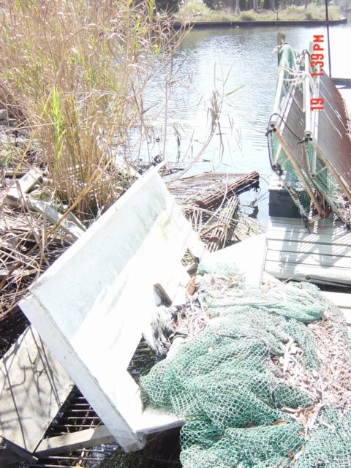
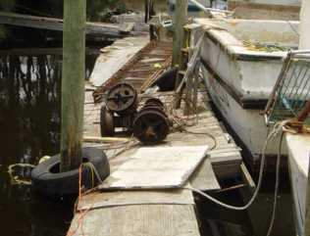
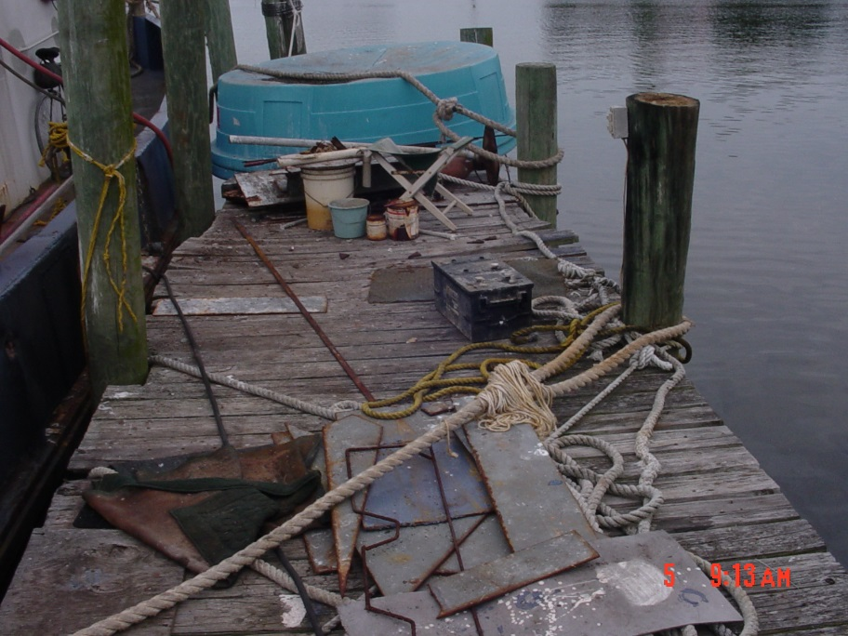
Unsafe Clutter on Docks
Environmental
And Safety
Issue
Notes:
One of the standard conditions in submerged lands leases requires the lessee to maintain the leased premises in good condition. Having clutter and garbage on the dock is one of the common non-compliance issues inspectors come across during inspections. The only solution to this issue is to clean up the mess.

Slide 27
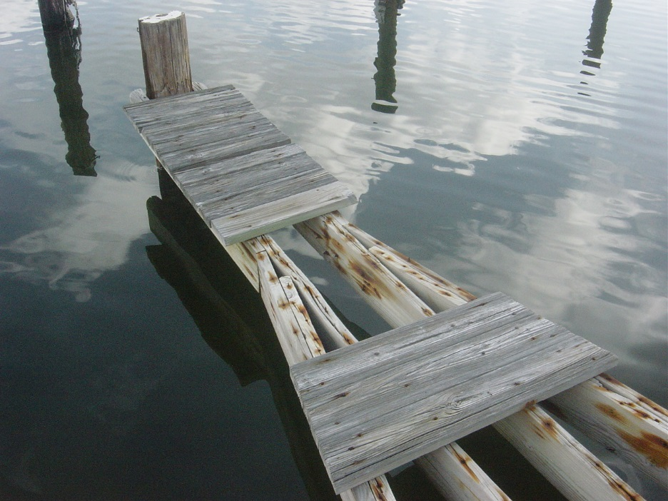
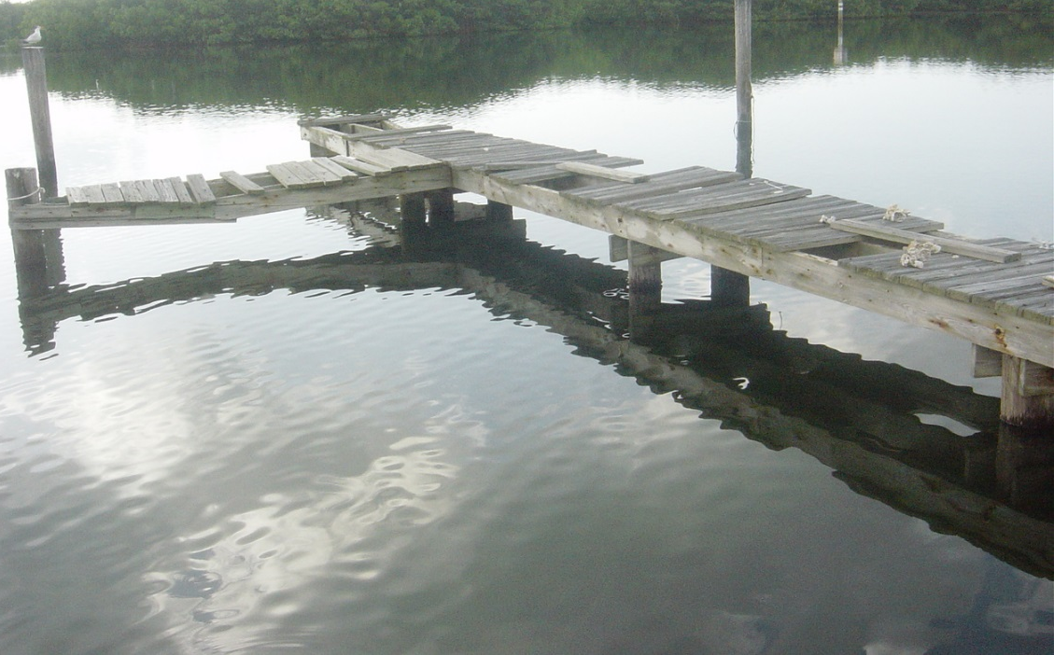
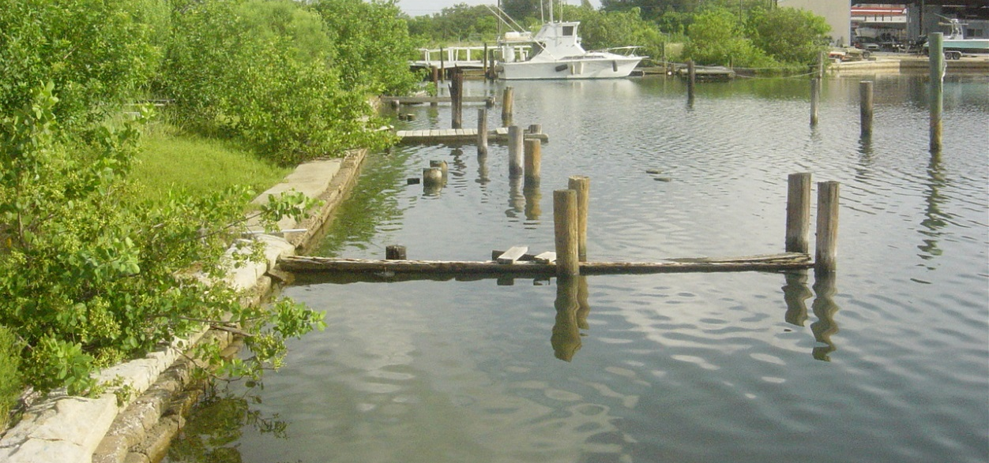
Docks in Disrepair/Unsafe
Notes:
Another common non-compliance issue is docks in disrepair.
The same standard lease condition that requires the lessee to maintain the leased premises in good condition, also requires keeping the structures in a good state of repair.
I have had lessees remove portions of facilities or the entire facilities from the water to comply, so they would not need a lease to comply. Most times they just repair the docks.

Slide 28
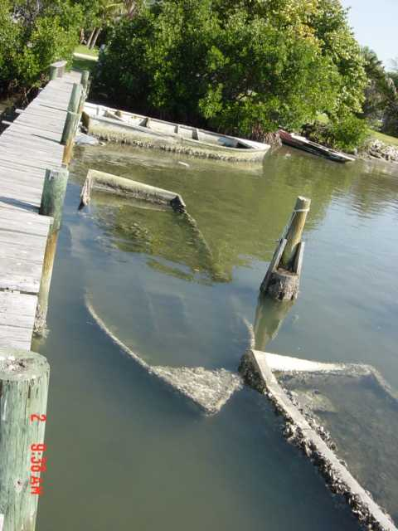
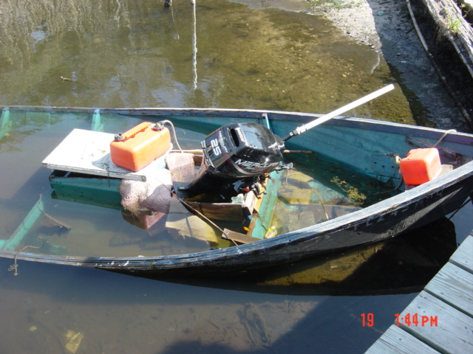
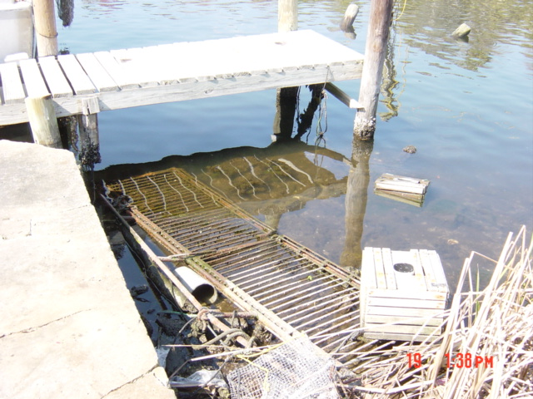
Derelict Vessels/Dumping
Notes:
"Derelict vessel" means any vessel that is left, stored, or abandoned: in a wrecked, junked, or substantially dismantled condition upon any public waters of this state, at any port in this state without the consent of the agency having jurisdiction thereof, or docked or grounded at or beached upon the property of another without the consent of the owner of the property.
There is a Derelict Vessel Removal Grant Program all local governments are eligible for participation in this program. It does run out of funding

Slide 29
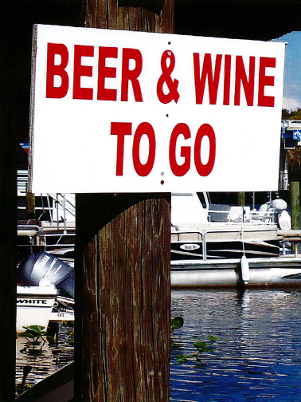
Sale of Alcohol on SSL
The Board of Trustees have historically prohibited advertising the sale of alcoholic beverages on SSL
Standard Lease Condition
Notes:
Another standard lease condition prohibits signs advertising the sale of alcoholic beverages within the leased premises.

Slide 30
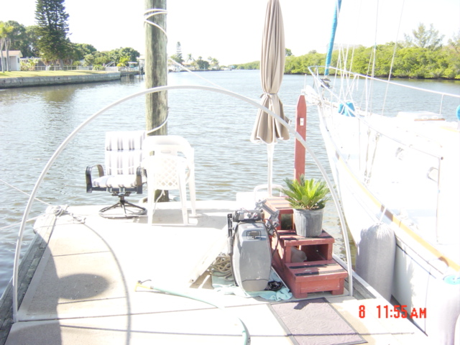
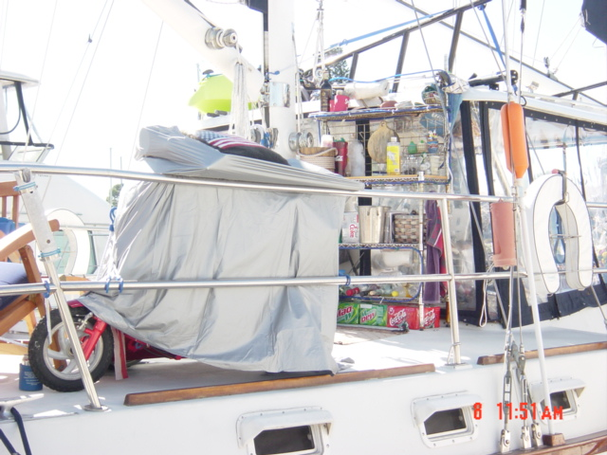
Liveaboards
Not more than 5 days straight
No more than 10 days in 30
Never more than 6 mo/yr
Never permanent residence
Notes:
Most leases prohibit liveaboard vessels from staying within the leased premises. This can be a difficult compliance issue to prove. Some evidence you might see of liveaboards are chairs with umbrellas, grills, potted plants, satellite dishes, and my favorite the “home sweet home” welcome floor mat. Some docks start to look like a front porch or garage. When you ask the dockmaster if they have liveaboards at the marina they say there is not. I like to strike up a conversation with the tenants at the marina.

Slide 31
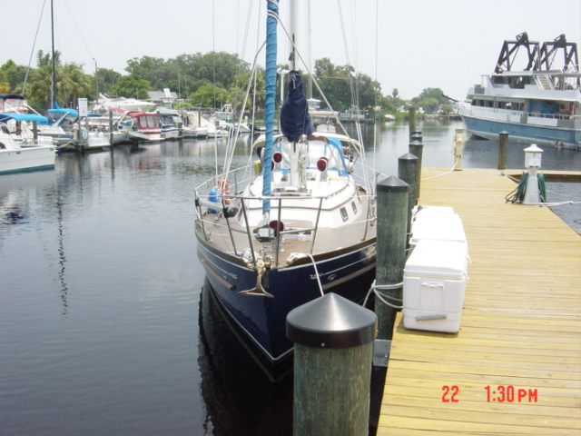
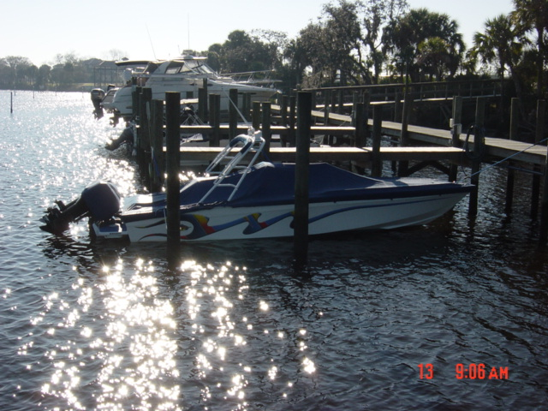
Mooring Outside Lease Area
What size vessels do the slips allow?
Could the boat fit if moored differently?
Even temporary moorings
must be within the lease area.

Slide 32
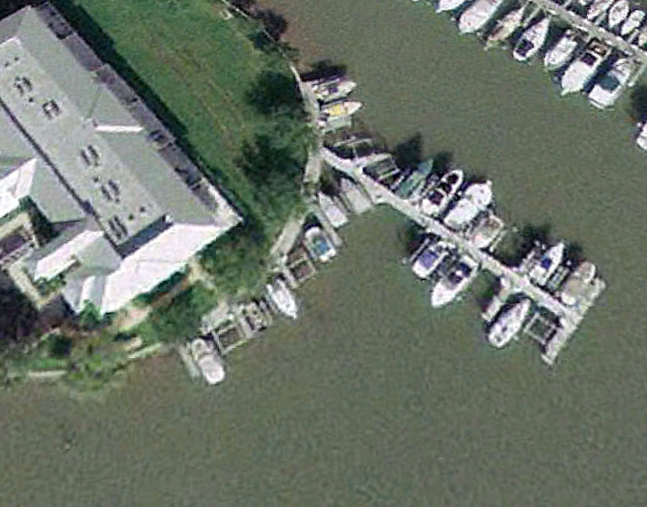
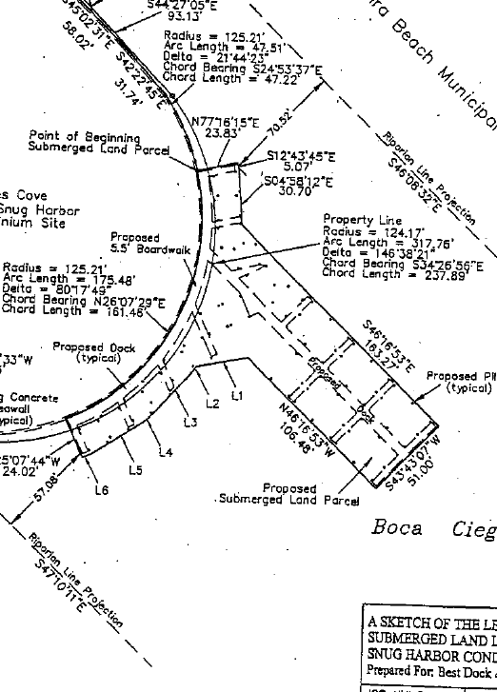
Mooring Outside Lease Area
Lease Survey “Box”
Aerial

Slide 33
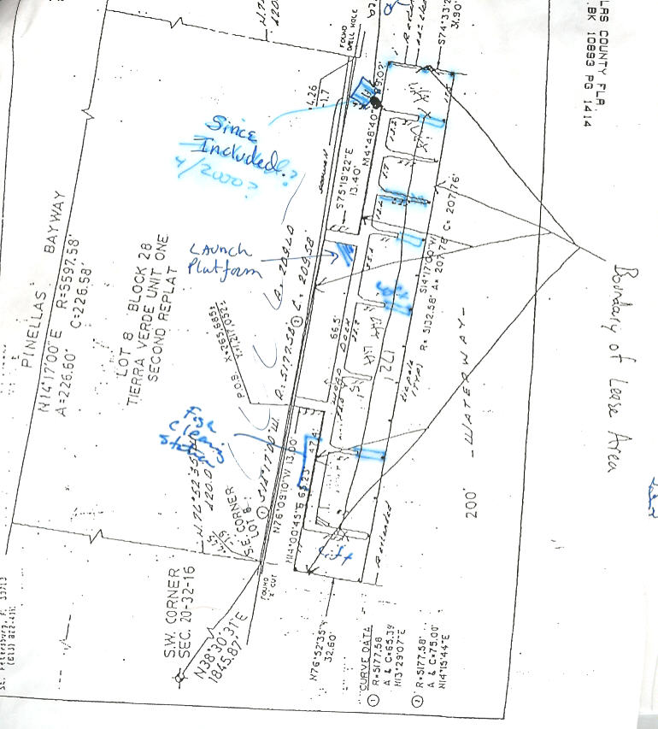
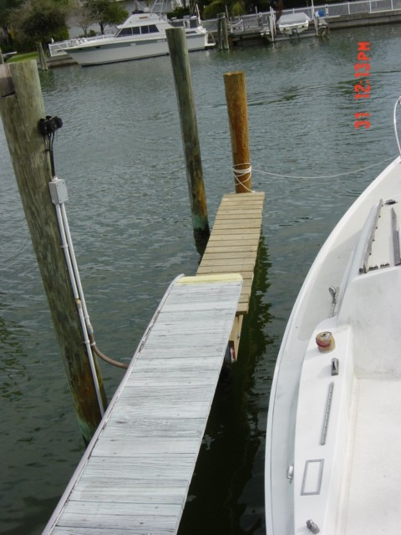
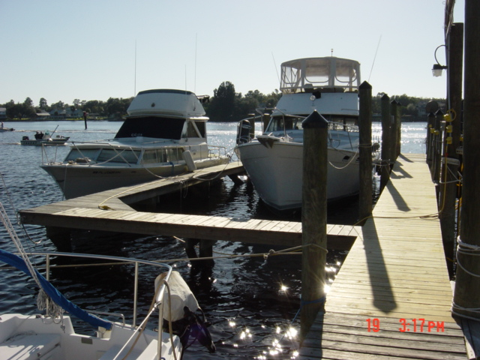
Structural Additions
- Inside lease area or outside?
- Increase in number of slips?

Slide 34
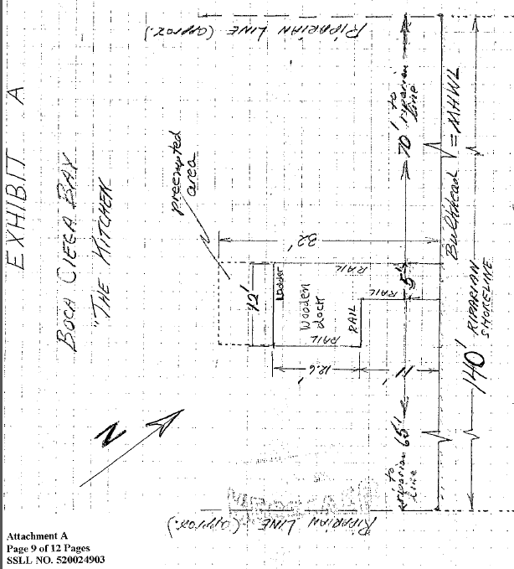
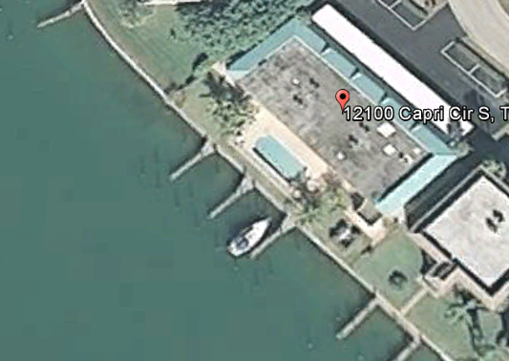
Structural Additions/Reconfigurations
Grandfathered Facility Sketch
Aerial
Notes:
Many leases that were authorized through grandfathering have sketches of the lease area done by the applicants or Department staff. Leases that are not grandfathered are required to have a field survey or a sketch done by a surveyor.
This is a site I inspected where the lease authorized a fishing pier for an apartment complex. When I got their I saw that the apartment complex was in the process of being converted to condo units and the fishing pier was removed and replaced with a 6-slip docking facility.

Slide 35
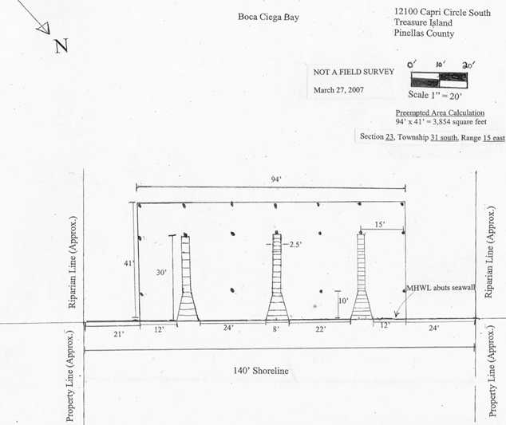
Structural Additions/Reconfigurations
Notes:
The upland owner wanted to try and get after the fact authorization for the facility so I had to put together a sketch to use in a TUA. would be required to

Slide 36
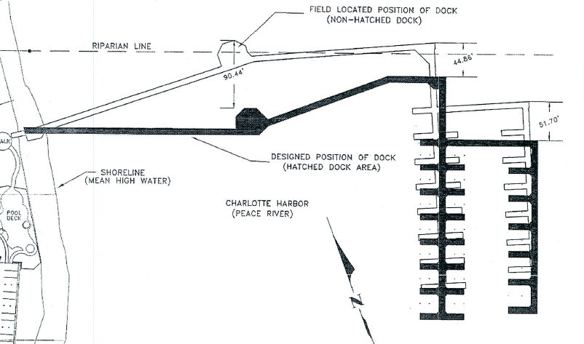
Structure Outside Lease Area
Notes:
This is a drawing I got from the SD. This is a facility that was permitted by the WMD. So, when doing an ERP transfer to operation we need to make sure that the structure is constructed as proposed because a deviation could result in the facility being outside the footprint of the lease.
In this drawing it appears the dock was constructed beyond the riparian area of the applicant, so unless if the applicant is able to get the neighbor to be a co-lessee or acquire riparian rights to the area the dock is now encroaching in the dock will need to be modified.
Neighboring property was County’s riparian rights easement.

Slide 37
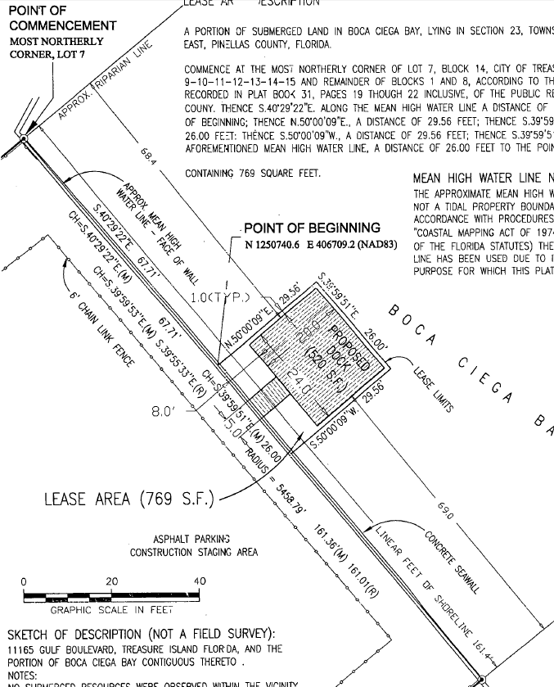
Structure Outside Lease Area

Slide 38
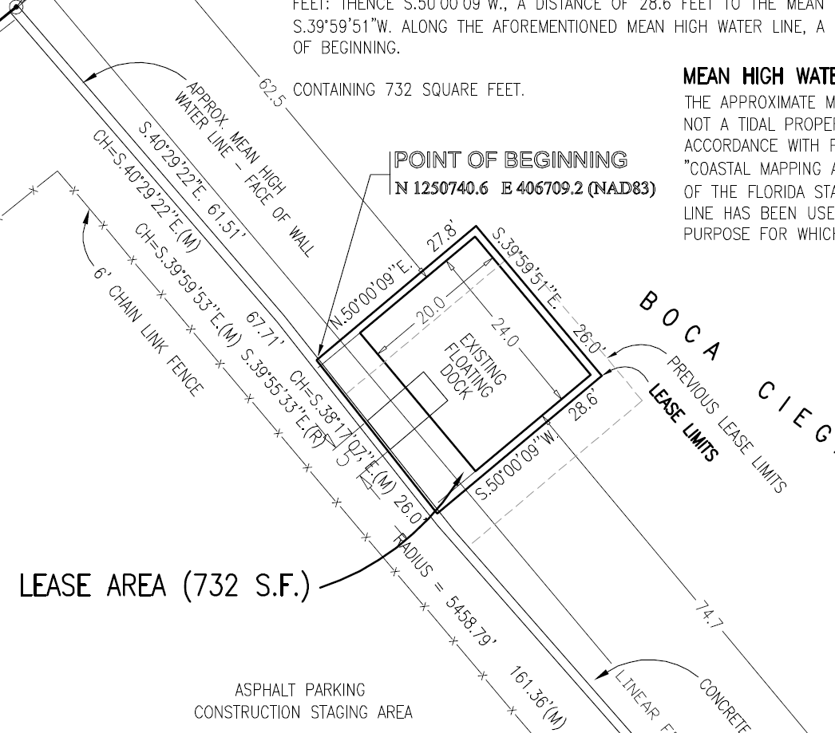
Structure Outside Lease Area

Slide 39
Non-Compliance w/ Special Lease Conditions
Common Examples
Failure to install/maintain required handrails and “no mooring” signs in areas where mooring is not to occur because of shallow water, areas excluded from lease, etc.
Failure to install/maintain required manatee signs.
Failure to install/maintain open to the public signs.

Slide 40
Post-Inspection
Prepare inspection report.
Submit completed inspection report for internal review.
Update ERPce and any applicable spreadsheets (CATT, Exposure Log, etc.) to document inspection and any observed non-compliance.
Email copy of approved inspection report to Kathy Griffin in the Bureau of Public Lands Administration.
Enter inspection report PDF in Oculus.

