Slide 1


Slide 2

SLER Operations and Procedures manual
Compliance Assistance Program Overview
Notes:
Good morning CAPS. My name is Allyson Minick and I work for the Submerged Lands and Environmental Resource Coordination Section in Tallahassee. I am responsible for the maintenance of the SLER Operations and Procedures Manual ( also, known as the OPM). This is a living document that is updated routinely and has many contributing authors. It is an incredible resources with TONS of updated and historic information that you may not be aware of….

Slide 3
What is the OPM?
Online Operations and Procedures Manual for the Submerged Lands and Environmental Resource Program
Contains information on the history of the program.
Current and historic guidance
Living document that is continuously updated
Notes:
the OPM contains lots of important information and guidance for the Submerged Lands and Environmental Resource program.

Slide 4
Accessing the OPM
The OPM can be accessed by DEP staff at: http://depnet/wrm/sler/erp/docs/SLERP_Online/MainIndex.pdf
External access for WMD’s and local delegated governments is available at:
http://depnet/wrm/sler/erp/docs/SLERP_Online/MainIndex.pdf
The Manual is also accessible through the Water Resource Management, Division Page http://water/wrm/, then selecting “Submerged Lands and Environmental Resources” under the “Programs” drop down menu.

Slide 5
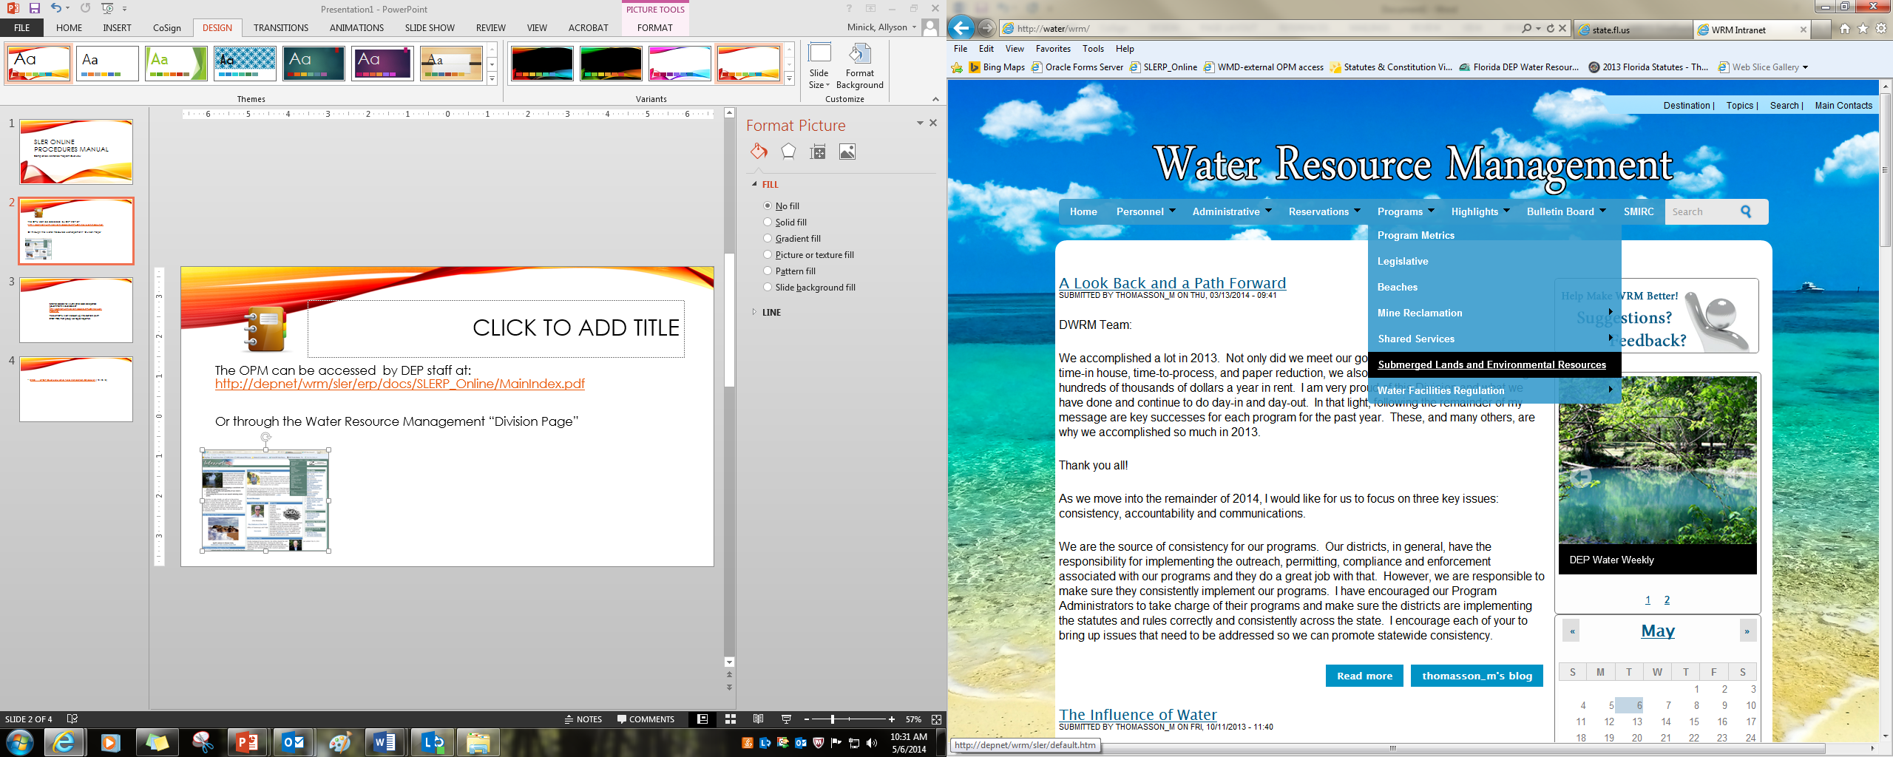

Slide 6
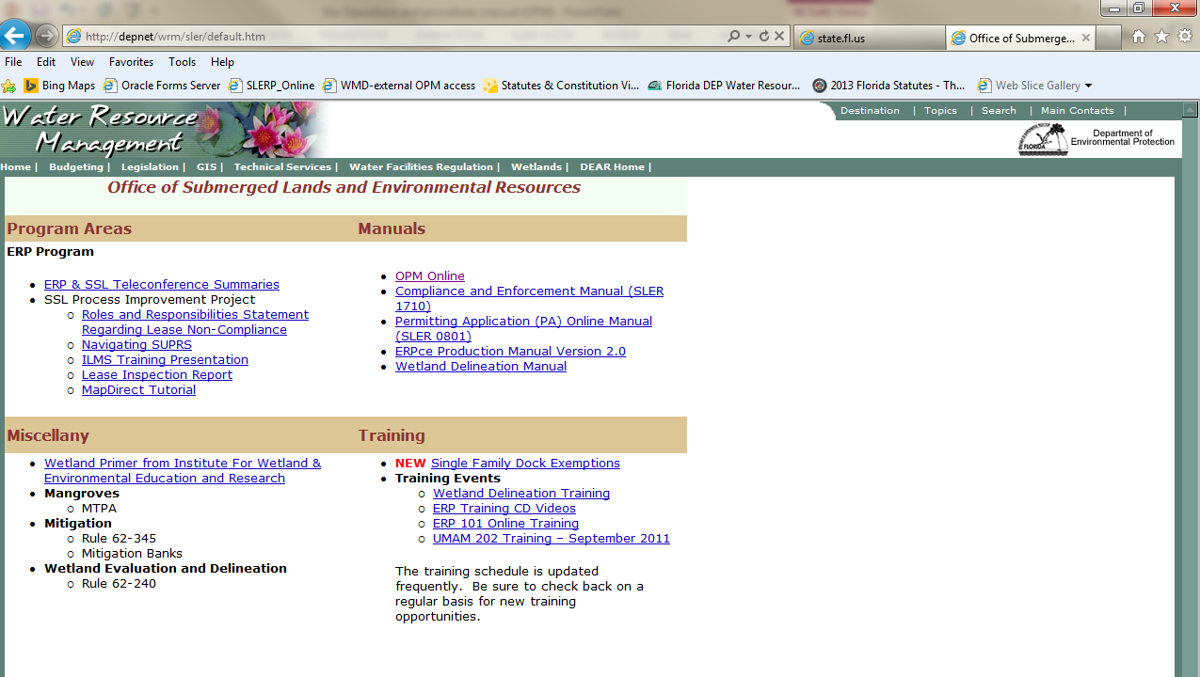

Slide 7
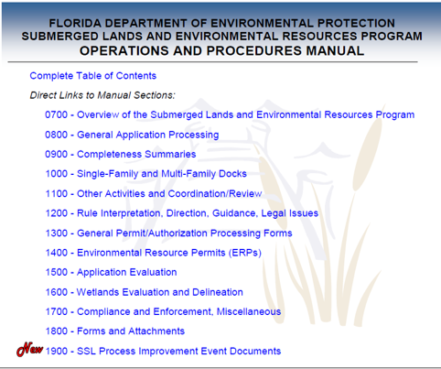
OPM Main Page
Contains:
A link to the Complete Table of Contents (15 pages)
Links to each of the Manual Sections (SLER 0700 to 1900)
Labeled Section Headers

Slide 8
ORGANIZATIONAL BREAK DOWN
Section Headers

Slide 9
Organization
Broken up into sections (SLER 0700- SLER 1900)
Each section groups like subjects (or like processes).
SLER 0700, Reference and Historical Information, contains valuable historical guidance and all delegation and interagency coordination documents. This includes the NEW 0700 SPGP Overview and Field Inspection Checklist for CAPS.

Slide 10

SLER O800 - 0900
SLER 0800, General Application Processing, contains proprietary guidance and forms such as information on title determination, resource surveys, DOA and Agenda procedures, Interagency Coordination, Frequently Asked Questions, etc.
SLER 0900, Completeness Summaries, contains routing memo’s for requesting CZM comments or EHG engineering reviews. Instructions for initial review of an application, Request for Additional Information forms and templates.

Slide 11
SLER 1000
SLER 1000, Single-Family and Multi-Family Docks, contains guidance on docks, docks in Aquatic preserve, docks in OFW’s, exempt docks, multi-family docks, multi-family docks, and proprietary rule criteria for docks.

Slide 12

SLER 1100
SLER 1100, Other Activities and Coordination/Review, contains guidance on coordination and processing of activities such as aquaculture, aerial transmission lines, boat ramps, dredging, seawalls, lease fees in arrears, roofed slips in AP’s, ACQ guidelines, film industry projects, navigational aids, siting act, superfund sites, CCCL, post certification submittals, DOT projects on SSL, and gas pipeline repair.

Slide 13
SLER 1200 -1300
SLER 1200, Rule Interpretation, Direction, Guidance, Legal Issues, includes BOT Direction to Staff, 62-25 and storm water management guidance, ADA compliance guidance, as well as info on federal navigation servitude, Indian Lands projects, etc.
SLER 1300, General Permit/Authorization Processing Forms, includes templates for all ERP permit documents and guidance on when to use them.

Slide 14
SLER 1400 - 1500
SLER 1400, Environmental Resource Permits (ERP’s), contains guidance on the evaluation, modification, transfer, duration, suspension and Revocation of ERP’s. Also includes guidance on variances, mitigation banks, and PE certification/signing and sealing by DEP PE’s.
SLER 1500, Application Evaluation, contains Water Quality and Sediment Data, Information on Reporting, Polymers and Flocculants, Mitigation Procedures and Conservation Easements, etc.

Slide 15
SLER 1600
SLER 1600, Wetlands Evaluation and Delineation, Formal Determination Information (updates in progress), Point Description worksheet, guidance on informal delineations, overview of federal and state wetland delineation vs. jurisdiction, minimum flow inundation for surface waters, etc.
SLERC Wetland Contacts
Camille Beasley- 58493
Stephanie “Lisl” Hinrichs- 58385
Eric Hickman- 58496

Slide 16
SLER 1700
Updated
SLER 1700, Compliance and Enforcement, contains links to OGC’s Compliance and Enforcement Manual, DEP Directive 923, Guidelines for Characterizing ERP violations, Field Warning Letters (SED), Model SLERP/CO, OGC org chart, NOUS information, State Lands Inspection form, etc.
LINKS TO OGC’s WEBSITE FOR TEMPLATES AND GUIDANCE

Slide 17
SLER 1800 - 1900
SLER 1800, Forms and Attachments, links to a PDF document which provides quick links to most forms within the OPM in alphabetical order.
SLER 1900, Process Improvement, contains resources for staff, training information, contact information, checklists, etc.

Slide 19
NEW AND UPDATED PROCEDURES
The last 2 pages of the Complete Table of Contents (pages 14 and 15) highlight new and updated forms or procedures.

Slide 20
CAP HIGHLIGHTS
Overview of useful documents for staff outside of the1700 section

Slide 21
Important Procedures
0700 SPGP Overview and Field Inspection Checklist (12.18.13)
SPGP compliance inspections required on a minimum of 10% percent of all projects issued with SPGP green.
0710 Interagency Agreements
Important information for determining whether the ERP activity is covered by a local delegation or falls to a WMD per the Operating agreements.

Slide 22
0810 – Title Determinations
Process for determining whether the activity is on State owned lands and therefore is required to meet both regulatory and proprietary rule requirements.
1017 – Proprietary Rule Criteria for Docks
Summary table of proprietary rules for each type dock (exempt, general permit, individual) including AP criteria and forms of authorization (Consent by Rule, Letter of Consent, Lease, or Easement)
1120 – Mangrove Trimming and Alteration
Review of 1996 Mangrove Trimming and Preservation Act includes FAQ section and trimming illustrations

Slide 23
1300 - Technical Staff Report
Contains the “regulatory basis of issuance.” Conditions for issuance and additional conditions of issuance of an ERP.
1515 – Conservation Easements
Instructions for processing and recording a conservation easement
1900 – SLERC, EHG and DSL Contacts
Updated contact information

Slide 24
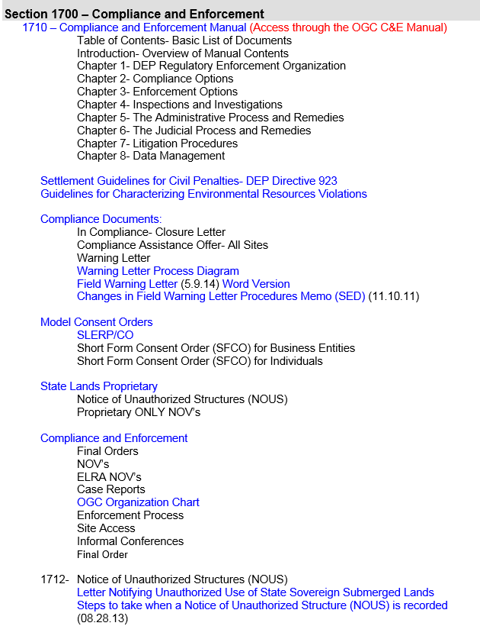
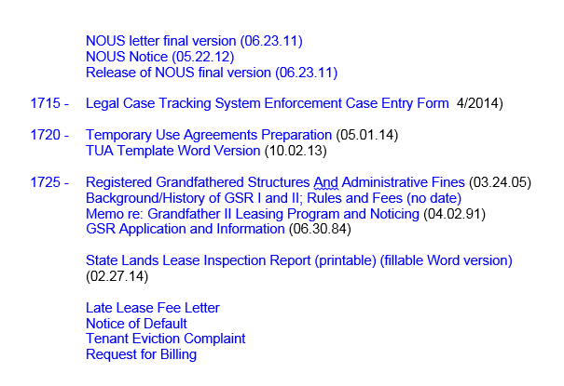
Section 1700 – Compliance and enforcement

Slide 25
Future OPM
A cheat sheet has been created to help identify frequently used guidance
The cheat sheet will be accessible from the OPM
The cheat sheet follows the order of the OPM
Documents are identified by section number which contain an active link to the actual document
Sections have a brief summary explaining the guidance contents

Slide 26
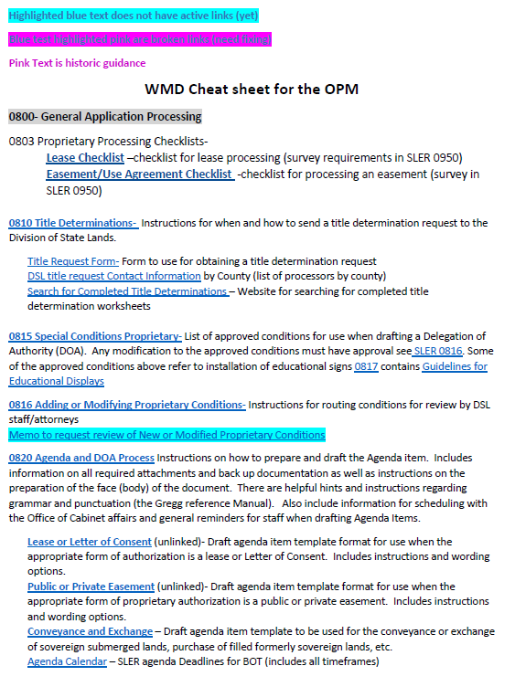
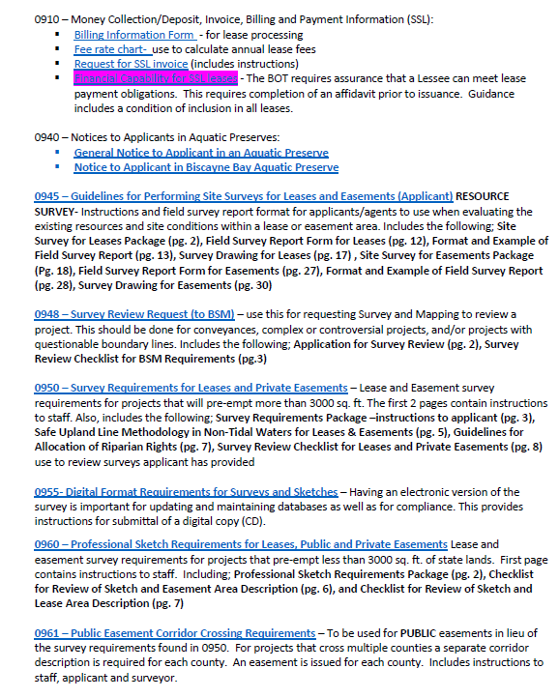
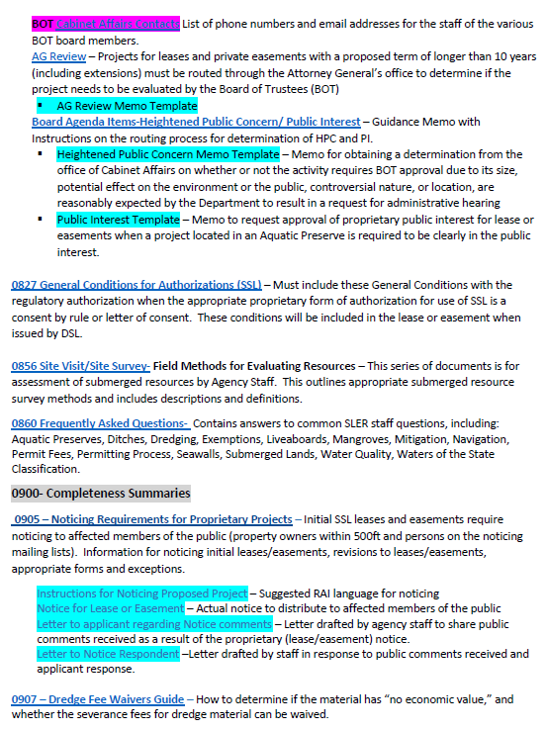

Slide 27
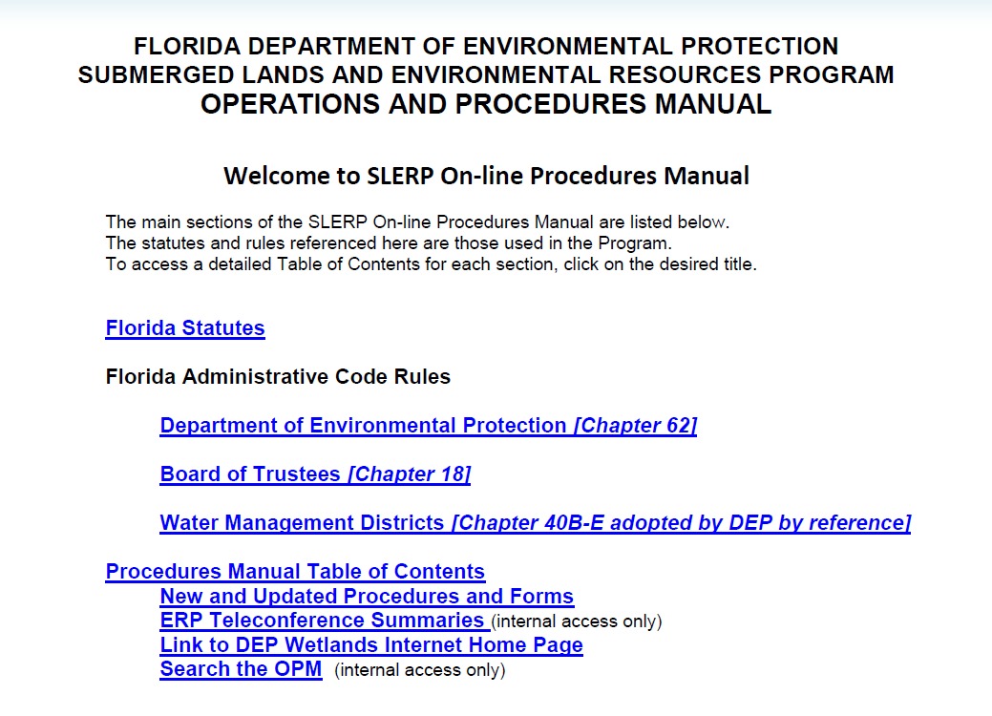
Searching the OPM
Staff can “search” the OPM by clicking the link (red arrow)
If you are searching for a topic discussed during a ERPA Teleconference include ERPA in your search criteria.
Example-
“Single-family docks ERPA”
This will improve your search results.

Slide 28
Questions ?

Slide 29
Contact
Allyson Minick
Submerged Lands and Environmental Resource Coordination
Allyson.Minick@dep.state.FL.us
(850)245-8489 or 58489

