Slide 1

Division of Water Resource Management
Large Dredging Project’s Spoil Dewatering & DMMAs: Reviewing
As-Built Drawings & Monitoring Reports
Richard Musgrove, P.E. Administrator – EH&G
June 2014

Slide 2
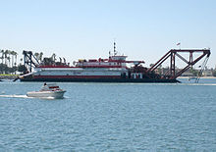
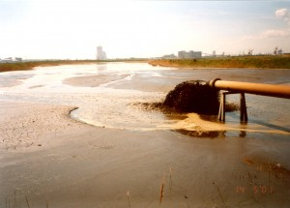
DMMAs
The Basics of Dredged Material Management Areas
These deposition areas include but not limited to:
Open water or unconfined areas
Beach nourishment sites
Off-channel partially confined areas
Contained beneficial use sites
Refilling abandoned coastal pits
Recreating longshore bars
This presentation will cover sites for upland and
“island” confined disposal areas!

Slide 3
DMMAs
Disposal sites should:
Be properly designed by a registered professional, having adequate spoil containment and embankment performance experience.
Have adequate capacity to contain all of the planned disposed spoil, including “over-dredged” quantities for all planned phases.
Have confinement embankment (dike) stability to prevent unwanted seepage, erosion and any possibility of catastrophic failure.
Provide reasonable assurances of adequate settling time, based on the materials’ composition (soil materials classification), so that water quality standards can be met at the point(s) of outfall discharge.
Maintain adequate “freeboard” above consolidated materials to accommodate final sloughing and/or distribution.
Be stable and maintainable (“Routine Custodial Maintenance”) throughout there planned life.

Slide 4
DMMAs
Guidelines for Design of Confined Disposal Areas:
US ACE Publication Number: EM 1110-2-5027
Title: Engineering and Design - Confined Disposal of Dredged Material
Publication Date: 30 September 1987
Additional existing site assurance technical items that should be included in the permit application:
Volumetric capacity and discharge calculations
Geotechnical site investigation information including; soil/materials testing, foundation analysis, permeability/hydraulic conductivity and embankment construction materials analysis
Existing structures (pipes, risers, supports, outfall dissipation) inspection and evaluation reports, if to be continued in use
Embankment stabilization requirements and designs

Slide 5
DMMAs
What else:
Stability/Seepage Analysis – flow net analysis may be needed to define the phreatic surface and flow lines in the foundation and fill being designed along with possible tailwater conditions
Design Safety Factors – embankments should be designed with a minimum factor of safety ( base of fill and within fill horizontal shear, embankment slopes)
Proper Site Preparation and Embankment Compaction based on borrow testing
Hydraulic adequacy evaluation and safe discharge of flows from high rainfall events including freeboard requirements
Hazard Classification, depending on location
Vegetative cover and stabilization methods for life – Minimum Operation and Maintenance Plans
Periodic Inspections

Slide 6
Disposal Area Design

Slide 7
Permit Conditions Example
Proposed D/As 17B, 18B, 19B, 20B and 34B are conceptually approved with respect to site location, based on the presence of wetlands identified during site inspections conducted in 2001. However, a minor modification to this permit is required for final authorization prior to the commencement of construction for the proposed upland D/As, or for any proposed expansion to the footprint of any existing D/A depicted in the approved permit drawings. With the request for modification(s), the Permittee is advised to submit the following:
Plan and cross-section drawings of the final design for the proposed dikes, weirs, piping and discharge ditches, including slopes, height, crest width and construction materials;
A stability analysis for the proposed dikes;
Capacity calculations based on assumed operating level, the seasonal high water level, design storm, and freeboard requirements; and,
A site-specific Stormwater Pollution Prevention Plan that includes best management practices (BMPs) that will be employed during construction to prevent erosion and runoff.

Slide 8
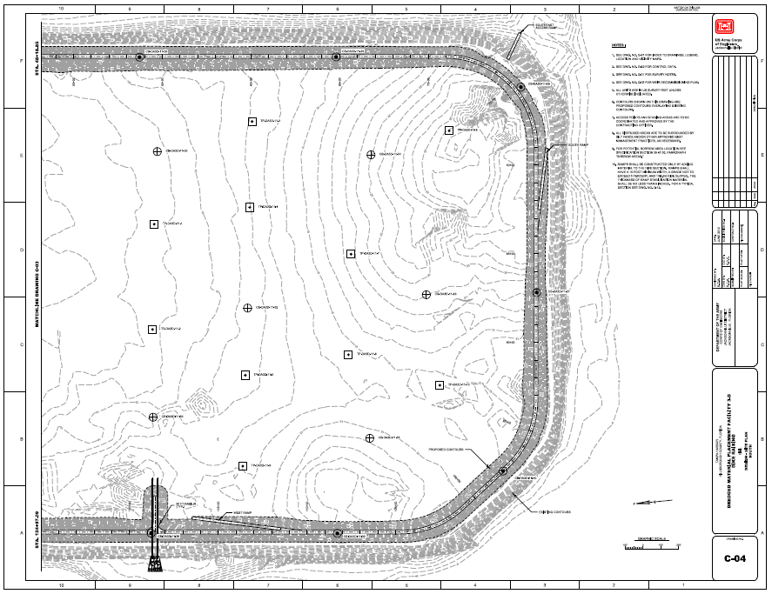
Disposal Area 3D Design

Slide 9
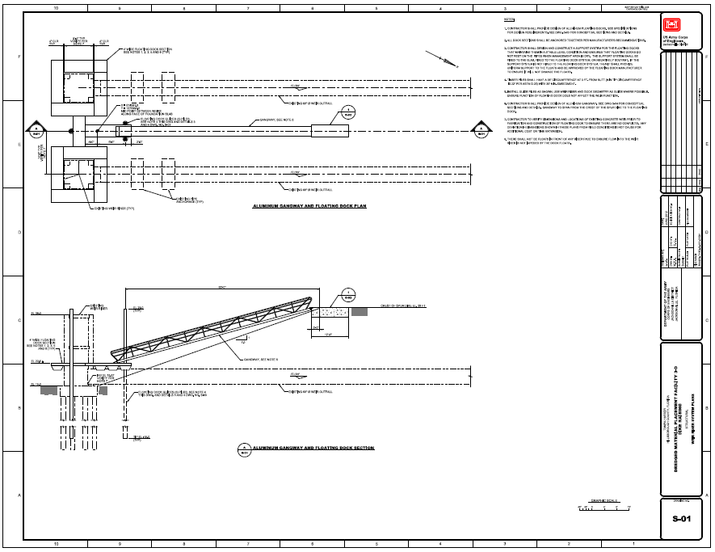
Disposal Area 3D Design

Slide 10
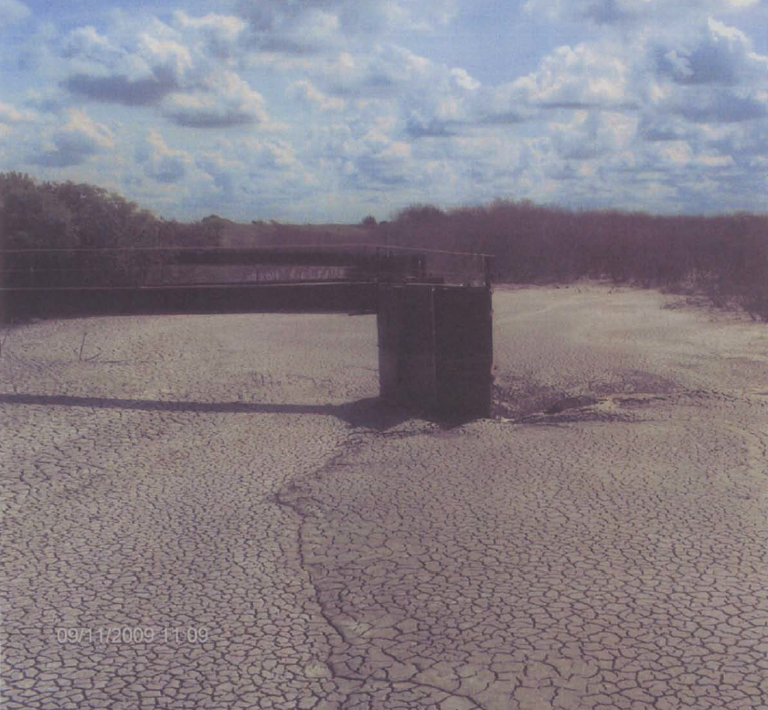
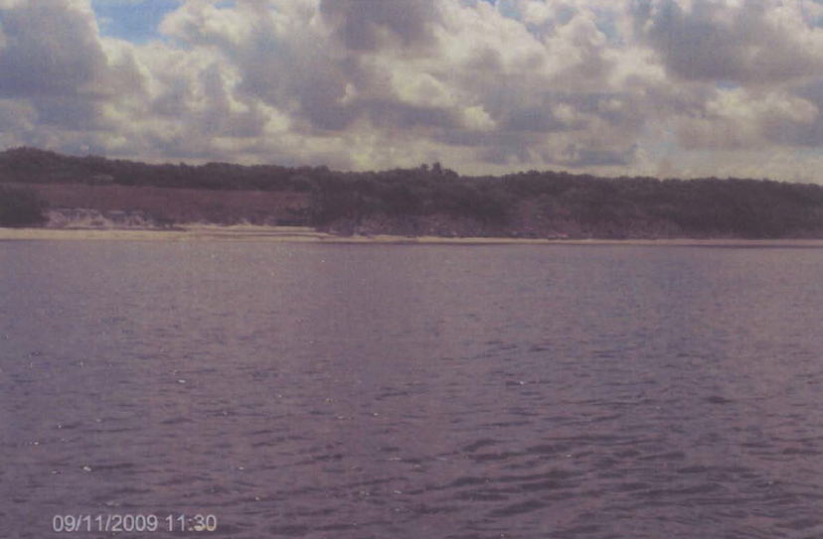
D A 3D Post Deposition Insp.
Freeboard Adequacy
Eroded Exterior Slope
Due Wave/Storm Action

Slide 11
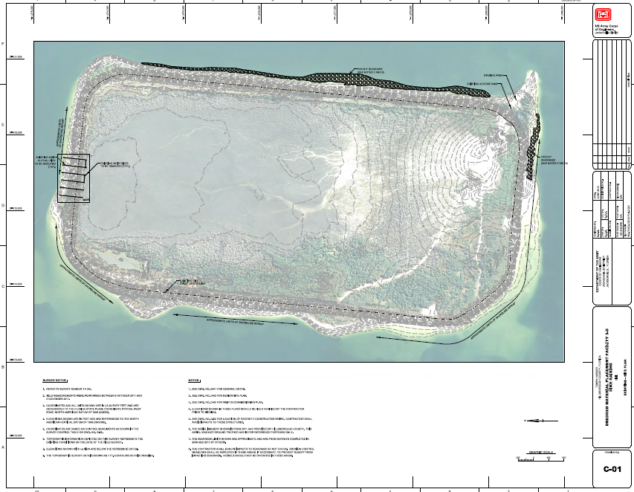
As- Built Reviews
Were the structures constructed where designed ? Are the DA dimensions in compliance with the permit plans ?
As-Built drawings should be based on post-deposition surveys/measurements and compliance/monitoring reports !

Slide 12
Post Deposition / Monitoring
Reviews should include:
Complete review of all as-built drawings and construction reports!
Is the final design different from the permitted plans? Why?
Were there changes made to the construction specifications due to unknown conditions or site issues?
Were there final verification borings or tests made of the in-place materials to substantiate compliance with the design?
Were all construction deviations provided in the final reporting?
Is information provided that shows compliance with final stabilization of embankment slopes and other areas required?
Can the facility be properly maintained for its planned life?
Has the completed work been formally accepted by letter?

Slide 13
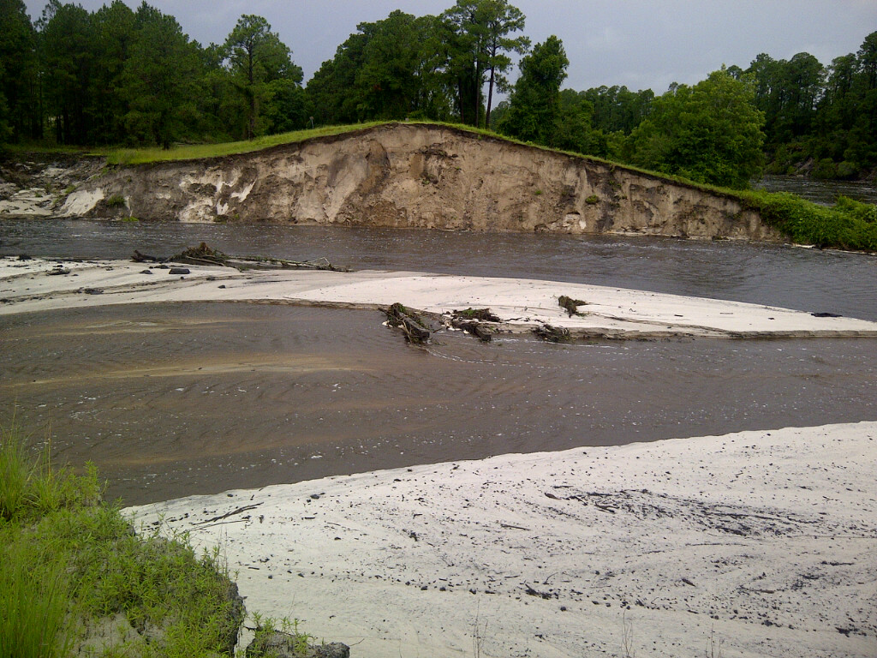
We don’t like failures!

Slide 14
Questions?
Need Help or Have Questions?
We can find an answer or should have the resources to do so?
Engineering, Hydrology & Geology Program
FDEP/DWRM
Richard Musgrove, P.E.
850-245-7579
Richard.Musgrove@dep.state.fl.us

