Slide 1
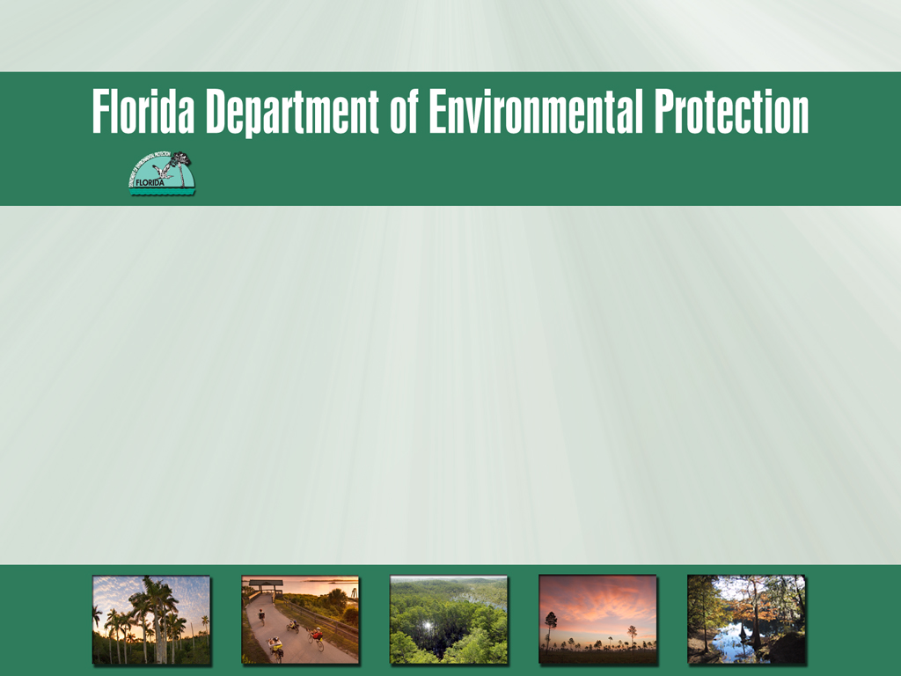
Submerged Lands and Environmental Resources Coordination Program
Overview of SPGP
for DEP CAP staff
Tuesday, June 10, 2014
Tori White, Deputy, Regulatory Division, USACE-Jacksonville
Andy May, SLERC Program, Div. of Water Resource Management

Slide 2
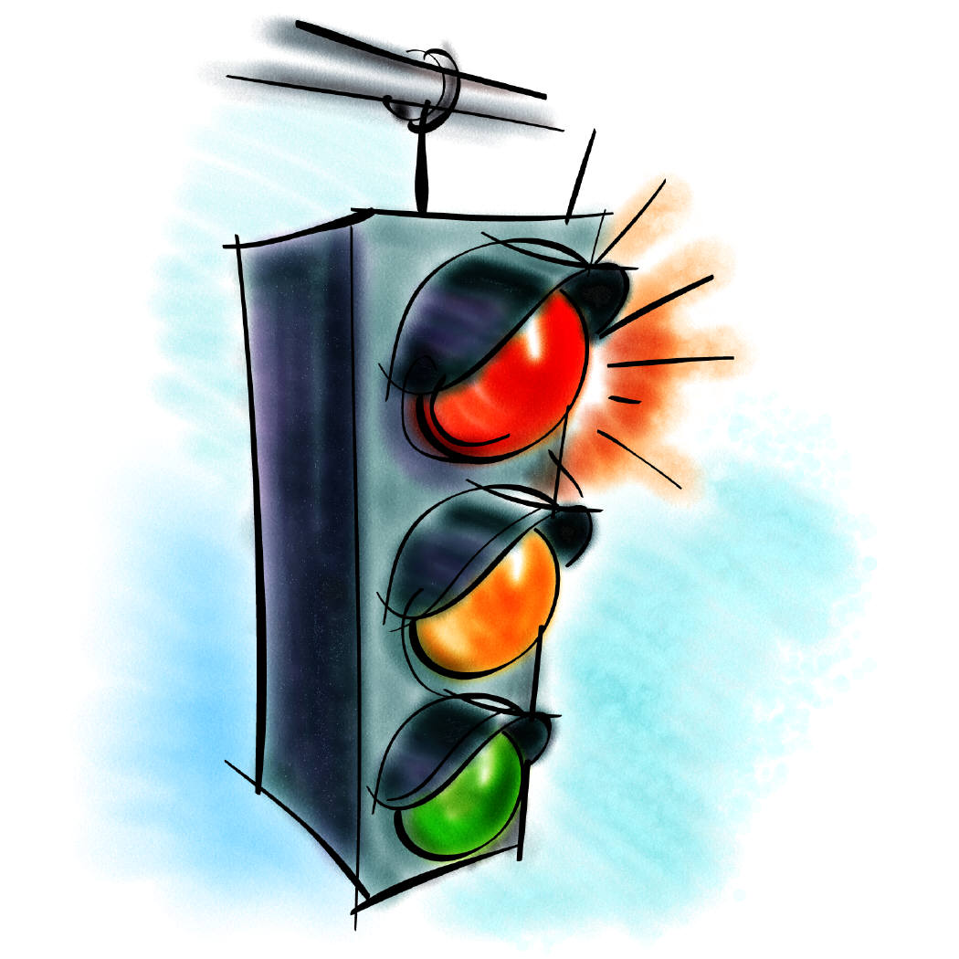
SPGP Lingo: the “traffic light” system
Under SPGP, reviewers categorize actions with simple color codes
  Red projects – have potential to affect T/E species and need to be processed by the Corps; these do not qualify for the SPGP
  Yellow projects – (a temporary designation) may not meet all of the design criteria and must be discussed with the Corps
  Green projects – meet design criteria and may be verified (after notification to NMFS, if applicable)
“Yellow” projects must first be sent to the Corps, who may either allow the state to verify (“Green”), or process the application themselves (“Red”)
Only projects that are “Green” may ultimately be verified under SPGP

Slide 3
Importance of the SPGP to Florida
To put the value of SPGP in perspective, here are some numbers based on statewide DEP data* from July 23, 2012** through May 13, 2014:
11,741 applications were subject to SPGP review***
5,789 projects were verified as “Green”
Over 75% (4,460) were docks or other piling-supported structures
3,636 were self-certified docks and boat lifts
That’s roughly 3,000 applications/year for which the permitting burden was reduced by this “one-stop shop” review. Most qualifying applicants are homeowners applying for projects at their private residence, who benefit greatly from this streamlined and less costly process. This also significantly reduces the Corps’ permitting workload. Florida is lucky to have an SPGP!!!
* Data taken from our PA database, as of 5/13/14
** Date the current Operating Agreement for SPGP IV-R1 was signed
*** i.e. all PA type/subtypes for which SPGP is currently a selectable option, on the “ERP screen” in PA
Submerged Lands and Environmental Resources Coordination Program

Slide 4


SPGP: CAP Staff’s Essential Role
Florida benefits from the SPGP program and the streamlined permit process it provides, but our ability to keep it depends largely upon the work of our compliance staff (i.e. you!).
The SPGP, like most of the Corps’ General Permits, must be re-issued every 5 years.
Each time the Corps seeks to issue an SPGP (or any other General Permit), it is subject to review and consultation by other federal agencies, including the US Fish and Wildlife Service and the National Marine Fisheries Service under their respective authorities (e.g. ESA, MBTA, MMPA, etc.). Those consultations involve close scrutiny of not only the proposed permit, but also the individual and cumulative impacts of all projects authorized thereunder.
This means that both DEP and USACE are under a lot of pressure to get it right, and as DEP’s compliance team, we’re counting on you.

Slide 5

SPGP: CAP Staff’s Essential Role
DEP and the Corps share compliance inspection responsibilities, under the SPGP*. To this end, both agencies have set a target of inspecting at least 10% of all projects authorized as “Green” under SPGP.
The SPGP does not grant DEP any federal enforcement authority. This means that if you find a possible violation of the SPGP, it is your responsibility to thoroughly document it and refer it to USACE, immediately. Inspection reports should be sent to: SAJ-RD-Enforcement@usace.army.mil.
However, if you are pursuing corrective action to address a violation of the state’s authorization or rules that you believe will also resolve the apparent federal violation, you should state as much in your inspection report and referral to the Corps. Do not, however, delay in referring the apparent violation!
Submerged Lands and Environmental Resources Coordination Program
Communication is important! Call your local Corps Regulatory Office to coordinate efforts.
* In fact, under our Operating Agreement with USACE, we also have a more broad responsibility to share with the Corps any relevant information relating to any possible violations of s. 404 of the Clean Water Act and/or s. 10 of the Rivers and Harbors Act of 1899.

Slide 6
“Doesn’t it just need to be exempt…?”
There has been a recurring misconception over the years that activities that qualify for some ERP exemptions automatically qualify for SPGP. This may be due to the wording of the SPGP, which cites some ERP exemptions as activities that might qualify for SPGP:
Submerged Lands and Environmental Resources Coordination Program
Conversely, staff have also misconstrued SPGP to be limited to activities that are exempt under ERP. Although most “Green” activities are exempt, that is not a requirement of SPGP, per se.

Slide 7
SPGP Criteria (locational)
The SPGP includes numerous requirements for the protection of federally-listed (threatened or endangered) species, and their habitats. Understanding these criteria is essential to ensuring compliance. Some of these criteria are geographic and exclusionary, in nature – for example, SPGP does not authorize any work within areas such as:
Monroe County
Most designated critical habitats of listed species (with the notable exception of piling-supported structures in smalltooth sawfish CH)
The Florida panther consultation area
Many specific waterbodies (e.g. Faka-union canal, Lake Miccosukee, King’s Bay/Crystal River, much of the Wekiva River, etc.)
Warm water aggregation or no-entry areas (see manatee key)
These criteria, by their nature, are fairly straightforward. While CAP staff should be aware of them, generally speaking, the permit reviewer (or self-cert system) will not have verified SPGP in such exclusion areas, in the first place.
Submerged Lands and Environmental Resources Coordination Program

Slide 8
SPGP Criteria (design/general)
In addition to the geographic exclusion areas, the SPGP has many other criteria that are either geographically-conditional, or that pertain solely to the design or use of the project. It is these conditions for which we are most reliant upon CAP staff to monitor compliance. Examples of these conditions include (but are not limited to):
Work must not adversely affect or disturb properties on (or eligible for) the National Historic Register
Docks constructed over marsh, seagrass or other aquatic/wetland vegetation must comply with the “Dock Construction Guidelines”, which require structures to “minimize and avoid” direct and shading impacts to vegetation, be elevated, have minimal (4’) walkway widths, be oriented north-south as much as possible, etc.
More stringent dock design criteria apply within the range of Johnson’s seagrass
Certain activity-based “kickouts” in the manatee key (see next slide), including: blasting or detonations, docks for “repeat use” vessels (water taxis, casino boats, etc.) or large freight vessels, etc.
Unfortunately, it is these criteria which are most likely to be violated, when the project is actually built, which is why CAP inspections are so important!
Submerged Lands and Environmental Resources Coordination Program

Slide 9
Demystifying the “Manatee Key”
The SPGP requires compliance with the Manatee Key (2013). The key can be challenging to understand for anyone not familiar with dichotomous keys. Simply put, it is a series of “either/or” questions that logically determine whether the activity, at the proposed location, presents an unacceptable risk to the Florida manatee and/or its habitat.
Submerged Lands and Environmental Resources Coordination Program
Proper use of the key requires study, but here are some tips:
Read the definitions in the glossary!
The key is not needed for projects within waters that are truly inaccessible to manatees
Projects with more than “insignificant” impacts to aquatic or emergent vegetation, or any project that keys out to “may affect” shouldn’t qualify for SPGP
Projects in (or in waters contiguous to) counties with approved Manatee Protection Plans* must comply with those plans
Most “multi-slip” facilities do not qualify, unless in a county with a MPP, or located in the panhandle
?
* Currently, this includes: BREVARD, BROWARD, CITRUS, CLAY, COLLIER, DUVAL, INDIAN RIVER, LEE, MARTIN, MIAMI-DADE, PALM BEACH, ST. LUCIE, SARASOTA, VOLUSIA
The 2013 manatee key may be viewed at:
http://www.saj.usace.army.mil/Portals/44/docs/regulatory/sourcebook/endangered_species/Manatee/2013_FINAL_ManateeKey.pdf

Slide 10
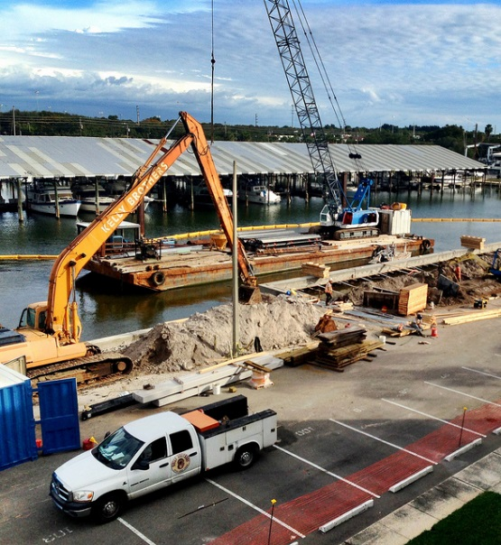
SPGP Criteria (construction)
The activities covered in the SPGP (i.e. docks, seawalls, boat ramps and maintenance dredging) often occur in open waters accessible to certain “listed” aquatic animal species, including the Florida manatee, smalltooth sawfish, Gulf and shortnose sturgeon, and all marine turtles. In addition to the siting and design requirements already mentioned, the SPGP includes additional criteria specifically intended to prevent “take” of these protected animals, during construction activities.
If the authorized project is under construction at the time of inspection, be aware of those requirements, e.g.:
Submerged Lands and Environmental Resources Coordination Program
Turbidity barriers must be of non-entangling material
Work vessels must be at idle/no-wake if clearance (not just total depth) is less than 4’
Work must cease if such an animal is within 50’
Manatee “Caution” signs must be displayed
Maximo Marina, St. Pete – credit: CreativeCommons.org

Slide 11
Planning and Prioritizing Inspection Effort
It takes time and effort to meet our compliance inspection obligations. Naturally, you’ll want to spend that time and effort wisely. While it is ultimately up to CAP staff and their leadership team, here are a few recommendations from SLERC:
When inspecting docks, emphasize those which appear to traverse SAV, marsh or mangrove habitats. These are susceptible to non-compliance, and are a priority for the Corps. Use local knowledge, GIS data and aerials to find good candidate sites.
Feel free to “double-dip” with required inspections of self-cert docks. You may as well get credit for both inspections!
Submerged Lands and Environmental Resources Coordination Program
Use desktop resources first, before you leave the office! The “ERP Focus” within MapDirect has been updated with available GIS data layers. These can help identify which sites may have special conditions (e.g. within sawfish critical habitat, or JSG range) which must then be field-verified.
Above all, become familiar with the SPGP-specific resources within your District. This includes knowing “special waters”, which counties have MPPs, etc.

Slide 12

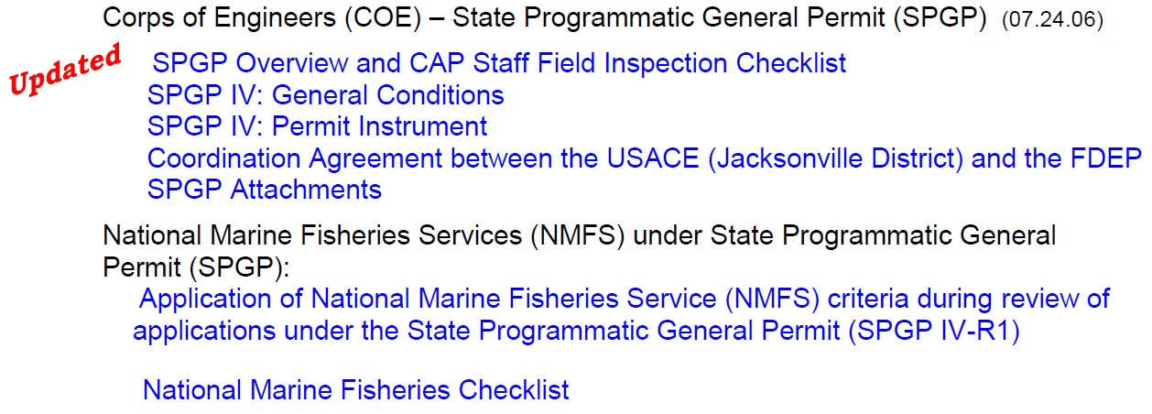
Tools: Corps Source Book & SLER OPM
USACE-JAX SourceBook (SPGP info under “General Permits”): http://www.saj.usace.army.mil/Missions/Regulatory/SourceBook.aspx
SLER OPM (SPGP info in Section 710):
http://depnet/wrm/sler/erp/docs/slerp_online/CompleteTOC.pdf
Submerged Lands and Environmental Resources Coordination Program

Slide 13
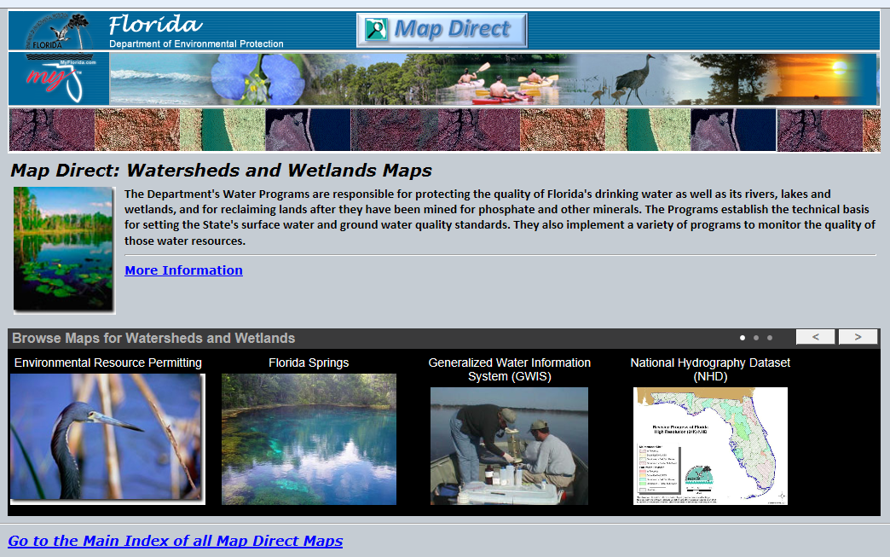
Tools: ERP “Focus” in MapDirect
Submerged Lands and Environmental Resources Coordination Program
Direct URL: http://ca.dep.state.fl.us/mapdirect/?focus=erp

Slide 14
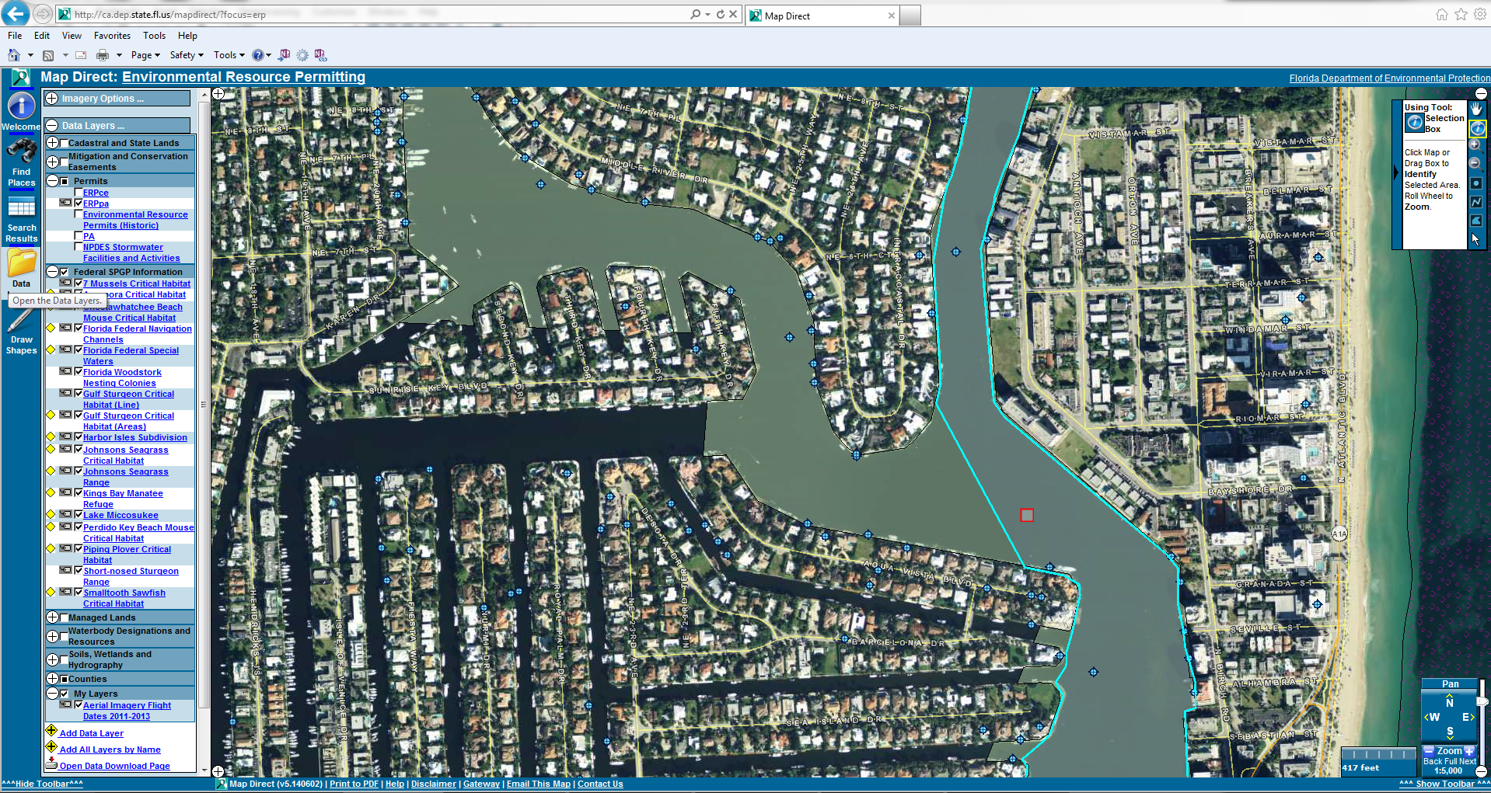
Tools: ERP “Focus” in MapDirect
Submerged Lands and Environmental Resources Coordination Program
SPGP data layers

Slide 15
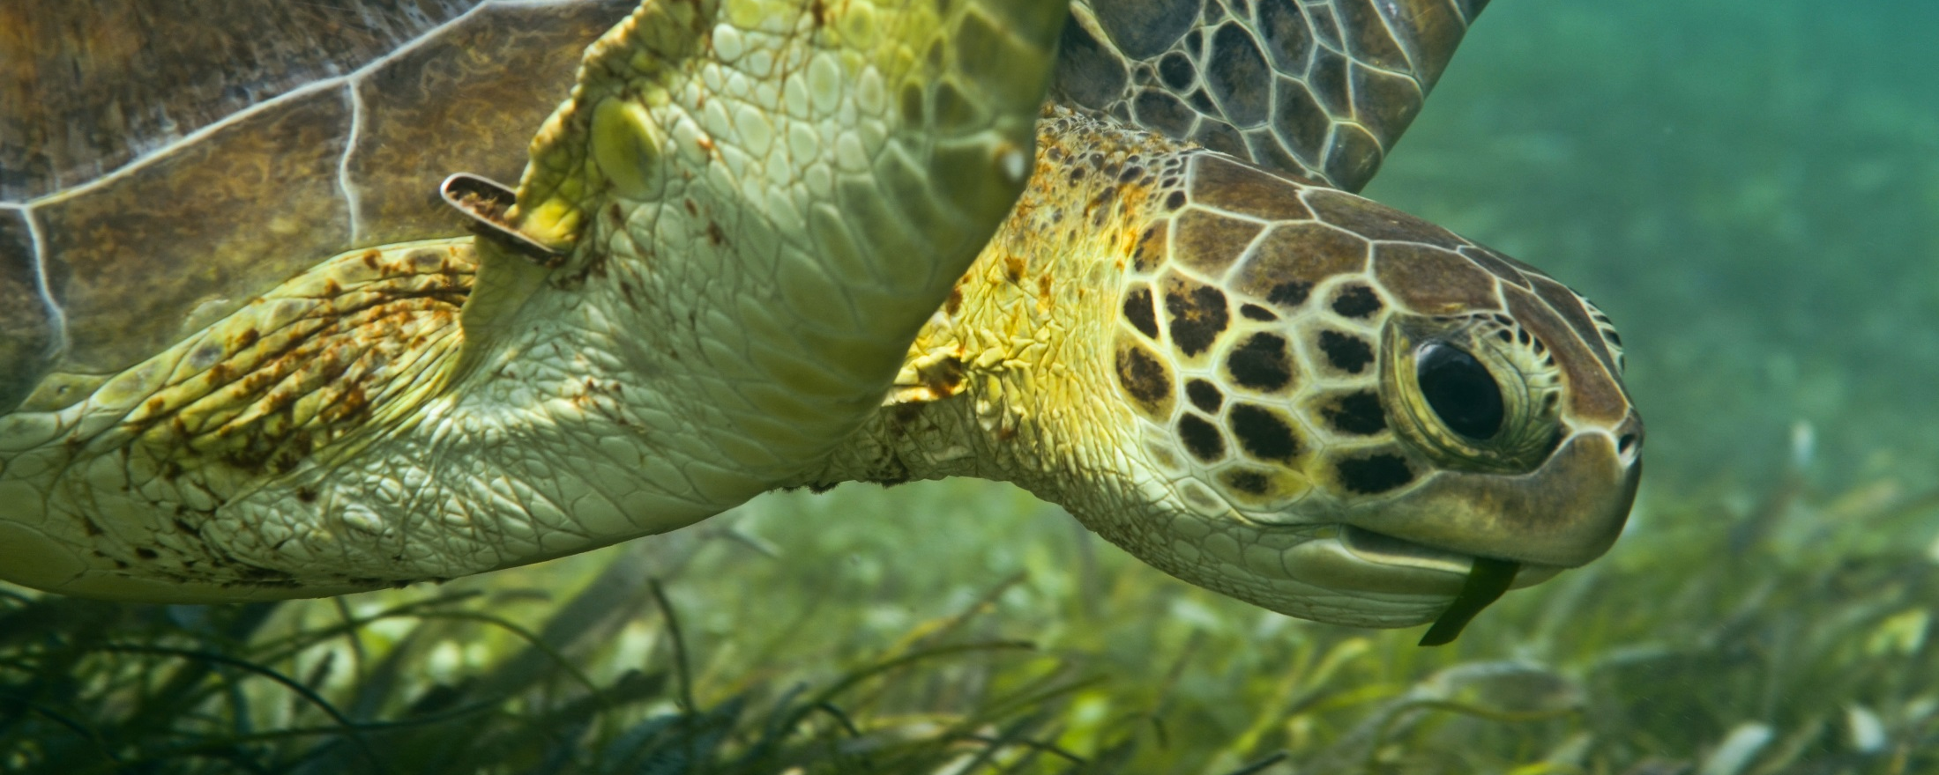
Submerged Lands and Environmental Resources Coordination Program
Thank you.
Questions…?
Photo Credit: Mike Gil

