Slide 1
Certified Surface Water Delineator (CSWD) Program
Eric Hickman
Environmental Administrator
FLDEP Wetland Delineation and Evaluation Section
Camille Beasley
Environmental Specialist III
FLDEP Wetland Delineation and Evaluation Section

Slide 2
Background
Consistent, predictable, repeatable delineation of wetlands and other surface waters essential to efficient ERP permitting
Currently no requirements or standards to delineate surface waters in Florida under Chapter 62-340, F.A.C.
SLERC wetland staff tasked to design certification program for delineation of wetlands and other surface waters

Slide 3
Errors/Inconsistency in Delineation
Category 1 Errors: insufficient technical skillsets in 5 broad categories
Plant ID
Plant Community ID
Soil ID
Hydrology ID
Chapter 62-340, F.A.C. knowledge and application

Slide 4
Errors/Inconsistency in Delineation
Category 2 Errors: Intentional misrepresentation of correct surface water boundary
Reasons:
  Financial gain
  Punitive motivations
  Budget constraints or insufficient field work
  Environmental protection zeal
  Current ERP business model fails to discourage misrepresentation
    Insufficient penalties (financial, time delay, loss of license, etc)
    No tracking list of repeat or serious offenders
    Failure by agency reviews to identify misrepresentation

Slide 5
Errors/Inconsistency in Delineation
Category 3 Errors: Ecological complexity
Naturally broad or complex ecotones
Highly altered plants, soils, or hydrology
Fire suppression or exclusion
Exotic dominated landscapes
Prolonged wet or drought conditions
Part II and/or IV hydrologic alteration

Slide 6
Certification Basics
Currently planned to be informal and voluntary allowing greater flexibility to evolve and adapt to feedback, experience, and data.
Program will be:
Voluntary
Pragmatic
Informal
Low Cost
Testing

Slide 7
Voluntary
Certification completely optional
Certification is not required for surface water delineations or ERP permits
Noncertified individuals may continue practicing without negative consequences
Agency consideration of private sector or regulatory CSWDs not mandated or formally defined

Slide 8
Pragmatic
Specific to wetland and non-wetland surface water delineation only
Program overlaps and is consistent with DEP responsibilities in §62-340.100(2), F.A.C.
Relies solely on demonstration of minimum proficiency in 5 technical skillsets (no grandfathering, minimum education, etc.)
Simple testing, tracking, and 20% auditing conducted by SLERC staff

Slide 9
Informal
No changes to statutes or rules
No changes in delineation or permit submittal processes
No disciplinary actions
No boards or committees
No formal review process of CSWD delineations
“Trial” program can be modified easily and quickly as necessary

Slide 10
Low Cost
No application fees, testing fees, certification fees or dues
Minimal additional DEP staff required
Minimal software requirements and expenses
Minimal travel expenses
Limited informal auditing minimizes expenses

Slide 11
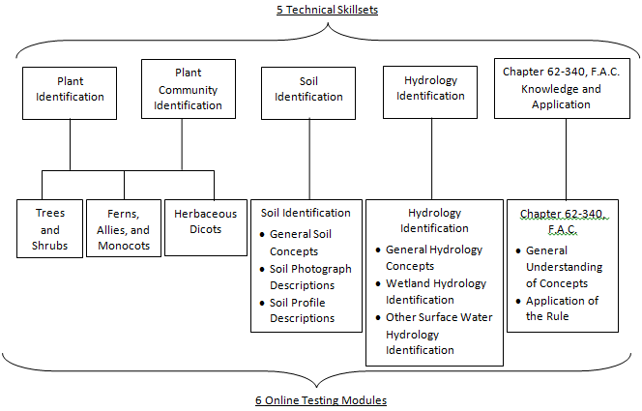
Online Testing

Slide 12
Program structure
Skillset proficiency demonstrated through 6 online testing modules and 1 field practicum
  Designed to eliminate Category 1 errors
Certification will divided into 2 regions based on tropical vs. subtropical flora
20% of submitted delineations audited
  Designed to help mitigate for Category 2 errors
  Results will not affect certification status
Certification good for 5 years, recertification requires completion of online and field tests
  No CEUs or minimum delineations performed

Slide 13
PROCESS
Apply to take online exams for subtropical or tropical region of Florida
Access to exams granted
Wait 12 months
Within 12 months prior to expiration
Fail one or more exam
Receive one more chance to pass failed exams
Pass all exams
Fail second chance
Apply to take scheduled field exam for appropriate region
Permission to attend field exam granted
Fail field exam
Receive one more chance to take field exam
Pass field exam
Fail second chance
Become certified in region for five years, listed on FDEP website

Slide 14
Current Status
Testing software obtained
Currently writing test questions
Anticipating online testing to begin early next year
Field practicum development will follow completion of online test development

Slide 16
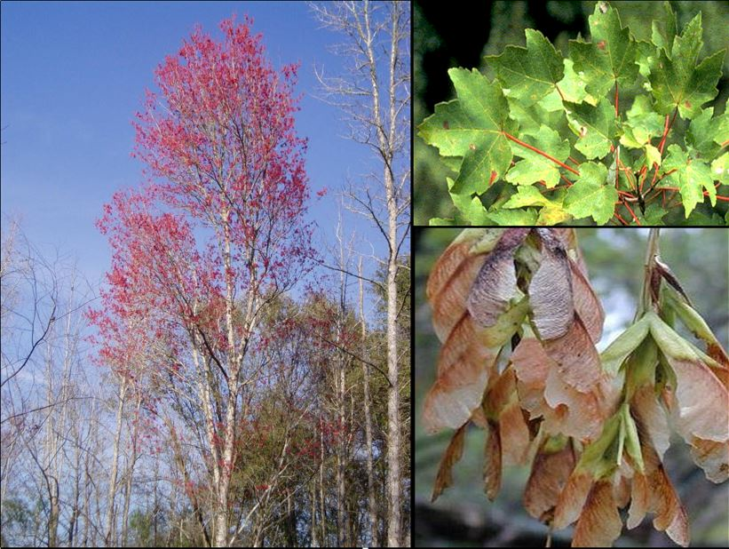
Form: large tree
Leaves: opposite, simple; 3-5 pointed lobes with serrations along margin; red petioles
Bark: light gray; smooth on young trees; forming long, narrow, scaly plates and darkening with age
Twig: reddish; bud also reddish
Fruit: reddish samara with elongated wing; paired
Flowers: small, red; in axillary clusters; appearing early spring
Habitat: shrub-tree wetlands, floodplains; common and abundant
A) | Liriodendron tulipifera
B) | Liquidambar styraciflua
C) | Populus deltoides
D) | Tilia americana
E) | Viburnum acerifolium
F) | Morus rubra
G) | Vitis rotundifolia
H) | Acer rubrum
I) | Morus alba
J) | Cornus foemina

Slide 17
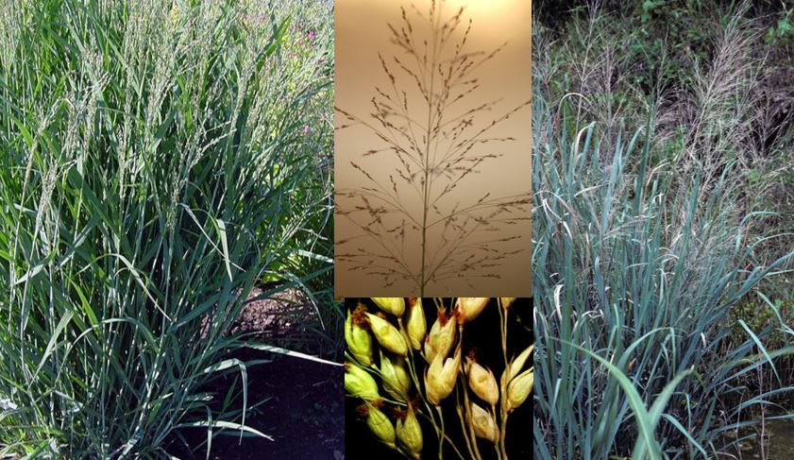
GRASS
Growth: spreading from long, scaly rhizomes, but appearing to form clumps; 1-2 m tall
Leaves: 10-50 cm long, narrow; arching or drooping; open sheath
Stems: stout; purple, especially at base
Ligules: ciliate to 5 mm long
Inflorescence: large, diffuse, erect panicle; 12-50 cm long; spikelets only on distal half of thin branches
Spikelets: glume and lemma spread distally; 1st glume at least half as long as spikelet, mostly surrounding base of spikelet, with central nerve almost keeled
Habitat: fresh or brackish marshes, estuaries, seasonally wet flatwoods, prairies, shores of rivers, ponds, and lakes
A) | Panicum verrucosum
B) | Paspalum distichum
C) | Eragrostis elliottii
D) | Panicum virgatum
E) | Manisuris rugosa
F) | Paspalum repens
G) | Echinochloa colonum
H) | Eriochloa michauxii

Slide 18
The vegetative stratum you've selected has an areal extent of plants comprised of 60% Obligate and Facultative Wet plants and 40% Upland plants. There are hydrologic indicators present, but no hydric soils. Which wetland test could you possibly meet?
A) | A
B) | B
C) | C
D) | D
E) | None
F) | Altered Sites

Slide 19
Redox depletions normally have:
A) | Value 4 or less and chroma 3 or more
B) | Value 4 or more and chroma 2 or less
C) | Value 4 or more and chroma 3 or more
D) | Value 3 or less and chroma 2 or less
E) | Value 3 or less and chroma 3 or more
F) | Value 3 or more and chroma 3 or more

Slide 20
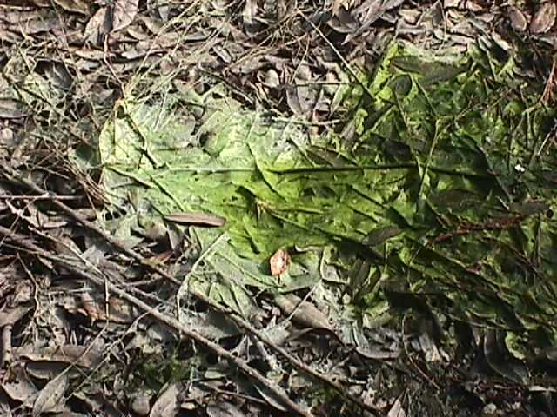
Which hydrologic indicator is best represented in this photo?
A) | Hydrologic data
B) | Drift lines and rafted debris
C) | Aufwuchs
D) | Evidence of aquatic fauna
E) | Secondary flow channels
F) | Morphological plant adaptations
G) | Algal mats
H) | Water marks

